Slide 1
The birth of the Institute

Slide 2
End of the 50’s Elementary Particles Physics Laboratory creation.
Monique René, Guy Vanderhaegen, Jean Sacton, Jean-Pierre Lagnaux
Applied Science Faculty. Director : Professor Baudoux

Slide 3
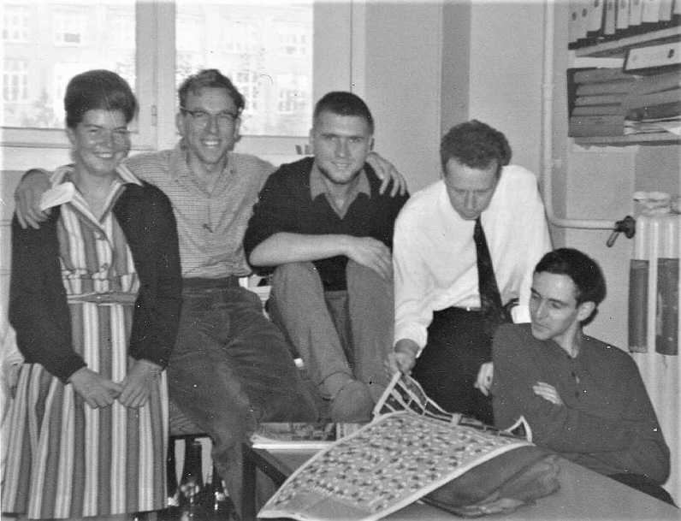
1965
Jacques Lemonne defended his PhD Thesis and joined
CERN as a Post Doc in Heavy Liquid Bubble chamber X2 experiment

Slide 4
1967
First Move: Square group G → D Building second floor

Slide 5
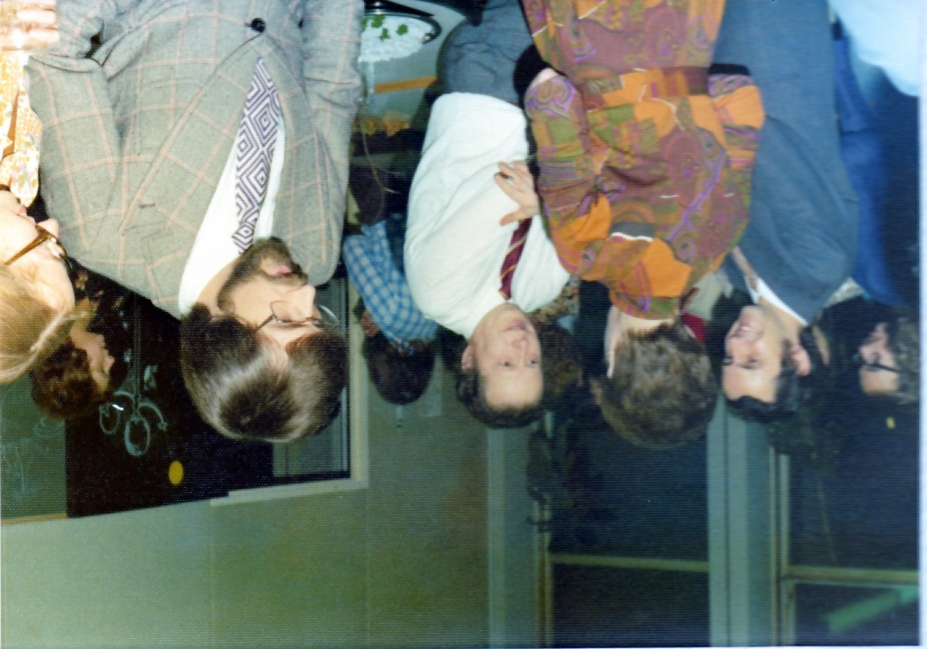
1969-1970
VUB Creation
« Laboratoire des Particules Elémentaires » → the Science Faculty (Director Jean Sacton)
Jacques Lemonne: Professor
Director of the « Dienst Fysica van de Elementaire Deeltjes»

Slide 6
1972
IIHE creation with the support of the FNRS-NFWO General Secretary Paul Levaux
Scientific committee headed by Professor Don Perkins

Slide 7
Resources put in common
Extensions of the laboratory to -1 and -2 floors of building D

Slide 9
Resources put in common
Extensions of the laboratory to -1 and -2 floors of building D
Polly (automatic scanning and measuring of bubble chamber pictures)
Digital PDP10 Computer

Slide 10
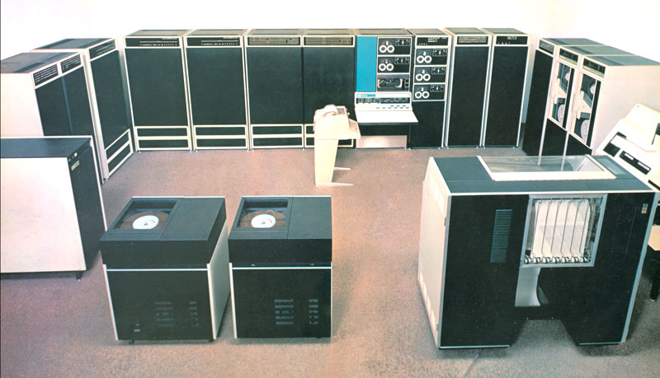

Slide 11
Resources put in common
Extensions of the laboratory to -1 and -2 floors of building D
Polly (automatic scanning and measuring of bubble chamber pictures)
Digital PDP10 Computer
Mirabelle and Gargamelle scanning tables

Slide 12
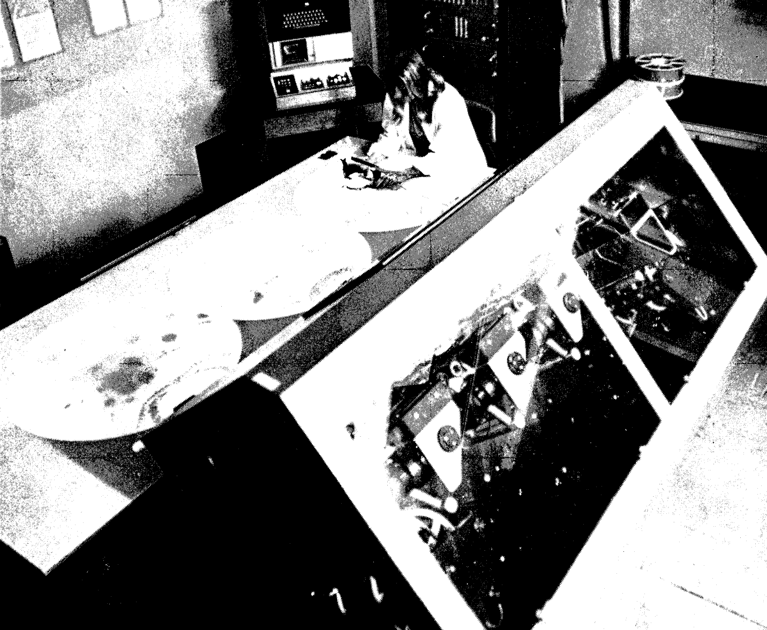

Slide 13
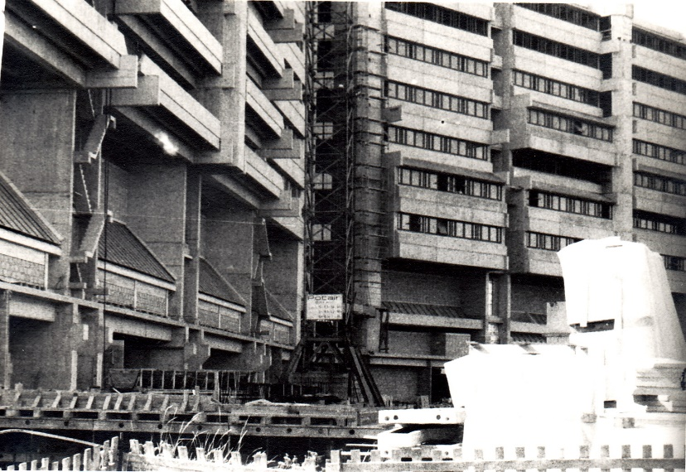
1976
Second move: Solbosch → Building G on the VUB campus

Slide 14
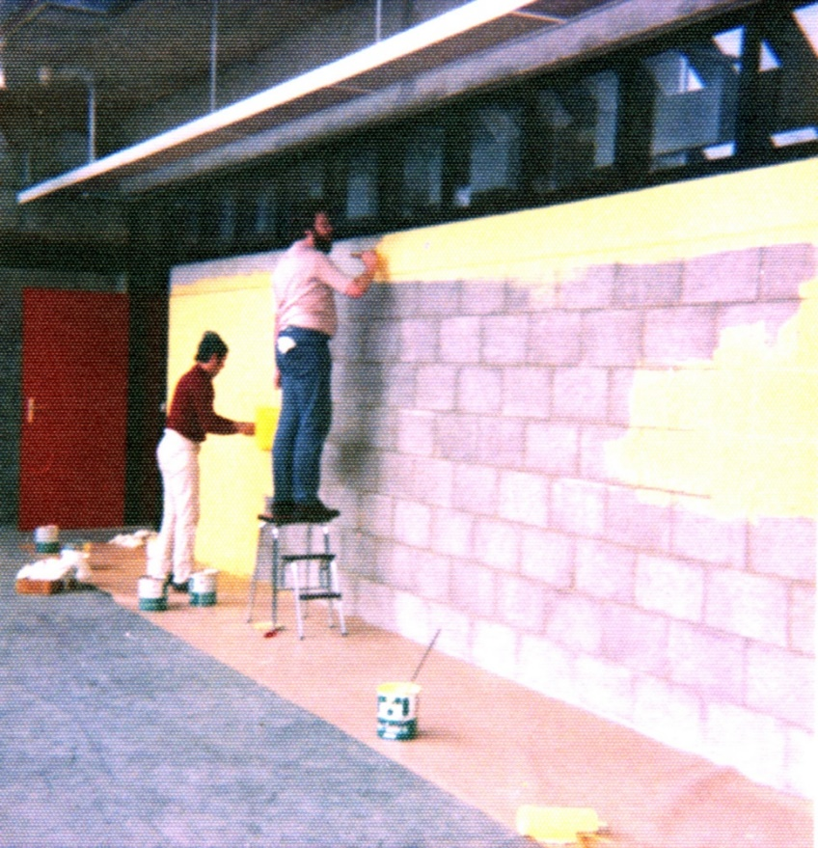
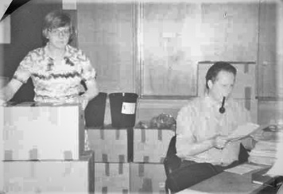
Large contribution of the researchers (16 ULB; 9 VUB)
and of the 30 technicians

Slide 15
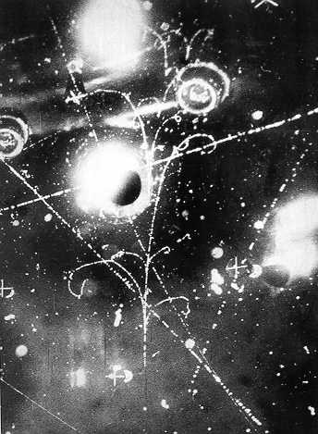
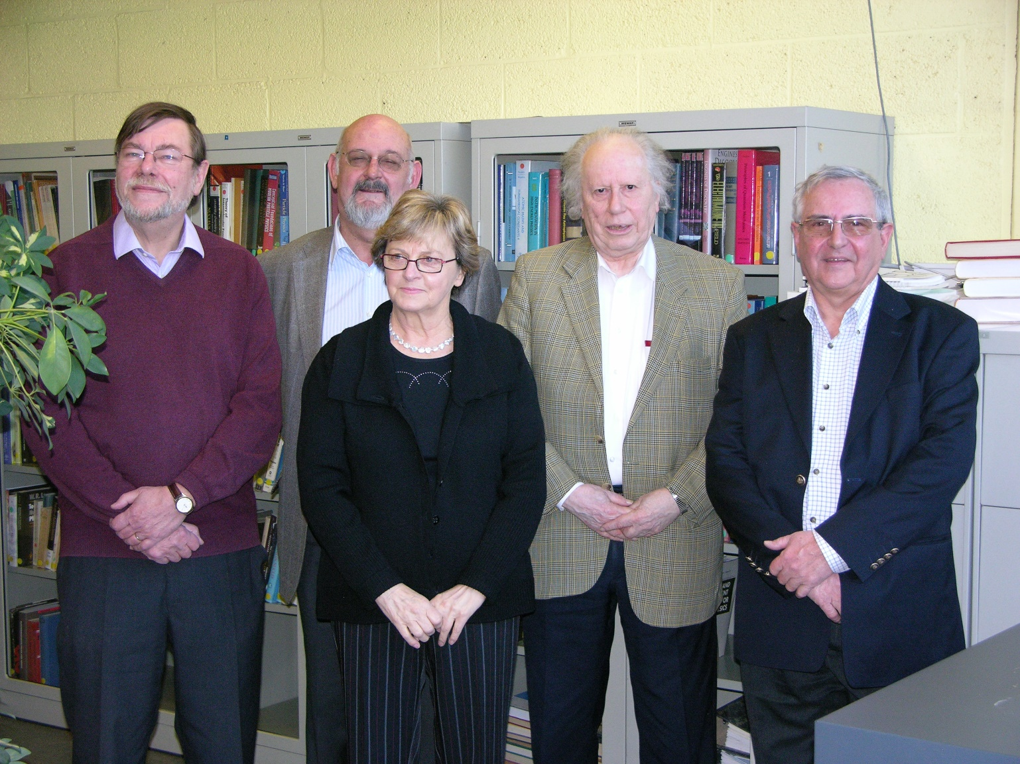
1973
n_{m}+ e⁻ n_{m}+ e⁻ observed by the IIHE teams
EPS-High Energy and Particle Physics Prize awarded in 2009

