Slide 1
Data processing for large research infrastructures: An example: The Worldwide LHC computing grid – History and some lessons learned
Frédéric Hemmer – European Organization for Nuclear Research
LHCb Experiment – Online-Offline transfers
CERN IT Department Head 2009-2021
ULB Alumni – ICME 1984
14 September 2022
Acknowledgements:
Material from Ian Bird, Simone Campana, Bernd Panzer-Steindel, Les Robertson and many others that I forgot to mention

Slide 2
Outline
The context
Computing at CERN
Looking backwards
Observations
The future
Finals words

Slide 3
The context

Slide 4
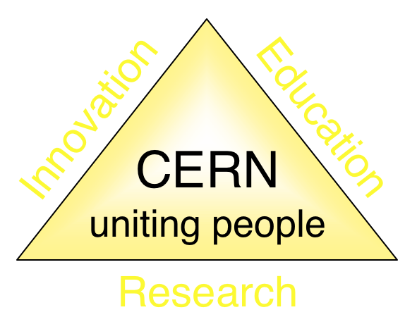
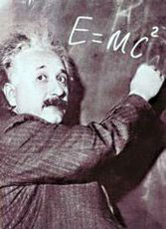
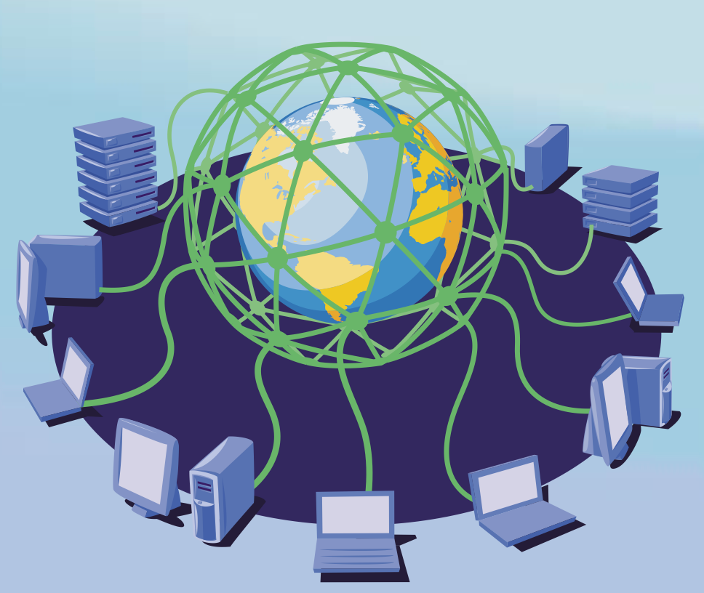
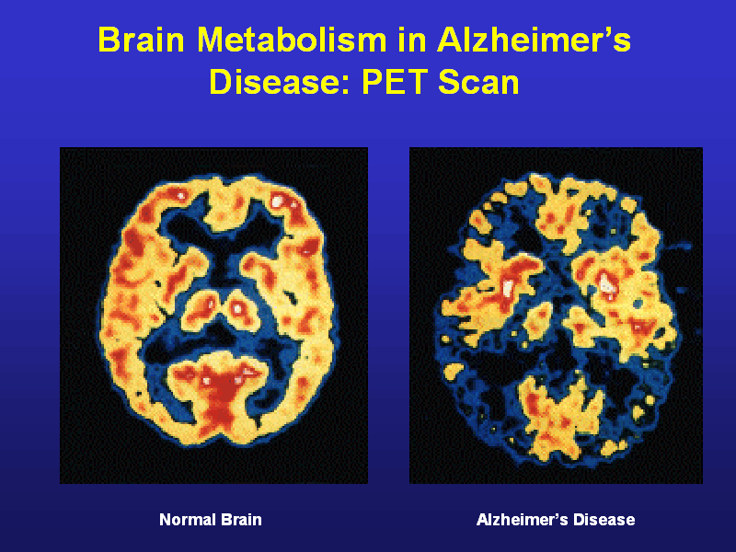
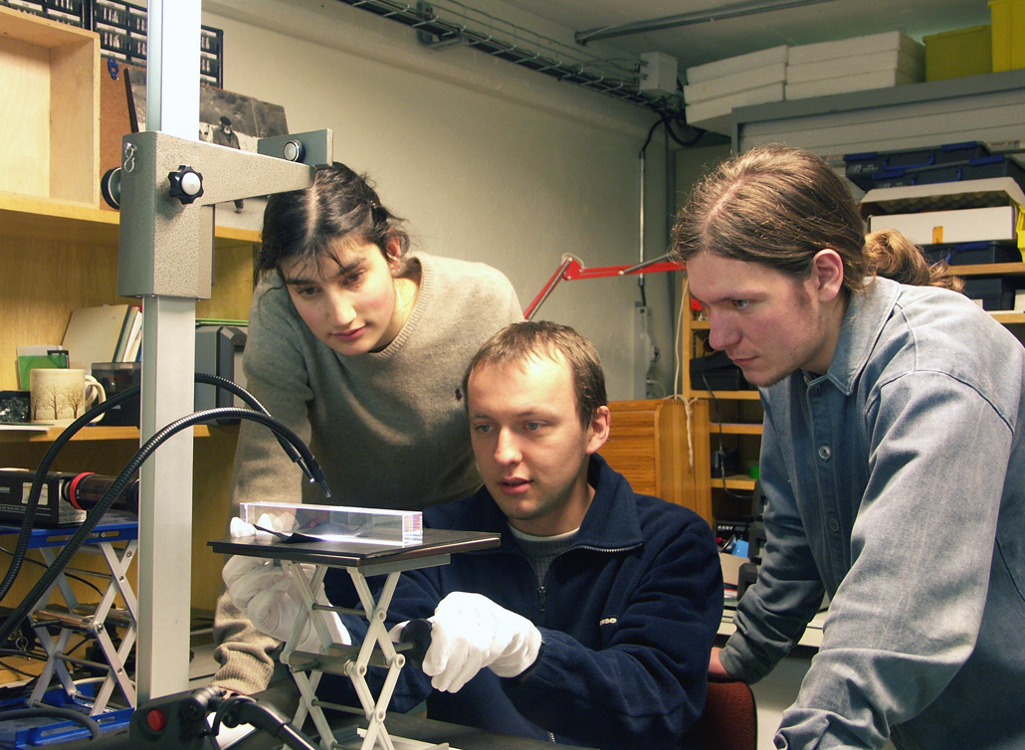
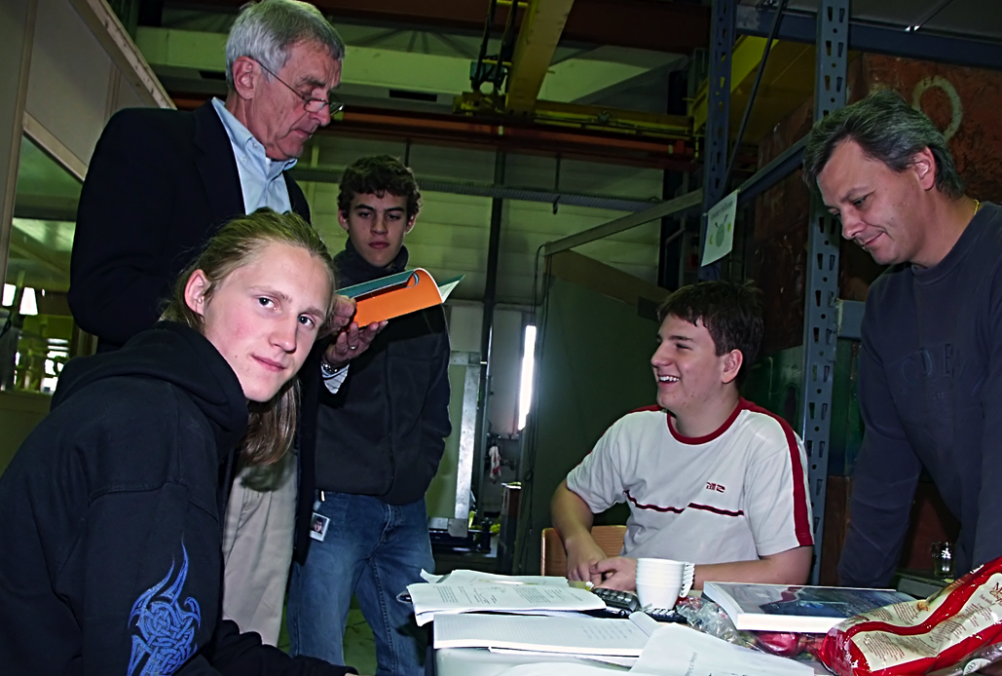
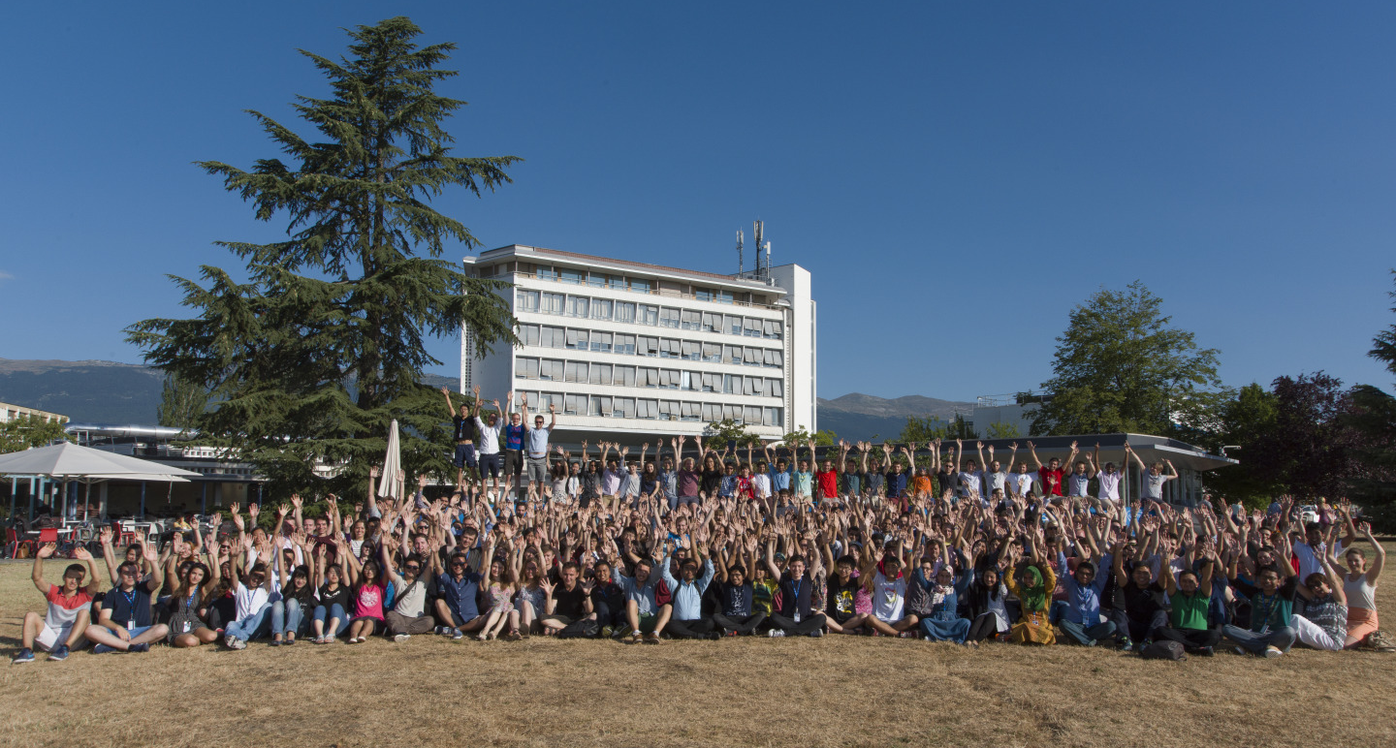
The Mission of CERN
Push back the frontiers of knowledge
E.g. the secrets of the Big Bang …what was the matter like within the first moments of the Universe’s existence?
Develop new technologies for accelerators and detectors
Information technology - the Web and the GRID
Medicine - diagnosis and therapy
Train scientists and engineers of tomorrow
Unite people from different countries and cultures
Notes:
4

Slide 5
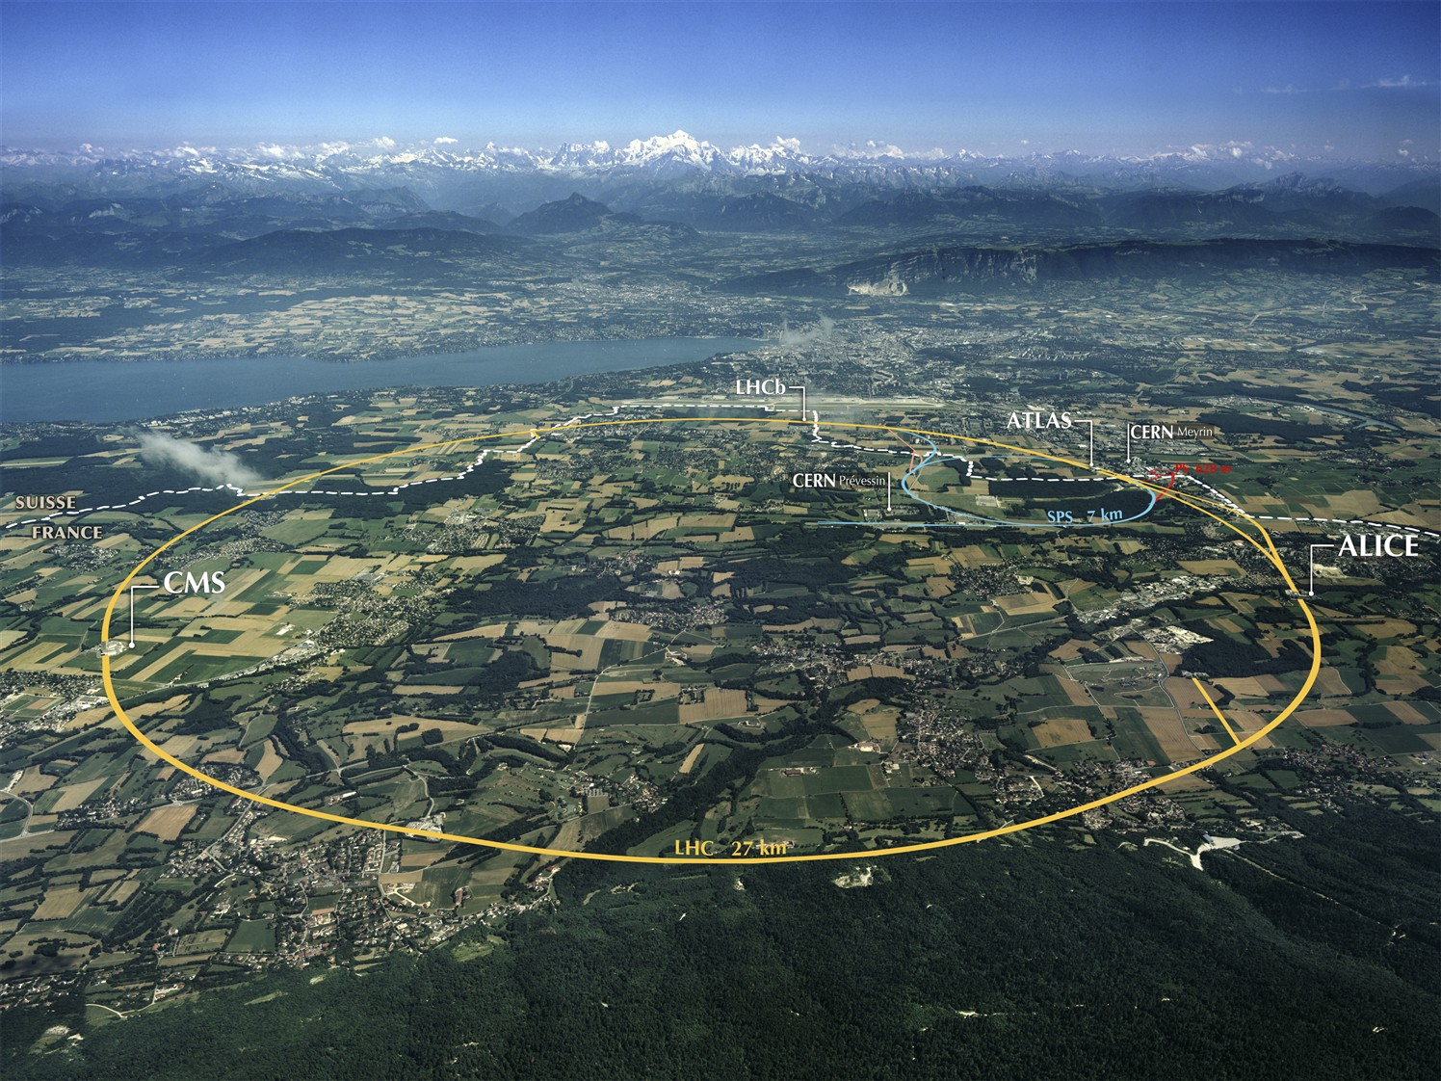
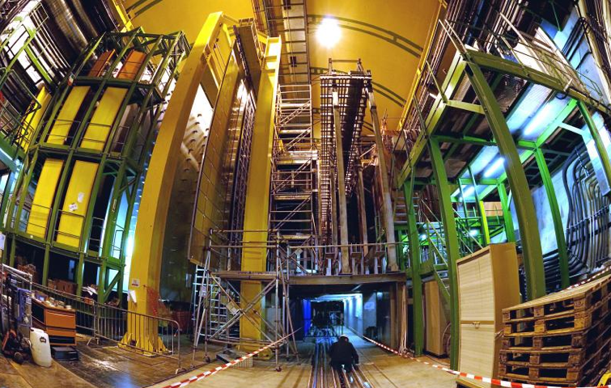
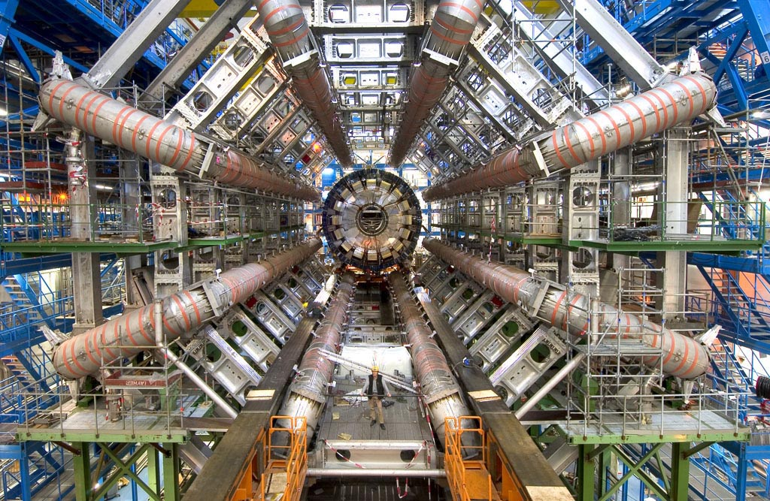
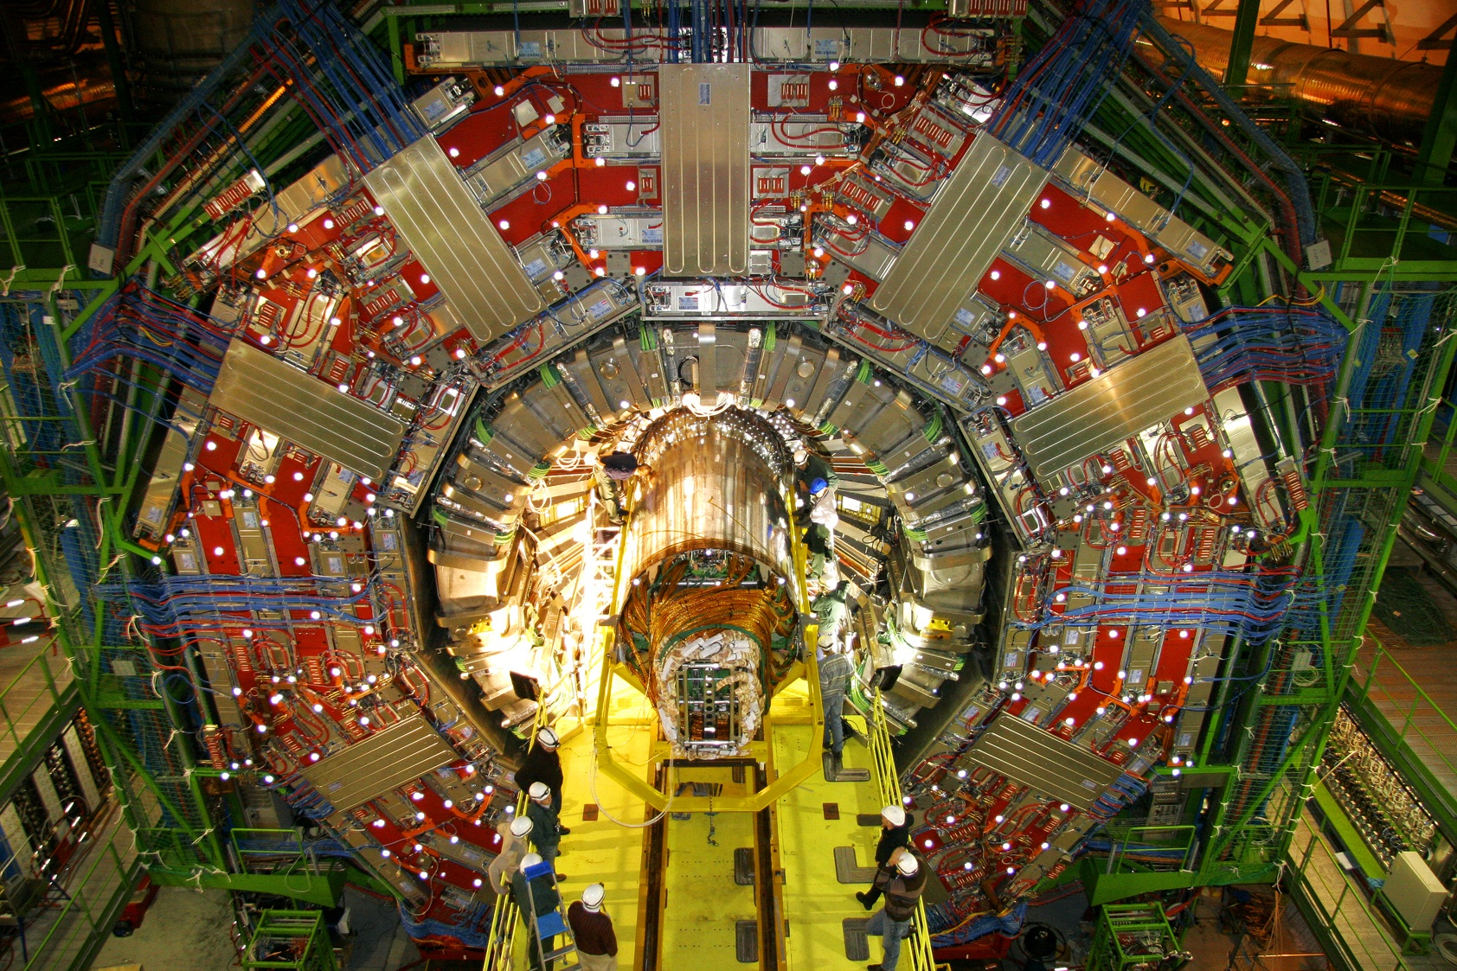
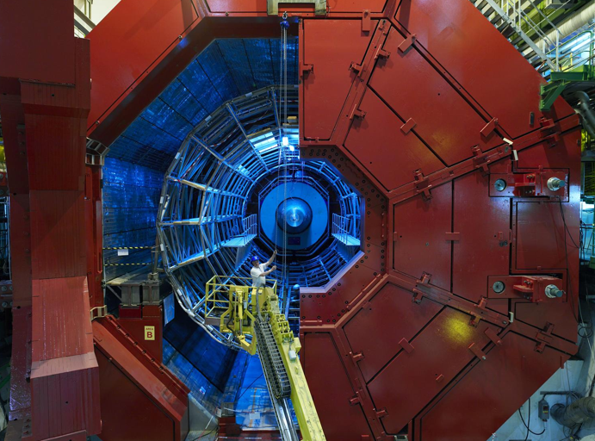
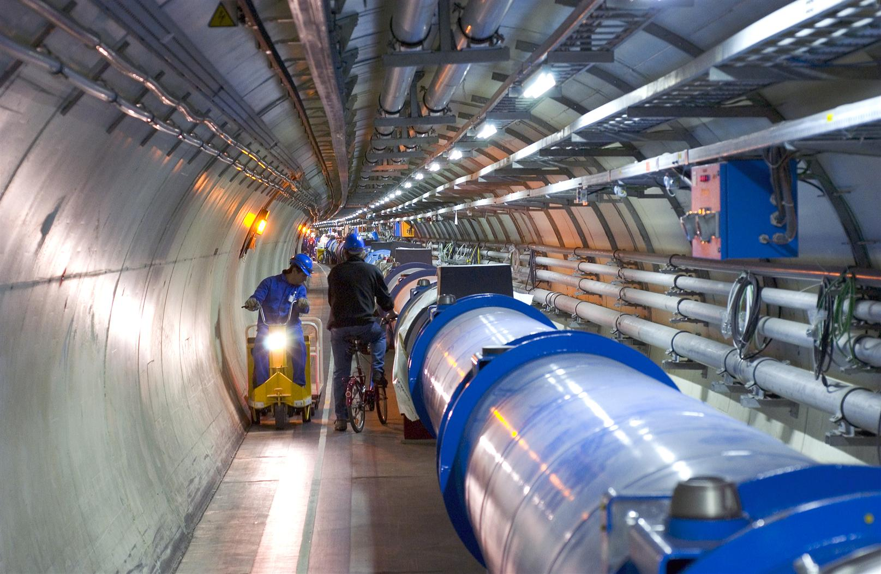
2010: a New Era in Fundamental Science
LHCb
CMS
ATLAS
Exploration of a new energy frontier
in p-p and Pb-Pb collisions
ALICE
LHC ring:
27 km circumference
Notes:
5

Slide 6
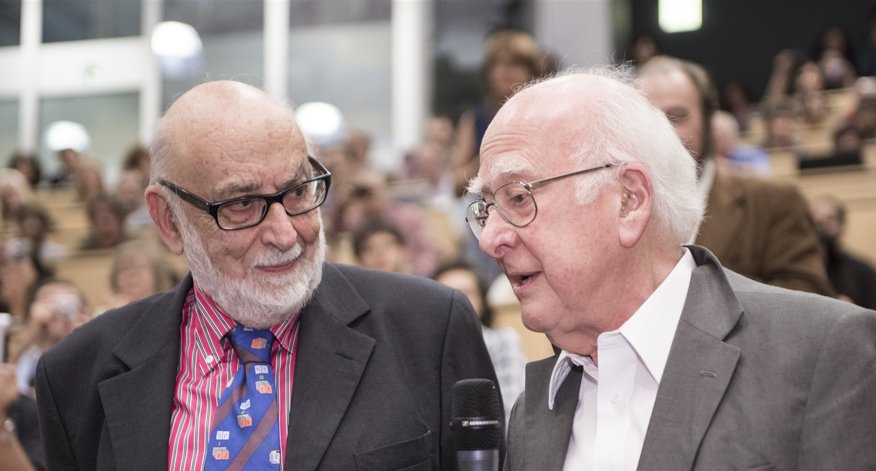
Discovery 2012, Nobel Prize in Physics 2013
The Nobel Prize in Physics 2013 was awarded jointly to François Englert and Peter W. Higgs "for the theoretical discovery of a mechanism that contributes to our understanding of the origin of mass of subatomic particles, and which recently was confirmed through the discovery of the predicted fundamental particle, by the ATLAS and CMS experiments at CERN's Large Hadron Collider”.

Slide 7
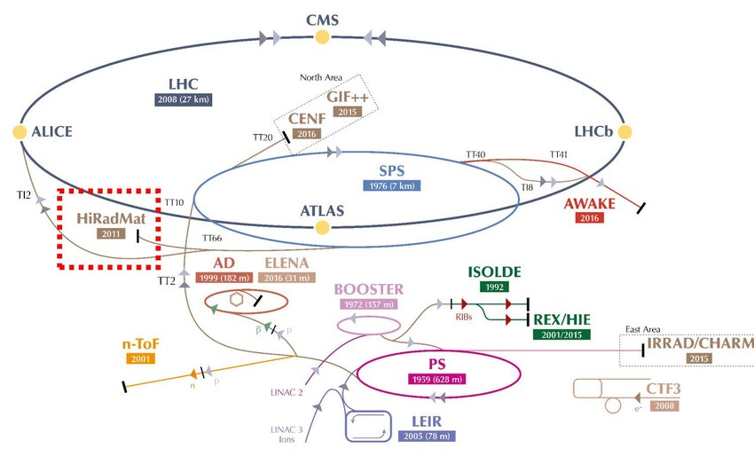
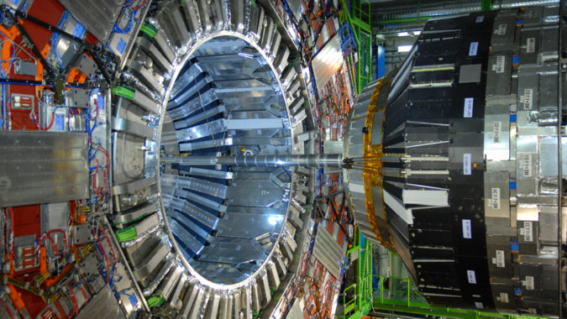
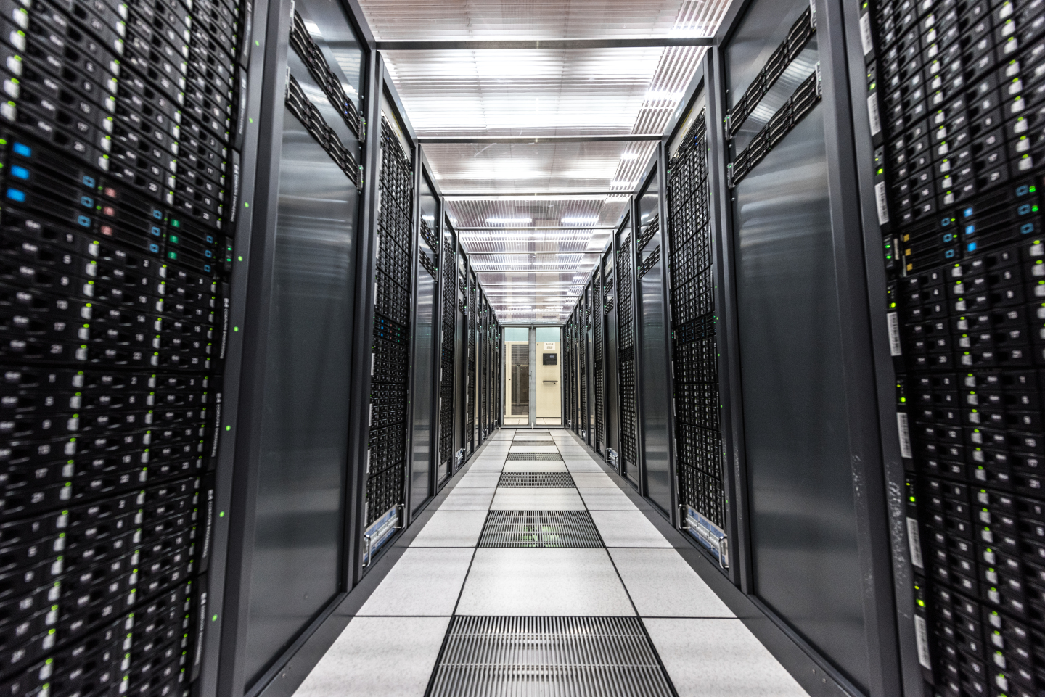
The three pillars of a discovery at CERN
Accelerators
Detectors
Computing

Slide 8
Computing @ LHC

Slide 9
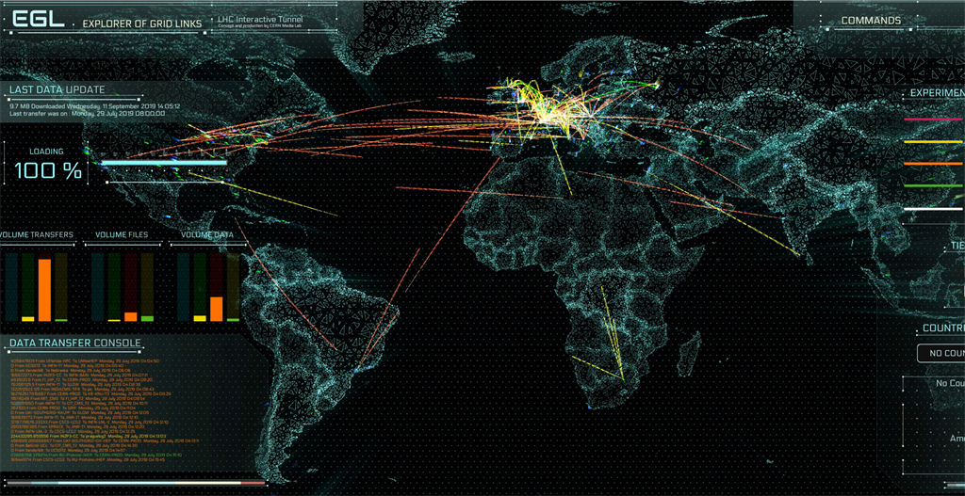
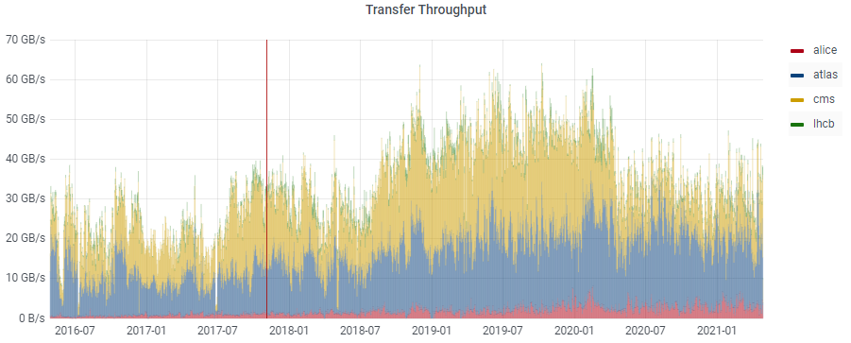
The Worldwide LHC Computing Grid (WLCG)
Used to store, distribute, process and analyse data.
1 million processing cores in about 160 data centres and 42 countries.
More than 1000 Petabytes of CERN data stored world-wide.

Slide 10
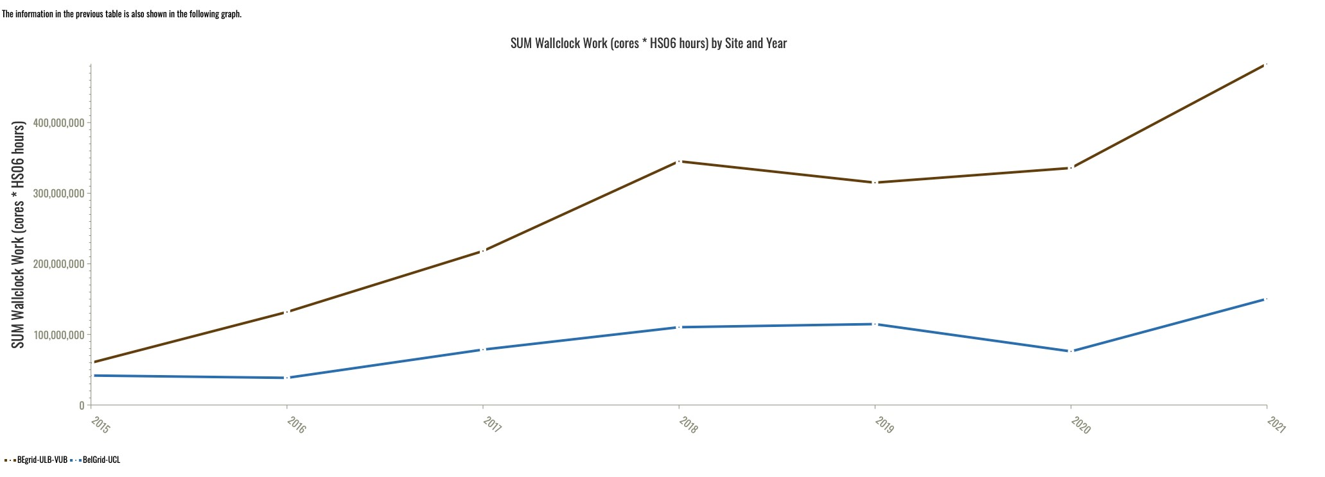
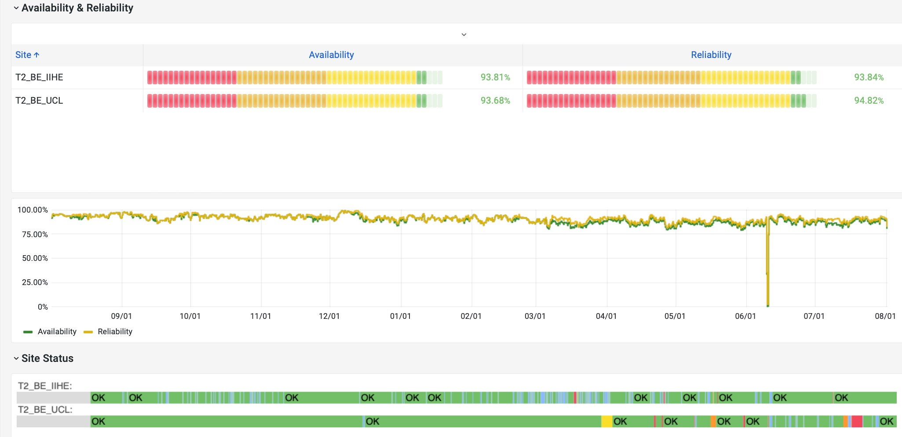
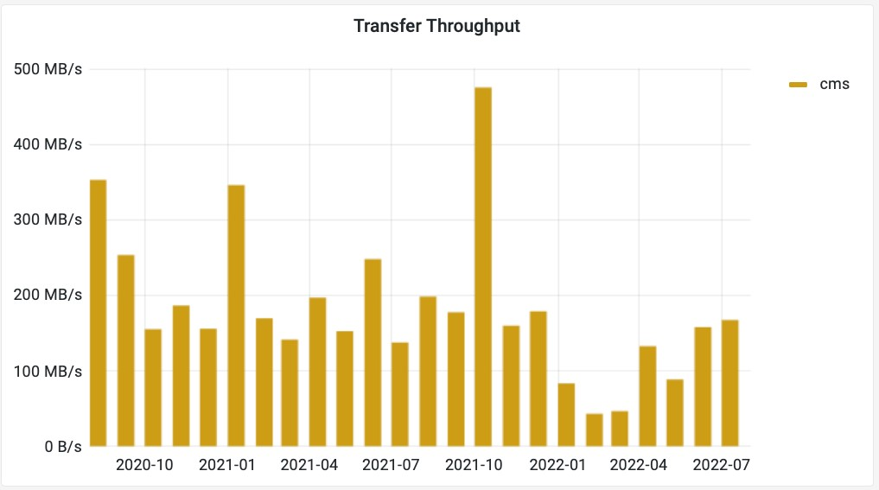
Belgium contributions to CMS as a Tier-2

Slide 11
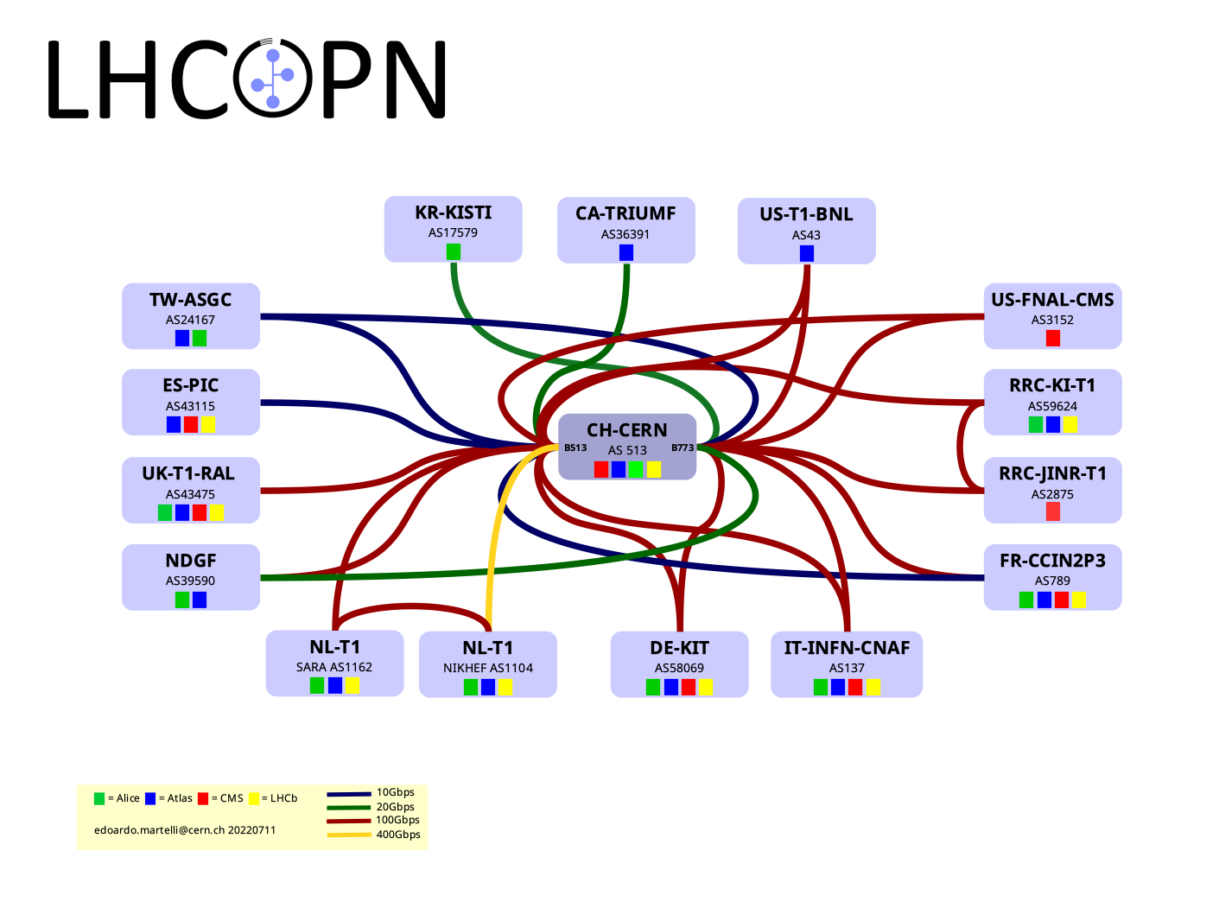
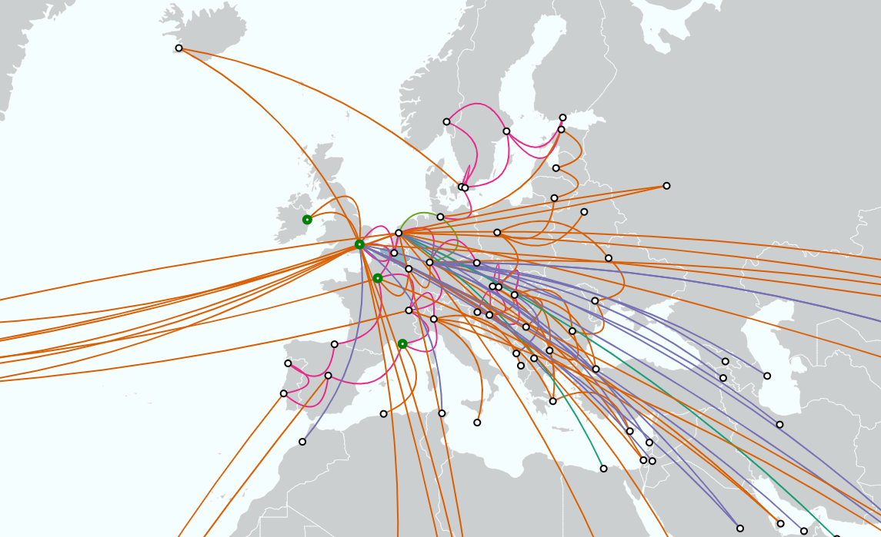
Dedicated global network connectivity
This takes many years to establish and evolve…

Slide 12
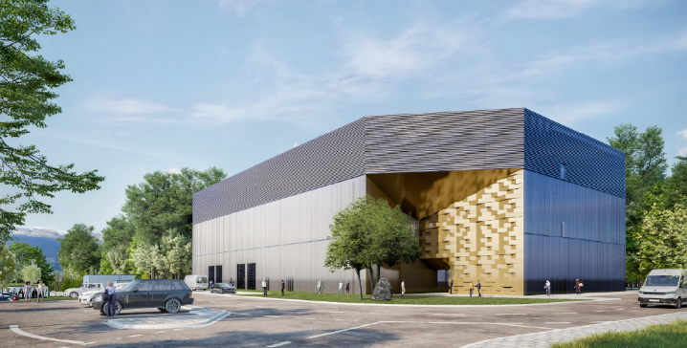
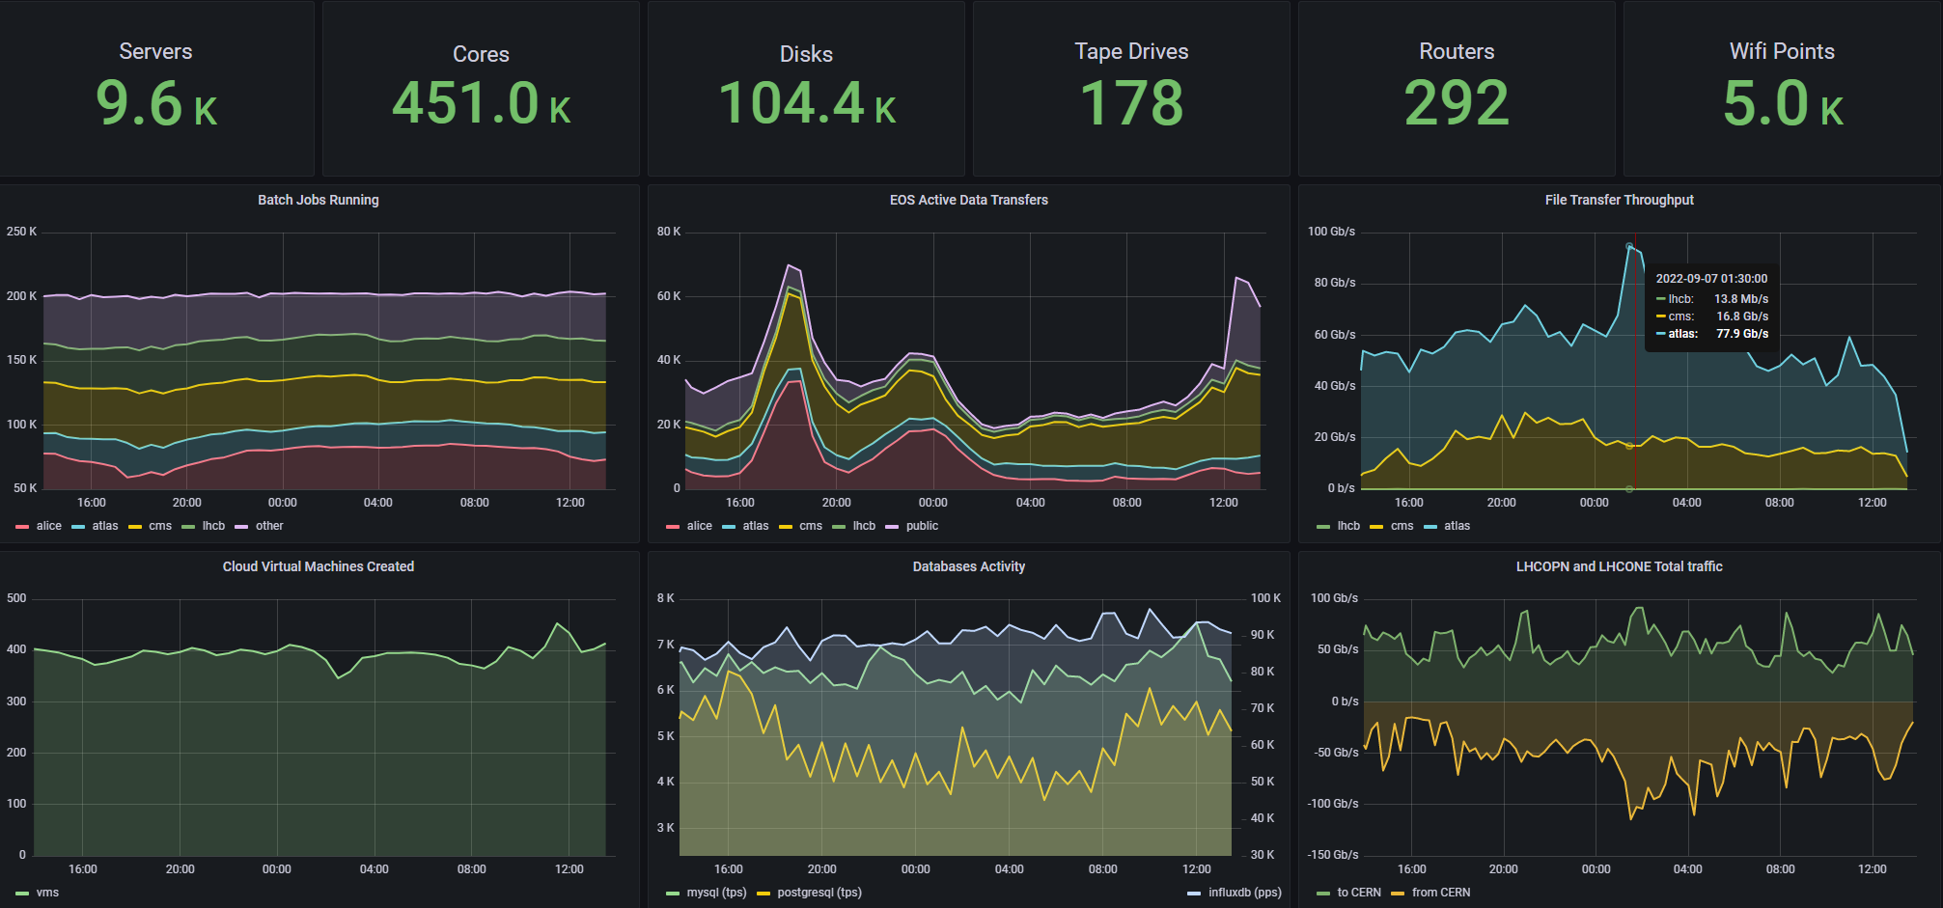
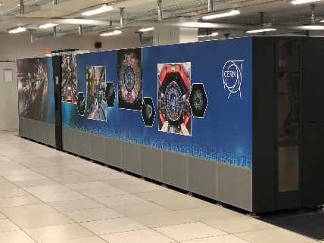
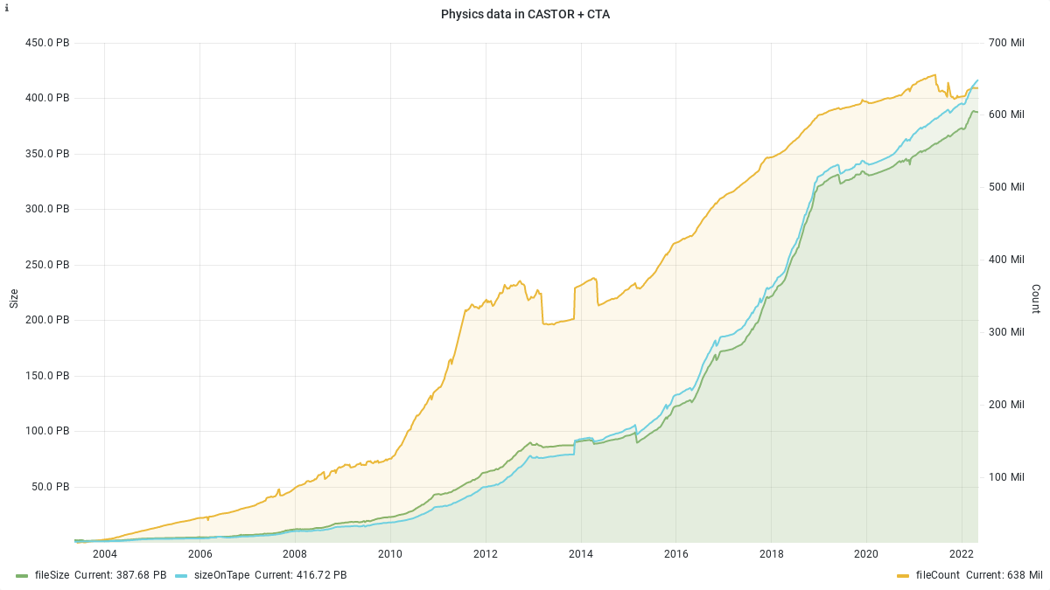
CERN Computing Facilities
New energy efficient data centre being built
Tape automated library
7 September 2022
LHC RUN 2 (2016-2018): 209 PB
LHC RUN 1 (2010-2012): 65 PB
The datacenter equipment is renewed ~every 5 years in average

Slide 13
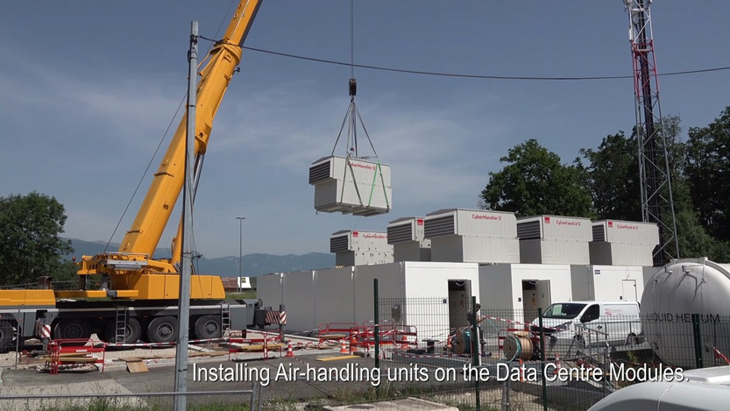
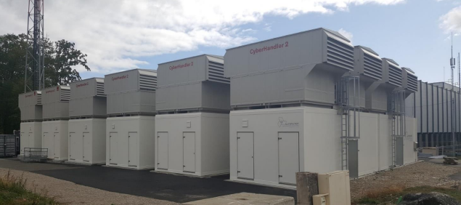
Experiments Online Computing – example LHCb

Slide 14
Back to the Future… or how did it all start?

Slide 15
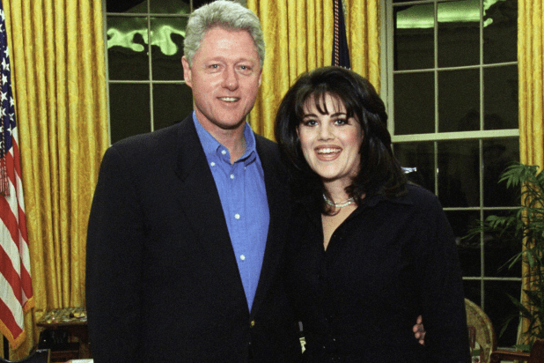
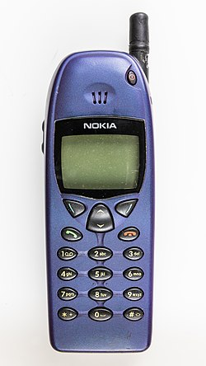
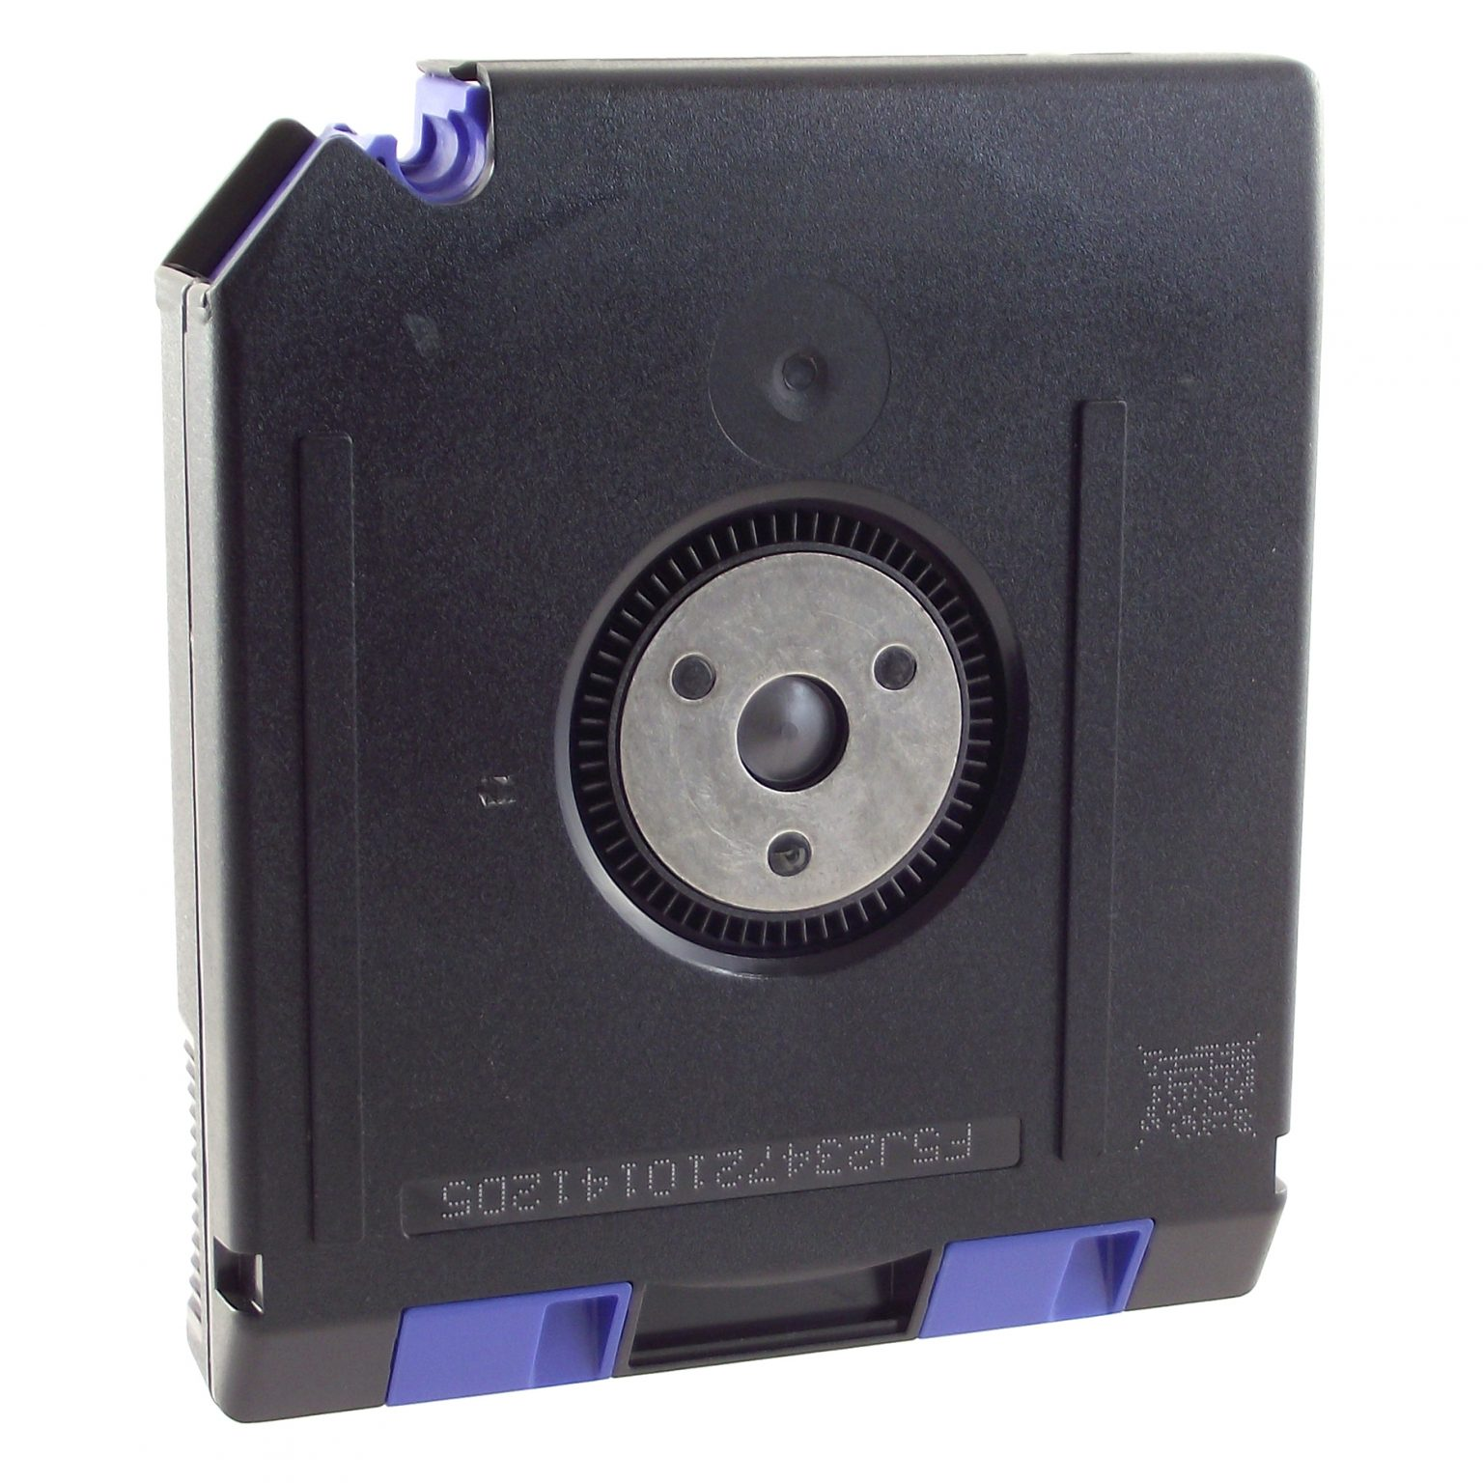
Work on the LHC computing grid started 24 years ago – Remember 1998?
Bill Clinton was impeached over his affair with Monica
Google was launched in September
The Nokia 6110 was the best mobile phone available
it would be another 9 years before the iPhone appeared
A good home network connection was 64 kbits/sec A high-speed inter-site network was 622 Mbits/sec (if available)
A big hard disk held 12GB in a hefty 5.25” package An IBM tape cartridge held 20GB
less than an Apple Watch today
Amazon had been selling books online for three years, but it would be a further 8 years before the announcement of the S3 (storage) and EC2 (Elastic Computing) services – the first cloud?

Slide 16
The Problem: Estimated** requirements for LHC offline computing
Compared with LEP - LHC detectors -- would produce much more data -- with more complex events
The LHC project budget had no line for computing at CERN
Most of the computing capacity required would have to come from outside of CERN
The “Moore’s Law” extrapolation of the funding available at CERN
** adapted from LCG Technical Design Report 2005 with start-up date of 2007

Slide 17
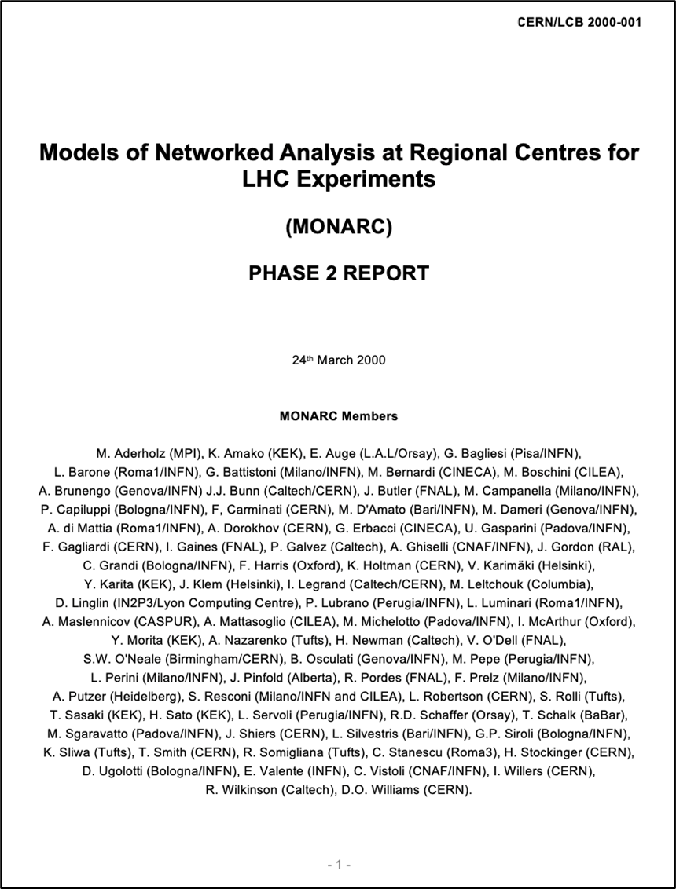
Search for a Solution
The MONARC** Project was started in 1997
to assess requirements, technologies and costs for LHC computing.
and propose a solution within the constraints of
the large data volumes
the need to incorporate resources of different capacity and functionality spread across the world
the bandwidth of wide area networking that could be expected in 2005
using an architecture that looked feasible to be implemented in the time available
** CERN/LCB 2000-001 Models of Networked Analysis at Regional Centres for LHC Experiments – H.Newman (chair) et al
The Importance of Community Buy-In

Slide 18
The Monarc distributed model
LHC Computing Model
Three-tier distributed computing model for the early years of LHC operation – from CERN/LCB 2000-001 Models of Networked Analysis at Regional Centres for LHC Experiments (note the WAN data rates and the “optional air freight”)

Slide 19
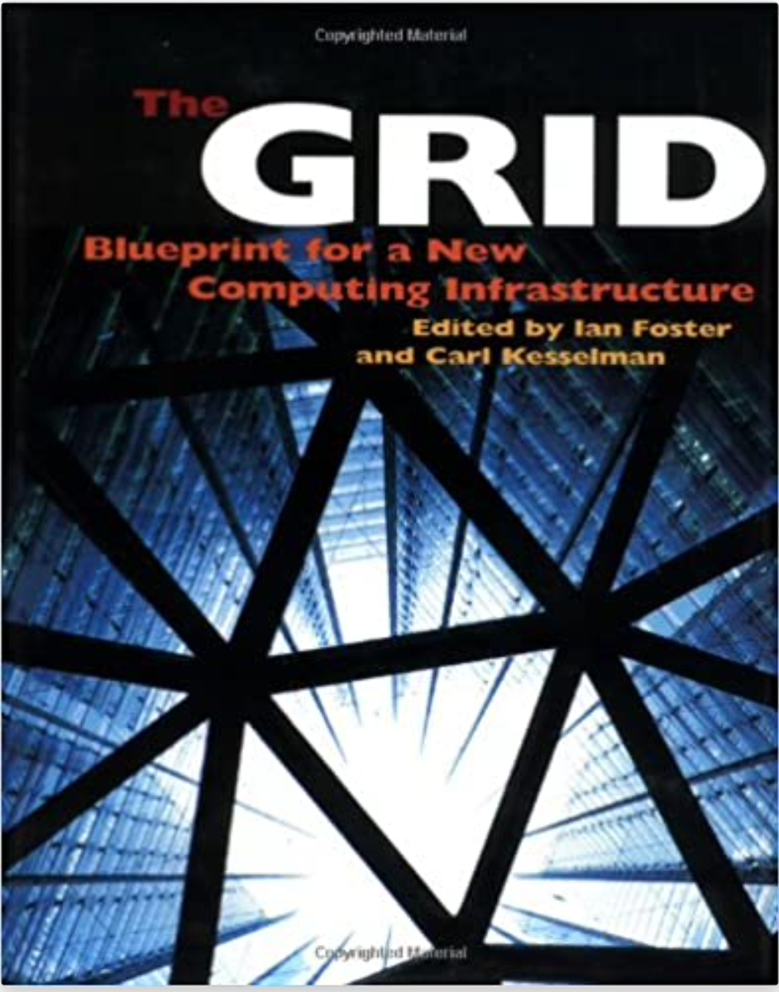
In the wider world the Grid concept was attracting interest
The Grid : Blueprint For A New Computing Infrastructure, Morgan Kaufmann, July 1998 – Carl Kesselman (USC) and Ian Foster (Chicago)
The Globus Project supported an open-source toolkit that included the basic functions needed to operate a Grid.
Early HEP pilots – the Particle Physics Data Grid in the US – a distributed simulation facility in INFN
Gave some confidence that distributed computing services for HEP would be feasible on the timescale of LHC

Slide 20
The LHC Computing Grid Project
This was all going to be very expensive in money and manpower, so we needed a formal structure acceptable to the CERN Council and the agencies funding the experiments
The project was set up in 2001 to
coordinate planning and provision of the computing resources for the LHC experiments
enable institutes and funding agencies to pledge formally resources and manpower
provide a collaboration style structure that ensured the wide representation of stake holders needed to maintain consensus
The project reported to the LHCC – the high-level coordinating body for experiments using the LHC.
LHC planning was evolving and the startup date moved to 2007, so we had a breathing space for development before interfaces would have to be fixed
The EU DataGrid project included participants from CERN* and many HEP institutes, and for the follow-on project, EGEE, it was agreed that institutes taking part in the LHC project could be associated no matter their home country – eventually involving 34 countries.
In the US LHC participants migrated towards the Open Science Grid (OSG)
As the LHC beams grew closer it was agreed that each participating centre would support a base set of functions
*The leader of EDG and EGEE was Fabrizio Gagliardi from CERN

Slide 21
LCG-1 Service Opened September 2003
Middleware package – components from –
European DataGrid (EDG)
US (Globus, Condor, PPDG, GriPhyN) → the Virtual Data Toolkit
Agreement reached on principles for registration and security
Certification and distribution process established and tested - June
Rutherford Lab (UK) to provide the initial Grid Operations Centre
FZK (Karlsruhe) to operate the Call Centre
Pre-release middleware deployed to the initial 13 centres – July
1 September release :
Taiwan, Brookhaven, CERN,
Bologna, Fermilab, Karlsruhe,
Lyon, Budapest, Moscow,
Prague, Barcelona,
Rutherford UK, Tokyo
Notes:
Status on 24 July 2003 – I will email an update on the 11th August
There are two activities going on in parallel:
-- Pre-production software is being deployed to 10 Regional Centres (Academia Sinica Taipei, BNL, CERN, CNAF, FNAL, FZK, IN2P3 Lyon, Moscow State Univ., RAL, Univ. Tokyo). This is a final validation of the distribution and installation process and tools, and establishes the network of service support people, but the Grid middleware is not the final version yet. About half of the sites have successfully installed this – a few (including BNL and Lyon) are very slow.
-- Final testing is under way of the first production set of Grid middleware. This is being done by a group of grid experts from the LHC experiments (the “loose cannons”). There are a few “show stoppers” and about 15 very serious bugs.
The target is to install the production software by the end of the month – one week from now!

Slide 22
From testing to data:
e.g. DC04 (ALICE, CMS, LHCb)/DC2 (ATLAS) in 2004 saw first full chain of computing models on grids
Independent Experiment Data Challenges
2004
SC1 Basic transfer rates
Service Challenges proposed in 2004
To demonstrate service aspects:
Data transfers for weeks on end
Data management
Scaling of job workloads
Security incidents (“fire drills”)
Interoperability
Support processes
2005
SC2 Basic transfer rates
SC3 Sustained rates, data management, service reliability
2006
SC4 Nominal LHC rates, disk→ tape tests, all Tier 1s, some Tier 2s
Focus on real and continuous production use of the service over several years (simulations since 2003, cosmic ray data, etc.)
Data and Service challenges to exercise all aspects of the service – not just for data transfers, but workloads, support structures etc.
2007
2008
CCRC’08 Readiness challenge, all experiments, ~full computing models
2009
STEP’09 Scale challenge, all experiments, full computing models, tape recall + analysis
2010
Ian Bird, CHEP 2010 Taipei

Slide 23
Planned distribution of Resources across the Grid from LCG Technical Design Report – LHCC2005-0024 - start-up in 2007 -
Tier-2s
Tier-2s
Tier-1s
Tier-1s
Tier-1s
CERN
CERN
CERN
CERN share :
16% 9% 33%

Slide 24
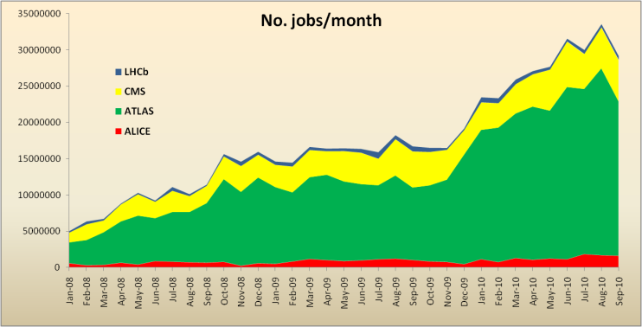
How did it work for first data taking? >140 sites, ˜250K CPU cores, ˜100 PB disk
1M jobs/day
Initial start & accident
Run 1
Ian Bird, CHEP 2010 Taipei

Slide 25
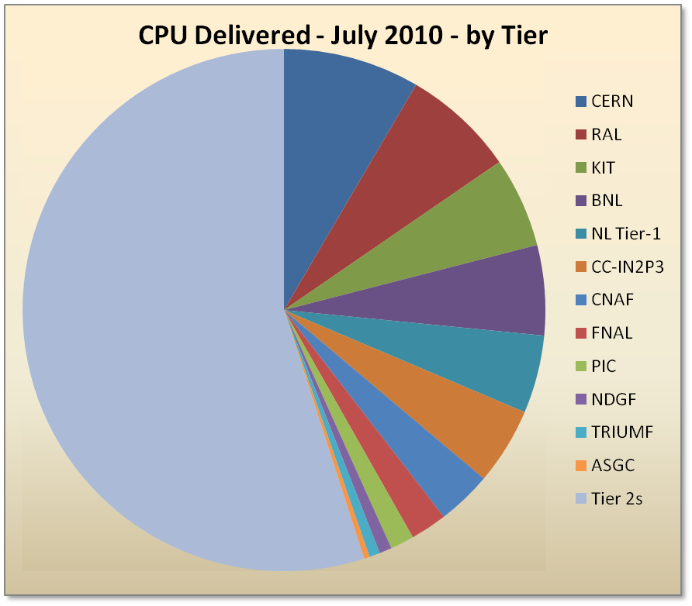
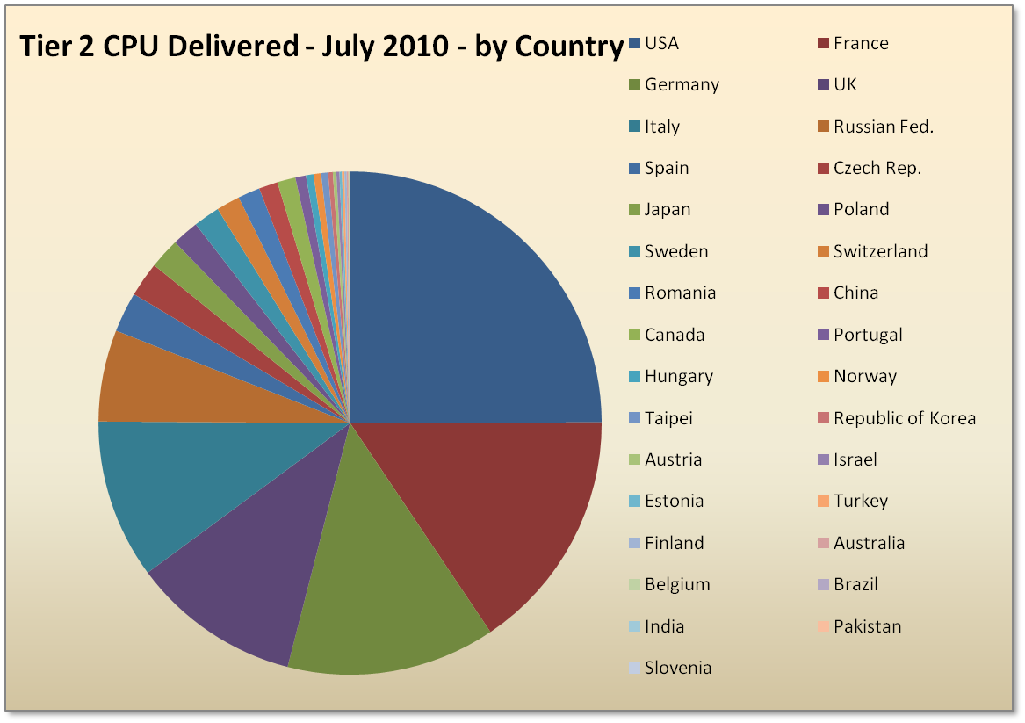
CPU – July 2010
Significant use of Tier 2s for analysis
frequently-expressed concern that too much analysis would be done at CERN is not reflected
The Importance of the Tier-2’s
Training Scientists and Engineers in distributed computing, networking and operations
Allows for local computing resources investments
Tier 0 capacity underused in general
But this is expected to change as luminosity increases
Ian Bird, CHEP 2010 Taipei

Slide 26
Words of caution

Slide 27
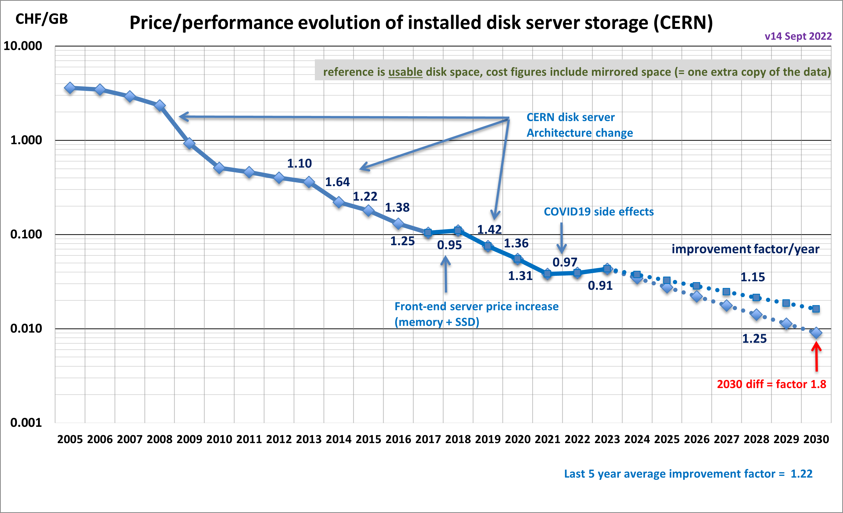
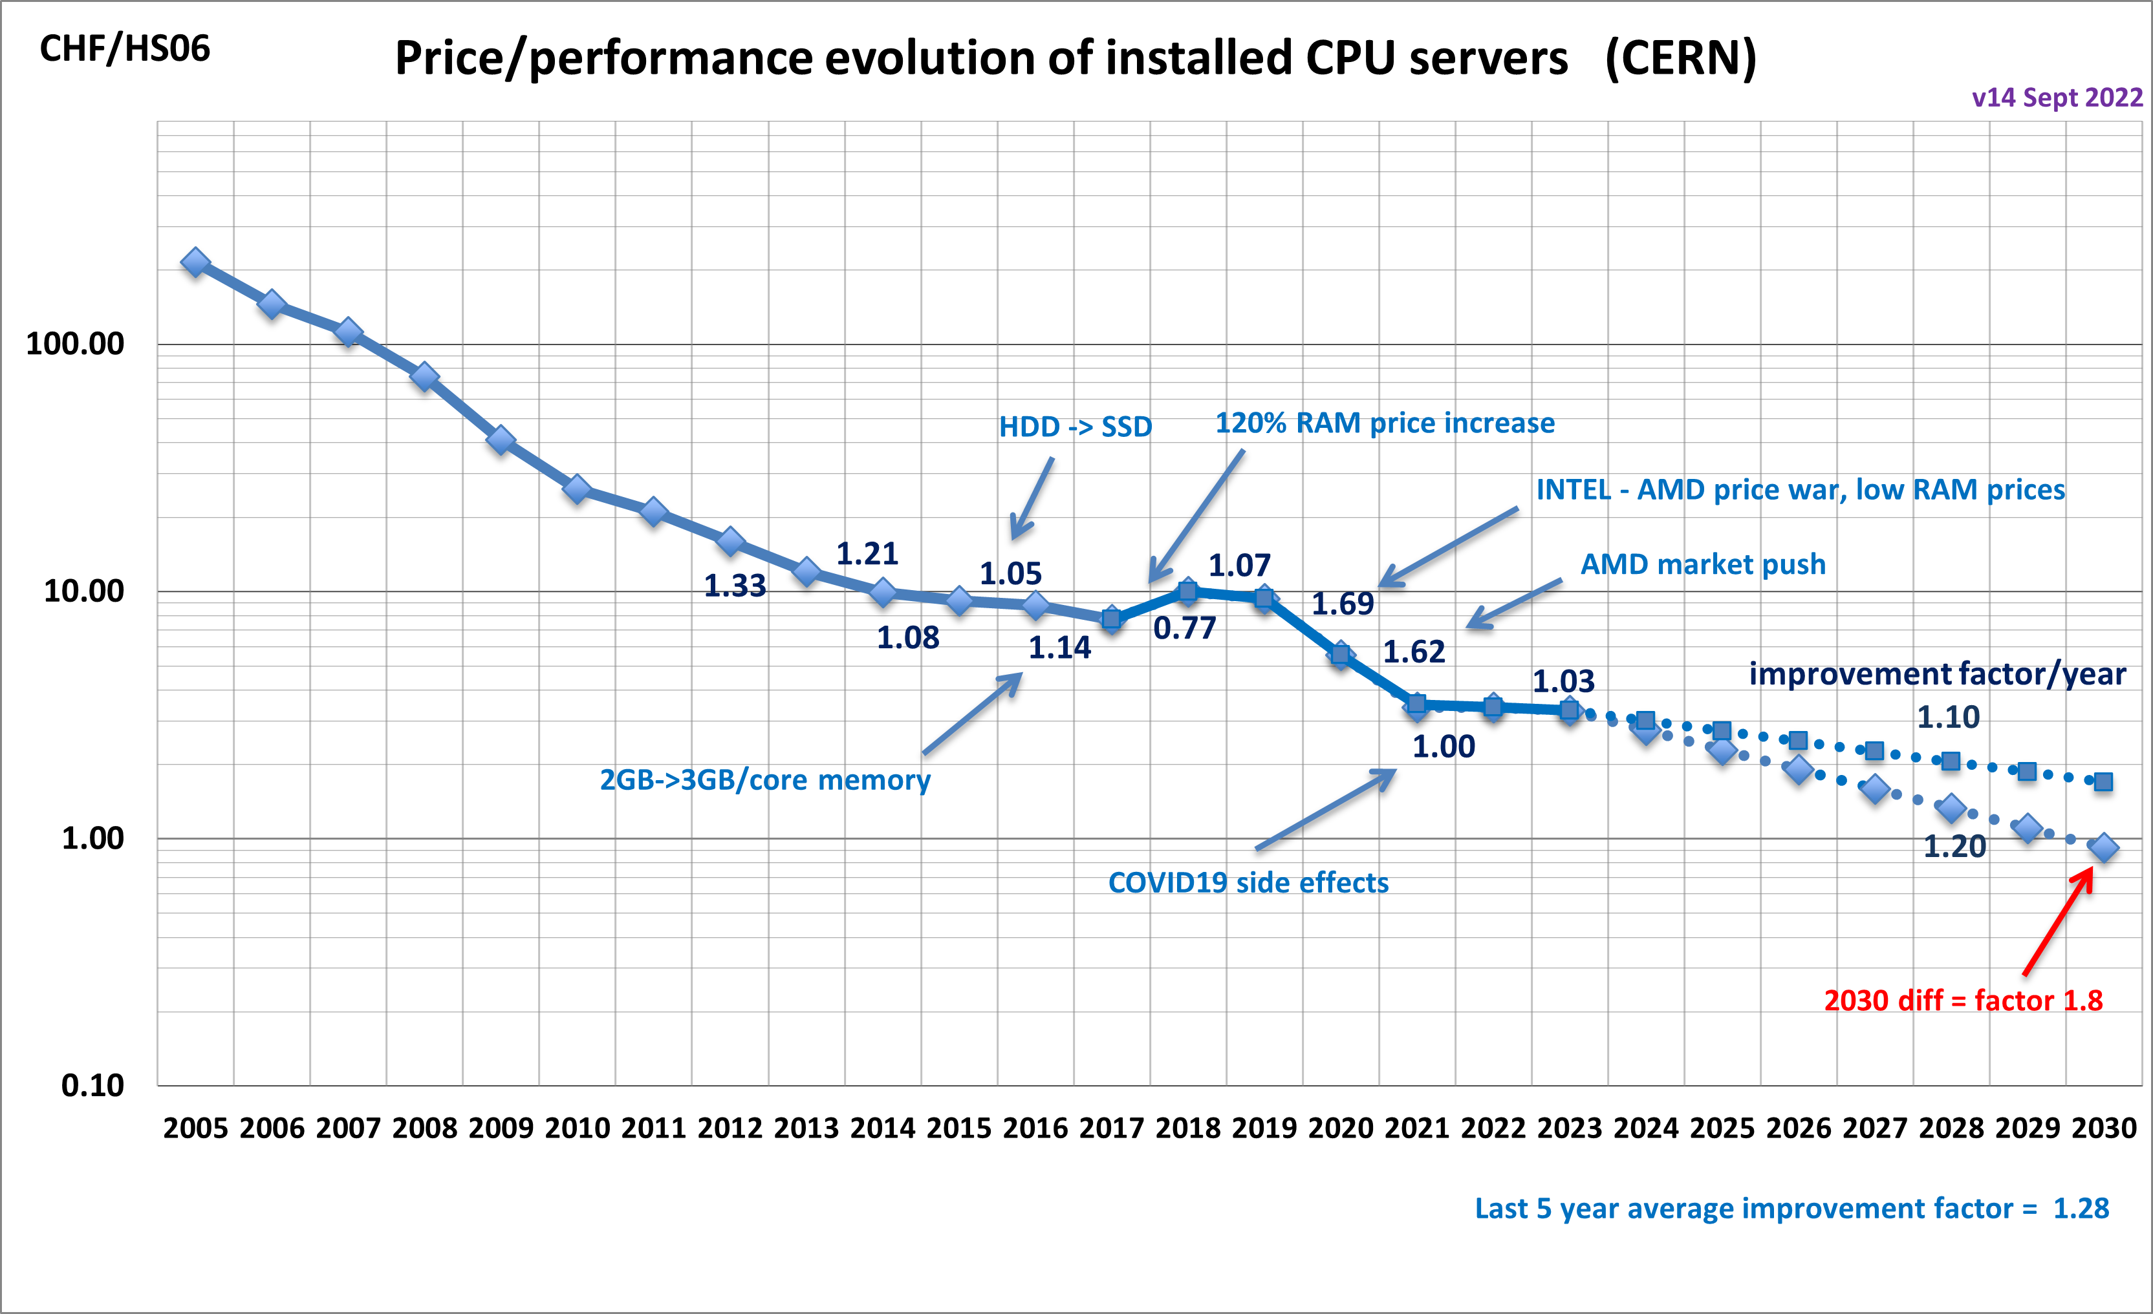
Price performance evolution
Markets can be volatile: must be agile in procurement

Slide 28
2008-2020 at CERN: Major Increase of Software Expenses
Expenses x2 over 12 years
Clear Trend:
Software costs would continue to increase in the near future due to commercial trends impacting the academic world
Since 2020: Autodesk, Mathworks, Gitlab, Atlassian
Uncertainties about Microsoft, Oracle, Smarteam, Catia, Cadence, etc.

Slide 29
Software: Market Trends (II)
Linux CentOS Future
The CentOS Project shifted its focus from CentOS Linux to CentOS Stream (announced in Dec 2020)
Stream is more dynamic (less stable) than CentOS Linux
Stream will have a 5 year support (rather than 10)
CentOS Linux 8 end of support: in 2022 (was 2029)
We are very small
We must be able to face the unexpected, even in the Open Source

Slide 30
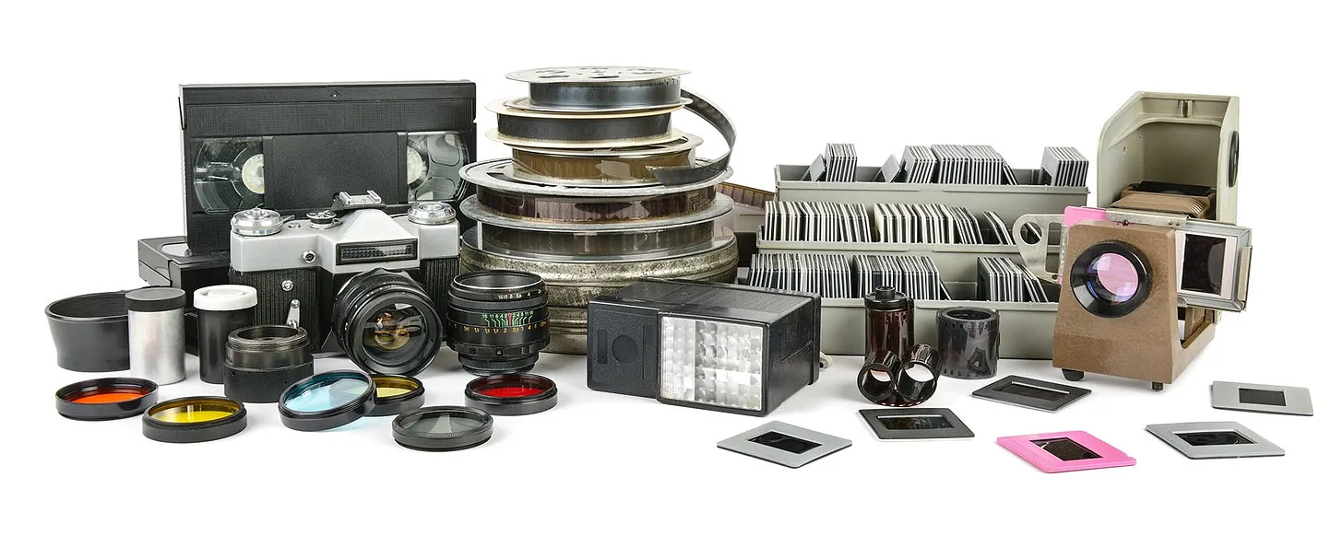
Data Preservation for Re-Use
Re-use: by Collaboration, Theorists, Scientists, Public, Others for Science, Education, & more
New analyses, reproducibility of results, linking papers to data, data sharing, etc (= Data Management Plan)
LEP data: ~100TB/expt until ~2030 (and more)
LHC data: many Exabytes and more – until FCC??
Preserve data, documentation, code, meta-data, etc
“Data” is the “easy” bit
More complicated is the metadata (calibration/alignment, logbooks, technical reports, powerpoint slides, etc.)
Even more complicated: data formats, operating systems and programming languages
We have evidence that we are already losing “data”
Some LEP experimental data could only be rescued because retired scientists had a private copy … at home
Early CERN WWW inforemoation was rescued from Robert Cailleau’s early Linux servers
…
The problem is not limited to High Energy Physics, Science, etc..
Think of legal documents or medical records…
The Importance of Data Preservation
Must be considered and funded during the life of a project, after is too late
This is our legacy to younger generations
The challenge is NOT limited to science
https://oldgoats.substack.com/p/ruminating-with-vint-cerf

Slide 31
The future

Slide 32
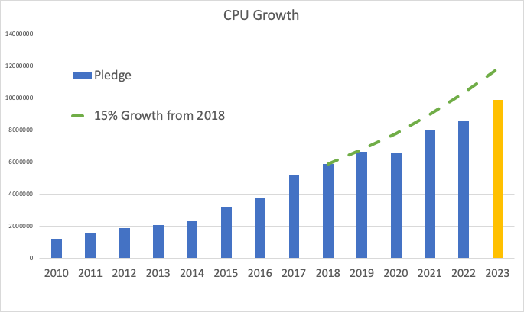
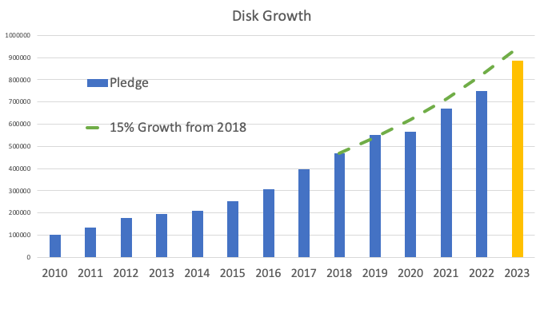
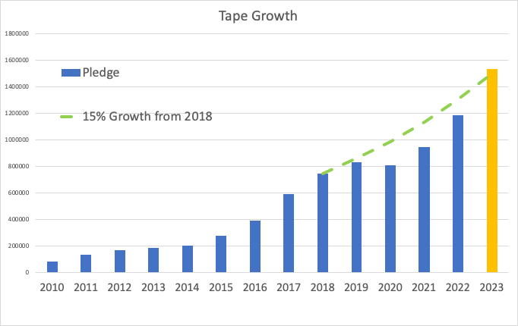
Resource needs for Run-3: outlook
WLCG resources for 2022 are deployed
Resource needs for 2023 are compatible with “flat budget scenario”.
Expect resource needs exceeding +15% growth in 2024 e.g. from LHCb

Slide 33
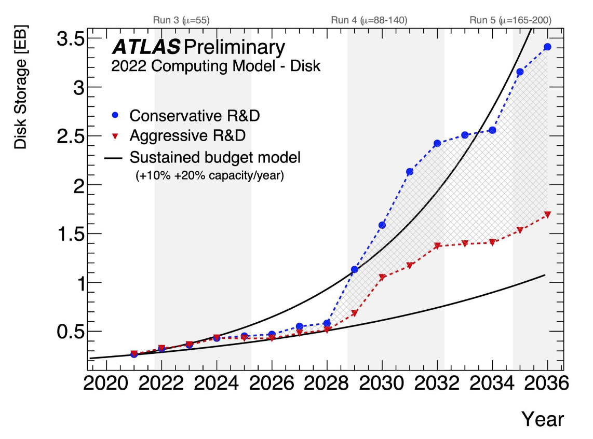
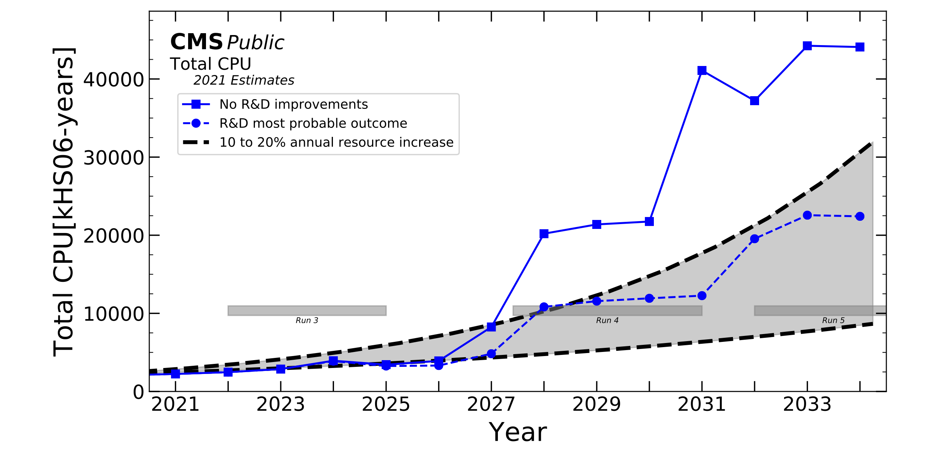
ATLAS and CMS needs for HL-LHC
The gap between available and needed resources is filling up, assuming the main R&D activities are successful
Investing in further (identified) R&D activities would fill this gap further. Need more effort
There are still large uncertainties

Slide 34
Finally…

Slide 35
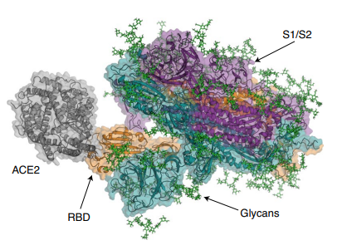
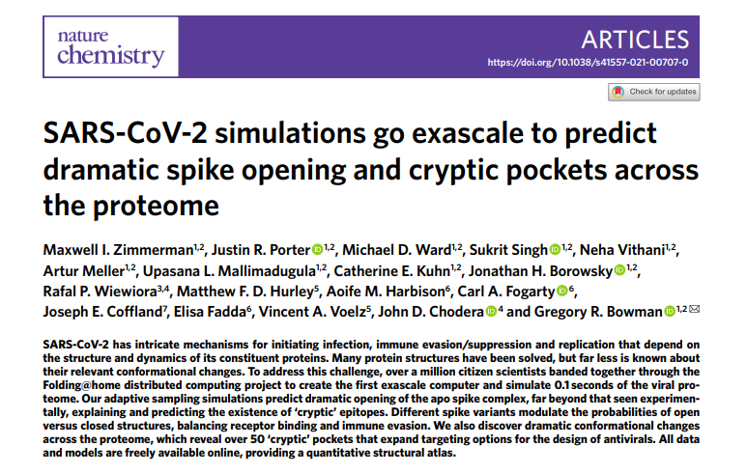
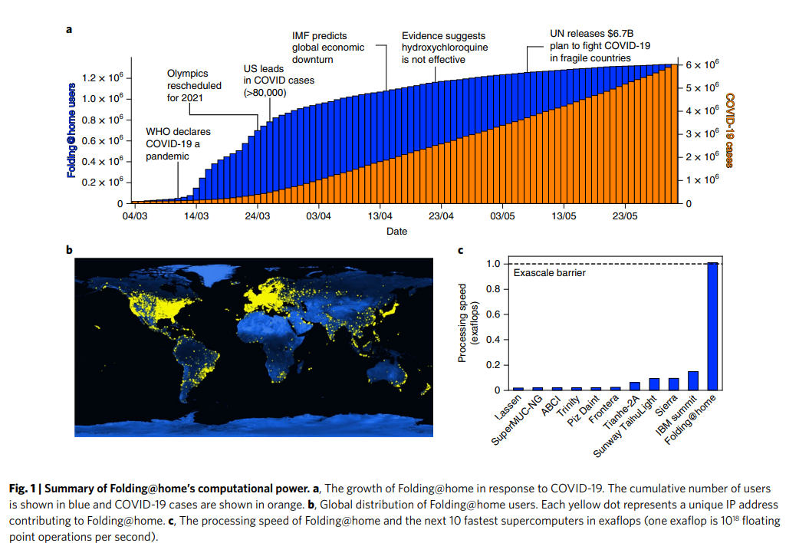
Impact on society
SARS-CoV-2 simulations go exascale to predict dramatic spike opening and cryptic pockets across the proteome | Nature Chemistry

Slide 36
Building large data intensive infrastructures Summary
Importance of community buy-in
Small contributions are important
“Unity make strength”
Computing costs are driven by the markets, not the technology
Significant costs can be optimized by being clever
Software license costs may become a major hurdle
While Open Source is not cost free
Data preservation: this is not just about data
Metadata and platforms are equally important
Much harder IMHO than paper preservation
HEP might be leading, but others have and will have similar requirements and needs
And will observe the same issues
This is not just limited to science
We have built a quite unique infrastructure for high energy physics, and we should be proud of it!

