Slide 1
Colloquium: 50 years of particle physics research Words from the funding agencies (F.R.S.-FNRS) 14 September 2022
Notes:
Maxime

Slide 2
1. THE FUND FOR SCIENTIFIC RESEARCH – FNRS
Private foundation of public utility (since 1928)
2,000 researchers at all stages of their scientific careers
1,000 research projects (research programs, research credits, equipment, international projects, ...)
All the fields of science
~ 200 Million € budgett
Science administration and evaluation (more than 15.000 international experts)

Slide 3
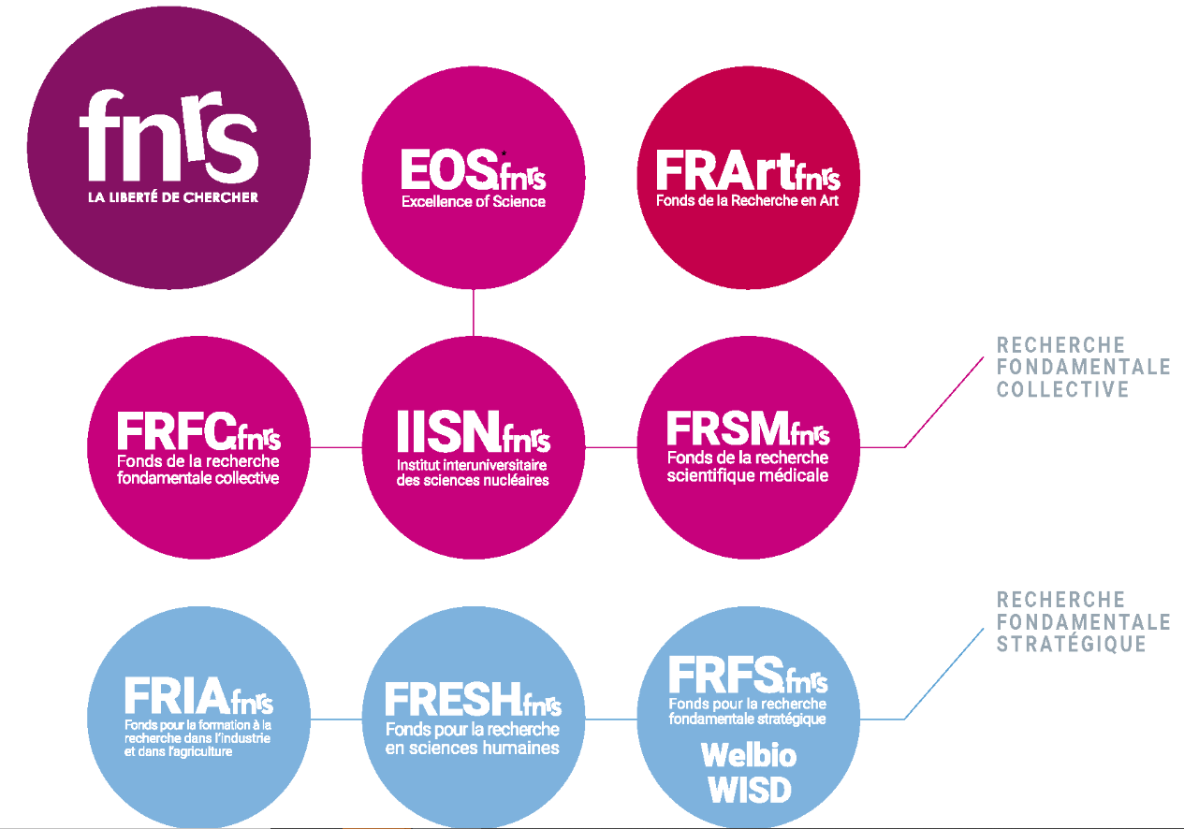
2. THE FUND FOR SCIENTIFIC RESEARCH – FNRS AND ITS SUPPORT TO FUNDAMENTAL PHYSICS
8 specialised associated Funds

Slide 4
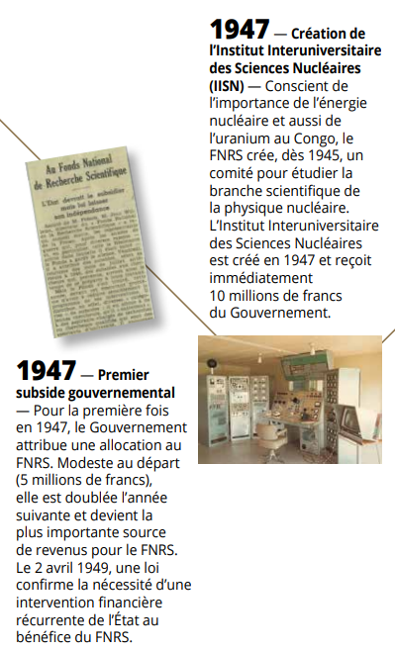
2. THE FUND FOR SCIENTIFIC RESEARCH – FNRS AND ITS SUPPORT TO FUNDAMENTAL PHYSICS (2)
1928: FNRS
1947 : IISN (Interuniversity Institute for
Nuclear Sciences)
1953: CERN
1972: IIHE

Slide 5
3. BELGIUM AS A KEY PLAYER IN RESEARCH IN PHYSICS
part of physics / astronomy amongst 2021 « Belgian » publications (scopus)

Slide 6
3. BELGIUM AS A KEY PLAYER IN RESEARCH IN PHYSICS (2)
most frequently acknowledged sources of financing in Belgian publications in physics / astronomy (2011-2021)
publications involving at least one author affiliated to a Belgian institution - scopus

Slide 7
4. F.R.S.-FNRS CONTRIBUTION TO IIHE (1)
F.R.S.-FNRS PhD grants and fellowships awarded to IIHE (2013-2022)
PhD grants and fellowships | Awarded to IIHE (2013-2022)
Research Fellows (ASP) | 5
FRIA doctoral grants (FRIA) | 7
Postdoctoral Researchers (CR) | 10
Scientific collaborators | 4
Research Associates (CQ) | 2
Senior Research Associates (MR) | 2
Research Directors (DR) | 3

Slide 8
4. F.R.S.-FNRS CONTRIBUTION TO IIHE (2)
F.R.S.-FNRS credits awarded to IIHE (2013-2022)
(IIHE main promoters and co-promoters)
Funding instruments | Awarded to IIHE
Interuniversity Institute for Nuclear Sciences (IISN) | 12
Excellence of Science (EOS) | 1
Equipment (infrastructure) | 1
Research logistic collaborator | 2
PINT-BILAT-M | 2
Notes:
Maxime

Slide 9
4. F.R.S.-FNRS CONTRIBUTION TO IIHE (3)
+ 5 M€ to CMS upgrade

