Slide 1
Overview ICHEP2016
Freya Blekman

Slide 2
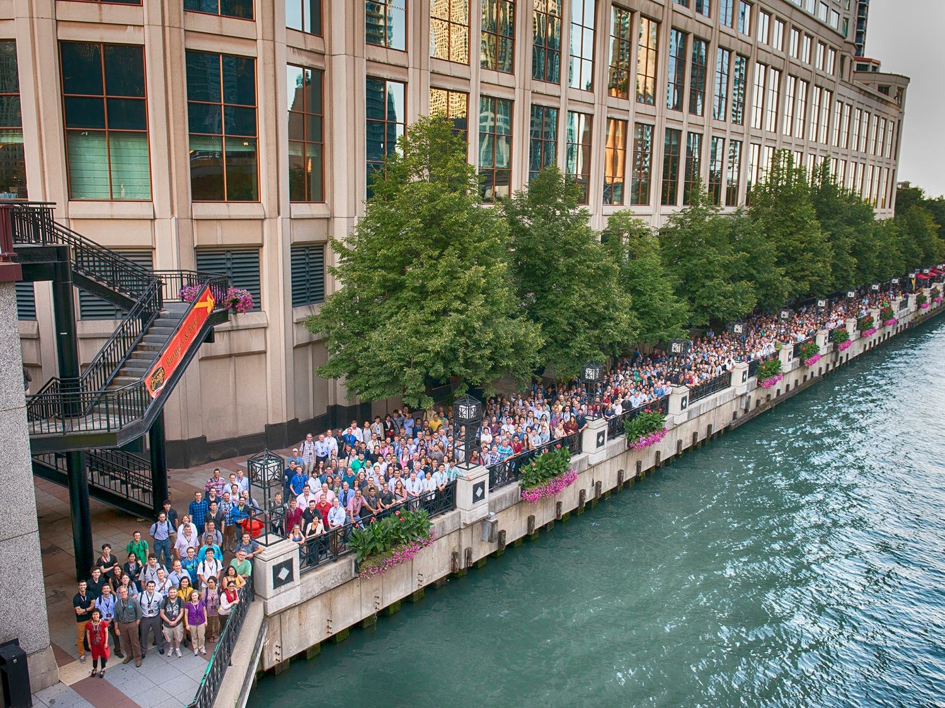
Largest conference in particle physics

Slide 3
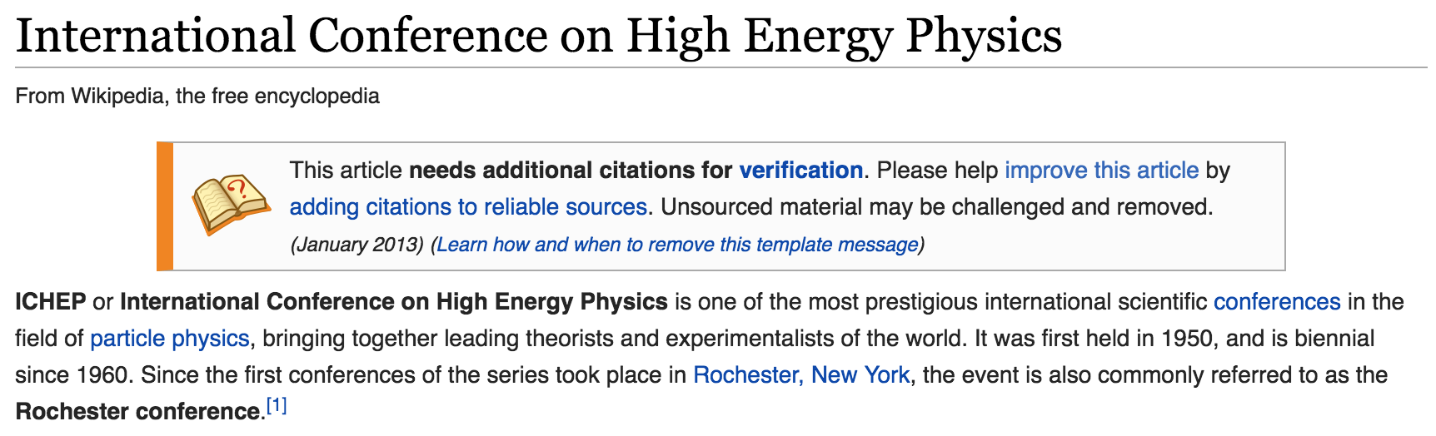
ICHEP - history
From wikipedia:
Specific structure:
  First 3 days: only parallel sessions
  Second 3 days: only plenary sessions

Slide 4
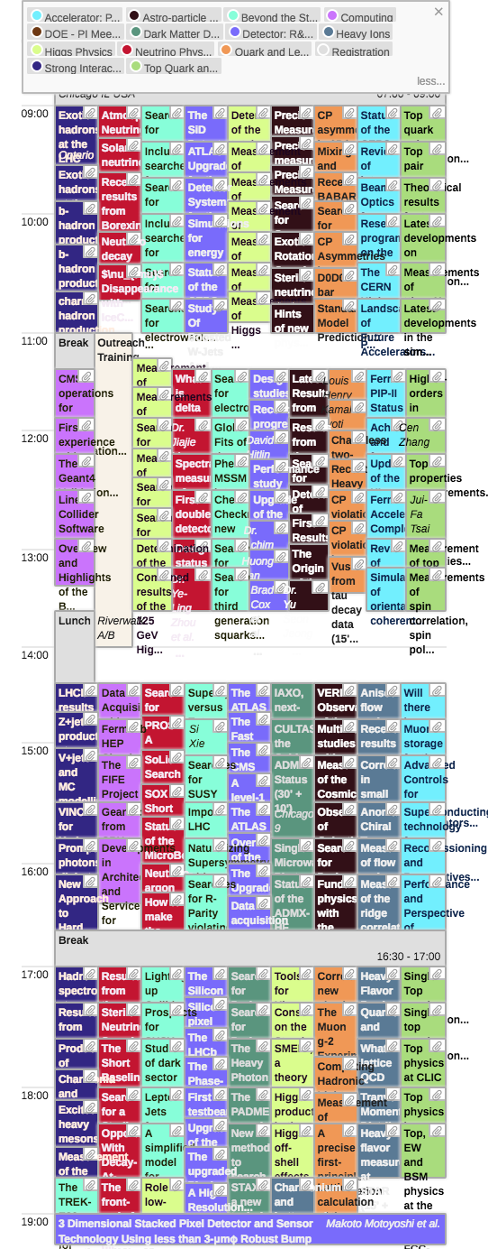
Many many many talks
Some cherry-picking
And substantial borrowing from plenary summary speakers
And still beware this is only highlights!
So – let’s get started
One day of parallel sessions

Slide 5
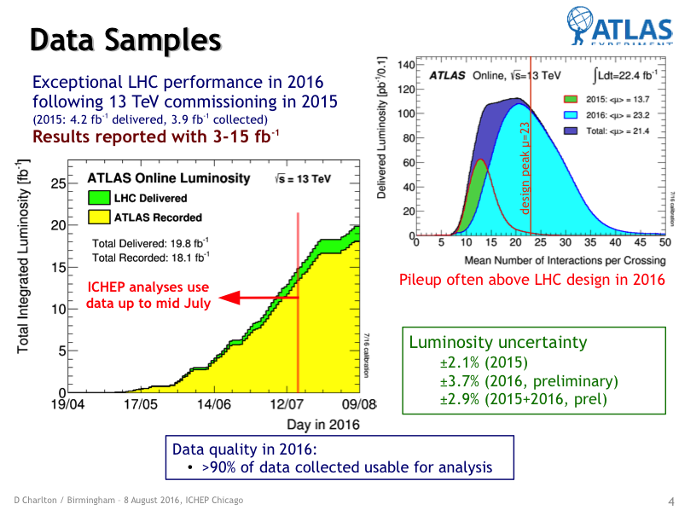
LHC

Slide 6
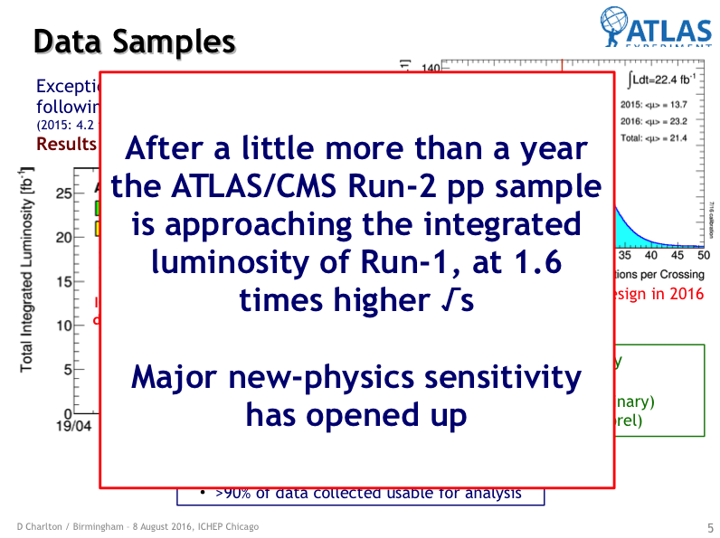
LHC

Slide 7
LHC

Slide 8
LHC
ATLAS: 64 new results for ICHEP
CMS: Over 70 new results for ICHEP
  Hard work by many people in Brussels IIHE workshop last week with some (not all) results we contributed to

Slide 9
Detector performance: trigger

Slide 10
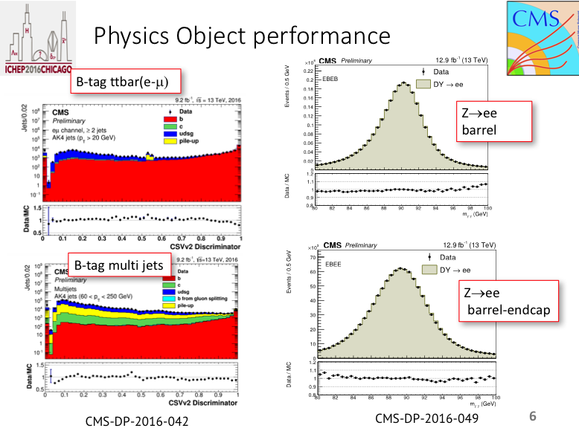
Detector performance: from detector to four-vector

Slide 11
High luminosity: mixed blessing

Slide 12
Standard Model

Slide 13
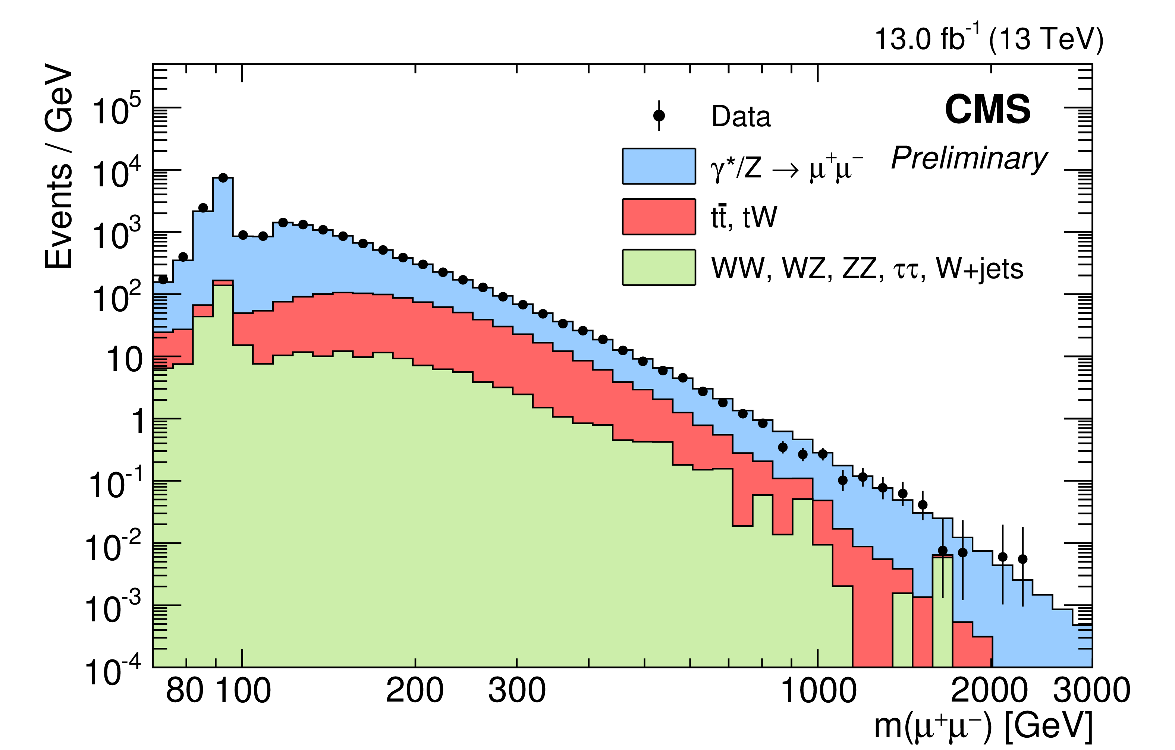
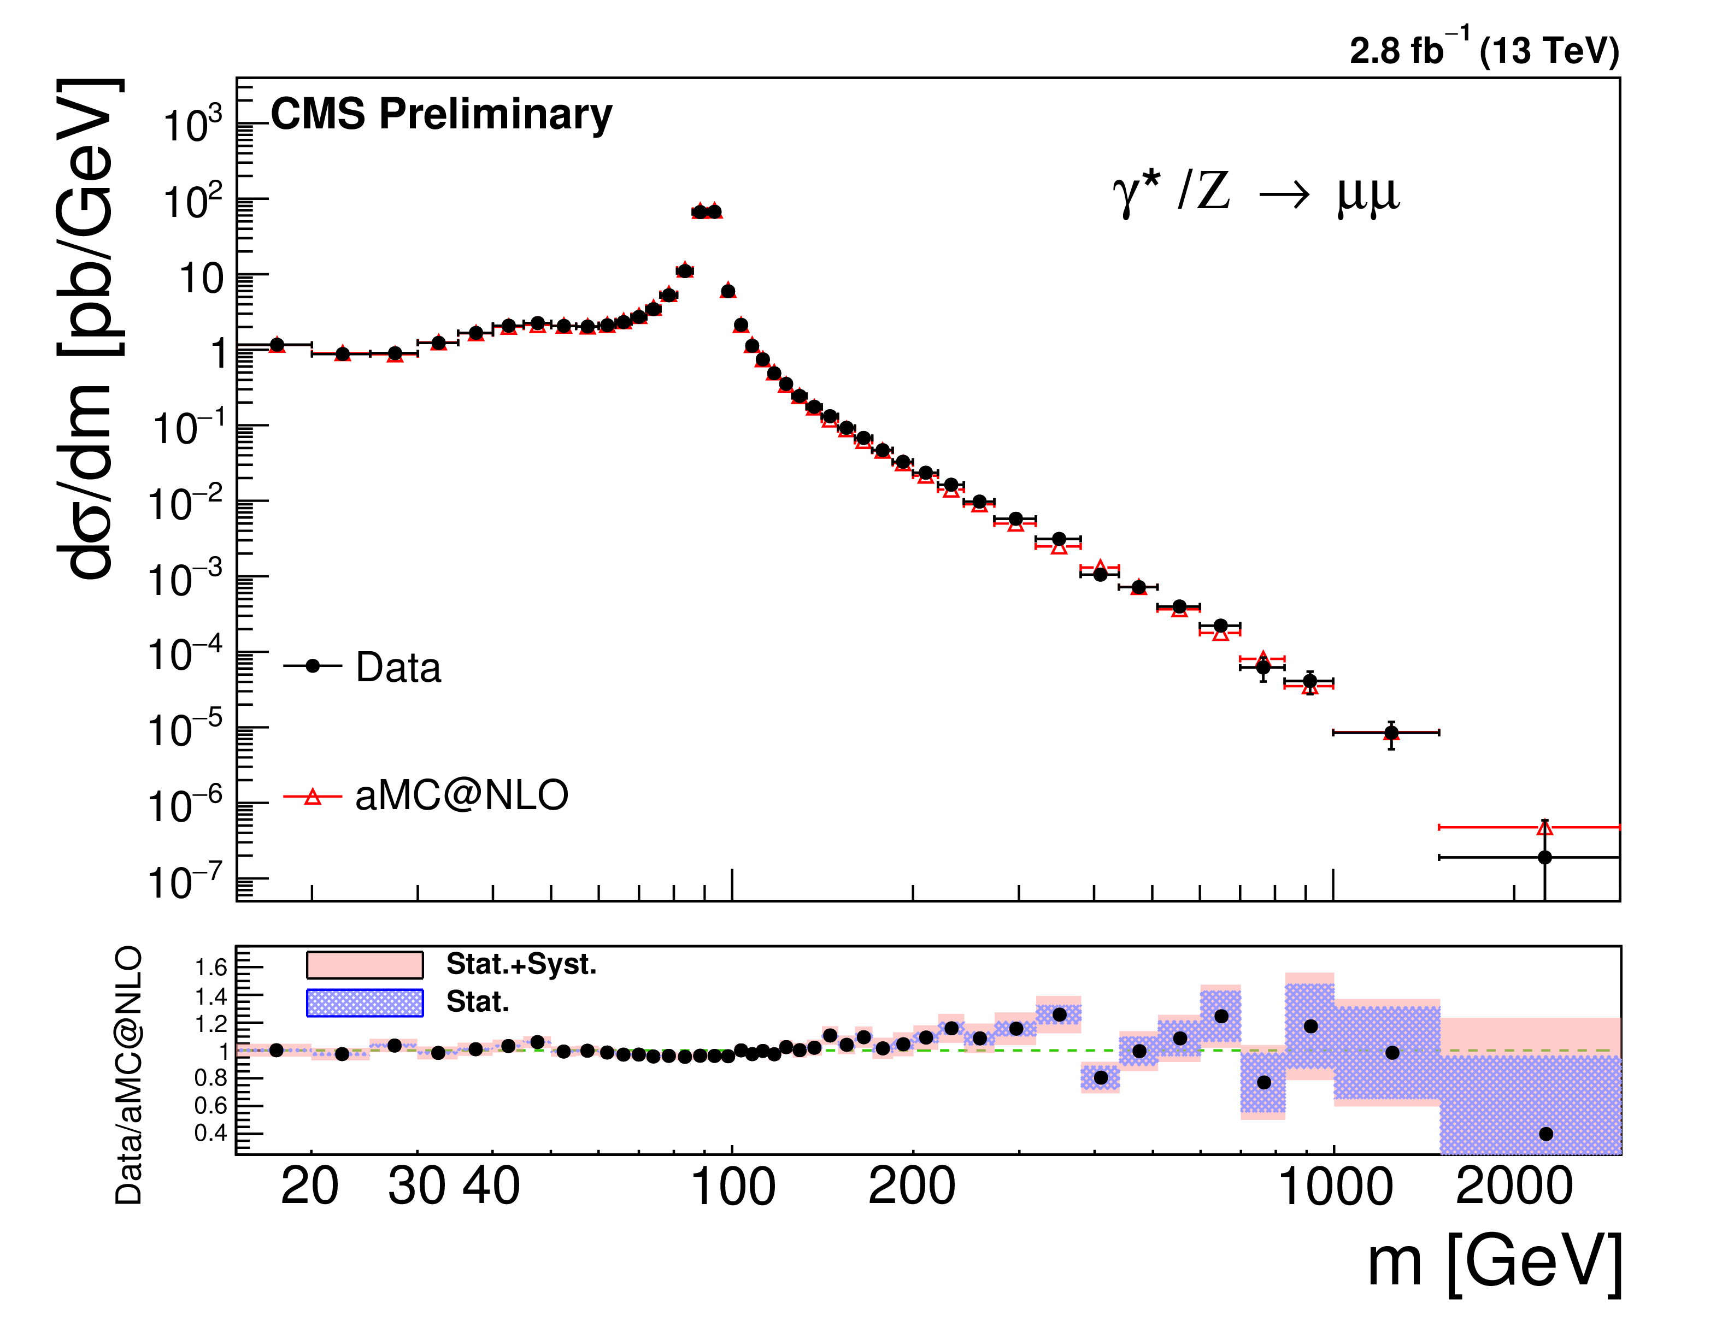
Intro: SM precision vs direct search
Very often, searches and SM measurements examine same data
  Usually searches have more data, and are released earlier, but also larger uncertainties
  SM measurements give very good feedback about more subtle effects, typically take longer but provide useful output like unfolded distributions and standard tools regarding data availability for pheno such as hepdata and rivet
Example: Differential cross sections
  useful input to theory and generator community
  Serve different goal but very similar distributions
    In case of dileptons: range is also very similar!
    Often measurements come much later due to detailed systematic studies
CMS-PAS-SMP-16-009
CMS-PAS-EXO-16-031

Slide 17
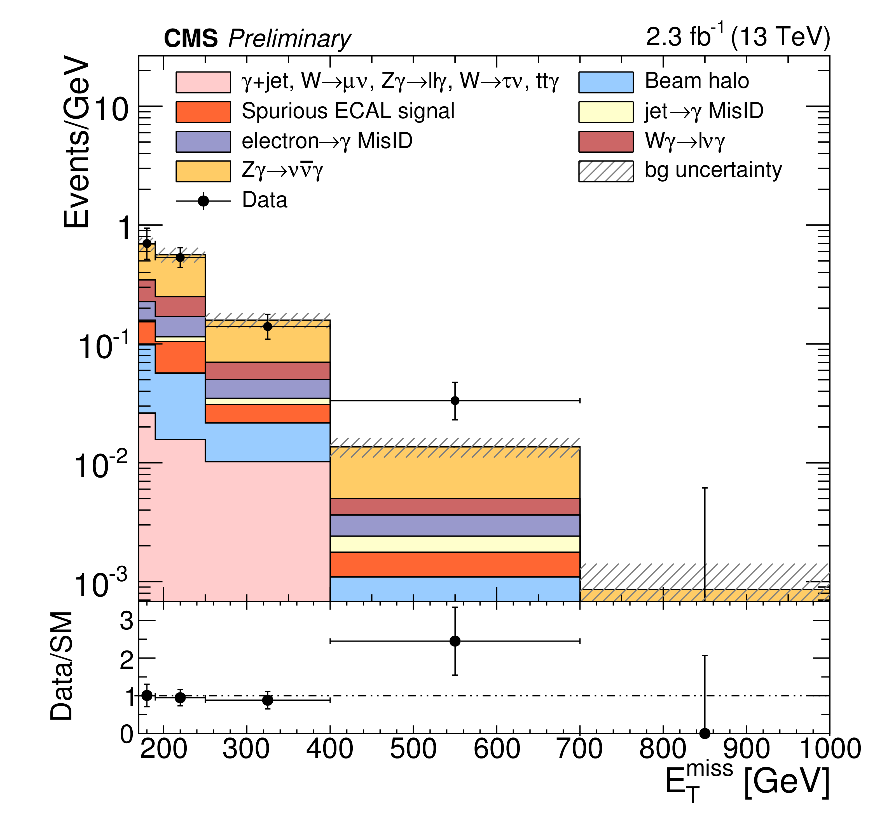
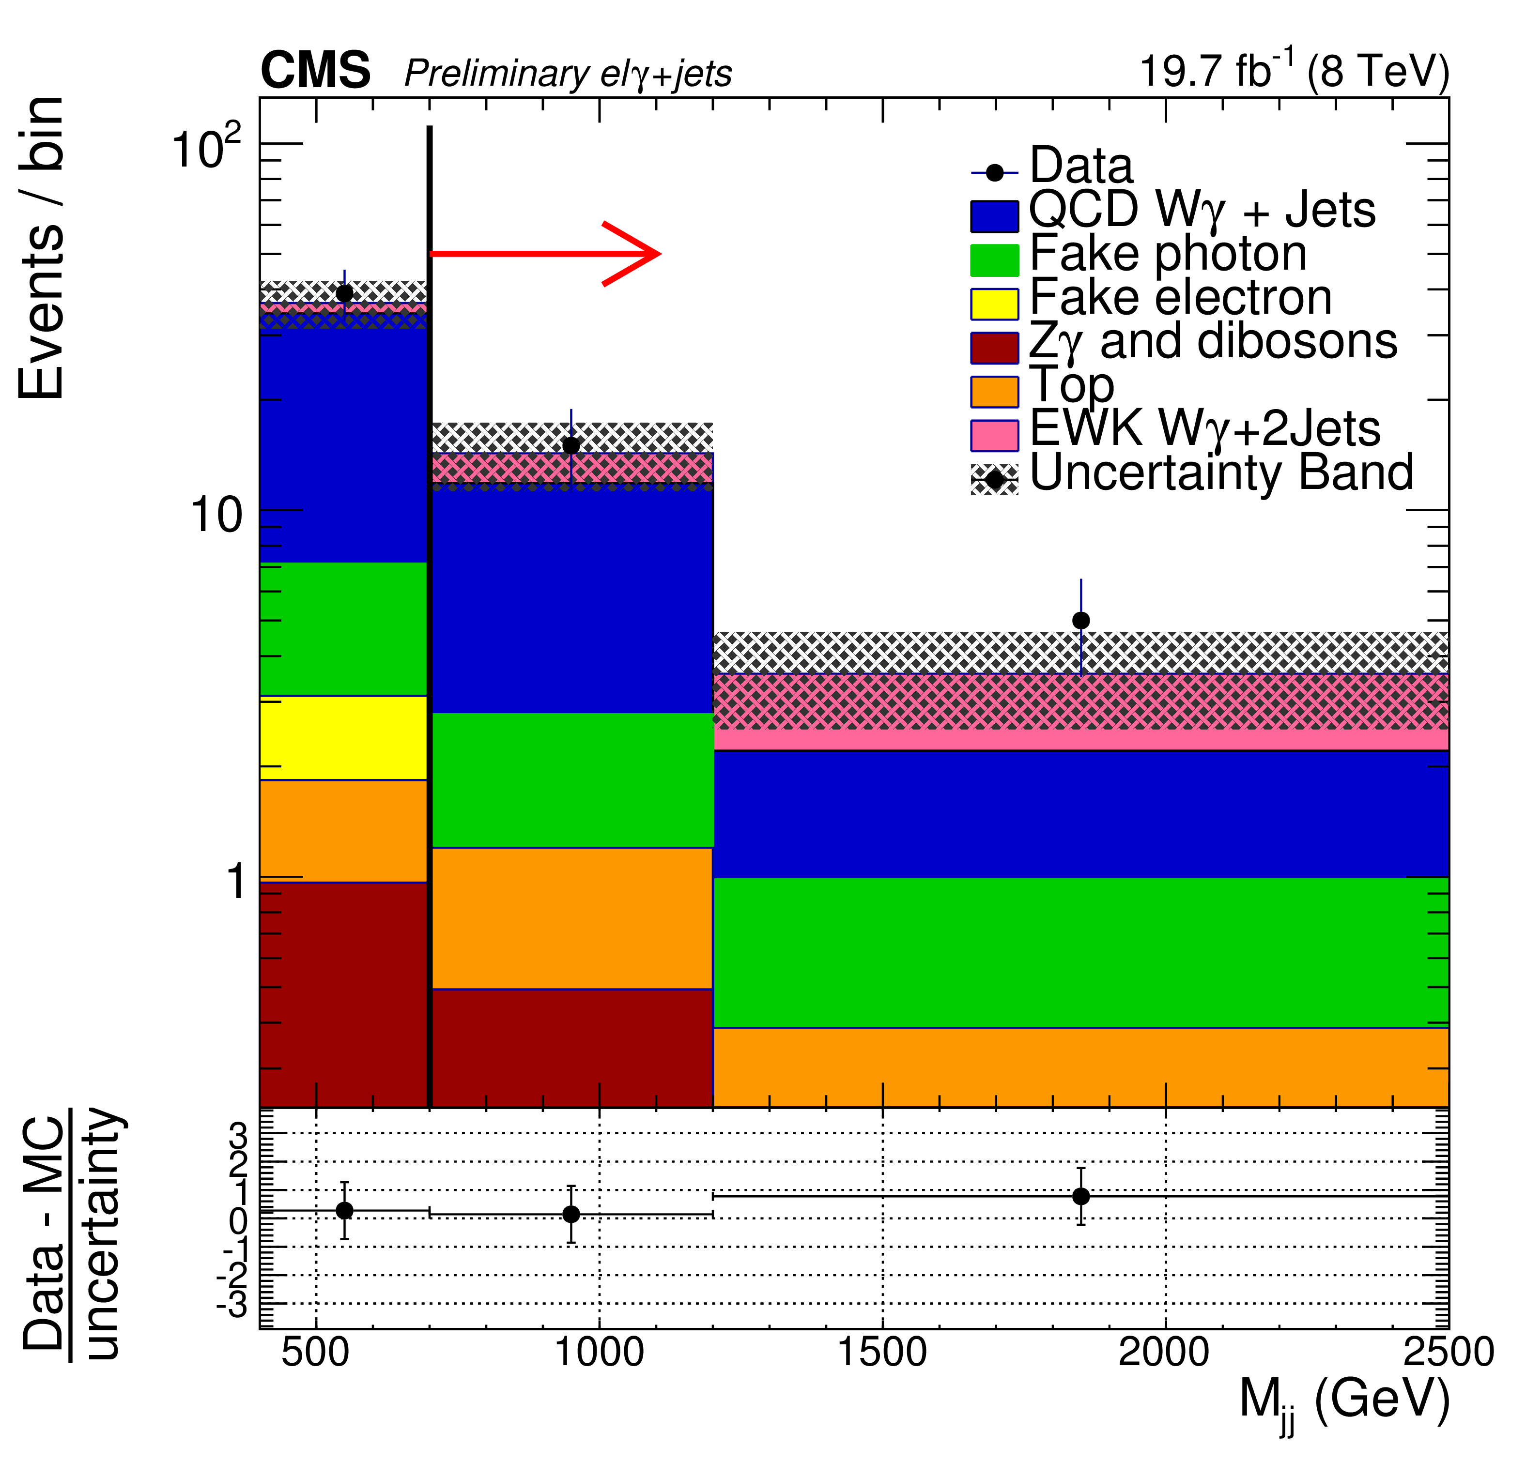
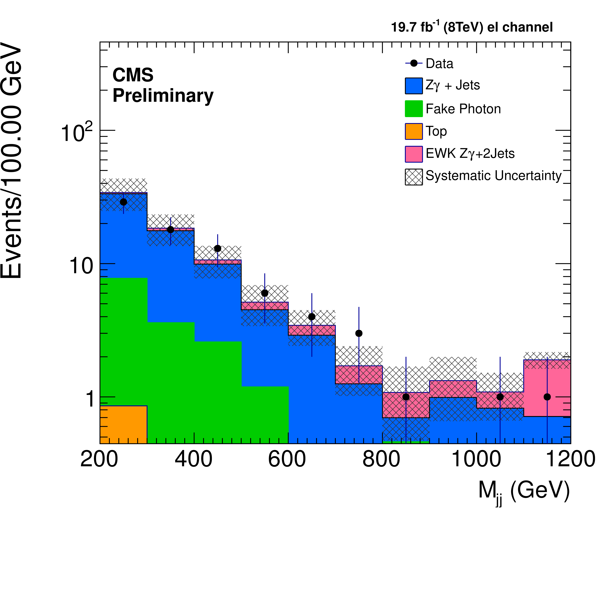
Triple gauge boson constraints
CMS-PAS-SMP-16-004
CMS-PAS-SMP-14-011
CMS-PAS-SMP-14-018
Multiboson production with photons
Provides sensitivity to EWK sector
Highest rate triboson production
Access to BSM though Triple/Quartic-Gauge-Couplings
  Using effective SM Lagrangean with Dim-6 and Dim-8 operators

Slide 18
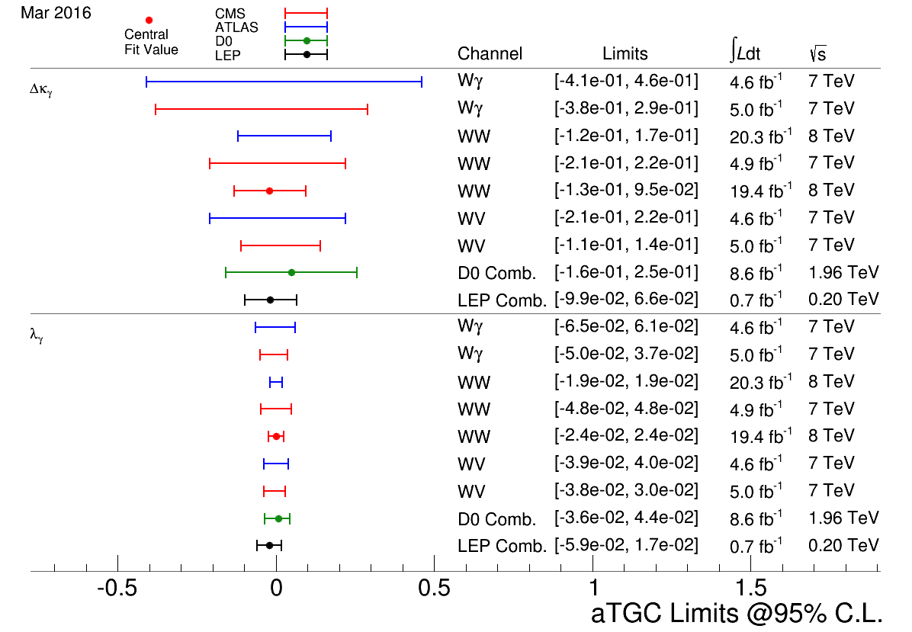
Limits on Triple Gauge Couplings
All aTGC/aQGC results at:
https://twiki.cern.ch/twiki/bin/view/CMSPublic/PhysicsResultsSMPaTGC

Slide 19
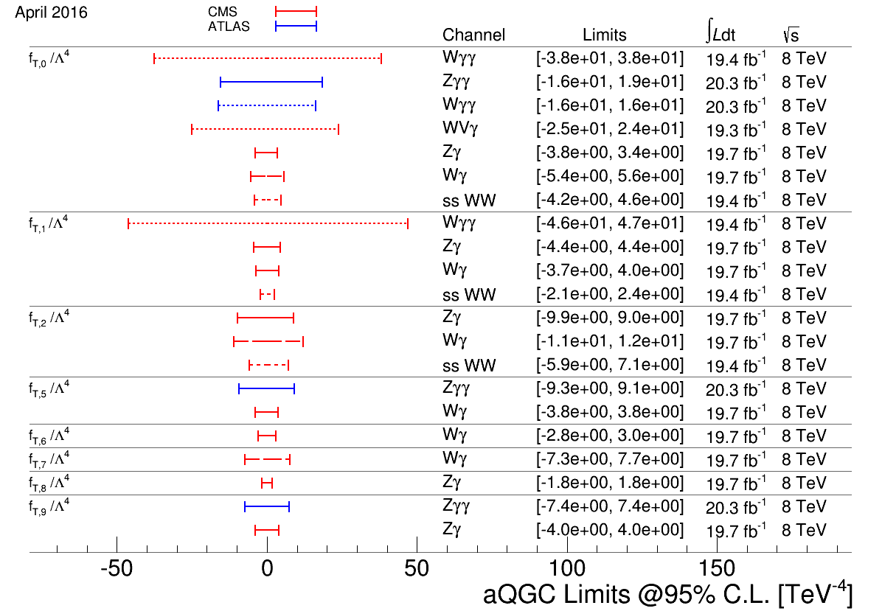
Limits Quartic Gauge Couplings
All aTGC/aQGC results at:
https://twiki.cern.ch/twiki/bin/view/CMSPublic/PhysicsResultsSMPaTGC

Slide 20
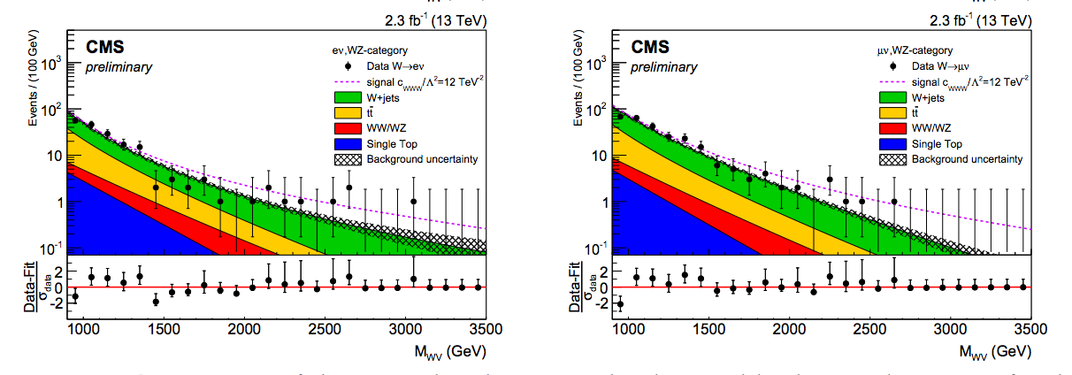
aTGC from semileptonic WV
First look at the13 TeV data:
  2015 dataset with one W boson to e/μ plus hadronic Z or W boson
    Using substructure techniques as high-mass
  Using diboson mass distributions to constrain anomalous coupling parameters
CMS-PAS-SMP-16-012

Slide 21
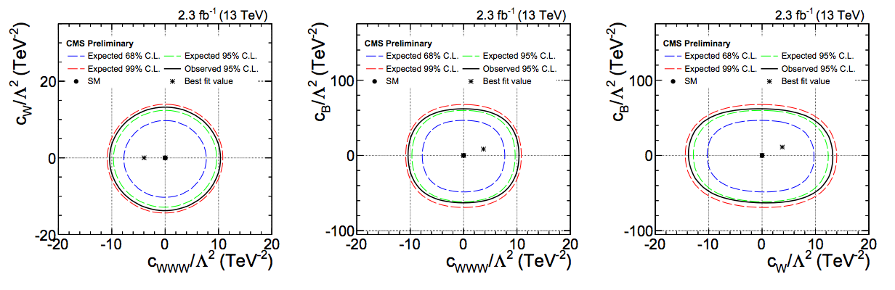
aTGC from semileptonic WV
First look at the13 TeV data:
  2015 dataset with one W boson to e/μ plus hadronic Z or W boson
    Using substructure techniques as high-mass
  Using diboson mass distributions to constrain anomalous coupling parameters
CMS-PAS-SMP-16-012

Slide 23
Standard Model

Slide 24
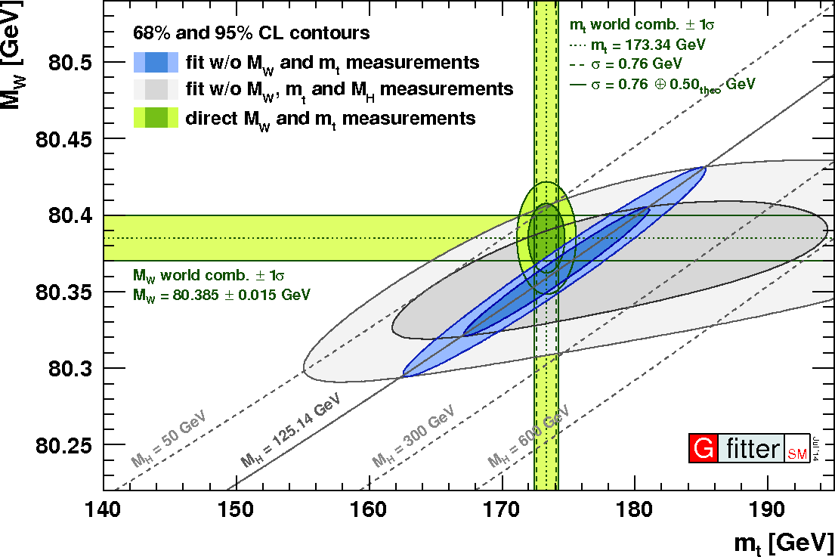
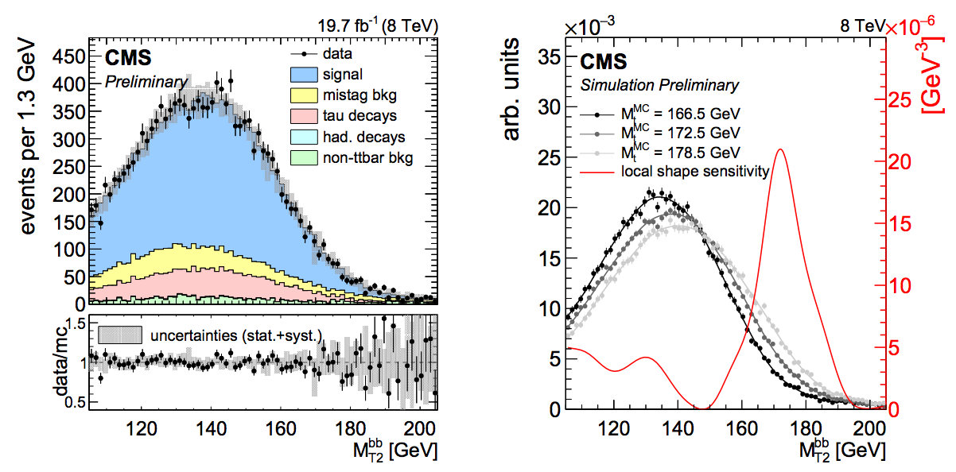
Top mass vs BSM
In SM fits: dependence top mass w.r.t. Higgs and W boson important
CMS: latest mass measurement in dileptons using MT2/MAOS (search-like variables)
Single measurement with a <1 GeV uncertainty:
  m_{t}=172.22 ± 0.18 (stat) +0.89 -0.93 (syst) GeV
  Fractional:± 0.001% ±0.005%
Top quark mass measurements are getting more and more accurate
  Theory: NLO MSbar vs pole mass uncertainty is of order 1/2 GeV
CMS-PAS-TOP-15-008

Slide 31
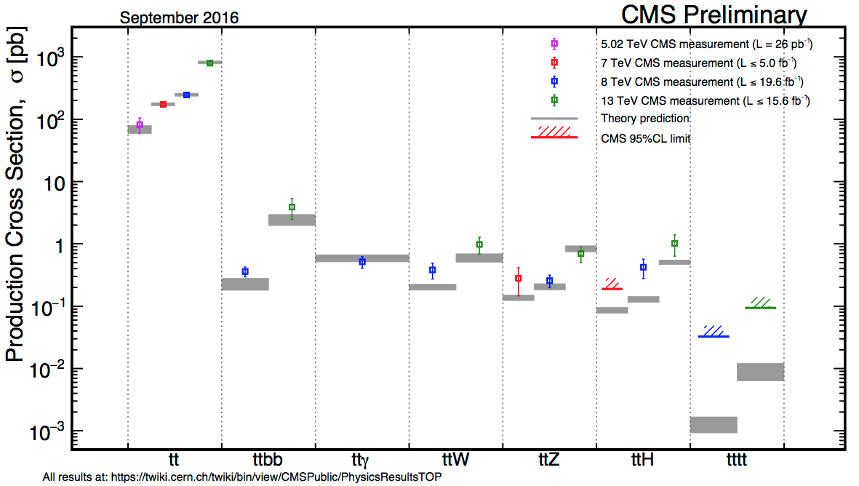
Many more results

Slide 32
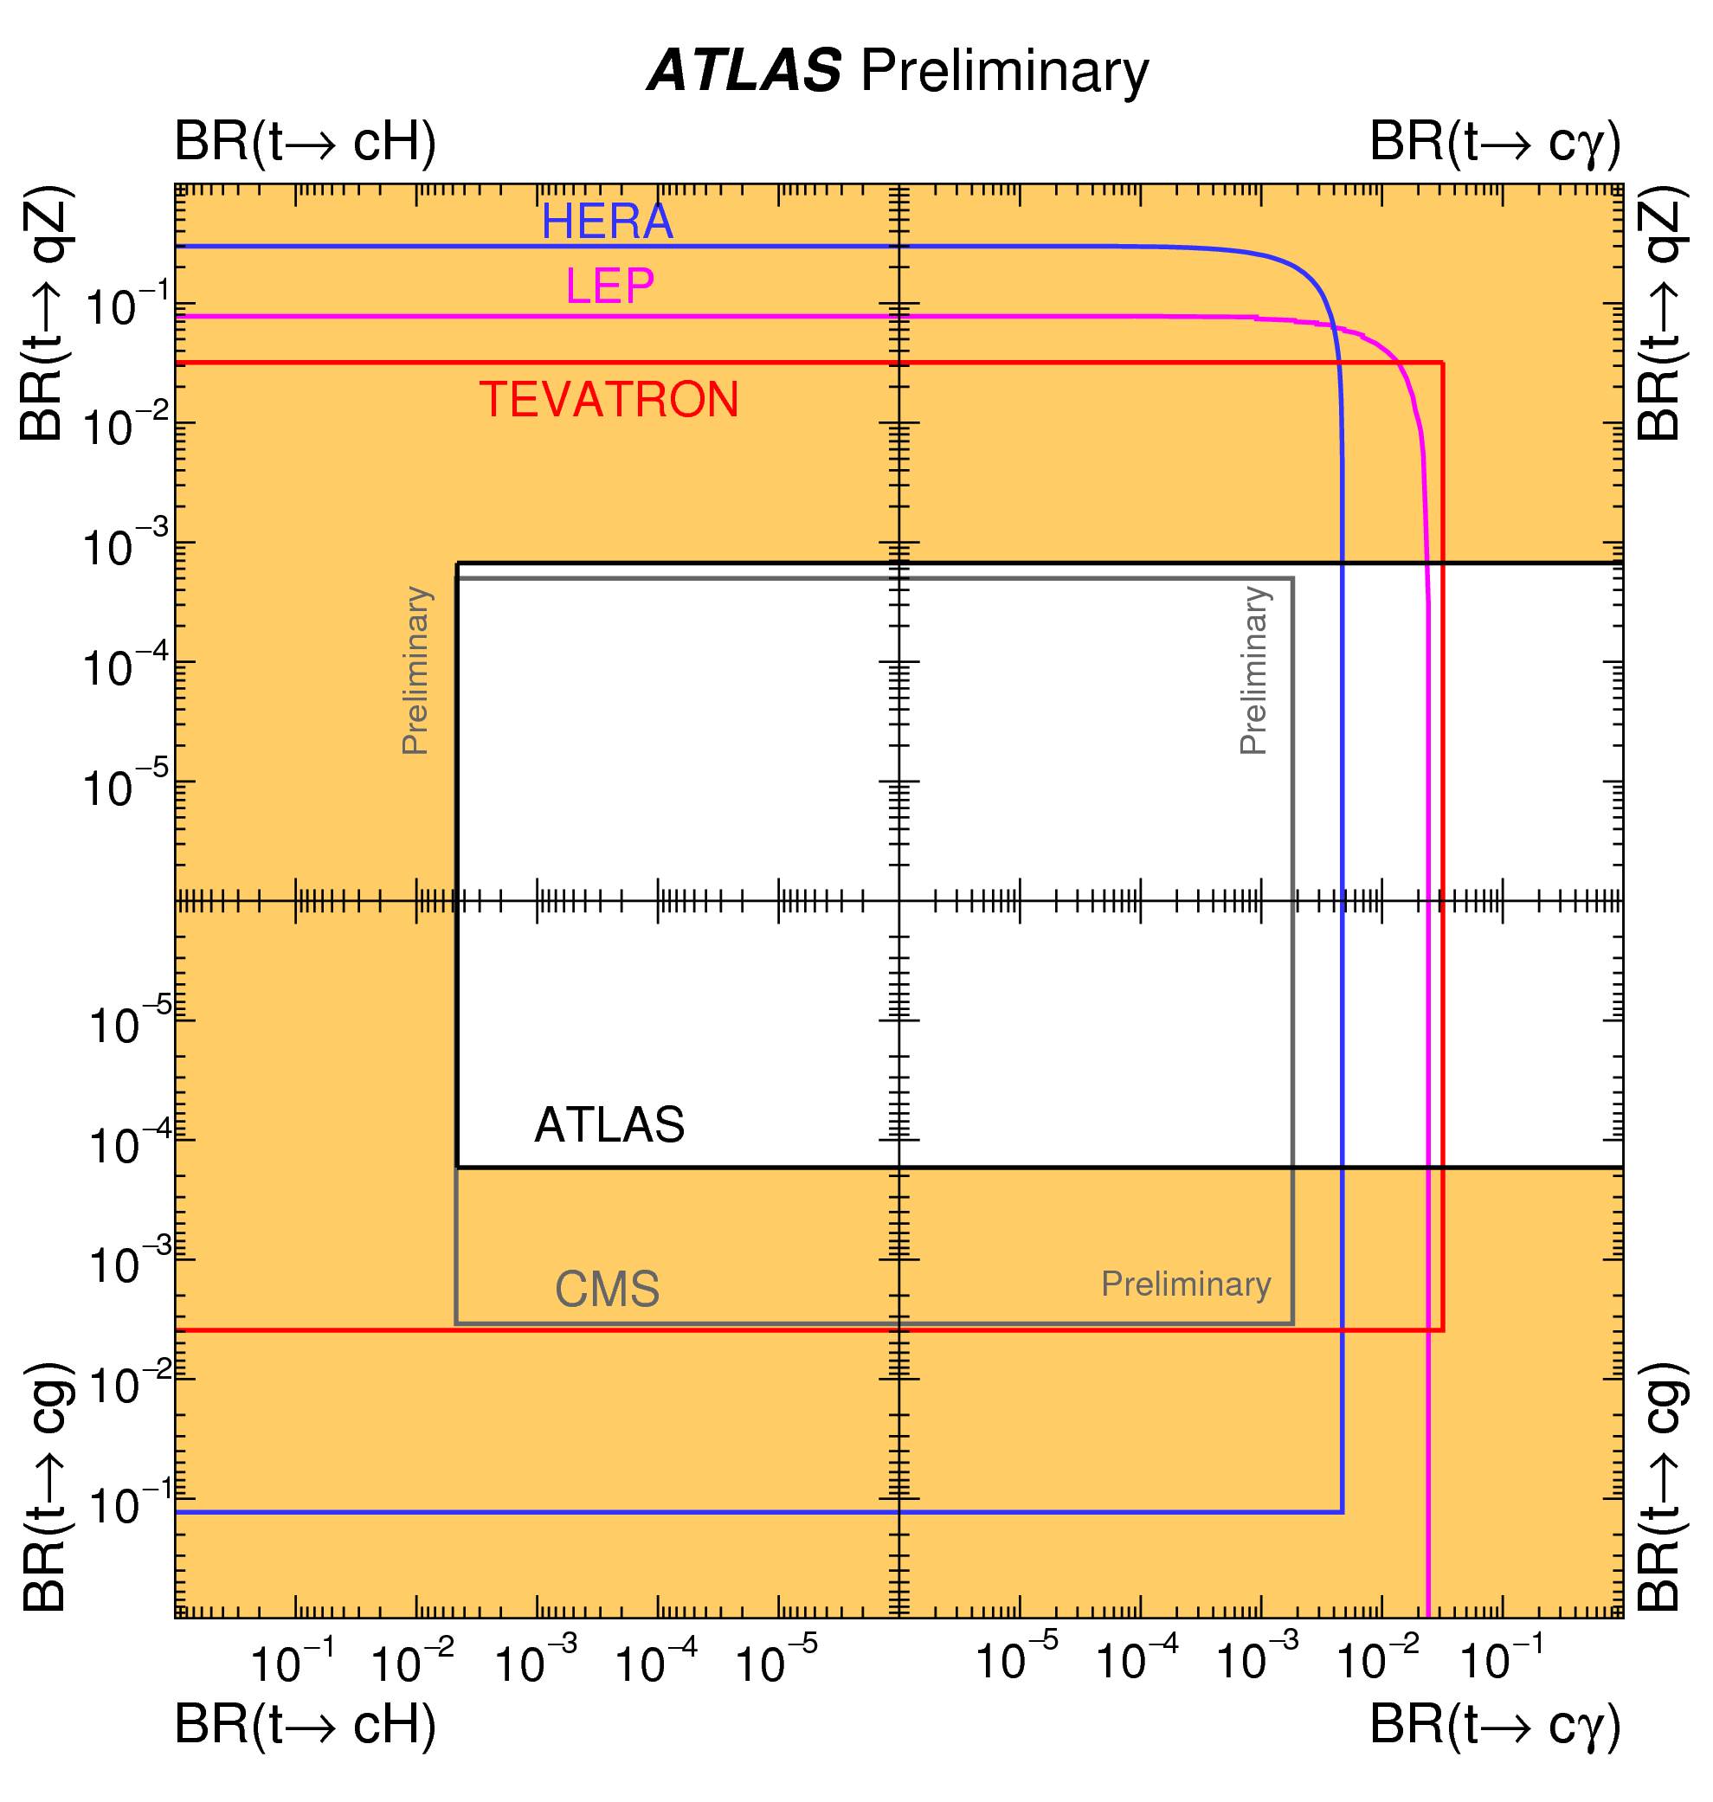
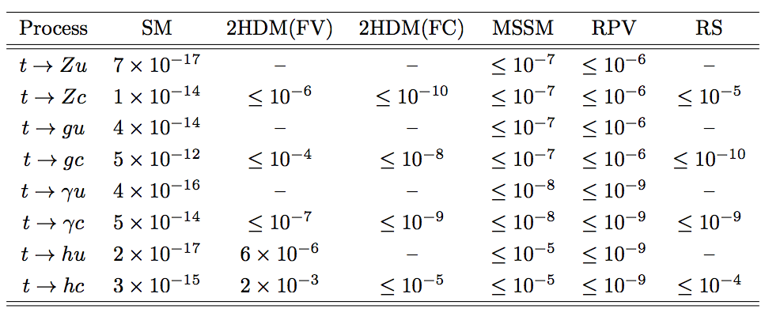
Many more results: top FCNC
FCNC are one of the best handles on constraining SM/indirectly discovering BSM in the top sector
Almost all popular BSM extensions predict increased rare decays of the top quark
arXiv:1311.2028

Slide 33


Extreme phase space ttbar: background for searches
Top quark compositeness (t*)
sGluons
ttH
more jets/V bosons
Vector-like quarks (t’/b’)
SM differential & BR measurements
incl spin correlations
Ttbar+DM
Single top+DM
(monotop)
High MET
TeV-scale mass
H⁰--->ttbar
H±--->tb
Z’--->ttbar
W’--->tb

Slide 44
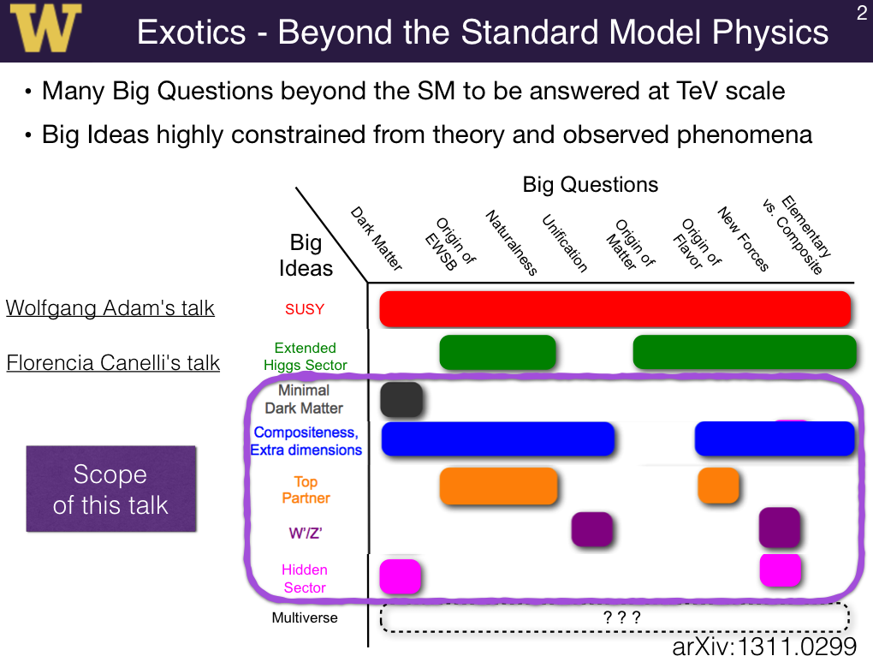

Slide 47
Very active subject – experimental experts at
VUB – HEP@VUB meeting?

Slide 52
Slide Kiwoon Choi:
This was not an waste of time!
We could learn more on many things related to BSM physics which communicate with the SM mainly through the SM gauge bosons:
Vector-like fermions,
EW symmetry preserving new strong forces,
Axion-like-particles,
Near threshold behavior of heavy particle loops,
Resonance-continuum interference,
Single photon vs diphoton-jet,
.....

Slide 54
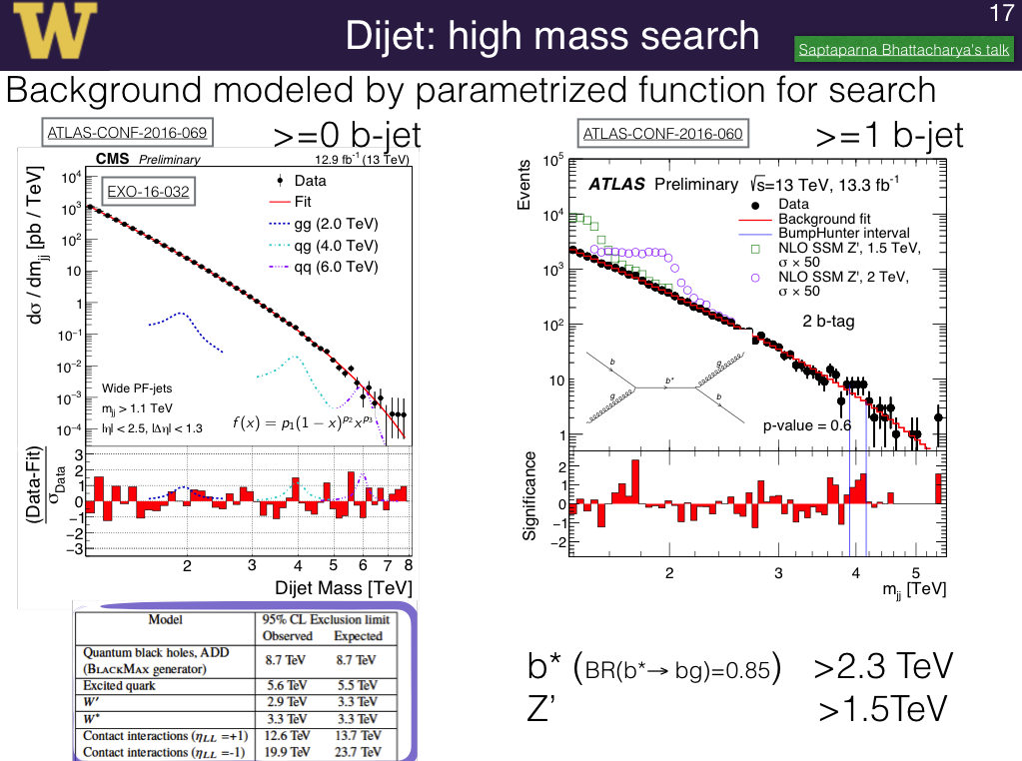

Slide 55
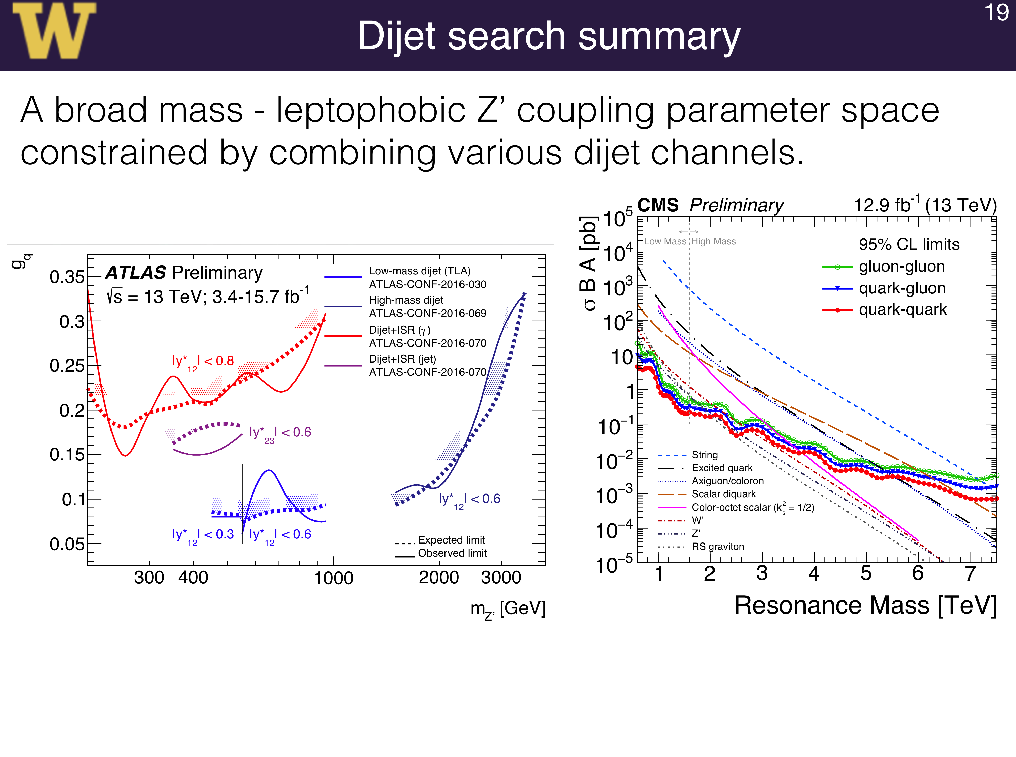

Slide 57
