Slide 1
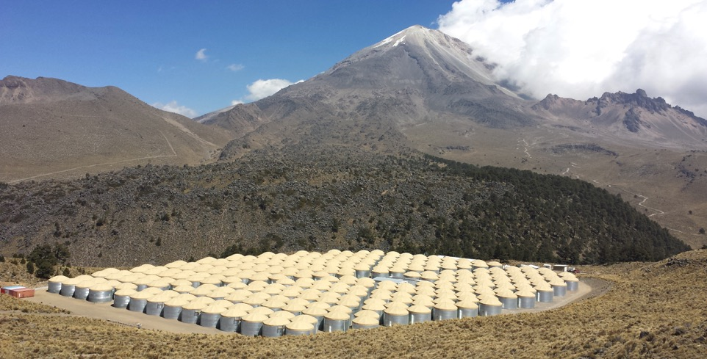




VHE Cosmic Ray Observations
with HAWC
Zigfried Hampel-Arias
14 October, 2016

Slide 2
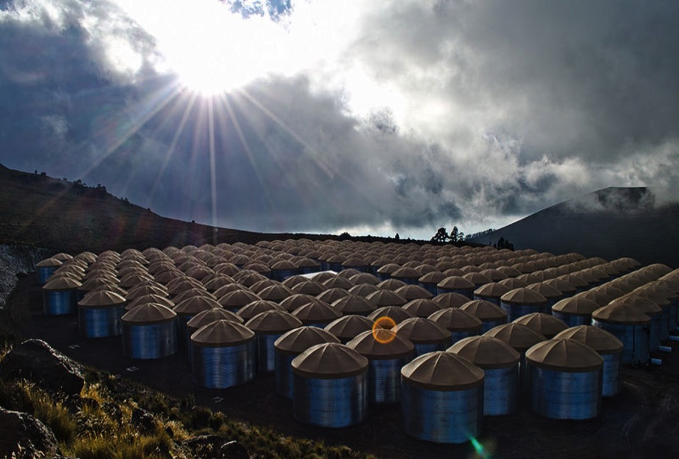
Outline
Very High Energy Astronomy
The HAWC Observatory
Experimental Results
Outline
Very High Energy Astronomy
The HAWC Observatory
Experimental Results

Slide 3
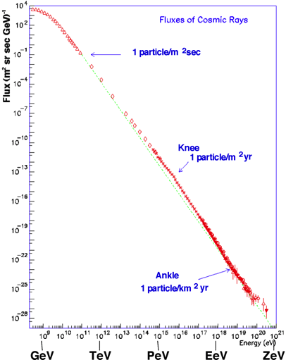
Galactic Cosmic Rays
Galactic
(VHE)
Extragalactic
Flux nearly single power law over:
10 decades in energy
30 decades in flux
Kinks
Very High Energy <-> Galactic
We have good ideas of how particle acceleration to high energies works, yet VHE sources elusive
Solar
Effects
Tevatron LHC
Other particles can help…

Slide 4
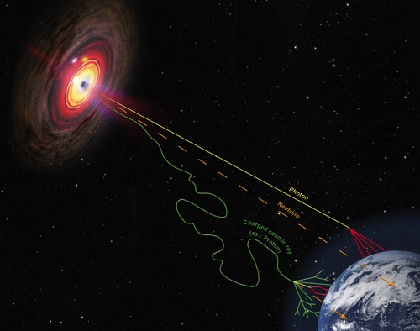
Universe in Multi-Messengers
Source: HAAP
Neutrinos are abundant, propagate unperturbed, but are weakly interacting.
Gamma rays propagate undeflected, but are
1000x less abundant than VHE CR.
Charged particles (Cosmic rays) are abundant but are deflected in magnetic fields.
Extragalactic
accelerator
Notable VHE Experiments
IceCube, ARA
CTA, HAWC
IceTop, HAWC

Slide 5

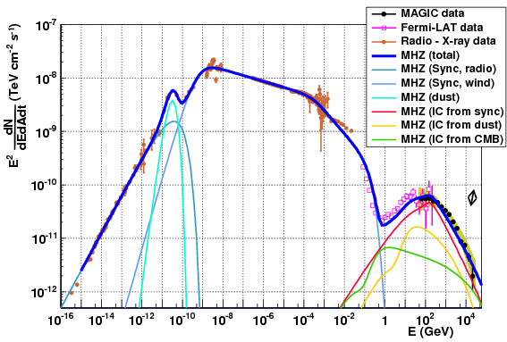
Galactic Gamma Source
Solar
Galactic
(VHE)
Extragalactic
Galactic TeV gamma emitter
VHE gamma environment -> particle acceleration
Again, huge flux variation over huge energy range!
VHE
Aleksic et al. JHEA (2015)
SNR

Slide 6
Very High Energy Astronomy
Probing the VHE sky
Use gammas to identify and characterize galactic cosmic ray acceleration sites
Measure cosmic ray energy spectra and arrival distribution to understand galactic environment
HAWC can measure both!
Crab Nebula

Slide 7
Outline
Very High Energy Astronomy
The HAWC Observatory
Experimental Results

Slide 8
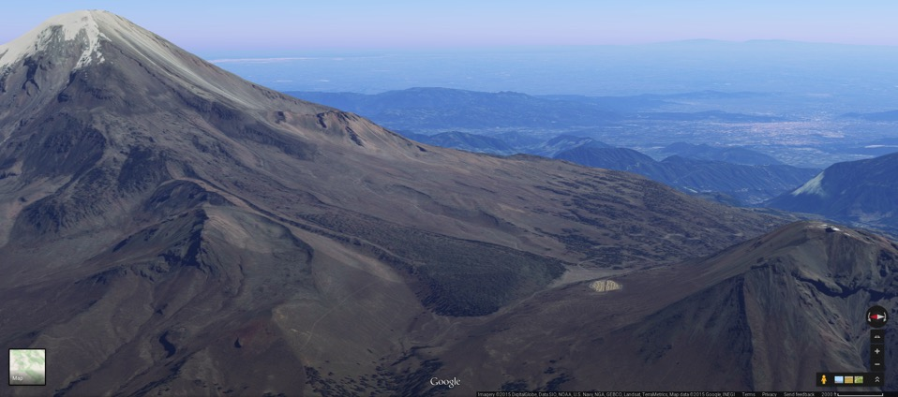
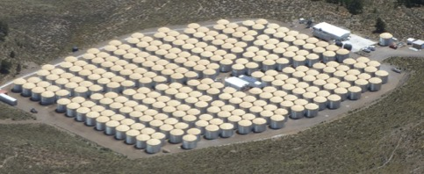
High Altitude Water Cherenkov
Air shower array near Puebla, Mexico
4,100 m a.s.l.
300 optically isolated water tanks
Dense 22,000 m² coverage
~95% duty cycle
~2 sr field of view
Pico de Orizaba
5160 m a.s.l.
Large Millimeter Telescope

Slide 9
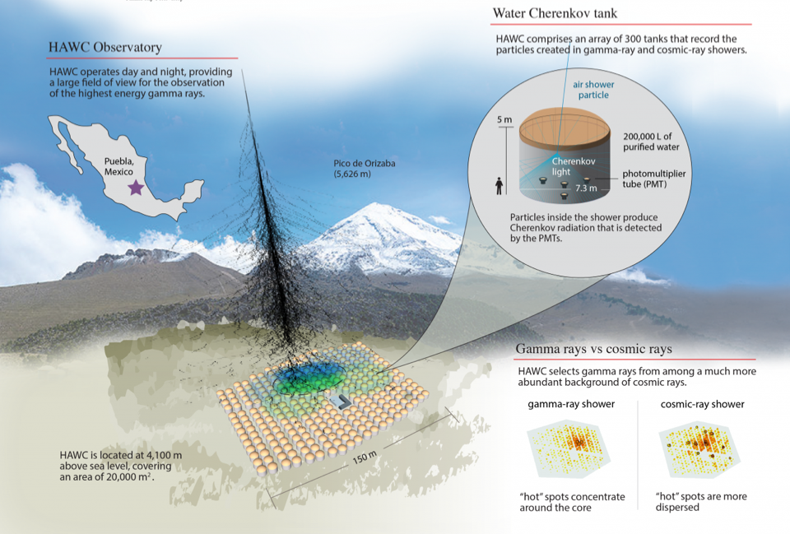

Slide 10
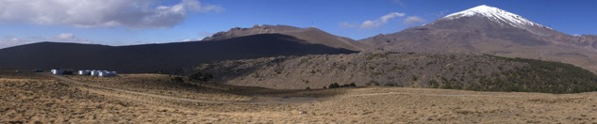

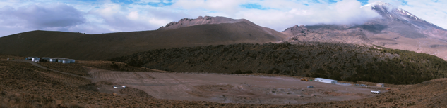
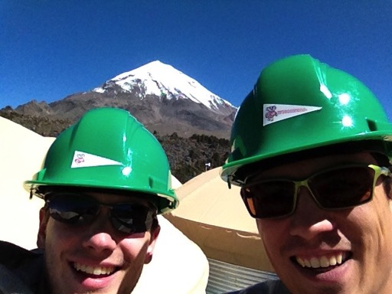
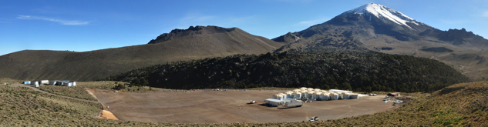
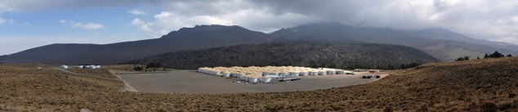
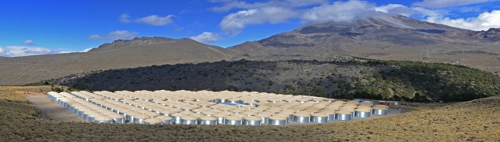
Construction
Important Dates
Feb 2011:
Project funding began
Aug 2013:
Operations with 111 water Cherenkov detectors (WCD)
Nov 2014:
250 WCD array complete
March 2015:
300 WCD array complete
~15 kHz data taking!
11/2010
02/2012
08/2012
05/2013
12/2014

Slide 11
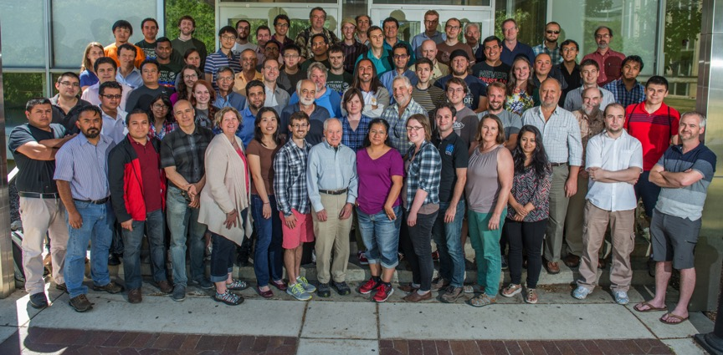





The HAWC Collaboration

Slide 12
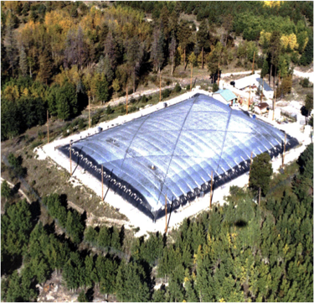
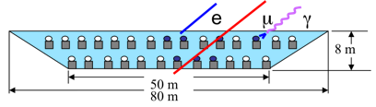
On the Shoulders of Milagro
Los Alamos, NM
4000 m²
2350 masl
100 GeV - 10 TeV
1st generation wide-field gamma telescope
Discovered:
>10TeV sources (Astrophys. J. 700 (2009) L127)
Diffuse galactic emission (Astrophys. J. 688 (2008) 1078)
TeV cosmic ray anisotropy (Astrophys. J. 698 (2009) 2121, Phys. Rev. Lett. 101 (2008) 221101)
HAWC builds on the success of Milagro
Literally: we recycled the PMTs!

Slide 13
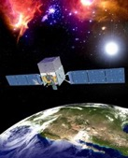
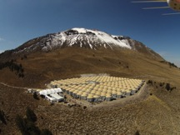
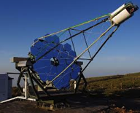
Detector Complementarity
Wide-field / Continuous Operation
VHE Sensitivity
Fermi, AGILE,
EGRET
HAWC, ARGO, Milagro
VERITAS, HESS, MAGIC
Space-Based
All sky coverage
<10 GeV range (area->flux limited)
Ground Air Shower Arrays
24 hr coverage of ½ sky
Unbiased surveys
Highest energies
IACTs
Excellent pointing
Surveys limited

Slide 14

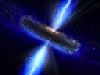
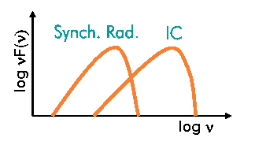


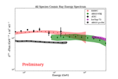
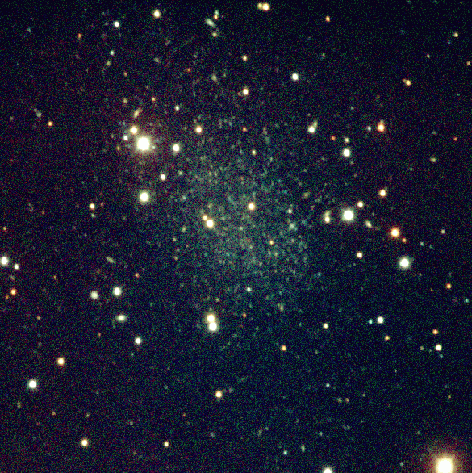
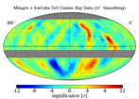
Science Goals
Galactic
Extragalactic
SNRs as accelerators
PWN – spectra, flares, e±
TeV Binaries
Galactic diffuse emission
Extended sources
Fermi Bubbles
Blazars – flares, accel mechanisms
EBL & propagation studies
GRB mechanisms
EG CR production & propagation
Cosmic Rays
Cosmic ray energy spectrum & composition
Anisotropy energy dependence
Solar physics
Dark Matter
Annihilating dark matter in DSG
DM decay limits
PBH, Q-Balls, exotics

Slide 15

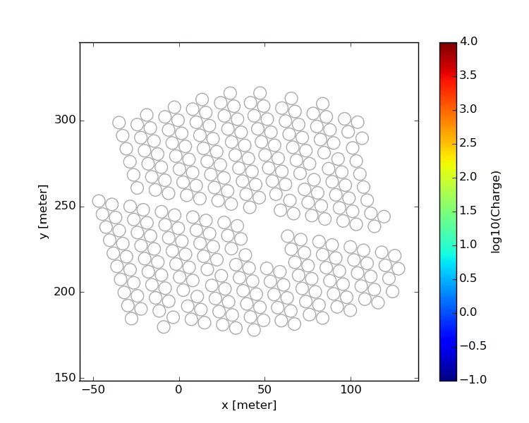
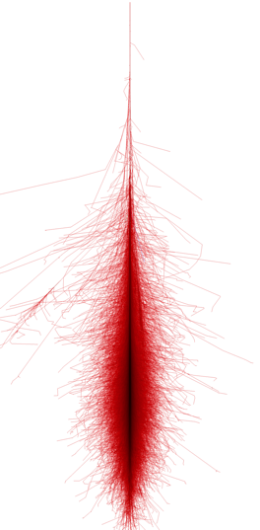
Air Showers in HAWC
Primary particle:
γ, p, He…

Slide 16
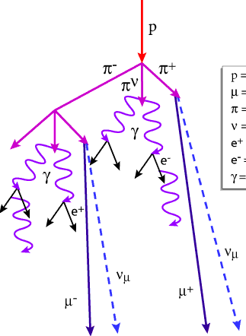
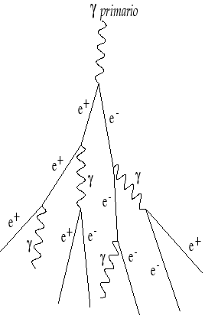
Event Identification
Primary particle dictates shower evolution
Hadronic Shower
Gamma Shower

Slide 17
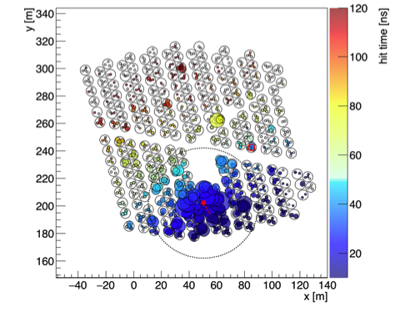
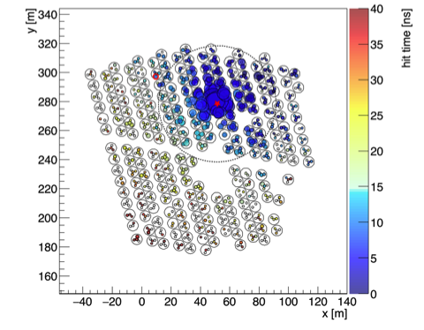
Event Identification
Event Display
Hadronic Shower
(Crab Off-Source)
Likely Gamma Shower
(Crab On-Source)
Play the G/H Separation game!
http://www.hawc-observatory.org/observatory/ghsep.php
Events from HAWC-250 Data

Slide 18
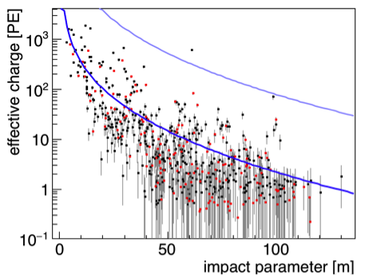
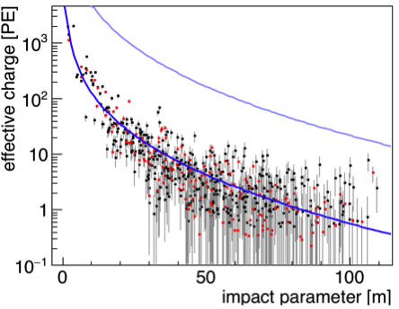
Event Identification
Lateral Charge Distribution
Hadronic Shower
(Crab Off-Source)
Likely Gamma Shower
(Crab On-Source)
Play the G/H Separation game!
http://www.hawc-observatory.org/observatory/ghsep.php
Events from HAWC-250 Data

Slide 19
Outline
Very High Energy Astronomy
The HAWC Observatory
Experimental Results:
Gamma Rays

Slide 20
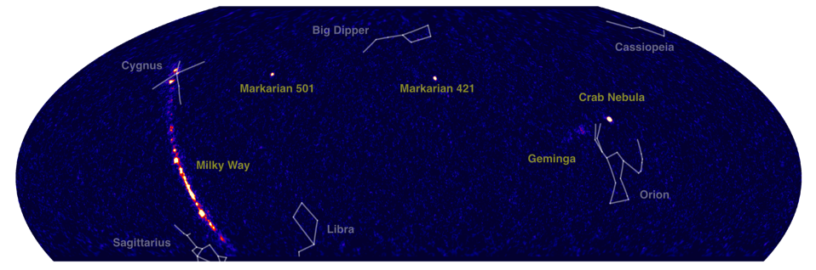
HAWC View of Gamma Ray Sky
1-100 TeV
M.Hui, APS 2016
Significance Map – Equatorial Coordinates
Notes:
Equatorial Coordinates

Slide 21
Geminga
Milagro TeV
(extended)
POINT SOURCE
T. Weisgarber TeVPA 2016

Slide 22
Outline
Very High Energy Astronomy
The HAWC Observatory
Experimental Results:
Cosmic Rays
Energy Spectrum
Moon Shadow
Anisotropy

Slide 23
Large Scale Anisotropy
Milagro observed TeV anisotropy
Unexpected: 1 TeV proton & μG -> 0.001 pc R_{g} << Nearest source
7 years of data
95 billion events
Limited energy resolution
Notes:
Larmor Radius for 1TeV proton in 10 microG/1nT field is .001 pc = .003 light years, orders of magnitude smaller than nearest sources, so why the anisotropy?!
The origin of the cosmic-ray anisotropy is currently not clear, but the discovery of this anisotropy clearly implies that the propagation of cosmic rays from their sources to us is not understood. Several scenarios for the origin of the anisotropy are currently discussed in the literature, making this a very active area of research.
The small-scale structure could be the product of turbulence in the Galactic magnetic field or an additional heliospheric effect. It also been suggested that the small-scale structure is produced in the decay of quark matter present in pulsars or in the self-annihilation of dark matter.

Slide 24
Large Scale Anisotropy - HAWC
Can study anisotropy features in greater detail: spatial, energy
Measurements of Cosmic Ray Anisotropy with HAWC – D. Fiorino, TeVPA 2016

Slide 25
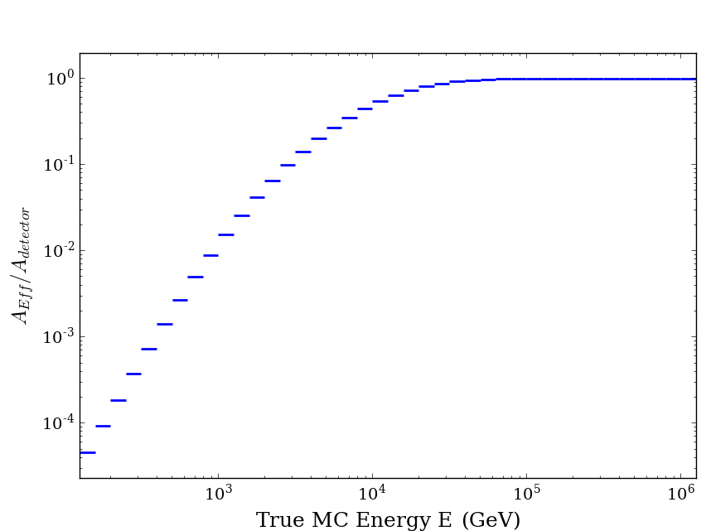
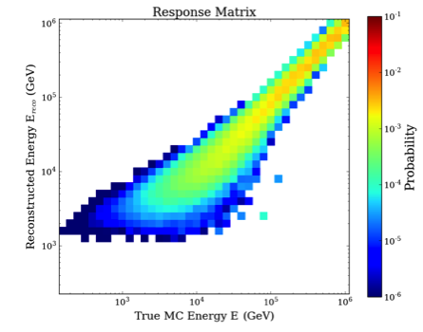
Detector Response to Cosmic Rays
Detector Efficiency
Response Matrix
Linear response
E>30 TeV
Connects E_{reco} to E_{true}
E_{reco} proton hypothesis based
Must assume spectrum:
fits to CREAM-II flight data
p, He, C, O, Si, Mg, Ne, Fe
A_{eff} equal to detector area (22,000 m²) beyond ~30 TeV
Flattening of efficiency indicates linear response.

Slide 26
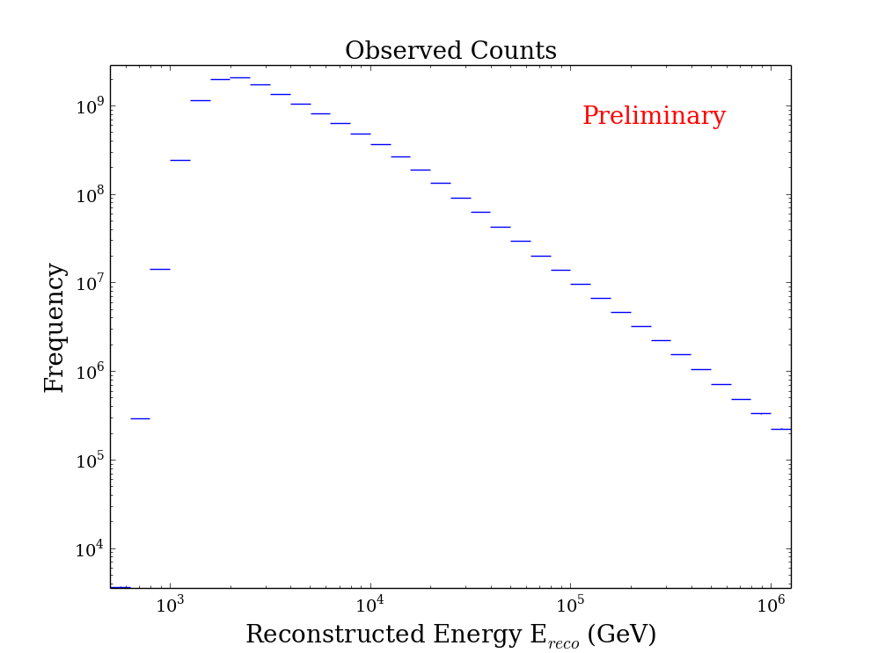
Reconstructed Data Sample
Reconstructed ~394 days spanning November 2014 - February 2016
( s)
_________ events
Core ON Array
cos(θ) > 0.96
Notes:
Very overhead, zenith < 17 deg

Slide 27
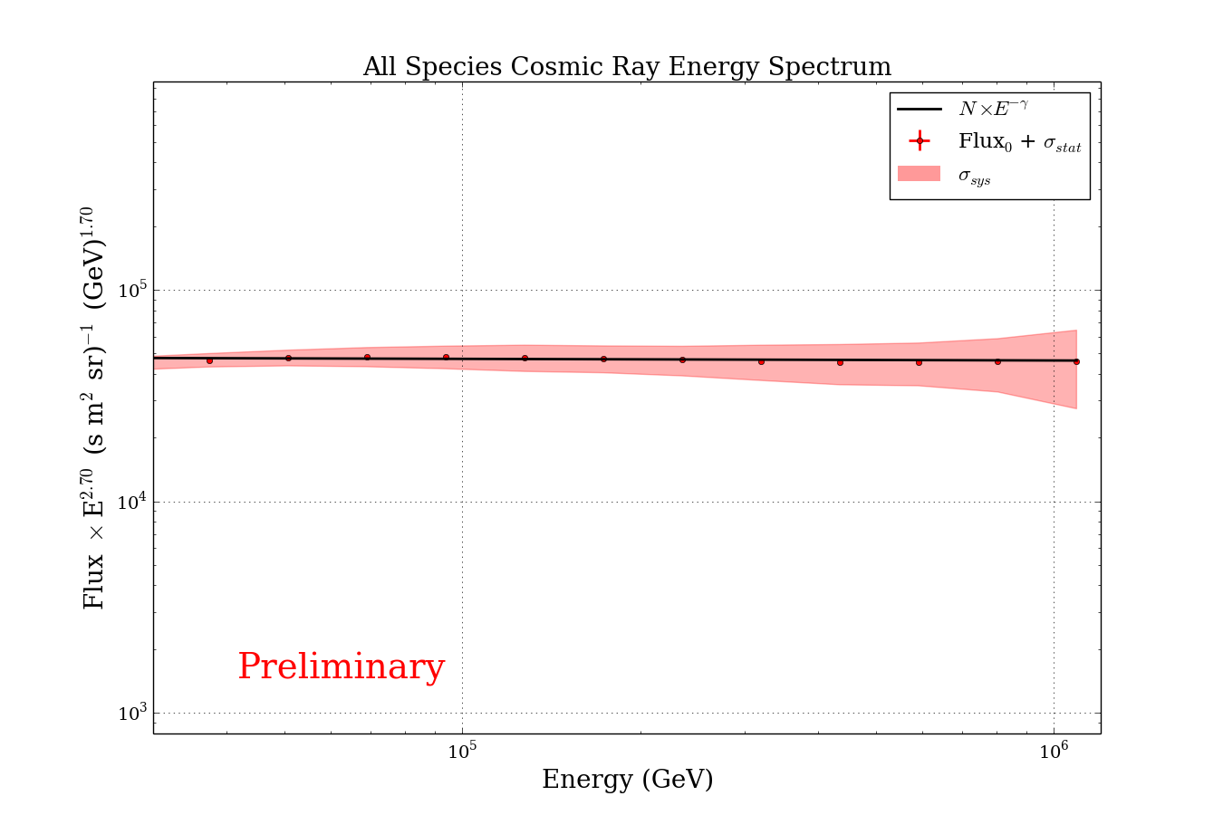
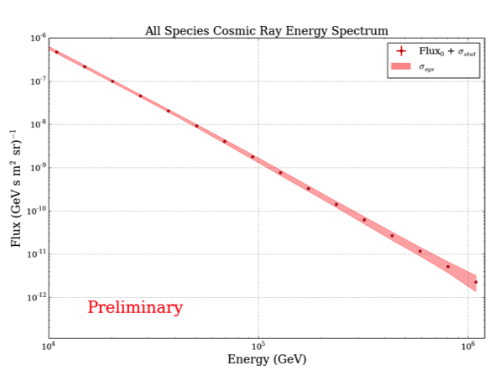
Unfolded Spectrum
Bayesian Unfolding
A la D’Agostini ^{[1]}
Converged in 2 iterations
(KS test btw iters < 10⁻³)
Regularized to power law at each step
Bands are systematics due to limited MC in response matrix
[1] G. D'Agostini, Nucl. Instrum. Meth. A 362 (1995) 487.

Slide 28
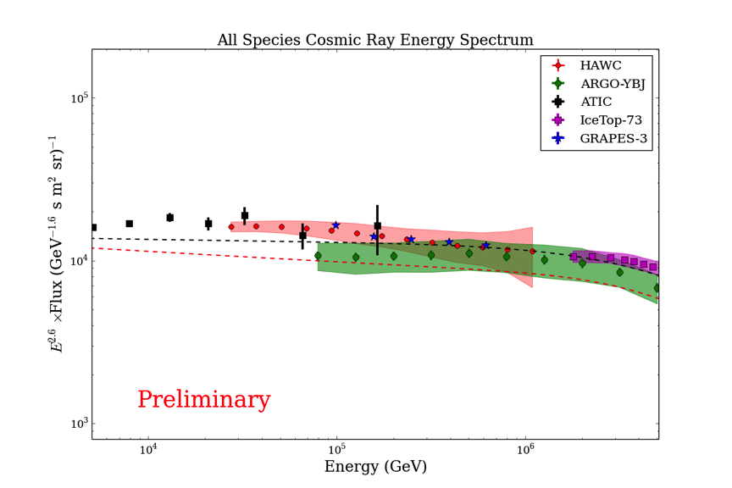
Comparison to Other Experiments
-- Gaisser et al 2013
-- Polygonato
HAWC bands are systematics from limited MC in response matrix
Other bands are full systematics
Direct Det. Region Knee Region
HAWC in Between!
ARGO-YBJ: Frascati Physics Series Vol. 58 (2014).
IceTop: Phys. Rev. D 88, 042004 (2013).
ATIC: Bull. Russian Acad. Sci. 73, 564 (2009)
GRAPES: J. Phys. G: Nucl. Part. Phys. 39 (2012)
Notes:
Detect detection region peters out… Beyond knee region dedicated detectors. HAWC suited to bridge the gap!

Slide 29
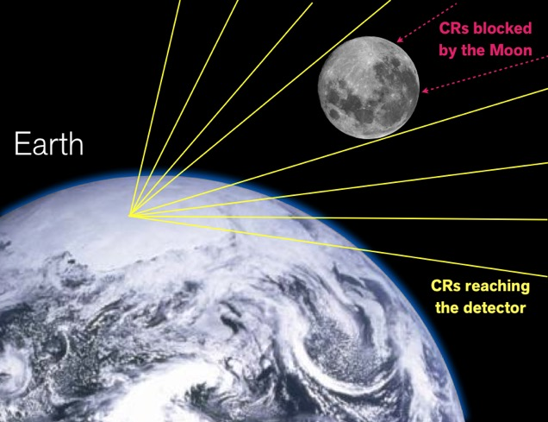
Moon Shadow
Source: WIPAC
Earth’s B-field deflects TeV-scale charged particles…
Thus, Moon shadow evolves with Energy!
GPU simulation speed ups x50

Slide 30
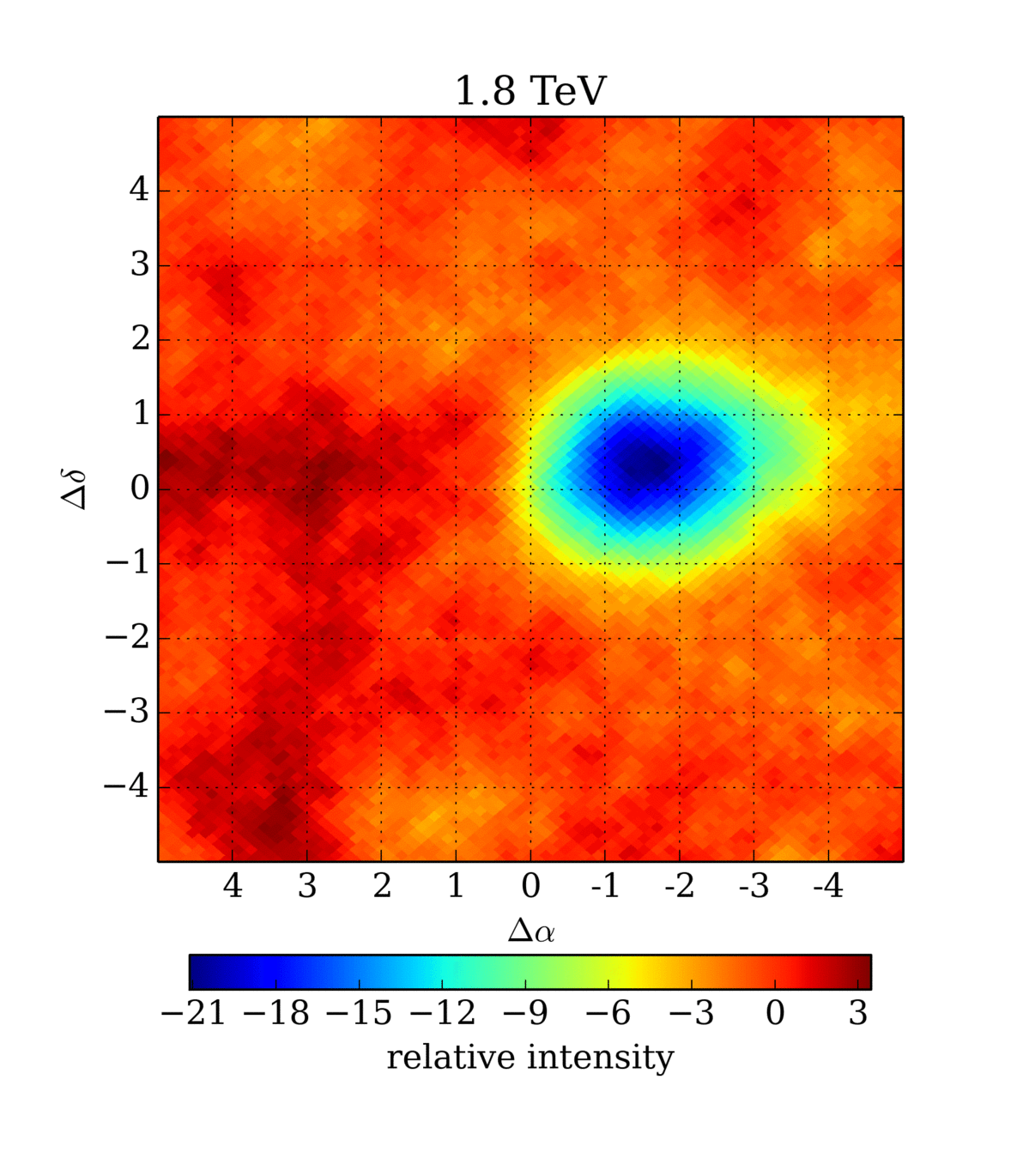
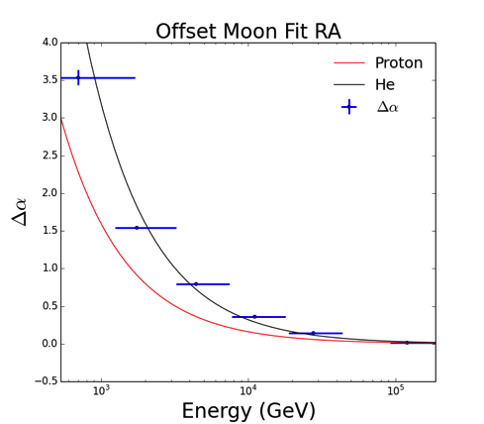
Moon Shadow
Fit to shadow centroid. Expect 1/E in sim
Observing heavier composition?
He crossover (CREAM)?
x10⁻³
Moon true position at (0,0)

Slide 31
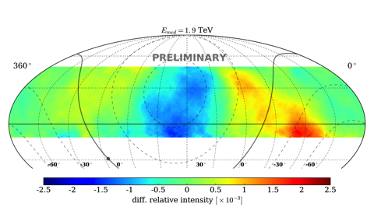
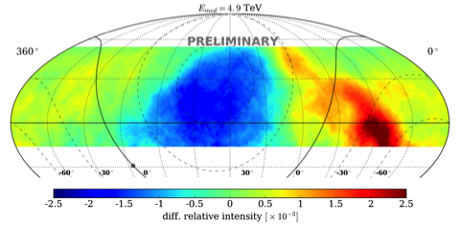
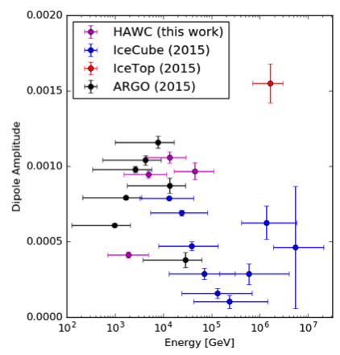
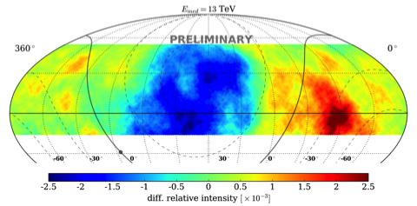
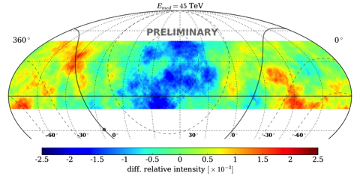
Anisotropy Energy Dependence
Beginning to investigate energy dependency of anis & specific regions
Stat fluct dominate highest energies
More dipolar with energy

Slide 32
Anisotropy Comparison

Slide 33
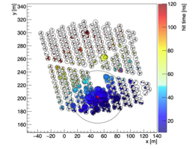
Outrigger Extension
Increase sensitivity to highest energy gammas and cosmic rays by improving core reconstruction
350 small WCD which will cover 4x HAWC area, boosting sensitivity by 3-4x at 50 TeV
Funded and in progress! ~1yr to completion
Simulated Outrigger Event
Notes:
This is my ‘Make HAWC Great Again, Again’ slide ☺

Slide 34
Conclusions & Outlook
Conclusions
HAWC is versatile TeV instrument
Probing VHE sky in both gamma and cosmic rays
Large TeV data set: 1 billion events / day
In Progress
Second HAWC Catalog coming soon
Improving upon and extending TeV CR anisotropy
Outriggers to improve sensitivity beyond 50 TeV
Look forward to upcoming results!

Slide 35
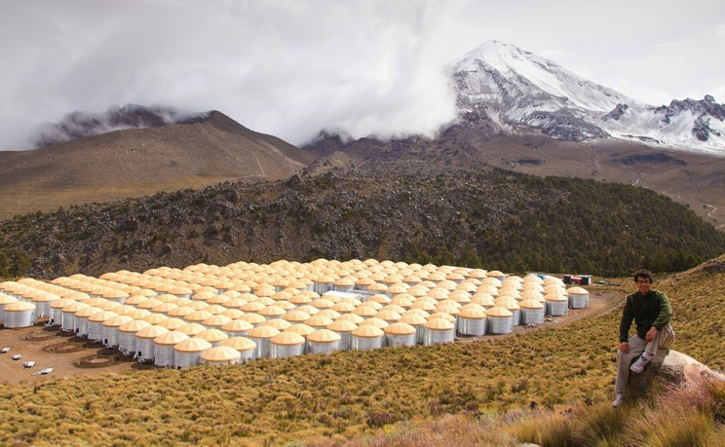
Thank you!

Slide 36
Los Backups

Slide 37





HAWC View of Gamma Ray Sky
Sending Alerts of Flaring Sources!
M.Hui, APS 2016
April 5, 2016 April 6, 2016 April 7,2016 April 8, 2016
Monitoring all gamma ray sources visible to HAWC every day.
Notes:
Equatorial Coordinates

Slide 38


HAWC View of Galactic Plane
~40 new sources in 1st year
25% are new TeV emitters!
Preliminary
Association unclear
SNR w/ very energetic pulsar
Pulsar ~8kpc (26,000 ly) away
2nd HAWC Catalog in Preparation
Notes:
Using present max likelihood fits to point sources with power law spectra with index=-2.7

Slide 39
T. Weisgarber TeVPA 2016
Notes:
Equatorial Coordinates

Slide 40
Aside: Making HAWC Sky Maps
Estimate background at each point in sky (<N>)
Relative Intensity: fractional deviation from background
Significance via Li & Ma formula
- Number of events in bin
- Est Bkg events in bin
- Right Ascension
- Declination

Slide 41



Energy Bins for Maps
Notes:
Very overhead, zenith < 17 deg

Slide 42


Reconstruction: Cosmic Rays
Need some data quality cuts!
Energy estimators very sensitive.
Core ON Array cuts
cos(θ) > 0.96
Reconstructed
Core Distribution
Angular Reconstruction
X_{res} ≈ 18 m (2 tank diams)
θ_{res} ≈ 0.5 deg
Notes:
Very overhead, zenith < 17 deg

Slide 43


Reconstruction: Gamma Rays
On-source/Off-source distributions
G/H Separation Parameter
Excess events near Crab
G/H Separation
Ring Averaged Deviations
Angular Reconstruction
Notes:
Very overhead, zenith < 17 deg

Slide 44




Cosmic Ray Energy Estimation
Built lateral distribution tables of MC proton shower hit patterns for range of simulated:
Energies
Arrival directions
Search tables to find the most likely energy!
Maximum likelihood for hits to come from radial, charge, zenith, energy bins.
Shower of unknown energy
?
?
?
⬥
Probability
Probability
Probability
⬥
⬥
⬥
⬥
⬥
⬥
⬥
⬥
⬥
⬥
⬥
⬥
⬥
⬥
⬥
⬥
⬥
⬥
⬥
⬥
⬥
⬥
⬥
⬥
⬥
⬥
⬥
⬥
⬥
⬥
⬥
⬥

Slide 45
HAWC Data Sample
Full HAWC array
Reconstructed ~394 days (3.406 x 10⁷ s)
1.271x10¹⁰ events
Applied Cuts:
Core ON array
nHit > 75
nHit Core_{<40m} >= 40
cos(θ_{reco}) > 0.96
(θ_{reco} < 17°)

Slide 46


Bayesian Unfolding: Machinery
D’Agostini [1] iterative unfolding requires some machinery:
E = True Energy
E_{reco} = Reconstructed Energy
DATA:
MC:
Raw Counts
N(E_{reco})
Unfolded Counts
N(E)
Unfolded Spectrum
F(E)
Mixing Matrix
P(E_{reco}|E)
Mixing Matrix Error Estimate
[1] G. D'Agostini, Nucl. Instrum. Meth. A 362 (1995) 487.

Slide 47
Bayesian Unfolding Procedure
n – reco-distribution
φ – true-distribution
P – response matrix
M – inverse of P
We have this from MC
We want this
Get this from unfolding
We have this from data
[1] G. D'Agostini, Nucl. Instrum. Meth. A 362 (1995) 487.

Slide 48



Bayesian Unfolding Procedure
Latin indices: reco variable index
Greek indices: true variable index
i – iteration number
P - response matrix
n – reco-distribution
φ – true-distribution
Initial prior of true variable
To calculate posterior, M
M is pseudo-inverse of P
[1] G. D'Agostini, Nucl. Instrum. Meth. A 362 (1995) 487.

Slide 49

Spectrum: Power Law Fit
Notes:
Differential flux vs energy

Slide 50


CREAM Model Abundances
Fractional Abundances
Ratio to Total CR Flux

Slide 51
Anisotropy: Previous Results
Measurements of Cosmic Ray Anisotropy with HAWC – D. Fiorino, TeVPA 2016
Arxiv: 1408.4805v2

Slide 52

Anisotropy Energy Dependence
Dipole plot is attractive because it can be simply explained.
It’s clear that a phase change is seen around 100 TeV.
It’s less clear when exactly this happens & trend at lower energies.

Slide 53
MC Details
Simulation:
Hadronic showers simulated with CORSIKA-740
QGSJetII, FLUKA interaction models
CREAM Composition Model: p, He, C, O, Si, Mg, Ne, Fe
Dedicated HAWC detector simulation and event reconstruction
Proton hypothesis used as energy estimate, E_{reco}, for all events
Data quality cuts to ensure cores are ON the array

Slide 54

Sensitivity to Point Sources
Large Millimeter Telescope

Slide 55


Shower Development & HAWC
Simulation
(CORSIKA)

Slide 56
Event Reconstruction
Typical high multiplicity event
Arrival Direction
Timing
Charge Distribution
Core Position ( )
Lateral distribution
Fit to modified NKG

