Slide 1
Soft and hard probes of the Quark Gluon Plasma at the LHC
Marco van Leeuwen
CERN, Nikhef and Utrecht University

Slide 2
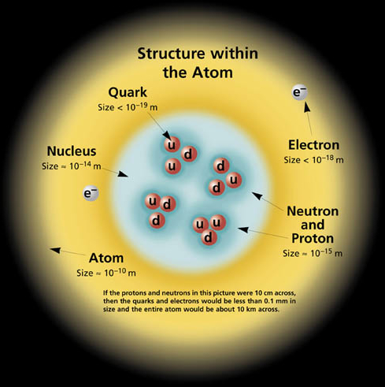
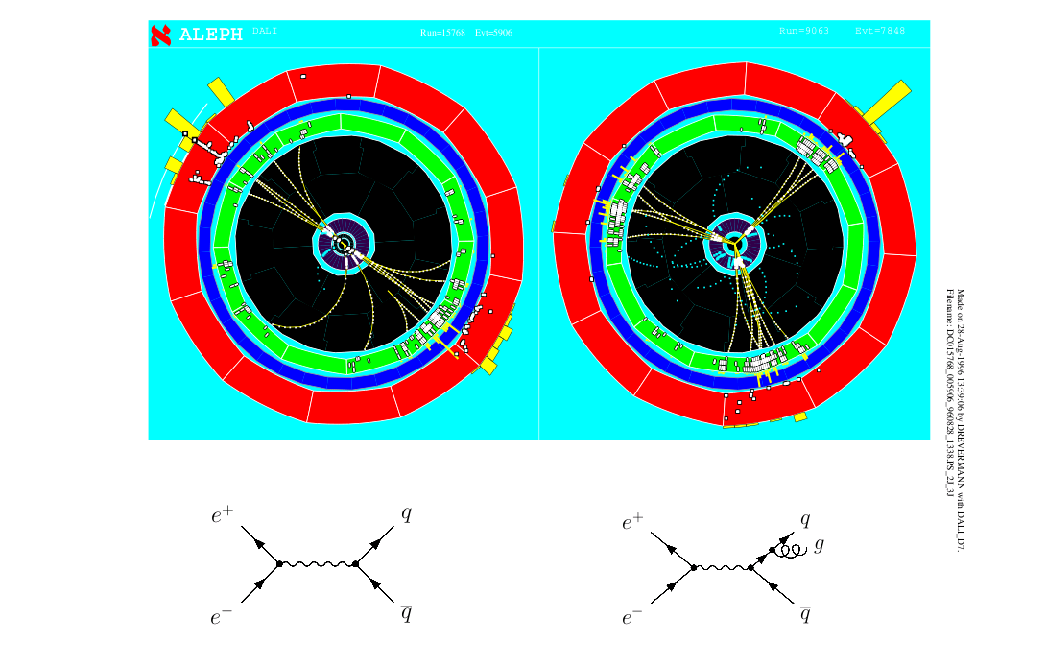
Quark, gluons and QCD
Quantum Chromodynamics is the theory of the strong interaction, which binds quarks into hadrons
In high-energy collisions:
Observe signatures of quarks, gluons (‘jets’)
In the ground state
quarks are bound inside protons and neutrons

Slide 3
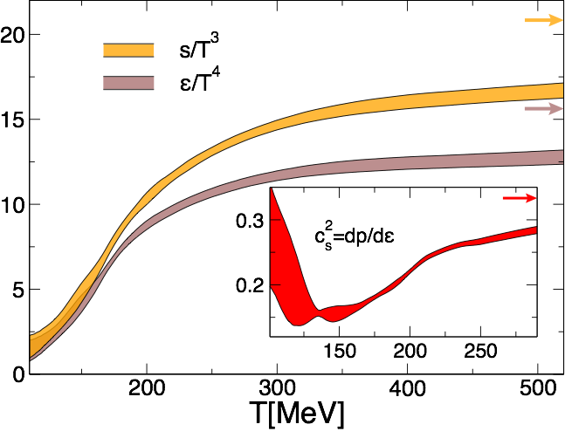
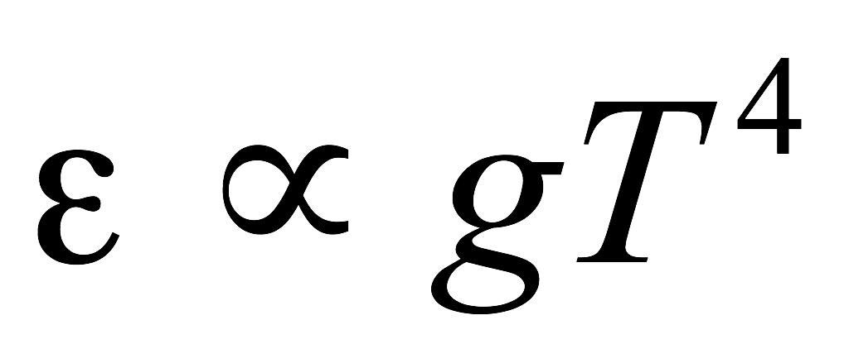
Introduction: Heavy Ion Physics
Equation of state
Energy density vs temperature
g: degrees of freedom
Borsanyi et al, PLB 730, 99
Nuclear matter
Quark Gluon Plasma
Tc ≈ 150 MeV
Study the properties of many-body QCD systems
Properties of equilibrium matter: equation of state, transport coefficient
Dynamics: hadronisation, interactions of partons with the medium

Slide 4
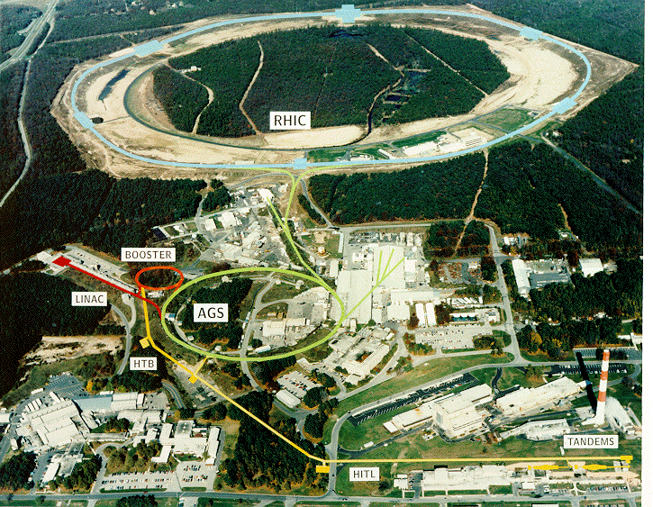
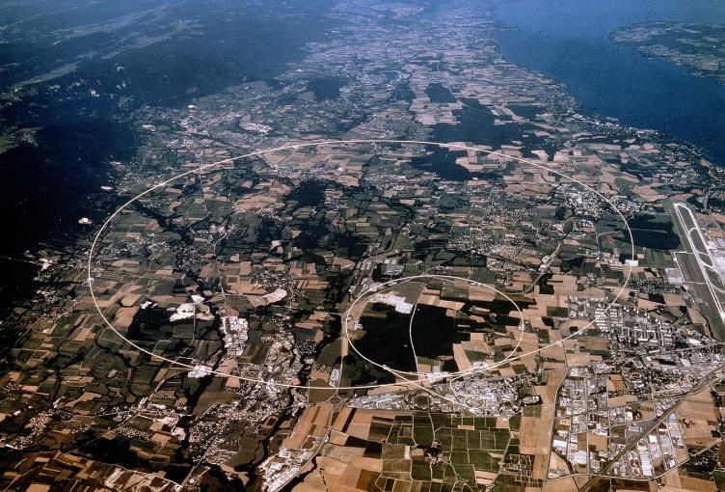
Intro: RHIC and LHC
RHIC, Brookhaven
LHC, Geneva
Au+Au √s_{NN}= 200 GeV
Run 2: Pb+Pb √s_{NN}= 5020 GeV
First run: 2000
First run: 2009/2010
STAR, PHENIX,
(PHOBOS, BRAHMS)
ALICE, ATLAS, CMS, LHCb

Slide 5
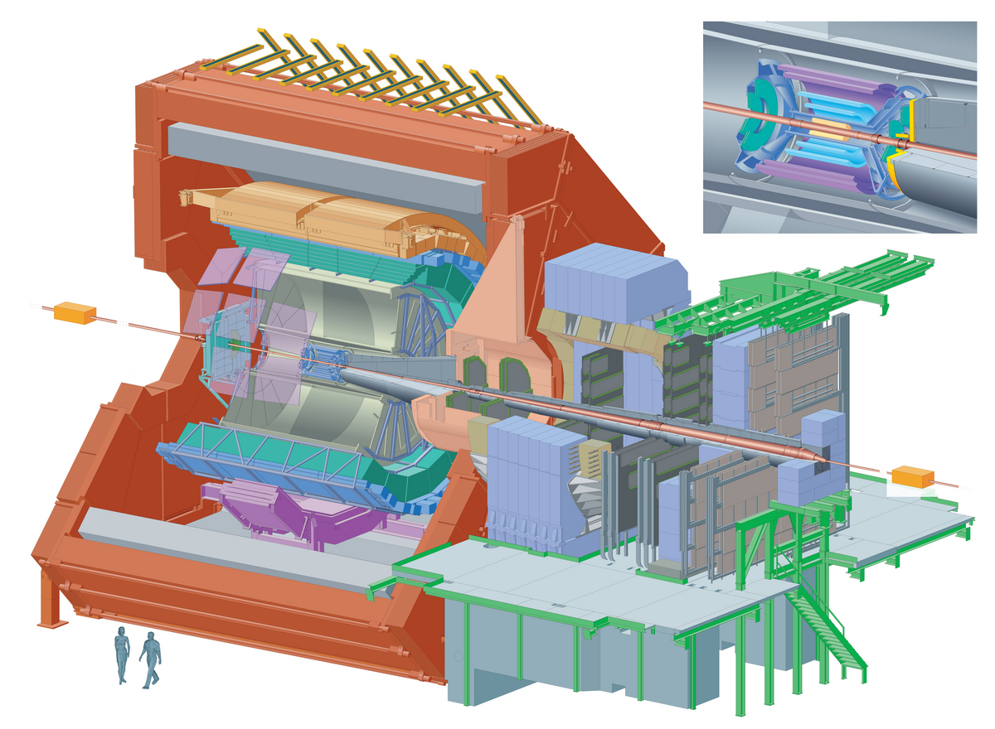
Detector example: ALICE
Central tracker:
|η| < 0.9
High resolution
TPC
ITS
EM Calorimeters
EMCal
PHOS
Particle identification
HMPID
TRD
TOF
Forward muon arm
-4 < η < -2.5
e.g. 2015: 100M hadronic Pb+Pb collisions, 800M p+p collisions

Slide 6
Soft probes: anisotropic flow
MADAI
Initial state (spatial) anisotropy ⇒ Pressure gradients ⇒ anisotropic flow: momentum space anisotropy

Slide 7
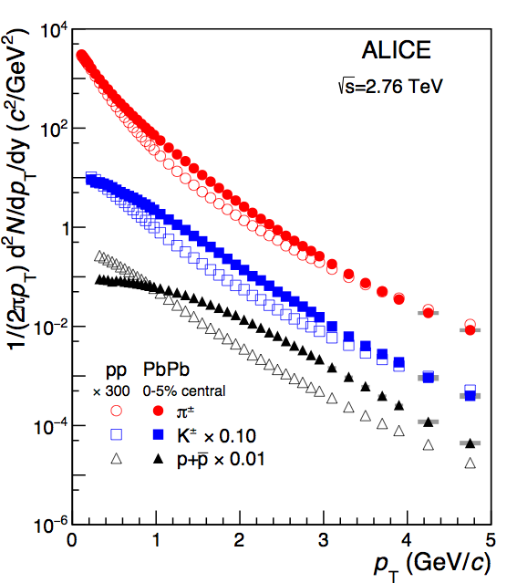
Radial and elliptic flow
Transverse momentum distribution
Spectra change from pp to Pb+Pb:
Increase in mean pT
Larger effect for larger mass
ALICE, PLB 736, 196
First indication of collective behaviour Pressure leads to radial flow
Same Lorentz boost (β) gives larger momentum for heavier particles
(m_{p} > m_{K} > m_{π})

Slide 8
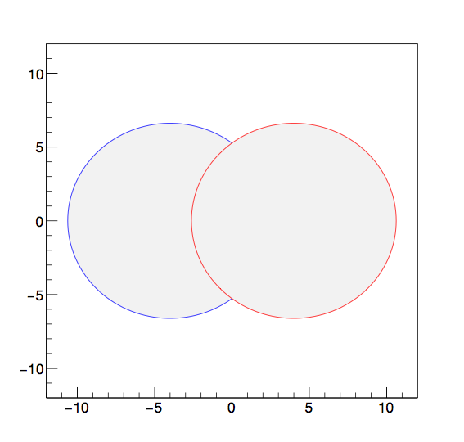
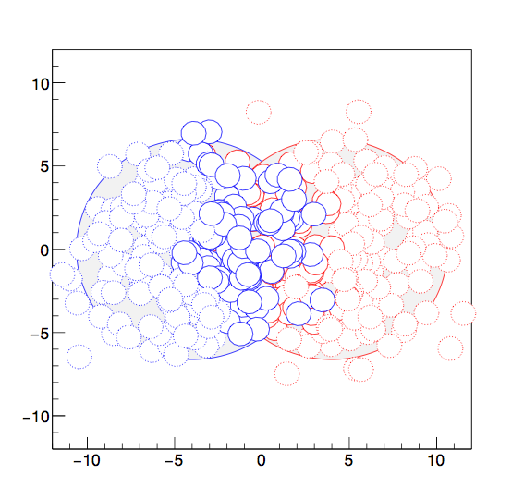
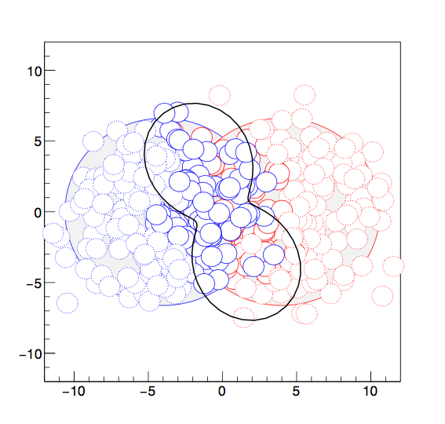
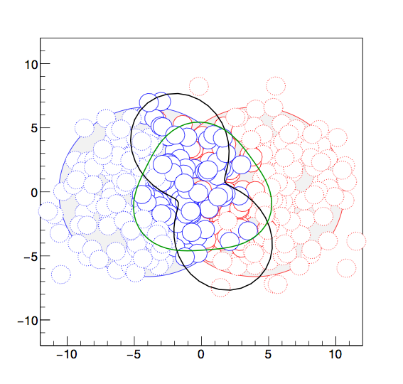
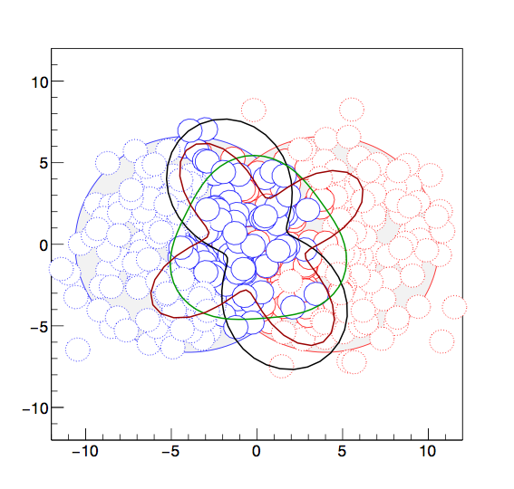
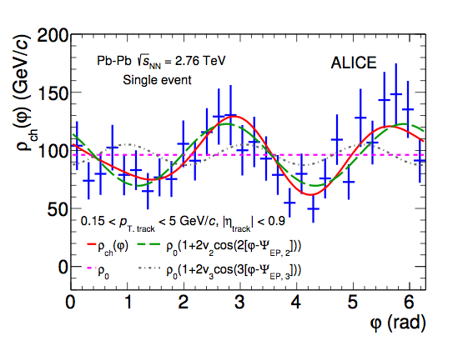
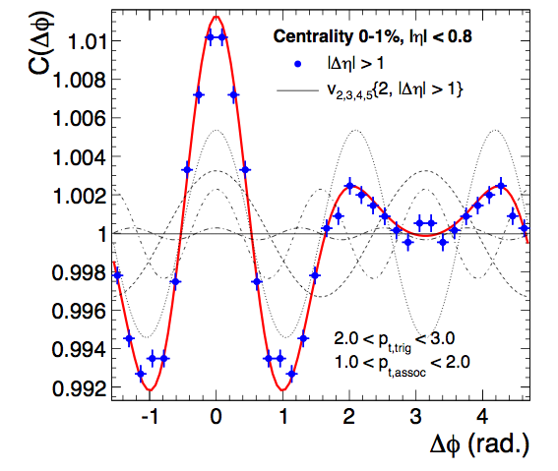
Azimuthal anisotropy: initial and final states
MC event: location of nucleons
Azimuthal distribution single event
ALICE, PLB 753, 511
Sum over many events
ALICE PRL. 107, 032301
Characterise shape by angular moments:
Initial state spatial anisotropies εn are transferred into final state momentum anisotropies vn by pressure gradients, flow of the Quark Gluon Plasma

Slide 9
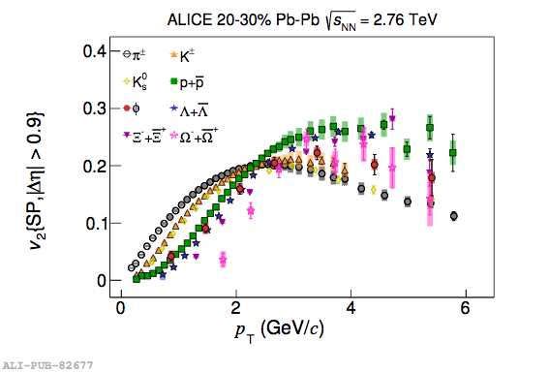
Anisotropic flow results
v3
JHEP106, 190
arXiv:1606.06057
v4
Mass-dependence of v₂ measures flow velocity
Tests hydrodynamical description, freeze-out models

Slide 10
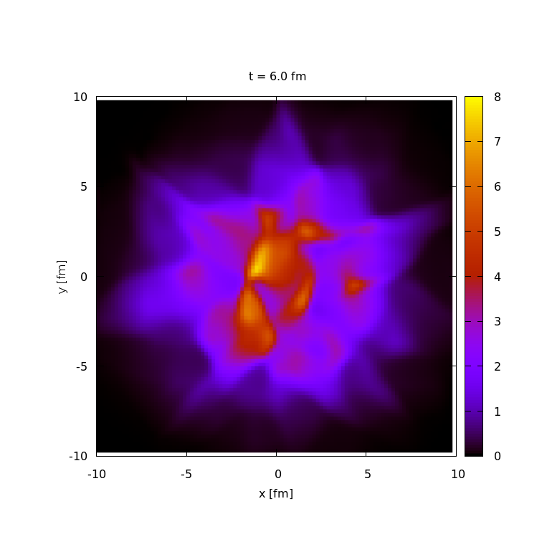
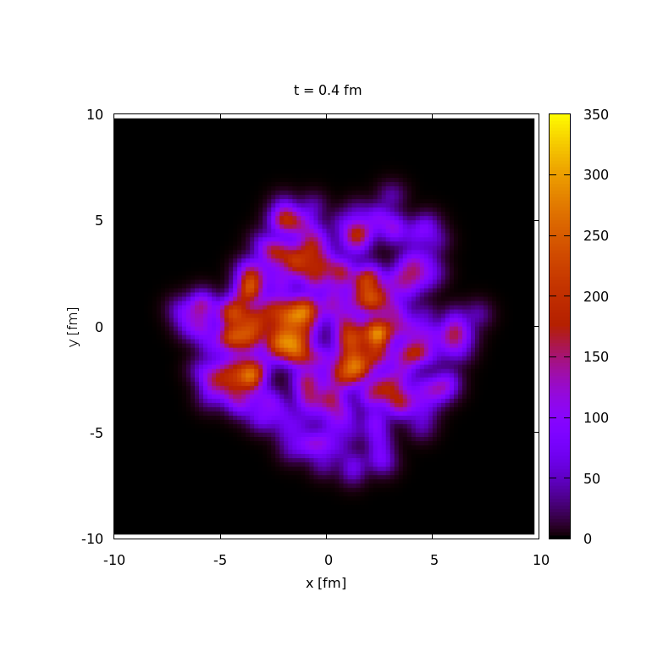
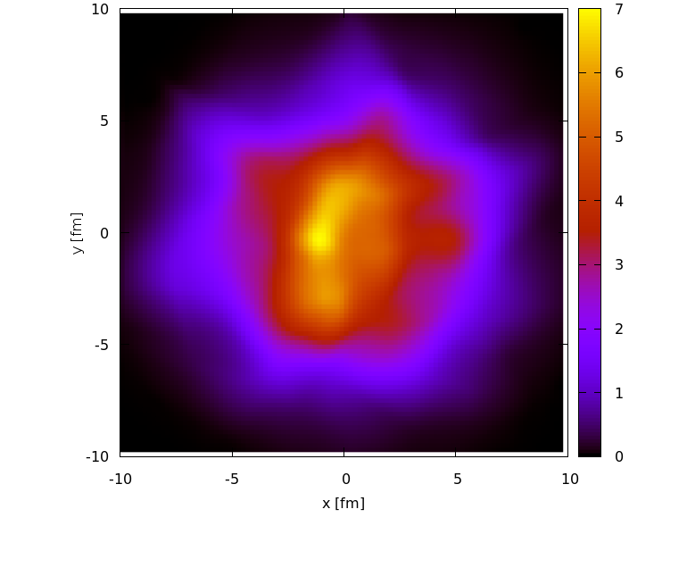
Higher harmonics and viscosity
Schenke and Jeon, Phys.Rev.Lett.106:042301
In general: initial state may be ‘lumpy’
(not a smooth ellipse)
η/s = 0
η/s = 0.16
How much of this is visible in the final state, depends on shear viscosity η
and a number of other model parameters

Slide 11
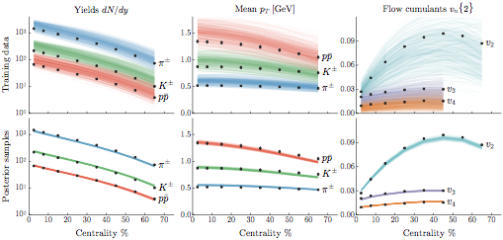
Global fit: input
J. E. Bernhard et al, arXiv: 1605.03954
Experimental input: yields, mean pT and harmonic flow vs pT
Model: initial anisotropies + medium response
Explores a large parameter space to investigate reliability/robustness of the modeling

Slide 12
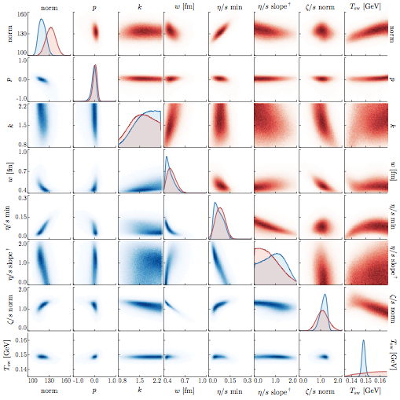
Global fit of initial state+hydrodynamics
J. E. Bernhard et al, arXiv: 1605.03954
εn : initial spatial anisotropies from initial state model
vn : observed final state momentum anisotropy
Response: modeled by hydrodynamic evolution
Total 9 parameters:
3 initial state ⟹ εn
4 QGP ⟹ response
2 model parameters

Slide 13
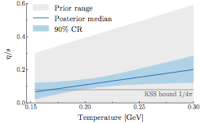
A global fit to anisotropic flow: main results
Total 9 parameters:
3 initial state ⟹ εn
4 QGP ⟹ response
2 model parameters
J. E. Bernhard et al, arXiv: 1605.03954
Viscosity of the QGP
Multiplicity production model
Fit constrains initial state geometry and transport properties at the same time
Follows an effective ‘saturation’ model
Viscosity close to lower bound

Slide 14
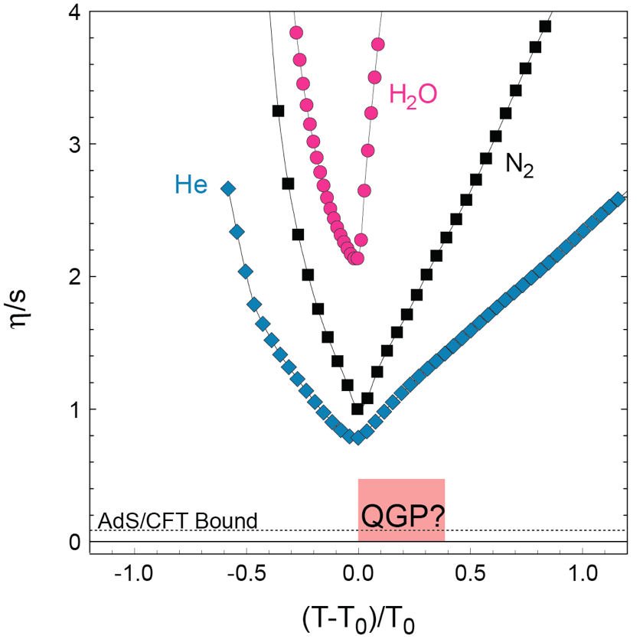
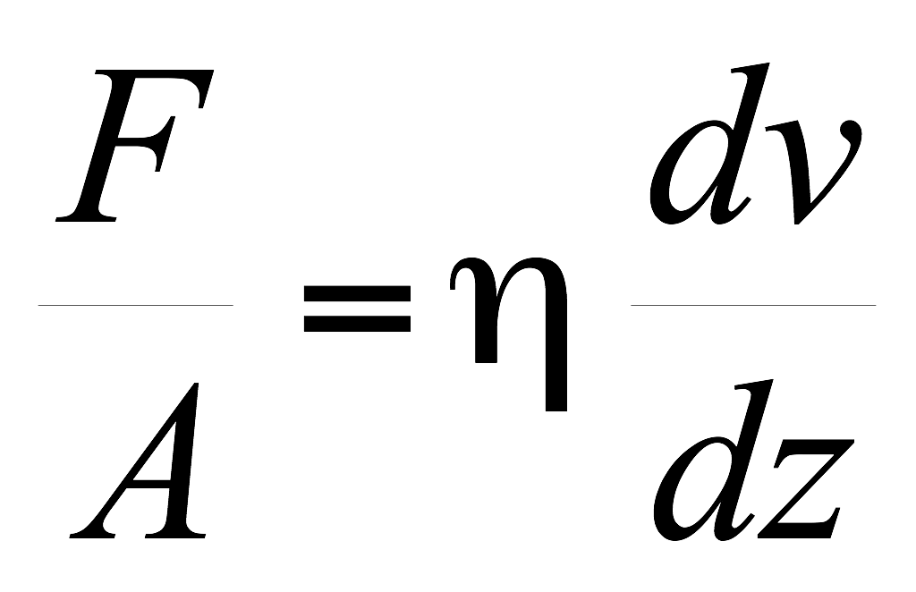
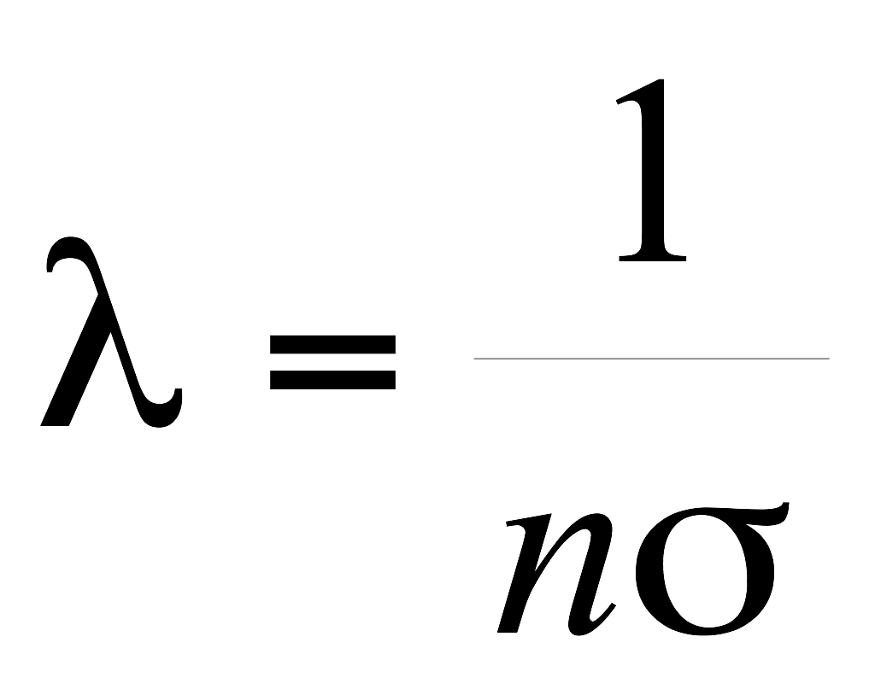
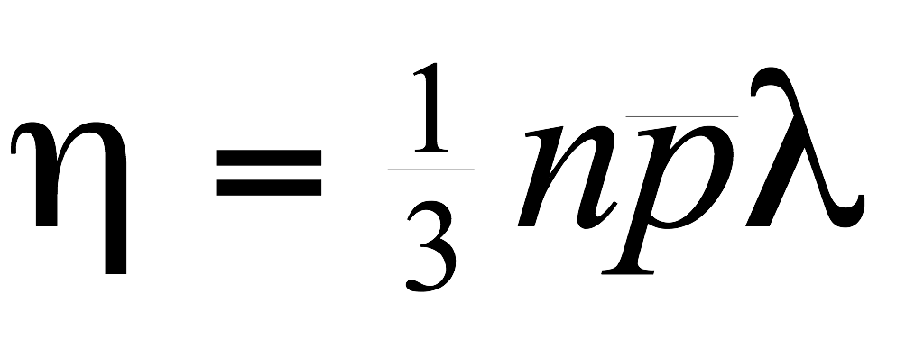
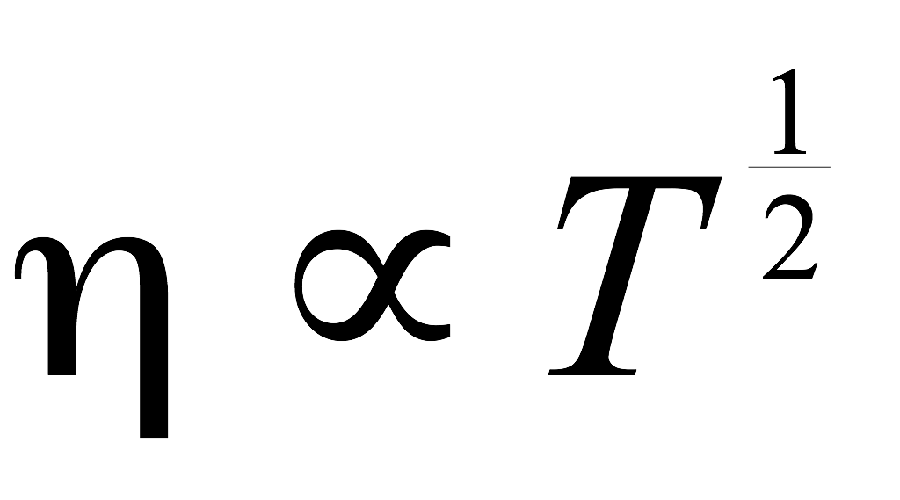
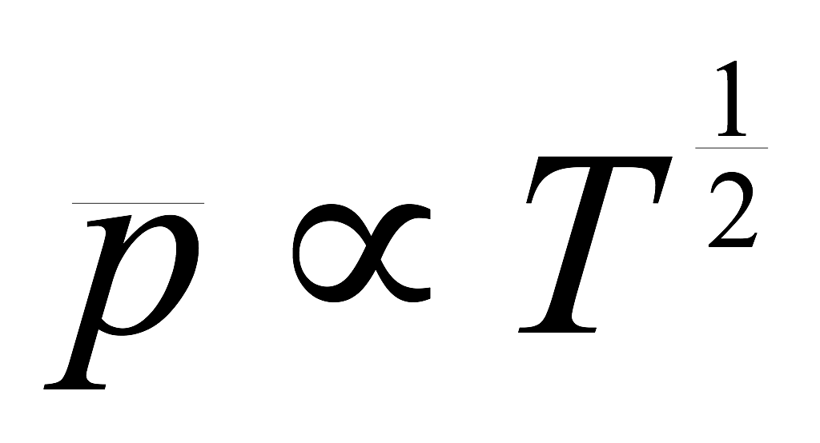
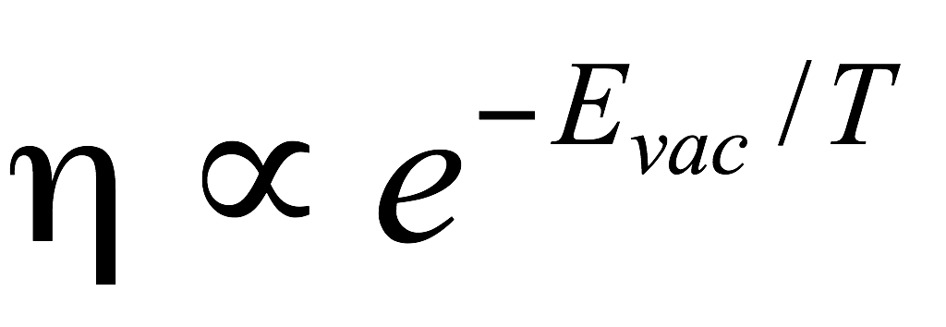
Viscosity
Viscous liquid dissipate energy
Temperature dependence of viscosity
For a dilute gas:
Liquid
gas
η increases with T
Liquid, densely packed, so:
Viscosity minimal at liquid-gas transition
E_{vac}: activation energy for jumps of vacancies
η decreases with T
QGP viscosity lower than any atomic matter

Slide 15
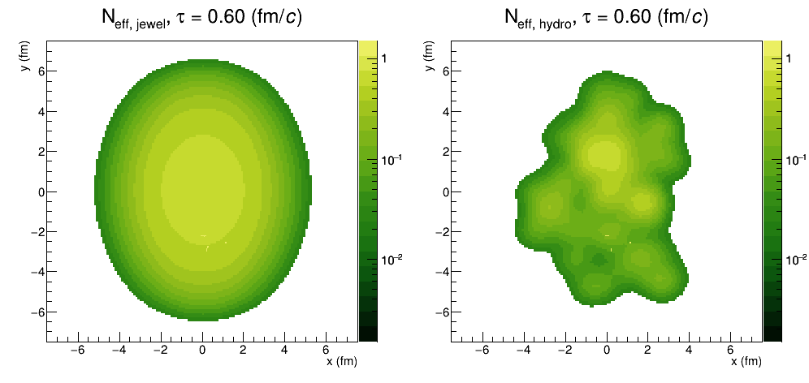
Higher pT: probes of the QGP
R Bertens, JEWEL simulation
Hard probes
Hard-scatterings produce quasi-free partons
⇒ Probe medium through energy loss
Expected to be dominant for pT > 5 GeV or so

Slide 16
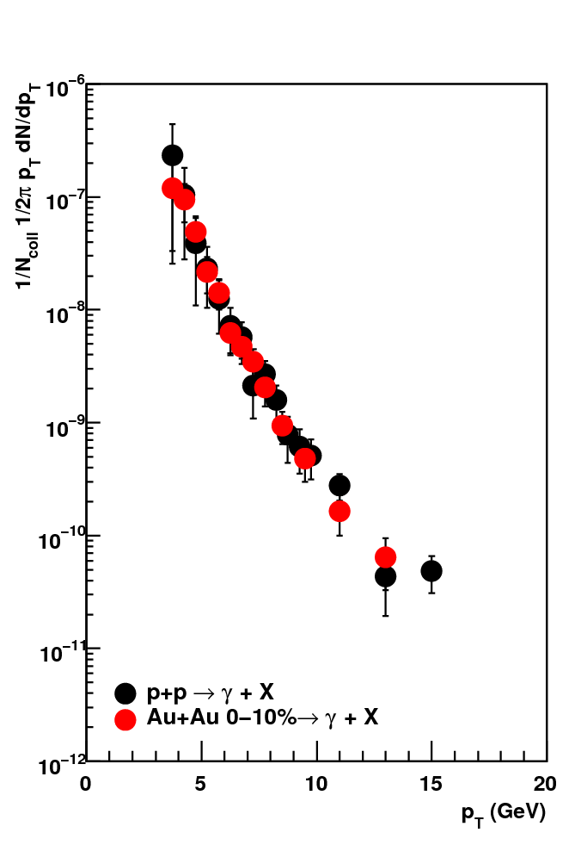
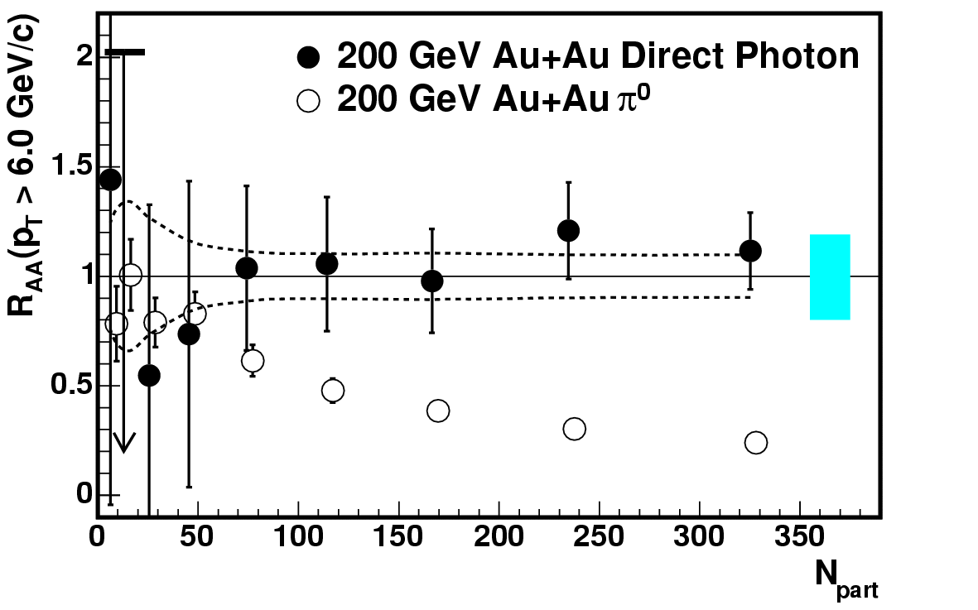
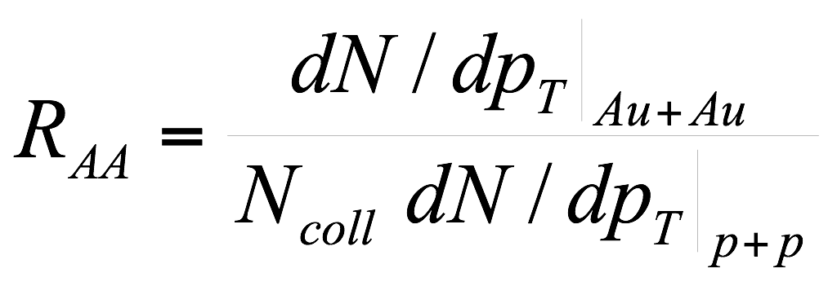
Nuclear modification factor: definition
Direct photon spectra
Nuclear modification factor RAA
PHENIX
PHENIX, PRL 94, 232301
Centrality
Scaled by N_{coll}
Direct γ in A+A scales with N_{coll}
A+A initial state is incoherent superposition of p+p for hard probes

Slide 17
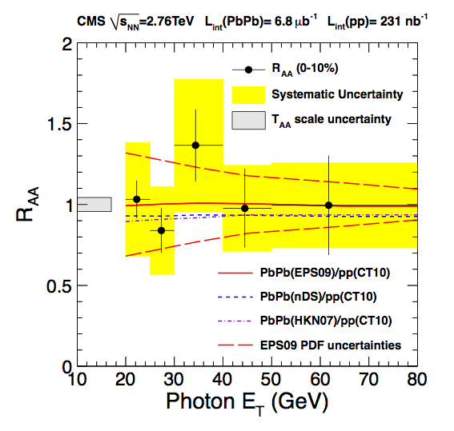
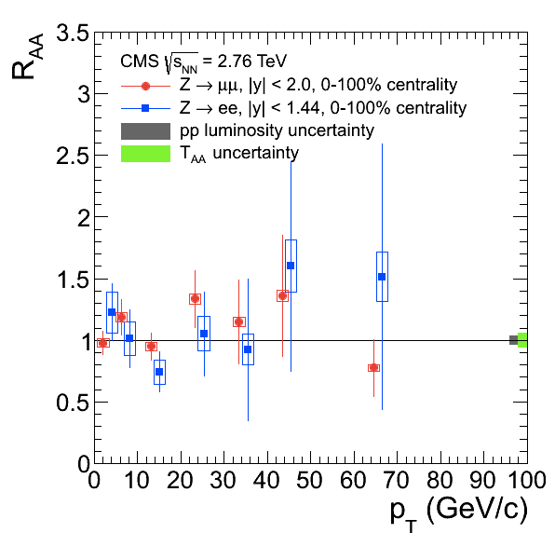
Non-interacting probes at LHC
CMS, arXiv:1201.3093
CMS, arXiv:1410.4825
Ncoll scaling also confirmed at LHC with 𝛾 and even Z (W)

Slide 18
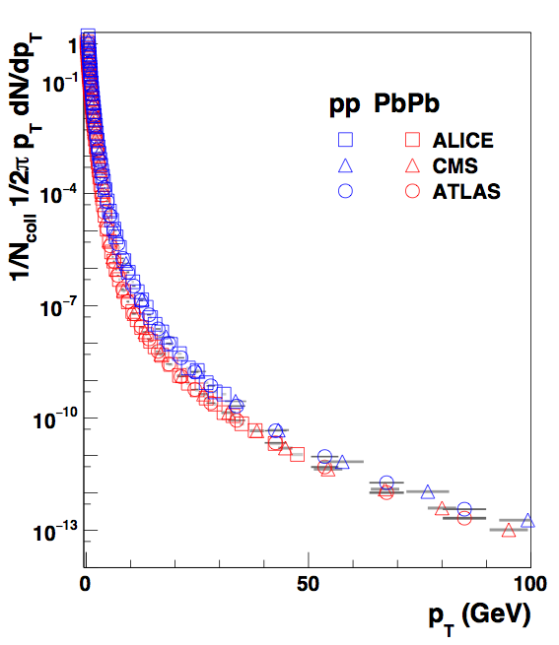
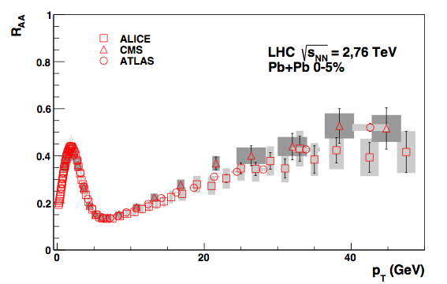
Nuclear modification: Pb+Pb
ALICE, PLB720, 52
CMS, EPJC, 72, 1945
ATLAS, arXiv:1504.04337
Charged particle pT spectra
Nuclear modification factor
Low pT: soft production,
Npart scaling
Energy loss
Ncoll: number of binary nucleon-nucleon collisions
R_{AA} < 1
Pb+Pb: clear suppression (RAA < 1): parton energy loss

Slide 19
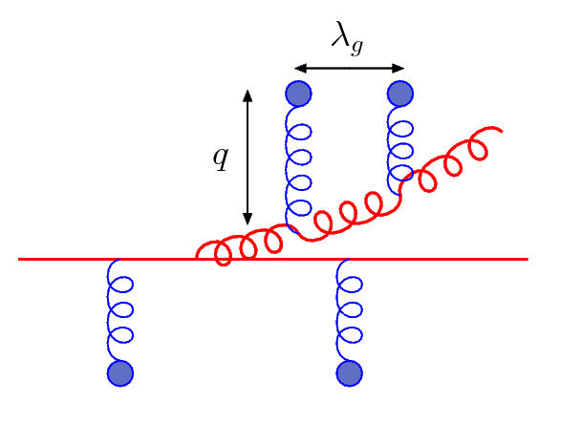
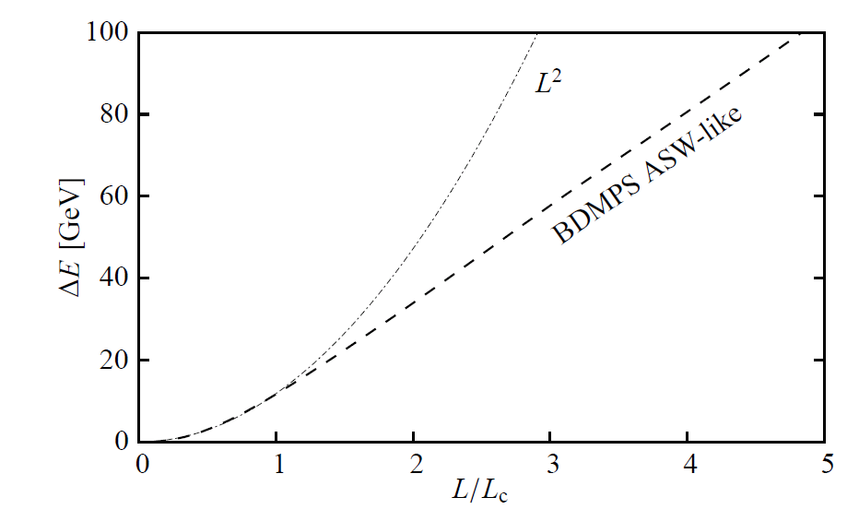
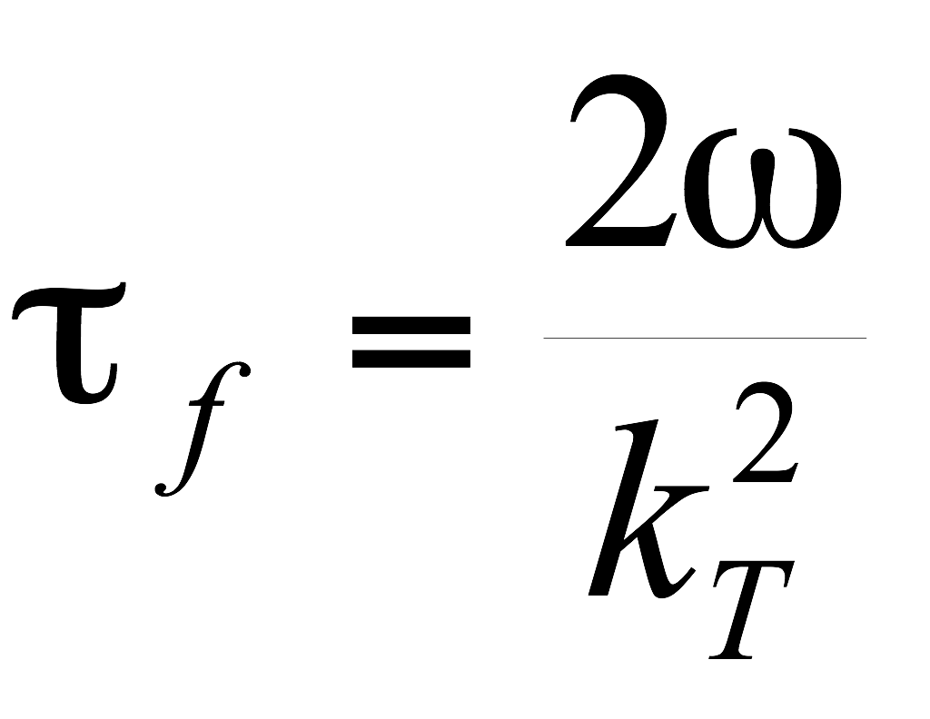
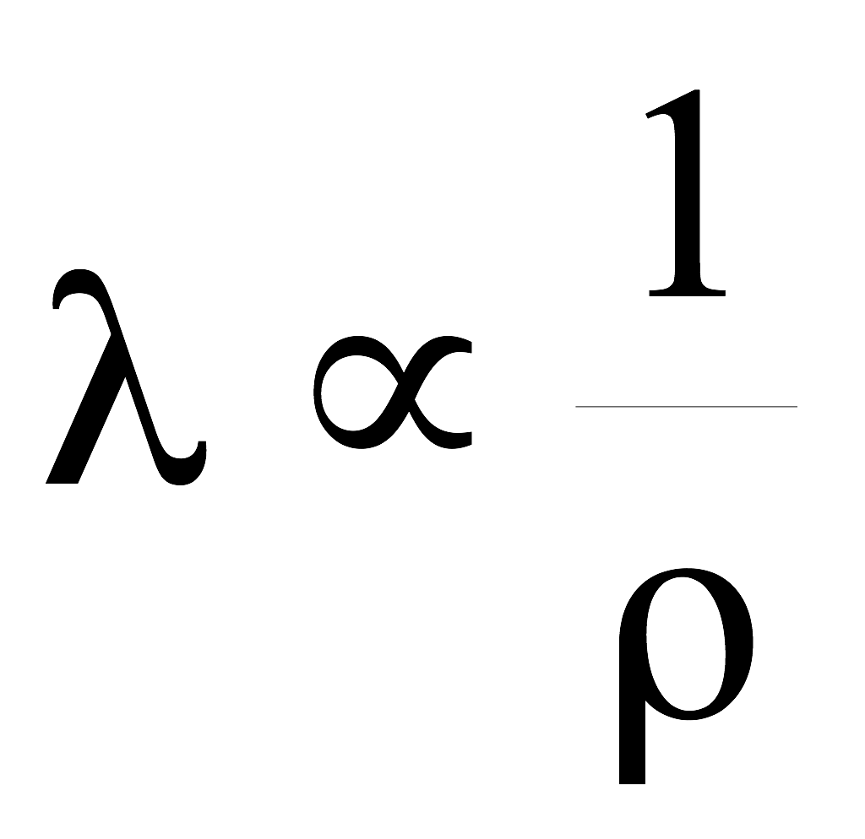
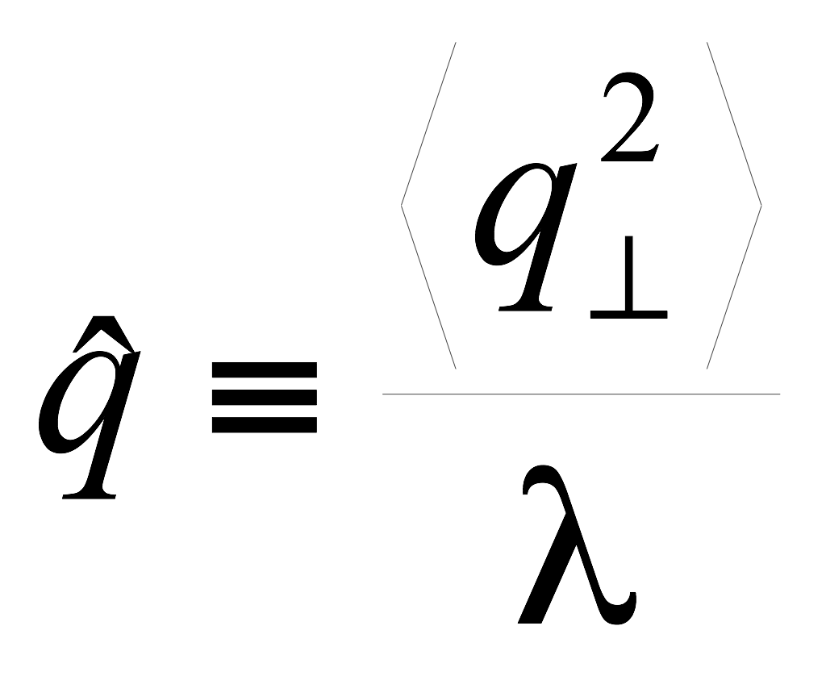
Medium-induced radiation
Landau-Pomeranchuk-Migdal effect
Formation time important
Zapp, QM09
radiated
gluon
propagating
parton
L_{c} = τ_{f,max}
Radiation sees length ~τ_{f} at once
If λ < τ_{f}, multiple scatterings
add coherently
Energy loss depends on density:
and nature of scattering centers
(scattering cross section)
Transport coefficient

Slide 20
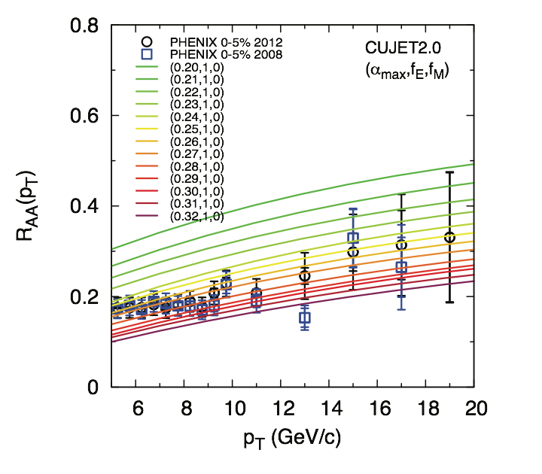
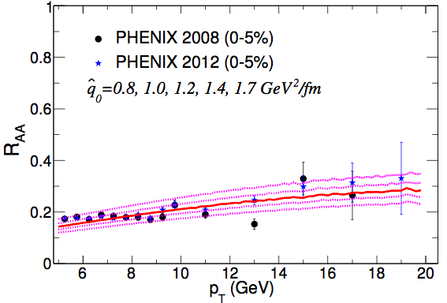
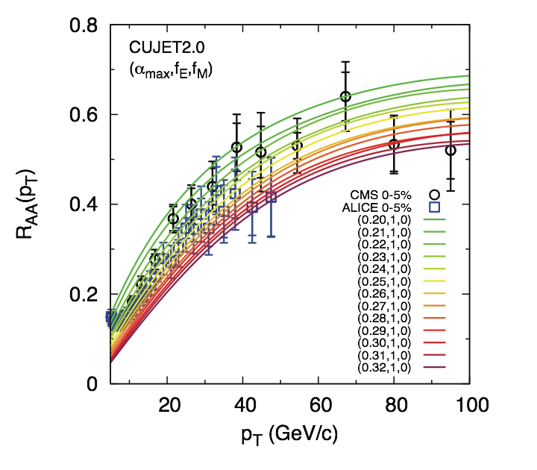
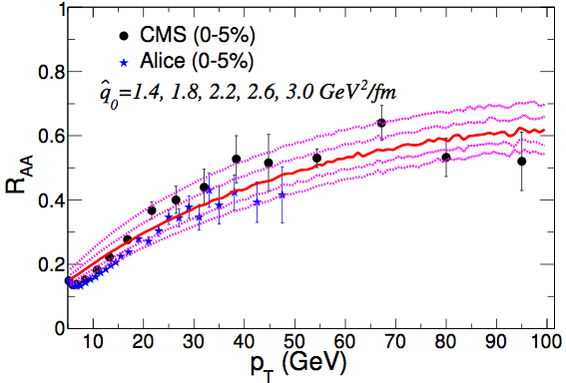
RHIC and LHC
RHIC
RHIC
Burke et al, JET Collaboration, arXiv:1312.5003
LHC
LHC
Systematic comparison of energy loss models with data
Medium modelled by Hydrodynamics (2+1D, 3+1D)
pT dependence matches reasonably well

Slide 21
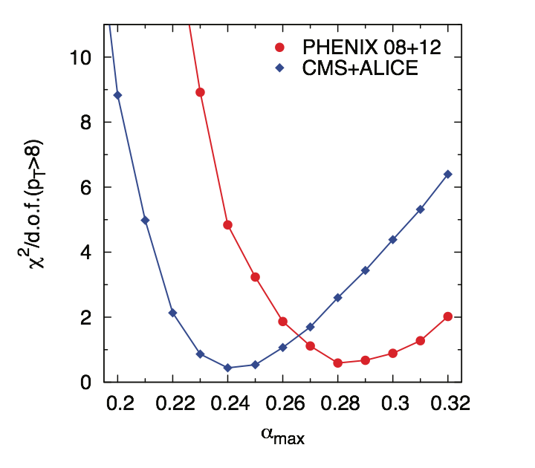
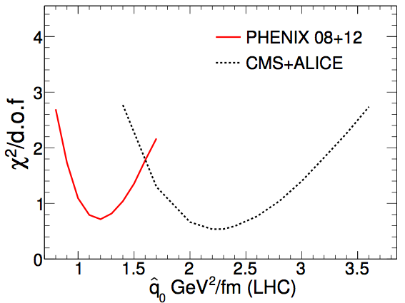
RHIC and LHC
CUJET 2.0
HT-BW
Burke et al, JET Collaboration, arXiv:1312.5003
CUJET: 𝛼s is medium parameter
Lower at LHC
HT: transport coeff is parameter
Higher at LHC

Slide 22
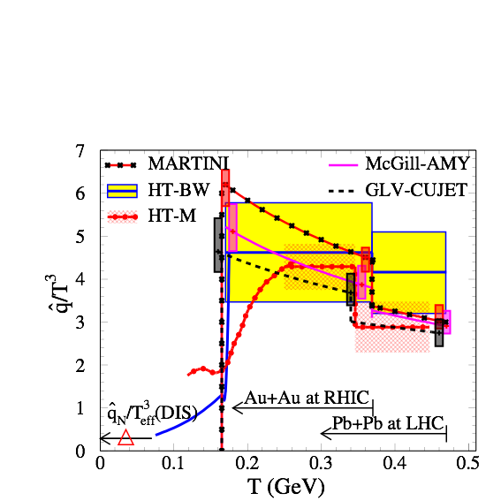
Summary of transport coefficient study
RHIC:
√s_{NN} = 200 GeV
(Ti = 370 MeV)
LHC:
√s_{NN} = 2760 GeV
Burke et al, JET Collaboration, arXiv:1312.5003
(Ti = 470 MeV)
values from different models consistent
Arnold and Xiao, arXiv:0810.1026
HTL expectation:
Sizeable uncertainties from 𝛼S, treatment of logs etc expected
Values found are in the right ballpark compared (p)QCD estimate
Magnitude of parton energy loss is understood

Slide 23
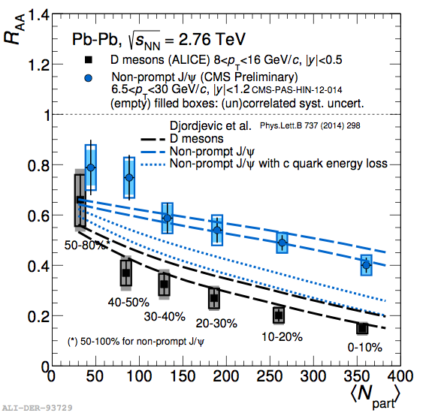
Heavy flavour RAA; mass dependence
ALICE, JHEP11, 205
Compare
beauty: non-prompt J/Ψ
charm: D-mesons
Larger suppression for charm than for beauty
Agrees with expected
‘dead-cone effect’
energy loss reduced when v < c
Indicates radiative energy loss: induced gluon bremsstrahlung

Slide 24
Charm v2
ALICE, QM2017, A Barbano
Azimuthal anisotropy of heavy quarks very similar to light quarks (pions)
Initial production is isotropic
Heavy quarks ‘feel’ the flow of the
Quark Gluon Plasma

Slide 25
Jet reconstruction
Experiment view
Theory/model view
Jet reconstruction: group particles together and add momenta
Several algorithms available; conceptually: draw cones, size R
The summed momentum is a measure of the parton energy; accuracy depends on R

Slide 26
Jets at LHC
ALICE
Transverse energy map of 1 event
ϕ
η
Clear peaks: jets of fragments from high-energy quarks and gluons
And a lot of uncorrelated ‘soft’ background

Slide 27
Di-jet momentum balance
CMS, PRC 84, 024906
Balanced di-jet: Aj = 0
Already pp, balance is not perfect: out-of-cone radiation and three-jet events
In-balance in Pb-Pb is much larger: energy loss

Slide 28
Photon-jet pT balance
CMS-PAS-HIN-16-002
γ
Photon does not lose energy in the QGP
Directly measures energy loss of jets
Sensitive to energy loss fluctuations
Recoil jet loses energy in the Quark Gluon Plasma

Slide 29
Jets: zooming in on energy loss
Goal: measure energy loss distributions
Longitudinal (fragmentation function)
Transverse (jet profiles)
Jet radius R
Simple expectation:
Limiting behaviour: for large enough R, expect R_{AA} = 1 (no suppression)
For smaller R: study out-of-cone radiation and in-cone jet modifications

Slide 30
Radial redistribution of energy
Will this continue at even larger R?
Radial distribution of momentum flow
Ratio Pb—Pb/pp
CMS, arXiv:1310.0878
CMS PAS HIN-12-013
Most of the jet energy is at small r
Modification in Pb—Pb: decrease at intermediate r, increase at large r

Slide 31
Radial distribution, large R
Ratio Pb—Pb/pp
Ratio Pb—Pb/pp
Pb—Pb 0-30% central
pT,jet > 120 GeV/c
CMS, arXiv:1609.02466
Increase of energy flow continues at large r
Modification in Pb—Pb: decrease at intermediate r, increase at large r
No sign of a limit or ‘typical radiation angle’

Slide 32
(anti-) Angular ordering in the medium
Salgado, Mehtar-Tani, Tywoniuk et al
PRL106, 122002 and follow-ups
arXiv:1210.7765
arXiv:1102.4317
Vacuum radiation: angular ordering subsequent radiations are at smaller angles
In-medium: opposite effect radiation outside cone preferred
Two resolution scales: medium scale vs opening angle
Ongoing development
Full implications not yet worked out

Slide 33
Summary
Things that we know:
QGP behaves like a liquid with extremely low viscosity η/s ≈ 0.1
Implies short mean free path: high density, strong interactions (quasi-particle picture may not be applicable)
High-momentum partons lose energy in the QGP
Magnitude of basic effect in agreement with expectations from (p)QCD
Charm/beauty difference indicates radiative energy loss dominates
Things that we wonder about:
pp, p+Pb show flow-like behaviour
What is the physical mechanism?
Does this have implications for understanding Pb+Pb? Or vice versa?
Energy loss: can we study the large-angle radiation?
Theory tools for jet-measurements under active development
Can we calculate soft radiation?

Slide 34
Thank you for your attention
Facebook: @ALICE.EXPERIMENT
Twitter: @ALICEexperiment

Slide 35
QCD phase diagram
Quark Gluon Plasma
(Quasi-)free quarks and gluons
Temperature
Critical
Point
Early universe
Confined hadronic matter
Elementary collisions
(accelerator physics)
High-density phases?
Neutron stars
Nuclear matter

Slide 36
Time evolution in a heavy ion collision
Quark Gluon Plasma/Liquid
(near) thermal equilibrium
Pre-equilibrium
Freeze-out (post-equilibrium)
Expectation: main difference between heavy ion collisions and pp, p+Pb volume + density ⇒ rescattering during evolution ⇒ approach to thermal equilibrium

Slide 37
Intro 2: Hard and soft processes
Heavy-ion collisions produce ‘quasi-thermal’ QCD matter
Dominated by soft partons p ~ T ~ 100-300 MeV
‘Bulk observables’
Study hadrons produced by the QGP
Typically p_{T} < 1-2 GeV
Physical model/picture: hydrodynamical flow, thermodynamics
‘Hard probes’
Hard-scatterings produce ‘quasi-free’ partons
⇒ Probe medium through energy loss
p_{T} > 5 GeV
Physical model/picture: hard scattering+parton energy loss
Two basic approaches to learn about the QGP
Bulk observables
Hard probes

Slide 38
Elliptic flow
Hydrodynamical calculation
Reaction plane
Elliptic flow:
Yield modulation in-out reaction plane
ϕ
reaction
plane
Anisotropy reduces during evolution v₂ more sensitive to early times
b

Slide 39
Comparing hadrons and jets
Suppression of hadron (leading fragment) and jet yield similar
Lost energy is transported to large angles (R > 0.3)

Slide 40
Increasing R to recover the energy
Ratio of spectra with different R
ATLAS, arXiv:1208.1867
ATLAS, arXiv:1208.1967
Larger jet cone: ‘catch’ more radiation → Jet broadening
However, R = 0.5 still has R_{AA} < 1
– Hard to see/measure the radiated energy

Slide 41
Radial profiles in pT bins
CMS-PAS-HIN-16-020

Slide 42
Hints of collective effects in p+p, p+Pb

Slide 43
Mean pT overview pp
QM15 talk, L Bianchi
Mean pT in pp collisions also increases with multiplicity and particle mass
Multiple (initial state) interactions
or proto-flow?
Or are they the same?
Logarithmic fit ‘to guide the eye’:

Slide 44
Mean pT overview pp, p+Pb, Pb+Pb
QM15 talk, A Ortiz
Increasing mean pT trend continues in p+Pb
Raises question: is there flow, collective behaviour in pp, p+Pb?
And how is it generated?

Slide 45
Two-particle correlations in pp and Pb+Pb
trigger
Near side
associated
Central Pb+Pb
p+p low multiplicity
p+p high multiplicity
CMS, arXiv:1201.3158
Ntrk < 35
Ntrk > 110
1 < pT < 3 GeV
CMS, PLB 718, 795
Near-side long range correlation: indicates early time origin
Seen in high-multiplicity pp and p+Pb events

Slide 46
Two-particle correlations
ATLAS-CONF-2016-026
High-multiplicity p+p
High-multiplicity p+Pb
2 < |Δη| < 5
Clear change in shape from low multiplicity to high multiplicity: no near-side peak in low multiplicity events
Away-side also affected: well described by dipole term (cos (2 Δ𝜑))
Smooth evolution from pp to p+Pb: effect stronger in p+Pb

Slide 47
Changing the projectile
B Schenke
v2 and v3 from ³He+Au
Sizeable v3 contribution seen with ³He
RHIC has collided a variety of small nuclei with Au to explore geometric effects
³He gives explicit triangular contribution in initial state
Effect is driven by initial spatial configuration

Slide 48
Flow in small systems: comparisons to hydro
Many aspects of the observed ridge have a natural explanation in hydrodynamics:
Long range correlation
2- and 3-fold symmetries
Dependence on initial geometry
Particle mass dependence
Kozlov et al, Nucl. Phys. A931 (2014)
Why would the system behave as a fluid?
Is there enough time, volume to thermalise?
Hydrodynamisation (isotropisation) of a dense gluon system?
Partonic/hadronic rescattering?
How many scatterings/what density is needed to approximate fluid behaviour?
Many recent developments; active discussion on interpretation
Romatschke, EPJC75, 305
2016 p+Pb run to shed more light on this

Slide 49
Hydro fit model parameters
J. E. Bernhard et al, arXiv: 1605.03954

Slide 50
Nuclear geometry: N_{part}, N_{coll}
b
Two limiting possibilities:
Each nucleon only interacts once, ‘wounded nucleons’ N_{part} = n_{A} + n_{B} (ex: 4 + 5 = 9 + …) Relevant for soft production; long timescales: σ ∝ N_{part}
Nucleons interact with all nucleons they encounter N_{coll} = n_{A} x n_{B} (ex: 4 x 5 = 20 + …) Relevant for hard processes; short timescales: σ ∝ N_{coll}

Slide 51
Nuclear modification factor RAA
New run 2 result:
RAA for 5 TeV Pb+Pb collisions
CMS-PAS-HIN-15-015
Values similar to 2.76 TeV
expected: medium density similar
(multiplicity increase 20%)
Increase vs pT indicates ΔE/E decreases with E
Expect in high energy limit E >> ΔE

Slide 52
Changes in fragmentation
Transverse fragment distributions
Longitudinal fragment distributions
0-10%
PAS CMS-HIN-12-013
CMS, arXiv:1310.0878
Enhancement at large R, low pT
No/very little modification at small R, large pT
Is this expected/understood?

Slide 53
Soft-collinear Effective Theory
Y-T Chien, I Vitev, JHEP 1412, 061 and 1605, 023
Radial profile Pb+Pb
Radial profile pp
CMS, arXiv:1310.0878
Need resummation to properly describe radial profile
R-dependence of RAA
Radial profile well described by SCET
ATLAS, arXiv:1208.1967
R dependence too strong?
Predictions for 𝛾-jet available

Slide 54
Jet shapes: radial moment
pT-weighted jet width
L. Cunqueiro, Quark Matter
Radial moment smaller in Pb+Pb
than pp (PYTHIA)
JEWEL model shows similar trend
Jets in medium narrower than in vacuum

Slide 55
Splitting fraction
SoftDrop grooming, momentum fraction of the first splitting: sensitive to splitting function
Larkoski et al, PRD 91, 111501
CMS-PAS-HIN-16-006
Comparison to JEWEL MC generator:
good (qualitative) agreement
SoftDrop β = 0, zcut = 0.1
ΔR12 > 0.1
⟨zg⟩ lower in Pb+Pb: softer fragmentation

Slide 56
RAA vs models
‘Analytical models’
Burke et al, JET Collaboration, arXiv:1312.5003
HT-BW
Several formalisms/approximations for parton energy loss exist
Allows to determine medium properties, transport coefficient
RHIC:
LHC:
(T=370 MeV)
(T=470 MeV)
HTL expectation:
Sizeable uncertainties from 𝛼S, treatment of logs etc expected
Arnold and Xiao, arXiv:0810.1026
Values found are in the right ballpark compared (p)QCD estimate
Magnitude of parton energy loss is understood

Slide 57
2-particle correlations
trigger
Near side
associated
PLB 708, 249
Intermediate pT
High pT
Pb+Pb
Near-side peak: jets (+decays): larger at high pT
Flow v2, v3: long range correlation (early times+ long expansion)
Near side long range correlation: flow (v2, v3)
Most prominent at lower pT
Away-side: recoil jet also gives a long-range correlation (η1 ≠ η2)

Slide 58
Strangeness production in pp, p+Pb
pT spectra in multiplicity-selected pp collisions
particle yields in multiplicity bins
ALICE, arXiv:1606.07424, arXiv:1307.6796, arXiv:1512.07227
Fraction of strange hadrons increases with multiplicity
Large effect for multi-strange Ξ and Ω
Mean pT increases with multiplicity
Similar enhancement in PbPb has been interpreted as thermalisation; global equilibration of the strangeness yield. Are they related?

Slide 59
Multiplicity dNch/dη in pp, Pb+Pb
PLB 753, 319
First results from Run-2: multiplicity at new energies
Trend continues to rise faster for AA than pp: conversion of energy to particles in AA is more efficient (larger ‘stopping’)

Slide 60
Multiplicity vs centrality PbPb
arXiv:1509.07299
Centrality dependence
very similar at 5.02 and 2.76 TeV
(overall factor 1.2)
Model comparisons:
Soft physics models agree
Hijing: some deviations
Driven by geometry
No change in contribution hard vs soft processes

Slide 61
v2 from di-hadron correlations
p+p
p+Pb
ALICE, PLB 726,164
Similar ‘mass ordering’ observed for v2 from two-particle correlations in p+Pb
Is this also pressure-driven?

Slide 62
Multi-particle correlations: testing collectivity
pp
p+Pb
Pb+Pb
CMS-HIN-16-010, arXiv:1606.06198
Multi-particle methods suppress few-particle (non-flow) correlations
Flow-like effect is indeed a multi-particle effect

Slide 63
Quarkonia: J/Ψ suppression
ALICE, arXiv:1606.08197
Run 2: 5 TeV Pb+Pb
Increase by recombination:
No sign of energy dependence
Compatible with model expectations
(small effects expected)
Suppression by quarkonium melting

Slide 64
Quarkonia: ϒ suppression
Run 2: 5 TeV Pb+Pb
ϒ suppression at 5 TeV similar to 2.76 TeV

Slide 65
Initial state: colliding nuclear matter
MC event: location of nucleons
with gaussian smoothing
Characterise shape by angular moments:
Symmetry planes change from event to event
Orientation measured for every event

Slide 66
Changing the projectile
B Schenke
RHIC has collided a variety of small nuclei with Au to explore geometric effects
³He gives explicit triangular contribution in initial state

Slide 67
Explore more degrees of constraint
LHC
RHIC
Model input: viscosity vs temperature
Niemi et al, arXiv:1509.02767, PRC93, 024907
New observable: event plane correlations

Slide 68
Changing the projectile
v2 and v3 from ³He+Au
v2 in p+Au, d+Au, ³He+Au
PHENIX, PRL 115 (2015) 142301
Sizable v3 contribution seen with ³He
—> Effect is driven by initial spatial configuration
v2 smallest for p+Au, as expected from geometry

Slide 69
RAA overview
ALICE: PLB 720, 52; EPJ. C74, 3054
CMS: http://arxiv.org/abs/1410.4825 (Z0) EPJ. C72, 1945; PLB 710, 256; PLB 715, 66
RAA < 1 for hadrons:
Parton energy loss
Hadrons: energy loss
R_{AA} < 1
γ: no interactions
R_{AA} = 1
RAA ≈ 1 for 𝛾, Z, W:
No energy loss for electromagnetic and weak probes
p+Pb: RpPb ≈ 1 at high pT
No/very small ‘cold nuclear matter’ effects on high-pT probes

Slide 70
Z-jet imbalance
CMS-PAS-HIN-15-013
Recoil jet pT reduced by energy loss
Effect persists up to high pT

Slide 71
So how is the lost energy distributed?
Most results point towards
Relatively large loss: 5-10 GeV per jet
Distributed to large angles (R > 0.5) and soft particle production (few GeV)
This is dramatically different from vacuum jets:
Most energy carried by a small number of particles in the jet core R < 0.2
… But reconstructed jets in Pb—Pb events look quite similar to pp
Focus of the field: understanding this apparent paradox:
Measurements: new observables, e.g. jet shape
Modeling: event generators (JEWEL, YaJEM etc)
Theory: exploring multi-particle emission in QCD (anti-angular ordering, democratic splittings due to color flow, thermalisation etc)

Slide 72
Jet RAA comparison
Good agreement between the experiments

Slide 73
Direct photons
Main expected sources:
High pT: hard scattering; quark-gluon Compton process
Low pT: thermal radiation
arXiv:1509.07324
Excess at low pT in central collisions
indicates thermal photon production

Slide 74
Jet shapes
Measure particle distribution inside jets on a jet-by-jet basis
Radial moment (girth)
pT-dispersion
pT-weighted jet width
(Normalised) spread of pT
Anti-correlated with multiplicity
Large range of jet shape variables can be explored
So far, focused on two: 1 transverse, 1 longitudinal

Slide 75
Jet shapes: pT,D
QM talk, Cunqueiro
pT,D slightly larger in Pb+Pb
than pp (PYTHIA)
JEWEL model shows similar trend
Larger pT,D: smaller multiplicity and/or harder fragment distribution

Slide 76
MC tools: JEWEL
Publicly available
Zapp, Krauss, Wiedemann, arXiv:1212.1599
Elastic+radiative energy loss; follows BDMPS-Z in appropriate limits Medium: Bjorken-expanding Glauber overlap
RHIC
LHC
Ti = 350 MeV @ 𝜏0 = 0.8 fm/c
Ti = 530 MeV @ 𝜏0 = 0.5 fm/c
Good agreement with JET collaboration values

Slide 77
Comparison to pQCD expectation
JET paper:
Burke et al, arXiv:1312.5003
HTL expectation:
Arnold and Xiao, arXiv:0810.1026
Constant depends on 𝛼s (took 𝛼s = 0.3) and jet E (via ln)
plus uncertainties due to assumptions, low momentum cut-off etc
Values found are in ‘reasonable agreement’ with pQCD estimate

