Slide 1



Radio detection techniques for high-energy cosmic-ray or neutrino-induced particle cascades
Krijn de Vries
IIHE
Vrije Universiteit Brussel
Notes:
1

Slide 2
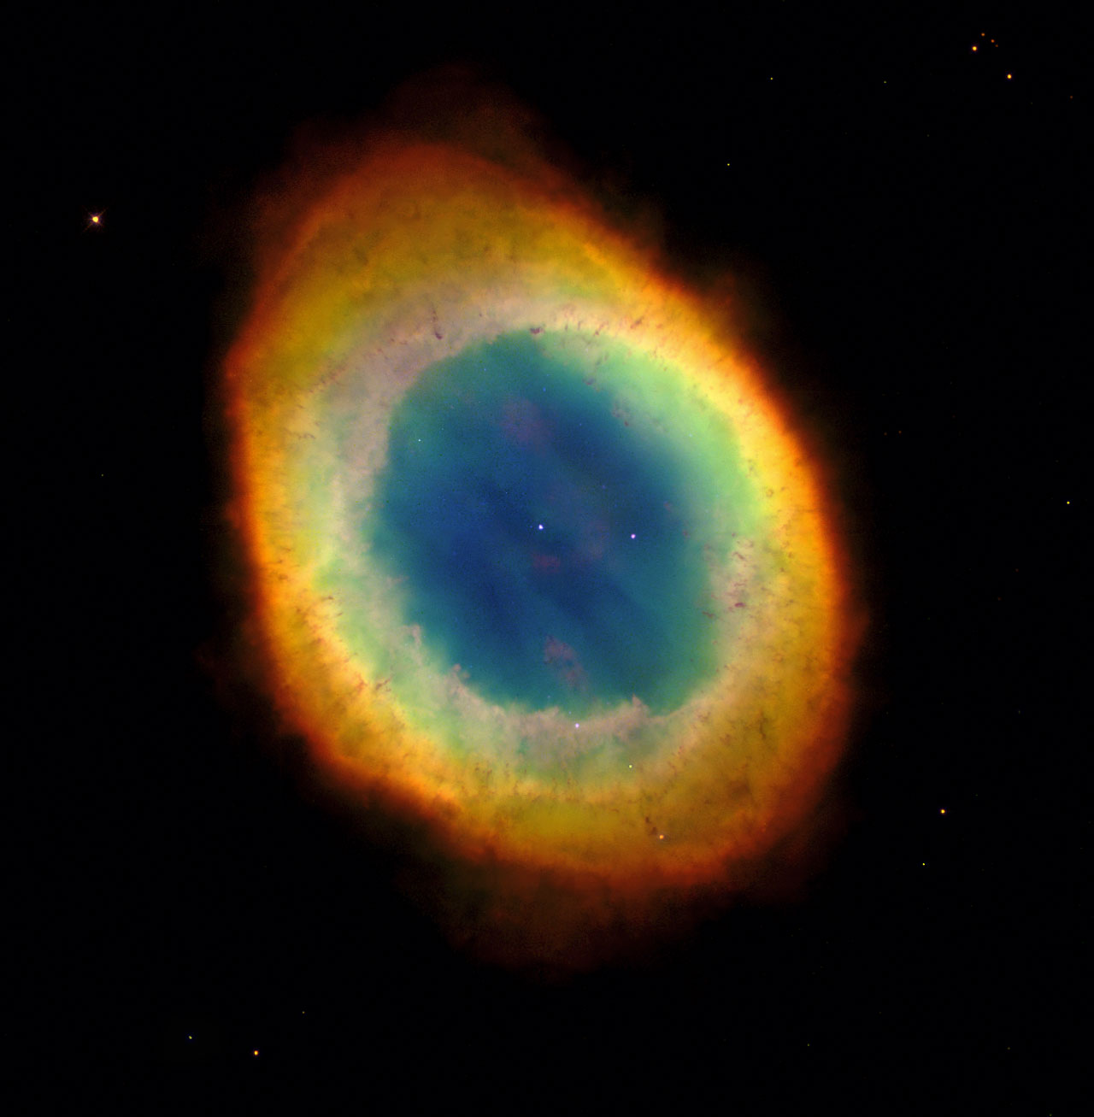
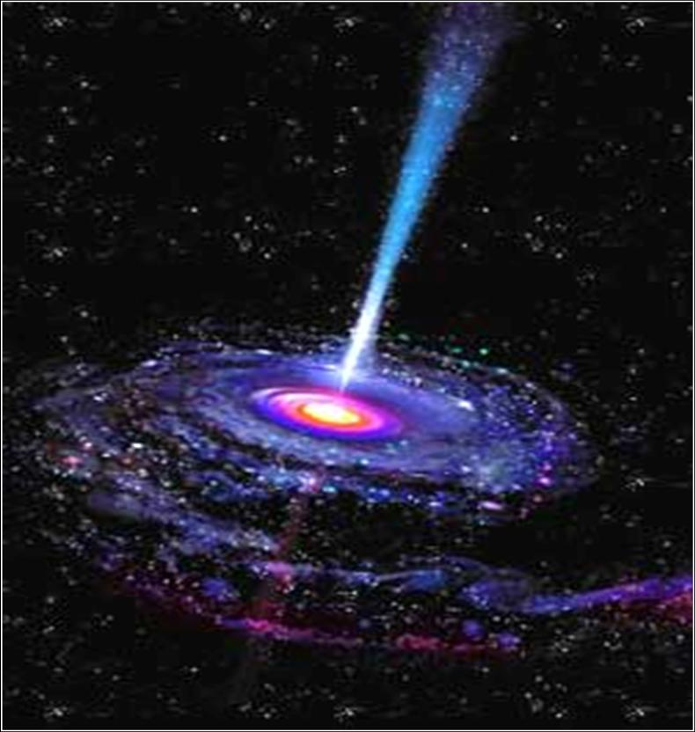
Why do we study high energy cosmic rays and neutrinos?
Origin of cosmic rays at the highest energies and their acceleration mechanism still unknown:
AGN, GRB, Exotic decay?
Do we see the GZK effect?
Cascade physics:
E>E(LHC), new physics…?
1

Slide 3
What do we need to find an answer to these questions?
Origin, acceleration mechanisms of cosmic rays at the highest energies and the GZK effect:
The cosmic-ray / neutrino spectrum
Composition of the initial cosmic ray
Shower physics:
Accurate shower measurements
2

Slide 4
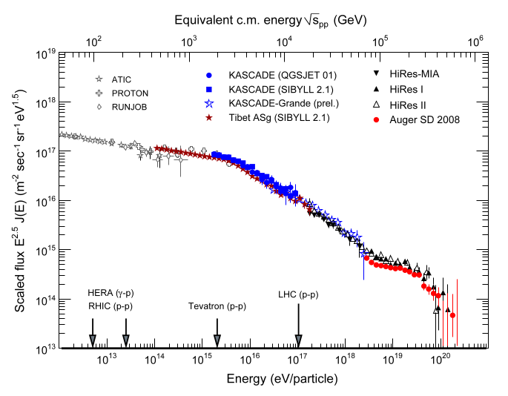
The cosmic-ray spectrum
Ankle, onset of the extragalactic component?
Knee, galactic to extragalactic?
GZK cut-off?
Very low flux at the highest energies
2
3

Slide 5
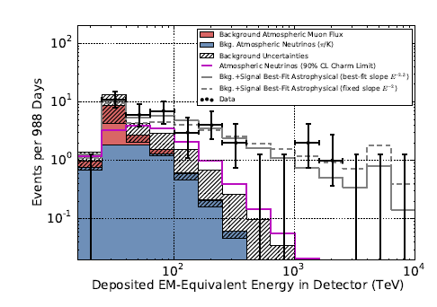
The cosmic-neutrino spectrum
Phys. Rev. Lett. 113, 101101 (2014)
Very low flux at the highest energies
Very low flux at the highest energies
4

Slide 6
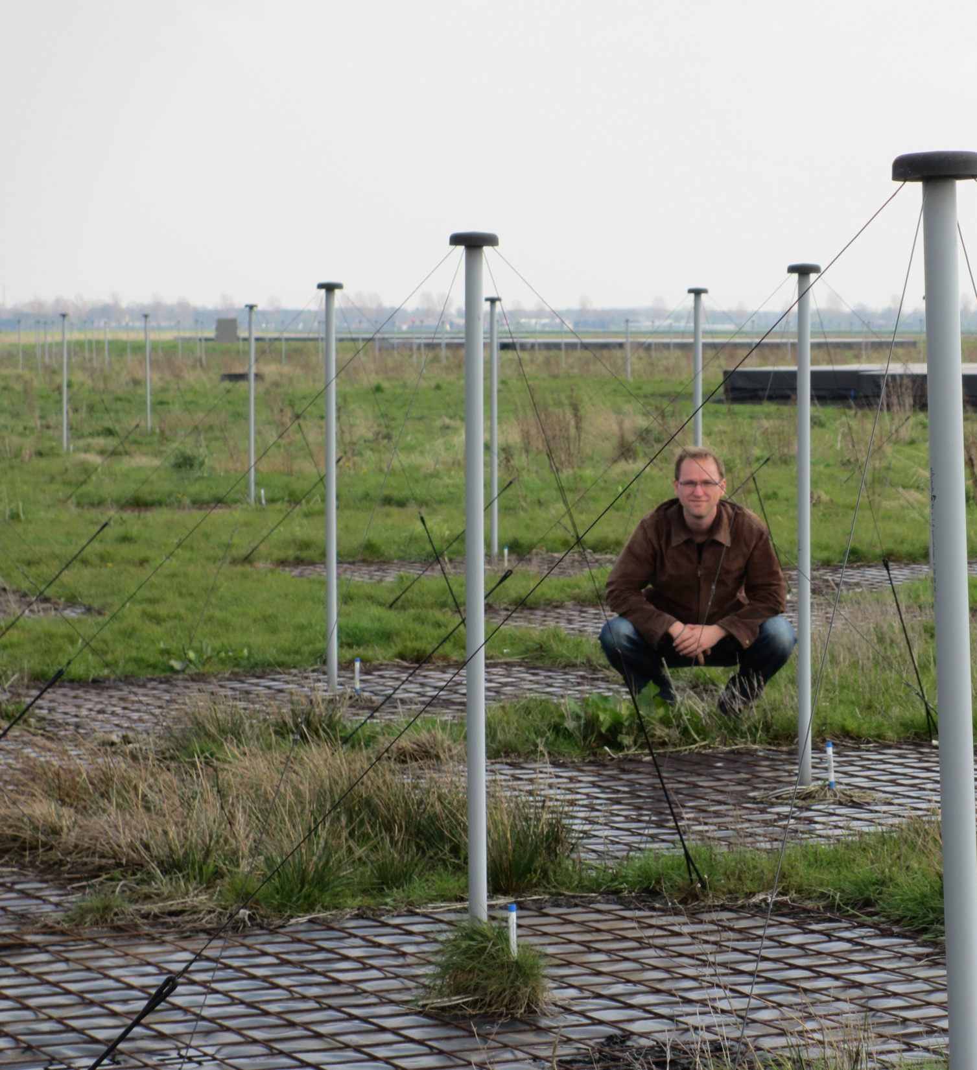
Very low flux at the highest energies
To detect this flux we need a very large detection volume
Signal with long attenuation length
Cost efficient detector
Radio
5

Slide 7

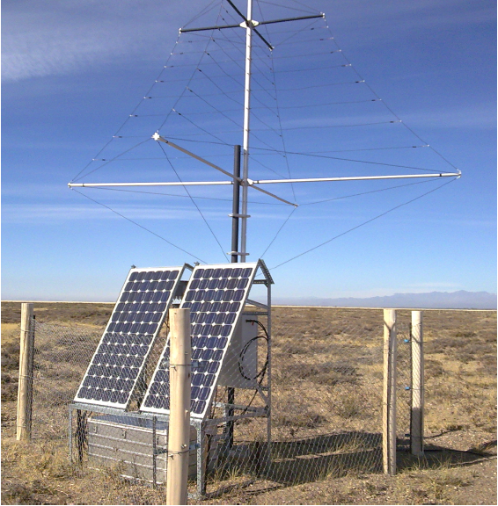

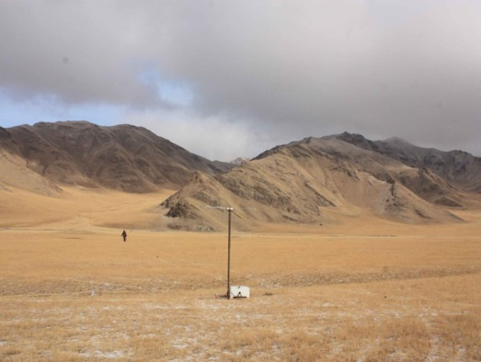


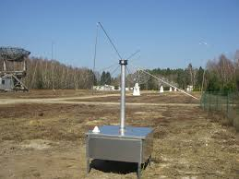
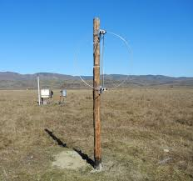
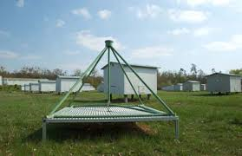

Can we use the Radio detection technique to measure air showers? YES!!
TREND
LOPES
CODALEMA
6

Slide 8
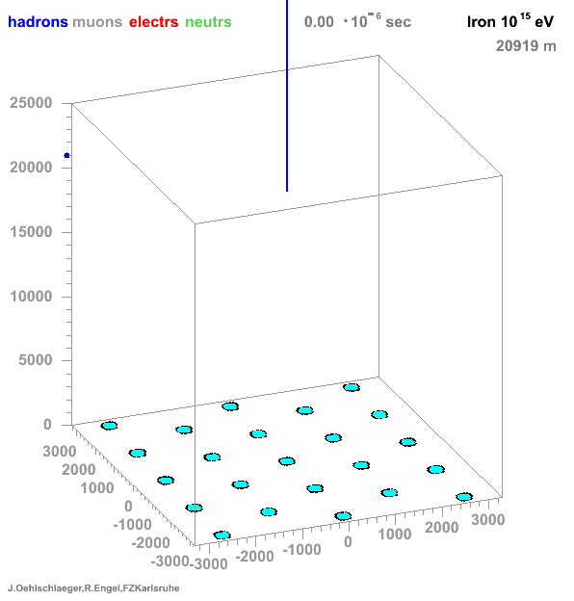
Why do we see radio emission?
Coherence over dimensions of the cascade
J. Oehlschläger and
R. Engel: http://www-ik.fzk.de/corsika/movies/Movies.htm
7

Slide 9
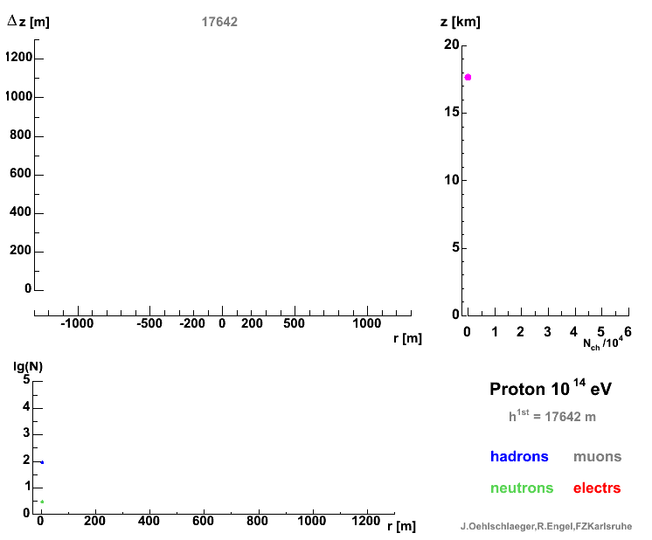
J. Oehlschläger and
R. Engel: http://www-ik.fzk.de/corsika/movies/Movies.htm
8

Slide 10
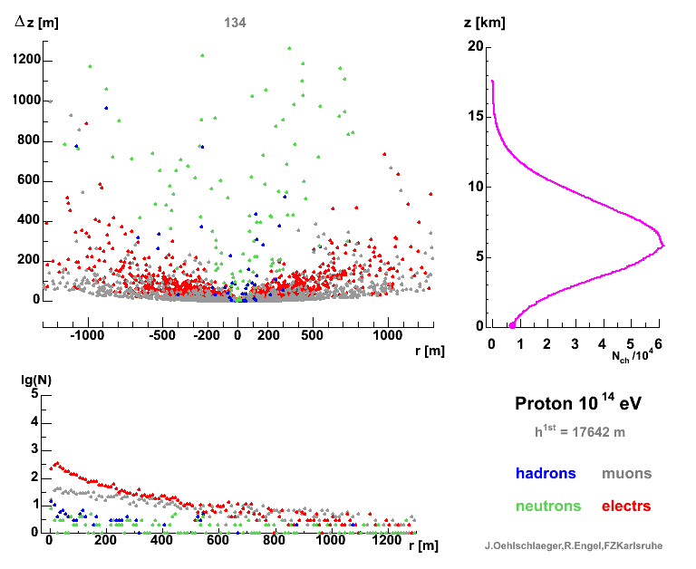
J. Oehlschläger and
R. Engel: http://www-ik.fzk.de/corsika/movies/Movies.htm
9
Notes:
10

Slide 11
Radio emission mechanisms:
Geomagnetic radiation
e⁺e⁻ pairs are deflected in Earth’s magnetic field due to the Lorentz force.
Net macroscopic current in the direction of the Lorentz force.
J
B
^
z
^
y
^
x
observer
10

Slide 12
Radio emission mechanisms:
Charge-excess emission
Several processes give rise to a net negative charge of the shower front (Askaryan):
1. Compton scattering
2. Knock out by shower particles
This leads to a net negative current in the direction of movement of the shower.
^
z
^
y
^
x
observer
11

Slide 13
Modelling: The Liénard-Wiechert potentials
D can become zero for index of refraction deviating from unity!
12

Slide 14
Retarded distance D(1)
4 km
Observer
100 m
13

Slide 15
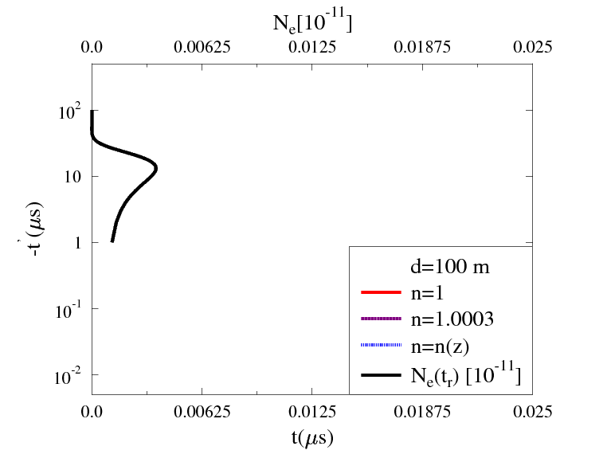
Retarded distance D(2)
t': emission time
t: observer time
14
Notes:
z=-ct’ Assen aanpassen

Slide 16
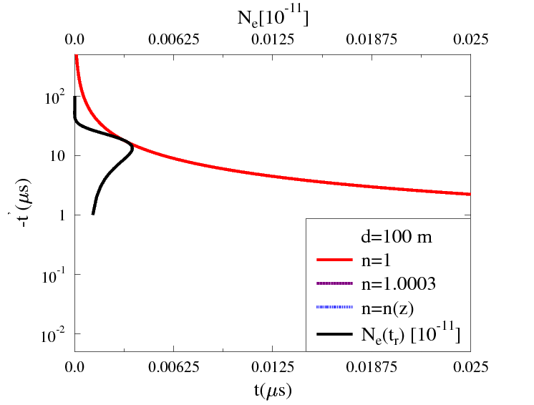
Retarded distance D(2)
t': emission time
t: observer time
14

Slide 17
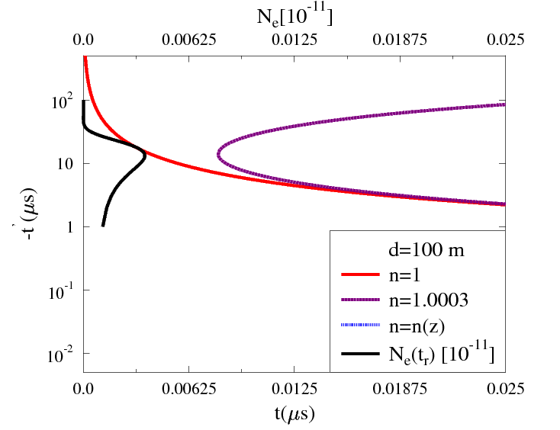
Retarded distance D(2)
t': emission time
t: observer time
14

Slide 18
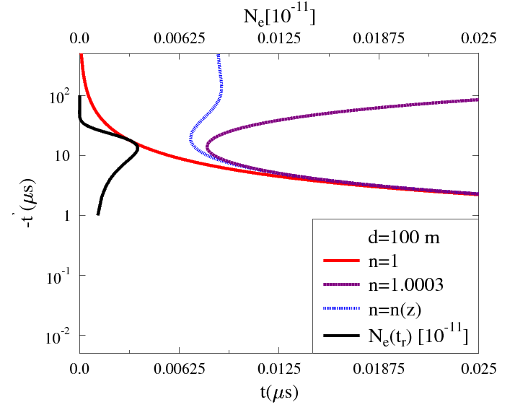
Retarded distance D(2)
t': emission time
t: observer time
14

Slide 19
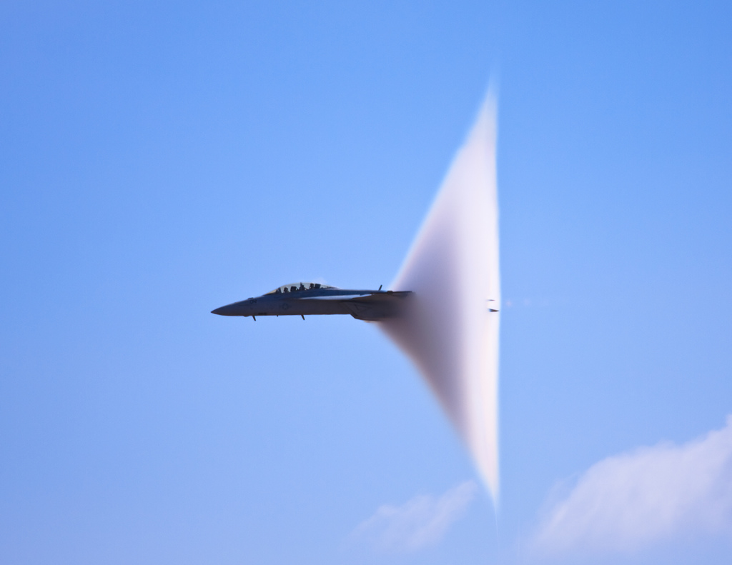
Retarded distance D(2)
N_{e}·10⁻¹¹
t': emission time
t: observer time
-t’(μs)
t(μs)
14

Slide 20
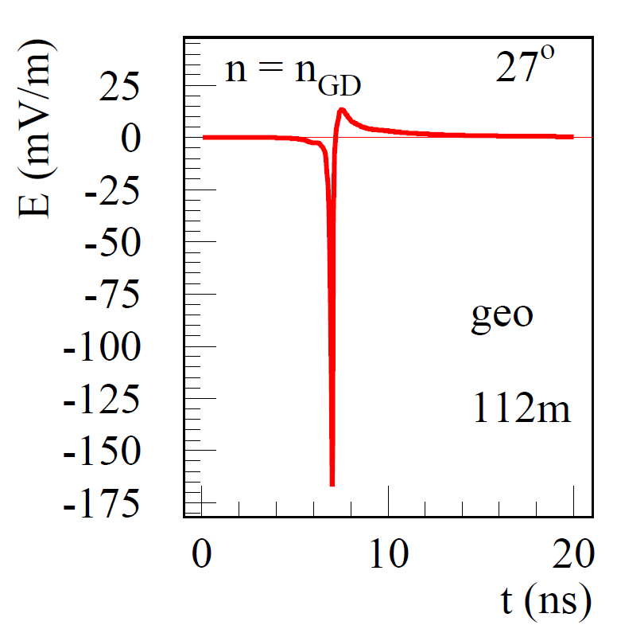
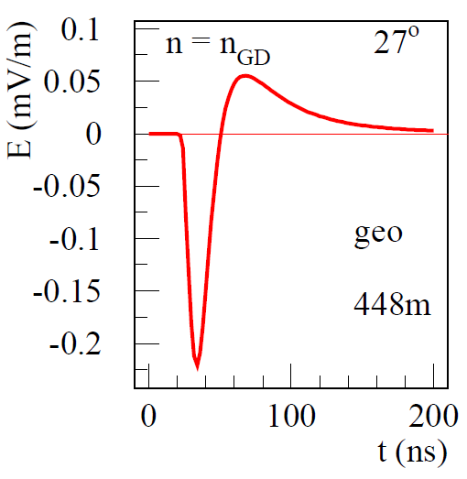
General pulse shape
Far from the Cherenkov distance:
Cherenkov distance:
Sharp edge of shower front
Shower profile pre shower max
Particle max
Shower max
15

Slide 21
Data vs Simulation
Can we observe Cherenkov effects in radio emission from air showers?
Can we observe and distinguish the different emission mechanisms:
Geomagnetic emission
Charge-excess emission
16

Slide 22
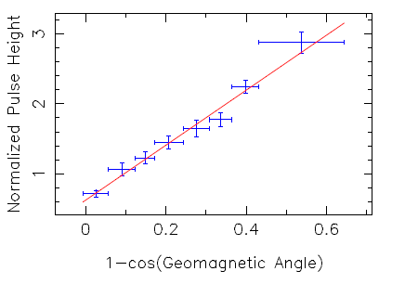
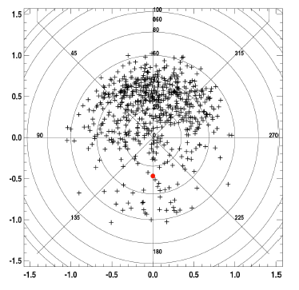
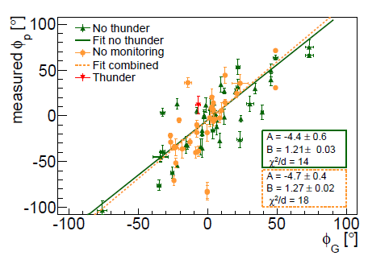
Example: The emission mechanisms
Geomagnetic emission
Well established!!
Tim Huege, LOPES, http://arxiv.org/pdf/
1009.0345
B. Revenu CODALEMA, http://arxiv.org/abs/0906.2832
H. Schoorlemmer, Pierre Auger Collaboration, Nucl.Instrum.Meth. A662 (2012) S134-S137
17

Slide 23
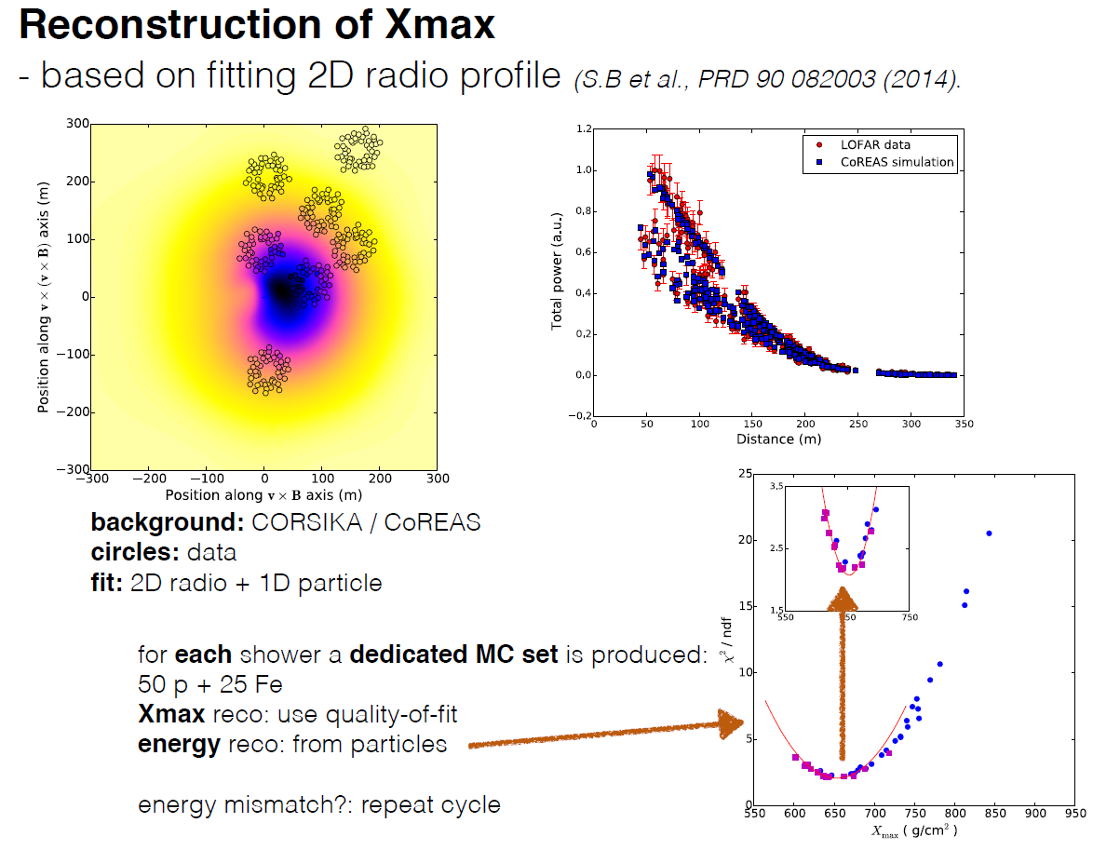
Results
Cherenkov effects + Emission mechanisms
Slide from Stijn Buitink @ ARENA 2016 conference
S.B. et al, Nature 531, 70 (2016)
18

Slide 24
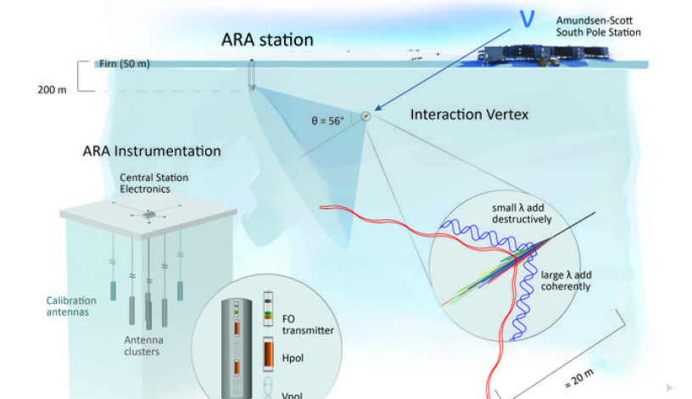
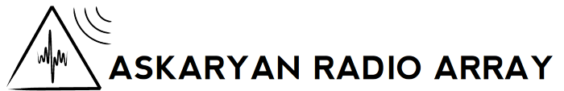
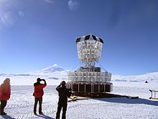
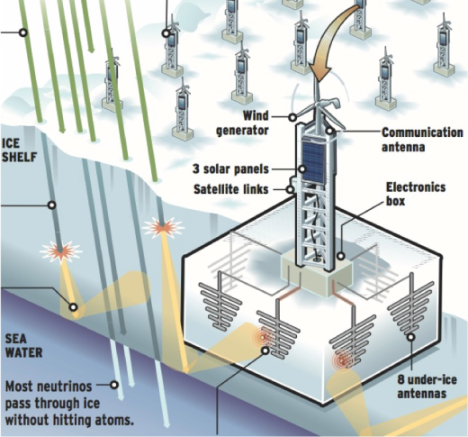
From air to ice/rock
High-energy neutrino detection
(GZK neutrino flux)
GRAND
ANITA
Pierre Auger
ARIANNA
19
Notes:
Antwoord op vragen vorige slide

Slide 25
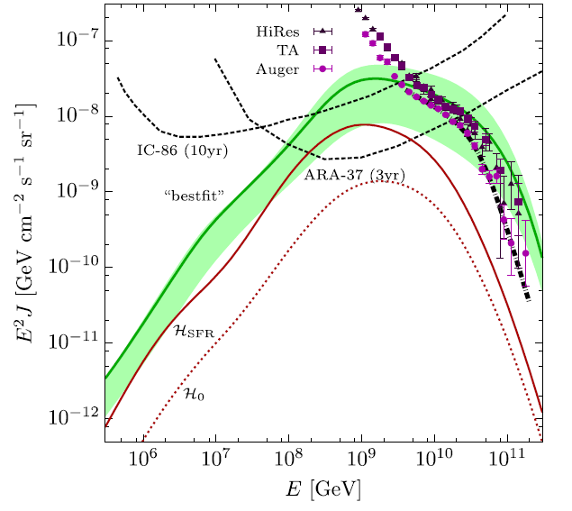
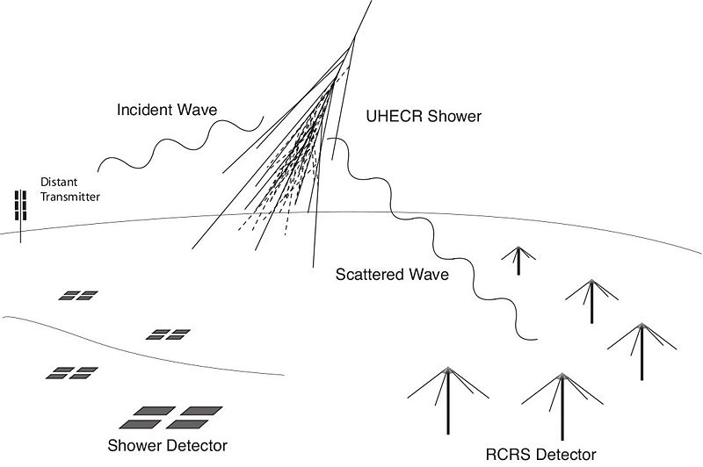
Radar detection
IceCube sensitive below several PeV
Sensitivity Gap in PeV – EeV region
M. Abou Bakr Othman et al,
Proceedings 32nd ICRC, Beijing 2011
Radar?
Askaryan Radio detectors become sensitive close to the EeV region
K.D. de Vries, Kael Hanson, Thomas Meures, Aongus O’Murchadha
Astropart.Phys.60:25-31,2015; arXiv:1312.4331
20

Slide 26
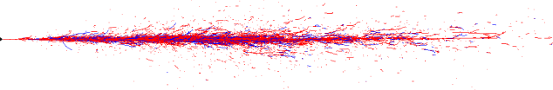
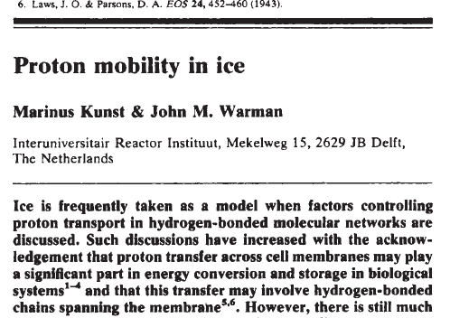
Radar scattering of a neutrino induced plasma
Leftover electrons from ionization:
Extension: O(30 cm)
Lifetime: O(1-20 ns)
Shower front electrons:
Extension: R_{L} = O(10 cm)
Lifetime: O(100ns)
Moving!
I
I
I
I
I
I
I
I
I
I
I
I
I
e⁻
I
I
I
I
I
I
e⁻
I
I
I
I
I
I
e⁻
I
I
I
I
I
I
e⁻
I
I
e⁻
e⁻
I
e⁻
Leftover protons from ionization:
Wide extension: O(5m)
Lifetime: O(10-1000 ns)
Ionization numbers come from Physical Chemistry research!
Figure from arXiv:1210.5140v2
21

Slide 27
RADAR scattering
Over-dense scattering:
Under-dense scattering:
Radar frequency < Plasma Frequency
Reflection from the surface of the plasma tube
Radar frequency > Plasma Frequency
Scattering off of the individual charges in the plasma
22

Slide 28
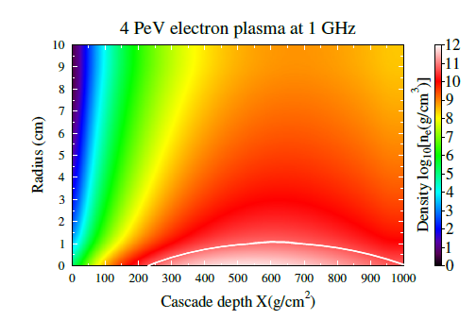
Modeling the radar scatter
23

Slide 29

Bi-static RADAR configuration
Effective area of receiver: A_{eff}
Transmitted power: P_{t}
Transmission over ¼ of a sphere: 1/(πR²)
Re-scattering over a sphere: 1/(4πR²)
Plasma scattering surface: σ_{eff}
Attenuation by the
medium
24

Slide 30
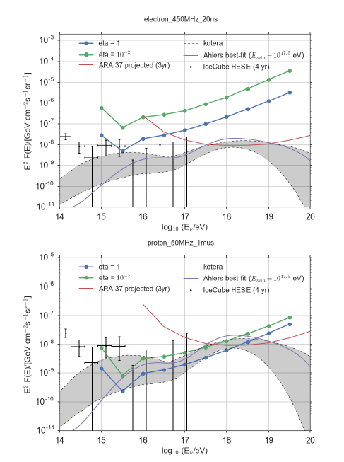
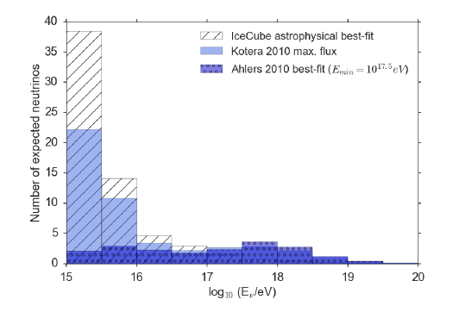
Sensitivity (Preliminary)
Multiple events expected in the PeV-EeV region
Credits: S. Toscano
25

Slide 31
Questions?

Slide 32
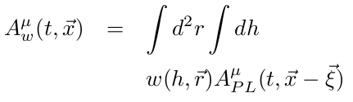
Resolve the divergences:
Finite dimensions of the shower front
Link emission time t' to observer time t:
Integrate over the particle distributions to obtain the full vector potential at the observer time t:
15

Slide 33
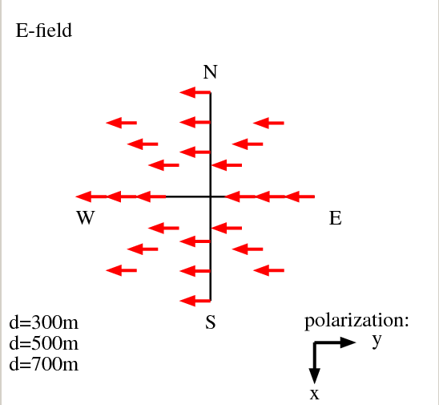
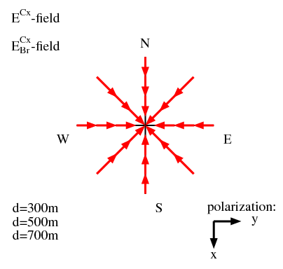
Results: The emission mechanisms
The polarization of the radio emission
Leading: Geomagnetic
Sub Leading: Charge Excess
Geomagnetic:
Charge excess (Askaryan):
K.D. de Vries, O. Scholten, K. Werner: Proceedings of the 31th ICRC (2009), Lodz, Poland.
18
Notes:
33
Simple explanation, field of a single charge/current. Interesting due to physics and dense media

Slide 34
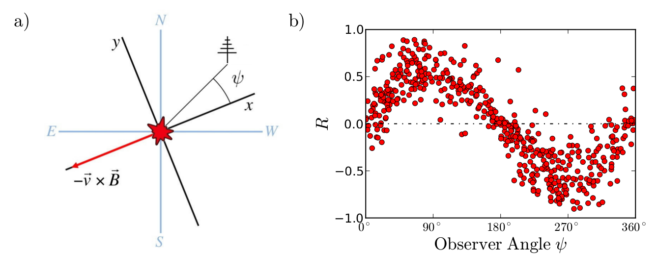
Results: The emission mechanisms
Charge-excess emission
Figure from E.D. Fraenkel
20

Slide 35
Results
Charge-excess emission
Data
EVA (n=1)
E.D. Fraenkel. Data from MAXIMA Setup @ Pierre Auger.
21

Slide 36
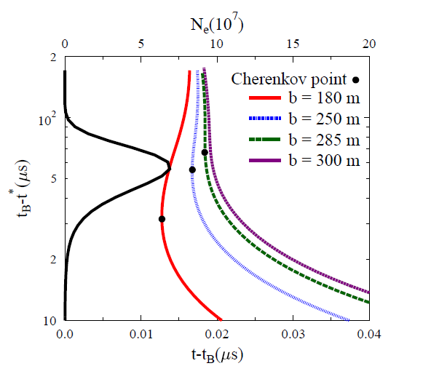
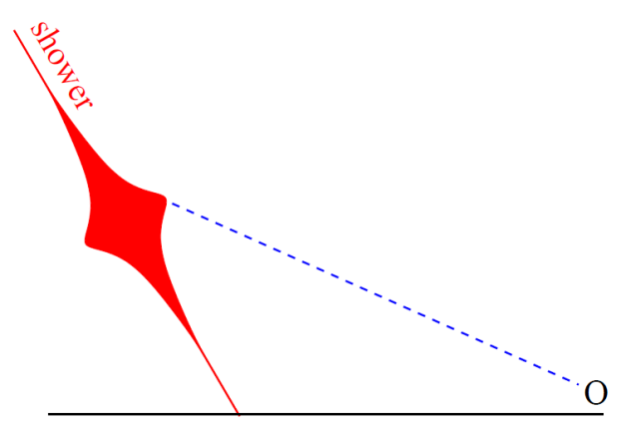
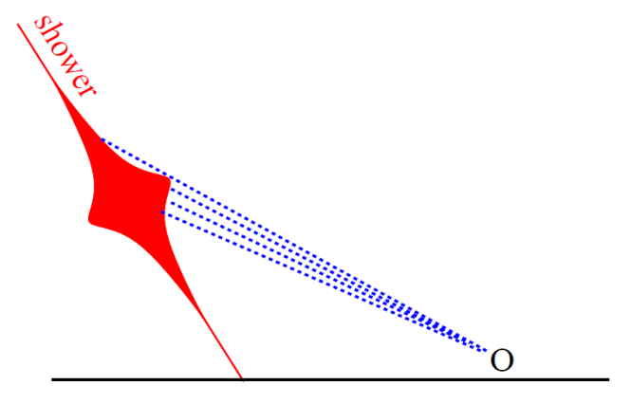
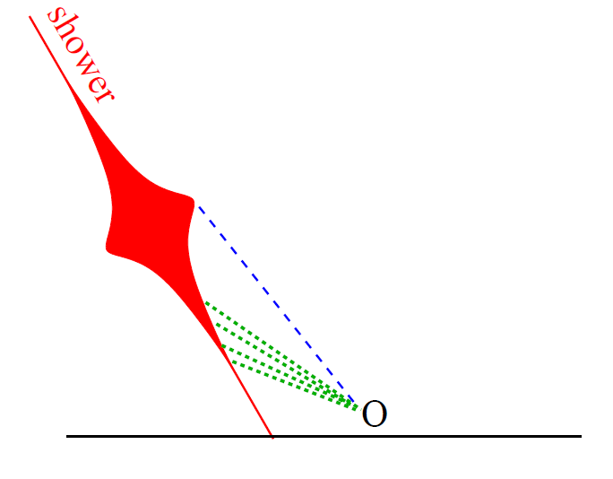
Cherenkov effects: Probing the shower profile
K.D. de Vries et al., PhysRevLett. 107, 061101 (2011) ; K. Werner et al., Astroparticle Physics 37 (2012) 5-16
22

Slide 37
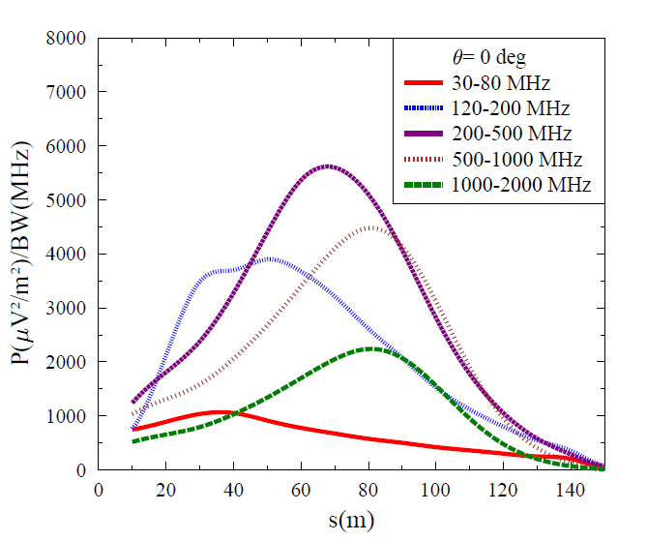
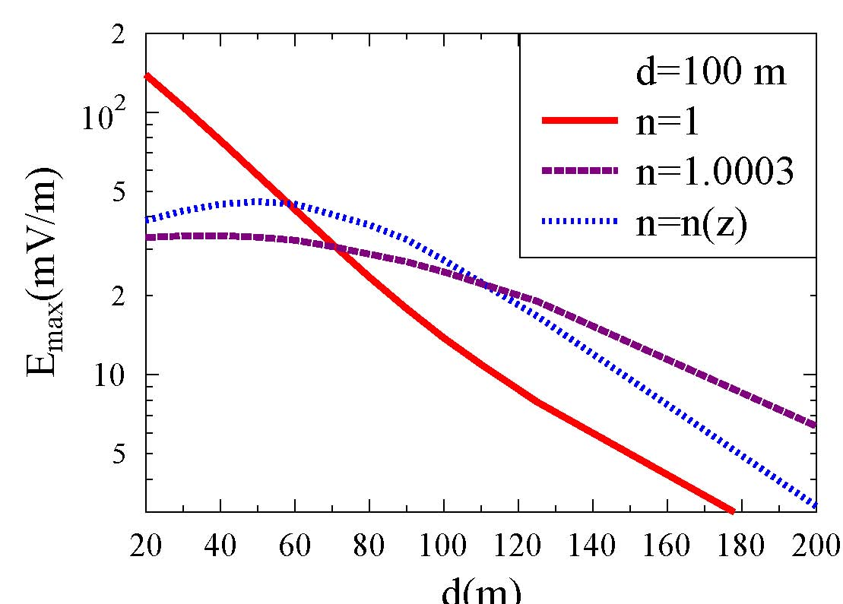
Results: Cherenkov effects the LDF
Cherenkov ring clearly visible, becomes sharper at high frequencies!
Link position d_max to emission height by:
23

Slide 38
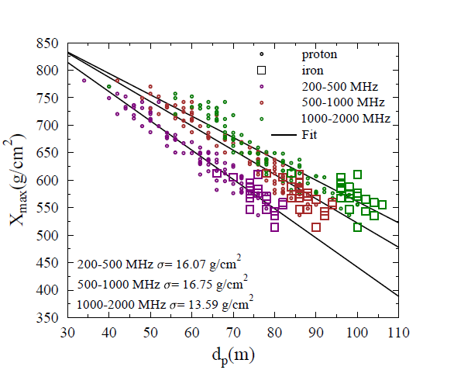
Results: Cherenkov effects determining X_max
24

Slide 39
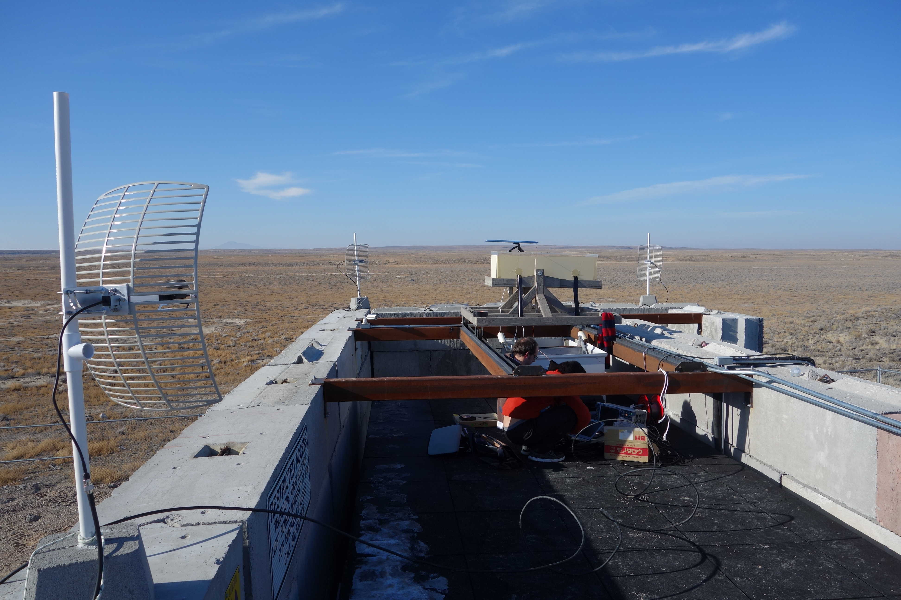
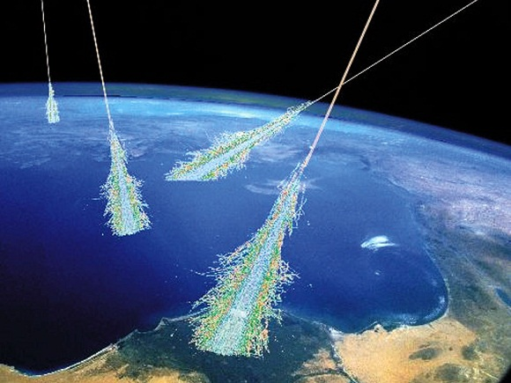
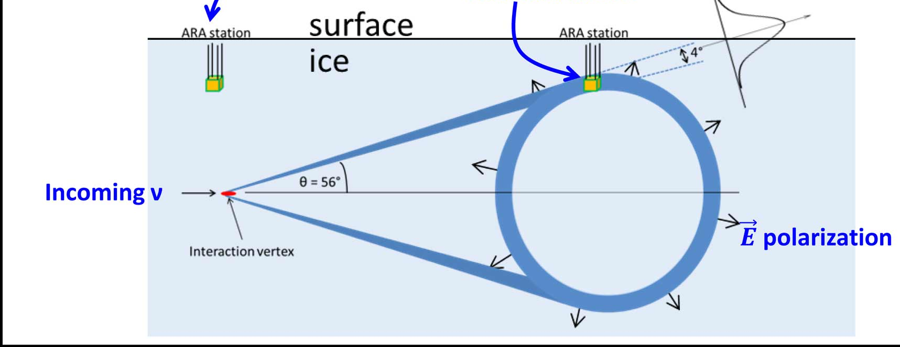
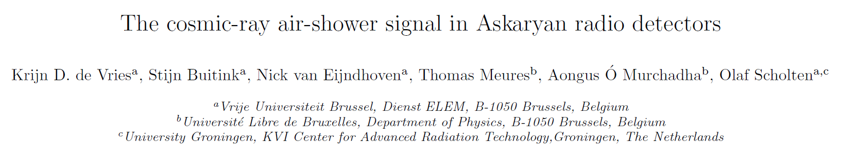
From air to ice:
Transition radiation and sudden appearance
Ice
27
Astropart.Phys. 74 (2016) 96-104

Slide 40


The cosmic ray air shower signal in Askaryan radio detectors
Sudden appearance signal very similar to transition radiation!!
Cosmic-ray air shower signal very similar to neutrino induced signal.
1) Possible background for
Askaryan radio detectors
2) In combination with surface
detectors, the signal becomes a very interesting calibration signal.
3) Observed signal would show on-site feasibility of the detection method!!
21
28

Slide 41

The air shower signal vs the neutrino induced cascade
Air Shower
Neutrino induced cascade
100 m
250 m
Observer
29

Slide 42


Beam “sudden appearance” signal in radio beam test experiments
Tokonatsu Yamamoto, Izumi S. Ohota (Konan U)
Krijn de Vries (Vrije Universiteit Brussel)
Kael Hanson, Thomas Meures (UW-Madison), Aongus O' Murchadha (ULB)
Daisuke Ikeda, Masaki Fukushima, Hiroyuki Sagawa, (ICRR)
Romain Gaior, Keiichi Mase, Shigeru Yoshida, Aya Ishihara, Matthew Relich, Takao Kuwabara, Shunsuke Ueyama (U of Chiba)
Gordon Thomson, John N. Matthews (U of Utah)
Shouich Ogio (OCU), Shin Bakkyun (Hanyang U), Tatsunobu Shibata (KEK)
30

Slide 43
Experimental setup
ice
Electron Beam
31

Slide 44


Beam characteristics
~10⁹ (40 MeV) electrons
~ 40 PeV
32

Slide 45

Sudden appearance energy density spectrum
Preliminary
33

Slide 46
The Cosmic-Ray air shower signal in Askaryan radio detectors
- The in-ice emission is due to the same
mechanism (Askaryan emission) as for a
neutrino induced cascade. The expected
signal is similar for CR and neutrino induced
cascades.
- In combination with surface detector the
detected signal might provide an excellent
(cross-) calibration.
- Emission mechanisms under investigation with
experimental results. Preliminary results show
good understanding.
34

Slide 47
Conclusions
Radio emission mechanisms very well understood!
Geomagnetic emission
Charge excess (Askaryan) emission
Geometry effects well understood!!
Cherenkov effects (crucial in air!!)
Transition radiation / sudden appearance radiation
- Detailed air shower physics possible:
Xmax determination -> Chemical composition
Thunderstorm detection (not treated)
The hunt for GZK neutrinos has started!!!
35

Slide 48

Radar scattering
Air
No scaling observed
We do see a strong signal, to be continued....
Accelerator background
16

Slide 49

Radar scattering
Ice
Scaling with input power
Accelerator background
17

Slide 50
Conclusions
- Modeling the RADAR scattering of
high-energy neutrino induced cascades
gives an energy threshold of several PeV.
- We performed a measurement to
determine the feasibility of this method.
- Obtained data hints toward a scattered
signal, analysis is ongoing.
18

Slide 51
Electric field:
Geomagnetic radiation
Make a partial integration such
that the derivatives acting on 1/|D|
act on the particle distributions.
16
Notes:
51
2 types Cherenkov radiation -> normal emission due to charged particles and cherenkov emission due to a moving current.

Slide 52

Results: Cherenkov effects
EVA Simulation for 60 degrees shower at the Auger site.
Geometry of ANITA event not known, so not 1 to 1 comparable!
31

Slide 53


LOFAR
6 x 48 antennas 40-70 MHz
A. Corstanje et al, arXiv:1109.5805v1 [astro-ph.HE] (ICRC)
K.D. de Vries et al., PhysRevLett. 107, 061101 (2011)

Slide 54

The Pierre Auger Observatory
3000 km²
1660 water Cherenkov tanks
4 Fluorescence detectors
Muon detectors
Radio detection stations
10

Slide 55

The Pierre Auger Observatory
11

Slide 56

The Pierre Auger Observatory:
Air shower detection
Fluorescence detection (FD): Measure electronic component due to excited nitrogen atoms
Surface detector (SD):
Measure muonic component through Cherenkov light of high energetic muons hitting the water tanks.
12

Slide 57

The Pierre Auger Observatory:
Latest results
The cosmic-ray spectrum, GZK effect??:
13

Slide 58

The Pierre Auger Observatory:
Latest results
The Chemical composition:
Xmax: Proton penetrates deeper compared to iron.
<Xmax>: More statistical fluctuations for protons compared to iron.
14

Slide 59

The Pierre Auger Observatory:
Latest results
The Chemical composition:
15

Slide 60

The Pierre Auger Observatory:
Latest results
The Chemical composition:
16

Slide 61

The Pierre Auger Observatory:
Latest results
New Physics at the highest energies?
P. Abrue et al
(Pierre Auger Collaboration)
Phys. Rev. Lett. 109, 062002 (2012)
17

Slide 62

Acceleration mechanisms
4

Slide 63
Cosmic Ray propagation
Deflection in galactic and intergalactic magnetic fields
Particle production:
GZK effect
Photodesintegration
3

Slide 64
Transport:
Magnetic Field containment
3D trajectories projected on X-Y plane
Inter- Galactic
B≤ 1-10 nG
50
B=10⁻⁹ gauss
B dir random
Y(Mpc)
1 EeV
3 EeV
From: J. Cronin, 2004
-50
10 EeV
100 EeV
-100
X(Mpc)
100
4

Slide 65

The GZK cut-off
Energetic protons loose energy through
Interactions with the cosmic microwave
background
UHE protons loose energy
Production of energetic neutrino’s
E> 6x10¹⁹ eV
CMB
Based on Lorentz Invariance,
What if …?
Greisen – Zatsepin - K’uzmin (GZK)
5

Slide 66


The GZK cut-off, but also…..
CMB photon
Photodisintegration at similar energies, so we need to know the composition
6

Slide 67

Active Galactic Nuclei (AGN)
supermassive
supermassive
black hole
black hole
10⁸ M_{sun}
Extremely high B-fields
> EeV particles?
8

Slide 68
The cosmic-ray spectrum:
Ankle, onset of the extragalactic component?
Knee, galactic to extragalactic?
GZK cut-off?
2
7

