Slide 1
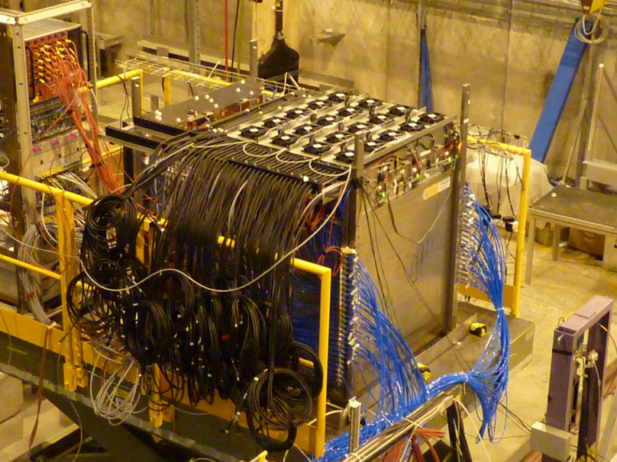
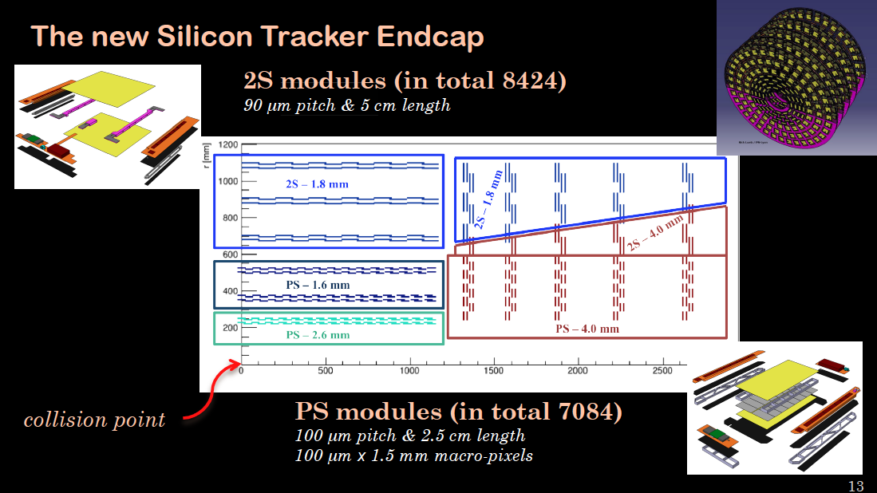
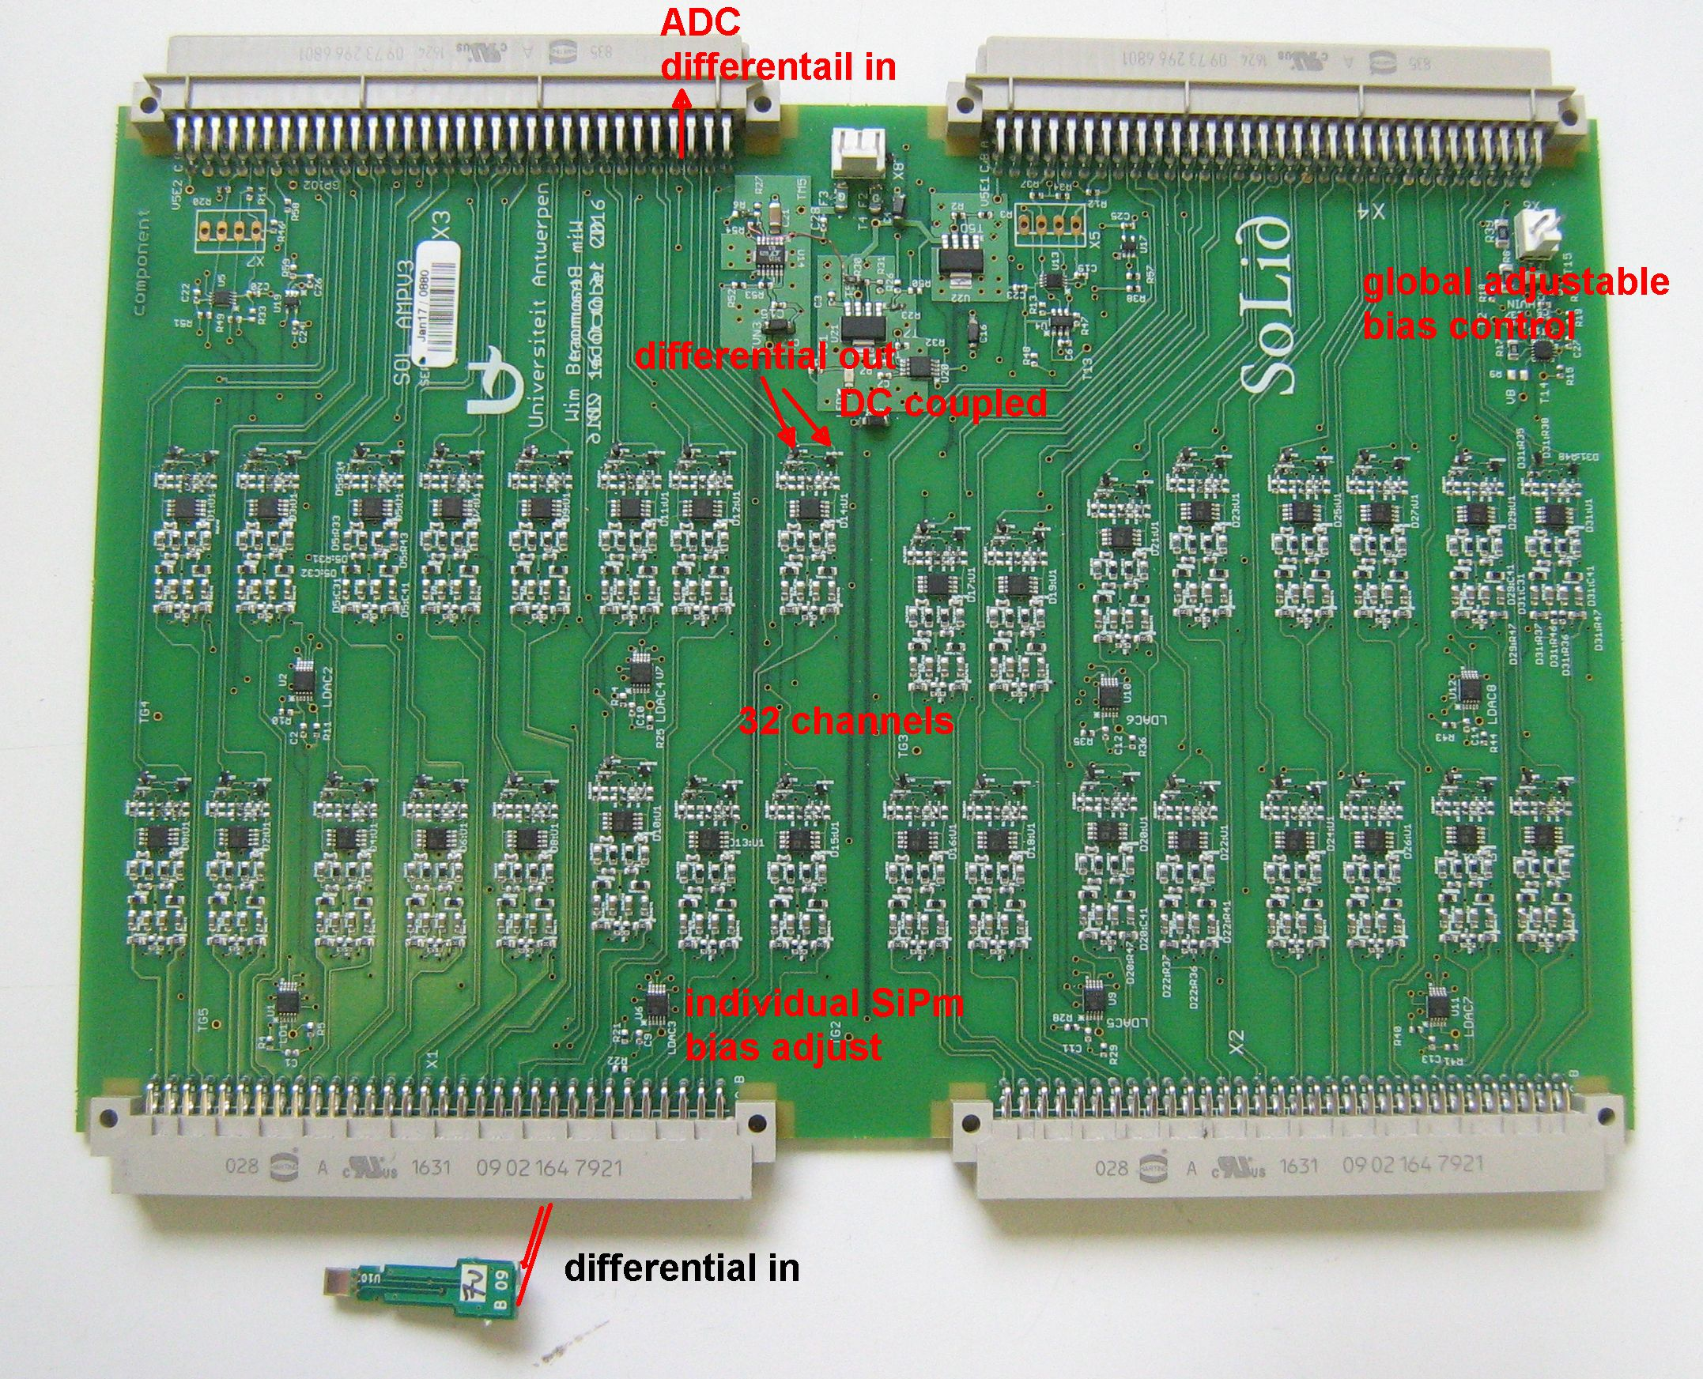
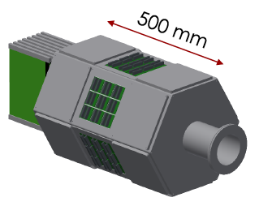
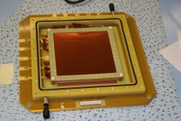
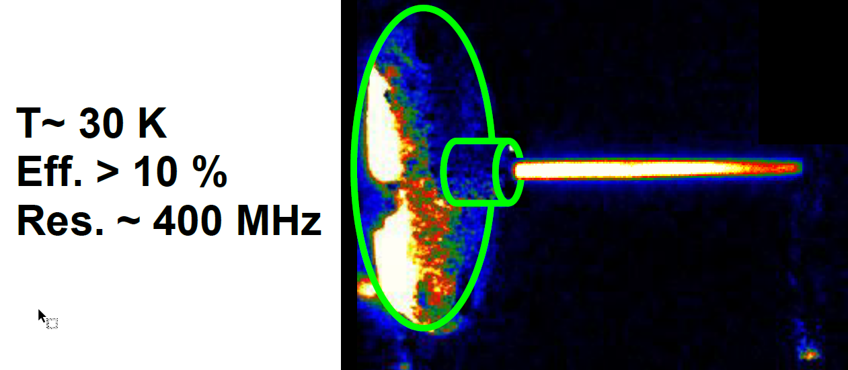
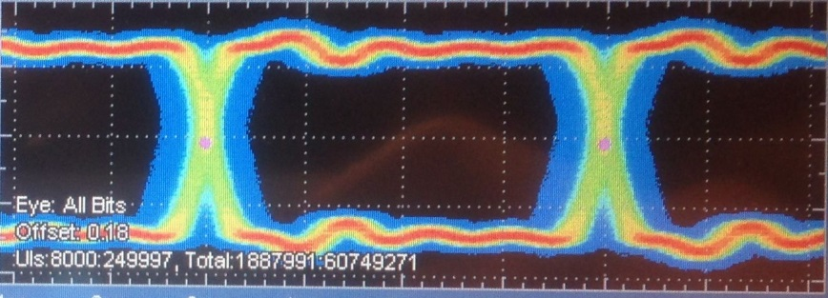
R&D activities in Belgium
G. De Lentdecker (ULB)

Slide 2
Outline
4 main axes
  Nuclear physics
    SpecMAT, In-gas jet laser ionization spectroscopy, MEDICIS, n2EDM
  High energy physics at collider
    CMS Tracker upgrade, CMS Forward Muon upgrade, gRPC, SDHCAL, Muography, TRAPPISTe, AIDA2020, precision control of large instruments
  High energy astroparticle
    ICECube-GEN2, Radar detection
  Electronics & Data Acquisition (DAQ)
    FPGA and xTCA based DAQ and embedded system
    JUNO electronics
    SOLID electronics

Slide 3

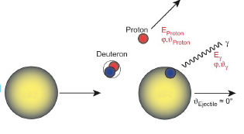
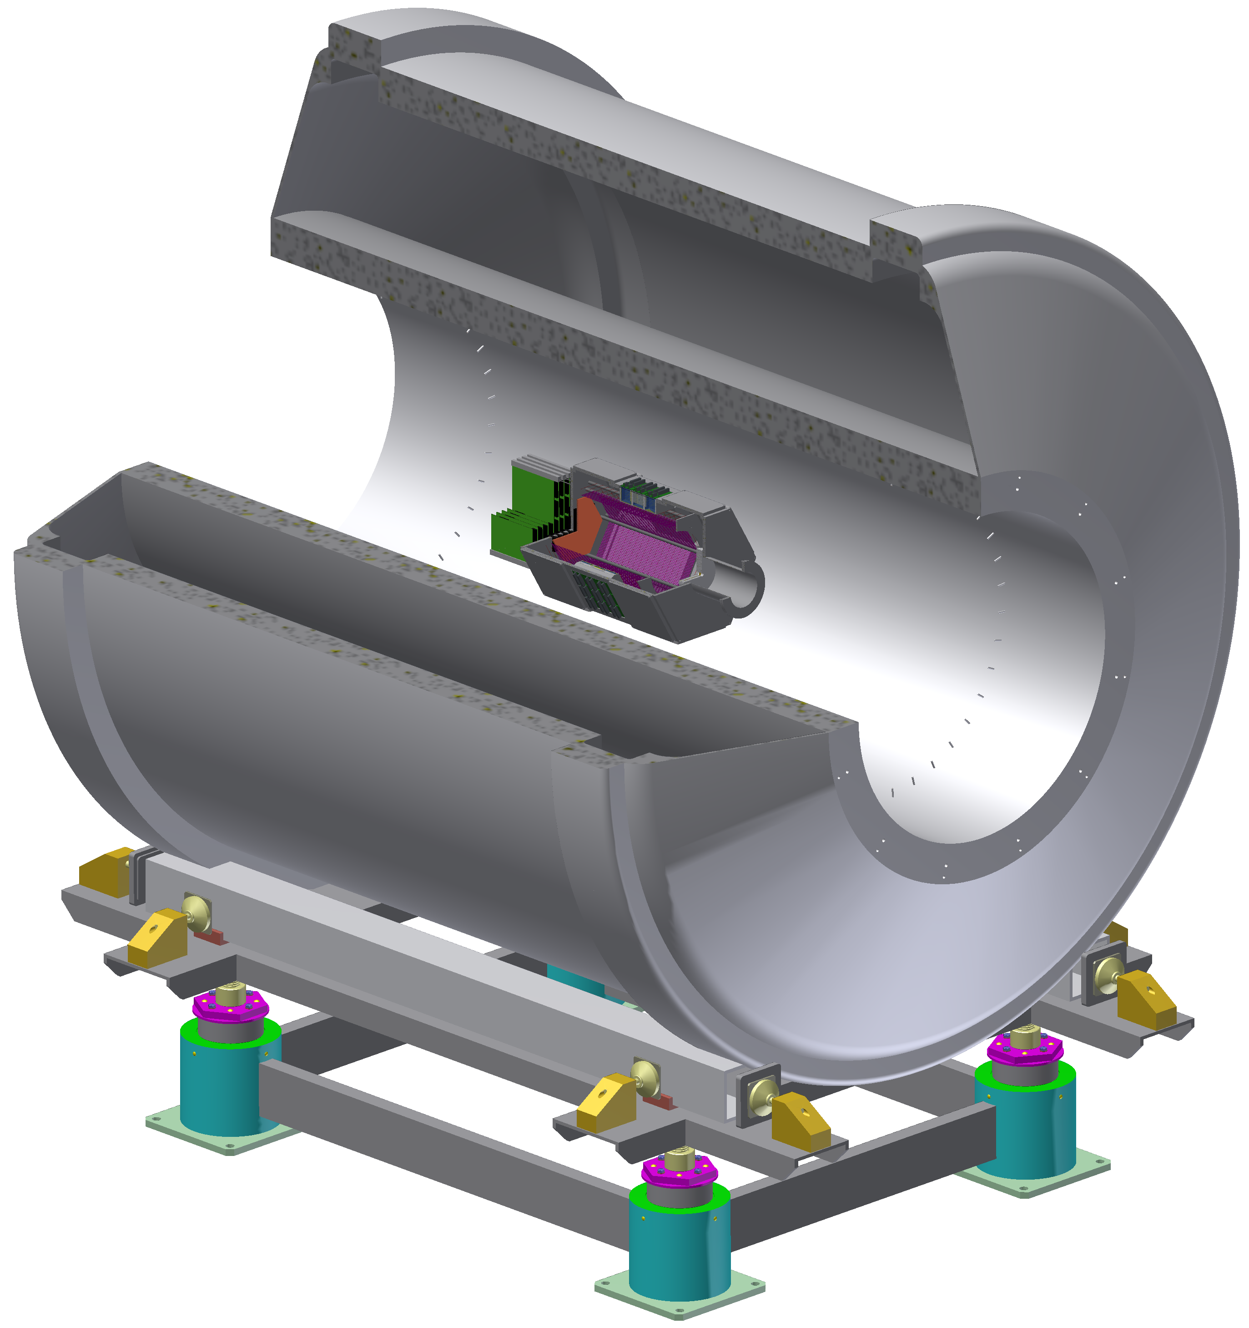

Nuclear Spectroscopy: SPECMAT
proton
SpecMAT
  Goal: Spectroscopy of rare nuclei far from stability using nucleon-transfer reactions
  Detector placed in the ISOL Solenoidal Spectrometer at HIE-ISOLDE
Development of an “active target” with 𝛾-ray detection in a strong magnetic field
  TPC surrounded by a 𝛾-ray detection array
  the detection gas is the target
  high luminosity and efficiency
𝛾-ray detection in magnetic field
  CeBr3 scintillators for good resolution (better than 4%) and efficiency
  SiPM for use in magnetic field
deuteron
photon
Heavy nuclei
ISS –ISOLDE
Solenoidal Spectrometer (4T)

Slide 4
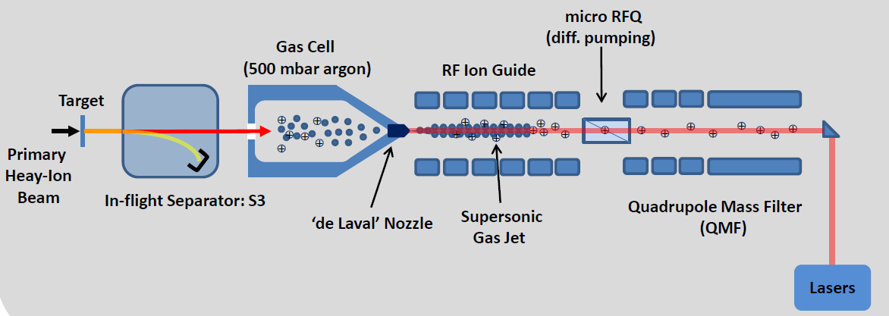
In-gas jet laser ionization spectroscopy
A new technique to allow for medium resolution (~300 MHz) laser spectroscopy experiments on neutron-deficient isotopes, including heavy elements region
To be coupled with the new Heavy Ion Accelerator of SPIRAL2 at GANIL (France)
KU Leuven has proposed this new concept
  Applied for the first time at Leuven Isotope Separator On-Line (LISOL) and coupled to the UCL Cyclotron
  Concept fully characterized and optimized at the new off-line laser and mass separator laboratory at KU Leuven
Quasi-collisional free
T ~ 30 K

Slide 5
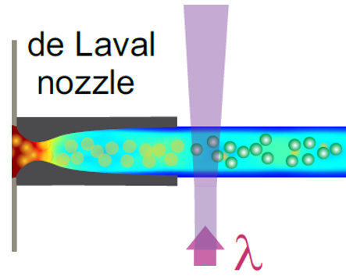
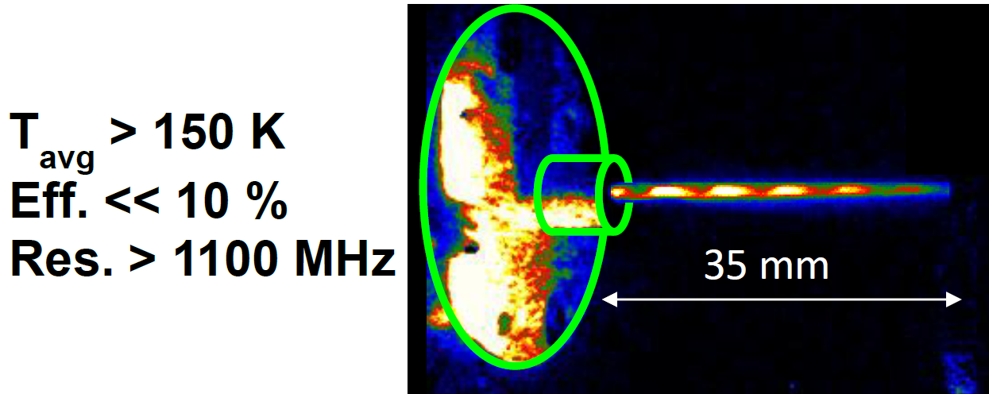
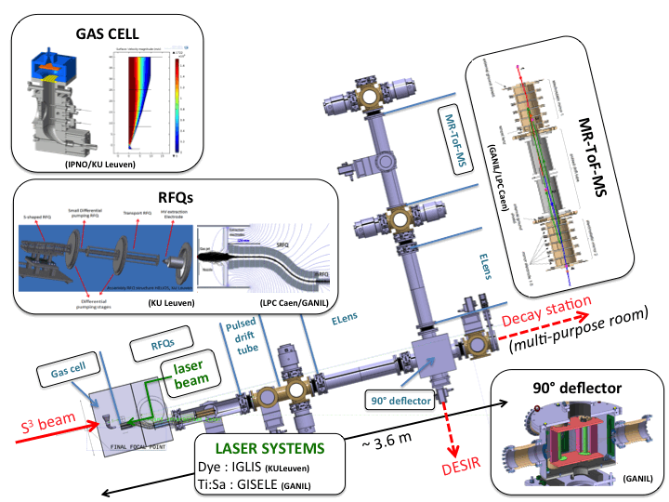
In-gas jet laser ionization spectroscopy
Visualization and validation at the KU Leuven laser laboratory
Based on this experience the Super Spectrometer Separator (S3) Low-Energy Branch project (S3-LEB) was designed:
Concept also implemented in
  Jyvaskyla (Finland)
  GSI/FAIR (Germany)
  RIKEN (Japan)
  Dubna (Russia)
Ar gas +
Cu atoms

Slide 6
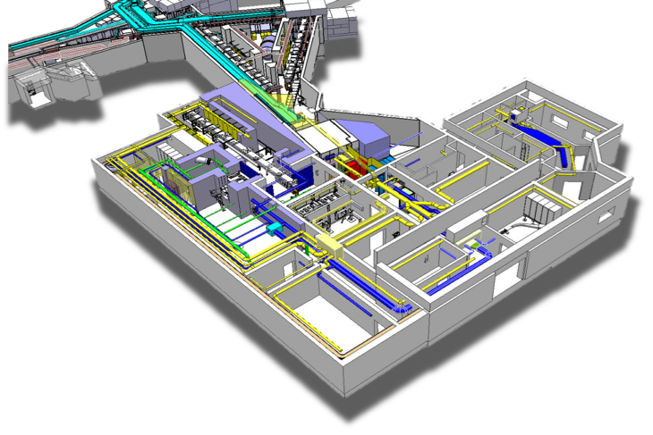
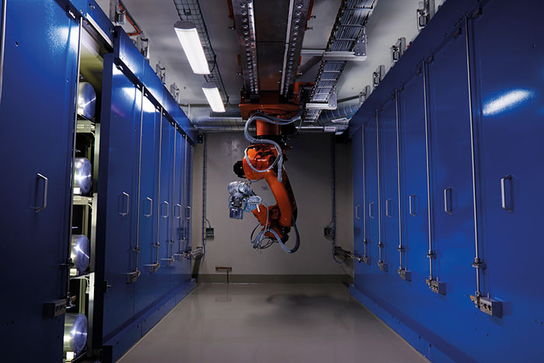
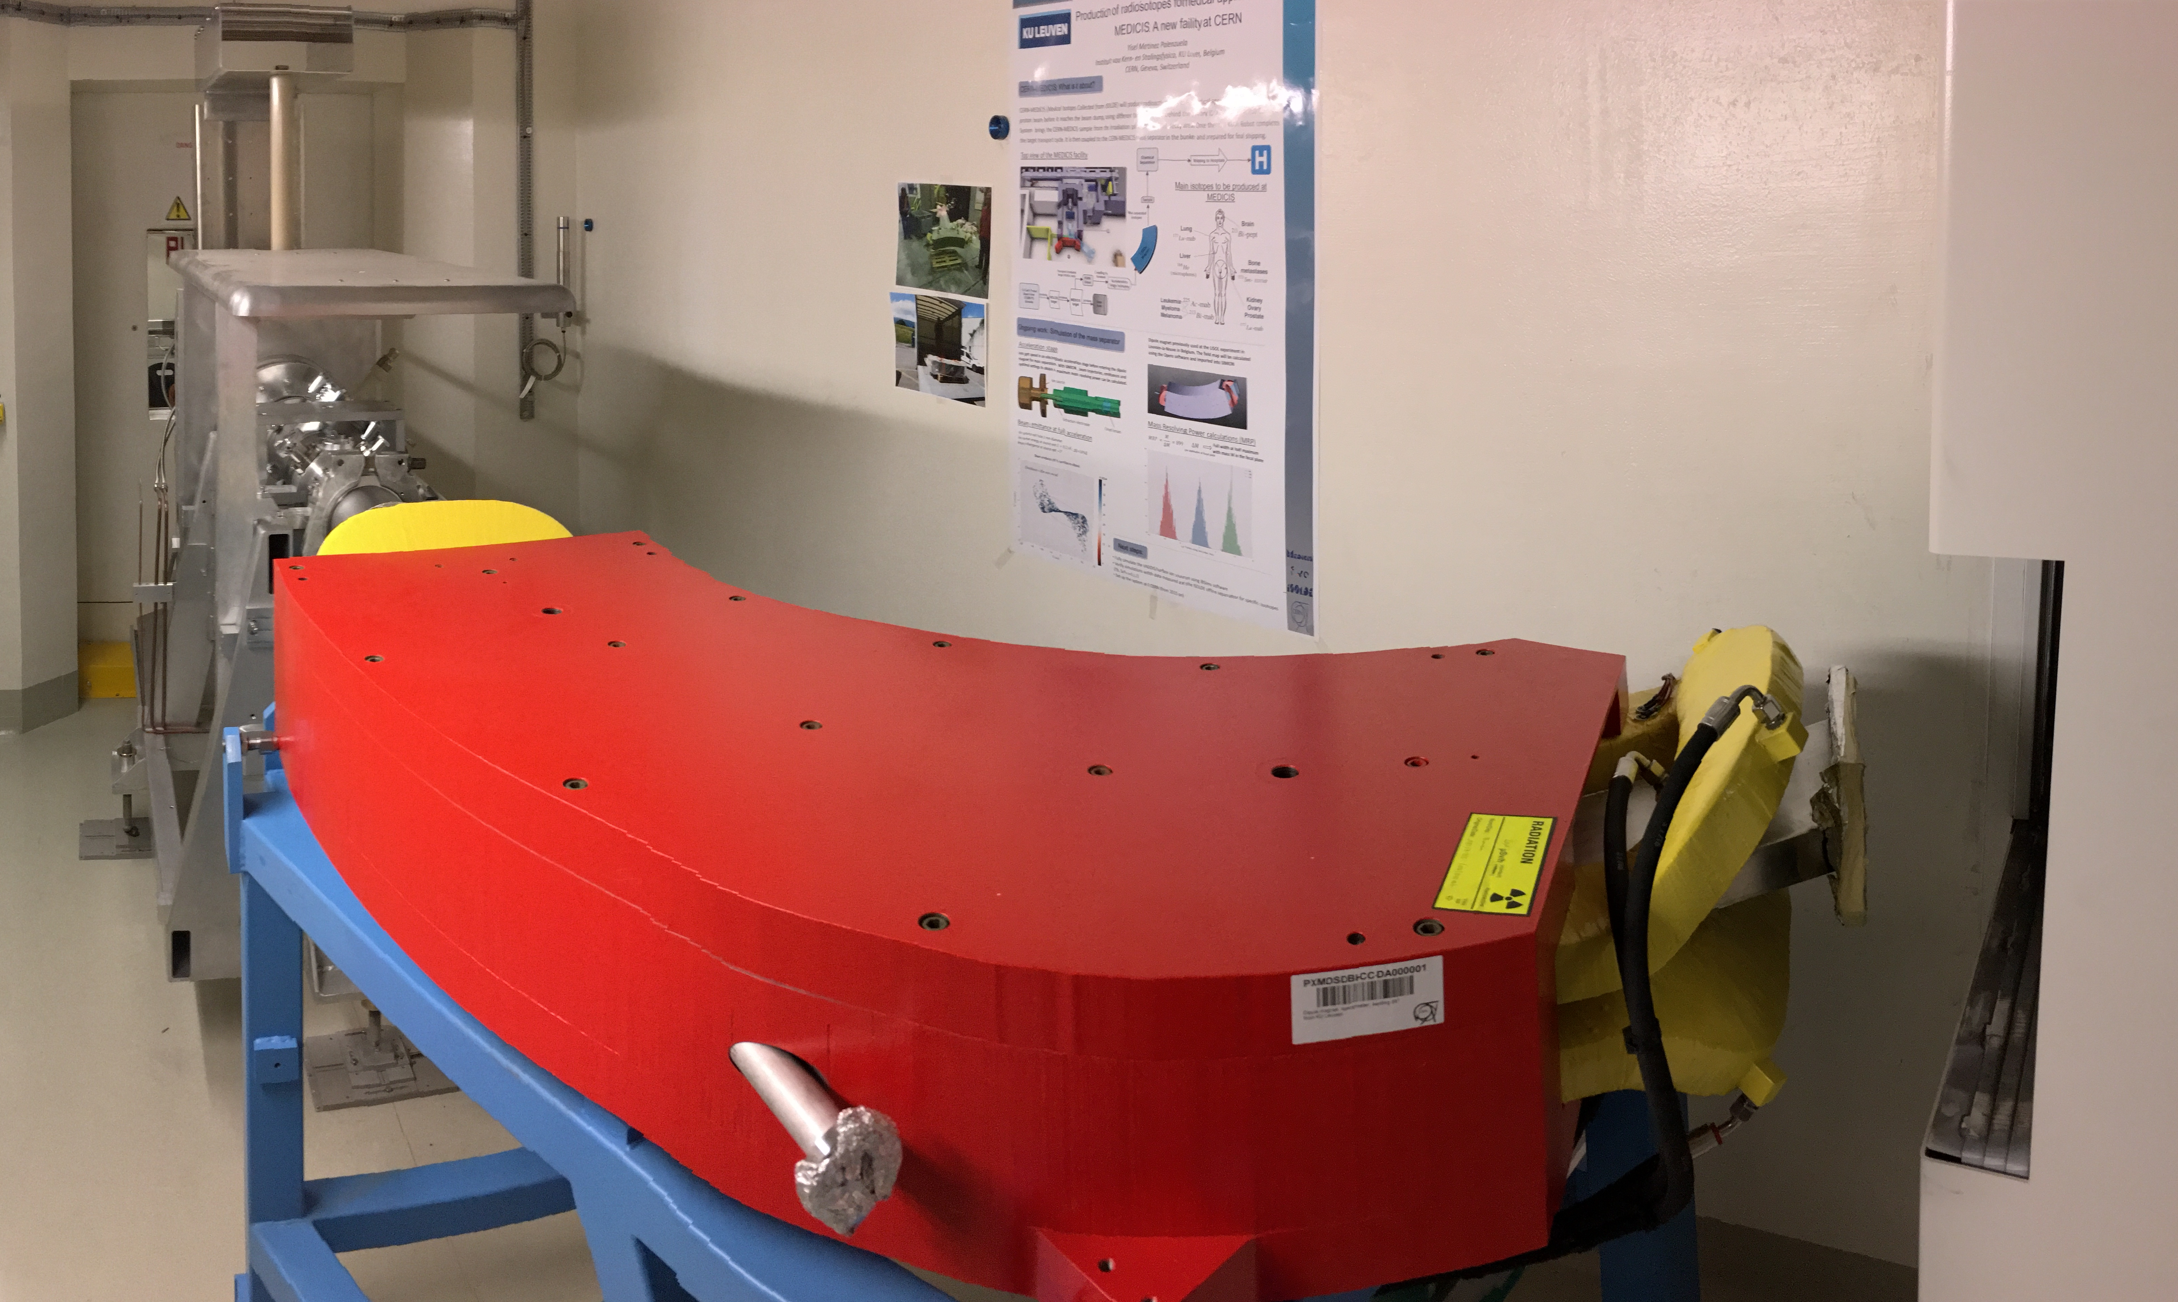

CERN MEDICIS
MEDical Isotopes Collected from Isolde
“Free” radioisotopes for medical research in partnership with HUG (Geneva), CHUV (Lausanne), but also UZ Leuven, UZ Brussel, and UZ Gent
New infrastructure: building, target storage, hot cell, front end, experimental hall
Dipole magnet from KU Leuven (LISOL)
Research in radioisotope production
First isotopes: summer 2017

Slide 7
CERN MEDICIS
Ion source developments:
  VADIS (Versatile Arc Discharge Ion Source)
    To improve the efficiency and the selectivity of the ion source
  RILIS (Resonant Ionisation Laser Ion Source)
    New ionisation schemes for lanthanites and actinides
    Optimising efficiency against purity
Study of Nuclear reaction cross sections
  Developing the protocols for the production of terbium and actinium isotopes
  Developing a new approach for the production of ¹¹C a PET isotope to be used in hadron therapy

Slide 8
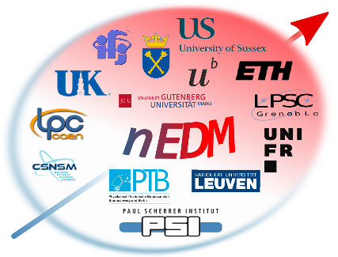
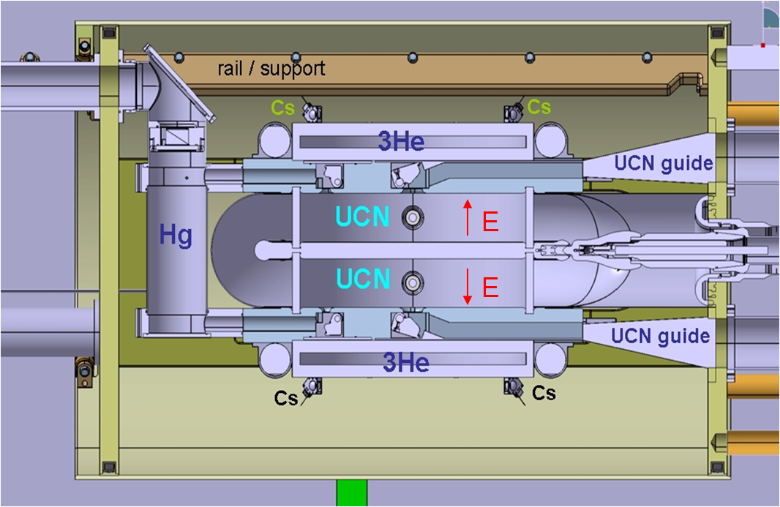
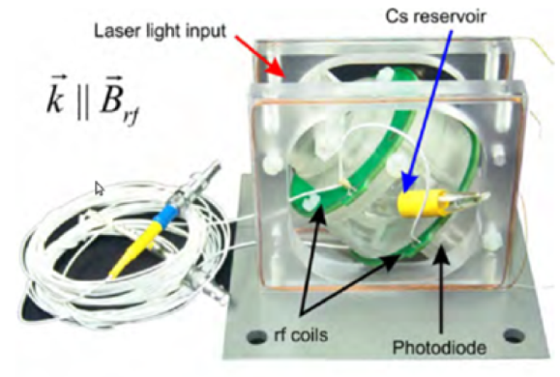
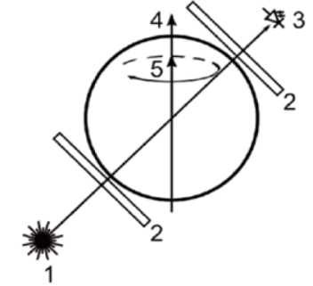
Neutron Electric Dipole Moment
n2EDM at Paul Scherrer Institute (PSI)
  Goal: improve the sensitivity to the level of 10⁻²⁷ e.cm
    A factor 10 better than current limit
  The precision depends on the statistics, the neutron polarisation, the magnetic field homogeneity and stability, the E field intensity,…
Main developments:
  Improvements to the Ultra Cold Neutron (UCN) source
  Double neutron precession chamber
    To simultaneously measure the 2 field configurations
    Reduce some systematic errors
  Cs, He and K-based magnetometry
    Transverse B field is a source of potential systematic errors
    1 microTesla field can be controlled with a sensitivity as low as 10 femtoTesla
Cs-magnetometer

Slide 9
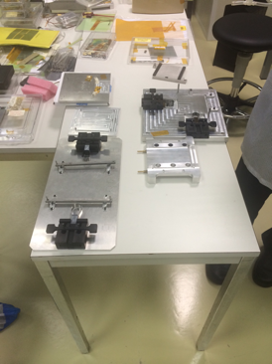
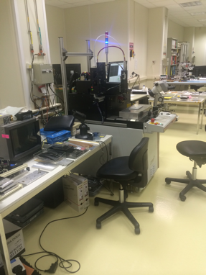
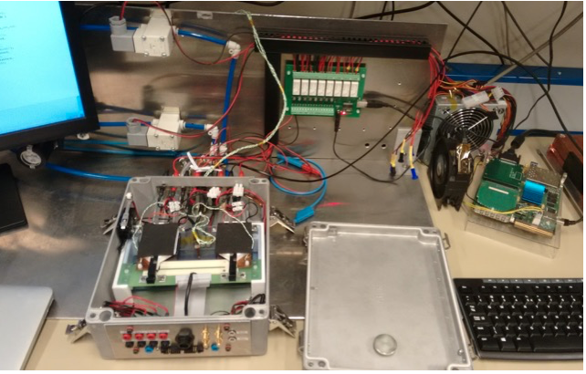





CMS Tracker Upgrade for HL-LHC
  Test of detector prototypes (in the labs and in test beams)
  Development of test system for the electronics
  Development of test systems at cold (-30°C)
  Development of the module assembly set-up
  Module assembly and test
  Development of the Dees assembly set-up
  Dees assembly and test
  Endcap assembly and commissioning

Slide 10
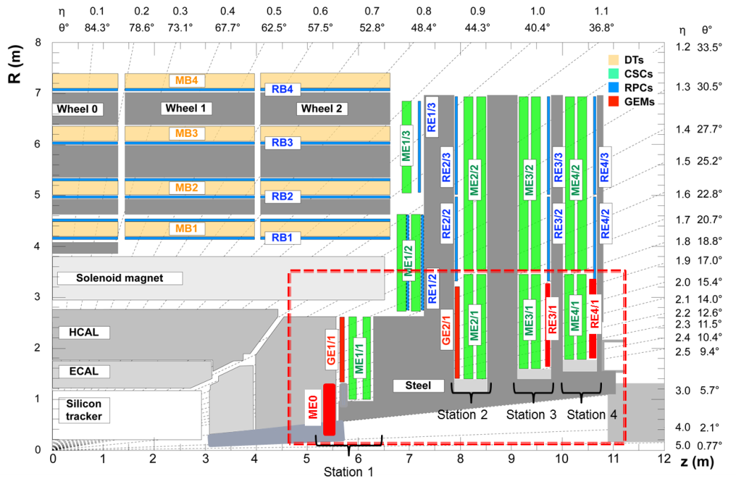
CMS Muon system upgrade for HL-LHC
To increase muon system redundancy, improve tracking and triggering, recover CSC inefficiencies at trigger level
GE1/1 Technical Design Report
Muon Phase-2 Technical Proposal
Muon TDR to be submitted to LHCC in Sept. 2017
Post LS3 2023 scenario
RE3-4/1, new generation of RPCs
Post LS2 2019 scenario
GE1/1 GEM station
Demonstrator installed 2016 EYETS
Full installation approved for LHC LS2
Post LS3 2023 scenario
ME0 GEM station:
  extending coverage up to |η|=3.8
GE2/1 GEM station

Slide 11
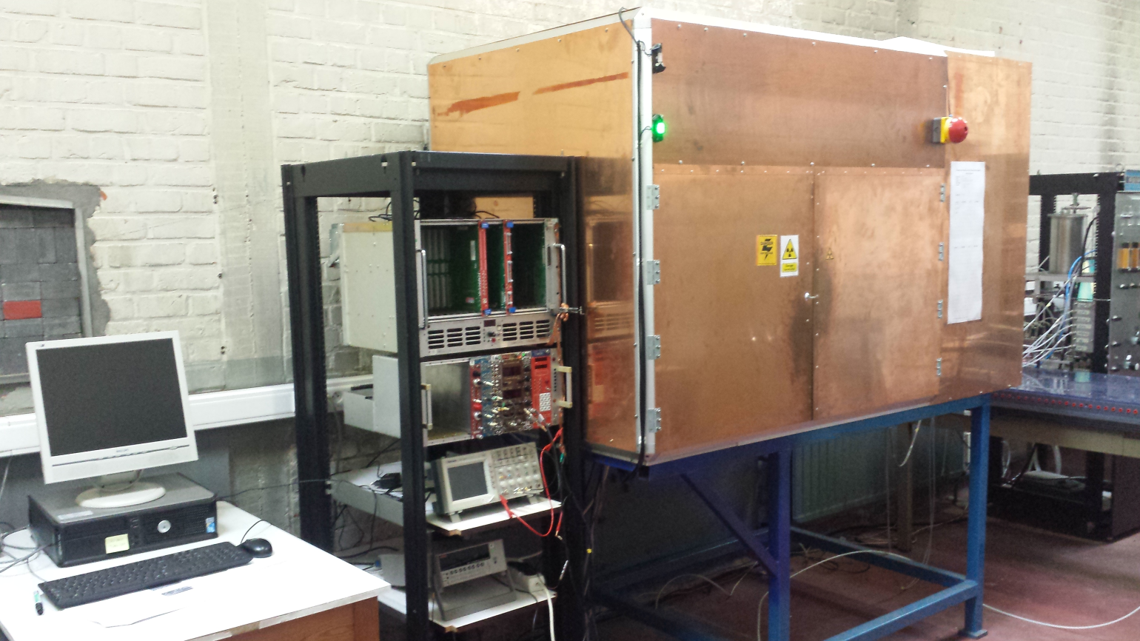
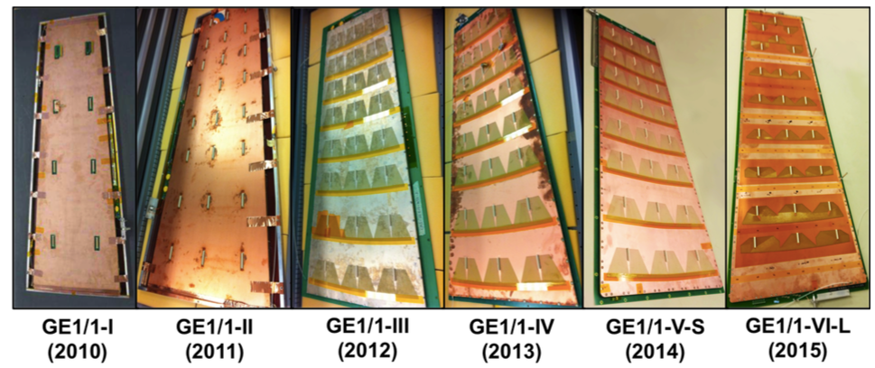
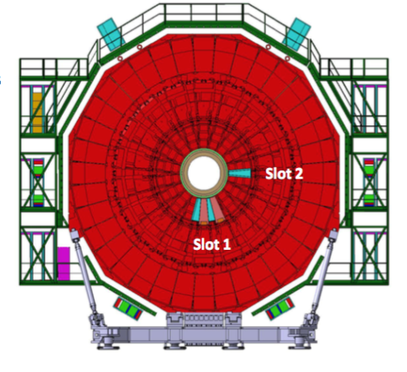
Triple-GEM detectors
CMS-GEM project initiated in 2009 by CERN & UGent
  Leader of the CMS Triple-GEM detector R&D
  One of the CMS Triple-GEM detector site
  Close collaboration with RD51 @ CERN
ULB joined the project in 2011
  Leader of the CMS Triple-GEM detector electronics
Project approved for installation in LS2 (2019-2020)
Pilot installation of 10 detectors in CMS recently completed

Slide 12
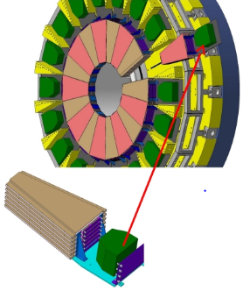
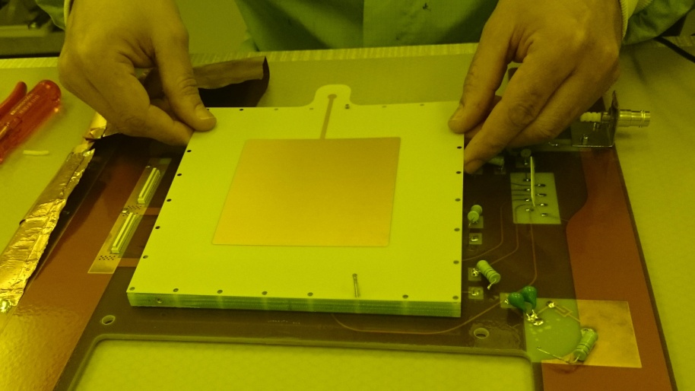
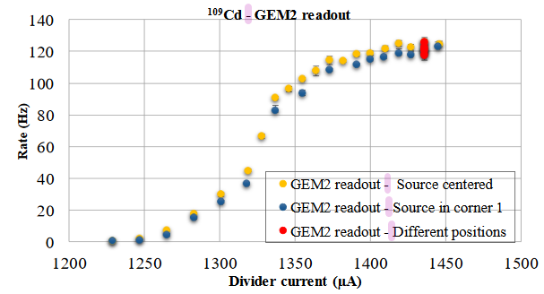
New CMS Muon Tagger (ME0)
Compact GEM stacks: 2 triple-GEM detectors back-to-back in common gas volume
Lab tests of first prototypes and SPS beam tests at CERN by UGent

Slide 13
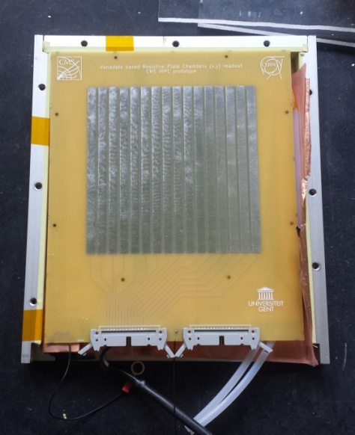
High rate capable RPC
Basic requirements compared to standard (bakelite)
  increased rate capability, i.e. O(2kHz/cm²);
  sufficient aging tolerance, i.e. O(2C/cm²);
  improved space resolution for tracking;
  new front-end electronics
R&D :
  low-resistivity electrode material like semi-conductive glass
    vanadium based glass, tunable bulk resistivity 10⁸⁻¹⁰Ωcm; relatively inexpensive,
      industrial production possible
  new geometries
    thinner electrodes and gas gaps, multi-gap structures,
  New electronics
    more sensitive, low noise front-end electronics

Slide 14
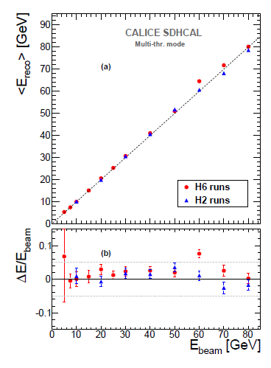
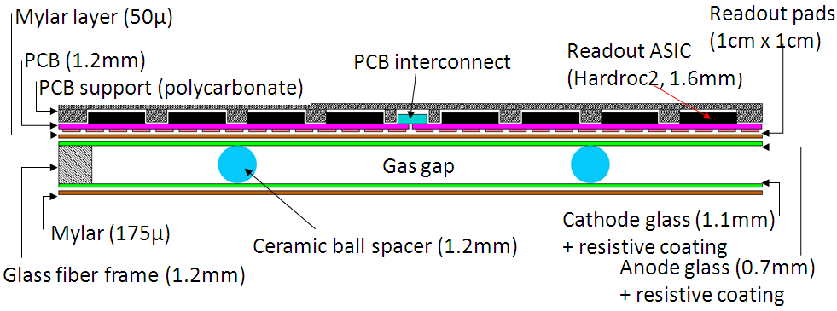
CALICE Semi-Digital HCAL
Semi-digital HCAL based on glass RPCs
  Analogue energy measurements replaced by simple hit counting
Very compact 1m² gRPC design (6mm) with embedded FE electronics, used for 1m³ SDHCAL technological prototype with 50 planes
UGent contribution to: chamber production, test beams, analysis, online tools
UCL contribution to:
Powering and cooling, test beams, analysis (energy resolution and particle Identification

Slide 15
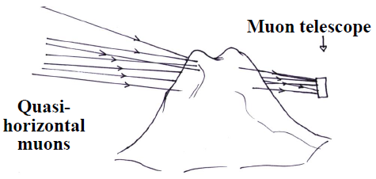
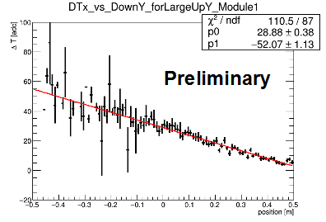
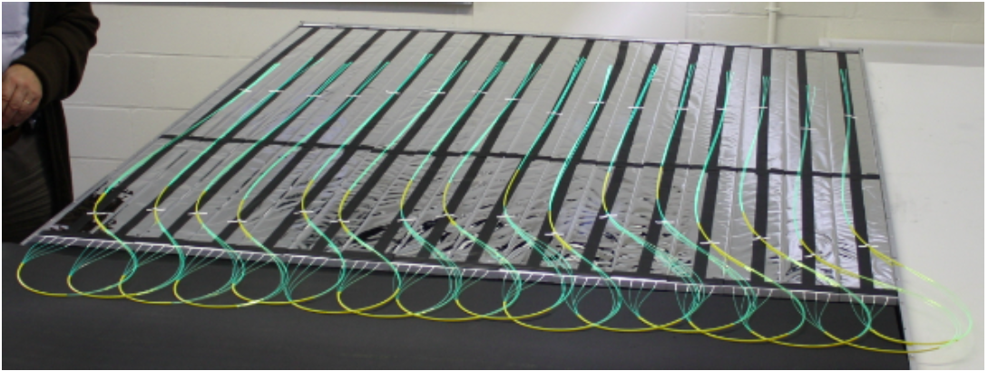
Muography
Imaging technique that relies on the measurement of the absorption of cosmic muons
Applications include geophysics (studying the interior of mountains; remote quasi-online monitoring of active volcanoes), archaeology, monitoring of nuclear reactors
Use of the local facilities at UCL and Ghent for further hardware developments based on glass RPCs
Also gaining experience by participating to the MURAVES collaboration (Italy) through algorithmic and data-analysis aspects (implementation of time-of-flight capabilities, optimization of the reconstruction algorithms, understanding of physics and instrumental backgrounds)
Local synergy with volcanologist P. Delmelle (UCL)
Study of the muon TOF with the MURAVES telescope
Cosmic test bench at UCL

Slide 16
TRAPPISTe
TRAcking for Particle Physics In SOI Technology
  Silicon On Insulator Monolithic Active Pixel Sensor
    Top active layer holds readout electronics
    Bottom handle wafer (HR) contains sensor
    Middle silicon oxide layer insulates the electronics from the sensor
SOI features
  No mechanical bonding (no bump pads and smaller sizes possible)
  Large gain and low noise operation are possible
  Full CMOS circuitry can be implemented on each pixel
  SEE cross sections are very small; latch-up almost absent wrt conventional CMOS
  Based on Industry Standard technology
  Emerging 3D integration techniques are a natural extension

Slide 17
TRAPPISTe
UCL joined the SOIPIX collaboration
TRAPPISTe-3
  LAPIS Technology
  Buried P Well (BPW) + Double SOI (SiO2) implemented
    Needed to correct for both backgate and TID effects
  Fully working
  Final test (laser and beam) in May 2017
UCLouvain chip
2.9 x 2.9 mm

Slide 18
AIDA2020
European project to develop Advanced Infrastructure for Detector and Accelerator
  UCLouvain participation: Transnational Access to Centre de Ressources du Cyclotron (CRC)
  NIF: Neutron Irradiation Facility
    Fast Neutrons (0-50 MeV)
    Flux: 1011 n/(cm2 s)
  LIF: Proton Irradiation Facility
    Protons 10-60 MeV
    Flux: 5 108 p/(cm2 s)
  HIF: Heavy-Ion Irradiation Facility
    Heavy Ion "cocktails”
    Single Event Effects on electronics
  Testing possible during irradiation
AIDA2020 irradiation @HIF
June 2016
Exemple of irradiation for LHCb ECAL

Slide 19


Precision control of large instruments
Non-magnetic inertial sensor for CLIC
  Optical inertial sensors capable to measure low frequency absolute motion smaller than one nanometer in magnetic environment
Active vibration isolation system
  To isolate the mirrors of gravitational wave detectors from seismic motion
NOSE: pendulum + interferometer

Slide 20
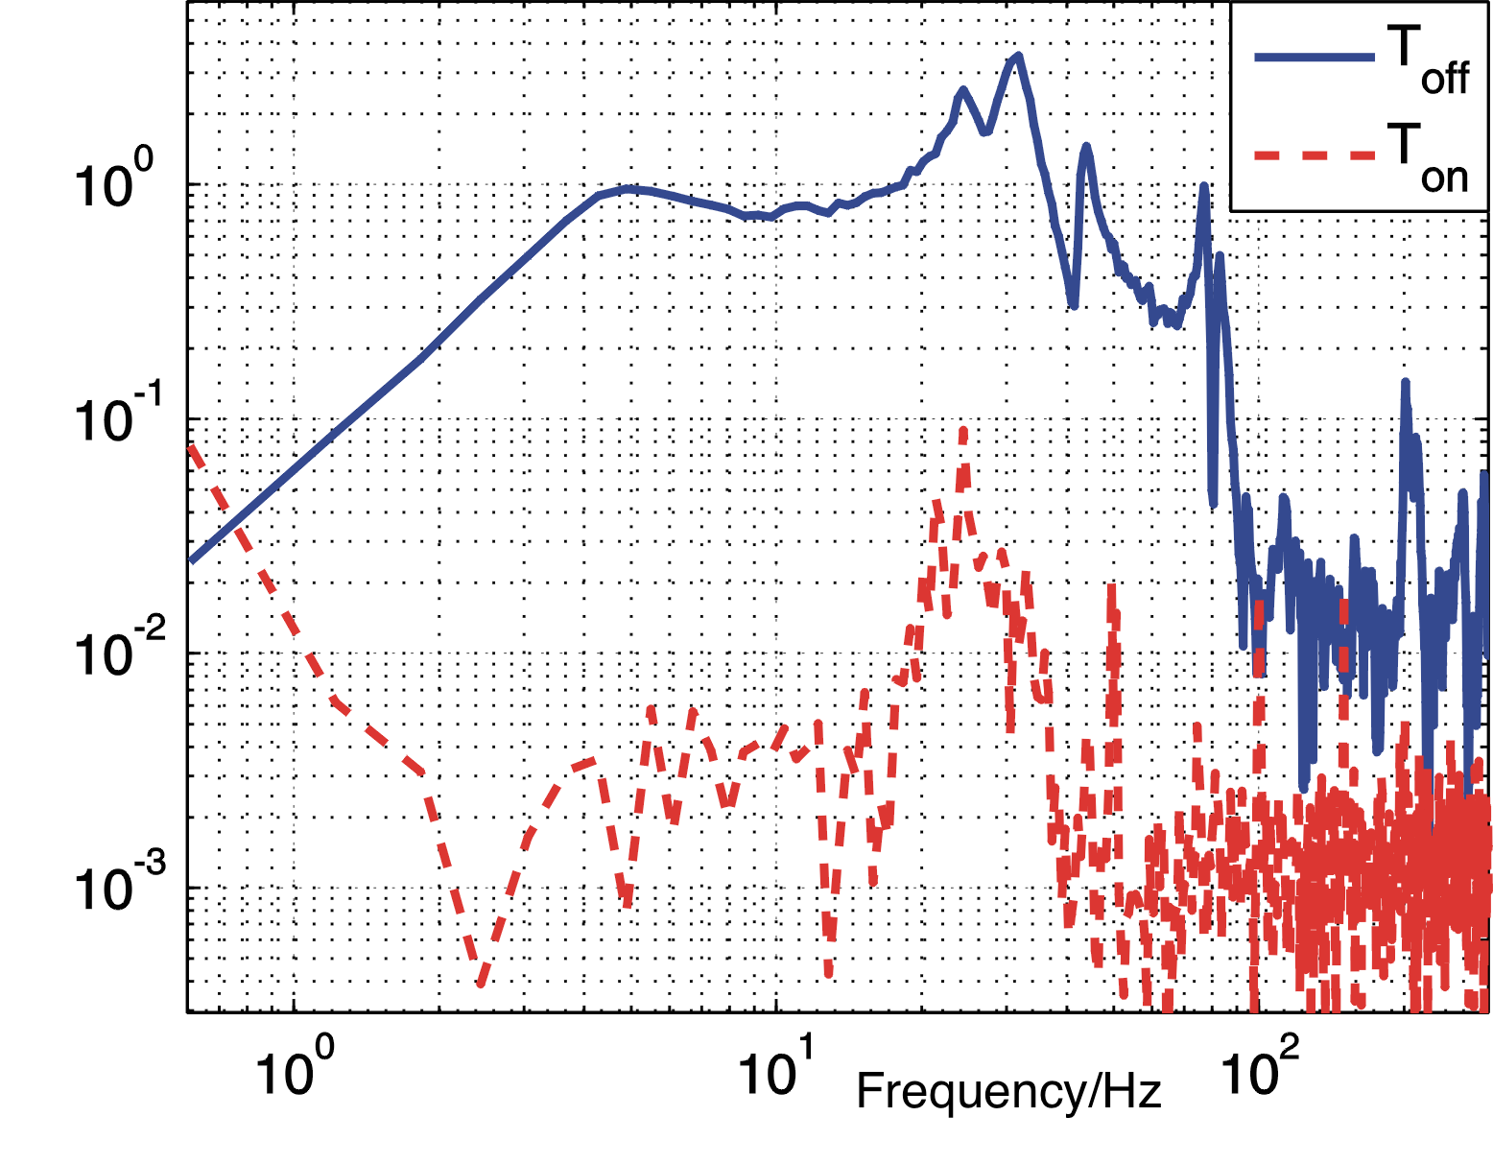
Precision control of large instruments
Non-magnetic inertial sensor for CLIC
  Optical inertial sensors capable to measure low frequency absolute motion smaller than one nanometer in magnetic environment
Active vibration isolation system
  To isolate the mirrors of gravitational wave detectors from seismic motion

Slide 21
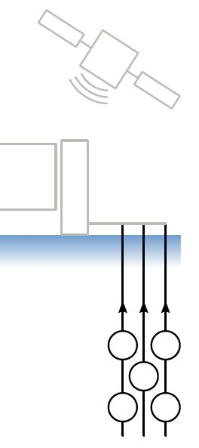
IceCube-GEN2 / PINGU
Improved data transmission to the surface
  Current system:
    Copper cables for power and data
    Bandwidth shared by 3 optical module (1Mbps)
    Use signal amplitude to carry information
  New transmission scheme
    Frequency division multiplexing
      Each frequency sub-band dedicated to a device
      Use signal amplitude and phase to carry information
      800 kbps per optical module
  Implementation
    Need new FPGA firmware with few-nanosecond synchronization capability

Slide 22
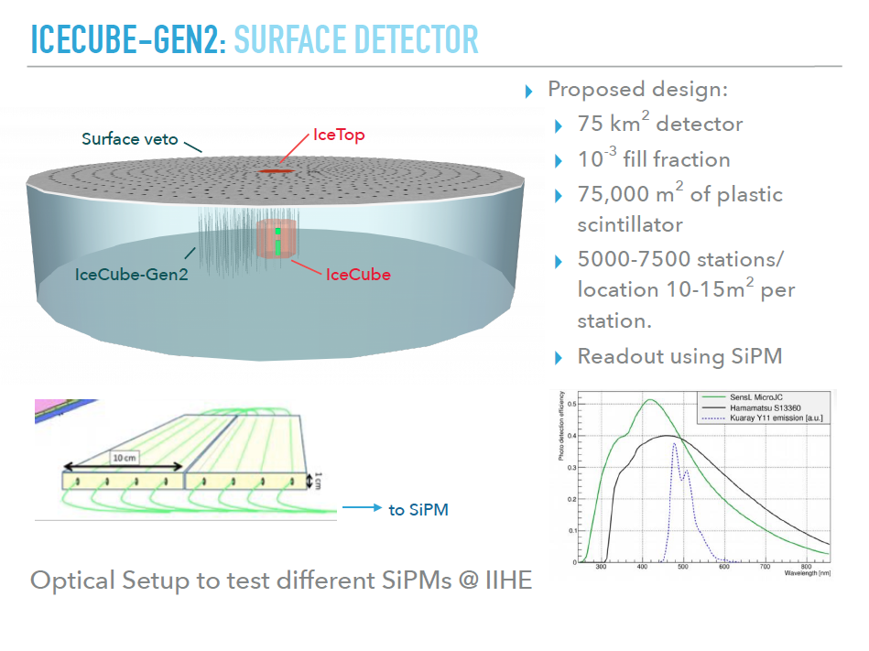
IceCube-GEN2 Surface Detector
Goal: surface veto
  75 km² detector
  75,000 m² of plastic scintillator
  SiPM readout
  10⁻³ occupancy
Optical setup to test different SiPMs being built in Brussels

Slide 23
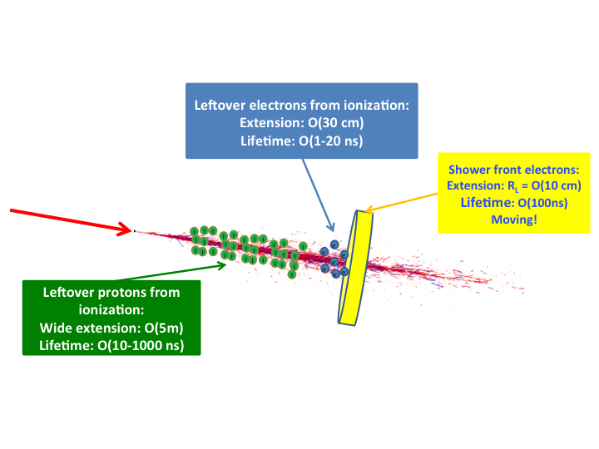
Search for HE (PeV-EeV) neutrinos
Radar scattering of a neutrino induced plasma
  Coherent scattering of over dense plasma region ( ν_{radar} < ν_{plasma})
  Plasma frequency scales with electron density

Slide 24

Search for HE (PeV-EeV) neutrinos
Return power: P_{r}
Bi-static RADAR configuration
Transmitted power: P_{t}
Re-scattering over a sphere: 1/(4πR²)
Transmission over ¼ of a sphere: 1/(πR²)
Plasma scattering surface: σ_{eff}
Attenuation by the
medium

Slide 25
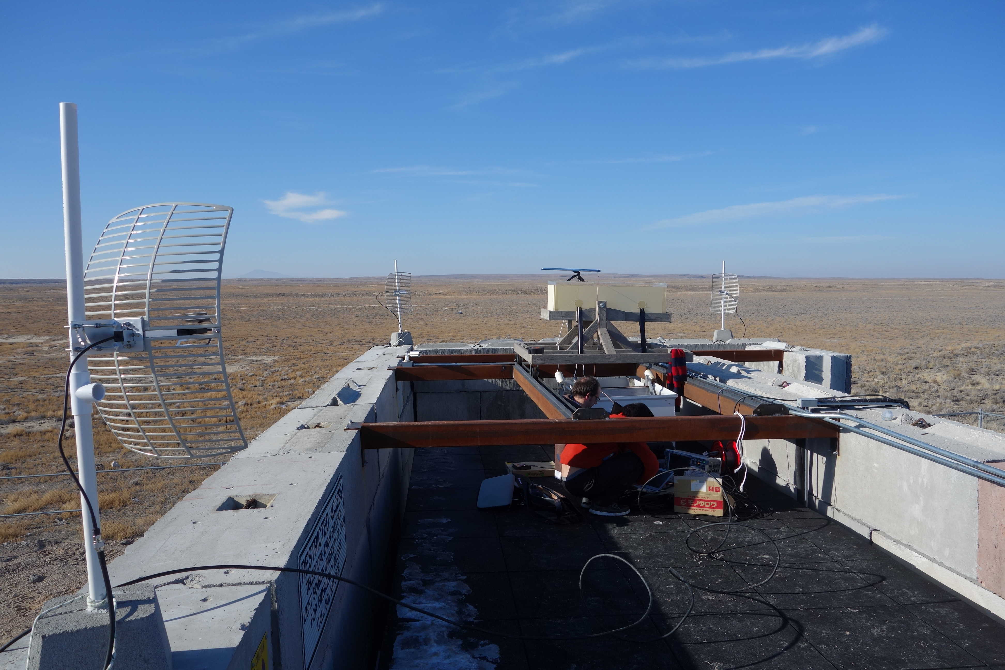
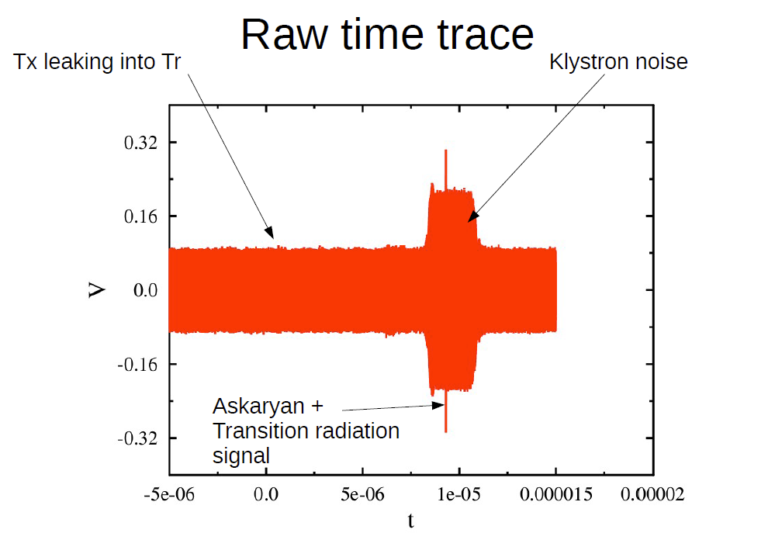
Search for HE (PeV-EeV) neutrinos
Ice
40 MeV electron beam
Modelling the radar scattering of high-energy neutrino induced cascades gives an energy threshold
Measurements performed to prove the feasibility of this method
Data analysis ongoing

Slide 26
Electronics and Data Acquisition (DAQ)
Backbone of any experiment
  Formatting, transferring and recording the data
  Always larger volume, faster, more processing power
  High performance requirements: reliability, flexibility, availability
Reliability and flexibility
  Extensive use of Field Programmable Gate Arrays (FPGA), PCs and industrial/commercial components
Availability:
  New standards from the telecommunication industry (xTCA)
Objectives
  Develop DAQ architecture independent of the detector to be read-out

Slide 27
Digital electronics
FPGAs are omnipresent in particle and nuclear physics
Nowadays FPGAs
  Contain millions of logic gates
  Can handle dozens of Gigabit transmission lines
  Can embed a soft processor (soft core)
  Can be fundred on the same silicon chip as a CPU (hard core)
The programming (firmware) and the use of the full potential of these chips become extremely difficult
  Development of high level development tools
  Research of dedicated algorithms

Slide 28
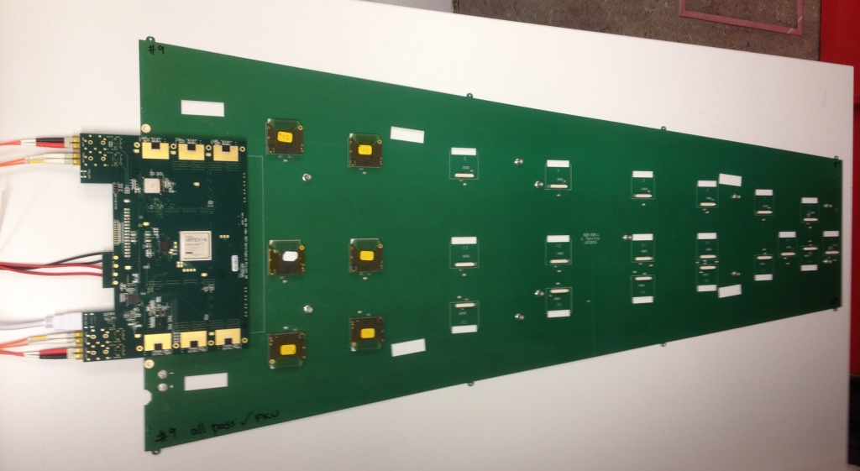
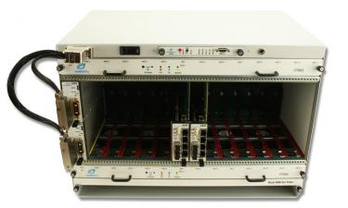
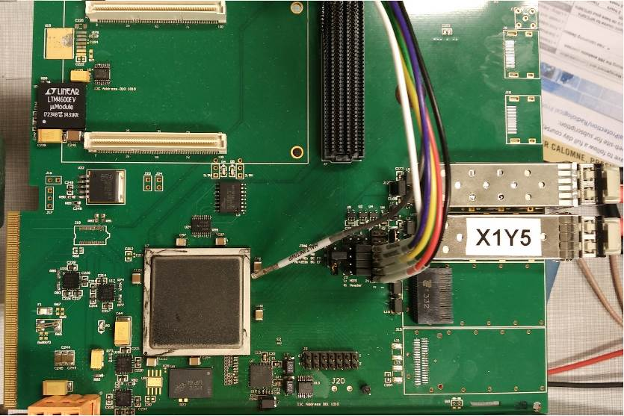
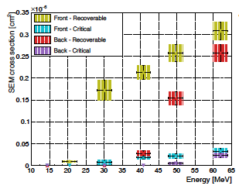
DAQ developments
Study of the xTCA as a new standard in the design of FPGA-based embedded (data acquisition) systems
ULB leader of the electronics & DAQ system of the CMS GEM upgrade:
Optical fibres
GEM detector
xTCA standard
xTCA board
On-detector electronics
Expertise in FPGA board design and firmware design
  Design of several FPGA boards
  Design process for parallel data processing in embedded system
  Use Matlab to synthesize firmware
Experience in irradiation of FPGAs
  Implementation of mitigation techniques
Virtex6 FPGA irradiated at UCL Cyclotron

Slide 29
FPGA algorithms
FPGAs are by nature massive-parallel devices (in comparison with classic processors)
We want to bring more processing power close to our detectors
  Given their power we are tempted to run high level algorithms (typically run on processors) onto FPGAs
  Need to adapt the algorithms to FPGA architecture
  Or to develop new algorithms adapted to massive parallelism

Slide 30
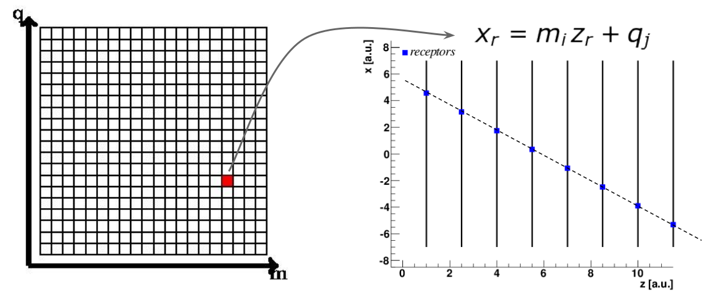
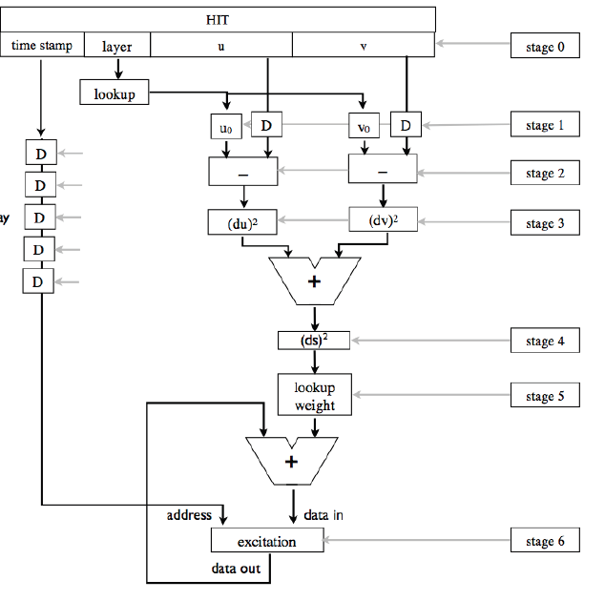
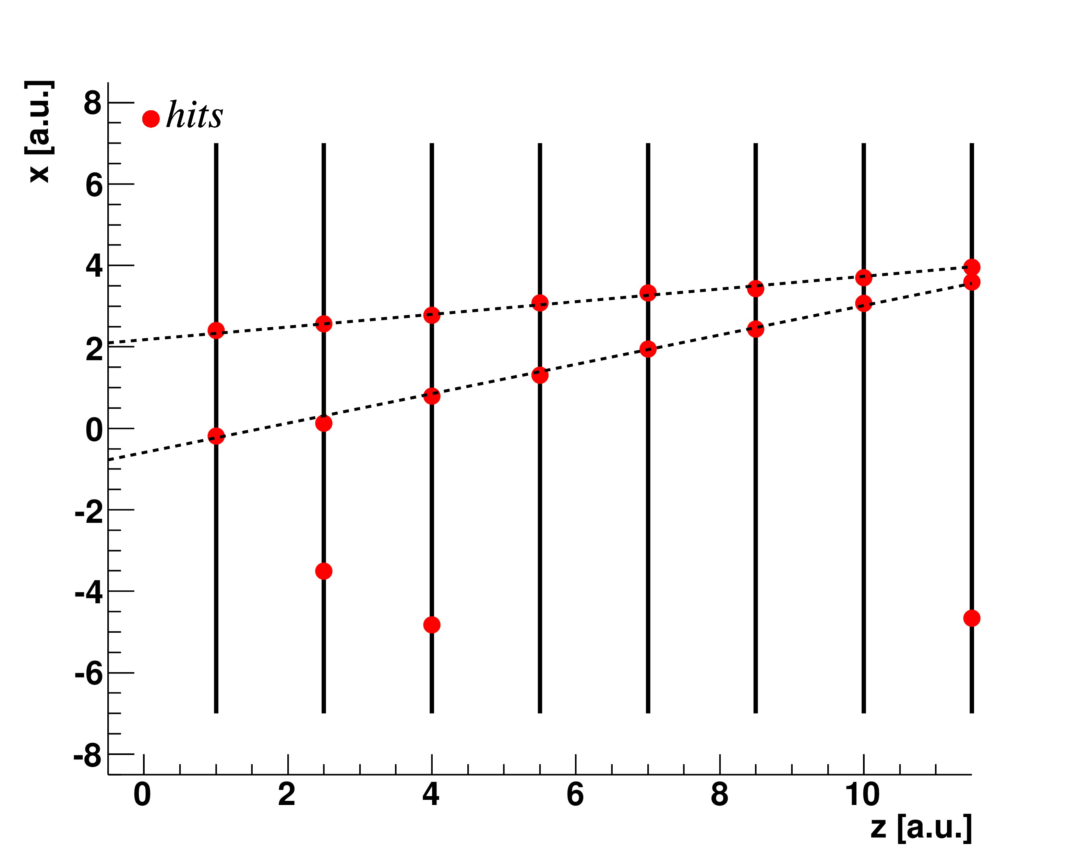
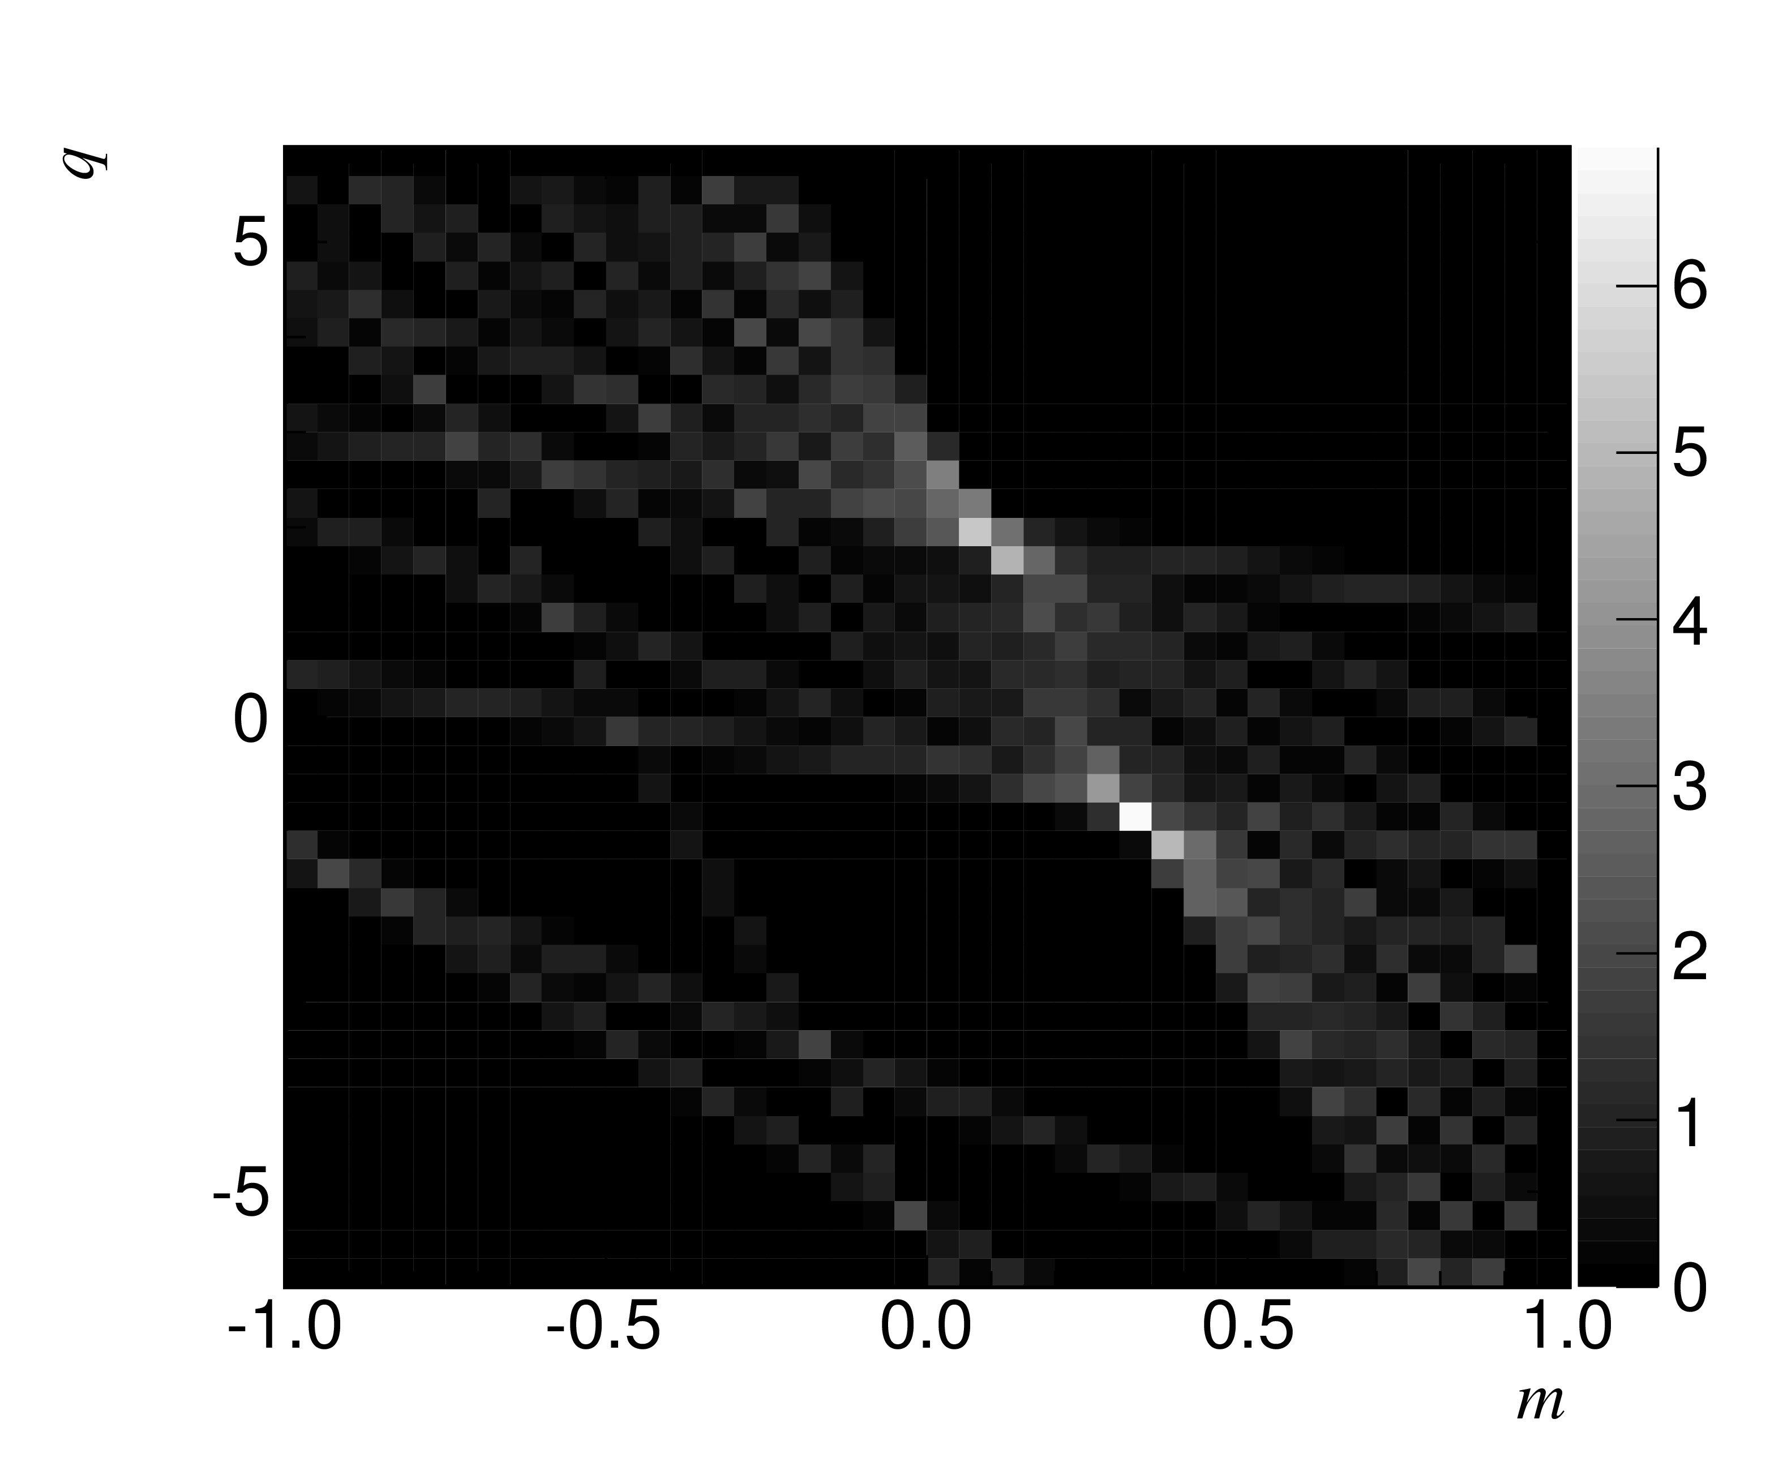

FPGA algorithms
RETINA for fast tracking
  Application: HL-LHC
Deconvolution for fast pulse reconstruction
  Application: γ-camera for counting of high rate (tens of MHz) of photons with some energy resolution
  1st proof of concept developed in
  collaboration with IBA
Mapping
Reconstruction

Slide 31

JUNO Electronics
Key challenge: transmit two data streams (100 and 250 Mbps) and two power channels (24 and 48 V) through one 100m-long ethernet cable

Slide 32


JUNO Electronics
Equalizer/cable driver test
(over 100 m cat5 ethernet cable)

Slide 33

SOLID Electronics
SiPM amplifier
  To detect 1 photon signals from Wave Length Shifter
    Lesson learned from SM1: too much pick-up noise
    Need long signal cables between SiPM and amplifier => differential signals up to ADC

Slide 34
Summary
Many R&D activities in nuclear and in high energy physics in Belgium
  These activities always involve state-of-the art technologies (detectors, electronics, precision instruments, …)
These activities are often conducted in the framework of flagship experiments
In these experiments and collaborations, the Belgian groups have a strong impact and important responsibilities
We are all concerned to maintain this level of expertize and this level of excellence in Belgium
  Highly qualified manpower, research engineers, logisticians, … is a must to ensure Belgium remains competitive in this area

Slide 35
Acknowledgment
Many Thanks to all my colleagues for providing me the informations:
  Juanan Aguilar (ULB)
  Barbara Clerbaux (ULB)
  Thomas Cocolios (KULeuven)
  Christophe Collette (ULB)
  Eduardo Cortina (UCLouvain)
  Krijn De Vries (VUB)
  Andrea Gianmanco (UCLouvain)
  Marc Loiselet (CRC-UCLouvain)
  Gerda Neyens (KULeuven)
  Riccardo Raabe (KULeuven)
  Dirk Ryckbosch (Ugent)
  Nathal Severijns (KULeuven)
  Michael Tytgat (UGent)
  Piet Van Duppen (KULeuven)
  Nick Van Remortel (UAntwerpen)
  Yifan Yang (ULB)

Slide 36
BACKUP

Slide 37


Slide 38


Slide 39


Nuclear reaction cross sections
¹¹C for PET-aided hadron therapy
  New target material: Boron Nitride
  Material characterisation
  Stability to oxidation
  Production and separation of ¹¹C¹⁶O
  Injection into medical synchrotrons for hadron therapy
  Energy dependence → COSY
Spallation cross section in the reaction Ta(p,*)Tb
  Optimising the production of the medical isotopes ¹⁴⁹Tb, ¹⁵²Tb, ¹⁵⁵Tb
XRD scan
BN target

Slide 40

CERN MEDICIS
A radioisotope is attached to a biomolecular carrier to be delivered to a cancer cell, where it decays, either for imaging or therapy.
Research focused on the production of radioisotopes that can offer new opportunity for nuclear medicine
  Nuclear reaction cross sections
  Ion source studies (plasma, lasers)
  Collection & separation protocols

Slide 41


Slide 42


Slide 43


Slide 44


Slide 45

Search for HE (PeV-EeV) neutrinos
RADAR return power estimation as a function of the source distance and transmitted power P_{t}
E > 4 PeV

