Slide 1







BELGIUM
IN
NUCLEAR PHYSICS
Gerda Neyens
Institute for Nuclear and Radiation Physics (IKS), KU Leuven, Belgium
and
ISOLDE, CERN
ISOLDE Physics Group Leader (from June 2017 onwards)
Belgian Research
Initiative on eXotic nuclei

Slide 2
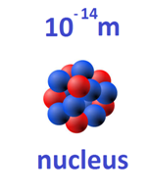




The atomic nucleus
?
Nuclear forces
quarks
Key Questions in Nuclear Physics Research using Radioactive Ion Beams
How are complex nuclei built from their basic constituents?
  get information on the strong interaction (link to QCD)
What is the structure of nuclear matter? ➔ collective versus individual nucleon behavior
What is the role of nuclei in the evolution of the universe ? ➔ stellar nucleosynthesis
Is there physics beyond the Standard Model ?

Slide 3
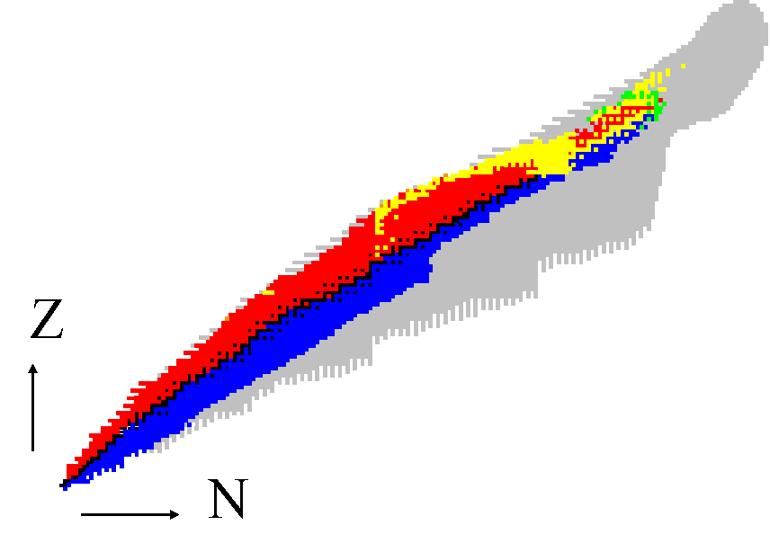
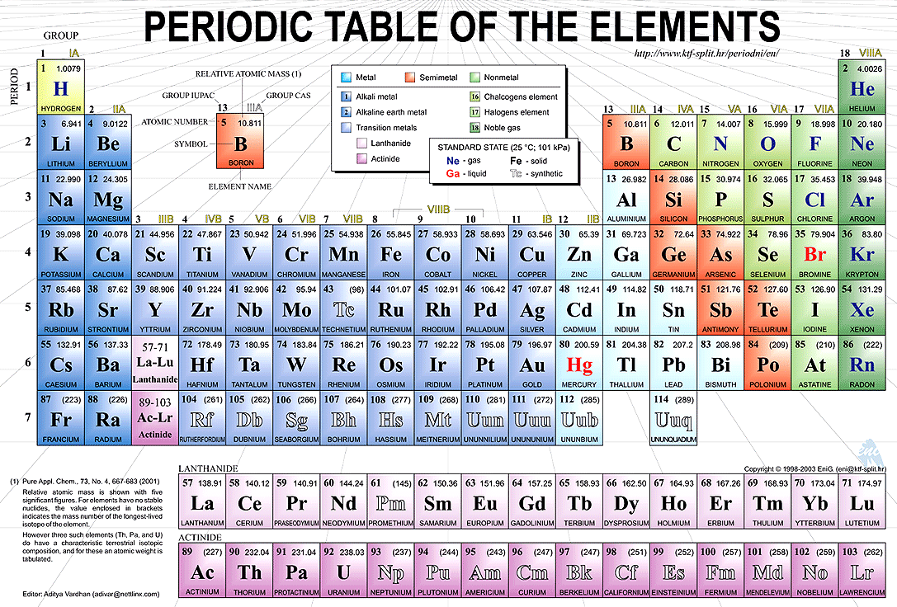









Our playground: the nuclear chart and ‘exotic nuclei’
Observed radioactive nuclei (~ 3000)
Periodiek
stable nuclei (~ 250)
Unobserved isotopes (~ 6000)
50
40
30
20
10
0
protons
systeem
drip lines (limits of existence)
0 10 20 30 40 50
neutrons
Perform experiments on exotic nuclei to test nuclear models

Slide 4
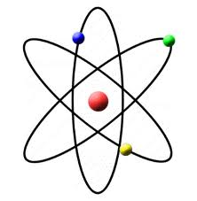
Experimental probes to study nuclear structure
Energy
Nuclear Reaction
T_{1/2}
I^{π}
^{A}Y
Gamma spectroscopy
Few-nucleon transfer
Radioactive decay
^{A-1}X (d,p)
Coulomb excitation
τ, angular correlations
Laser spectroscopy
(radius, moments, spin)
Mass spectroscopy
(binding energy)
^{A}X
NEED SLOW and ACCELERATED RADIOACTIVE BEAMS

Slide 5
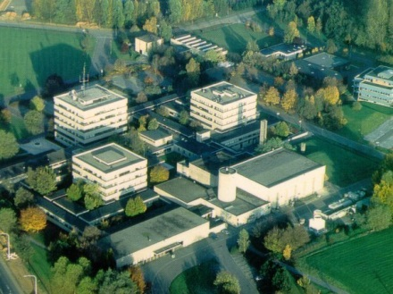
Cyclotron Research Centre at Louvain-la-Neuve
  In operation since beginning
  of the ’70s
  Main machine:
  K=110 cyclotron “Cyclone”
  Programme:
  - nuclear physics research
  - applications
  - neutron therapy
  Second cyclotron (1987):
  H– 30 MeV, 500 μA
  Post-accelerated RI beams
  (1989-2008)
Development of new detectors and techniques
Export to international facilities
STOPPED FOR NUCLEAR PHYSICS RESEARCH IN 2015

Slide 6
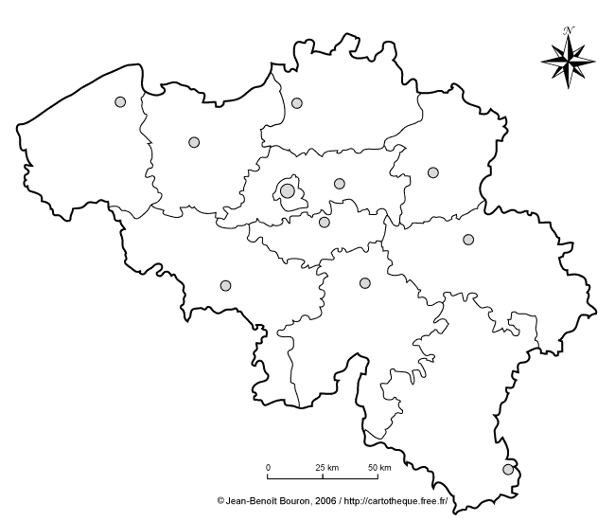






Nuclear Physics in Belgium
We were united in the Federal funded IAP-network (2007-2017):
The Belgian Research Initiative on eXotic nuclei (BriX)
Federal laboratory
Nuclear experiments
Nuclear theory
Atomic physics and fundamental
interactions

Slide 7
Interuniversity Attraction Poles Program: 30 years !
Period | Partners | Research Activities
1987-1991 | U.C.L. – U.L.B. – K.U.Leuven
1992-1996 | U.C.L. – U.L.B. – K.U.Leuven
1997-2001 | U.C.L. – U.L.B. – K.U.Leuven
2002-2006 | U.C.L. – U.L.B. – U.Gent - K.U.Leuven
2007-2011 | U.L.B. – U.Gent – SCK•CEN -K.U.Leuven
2012-2017 | U.L.B – U. Gent – KU Leuven – U. Liege – SCKCEN
First (worldwide) post-accelerated radioactive beam production by coupling two cyclotrons
⁶He, ^{10,11}C, ¹⁵O, ¹⁸F, ^{18,19}Ne
- Resonant laser ionization of exotic nuclei
(efficient and selective production)
- New instrumentation
Laser ion source
LEDA array (segmented silicon detector)
MINIBALL (segmented germanium detector array)
Penning trap for weak interaction studies
Nuclear astrophysics: exp. and theory (e.g. ¹³N(p,γ))
Nuclear structure and reactions: experiment & theory
ground-state properties (moments, charge radii)
decay studies
Coulomb excitation
fusion, fission and transfer reactions
Fundamental interaction studies
Nuclear Astrophysics
Nuclear Structure
Exotic Nuclei
Notes:
Evolved from local research to international (mostly ISOLDE)

Slide 8
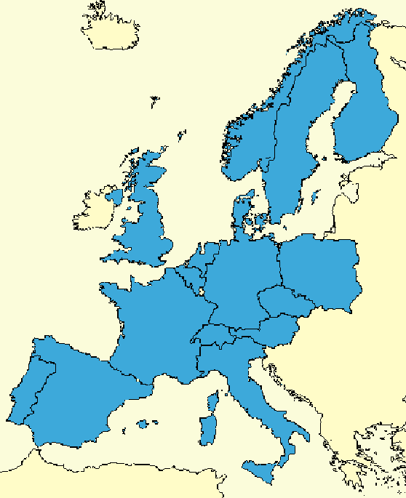
Main accelerator facilities where Belgium is active
(with strong R&D and physics programmes)
Species: from neutron beams to radioactive ion beams
Energy: from ~ rest up to 50 MeV/u
Half-life: from ms to hours
CRC-Louvain-la-Neuve
2016: LISOL mass separator to CERN
for MEDICIS
(study production of new medical isotopes)
GANIL-Caen
SPIRAL2
(10-15%)
GSI-Darmstadt
PSI-Villingen
(5%)
ISOLDE–CERN
HIE-ISOLDE
(80-85%)

Slide 9

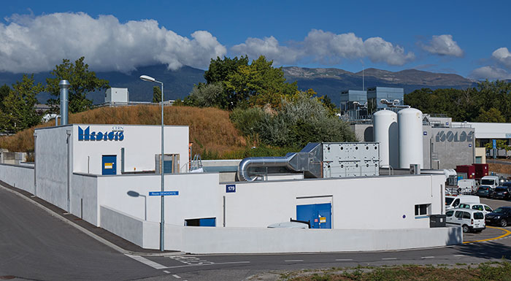
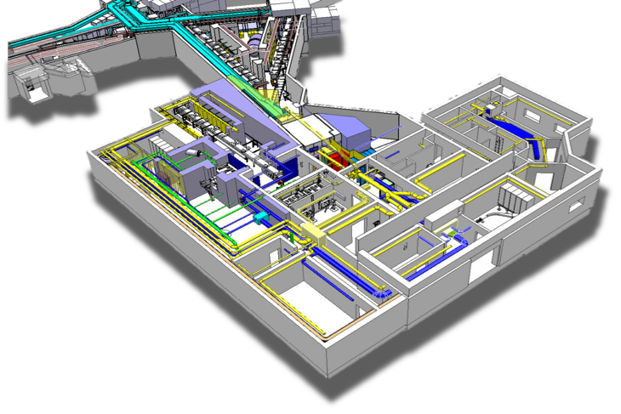
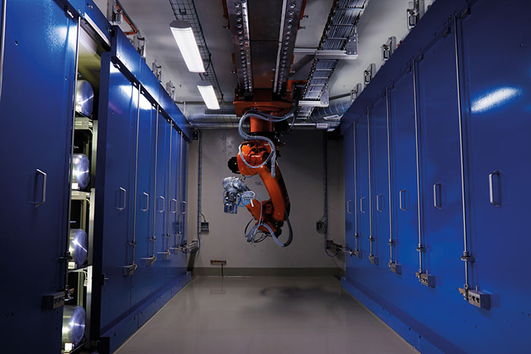
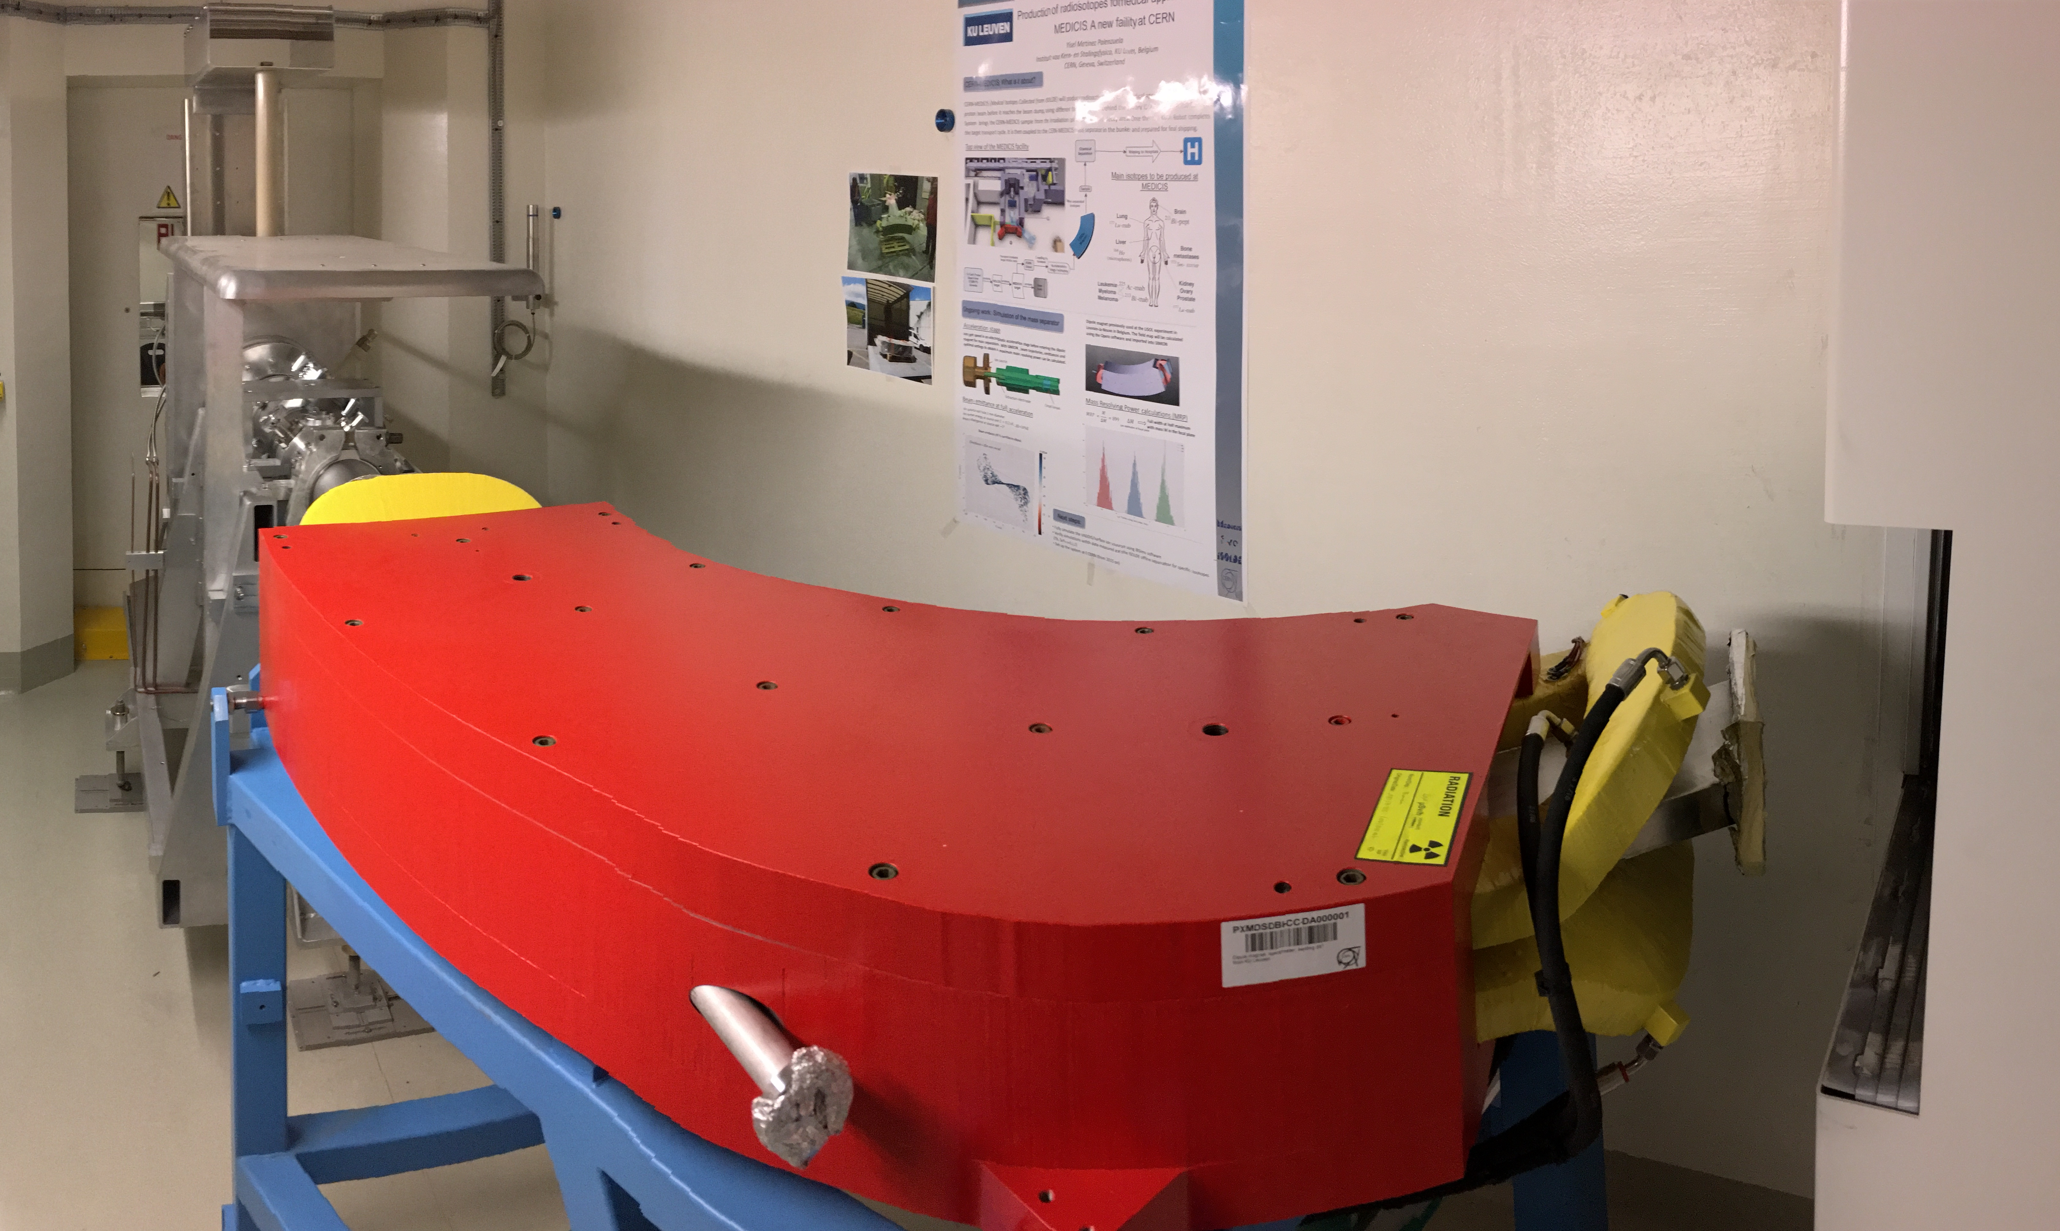
CERN MEDICIS
CONSTRUCTION STARTED 2013
MEDical Isotopes Collected from Isolde@CERN
R&D Spin-off from ISOLDE ➔ use ‘unused’ protons to produce radioisotopes for medical research in partnership with HUG (Geneva), CHUV (Lausanne), but also UZ Leuven, UZ Brussel, and UZ Gent
New infrastructure: building, target storage, hot cell, front end, experimental hall
Dipole magnet from KU Leuven (LISOL-LLN)
Research in radioisotope production
FIRST ISOTOPES: summer 2017
New tenure track prof. Thomas Cocolios

Slide 10
Main accelerator facilities where Belgium is active
Species: from neutron beams to radioactive ion beams
Energy: from ~ rest up to 50 MeV/u
Half-life: from ms to hours
in-jet laser spectroscopy
CRC-Louvain-la-Neuve
GANIL-Caen
SPIRAL2
(10-15%)

Slide 11
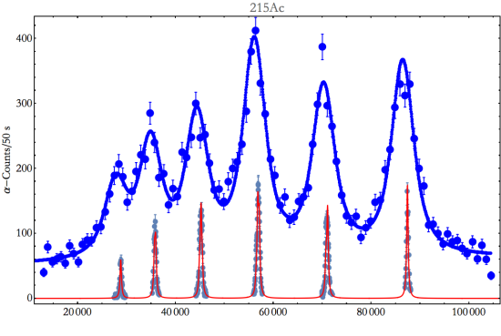
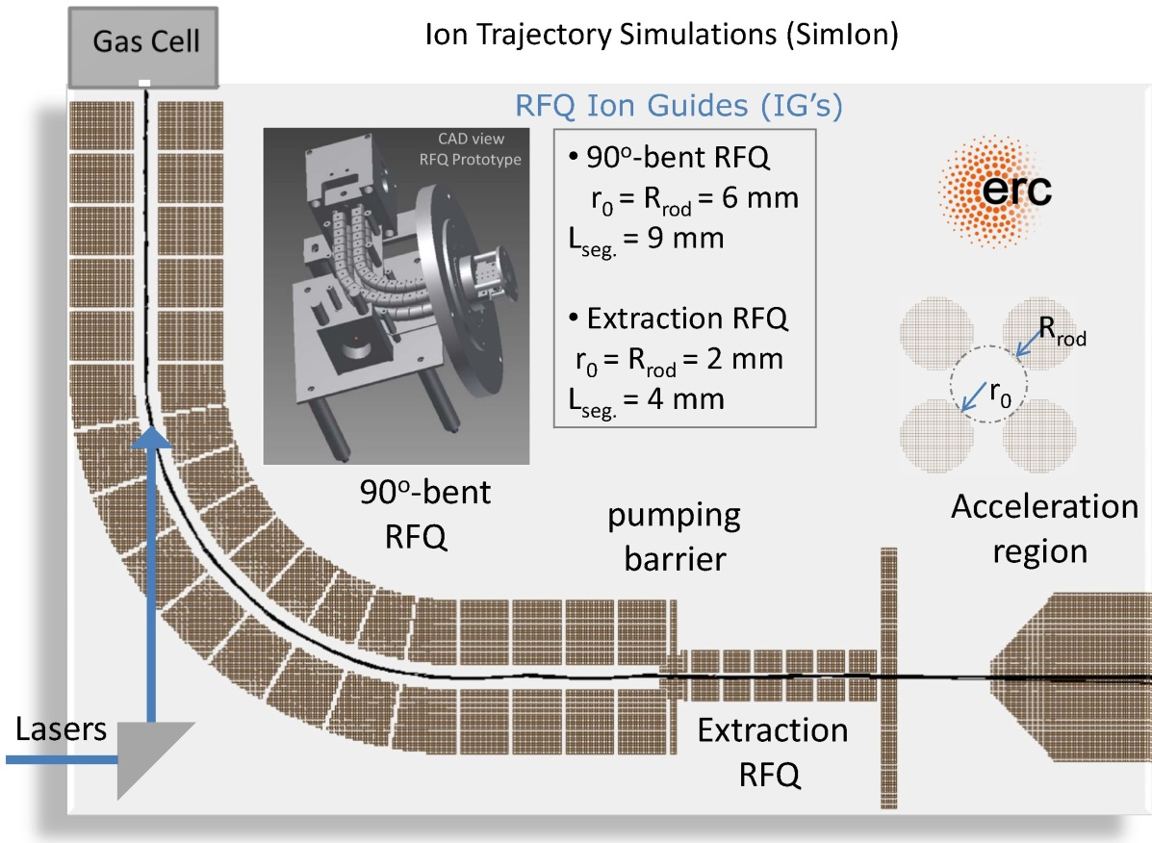
From in-source to in-jet laser spectroscopy: HELIOS
  In-source laser spectroscopy
  fast, efficient
  but low resolution
  In-jet
  Strong reduction of broadening effects
  → improved resolution
  (proof of principle at LISOL 2015 on 215Ac)
  HELIOS (ERC)
  Dedicated laser facility
  at the IKS for off-line studies towards the heaviest elements
²¹⁵Ac
R. Ferrer,- Nature Communications 8 (2017) 14520
M. Laatiaoui,- Nature 538 (2016)
Heavy Element Laser Ionization Spectroscopy - HELIOS
P. Van Duppen

Slide 12
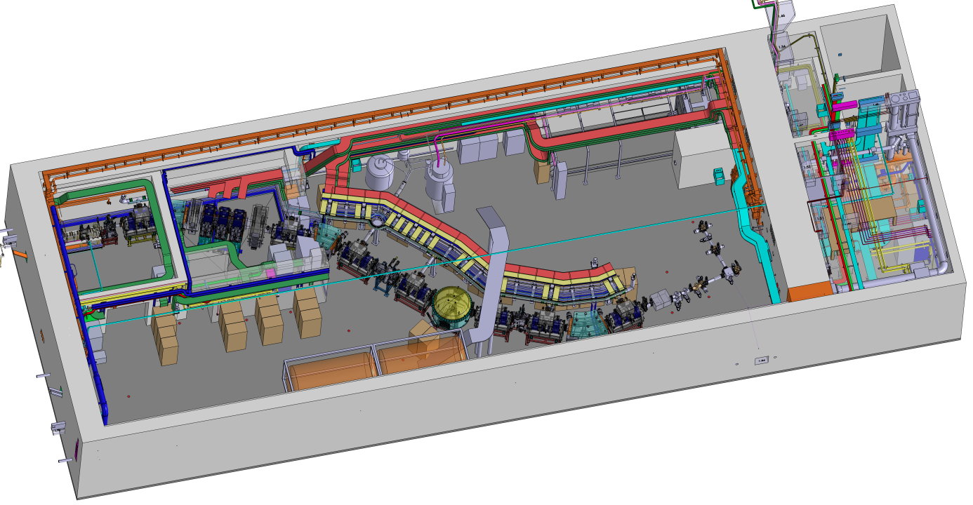
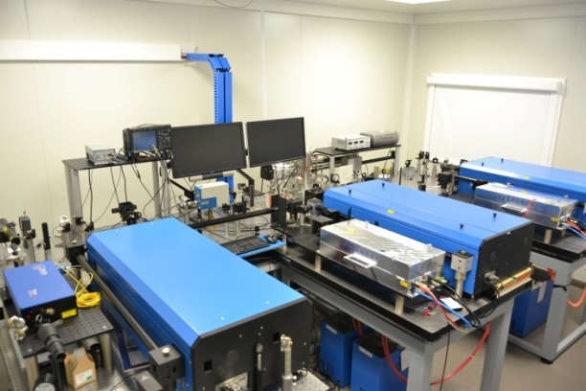
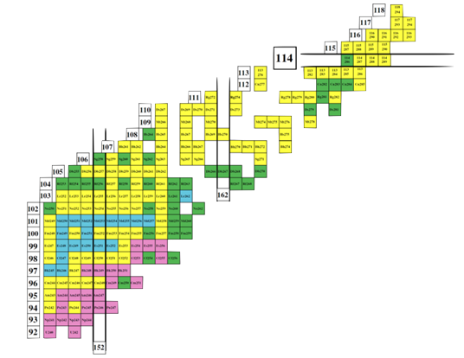
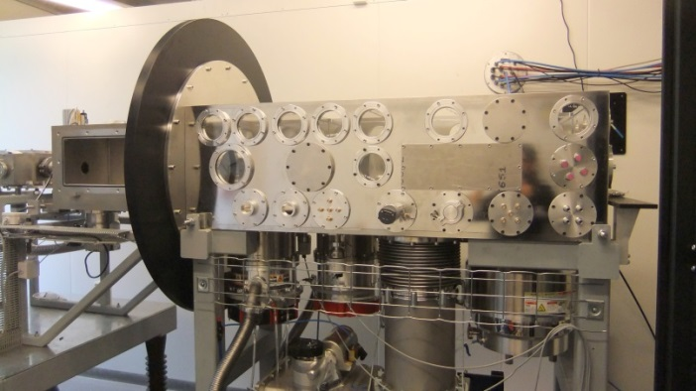




HELIOS at S³ in GANIL
Operational in 2019
  S3 Low-Energy Branch at GANIL-SPIRAL2
  Production at the Super Separator Spectrometer S3 (GANIL)
  Laser resonance ionization spectroscopy in the heavy element region
  Mass measurements, isomeric beams, decay studies…
HELIOS
P. Van Duppen, M. Huyse

Slide 13
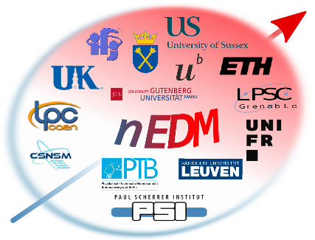

Main accelerator facilities where Belgium is active
Species: neutron beams
Measuring the neutron’s Electric Dipole Moment (n-EDM) at PSI
Related to the question of matter/anti-matter in the universe
  (baryon asymmetry puzzle)
Search for CP violation
Highest sensitivity to n-EDM ever
PSI-Villingen
(5%)
Addional results: searches for new forces, ultra-light axions, and Lorentz violation.
N. Severijns

Slide 14
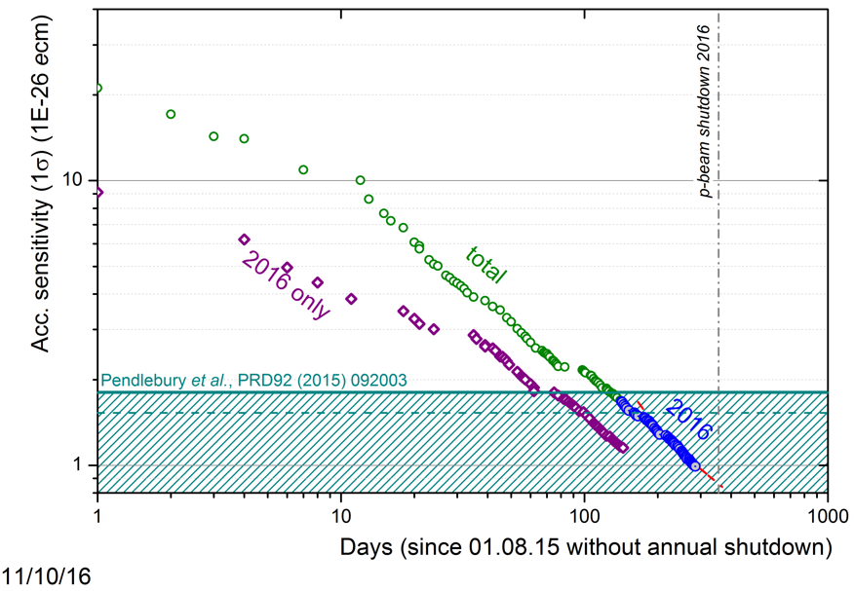
nEDM accumulated sensitivity 07/08/2015 – 10/11/2016: 1.0 x 10^{‐26} e cm
previous best result
N. Severijns

Slide 15
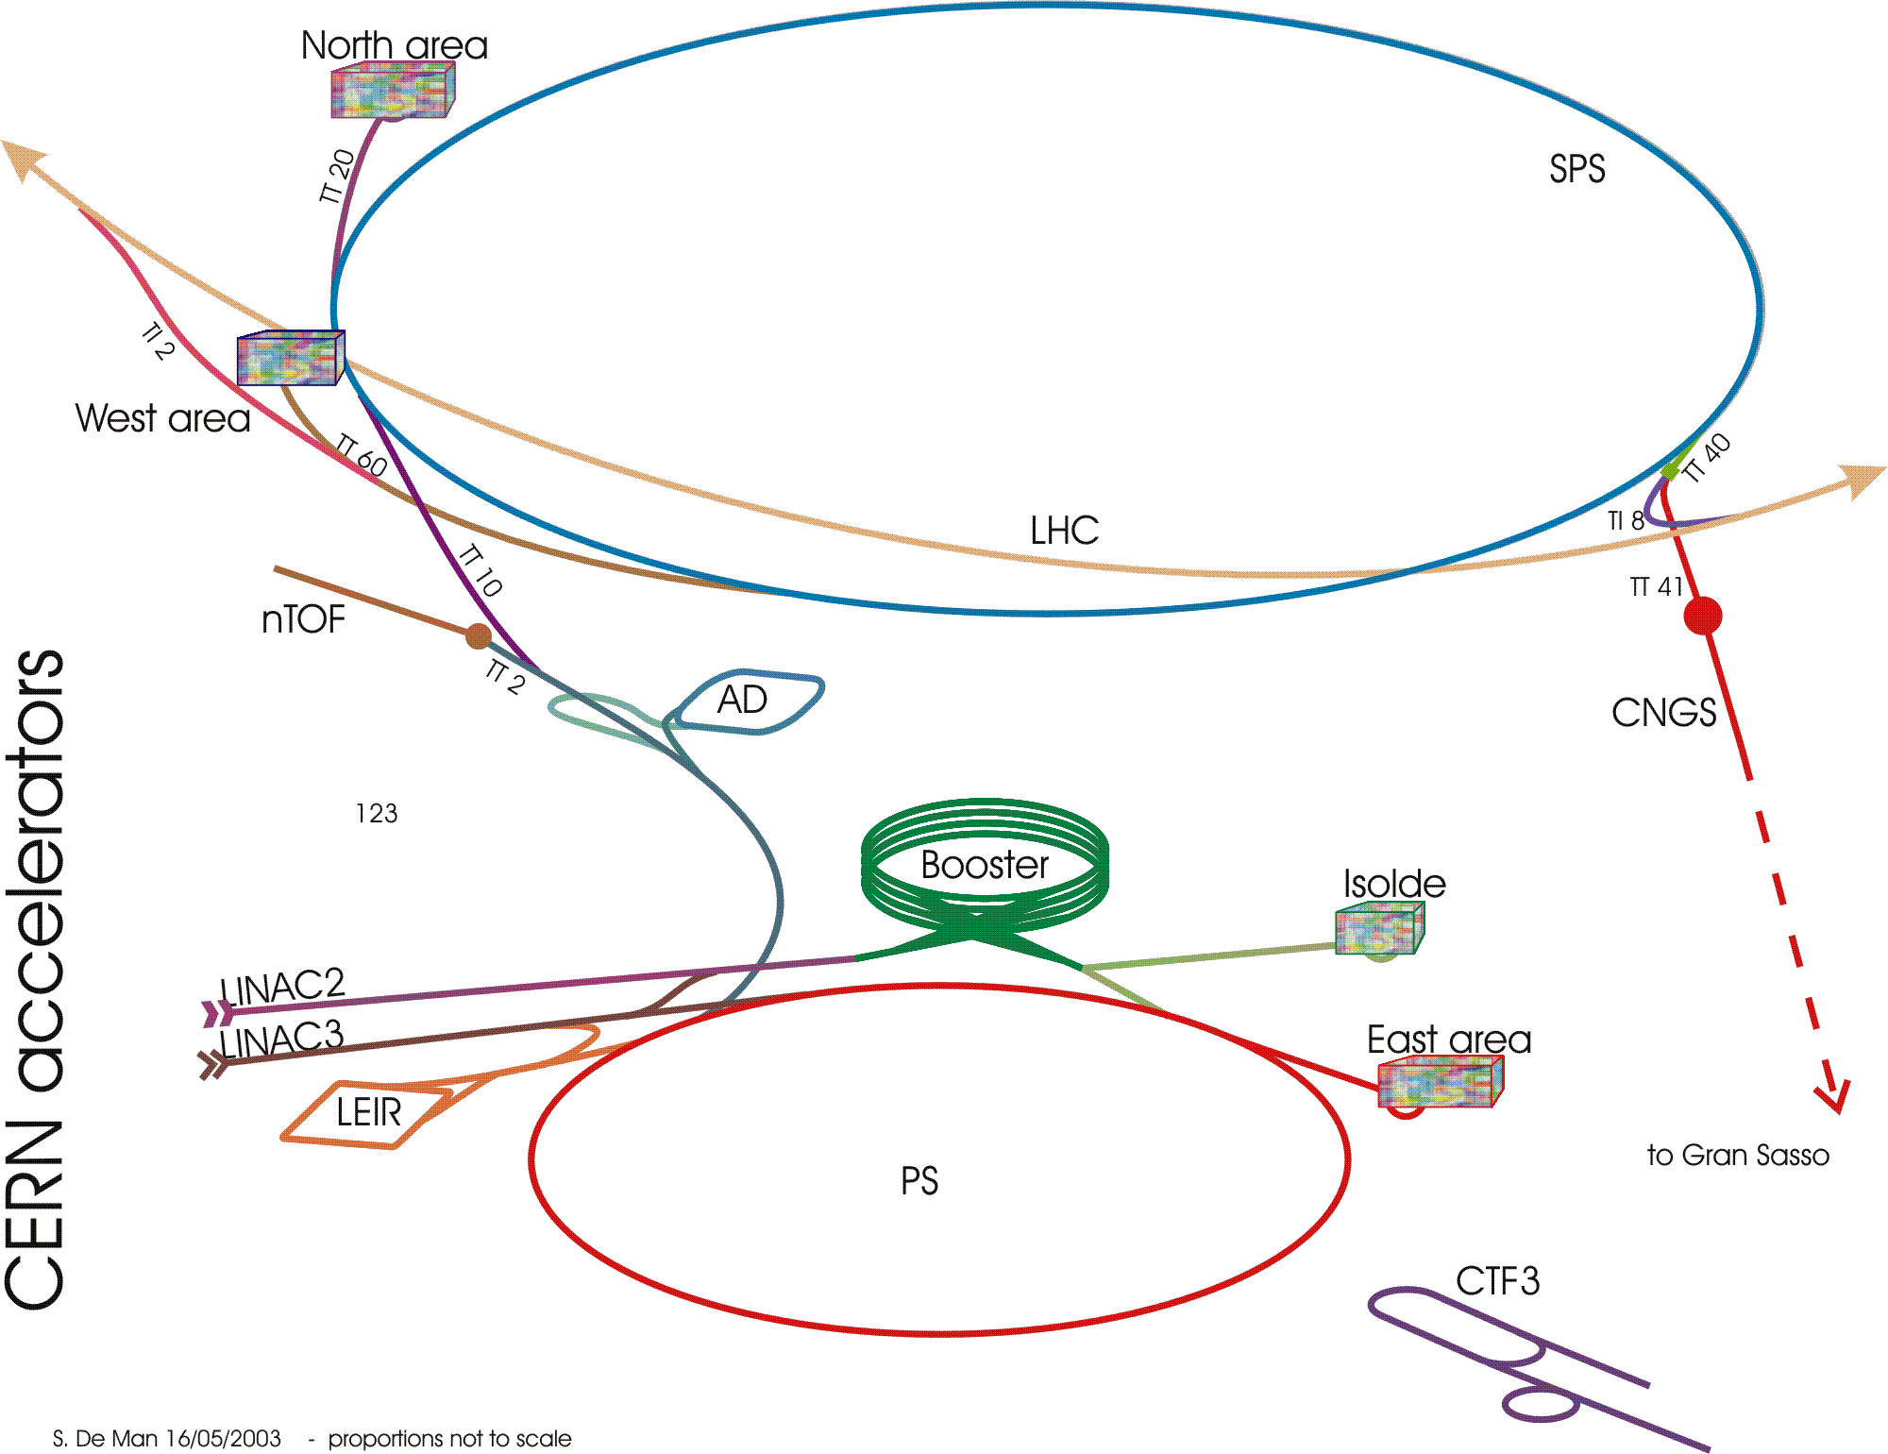
Most nuclear physics experiments (80%) at ISOLDE@CERN
LHC
Protons
1.2 10¹³ pps
1.4 GeV
40-50% of CERN’s produced protons

Slide 16
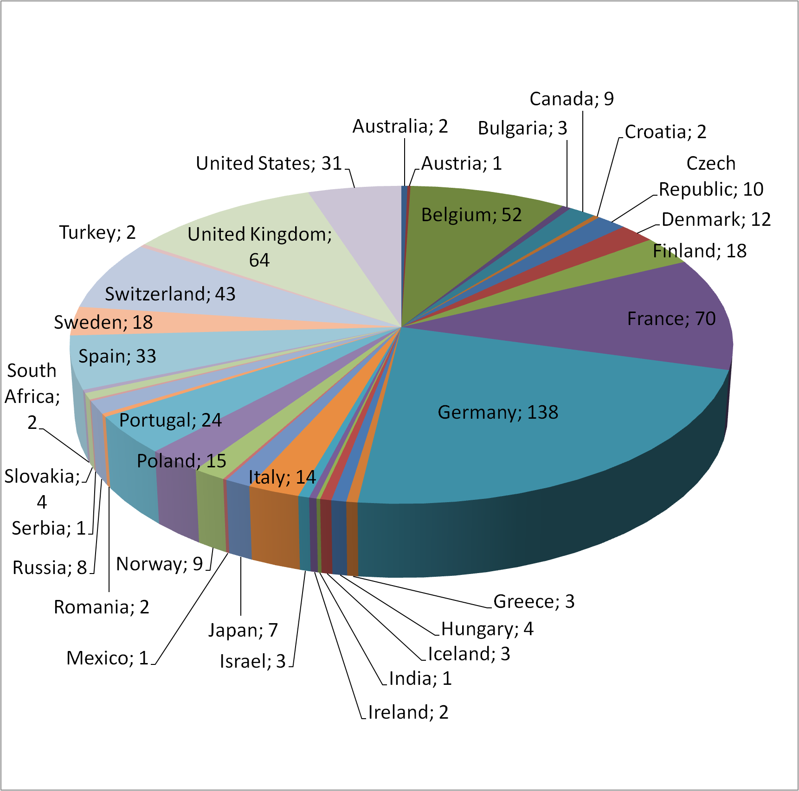
The ISOLDE users community
Number of scientists per country
> 800 scientists
from 209 institutes
from 41 countries
~ 50 experiments/year
(~ 15-20 with Leuven)
> 20 PhD’s per year
(~ 4/year at Leuven)
> 80 publications/year
of which many “Letters” and several Natures …
(~ 25-30/year with Belgium)
5 main users:
Germany, France, UK, Belgium, Switzerland

Slide 17
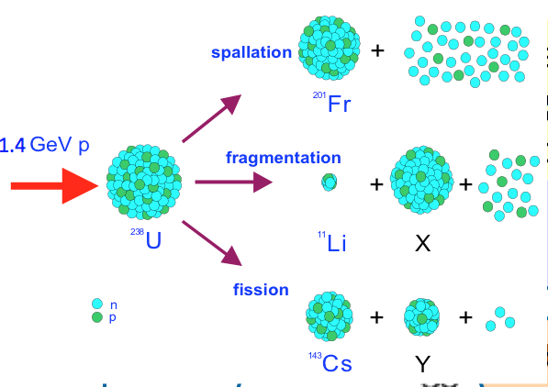
ISOLDE is world-leading thanks to wide variety of radioisotopes in wide energy range
So far ~ 700 radioactive isotopes of > 60 elements @ 40-60 keV
> 70 re-accelerated isotopes (using REX-ISOLDE) since 2001

Slide 18
Research with radioactive nuclides @ ISOLDE
ISOLDE today offers the largest range of nuclei of any ISOL facility worldwide
Nuclear physics
and
atomic physics
Material science and
life sciences
Ion traps
Emission Channeling
Decay spectroscopy
IDS
With low-energy beams from ISOLDE ion sources
decay pattern
mass
Laser spectro-scopy
transition probability
Nucleon-transfer reactions
spin, parity
e-m moments
With post-accelerated beams
from REX and HIE-ISOLDE
half-life
radius
Beta-detected NMR
Coulomb excitation
Beta-decay correlations
Nuclear astrophysics
Fundamental interactions
Leuven involved/leading
Notes:
In the center the observable we measure and the fields of impact.
The intermediate ring describe the techniques used in the measurements

Slide 19
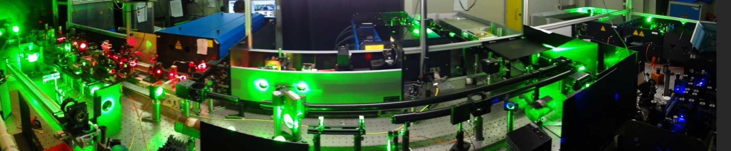

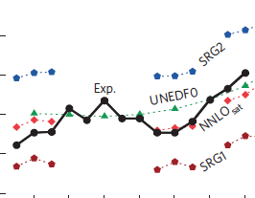
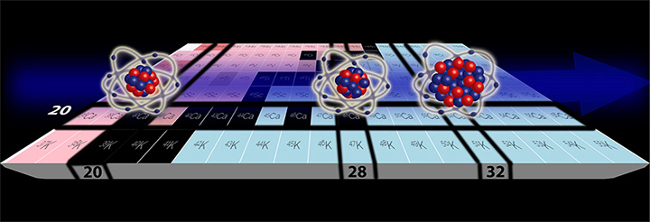
ISOLDE LOW ENERGY BEAMS – BELGIAN HIGHLIGHTS
Collinear laser spectroscopy
→ Now further improving sensitivity by factor 500 @ CRIS
In-source laser spectroscopy
RILIS: Ionisation potential of Astatine
S. Rothe et al, Nature Communications 4 (2013), 1835
COLLAPS: Radii of ⁴⁰⁻⁵²Ca
R. Garcia-Ruiz et al, Nature Physics 12 (2016) 594
Least abundant element on Earth
Series of Rydberg states
Ionisation Potential = 9,31751 (8) eV
Unexpectedly large charge radius of ⁵²Ca
Important for nuclear structure studies towards heaviest elements and
for atomic physics
P. Van Duppen
G. Neyens

Slide 20


From REX-ISOLDE to HIE-ISOLDE
REXEBIS
REX-ISOLDE
Mass separator
ISOLDE
9-GAP RESONATOR
7-GAP RESONATORS
IH
RFQ
ISOLDE beam
Primary
target
High energy
driver beam
protons
Rebuncher
3.0 MeV/u
2.2 MeV/u
0.3 MeV/u
60 keV
Experiments
1.2 MeV/u
REXTRAP
H
Radioactive
He
Li
Be
Decay product in REXTRAP
B
C
N
O
F
Ne
Stable
REX-ISOLDE started in 2001 and ended (temporarily) in 2012
Na
Mg
Al
Si
P
S
Cl
Ar
K
Ca
Sc
Ti
V
Cr
Mn
Fe
Co
Ni
Cu
Zn
Ga
Ge
As
Se
Br
Kr
Rb
Sr
Y
Zr
Nb
Mo
Tc
Ru
Rh
Pd
Ag
Cd
In
Sn
Sb
Te
I
Xe
Cs
Ba
*La
Hf
Ta
W
Re
Os
Ir
Pt
Au
Hg
Tl
Pb
Bi
Po
At
Rn
Fr
Ra
*Ac
Rf
Db
Sg
Bh
Hs
Mt
0
Ds
Rg
Cn
113
114
115
116
117
118
*Lanthanides
*Actinides
Ce
Pr
Nd
Pm
Sm
Eu
Gd
Tb
Dy
Ho
Er
Tm
Yb
Lu
Th
Pa
U
Np
Pu
Am
Cm
Bk
Cf
Es
Fm
Md
No
Lr
> 70 beams accelerated to 3 MeV/u since 2001

Slide 21
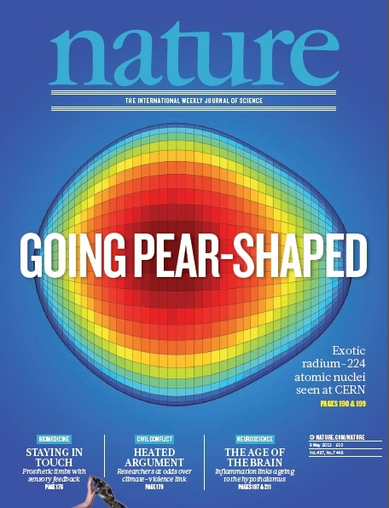
Coulomb excitation:
  collectivity versus individual nucleon behaviour
P. Van Duppen
M. Huyse
^{184,186,188}Hg; Bree PRL (2014)
¹⁹⁶⁻²⁰²Po; Kesteloot PRC (2015)
^{202,204}Rn; Gaffney PRC (2015)
Probing shape coexistence
126
^{222,224}Ra^{; 220,222}Rn
Probing Pear Shape
Gaffney Nature 2013
82
¹¹⁰Sn; Cederkäll PRL 2007
^{106,108}Sn, Ekstrom PRL 2008
50
^{96,98}Sr, ⁸⁸Kr, ⁹²Kr Albers PRL 2012
Clement PRL 2016
50
^{122,124,126}Cd
^{138,140,142,144}Xe
^{140,148,150}Ba
20
28
Evolution of collectivity around ¹³² Sn
8
⁷⁰Se Hurst PRL 2007, Shape coexistence
28
^{74,76,78,80}Zn Probing large scale shell model, Van de Walle, PRL 2007
20
8
^{67,69,71,73}Cu, Stefanescu PRL 2008
^{68,70}Cu, Isomeric ⁶⁸Cu, Stefanescu PRL 2007
^{30,31,32}Mg, Niedermaier PRL2005
NEED UP TO 5 MeV/u TO BE MORE SENSITIVE

Slide 22
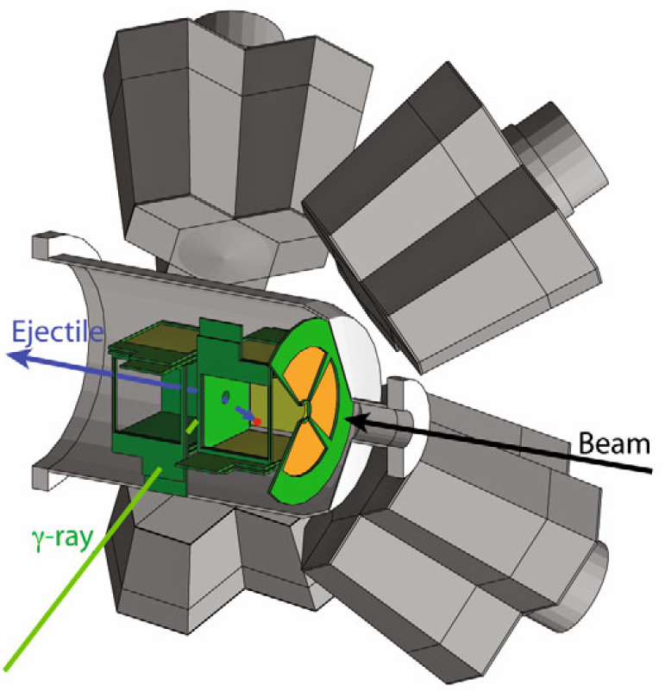
One and two-neutron transfer reaction studies:
  single-particle properties
  halo and cluster structures
R. Raabe
P. Van Duppen
M. Huyse
126
82
d(⁶⁶Ni,p)⁶⁷Ni Diriken PLB 2014, PRC 2016
t(⁶⁶Ni,p) ⁶⁸Ni Elseviers
d(⁷⁸Zn,p)⁷⁹Zn Orlandi PLB2015
50
50
20
28
8
t(⁷²Zn,p)⁷³Zn Hellgartner
t(⁴⁴Ar,p)⁴⁶Ar Nowak PRC(2016)
t(³⁰Mg,p)³²Mg, Wimmer, PRL 2010
28
20
Light nuclei, halos & clusters
d(⁸Li,p)⁹Li*; Tengborn PRC (2011) d(⁹Li,p)¹⁰Li
d(¹¹Be,p)¹²Be Johansen PRC (2013)
¹¹Be+⁶⁴Zn Di Pietro PRL (2010)
8
NEED UP TO 10 MeV/u TO BE MORE SENSITIVE

Slide 23


From our 2010 presentation:
The HIE-ISOLDE project concentrates on the construction of a SC LINAC and associated infrastructure in order to upgrade the energy of the post-accelerated radioactive ion beams to 5.5 MeV/u in 2013 (2015-2016) and 10 MeV/u by 2015 (2017-2018)
The design study for the intensity upgrade, also part of HIE-ISOLDE, starts in 2011/2012, and addresses the technical feasibility and cost estimate for operating the facility at 10 kW once LINAC4 and PS Booster are online.
→ Staged approach – new building constructed during LS1 !

Slide 24
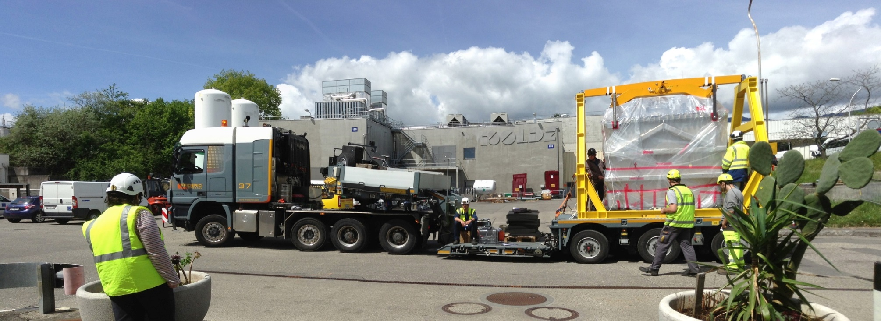
First Cryomodule spring 2015: from 3 to 4.3 MeV/u
2nd of May 2015
0.5 km/h

Slide 25
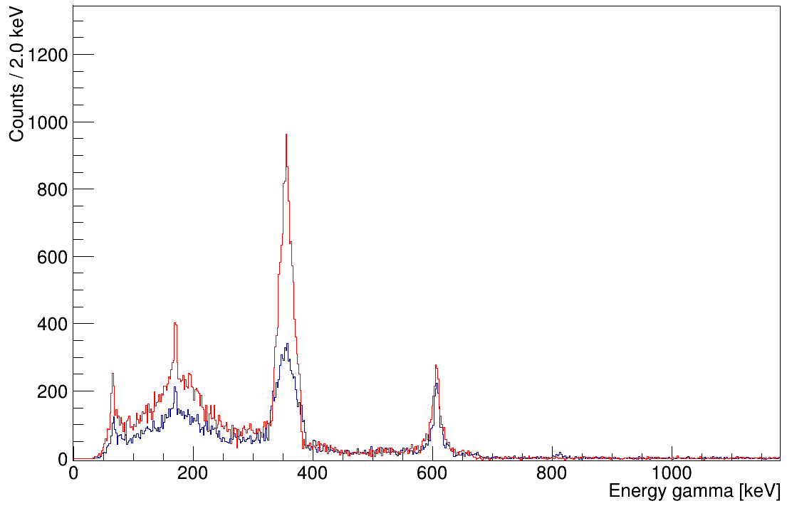
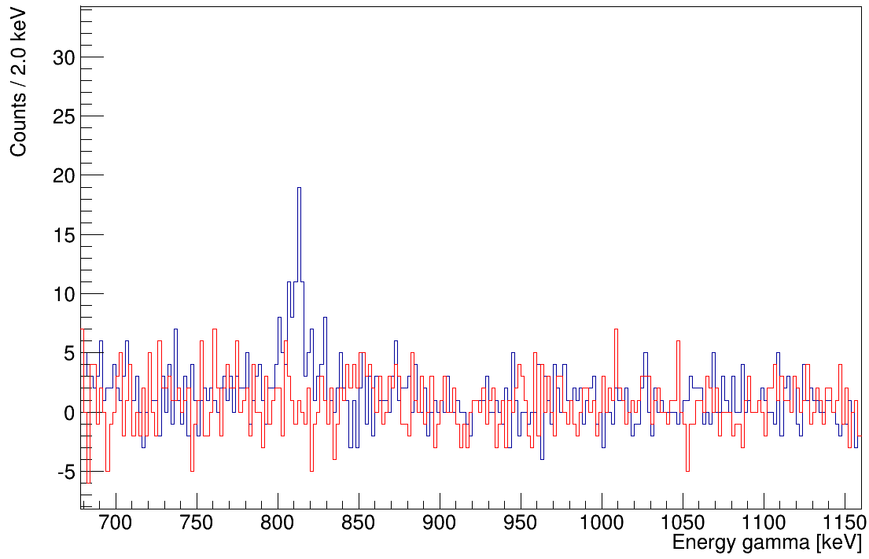
First Coulex experiment at HIE ISOLDE October 2015
⁷⁴Zn(10⁶ pps, 4 MeV/u) + ¹⁹⁶Pt
4.0 MeV/u (~ 5 hours)
⁷⁴Zn on ¹⁹⁶Pt at two different energies
4⁺
2.8 MeV/u (~ 16 hours)
⁷⁴Zn 4⁺ → 2⁺
2⁺
¹⁹⁶Pt 2⁺ → 0⁺
0⁺
⁷⁴Ga Cont.
⁷⁴Zn 2⁺ → 0⁺
⁷⁴Zn 4⁺ → 2⁺
Experiment proposed by KU Leuven team

Slide 26
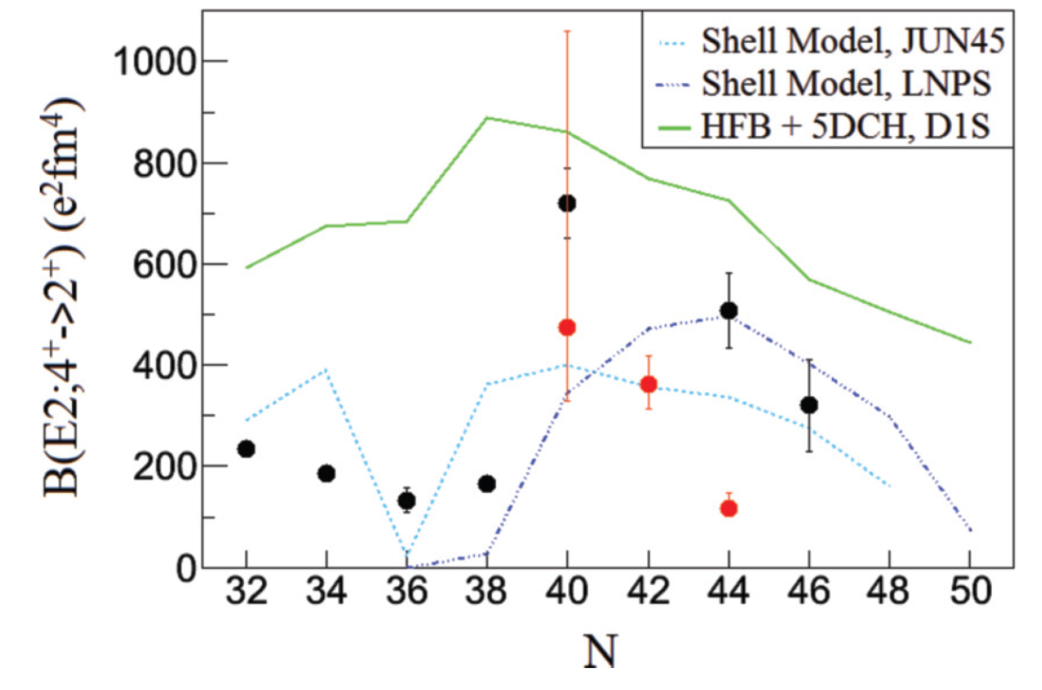
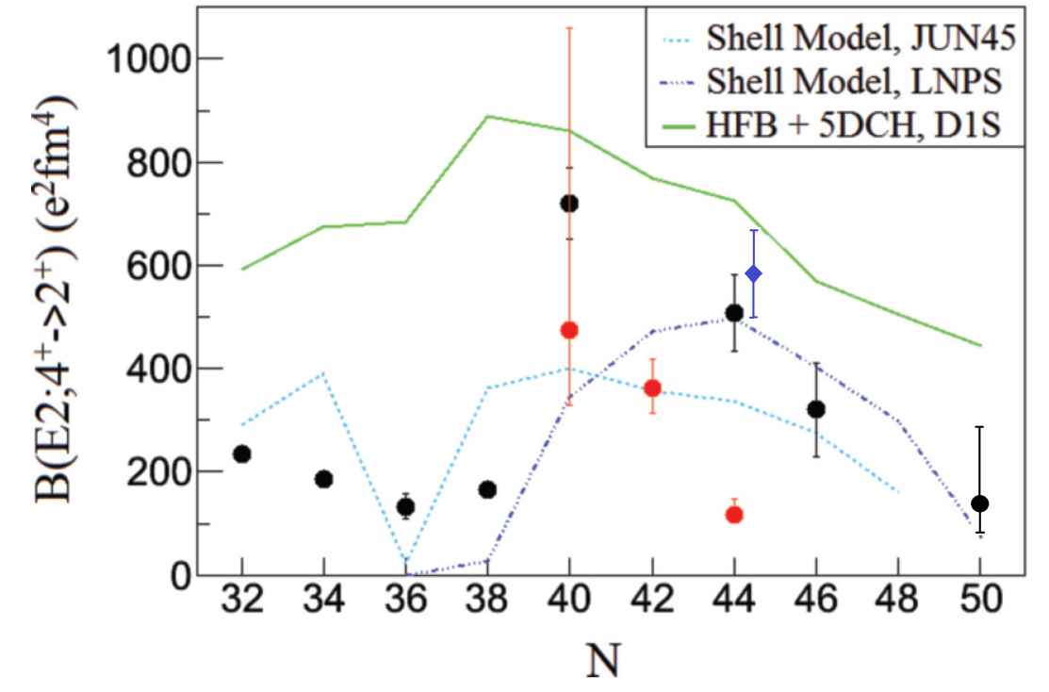
Zn
62 | 63 | 64 | 65 | 66 | 67 | 68 | 69 | 70 | 71 | 72 | 73 | 74 | 75 | 76 | 77 | 78 | 79 | 80
Transition probability between excited states in Zn isotopes
➔ probing single-particle versus collective behavior
➔ probing onset of deformation
HIE ISOLDE (2015)
Conflicting data for
⁷⁴Zn
Louchart PRC 2013 (AGATA)
Van De Walle PRL 2007 (REX-ISOLDE)
Louchart PRC 2013 (decay AGATA)
Van De Walle PRL 2007 (REX-ISOLDE)
Andreas Illana Sison (KU Leuven) et al. to be published

Slide 27
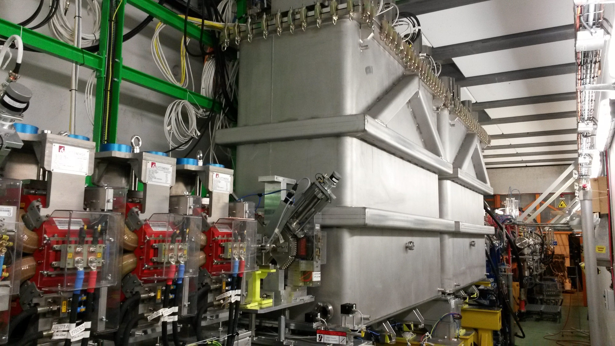
Spring/summer 2016: installation one more Cryomodule

Slide 28
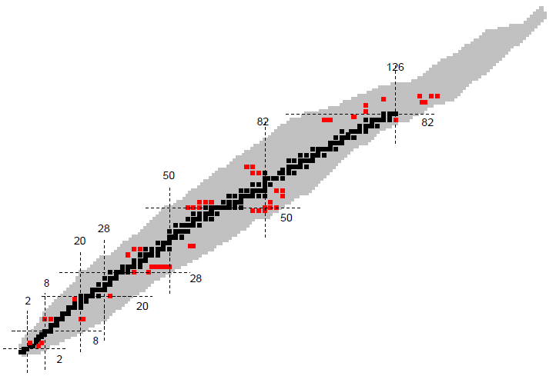
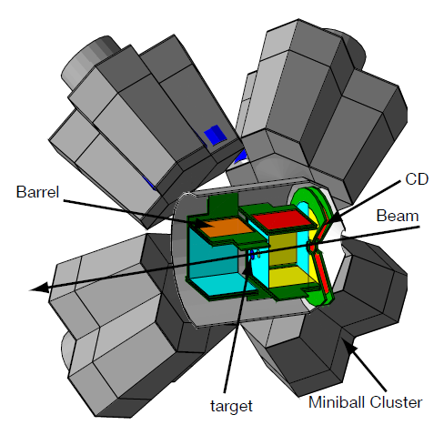

Radioactive beams @ 5.5 MeV/u for Coulex and Transfer
First radioactive beams on 9 September 2016 Sn-110
Experiments fall 2016:
  Coulomb excitation of ¹¹⁰Sn, ¹⁴²Xe, ¹³²Sn,
  Transfer reaction with ⁹Li beam
Transfer reactions
MINIBALL
For Coulex
T-REX for particle detection
8 DE-E_{rest} Barrel det.
1 DE-E_{rest} CD detectors
MINIBALL for gamma detection
8 Miniball triple (HPGe) clusters
Crystals: 6-fold segmented
5% efficiency at 1.33 MeV
mgb@cern.ch
28

Slide 29
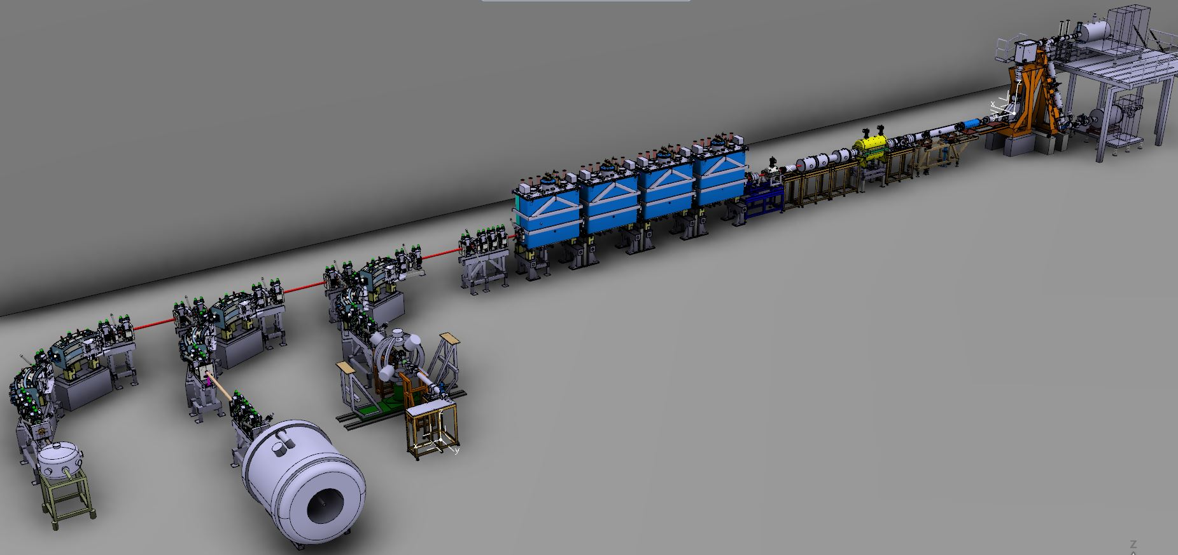
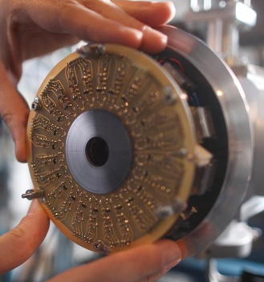
HIE-ISOLDE Phase 2 up to 7 MeV/u (2017) and 10 MeV/u (2018)
Cd-Si Detector
T-REX
SPEDE
MINIBALL
Movable Setups
ISOL Solenoidal Spectrometer

Slide 30
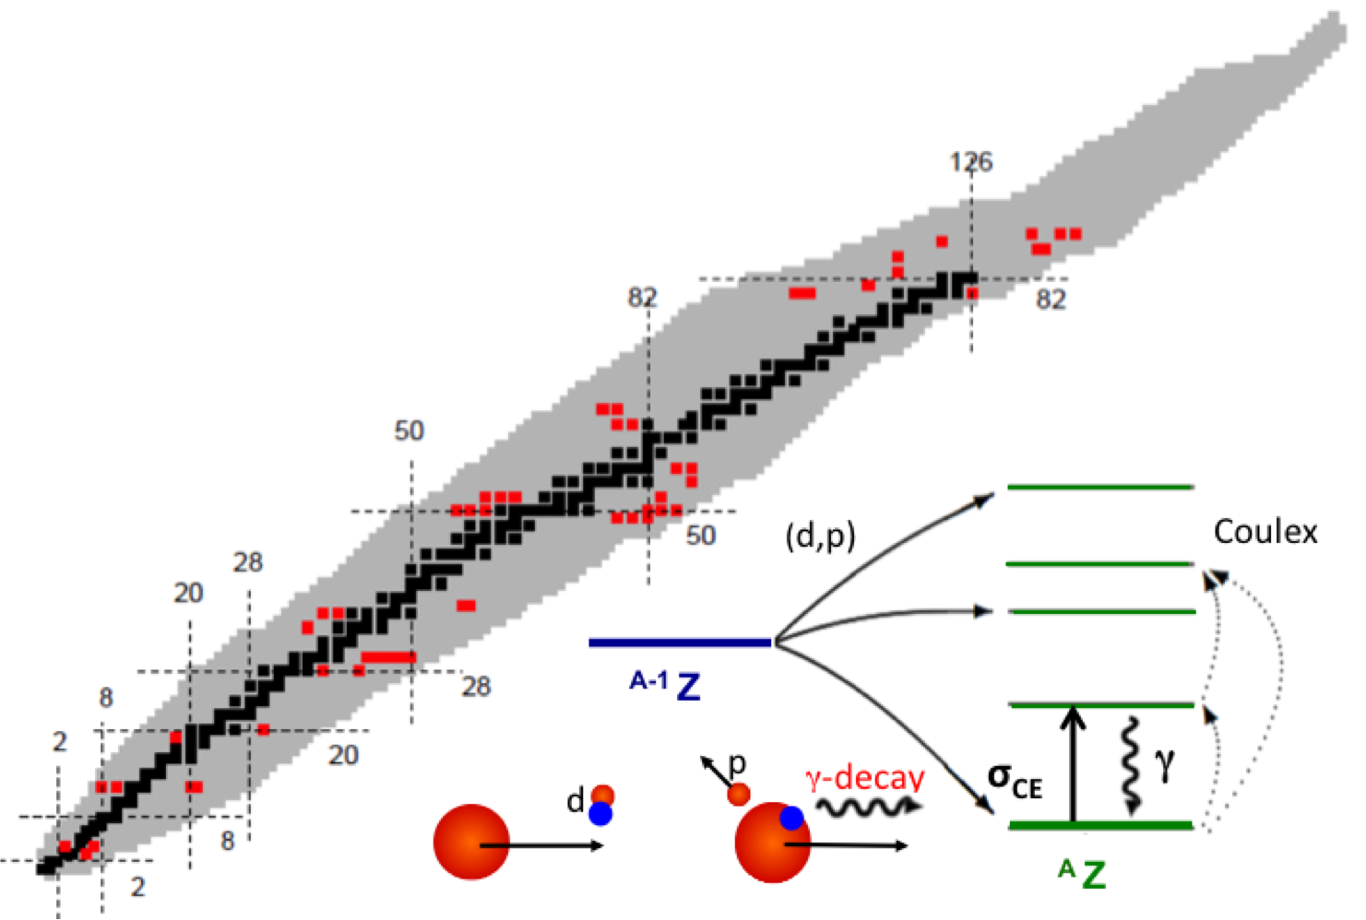
Physics at HIE-ISOLDE
The new energy window gives the opportunity to address new physics questions:
30 Experiments approved (25% from Leuven)
> 700 shifts
Isospin symmetry
Magic numbers far from stability
Collectivity versus Single Particle
Shape Coexistence
Reaction for nucleo-synthesis studies

Slide 31
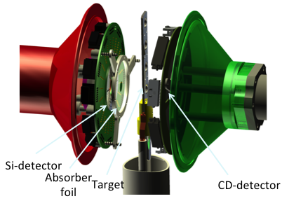
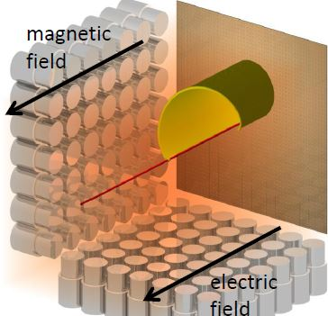
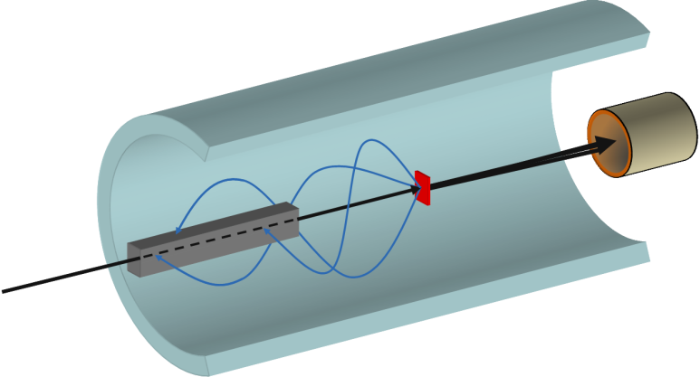
Instrumentation
Miniball + T-REX (upgrade planned)
COULEX + Transfer
SPEDE: added to Miniball+T-REX
Multipurpose reaction chamber
CORSET chamber for fusion-fission reactions
MAYA/ACTAR/SpecMAT: resonant scattering
+ transfer
ISOL Solenoidal Spectrometer: ISS
  (installed March 2017)
R. Raabe
Notes:
First experiments in 2016: 108Sn, 142Xe, 78-80Zn, 134-136Sn, 9Li, 66Ni or 70Se
Other approved experiments: 59Cu(p,alpha); 7Be(d,p) (d,d); 20Mg+MAYA; 70Ni(d,p); 94,95Rb+CORSET (quasi fission-fusion); 140Sm, 182Hg, 221Ra, 186,188Pb

Slide 32
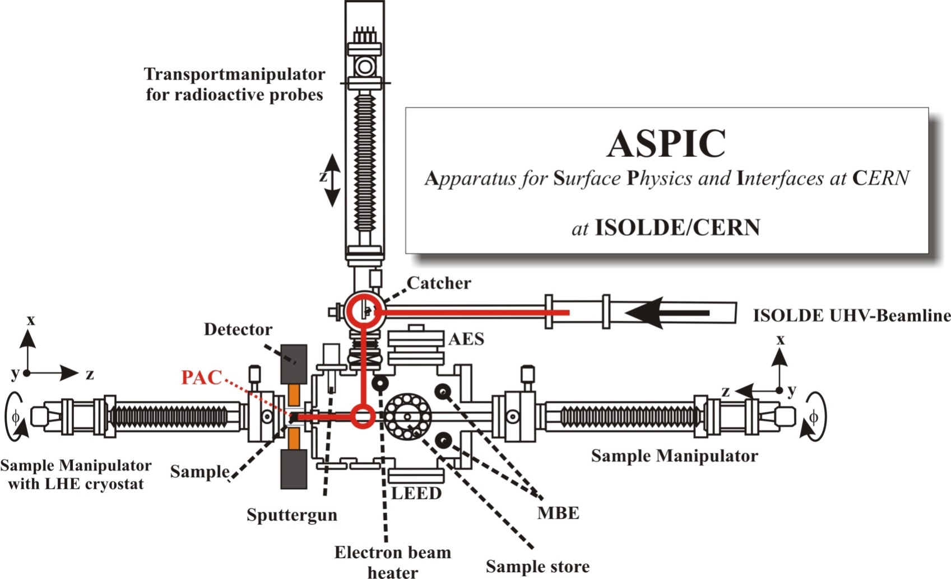
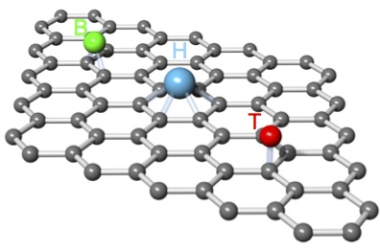
Materials research at ISOLDE:
Upgrade of the Apparatus for Surface Physics and Interfaces at CERN (ASPIC)
Locally probing structural and electronic properties of 2D materials
using hyperfine interactions (ongoing upgrade)
Soft-landing of selected radioactive probes on the surface of 2D materials under ultra-high vacuum
In-situ measurement of hyperfine parameters as a function of temperature, applied electric and magnetic field…
Quantitative analysis based on ab initio density functional theory (DFT) calculations
J. Phys. G: Nucl. Part. Phys. (2017)
https://doi.org/10.1088/1361-6471/aa659e
New tenure track Lino Pereira

Slide 33
CONCLUSIONS
Nuclear Physics in Belgium is now fully international !
Belgian scientists play leading roles in new developments at ISOLDE-CERN, GANIL-SPIRAL2 and PSI
Many publications in high-impact papers
2 ERC-funded projects
Belgian scientists are involved in the science policy of existing and planned new facilities
  (member of SPC@CERN, ISOLDE group leader, president of GANIL users group, chair of the BEC Belgian EURISOL Consortium, …)
PROBLEM: no more funding schemes for international equipment investment !

Slide 35
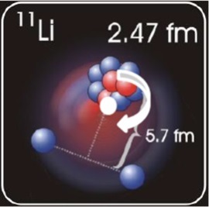
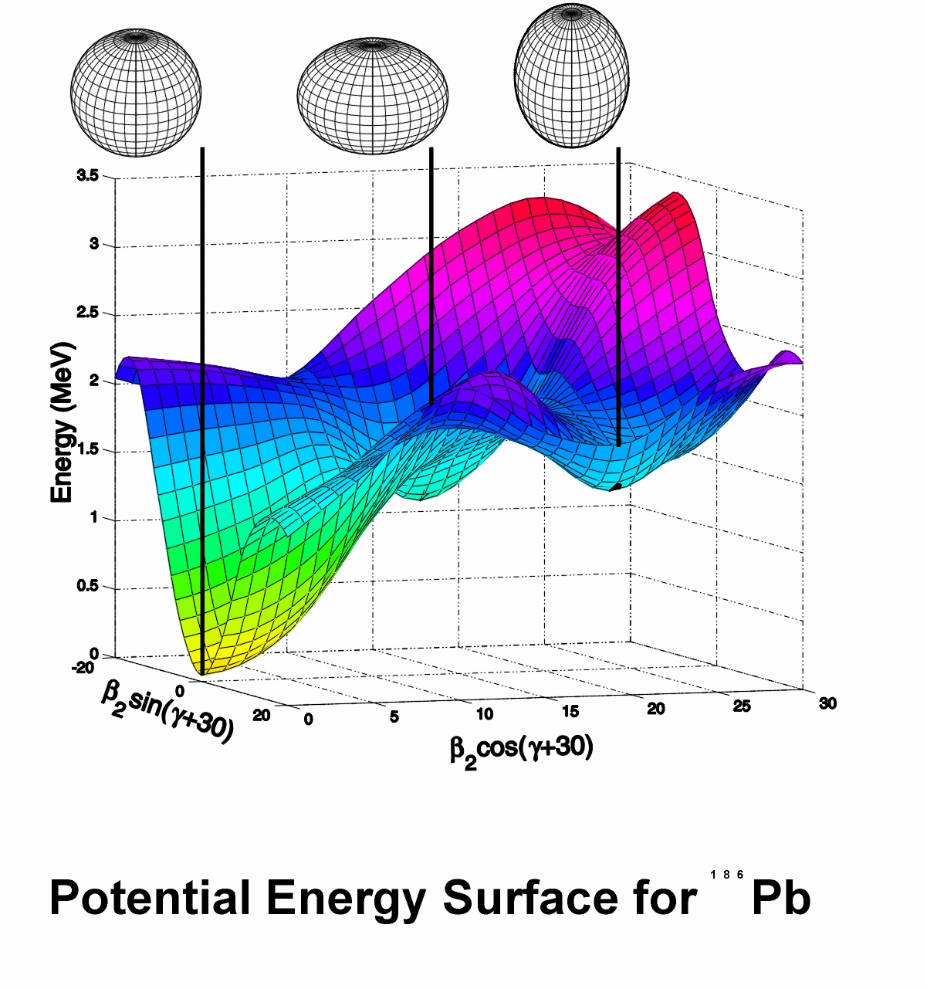
Nuclear Models
  Halo nuclei
  Magic numbers (Z or N = 20, 28,…)
  Collective versus individual nucleon behavior
EXOTIC NUCLEI
j’<
j<
j’>
126
j>
proton
neutron
82
Density Functional Theory
50
50
stable
β⁺/EC
β⁻
α
fission
unknown
20
28
8
28
Configuration Interaction
Nuclear Shell Model
20
8
Ab Initio calculations
¹⁸⁶Pb
Perform experiments on exotic nuclei to test nuclear models

