Slide 1
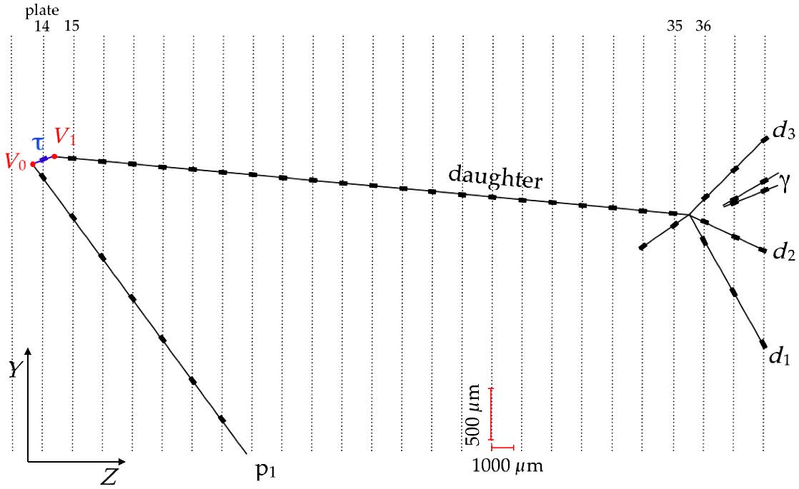
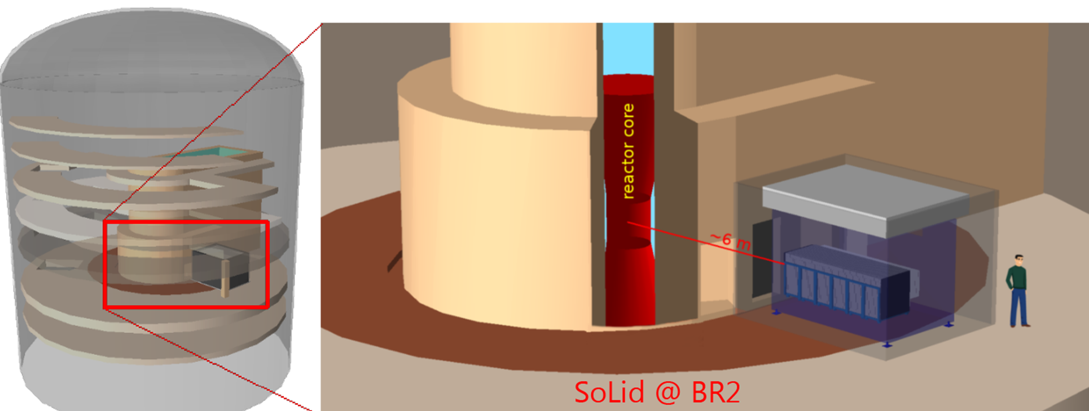
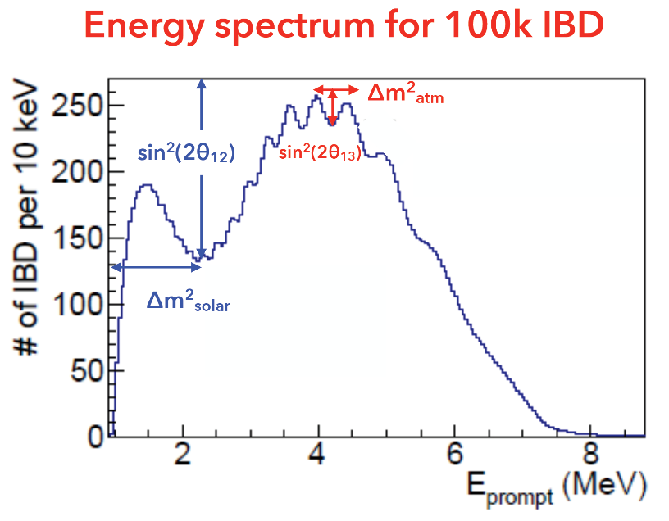
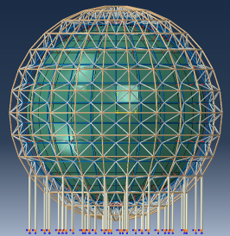
Neutrino Physics in Belgium
Nick van Remortel
University of Antwerp, Belgium
RECFA meeting
Brussels 21/4/2017

Slide 2
Experimental facts and consequences
Since 1998: unambiguous proof of neutrino oscillations $→$ ν mass
Dirac (Majorana) $ν^{′}s$: 3masses($m_{1}, m_{2}, m_{3}$), 3 angles ($θ_{12},θ_{13},θ_{23}$), 1 (3) CP-phase
Oscillation experiments:
Not sensitive to Dirac vs Majorana
Measure very small $Δm_{ij}^{2}=m_{i}^{2}−m_{j}^{2}$
Only 2 independent values: $Δm_{sol}^{2}=Δm_{21}^{2}=7.37×{10}^{−5}{eV}^{2}$ $∆m_{atm}^{2}=\left|∆m_{32}^{2}\right|=2.50×{10}^{−3}{eV}^{2}$
Measure very large $\sin^{2}\left(θ_{ij}\right)$
CP-violating part: depending on signs of mixing, and on $θ_{13}$
Short baseline reactor & long baseline accelerator $→$ measure Dirac CP phase
Long baseline accelerator & matter effect, and long baseline reactor neutrino $→$ measure sign of $∆m_{32}^{2}$ (JUNO)
Other measurements:
Asolute mass scale and confront with cosmology
Dirac or Majorana
See-Saw?
More than 3 ? (SoLid)
Totally different from quark
mixings

Slide 3
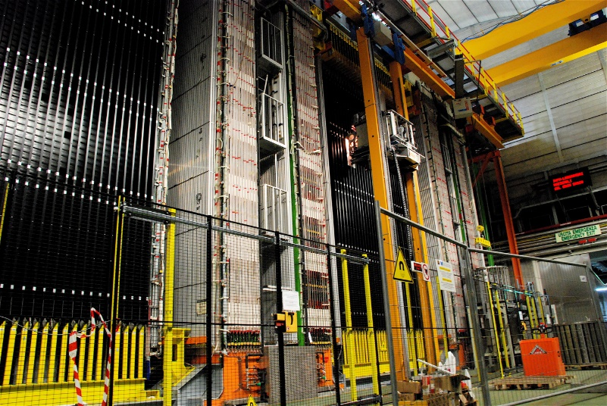
Legacy experiments
Involvement of ULB, VUB, UCL in neutrino beam experiments, searching for $ν_{μ}→ν_{τ}$ in appearance mode
CHORUS: L/Eν≃0.6km/27GeV
datataking stopped in 1997: latest papers in 2011
(IIHE-ULB) P. Vilain, G. Wilquet,
(UCL) D. Favart, T. Delbar, G. Grégoire
OPERA: L/Eν≃ 730km/17GeV
(IIHE-ULB) P. Vilain, G. Wilquet,
data taking 2008-2012:
Latest update on $ν_{μ}→ν_{τ}$ in 2015
Interpretation of data in terms of steriles (2015)
More coming ..

Slide 4
OPERA
Belgian responsibilities: G. Wilquet, P. Vilain
Scintillator strip Target Tracker
Design&Simulations
Chair Collab. board
Chair Editorial board
Scientific output since 2010:
15 Peer Reviewed papers (2 in 2015, 1 in 2016)
4 more in writing
5th CC interaction candidate in OPERA
5 $ν_{τ}$ Candidates out of 5408 scanned interactions
Confirmation of atmospheric ν oscillations due to
$$ν_{μ}⟷ν_{τ}$$
Phys. Rev. Lett. 115, 121802 (2015)
$$Δm_{23}^{2}=3.3 × {10}^{−3 }{eV}^{2}$$

Slide 5
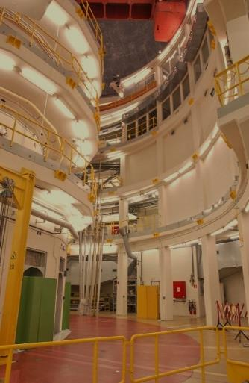
SoLi∂ at BR2
ν
ν
ν
ν
ν ?
ν
ν
ν

Slide 6
Belgium @ SoLid
Total construction (material) cost: 1.2 MEur
SoLid construction constrained by Spending profile
Belgian Funding:
Vlaamse Hercules Stichting: 450 KEur
FWO: 2 projects (mostly PhD/postdoc grants)
530 + 600 kEur for 2015-2020, covering:
4 FYE Gent
8 FYE Antwerpen
8 FYE Brussels
80k service&operation SCK
Relatively small experiment: 12 institutes, ~50 collaborators
Belgian participation since 2013, via:
UGent:
5 FTE: D. RyckBosch (IB Chair), M. Labare, C. Moortgat (SCK), I Michiels, Ph. Van Auwegem, P. Sennesael, Ch. Schuerens
Construction, Simulation, Analysis
VUB:
2 FTE: J. D’Hondt, P. Van Mulders (convener), L. Kalousis (convener), S. Vercaemer
Construction, Simulation, Analysis
UAntwerpen:
5FTE: N. van Remortel (tech Coordinator), I Pinera (convener), Y. Abreu, W. Beaumont, M. Verstraeten, S. Vercaemer, A. De Roeck (Pub comm. Chair)
Electronics, Construction, Simulation, Analysis
SCK-CEN:
3 FTE: E. Koonen, B. Coupé, L. Ghys (convener) , S. Kalcheva, J. Mermans, G. Van Den Branden, S. Van Dyck
Reactor flux, spectrum, Construction, Analysis

Slide 7
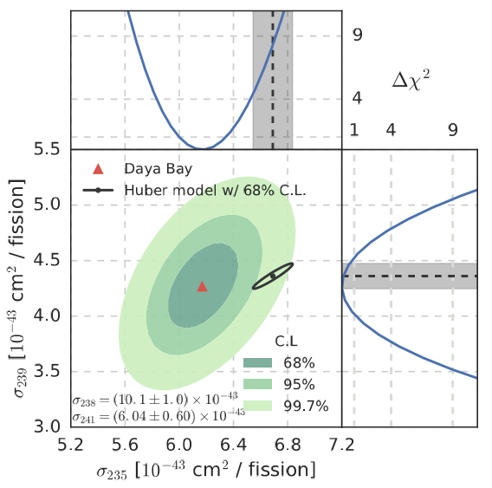
SoLid physics goals
Challenge some long-standing neutrino anomalies: Radiochemical, Reactor, LSND-Miniboone
Measure reference ${\overline{ν}}_{e}$ spectrum of pure ${}_{}^{235}U$
Demonstrate compact, cheap, highly segmented ${\overline{ν}}_{e}$ detector technology: Reactor monitoring
SoLid baseline coverage

Slide 8
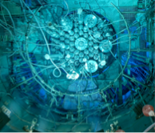
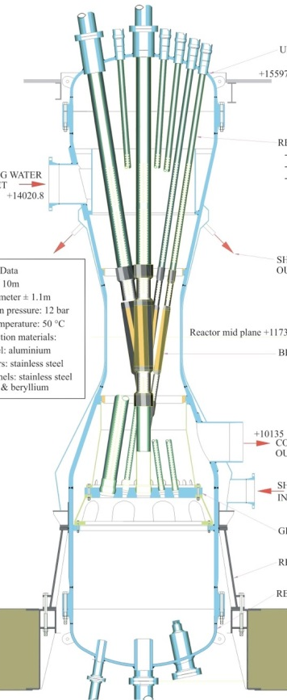
Belgian Reactor 2 (BR2)@ SCK•CEN: Unique environment
BR2 Confinement building
Aluminum pressure Vessel
Twisted core
BR2 reactor:
95% Enriched 235U
Effective core diameter d=0.5m
Peak power: 70-80 MW_{th}
Duty cycle: ~ 150 days/year
Low accidental background
SoLid ${\overline{ν}}_{e}$ detector:
2 T fiducial, no overburden
Baseline: 6.2 – 9.2m
On-axis with reactor core
~400 triggered & selected ${\overline{ν}}_{e}/day$

Slide 9
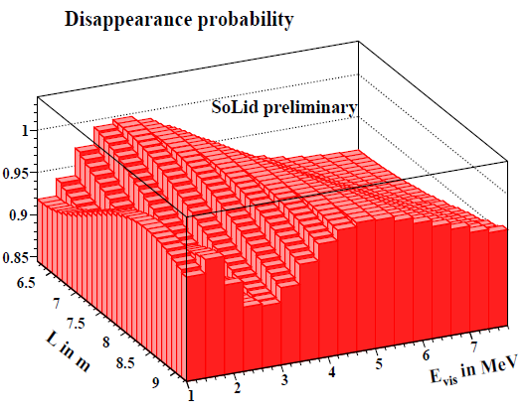
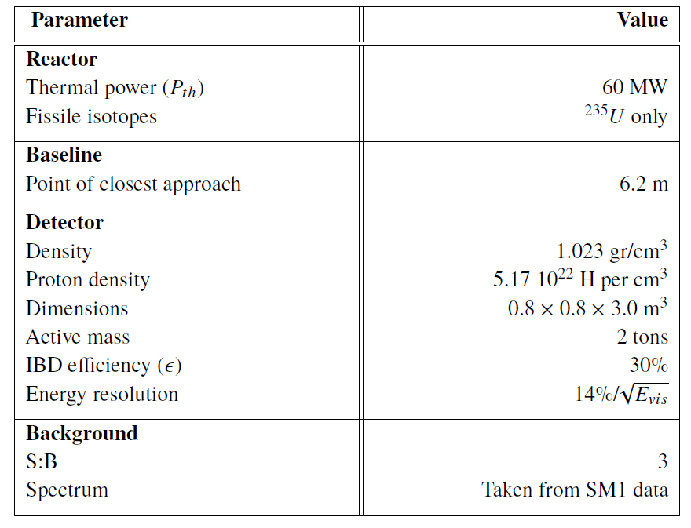
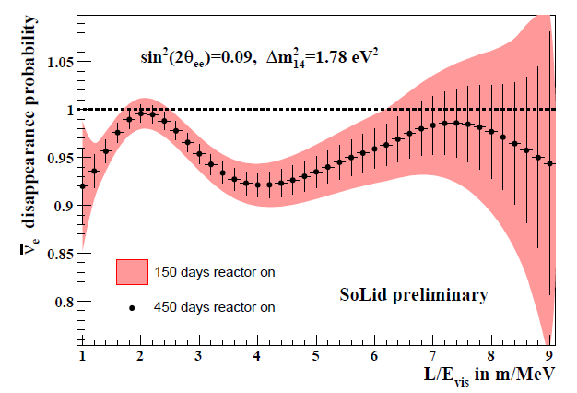
Main Features of SoLid
Expectations from detailed simulation

Slide 10
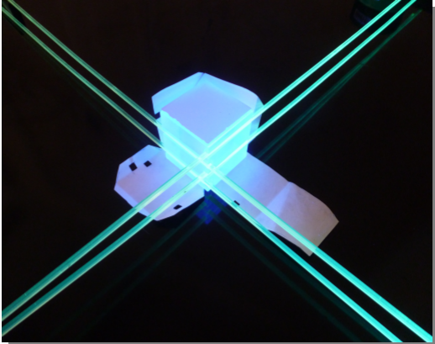

Slide 11
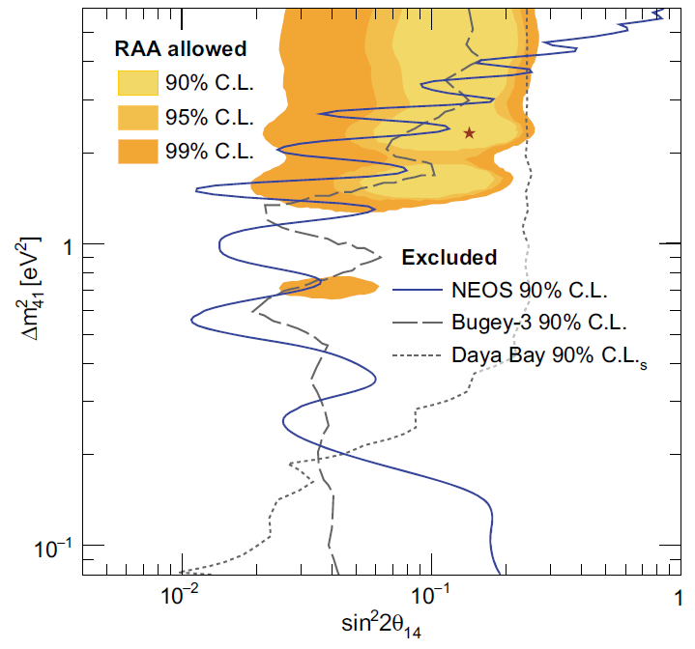
SoLid sensitivity to sterile ν’s
Competing experiments:
NEOS (Korea): Completed
DANNS (Russia): Online
STEREO (France):Online
PROSPECT (USA): start 2017

Slide 12
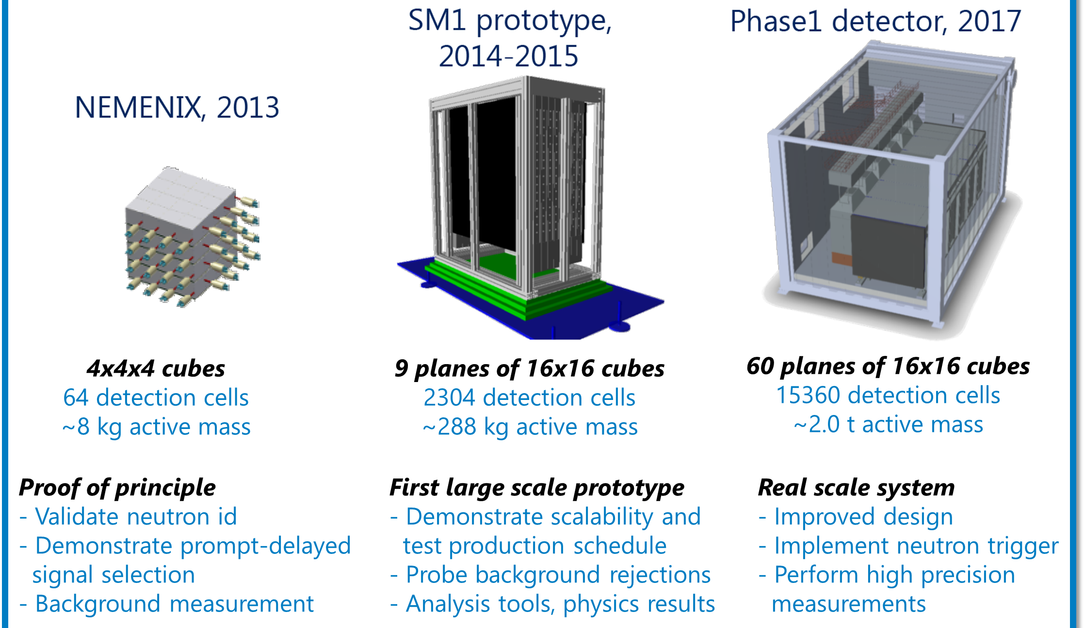
SoLid Timeline

Slide 13
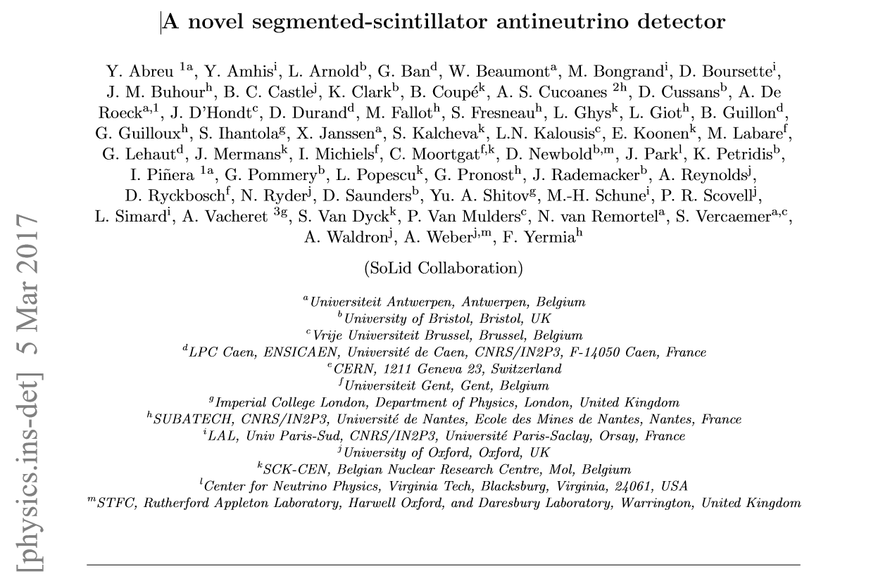
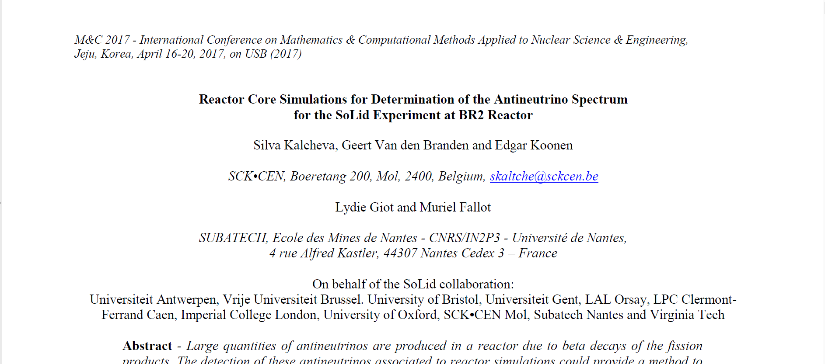
SM1 Highlights
Demonstrated stability of operation on-site at BR2
Calibration& equalization of response up to 2%
Demonstrated achievable energy resolution of 14%@1 MeV
Identified and measured main backgrounds: S/N= 3:1 achievable by exploiting:
Extra shielding
Topology cuts
Multiplicity & tracking
Neutron ID trigger at very low amplitude threshold
Reactor group & Simulation: First predicted energy spectra & rates

Slide 14
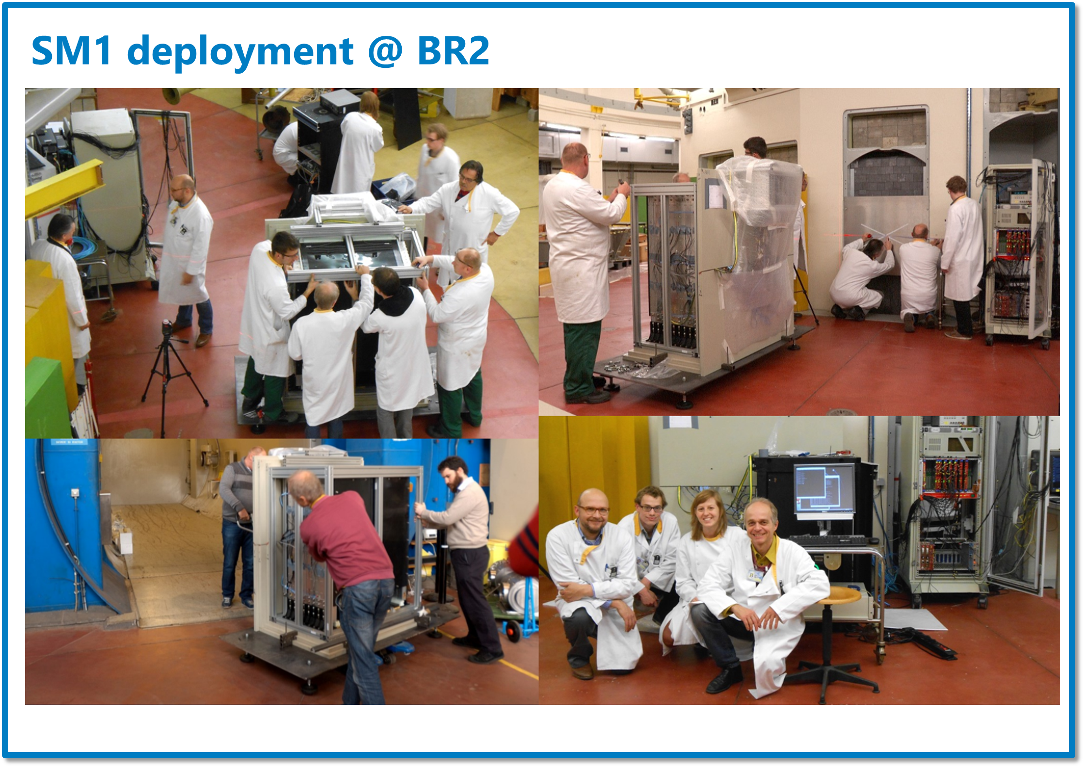
2015

Slide 15
Specific contributions
Neutron ID: S. Vercaemer, Y. Abreu
Cosmogenic backgrounds: L. Kalousis, P. van Mulders, I. Pinera, C. Moortgat
Reactor backgrounds: L. Ghys, P. van Mulders
Simulation: geometry, reactor building, detector & readout: M. Verstraeten, I. Pinera, …
Sensitivity, Limits, Oscillometry: L. Kalousis, S. Vercaemer
Intrinsic backgrounds: Y. Abreu
Databases & Quality control: M. Labare

Slide 16
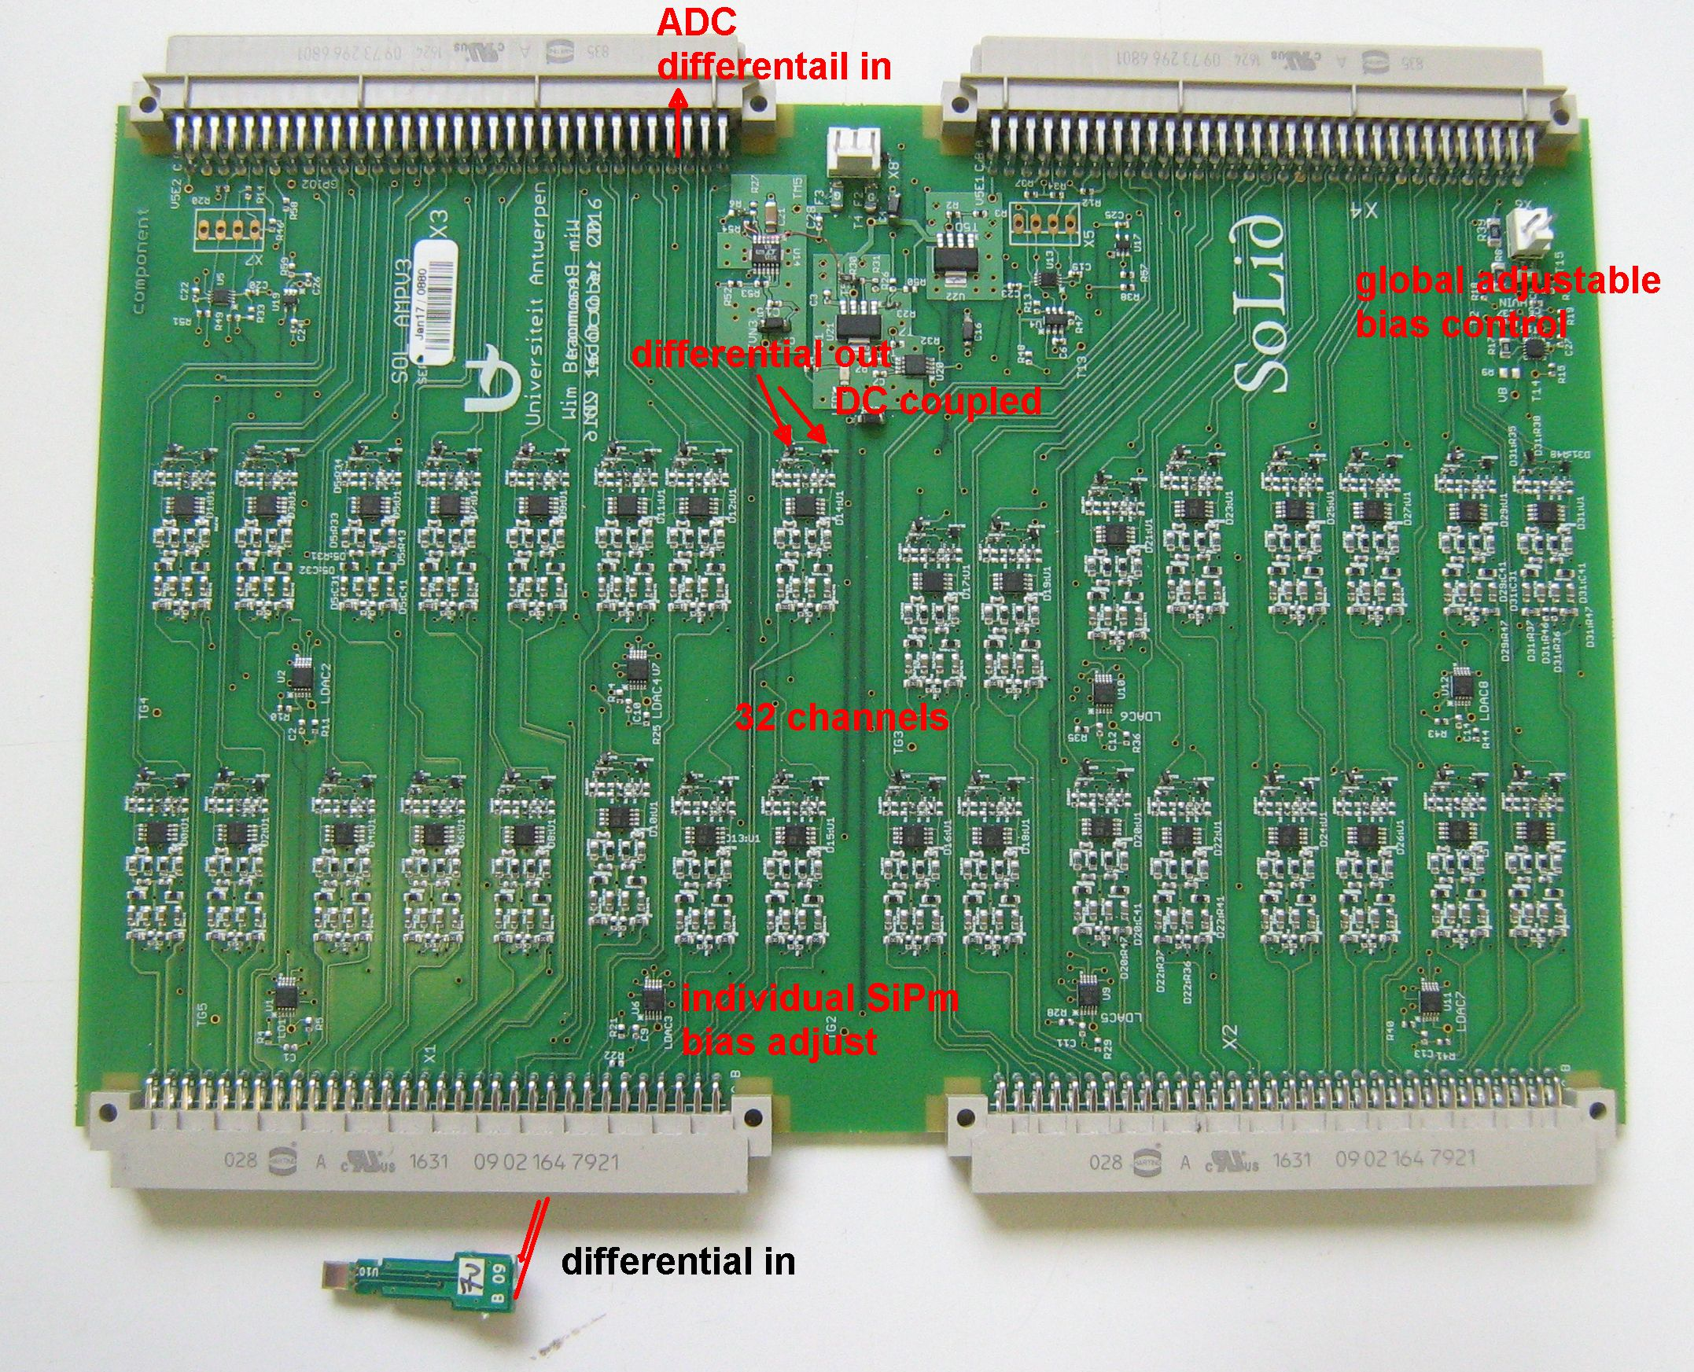
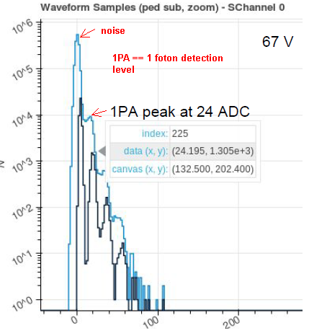
SOLID SiPm amplifier
R&D and Construction
2016-2017
To achieve : detect 1 photon signals from the ws fiber
SM1 lesson : to much noise pickup
Long signal cables between SiPm and amplifier still optimal choice for integration.
Full differential signal, from SiPm up to the ADC

Slide 17
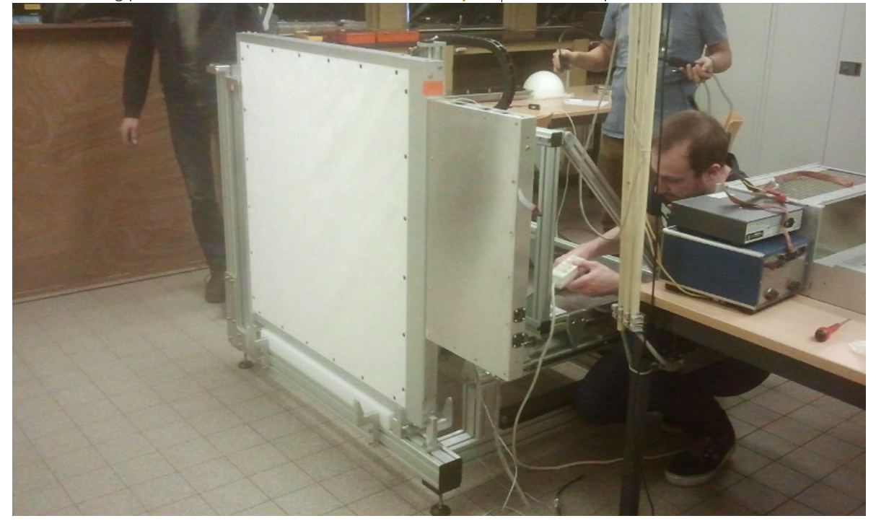
Construction& Assembly & Quality control
2016-2017
Production & assembly in Gent and RAL (UK)
Site preparation: SCK
Quality Control & Calibration: Gent
Physics run: Start July 2017
Complete detector before Sept
150 days reactor time/year: 2018-2019
Ideas for extension: CHANDLER technology

Slide 18
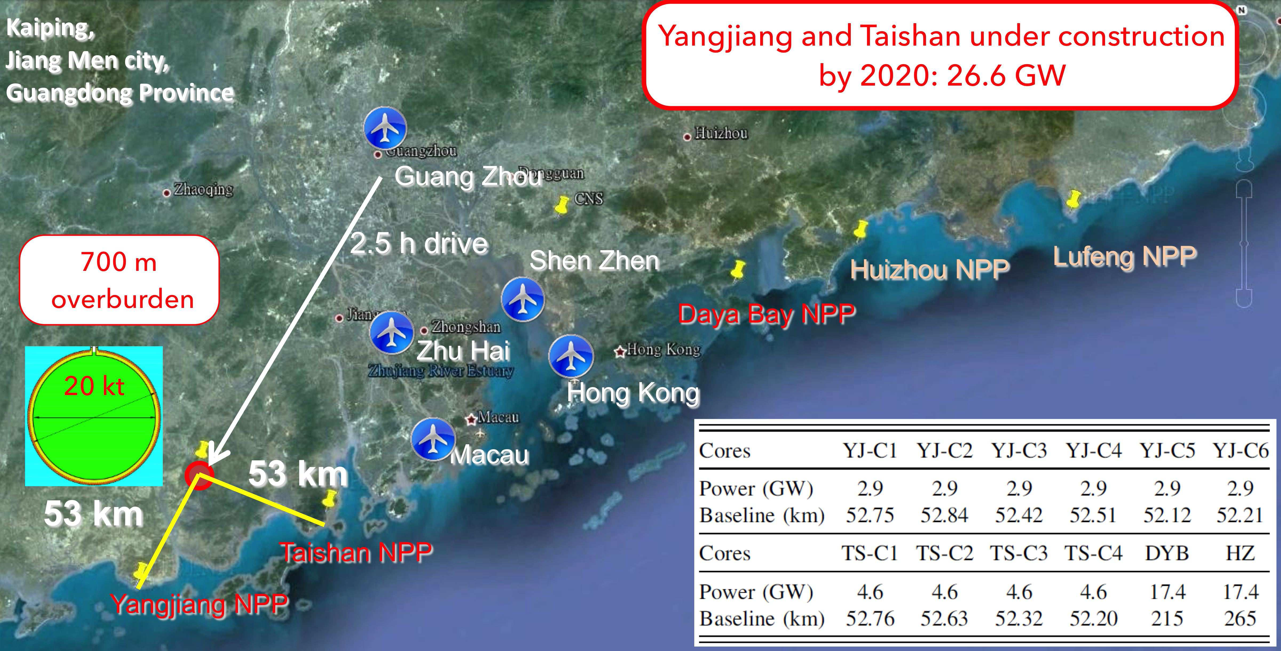
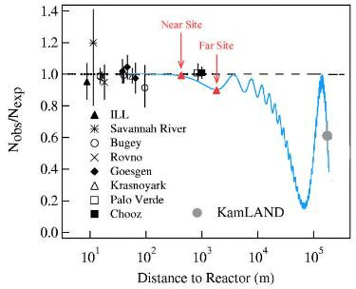
JUNO
53 km
Medium baseline: 53 km
Reactor experiment
20 kTon liquid scintillator
Providing $3\%/\sqrt{E}$ resolution
★

Slide 19
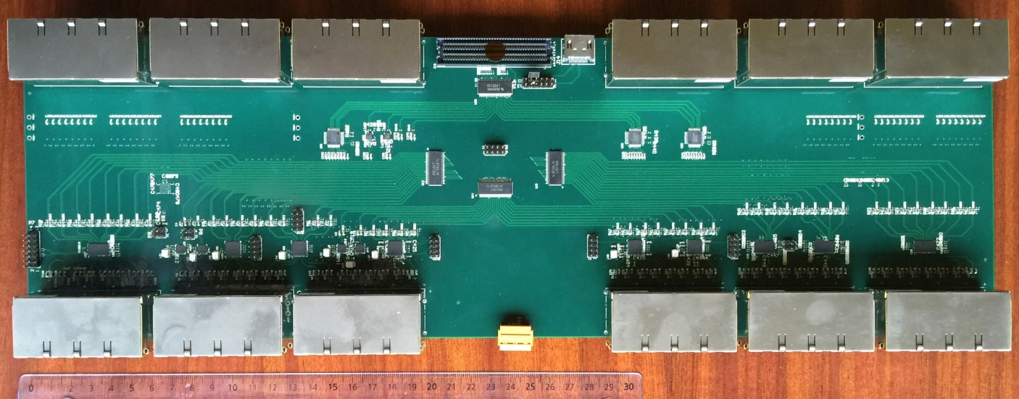
Belgium @ JUNO
Global JUNO Budget: 300 Meur, 45 Meur covered by non-Chinese
Belgian Funding:
230 kEuros (spread on 4 years) from the IISN (FNRS) : Finalization of the design, test and prototypes on the BECs and construction and assembly of a total of 435 BECs (prize : 528 €/BEC)
JUNO: 70 institutions, 521 collaborators
Belgian participation since 2015, via:
ULB (IIHE):
B. Clerbaux & Y. Yang
Design & production of Back End readout Card(BEC)
Later participation in simulation & Analysis
Collaboration with EU-JUNO : well established – EU fund requested for a ITN
Collaboration with China : via CSC PhD scholarship : well established
(IIHE has 7 CSC/master students from Tsinghua, IHEP, PKU, Beihang)
Drivers
Translators

Slide 20
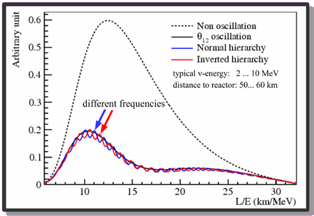
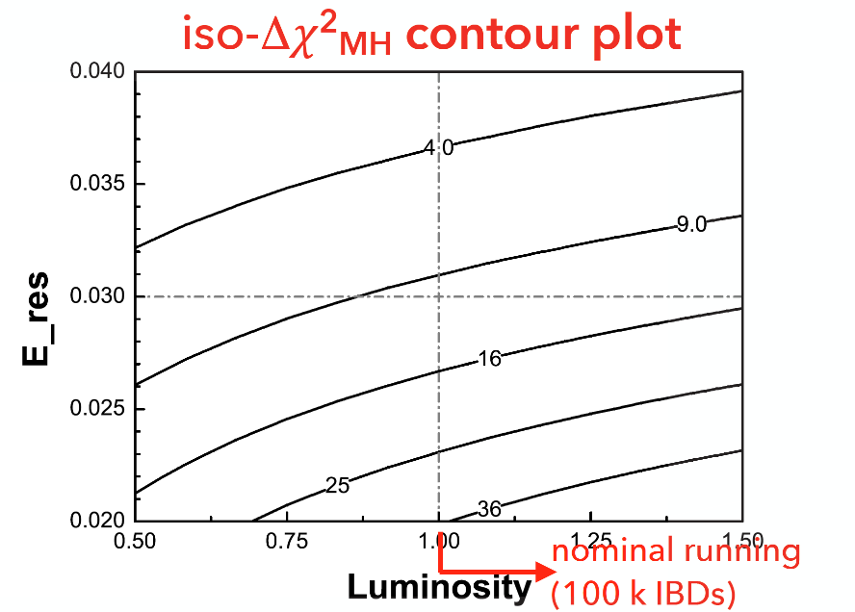
JUNO physics
The L/E spectrum contains
the NMH information !
Define a discriminator :
Probing the mass hierarchy
Three oscillation parameters : Δm²₁₂, IΔm²₃₂I and sin²2θ₁₂ can be measured with precision better than 1%.
→ Probing the unitarity of U_{PMNS} to ~1% level
NMH : For σ(E) = 3% at 1 MeV → 3σ sensibility (ΔΧ=9)
for 100 000 events (20Kt x 36 GW x 6 years of data taking)
But also :
Neutrino from supernova burst
Solar neutrinos
atmospheric neutrinos
Geoneutrinos
Exotic searches as nucleon decay and dark matter
3σ
4σ
5σ

Slide 21
JUNO Technology
Signal rate : 60 events/day
Background rate : 3.8 events/day
Energy resolution requirement : 3%/√E (MeV)
LS : Scintillator attenuation length
PMT : high light yield :
high photocathode coverage and
high detection efficiency of PMT’s
PMT with low dark current
Energy scale require calibration at the sub-percent level :
Comprehensive calibration program (cable loop system, remotely operated
vehicle, guide tube) to address both the non-uniformity and non-linearity
Double calorimetry : Large PMT and small PMT systems
Neutrinos are observed via Inverse Beta Decay (IBD) :
→ Very clean signature
→ Energy : (2 to 8) MeV

Slide 22
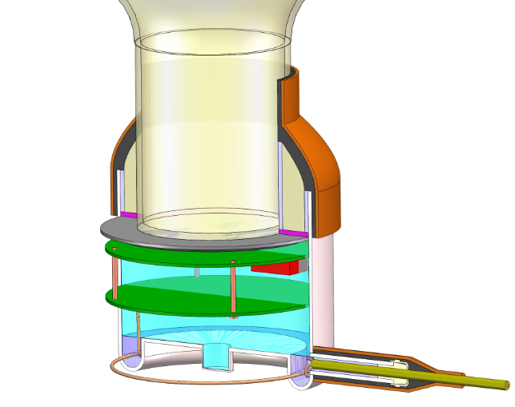
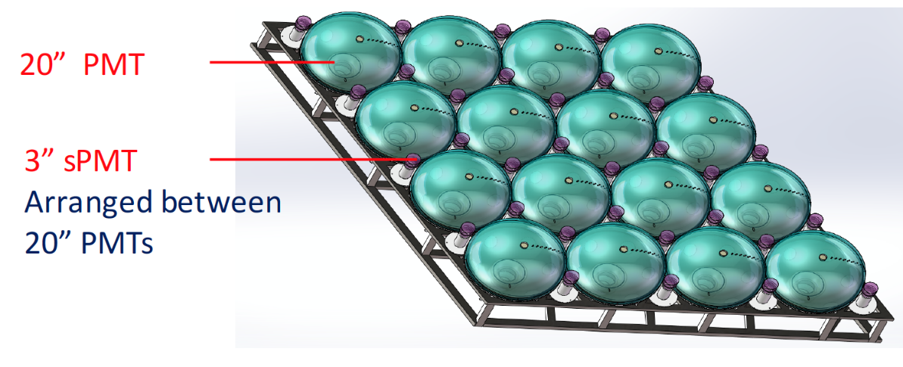
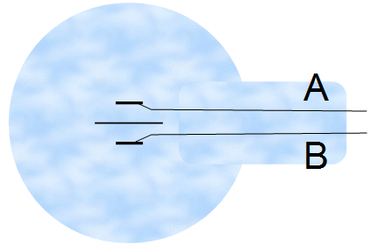
PMT & readout
BEC
Back End Card
DAQ
Power
RELIABILITY Goal :
< 0.5% failure of
electronics
within 6 years
(1% whole system including PMTs)
Trigger
Timing
x 400
100m Cable : x 19000!
→ Small PMT system
recently approved
x 19 000
ADU
Analog to Digital Unit
GCU
Global Control Unit
PMT
HV

Slide 23
BEC card
DAQ
Trigger/Clock/DCS
8 layer PCB
48 cm x15 cm
8 Ethernet connectors (RJ45)
Connectors for the
mezzazine card with FPGA
Y. Yang (ULB)
Drivers
Translators
Equa-
lizers
8 Ethernet connectors
Short term future : Combine test for
Power injection test (with Aachen group)
Signal quality test (PRBS)
Full data chain test (with Padova group)
GCU

Slide 24
Time Schedule
JUNO is
presently
on schedule
Filling
Civil
construction
PMT
production
Exp. approved
Int. Coll.
formed
Detector assembly and installation
★
......
2013 2014 2015 2016 2017 2018 2019 2020 2025
JUNO member
IISN 4-year convention
proposal
Data taking
NMH measurement

Slide 25
Proposed Research
★
2013 2014 2015 2016 2017 2018 2019 2020 2025
IISN 4-year convention
proposal
A contribution to the electronics readout system : BECs
- Finalize the R&D and design –prototype construction with final components
- Design of the test and quality control systems
- Participate to large size JUNO prototype detector in IHEP
- Mass production in 2018/2019 - installation and commissioning in 2020
In Collaboration with Padova - Aachen – Tsinghua – IHEP – SunYatSen and Wuhan U.
Contribution to the data analysis preparation using simulation :
- Software development of JUNO – Small PMT systems – not yet available
- Use of the small PMT system to monitor the energy resolution of the LPMT
- Complementary approach to be optimized using simulations
- Goal : improvement of the non-stochastic term of ΔE/E
- Crucial to be ready in 2020 when the data arrive
In Collaboration with APC Paris – Mainz/Jülich

Slide 26
Conclusion
Belgium is ramping up involvement in new generation neutrino experiments
Following a long standing tradition
Funding small compared to flagship experiments
Mostly R&D and construction
Soon data taking and physics data analysis
Lots of new & Enthousiastic students/postdocs involved
Opportunity for visibility

