Slide 1

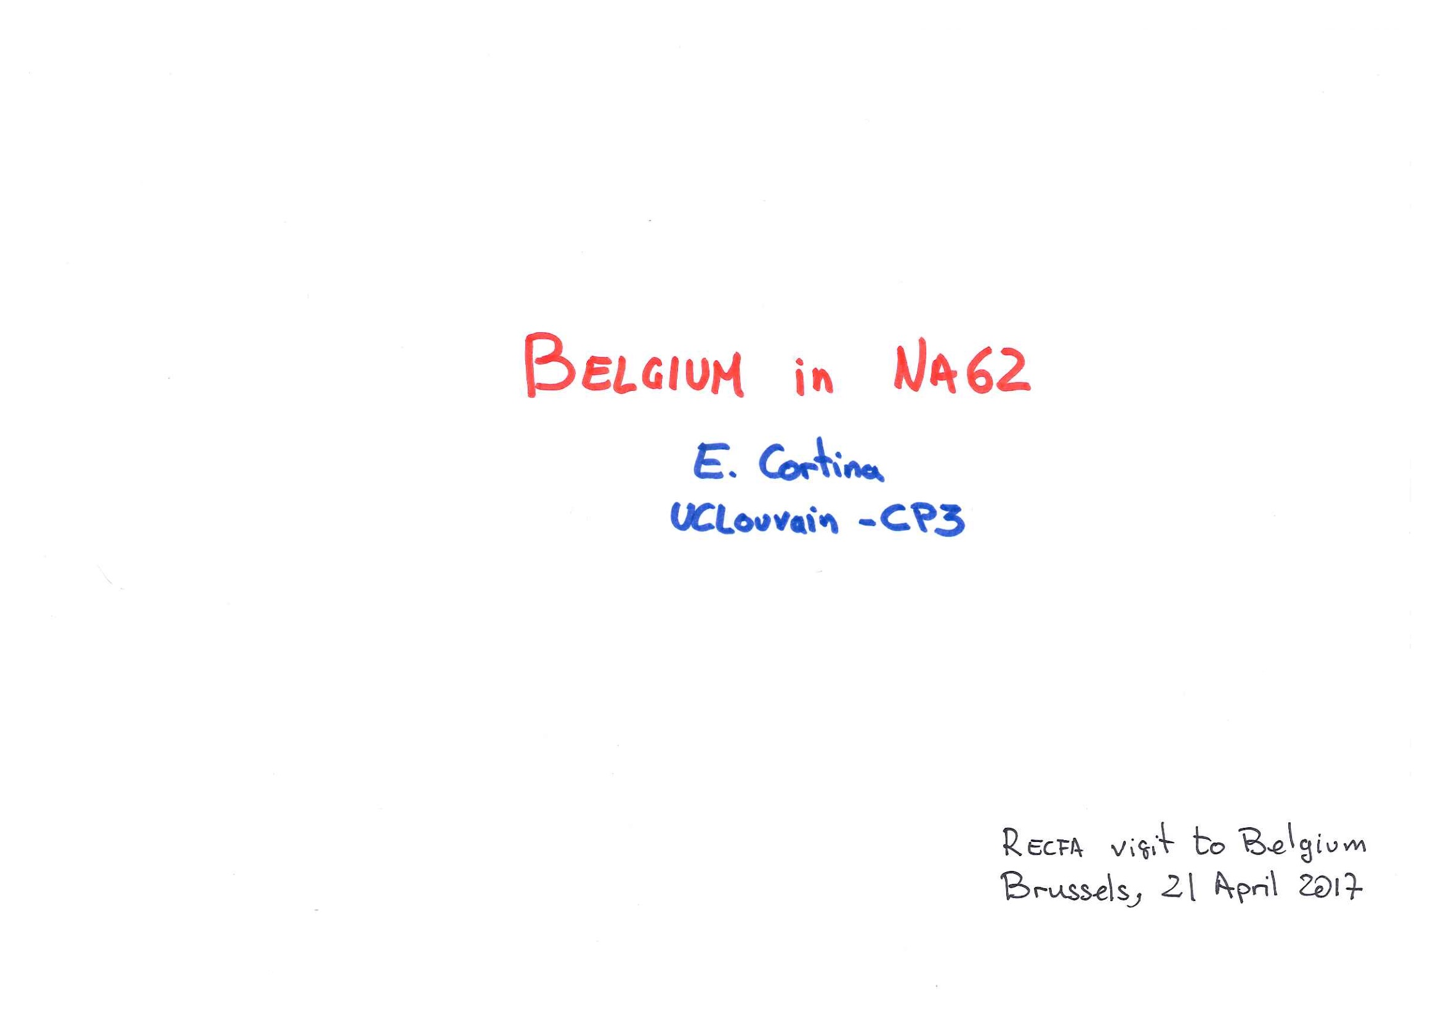

Slide 2
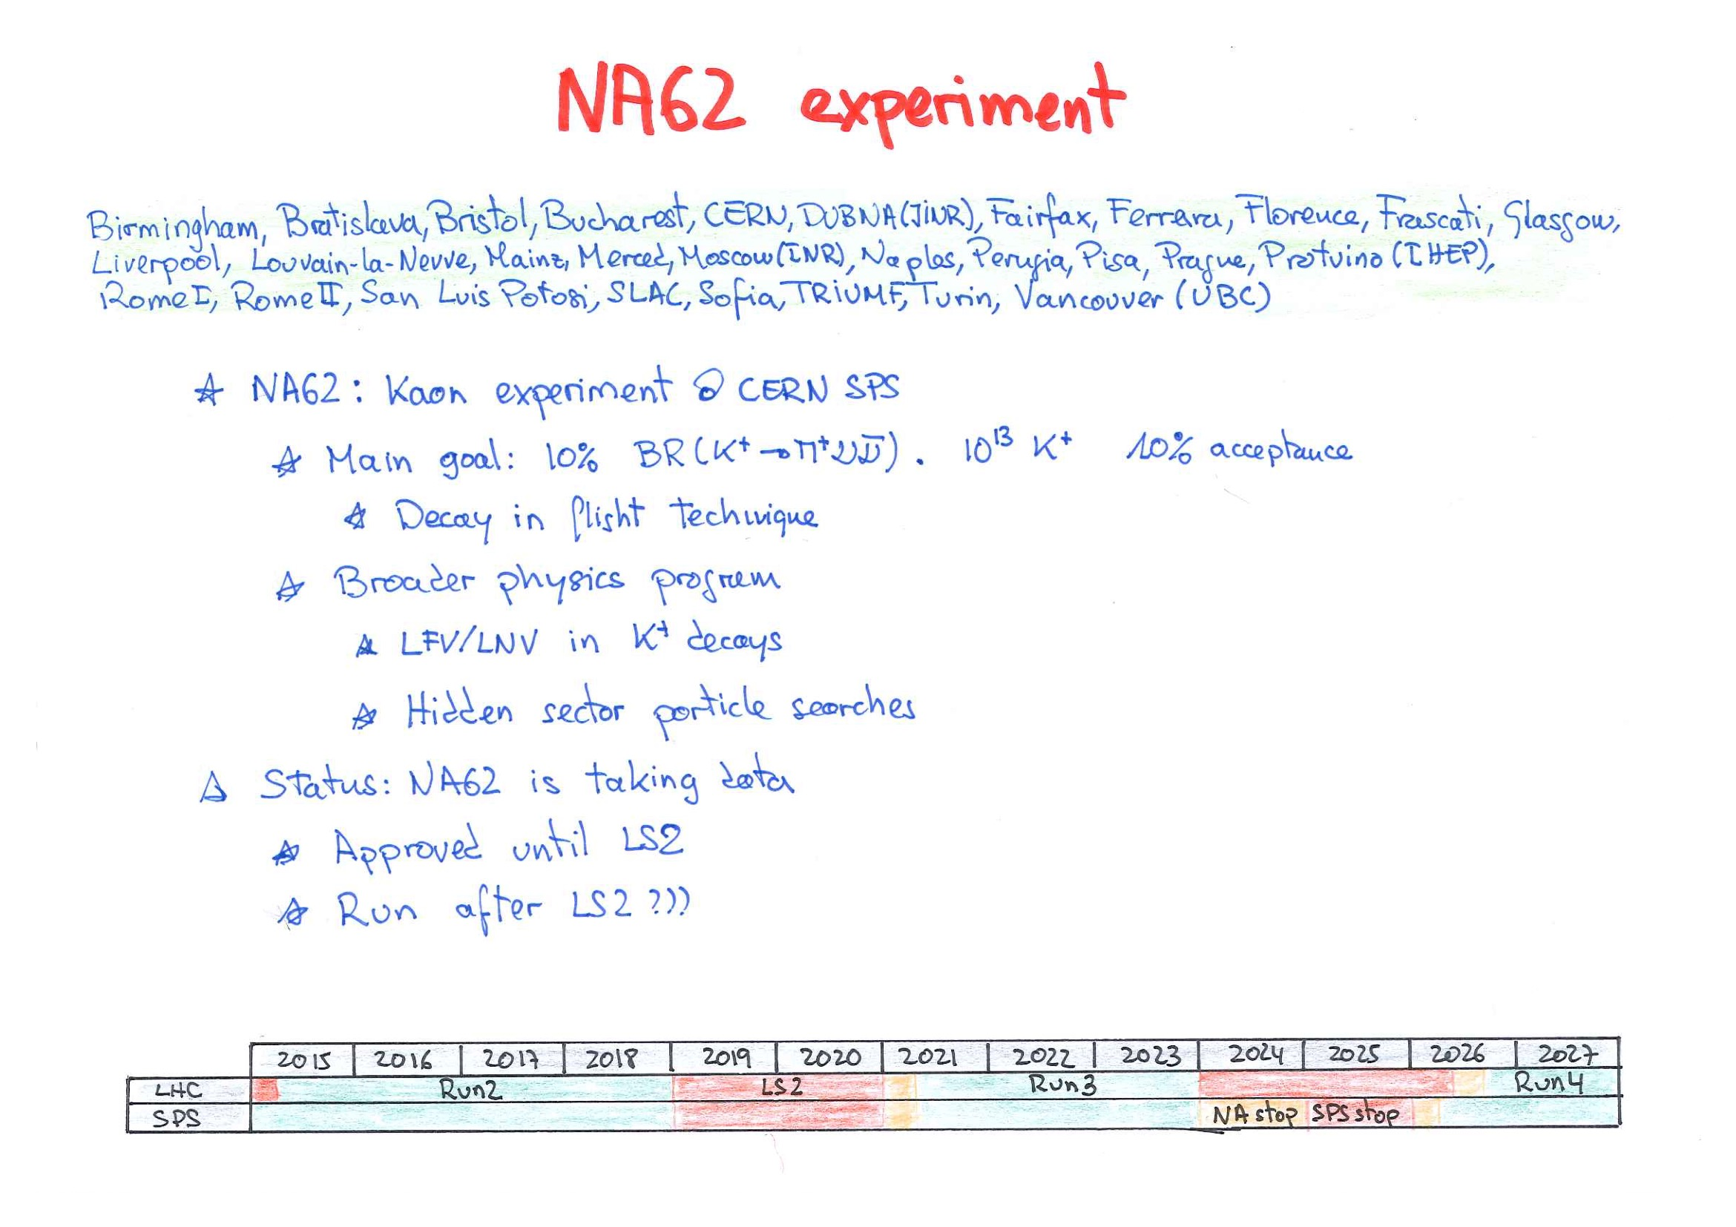

Slide 3
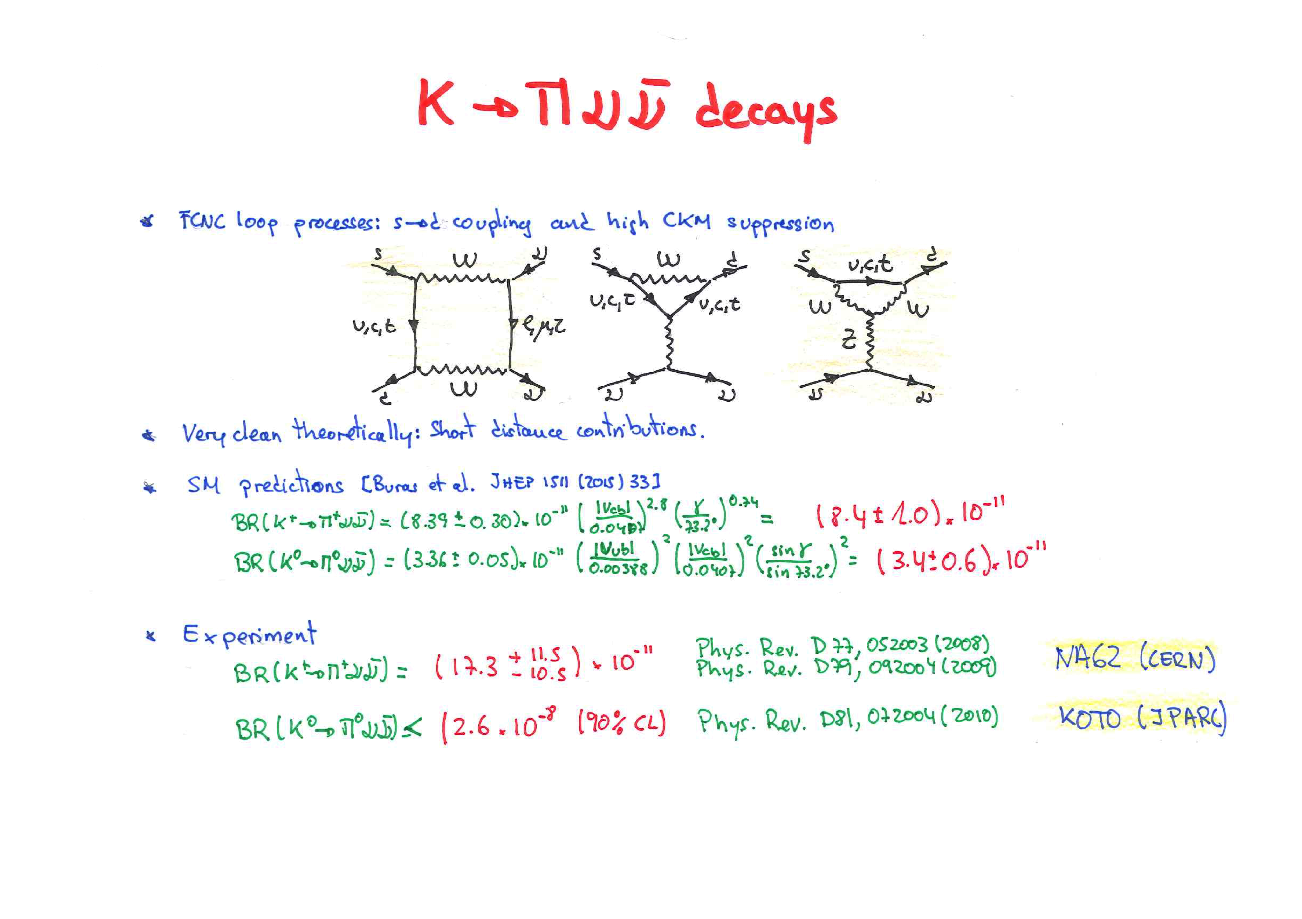

Slide 4
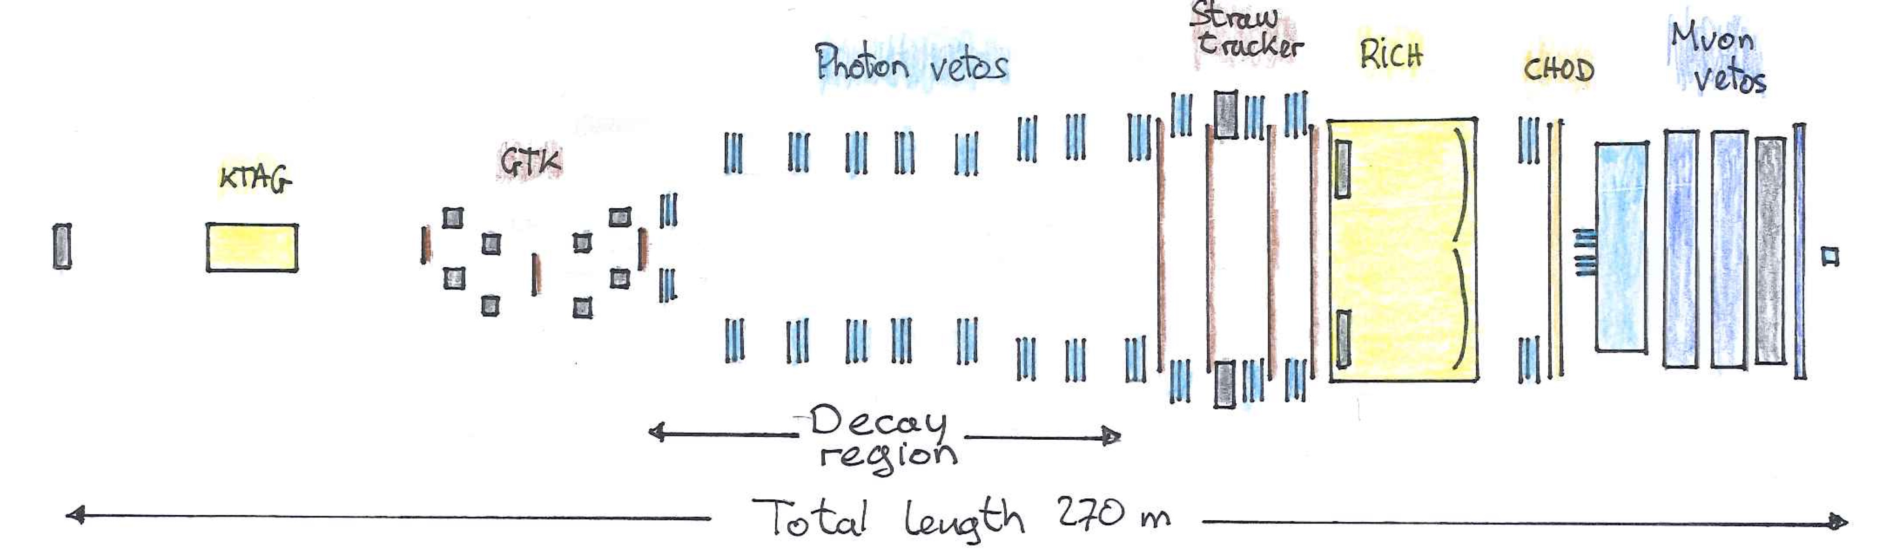

Slide 5
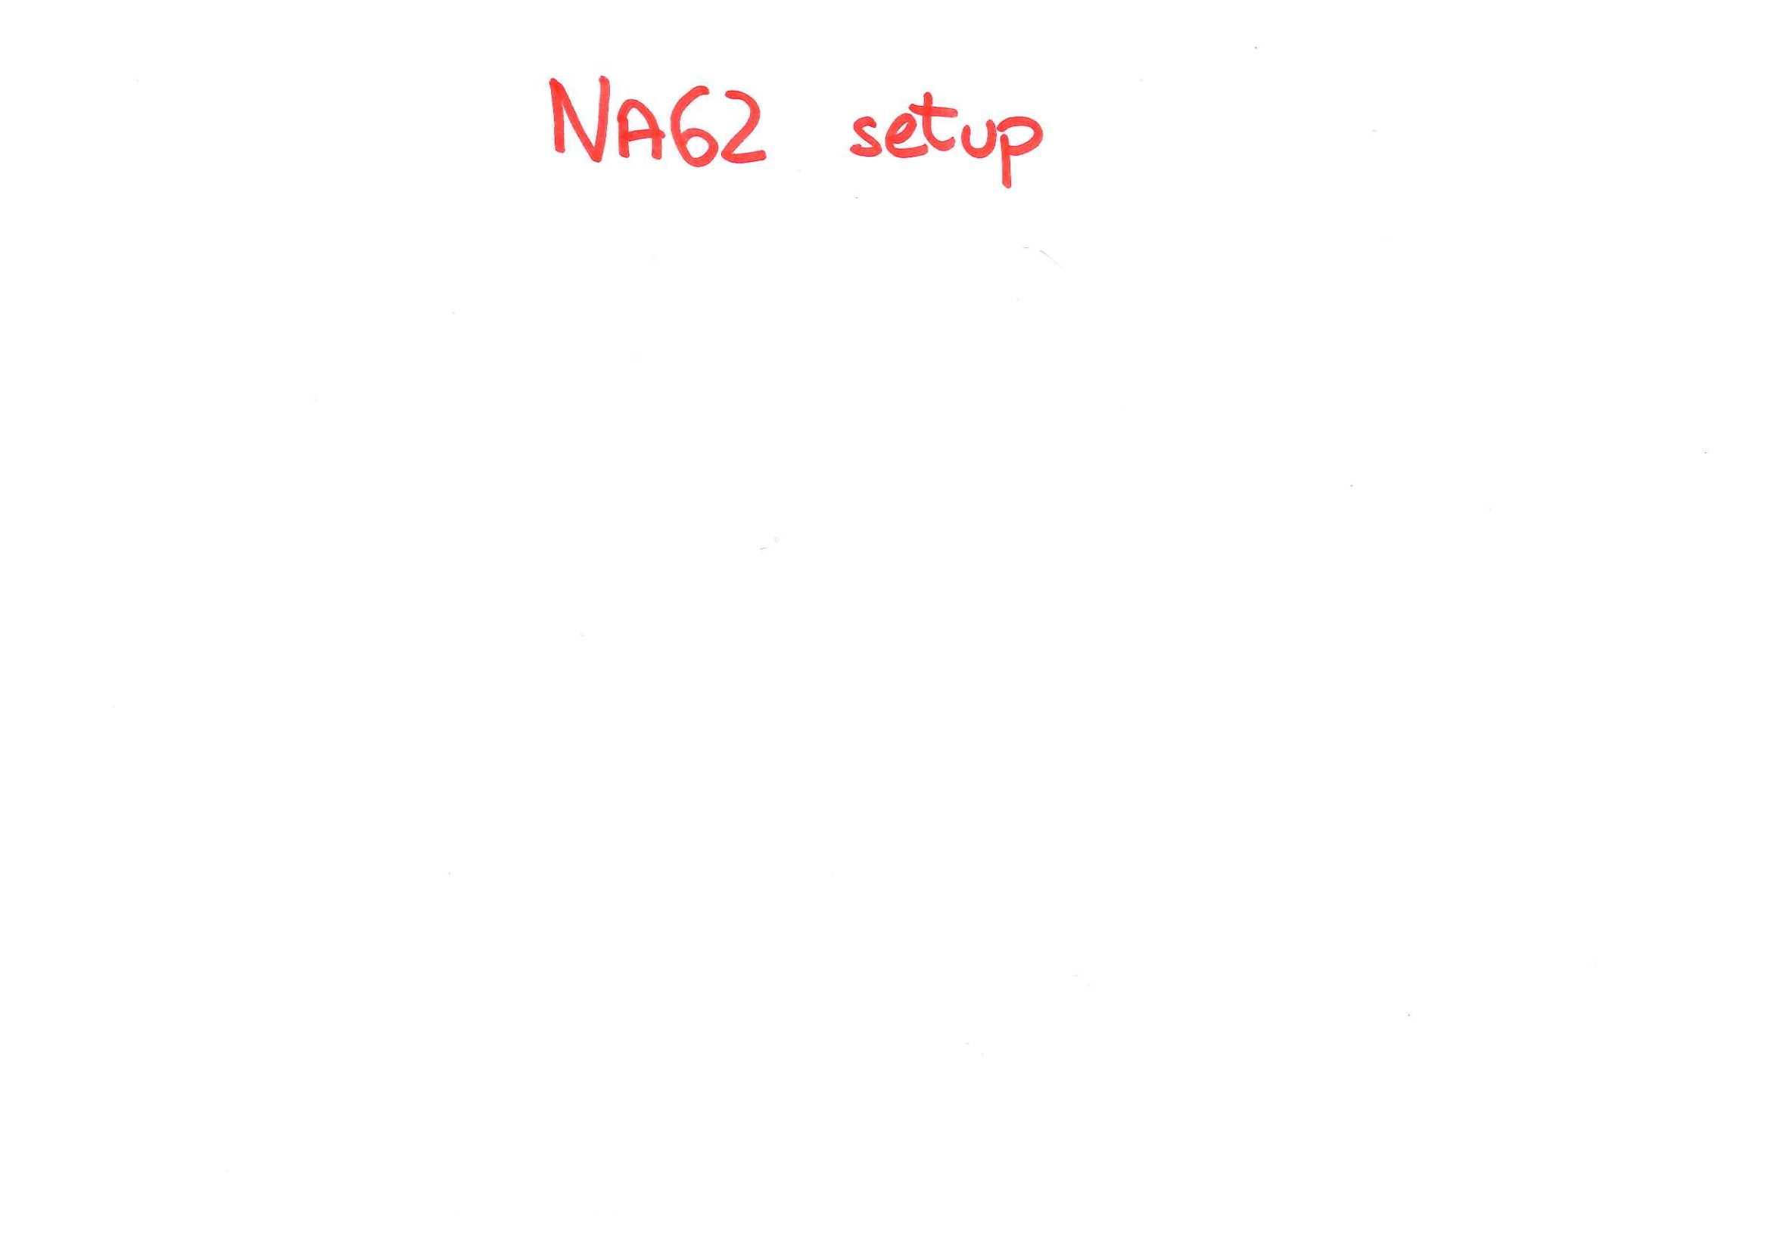
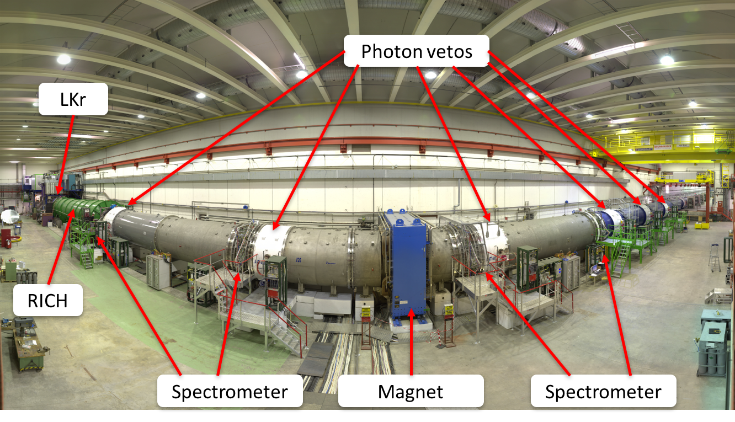

Slide 7
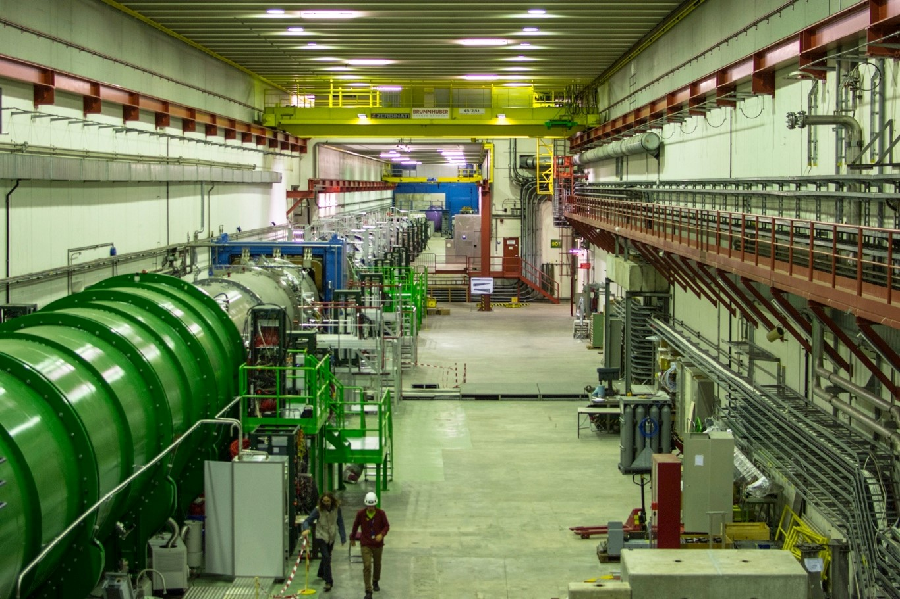

Slide 8
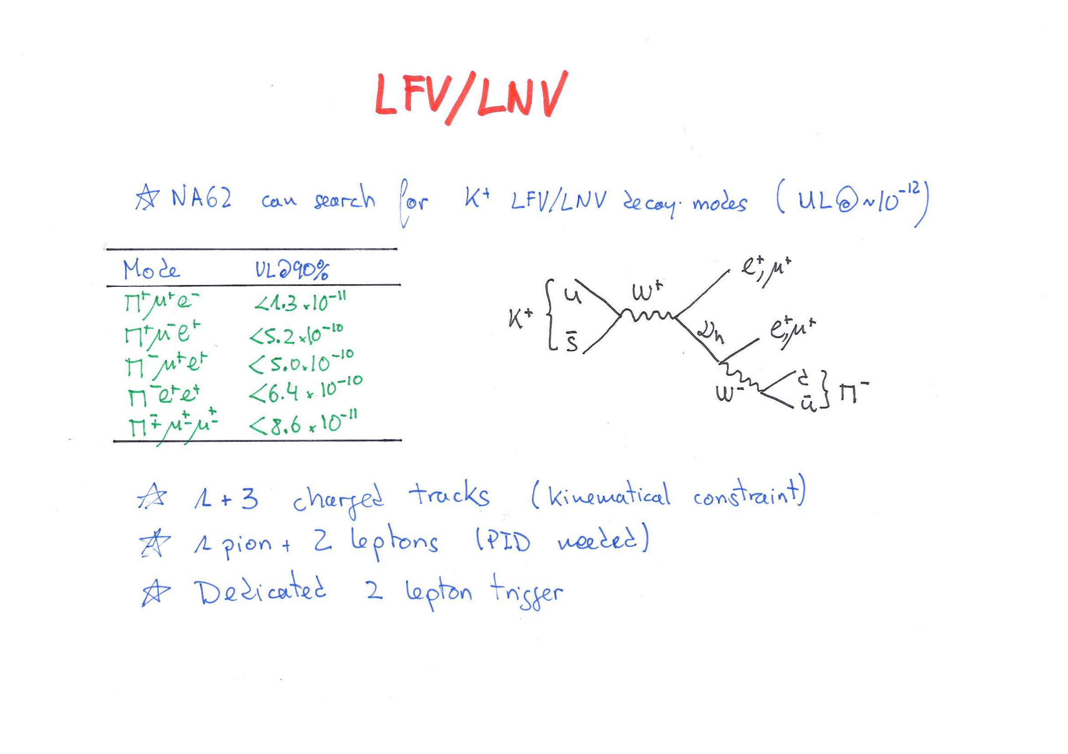

Slide 9
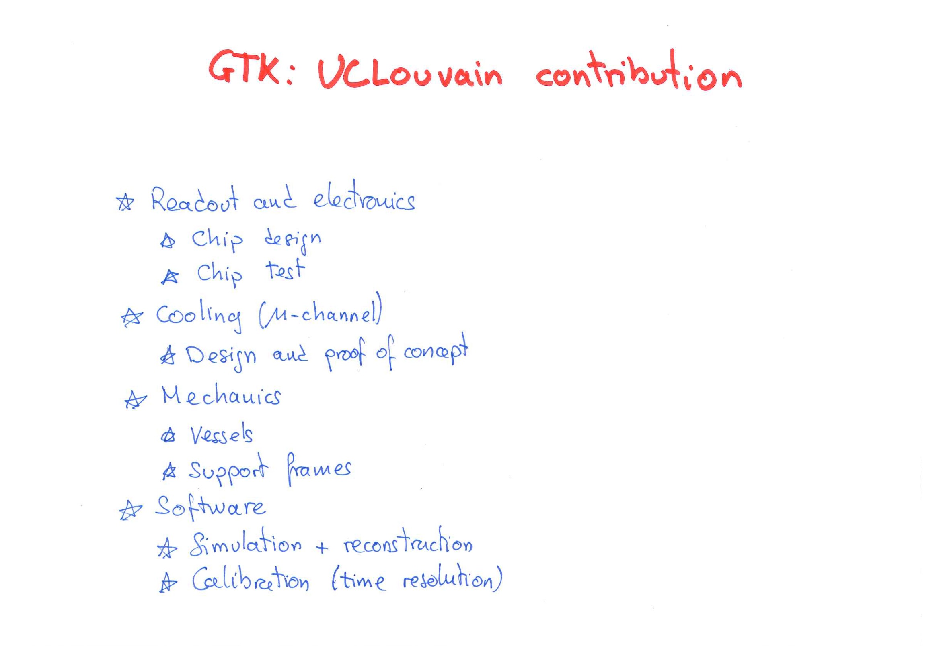
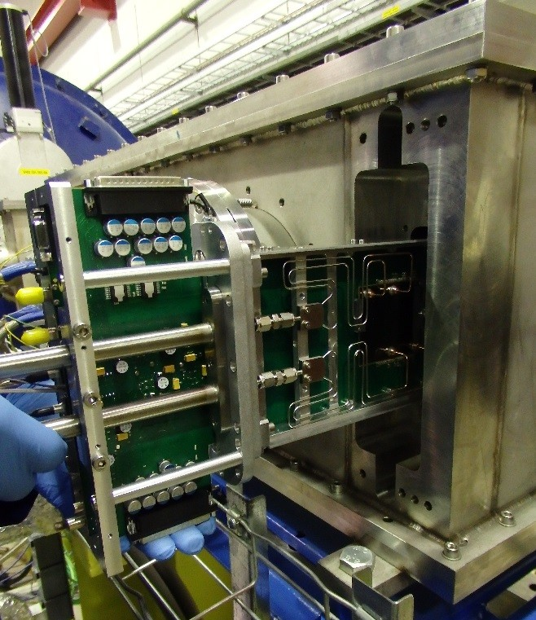

Slide 10
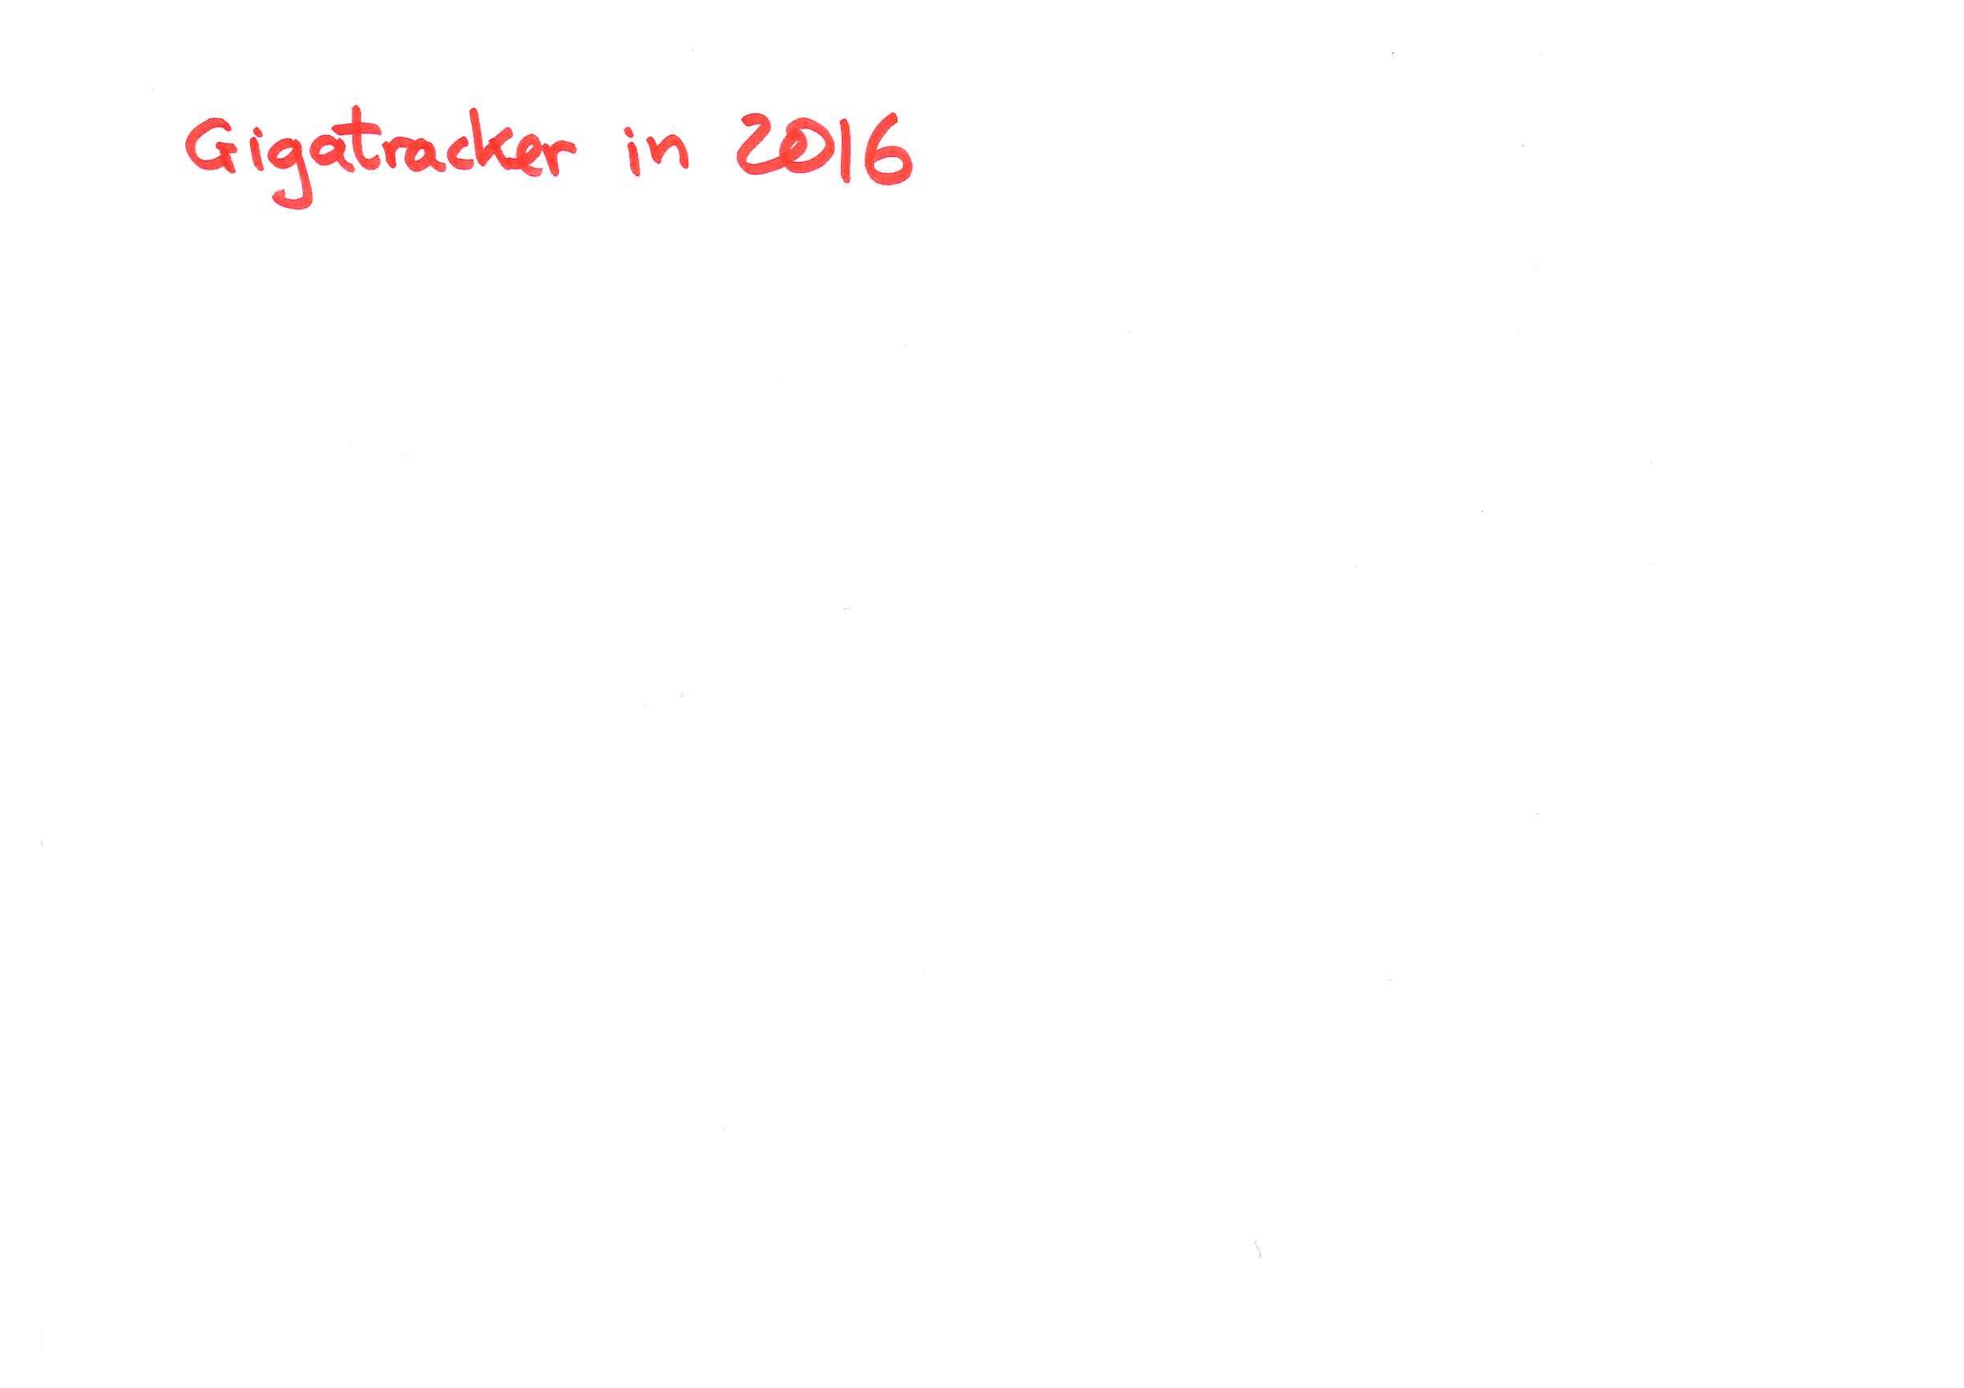
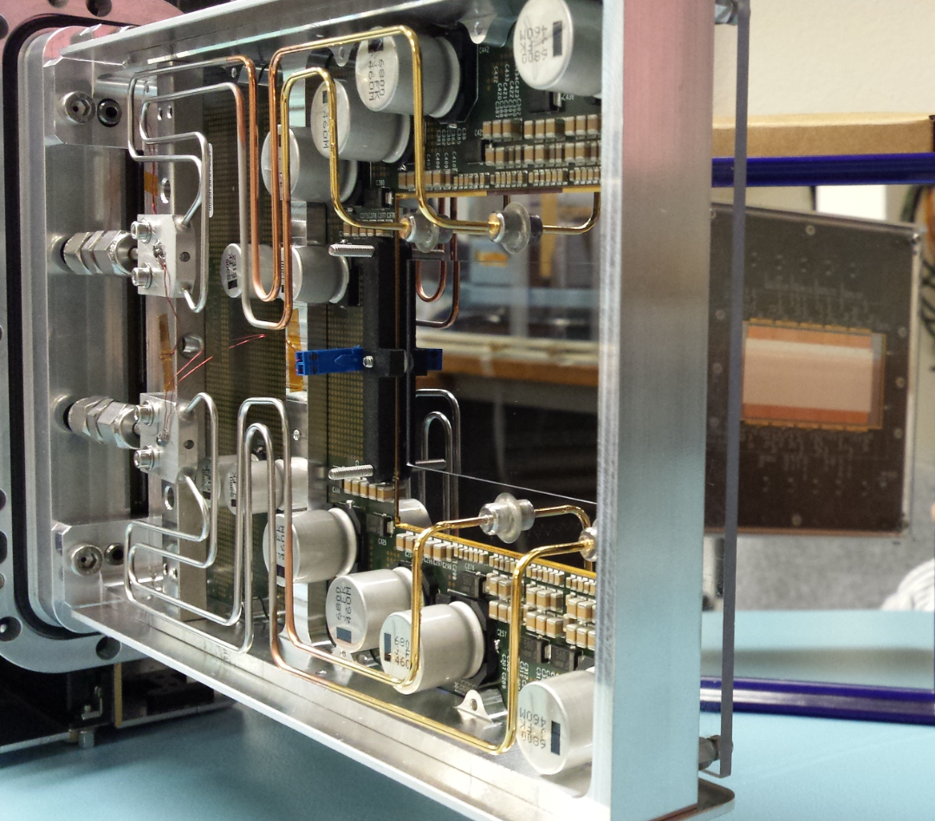

Slide 11
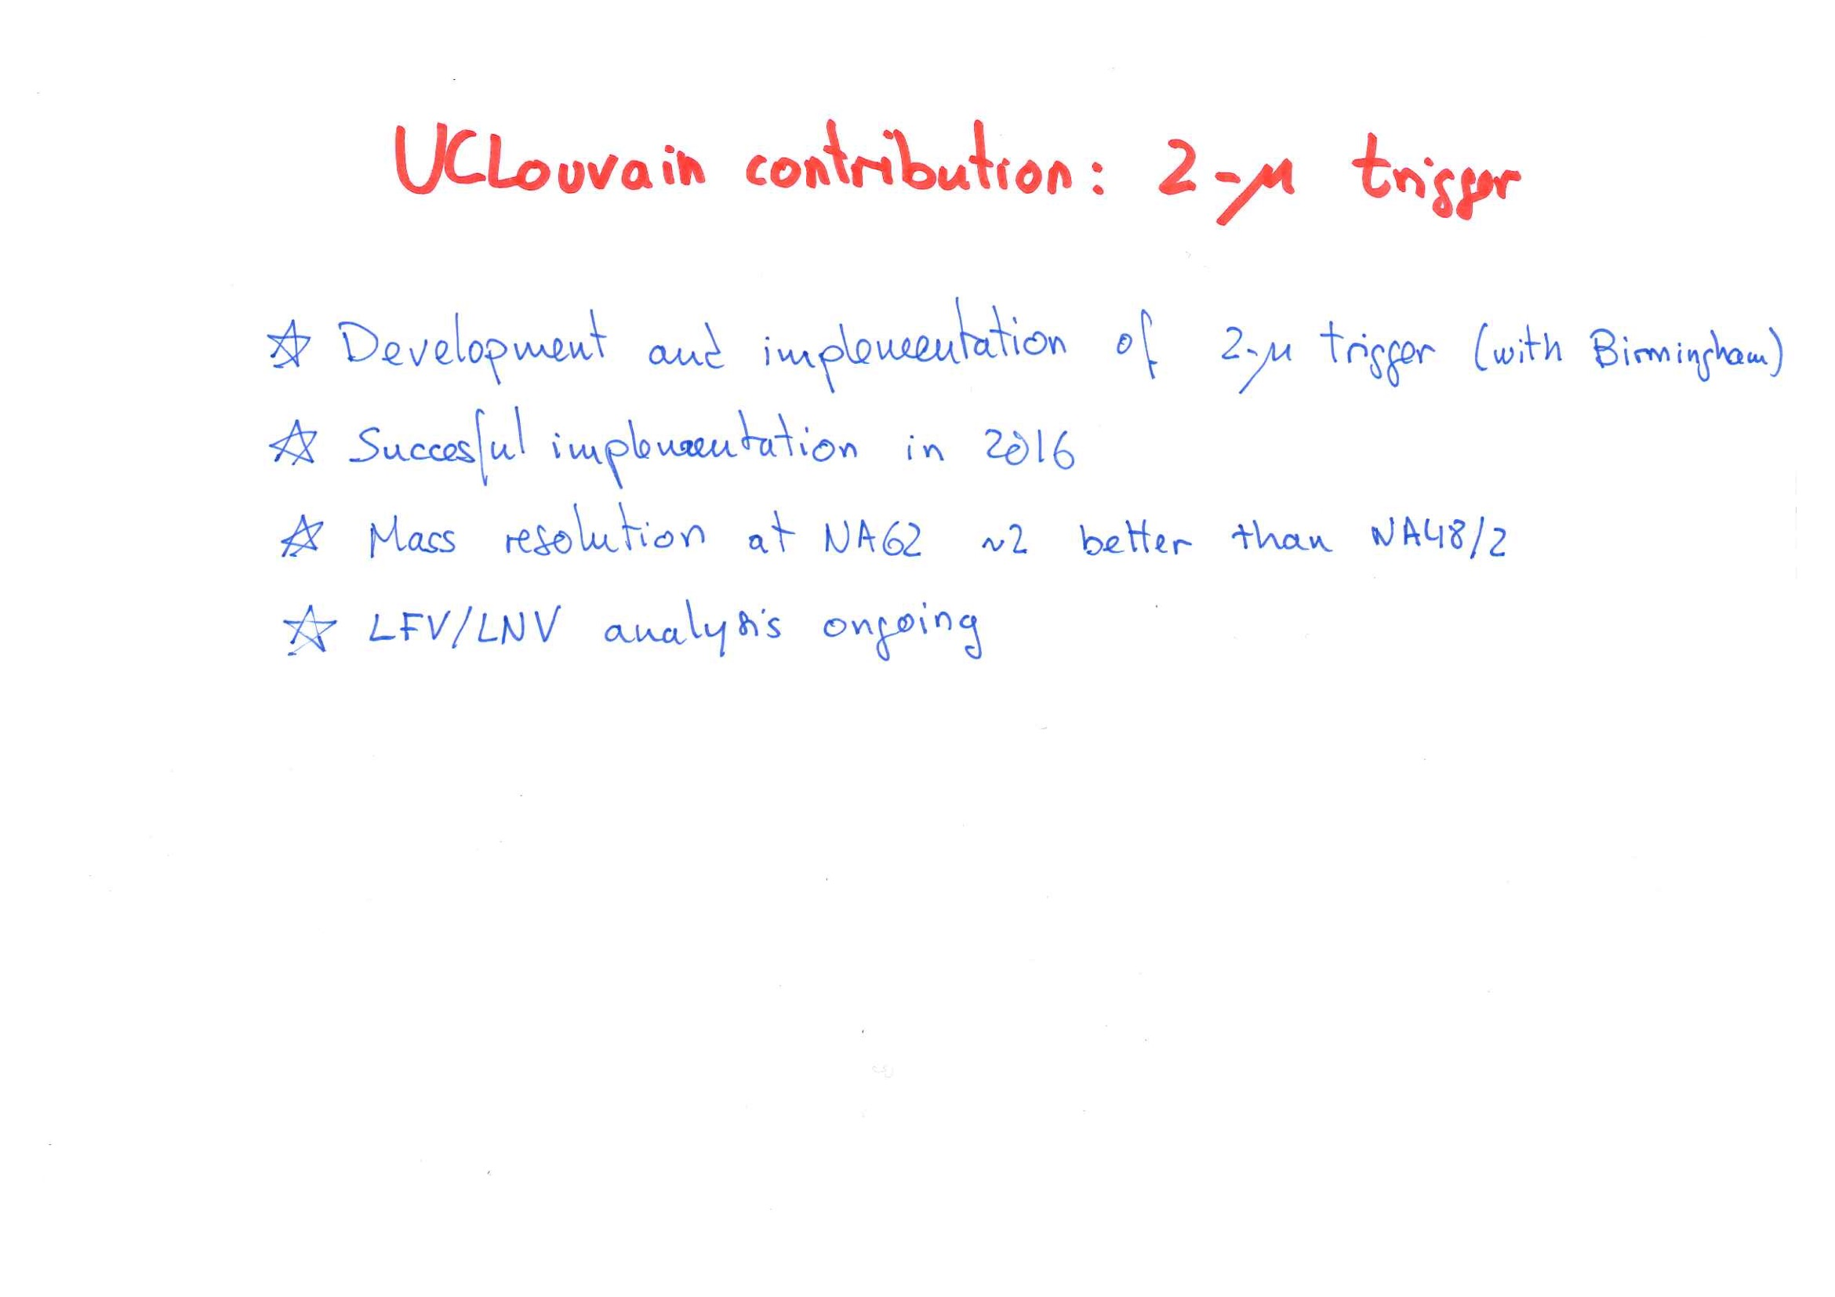
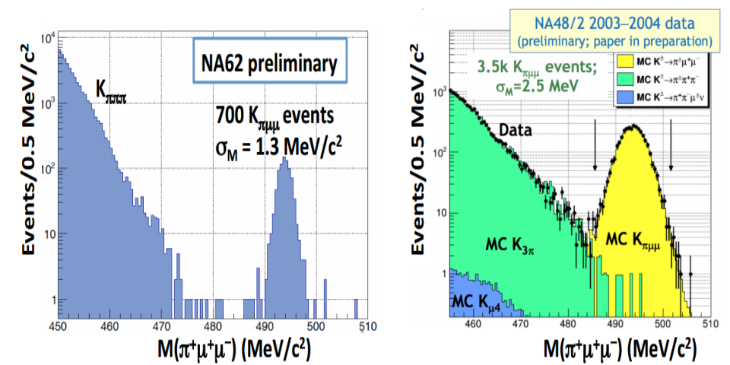

Slide 12
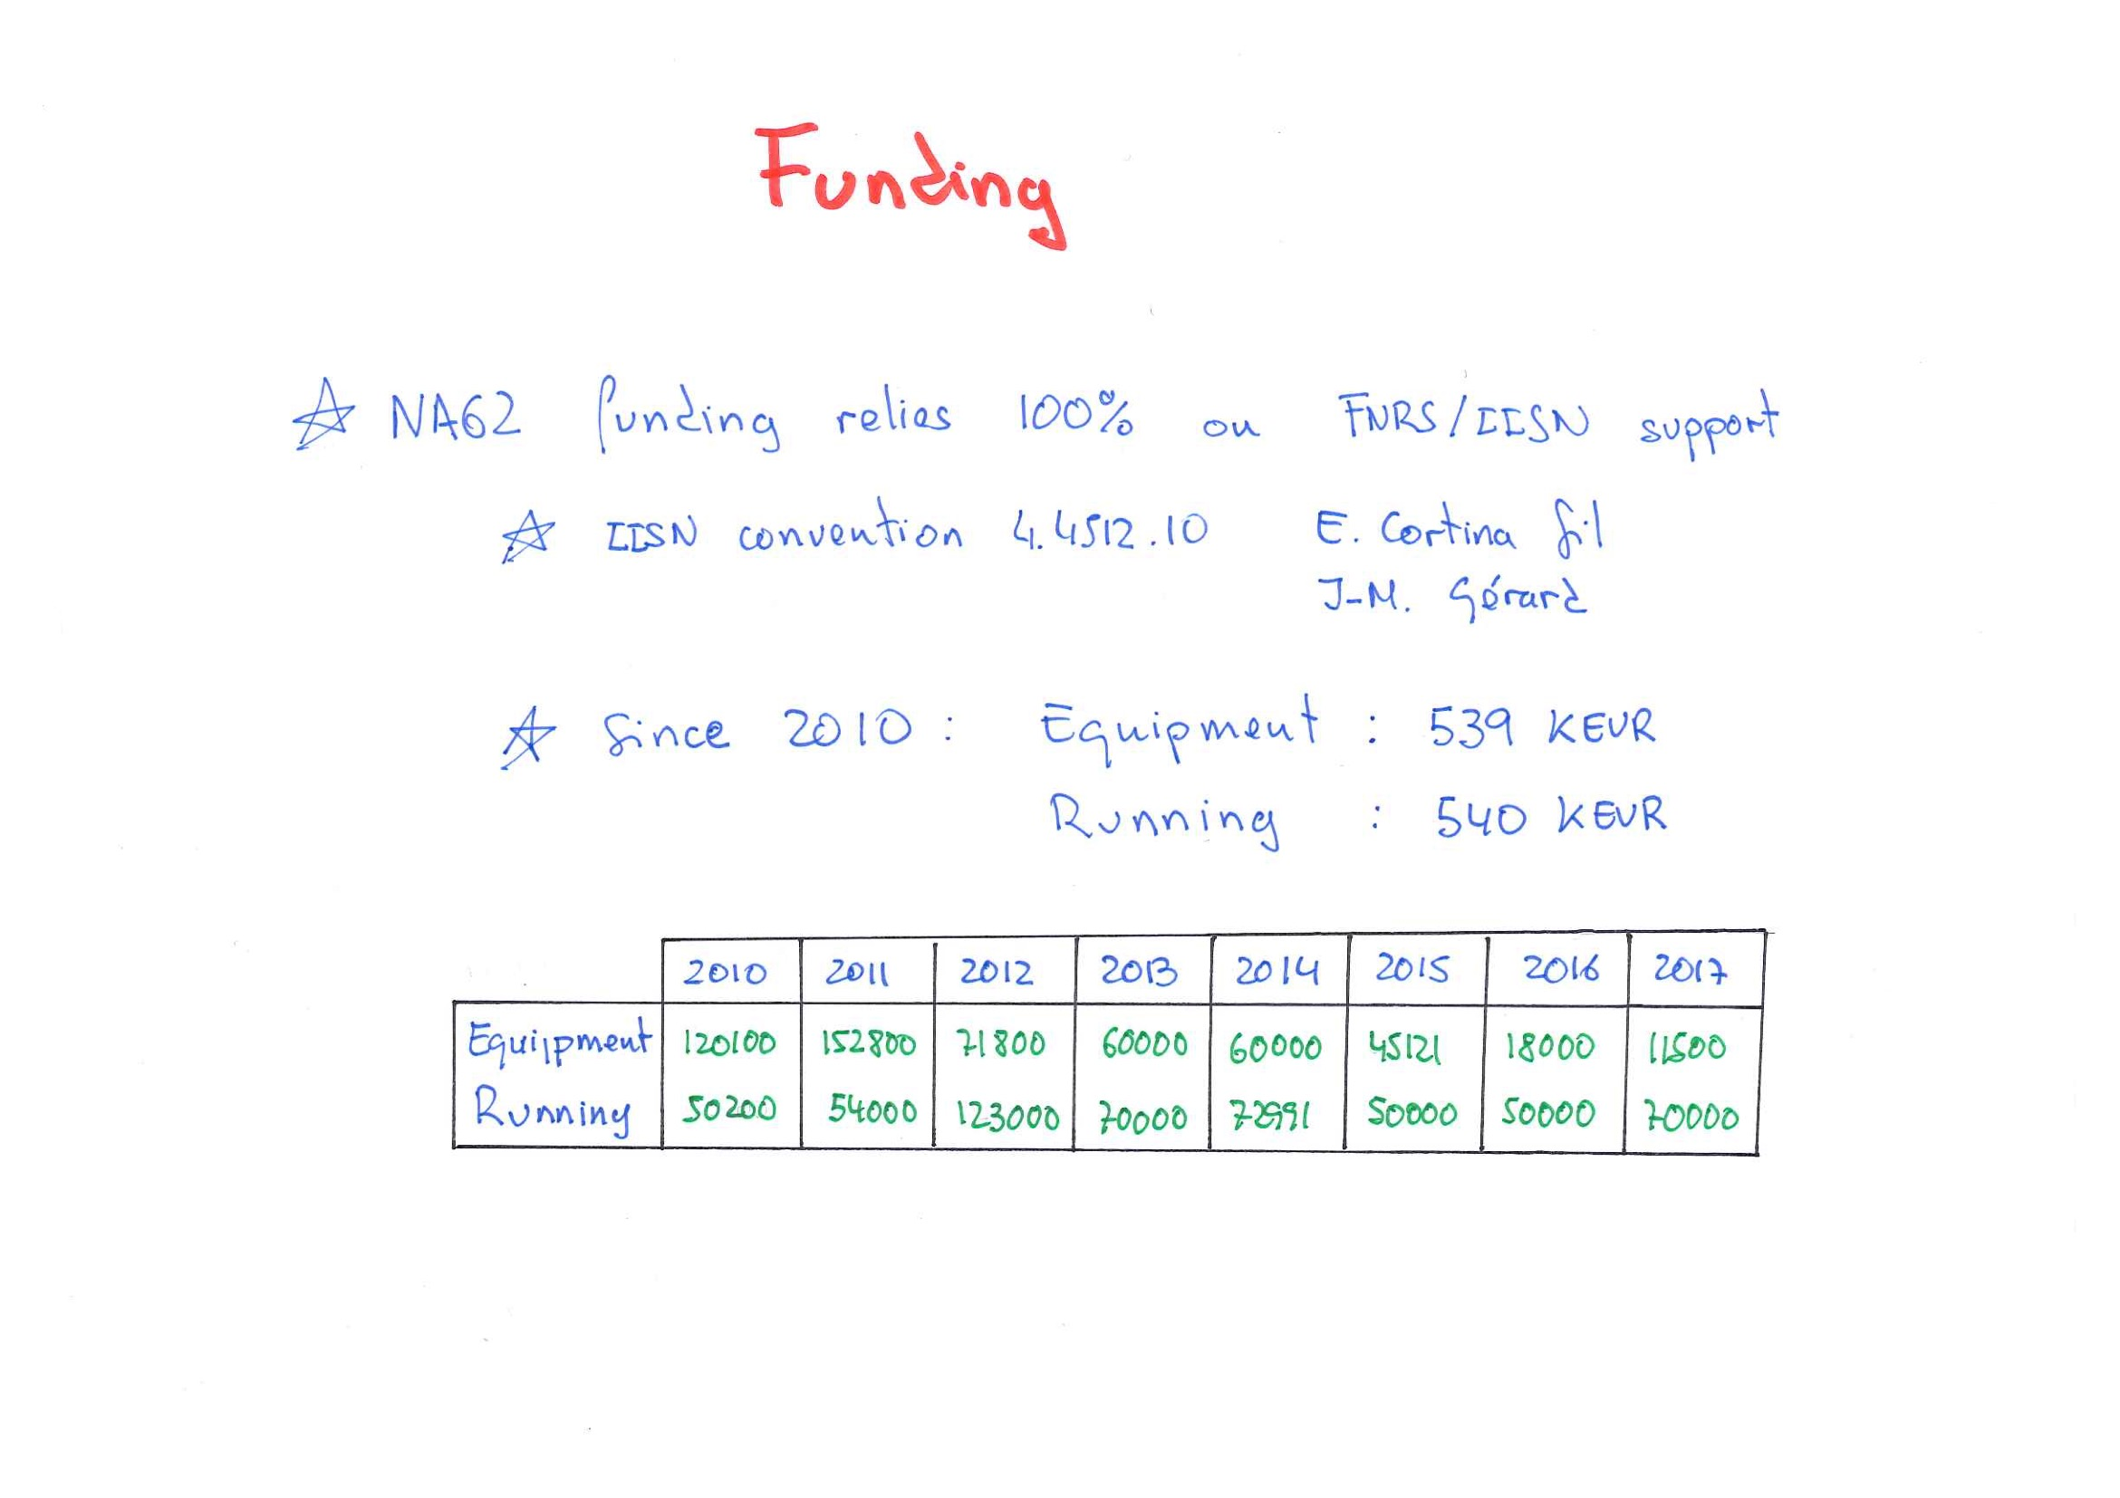

Slide 13
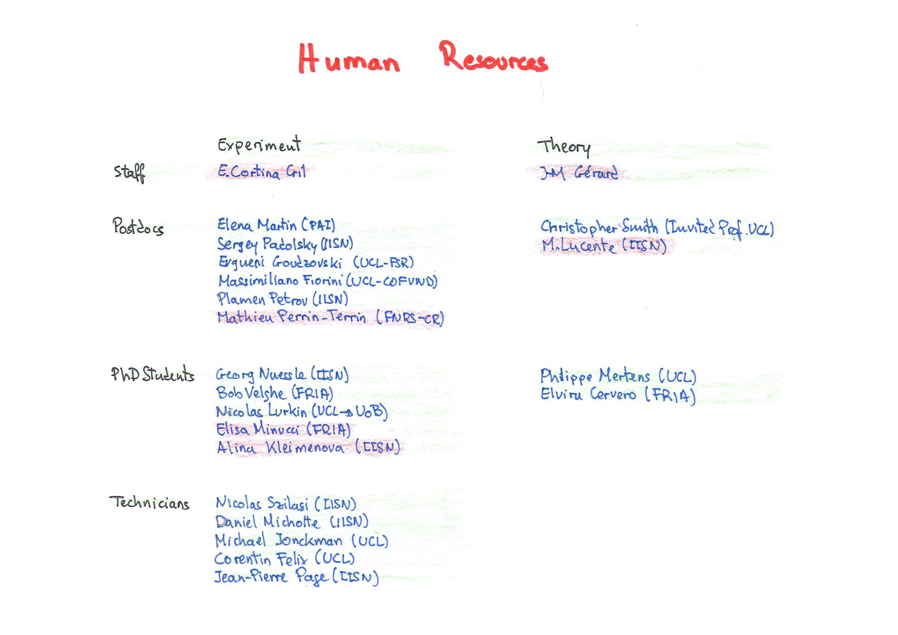

Slide 14
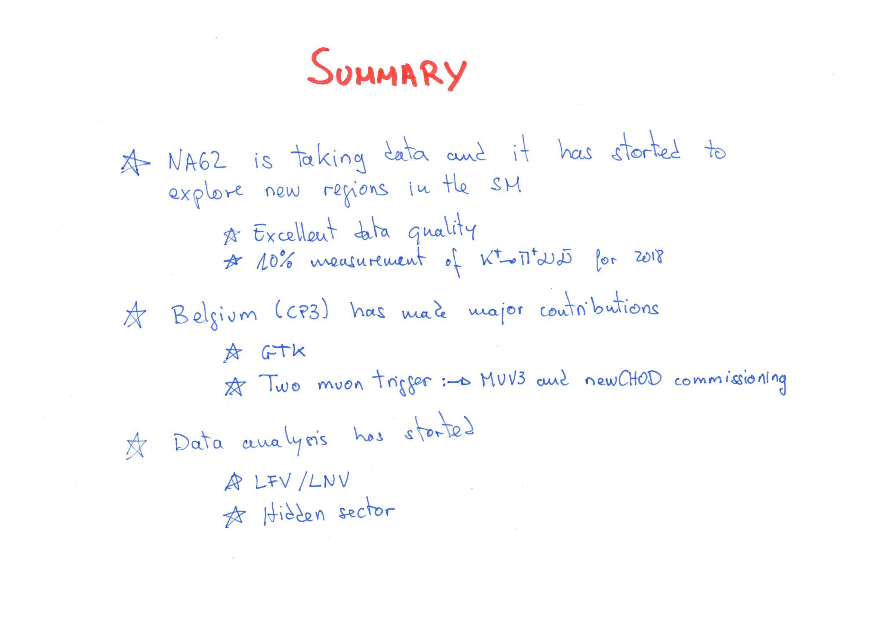

Slide 15
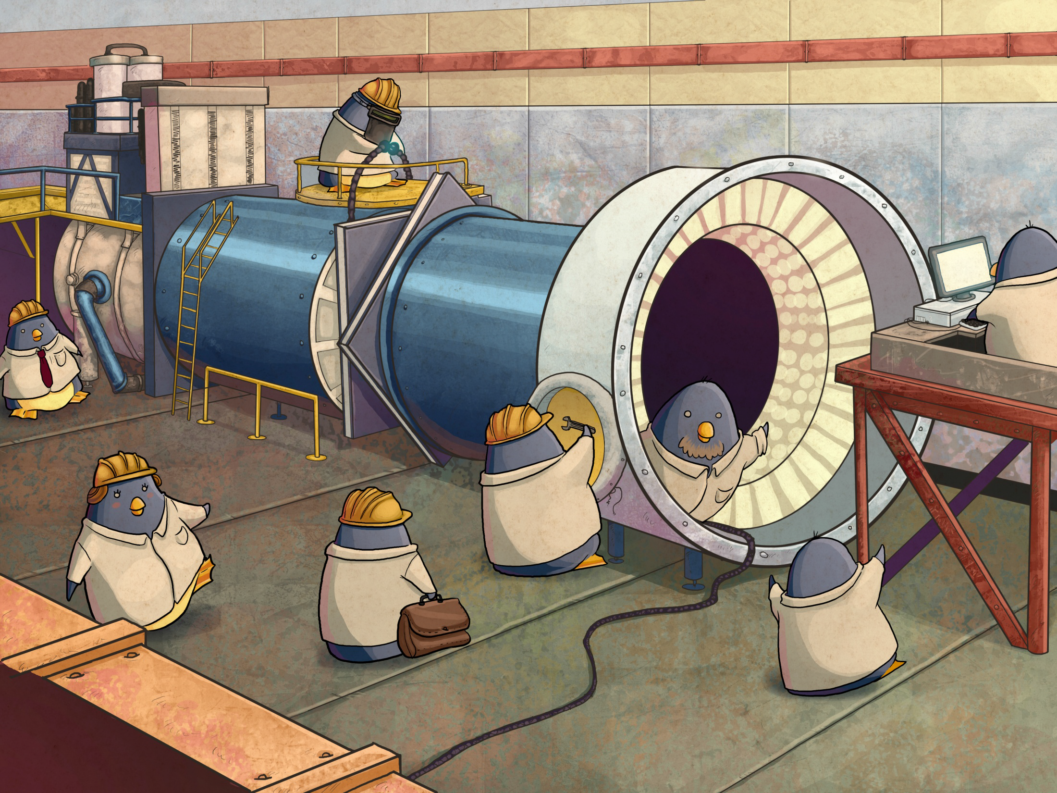

Slide 16
Backup

Slide 17
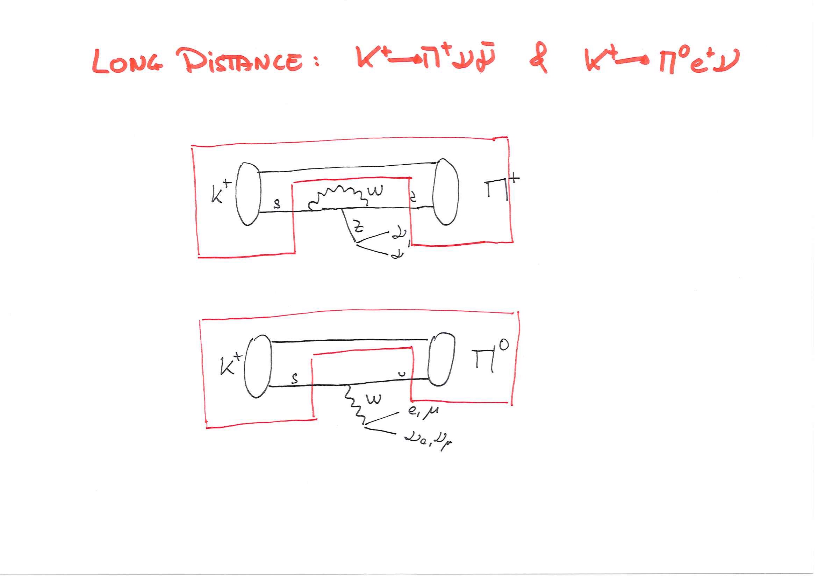
K+->pi+nunubar calculation

Slide 20
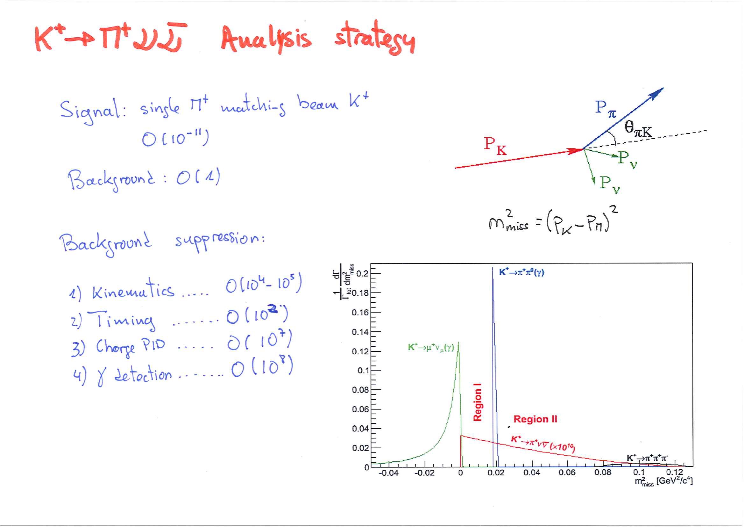
Why 75 GeV?

Slide 21
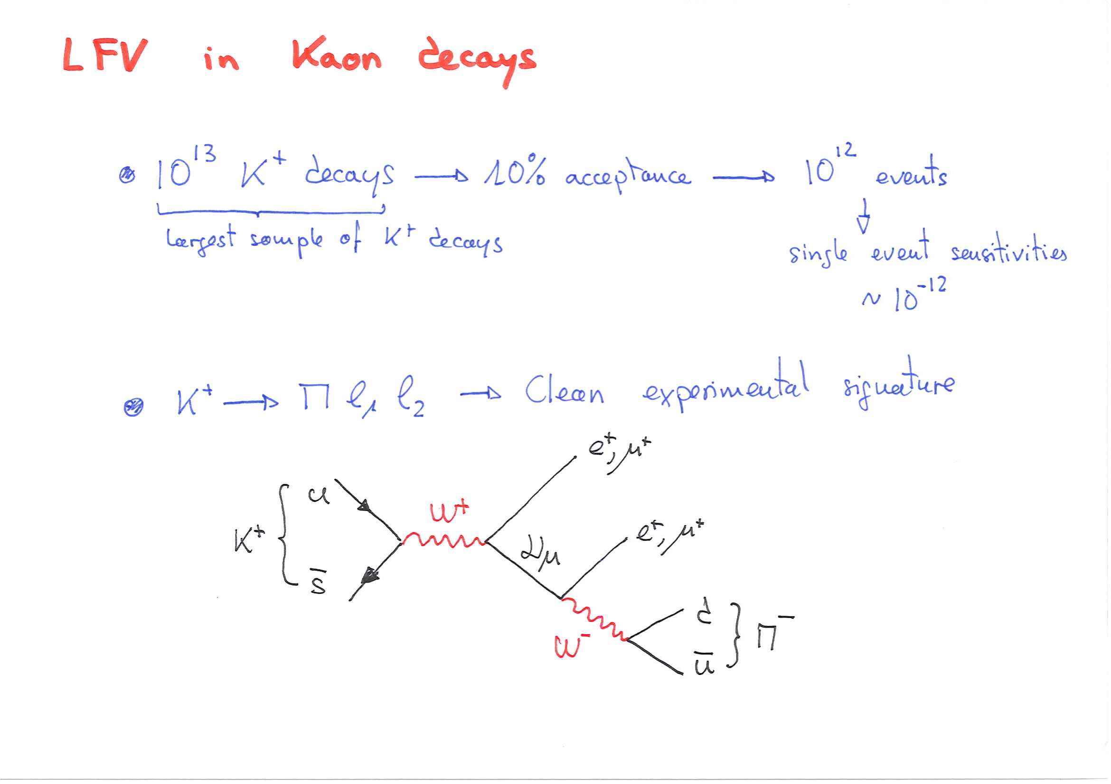
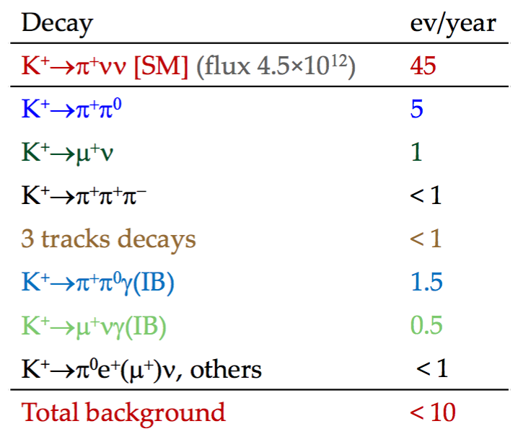
Expected performances and Sensitivity

Slide 22
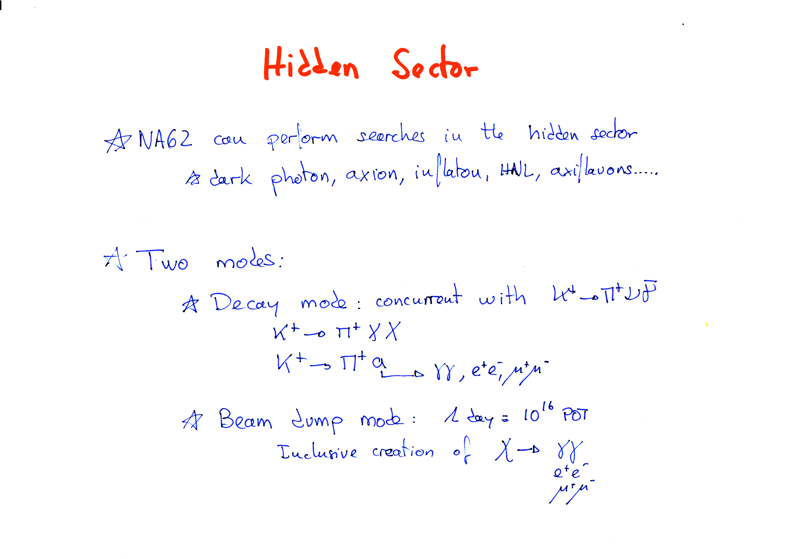

Slide 23
NA62 potential

Slide 24
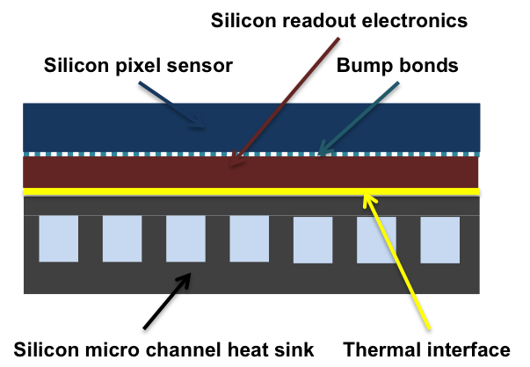
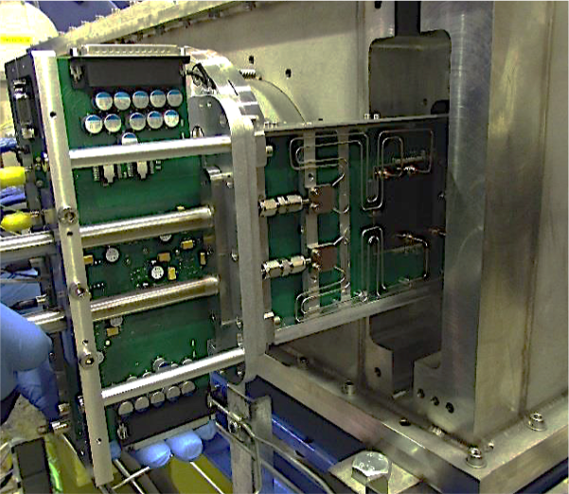

Slide 25
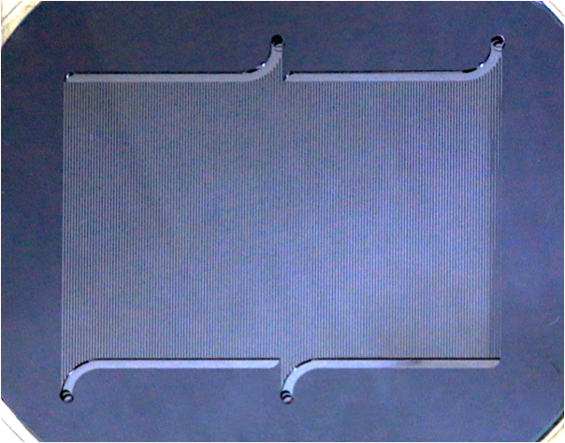
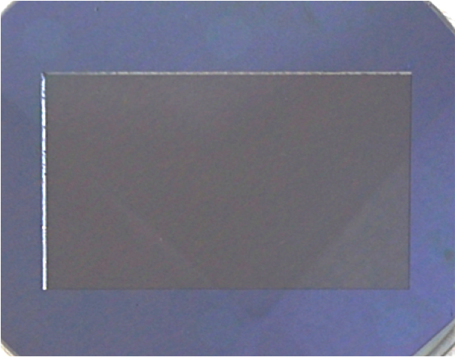
µ-channel cooling (1)
30 + 30 μm Silicon = 0.0064 % X₀
(above and below channels)
30 + 30 + 70 μm Silicon = 0.0139 % X₀
(between channels)
70 μm C6F14 = 0.0037 % X₀
30 μm epoxy = 0.0008 % X₀
Sensitive Area
Total material budget in the acceptance area = 0.013 X₀%
(min 0.011% - Max 0.015%)
Channels 200 x 70 μm
Wall thickness 200 μm
Dual inlet and outlet
Manifolds 280 μm deep, rectangular

Slide 26
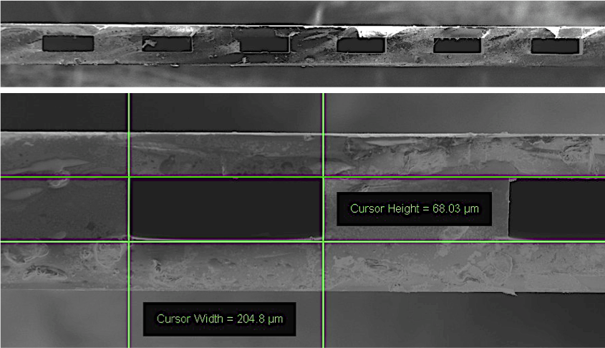
µ-channel cooling (2)

Slide 27
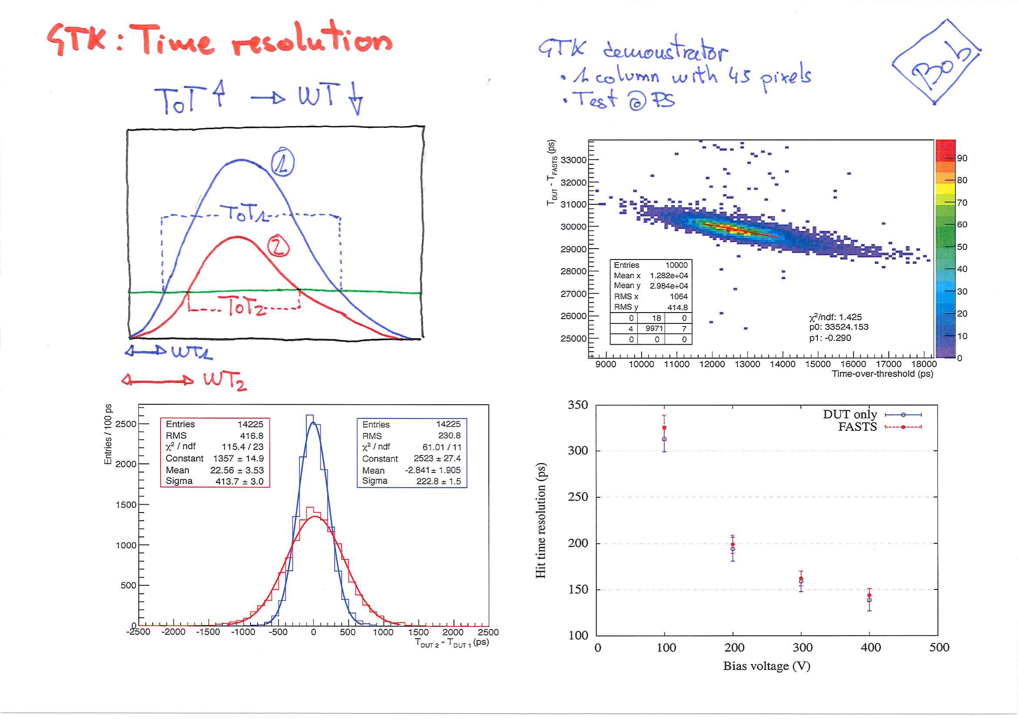
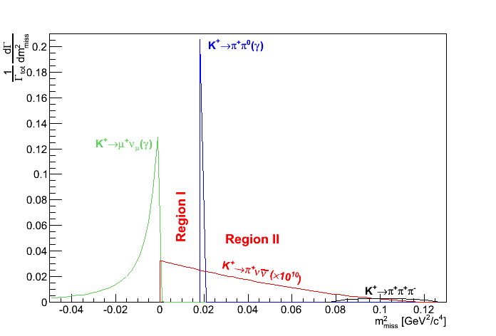
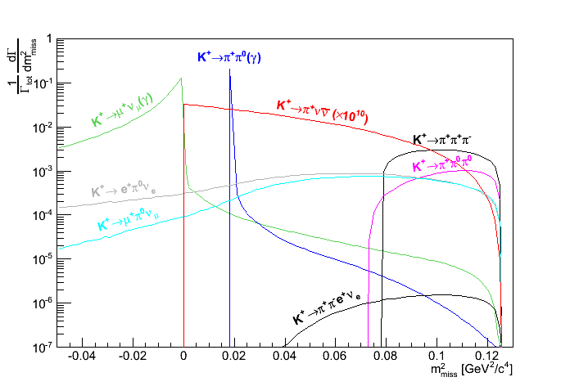
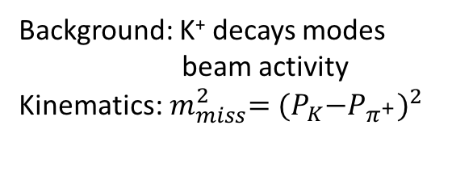
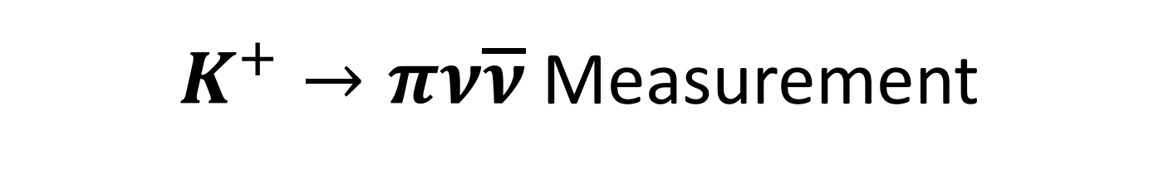
$K^{+}→πν\overline{ν}$ Measurement
Background: K⁺ decays modes
beam activity
Kinematics:${ m}_{miss}^{2}={{(P}_{K}−P_{π^{+}})}^{2}$
Experimental principles:
Precise kinematic reconstruction
PID: K upstream, 𝑒/𝜇/𝜋 downstream
Hermetic 𝛾 detection
Sub-ns timing
Key analysis requirements
2 signal regions in 𝑚𝑚𝑖𝑠𝑠2
15<𝑃𝜋<35GeV/c
Vertex in 65 m long decay region

Slide 28
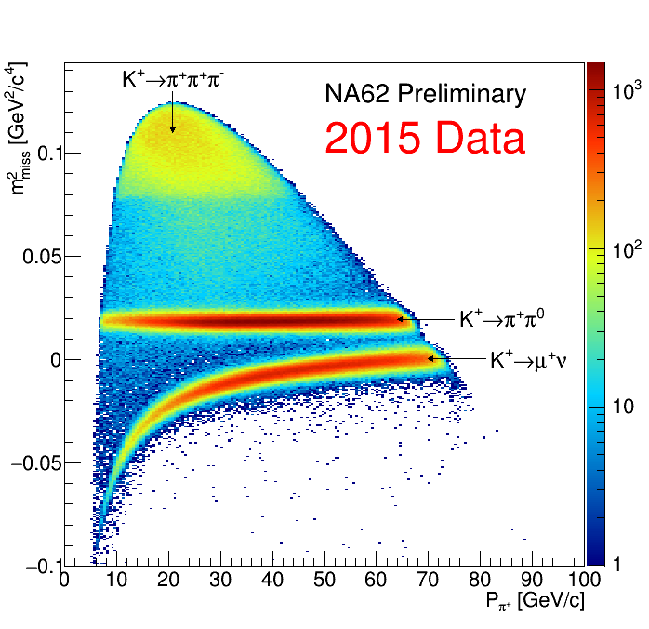
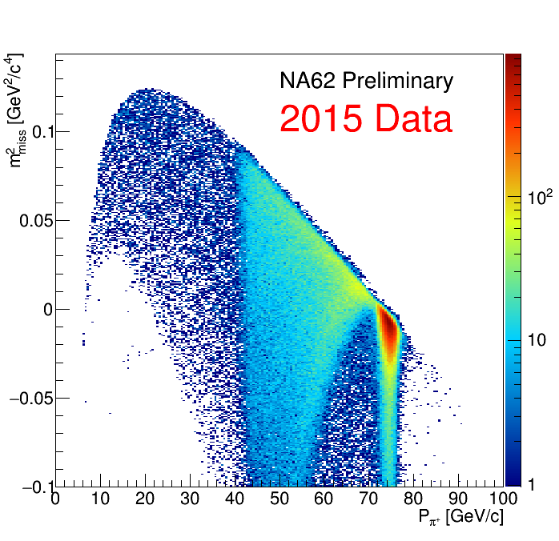
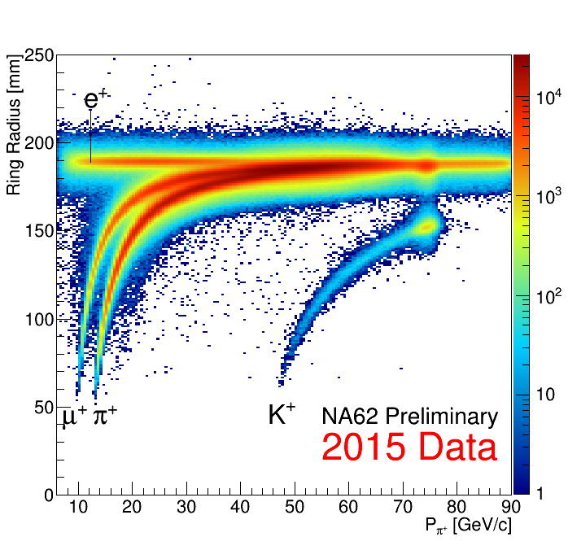
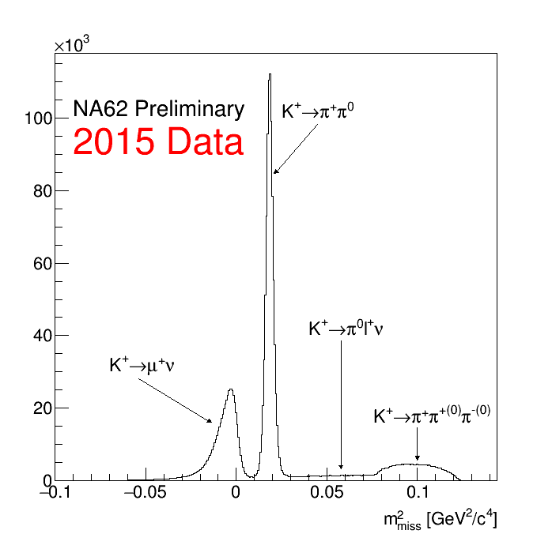
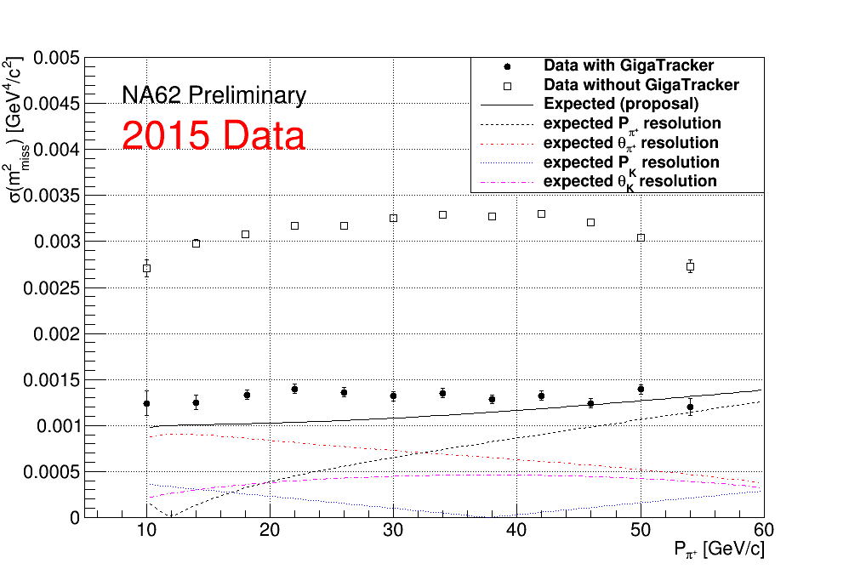
NA62 detector performance
Kaon ID
Downstrean PID
Kinematics

Slide 29
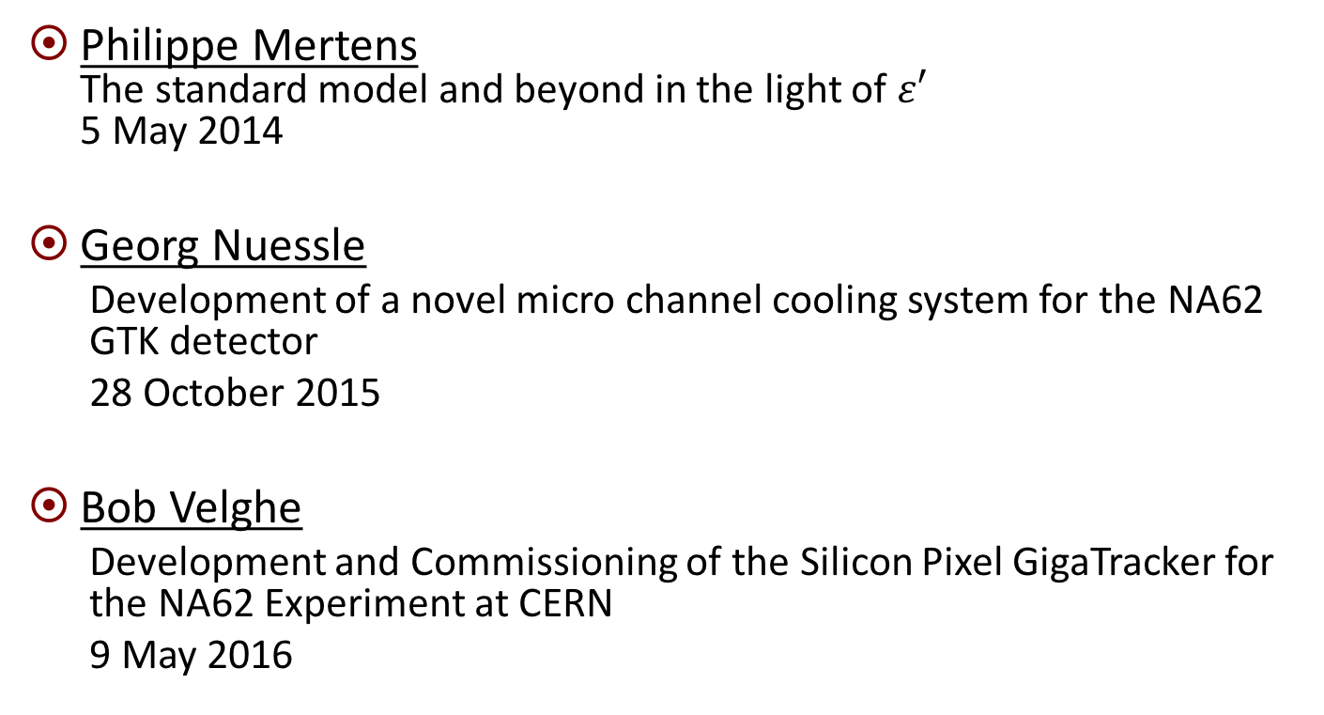
PhD thesis
Philippe Mertens
The standard model and beyond in the light of $ε′$
5 May 2014
Georg Nuessle
  Development of a novel micro channel cooling system for the NA62 GTK detector
  28 October 2015
Bob Velghe
  Development and Commissioning of the Silicon Pixel GigaTracker for the NA62 Experiment at CERN
  9 May 2016

Slide 30
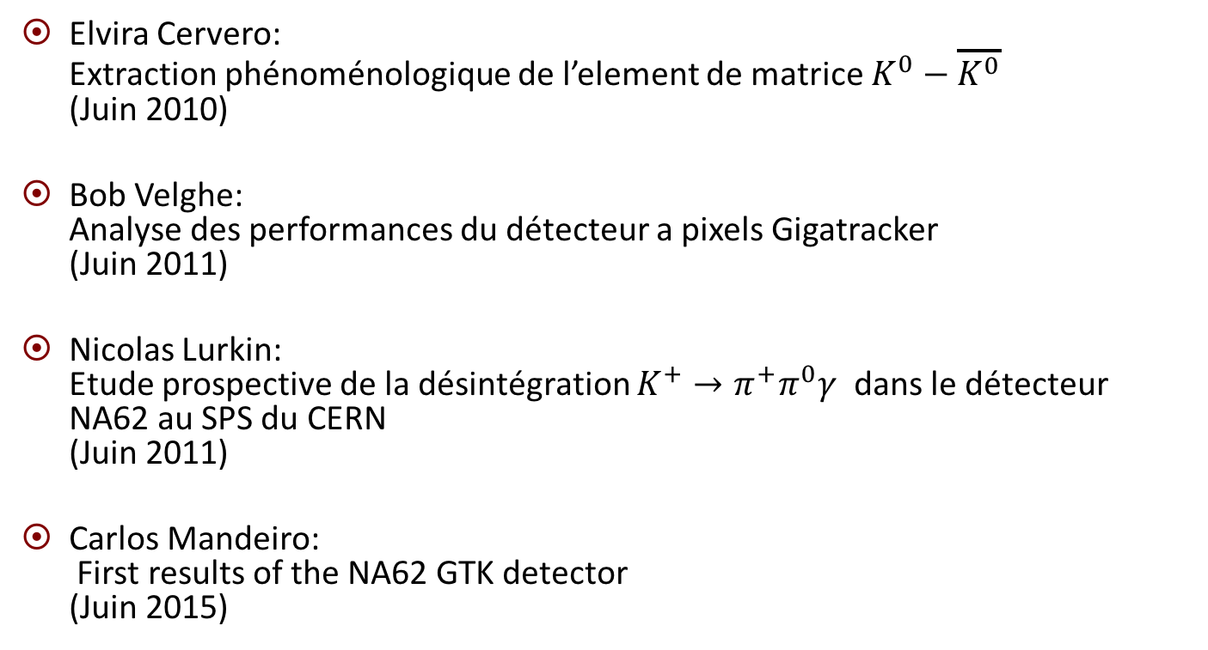
Master thesis
Elvira Cervero:
Extraction phénoménologique de l’element de matrice $K^{0}−\overline{K^{0}}$
(Juin 2010)
Bob Velghe:
Analyse des performances du détecteur a pixels Gigatracker
(Juin 2011)
Nicolas Lurkin:
Etude prospective de la désintégration $K^{+}→π^{+}π^{0}γ$ dans le détecteur NA62 au SPS du CERN
(Juin 2011)
Carlos Mandeiro:
First results of the NA62 GTK detector
(Juin 2015)

Slide 31
Conferences (2014-2016)
Plamen Petrov. DIS 2014 , Warsaw, Poland, 28 Apr: “Measurement of the kaon decay to pi gamma gamma-2 May 2014”, Proceedings of Science DIS2014 166 (2014)
Bob Velghe et al. “GigaTracker, the NA62 Beam Tracker”. In: PoS Vertex2014 (2015), p. 018.
Plamen Petrov. 27th Rencontres de Blois , Blois, France, 31 May - 5 Jun 2015:
“Recent results and prospects on kaon physics from CERN”
Plamen Petrov. KAON2016 Conference, 14-17 Sep 2016, Birmingham, UK
"Prospects for exotics and LFV at NA62 »
Elisa Minucci. 14th International Conference on Meson-Nucleon Physics and the Structure of the Nucleon.(MENU2016) July 25-30, 2016 in Kyoto, Japan
"Search of K^{+} \to pi^{+} nu nubar at the NA62 experiment at CERN".

Slide 32
NA62 Internal notes
NA62-13-05 dated 14.02.2013
Offline Database Integration: Getting Started
Eduardo Cortina Gil - Sergey Podolsky - Bob Velghe
NA62-16-05 dated 07.06.2016
  Method for vertex fit in NA62
  E.Minucci - P.Petrov
NA62-16-07 dated 21.06.2016
  Pi0 neutral decays at NA62
  E.Minucci - T.Spadaro

Slide 33
Publications
NA62 Technical Design
http://na62.web.cern.ch/na62/Documents/TD_Full_doc_v10.pdf
Test-beam results of a silicon pixel detector with Time-over-Threshold read-out having ultra-precise time resolution
G. Aglieri Rinella (CERN) et al.. 2015.
Published in JINST 10 (2015) no.12, P12016
DOI: 10.1088/1748-0221/10/12/P12016
The Beam and detector of the NA62 experiment at CERN
NA62 collaboration
arXiv:1703.08501 [physics.ins-det]
Submitted to JINST

Slide 34
Publications
J.-M. GERARD
An upper bound on the Kaon B-parameter and Re(K )
JHEP 02 (2011) 075.
P. MERTENS and C. SMITH
The $s\to d\gamma$ decay in and beyond the standard model.
JHEP 08 (2011) 069.
J.-M. GERARD and P. VALENTE
Role of Kaon Physics, present-future.
Comptes Rendus Physique 13 (2012) 127-132.
E. CERVERO and J.-M. GERARD
Minimal violation of flavour and custodial symmetries in a vectophobic Two-Higgs-Doublet-Model.
Phys. Lett. B712 (2012) 255.
J.-M. GERARD and Z.Z. XING
Flavor mixing democracy and minimal CP violation.
Phys. Lett. B713 (2012) 29.
J.-M. GERARD and P. MERTENS
Weakly-induced strong CP-violation.
arXiv :1206.0914, Phys.Lett. B71(2012) 316-321.
A.J. Buras, J.-M. GERARD, W.A. Bardeen.
Large N Approach to Kaon Decays and Mixing 28 Years Later: $\Delta=1/2$ Rule, $\hat{B}_{K}$ and $\Delta M_{K}$
Eur.Phys.J. C74 5, DOI: 10.1140/epjc/s10052-014-2871-x e-Print: arXiv:1401.1385 [hep-ph]
A.J. Buras and J.-M. GERARD,
Upper bounds on ε′/ε parameters B6(1/2) and B8(3/2 from large N QCD and other news,
JHEP 12 (2015) 008. (arXiv: 1507.06326).
A.J. Buras and J.-M. GERARD,
Final state interactions in K → ππ decays: ΔI = 1/2 rule vs. ε′/ε,
Submitted to JHEP (2016). (arXiv: 1603.05686).

Slide 35
Budget
As the construction phase has finished the required budget is for running the experiment:
Human resources: 1 Postdoc + 1 phd student
Common Fund |  | 30 kEUR/year
GTK sensor replacement |  | 11.5 kEUR/year
Long stays at CERN |  | 26.4 kEUR/year |  | GTK conveenor Shifts
NA62 meetings |  | 12 kEUR/year
Conferences, Invited researchers |  | 6 kEUR/year
Lab running budget |  | 8.8 kEUR/year

Slide 36
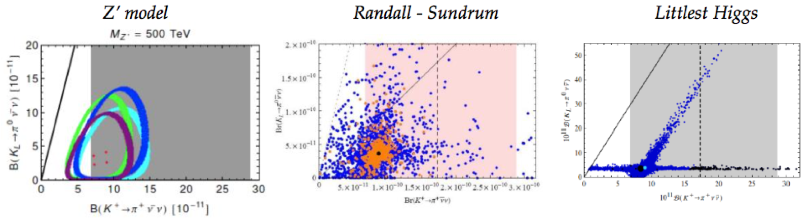
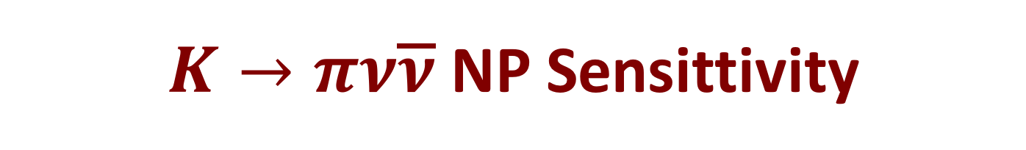
$K→πν\overline{ν}$ NP Sensittivity
Simplified Z, Z’ models [Buras, Buttazzo,Knegjens, JHEP 1511 (2015) 166]
Littlest Higgs with T-parity [Blanke, Buras, Recksiegel, EPJ C76 (2016) no.4 182]
Custodial Randall-Sundrum [Blanke, Buras, Duling, Gemmler, Gori, JHEP 0903 (2009) 108]
MSSM non-MFV [Tanimoto, Yamamoto arXiv:1603.0796, Isidori et al. JHEP 0608 (2006) 064]
Constraints from existing measurements (correlations model dependent):
  Kaon mixing and CPV, CKM fit, K,B rare meson decays, NP limits from direct searches
g

