Slide 1
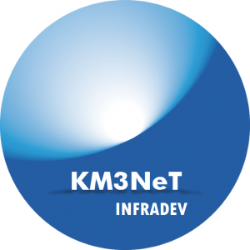



KM3NeT & INFRADEV JOINT MEETING
KM3NeT in the Global Science Context
Juande Zornoza, IFIC (UV-CSIC)
H2020: KM3NeT 2.0
Brussels, 9/11/2018

Slide 2
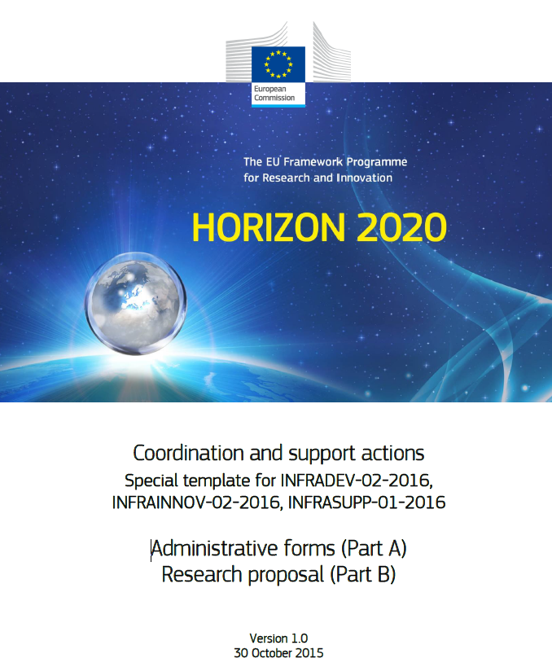
H2020-InfraDeV
This call focuses on developing new world-class research infrastructures.
The aim is to facilitate and support the implementation and long-term sustainability of the research infrastructures identified by the European Strategy Forum on Research Infrastructures (ESFRI) as well as of other world-class research infrastructures.

Slide 3
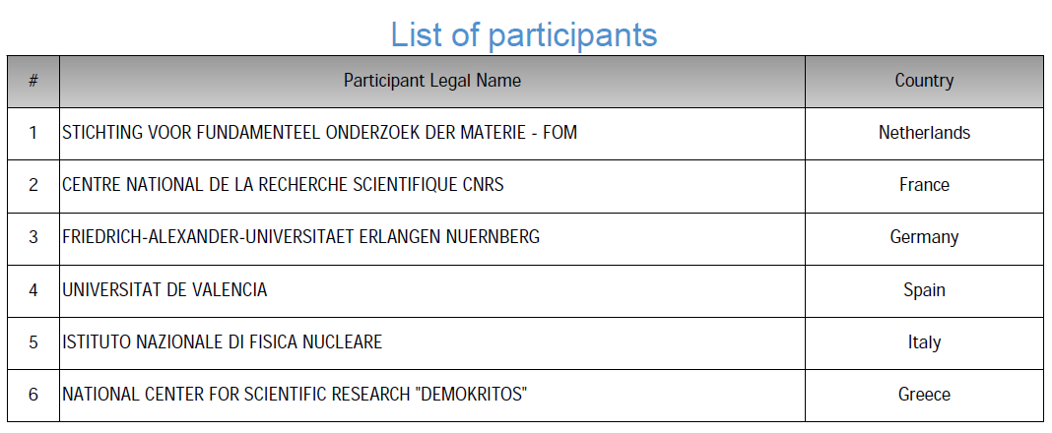
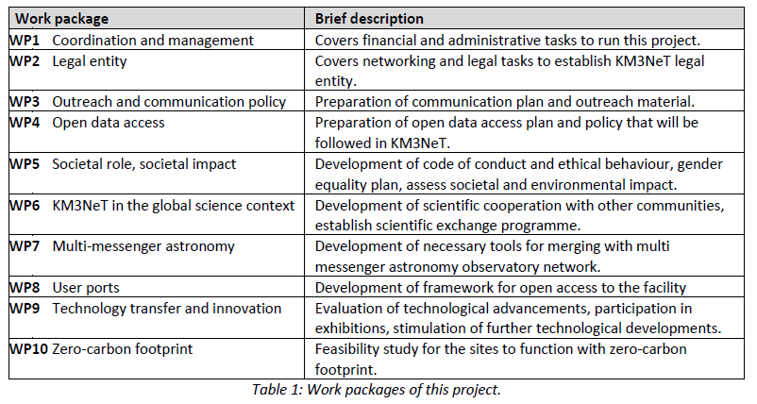
KM3NeT-InfraDev

Slide 4
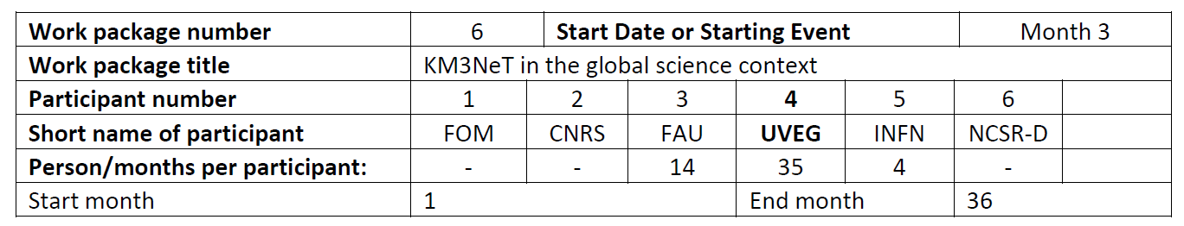
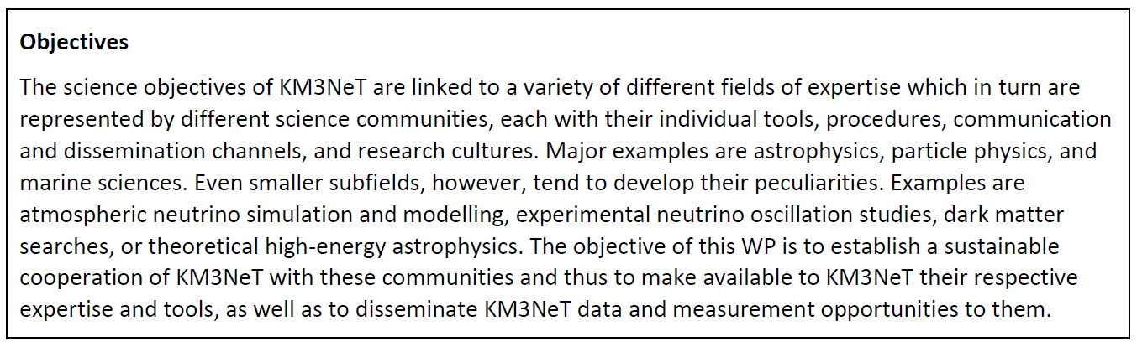
WP6: Work Package Overview

Slide 5
List of tasks
6.1: Institutionalising scientific cooperation with other science communities (months 3-24)
6.2 Establishing a scientific exchange program for KM3NeT (months 3-30)
6.3 Exploring physics new physics opportunities for KM3NeT (months 13-36)

Slide 6
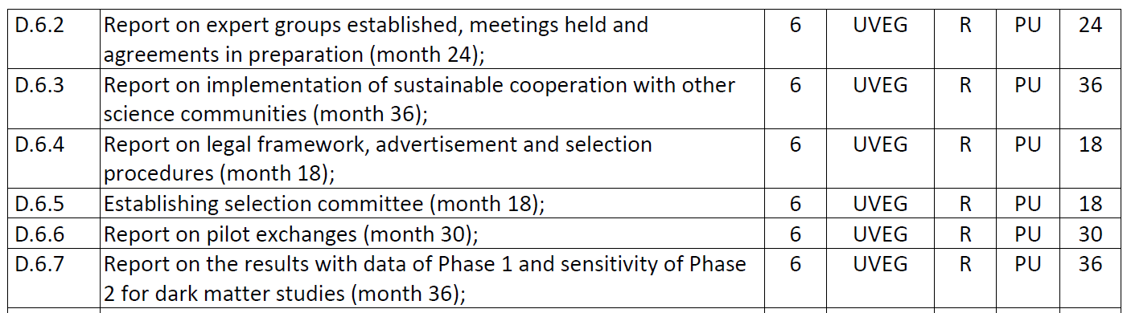
Deliverables and milestones

Slide 7
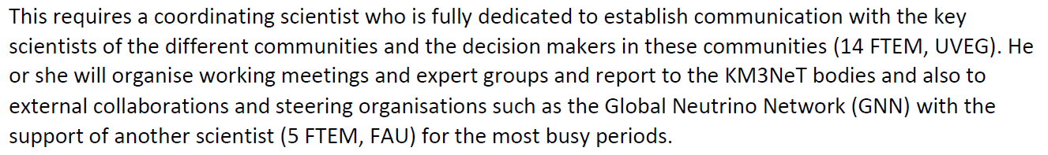
Task 6.1: Introduction
Institutionalising scientific cooperation with other science communities

Slide 8
Task 6.1: Activities
Study on the systematics in the NMO analysis
  to improve the robustness of our performance estimations
  to strengthen the scientific community support
Organization of workshops
  Two first workshops in November 2018:
    NMO: IFIC (coupled to internal face-to-face meeting of KM3NeT-ORCA)
    Dark matter: Brussels (Juanan Aguilar agreed to host it)
  Further plans for 2019: Sea science (Italy?) and Mult-messenger (CPPM?)
Provide discussion channels in the scientific community for particular topics
  Working (Sub)Group on cross section systematics internal in the collaboration
  Discussion forum with expert of KM3NeT plus theoreticians and other experimentalists

Slide 9
Task 6.1: Deliverables
Deliverables
D 6.1 Six working group meetings organized and held (months 3-24)
D 6.2 Report on expert groups established, meetings held and agreements in preparation (month 24)
D 6.3 Report on implementation of sustainable cooperation with other science communities (month 36)

Slide 10
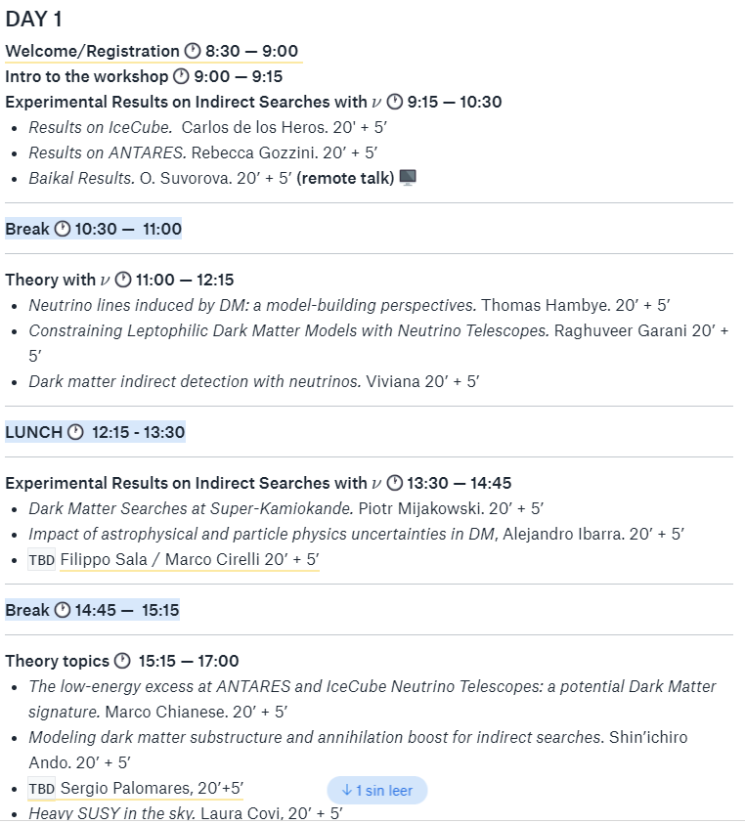
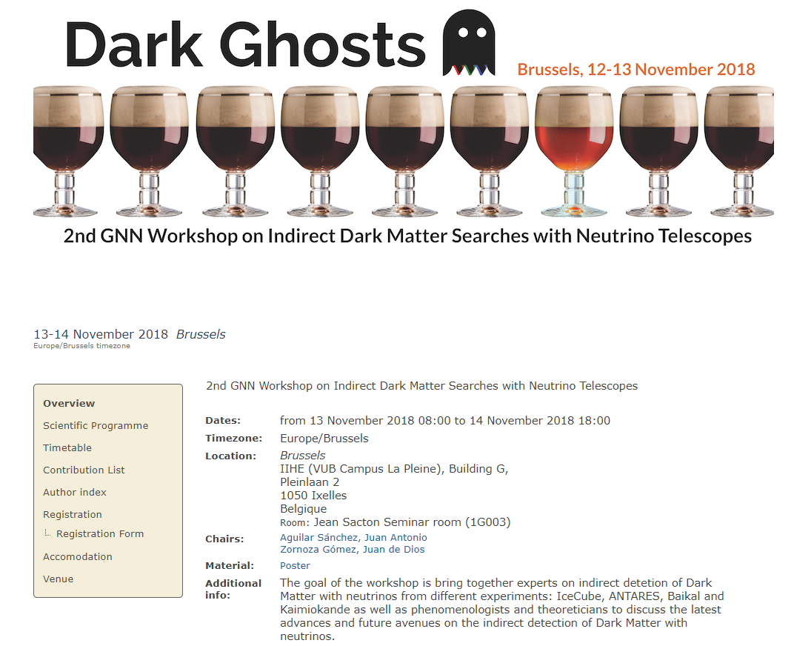
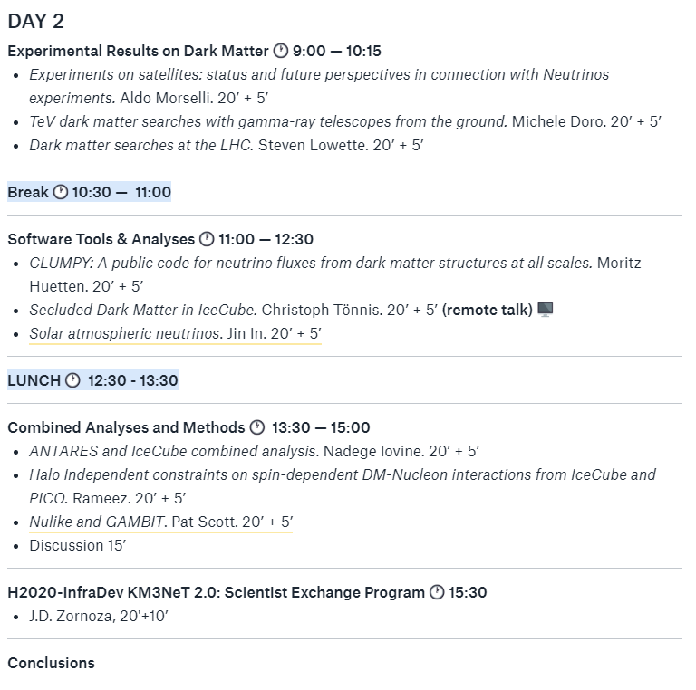
http://indico.iihe.ac.be/indico/conferenceDisplay.py?confId=1199

Slide 11
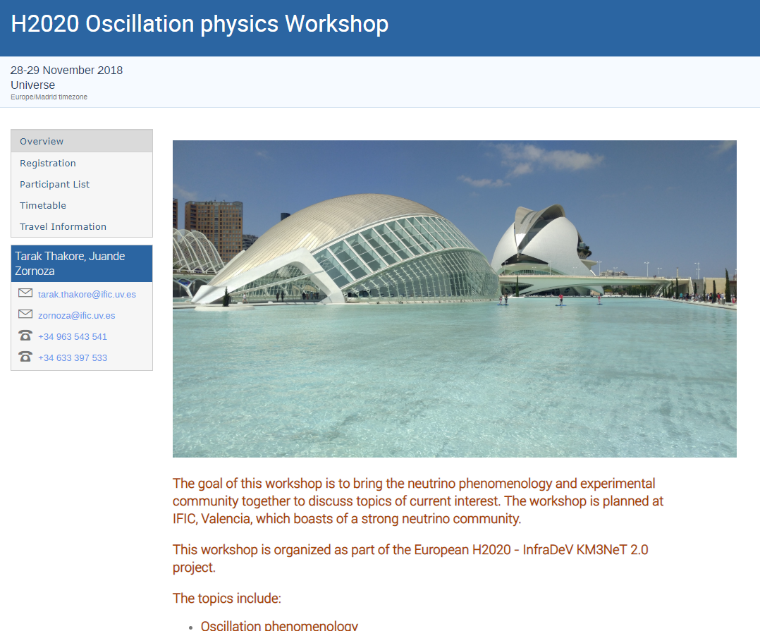
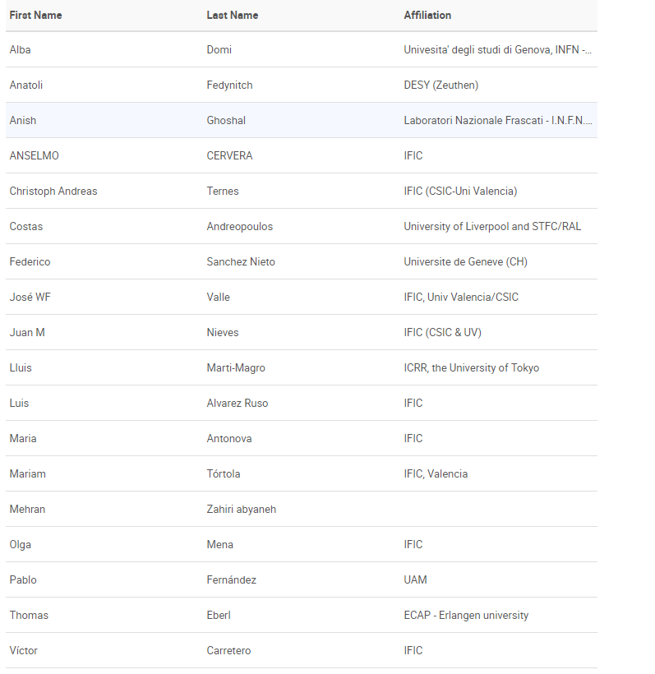
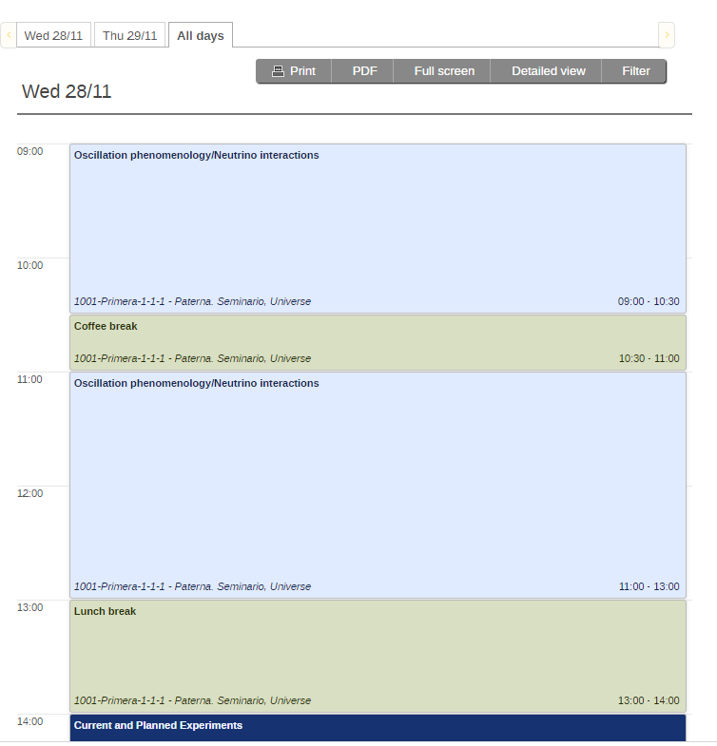
https://indico.ific.uv.es/event/3395/

Slide 12
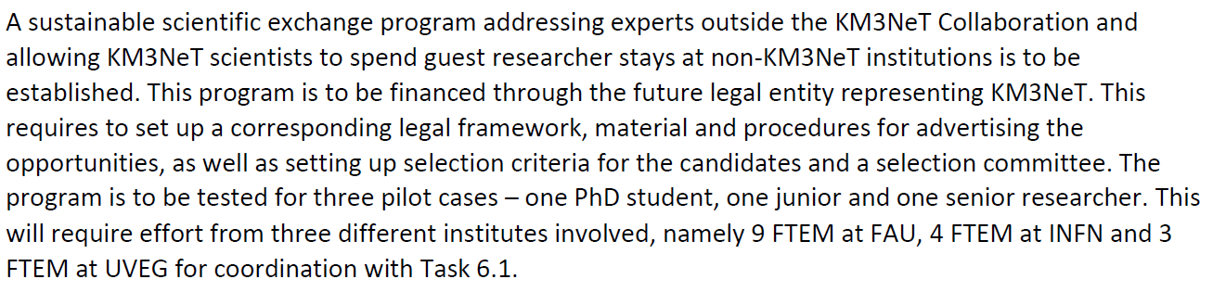
Task 6.2: Introduction
Establishing a scientific exchange program for KM3NeT

Slide 13
Task 6.2: Activities
Questionnaire about funding opportunities in each participant country
List of contact people for each country
In preparation: Committee for selection rules, etc.

Slide 14
Task 6.2: Deliverables
D 6.4 Report on legal framework, advertisement and selection procedures (month 18)
D 6.5 Establishing selection committee (month 18)
D 6.6 Report on pilot exchanges (month 30)

Slide 15
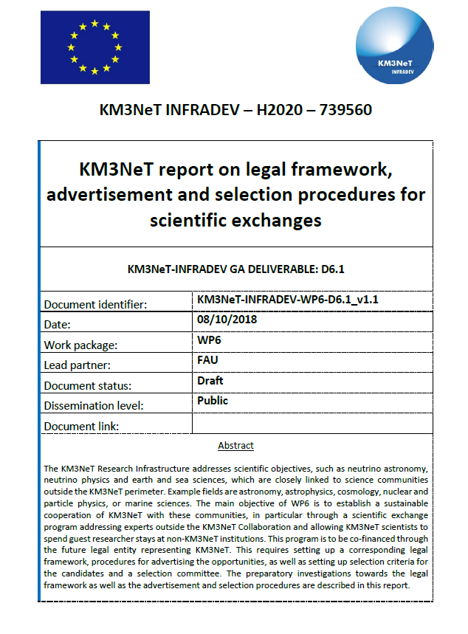
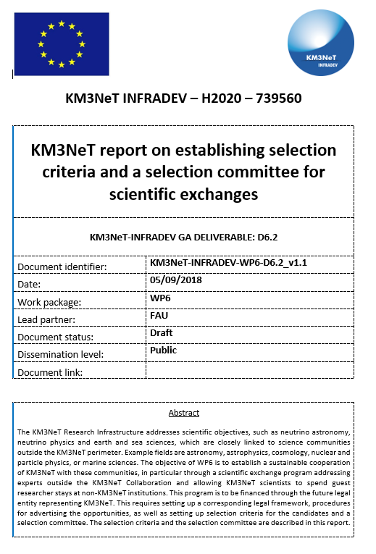
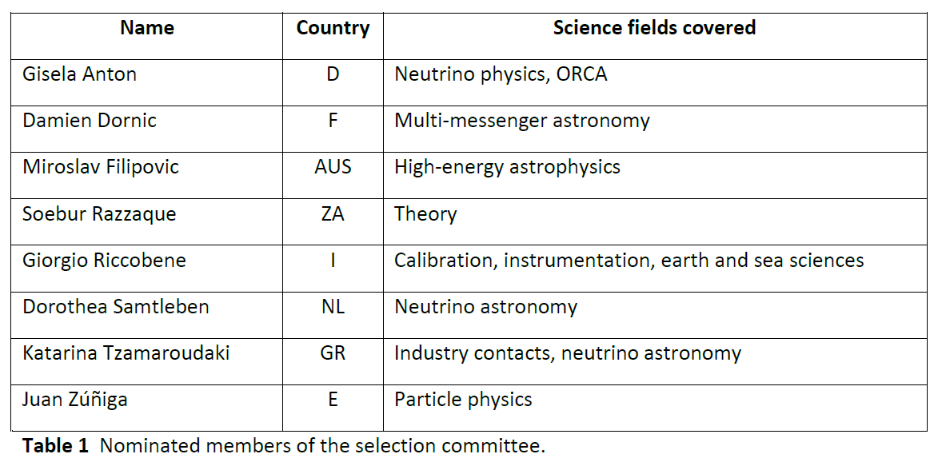
Task 6.2

Slide 16
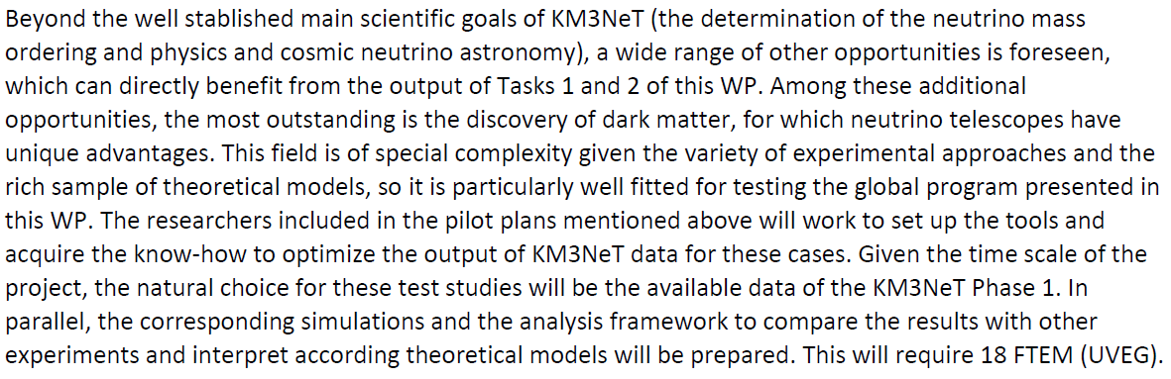
Task 6.3: Introduction
Exploring physics new physics opportunities for KM3NeT

Slide 17
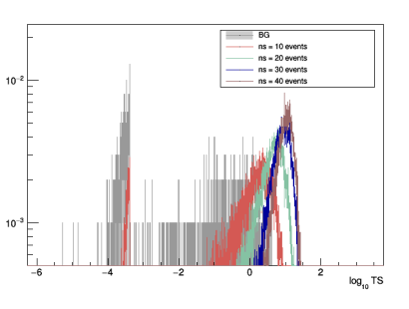
Task 6.3: Activities
Rebecca (IFIC): Estimation of ARCA sensitivity for Galactic Center done (under checking now)
Meghna (Warsaw): Estimation of ARCA sensitivity for the Sun going-on
Test statistic distribution for GC/ARCA

Slide 18
Task 6.3: Deliverables
D 6.7 Report on the results with data of Phase 1 and sensitivity of Phase 2 for dark matter studies (month 36)

