Slide 1
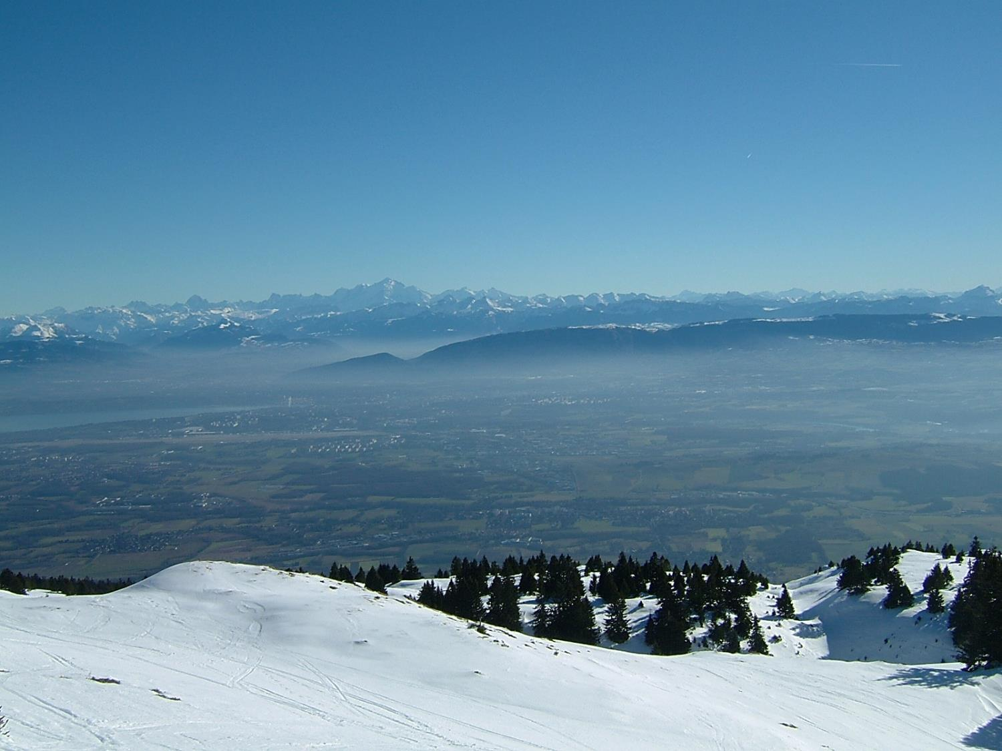
Physics at Lepton Colliders
Paolo Giacomelli
INFN Bologna
EOS Solstice meeting
Bruxelles, 20/12/2018
Thanks to A. Blondel and P. Janot
and other collaborators
Photo J. Wenninger

Slide 2
Overview
The proposed future Lepton Colliders
Circular Colliders
Linear Colliders
Discovery potential
EW observables
The Higgs factory
pp collider at 100 TeV
IDEA
Conclusions
Caveat
Cannot possibly cover all the physics landscape!
A personal selection applied…

Slide 3
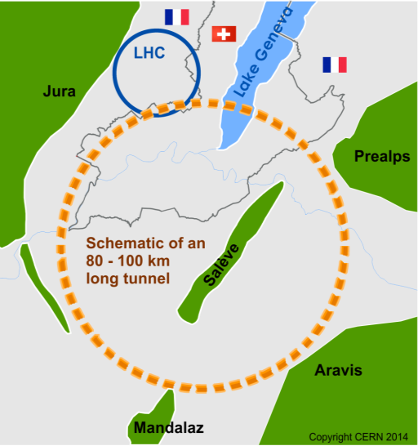
The Future Circular Colliders
CDR and cost review to appear Q4 2018 for ESU
International collaboration to Study Colliders fitting in a new ~100 km infrastructure, fitting in the Genevois
Ultimate goal: 100 TeV pp-collider (FCC-hh)
→ defining infrastructure requirements
Two possible first steps:
e⁺e⁻ collider (FCC-ee) High Lumi, E_{CM} =90-400 GeV
HE-LHC 16T ⇒ 27 TeV in LEP/LHC tunnel
Possible addition:
p-e (FCC-he) option
~16 T magnets
From what we know today :
the way by FCC-ee is probably the fastest and cheapest way to 100 TeV.
That combination also produces the most physics. It is the assumption in the following.
also a good start for μC!
From European Strategy in 2013: “ambitious post-LHC accelerator project” Study kicked-off in Geneva in Feb 2014

Slide 4
Circular colliders: FCC-ee detectors
IDEA
CLD
2 T solenoid
Full Si tracker
SiW HG EM calorimeter
Sci.-steel HG HCAL calorimeter
Muon detector with RPCs
2 T thin solenoid
Si vertex
Wire chamber
Dual Readout calorimeter
MPGD-based Muon detector
CDR to be published in January 2019

Slide 5
Possible Timeline of the FCCs
Technical Schedule for each of the 3 options
20
22
24
26
28
30
32
34
36
38
40
42
Technical Design Phase
Strategy Update 2026 – assumed project decision
Dipole short models
Dipole long models
16 T magnets
SC Magnets
16 T dipole indust. prototypes
16 T dipoles preseries
16 T series production
Civil Engineering FCC-hh ring
FCC-hh
FCC-hh
CE TL to LHC
LHC Modification
Installation + test FCC-hh
FCC-ee
CE FCC-ee ring + injector
FCC-ee
Injector
Installation + test FCC-ee
LHC Removal
HE-LHC
HE-LHC
Installation HE-LHC
schedule constrained by 16 T magnets & CE
→ earliest possible physics starting dates
FCC-ee: 2039
FCC-hh: 2043
HE-LHC: 2040 (with HL-LHC stop LS5 / 2034)

Slide 6
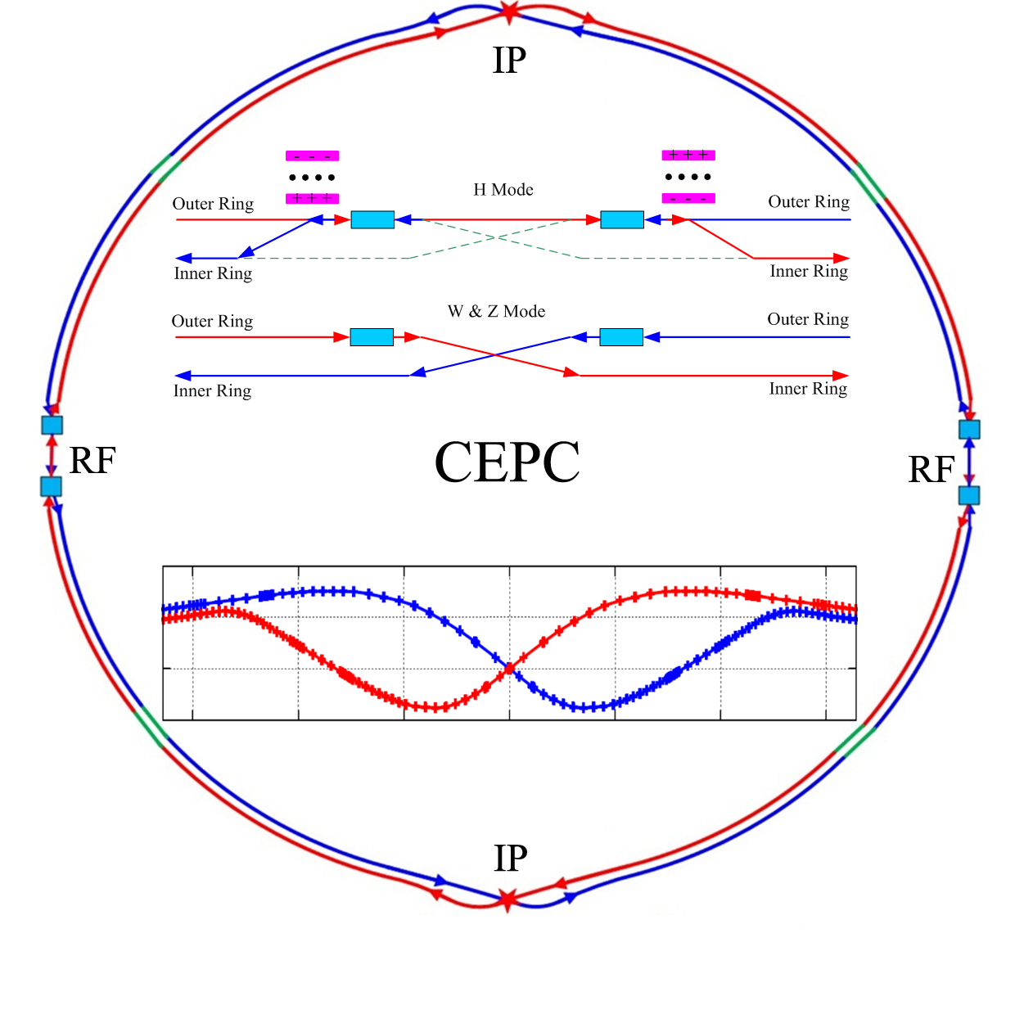
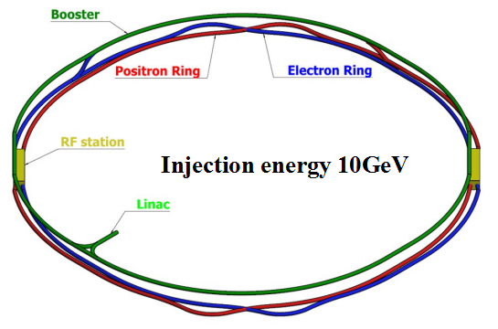
Circular colliders: CEPC
CDR published in November 2018
Higgs, W, and Z modes
Syncrotron Radiation power 30MW/ beam,
upgradable to 50MW/beam
CEPC collider ring (100km)
CEPC booster ring (100km)
Center of mass energy 91 - 240 GeV
Max. luminosity (√s=240 GeV) 3 x 10³⁴ cm⁻²s⁻¹
Later install SPPC (pp collider) √s = 100-120 TeV

Slide 7
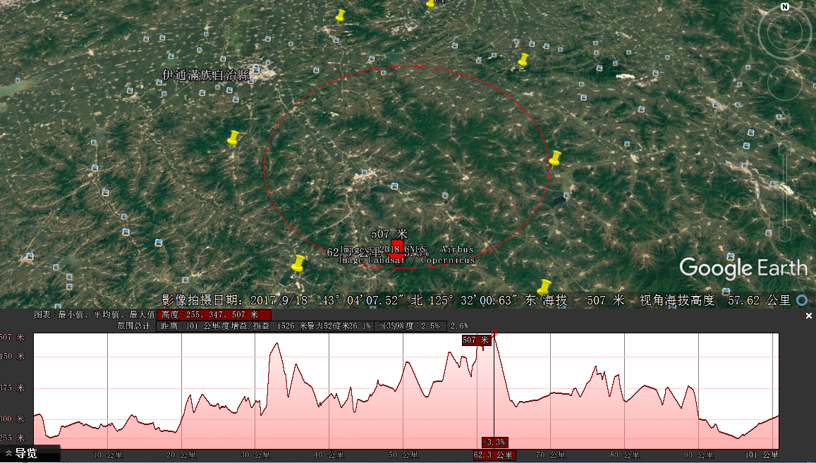
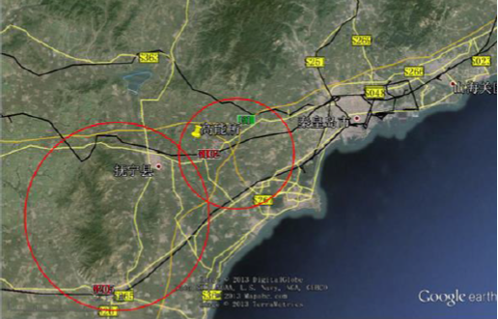
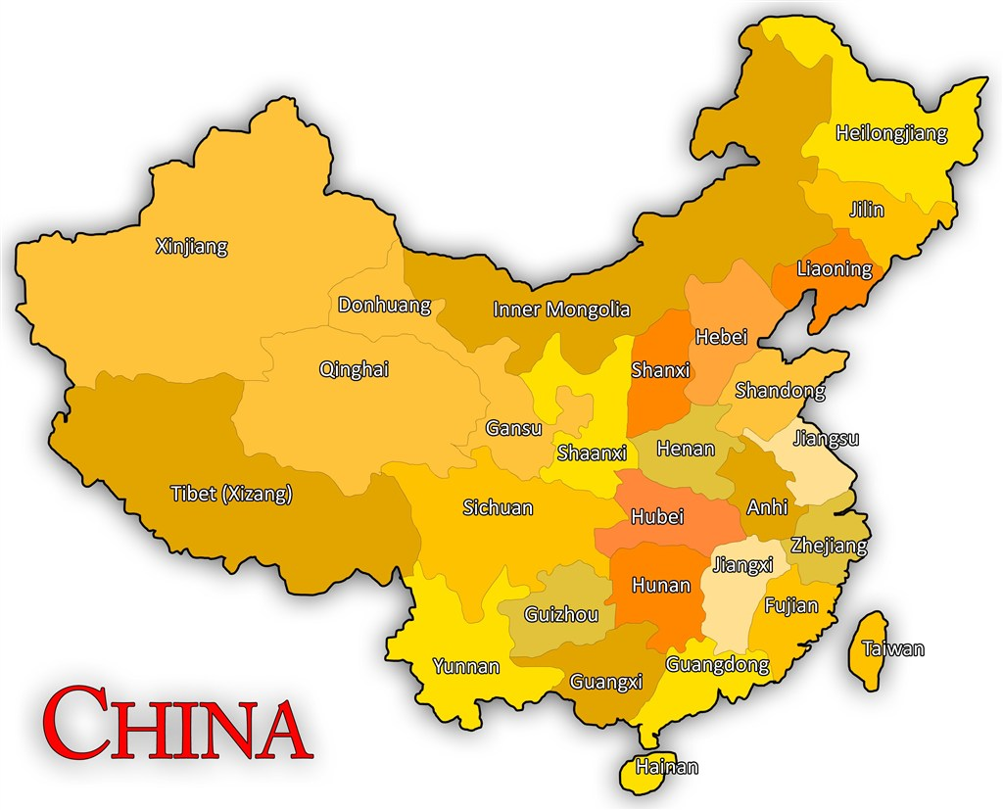
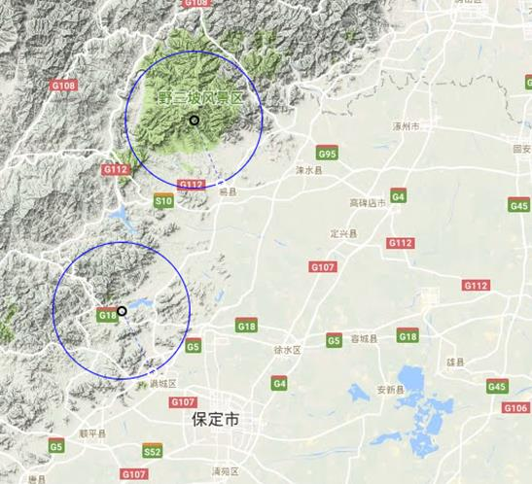
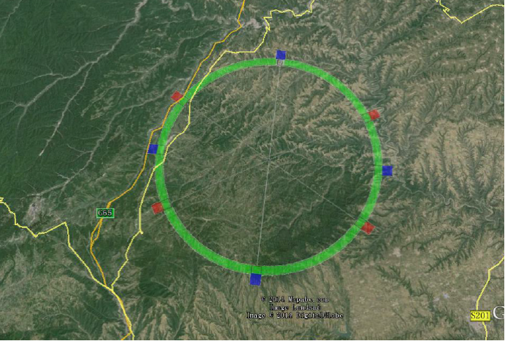
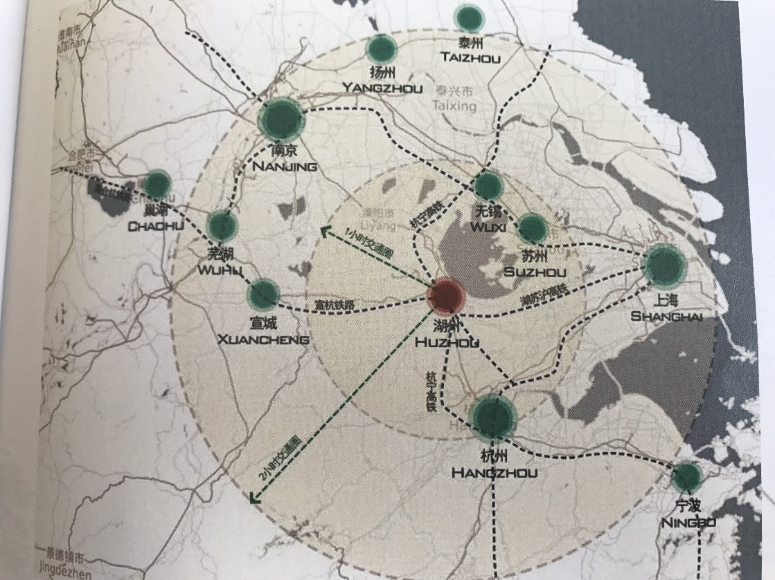
CEPC Site Selections
6
Huanghe Company participated
1
1)
4
4
2
2)
5
1) Qinhuangdao, Hebei Province（Completed in 2014）
2) Huangling, Shanxi Province（Completed in 2017)
3) Shenshan, Guangdong Province(Completed in 2016)
4) Baoding (Xiong an), Hebei Province (Started in August 2017)
5) Huzhou, Zhejiang Province (Started in March 2018)
6) Chuangchun, Jilin Province (Started in May 2018)
3)
3

Slide 8
Linear colliders: ILC
Length ~20 km
for √s=250 GeV
SID
ILD
Center of mass energy 250 GeV, upgradable to 500 GeV and possibly to 1 TeV
Accelerating gradient 31.5 MeV/m
Max. luminosity (√s=250 GeV) 1.5 x 10³⁴ cm⁻²s⁻¹

Slide 9
Linear colliders: ILC
To be hosted by Japan
Site selected is Kitakami
Breaking News!!
Japan’s Science Council does not support ILC!
Decision pending by Japan
since 2013…
XFEL built at DESY is a 10% version of the ILC.
19/12/2018
ILC
2018

Slide 10
Linear colliders: CLIC
4 T solenoid
Si tracker
HG calorimeter
Muon detector
Center of mass energy 380 GeV, upgradable to 1.5 TeV and possibly to 3 TeV
Accelerating gradient ~100 MeV/m
Max. luminosity (√s=380 GeV) 1.5 x 10³⁴ cm⁻²s⁻¹

Slide 11
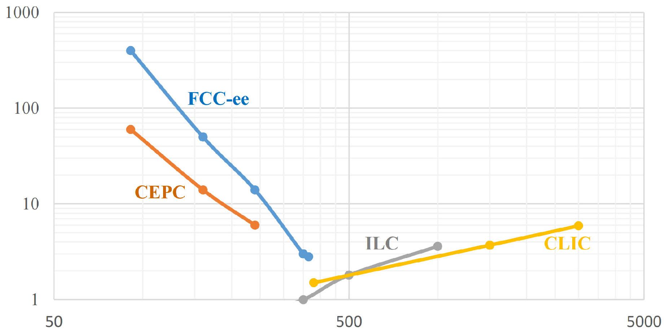
Future lepton colliders luminosities
Z
WW
H
tt
Total luminosity [10³⁴ cm⁻²s⁻¹]
√s (GeV)
Clear advantage in luminosity for circular colliders vs. linear colliders.
Linear colliders (CLIC) have higher energy reach, but less than a pp collider.

Slide 12
FCC-ee Run Plan
(ab⁻¹⁾
indicative: total ~15 years
O(1/3) of the machine cost
comes O(10) years after start
Event statistics :
E_{CM} errors:
Z peak E_{cm} : 91 GeV 5x10¹² e⁺e⁻ → Z
WW threshold E_{cm} : 161 GeV 10⁸ e⁺e⁻ → WW
ZH threshold E_{cm} : 240 GeV 10⁶ e⁺e⁻ → ZH
‾tt threshold E_{cm} : 350 GeV 10⁶ e⁺e⁻ →‾tt
LEP x 10⁵
LEP x 2.10³
Never done
Never done
100 keV
300 keV
1 MeV
2 MeV

Slide 13
FCC-ee discovery potential
Today we do not know how nature will surprise us. A few things that FCC-ee could discover :
NB Not only a «Higgs Factory», «Z factory» and «top» are important for ‘discovery potential’

Slide 14
EW observables at FCC-ee
Observable | Measurement | Current precision | FCC-ee stat. | Possible syst. | Challenge
m_{Z} (MeV) | Lineshape | 91187.5 ± 2.1 | 0.005 | < 0.1 | QED corr.
G_{Z} (MeV) | Lineshape | 2495.2 ± 2.3 | 0.008 | < 0.1 | QED / EW
R_{l} | Peak | 20.767 ± 0.025 | 0.001 | < 0.001 | Statistics
R_{b} | Peak | 0.21629 ± 0.00066 | 0.000003 | < 0.00006 | g → bb
N_{ν} | Peak | 2.984 ± 0.008 | 0.00004 | < 0.004 | Lumi meast
sin²θ_{W}^{eff} | A_{FB}^{μμ} (peak) | 0.23148 ± 0.00016 | 0.000003 | <0.000005 | Beam energy
1/a_{QED}(m_{Z}) | A_{FB}^{μμ} (off-peak) | 128.952 ± 0.014 | 0.004 | < 0.004 | QED / EW
a_{s}(m_{Z}) | R_{l} | 0.1196 ± 0.0030 | 0.00001 | <0.0002 | New Physics
*
*
Great improvement across all the measurements !
Observable | Measurement | Current precision | TLEP stat. | Possible syst. | Challenge
m_{w} (MeV) | Threshold scan | 80385 ± 15 | 0.6 | < 0.6 | EW Corr.
G_{W} (MeV) | Threshold scan | 2085 ± 42 | 1.5 | <1.5 | EW Corr.
N_{ν} | e⁺e⁻→ γZ, Z→ νν, ll | 2.92 ± 0.05 | 0.001 | < 0.001 | ?
a_{s}(m_{W}) | B_{had} = (Γ_{had}/Γ_{tot})_{W} | B_{had} = 67.41 ± 0.27 | 0.00018 | < 0.0001 | CKM Matrix
Observable | Measurement | Current precision | TLEP stat. | Possible syst. | Challenge
m_{top} (MeV) | Threshold scan | 173340 ± 760 ± 500 | 20 | <40 | QCD corr.
G_{top} (MeV) | Threshold scan | ? | 40 | <40 | QCD corr.
l_{top} | Threshold scan | m = 1.2 ± 0.3 | 0.08 | < 0.05 | QCD corr.
ttZ couplings | √s = 365 GeV | ~30% | ~2% | <2% | QCD corr
* work to do: check if we can improve

Slide 15
Higgs Factory
Higgs provides a very good reason why we need a lepton (e⁺e⁻ or μμ) collider

Slide 16
Higgs production at an e⁺e⁻ collider
“Higgstrahlung” process close to threshold
Production cross section has a maximum at near threshold ~200 fb
10³⁴/cm²/s ➔ 20’000 HZ events per year
e⁻
H
Z – tagging
by missing mass
Z*
e⁺
Z
For a Higgs of 125 GeV, a centre of mass energy of 240-250 GeV is optimal
➔ kinematical constraint near threshold for high precision in mass, width, selection purity

Slide 17
Higgs production at FCC-ee
FCC-ee
5 ab-1@240 GeV
~1.5 ab⁻¹@365 GeV
 | FCC-ee 240 GeV | FCC-ee 365 GeV
Total Integrated Luminosity (ab⁻¹) | 5 | 1.5
# Higgs bosons from e⁺e⁻→HZ | 1,000,000 | 180,000
# Higgs bosons from fusion process | 25,000 | 45,000
Higgs Factory!

Slide 18
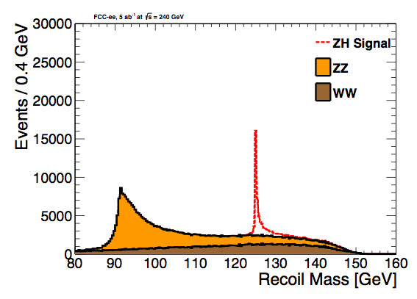
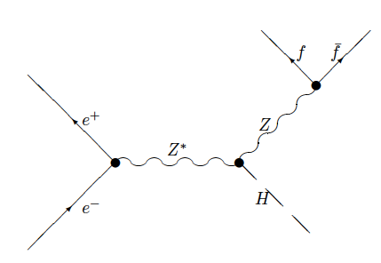
Higgs couplings to Z
Recoil method provides a unique opportunity for a decay-mode independent measurement of the HZ coupling
Higgs events are tagged with the Z boson decays, independently of Higgs decay mode, mrecoil = mH
Expected precision 0.7% on the ZH cross section
Using only leptonic Z decays and only a measurement at 240 GeV so far
Higgs-strahlung

Slide 19
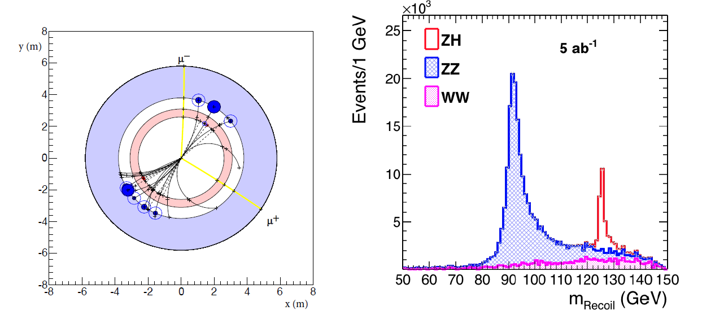
Z-tagging by missing mass
total rate ∝ g_{HZZ}²
ZZZ final state ∝ g_{HZZ}⁴/ Γ_{H}
measure total width Γ_{H}
g_{HZZ} to ±0.2% and many other partial widths
empty recoil = invisible width
‘funny recoil’ = exotic Higgs decay
easy control below threshold
e⁻
H
Z*
e⁺
Z

Slide 20
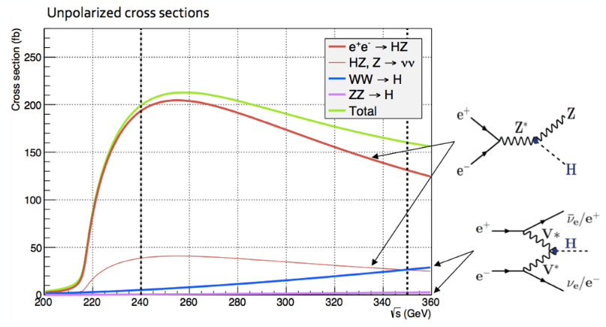
Higgs boson width
Total Higgs boson width can be extracted from a combination of measurements in a model independent way
1) tagging Higgs final states
2) measurements of vector boson fusion production at 365 GeV
3) combination of all measurements
Precision obtainable on δΓ_{H}/Γ_{H} ~ 1.6%

Slide 21
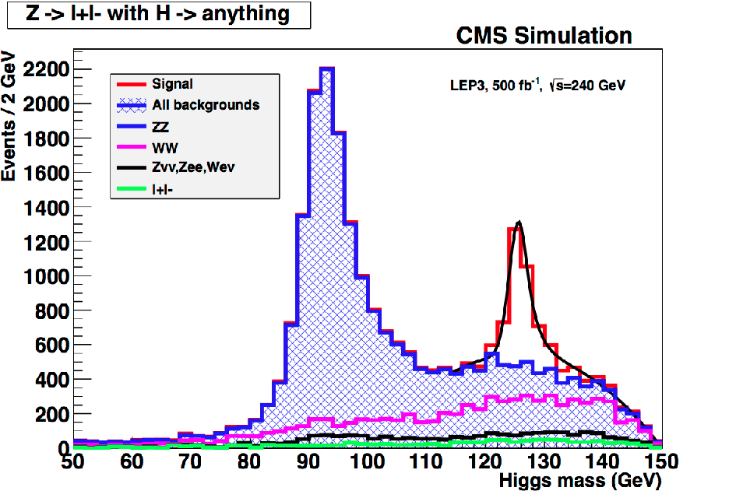
Higgs boson couplings, ZH→ℓℓX
C. Bernet
FCC week 2018
Ongoing work, should lead to better results in TDR
CLD: 15% improvement due to higher lepton efficiency

Slide 22
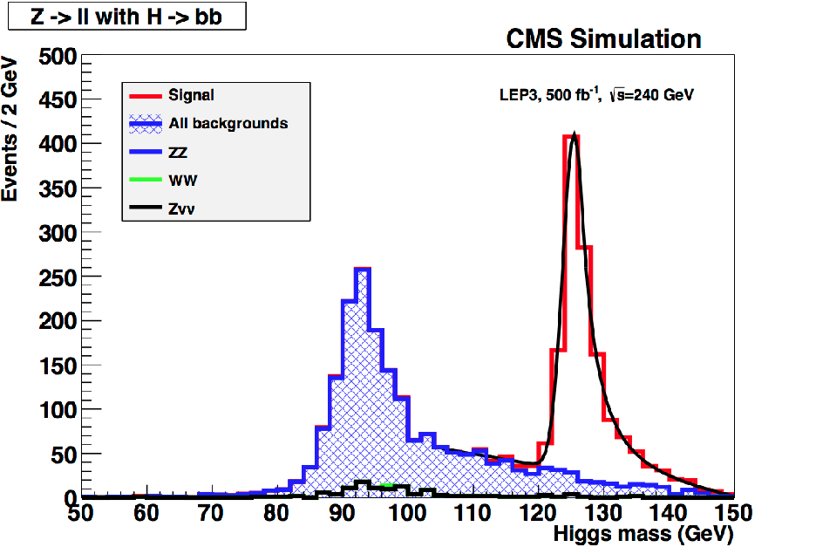
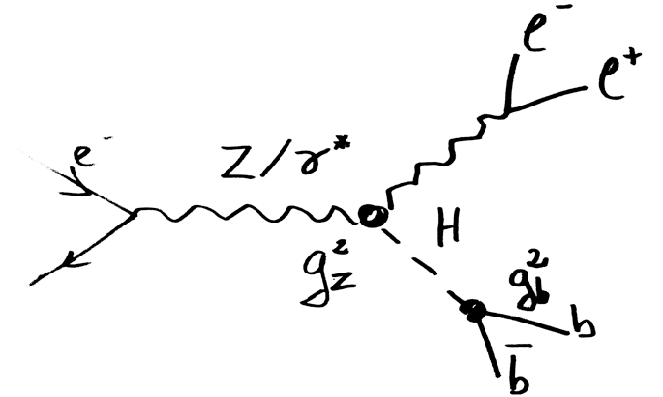
Higgs boson couplings, ZH→ℓℓbb
C. Bernet
FCC week 2018
Ongoing work, should lead to better results in TDR
CLD: 20% improvement due to higher lepton efficiency and better b tagging

Slide 23
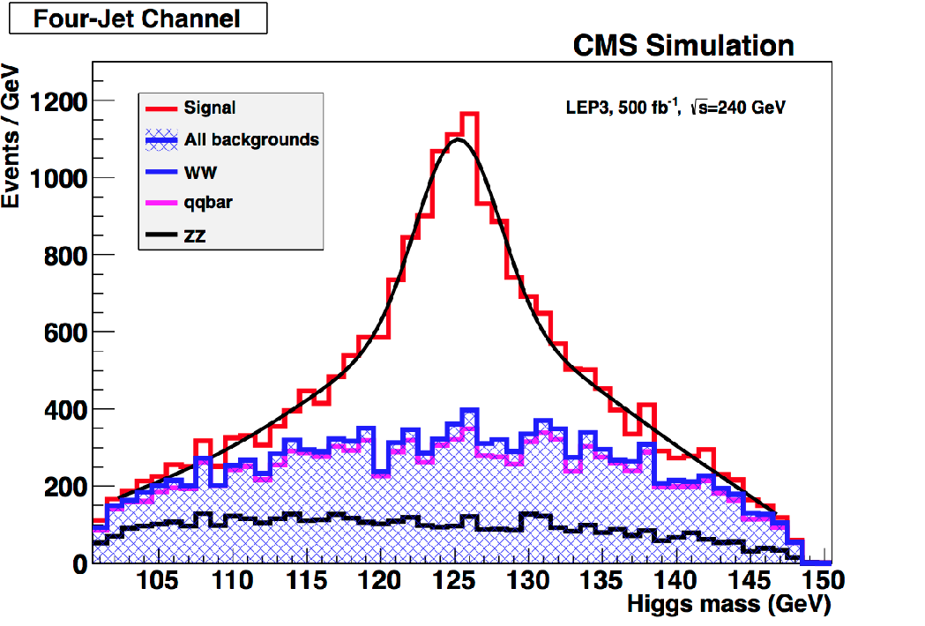
Higgs boson couplings, ZH→qqbb
C. Bernet
FCC week 2018
Ongoing work, should lead to better results in TDR
CLD: 35% improvement due to better b tagging and particle flow

Slide 24
Higgs boson couplings
Precision Higgs coupling measurements
Absolute coupling measurements enabled by HZ cross section and total width measurement
Data at 365 GeV constrain total width
only used H→bb in fusion production so far
Tagging individual Higgs final states to extract various Higgs couplings
Couplings extracted from model-independent fit
Statistical uncertainties are shown for 5 ab⁻¹@240 GeV and 1.5 ab⁻¹@365 GeV (from arXiv:1308.6176)
all measurements are under review / are being redone
possible improvements of 10-35% on cross section measurements
in % | FCC-ee 240 GeV | +FCC-ee 365 GeV | +HL-LHC
δg_{HZZ} | 0.25 | 0.22 | 0.21
δg_{HWW} | 1.3 | 0.47 | 0.44
δg_{Hbb} | 1.4 | 0.68 | 0.58
δg_{Hcc} | 1.8 | 1.23 | 1.20
δg_{Hgg} | 1.7 | 1.03 | 0.83
δg_{H𝛕𝛕} | 1.4 | 0.8 | 0.71
δg_{Hμμ} | 9.6 | 8.6 | 3.4
δg_{H𝛄𝛄} | 4.7 | 3.8 | 1.3
δg_{Htt} |  |  | 3.3
δΓ_{H} | 2.8 | 1.56 | 1.3
Several couplings improve further by doing a combined fit with HL-LHC

Slide 25
Comparison with other e⁺e⁻ colliders
Collider | μ Coll125 | ILC250 | CLIC380 | LEP3240 | CEPC250 | FCC-ee240 | FCC-ee365
Years | 6 | 15 | 7 | 6 | 7 | 3 | 4
Lumi (ab⁻¹) | 0.005 | 2 | 0.5 | 3 | 5 | 5 | 1.5
δm_{H} (MeV) | 0.1 | 14 | 110 | 10 | 5 | 7 | 6
δΓ_{H} / Γ_{H} (%) | 6.1 | 3.8 | 6.3 | 3.7 | 2.6 | 2.8 | 1.6
δg_{Hb} / g_{Hb} (%) | 3.8 | 1.8 | 2.8 | 1.8 | 1.3 | 1.4 | 0.68
δg_{HW} / g_{HW} (%) | 3.9 | 1.7 | 1.3 | 1.7 | 1.2 | 1.3 | 0.47
δg_{Hτ} / g_{Hτ} (%) | 6.2 | 1.9 | 4.2 | 1.9 | 1.4 | 1.4 | 0.80
δg_{Hγ} / g_{Hγ} (%) | n.a. | 6.4 | n.a. | 6.1 | 4.7 | 4.7 | 3.8
δg_{Hμ} / g_{Hμ} (%) | 3.6 | 13 | n.a. | 12 | 6.2 | 9.6 | 8.6
δg_{HZ} / g_{HZ} (%) | n.a. | 0.35 | 0.80 | 0.32 | 0.25 | 0.25 | 0.22
δg_{Hc} / g_{Hc} (%) | n.a. | 2.3 | 6.8 | 2.3 | 1.8 | 1.8 | 1.2
δg_{Hg} / g_{Hg} (%) | n.a. | 2.2 | 3.8 | 2.1 | 1.4 | 1.7 | 1.0
BR_{invis} (%)_{95%CL} | SM | < 0.3 | < 0.6 | < 0.5 | < 0.15 | < 0.3 | < 0.25
BR_{EXO} (%)_{95%CL} | SM | < 1.8 | < 3.0 | < 1.6 | < 1.2 | < 1.2 | < 1.1
FCC-ee and CepC have a clear edge over linear colliders

Slide 26
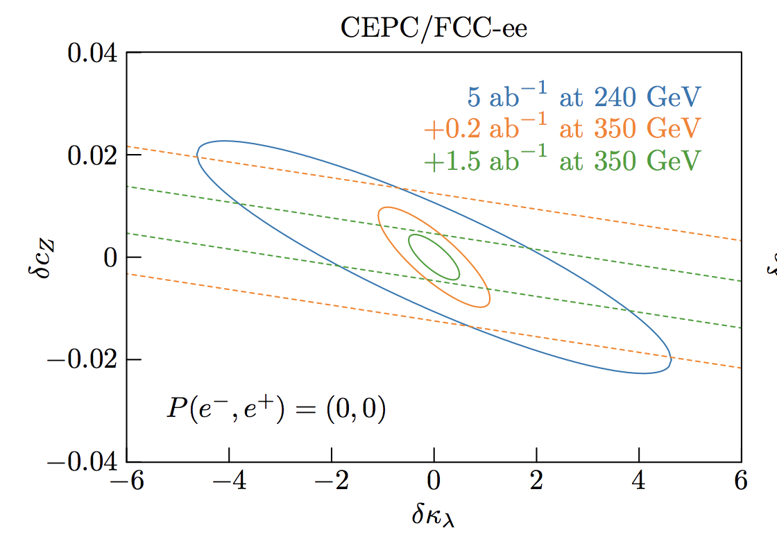
Higgs self-coupling
√s dependence of the “effective” g_{HZ} and g_{HW} to the Higgs self-coupling
Accessible from the high-precision runs at 240, (350), and 365 GeV
Arising from Higgs-triangle and -loop diagrams
Very large HZ datasets allow g_{ZH} measurements of extreme precision
Indirect and model-dependent probe of Higgs self-coupling
A precision on δκ_{λ} of ±40% can be achieved, and of ±35% in combination with HL-LHC.
If c_{Z} if fixed to its SM value, then the precision on δκ_{λ} improves to ±20%

Slide 27
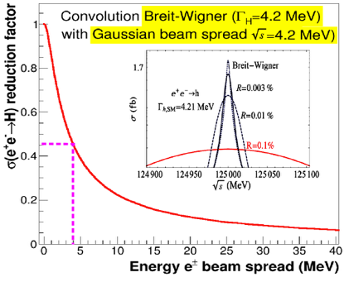
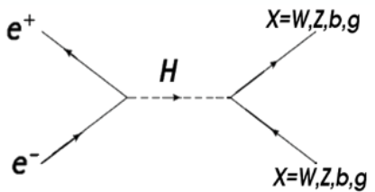
electron Yukawa coupling
s-channel Higgs production
unique opportunity for measurement close to SM sensitivity
highly challenging; σ(ee→H) = 1.6 fb;
various Higgs decay channels studied
studied monochromatization scenarios
baseline: 6 MeV energy spread, L = 2 ab⁻¹
optimized: 10 MeV energy spread, L = 7 ab⁻¹
limit ~3.5 times SM in both cases

Slide 28
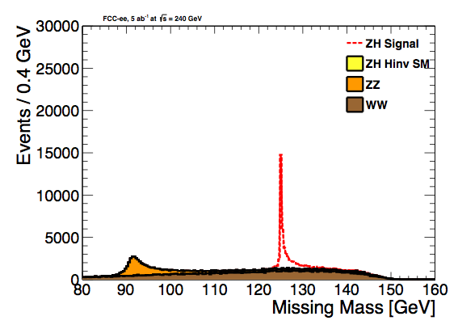
Higgs invisible decays
Higgs boson to invisible decays are predicted for instance in the Higgs-portal model of Dark Matter.
Follows FCC-ee ZH cross section measurement
for visualization BR(H->inv) = 100%
95%CL upper limit using 5ab⁻¹ is 0.47%
Study using leptonic Z decays in Eur. Phys. J. C (2017) 77: 116
Hadronic Z decays under study. Show similar performance

Slide 29
BSM Higgs
Excellent opportunities for BSM Higgs searches
arXiv:1612.09284

Slide 30
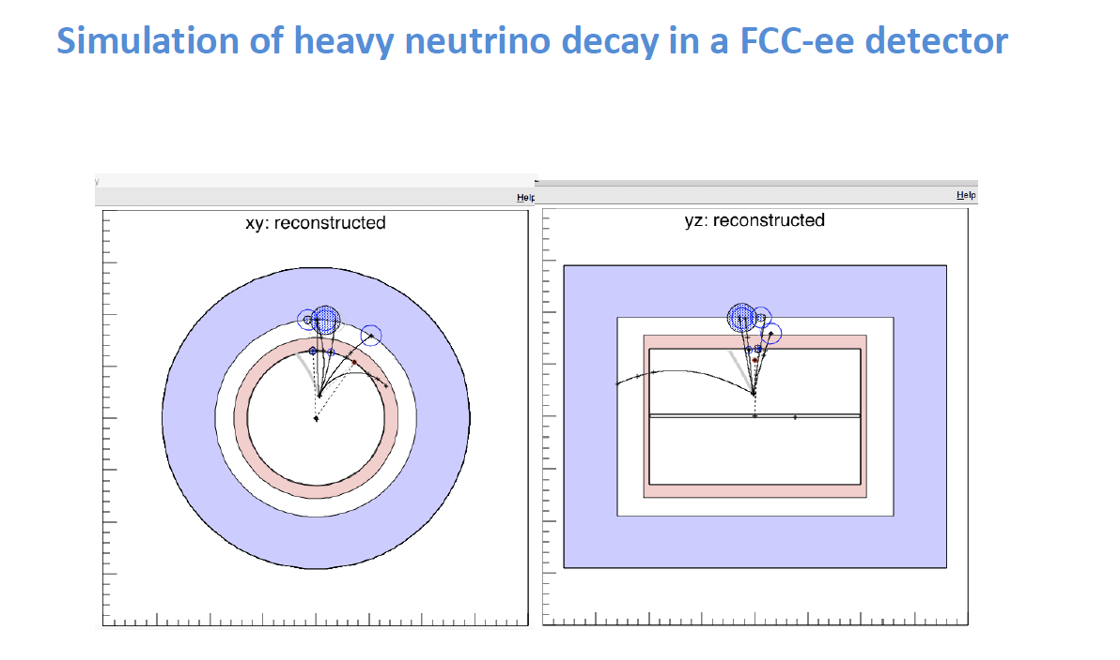
Heavy neutrino at FCC-ee

Slide 31
100 TeV

Slide 32
FCC-hh parameters

Slide 33
FCC-hh discovery potential highlights
FCC-hh is a HUGE discovery machine (if nature …), but not only.
FCC-hh physics is dominated by three features:
Highest center of mass energy → a big step in high mass reach!
ex: strongly coupled new particles up to >30 TeV
Excited quarks, Z’, W’, up to ~tens of TeV
Give the final word on natural Supersymmetry, extra Higgs etc.. reach up to 5-20 TeV Sensitivity to high energy phenomena in e.g. WW scattering
HUGE production rates for single and multiple production of SM bosons (H, W, Z) and quarks
Higgs precision tests using ratios to e.g. γγ/μμ/ ττ/ZZ, ttH/ttZ @<% level
Precise determination of triple Higgs coupling (~3% level) and quartic Higgs coupling
detection of rare decays H → Vγ (V= ρ, ϕ, J/ψ, ϒ, Z…)
search for invisibles (DM searches, RH neutrinos in W decays)
renewed interest for long lived (very weakly coupled) particles.
rich top and HF physics program
Cleaner signals for high P_{t} physics
allows clean signals for channels presently difficult at LHC (e.g. H → bb)

Slide 34
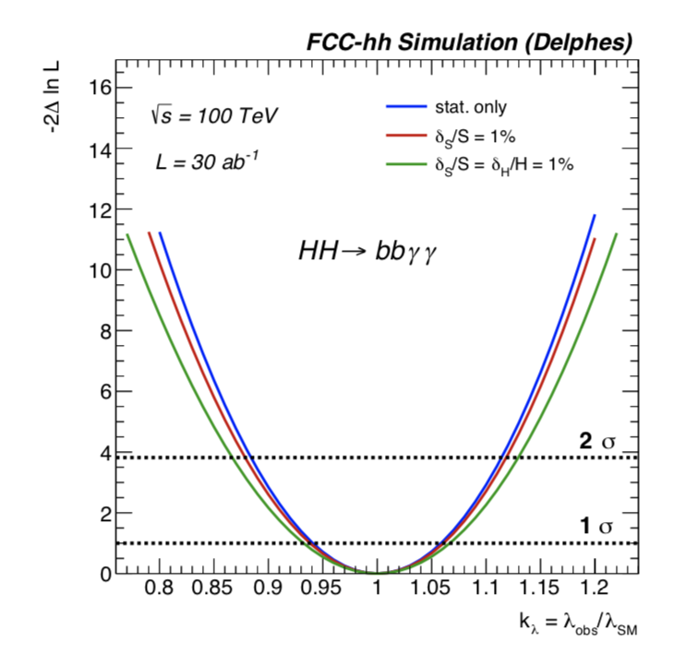
Higgs self-coupling at FCC-hh
EFT Lagrangian
Enormous di-Higgs samples produced at FCC-hh
σ(100 TeV) / σ(14 TeV) ≅ 40
L (FCC-hh) / L (HL-LHC) ≅ 10
Naively, factor 20 smaller statistical uncertainty
Studied a number of final states
bbɣɣ most sensitive channel
δμ ≅ 2-4%
δϰ ≅ 5%
Details in arXiv:1606.09408 and arXiv1802.01607

Slide 35
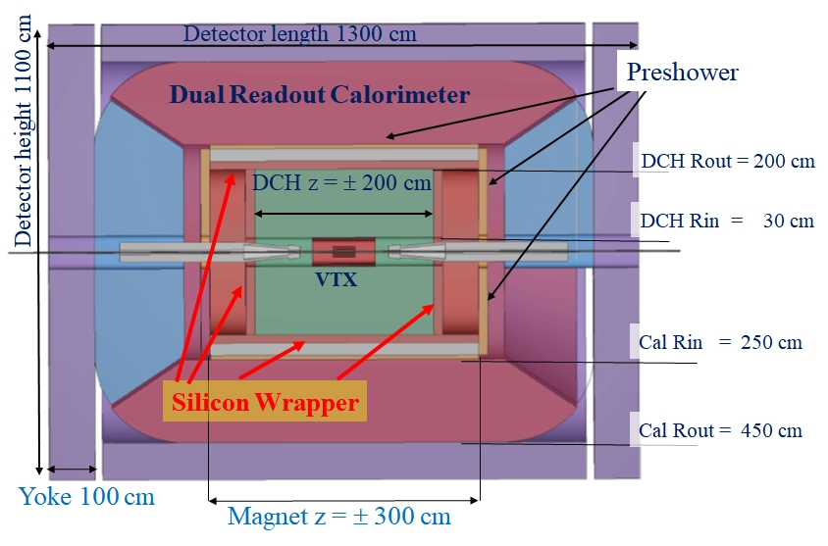
IDEA detector layout
Detector for circular lepton collider

Slide 36
IDEA detector concept
IDEA detector concept based on:
Si vertex detector
Excellent particle-ID (wire chamber)
Very low material budget
Thin Magnet 2 Tesla field
Preshower
Dual readout calorimeter
Muon detector
Same detector concept proposed for both FCC-ee and CEPC!
IDEA is described in both CDRs.
Initially proposed by Italy and INFN, but now looking for international collaborators !
A lot of interesting R&D to be performed and excellent physics prospects ahead of us!

Slide 37
IDEA slice test
Performed in September 2018 at the CERN H4 beam line
IDEA Slice test
Wire chamber
Preshower
DR calorimeter
DR calorimeter
Muon detector

Slide 38
Conclusions
Several future lepton colliders are being proposed
Circular: FCC-ee and CEPC
Linear: ILC and CLIC
Circular colliders have much larger luminosities, while linear colliders can reach higher energies
Circular lepton colliders can later be replaced by very high energy pp colliders
the sequential implementation of a lepton and a hadron collider maximises the physics reach
Attractive scenarios of staging and implementation (budget!) cover more than 50 years of exploratory physics, taking full advantage of the synergies and complementarities
X
CEPC could start at the beginning of the 2030s
FCC-ee could start seamlessly at the end of HL-LHC
FCC-ee and CEPC promise the best EW and Higgs measurements

Slide 39
Backup

Slide 40
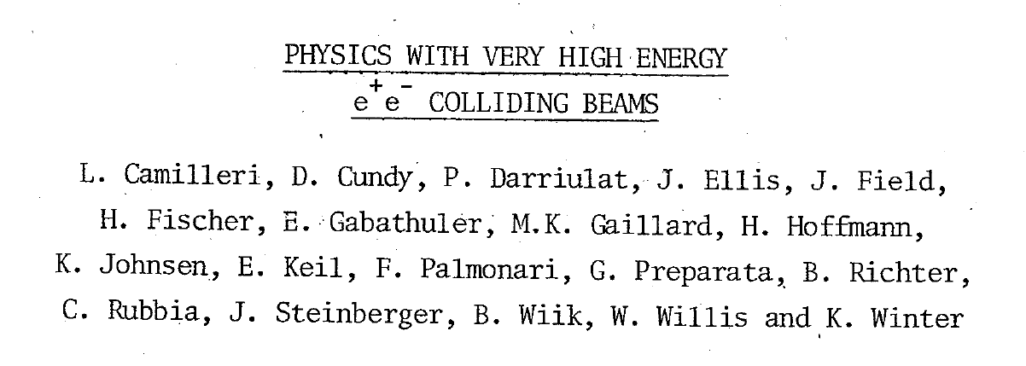
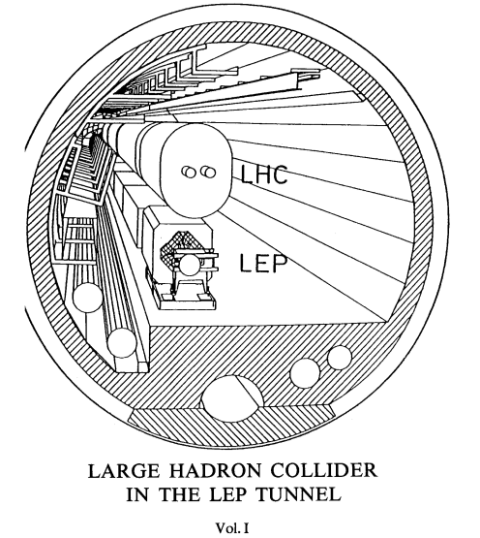
A successful model!
Did these people know that we would be running HL-LHC in that tunnel >60 years later?
e+e- 1989-2000
p p 2009-2039
Let’s not be SHY!
Alain Blondel The FCCs

Slide 41
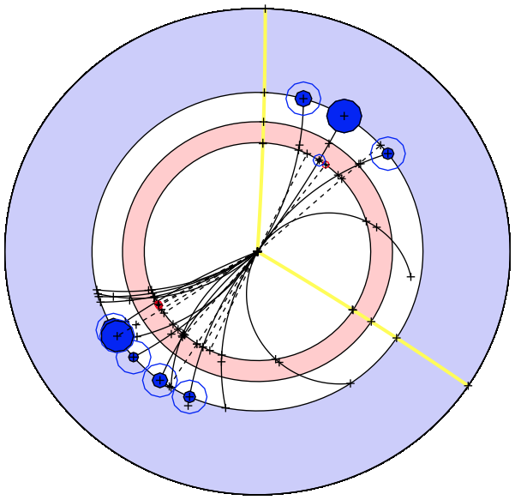
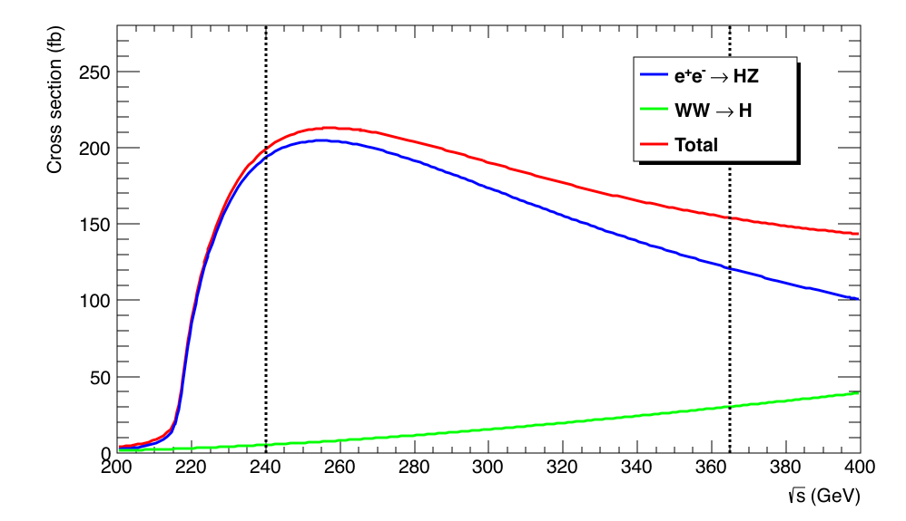
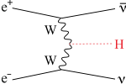
Circular e⁺e⁻ colliders: FCC-ee, CepC
Basic measurements similar for all e⁺e⁻colliders
Some differences in experimental conditions
e⁺e⁻ → HZ at √s = 240-250 GeV : Higgs boson are tagged with a Z and m_{Recoil} = m_{H}
Measure σ_{HZ} (∝ g_{HZ}²) independently of H decay: absolute determination of g_{HZ}
Measure σ_{HZ} × BR(H → invisible) and many exclusive decays σ_{HZ} × BR(H → XX)
Infer Higgs width Γ_{H} from σ_{HZ} × BR(H → ZZ) (∝ g_{HZ}⁴/Γ_{H})
Fit couplings g_{HX} from BR(H → XX) and Γ_{H} in a model-independent manner
e⁺e⁻ → HZ completed with WW fusion at √s = 350-365 GeV at FCC-ee
Improves all precisions, especially on g_{HW} and Γ_{H}
First glance at top Yukawa coupling λ_{t} and Higgs self coupling λ_{H} (next slides)
m⁻
m⁺
e⁺e⁻→ HZ

Slide 42
«First look of the physics case of TLEP» (original name of FCC-ee): 398 quotes today
Much more than a Higgs factory!

Slide 43
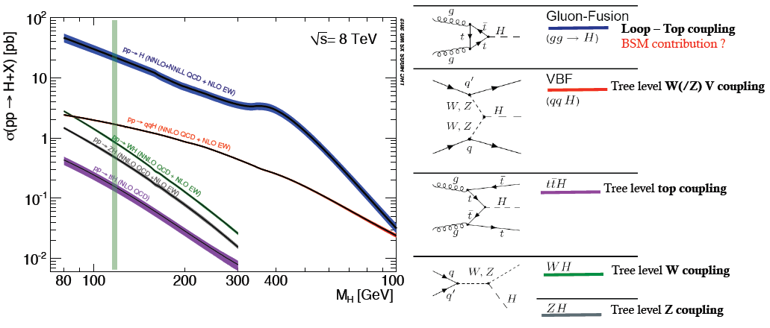
Higgs production at LHC
Verified experimentally!
THE LHC is a Higgs Factory…BUT
several tens of Million Higgs already produced… > than most Higgs factory projects.
difficult to extract the couplings because σ_{prod} uncertain and Γ_{H} is unknown (invisible channels) → must do physics with ratios.
σ_{i→f} ^{observed} ∝ σ_{prod} (g_{Hi} )²(g_{Hf})²
Γ_{H}
relative error scales with
1/purity and 1/√efficiency of signal

Slide 44
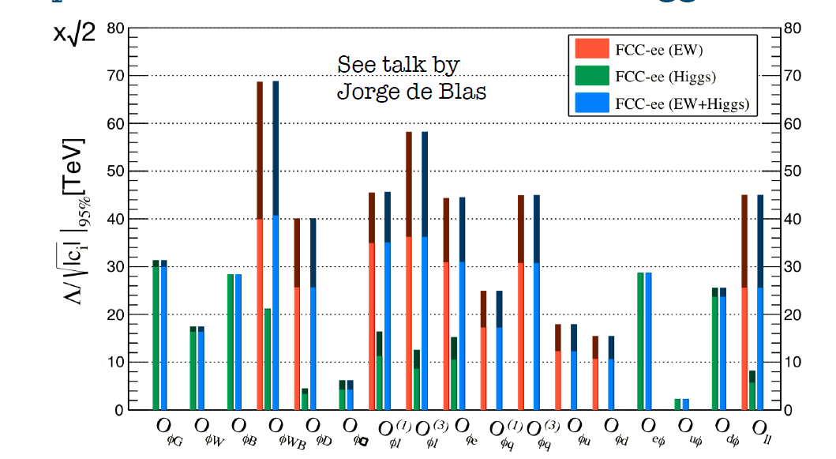
FCC-ee indirect reach
w/o theory uncertainties
L (TeV)
with current
theory uncertainties
many EFTs
J. De Blas, Jan. 2017
Conclusion from Precision Calculations Mini-Workshop in January 2018:
The necessary theoretical work is doable in 5-10 years perspective, due to steady progress in methods and tools, including the recent completion of NNLO SM corrections to EWPOS. This statement is conditional to a strong support by the funding agencies and the overall community. Appropriate financial support and training programs for these precision calculations are mandatory.
Several EFTs will achieve sensitivity exceeding 50 TeV (decoupling physics!)
junction with FCC-hh EFTs under progress by Jorge de Blas

Slide 45
Higgs self-coupling λ_{H} (How H, W, Z get masses…)
The FCC-ee does not produce pairs of Higgses from which one can extract λ_{H}
but the ZH cross-section receives a E_{cm} - dependent correction from it.
investigating now : the possibility
of reaching 5σ observation of
Higgs self coupling at FCC-ee:
4 detectors
+ recast of running scenario

Slide 47
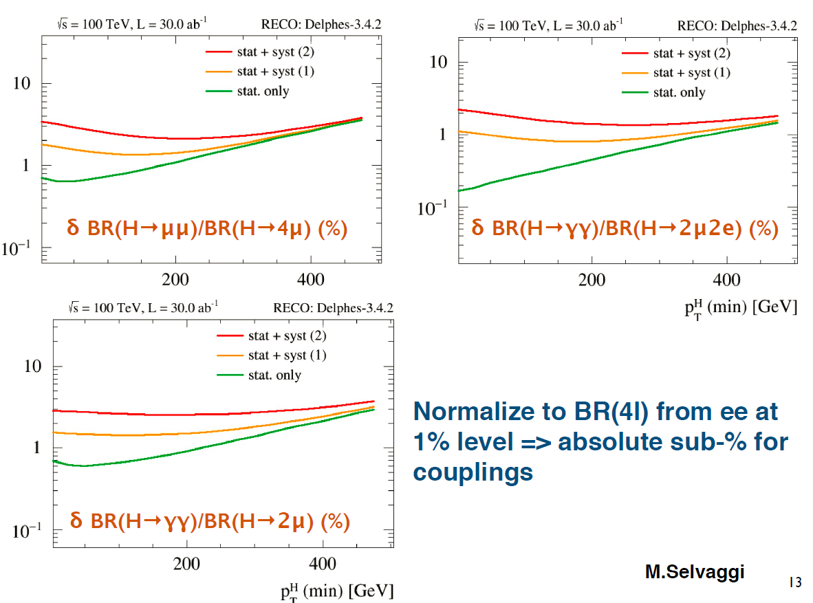
Ratios of BRs
For rare decays (μμ, γγ, γZ) normalize to H→ ZZ well measured at FCC-ee

Slide 50
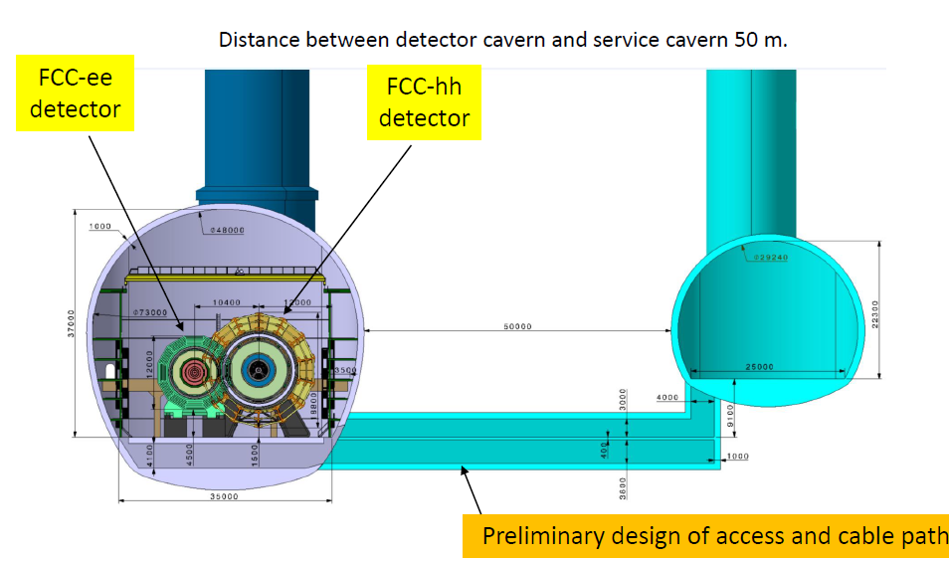
The same cavern

Slide 51
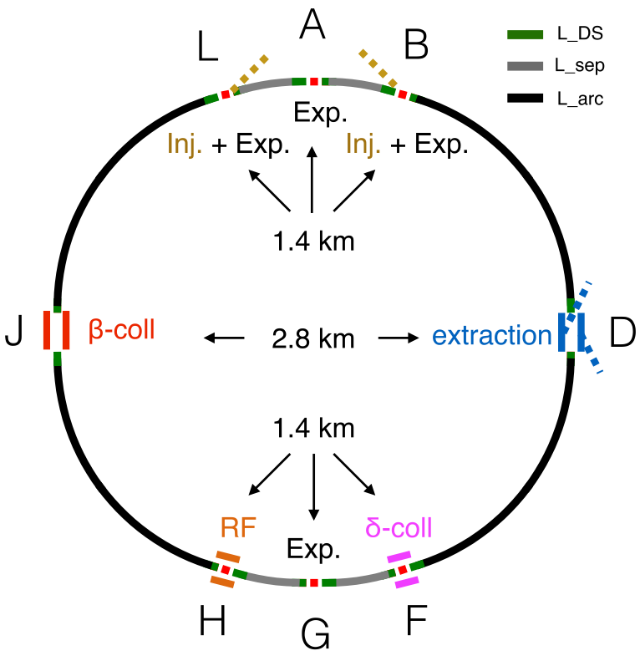
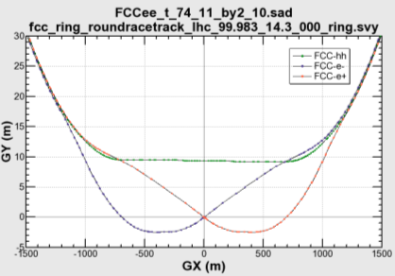
common layouts for hh & ee
11.9 m
IP
30 mrad
FCC-hh/
ee Booster
9.4 m
0.6 m
Lepton beams must cross over through the common RF to enter the IP from inside.
Only a half of each ring is filled with bunches.
Common
RF (tt)
Common
RF (tt)
Max. separation of 3(4) rings is about 12 m:
wider tunnel or two tunnels are necessary around the IPs, for ±1.2 km.
IP
FCC-ee 1, FCC-ee 2,
FCC-ee booster (FCC-hh footprint)
Asymmetric IR for ee, limits SR to expt
2 main IPs in A, G for both machines
Notes:
Check with Katsunobu to have latest layout.
Check with detector people if 9 m offset is acceptable for ee detector

Slide 52
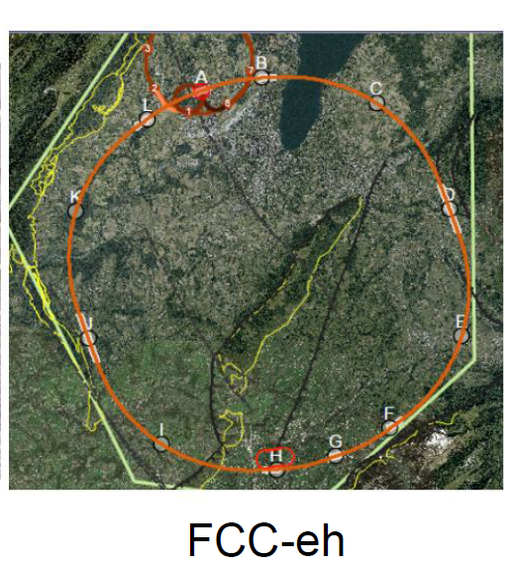
FCC-eh and ERL
LHeC or FCC-eh function as an add-on to LHC or FCC-hh respectively:
additional 10 km circumference
Electron Recirculating Linac (ERL).
The possibility to collide FCC-ee with FCC-hh is not considered in the framework of the study
In the case of FCC-eh it could profit from the -- then existing -- FCC-hh,
and, perhaps, from considerable RF of the -- then dismantled -- FCC-ee

Slide 53
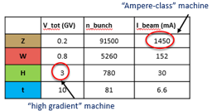
IMPLEMENTATION AND RUN PLAN
Three sets of RF cavities for FCC-ee & Booster:
Installation as LEP ( ≈30 CM/winter)
high intensity (Z, FCC-hh): 400 MHz mono-cell cavities, ≈ 1MW source
high energy (W, H, t): 400 MHz four-cell cavities, also for W machine
booster and t machine complement: 800 MHz four-cell cavities
Adaptable 100 MW, 400 MHz RF power distribution system +High efficiency
➔ Spreads the funding profile
HL-LHC
Z 150 ab⁻¹
W 10 ab⁻¹
ZH thresh 5ab⁻¹
tt thresh + tt 365 1.5ab⁻¹
4 years
1 yr
3 years
5 years
indicative: total ~15 years
O(1/3) of the machine cost
comes O(10) years after start

Slide 54
FCC-hh discovery potential
Physics at a 100 TeV pp collider: CERN Yellow Report (2017) no.3
1) Standard Model processes: https://arxiv.org/pdf/1607.01831v1.pdf
2) Higgs and EW symmetry breaking studies: https://arxiv.org/pdf/1606.09408v1.pdf
3) Βeyond the Standard Model phenomena: https://arxiv.org/abs/1606.00947
4) Heavy ions at the Future Circular Collider: https://arxiv.org/abs/1605.01389
Now proceeding to ascertain these cross-section calculations with real detector and simulations…

Slide 55
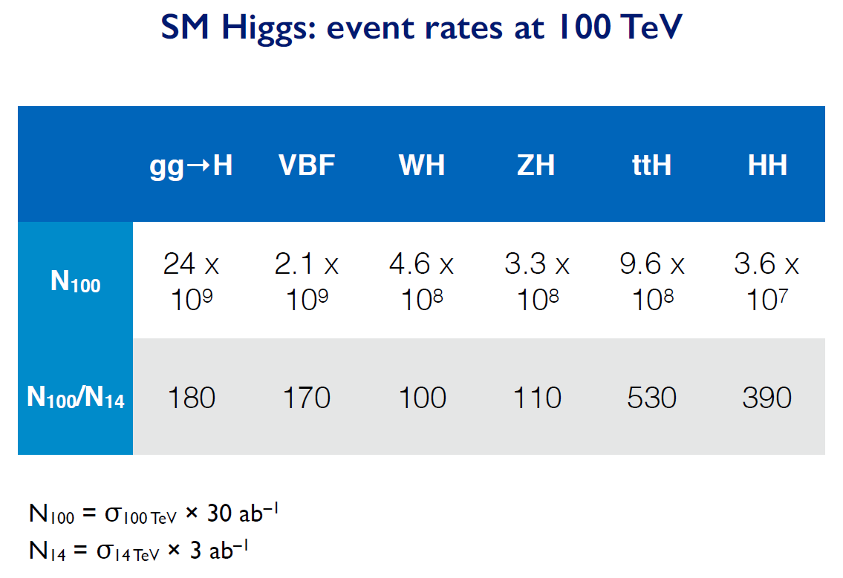
Higgs events rates

Slide 56
g_{Hxx} | FCC-ee | FCC-hh | FCC-eh
ZZ | 0.22 % | < 1% *
WW | 0.47%
Γ_{H} | 1.6%
γγ | 4.2% | <1%
Zγ | -- | 1%
ttH | 13% | 1%
bb | 0.7% |  | 0.5%
ττ | 0.8%
cc | 0.7% |  | 1.8%
gg | 1.0%
μμ | 8.6% | 1-2%
uu,dd | H→ ργ? | H→ ργ?
ss | H→ φγ ? | H→ φγ ?
ee | ee → H
HH | 40% | ~3-5% | 20%
inv, exo | <0.55% | 10⁻³ | 5%
HIGGS PHYSICS
Higgs couplings g_{Hxx} precisions
hh, eh precisions assume
SM or ee measurements
FCC-hh : H→ ZZ to serve
as cross-normalization
for ttH, combination of
±4% (model dependent)HL-LHC
with FCC-ee will lead to
ttH coupling to ± 3%...
model independent!
for g_{HHH} investigating now : the possibility of reaching 5σ observation at FCC-ee:
4 detectors
+ recast of running scenario

Slide 57
Another example of Synergy and complementarity
while ee covers a large part of space very cleanly ,
its either ‘white’ in lepton flavour or the result of EWPOs etc
Observation at FCC –hh or eh would test flavour mixing matrix!
EWPO
sensitivity
up to very high mass scales
7/6/2018
Alain Blondel Physics at the FCCs
detailed study required for all FCCs – especially FCC-hh to understand feasibility at all

Slide 58
Examples of complementarity
Higgs Physics
ee → ZH fixes Higgs width and HZZ coupling , (and many others)
FCC-hh gives huge statistics of HH events for Higgs self-coupling and ttH
and rare decays, including invisible.
Search for Heavy Physics
ee gives precision measurements (m_{Z} m_{W} to < 0.6 MeV, m_{top} 10 MeV, etc…)
sensitive to heavy physics up to … 100 TeV (for weak couplings)
FCC-hh gives access to direct observation at unprecedented energies
Also huge statistics of Z, W H and top → rare decays
QCD
ee gives α_{s} ± 0.0002 (R_{had} at Z, W and taus)
also H → gg events (gluon fragmentation!)
ep provides structure functions and αs ± 0.0002
all this improves the signal and background predictions for new physics signals at FCC-hh
Heavy Neutrinos
ee: very powerful and clean, but flavour-blind
hh and eh more difficult, but potentially flavour sensitive
NB this is very much work in progress!!

Slide 59
Vector Boson Scattering (VBS)
• First opportunity to measure precisely the VLVL component that unitarizes VBS at high energy (barely 3σ at HL-LHC)
• Sets constraints on detector acceptance (fwd jets at η≈4)
• Study W^{+/-}W^{+/-} (same-sign) channel
• Large WZ background at FCC-hh
• 3-4% precision on W_{L}W_{L} scattering achievable with full dataset!

Slide 60
Top Yukawa
ttH
• Production ratio σ(ttH)/σ(ttZ)
• Predicted 1% precision [1507.08169]
• Measure σ(ttH)/σ(ttZ) in H/Z→bb mode in the boosted regime, in the semi-leptonic channel
• Perform simultaneous fit of double Z and H peak
ttZ

Slide 61
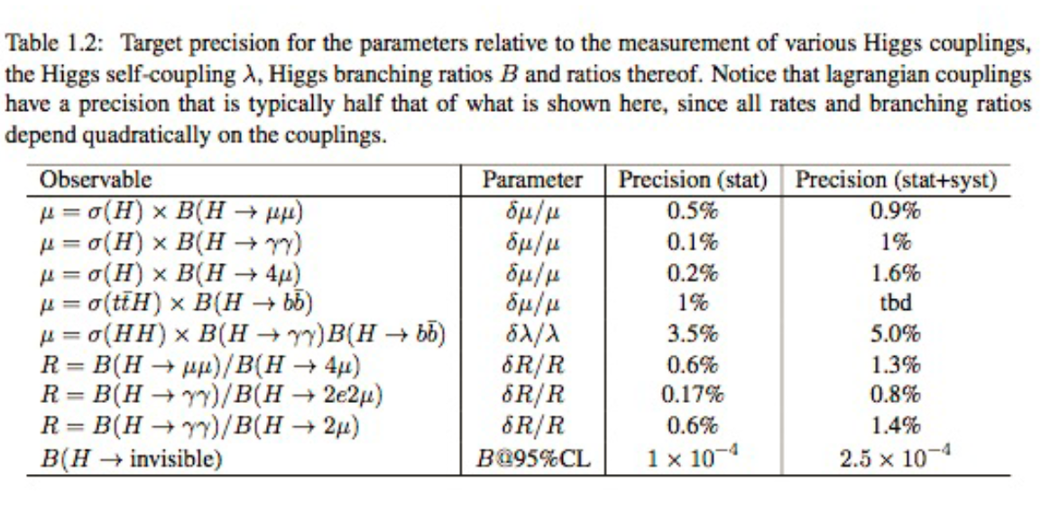
λ_{H} at FCC-hh
λ_{H} at the few percent level
To reach a precision on λ_{H} at the few percent level requires a linear collider of at least 3 TeV
(ILC 500 GeV can obtain a ±30% indication and CLIC 3 TeV estimate is ±10%)

