Slide 1
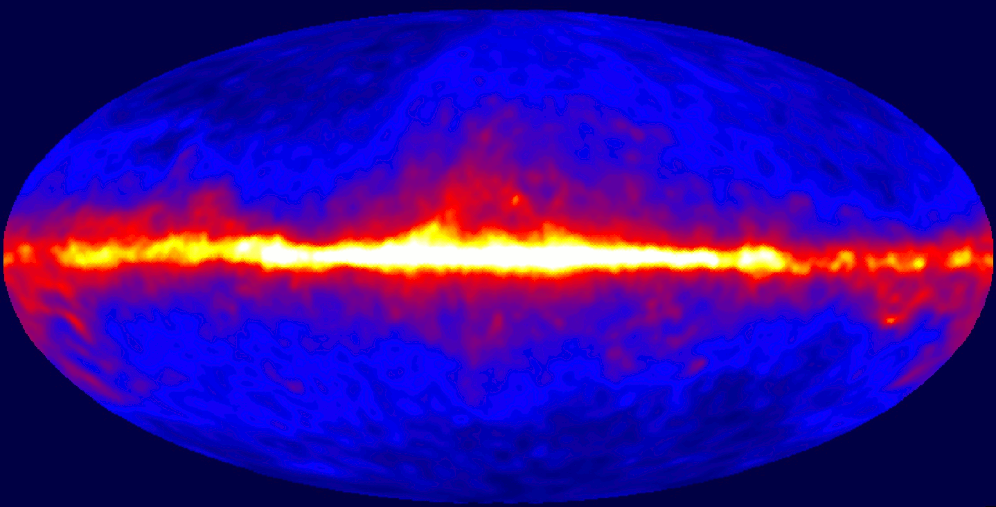
IceCube analysis on GRB precursors
IIHE annual meeting
22-nov-2019
Paul Coppin
Promotor: Prof. Nick van Eijndhoven

Slide 2
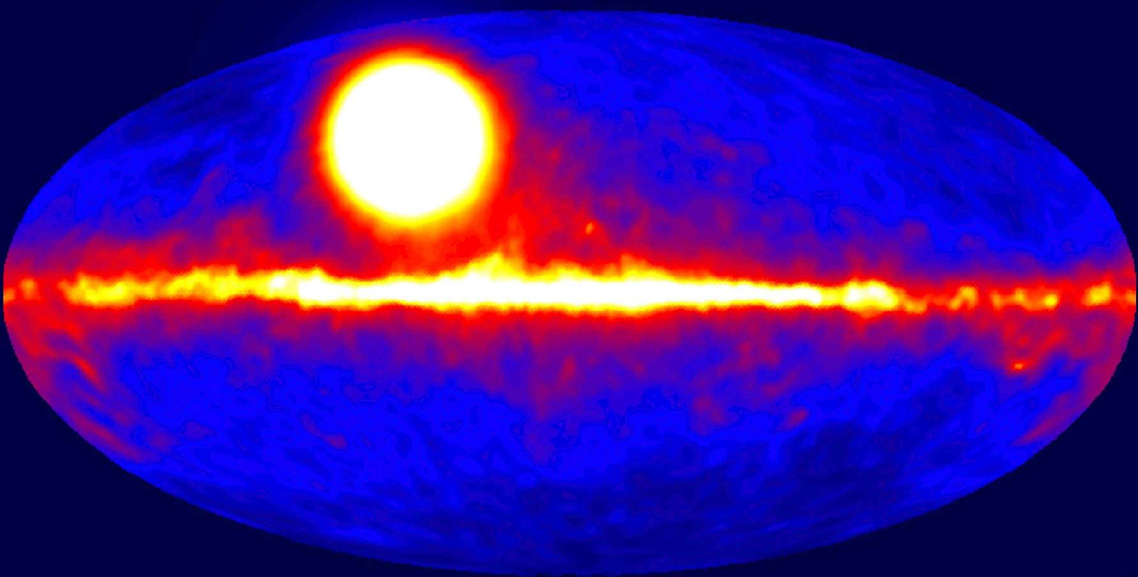
Discovery of GRBs

Slide 3
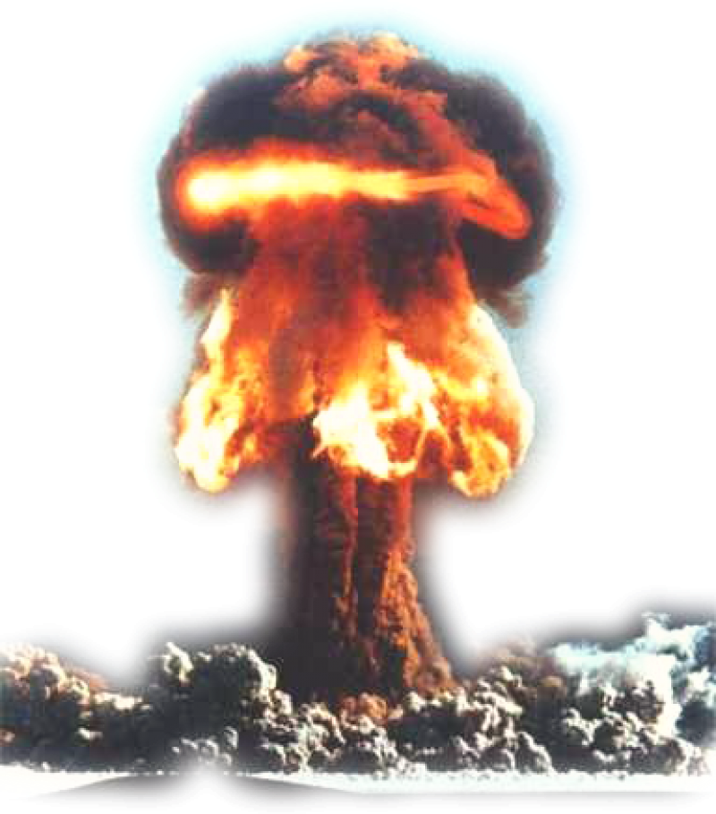
Discovery of GRBs
Vela satellites deployed to check partial test ban treaty. Gamma-ray flashes seen, but non-consistent with nuclear bomb.
First GRB detected in 1967
Galactic or extra-galactic?
>100 models proposed by 1992

Slide 4
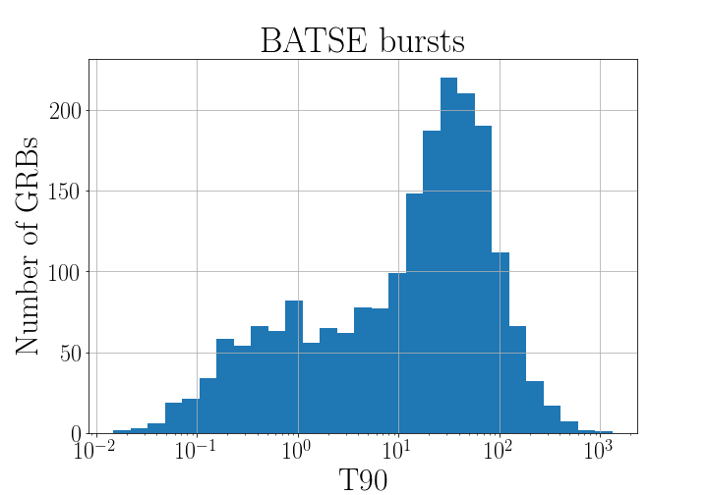
What we know by now
Two progenitor types:
Binary neutron star mergers $→$ short burst $(<2s)$
Massive star collapse $→$ long burst $(>2s)$
Satellites: Fermi, Swift, …
~1 GRB is observed per day
Distance: $z\sim$2 $\left(i.e.∼10 Gpc\right)$
Energy released: $𝒪({10}^{52} erg)$
short long

Slide 5
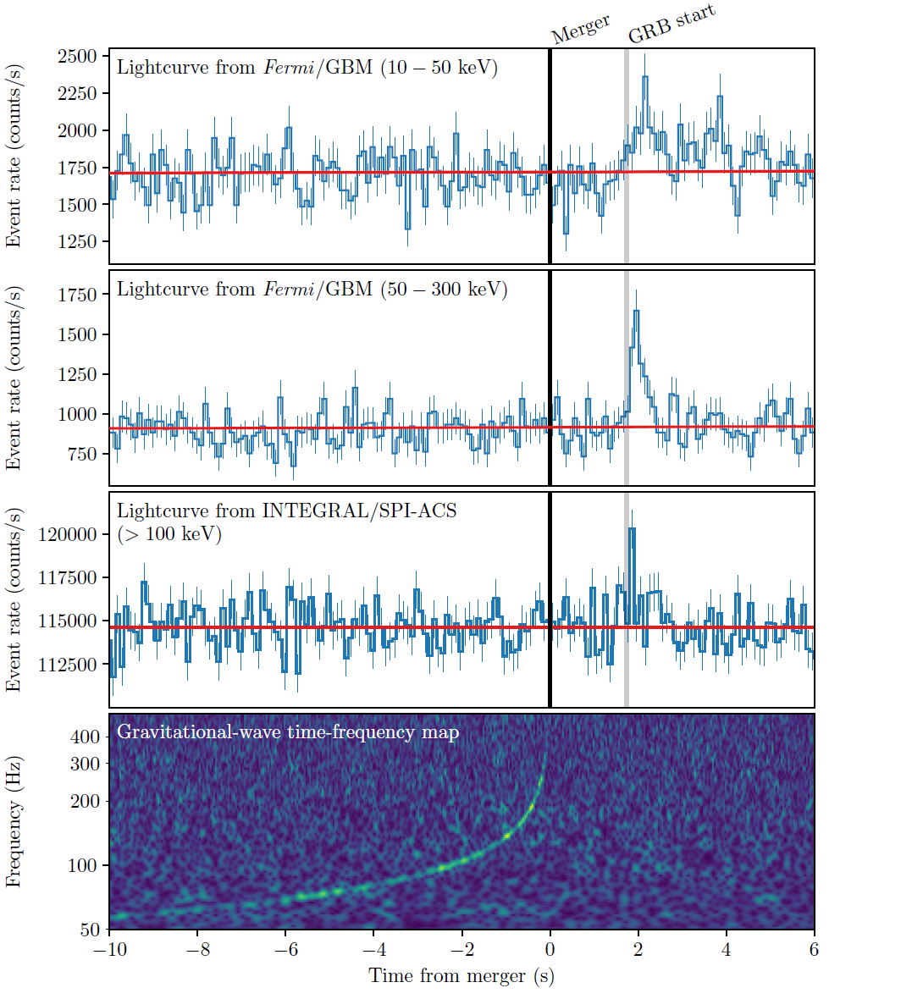
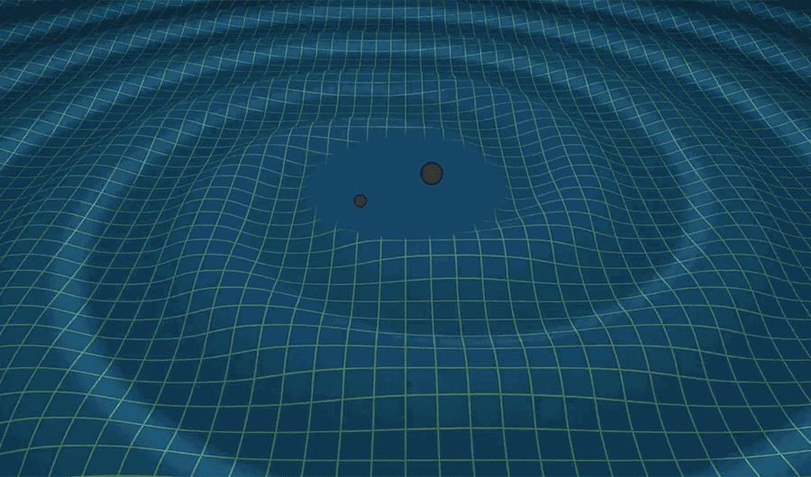
GRB170817A
First GW detection of a GRB!

Slide 6
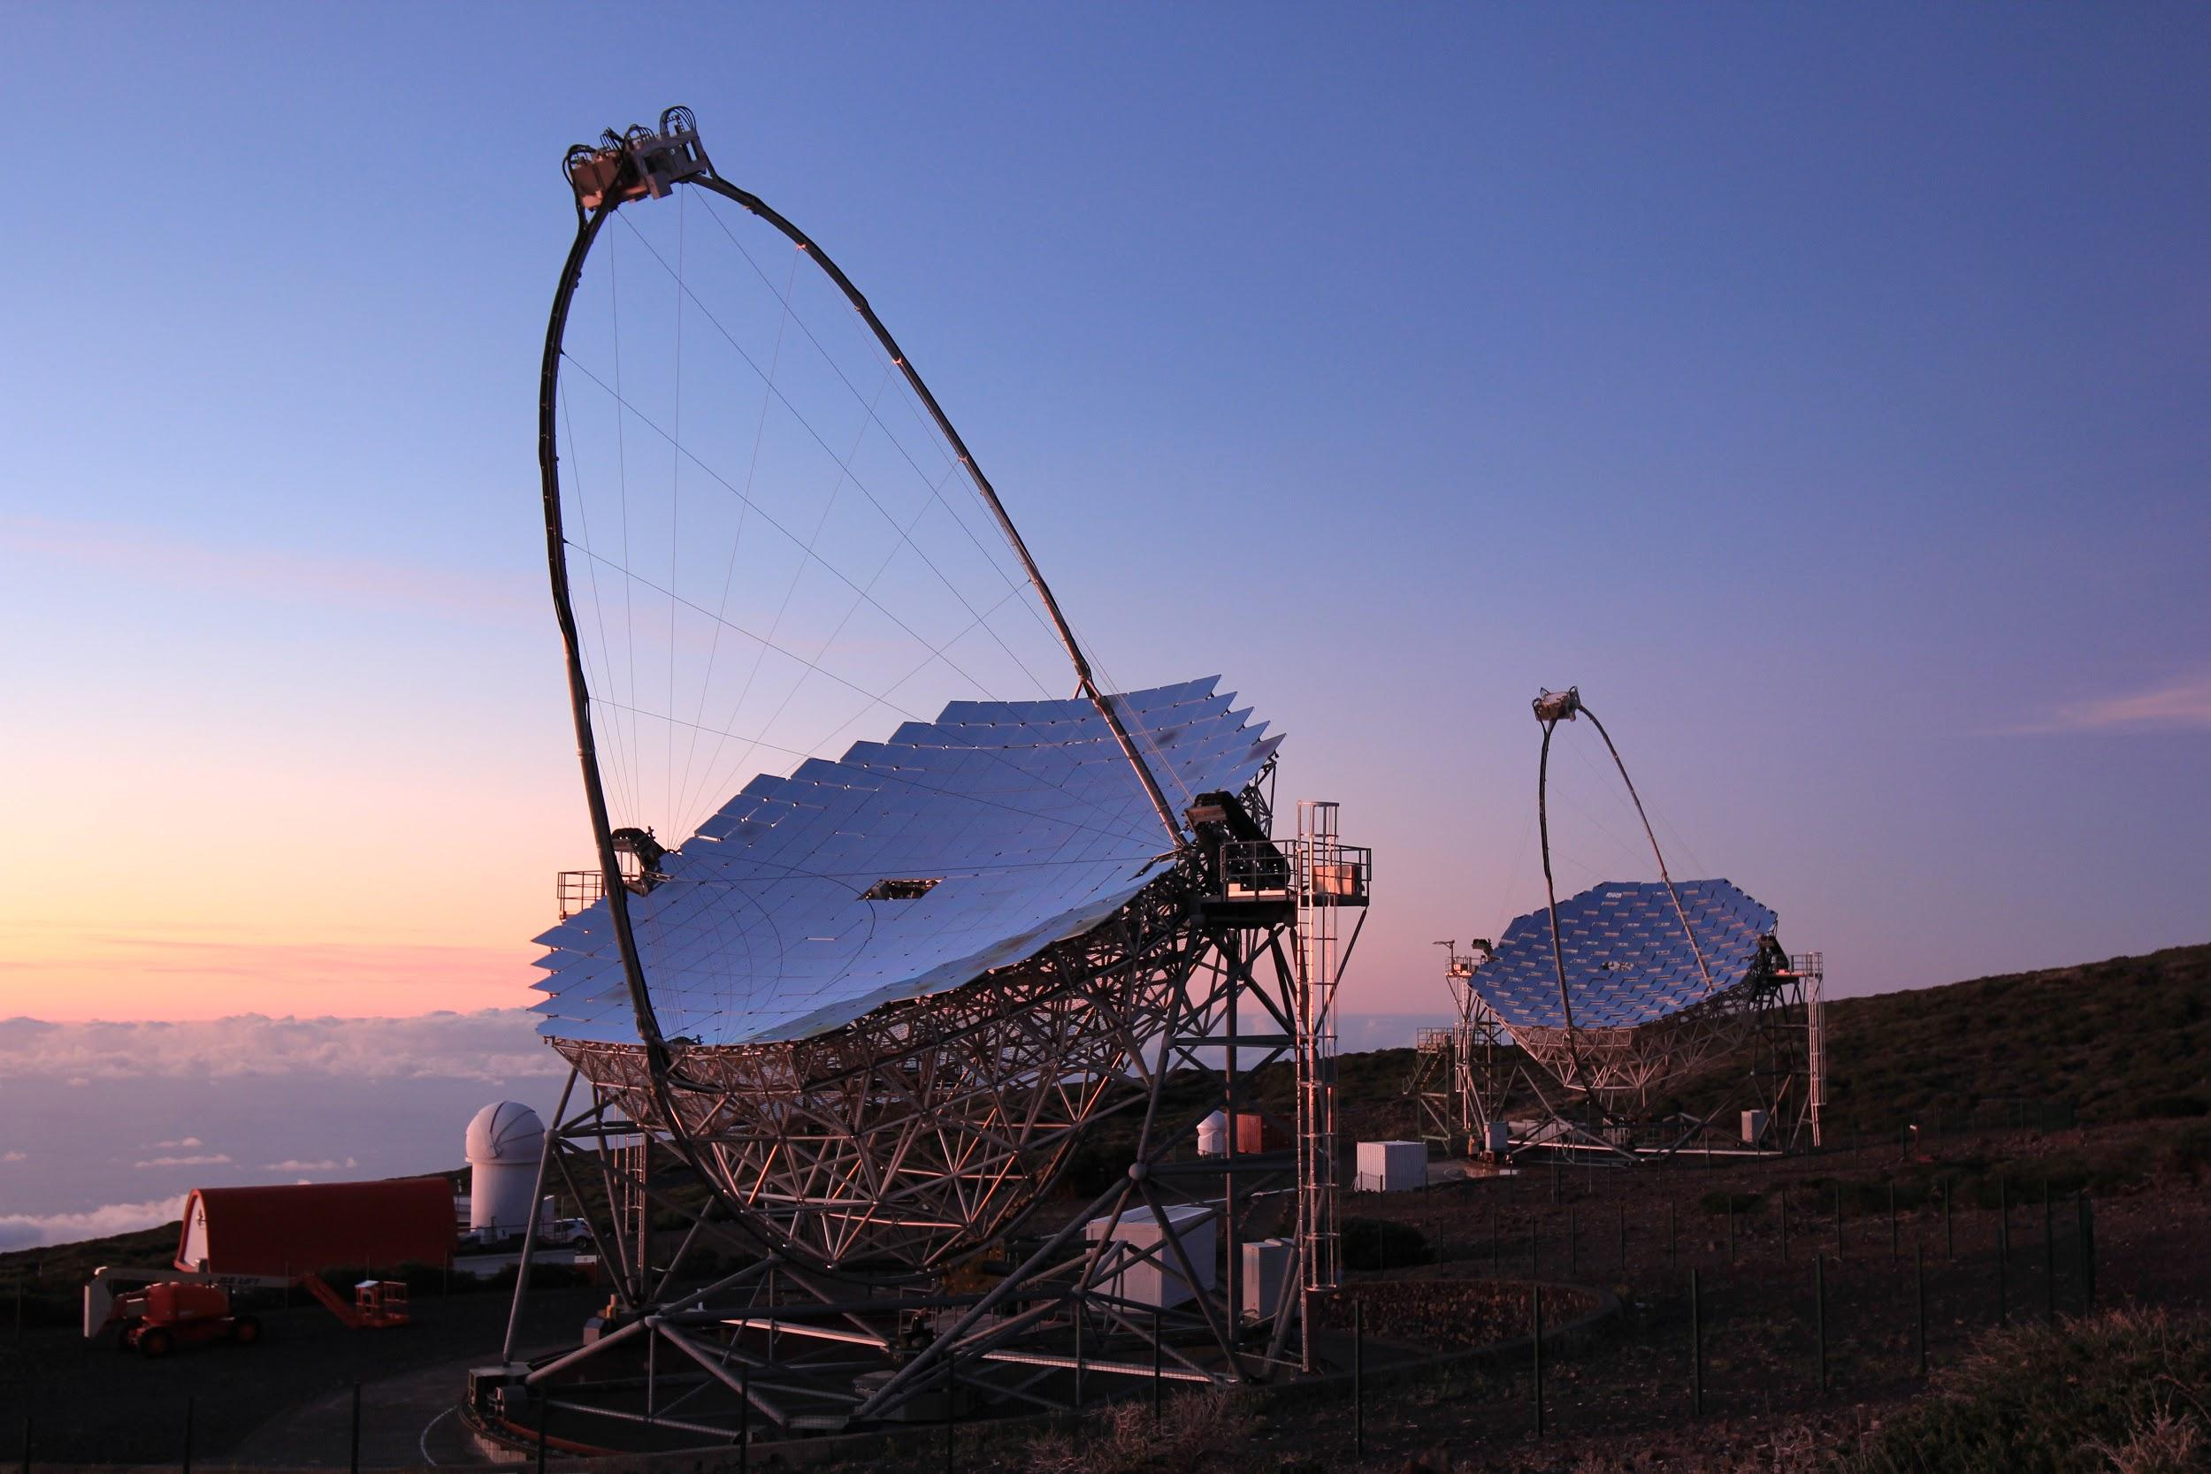
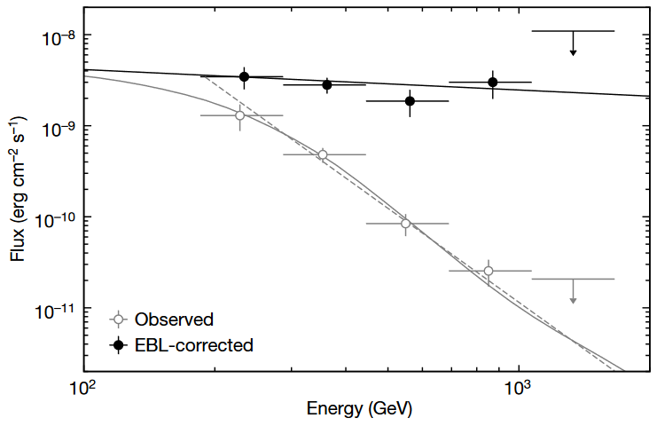
GRB190114C
First GRB detected with an IACT!
Magic telescope in La Palma
TeV $γ$-rays observed
https://doi.org/10.1038/s41586-019-1750-x

Slide 7
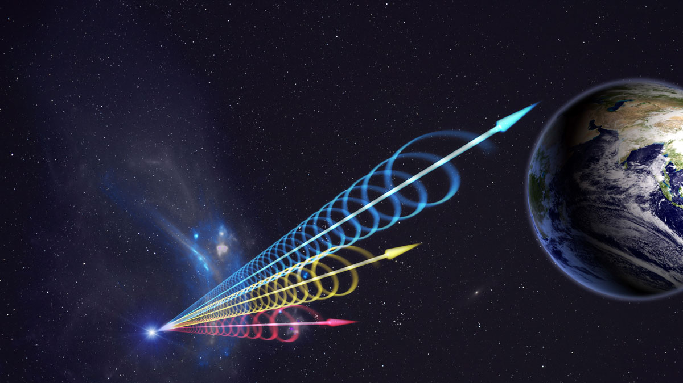
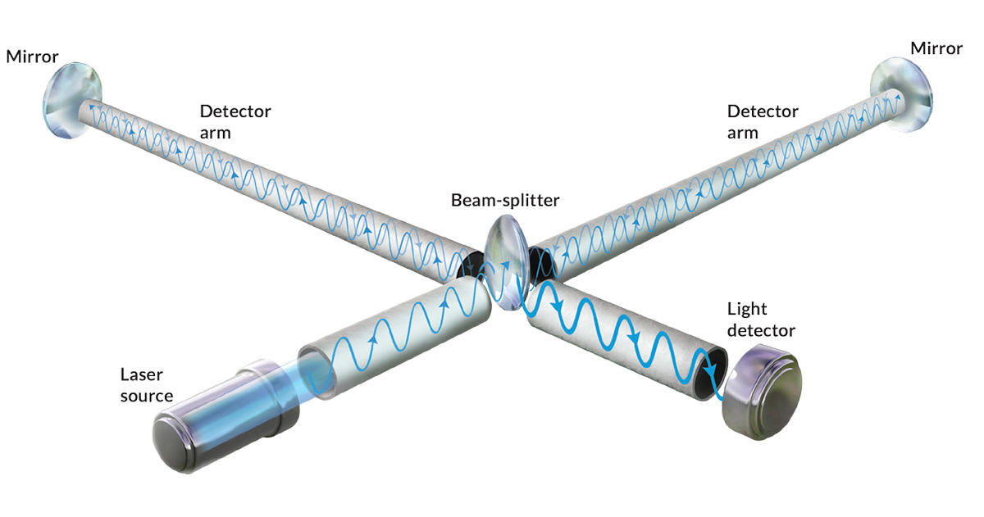
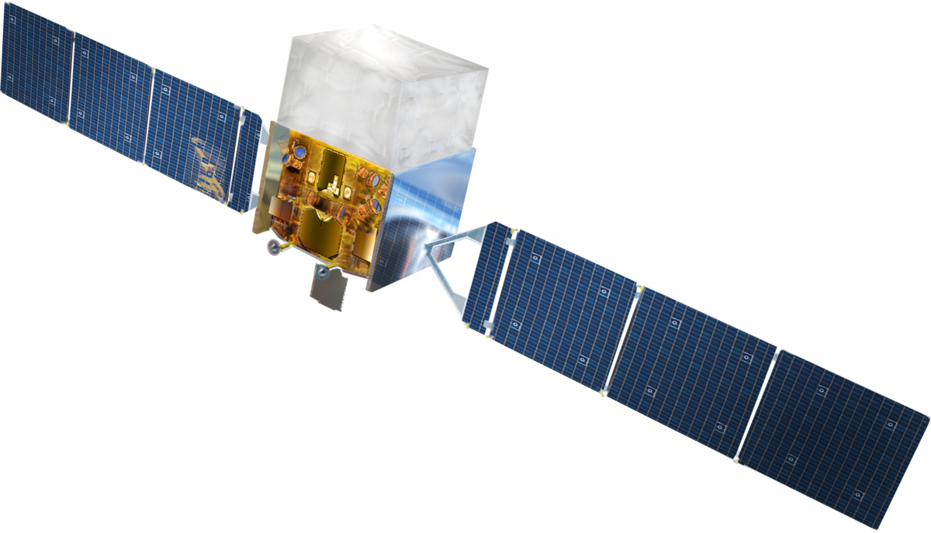
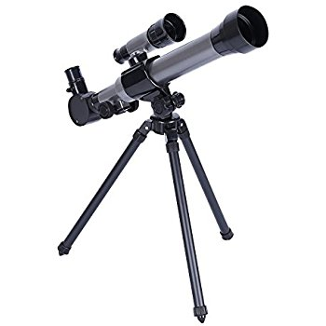
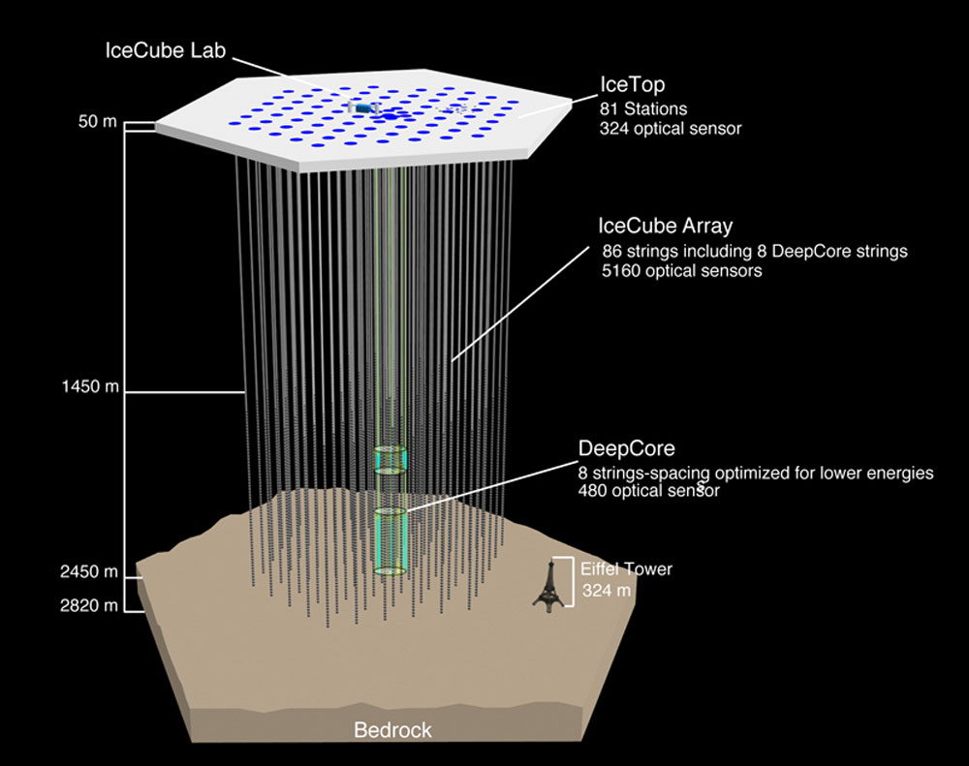
GRBweb
https://icecube.wisc.edu/~grbweb_public/
Catalog of GRBs combining data from all detectors
Current version developed at the IIHE
Updated every week
GW
$$γ$$
$$ν$$
$$μ$$

Slide 8
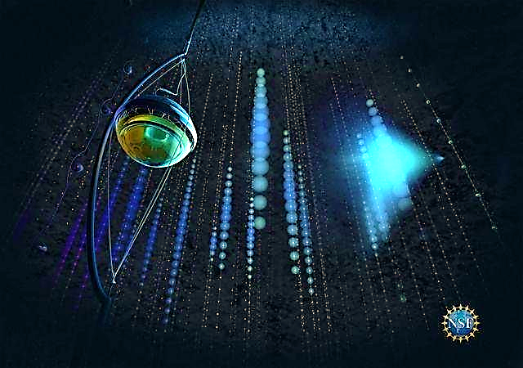
Do GRBs emit neutrinos?
Extremely energetic
$p+γ→Δ^{+}→n+π^{+}$ $π^{+}→e^{+}+ν_{e}+ν_{μ}+{\overline{ν}}_{μ}$
Low background search for IceCube
Know where to look
Know when to look

Slide 9
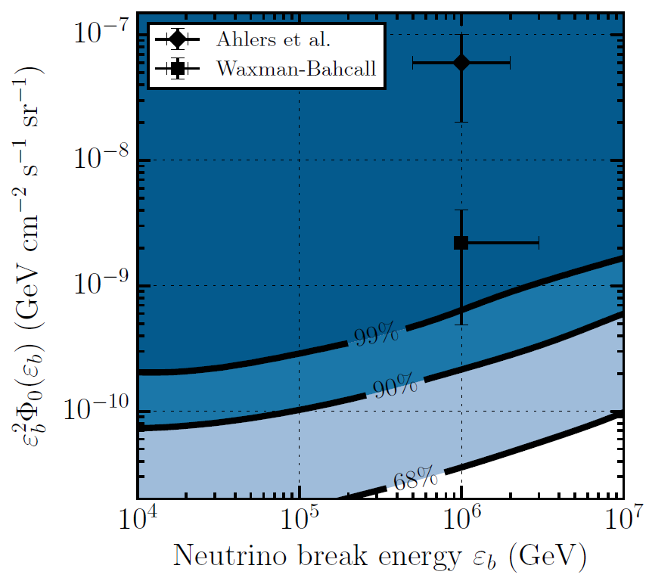
IceCube prompt analysis results

Slide 10
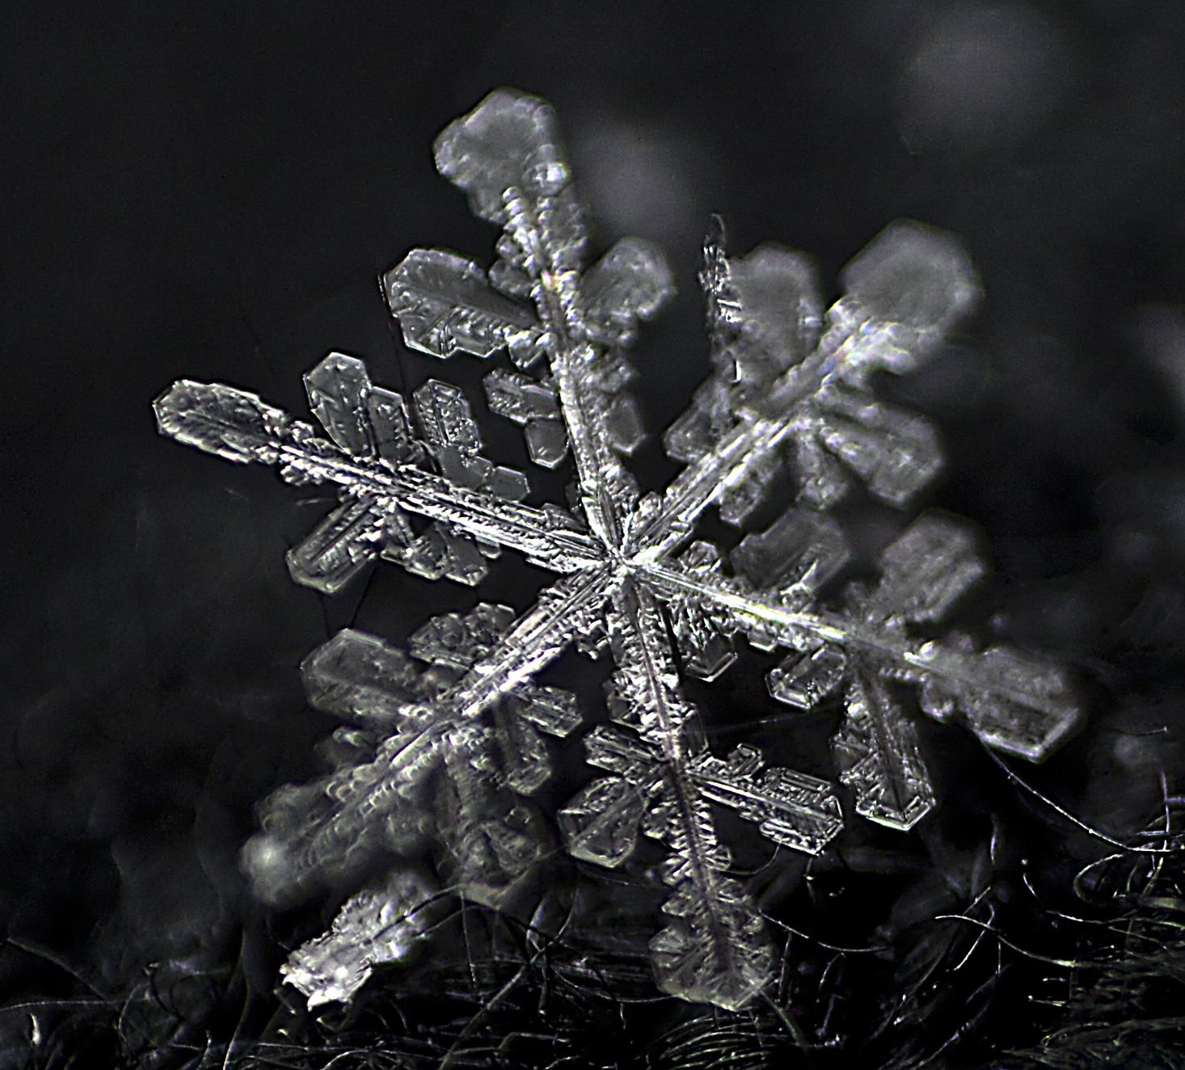
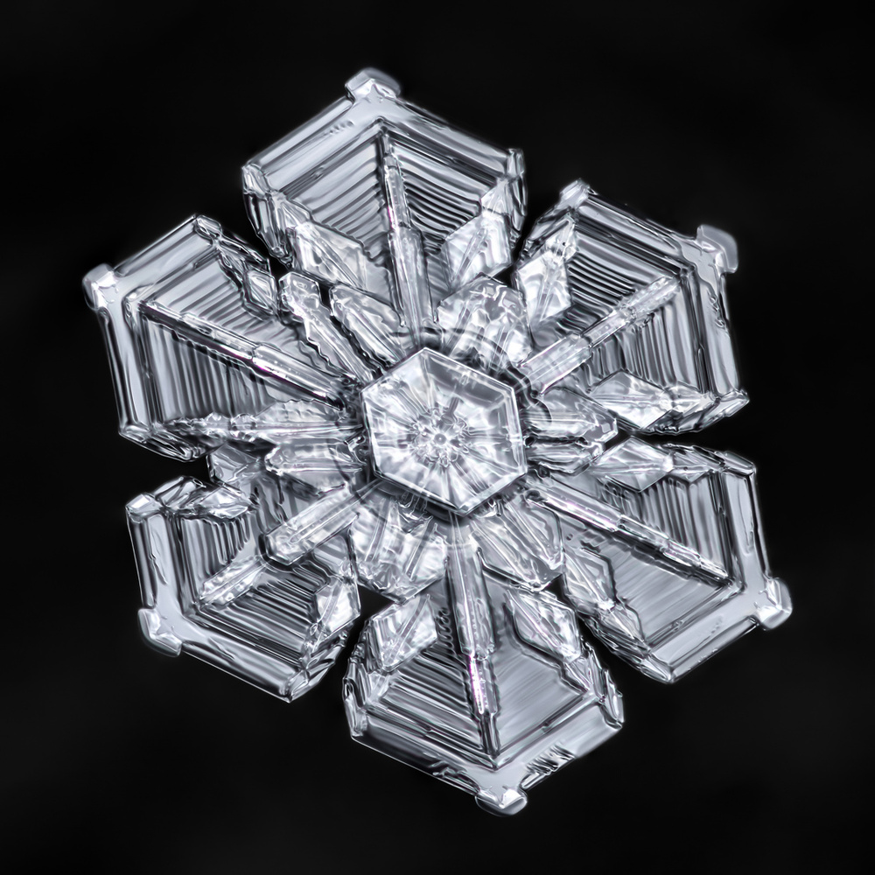
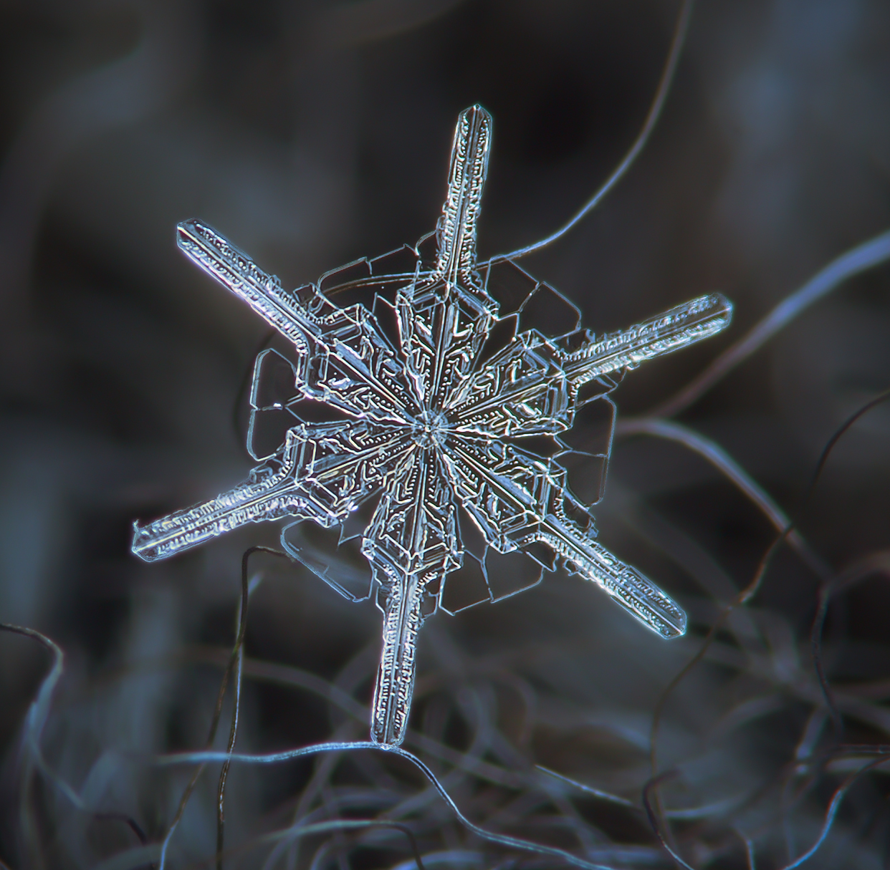
Does this mean GRBs don’t emit neutrinos?
No: “Each GRB is as unique as a snowflake”

Slide 11
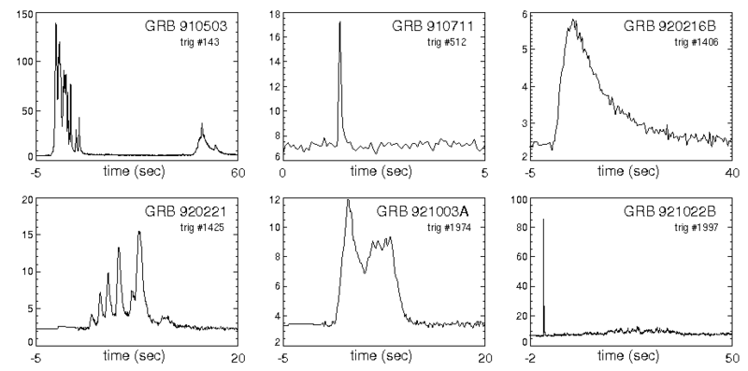
Does this mean GRBs don’t emit neutrinos?
No: “Each GRB is as unique as a snowflake”
Light curves wildly differ
Many special cases
Obscured/choked GRBs
…

Slide 12
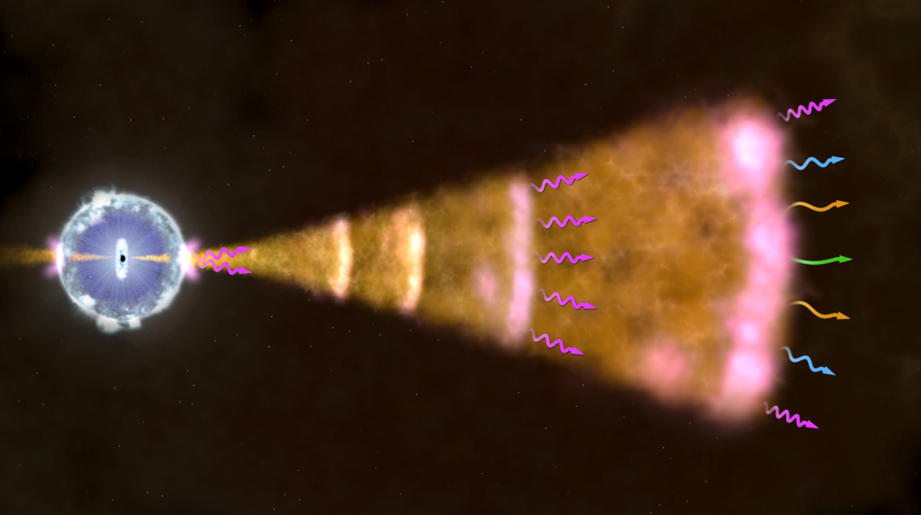
Does this mean GRBs don’t emit neutrinos?
No: Limits only apply to the prompt phase!
Afterglow
Prompt
Precursor

Slide 13
GRB precursors
Observed in ~15% of all bursts
Suggests central engine activity is already ongoing
Not fully understood, many models have been proposed
Higher density $→$ more hadronic interactions

Slide 14
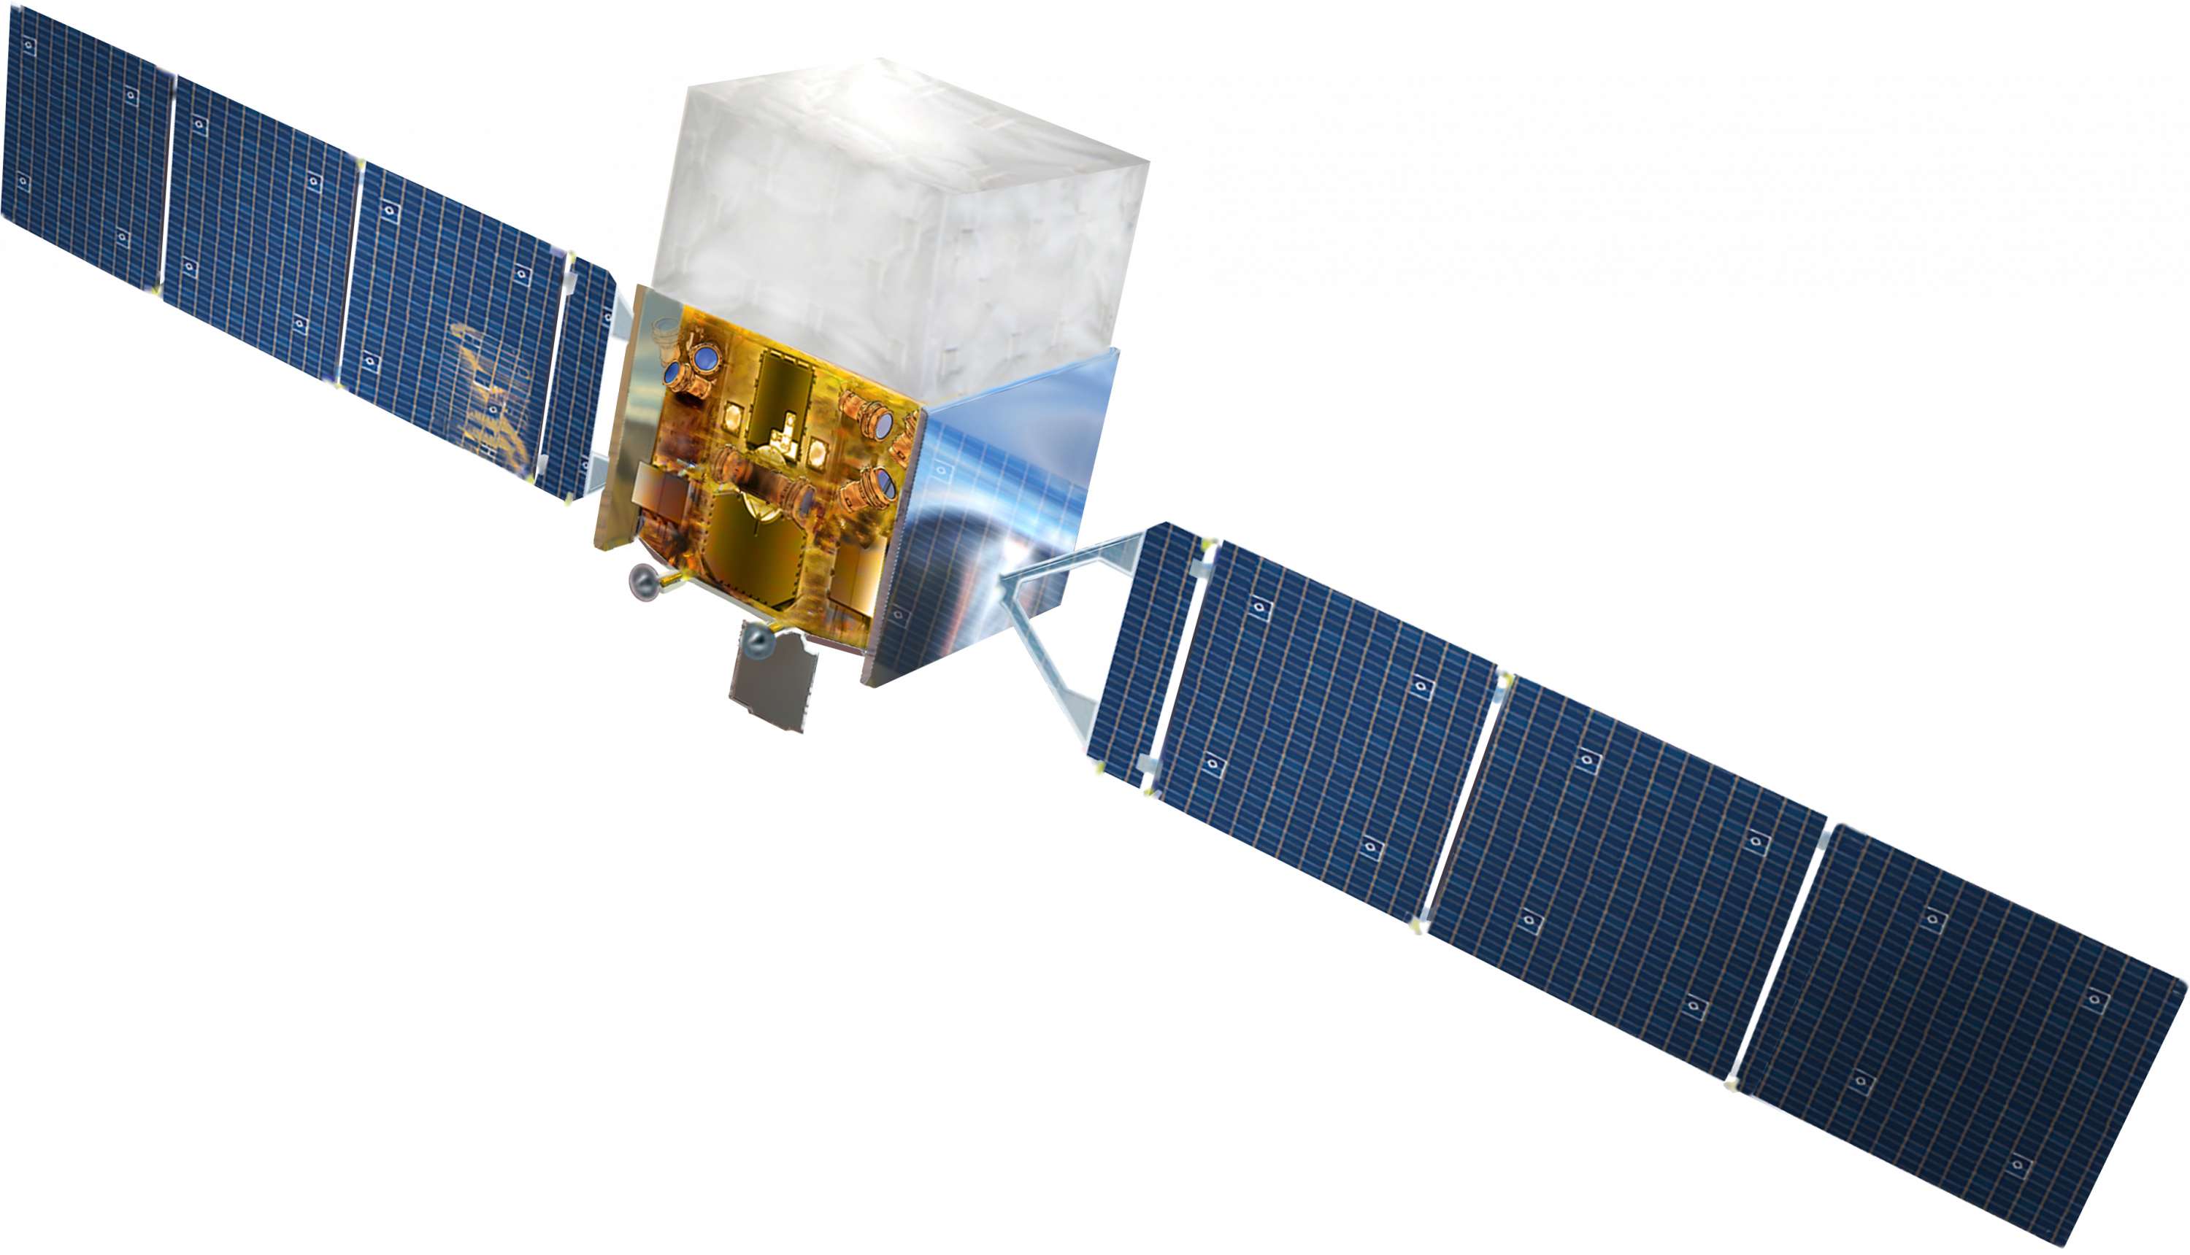
Identifying GRB precursors
Catalogue of GRB precursors required:
Fermi-GBM data publicly available
Create background subtracted light curves
Identify precursors

Slide 15
Stacking analysis overview
Two approaches:
Search for $ν$ during the precursors: $Δt_{p}$
Search for $ν$ before the prompt emission: $Δt$
$$Δt$$
$$Δt_{p}$$

Slide 16
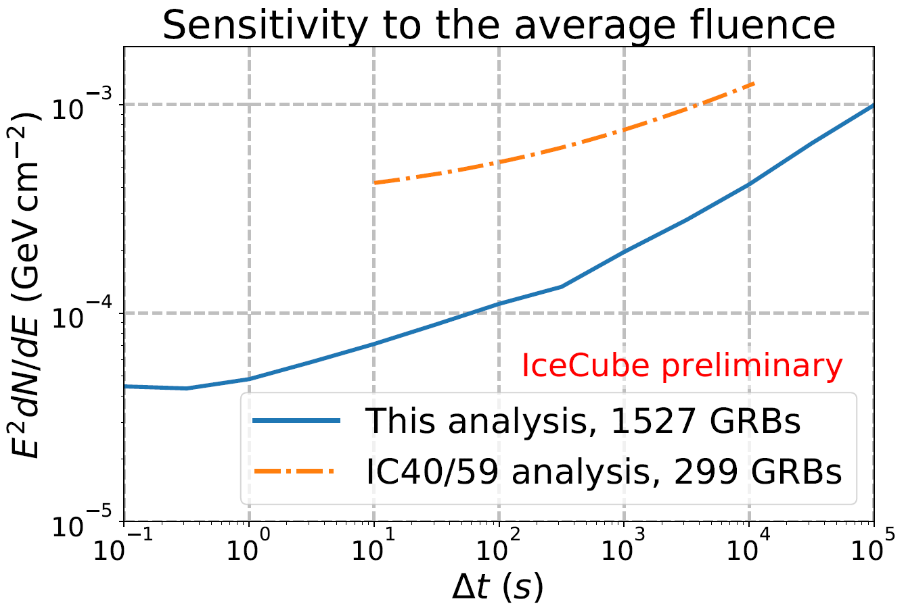
Stacking analysis sensitivity
Shown at ICRC

Slide 17
Conclusion
Recent discoveries: First GW & IACT detection of a GRB
IceCube has not seen a significant excess from GRBs yet
My analysis: Look for neutrinos from the precursor phase
Identify precursors using Fermi-GBM data
Look for coincidences in IceCube

Slide 18
Questions?

Slide 19
Back-up slides

Slide 20
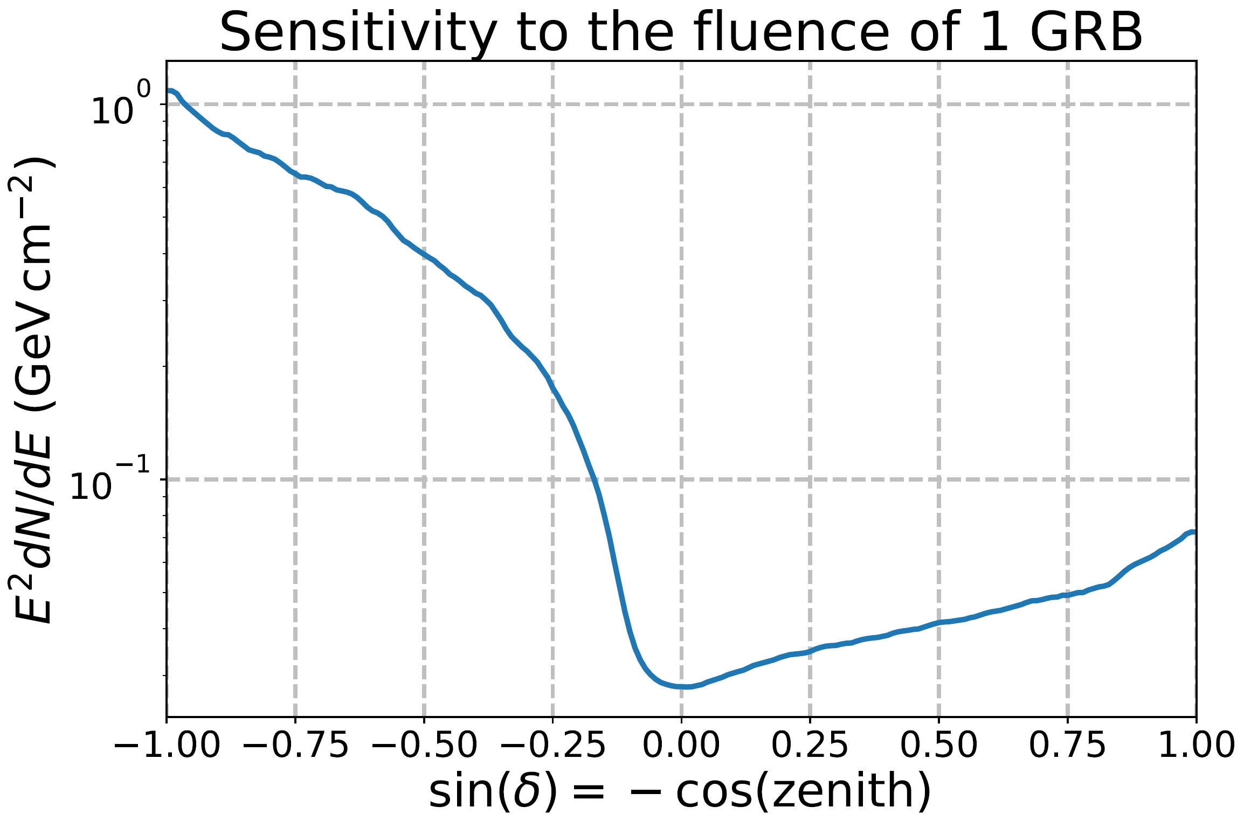
Sensitivities – Single GRB
Search is ´background free´ if $Δt<$ 1000s $⇒$ Sensitivity requires 2.3 signal events to be observed
$$0,9=\sum_{k=1}^{∞}{\frac{λ^{k}}{k!}}e^{−λ}=1−e^{−λ} ⇒λ=\ln\left(10\right)≈2,3$$

Slide 21
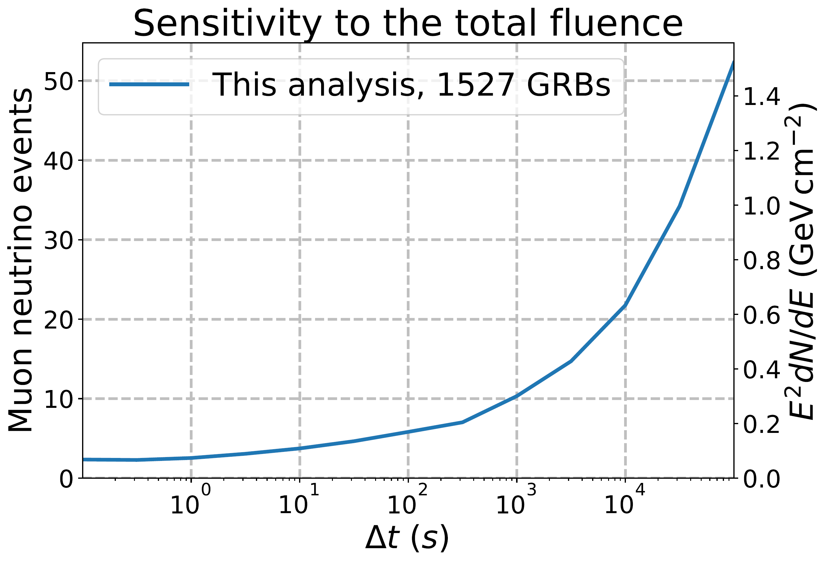
Sensitivities – Stacking all GRBs
Declination dependence averaged out over all GRBs
Sensitivity mainly dependent on the time window size $Δt$

Slide 22
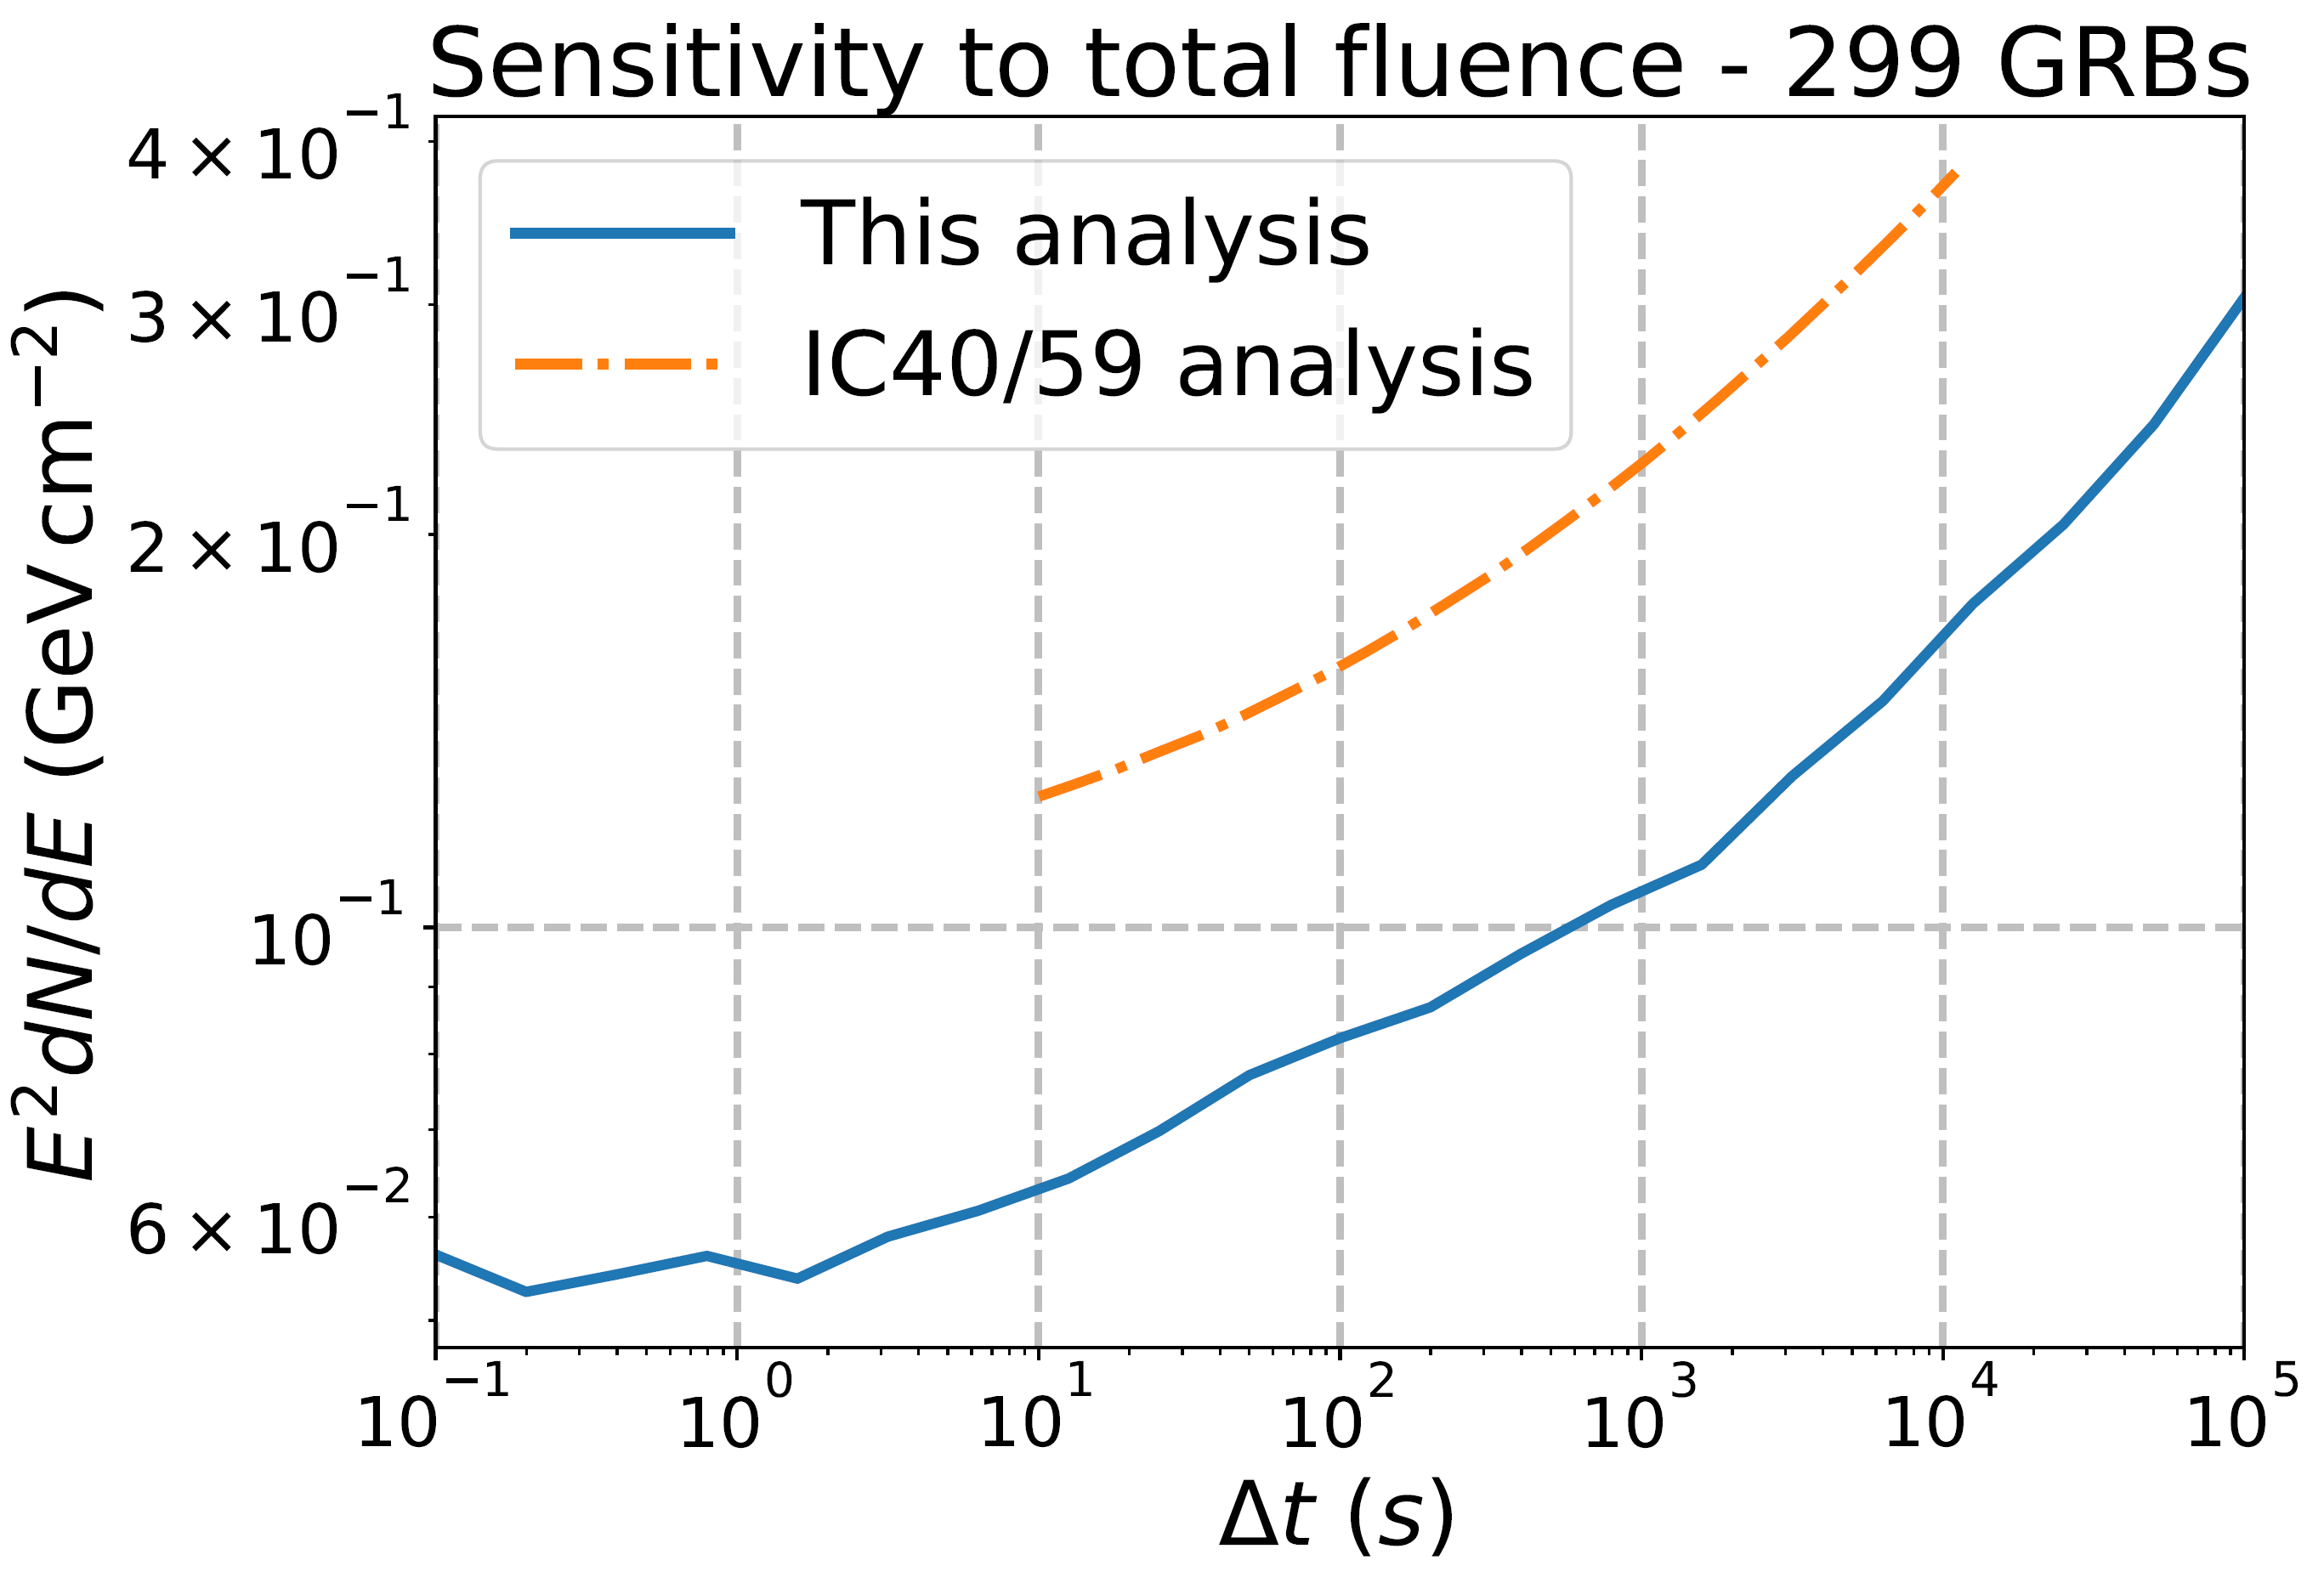
Sensitivities – Stacking 299 GRBs
Previous published limits date back to IC40/59
Differences:
Number of GRBs
(Analysis software)
Event selection
Detector geometry
2.2
2.1
1.9
2.0

Slide 23
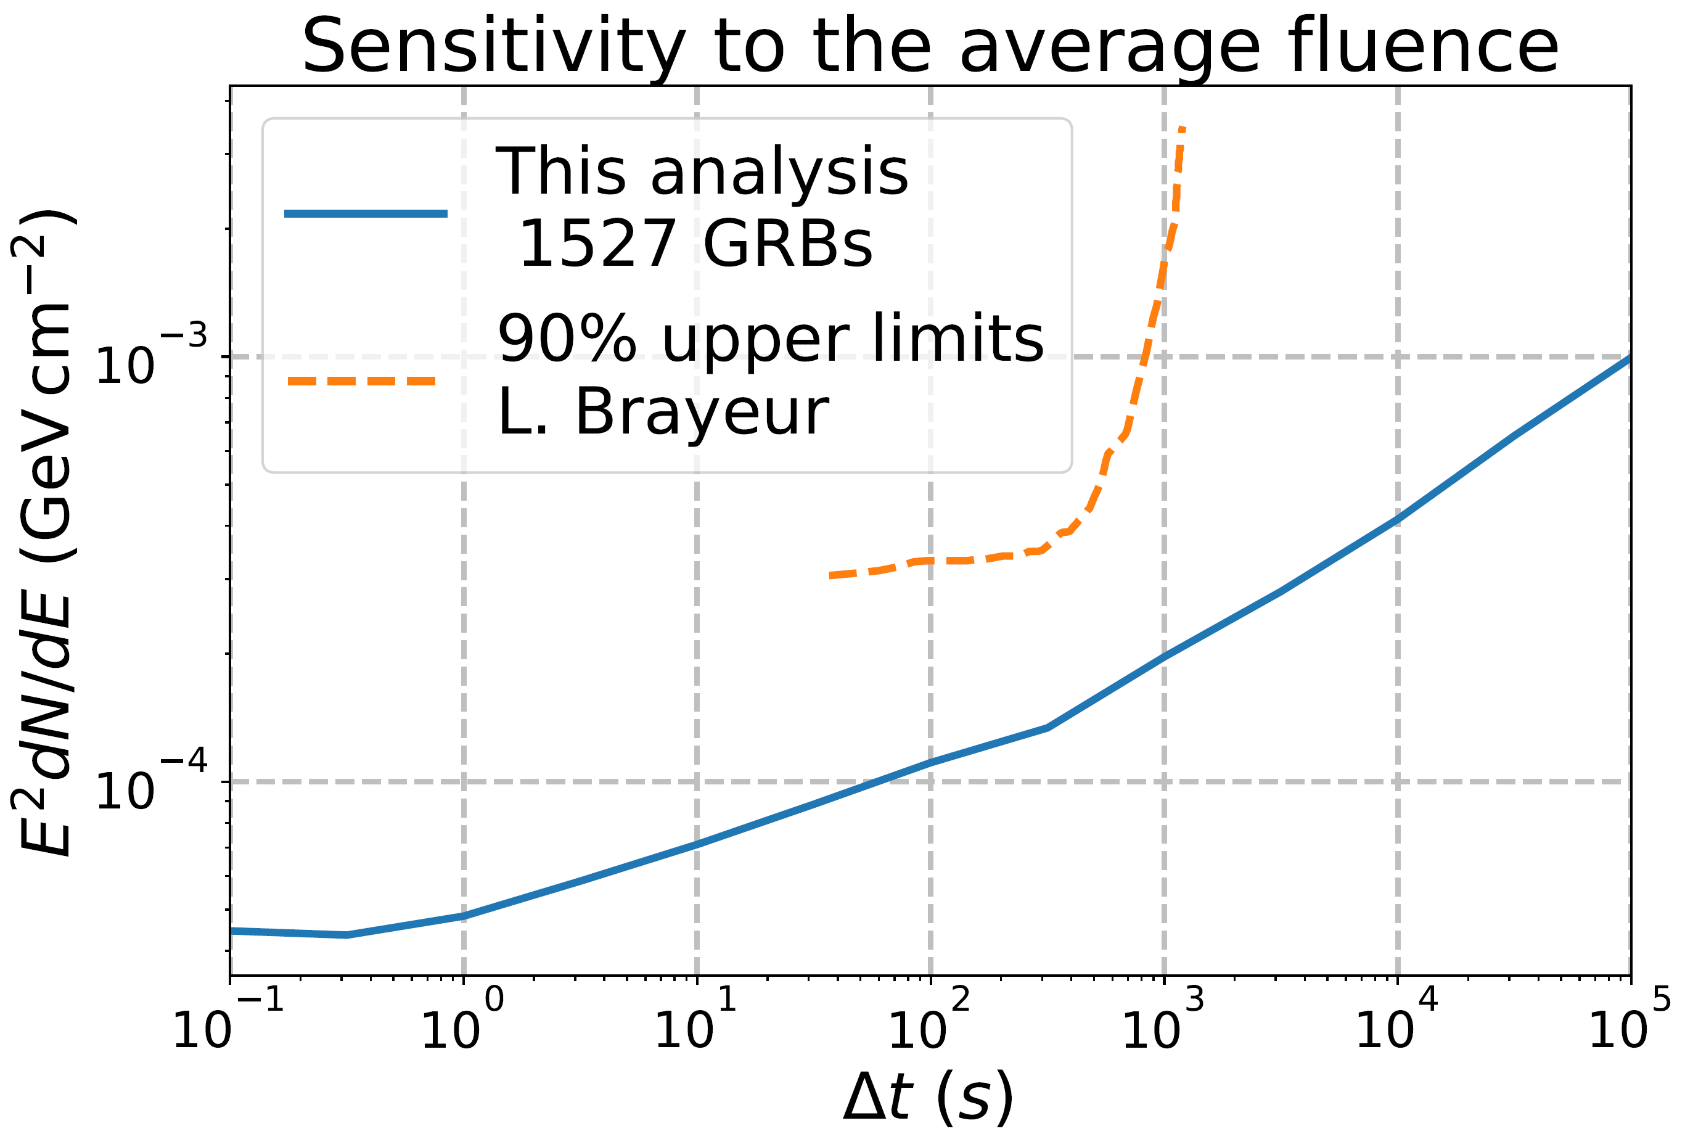
Precursor limits placed by L. Brayeur
468 GRBs

Slide 24
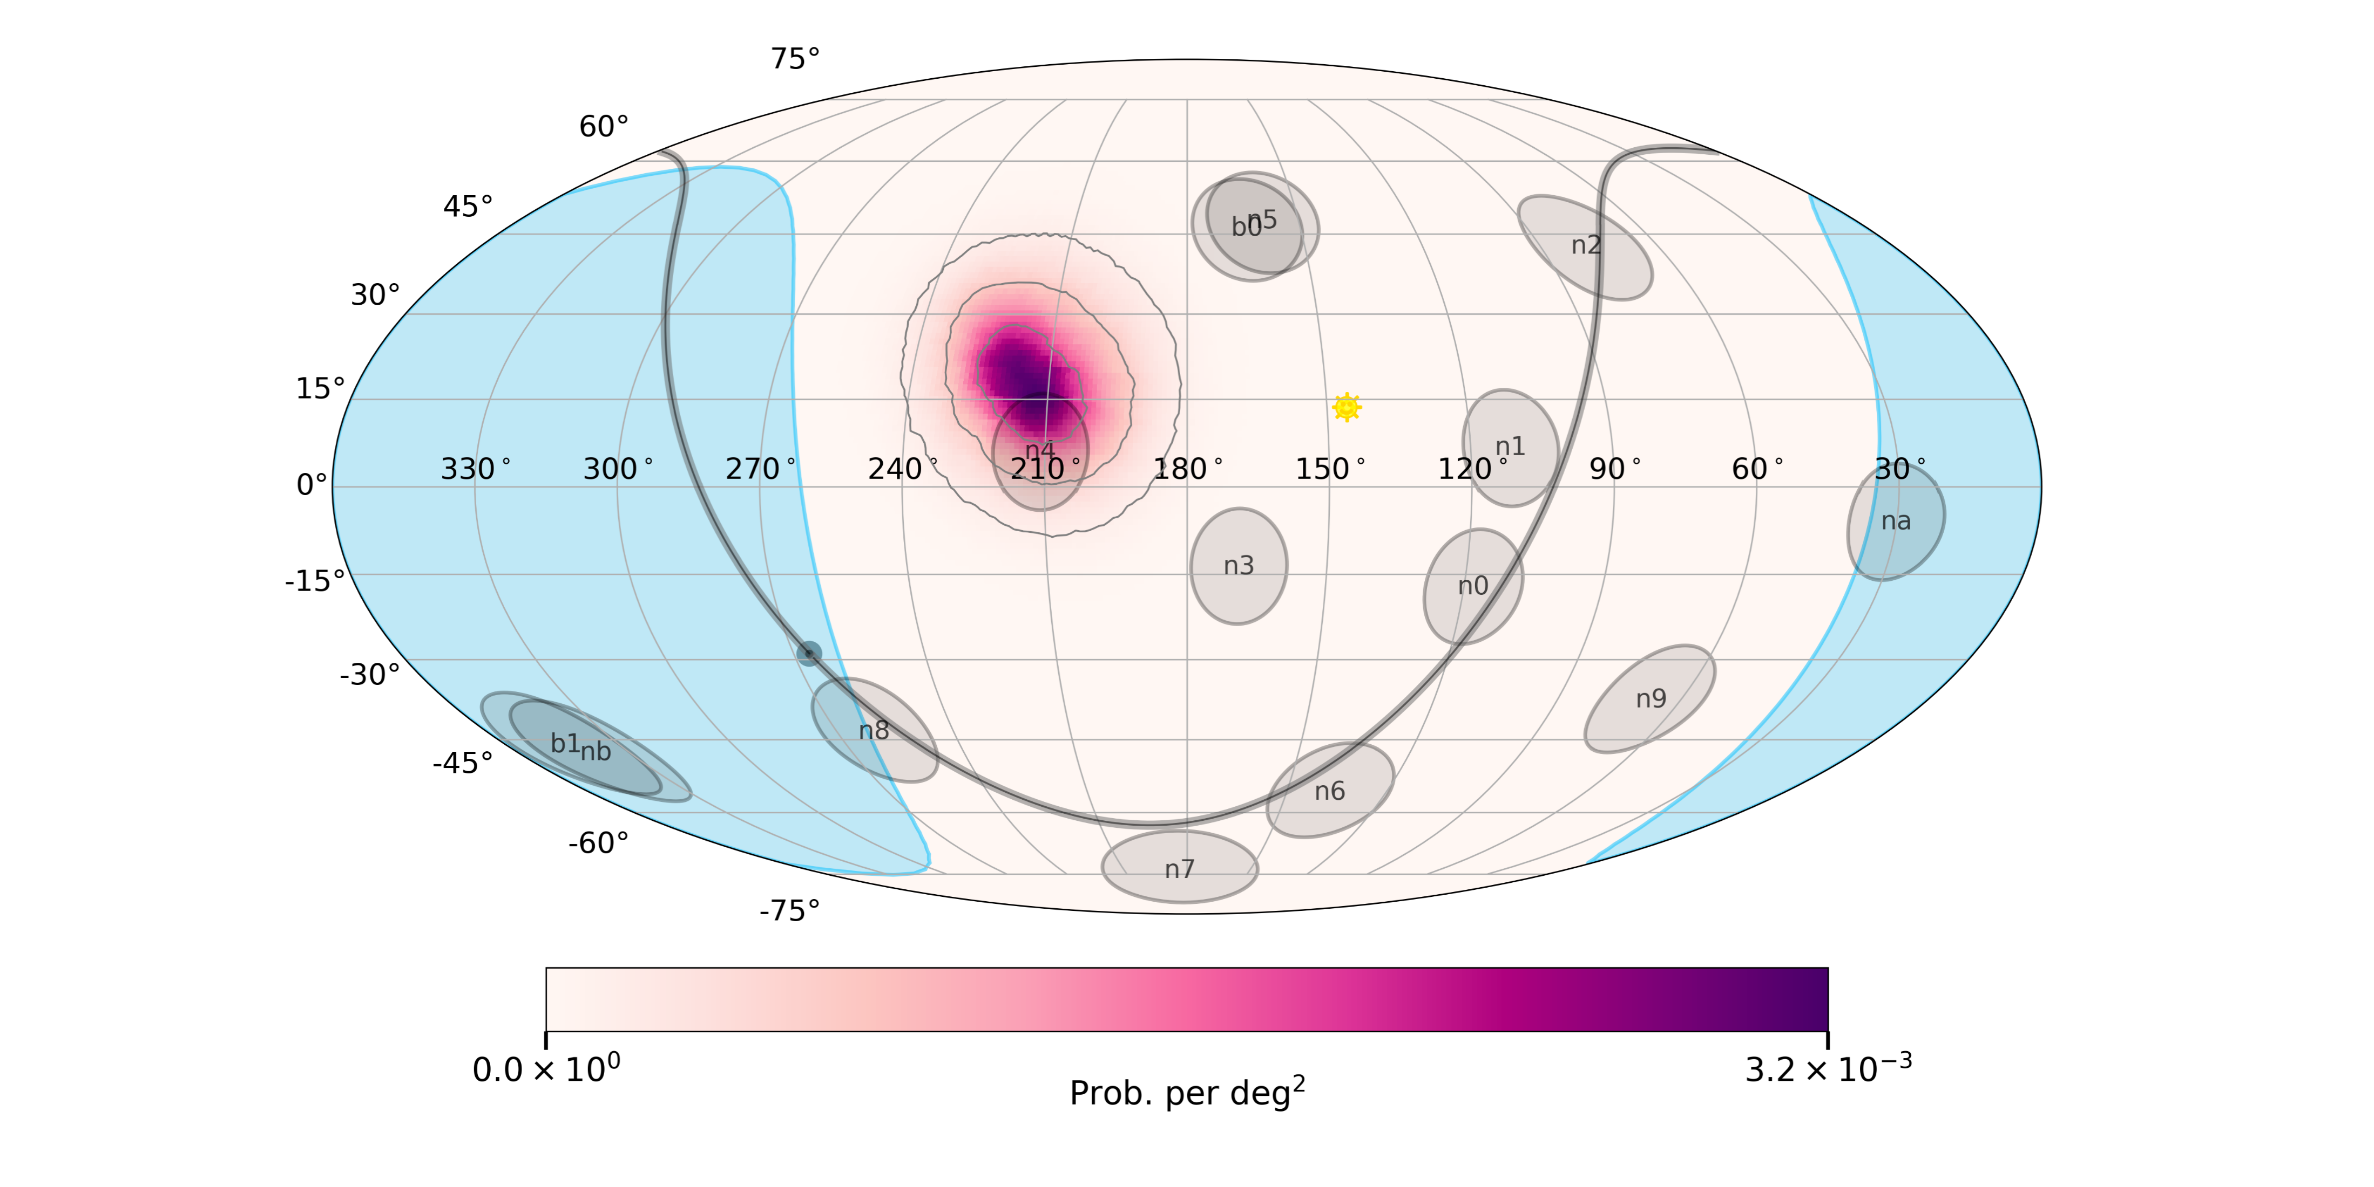
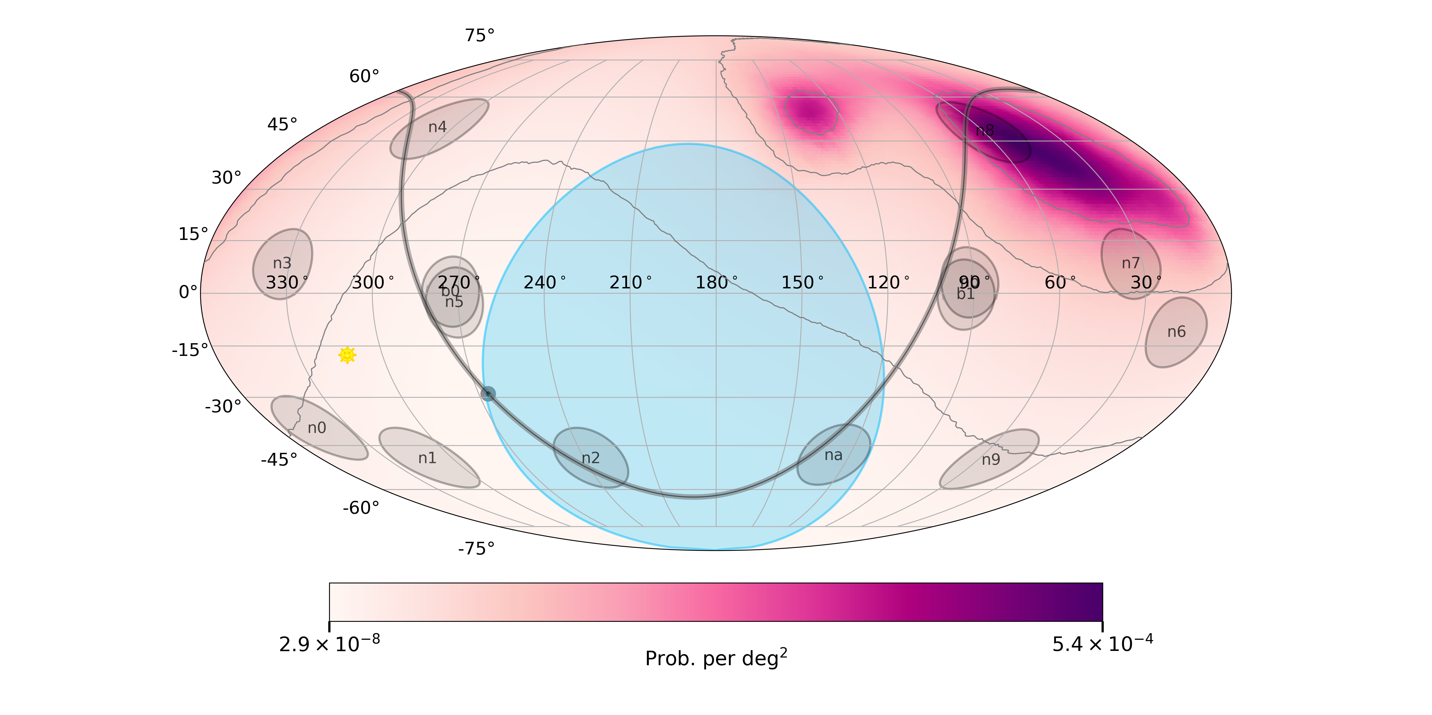
Spatial priors for GBM bursts
Fermi-GBM localizations ill described by a 2d Gaussian
Healpix prior recently became available for all GBM bursts
Proper treatment in csky in progress for (time-dependent) stacking analyses

Slide 25
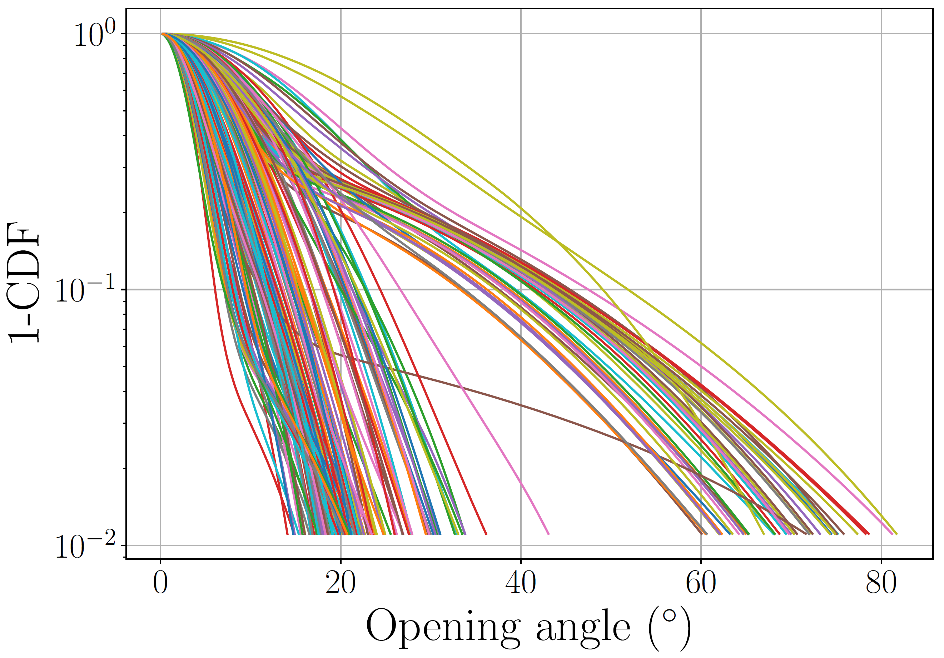
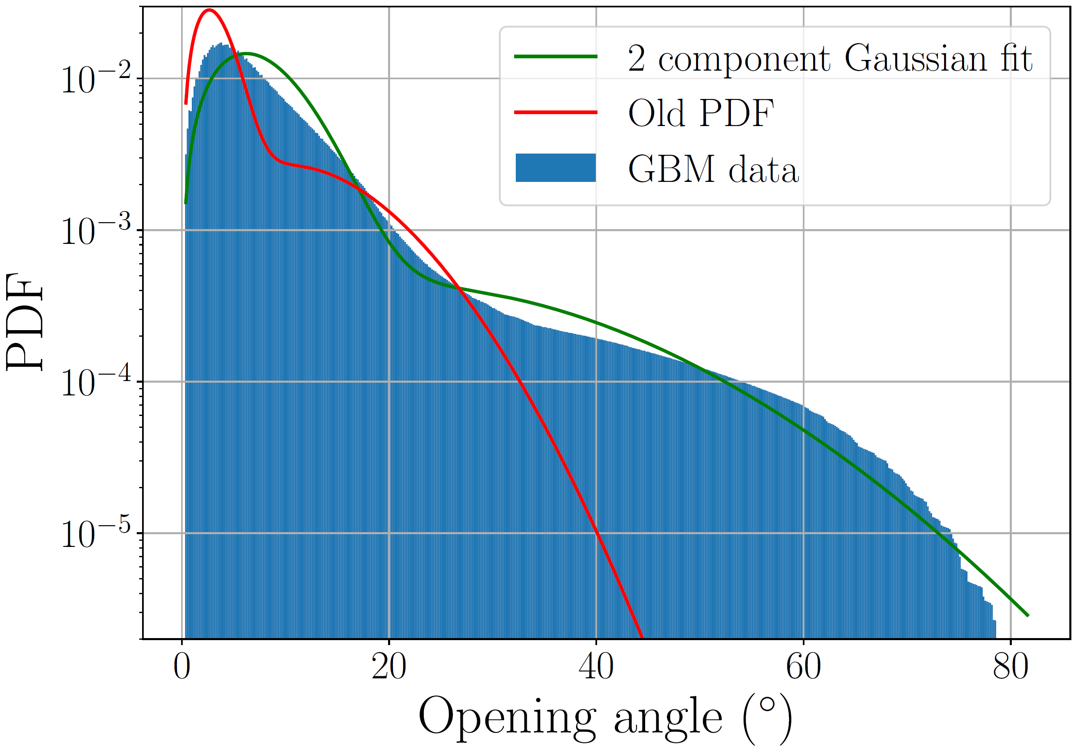
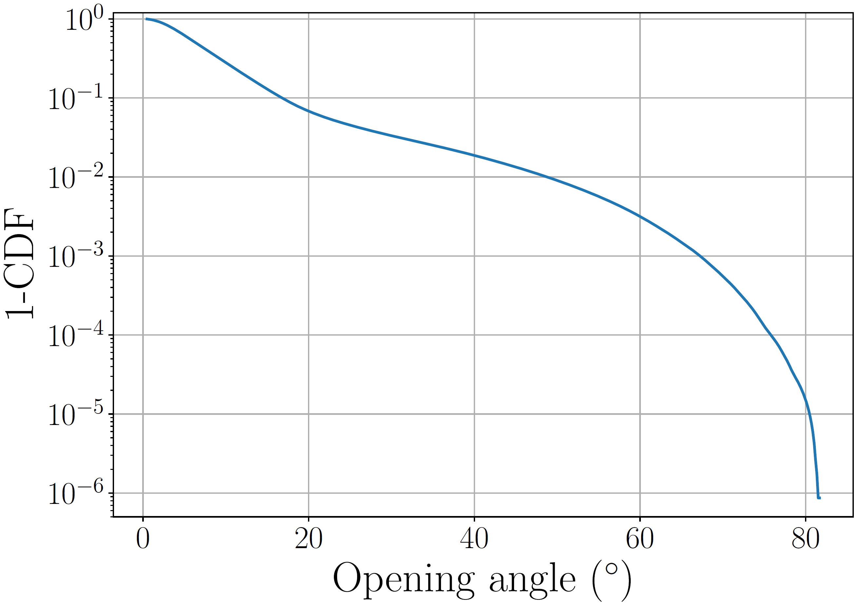
Localization of GRBs by Fermi-GBM
20% of all bursts have ‘bad’ contours
PDF in previous IceCube analyses too optimistic
Per burst CDF (one line corresponds to one GRB)
Combined PDF of 100 bursts
Combined CDF of 100 bursts

Slide 26
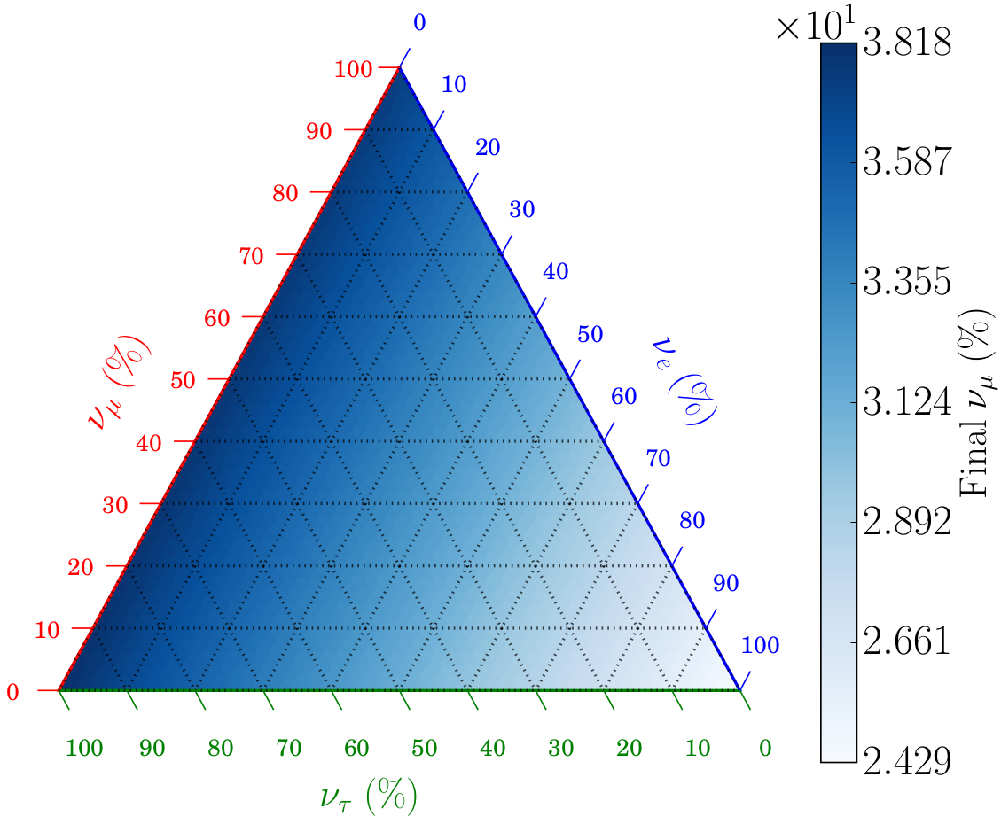
$ν_{μ}$ fraction after oscillations

Slide 28
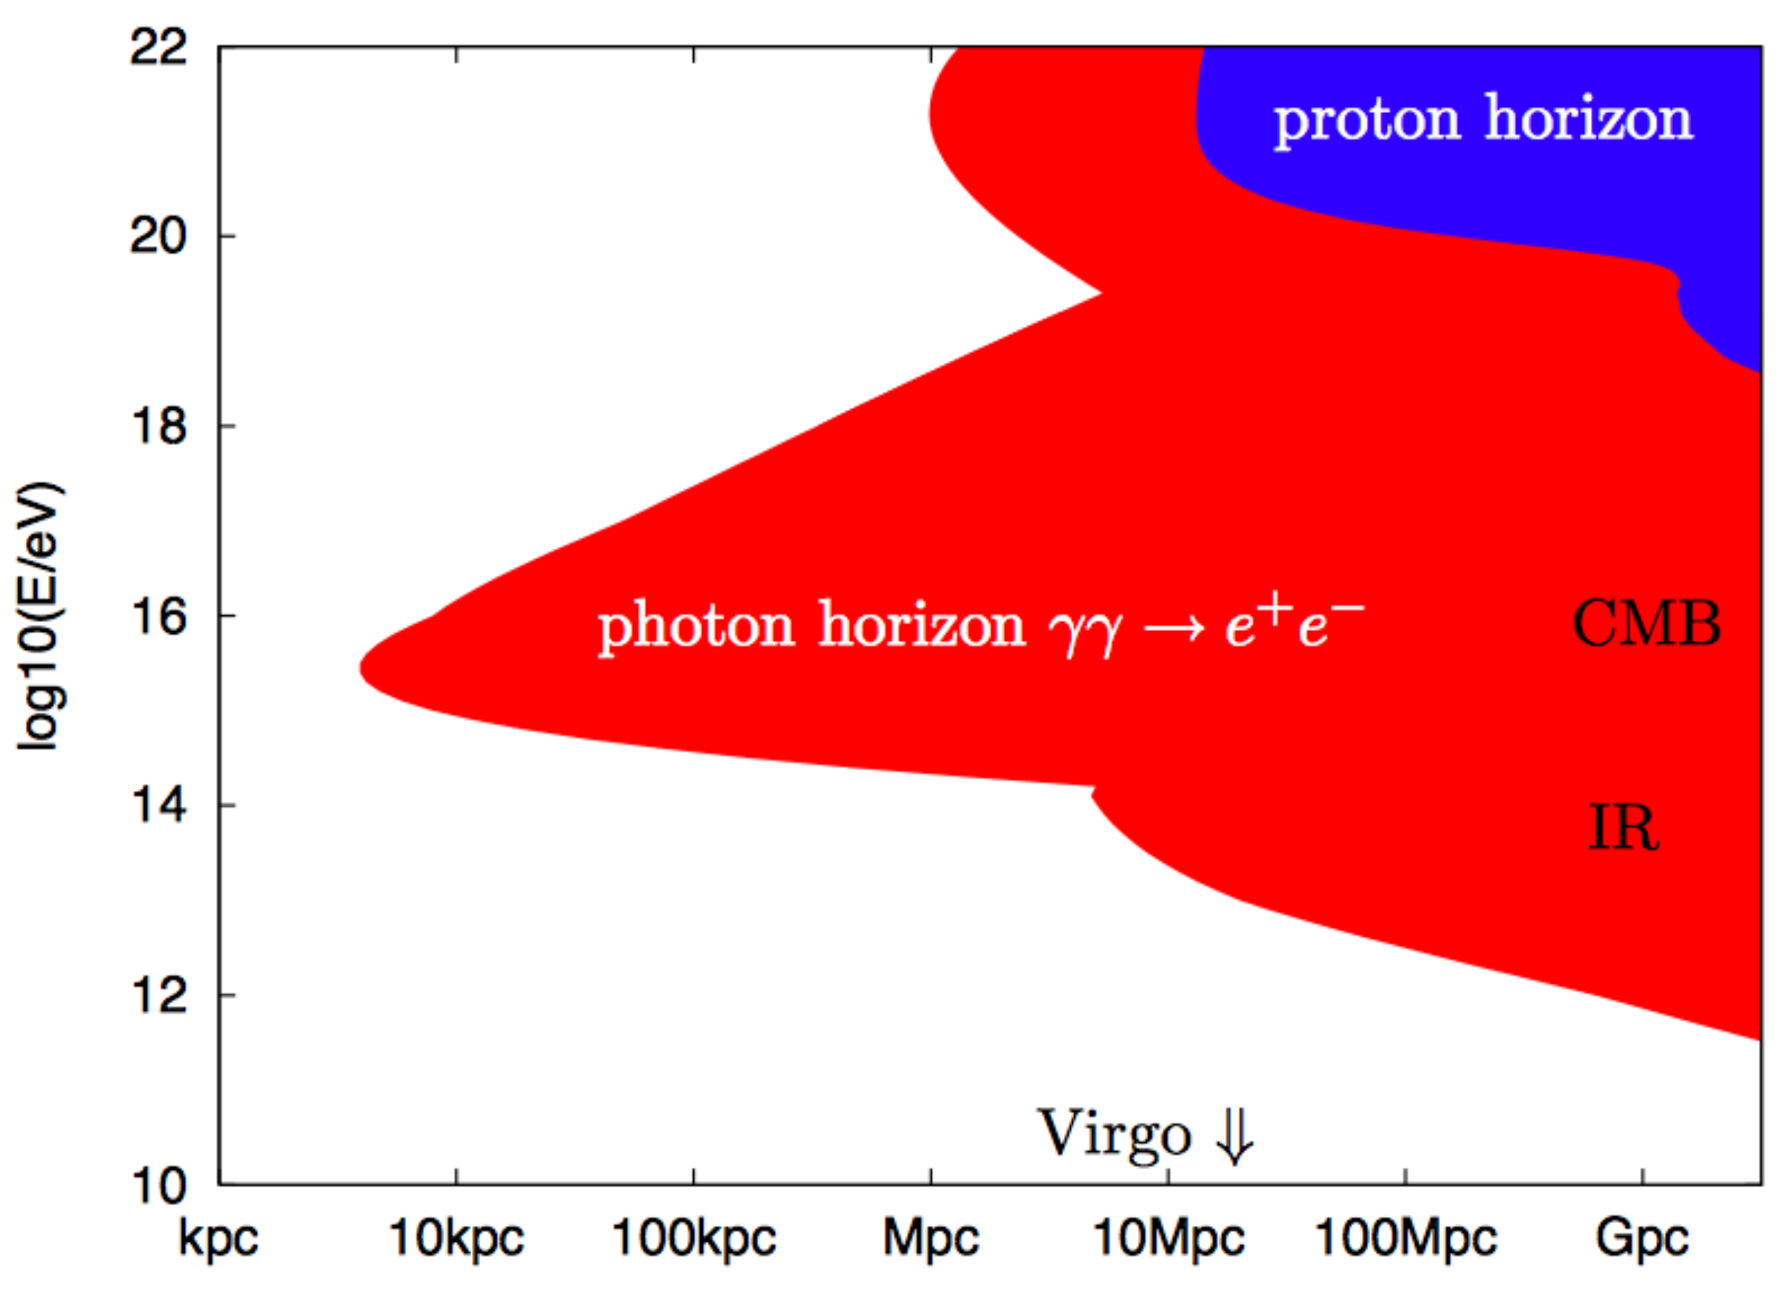
Photon horizon

