Slide 1



General Meeting
18 May 2020

Slide 2
COVID-19 induced a worldwide pandemic and impacted our lives since earlier this year
Even if collectively we managed to “flatten the curve”, many of us have been directly or indirectly affected
Predictions indicate that the virus will continue to impact our society for a significant period
We have to continue to take care of each other!
https://commons.wikimedia.org/wiki/File:COVID-19-Europe-selection-relative-deaths-log.svg

Slide 3
https://www.ecdc.europa.eu/en/covid-19-pandemic
“flatten the curve”
#new cases per day
#deaths per day

Slide 4
webportals to general information
Federal government Belgium: https://www.info-coronavirus.be/en/
Information from ULB: https://www.ulb.be/en/coronavirus-covid-19-information-and-safety-measures
Information from VUB: https://www.vub.be/en/backtocampus#home
Especially the “precautions” part of the VUB website

Slide 5
In general a phased exit strategy is deployed

Slide 6
In general a phased exit strategy is deployed

Slide 7
This meeting
Main objective of this meeting: inform IIHE members about the measures being taken related to safety and health during this phased back-to-the-IIHE period
The functioning of IIHE services
IIHE regulations
Access to the IIHE
Weekly schedule
Outgoing and incoming travel
Opportunity for Questions & Answers
Weblink to the IIHE regulations in place during this period: https://drive.google.com/drive/folders/1GPU3h3u81BAt4khVHGcGWTu-VmUOwLle

Slide 8
The IIHE administration & IT teams
General rule: work from home, and arrange with your supervisor(s) a work schedule that seeks continuity of research and education
IIHE administration: althought the offices of the IIHE secretariat (ULB and VUB) remain closed, Audrey and Sofie remain reachable via email
IIHE IT services: similar for the offices of the IIHE IT team, and our IT team remains reachable via email and other media
If there is a need for administration or IT support that requires presence at the IIHE, please contact the administration or IT team, as well as the IIHE directors. We will try to find alternative solutions, and only upon explicit agreement we might proceed to a real presence at the IIHE.
Surface mail is collected every week and available in your mailbox in the social room. If it looks important you'll be contacted by email. If you expect something important, please inform Sofie (VUB) or Laurent (ULB).
Many thanks to Audrey, Sofie, Marleen, Adriano, Denis, Olivier, Romain, Shkelzen, Stéphane for their continuous support!

Slide 9
IIHE regulations for access
Making progress with research that depends on specific equipment and/or installations is jeopardised today. Within the spirit of the ongoing phased exit strategy we started earlier this month to verify how to mitigate this.
Accordingly, and with a view on your safety and our collective safety, we provided via the mentioned weblink an overview of the “IIHE-COVID19” regulations in place from 11 May 2020 onwards (an extract on the next slide)
They built on the general regulations defined by the VUB
We request you inform yourselves about these regulations and you comply with them; these regulations will evolve, e.g. when more people are present at the IIHE
The VUB cleaning team and the VUB technical services (e.g. for technical emergency intervention) have been asked to comply with these regulations
Not everything can be written in regulations, and we count on your common sense. We sincerely thank you for your continuous efforts.

Slide 10
Snapshot of VUB precautions
https://www.vub.be/en/backtocampus#precautions

Slide 11
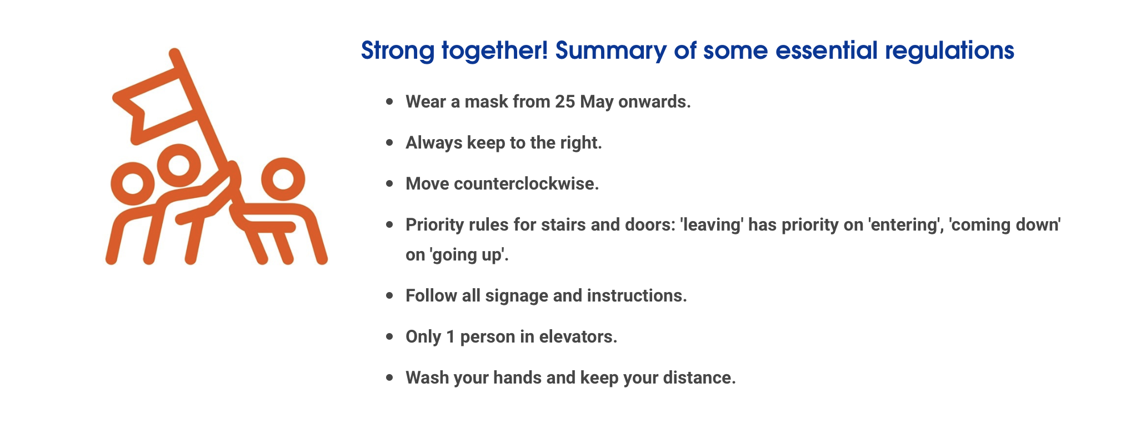

Slide 12
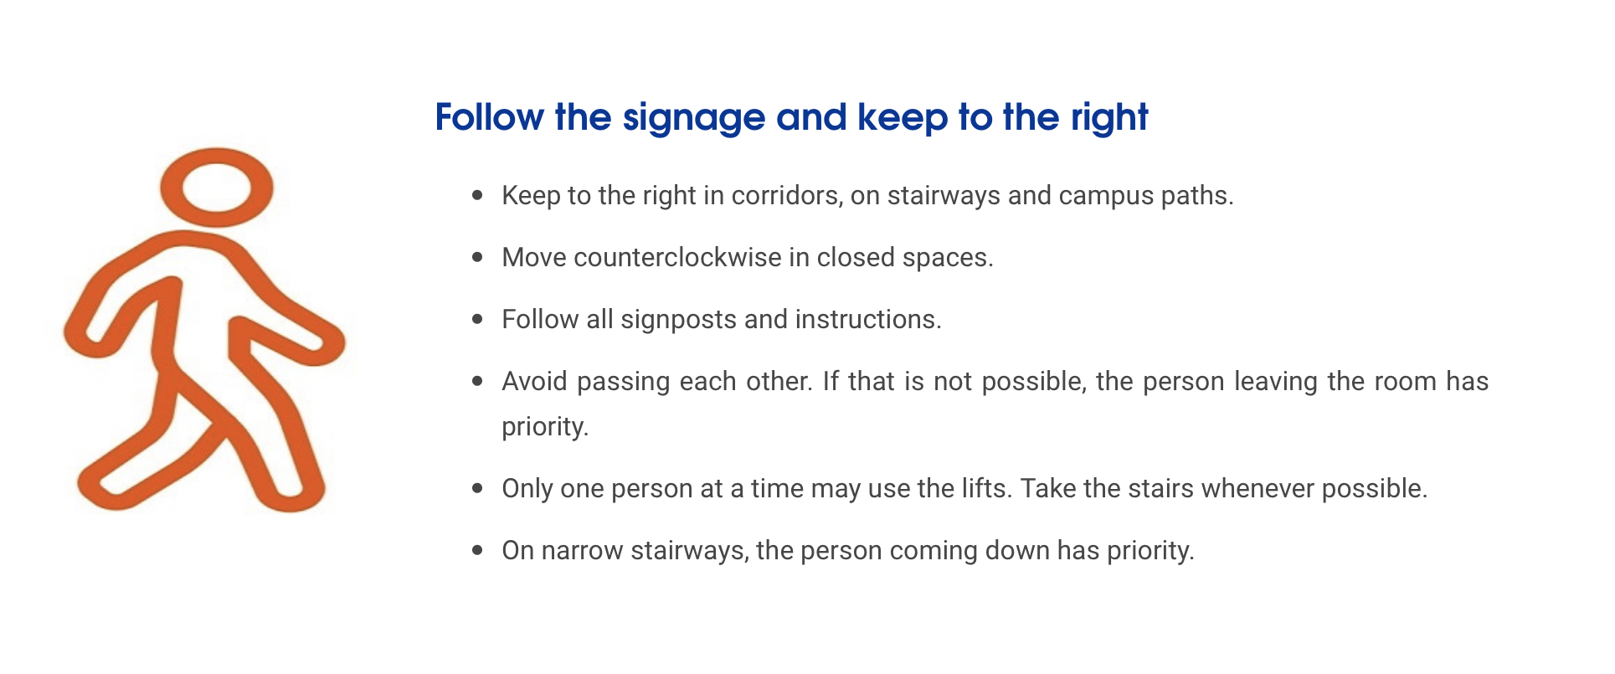

Slide 13
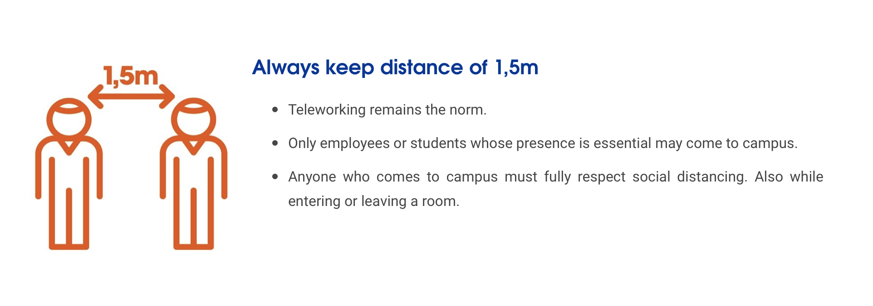

Slide 14
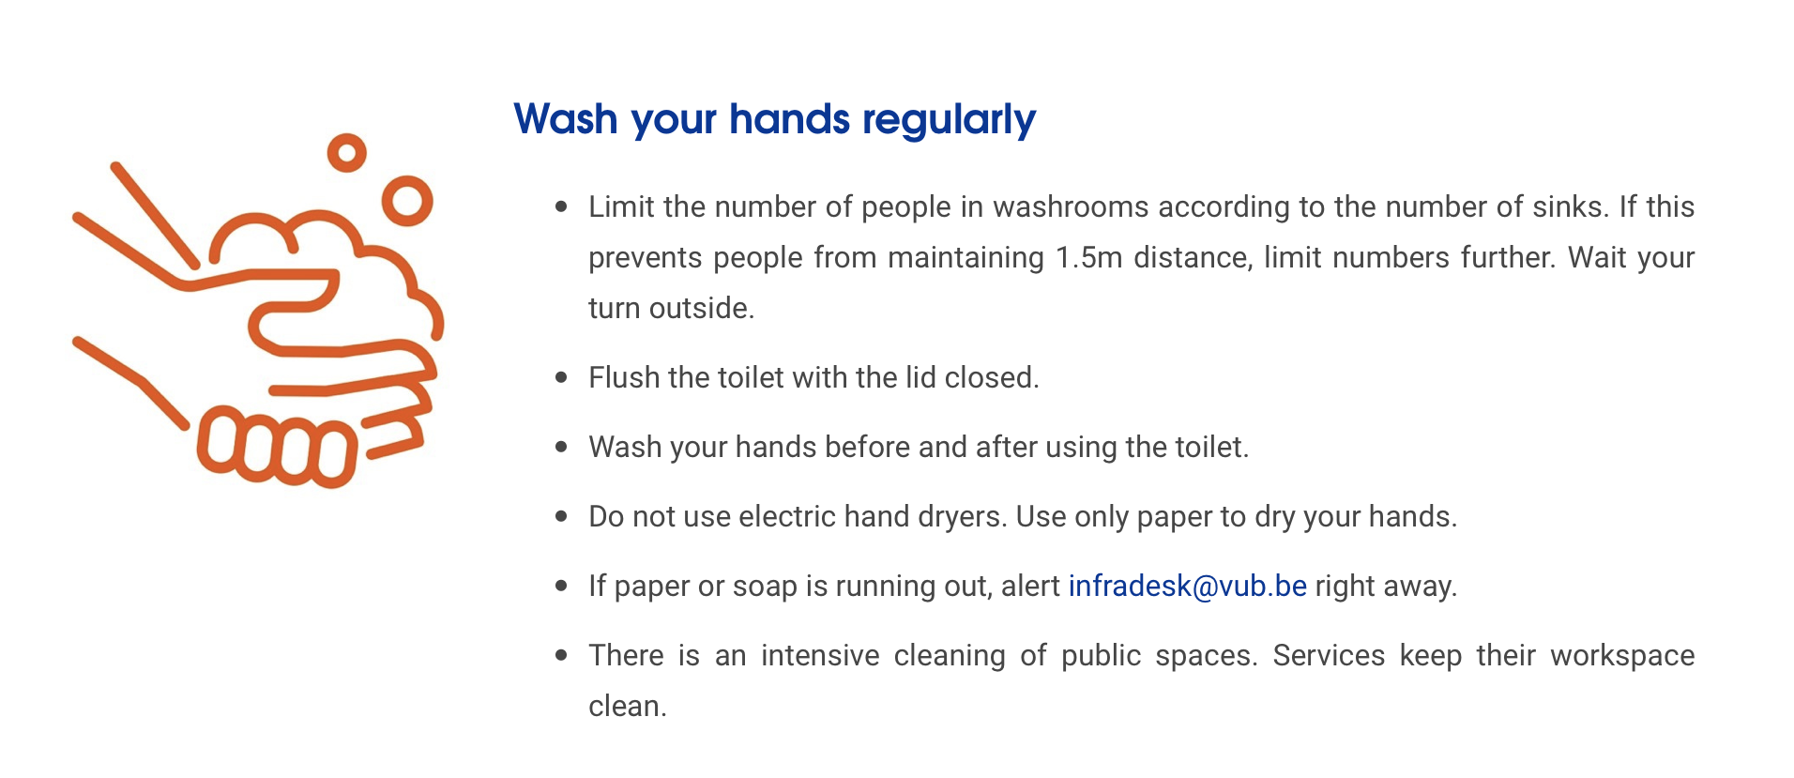

Slide 15
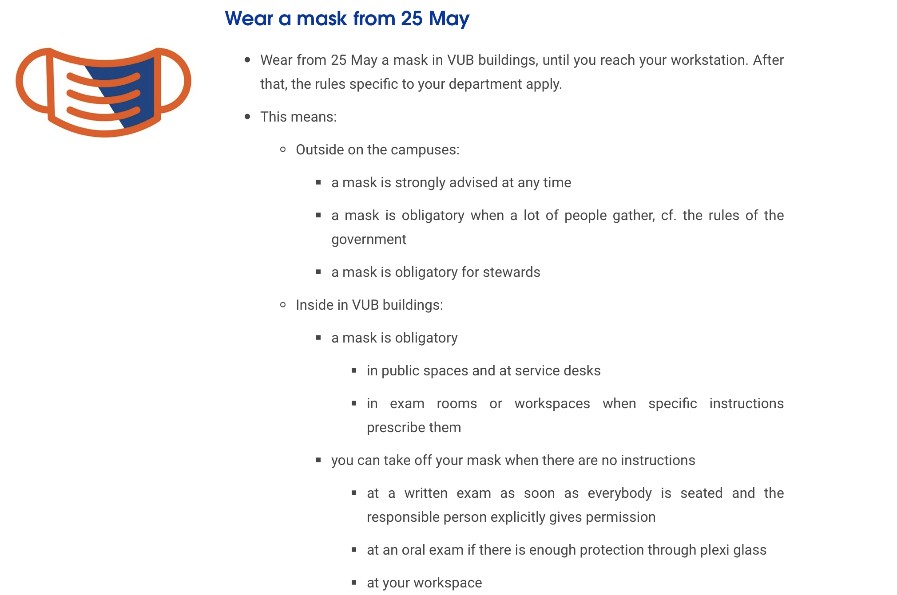

Slide 16
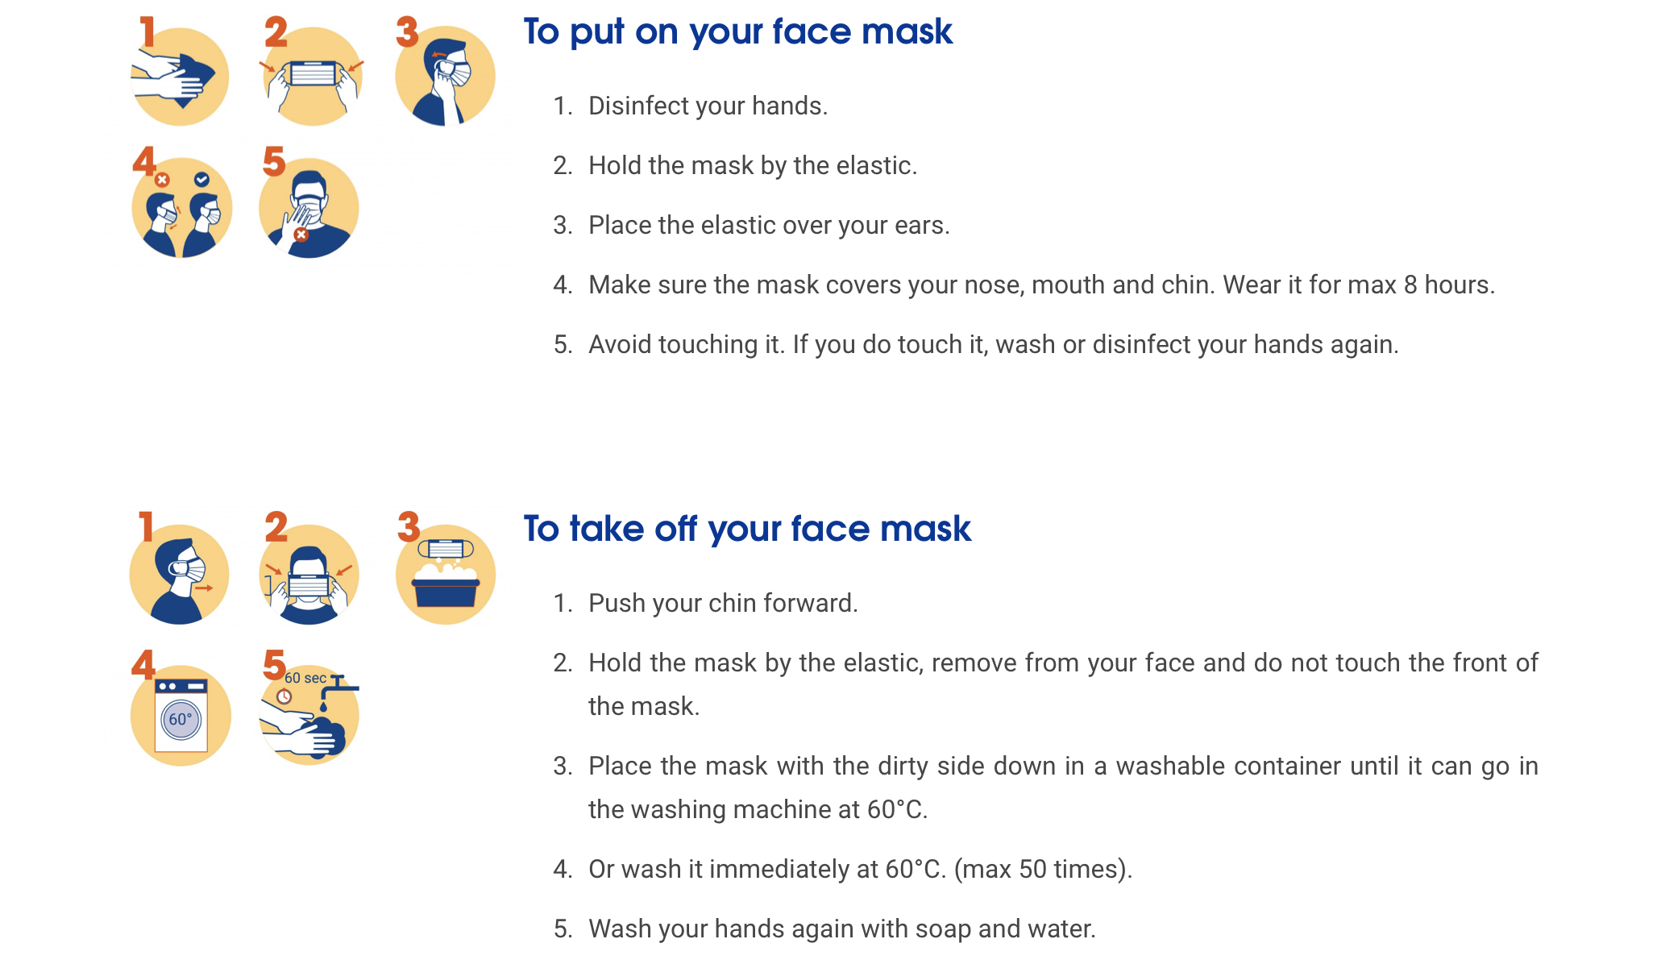

Slide 17
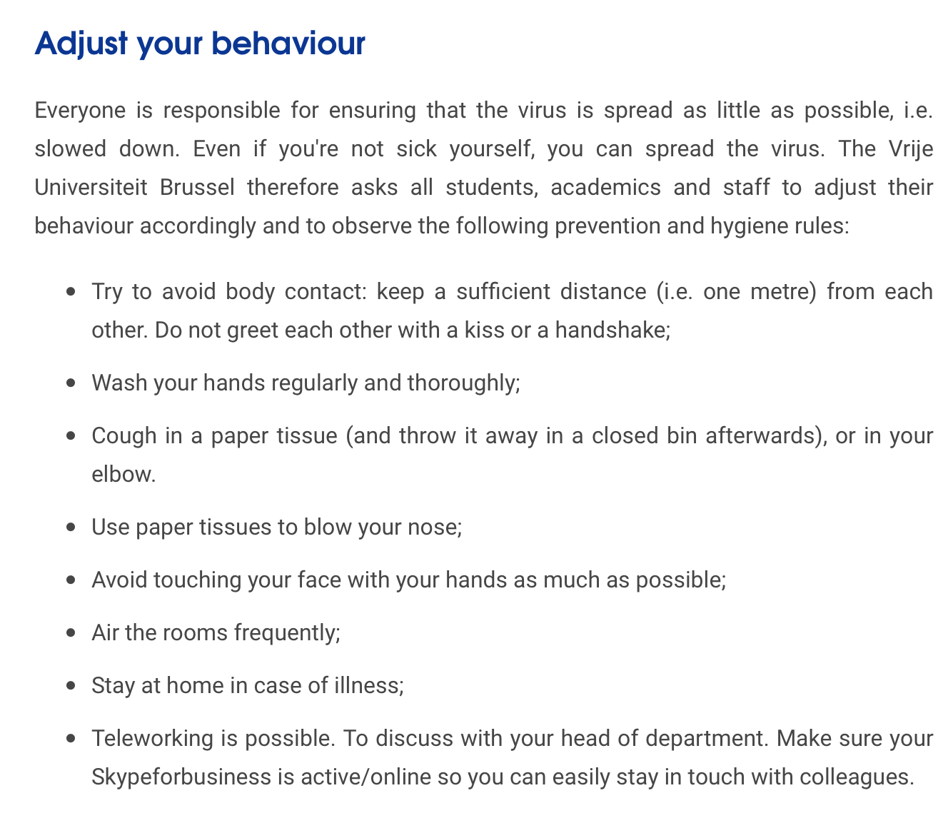

Slide 18
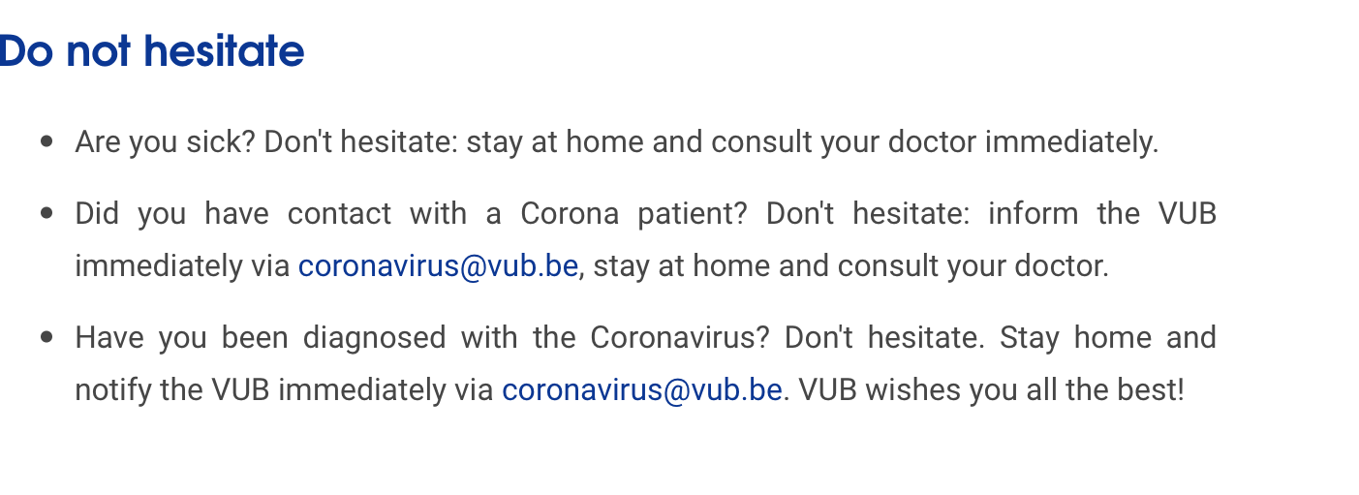
VUB
ULB
For ULB persons, please contact Dr. Alain Levêque (alain.leveque@ulb.be) who is the coordinator of ULB’s coronavirus response, and include your surname, name, date of birth and/or ULB ID. Briefly explain why you are contacting him, and provide a telephone number. Alain Levêque will get in touch with you.

Slide 19
IIHE regulations for access
(an extract)
When entering the IIHE, everybody is requested to wear a mask. When you are alone inside your office or your dedicated lab space masks are not compulsory. When entering the IIHE you are requested to wash your hands thoroughly and materials are available in the IIHE social room.
For each IIHE member coming to the institute a “safety & disinfection package” is made available, follow the instructions in the IIHE social room. With a view to provide sufficient packages, you are requested to inform the directors when you collected a package. Disinfection waste is to be collected in dedicated bags, and these bags are to be deposited in the social room at the space indicated.
Only 4 persons are allowed at the same time in the IIHE social room. Every time you are entering the IIHE social room you are requested to wash your hands thoroughly. You are requested to thoroughly clean with water and soap all kitchen materials you used, and to disinfect all surfaces and other items used in the social room.
Close and lock the IIHE entrance doors, your office and workspace doors when you leave the IIHE. The IIHE entrance doors should be closed and locked at all time during this period.
Individual transport is encouraged to come to the IIHE. Try to avoid using the public transport during peak hours to come to the IIHE.

Slide 20
VUB regulations for safety in laboratories
The VUB made available general regulations for the safety in laboratory spaces
The VUB requires everyone working in research laboratories at the VUB (including the IIHE) to be informed about general safety aspects, especially in current times this is essential
For all IIHE members who have not yet done, we request you to read the related documents available via the weblink
When you arrive back at the IIHE in the coming weeks, print and sign the declaration of read and agreed. You are requested to deposit the signed document in the mailbox in front of the office of Marleen/Sofie (1G006). Surely you can do this digitally as well, and provide Sofie with the signed document via email (sofie.vandenbussche@gmail.com).

Slide 21
Access to the IIHE
In case your work requires frequent access to the IIHE laboratory and/or office spaces, please discuss this with your supervisor and/or team, and accordingly inform the IIHE directors, especially when, where, who, why
Provide the IIHE directors as well the phone number on which you will be reachable while at the IIHE
Inform the IIHE directors if there is a safety risk connected to the work, for example high-voltage, the use of gases, heavy weights, …
If we have an overall picture, we can develop coherent solutions to accommodate the access requests and in accord with general regulations of our host university

Slide 22
Weekly
IIHE access schedule
Taking into account the requests received by Thursday, every Friday we communicate the IIHE access schedule for the next week
The weekly schedules are available via the weblink
Surely, such a schedule is only useful if indeed no other persons are present at the institute; therefore, it is requested that no IIHE members are present at the institute other than those indicated in the schedule
The weekly schedule is fixed every week, and only in emergency or very exceptional cases the weekly schedule can be revisited on the fly

Slide 23
Example for this week

Slide 24
Outgoing and incoming travel
Travel restrictions are in place throughout the world and imposed by governments
The access to several research institutions is restricted, e.g. CERN (https://home.cern/news/news/cern/cern-and-covid-19)
At the VUB, international travel is not allowed for study or research purposes until 13 September 2020
At the ULB, it could be allowed but should be requested
Incoming visitors to the IIHE, i.e. non-IIHE members for example for seminars or research collaborations or outreach, are in general not allowed but can very exceptionally be considered upon a timely requested to the IIHE directors (via email)
Except for exams, there should be no bachelor or master students at the IIHE
Regulations for the Belgian apartments nearby CERN are available via the weblink

Slide 25
Thank you!
Back-to-the-IIHE
… but health and safety first!

Slide 26
Questions
&
Answers

