Slide 1

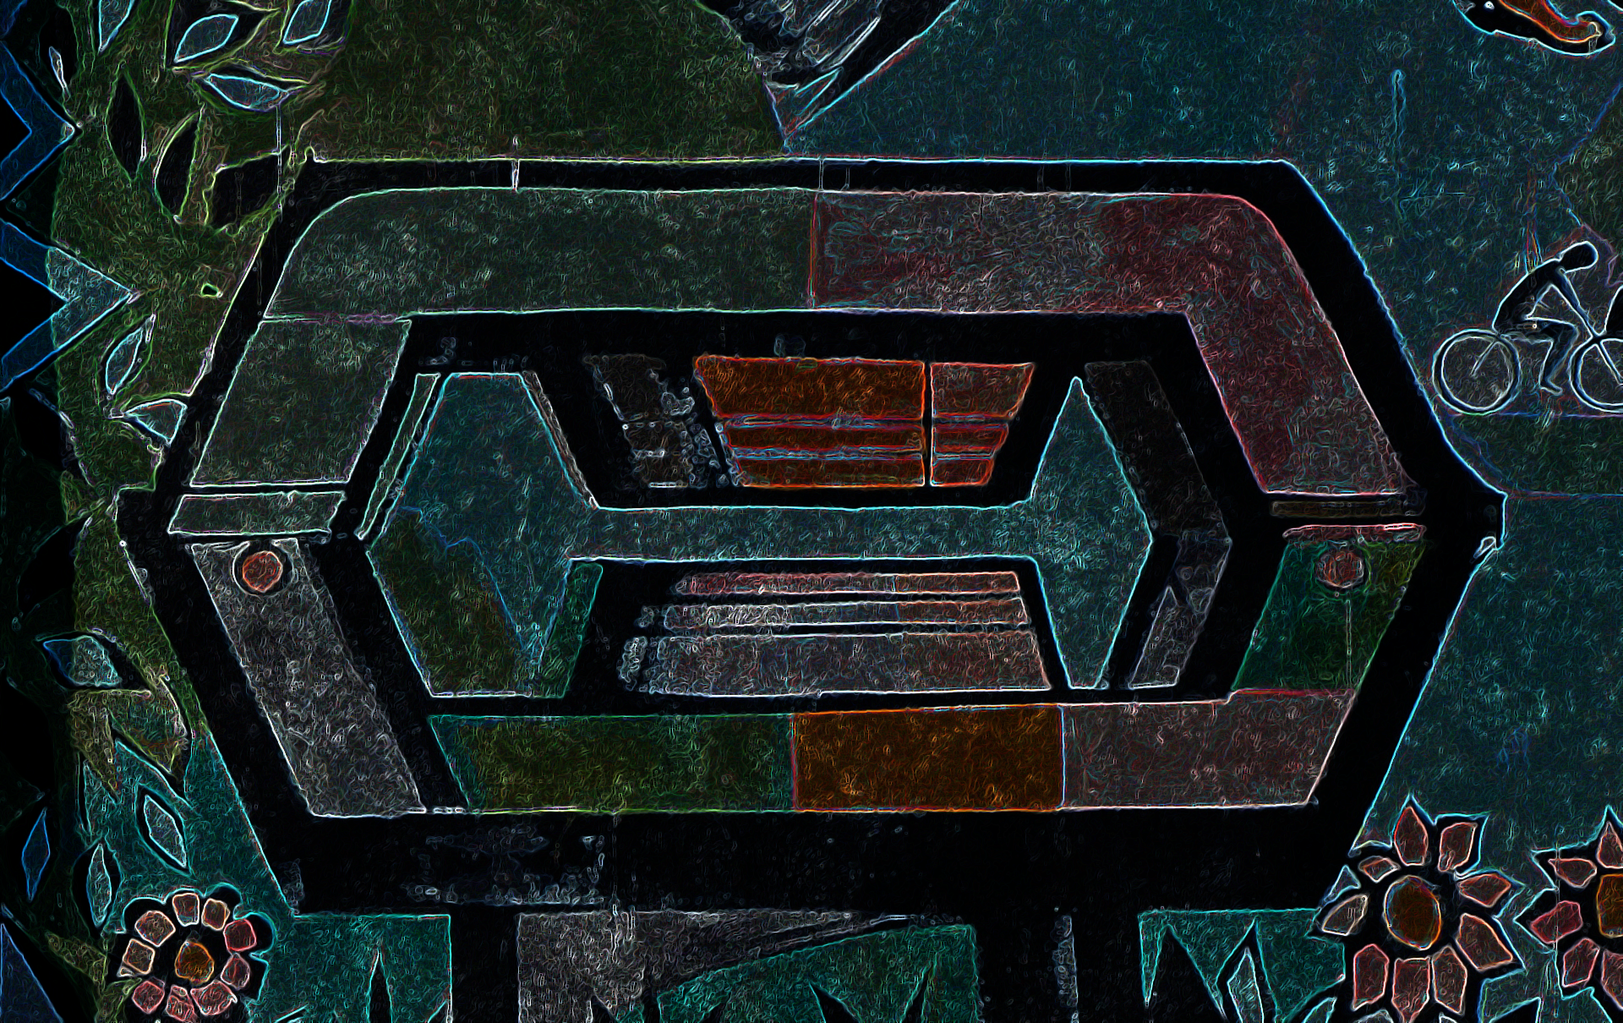
Astroparticle physics at UCLouvain’s CP3
11th CosPa meeting | ULB | Brussels | 29.10.2021
Astroparticle Cosmology
Muography Gravitational waves
Gwenhaël de Wasseige and Joris van Heijningen
on behalf of many researchers at UCLouvain

Slide 2
Astroparticle physics at UCLouvain’s CP3
11th CosPa meeting | ULB | Brussels | 29.10.2021
Astroparticle Cosmology
Compact
sources
Environmental
studies
Primordial sources
Muography Gravitational waves
Gwenhaël de Wasseige and Joris van Heijningen
on behalf of many researchers at UCLouvain

Slide 3
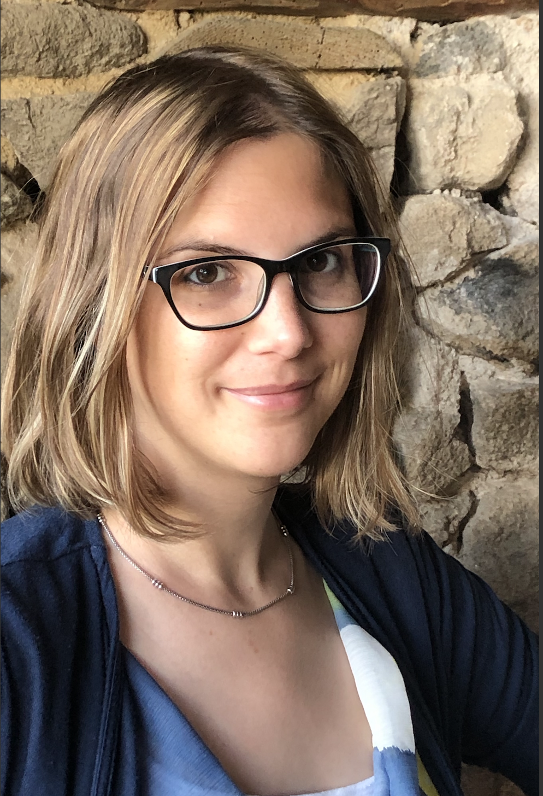
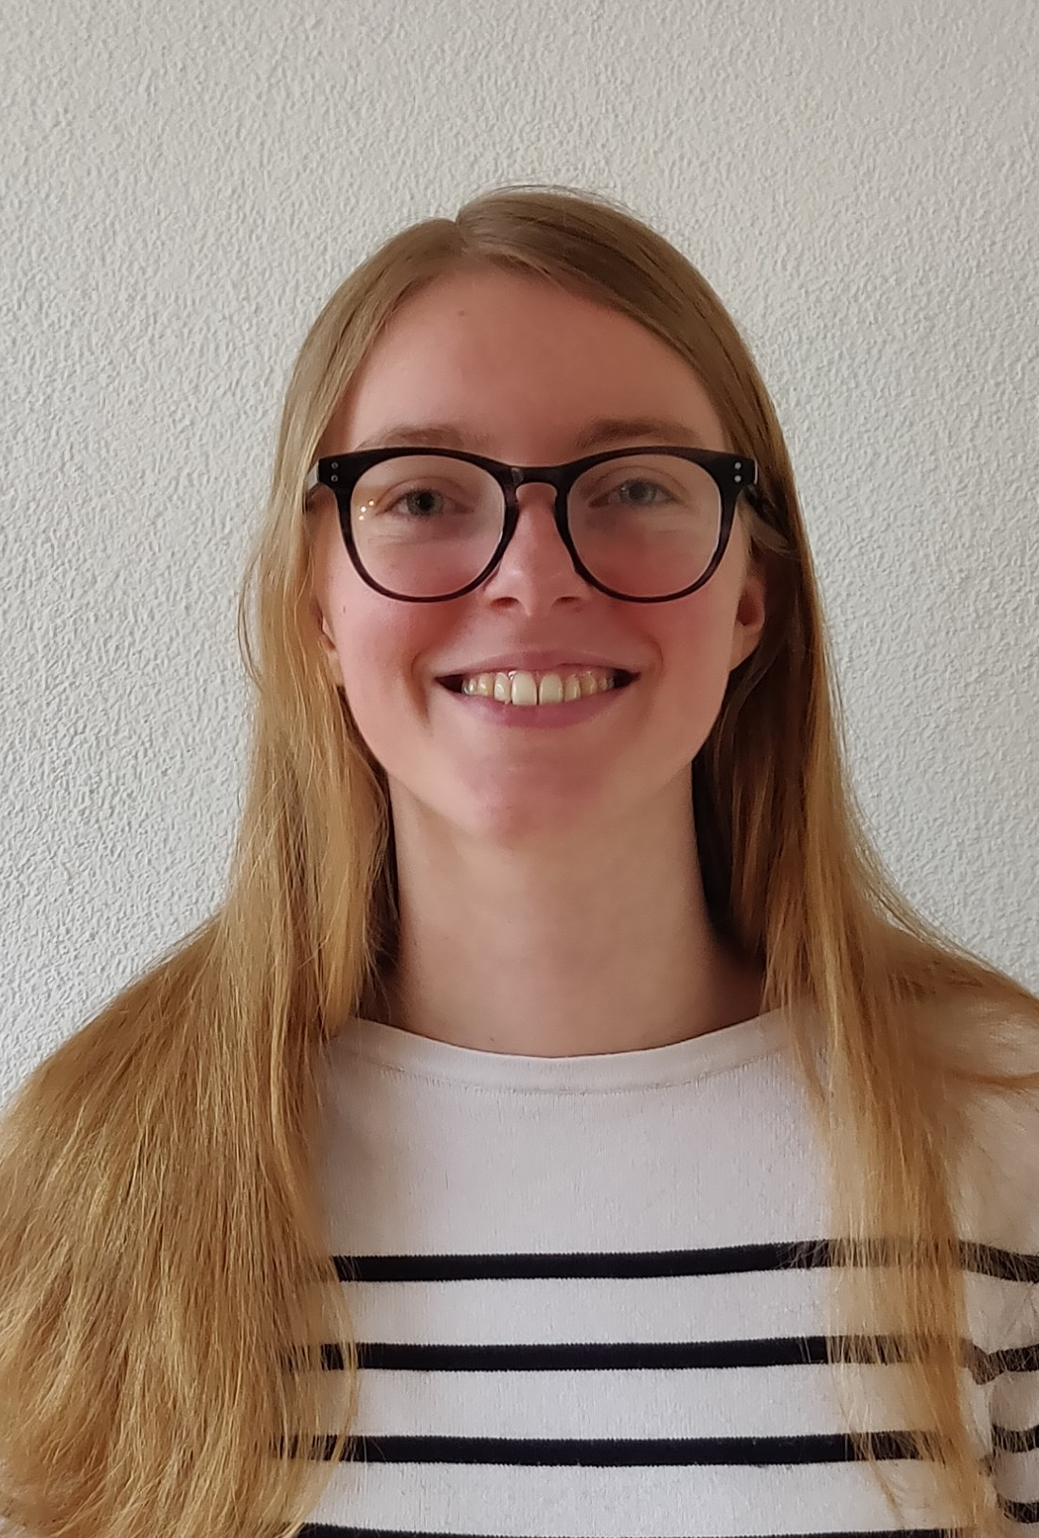
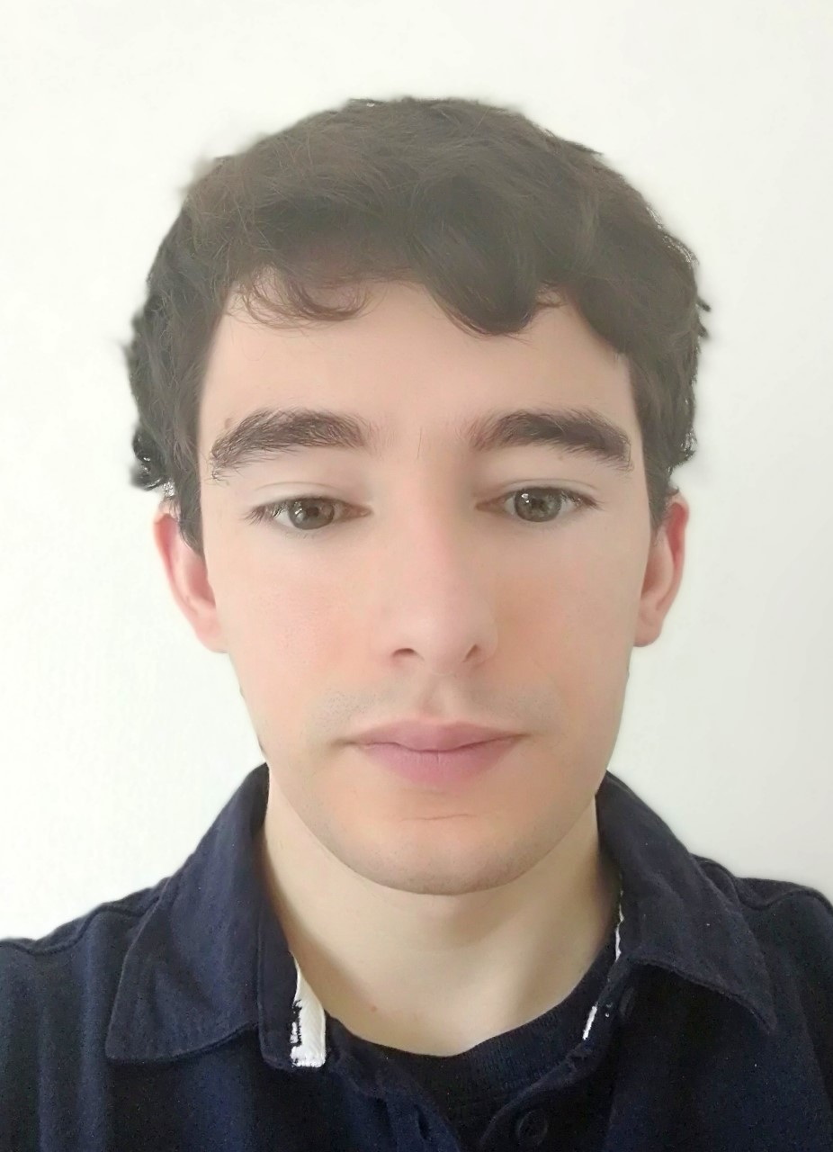
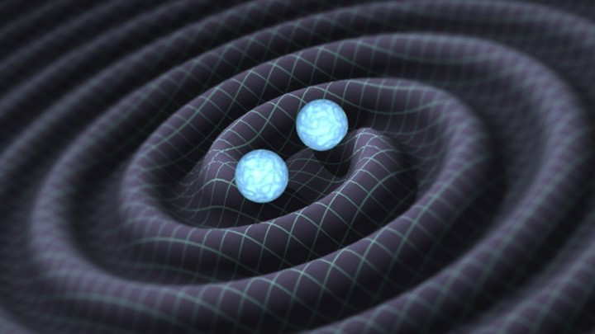
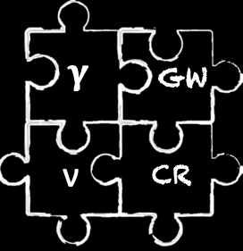
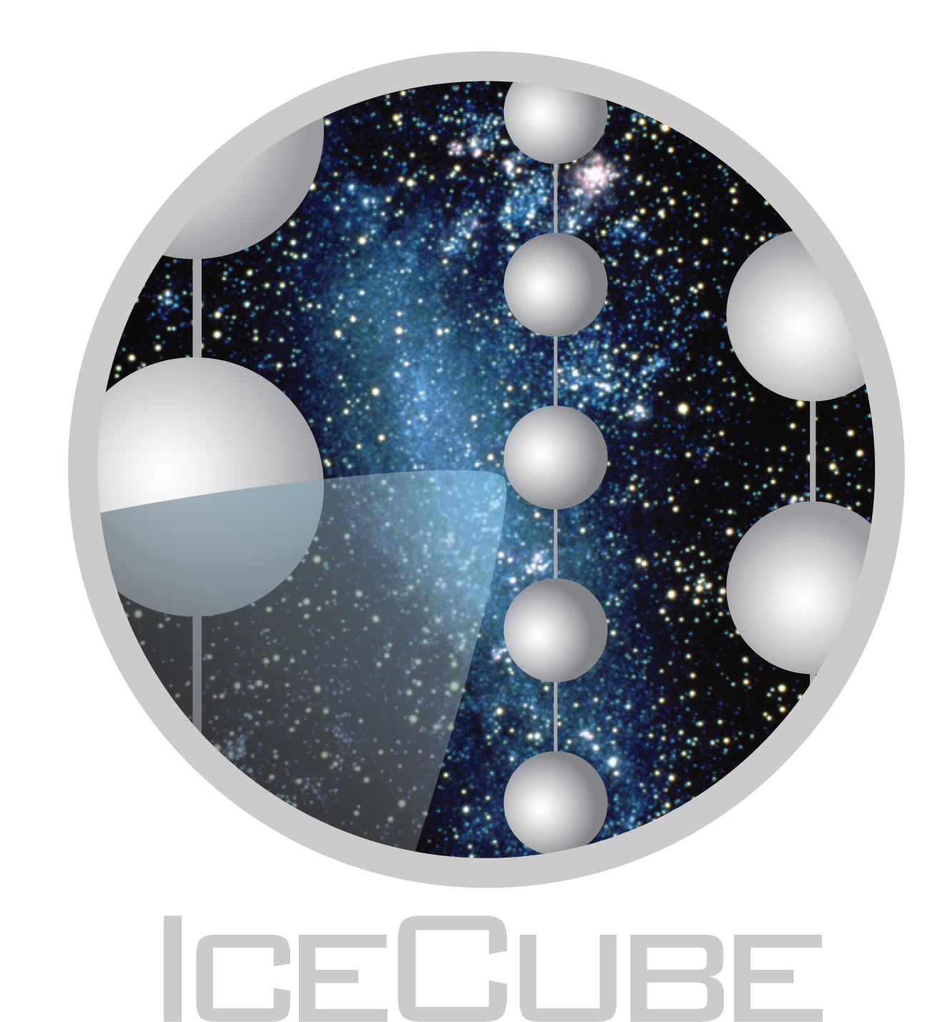
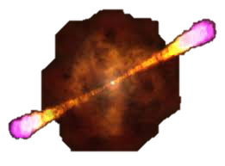
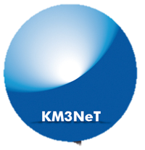
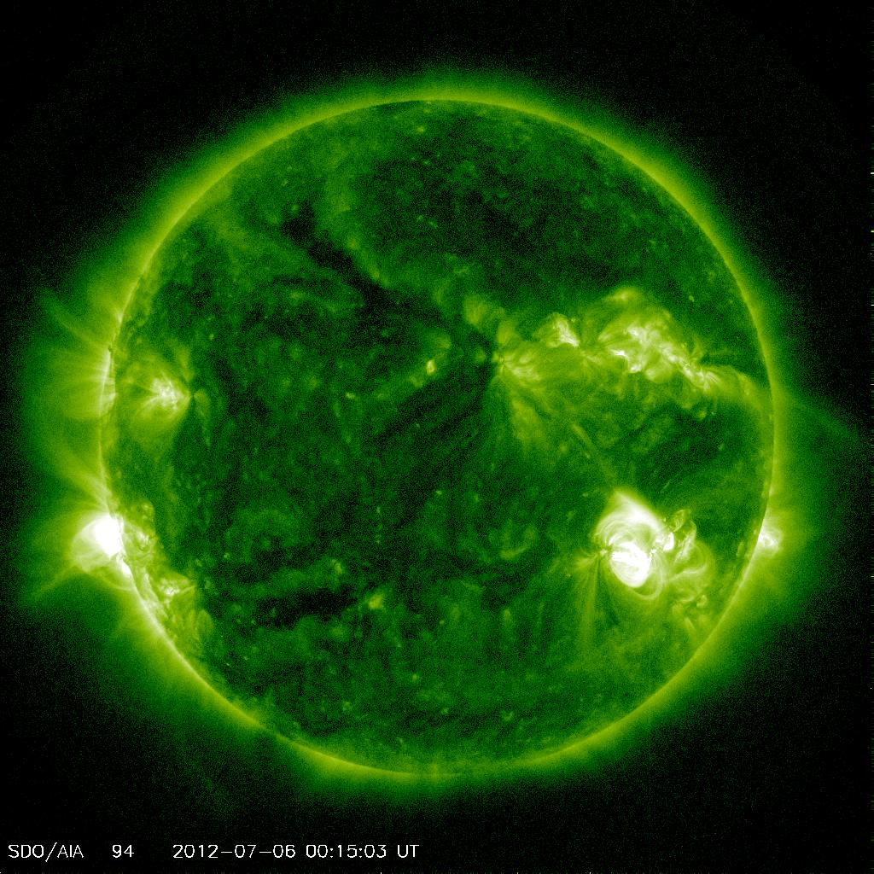
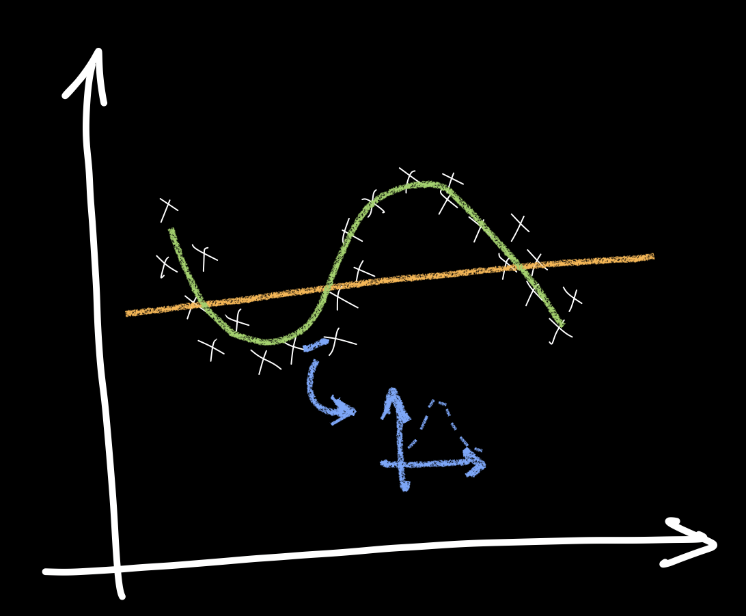
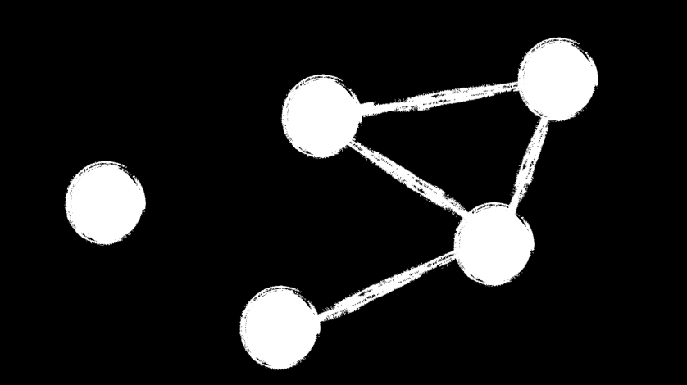
Neutrino
In short:
- Reconstruction tools
- Event selections
- Data analyses
- Alert systems
- Science communication
Data science
tools
Astrophysical transients

Slide 4
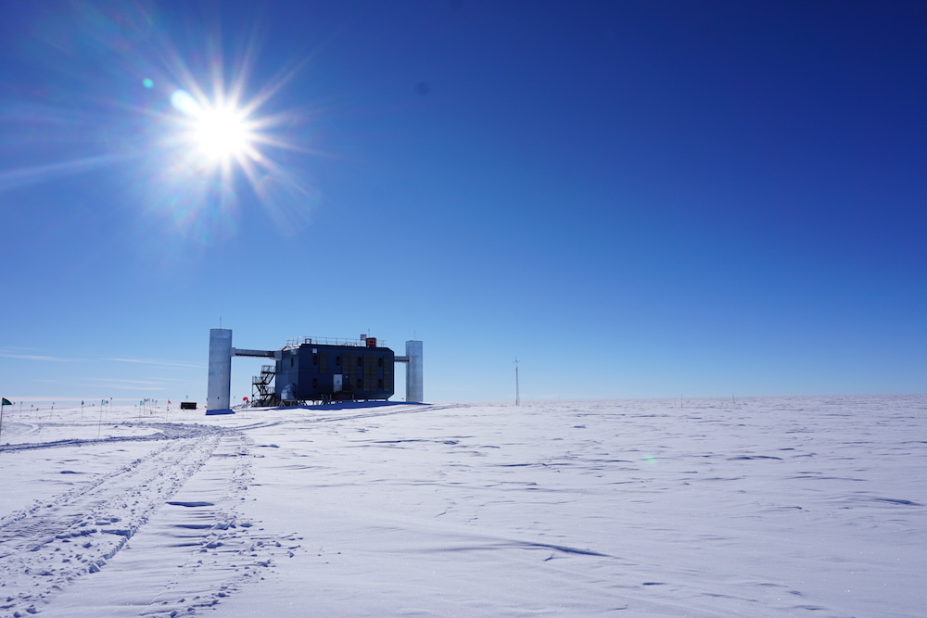
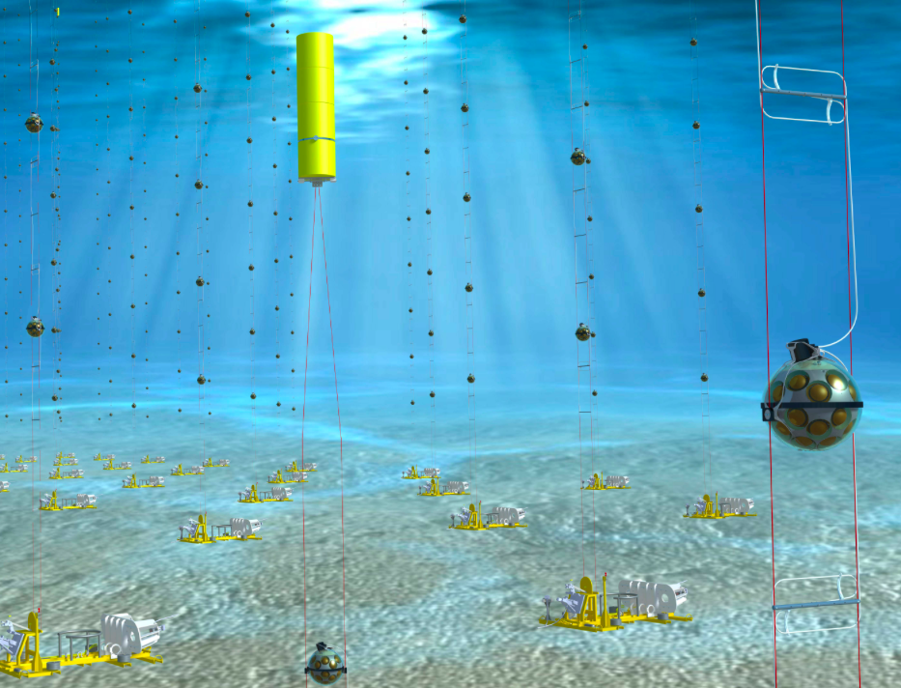
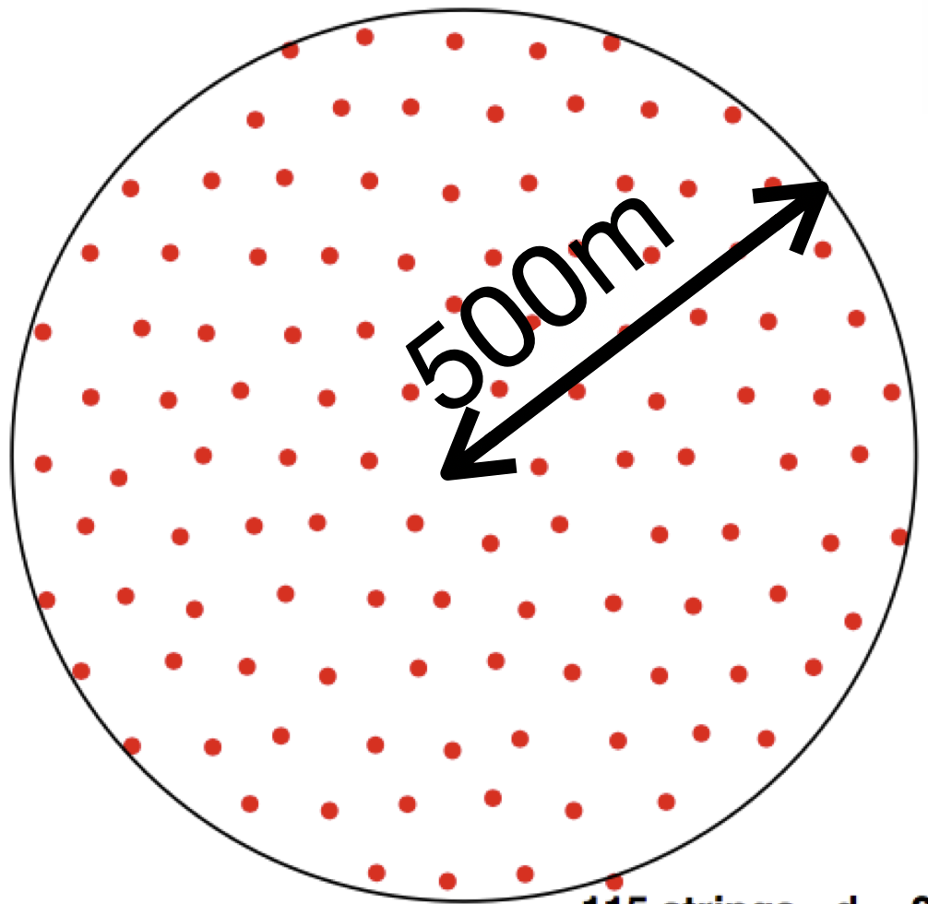
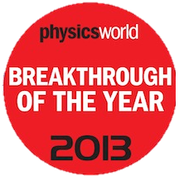
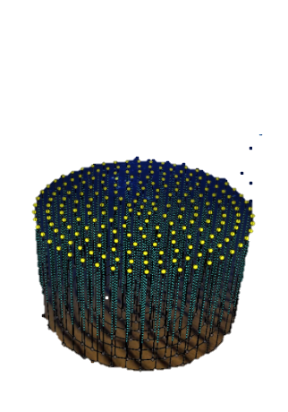
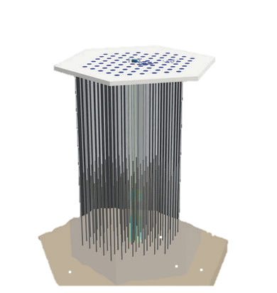
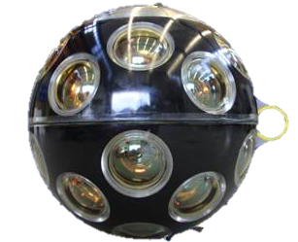
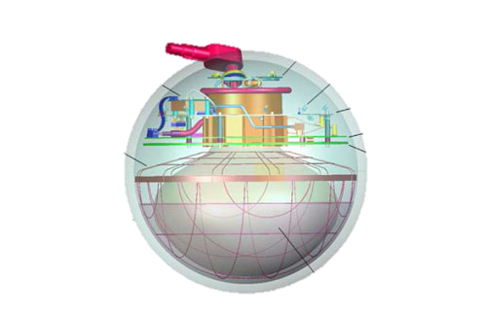
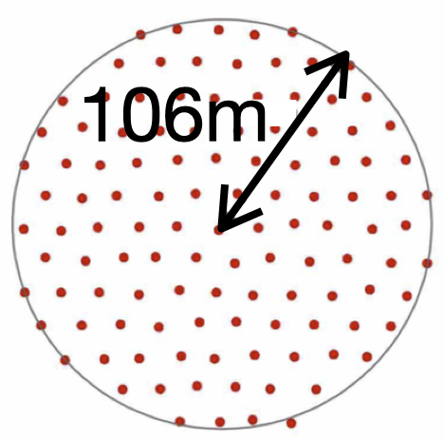
IceCube Neutrino Telescope
South Pole,
Antarctica
KM3NeT
Mediterranean Sea,
France and Italy
ARCA
ARCA
8 ARCA in operation
+ 15 in April
2070 sensors/block
5160 sensors
6 ORCA in operation
+ 7 in November
+ 2-3 in April
1 km³
Running for 10 years in its full configuration
Coming extensions:
Upgrade + Gen2
Final configuration:
ORCA 115 Detection Units (DUs)
ARCA 2 X 115 DUs
ORCA

Slide 5
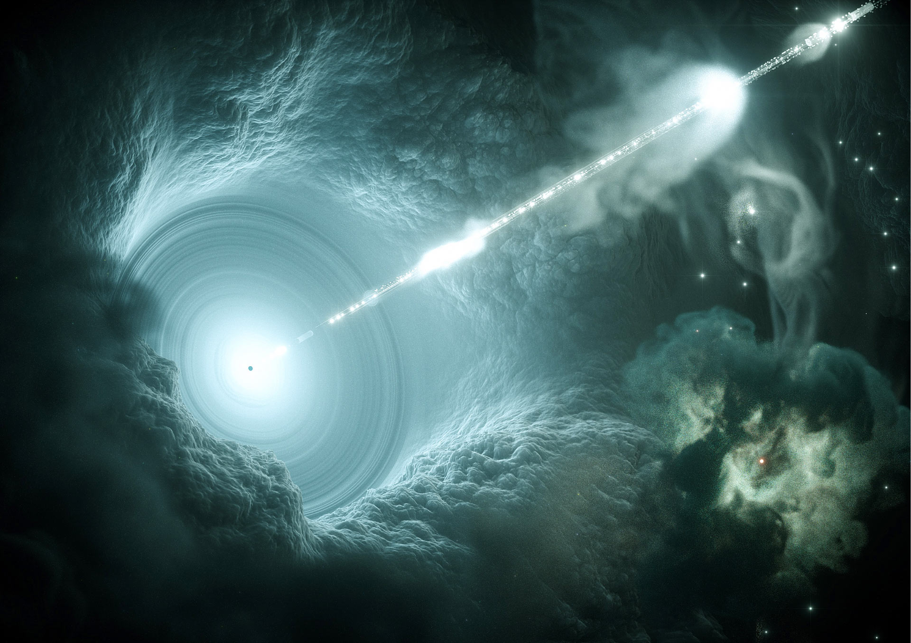
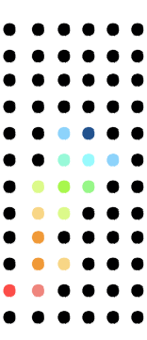
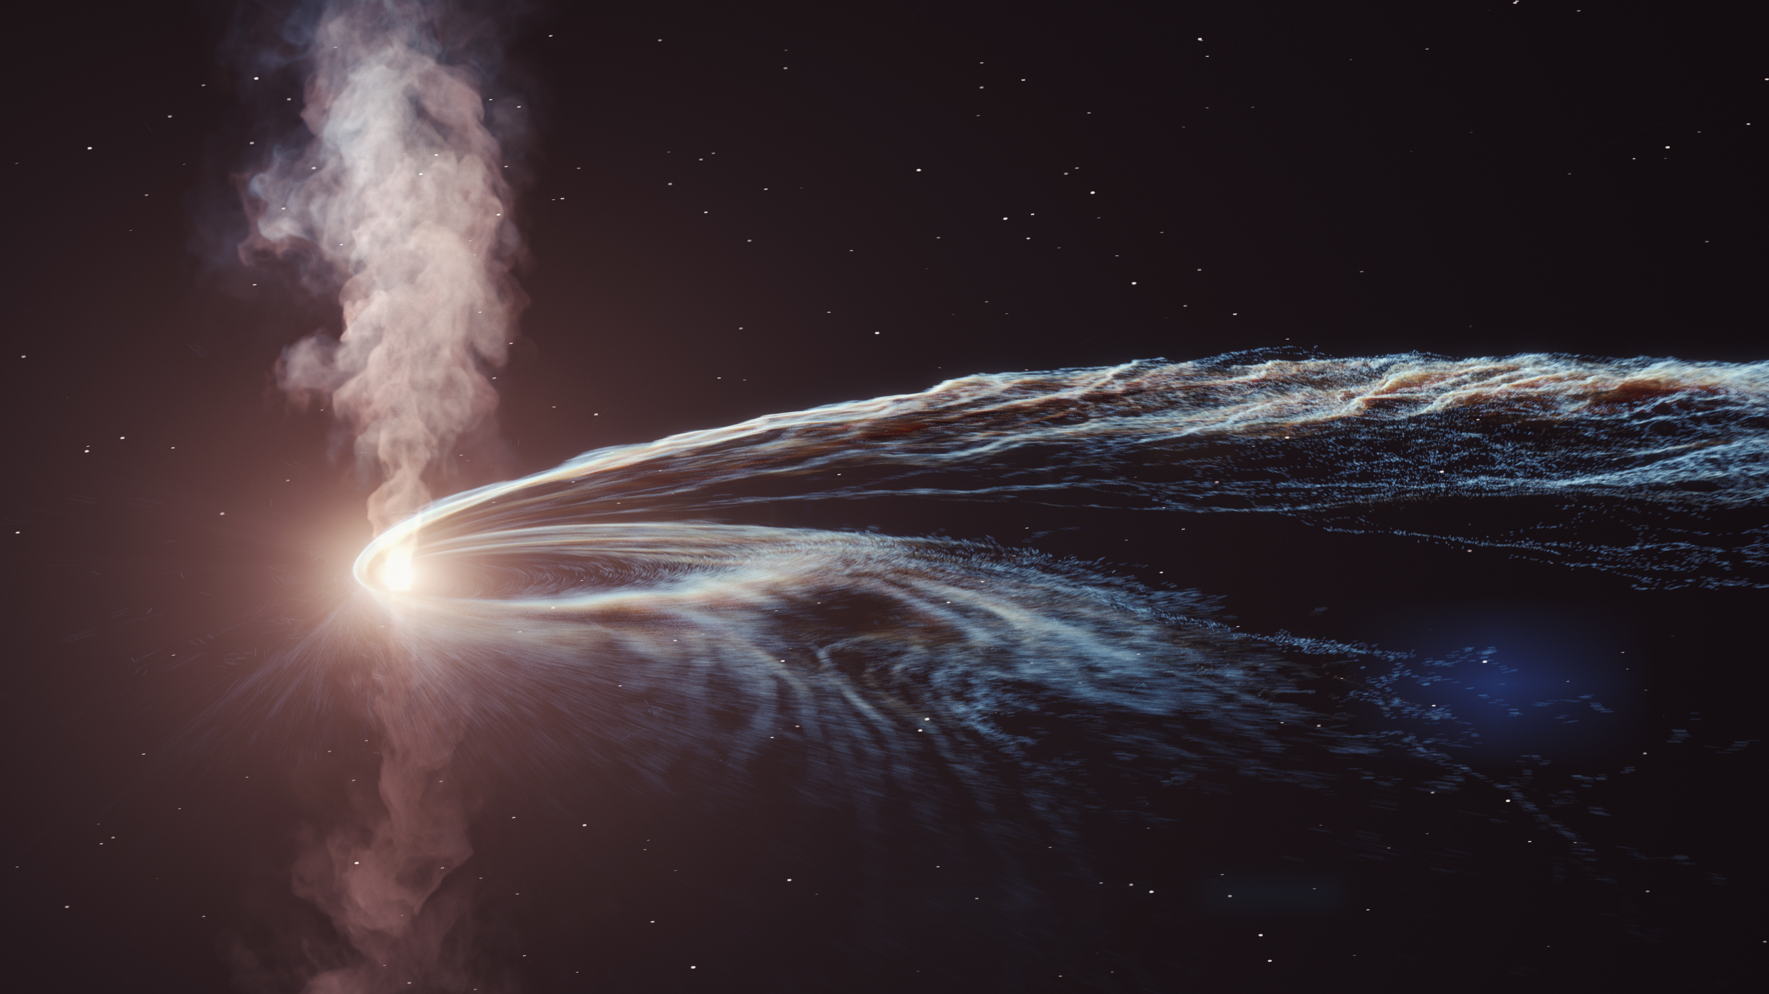
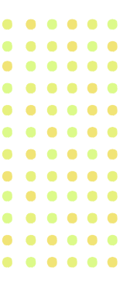
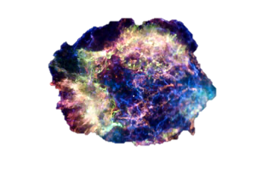
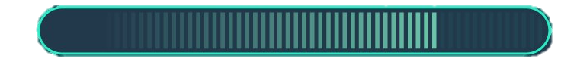
Flaring Blazar
Tidal Disruption Event
Identification of other sources
Loading
Core Collapse Supernova

Slide 6
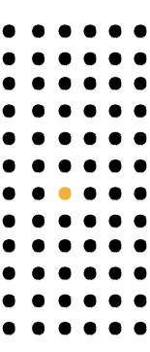
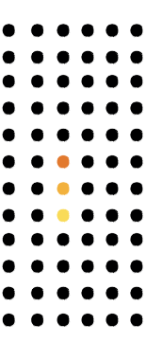
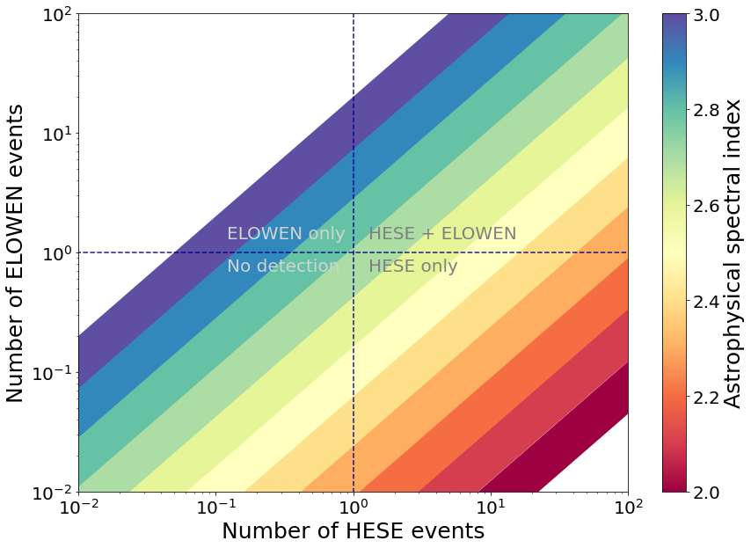
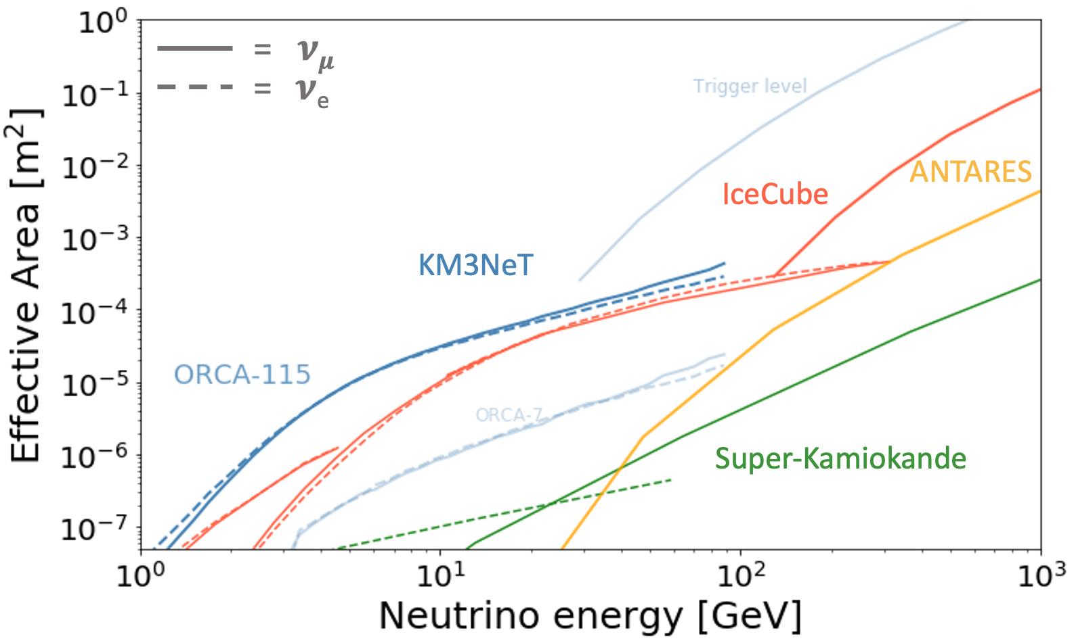
ORCA
ARCA
ORCA
IceCube
ORCA
Upgrade
Mainly coming from pn instead of pɣ
1
E
Why going to lower energies?
0.5-5 GeV
2
3
TeV-PeV scale

Slide 7
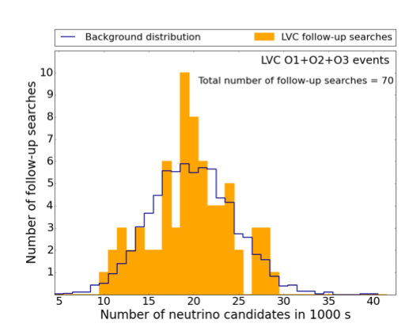
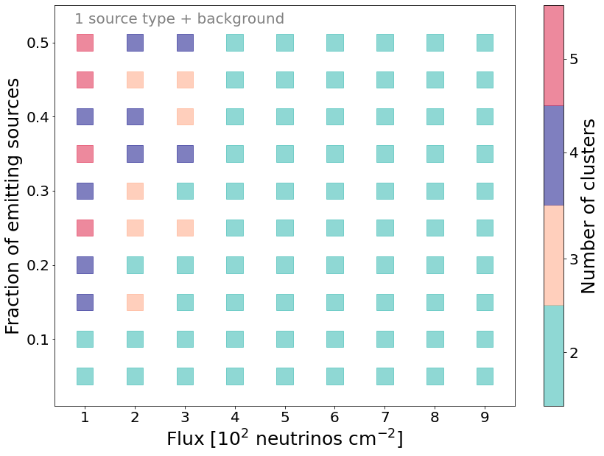
Compact binary mergers
Background distribution
Upper limit
GW followup
Sensitivity
p-value = 5%
+
Combination of different sites
= reduce the background
+ boost the astrophysical signal

Slide 8
Muography

Slide 9
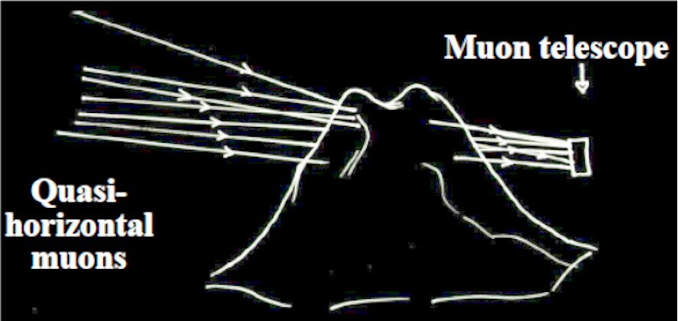
The CP3 muography team
https://cp3-git.irmp.ucl.ac.be/muographycp3
Samip Basnet (PhD student)
Eduardo Cortina (Professor) - also NA62
Ishan Darshana (PhD student)
Andrea Giammanco (Senior researcher) - also CMS
Raveendra Karnam (Postdoc)
Maxime Lagrange (PhD student)
Marwa Moussawi (PhD student)
Ilker Topuz (PhD student, jointly with Tartu & GScan)
New postdoc funded by SilentBorder (H2020 project)
(+ part-time contributions by other CP3 staff)

Slide 10
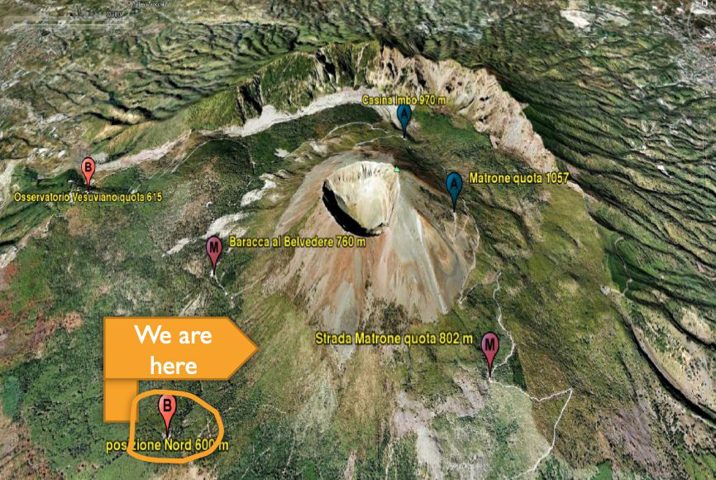
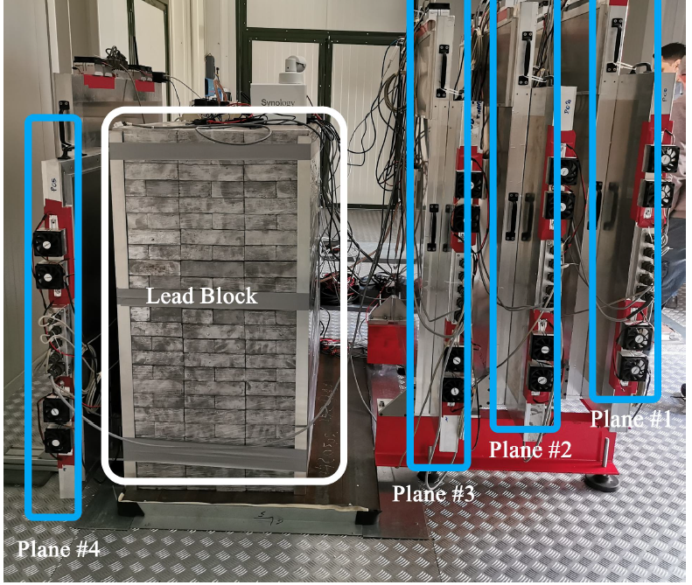
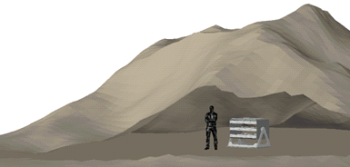
Muography to keep an eye on Mt. Vesuvius
Members of CP3 are participating to the MURAVES experiment in Italy: MUon RAdiography of VESuvius, taking data since Dec. 2019
MURAVES is a consortium of volcanologists of INGV and physicists of INFN, University Federico II Naples, University of Florence, UCLouvain (since 2019), UGent (since 2019)
CP3 is taking care of end-to-end Monte Carlo simulations, and some analysis tasks.

Slide 11
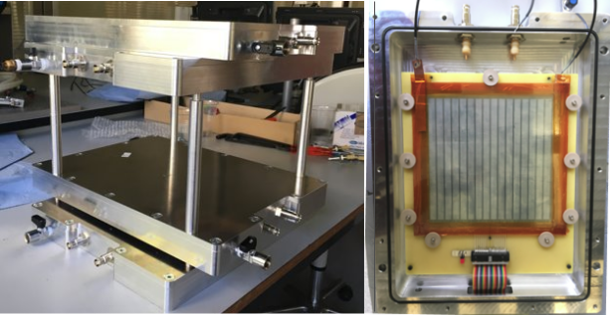
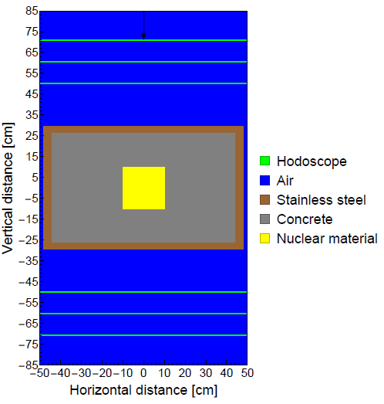
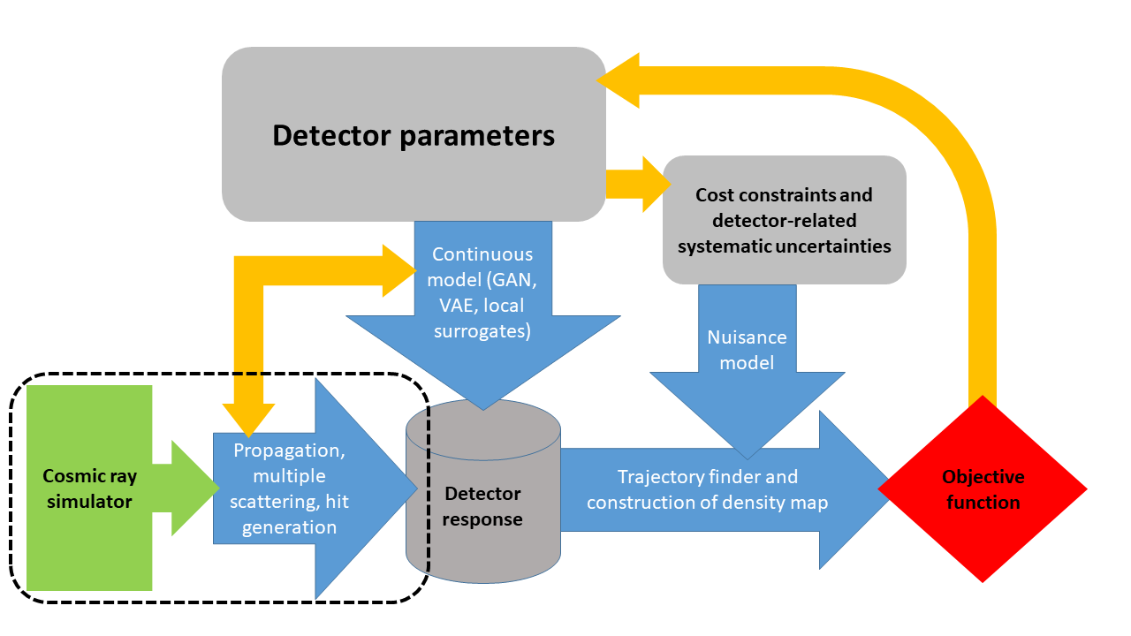
Portable muon telescope
Modular, compact, light detector based on Resistive Plate Chambers;
Use cases: confined spaces with unfriendly logistics;
Local R&D project for detector and electronics;
Very recently submitted two patents related to this project.
MODE collaboration:
  Machine-learning Optimized Design of Experiments
  Developing general parametric simulation pipeline for muon tomography case studies

Slide 12
Gravitational wave research

Slide 13
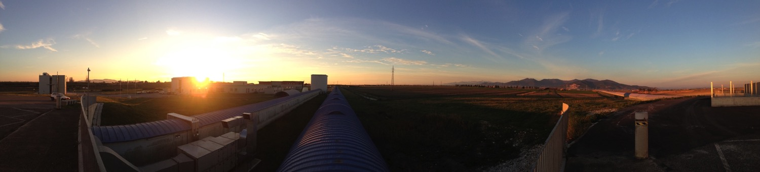
The CP3 gravitational wave team
  Permanent staff: G. Bruno (V, A), C. Lauzin(I), C. Ringeval (T),
  J. van Heijningen (V, I)
  Support: A. Tanasijczuk (V, computing)
  Postdoc: P. Auclair (Th), F. Badaracco (V, I), E. Ferreira (I),
  A. Miller (V, A), M. Sieniawska (V, A), J. Suresh (V, A),
  D. Da Cunha (Th)
  PhD student: R. Cabrita (I, V), A. Depasse (V, A), F. De Lillo (V; A)
V = Virgo Member
A = Analysis
Th = Theory
I = Instrumentation
13

Slide 14
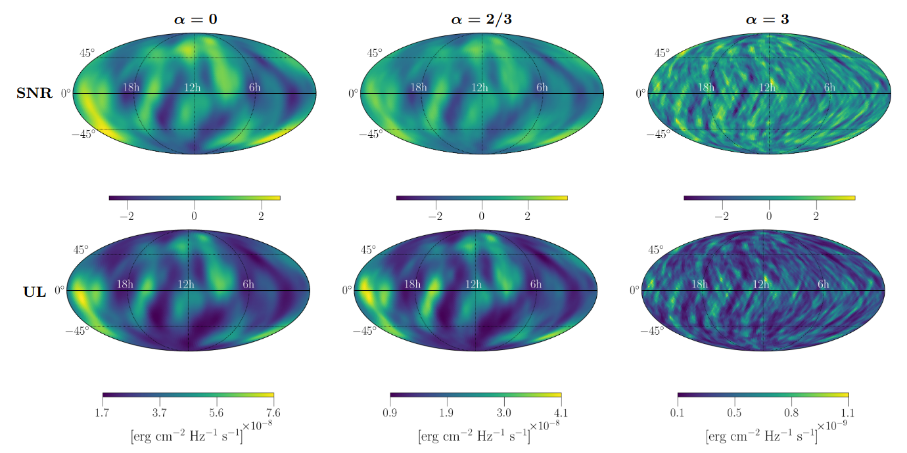
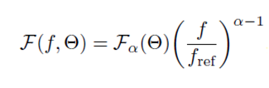
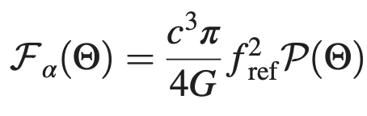
Anisotropic search in the stochastic GW background
The SGWB is a superposition of unresolved sources;
Searches by correlating detector outputs;
  Anisotropic: spherical harmonics (extended sources), broadband radiometer (point-like sources), narrowband radiometer (point-like, known sources);
  Also search for specific
  signatures of cosmic
  strings models.
Federico De Lillo
Jishnu Suresh
GW flux using O1,O2,O3
from LIGO only and GW energy flux model:
, with
LVK collaborations, arXiv:2103.08520
14

Slide 15
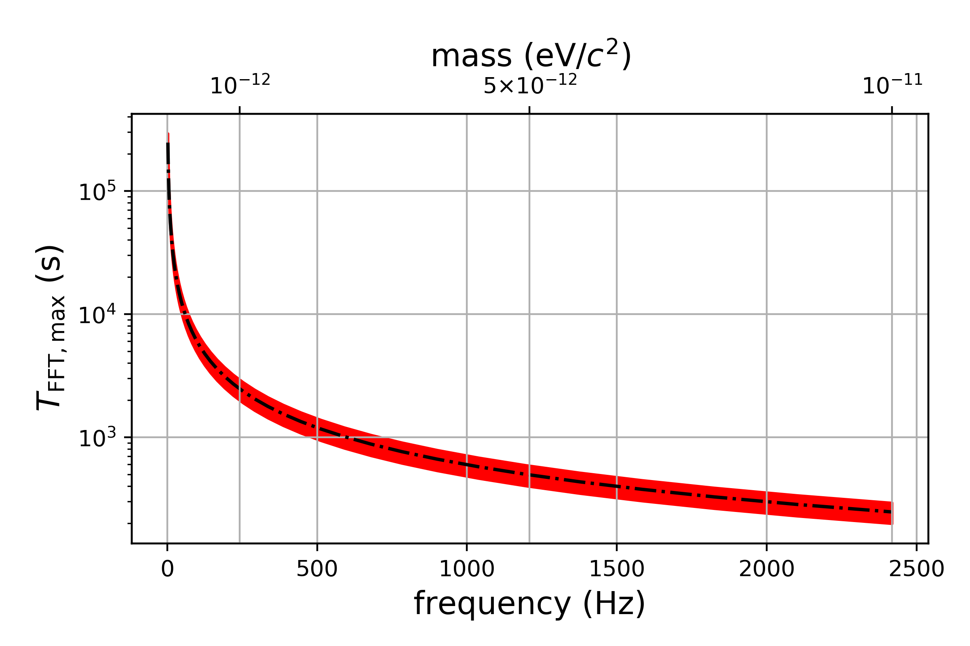
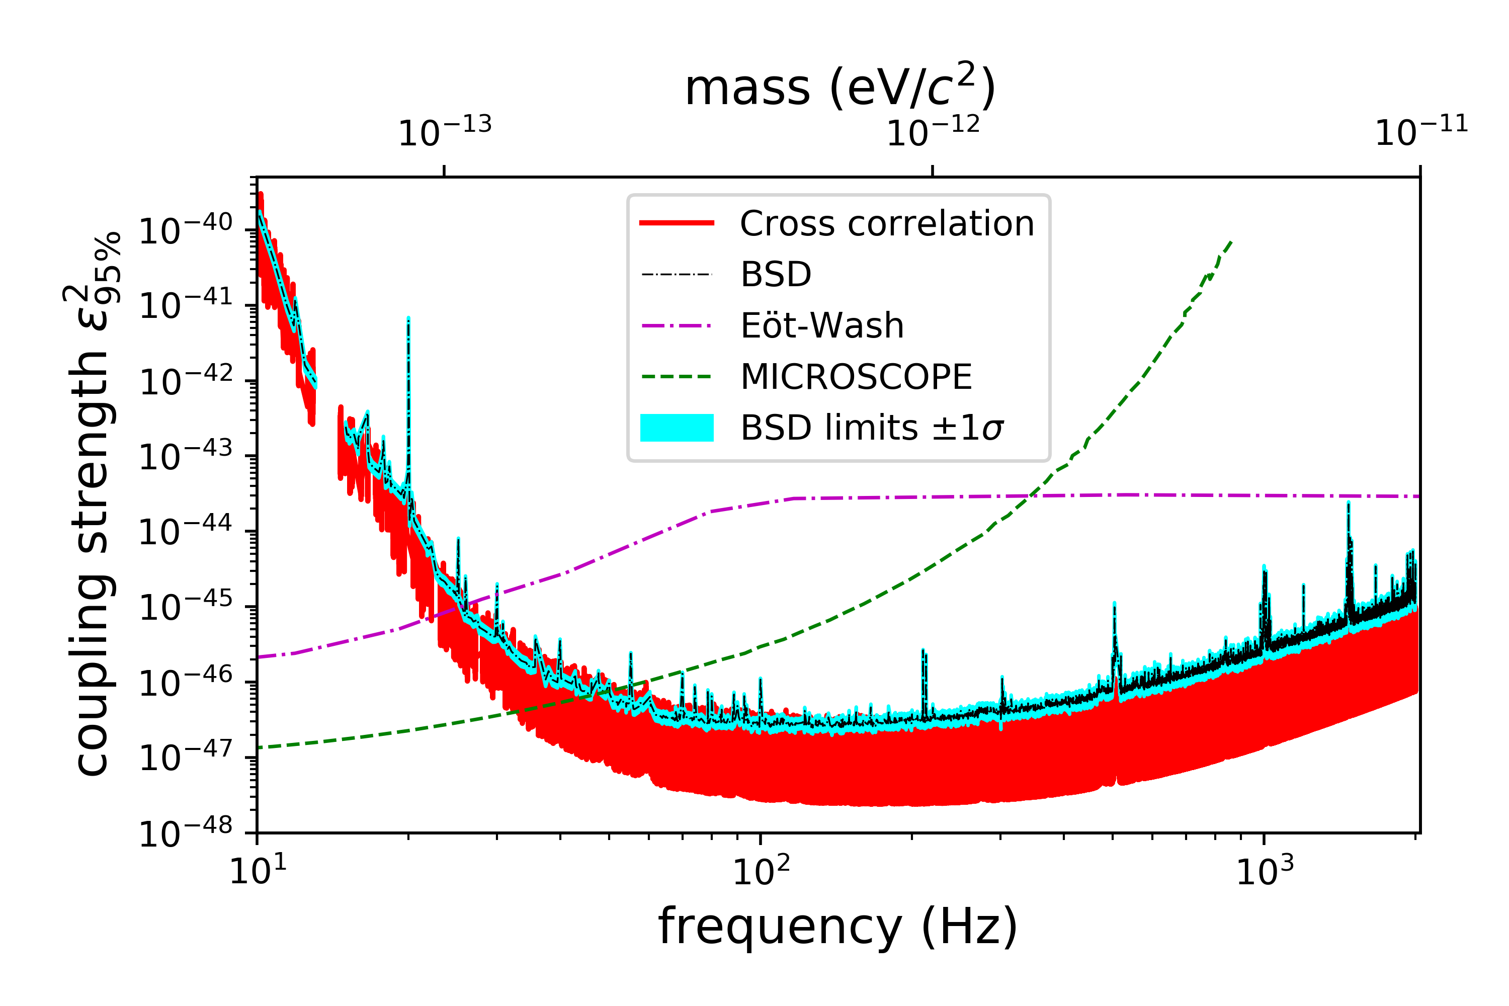
Searching for dark photon dark matter
Developed a method that carefully varies the Fast Fourier Transform length as a function of the expected frequency modulation caused by a dark photon signal;
Ran a search for dark photon dark matter in LIGO/Virgo/KAGRA data using a cross-correlation and excess power method (BSD), producing the best constraints on the coupling of dark photons to baryons for a wide range of ultralight dark photon dark matter;
Developing Wiener filter method to
distinguish among types of dark matter
interactions and better follow-up
candidates returned in future searches
(📝 Miller and Badaracco, in prep.)
Miller et al., PRD 103.10 (2021)
FFT length accounts for Maxwell-Boltzmann distributed velocities of dark photons, such that this modulation is confined to one frequency bin
Francesca Badaracco
Andrew Miller
Constraints on the coupling strength of dark photons to baryons for each method used in the search, in comparison to existing dark matter experiments
15
Abbott et al. (LVK), arXiv:2105.13085 (2021)

Slide 16
Continuous waves from boson clouds
Dark matter can form clouds around black holes if its Compton wavelength is comparable to the size of the black hole
Boson clouds can emit continuous gravitational waves as they annihilate after superradiance (Ω_{b}< Ω_{BH})
This system will emit quasi-continuous GW;
  ν_{GW} ≈ 2 m_{b} ;
  m_{b} sensitivity around [10⁻¹³ - 10⁻¹¹] eV;
Methods 📝 on vector boson clouds and search in advanced detector data for nearby galactic binaries is planned.
Antoine Depasse
Andrew Miller
16

Slide 17
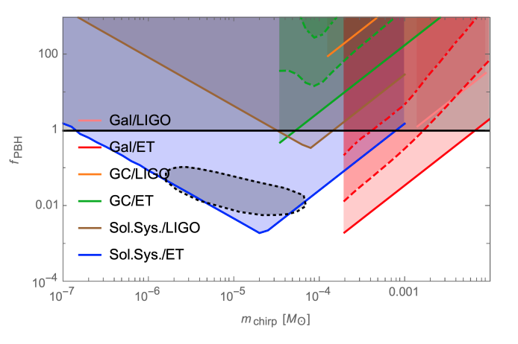

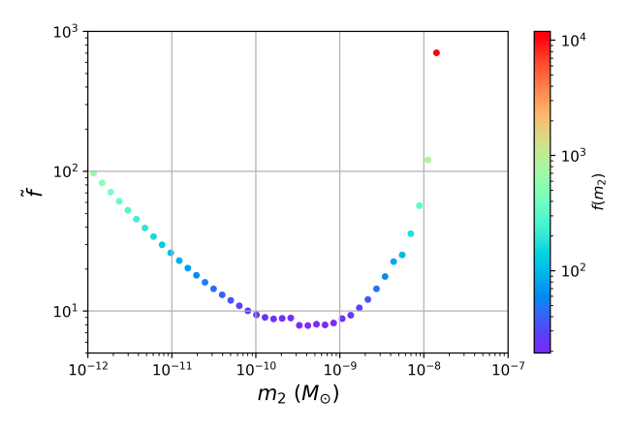
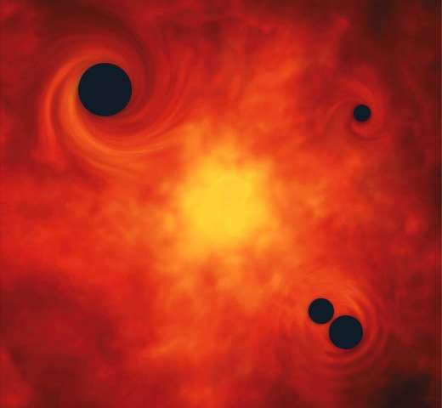
Constraining subsolar PBHs with CW searches
Adapted (Generalized) Hough Transform to search for inspiraling sub-solar systems with chirp masses between 10⁻⁷ - 10⁻³ M_{sun}
  Projected constraints on fraction of dark matter PBHs could compose, f_{pbh}, with Einstein Telescope
Using continuous-wave upper limits from O3a, derived model-independent merger rates, and constrained quantity related to f_{pbh} for chirp
masses of 10⁻⁷-10⁻⁴ M_{sun} for equal-mass and asymmetric mass ratio binaries
Working on applying the Hough to “mini-EMRI” systems detectable with LIGO/Virgo
(with H. Guo, 📝 in prep.)
Miller et al., Phys. Dark Univ. 32 (2021)
Projected constraints at three distances: solar system, galaxy and galactic center for two PBH mass functions (solid and dashed lines)
Federico De Lillo
Andrew Miller
Sebastian Clesse (ULB)
Miller et al., arXiv:2110.06188 (2021)
Actual constraints from O3a upper limits m₁=2.5 M_{sun} f(m₂): PDF for m₂; assumes f(m₁)=1 and no rate suppression
17

Slide 18
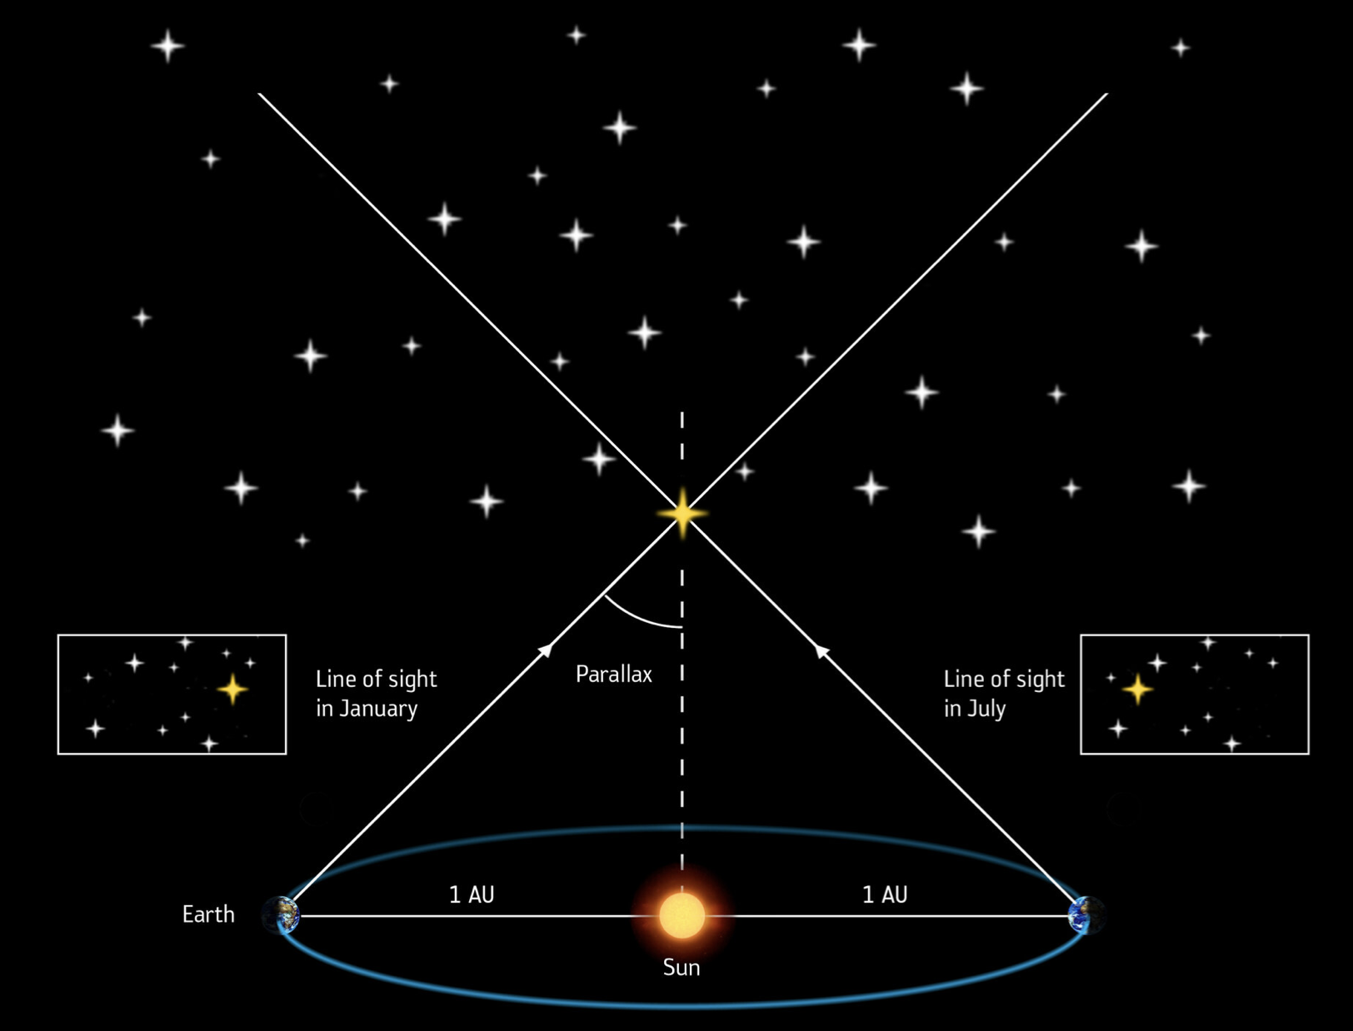

Gravitational wave parallax
Magdalena Sieniawska
Andrew Miller
Distance estimation method for the continuous gravitational wave sources;
Suitable for the near sources (how near?);
Is it possible to measure parallax with the Frequency-Hough analysis method?
What search grid/sky resolution do we need?
18

Slide 19


Stochastic GW Background from Cosmic Strings
Topological defects that could have formed in the early Universe;
Predictions on average GW energy density in the universe from cosmic strings.
C. Ringeval and T. Suyama JCAP12 027 (2017)
Christophe Ringeval
Disrael da Cunha
B.P. Abbott et al., Phys. Rev. Lett. 118, 121101 (2017)
19

Slide 20

Computing efforts for the LIGO Virgo collaboration
June 2020 LIGO/Virgo CPU hours accounting (core hours)
Virgo online computing at EGO;
  Data collection, calibration and monitoring (O(10⁵) auxiliary channels)
  DetChar and data validation
  Low-latency searches (for public alerts)
Virgo offline computing at several centers, including UCLouvain;
  Common distributed computing
  Contribute CPU for opportunistic use
Our WLCG Tier2 accepts LVK
jobs and was extended with
512 CPUs in March 2021 (ARC funded, +funding requested);
https://github.com/AndresTanasijczuk/SlurmDagman
StashCache origin deployed at UCLouvain in 100 TB storage server (ARC funding) – data transfer tests ongoing
Andres Tanasijczuk
20
Notes:
- Enabled the UCLouvain WLCG Tier2 to accept LIGO/Virgo jobs via OSG grid. The LIGO/Virgo grid jobs use our resources opportunistically. We plan to extend our cluster with ~500 worker nodes for Virgo in ~June 2021.
- For users that can not run their analyses on the grid: Our cluster uses the SLURM batch system. Most LIGO/Virgo analyses either use the HTCondor batch system or at least need a way to manage job dependencies in a DAG (HTCondor DAGMan). We developed an application to manage a DAG of jobs in Slurm (https://github.com/AndresTanasijczuk/SlurmDagman).
- For users that need more computing resources (or higher priority access) than available on the grid or in UCLouvain, we enabled submission from Louvain to the CNAF HTCondor cluster.
- Starting to test the deployment of a StashCache Origin server in UCLouvain. Will be used to host (a copy of) the Virgo h(t) data, which are then made available to users via CVMFS (Cern VM File System). Current server hosted in Nebraska. Plan to have a duplicate server in Brussels.

Slide 21






Benchtop suspensions for ETpathfinder
Detection bench
LIGO example
Nicolas Szilasi
Hervé Laurent
Joris van Heijningen
Detection bench layout
21

Slide 22






Mode mismatch mitigation for Advanced Virgo
Ricardo Cabrita
Joris van Heijningen
Setup at UCLouvain to test MM techniques at 1550nm;
Phase camera to indentify out-of- phase cylindrical modes.
Mode matching (MM)
Gaussian funda-
mental mode
First order cylin-
drical mode
mode converter
K. Agatsuma et al., Opt. Express 27, 18533-18548 (2019)
Contibute to interferometer
control with & team;
22
Notes:
Relate PC observables to interferometer conditions.
Generate error signals for the Thermal Compensation system.
Understand the phase maps and use them for mode content analysis.

Slide 23





Cryogenic inertial sensors for E-TEST
Mechanics made out of Niobium (Nb), fully superconducting at T = 5 K;
We expect fm/√Hz sensitivity from 1 Hz onwards, interesting for ET and LGWA;
Can monitor impact of cryocoolers.
J. Harms et al., ApJ 2021 910 1
passive
isolation
stages
🌖
Elvis Camilo Ferreira
Francesca Badaracco
Nicolas Szilasi
Joris van Heijningen
cryostat
cold
platform
Silicon
mirror
100+kg
active
isolation
platform
A. Bertolini et al.,2006, NIM A, 556, pp 616-623
JVvH, 2020, JINST 15 P06034
23

Slide 24







Current research on inertial sensor
Collaboration with Innovative Coating Solutions (Belgium) for custom superconducting coils.
x
Coil-magnet
Superconducting coil
samples
Now (magetron) sputtering Nb and NbN
Superconductivity collaboration and testing with Andrea Perali (UniCam) and Filip Tavernier (KULeuven), respectively
Using polarizing optics, all light ends up at PDs, so 41% less shot noise at same input power and less heat load.
Magnetic pressure on proof mass by Meissner effect

Slide 25
Astroparticle physics at UCLouvain’s CP3
11th CosPa meeting | ULB | Brussels | 29.10.2021
Astroparticle Cosmology
Compact
sources
Environmental
studies
Primordial sources
Muography Gravitational waves
Gwenhaël de Wasseige and Joris van Heijningen
on behalf of many researchers at UCLouvain

