Slide 1
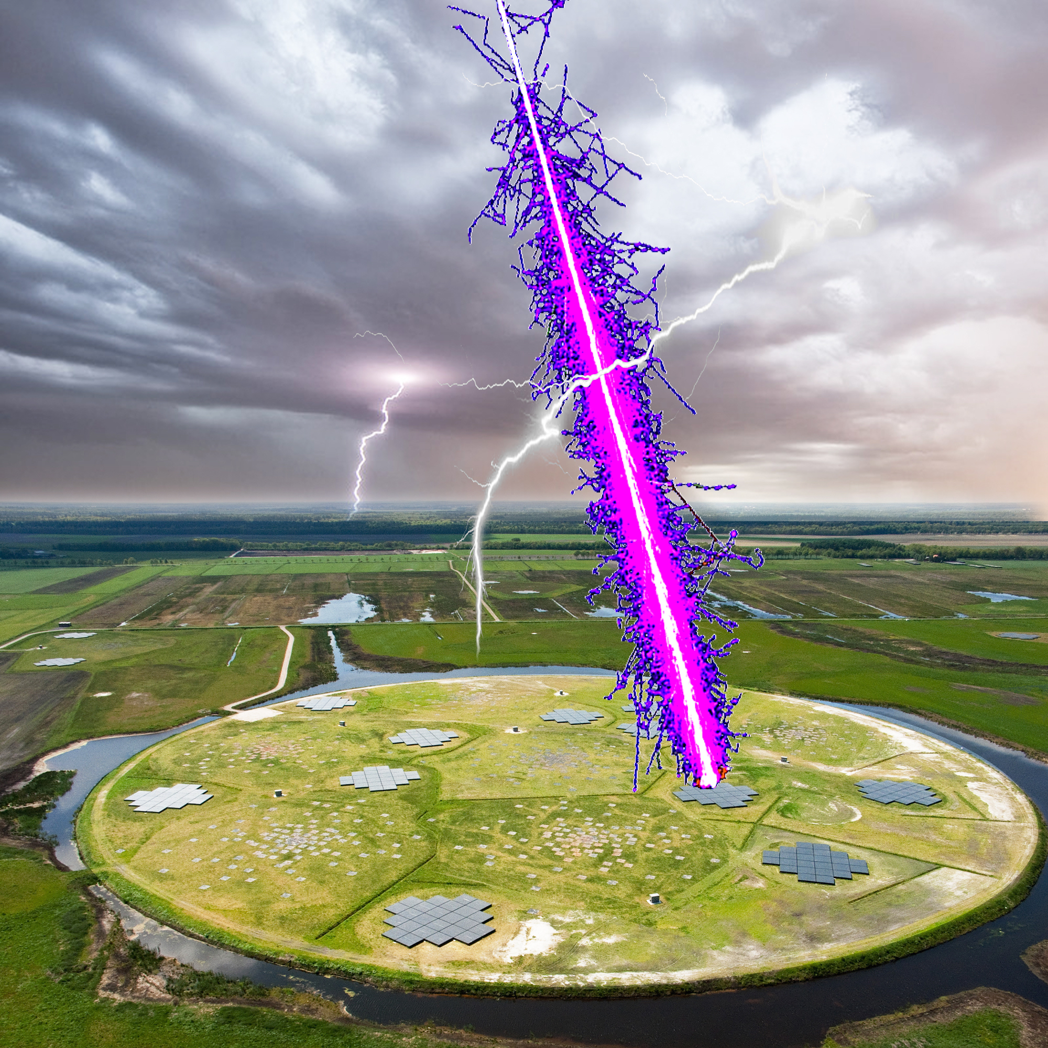


Radio detection of cosmic particles
A historical overview and theory
Olaf Scholten

Slide 2
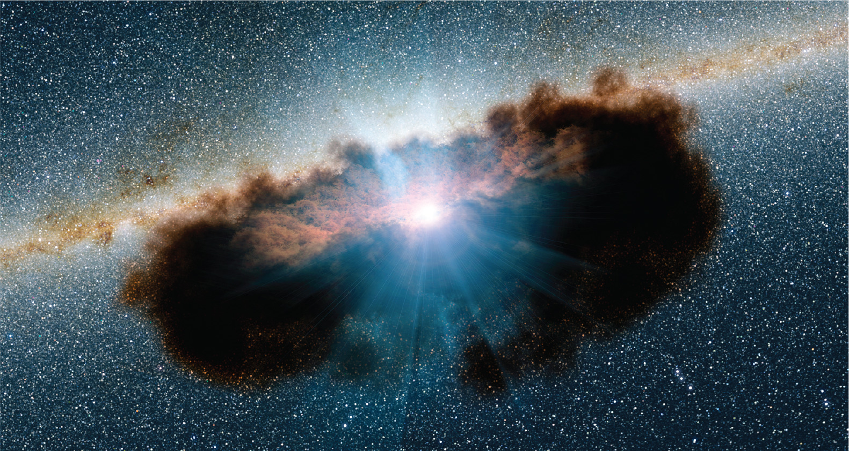
Why UHECR & UHEν radio frequency detection?
Towards multi-messenger astronomy
Prime example: Icecube Science article:
Want to improve statistics & pointing accuracy
M77 ‘Squid’ UHEν
Peak intensity of UHEν from UHEν
IceCube:
Neutrinos unveil hidden galactic activities
An obscured supermassive black hole may be producing high-energy cosmic neutrinos

Slide 3
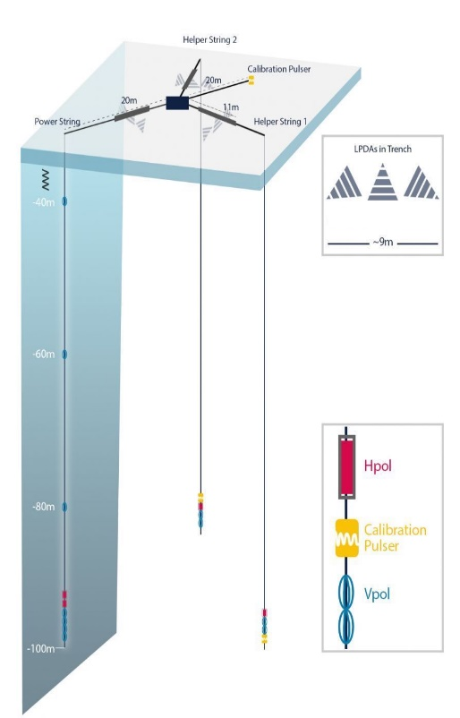
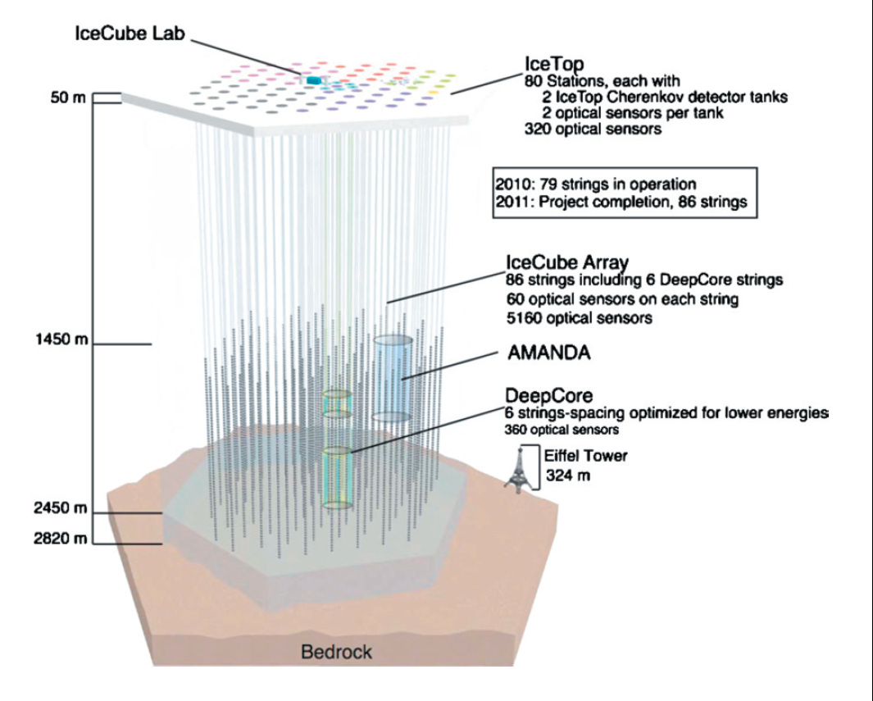
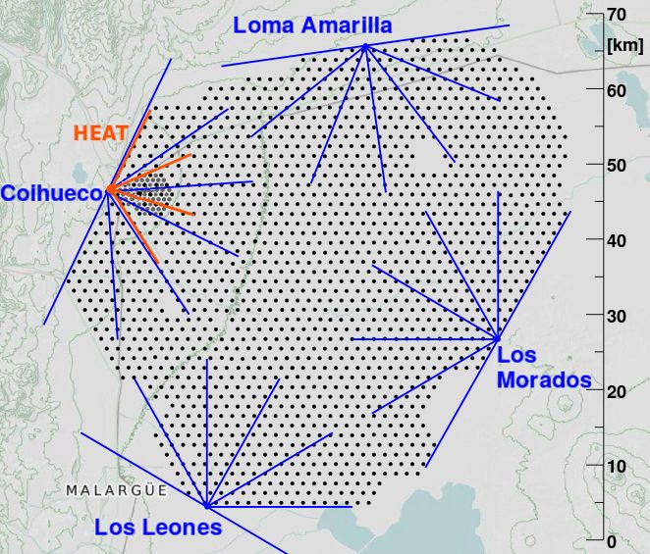
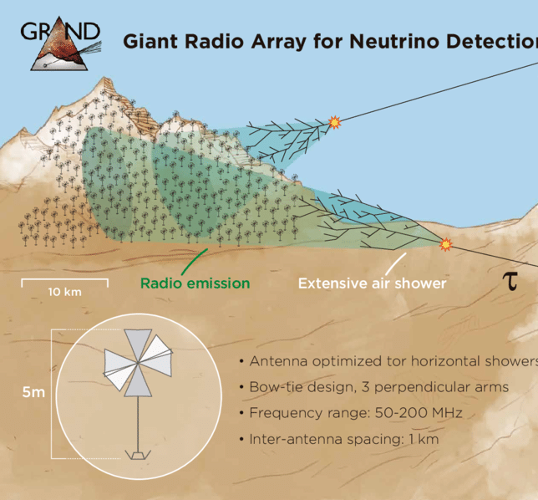
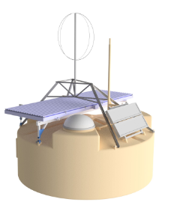
Statistics, thus large detectors: use radio emission from UHE-CR and -ν
Radio Frequency (RF):
  Simple, cheap detectors
  RF waves are not attenuated in air & ice
Recent:
add-on or driving technology of major experiments, such as
RNO-G & IceCube
Pierre Auger Observatory
Grand

Slide 4
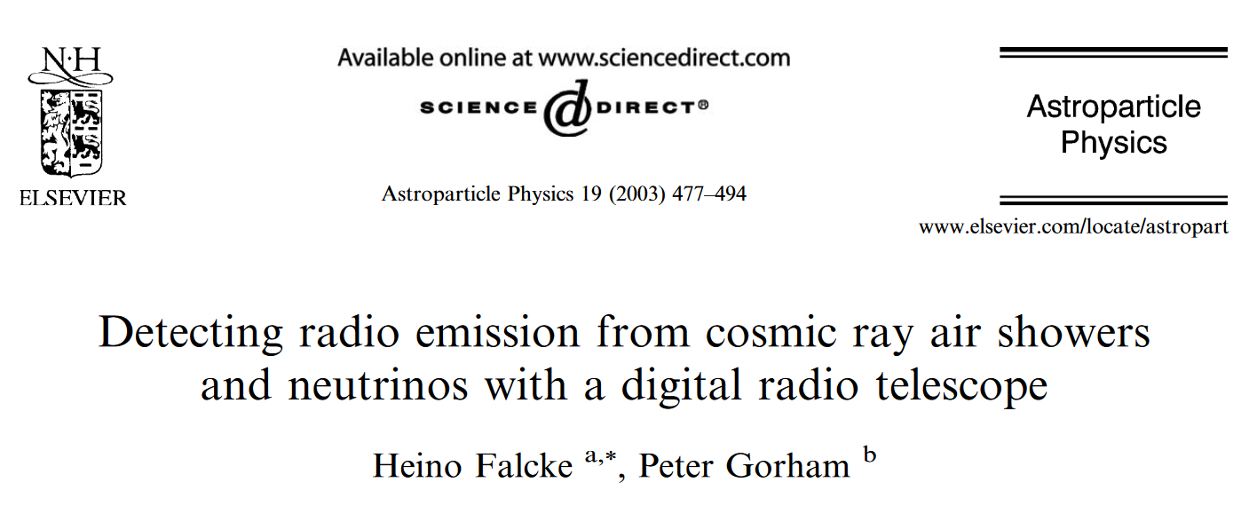
Radio frequency observations
Jelley et al. 1965; Allan & Jones 1966: first detection of short pulses emitted by cosmic-ray induced air showers.
2003, birth of modern RF air shower detection:

Slide 5
Coherent emission, basic mechanisms
Coherent: intensity ~ (# particles )² ~ (shower energy)²
In medium:
G.A. Askaryan,
Sov. Phys. JETP 14, 441 (1962); 21, 658 (1965)
Askaryan = Charge excess radiation:
- Negative charge buildup at shower front.
- Front moves faster than in-medium speed of light
In air:
F.D. Kahn and I. Lerche, Proc. Royal Soc. A289, 206 (1966)
Geomagnetic = Transverse current:
- Electrons & positrons have transverse drift, induced by geomagnetic field.

Slide 6
Modern modelling of radio signal
Need modelling of VHF emission from showers to extract direction, mass, energy.
A) Forward modeling (discussed here)
Have model for emission of radiation from particle shower and find best fit to data
- Microscopic (add emission from each electron) : CoREAS & ZHAires
- Macroscopic (calculate emission from moving charge cloud): EVA & MGMR
B) Parametrizations of radio footprint
C) Interferometric reconstruction
Trace back signal of each antenna to particle shower.

Slide 7
Microscopic ⬅➔ Macroscopic approaches
Microscopic, full Monte Carlo (ZHAireS, CoREAS):
  Accounts for complete shower physics
  Minimum of approximations
  Monte Carlo based (random value for X_max)
  Very CPU intensive
  Difficult to get insight in physics
Macroscopic, semi analytic (MGMR):
  Not CPU intensive
  Predictive, steepest descent search, applicable to more complicated cases
  Insight in physics, understand importance of shower structure
  Parametrization of shower physics
  Approximations
E. Zas, F. Halzen, and T. Stanev, Phys. Rev. D 45, 362 (1992)
J. Alvarez-Muñiz and E. Zas, Phys. Lett. B 411, 218 (1997)
T. Huege, H. Falcke, A & A 19, 412 (2003)
O. Scholten, K. Werner, F. Rusydi, Astropart. Phys. 29, 94-103 (2008)

Slide 8
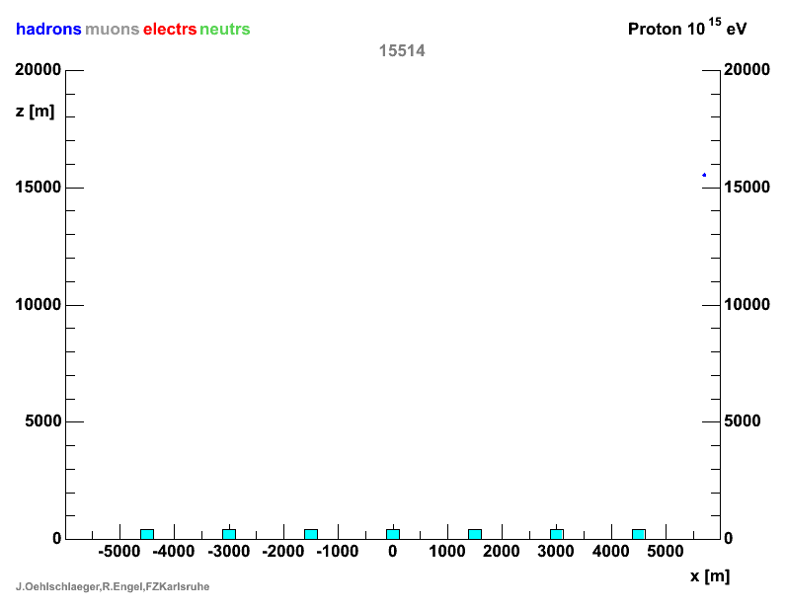
General mechanism of Radio emission
In medium (ice or rock):
Askarian effect (charged particle moving faster than in-medium speed of light)
Corsika airshower
In air:
Askarian & Geomagnetic effects
(electric current induced by Lorentz force)

Slide 9
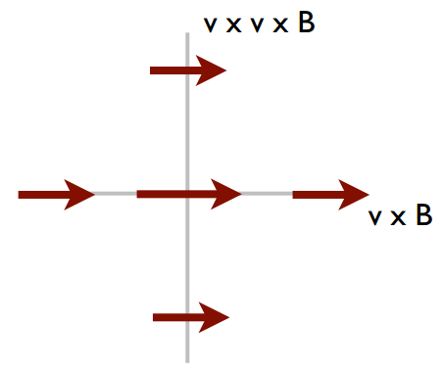
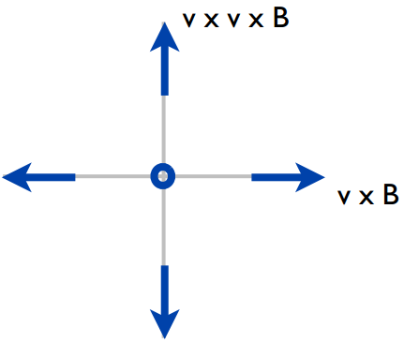

Two mechanisms can be distinguished
Geomagnetic = Transverse current
Charge excess
Air shower
The full signal:
Time varying &
Cherencov
Air shower
B_{E}
$$\vec{E}={\vec{E}}_{G}+{\vec{E}}_{C}$$
-
-
V=C
V=C
+
j
+
-
-
(N₋ - N₊)
(N₋ + N₊)
+
-
K. Werner et al., ApP 29 (2008) 393
+
-
-
-
CE
GM
c/n
c/n
Linearly polarized,
radially from shower axis
Linear polarization, along v x B

Slide 10
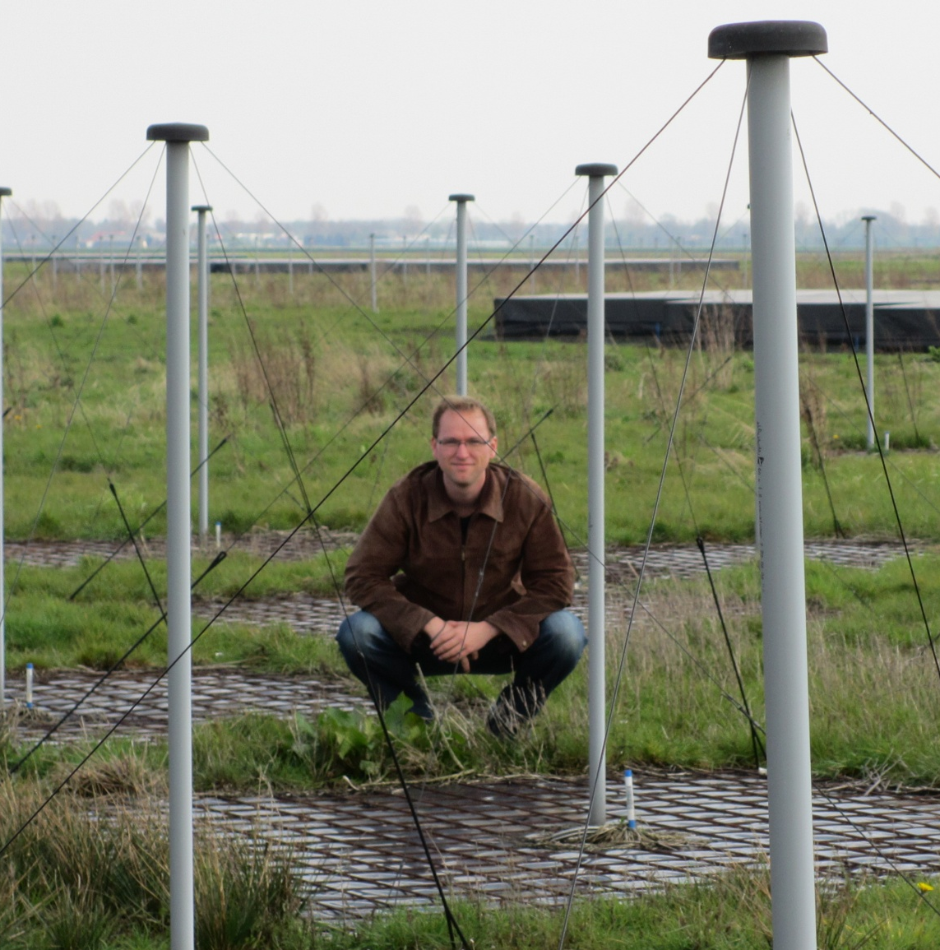
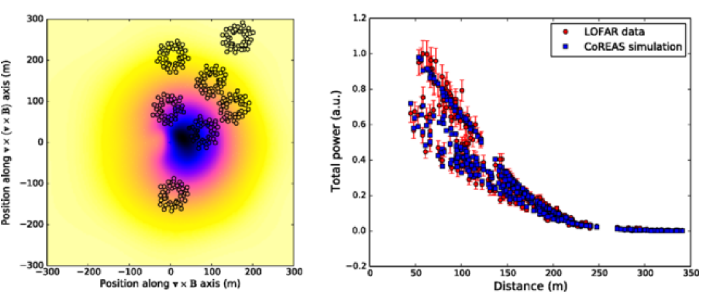
Precision Measurement
Superterp, LOFAR core
Stijn Buitink, Phys. Rev. D 90, 082003 (2014)
Mass, energy, angle?

Slide 11
Asymmetry intensity footprint
GM
CE
Core particle shower
RF is asymmetric around particle core due to interference GM & CE

Slide 12
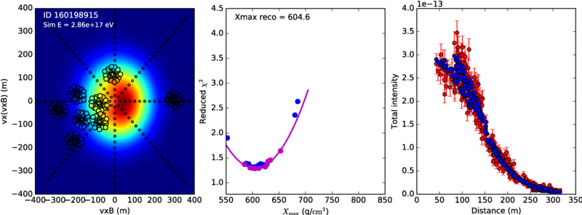
Microscopic (CoREAS) approach
For each measured event:
Perform about 30 CoREAS calculations and plot mean-square deviation from data v.s. X_max
Minimum chi-square defines value X_max
Typical result
From A.Corstanje et al, PRD 103, 102006

Slide 13
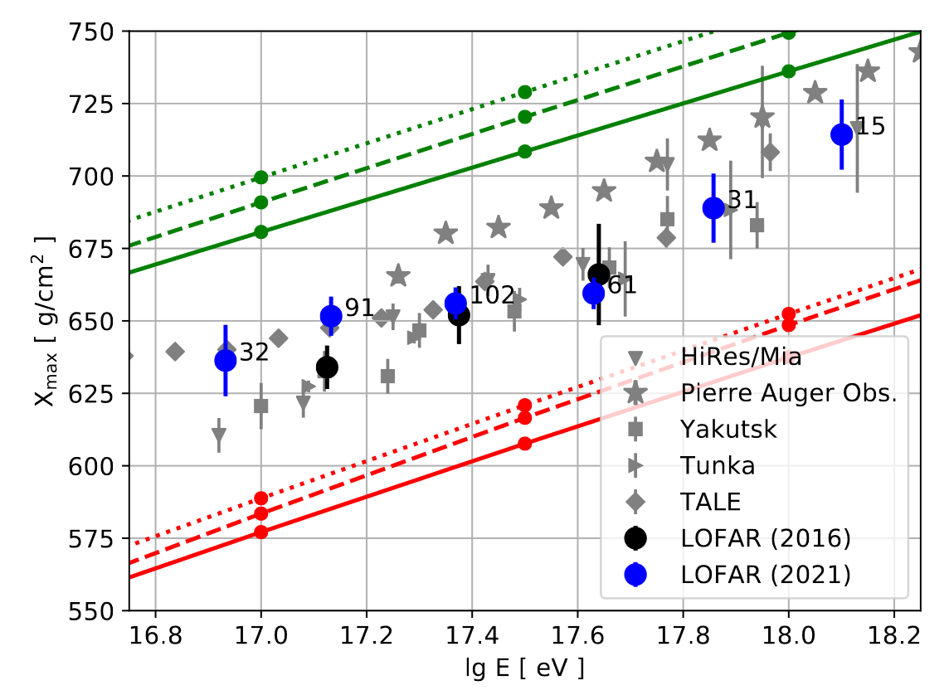
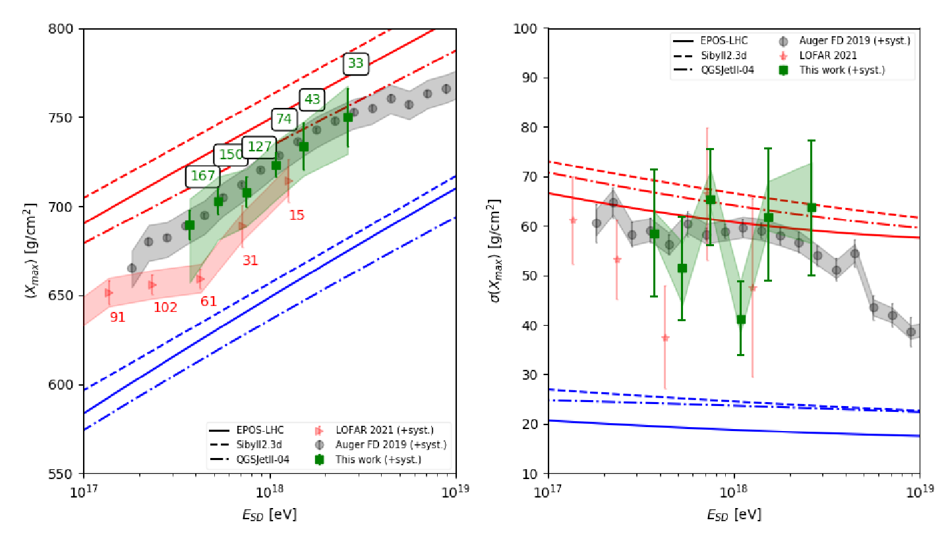
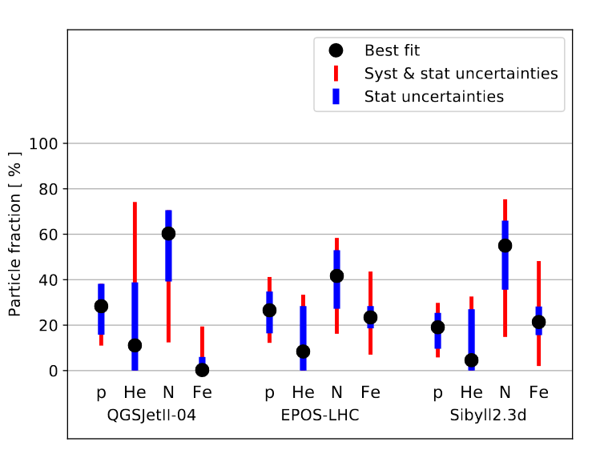
Arthur’s & Bjarni’s results
Arthur Corstanje (LOFAR)
Bjarni Pont (Pierre Auger Observatory, Engineering Radio Array)
Physics:
Moderately heavy, ~ Nitrogen
Results obtained using CoREAS
Requires ~50 simulations per measured event
Each simulation ~ 24h CPU

Slide 14
Macroscopic approach
MGMR: radiation emitted from parametrized time-dependent charges & currents in air-shower pancake, moving with speed-of-light.
Fast & Insight in physics of radio emission:
Drift velocity proportional to inverse-square-root of air density:
v_{d} ~ 1/√ρ(air)
Similar to terminal velocity of macroscopic particle in medium.
Maximum charge excess (proportional to ρ(air)) deeper in atmosphere then maximum of current. Slight arrival time (=phase) difference causes circular polarization of radio signal.

Slide 15
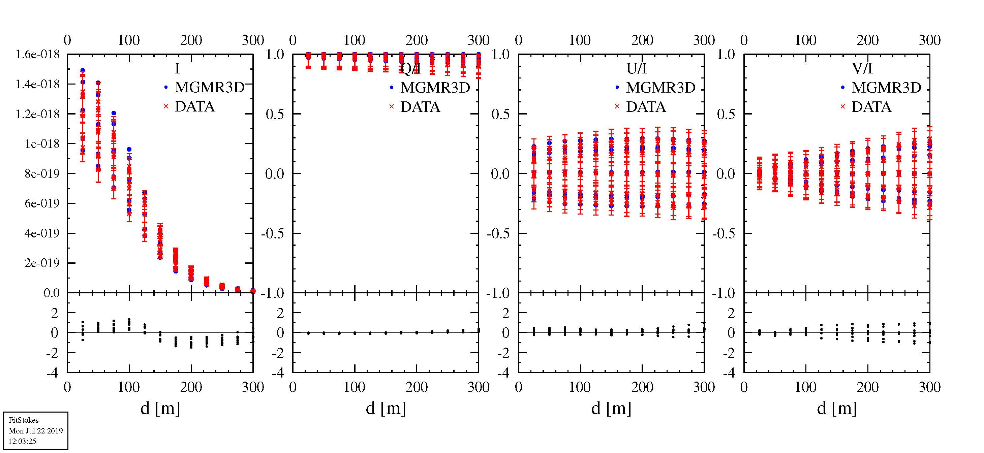
Fairweather
MGMR3D - CoREAS
Stokes parameters: I, Q, U, V
Linear polarization angle: 2 φ =atan(U/Q)
Circular polarization = V/I
Intensity
Q/I=1, U/I=0: polarization in vxB direction
Circular polarization
Linear polarization direction
V/I & U/I ≠ 0
due to charge excess

Slide 16
Comparison for many CoREAS showers
Usually good fit with few exceptions:
Chi² fitting of CoREAS-generated footprints with MGMR
Δ X_{max}= 60 g/cm²
Large chi²
Different profile
X^{MGMR}
Sensitive to shower non universality
➔ More shower parameters, beyond X_{max} can be extracted
X^{CoREAS}

Slide 17
Atmospheric electric fields
Upper E(h)=0 height
Transverse current:
- Electrons & positrons have transverse
drift, induced by EM force.
- Multi-directional along F_{em} = v x B + E(h)
- Direction and magnitude E depends on height
- Current determined by component perp to shower direction
# Charge excess:
- Linearly polarized,
radially from shower axis
Middle E(h)≠0 height
F_{em}
lower height
F_{em}
The full signal: superposition of all
Gia Trinh et al. Phys. Rev. D 93, 023003 (2016); arXiv:1511.03045

Slide 18
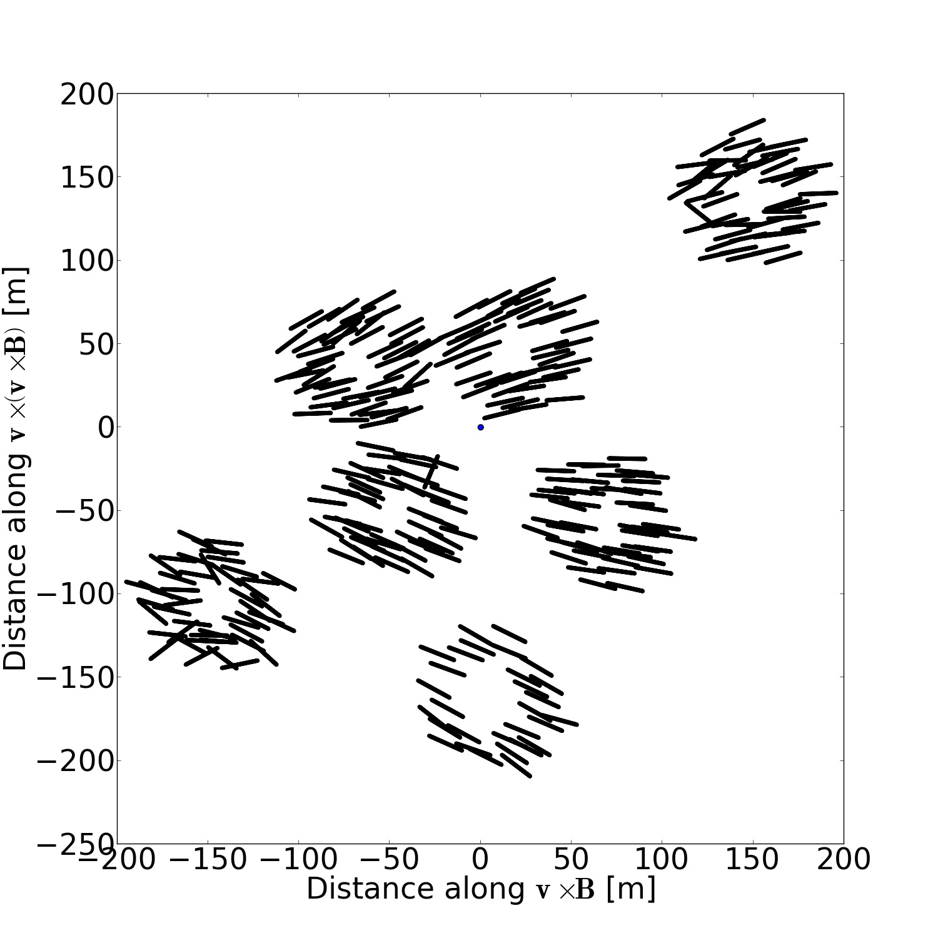
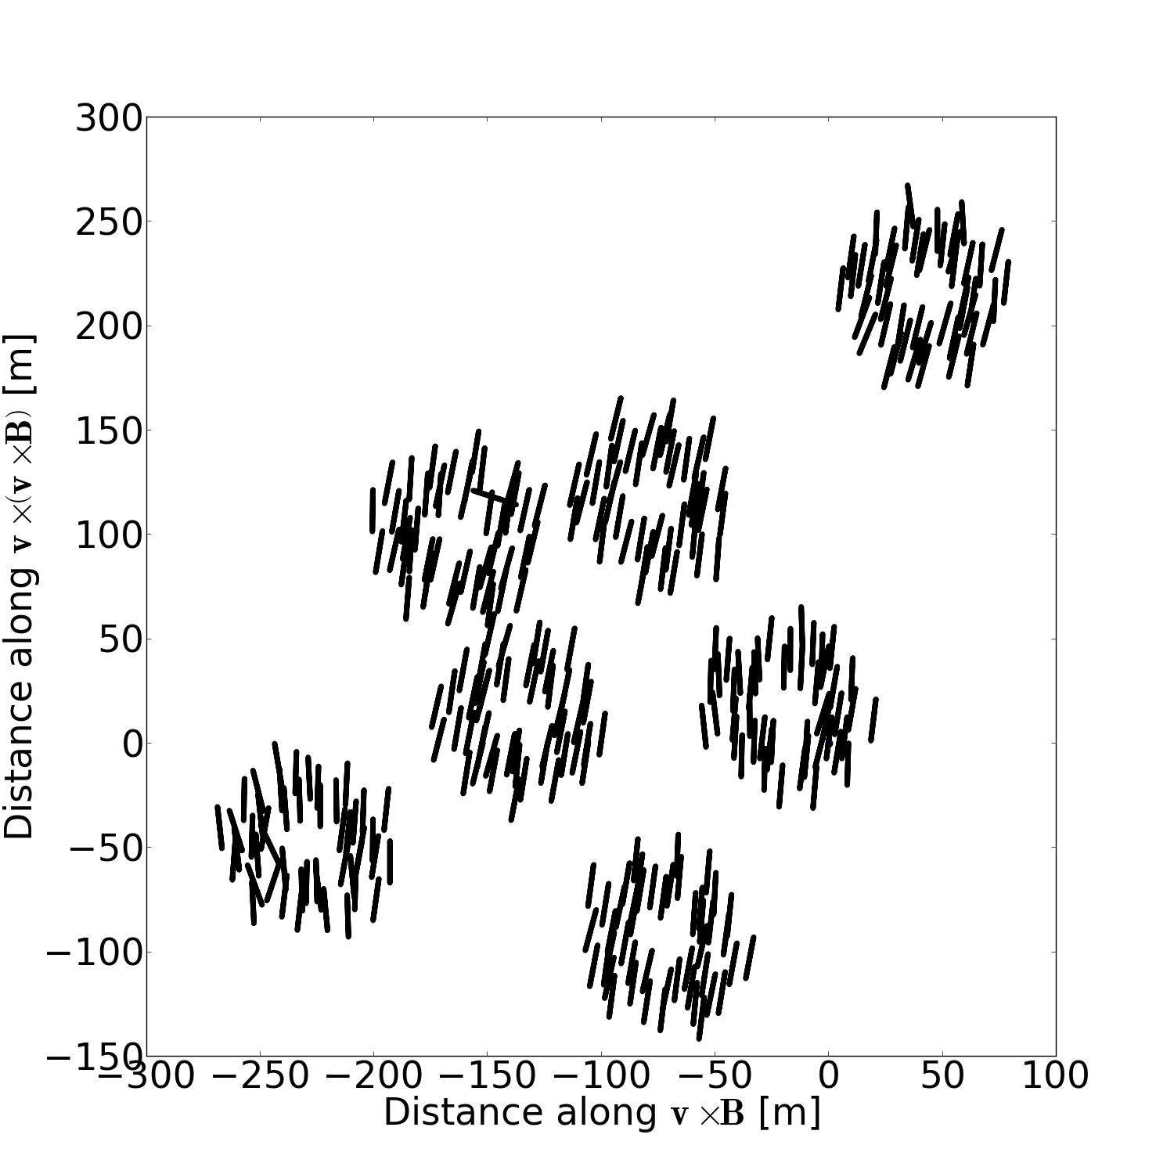
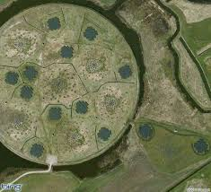
Observations; polarization footprint
Fair weather vs thunderstorm
P. Schellart et al.
(PRL 114, 165001)

Slide 19
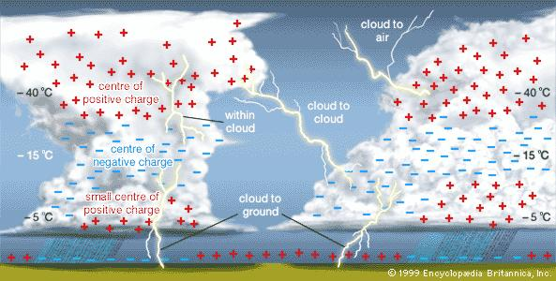
Determining atmospheric electric fields
$$h$$
model
$$h_{1}$$
$$h_{2}$$
$$h_{3}$$
Two directions
0
$$E_{⊥}$$
Challenge: Many parameters → grid search cumbersome
Levenberg-Marquardt minimization requires: Fast & Deterministic code
Use MGMR

Slide 20
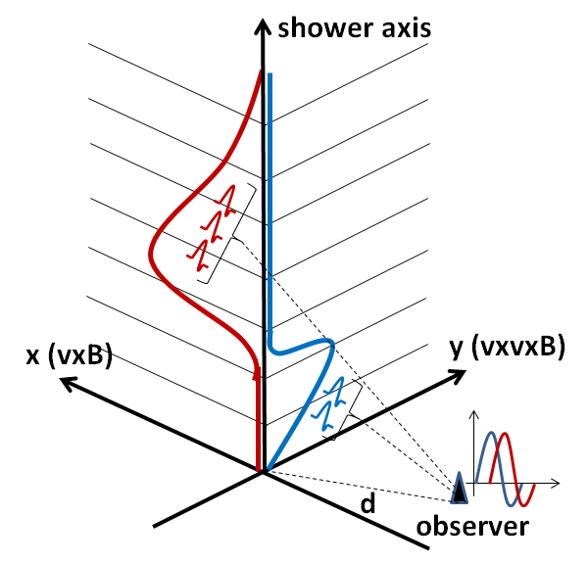
Physics for thunderstorm events
Atmospheric fields induce electric currents in shower plasma
Like for Fair Weather:
Circular polarization due to emission-height differences.
Here: caused by height dependence of orientation of atmospheric fields.
Independent of
azimuth position.
$${\vec{E}}_{1}$$
$${\vec{E}}_{2}$$
90
time

Slide 21
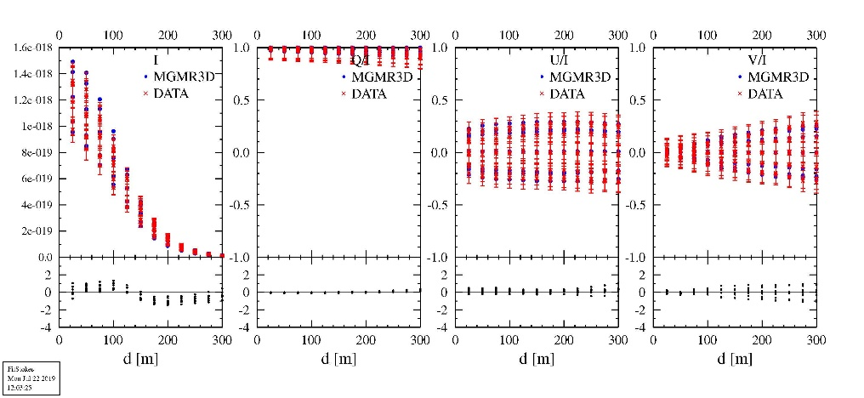
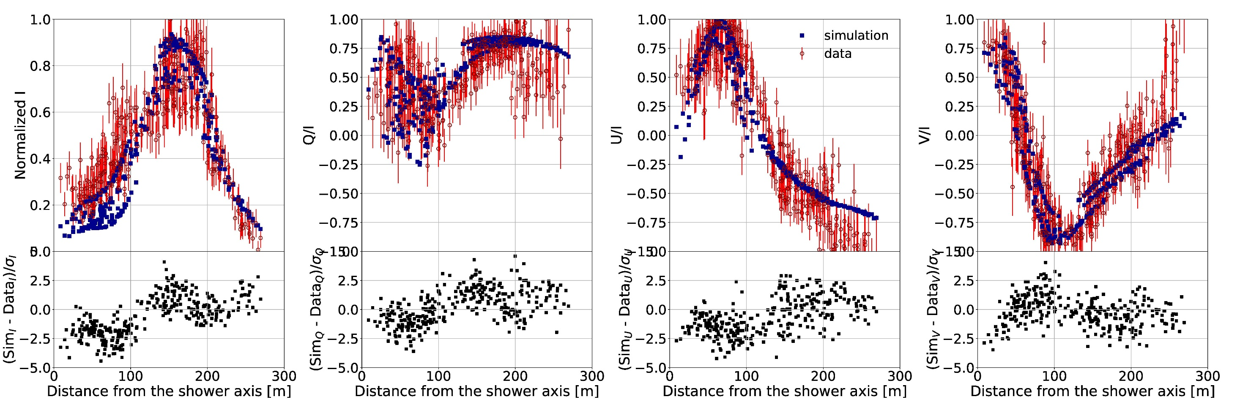
A Thunderstorm event (#7)
Dots: best fit calculation
Fair weather
Circular polarization
Q/I=1, U/I=0: polarization in vxB direction
Footprint determined by atmospheric electric fields;
invert problem to find the fields

Slide 22
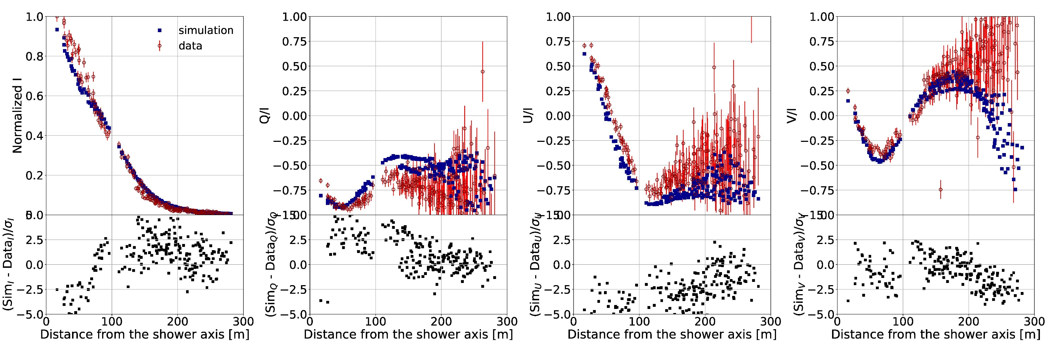
A Thunderstorm event (#9)
Dots: best fit calculation
Footprint determined by atmospheric electric fields;
invert problem to find the fields

Slide 23
Analysis - Tomography
Relate to atmospheric data and charge structure:
Radar top 8.8 km Top positive charge 8 km
-10 degree 4.2 km Main negative charge 3.5 km
Freezing 2.5 km lower positive charge 1.5 km
Radar reflectivity

Slide 24
Summary
Field is very young, developed fast
Modern (digital) radio detection started in 2003
Understanding in terms of geomagnetic (transverse current) & charge excess radiation (with Cherenkov effects) from 2008
Precise detection & interpretation of radio footprint (with LOFAR) in 2014
Complementary Microscopic and Macroscopic approaches
Present: major roll-out of radio detection GRAND, Pierre Auger Observatory, IceCube & RNO-G, SKA

Slide 25
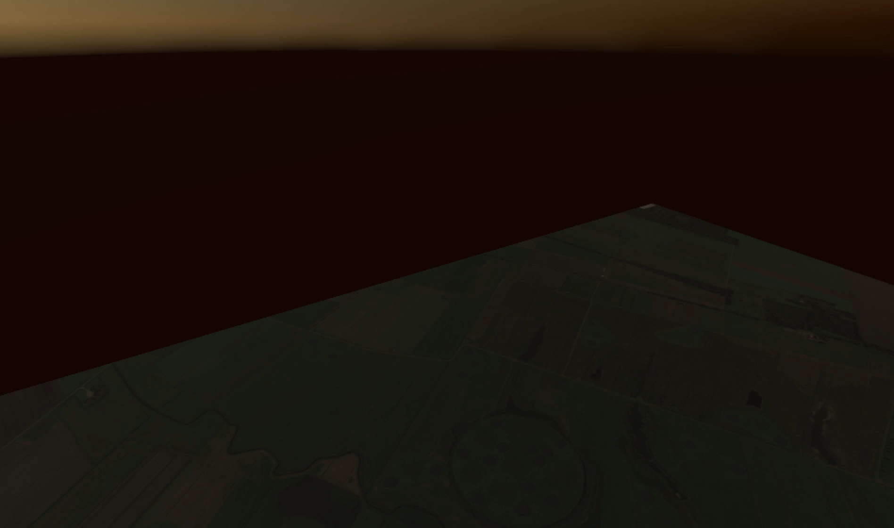
LOFAR lightning physics:
1) Non-intrusive E-field determination
2) Nano-second LMA
B. Hare et al., Nature 568, 360–363 (2019)

Slide 26
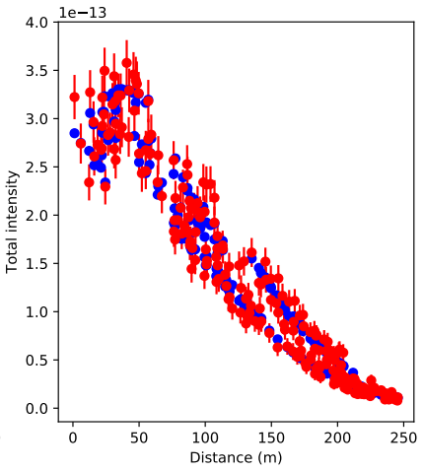
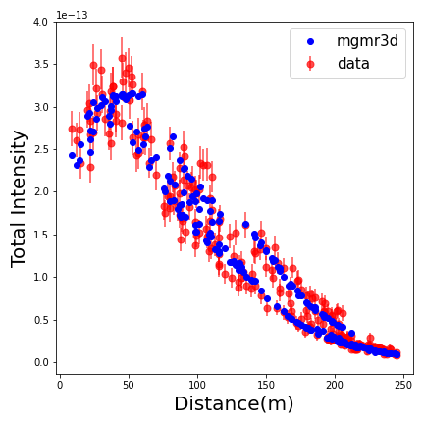
Applying to LOFAR data
Compare results CoREAS and MGMR based analyses of LOFAR data.
Fit: Energy, X_{max}, & Core position. Compare extracted parameters for all 270 quality events.
CoREAS
X_{max} = 679 g/cm²
core@ (102,-42) m
Chi² =1.15
ΔX_{max} = 675 g/cm²
core@ (99,-55) m
Chi² =1.25

Slide 27
Applying to LOFAR data
Compare results CoREAS and MGMR based analyses of LOFAR data.
Fit: Energy, X_{max}, & Core position. Compare extracted parameters for all 270 quality events.
RMS(ΔE)=19%
RMS(ΔX_{max})=26 g/cm²
σ(X_{max}^{CoREAS})=14.5
Thus
σ(X_{max}^{MGMR})=22.5 g/cm²
ΔE [%]
ΔX_{max} [g/cm²]

Slide 28
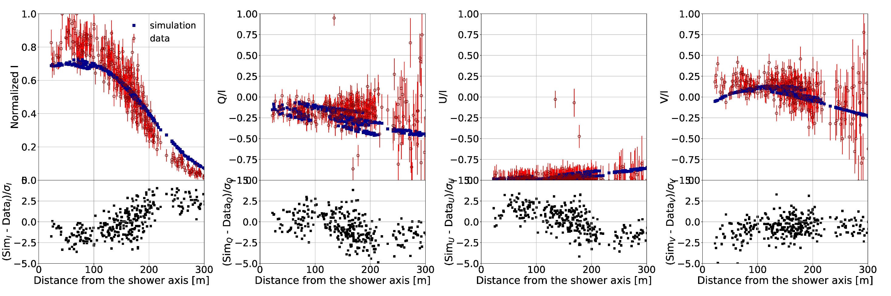
A Thunderstorm event (#6)
Dots: best fit calculation
Footprint determined by atmospheric electric fields;
invert problem to find the fields

Slide 29
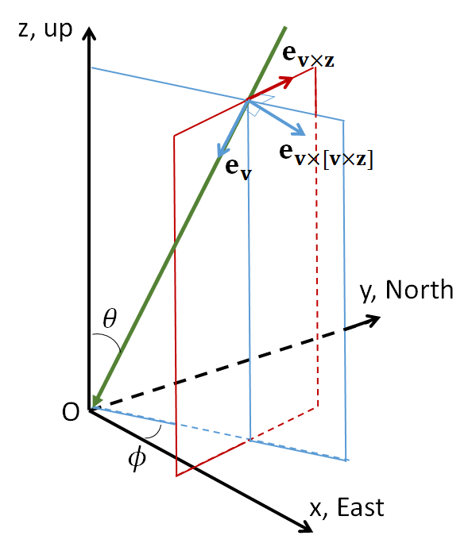
Analysis of two events (#6, #7)
radar reflectivity
Two events in 10 minutes,
through same cloud

Slide 30
Conclusions
MGMR offers an fast alternative for analyzing shower radio footprints for
  Fair weather events to extract air shower profile
  Thunderstorm events to extract atmospheric electric fields
Some relevant Publications:
- Gia Trinh et al., Influence of Atmospheric Electric Fields on the Radio Emission from Extensive Air Showers., Phys. Rev. D 93, 023003 (2016); arXiv:1511.03045.
- Gia Trinh et al., Thunderstorm electric fields probed by extensive air showers through their polarized radio emission. Phys. Rev. D, 95 (2017) 083004
- Olaf Scholten et al,, Analytic calculation of radio emission from parametrized extensive air showers: A tool to extract shower parameters. Phys. Rev. D, 97 (2018) 023005
- Gia Trinh et al., Determining electric fields in thunderclouds with the radiotelescope LOFAR, JGR 125, e2019JD031433 (2020).
- Gia Trinh et al., Determining atmospheric electric fields using MGMR3D. Phys. Rev. D105, 063027 (2022)
- Pragati Mitra, High precision reconstruction of air shower properties with dense radio arrays, PhD thesis VUB 2021 and in preparation.

Slide 31
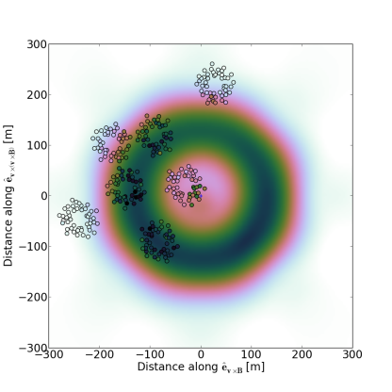
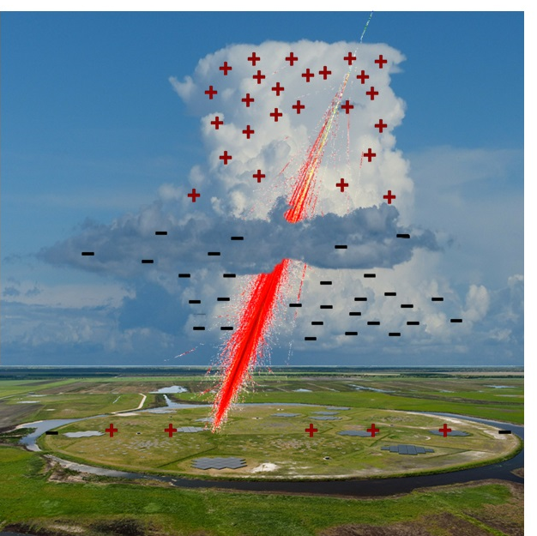








Fitting the intensity
P. Schellart , T.N.G. Trinh et al.
(PRL 114, 165001)
$$h$$
$$h_{above}$$
E_{a}
$${\vec{E}}_{⊥above}$$
$$h_{below}$$
$${\vec{E}}_{⊥below}$$
E_{b}
$$E_{⊥below }= {kE}_{⊥above}$$
$$\vec{v}$$
0
$$E_{⊥}$$

Slide 32
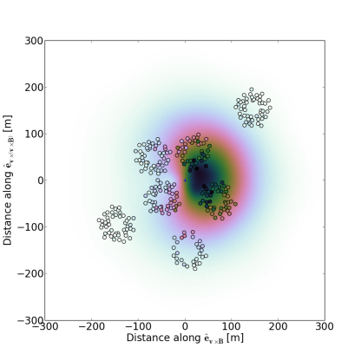

Fair weather vs thunderstorm
Observations; intensity footprint
S. Buitink et al.
PRD 90, 082003 (2014)
P. Schellart et al.,
PRL 114, 165001 (2015)

Slide 33
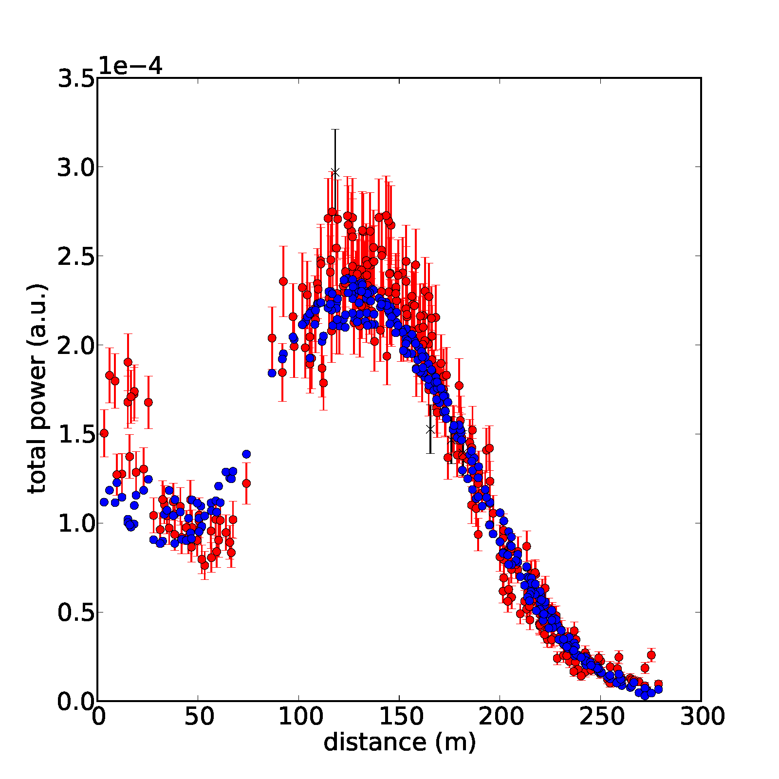
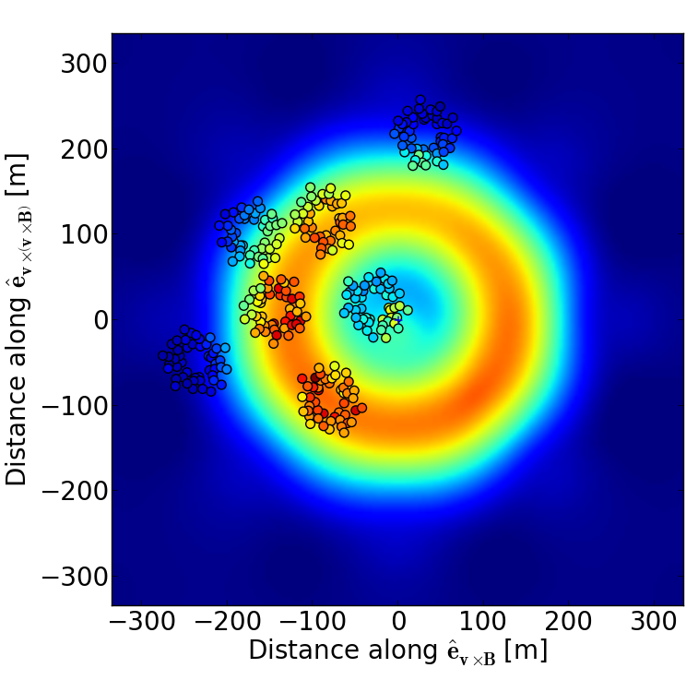
Structure of the field
A reconstructed thunderstorm event
P. Schellart et al.
(PRL 114, 165001)
P. Schellart et al.
(PRL 114, 165001)

Slide 34
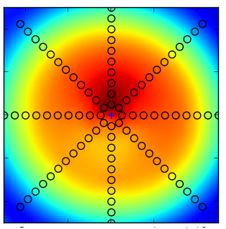
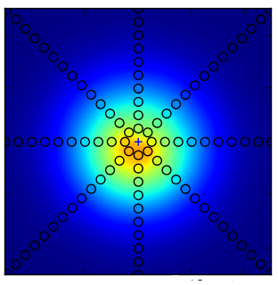
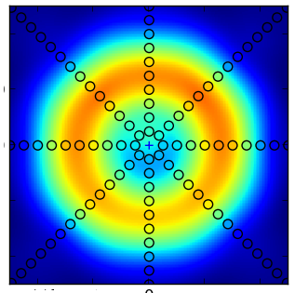
Ring vorming door intergerentie
$$h$$
$$h$$
$$h$$
$$h_{above}$$
$$h_{above}$$
Two-layer E-fields $↔$ ring-like structure
$$h_{below}$$
$$h_{below}$$
$$h_{below}$$
0
$$E_{⊥}$$
0
$$E_{⊥}$$
0
$$E_{⊥}$$
+
=

Slide 35
Interpretation circular-polarization for fair weather
GeoMagnetic:
Charge eXcess:
ChX Peaks lower in atmosphere than GM (physics)
At 100 m, 30-80 MHz, delay = 1 ns
GeoMagnetic
ChargeX
vxB
φ
φ
time
observer
Stokes parameter V is measure of circular polarization
Slight delay between GM &ChX causes rotation in polarization

Slide 36
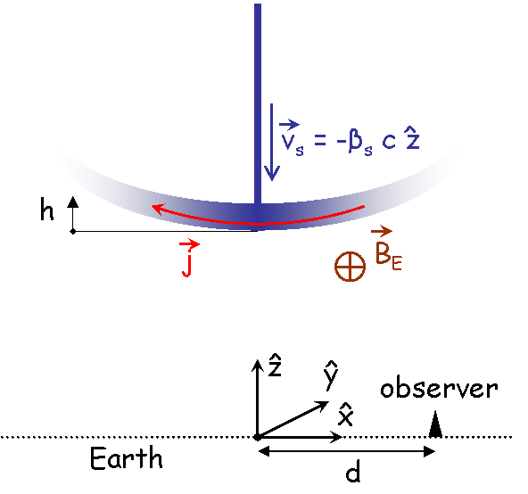
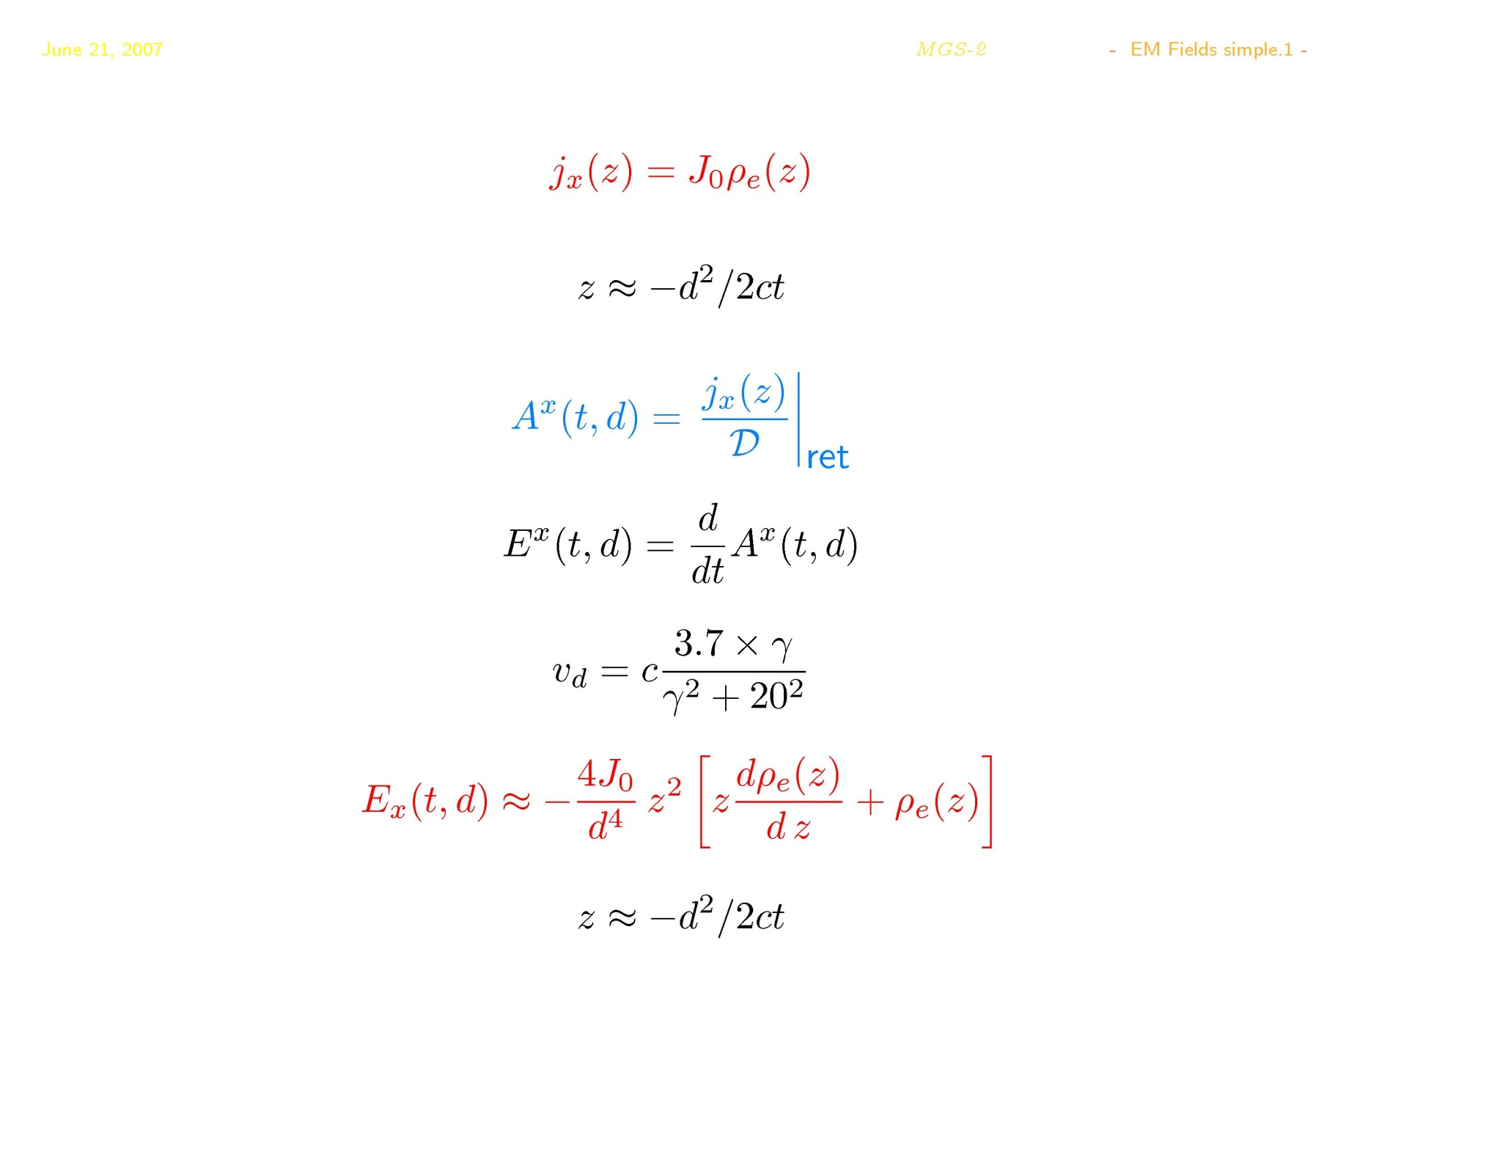
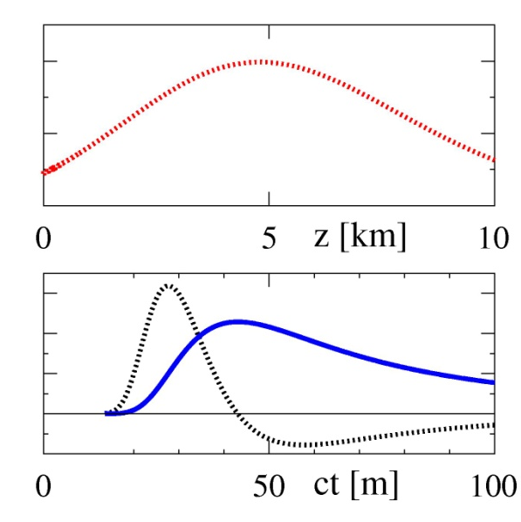
Macroscopic GeoMagnetic Radiation
> The Basic picture <
Horizontal drift velocity of electrons creates current
Air shower
Pancake = e⁺ e⁻ plasma
Electric current develops when plasma moves through magnetic field of the Earth
Radiation emitted by time varying electric current
Parametrized:

Slide 37
LOFAR
Radio emission mechanisms
Include AtmElField, e-par, e perp, circ pol
Footprint, stokes, fair-weather values & plot
Thunderstorm values & plots
Inverse problem, fitting
Full field, tomography
Conclusions –also E in non th-clouds – non intrusive tomography

