Slide 1
MARES:
A Macroscopic Approach to the Radar Echo Scatter
Enrique Huesca Santiago
Vrije Universiteit Brussel / IIHE
on behalf of the RET Collaboration
ERC805486, NSF/PHY-201298, FWO-12ZD920N

Slide 2
Key concept 1:
Radar cross section

Slide 3
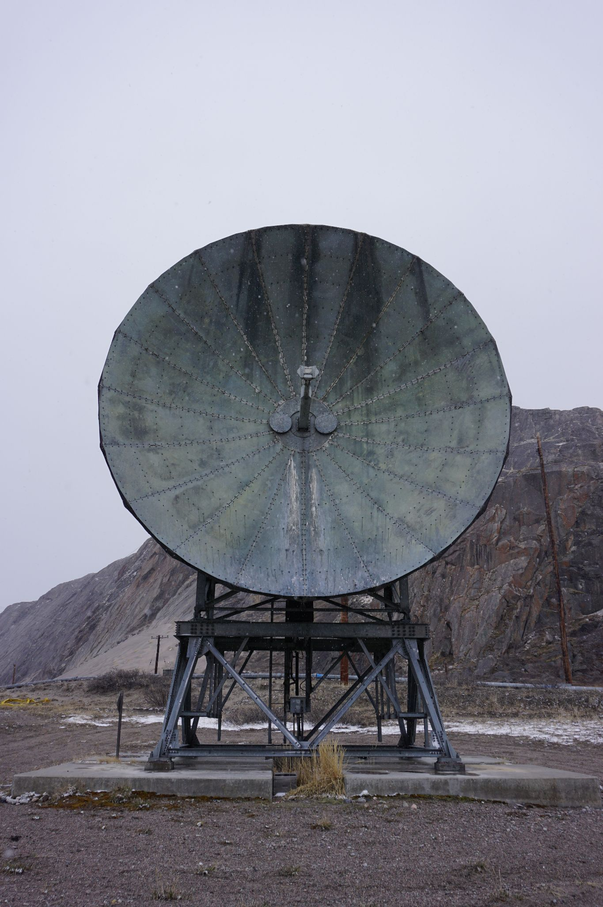
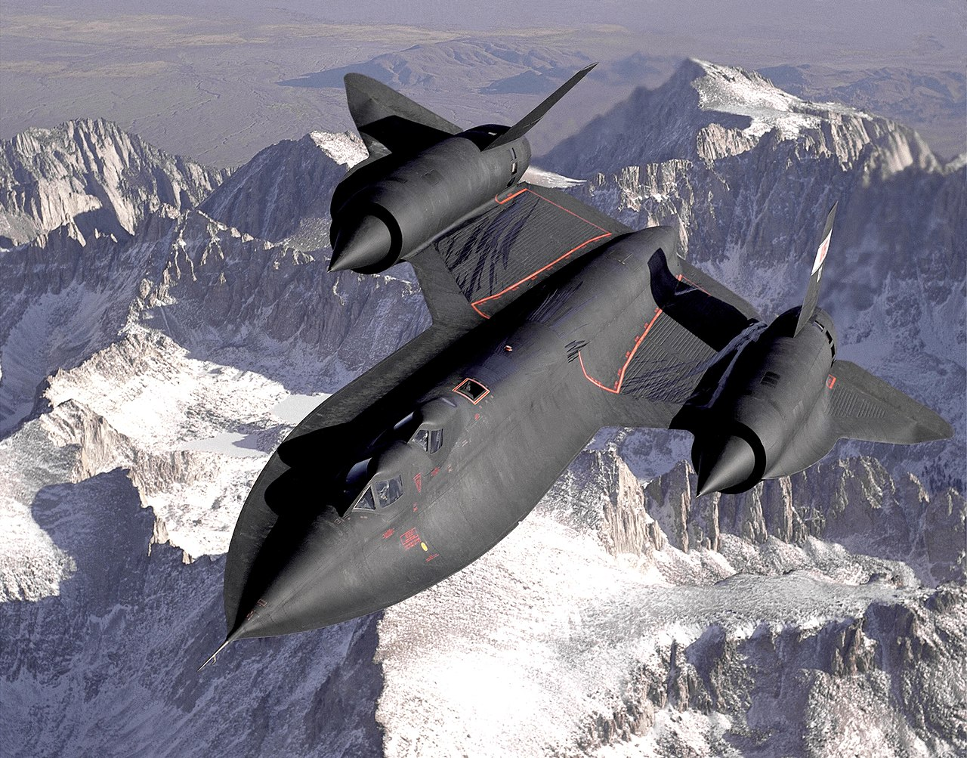
How does radar work?
(Not to scale)
R_{T}
R_{R}
TX
Transmitter
RX
Receiver
Notes:
READ THE SLIDE
If the target would be opaque (PEC), then its RCS could be computed via geometrical optics, we could just use the projected shape onto the TX and save time.
We have a thin plasma, so we need to work within the physical optics, and figure out the cascade response to the TX.
The only thing I have left is to convince you that we compute this response properly

Slide 4
Key concept 2:
Collisional electron plasma

Slide 5
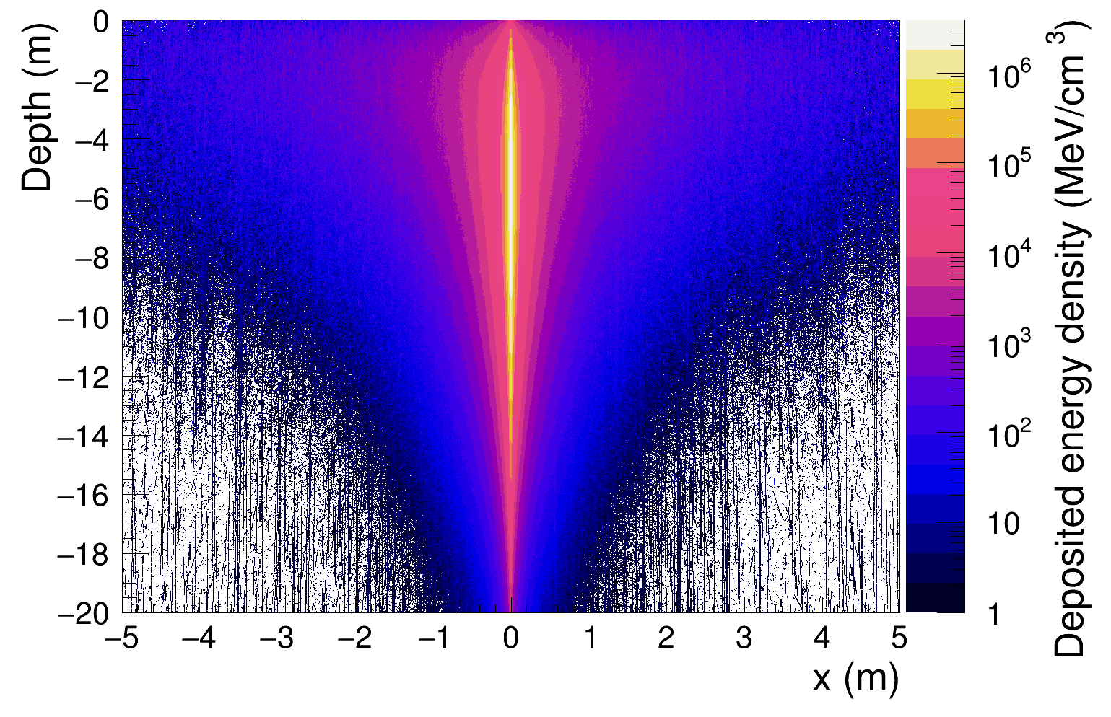
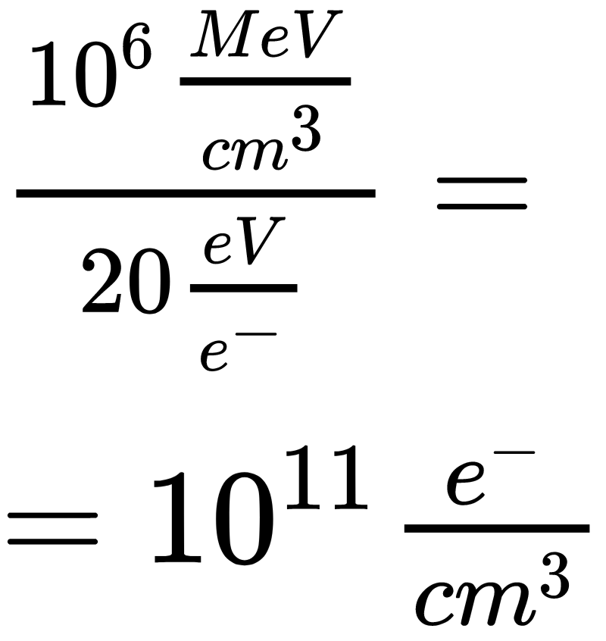
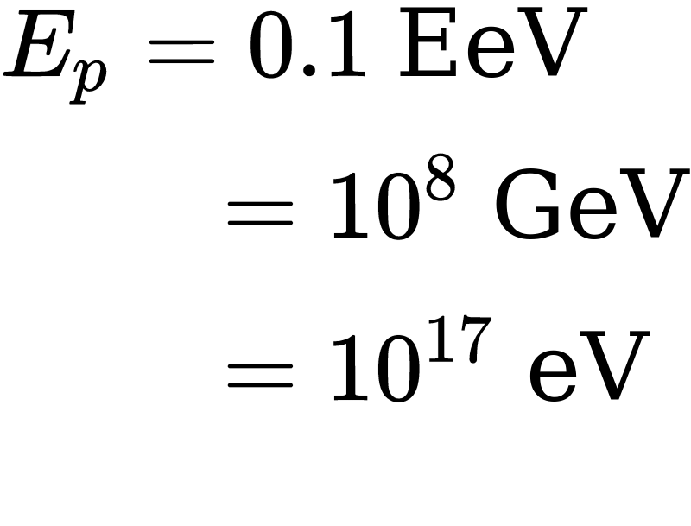
What does a particle cascade in ice look like?
Credit: Simon de Kockere
Notes:
(Context)
This is the footprint of a typical 10^8 GeV impacting on ice at Xmax
(We can see a bit of regeneration of the core)
After the shower front passes through the ice, and the deposited energy is in the form of fully ionised, free electrons from the ice.
These electrons have an expected lifetime of 10 ns where they can scatter (re-radiate) freely before dissapearing by recombination/etc.
A peak density of 10^12 e/ cm^3 is still VERY low compared to typical ice density (N_A ~ 10^23?).
What we are trying to detect with our radar is a thin, “cold”, collisional plasma, more akin to a free electron gas than to a proper astrophysical plasma.

Slide 6
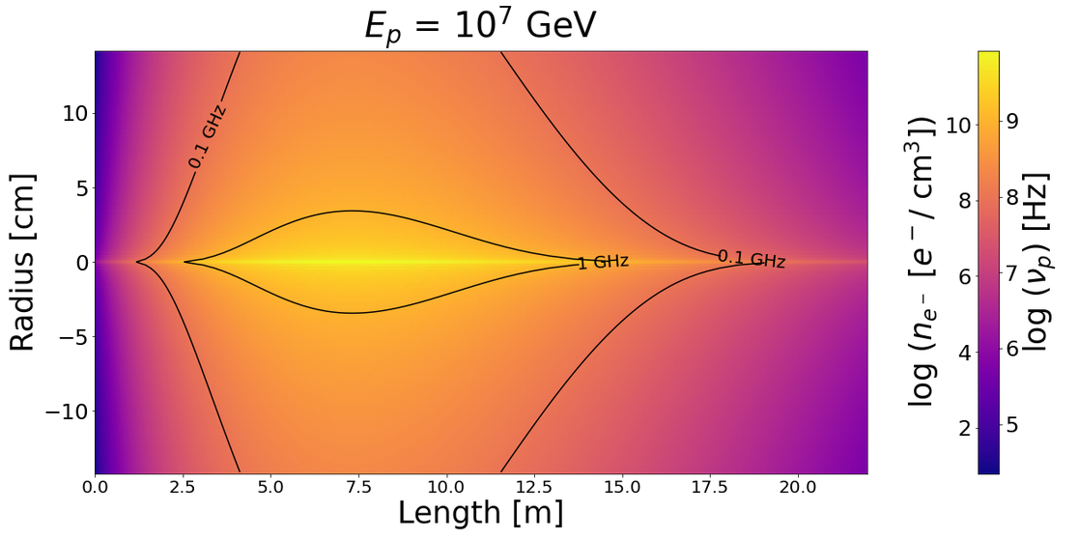
How can we describe the cascade’s core?
Nishimura, Kamata & Greisen: Air showers (Progr. Theoret. Phys. 6, 93 (1958) & Prog. Cosmic Ray Phys., vol. III (1965) )
K. Werner, K. de Vries, O. Scholten: In-ice neutrino cascade (arxiv:1312.4331)
Simon de Kockere, et al. : Air shower cores from CR that propagate through ice (arXiv:2202.09211)

Slide 7
MARES:
The macroscopic scatter model

Slide 8
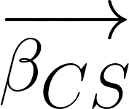
The radar scatter
(Not to scale)
TX
Transmitter
CS
Cascade
RX
Receiver
R_{T}
R_{R}
Notes:
READ THE SLIDE
If the target would be opaque (PEC), then its RCS could be computed via geometrical optics, we could just use the projected shape onto the TX and save time.
We have a thin plasma, so we need to work within the physical optics, and figure out the cascade response to the TX.
The only thing I have left is to convince you that we compute this response properly

Slide 9
The line approximation
L_{TX}
L_{RX}
N_{RX}
N_{TX}
R_{RX}
R_{TX}
TX
Transmitter
RX
Receiver
|R_{TX}|
|R_{RX}|
𝝈_{i} (RCS)
V

Slide 10
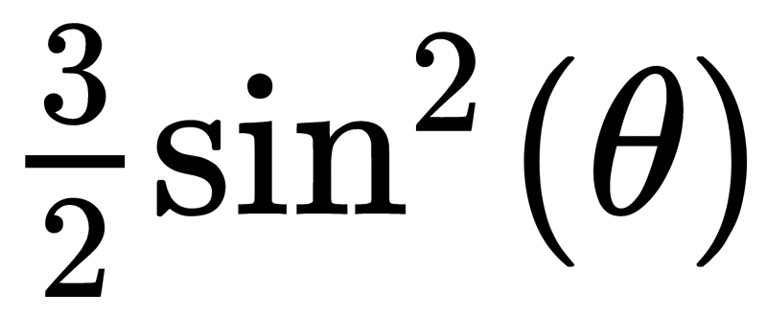
The radar cross section

Slide 11
The radial integration
RX
Receiver

Slide 12
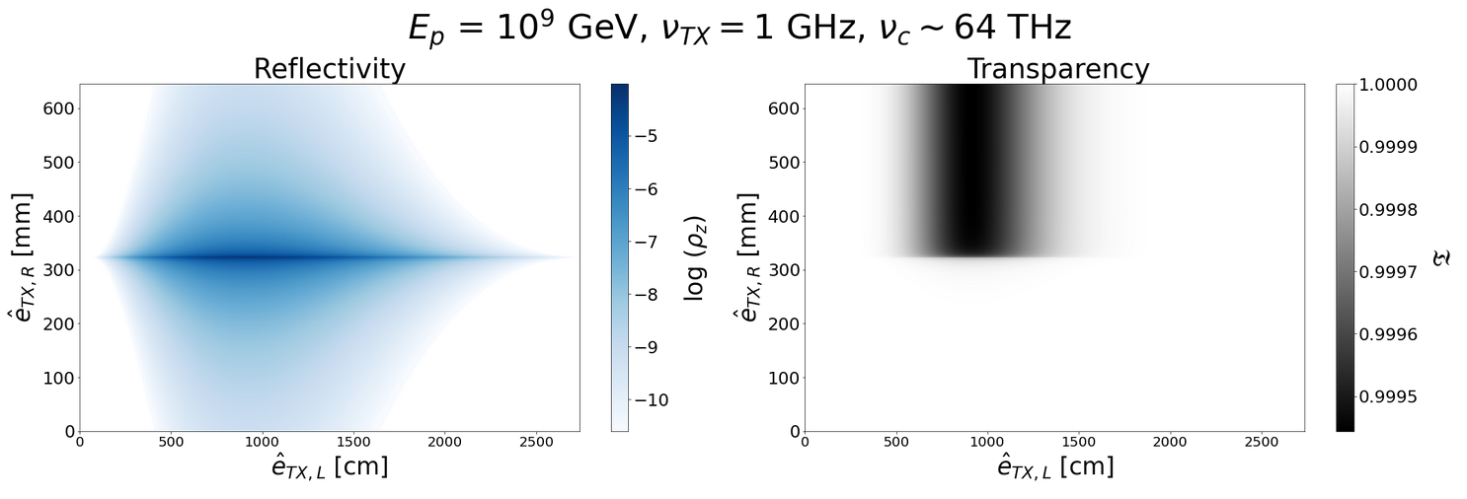
The transparency

Slide 13
Results:
What does the signal look like?
Notes:
How does this look in practice? After the math framework, I am going to show you an intuitive picture by investigating how the incoming radio wave imoves through the plasma/.

Slide 14
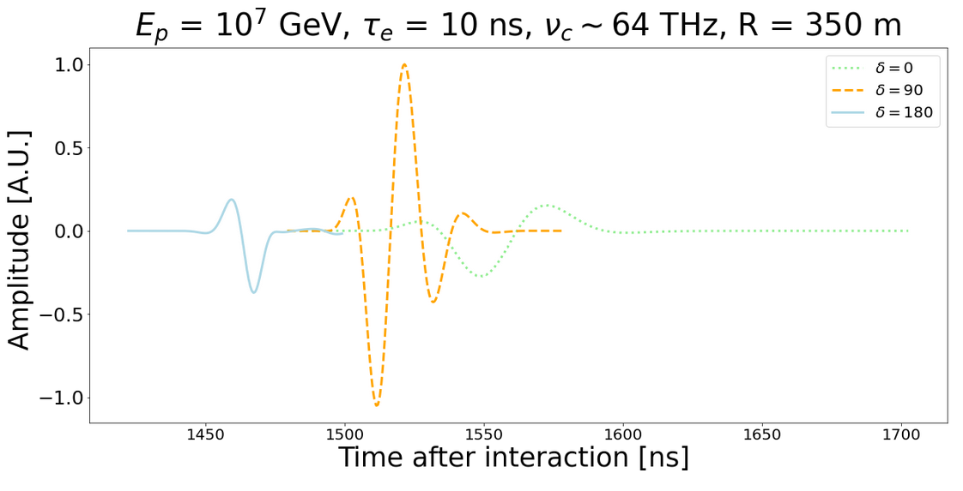
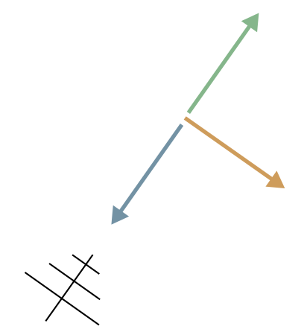
The MARES received signal
RX

Slide 15
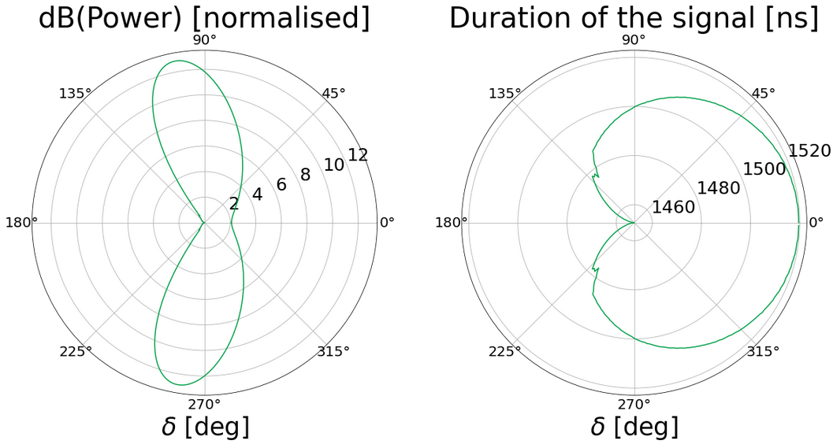
The MARES signal features

Slide 16
Thank you!

