Slide 1
Synthesis of radio emission from cosmic ray air showers
cosPa meeting 19/06/2023
Mitja Desmet

Slide 2
State-of-the-art simulation codes limit our analyses
introduction
When detecting extensive air showers (EAS) using their radio emission, we use Monte-Carlo based simulation codes to
Characterising and evaluating our detector performance.
Perform analyses on our data (for example reconstructing $X_{max}$).

Slide 3
State-of-the-art simulation codes limit our analyses
introduction
When detecting extensive air showers (EAS) using their radio emission, we use Monte-Carlo based simulation codes to
Characterising and evaluating our detector performance.
Perform analyses on our data (for example reconstructing $X_{max}$).

Slide 4
State-of-the-art simulation codes limit our analyses
introduction
When detecting extensive air showers (EAS) using their radio emission, we use Monte-Carlo based simulation codes to
Characterising and evaluating our detector performance.
We will want to simulate many more antennas for future arrays (GRAND, SKA, Auger Radio Detector).
Perform analyses on our data (for example reconstructing $X_{max}$).
We want to extract more information from radio data, like for example the width and asymmetry of the particle number distributions (often referred to as the $L$ and $R$ parameters).

Slide 5
We need a faster way of simulating the radio emission from eas
introduction
1 CORSIKA/CoREAS shower with
Proton primary
Primary energy of ${10}^{18}$ eV
6 simulated antennas
took 8 days to complete.

Slide 6
Template synthesis uses semi-analytical relations to characterise the radio emission from EAS
The method
In template synthesis, we characterise the radio signal in an antenna using a parametrized function.
By relating the parameters of this function to the air showers properties (primary energy, geometry, longitudinal profile), we find relations which can be used to “morph” the emission from one EAS to one with different properties.
These relations are extracted from a set of Monte-Carlo simulations, thus benefitting from their precision.
The goal: have a method which only needs one Monte-Carlo simulation as input to synthesise the radio emission from hundreds of other ones for a fraction of the computational cost.

Slide 7
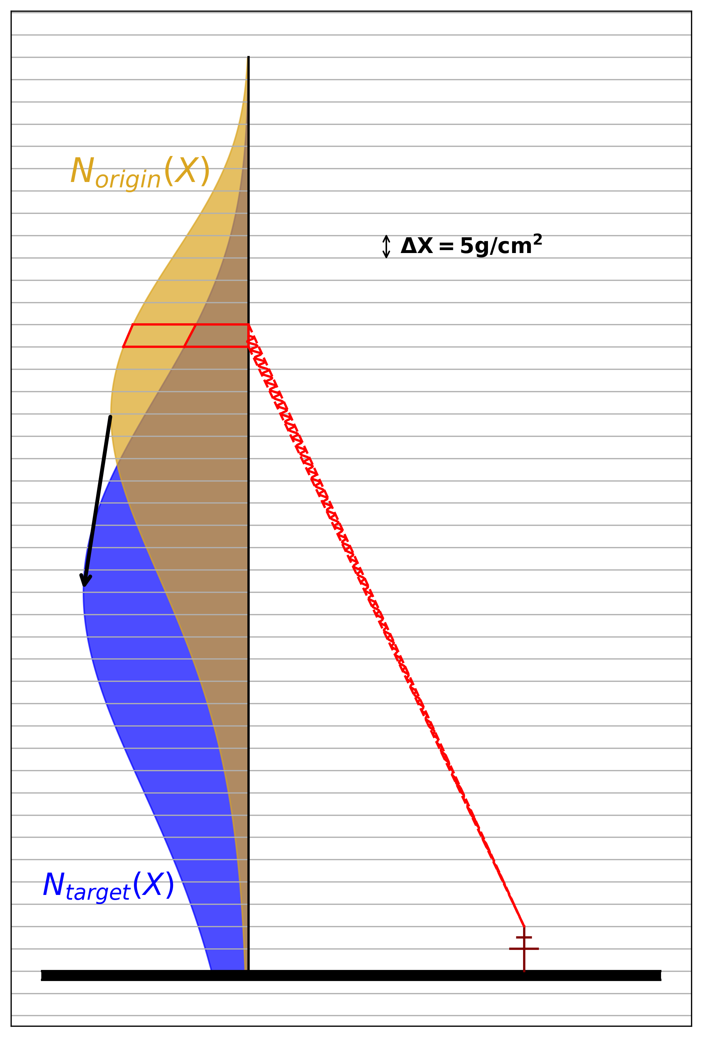
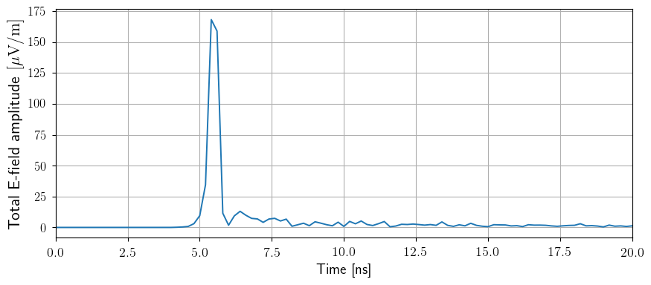
Template synthesis considers slices of the atmosphere as point sources
The method
Instead of parametrizing the total emission, we look at the emission coming from atmospheric slices with constant atmospheric depth.
The emission from a slice depends on the number of particles in it, $N_{slice}$, as well as the age of the shower in that slice.

Slide 8
We consider the geomagnetic and charge-excess components separately
The method

Slide 9
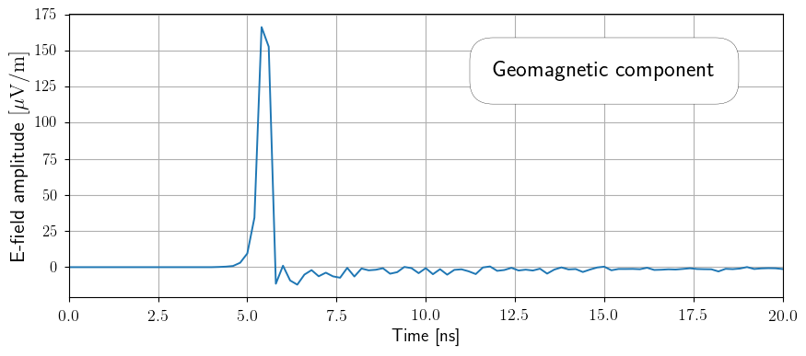
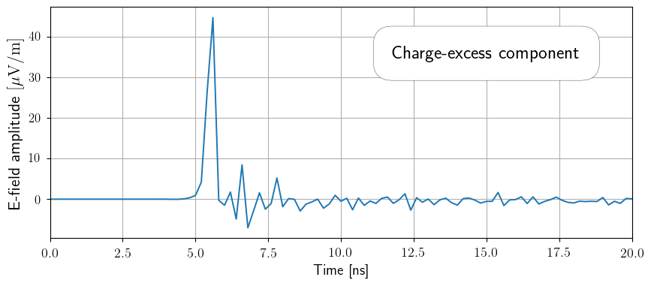
We consider the geomagnetic and charge-excess components separately
The method

Slide 10
We parametrize the amplitude frequency spectrum of each component
The method

Slide 11
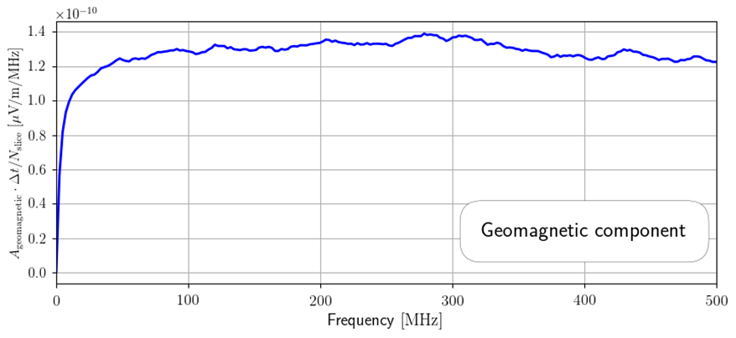
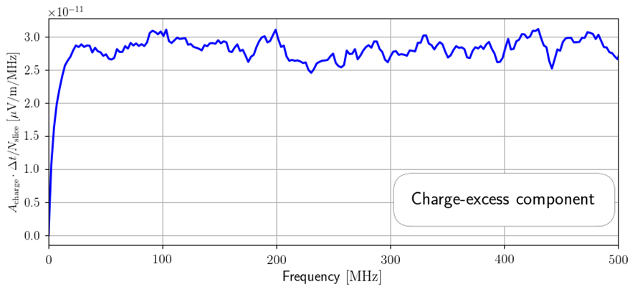
We parametrize the amplitude frequency spectrum of each component
The method
$$A\left(f\right)=| DFT\left\{s\left(t\right)\right\} |$$

Slide 12
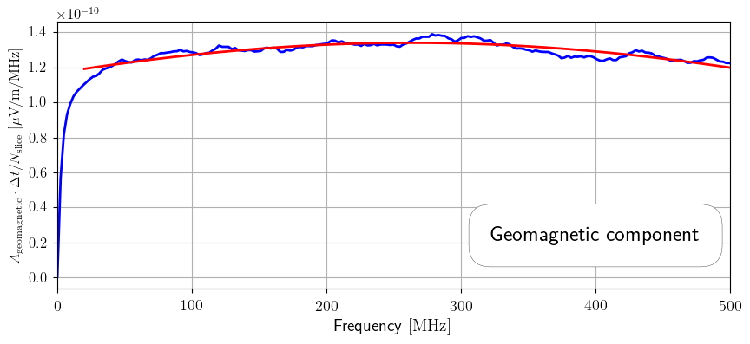
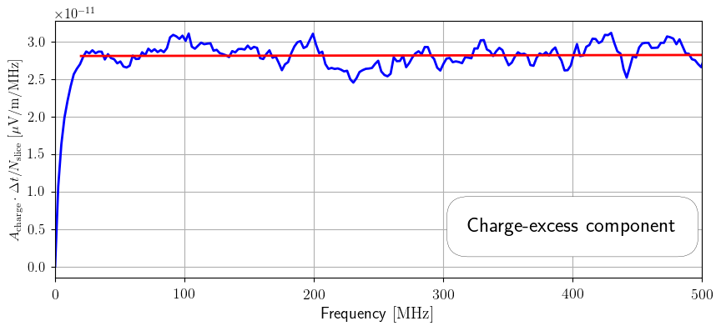
We parametrize the amplitude frequency spectrum of each component
The method
$$A_{geo}=\left(a⋅N_{slice}\right)⋅exp⁡(b⋅\left(f−f_{0}\right)+c⋅{\left(f−f_{0}\right)}^{2})$$
$$A_{ce}=\left(a⋅N_{slice}\right)⋅exp⁡(b⋅\left(f−f_{0}\right))$$
[20, 500] MHz

Slide 13
We parametrize the amplitude frequency spectrum of each component
The method
$$A_{geo}=\left(a⋅N_{slice}\right)⋅exp⁡(b⋅\left(f−f_{0}\right)+c⋅{\left(f−f_{0}\right)}^{2})$$
Spectral parameters

Slide 14
The spectral parameters can be related to the xmax of the shower
The method
Geomagnetic
Charge-excess
Value of a/b/c parameter
Value of a/b parameter
$X_{max}$ of the shower
$X_{max}$ of the shower

Slide 15
The spectral parameters are correlated with xmax
The method
We repeat this process for 600 showers, simulated with CORSIKA and using CoREAS for the calculation of the radio emission.
We used QGSJETII-04 and FLUKA as hadronic interaction models.
All showers had the same, vertical geometry.
The atmosphere and magnetic field were also kept constant.
Half of the showers had a proton as primary particle, the other half had an iron nucleus.
For each primary type, we simulated showers with primary energies of ${10}^{17}$, ${10}^{18}$ and ${10}^{19}$ eV (100 showers for each energy).

Slide 16
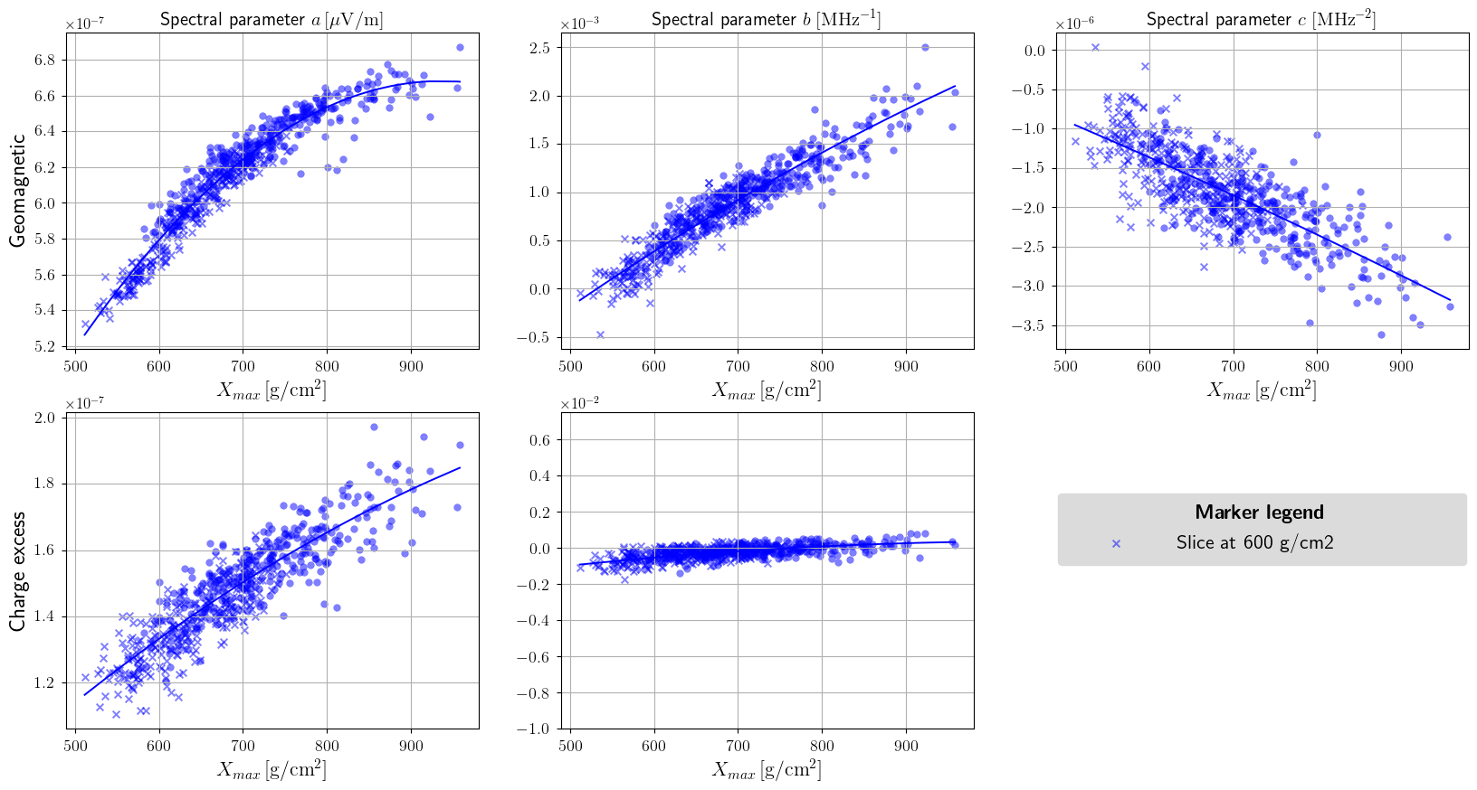
Spectral functions

Slide 17
The spectral functions encode the parabolic dependence of the spectral parameters on Xmax
The method
The previous plot was made for one atmospheric slice and for a single antenna. We can do this for every simulated antenna, going over every of the 207 slices to obtain the complete spectral functions

Slide 18
We synthesise starting from a longitudinal profile
The synthesis
Given a target longitudinal profile, we can use the spectral functions to synthesise the radio emission. To do this, we start from our initial microscopic simulation (the “origin”).
We have the $X_{max}^{origin}$ and the $X_{max}^{target}$.
With these we can evaluate the spectral functions for the origin and the target in every slice.
For every slice, we also have the number of particles in the origin and target profile, $N_{slice}^{origin}$ and $N_{slice}^{target}$ respectively.
Together with the evaluated spectral parameters, we can calculate the fitted amplitude spectra in each slice.
$$A=\left(a⋅N_{slice}\right)⋅exp⁡(b⋅\left(f−f_{0}\right)+c⋅{\left(f−f_{0}\right)}^{2})$$

Slide 19
We process the origin shower into a template
The synthesis
Phase freq. spectrum
Signal origin shower (MC)
Template
$∀$ (slice, antenna)
Divide by $A_{geo/ce}$
evaluated with $X_{max}^{origin}$ and $N_{slice}^{origin}$
Amplitude freq. spectrum

Slide 20
From the template we synthesise the signal
The synthesis
Phase freq. spectrum
Signal target
shower
Template
$∀$ (slice, antenna)
Multiply with $A_{geo/ce}$
evaluated with $X_{max}^{target}$ and $N_{slice}^{target}$
Amplitude freq. spectrum

Slide 21
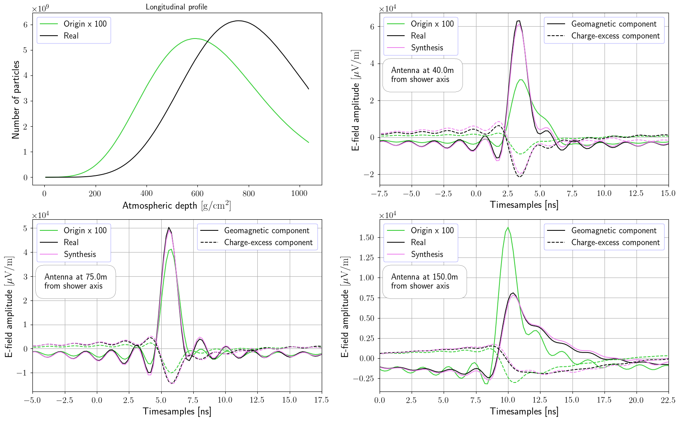

Slide 22
We evaluate the performance of template synthesis over our simulation set
The test
To gauge the capability of template synthesis to accurately synthesise the radio emission, we subsequently use every shower from our simulation as the origin shower.
We then synthesise the emission for every other shower in the set (using the longitudinal profile from CORSIKA).
Using two different metrics, we score the synthesised signal.
Comparing the peaks of the synthesised and CoREAS signals.
Comparing the energy fluence of the synthesised and CoREAS signals.

Slide 23
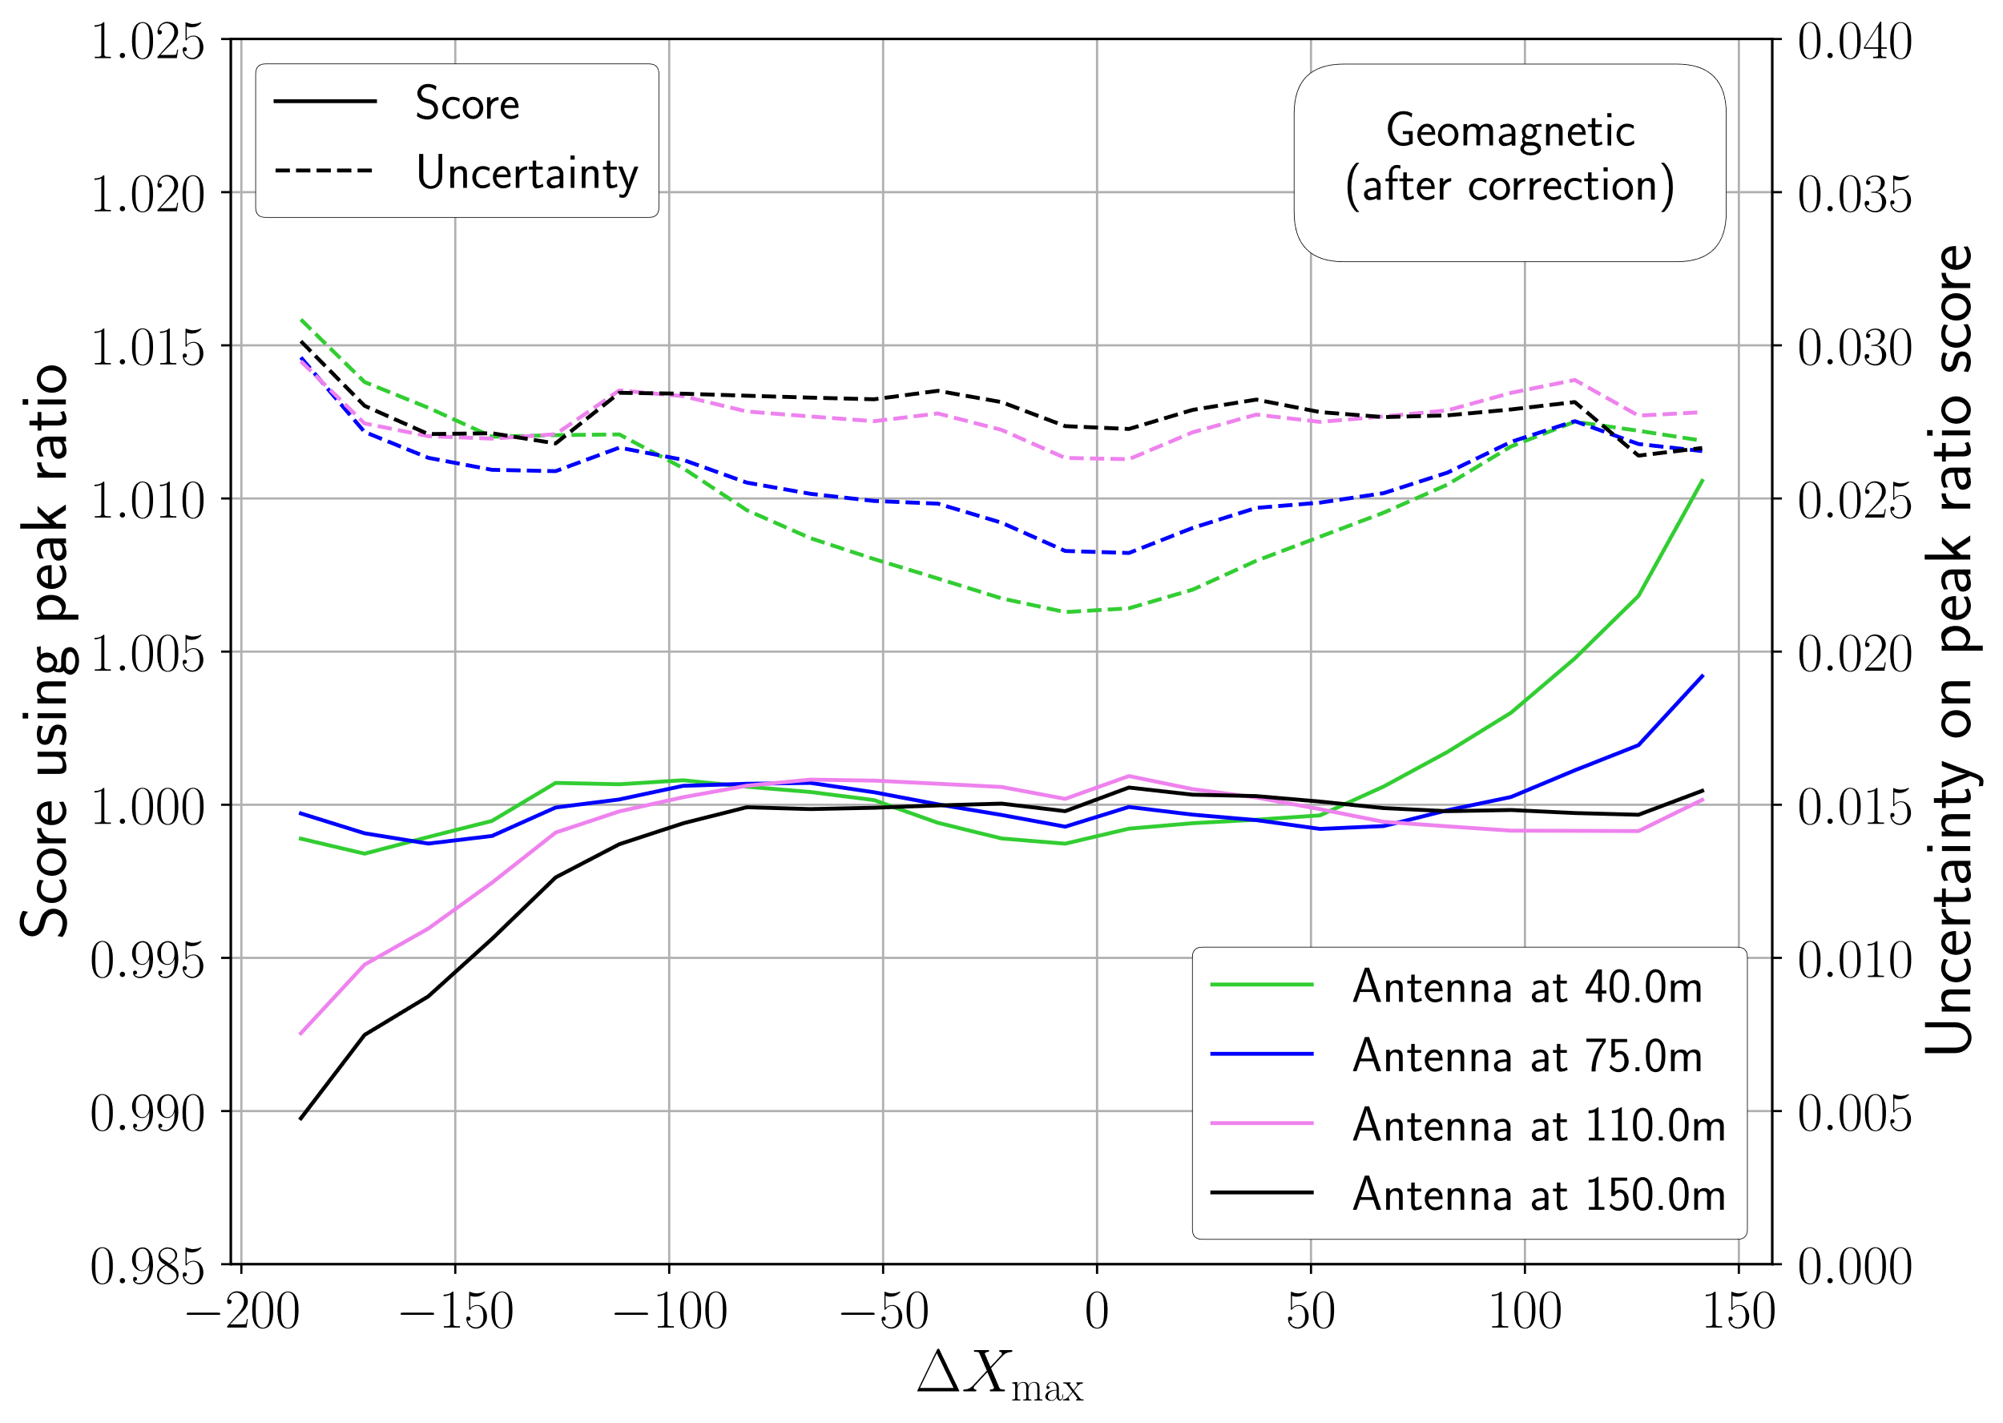
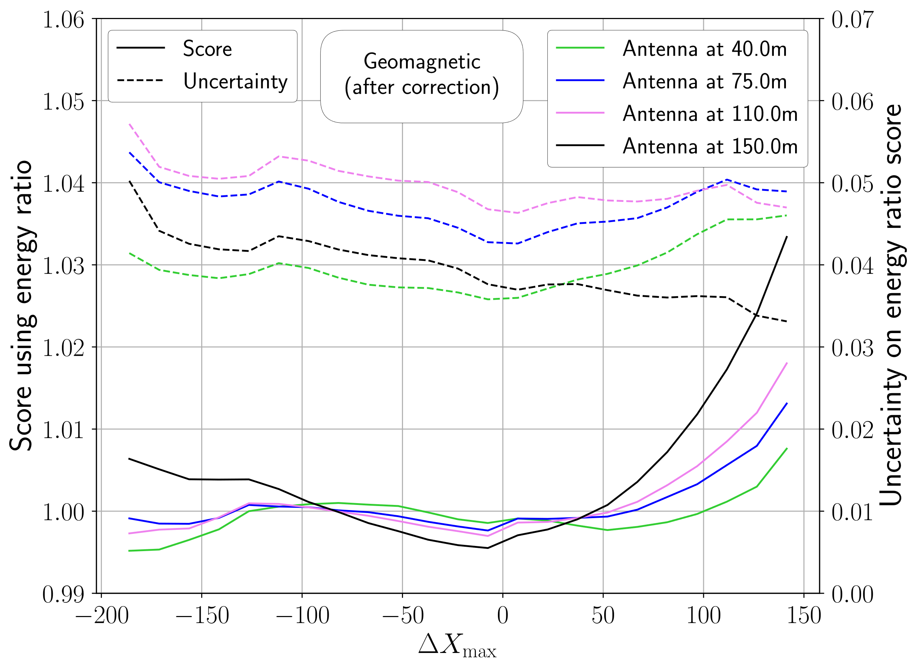
The shift in xmax determines the synthesis quality
The test
[$g$ /$cm^{2}$]
[$g$ /$cm^{2}$]

Slide 24
We have a proof-of-principle for vertical air showers
conclusion
The method performs well for vertical air showers.
We are preparing a publication on these results (Template synthesis approach for radio emission from extensive air showers; M. Desmet, S. Buitink, T. Huege, D. Butler, R. Engel, O. Scholten).
Recent results indicate we can play the same game for other geometries and achieve good synthesis quality.
Next steps:
Understand the scaling of the spectral functions with geometry.
For this, we will probably need to reinterpret the spectral functions as being dependent on (some proxy of) shower age instead of purely $X_{max}$.

Slide 25
Thank you

Slide 26
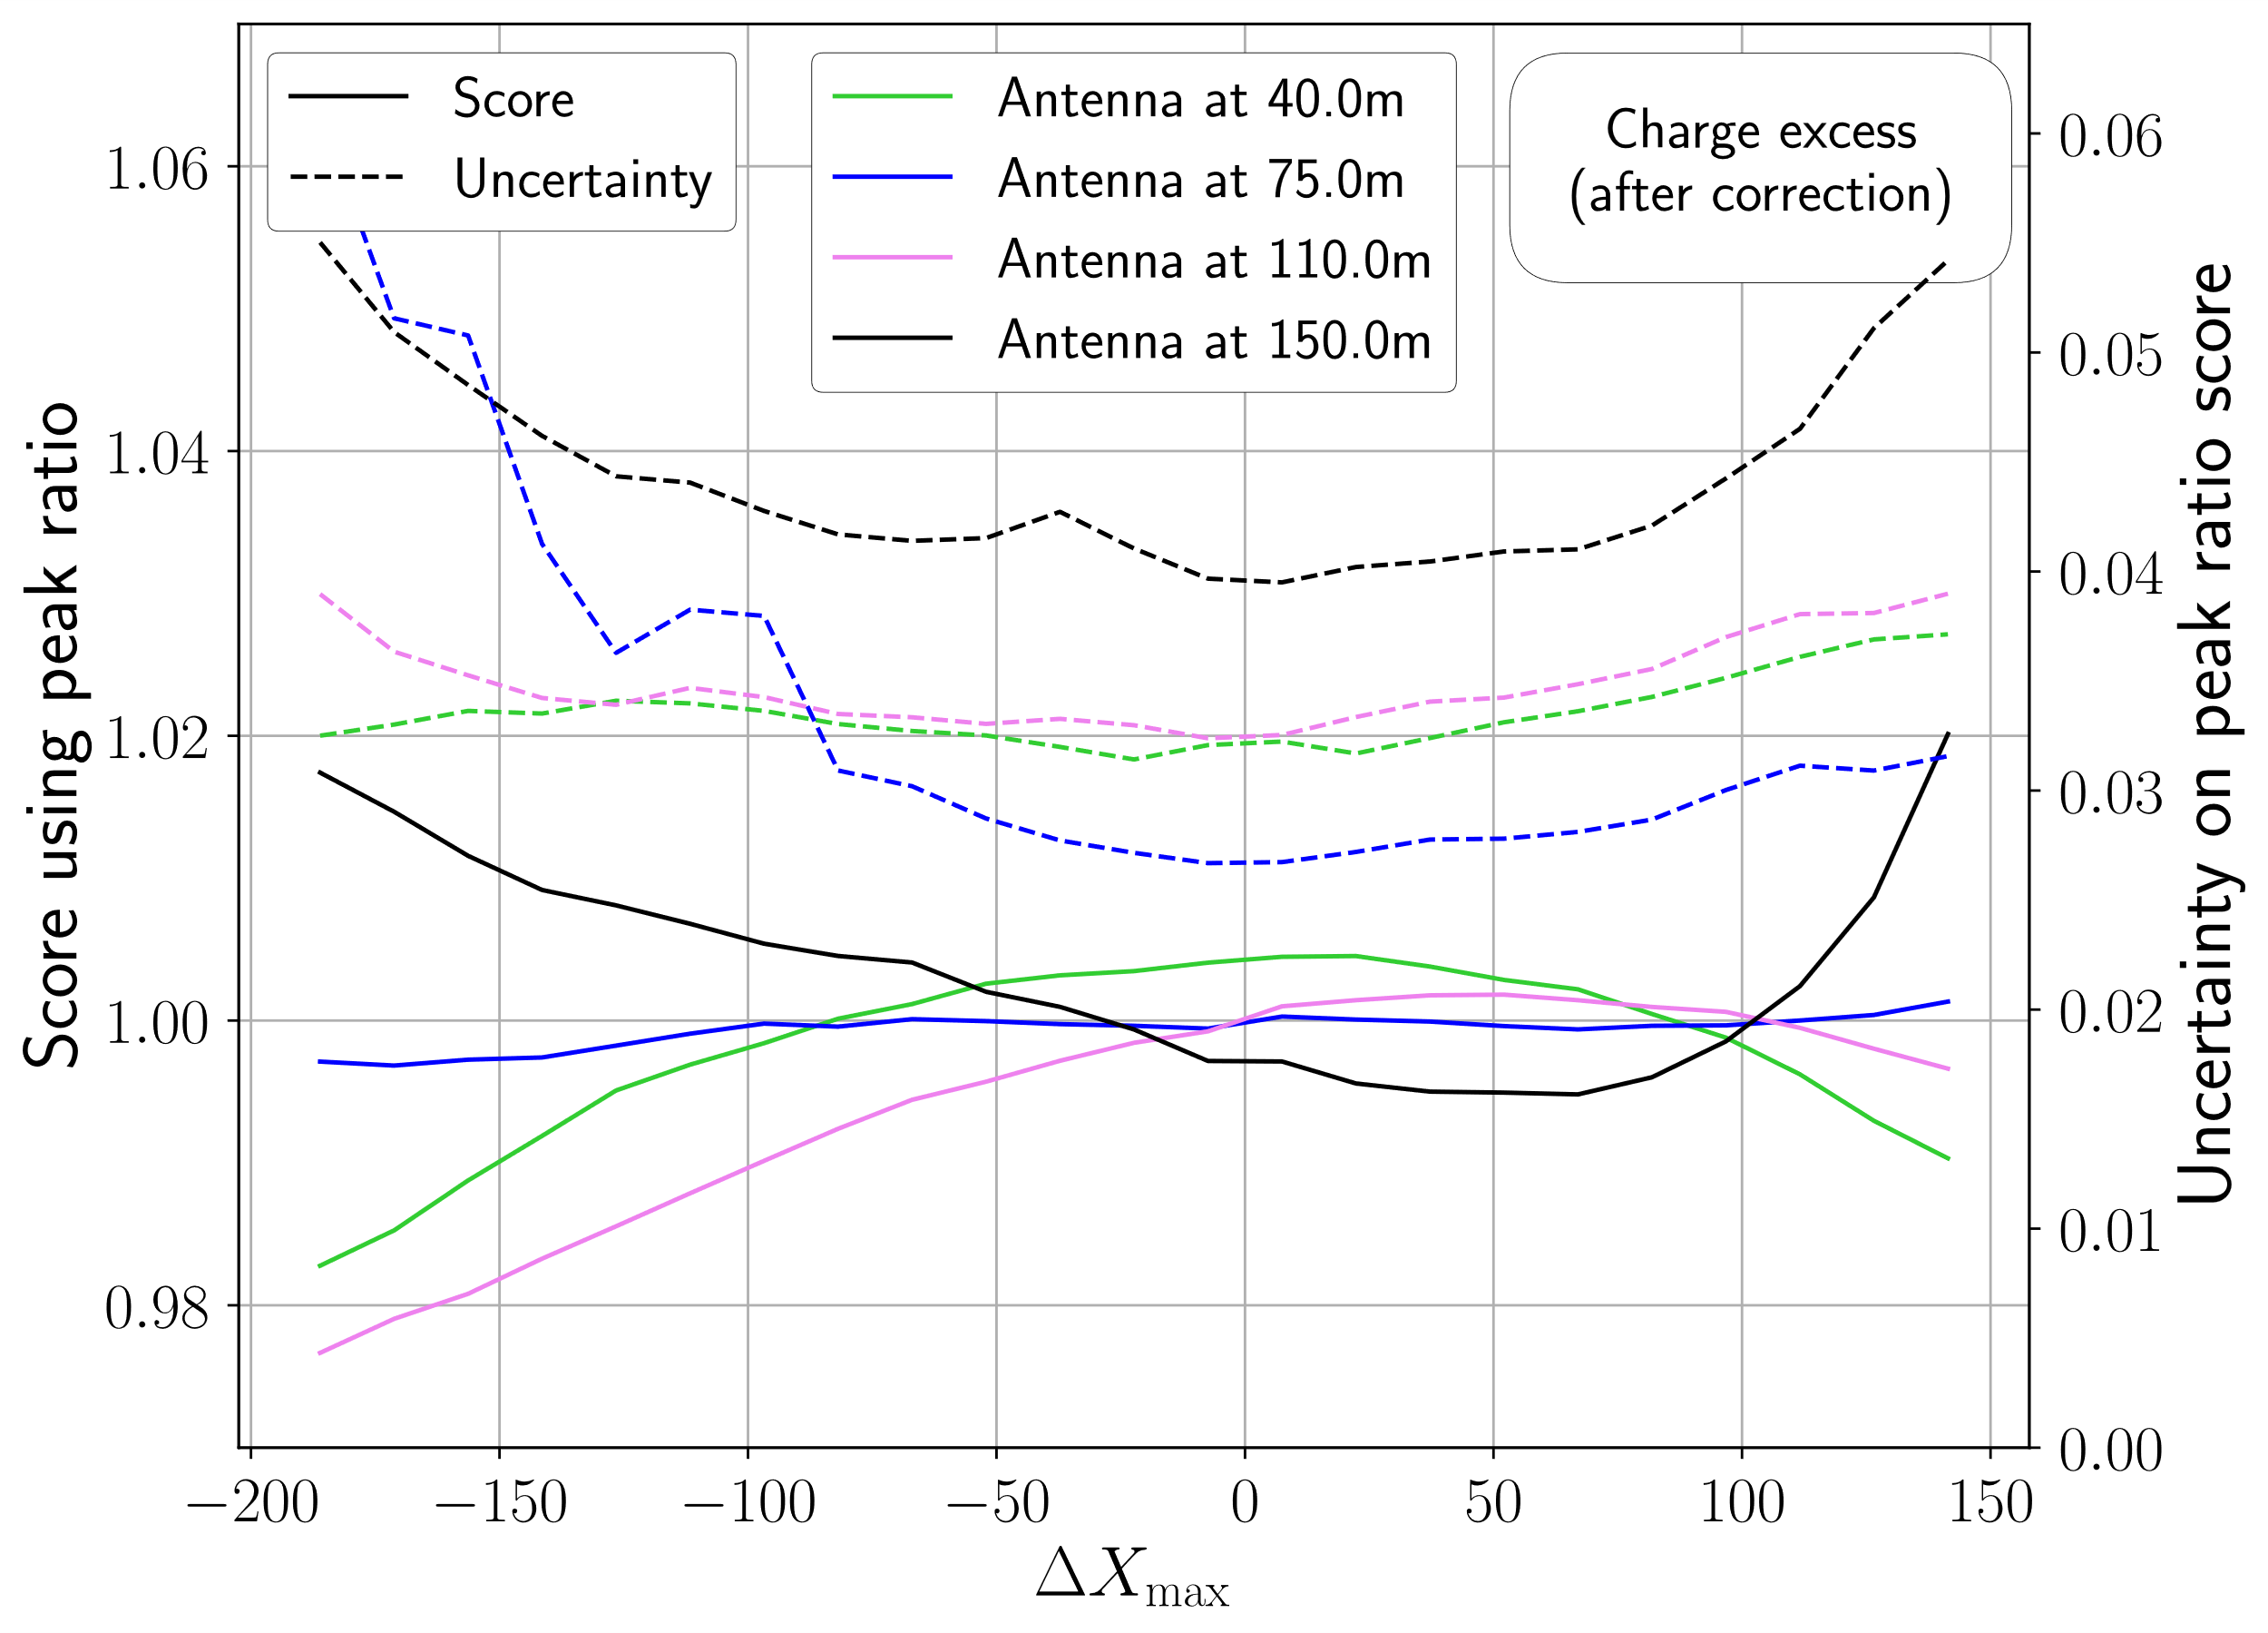
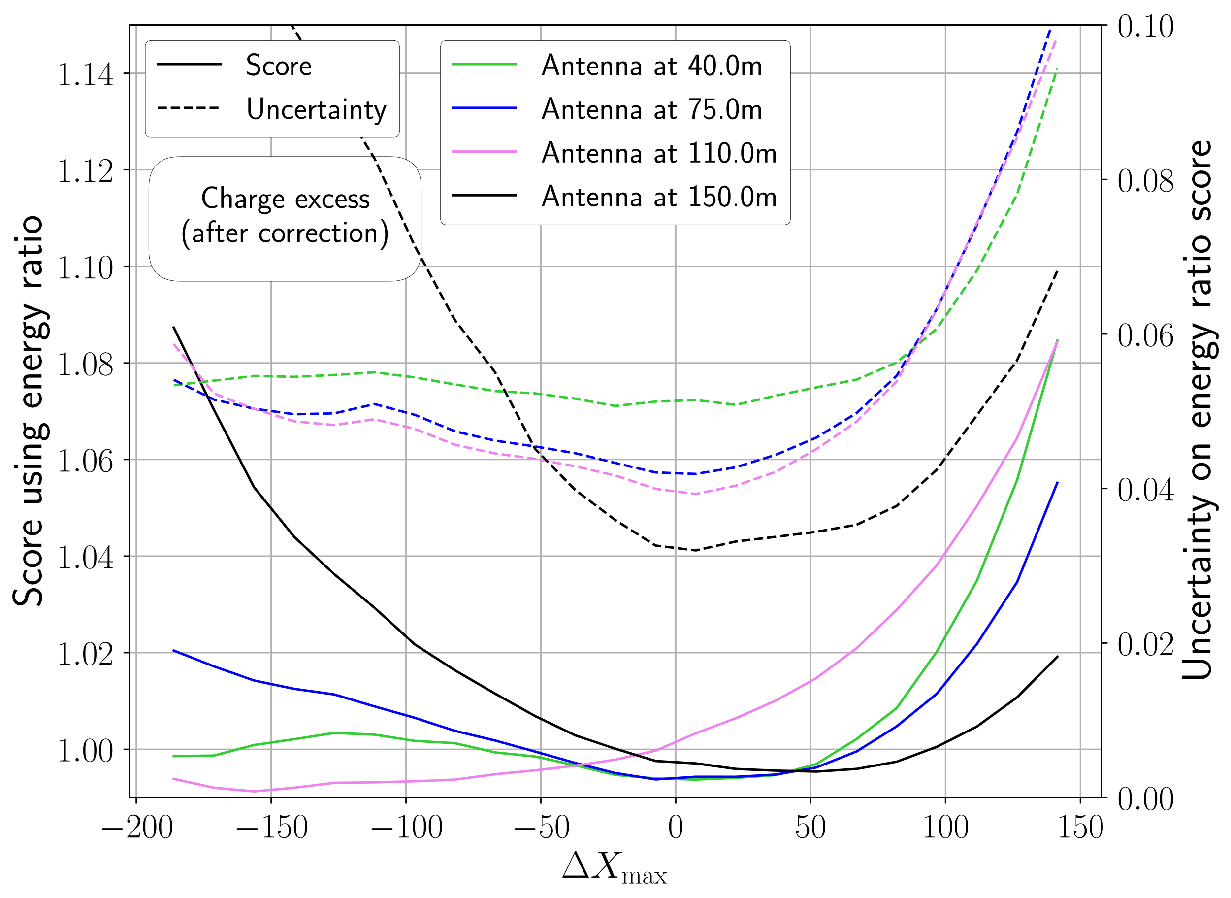
The shift in xmax determines the synthesis quality
The test

Slide 27
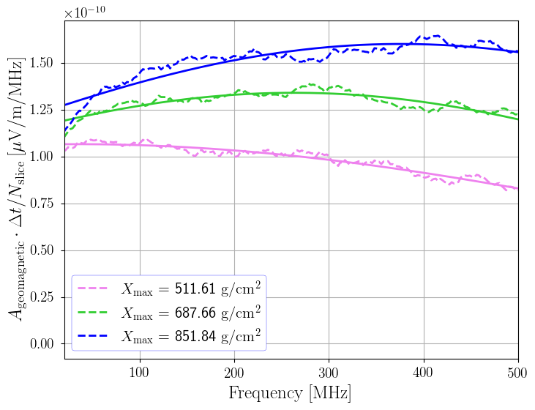
Template synthesis considers slices of the atmosphere as point sources
The method
The emission from a slice depends on the number of particles in it, $N_{slice}$, as well as the age of the shower in that slice.

Slide 28
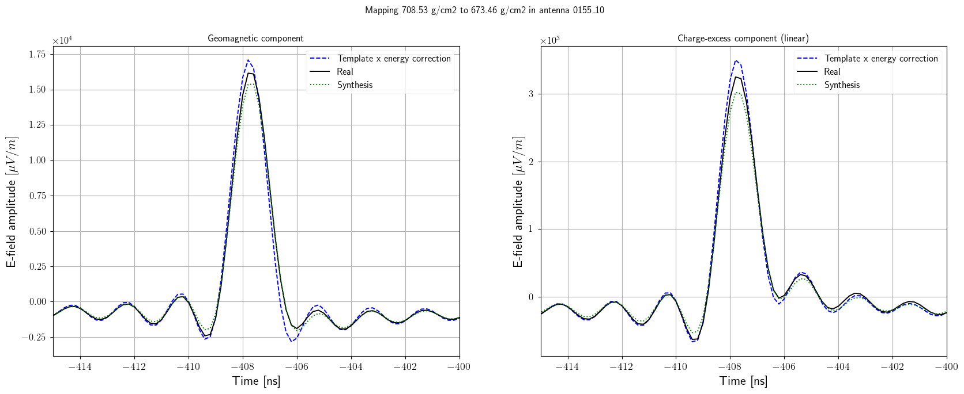
45-degree template synthesis

Slide 29
Template synthesis uses semi-analytical relations to characterise the radio emission from EAS
The method
Radio Morphing
Reference shower
Scaling with shower parameters (prim. E, zenith, air density,…)
Single point of emission
Template Synthesis
Origin shower
Many sources along shower axis
(Fourier interpolation)
(3D interpolation)
Scaling with shower parameters (prim. E, particle number, …)

