Slide 1
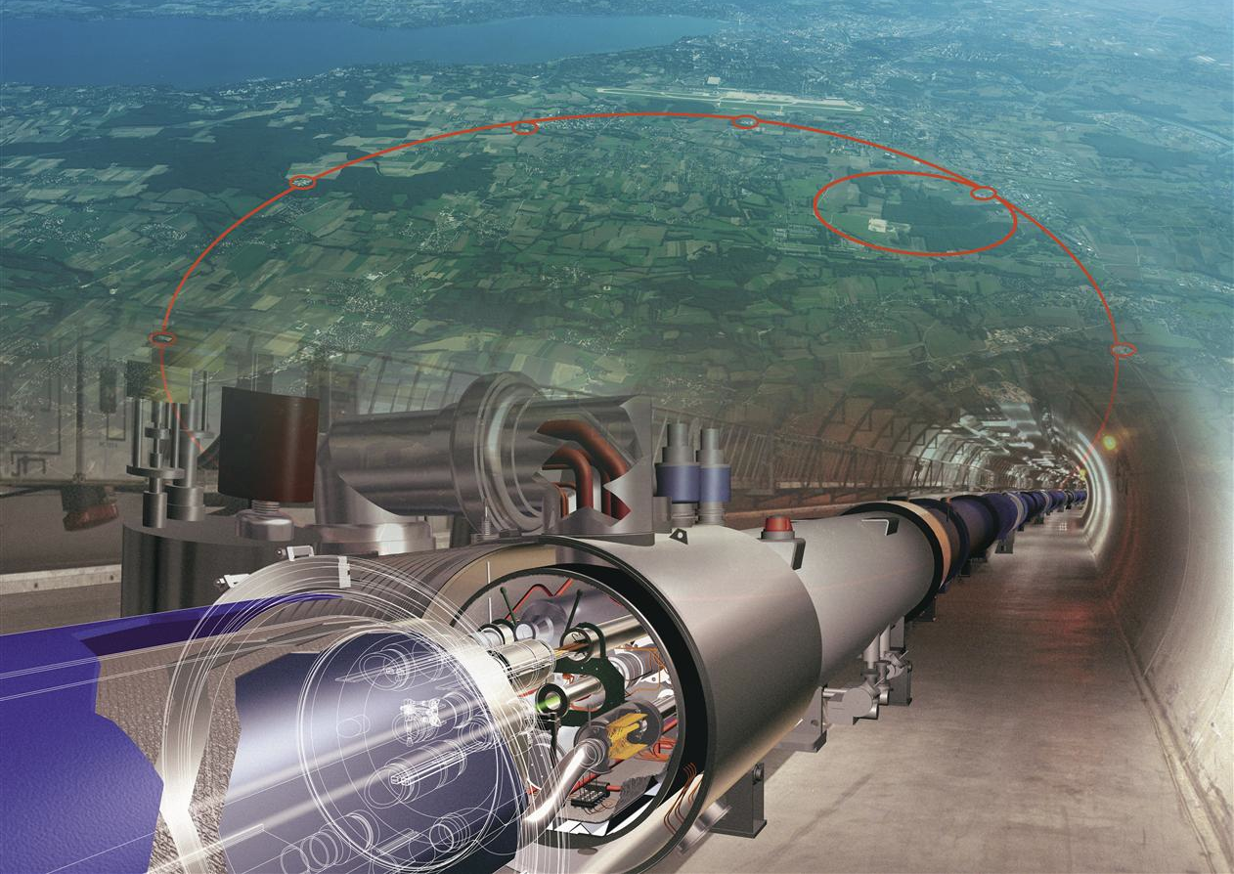
Unlocking the charm-Higgs coupling at the LHC
Study proton collisions
at the LHC
Prof. Jorgen D’Hondt (VUB)
Jorgen.DHondt@vub.be

Slide 2
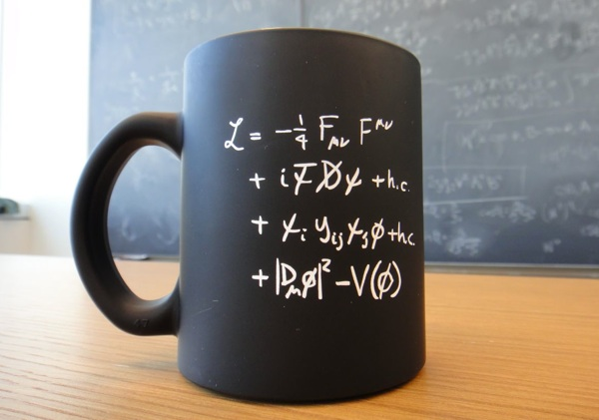
Unlocking the charm-Higgs coupling at the LHC
Standard Model of Particle Physics
Study proton collisions
at the LHC
Prof. Jorgen D’Hondt (VUB)
Jorgen.DHondt@vub.be

Slide 3
Unlocking the charm-Higgs coupling at the LHC
Many mysteries and problems remain to be addressed
Standard Model of Particle Physics
Study proton collisions
at the LHC
Prof. Jorgen D’Hondt (VUB)
Jorgen.DHondt@vub.be

Slide 4
Unlocking the charm-Higgs coupling at the LHC
Many mysteries and problems remain to be addressed
Standard Model of Particle Physics
Study proton collisions
at the LHC
Prof. Jorgen D’Hondt (VUB)
Jorgen.DHondt@vub.be

Slide 5
Unlocking the charm-Higgs coupling at the LHC
Many mysteries and problems remain to be addressed
Standard Model of Particle Physics
The Higgs sector is a unique window
to probe for new physics
Study proton collisions
at the LHC
Prof. Jorgen D’Hondt (VUB)
Jorgen.DHondt@vub.be

Slide 6
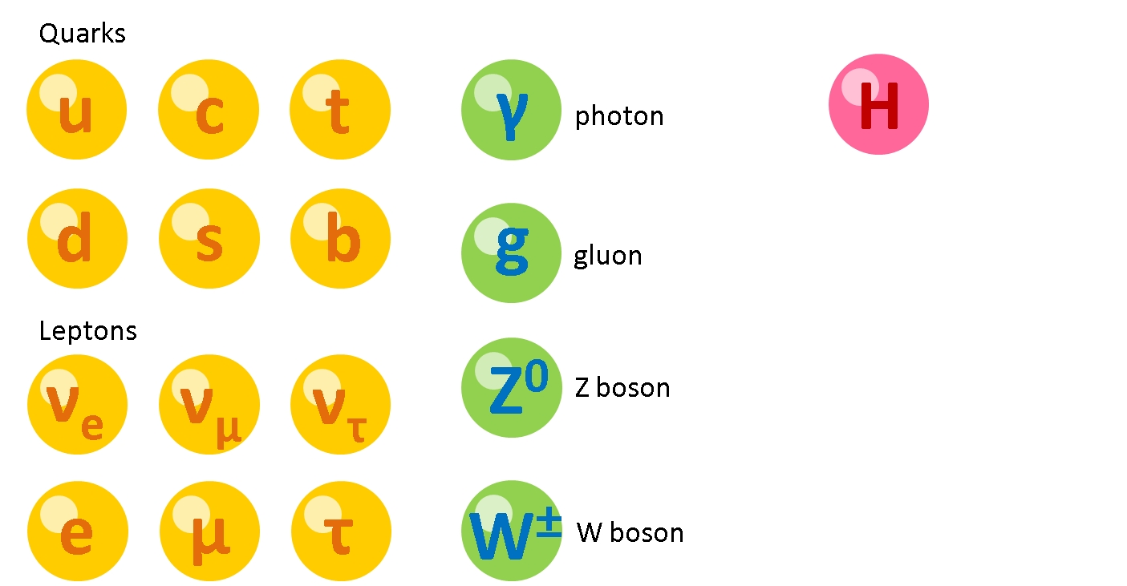
The charm-Higgs coupling
The next window of opportunnity at the LHC at CERN to probe for new physics phenomena

Slide 7
The charm-Higgs coupling
The next window of opportunnity at the LHC at CERN to probe for new physics phenomena

Slide 8
The charm-Higgs coupling
The next window of opportunnity at the LHC at CERN to probe for new physics phenomena
Theory prediction
The particle mass depends on the coupling strength with the H field
y_{f} ∝ κ_{f} m_{f} + others
g_{V}² ∝ κ_{V} m_{V}² + others
simple coupling modifiers
(SM-oriented analysis)
involving new particles and/or new interactions
(BSM-oriented analysis)
Develop methods: machine learning, Effective Field Theories, data analysis & statistical methods, precision measurement methods, …

