Slide 1
Consistent description of cluster and shell models
Naoyuki Itagaki (Osaka Metropolitan University)
June 2. 2023, Bruxelles

Slide 2

Our dream
Cluster model
Shell model

Slide 3

Combining these two features
Cluster side
Shell model side
Big computational challenge
including modern ab initio ones

Slide 4
From the shell model side
¹²C ground state
¹²C Hoyle state
T. Otsuka, T. Abe, T. Yoshida, Y. Tsunoda, N. Shimizu, N. Itagaki, Y. Utsuno, J. Vary, P. Maris, H. Ueno
Nature Communications 13:2234 (2022)

Slide 5
Combining these two features
Cluster side
Shell model side
This talk

Slide 6
1. How can we transform the cluster model wave functions to the shell-model ones?

Slide 7

α
α
α
¹²C

Slide 8
α
α
α
¹²C

Slide 9



d3/2
N=2 (s,d)
s1/2
d5/2
p1/2
N=1 (p)
subclosure
p3/2
N=0 (s)
s1/2
jj-coupling shell-model
three-dimensional
harmonic oscillator
with spin-orbit contribution

Slide 10
Antisymmetrized quasi-cluster model
(AQCM)
spatial part of the single particle wave function
exp[-ν( r – R )²]
Four nucleons share the same R value
as in traditional cluster models
no spin-orbit effect
R → R＋i Λ (e_spin x R)
α cluster
→ quasi cluster
N. Itagaki, J. Cseh, and M. Płoszajczak, Phys. Rev. C 83, 014302 (2011)

Slide 11
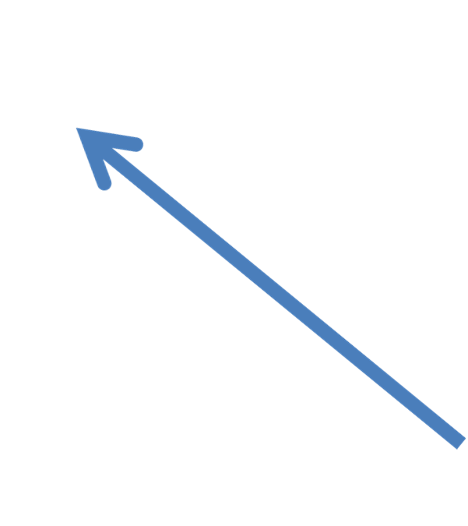

z axis
y axis
x axis

Slide 12
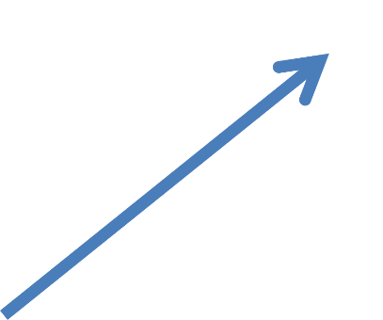
z axis
y axis
α cluster
x axis

Slide 13

z axis
y axis
α cluster
x axis

Slide 14
z axis
R → R＋i Λ (e_spin x R)
y axis
quasi cluster
x axis

Slide 15
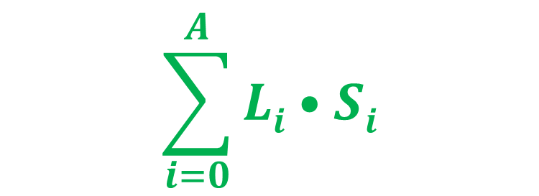
One-body spin-orbit operator
¹²C
R = 0.01 fm
p3/2: j=3/2, l=1, s=1/2,
L*S =
( j(j+1) - l(l+1) - s(s+1) )/2 = 1/2
(s_{1/2})⁴(p_{3/2})⁸

Slide 16
¹²C
L: relative distance between clusters
L = 3 fm
Λ = 0
L = 0.01 fm
Λ = 0

Slide 17
¹²C L = 0.01 fm
Λ = 0
Λ = 1
XZ
XY

Slide 18
2. How can we use it?
--- can we distinguish whether the actual nucleus is cluster-model-like or shell-model-like?

Slide 19
We can prepare shell- and cluster-model wave functions based on AQCM on the same footing
Wataru Horiuchi’s idea
If we prepare shell- and cluster-model wave functions, both reproducing the observed charge radius, we could see the difference in the proton elastic scattering. He can connect AQCM to his Glaubar-model calculation.

Slide 20
Application to ¹²C
S-type (jj-coupling shell model)
We take the small-distance limit of α clusters.
Л is set to 1.
The Gaussian size parameter ν for the single particles
is adjusted to reproduce the experimental charge radius.

Slide 21
Antisymmetrized quasi-cluster model
(AQCM)
spatial part of the single particle wave function
exp[-ν( r – R )²]
Four nucleons share the same R value
in traditional cluster models
no spin-orbit effect
R → R＋i Λ (e_spin x R)
α cluster
→ quasi cluster
N. Itagaki, J. Cseh, and M. Płoszajczak, Phys. Rev. C 83, 014302 (2011)

Slide 22
Application to ¹²C
S-type (jj-coupling shell model)
We take the small-distance limit of α clusters.
Л is set to 1.
The Gaussian size parameter ν for the single particles
is adjusted to reproduce the experimental charge radius.
C-type (α-cluster model)
We prepare three ``free” α particles.
Л is set to 0.
The distances between three α particles
with an equilateral triangular configuration are
adjusted to reproduce the experimental charge radius.

Slide 23
¹²C ground state is shell or cluster?
(density distribution)
W. Horiuchi and N. Itagaki, Phys. Rev. C 107, L021304 (2023)

Slide 24
¹²C ground state is shell or cluster?
(proton elastic scattering, 1000 MeV)
W. Horiuchi and N. Itagaki, Phys. Rev. C 107, L021304 (2023)

Slide 25
¹²C ground state is shell or cluster?
(proton elastic scattering, 1000 MeV)
W. Horiuchi and N. Itagaki, Phys. Rev. C 107, L021304 (2023)

Slide 26
Application to ¹⁶O
S-type (jj-coupling shell model)
We take the small-distance limit of α clusters
with a tetrahedron configuration.
The Gaussian size parameter ν for the single particles
is adjusted to reproduce the experimental charge radius.
C-type (α-cluster model)
We prepare four ``free” α particles.
The distances between four α particles
with a tetrahedron configuration are adjusted
to reproduce the experimental charge radius.

Slide 27
¹⁶O ground state is shell or cluster?
(proton elastic scattering, 1000 MeV)
W. Horiuchi and N. Itagaki, Phys. Rev. C 107, L021304 (2023)

Slide 28
¹⁶O ground state is shell or cluster?
(proton elastic scattering, 1000 MeV)
W. Horiuchi and N. Itagaki, Phys. Rev. C 107, L021304 (2023)

Slide 29
Elastic charge form factor
W. Horiuchi and N. Itagaki, Phys. Rev. C 107, L021304 (2023)

Slide 30
What is the difference between proton elastic and electron scattering?
Proton elastic scattering is sensitive to the surface region (we can probe the diffuseness).
Proton elastic scattering could be possible for some ``unstable” nuclei.
Electron scattering also contains the information of the inner region.
They are complimentary to each other.

Slide 31
3. How about the clustering in the medium-heavy region?

Slide 32
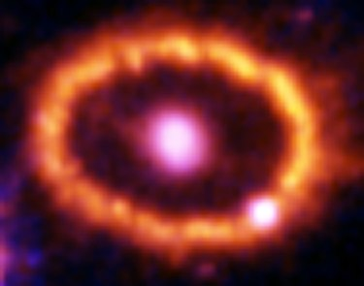
⁴⁴T important nucleus for the observation of the supernova explosion
Mainly produced via ⁴⁰Ca(⁴He,γ)⁴⁴Ti

Slide 33
⁴⁰Ca
⁴He
±
⁴He
⁴⁰Ca
Inversion doublet structure
T. Yamaya et al, Prog. Theor. Phys. Suppl. 132 73 (1998)

Slide 34
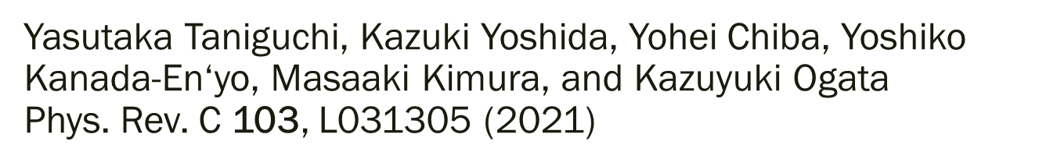
Alpha knockout reaction

Slide 35
Cluster
Chikako Ishizuka, Hiroki Takemoto, Yohei Chiba, Akira Ono, Naoyuki Itagaki
Phys. Rev. C 105, 064314 (2022)

Slide 36
Chikako Ishizuka, Hiroki Takemoto, Yohei Chiba, Akira Ono, Naoyuki Itagaki
Phys. Rev. C 105, 064314 (2022)

Slide 37
Spin-orbit interaction is a driving force that breaks the clusters and enhances the symmetry of jj-coupling shell model
Cluster side
shell-model side
spin-orbit interaction

Slide 38
Proton elastic scattering for ⁴⁴Ti
S-type (jj-coupling shell model)
We take the small distance limit between ⁴⁰Ca and ⁴He.
The Л value of ⁴He is set to 1.
The Gaussian size ν for the single particles is adjusted
to reproduce the experimental charge radius of ⁴⁴Ti.
C-type (α+⁴⁰Ca cluster model)
The Gaussian size ν for the single particles is adjusted
to reproduce the experimental charge radius of ⁴⁰Ca.
The distances between α (Л=0) and ⁴⁰Ca is adjusted
to reproduce the experimental charge radius of ⁴⁴Ti.

Slide 39
⁴⁴Ti and ⁵²Ti ground states are shell or cluster
(proton elastic scattering at 320 MeV)
W. Horiuchi and N. Itagaki, Phys. Rev. C 106, 044330 (2022)

Slide 40
Tensor interaction could be the salvation of the clustering
How can we include this effect in the cluster model?

Slide 41
iSMT
N. Itagaki and A Tohsaki, Phys. Rev. C 97 014304 (2018)
⁴He
p↑
p↑
p↓
p↓
n↓
n↑
n↑
n↓
p↑ Gaussian center R = i d e_{z}
n↑ or n↓ Gaussian centers R = - i d e_{z}
d = 0, 0.75, 1.5, 2.25, ….. , 5.25 fm

Slide 42
Cluster
Chikako Ishizuka, Hiroki Takemoto, Yohei Chiba, Akira Ono, Naoyuki Itagaki
Phys. Rev. C 105, 064314 (2022)

Slide 43
Conclusions
Using AQCM, we can prepare both cluster and shell wave functions on the same footing.
We can distinguish whether actual nuclei are cluster-model-like or shell-model-like by connecting to the proton elastic scattering calculation based on the Glauber theory.
We started probing the clustering in medium-heavy nuclei, and the tensor interaction could be the salvation of the clustering.

