Slide 1
« Concluding remarks »
June 2, 2023
Daniel Baye

Slide 2
Not a summary talk !
About Pierre
… or more precisely:
Facts and personal memories about Pierre Descouvemont’s scientific career in a more or less chronological order

Slide 3
Student
Pierre studied engineering in the Faculty of Applied Sciences of ULB (also called « Ecole Polytechnique »).
In 1978, an unusually small number of students had chosen the option Physics : only 2 !
One of them was Pierre.
Pierre followed the Quantum Mechanics courses of Prof. Demeur.
I was in charge of the exercises.
A very agreable task: the two students worked efficiently together without much needing my help.
Quite convenient when I became a poorly sleeping father !
Not surprisingly, Prof. Demeur and I were happy that Pierre chose our group to make his
« Travail de Fin d’Etudes » (End-of-studies work).
1981: Pierre became Master in Applied Sciences, option Physics (« Ingénieur civil Physicien »)
He graduated with the highest mark: « La Plus Grande Distinction ».

Slide 4
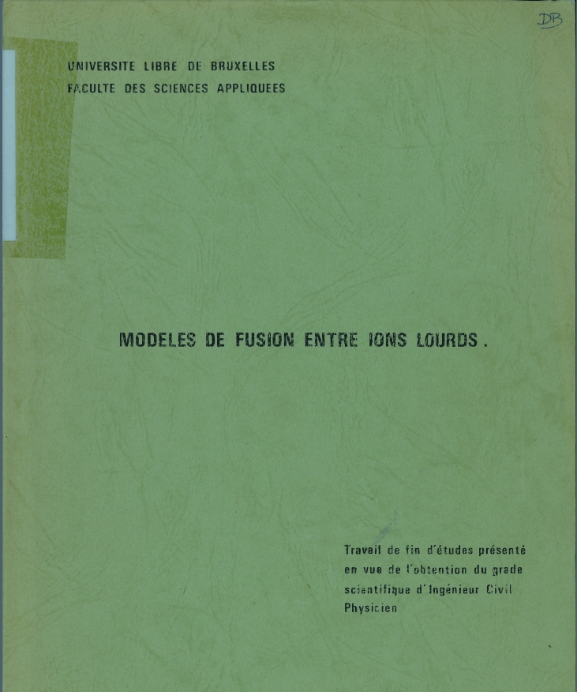
Anonymous undated report:
Models of heavy-ion fusion

Slide 5
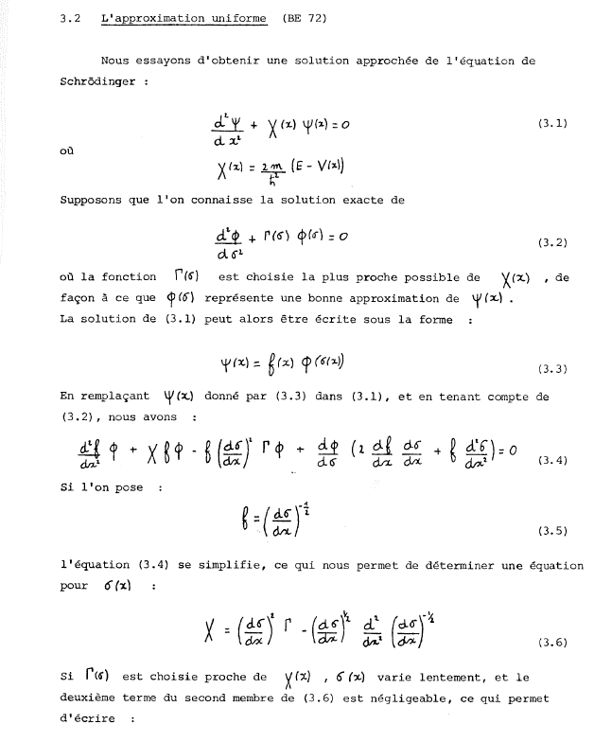
This was a time without laptops, without LaTeX, …
The text was typed leaving space for handwritten formulas.
In this report, Pierre
explained the notion of heavy-ion fusion,
described experimental techniques,
reviewed two popular simple models,
and developed a model unifying them.

Slide 6
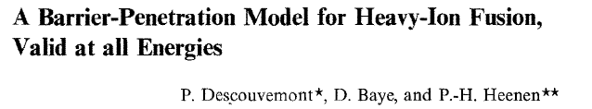
1982: First publication

Slide 7
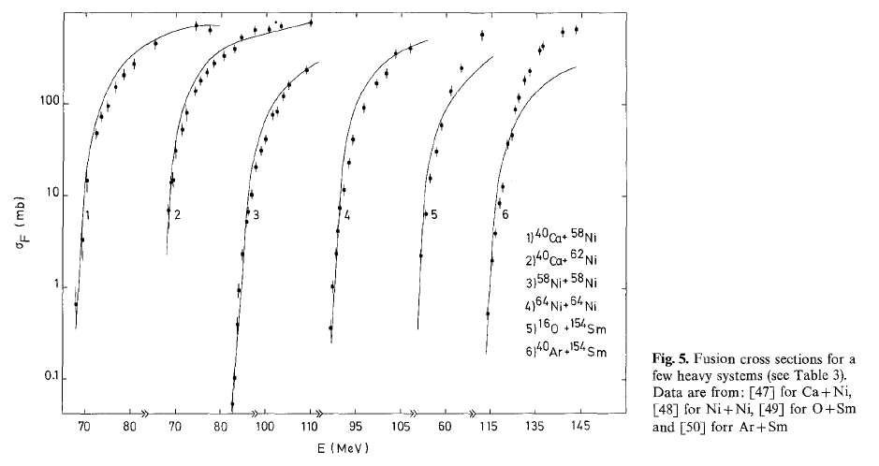
But the model was not so good for heavier systems.
Pierre’s advisers had been too optimistic.

Slide 8
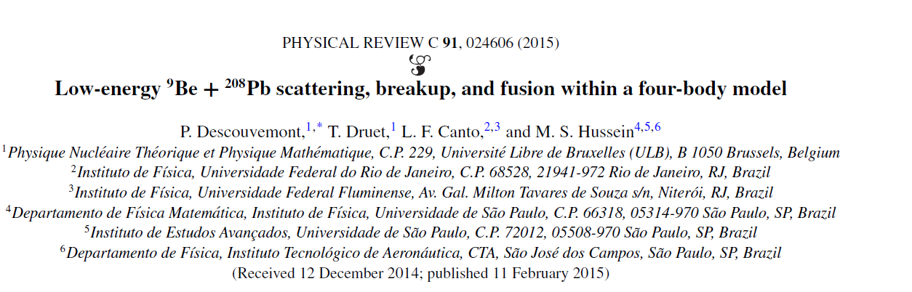
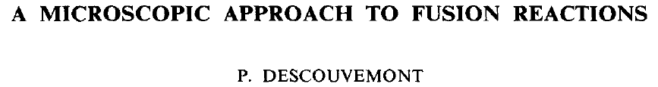
Project for a thesis?
After the limited success of this first study of fusion, the question for Pierre’s thesis project was:
how can one describe heavy-ion fusion with a microscopic model ?
Without a clear answer, we proposed to « first » redirect the thesis project to lighter ions
... and the final thesis does not contain anything about heavy-ion fusion.
But later, Pierre returned to this question several times.
With optical potentials
With CDCC

Slide 9
Purest form of fusion: radiative capture
A + B → C + γ
A description is possible
with the microscopic cluster model
… and is the main topic of Pierre’s thesis

Slide 10
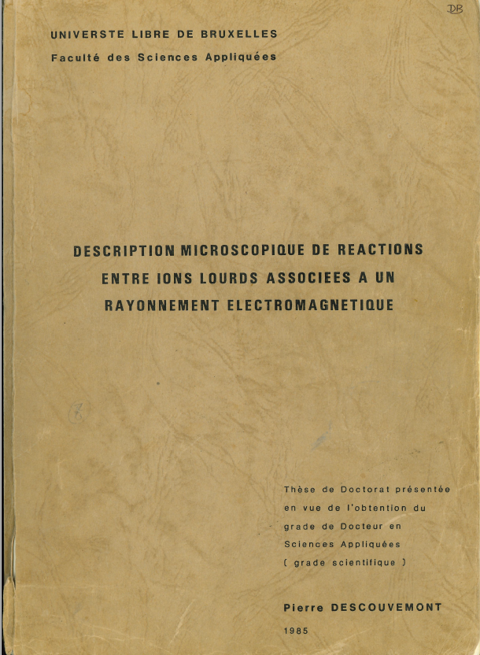
1985: PhD
Microscopic description of reactions
between heavy ions associated with an
electromagnetic radiation
This thesis contains some crucial topics of Pierre’s scientific career:
MICROSCOPIC DESCRIPTION
R MATRIX
RADIATIVE CAPTURE

Slide 11
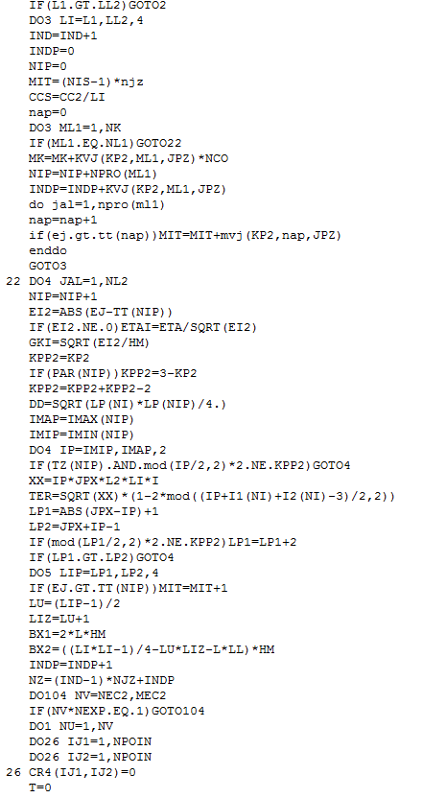
For his thesis, Pierre first adapted the code MRM:
« Microscopic R-matrix method »
allowing a microscopic description of wave functions
necessary for radiative capture.
He then developed the code FUSMIC
« Fusion, microscopic description »
1719 lines of code
WITHOUT A SINGLE COMMENT
Private question:
Pierre, will you have time for a writeup of FUSMIC after retiring ?

Slide 12
Applications of the microscopic cluster model
Electromagnetic transitions between bound states
Radiative capture
¹⁶O(α,γ)²⁰Ne
¹²C(α,γ)¹⁶O
¹²C(¹²C,γ)²⁴Mg
⁻ And…

Slide 13
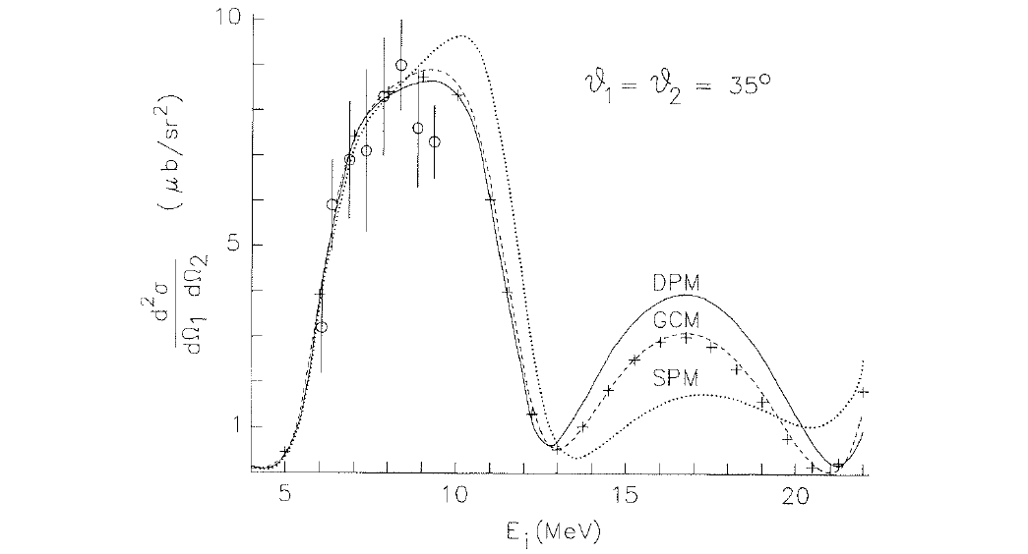
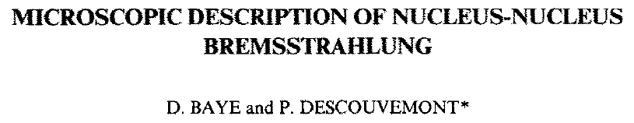
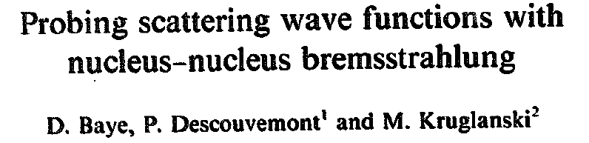
Nucleus-nucleus bremsstrahlung
A + B → A + B + γ
α(α,αγ)α
Unfortunately, no data available
at energies where models differ
Application to α(α,αγ)α

Slide 14
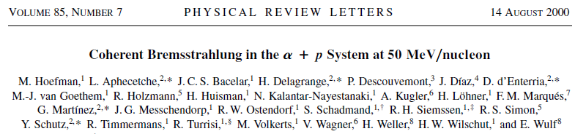
¹⁶O + α bremsstrahlung
First publication as single author
Theoretical contribution to an experiment:
α + p bremsstrahlung with the Groningen group

Slide 15
1988: First visit to Japan
Pierre and I attended 3 successive conferences
Tokyo
Kyoto (Cluster 88)
Sapporo
… and made a nice touristic journey !

Slide 16
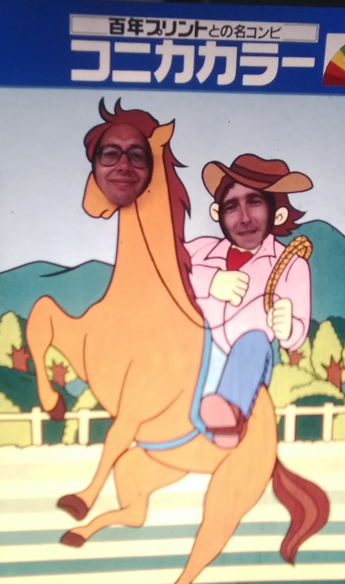
Nuclear physicists
… in the Far-East

Slide 17
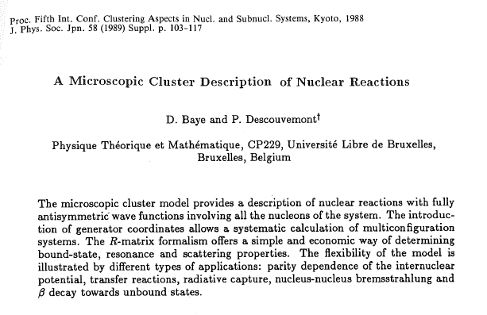

Slide 18
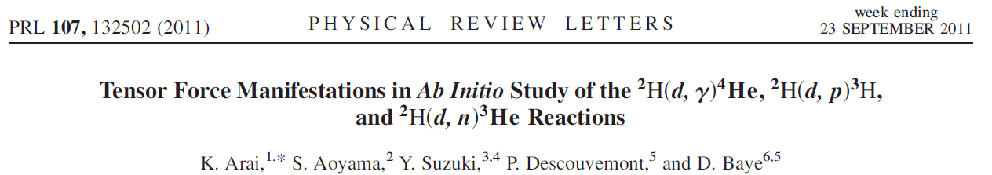
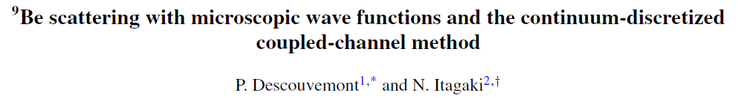
These first conferences in Japan were paving the way to Pierre’s Japanese collaborations
Y. Suzuki, K. Arai, S. Aoyama, W. Horiuchi (Niigata)
Y. Fujiwara (Kyoto)
N. Itagaki (Kyoto)
H. Suno (Kobe)

Slide 19
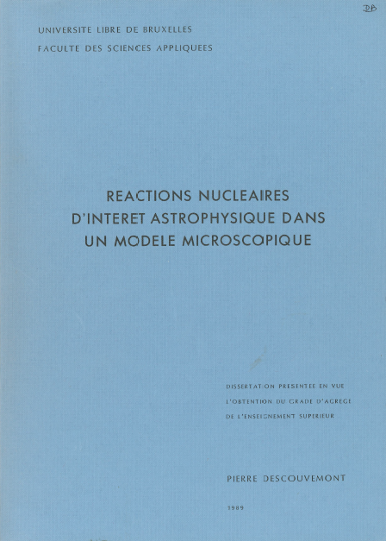
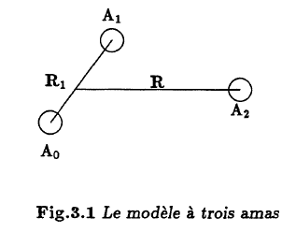
1989: Habilitation thesis (« Thèse d’agrégation »)
Many topics:
- Three-cluster microscopic model
- Various reactions of astrophysical interest
- β decay to unbound states
- Microscopic investigation of transfer and fusion
- …

Slide 20
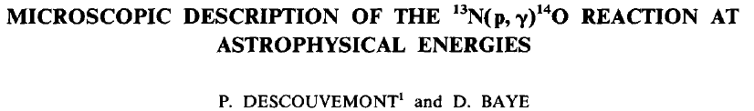
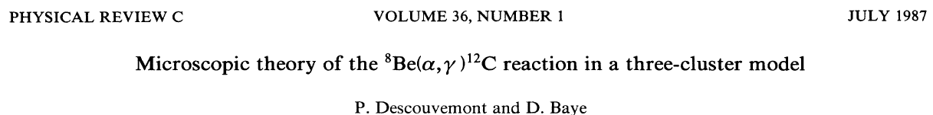
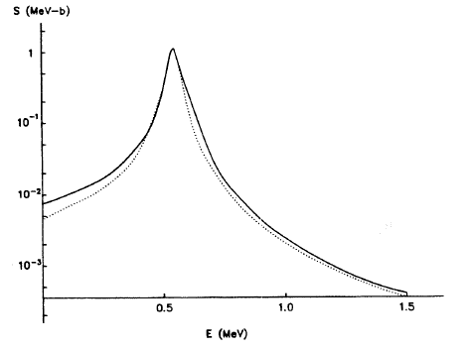
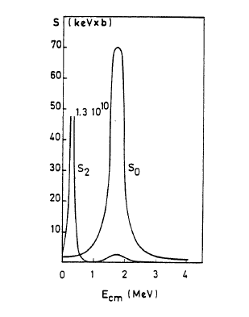
Microscopic two-cluster model
Proton capture on a radioactive nucleus
(being measured at Louvain-la-Neuve)
Hot CNO cycle
Microscopic three-cluster model
Triple alpha process:
Hoyle state and its 2⁺ excitation

Slide 21
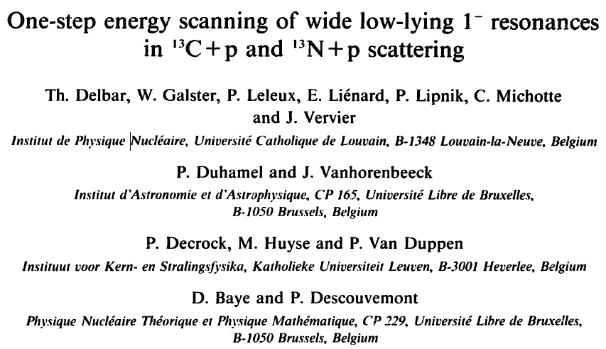
1990’s: first experiments with radioactive nuclei
Close collaboration with experimentalists from Belgian universities UCL, ULB and KUL
Theorists struggling to understand new vocabulary:
?? what can be the meaning of « straggling » ??

Slide 22
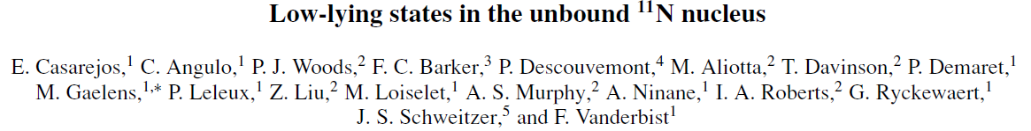
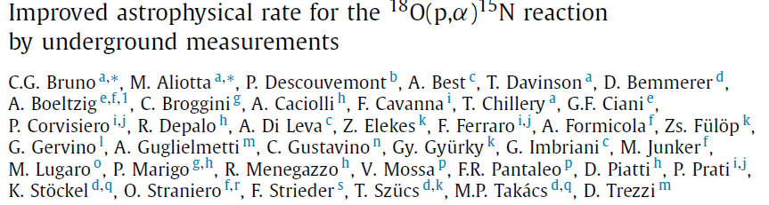
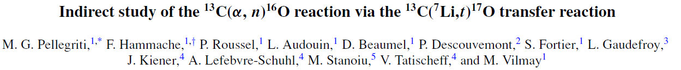
Pierre participated to the interpretation of experiments for various groups
Louvain-la-Neuve, Groningen, Ganil, Orsay, TRIUMF, LUNA, RIBRAS
He is co-author of 20 experimental papers and of many contributions,
often with experimentalists invited at this workshop.
In many cases, he made use of the R matrix method…

Slide 23
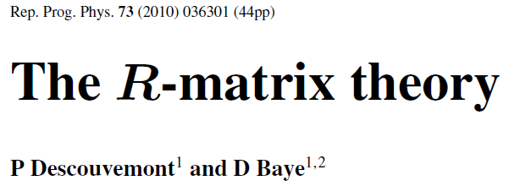
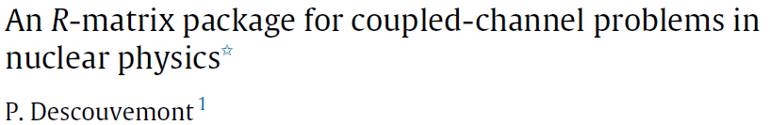
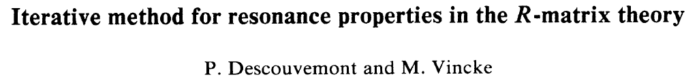
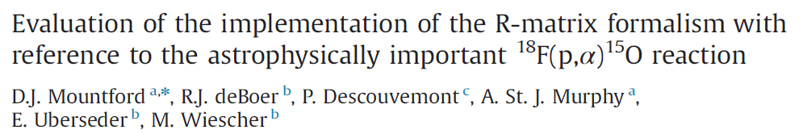
R matrix theory
There are two variants of the R-matrix method:
The original phenomenological R matrix provides fits of data.
The calculable R matrix can provide accurate scattering solutions of the Schrödinger equation.
Pierre explored various aspects of the theory and made a number of applications of both variants.

Slide 24

1992: Uzbekistan connection
N.K. Timofeyuk
- First visitor from the former USSR
Shock of scientific cultures:
Thanks to Natasha, we learned the importance of ANC for radiative capture
« You have computers, we have ideas. »
- And other topics
E.M. Tursunov
This paper led to a controversy with our colleagues Y. Suzuki and Y. Fujiwara:
why do « identical » correct calculations give very different results ?

Slide 25
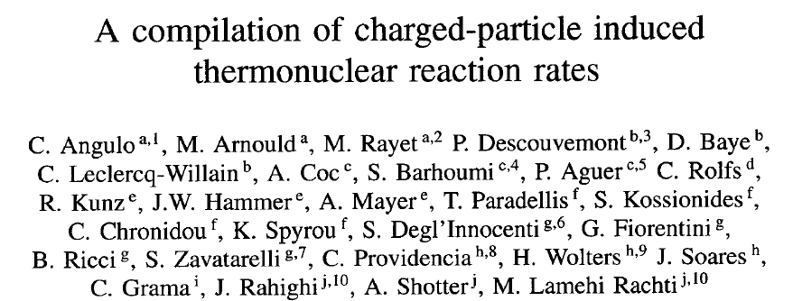
1999: The NACRE compilation
Around 1995, M. Arnould and C. Rolfs proposed to create a modern compilation of reaction rates
for nuclear reactions of astrophysical interest.
The project involved 28 participants from 10 laboratories of 8 countries and required many meetings,
often quite lively.
Pierre was one of the most active participants and main writers of the text.
The compilation was later named NACRE for « Nuclear Astrophysics Compilation of REaction rates ».
It has received more than 2800 citations.

Slide 26
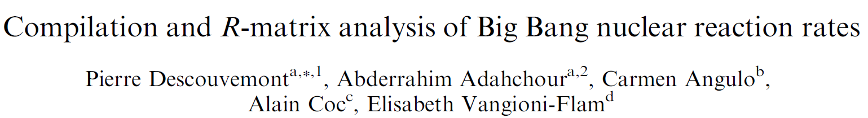
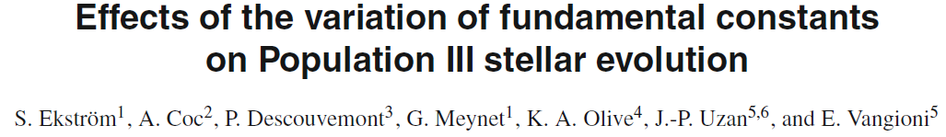
Nuclear astrophysics
After the NACRE compilation, Pierre continued to be interested in astrophysical applications in collaboration
with several participants to this workshop.

Slide 27
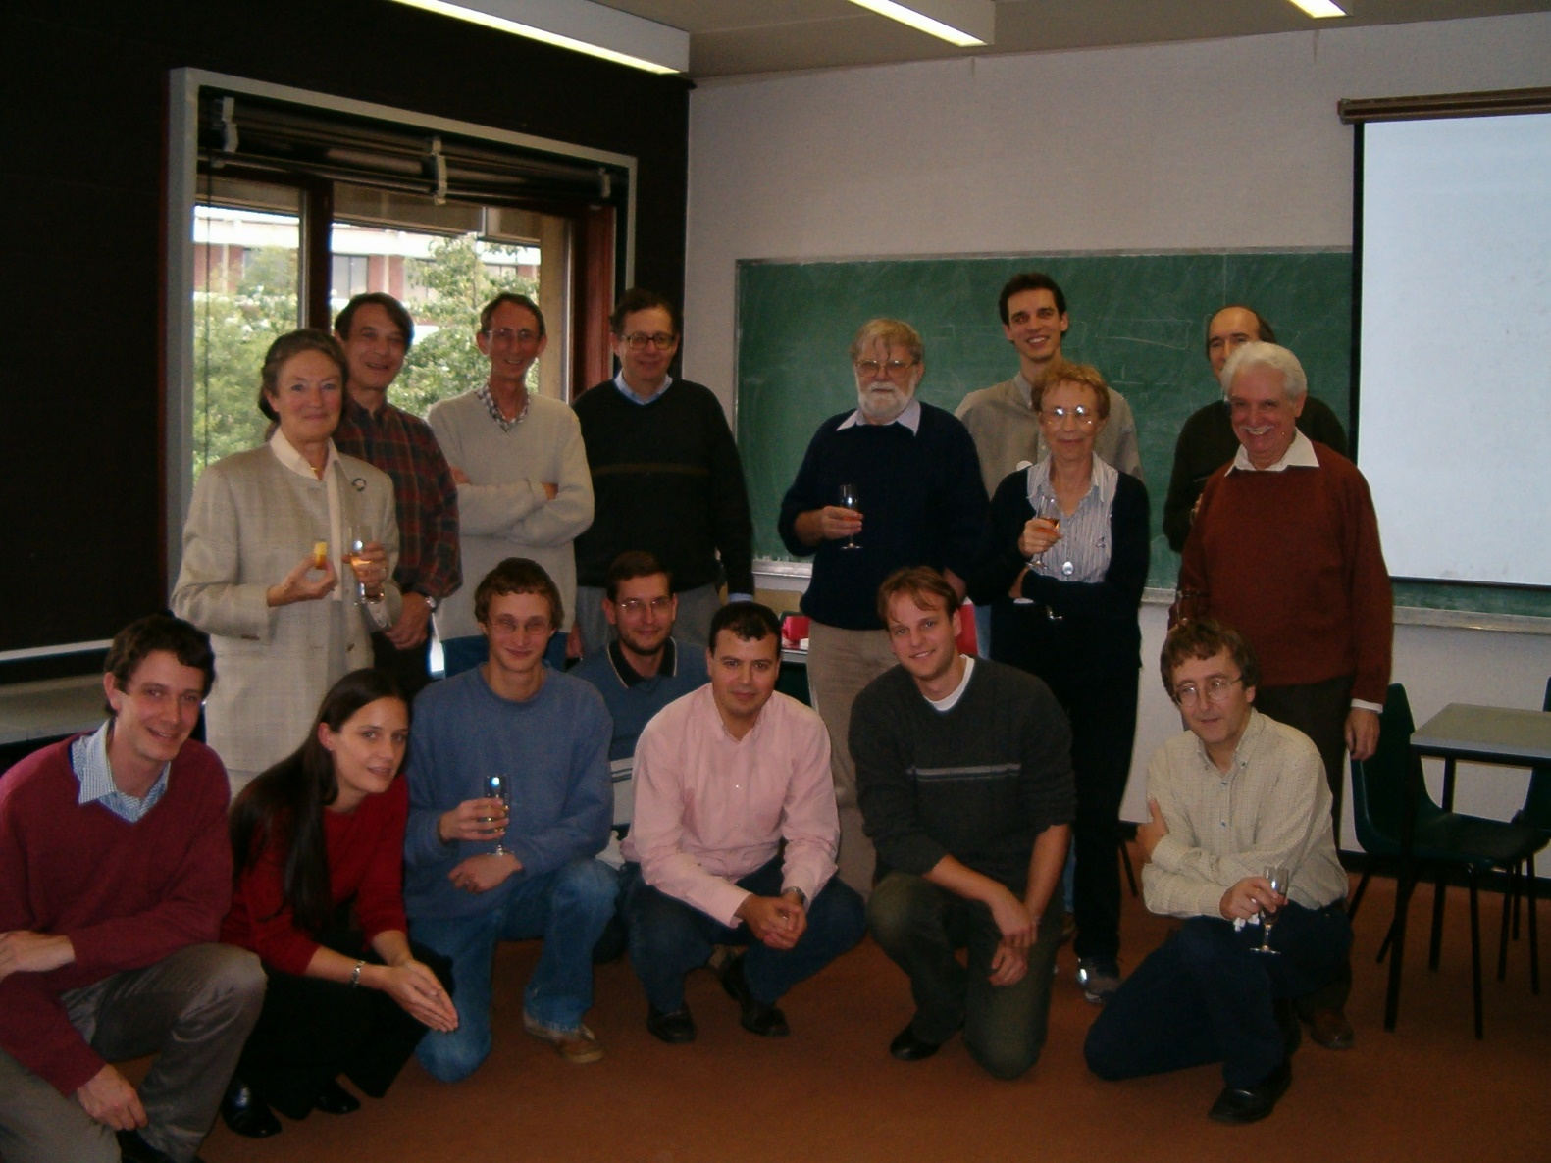
FNRS and ULB
1981: FNRS PhD student
1986: FNRS PostDoc
1989: FNRS research associate
1998: Research Director at FNRS
2004: Director of the Nuclear Physics
department of ULB

Slide 28
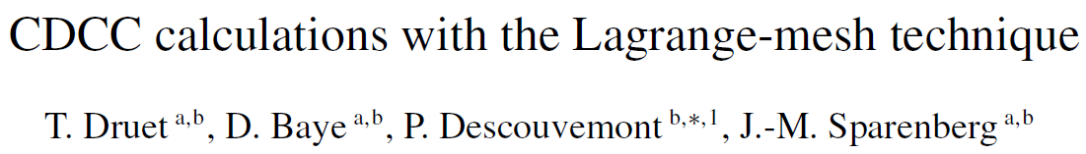
2010: CDCC
« Completely Discouraging Complicated Calculations »
A first attempt by Pierre’s student Thomas Druet makes novel uses of R-matrix method
For Pierre, a three-body method is not enough
But he likes microscopic models even more.

Slide 29
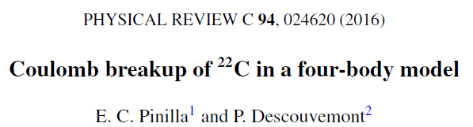
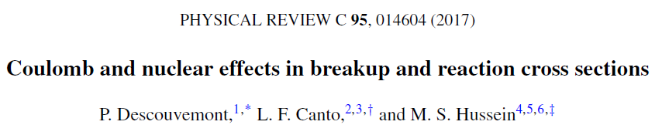

Other topics of interest:
Coulomb and nuclear breakup
Transfer

Slide 30
Statistics
320 papers and published contributions, 1 book
more than 40 articles as single author
about 80 different co-authors from 15 countries (only for theory)
8 PhD theses and 10 Postdocs supervised
Courses:
- Quantum theory of collisions
- Nuclear Physics
Many invited presentations, seminars and courses in many countries

Slide 31
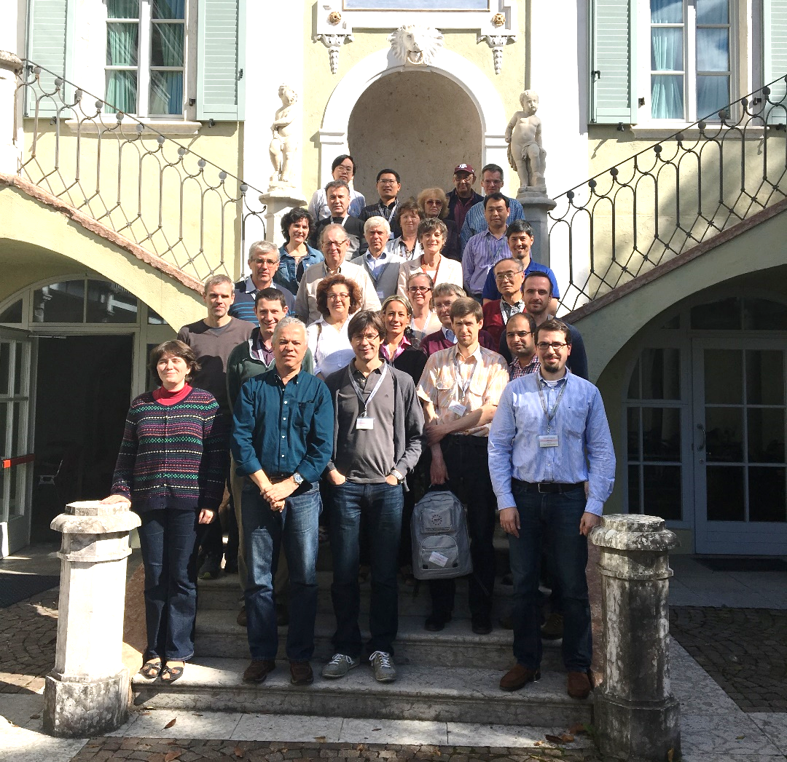
A souvenir from Trento (2016)
Question:
is Pierre trying to hide or to be seen?

Slide 32
A personal note
What numbers and lists do not tell.
Pierre has an unfailing patience to help me with my computer problems.
Many times took he hours to help me installing a computer or explaining me how to use new softwares.
Not to forget solving administrative difficulties !
I am sure that other retired members of the group confirm this patience.
Thank you !

Slide 33
Concluding remark:
All the best for your retirement, Pierre !

