Slide 1
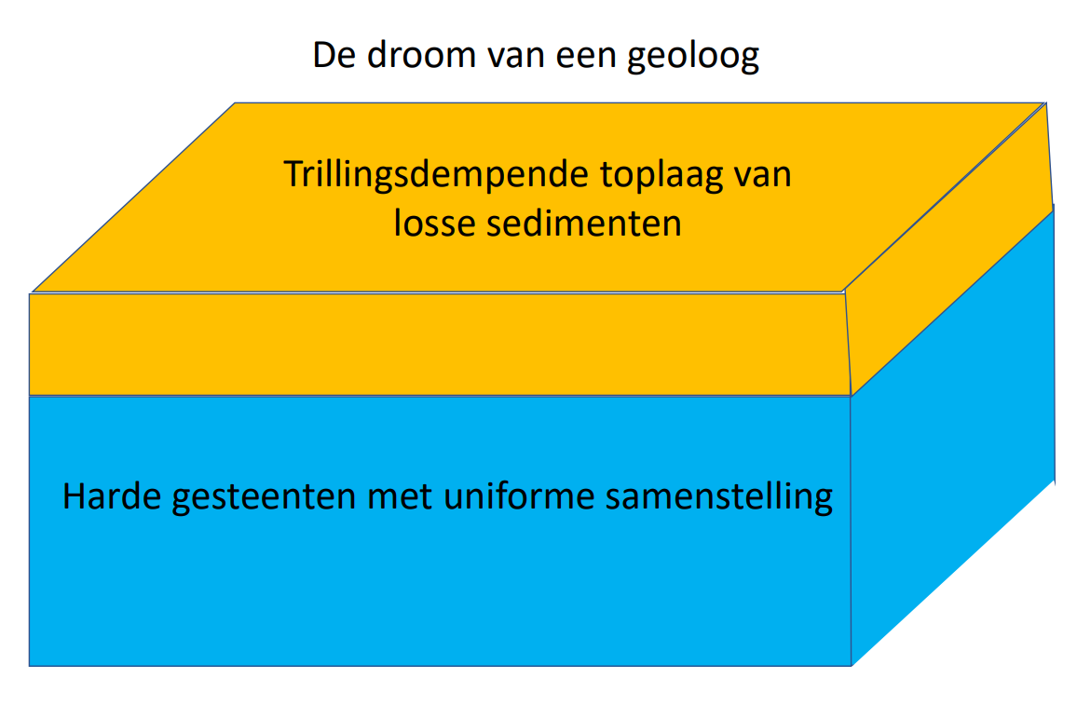
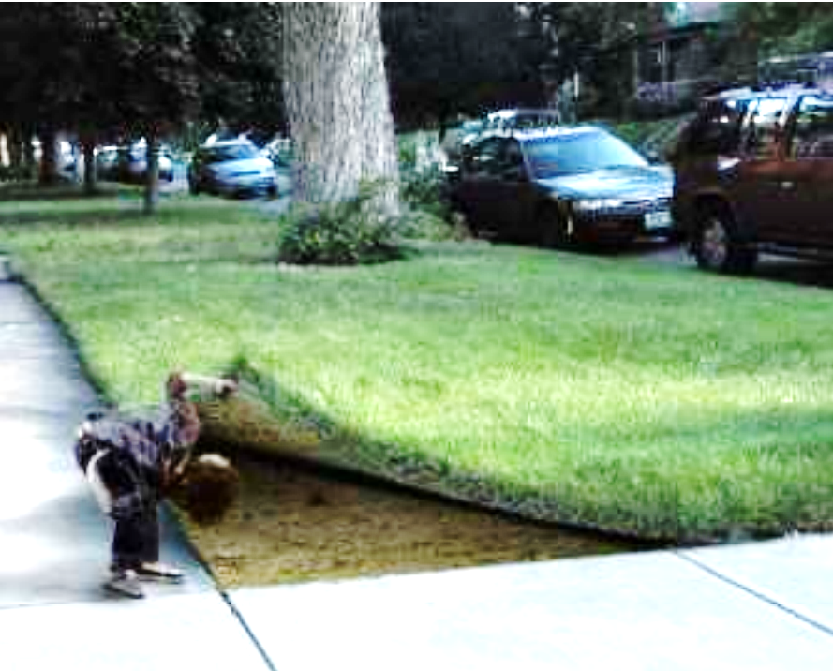
Geological studies in the EMR region
The dream of a geologist
Noice reducing toplayer of loose sediments
Hard rocks with uniform composition

Slide 2
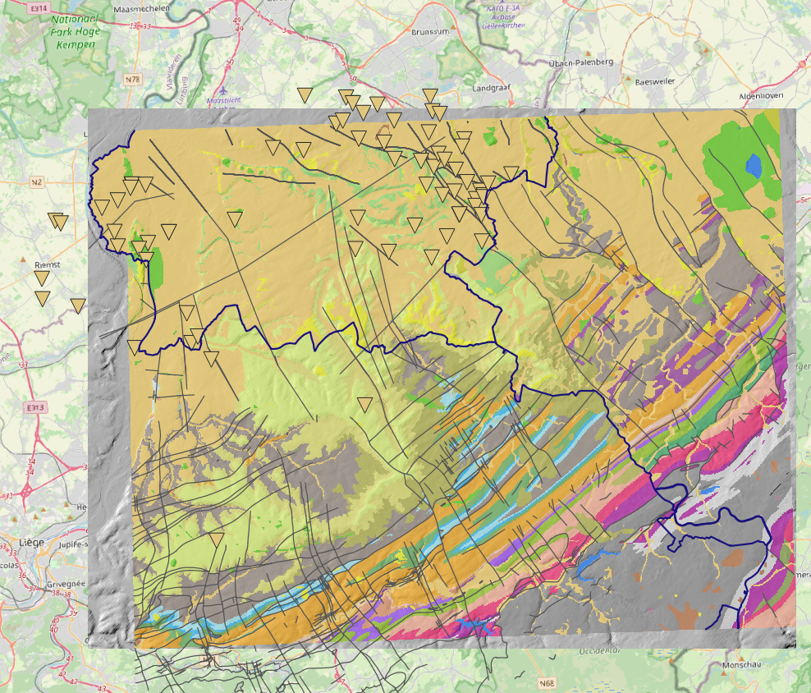
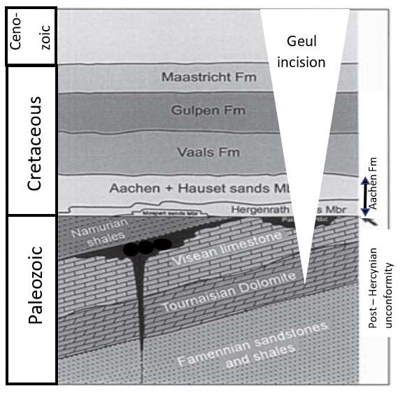
Complex rock type
2 sets of faults (NNW – SSE & NE – SW)
Limestones that underwent 2 periods of
karstification

Slide 3
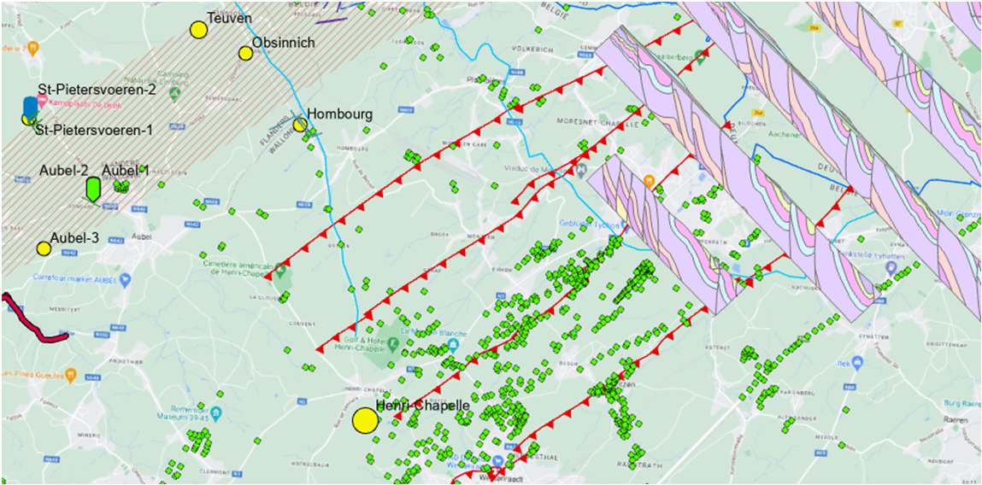

Slide 4
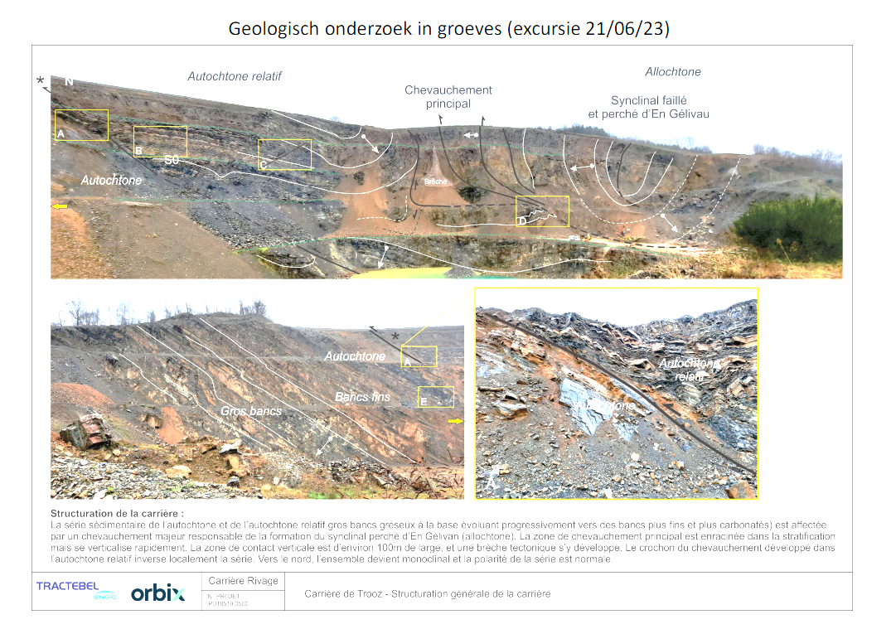
Geological complexity can be studied in quarries (excursion 21/06/23)

Slide 5
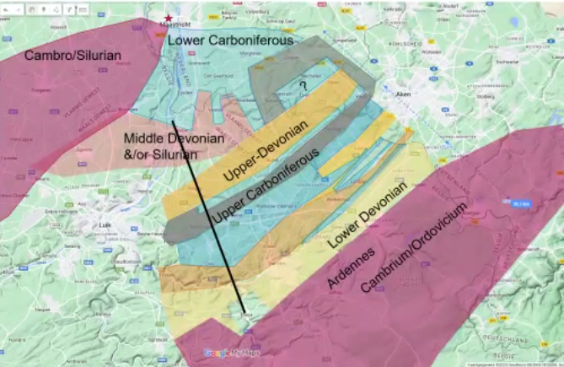
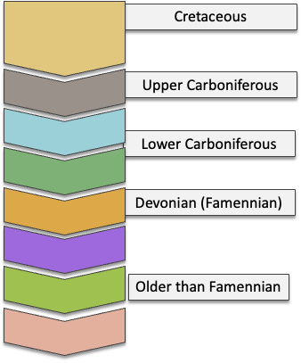
Simplified geological units at ET level (± 100m above SL)
Contrasting geological concepts

Slide 6
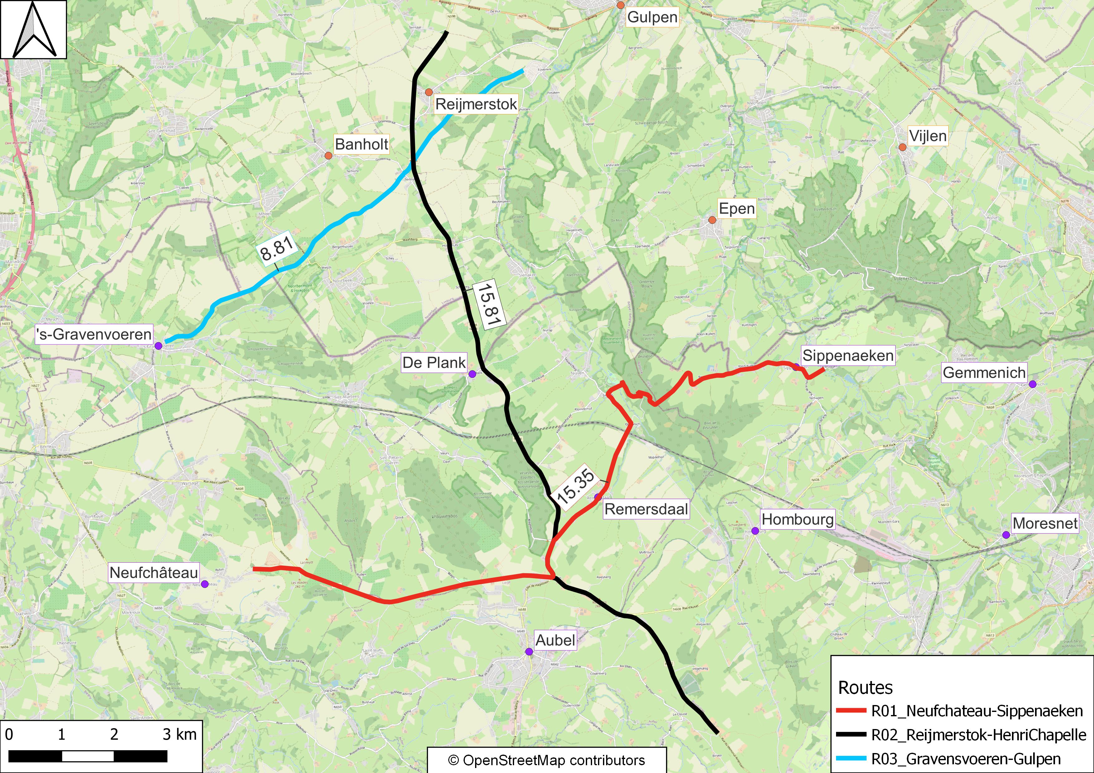
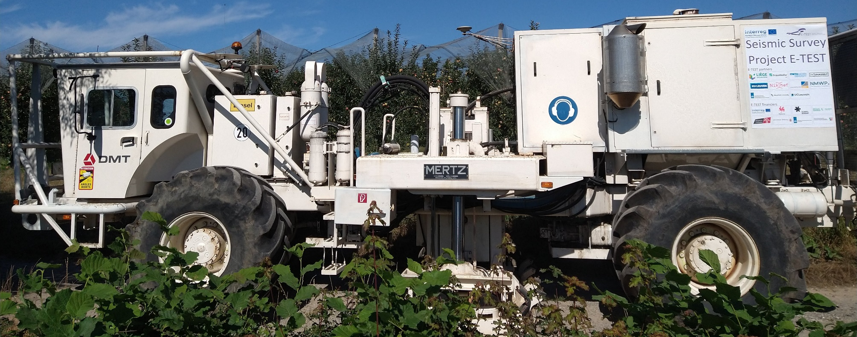
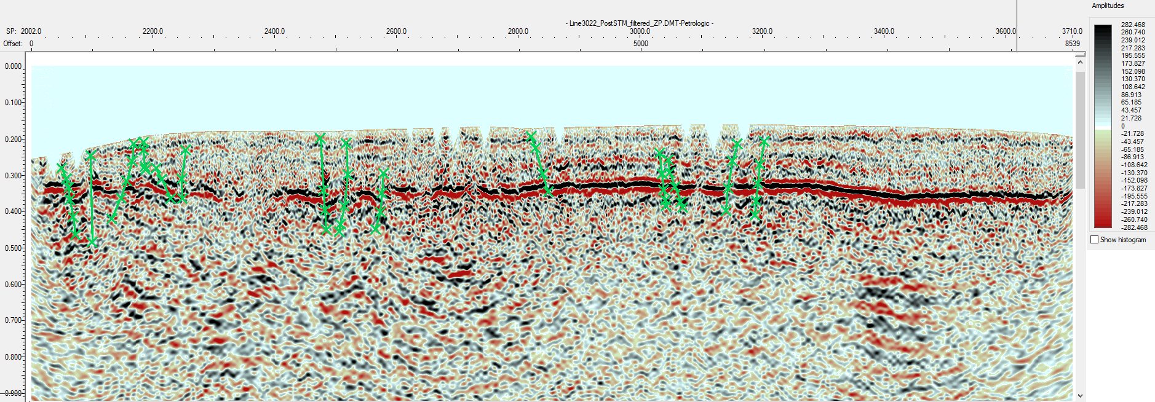
How to unravel the geology: indirect methods (active & passive seismics)
Line 3022
Blue line

Slide 7
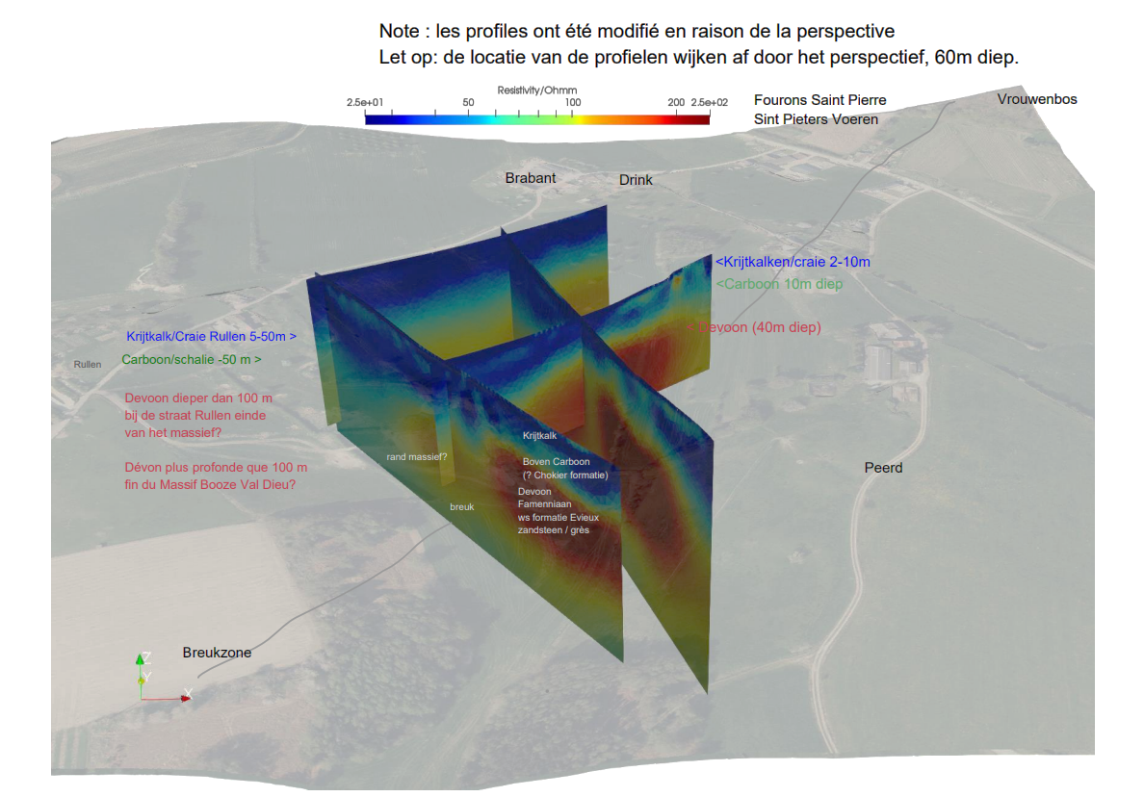
Indirect methods (ERT)
De-risking of the Booze – Val-Dieu block (BVD)
Positie BVD moved
about 300m
Northward based
on ERT

Slide 8
Direct methods : drilling
Borehole Cotessen
Drilled between 10/20231 & 12/2021
Final depth 251m
Cored + geophysical logging

Slide 9
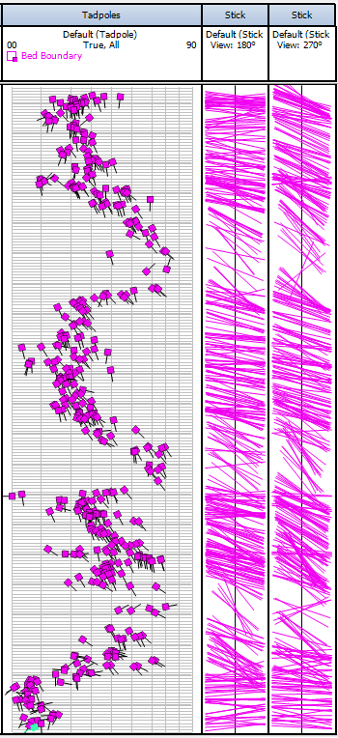
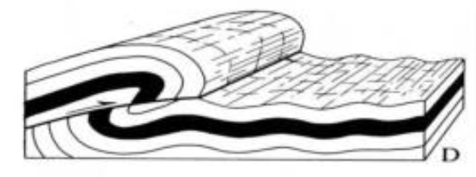
Interpretation: Overturned folds with thrusts
Cross-section near Aachen showing thrusts and overturned beds
Source: Artie William slideserve.com

Slide 10
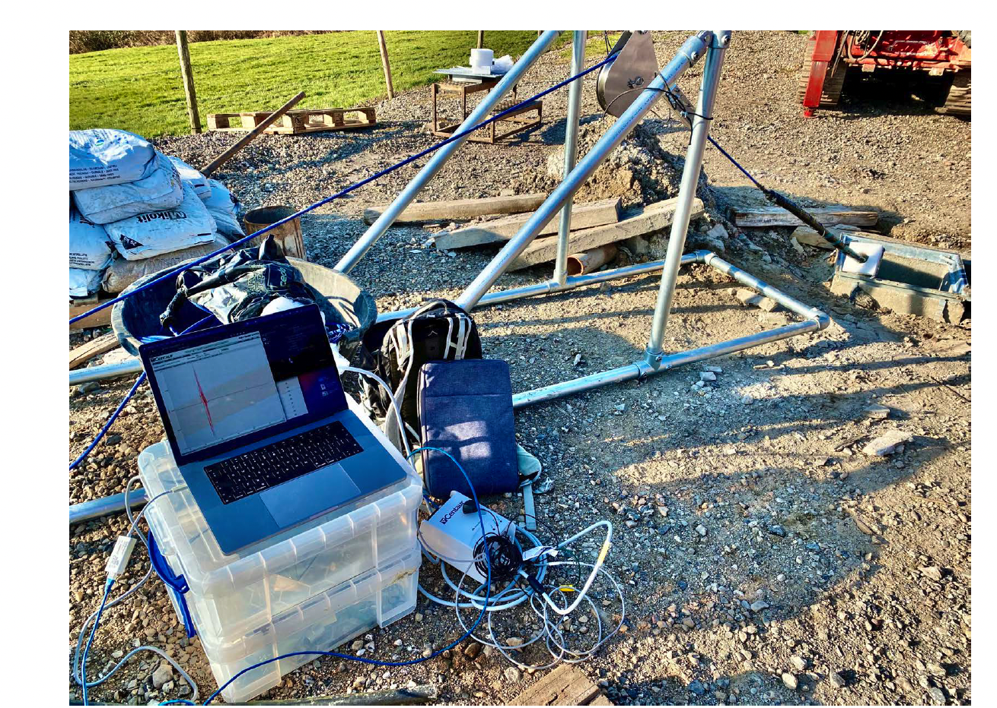
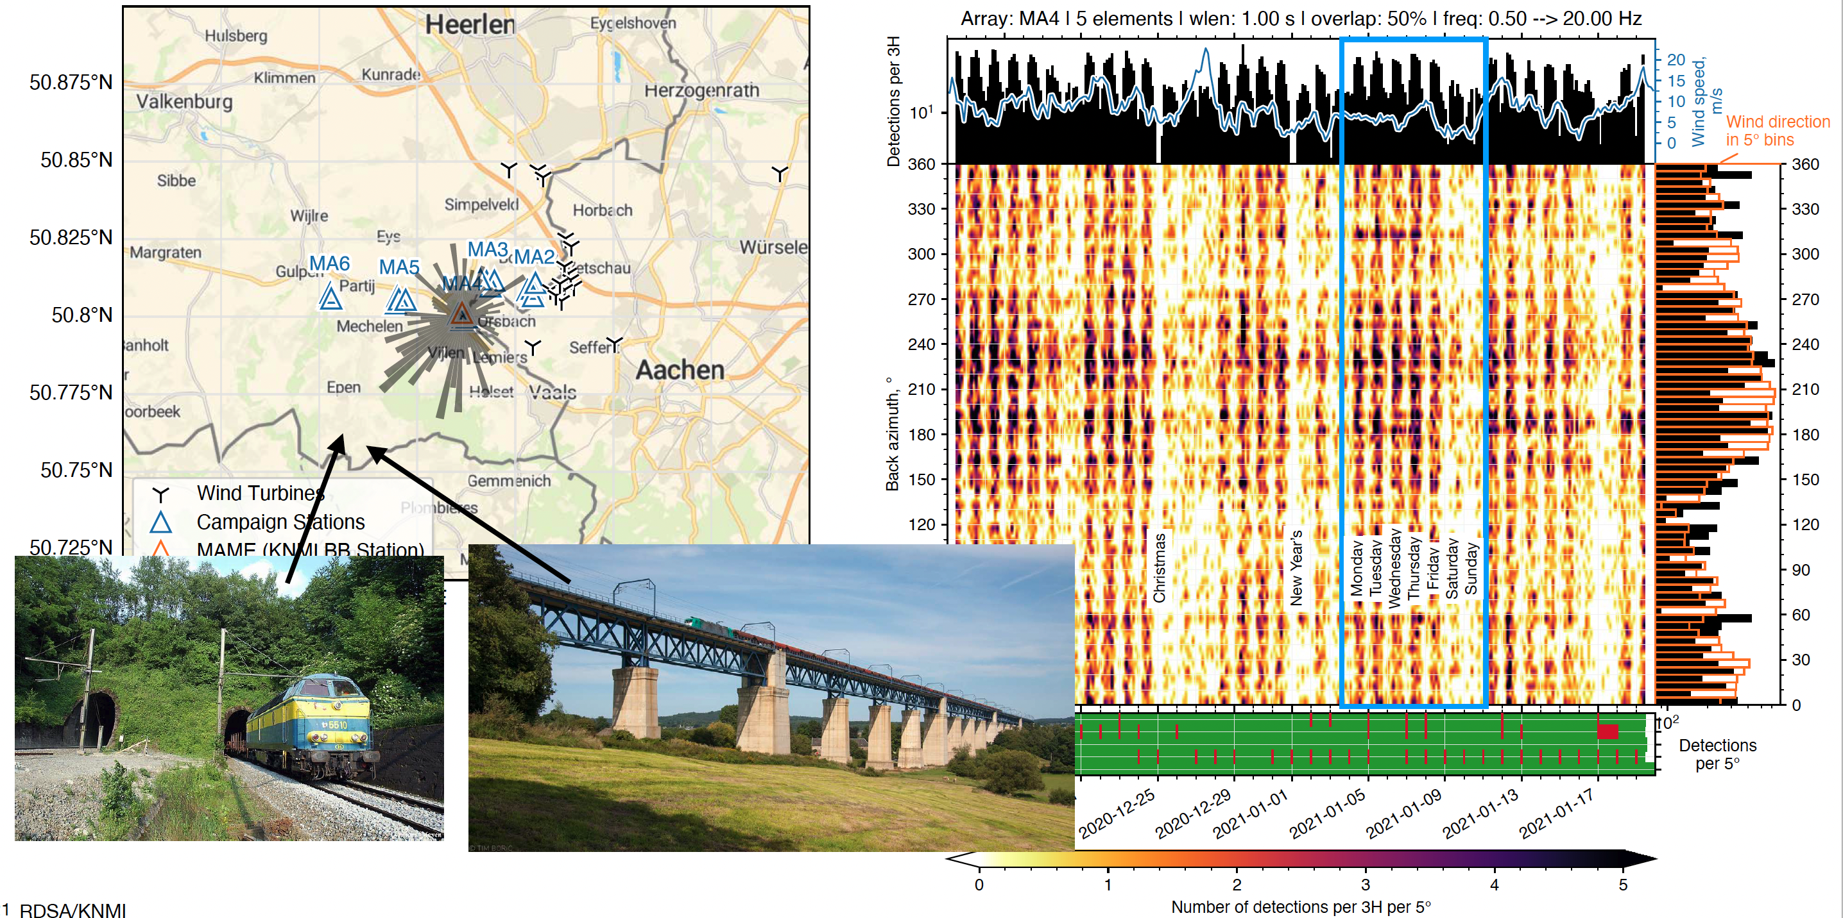
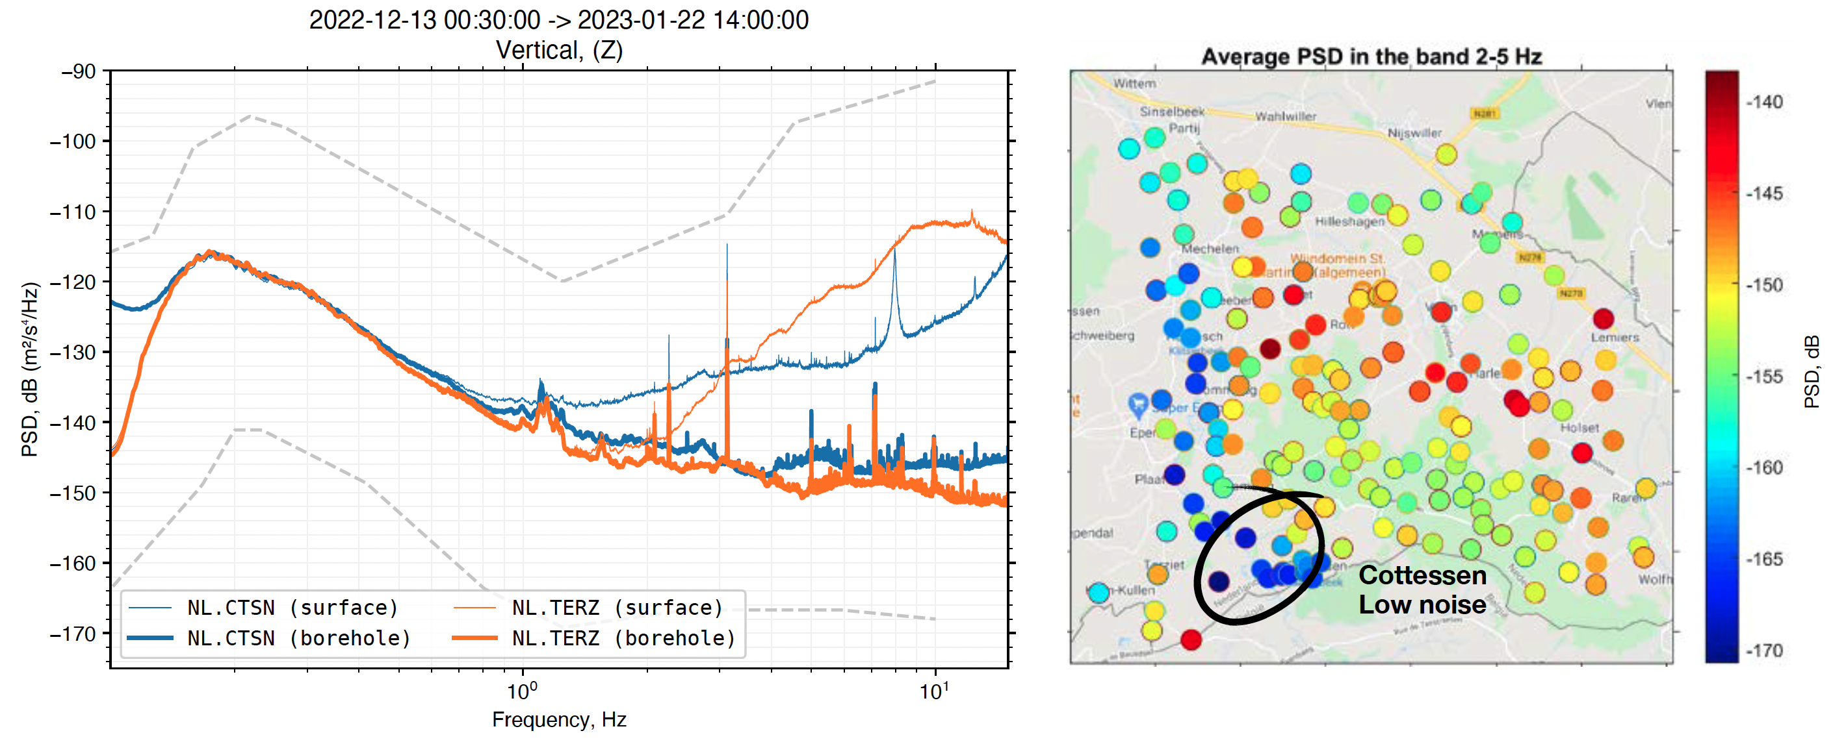
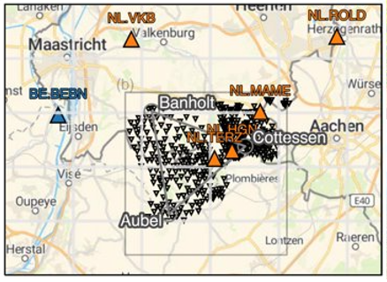
Seismic noise levels (surface & DEPTH)

Slide 11
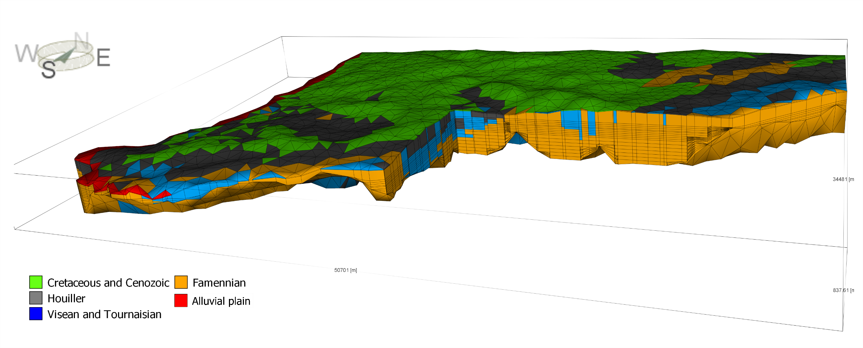
Groundwater model (regional) Geotechnical analysis
(Alain Dassargues, ULiège)

Slide 12
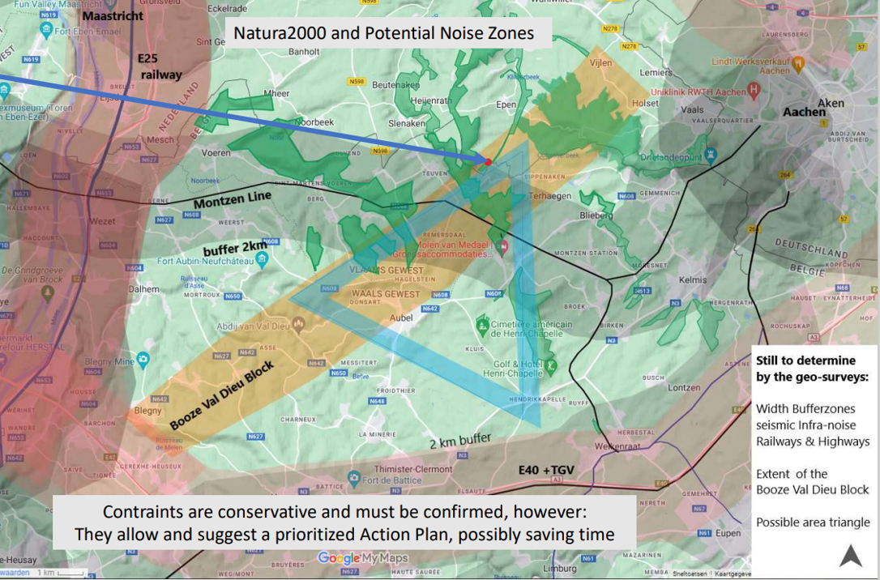
Simplified geological cross-section

Slide 13
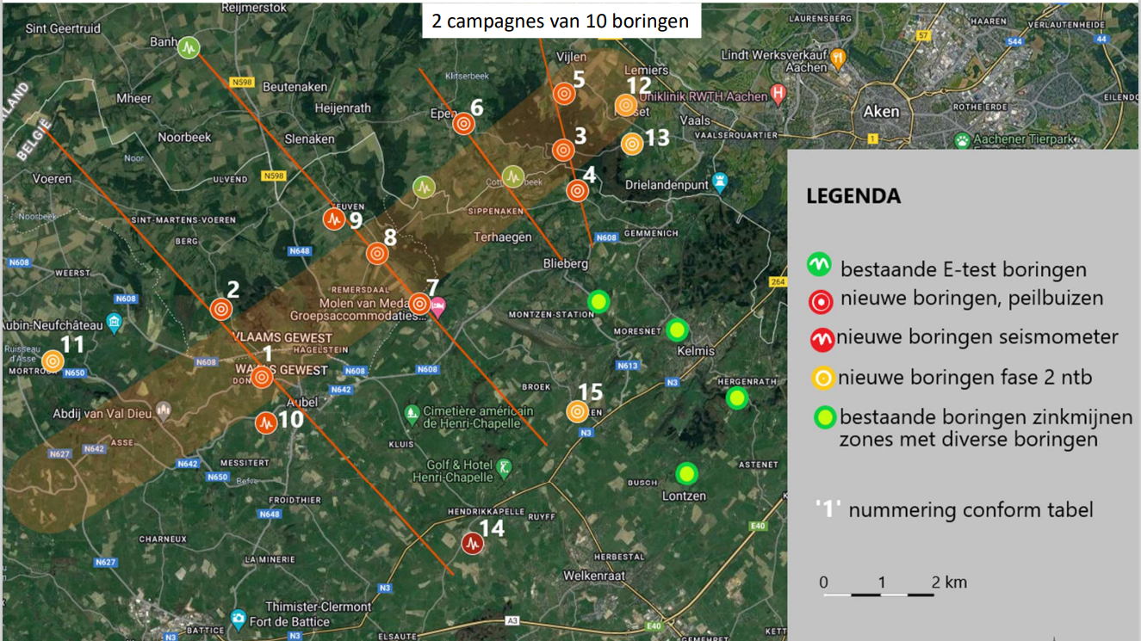

Slide 14
De-risking subsurface model: planned activities

