Slide 1
Geological studies – part 2
Jef Deckers

Slide 2
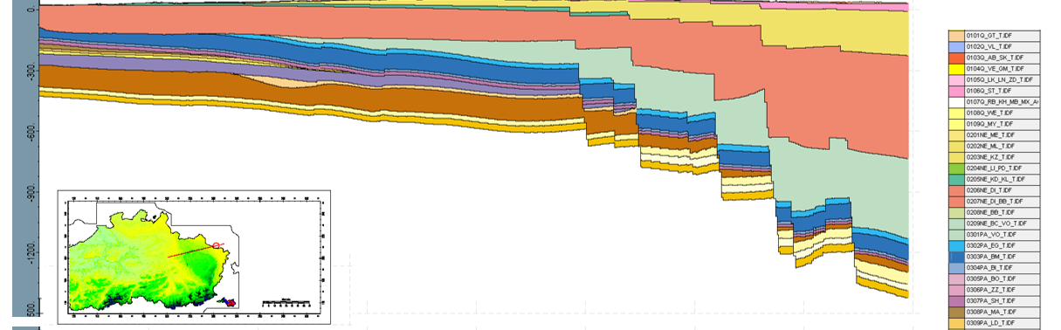
Need for a geological model
Geological knowledge critical for picking the location of the ET
Also for constructing the ET, need for a good understanding of the subsurface
Typical way to distribute subsurface information: geological models and/or cross-sections

Slide 3
Need for a geological model
Geologically very complex area
Thus far, no detailed geological model

Slide 4
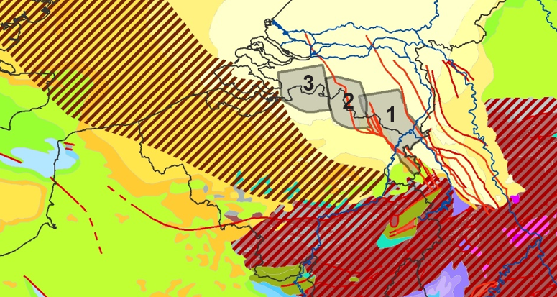
Need for a geological model
VITO has >15 year of experience of creating geological and hydrogeological models, mainly of the Flemish subsurface (incl. Voerstreek) for the Flemish Government
For 11 years also interregional with the Netherlands. Partners are TNO and GSB
For ET, interregional project with KULeuven, close cooperation with TNO and Nikhef

Slide 5
Need for a geological model
Typical flow chart interregional models
Data collection
Correlation of geological units across boundaries = using the same language
Reinterpret geological data according to the chosen language
Create geological model/cross sections

Slide 6
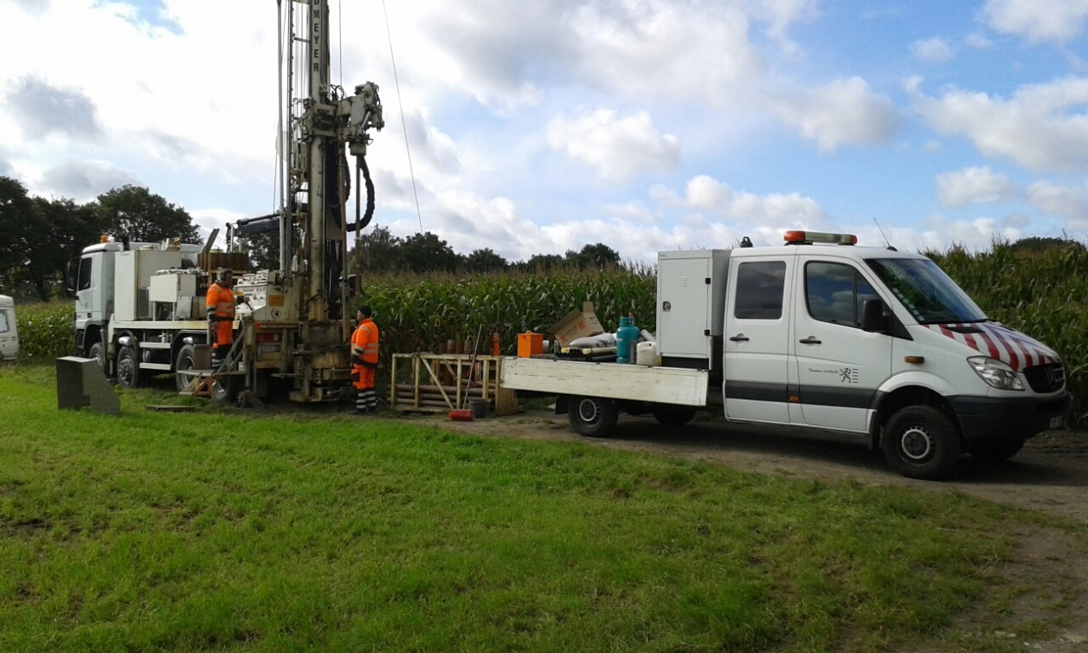
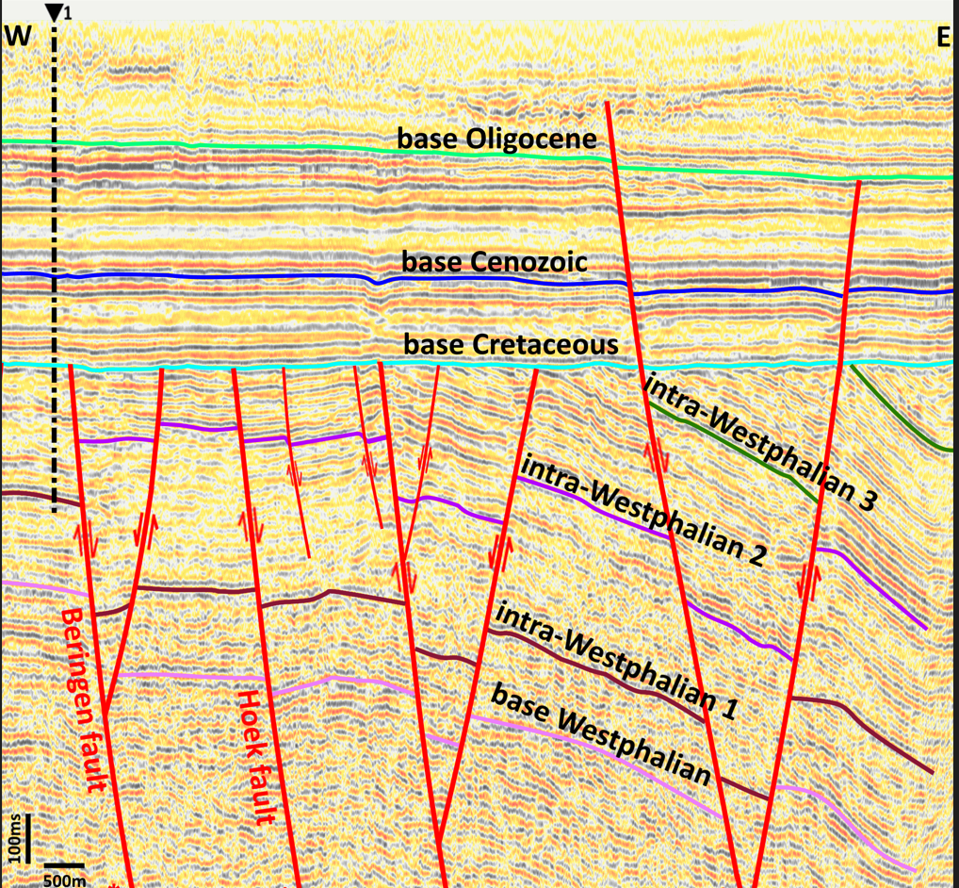
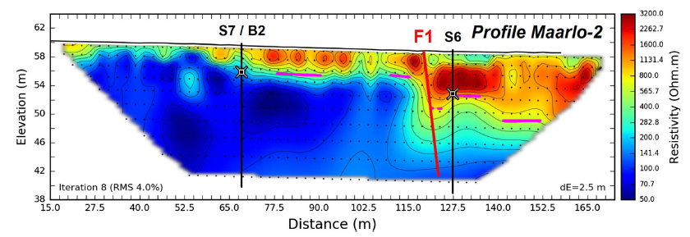
Data collection
New data collected, various types
Boreholes, with geophysical logging
Electric resistivity profiling
Seismic lines
Magnetic data
Topographic data
For geological mapping, all this data needs to be integrated
-> Need for a structured data gathering
-> Together with TNO

Slide 7
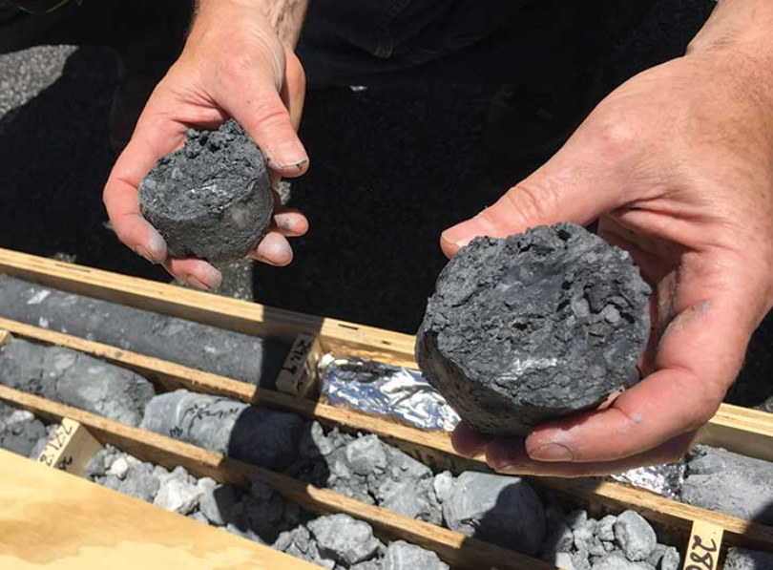
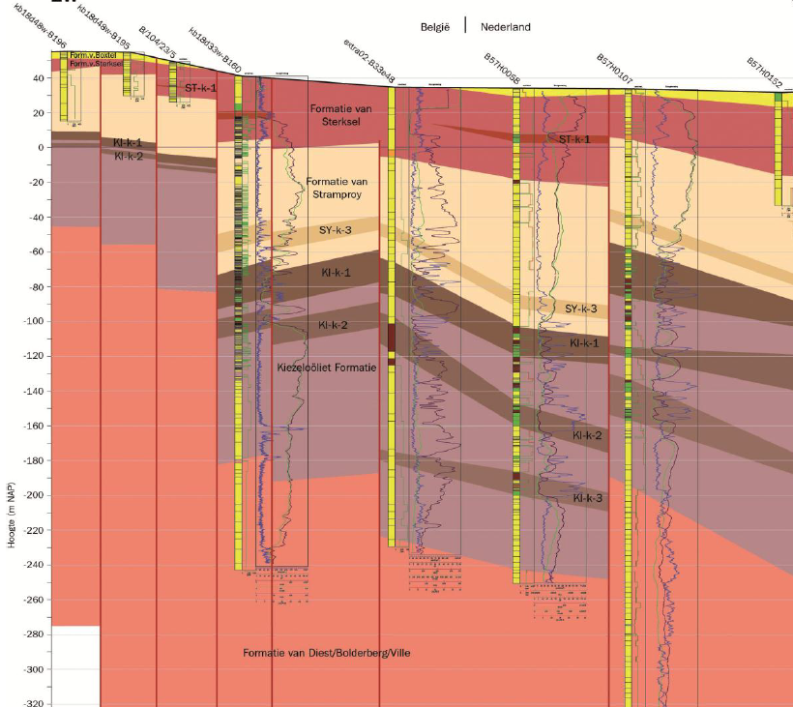
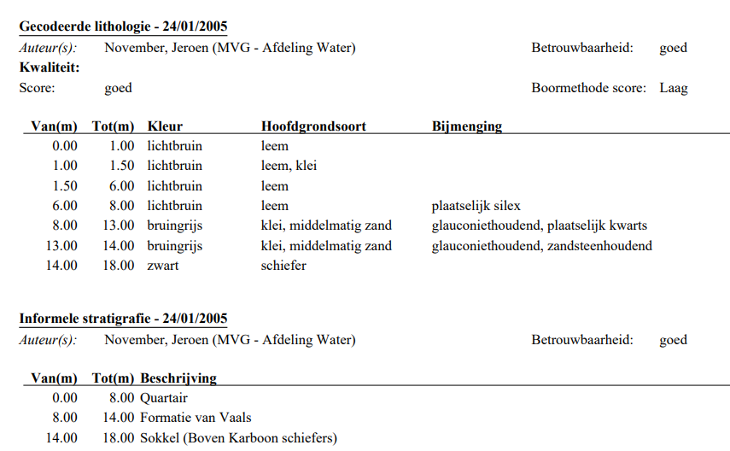
Data collection
Main inputdata: lithological descriptions and interpretations from boreholes or field observations

Slide 8
Data collection
Main inputdata: lithological descriptions and interpretations from boreholes or field observations
Some data provided with geologic interpretations, sometimes multiple interpretations
Others don’t have interpretations
Different names for different geological units across and within borders
Observation in the field vs boreholes
-> Need for consistently interpreted set

Slide 9
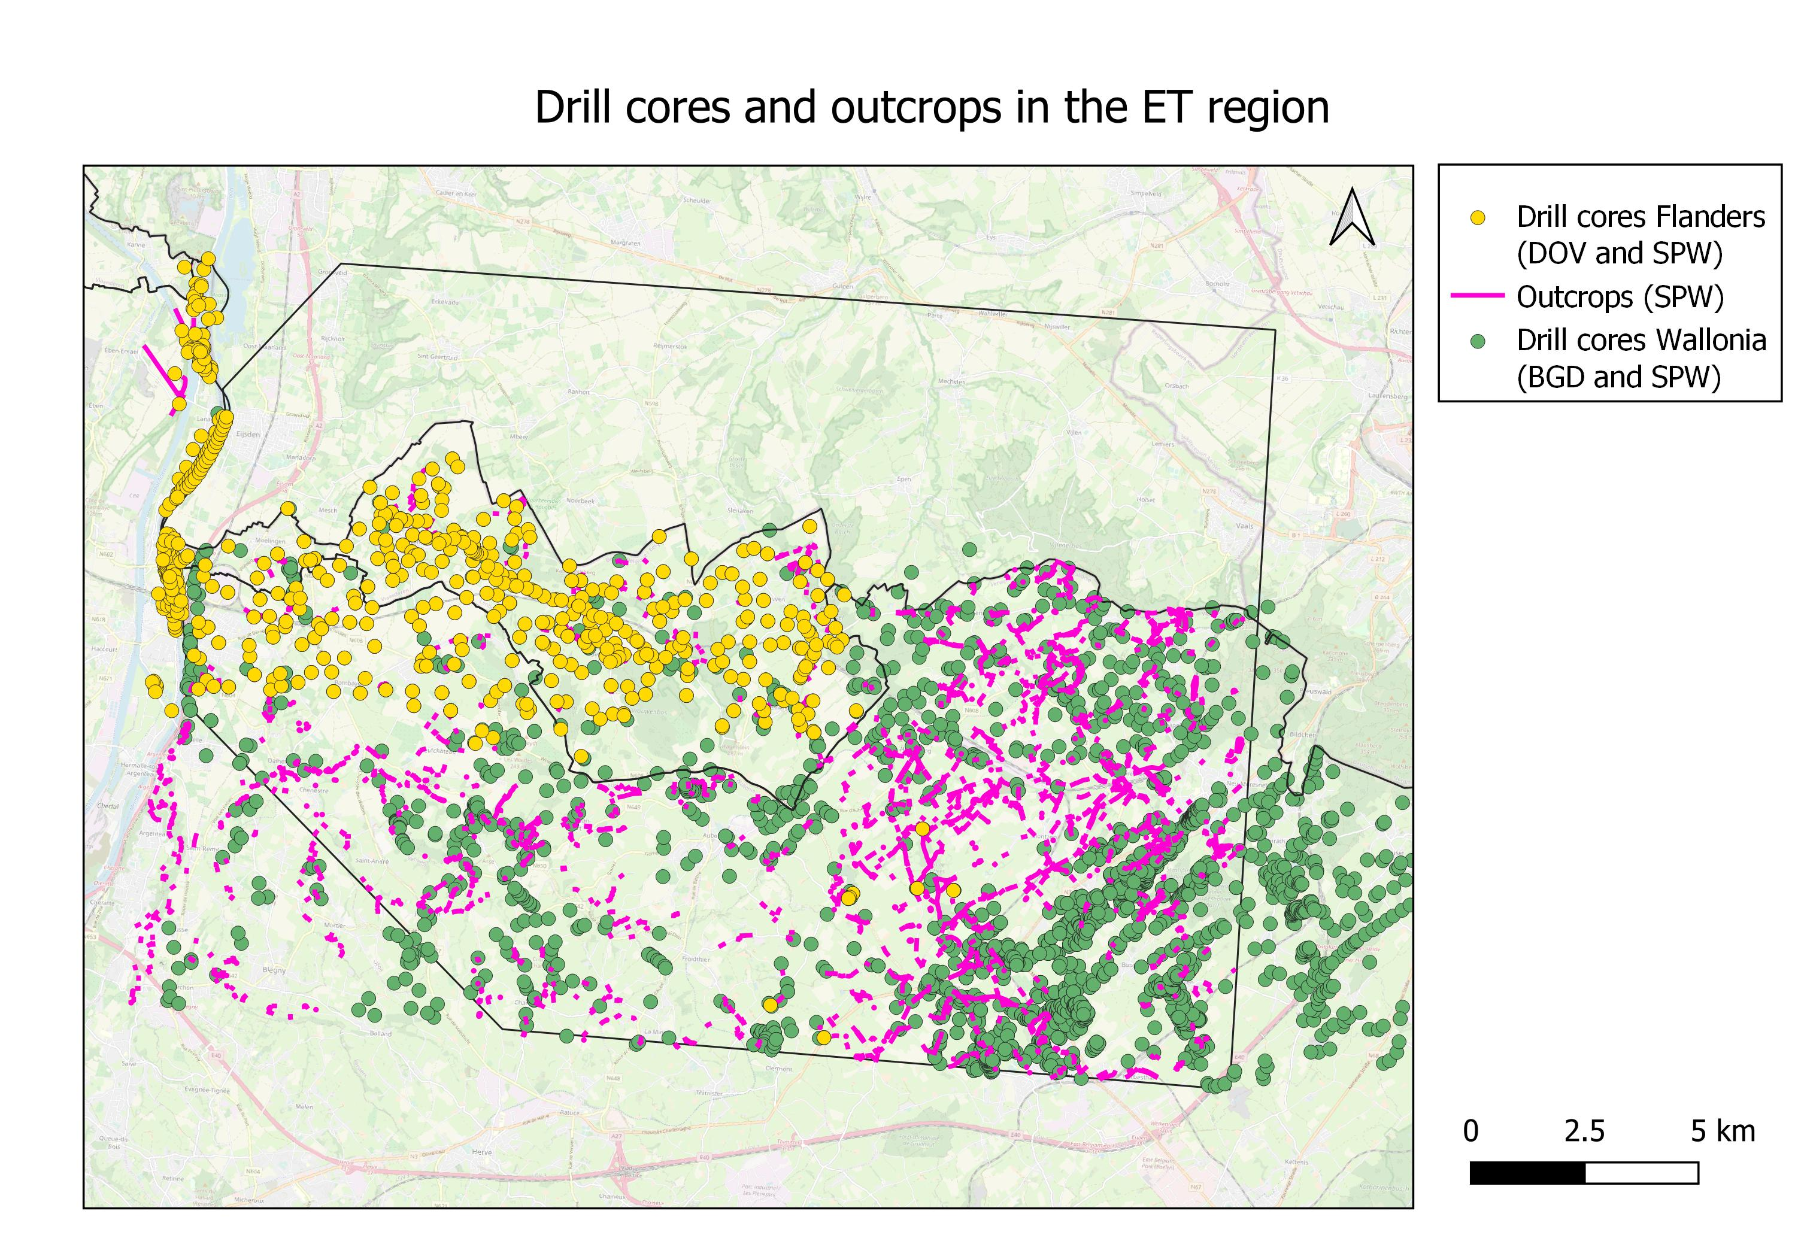
Data collection
Many data available, but:
Not integrated
Not harmonized
Not filtered on quality

Slide 10
Need for a geological model
Typical flow chart interregional models
Data collection
Correlation of geological units across boundaries = using the same language
Reinterpret geological data according to the chosen language
Create geological model/cross sections
Our task

Slide 11
Need for a geological model
Typical flow chart interregional models
Data collection
Correlation of geological units across boundaries = using the same language
Reinterpret geological data according to the chosen language
Create geological model/cross sections
Our task
TNO

