Slide 1
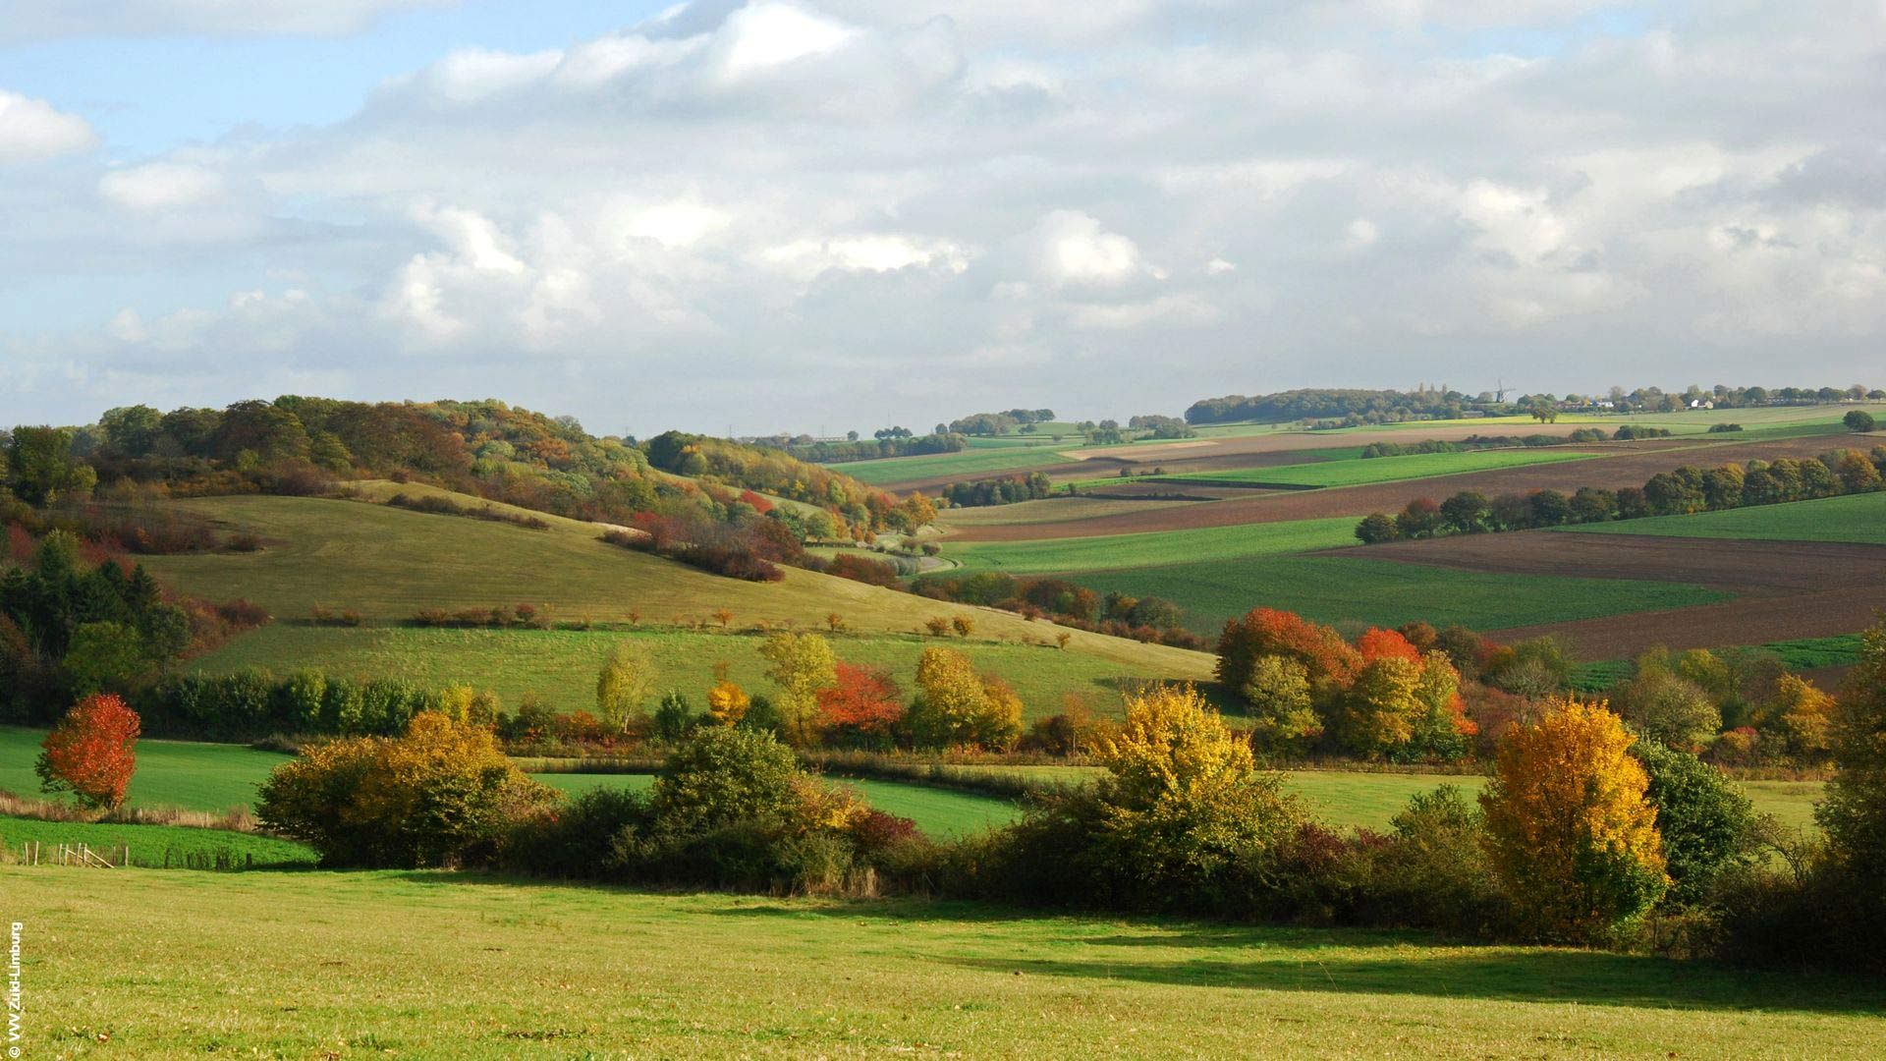
Correlated seismic noise impact on ET
Nick van Remortel
Kamiel Janssens
University of Antwerp, Belgium
IRI Workshop
November 27, 2023

Slide 2
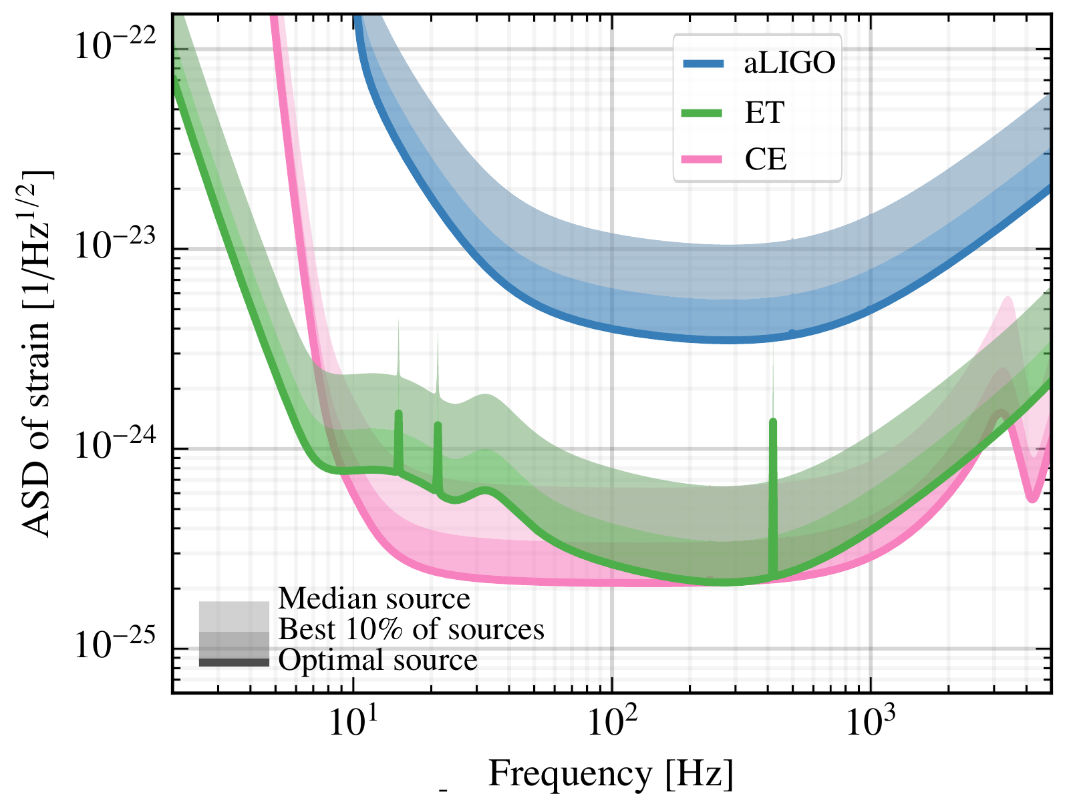
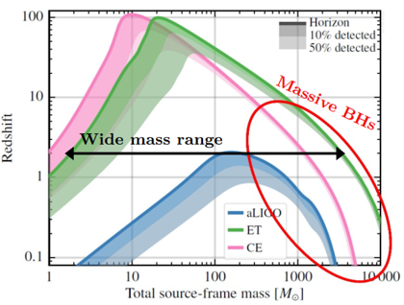
2nd gen vs 3rd gen GW interferometers:
2nd Generation (aLIGO, AdV, KAGRA) sensitive down to 20 Hz
3rd Generation (ET, CE) will be 10x more sensitive in the bucket
ET will extend sensitivity down to 2Hz, allowing
Detection of more massive binary black holes
Extending the detection time prior to merger from <1sec to 30 minutes!
Source: M. Branchesi et al JCAP07(2023)068
Credits: GWIC 3G Committee, the GWIC 3G Science Case Team, and the International 3G Science
Team Consortium, “3G Science Book,” 2020

Slide 3
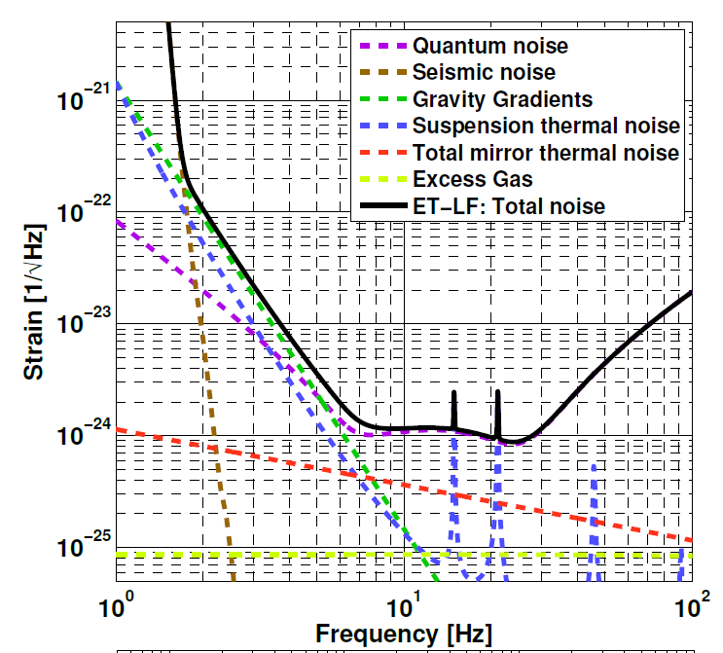
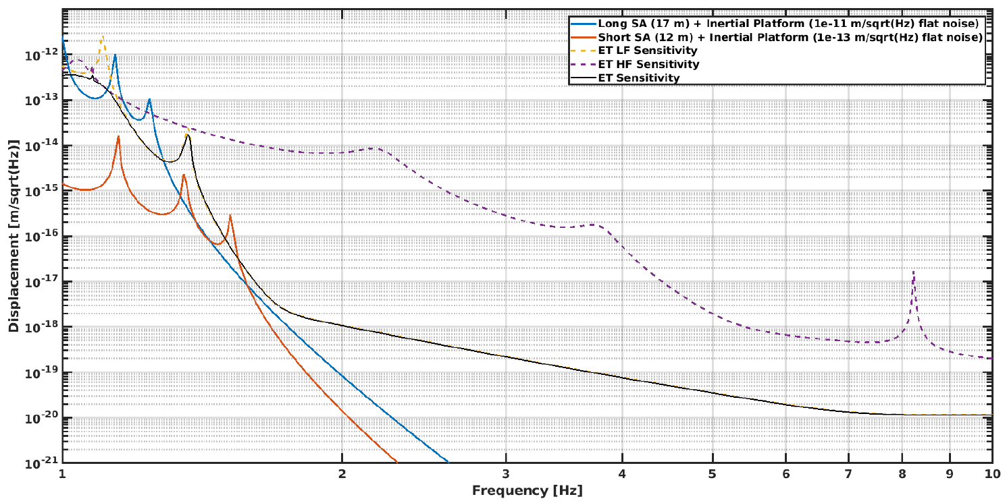
Seismic noise contribution for ET:
Curves shown for underground construction
Seismic ‘wall’, after active and passive attenuation at 2Hz using Virgo-like superattenuators of 12-17 meter high!
Newtonian Noise (Gravity Gradients) important up to 10Hz This already assumes a factor 3 suppression
Source: ET design report update 2020

Slide 4
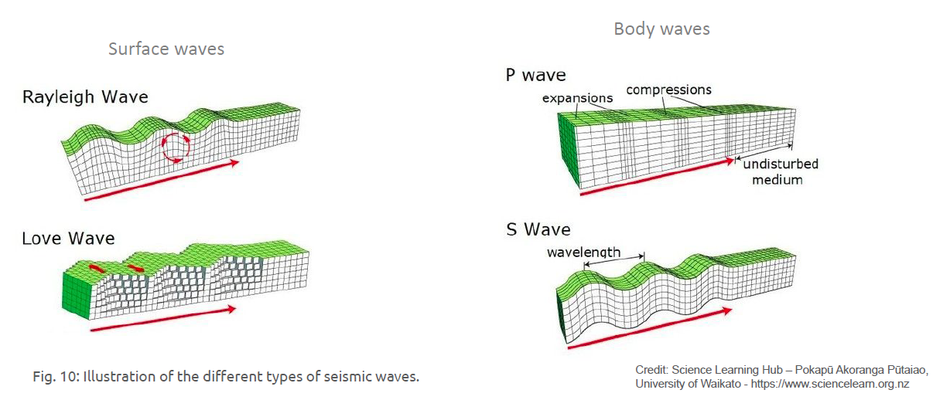
Types of Seismic noise:
Are dominant at >200m depth
Are damped exponentially with depth
Seismic noise + Newtonian
Density changes
Cavity wall displacement
Seismic noise
+ Newtonian
Seismic noise
Seismic noise + Newtonian
Cavity wall displacement

Slide 5
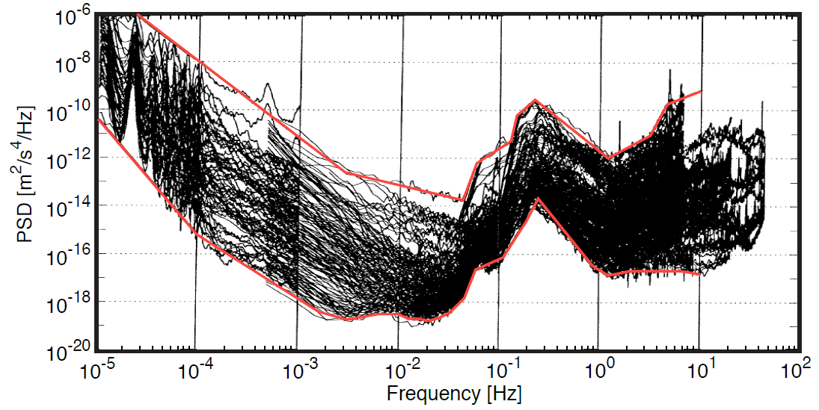
Seismic Background across the planet:
From: J. Peterson, “Observations and modeling of seismic background noise.” Open-file report
93-322, 1993.
Long-term seismic measurements from 75 stations across the globe at surface and up to 350m depth
Determined a global upper and lower level of seismic noise
3 main Frequency ranges of interest:
f<0.01 HZ: Tidal effects
f=0.05 and f=0.2Hz: Miscroseisms due to oceans
f>1Hz: Environmental & anthropomorphic noise
Reaches a plateau at f> 10Hz
Is very time & location dependent
Can be suppressed by going underground

Slide 6
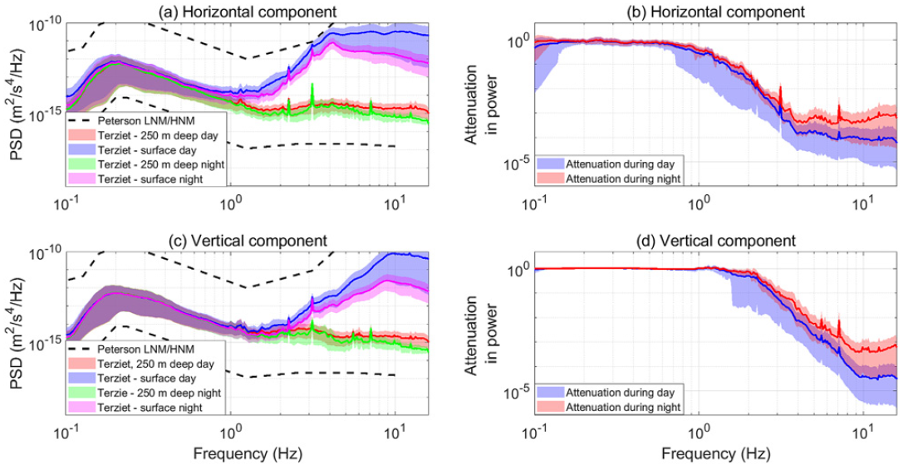
Surface vs underground:
Seismic velocity spectra measured at
Left: Sos-Enattos (Sardinia) P2 borehole at 264m depth
Right: Terziet (NL) borehole at 250 m depth
Power Spectral Density at Terziet Borehole:
Day night difference at the surface indicates anthropomorphic component
Power density can be suppressed by 4 orders of magnitude
Source: S. Koley et al 2022 Class. Quantum Grav. 39 025008
Surface measurements
Surface measurements
From: Conceptual design and noise budget of Einstein Telescope (paper in preparation)

Slide 7
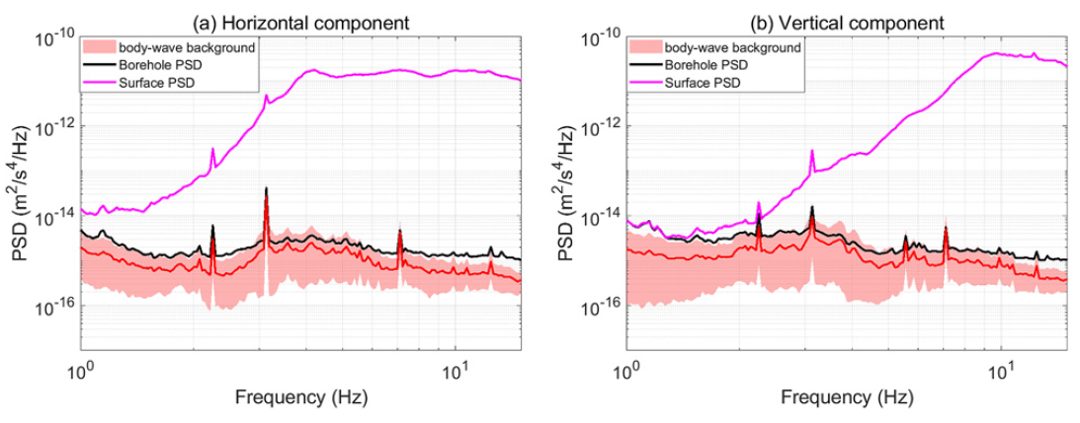
Gravity gradient, aka. Newtonian Noise:
From: R. Weiss, ‘‘Quarterly Progress Report of the Research Laboratory
of Electronics of the Massachusetts Institute of Technology’’ ~1972!, Vol. 105, p. 54.
Seismic displacement noise can be suppressed by passive/active attenuation systems
Newtonian noise exerts a physical force on the test masses and can not be attenuated
Newtonian Noise is caused by
Coupling of seismic waves to environment
Rayleigh waves & Body waves
Changes in atmospheric condition
Rayleigh waves >4Hz have wavelengths of ~125m and attenuate exponentially with depth
Key Point: Dominant contribution to NN in underground due to Body waves
Source:
F. Amann et al 2020 Rev. Sci. Instrum. 91, 094504
S. Koley et al 2022 Class. Quantum Grav. 39 025008
M. Bader et al 2022 Class. Quantum Grav. 39 025009
Exponential decrease with depth, h
Measured
Vertical displacement PSD
No decrease with depth, h

Slide 8
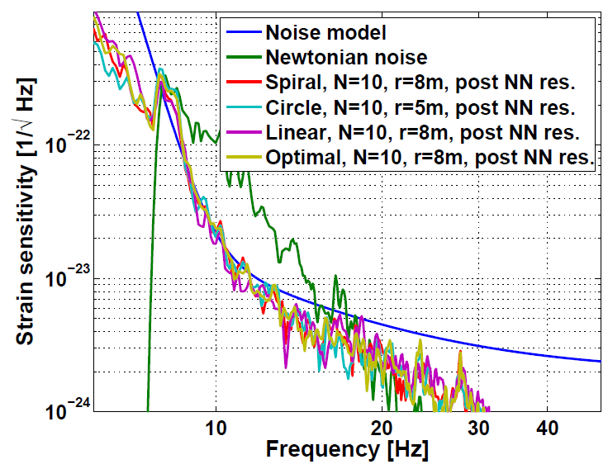
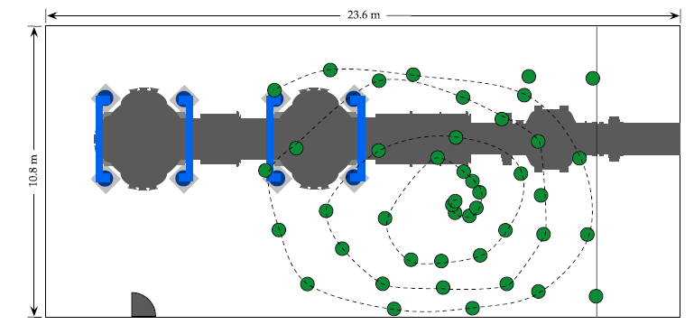
Suppression of Newtonian Noise
Sources:
J. C. Driggers, Phys. Rev. D 86, 102001 (2012)
M. Coughlin et al Phys. Rev. Lett. 121, 221104 (2018)
M Coughlin et al 2014 Class. Quantum Grav. 31 215003
M Coughlin et al 2016 Class. Quantum Grav. 33 244001
Via network of seismometers surrounding a test mass
Correlate the output of seismometers with the measured movement of the test mass
Apply a feed forward Multiple-Input-Single-Output Wiener filter
Predict Newtonian Noise from measured seismic waves
This is model dependent: reduction factors of 3-100!
Apply residual correction via offline measurements
Seismometer-test mass
Seismometer-Seismometer
Testmass-testmass
Typical seismometer array at LIGO end station

Slide 9
Suppression of Newtonian noise underground
Source: F Badaracco and J Harms 2019 Class. Quantum Grav. 36 145006
Key messages:
Main reason to build ET underground is the suppression of Rayleigh waves that induce Newtonian Noise
Even then, Newtonian Noise dominates the sensitivity at low Frequencies and needs to be suppressed
Conservative suppression factor 3 assumed in all ET sensitivity curves, independent of frequency
ET at the surface
ET below the surface
Rayleigh
Rayleigh
Rayleigh
Rayleigh

Slide 10
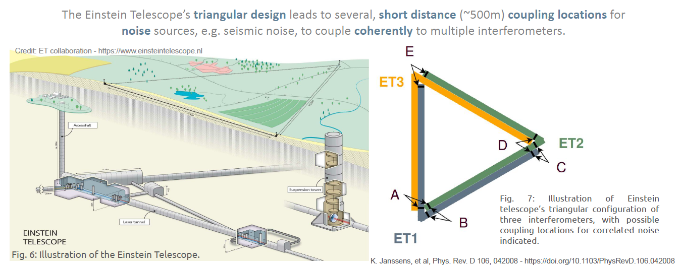
How correlated is seismic + newtonian noise over large distances?
Typical distance
Between input-end test masses: ~400m

Slide 11
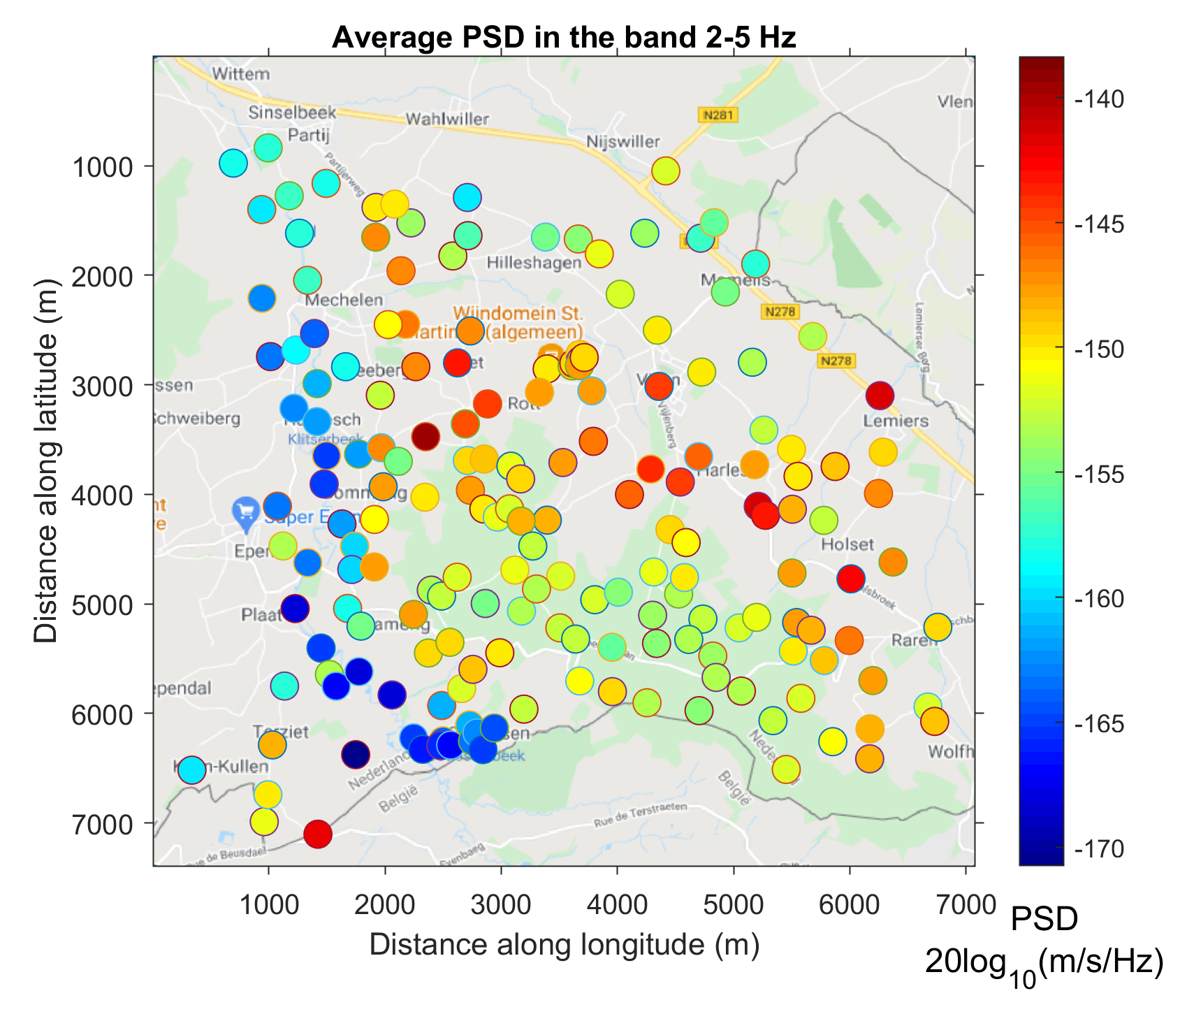
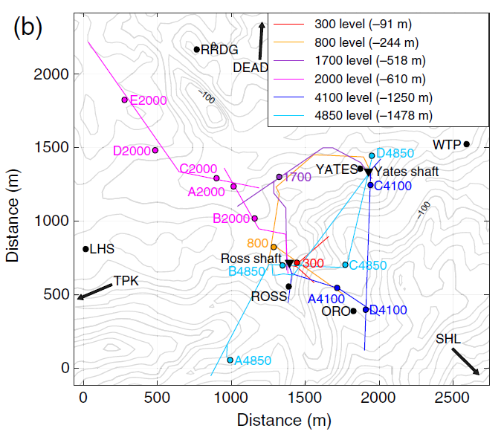
The Terziet and Homestake seismometer networks
S. Koley et al 2022 Class. Quantum Grav. 39 025008
Website of network: https://www.fdsn.org/networks/detail/3T_2020/
V. Mandic et al 2018 Seismological Research Letters 89 (6): 2420–2429
Sanford lab at Homestake mine South Dakota
24 broadband seismometers of which 15 underground
With depths varying between 91m and 1478 m
Hundreds of geophones in EMR region, including two boreholes with surface and subsurface seismometers

Slide 12
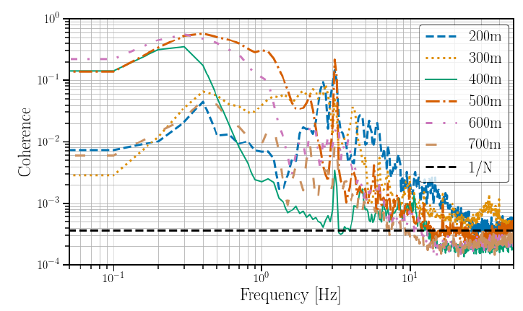
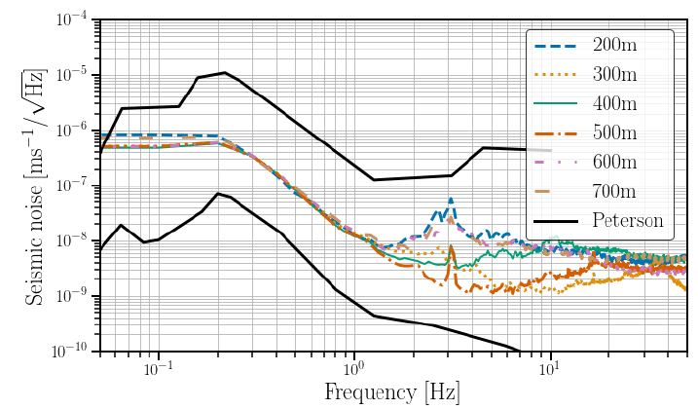
Coherence and PSD vs distance at surface:
Source: K. Janssens et al 2022 Phys. Rev. D 106, 042008
Findings:
Significant coherence measured up to f<10Hz
Up to large distances: <700m
No clear decrease with increasing separation
Not compatible with assumption of isotropic, homogeneous seismic field
Points to large antropogenic noise
Coherence: is there correlated seismic noise
beyond random? YES! Up to 700m or longer!
Note: not all baselines are at same central location
and measured at same time
Median coherence of Terziet surface geophones vs distance
T. Yokoi and S. Margaryan, Geophysical Prospecting 56, 435 (2008).
Cross Spectral density: How big is the impact on
Cross correlated techniques

Slide 13
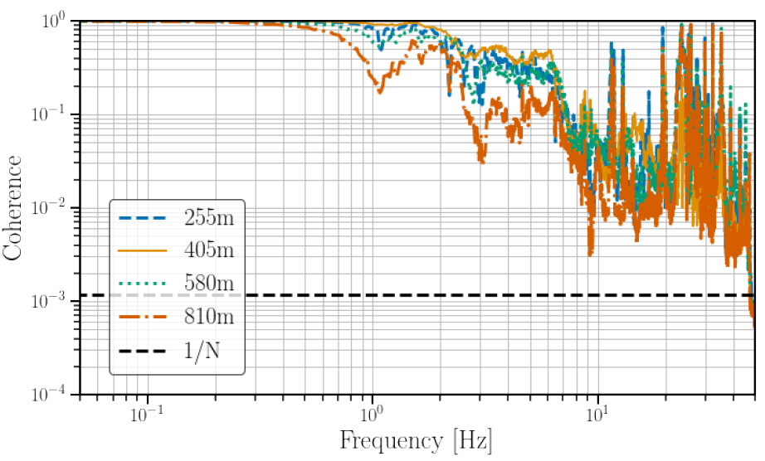
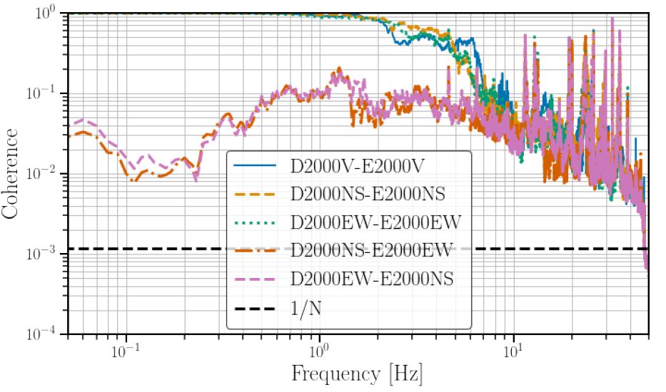
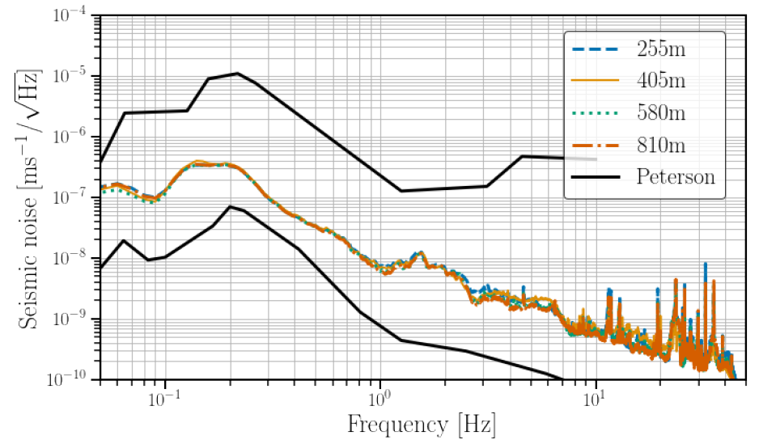
Homestake mine @600m depth
Choice of depth motivated by several seismometers with separations between 125m and 1200m
Seismometers can measure in 3 directions!
More than 50% of time there is significant coherence up to f<40Hz
Coherence in perpendicular directions significantly lower than for parallel until 6 Hz → anthropogenic sources
Coherence seems to diminish with depth, except for 405m
CSD does not vary with depth and at least 10x lower than at surface
parallel
perpendicular
Separation
of 405m

Slide 14
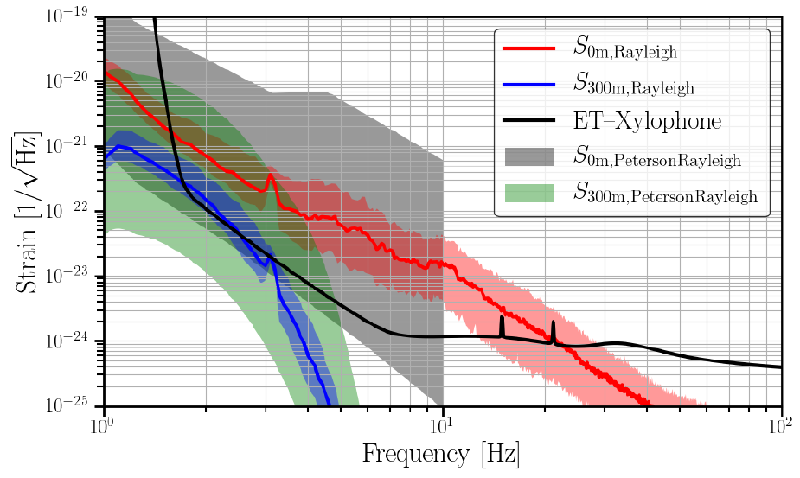
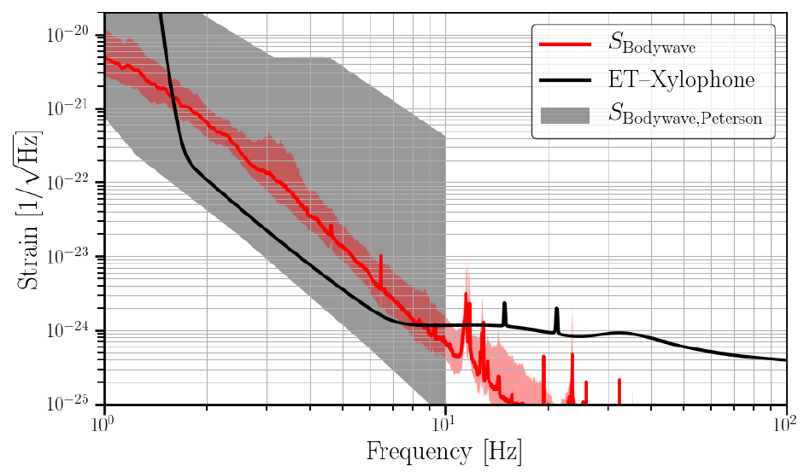
Projection of CSD into the ET Noise curve
Measured
Vertical displacement PSD (or CSD)
Exponential decrease with depth, h
If ET is located at surface: NN curve from Rayleigh up to f<30Hz
At 300m depth: NN from Rayleigh troublesome up to f<3Hz
Measured correlated body waves at 60mm depth in quiet environment are detrimental up to f<10Hz
Direct measurements confirming earlier estimates
Reduction by factor 10 needed
underground
surface
underground

Slide 15
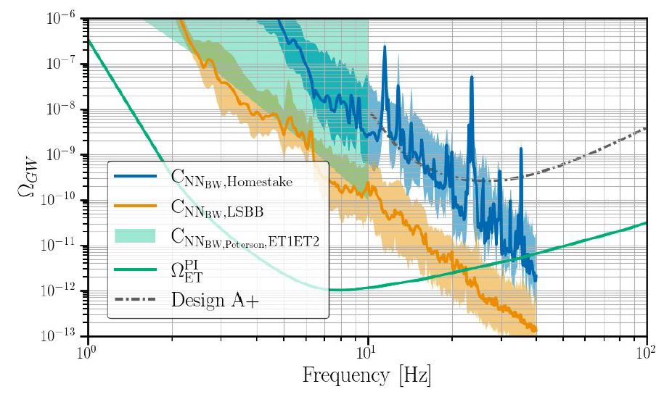
Impact of correlated Newtonian Noise on stochastic GW searches
Impact of correlated Newtonian noise due to body waves is detrimental for stochastic searches up to f<40Hz (containing 95% of sensitivity)
NN Reduction factors of order 100 needed at each interferometer to suppress this impact
New measurements at LSBB indicate order of magnitude better (is very quiet site)
Many physics extracted by correlating two interferometers
Stochastic searches look for signals below the noise curve
This is achieved by cross-correlating multiple interferometer data, assuming uncorrelated noise
$$Ω_{GW}\sim$$
PRELIMINARY

Slide 16
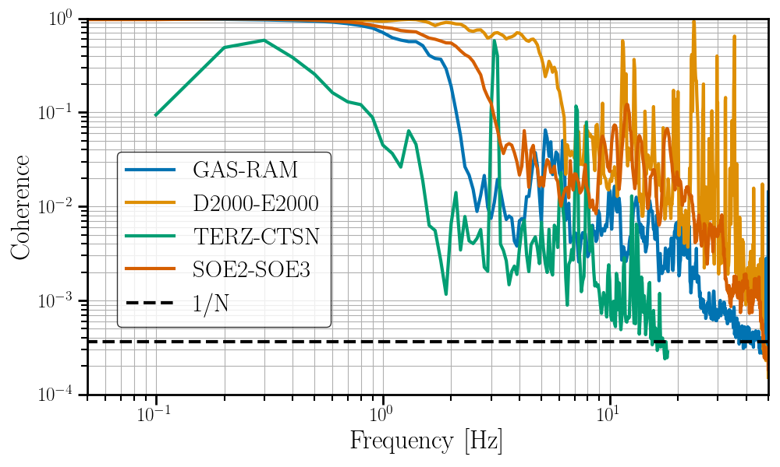
Site comparison
There seems to be strong site dependence on level of coherence
Coherence at LSBB (200m deep) lower than Homestake and Sardegna (400-600m deep)
Note: Distance between underground borehole seismometers at Terziet is 2,4 km and not representative
Ideally: 2nd borehole in EMR region close to Terziet surface area separated by 400m
For the moment: Measure at LSBB
LSBB: 600 m dist, 200m depth
Homestake: 400 m dist, 600m depth
Terziet: 2400 m dist, 200m depth
Sardegna: 400 m dist, 140m depth

Slide 17
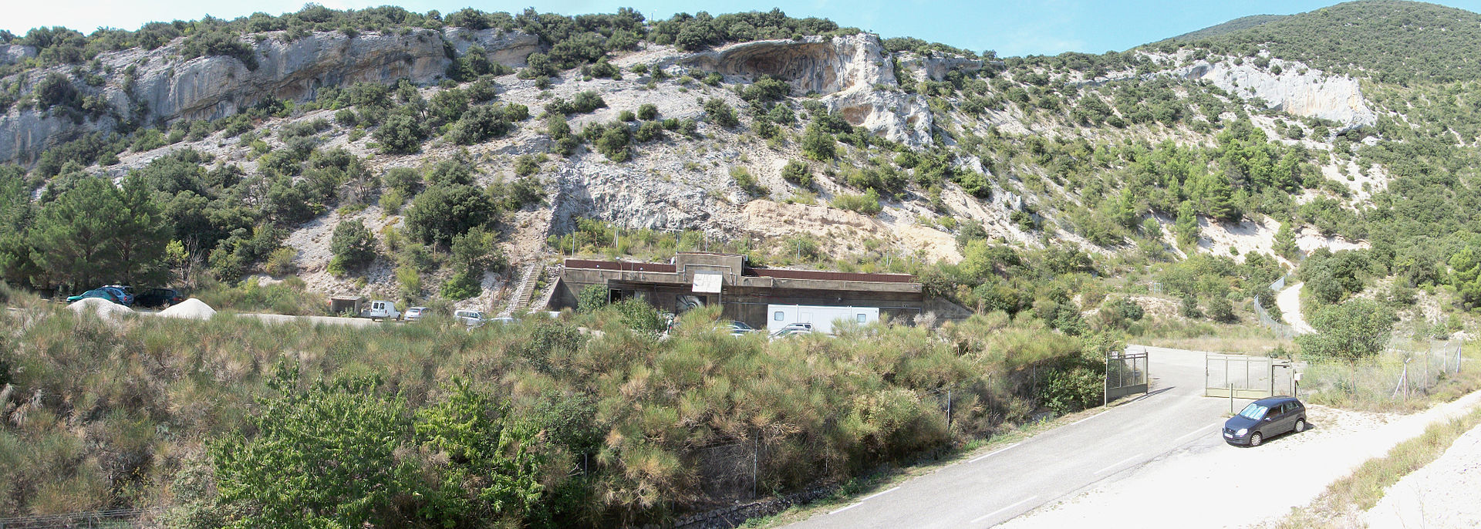
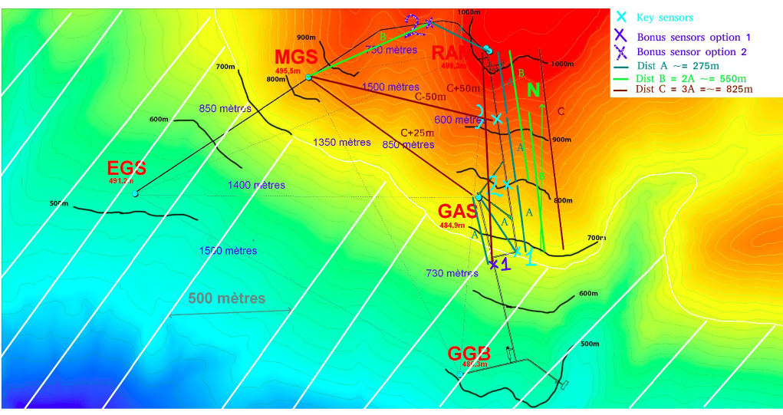
The LSBB seismic project
Laboratoire Souterrain à Bas Bruit (Rustrel, Vaucluse FR)
Former nuclear launch site of France
Seismically very quiet
Electromagnetically shielded
Tunnel complex of 4km
Anti-blast gallery at 280m depth with existing fixed seismometer array diatance range 600m-850m
Possible location for interfereometer w. cold atoms
We propose: Extend existing array with 4 new mobile seismometers (one of which we purchased on IRI budget: 20kEur)
Start campaign investigating dependence on depth, distance, orientation …

Slide 18
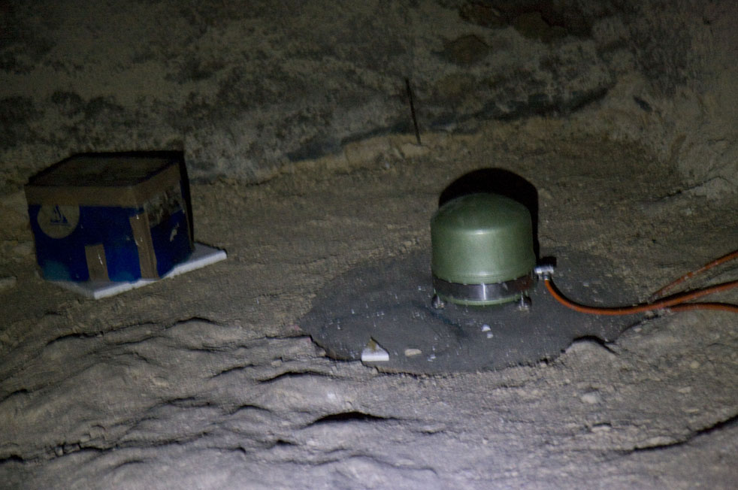
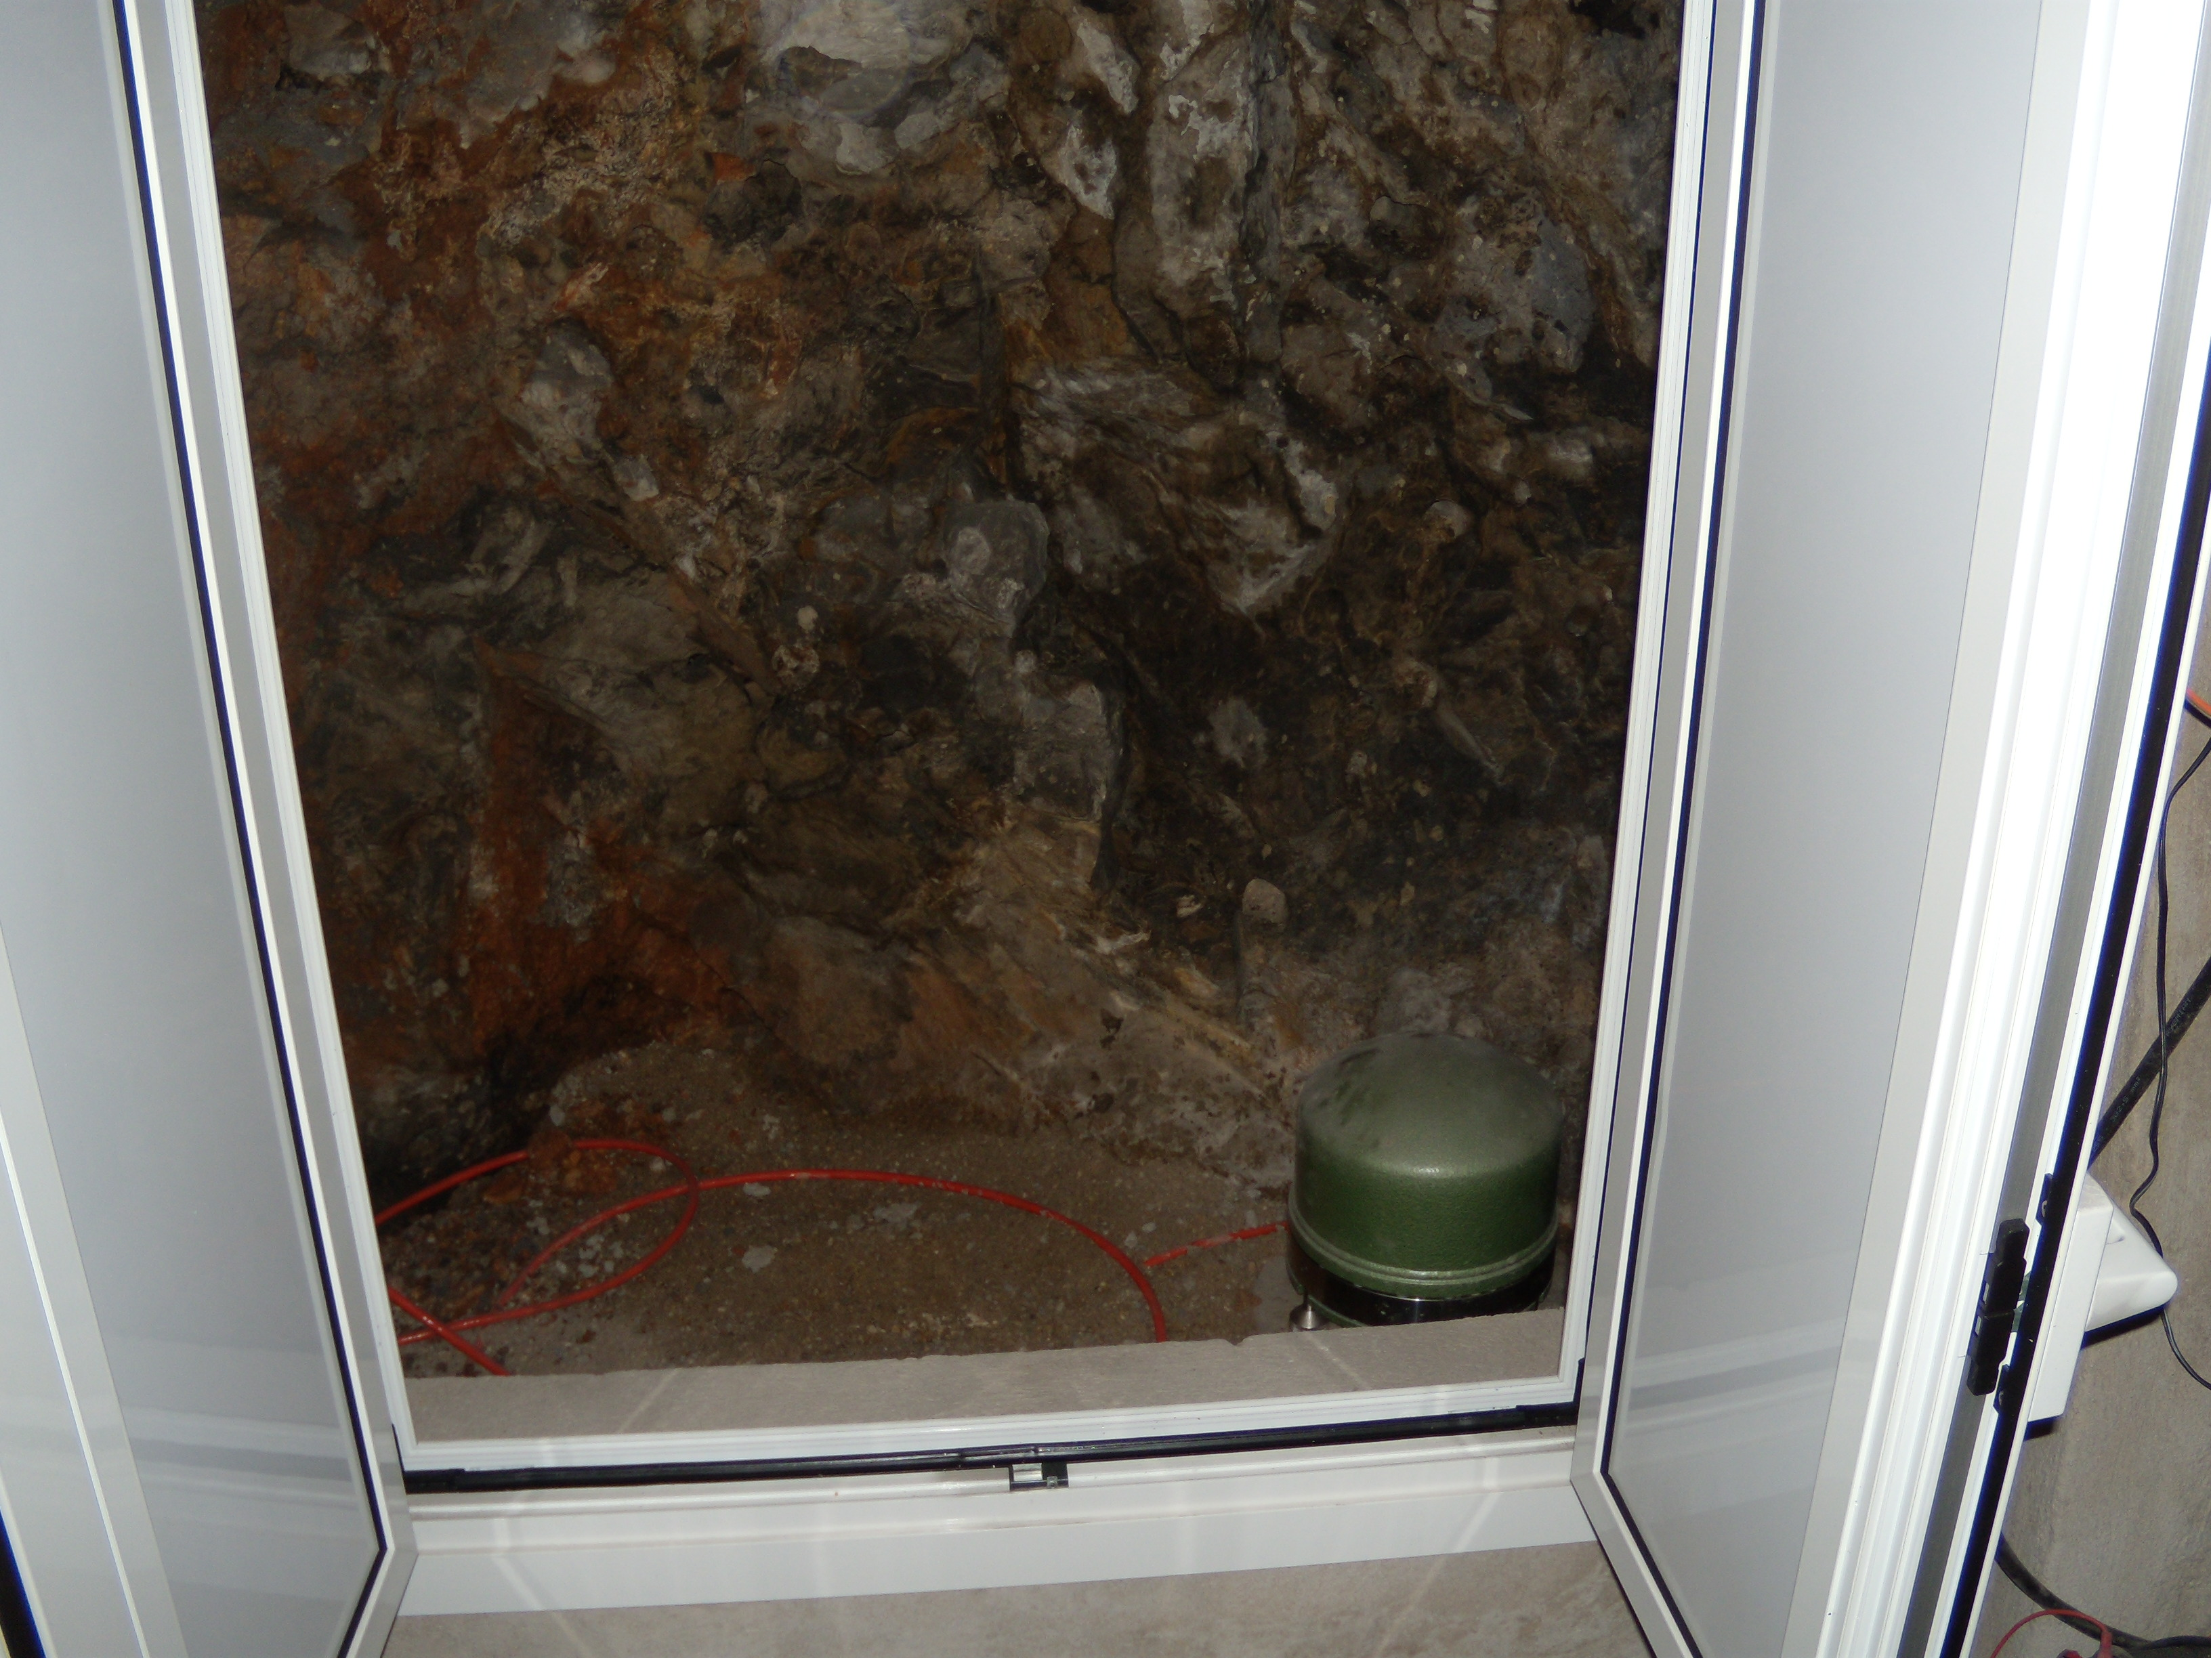
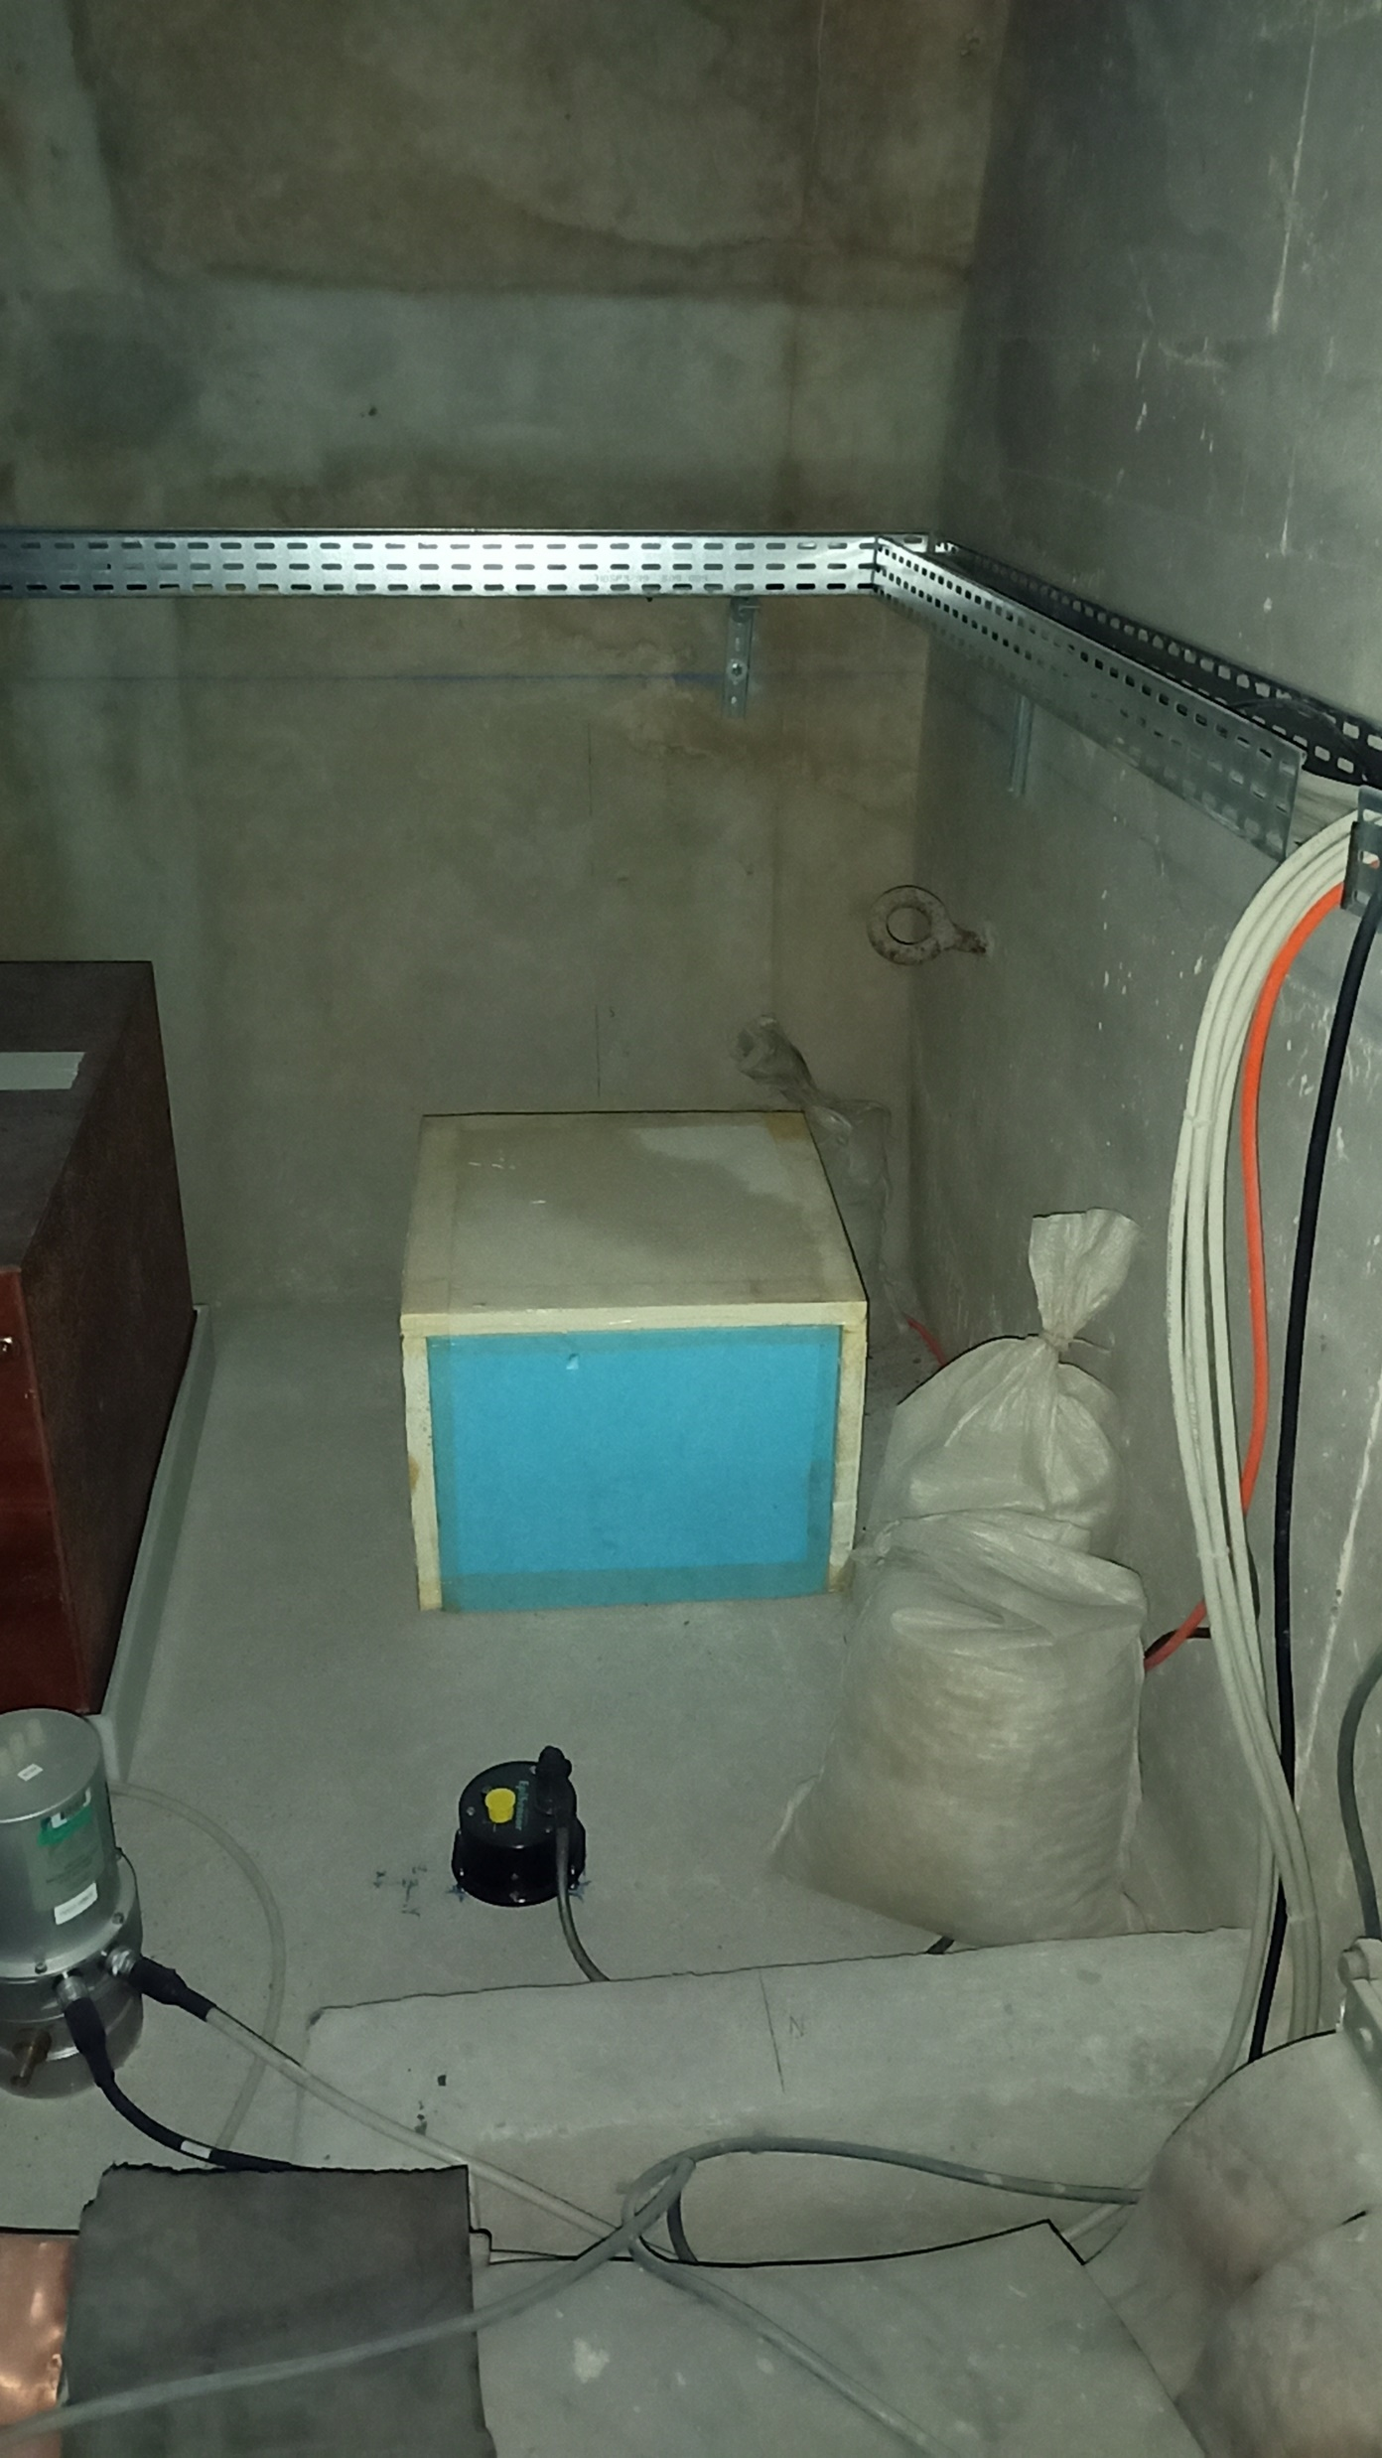
Conclusions & Outlook
Seismic fields being mapped in various regions
Subsurface fields are less known in EMR region
High quality data from subsurface seismometer arrays at Homestake and LSBB are being exploited
Newtonian Noise induced by subsurface body waves is the biggest limitation for ET sensitivity in Frequency range up to 10Hz!
Correlated Newtonian Noise is very significant for co-located interferometers in the standard ET triangle geometry
These correlated NN noise contributions make an improved measurement of the stochastic GW background with a triangular ET nearly impossible!
New interesting seismic campaign starting at LSBB to elucidate dependence on depth, distance, orientation, …. In collaboration with ARTEMIS Nice and UGent
Open to other collaborators!

