Slide 1
Metallurgical aspects of the ET beampipe design
Department of Electromechanical, Systems and Metal Engineering
  Materials Science and Technology group
FWO workshop | Alexey Gervasyev | 27 November 2023

Slide 2
Outline
General ET beampipe design considerations
Overview of steels potentially to be used as the beampipe material
Ferritic stainless steel welded joint formability

Slide 3
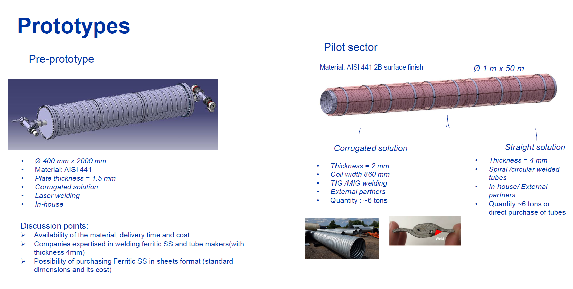
General ET beampipe design considerations
120 km long, 1 m diameter ultra-high vacuum pipeline
Pipe making technology:
Spiral welded
Longitudinally welded
Double longitudinally welded
Reinforcement:
Stiffener rings
Corrugations
No reinforcement
Material:
Austenitic stainless steel
Ferritic stainless steel
Non-stainless low-carbon steel
NEW
Already 27 combinations, but there are other aspects…
3 (sub-size) pre-prototypes made of the 3 materials
50 m pilot sector
To be produced at CERN

Slide 4
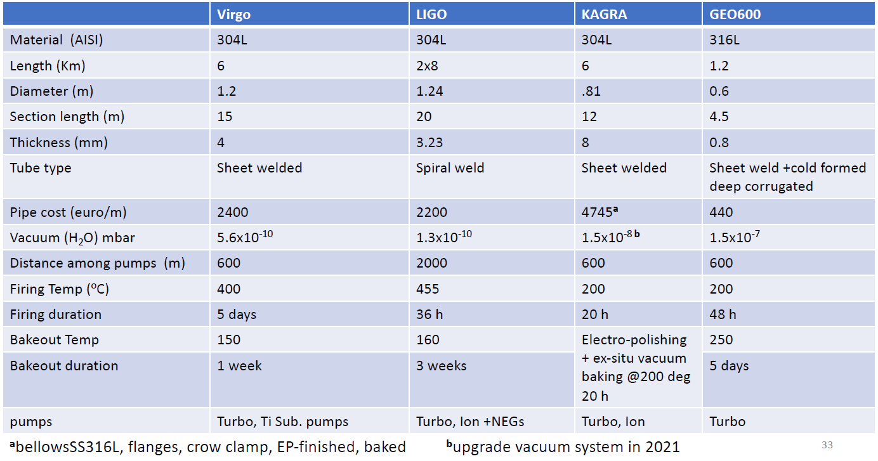
General ET beampipe design considerations
[Aniello Grado, Beampipes for Gravitational Wave Telescopes seminar at CERN, March 2023]

Slide 5
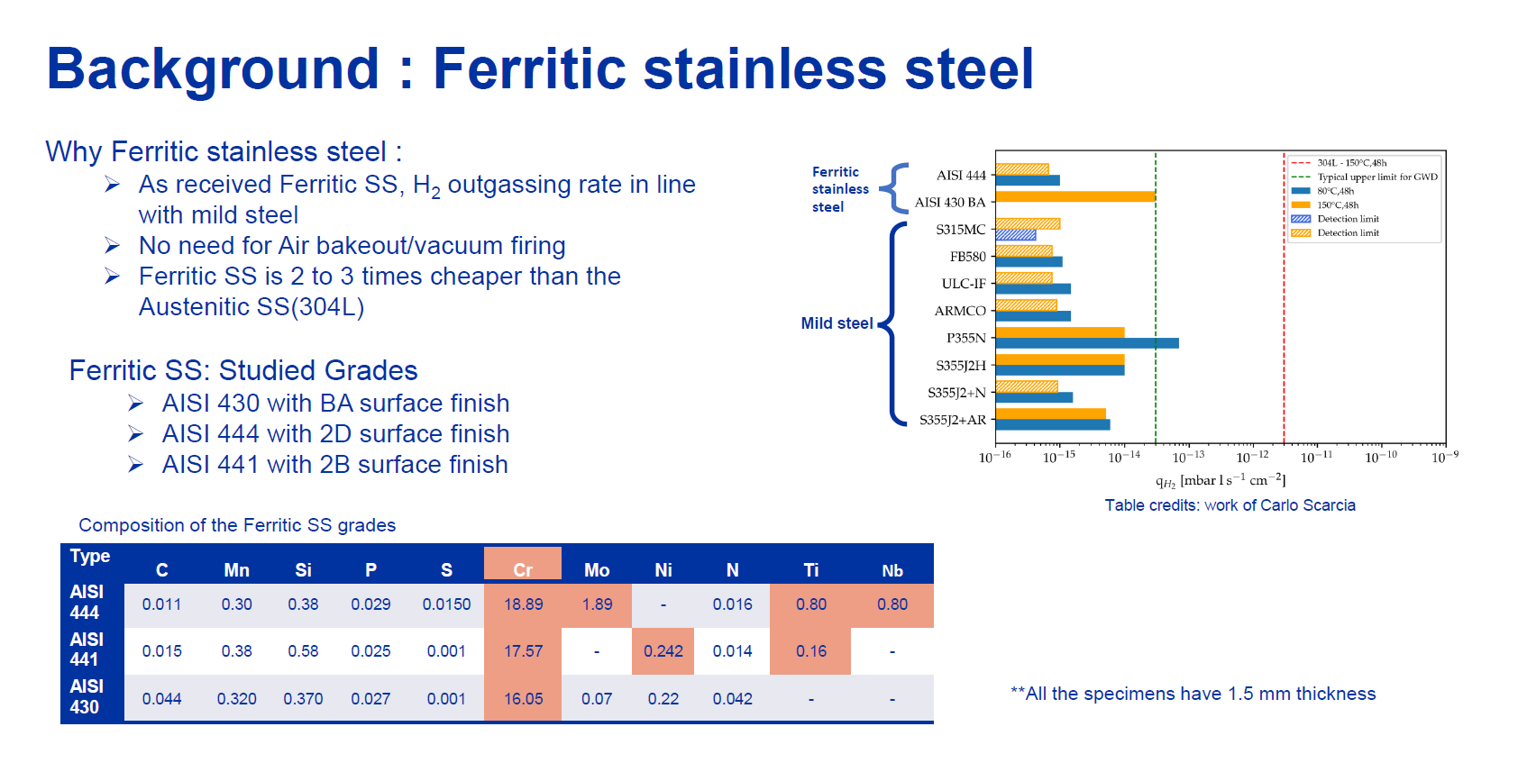
General ET beampipe design considerations
[CERN]

Slide 6
Overview of steels potentially to be used as the beampipe material
Commercially available line pipes
[muelheim-pipecoatings.com]

Slide 7
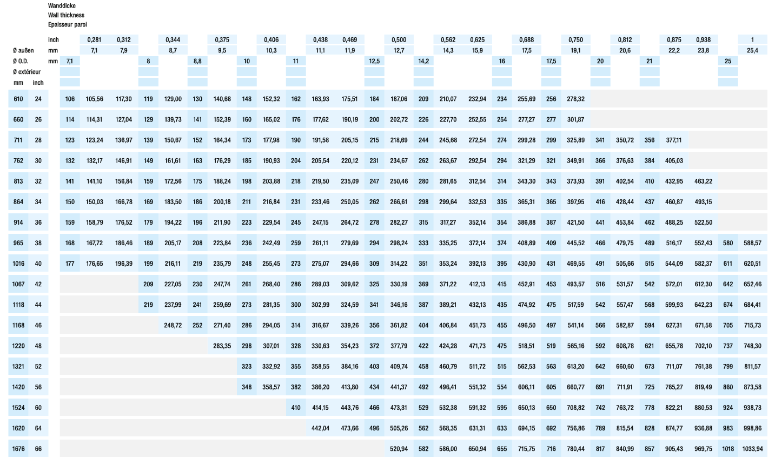
Overview of steels potentially to be used as the beampipe material
Commercially available line pipe – product range
[mannesmann-grossrohr.com]

Slide 8
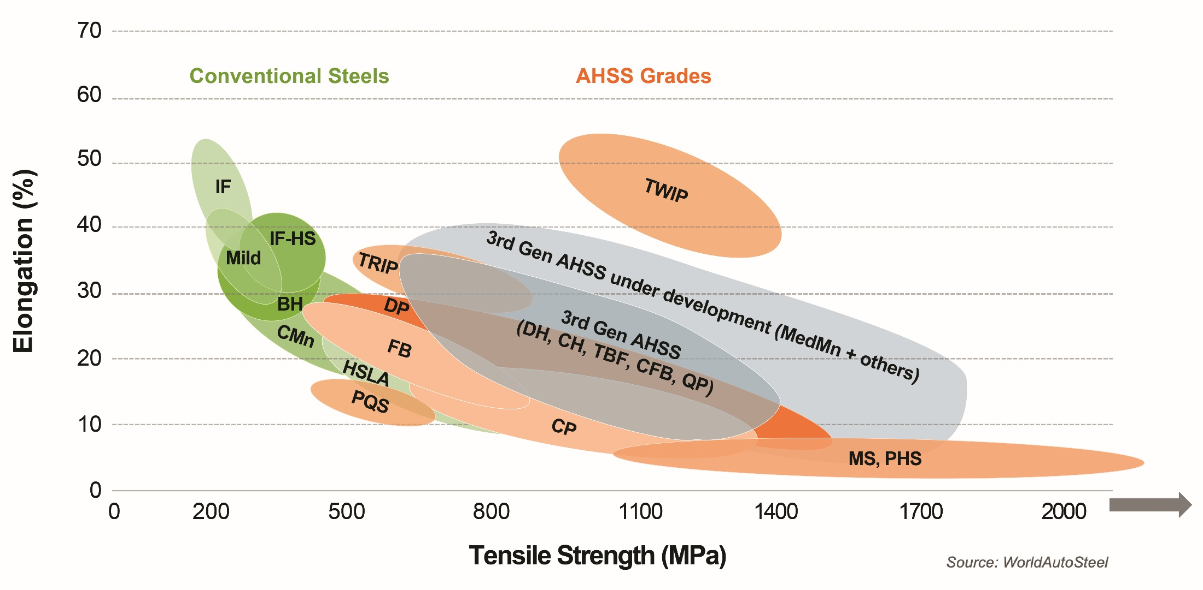
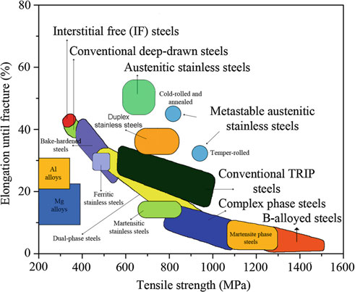
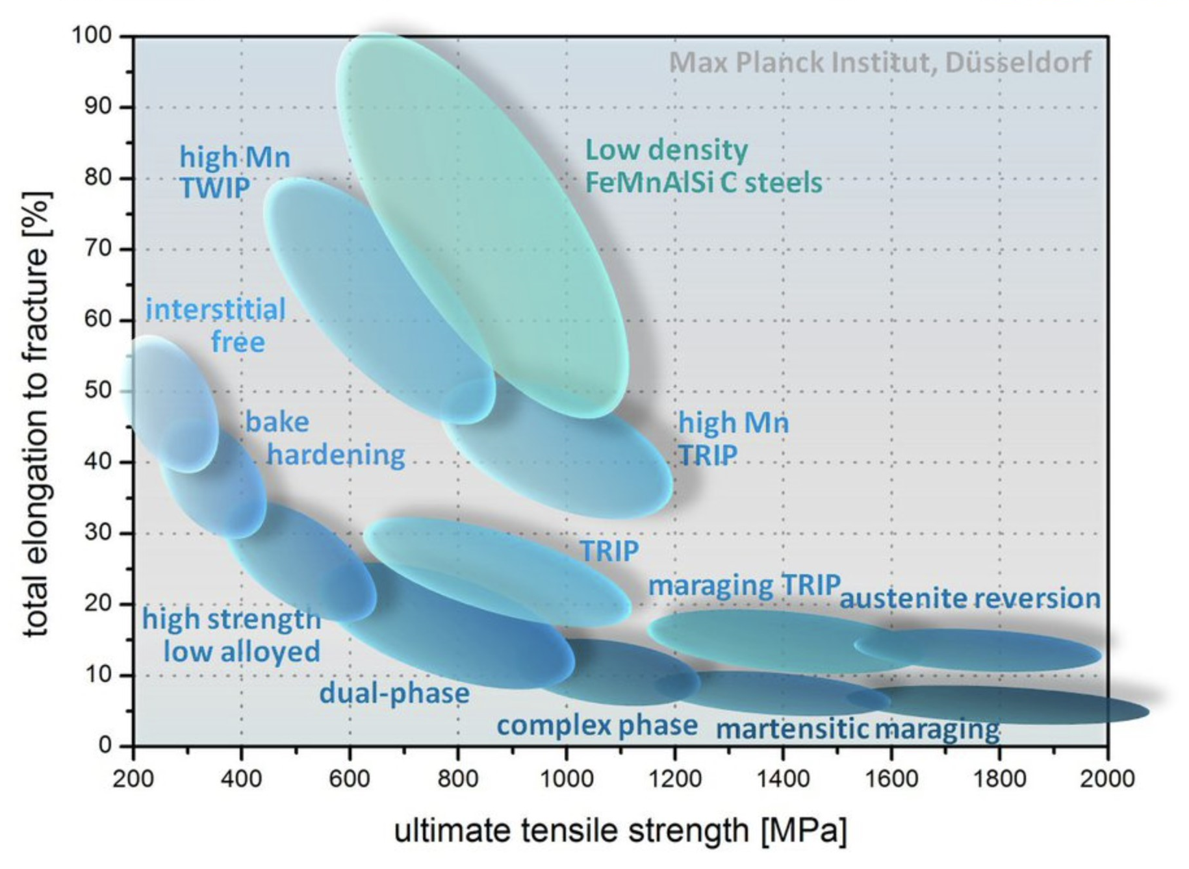
Overview of steels potentially to be used as the beampipe material
Steel can be very different
[Rajasekhara et al 2011]
[WorldAutoSteel]

Slide 9
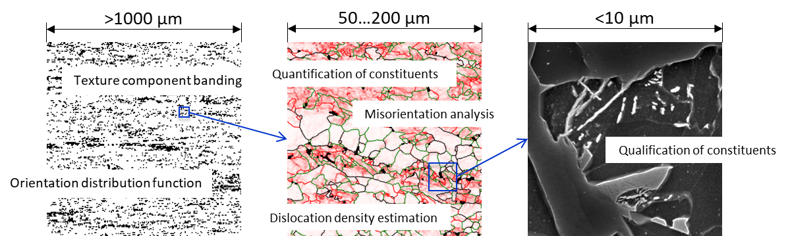
Overview of steels potentially to be used as the beampipe material
Steel microstructure complexity
[Gervasyev at al]

Slide 10
Overview of steels potentially to be used as the beampipe material
Stainless
Non-Stainless

Slide 11
Overview of steels potentially to be used as the beampipe material
Stainless
Non-Stainless

Slide 12
Overview of steels potentially to be used as the beampipe material
Stainless
Non-Stainless

Slide 13
Overview of steels potentially to be used as the beampipe material
Stainless
Non-Stainless
Excellent
Not-so-good
Good

Slide 14
Overview of steels potentially to be used as the beampipe material
Pipe manufacturing and pipeline construction
Pipe manufacturing and pipeline construction??
Pipeline construction??

Slide 15

Overview of steels potentially to be used as the beampipe material
Austenitic stainless steel alternatives (to reduce the cost)
Ferritic stainless steel
Non-stainless steel
Formability of welded joints?
Cleaning?

Slide 16
Ferritic stainless steel welded joint formability
The immediate task is to produce pre-prototypes of the ET beam pipe, smaller diameter pipe sections to be manufactured in CERN
The pre-prototypes are longitudinally welded corrugated pipes, corrugations are applied by cold forming of the welded pipe
AISI 430 FSS welds failed by brittle cracking during the cold forming
Grades 444 and 441 demonstrated better performance but some damage still occurred
Change of the welding process from TIG to laser welding apparently led to satisfactory results
Metallurgical aspects of the FSS welding in these challenging conditions must be understood

Slide 17
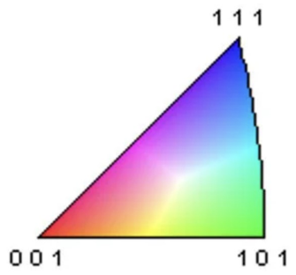



Base metal
444
441
430
800μm
ND
800μm
800μm
RD

Slide 18
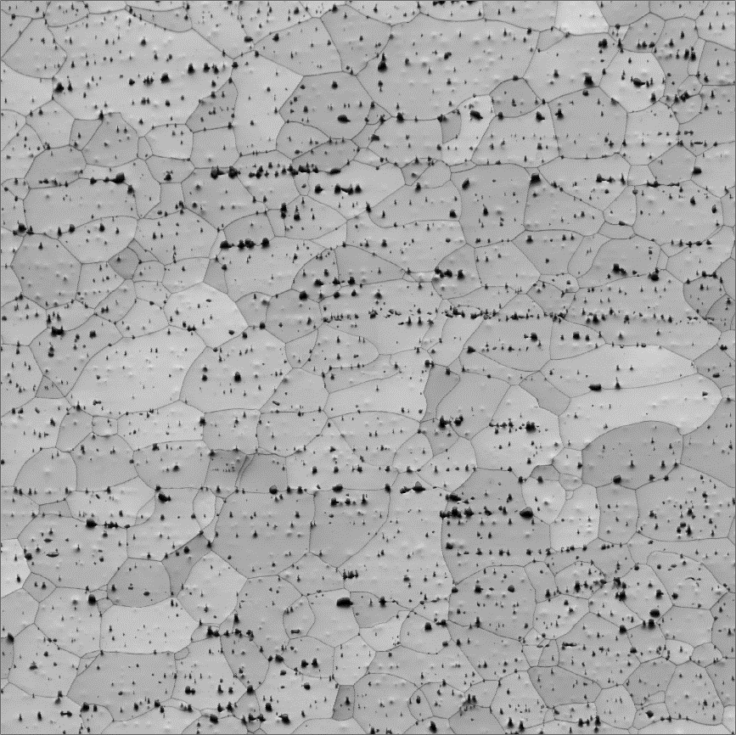
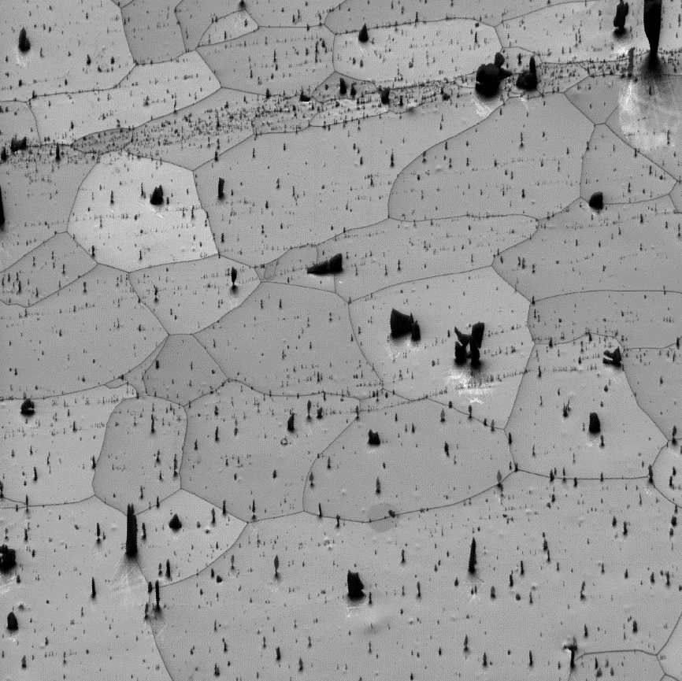
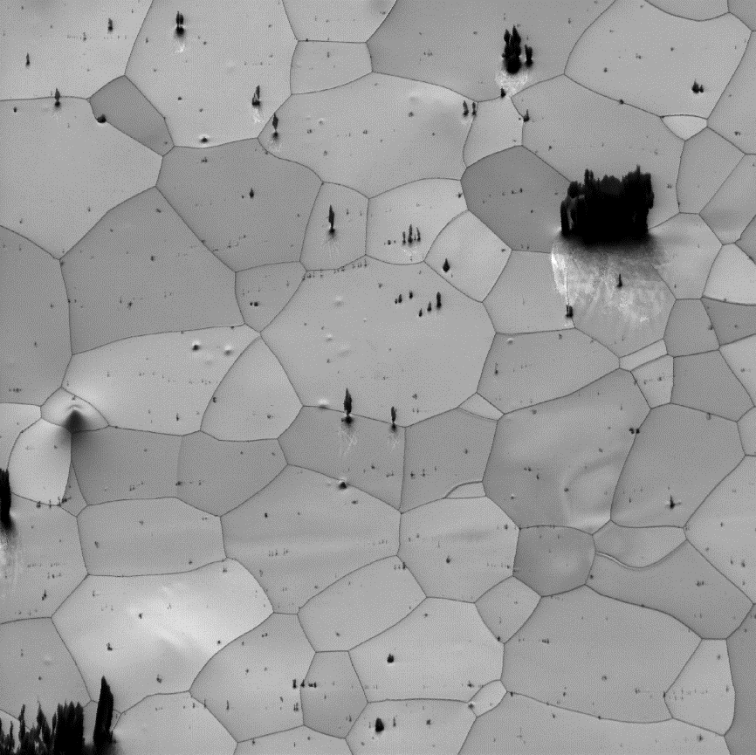
Base metal
430
444
441
Nb Kα
Ti Kα
Cr Kα
ND
RD
200μm
200μm
200μm

Slide 19
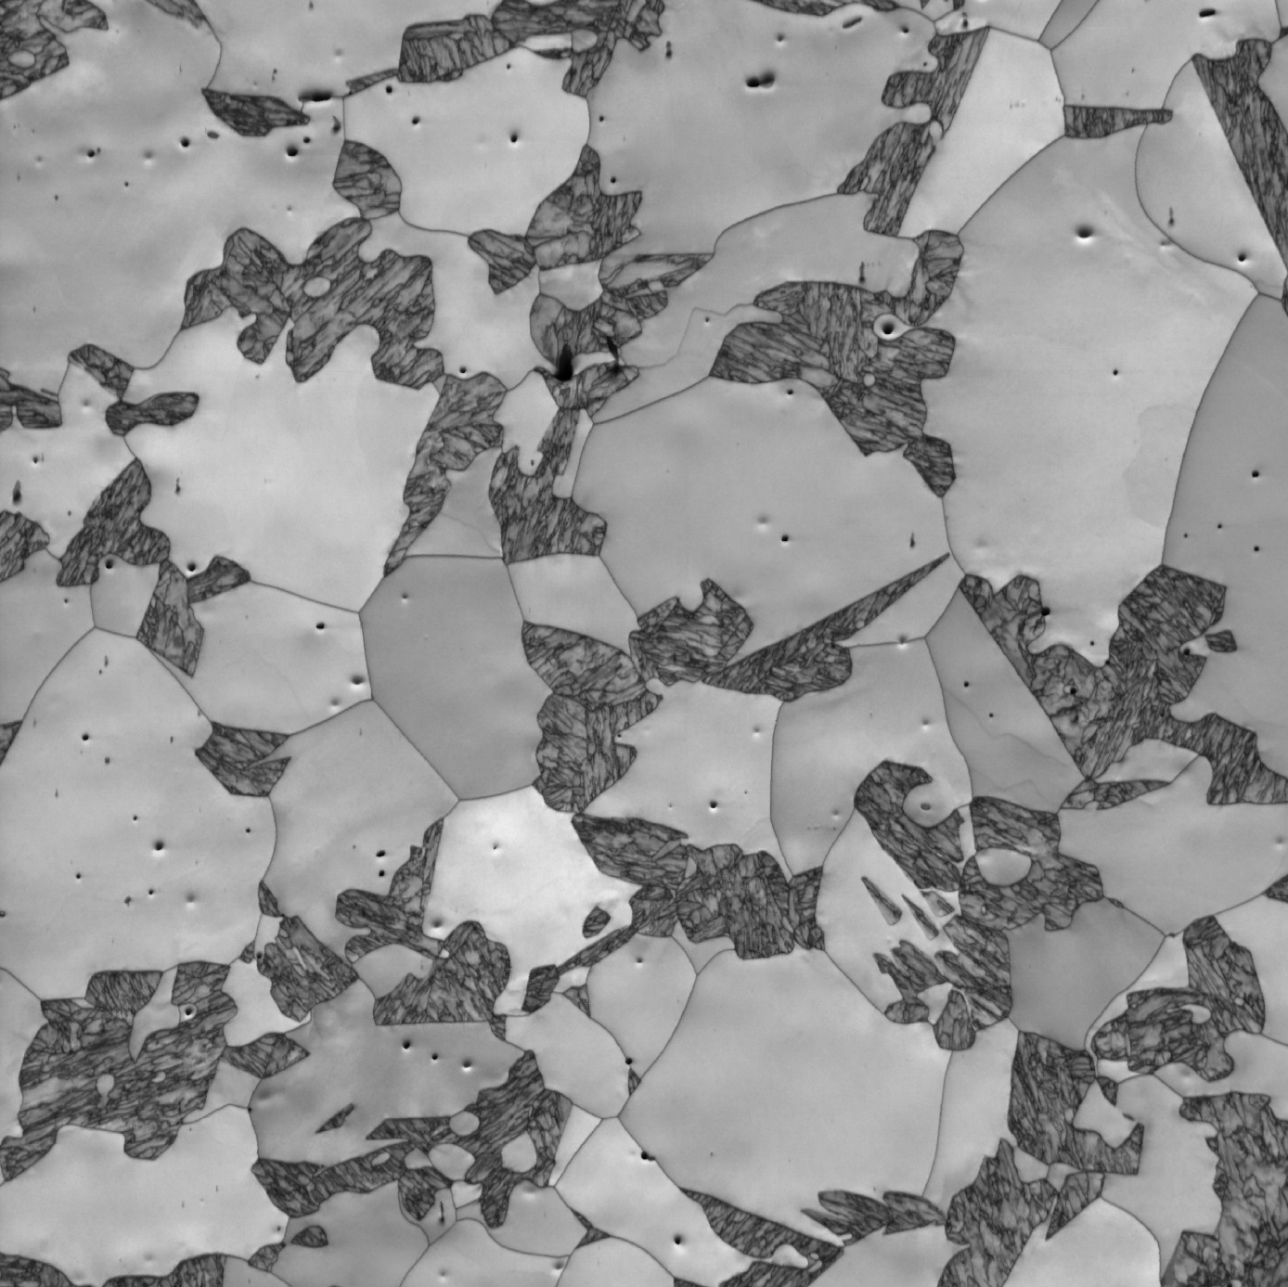
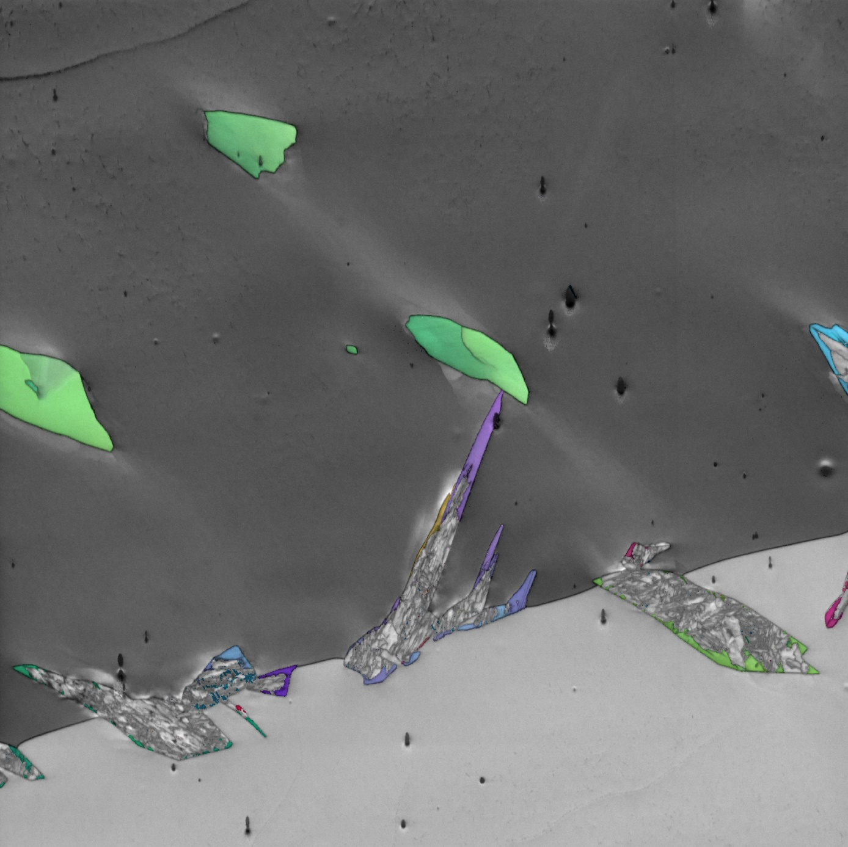
430 TIG welding joint
1 mm

Slide 20
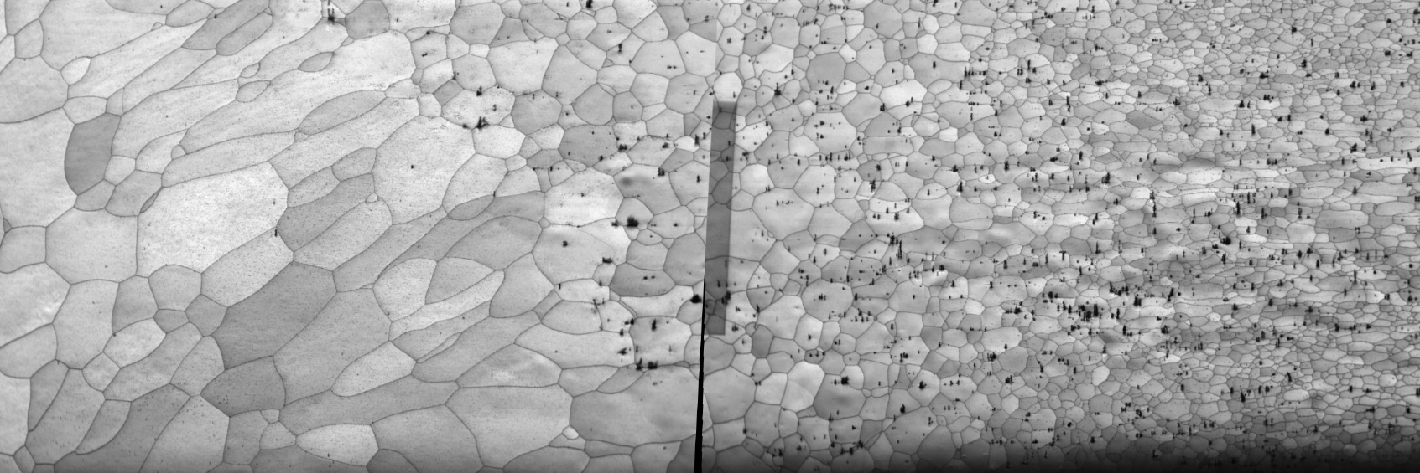

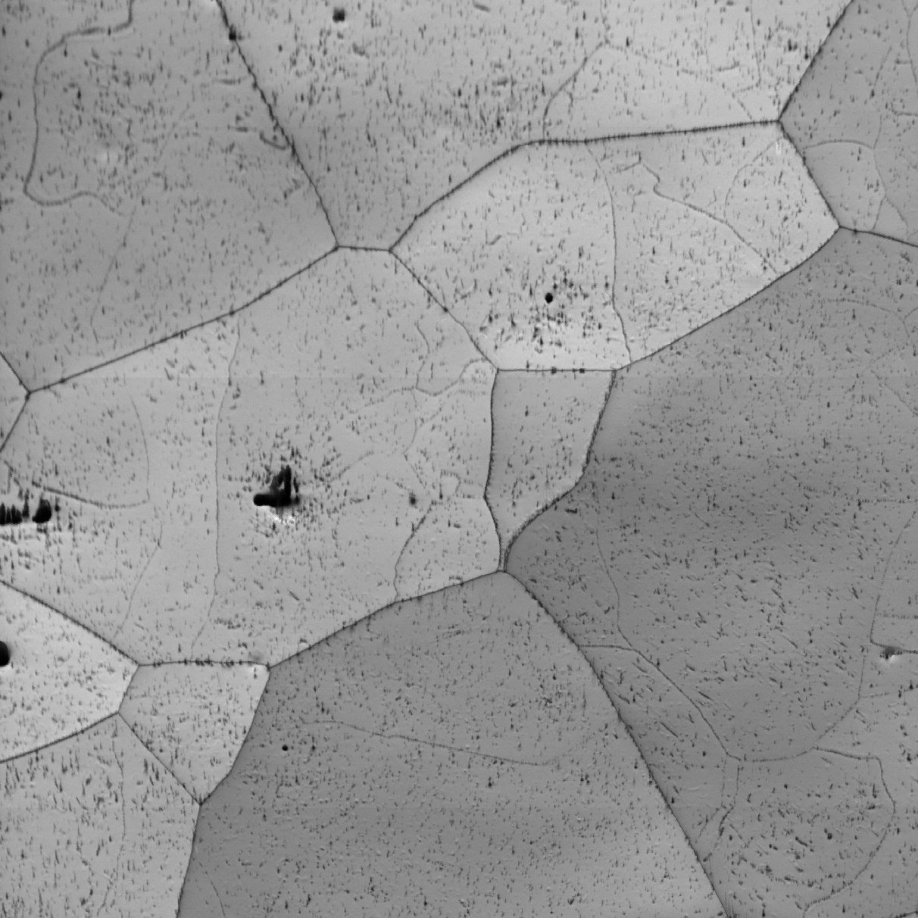
444 TIG welding joint
1.5 mm

Slide 21
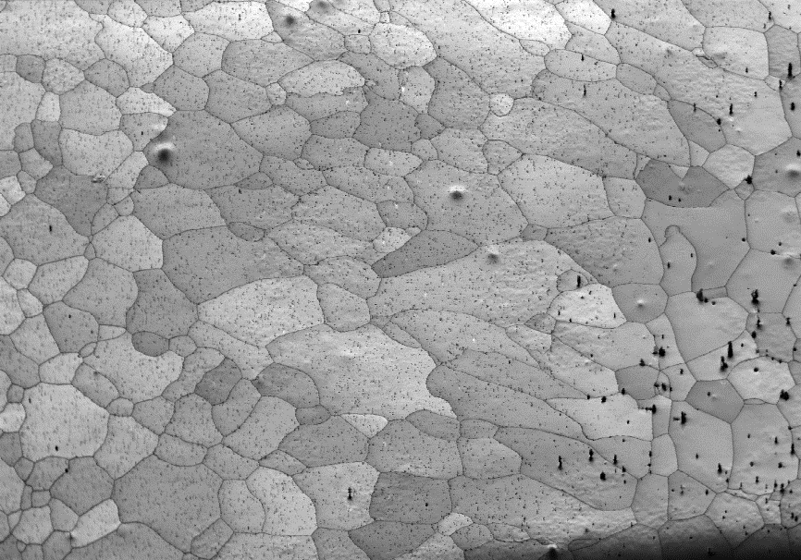
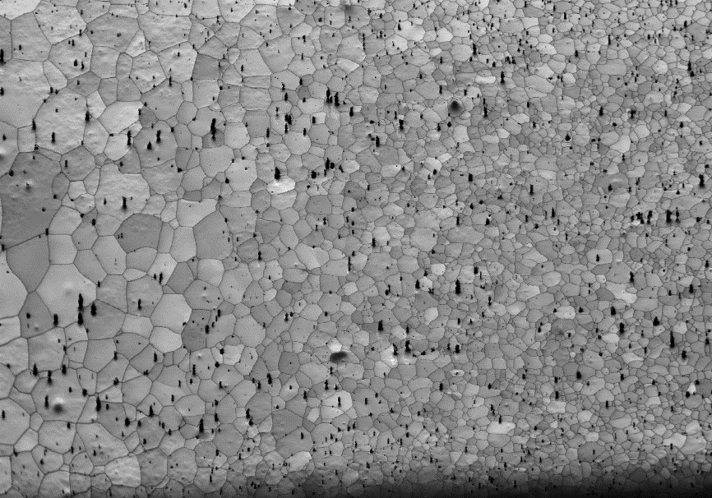

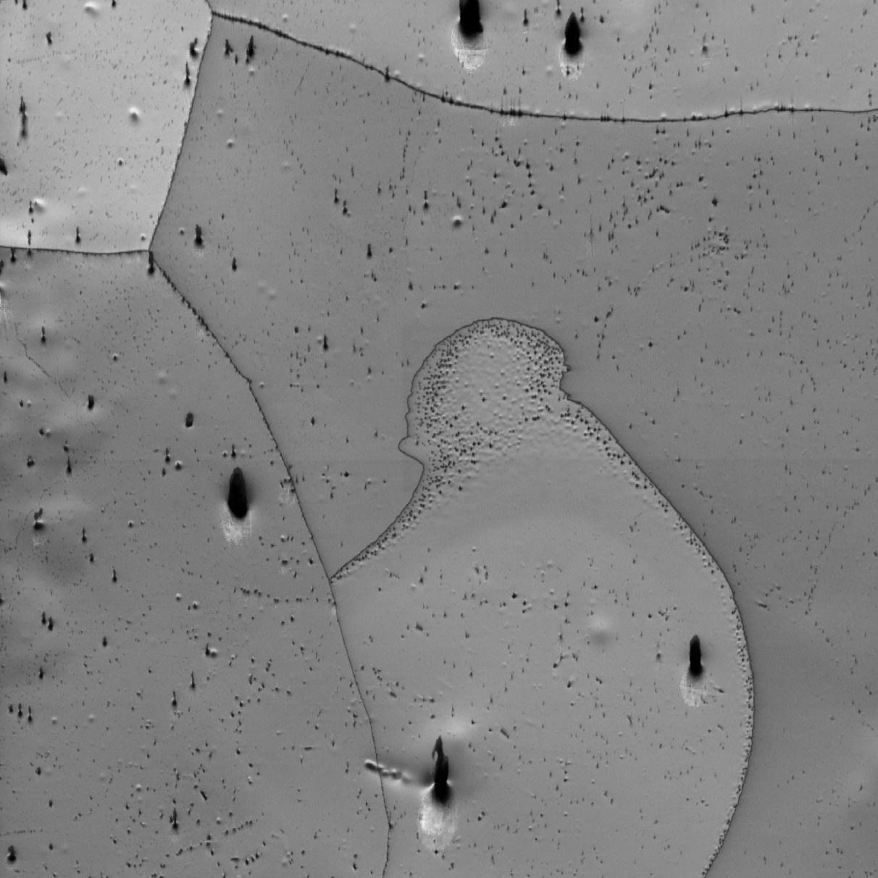
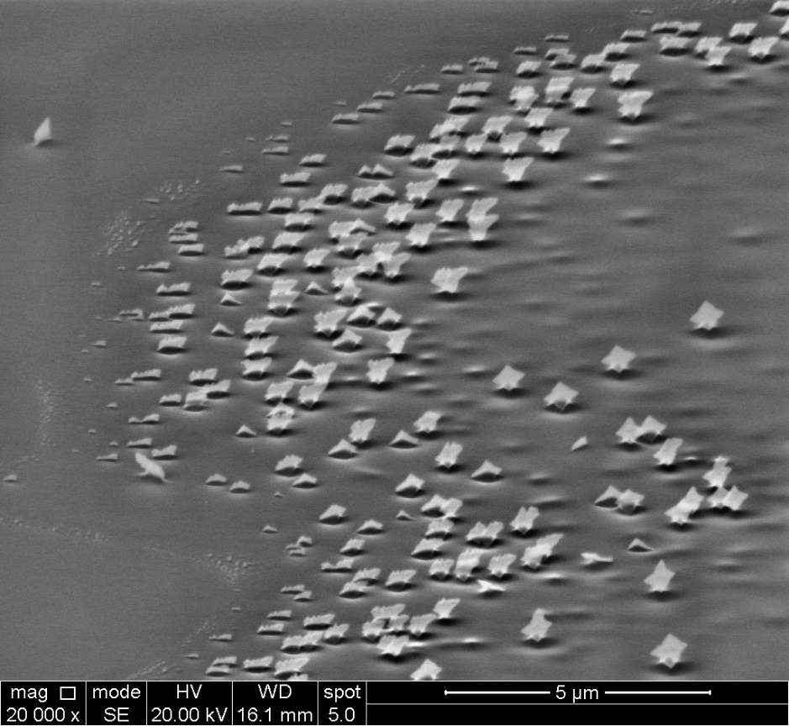
441 TIG welding joint
1.5 mm

Slide 22
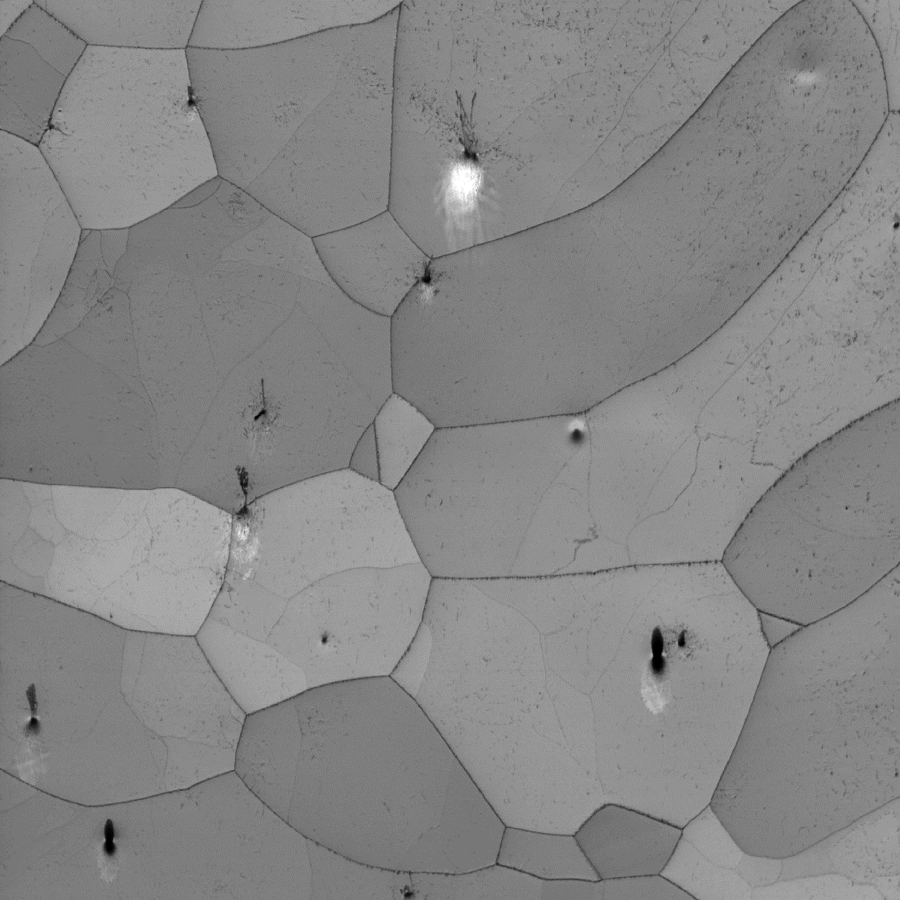
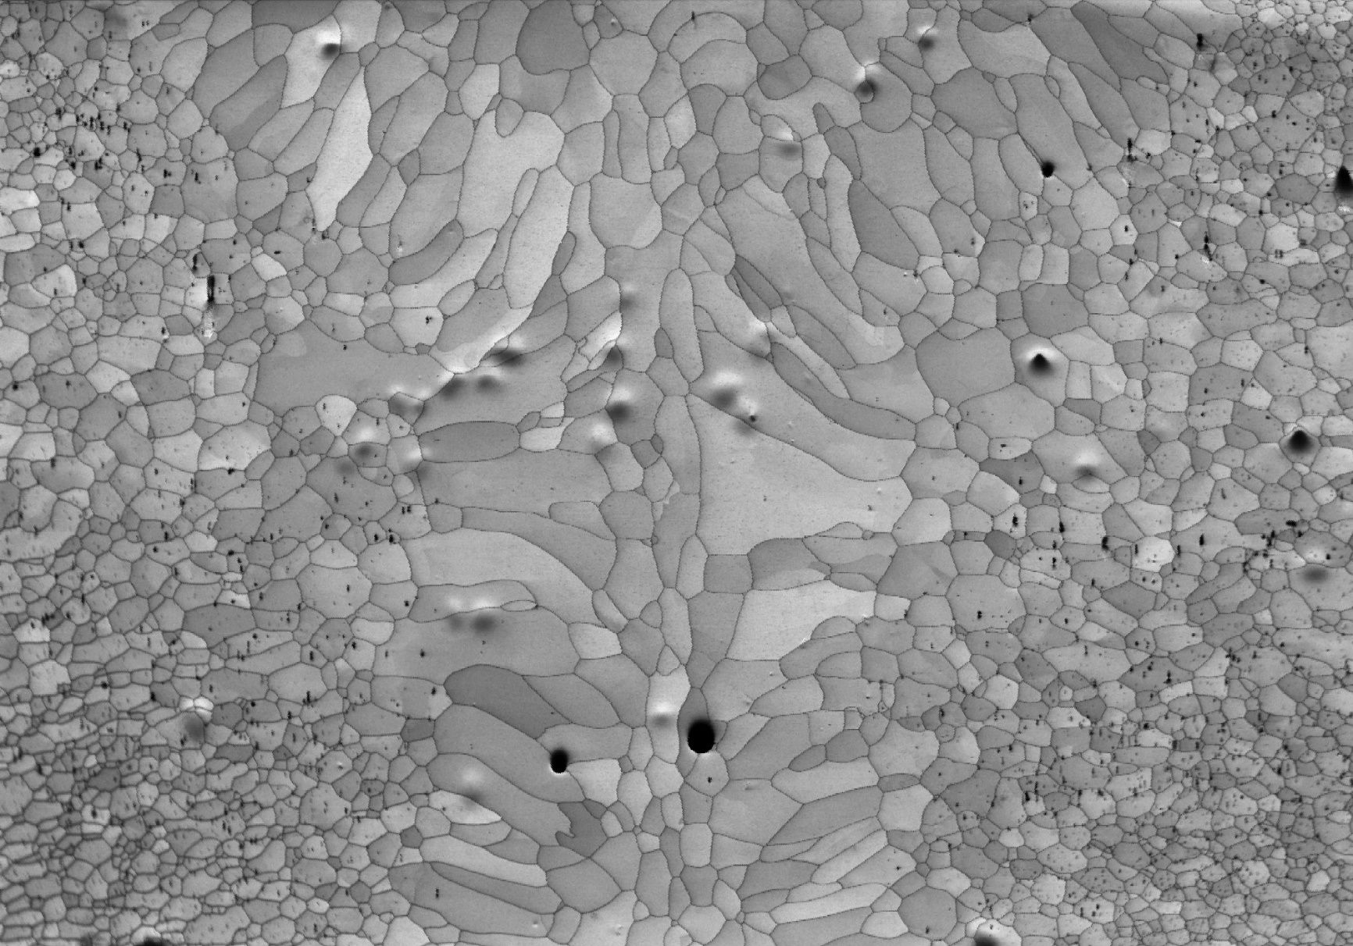
444 Laser (pulsed) welding joint
1.5 mm

Slide 23
Basic welding heat transfer model
Tungsten Inert Gas (TIG) welding parameters
(aka Gas Tungsten Arc Welding (GTAW), an arc welding process that produces the weld with a non-consumable tungsten electrode)
Pulsed
I =40 A to 85 A
Pulse time = 0,15 s
V = 12 V
Speed = 130…145 mm/min
=> Heat input ≈ 185 J/mm

Slide 24
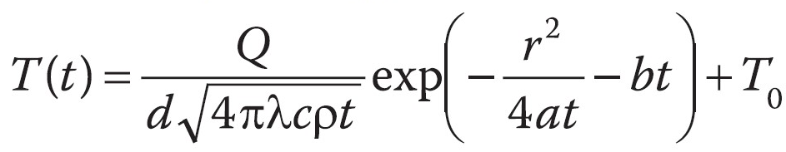
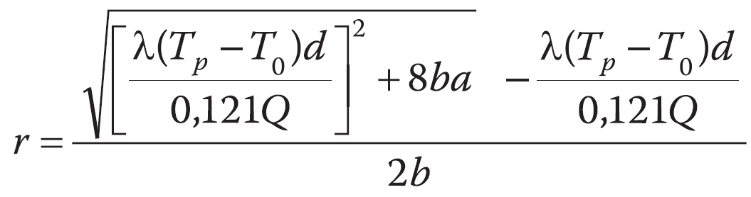
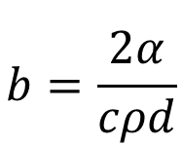
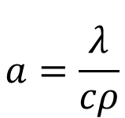
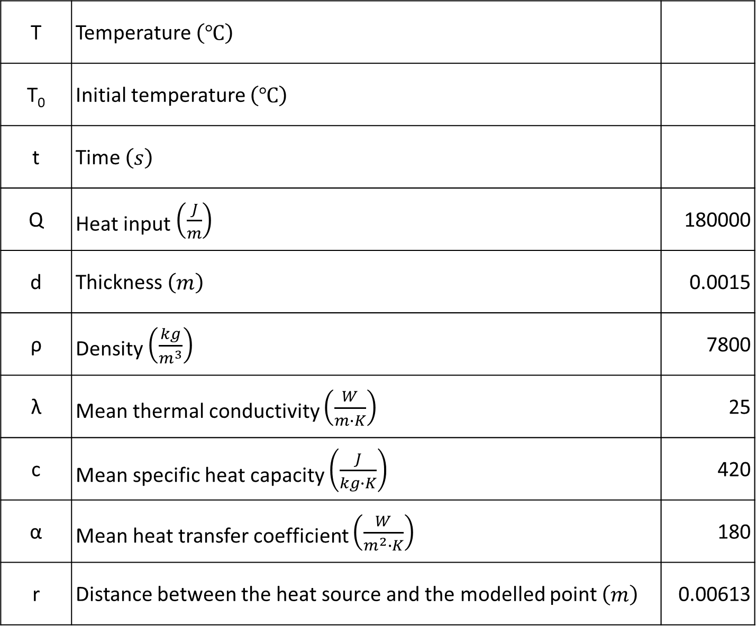
Basic welding heat transfer model
[N.N. Rykalin (1951)]
T | Temperature $\left(℃\right)$
T₀ | Initial temperature $\left(℃\right)$
t | Time $\left(s\right)$
Q | Heat input $\left(\frac{J}{m}\right)$ | 180000
d | Thickness $\left(m\right)$ | 0.0015
ρ | Density $\left(\frac{kg}{m^{3}}\right)$ | 7800
λ | Mean thermal conductivity $\left(\frac{W}{m∙K}\right)$ | 25
c | Mean specific heat capacity $\left(\frac{J}{kg∙K}\right)$ | 420
α | Mean heat transfer coefficient $\left(\frac{W}{m^{2}∙K}\right)$ | 180
r | Distance between the heat source and the modelled point $\left(m\right)$ | 0.00613
$$a=\frac{λ}{cρ}$$
$$b=\frac{2α}{cρd}$$
With the peak temperature of 1350°C

Slide 25
Basic welding heat transfer model
180 kJ/m – heat input estimated from the welding parameters, 240 and 120 kJ/m – arbitrary higher and lower heat inputs

Slide 26
Dilatometer simulations
RD
Dilatometer specimen:
10 mm × 5 mm ×
sheet thickness (1.5 mm)
Microstructure measurements
TD
Dilatometer measures dimensional changes in material as a function of temperature.
It can implement complex temperature-time programs with high heating and cooling rates using induction heating and cooling by inert gas stream.
Thermocouple welding spot

Slide 27
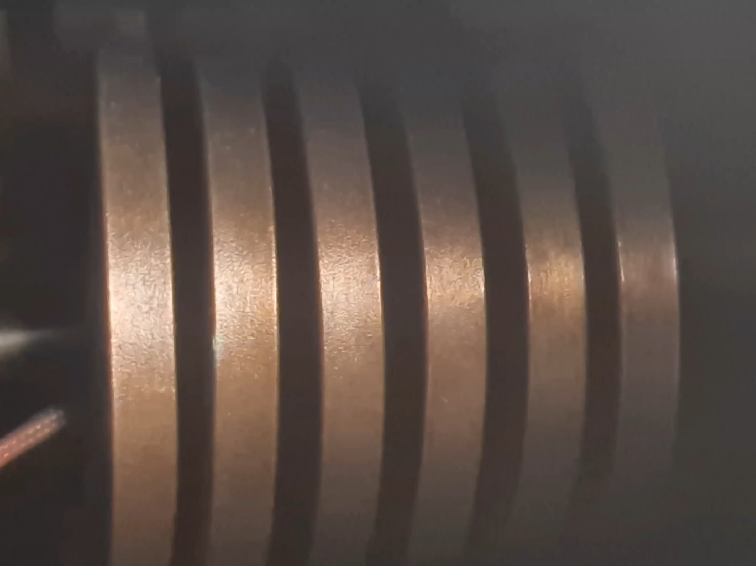
Dilatometer simulations
Two treatments: much faster and much slower cooling rates compared to the model estimation

Slide 28
444 Dilatometer simulations
Fast dilatometer treatment
Slow dilatometer treatment
1.5 mm
1.5 mm
ND
RD

Slide 29
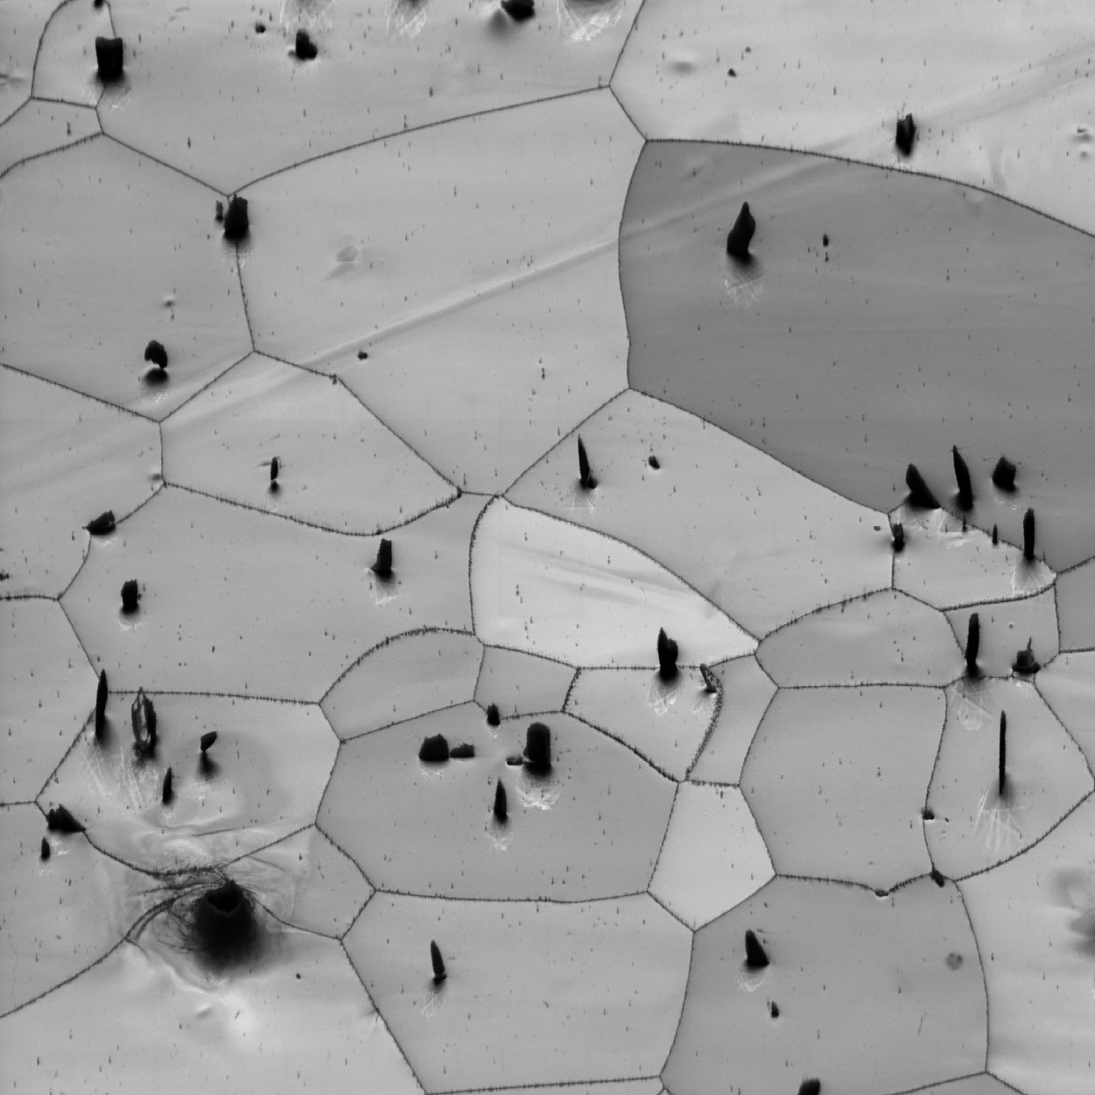
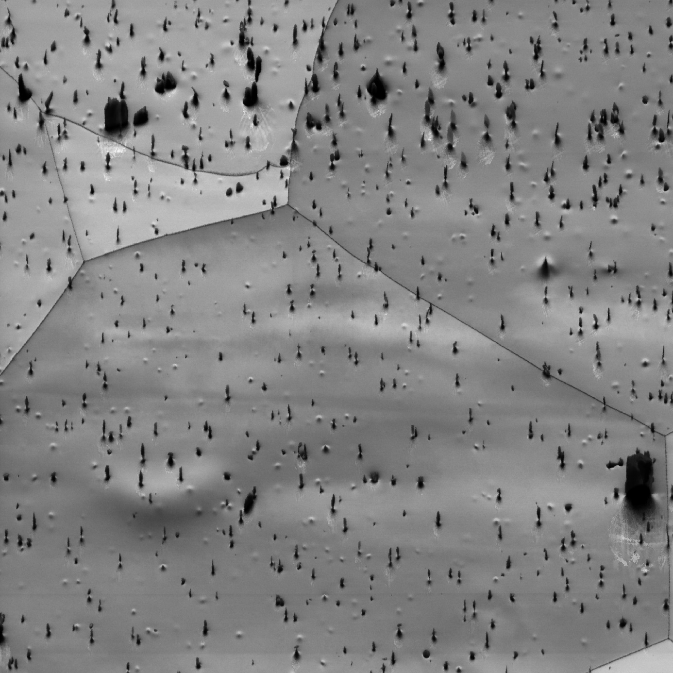
444 Dilatometer simulations
Fast dilatometer treatment
Slow dilatometer treatment
200μm
200μm

Slide 30
444 Dilatometer simulations
Fast dilatometer treatment
Slow dilatometer treatment

Slide 31

444 Dilatometer simulations
Fast dilatometer treatment
Lazer welding HAZ
200μm
200μm

Slide 32

444 Dilatometer simulations
Slow dilatometer treatment
TIG welding HAZ
200μm
200μm

Slide 33
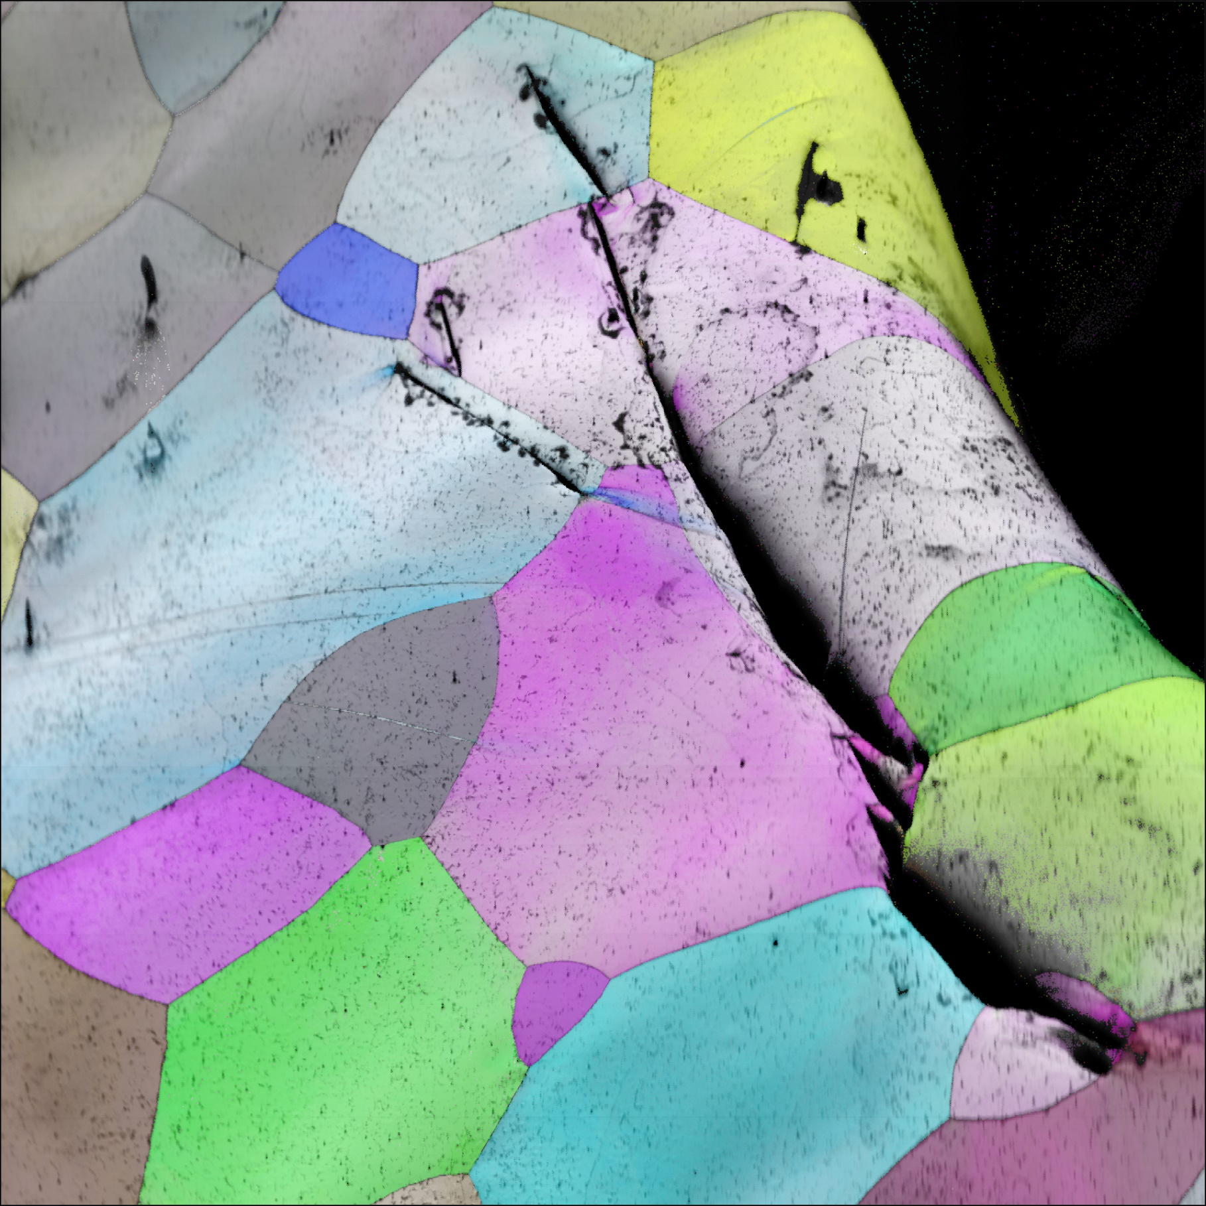
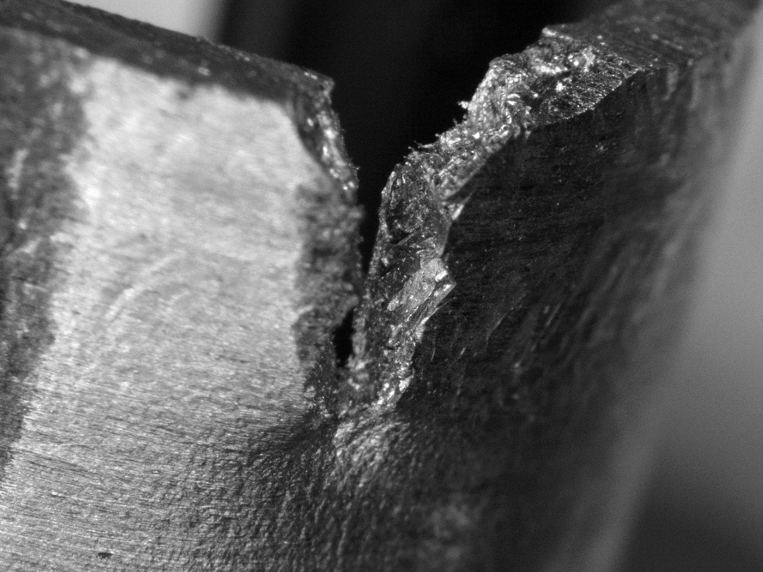
Corrugated 444 TIG weld with failure
Since the fracture is (quasi-)brittle, there are secondary cracks which can be used to analyse the fracture characteristics.
Therefore, electropolishing was used to prepare the sample (it doesn’t blunt the edges of the secondary cracks too much).
400 µm

Slide 34

Corrugated 444 TIG weld with failure
(?)
Intragranular fracture corresponds to the {001} cleavage planes (cube face)
(?)
(?)
Intergranular fracture is also present

Slide 35

Corrugated 444 TIG weld with failure
(Deformation) twinning detected
Σ3 CSL boundaries

Slide 36
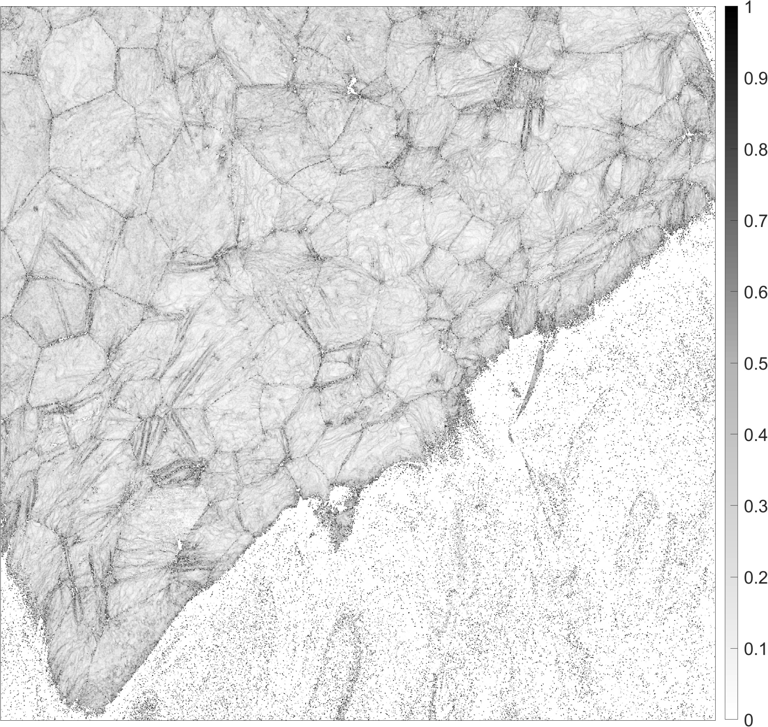
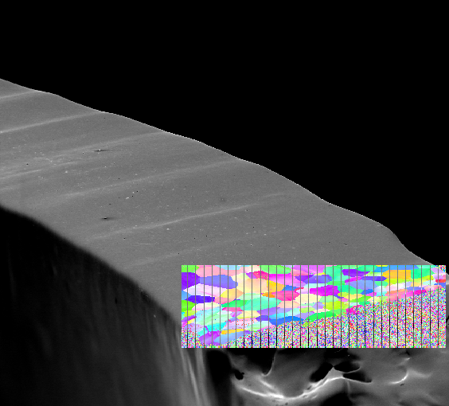
Corrugated 444 TIG weld with failure
KAM (°)
Strain heterogeneities (shear/deformation bands, twins) formed during the cold forming in combination with the grain boundary precipitation could provide conditions for cleavage fracture initiation.
Cleavage fracture propagation is then easy due to the large grain size.
1250 µm

Slide 37
Comments – FSS weld formability
Unlike grade 430, grades 444 and 441 never transform to austenite
The microstructure of 444 and 441 steels is therefore defined by the ferrite grain size and Nb and Ti –based precipitation which occurs both inside ferrite grains and along their boundaries
It doesn’t appear feasible to completely supress the grain boundary precipitation by quenching
Therefore, the only way to improve the weld toughness (given any post-heat-treatment is not practical) is to reduce the grain size (which was to a significant extent achieved by laser welding).
Finer grain size should
  Improve the resistance to cleavage fracture propagation,
  Reduce the propensity to form strain heterogeneities.

Slide 38
Concluding Comments
Collaboration between the Materials Science and Technology group of UGent and the Materials sector of CERN has been established
The work so far has been focused on the welding technology optimization to allow the manufacturing of the ferritic stainless steel pre-prototype
The results suggest that the use of very low heat input welding technique (laser) and stabilized FSS grades 444 or 441 allows to achieve good enough formability of the welds to withstand the corrugation forming process, and therefore the FSS pre-prototype can be manufactured identically to the other two
That said, if the FSS becomes the material of choice, corrugation should probably be avoided (and stiffener rings should be used instead)
Another important activity is to search for and to work with industrial partners who are to help with the pilot sector manufacturing

Slide 39

Thank you!

Slide 40



Alexey Gervasyev
Post-doctoral researcher
Materials Science and Technology group alexey.gervasyev@ugent.be www.ugent.be
Universiteit Gent
@ugent
@ugent
Ghent University

