Slide 1
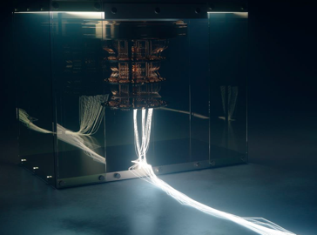

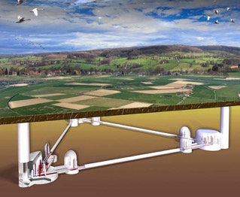
UHasselt what we do in quantum and GW
….Adressing Challenges of Quantum Technology
U : I3 ⊗|0⟩⟨0| + I3 ⊗|−1⟩⟨−1| + (|1⟩⟨1| + |−1⟩⟨0| + |−1⟩⟨−1|) ⊗ |1⟩⟨1|
Quantum Chips
technologies
Quantum
Communication
Quantum
Computing
Quantum Noise
and Space
- Quantum sensing (Amadeus, QuMicro, CQeeN)
- Secure Quantum Communication (Be-QCI, BeQuNet)
- Quantum Computation (Q-Lumi Computer, SPINUS – NV)
- Gravitational Wave Detection (IRI- FWO), Quantum space programmes
Solid State Qubits (NV diamond, SiV, GeV..)
Groups
People/Gr
Q- LAB
Q- Hardware
Q- Sensors
Q- Space
3 Professors
25 staff
25 BSc/MSc students

Slide 2
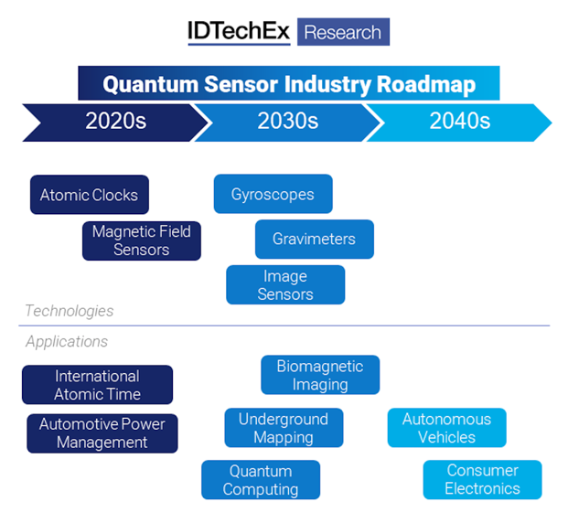
Quantum Sensing in GW
Transition from classical sensors to quantum sensors:
Sensitivities
Combined sensors for various detection fields
Clocks and networks
Data transfer to quantum communication networks
Connection of sensors via quantum links
to quantum computer

Slide 3
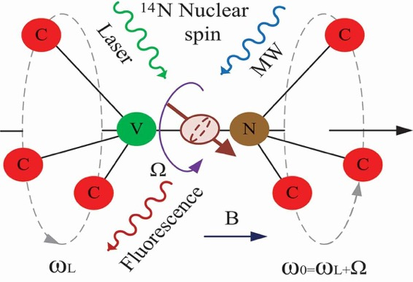
Possibility for Quantum Sensing for GW
Magnetic Field ( 10 fT – 10 T )
Electric Field ( < single electron charge )
Temperature, nanoscale ( < 10 mK )
Position, gyroscopes, accelarators
(10⁻⁶ mrad/Hz^{1/2 ,} 10-⁵ (deg s⁻¹)/√Hz mm³
Force sensors (attoN)
Attomic clocks (< 10⁻¹⁸ sec)
Electromagnetic noise
Sesmic sensing
(quantum networks)
Solid state NV diamond qubits
Liye Zhao, Advances in Physics X, 2022

Slide 4
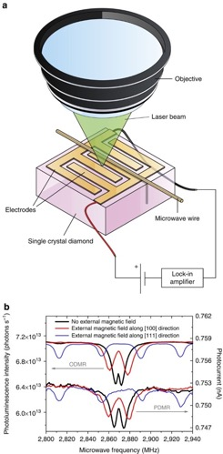
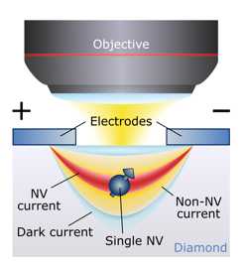
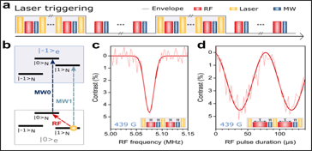
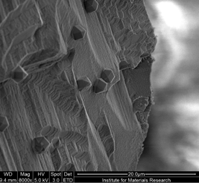
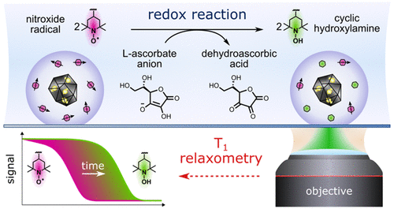
Topics per groups:
Q-Lab (M. Nesladek)
Diamond Quantum Chip
M.Gulka, Nature Comm., 12, 4421 (2021)
P. Siyushev, Science, 363,728-731 (2019)
E. Bourgeois, Nature Comm., 6, 8577 (2015)
Diamond
quantum magnetometer on ISS
Fidelity: 99.96
Q. Sensing –Magnetometry, Q NMR
H. Zheng: Phys. Rev. Applied 18, 024079 (2022),
Electrical-Readout Microwave-Free Sensing with Diamond
Nanodiamond Qauntum Sensors for Biology and Chemistry:
J. Barton, ACS Nano 2020, 14, 10, 12938–12950,
NV Nanoscale Dynamic Readout of a Chemical Redox
Process Using Radical chemistry
J. Prooth, Adv. Q, Technologies, 2023 in press:
Enhanced T1 spin relaxation in Nanodiamond
M. Nesladek , M Spira Nature Photonics (2022)
NV Quantum Voltage Microscope for Neuron Sensing

Slide 5

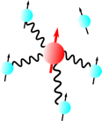
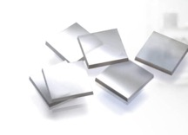
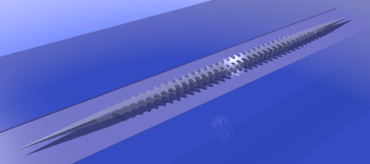
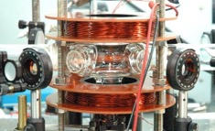
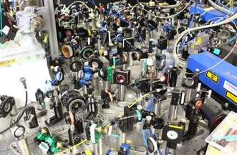
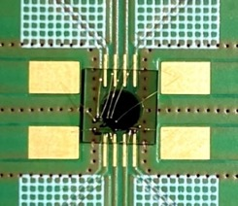
Quantum Hardware P. Siyushev
SiV, GeV, SnV,…. IV-vacancy
Aim:
Development of a solid-state quantum toolbox for realization of long distance quantum communication suitable for practical (commercial) application.
It includes:
precision quantum control
quantum nanophotonic devices
quantum communication protocols
related technologies
Application of the activity:
application to metrology and sensing
(vibrations, temperature, forces, gravity….)
From table top to chip

Slide 6
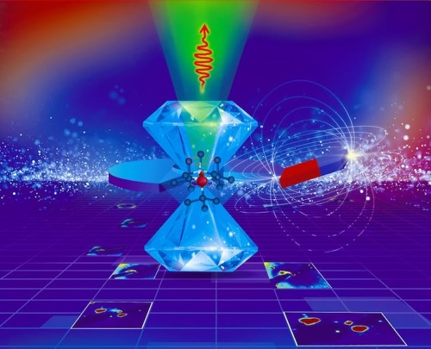
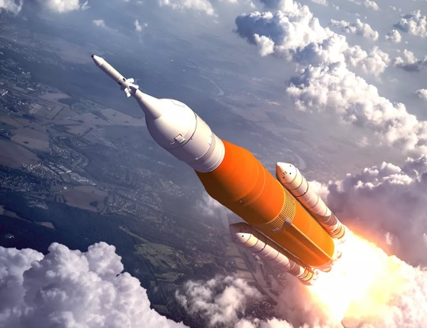
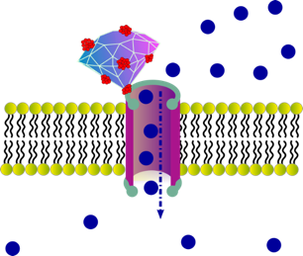
Quantum sensing A. Ermakova
Joint project between UHasselt and the Royal Belgian Institute for Space Aeronomy.
Aim: Quantum sensing with defects in crystals for space applications:
detection of magnetic and electric fields on space, planets, etc.
Quantum sensing to study biological systems: intracellular thermometry and magnetometry, detection metallo-proteins and magnetically active molecules.
Thermometry

Slide 7
Work done at E-TEST
Noise in GW detection
Shot, back-action -> SQL

Slide 9
Comparison of spectral noise density for various GW arrangements
Towards using NMR
- singlet state spin system
Matching the detection
fequency to
Larmor precission

Slide 10
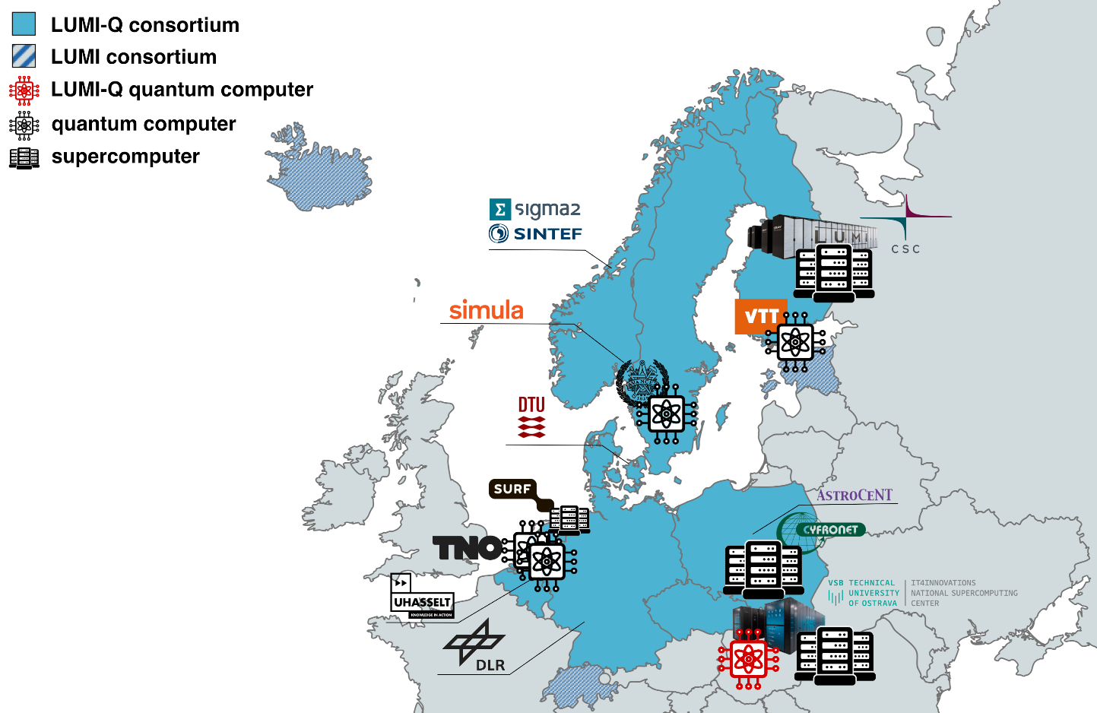
LUMI-Q
Access to Q-computing via LUMI- Q
Inclusive
  Builds on the 10-country pan-European
  LUMI consortium + The Netherlands and Germany
  The procured quantum computer is a quantum computer for Europe, not a single country
Diverse
  Getting several QCs to the fingertips of
  researchers and developers is crucial for
  catalysing software development.
  Different problems will fit different architectures and software stack infrastructure better
Accessible
  By being available through several platforms distributed throughout Europe, LUMI-Q provides
  a familiar interface to a uniquely large user base
Notes:
The LUMI-Q consortium is Inclusive, Diverse and Accessible. The consortium has large overlap with the LUMI consortium, includes 14 organizations from 10 countries.
The connection to the LUMI consortium offers many synergy opportunities. Further, the LUMI-Q partners bring diversity of expertise into the consortium, several consortium members already operate quantum computers.
Includes Helmi quantum computer at VTT, Finland, QAL9000 at CHALMERS University, Sweden and the Spin-2 and Starmon-5 quantum computers at TNO, Netherlands.
Having inclusivity and diversity in its fundament, the LUMI-Q aims to expand on this concept with the EuroHPC LUMI-Q quantum computer, expanding the existing ecosystem, unifying and standardizing the underlying APIs (Application programming interfaces).
The LUMI-Q quantum computer will be installed at EuroHPC Karolina site, Ostrava, Czech rep.

Slide 12
Topics form UHasselt
Quantum sensors
Access to quantum computer
Quantum noise research

