Slide 1
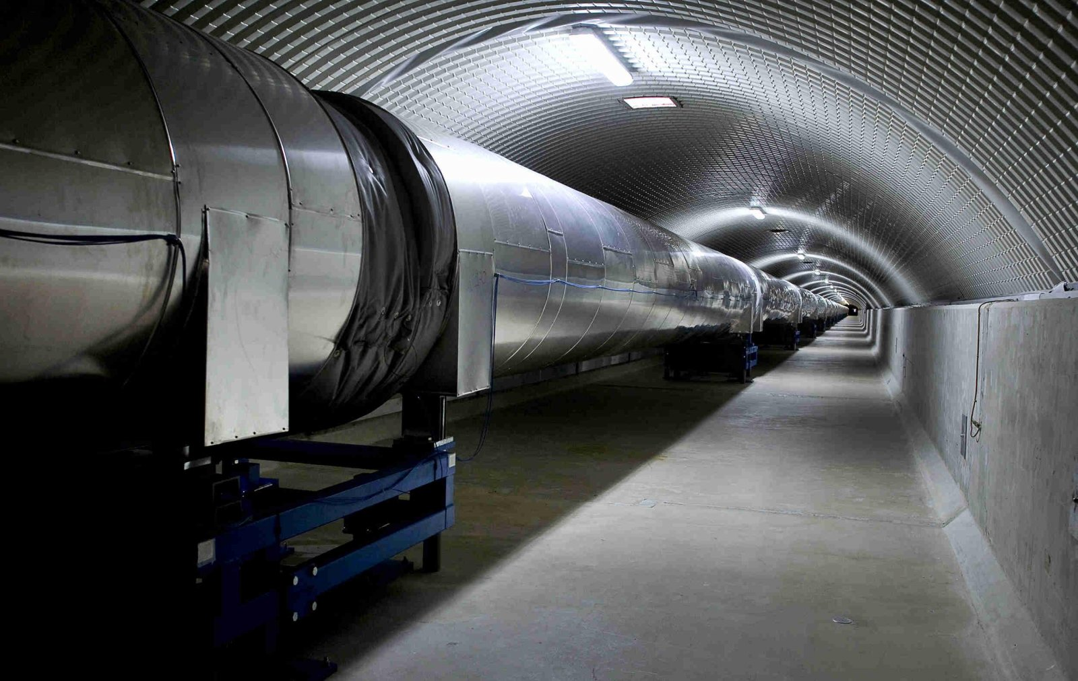
The ET beampipe vacuum system
Nick van Remortel
University of Antwerp, Belgium
IRI Workshop
November 27, 2023

Slide 2
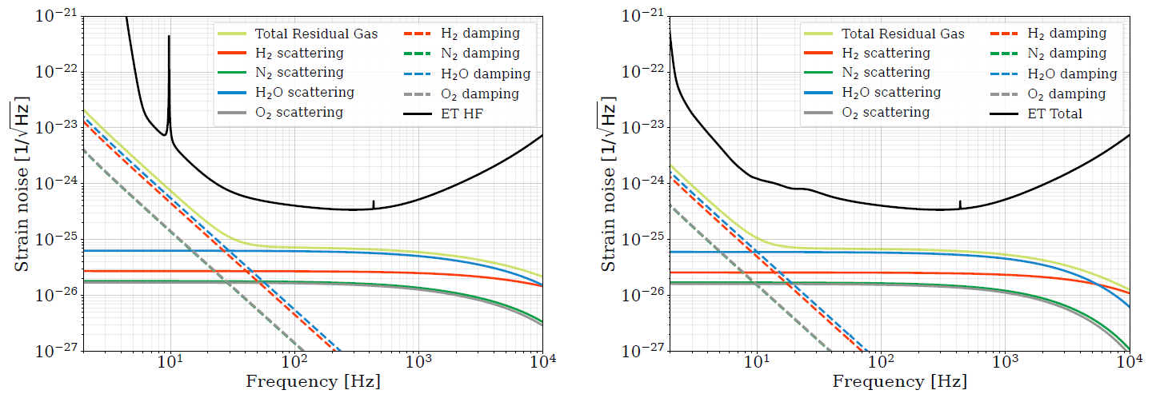
Residual gas noise contribution for ET:
Impact of residual gas in ET’s optical beam:
Affect phase of laser field as gas molecules transverse the beam, proportional to:
mass,
square of polarizability
Partial pressures
Noise on mirrors as gas particles collide with mirror surface: gas damping at low f
Mirror cleanliness
Acoustic isolation
Source: S.E. Whitecomb, LIGO-T840003
Source: ET design report update 2020

Slide 3
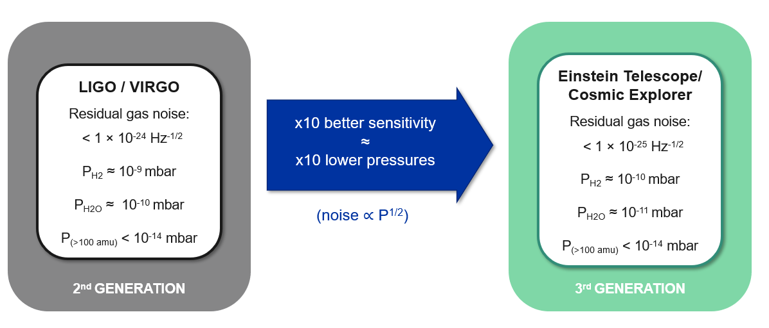
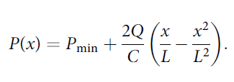
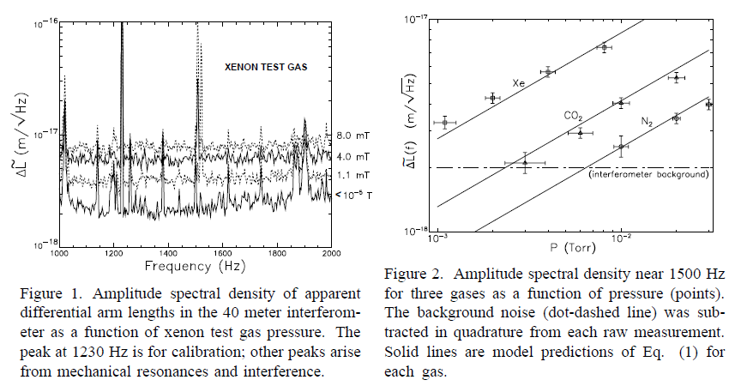
Pressure impact on power spectral density noise curve
Simple calculation assumes constant pressure profile
Pressure profile depends on:
Outgassing rate, Q
Pump distance, L
Pumping speed, S
Pipe conductance, C
$$P_{min}=2Q/S$$
Impact on power spectral density:
Density ~partial pressure
Source: M. Zucker and S. E. Whitcomb, LIGO DCC P940008

Slide 4
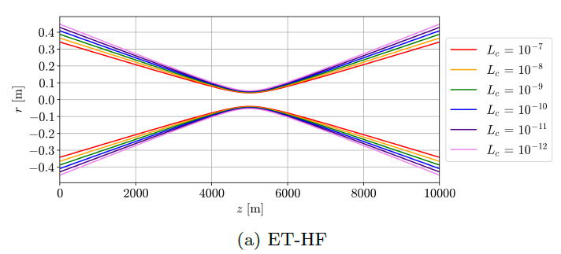
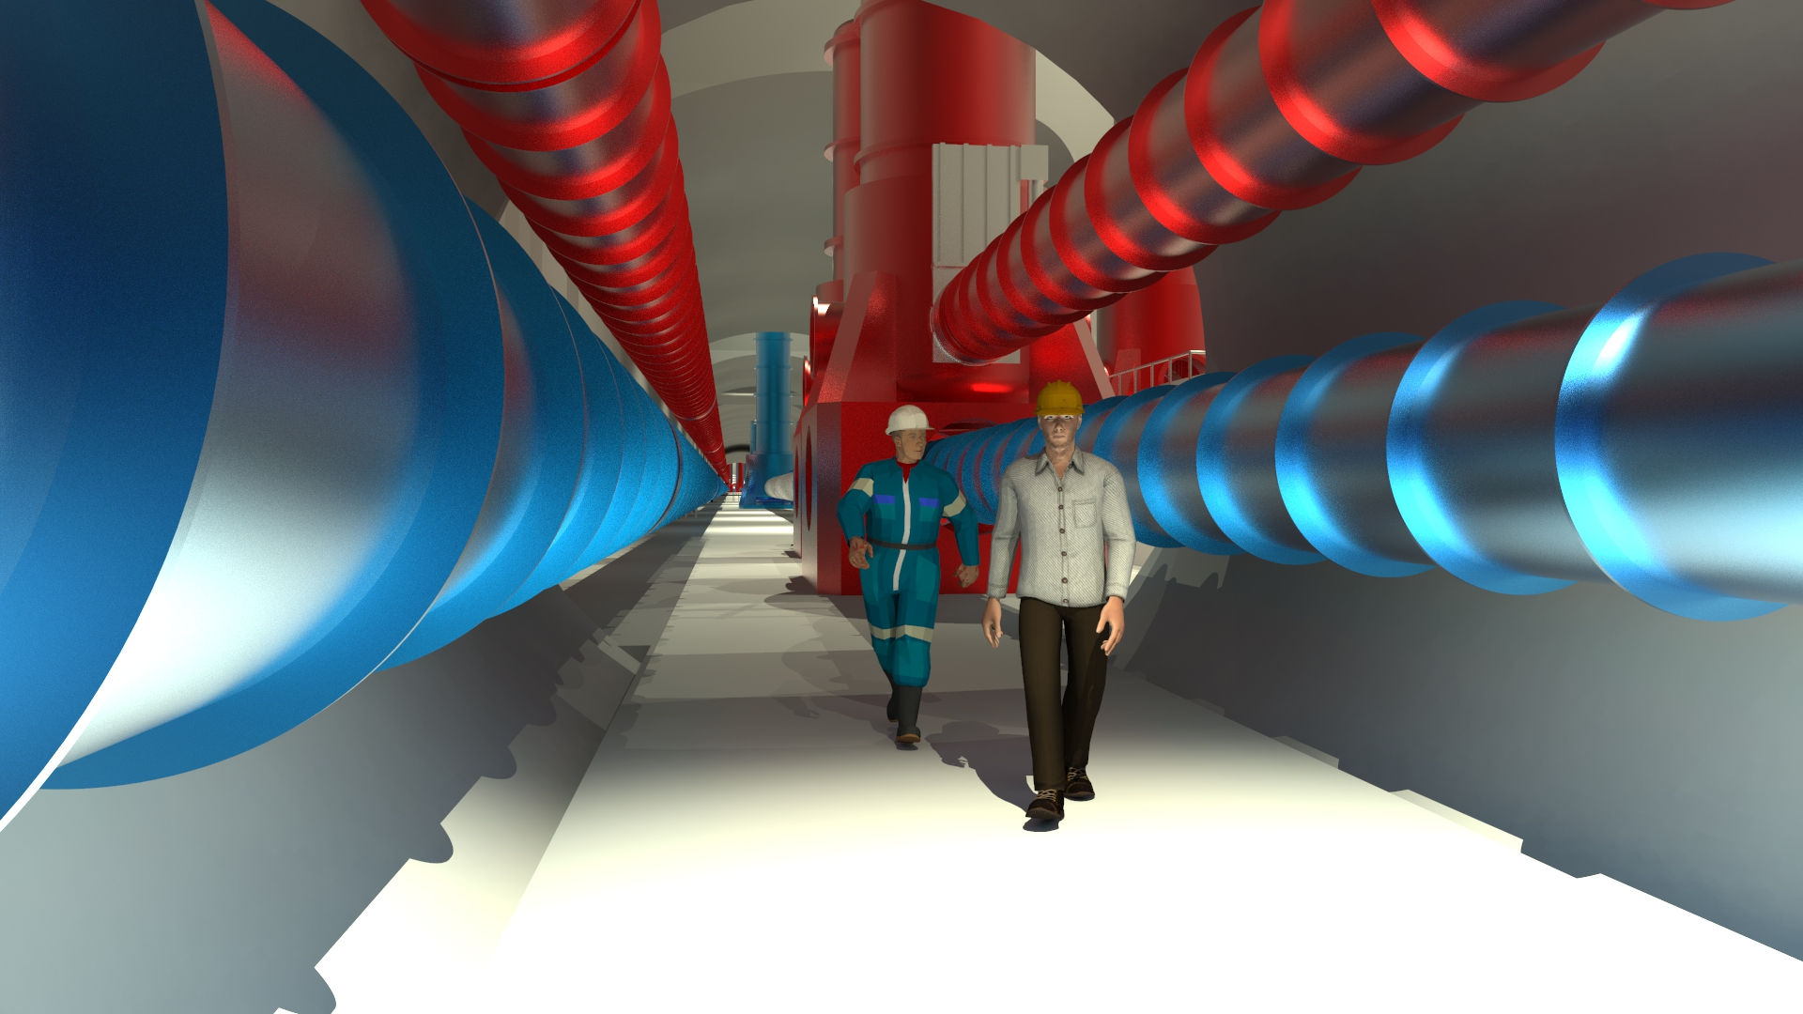
Scattered light
source: M. Andrés-Carcasona et al. arXiv:2307.14104 [gr-qc]
Optical baffles shield mirrors from stray light
Typical baffle size is 0.1 m
Implies minimal beam pipe diameter of 1m
If pipe needs bakeout: thickness of insulation
Welding/repair and safety margins
Optical aperture of ET’s laser beam
Minimal aperture of vacuum tube design with constant radius determined by the losses close to the mirrors
Aim to maintain losses below L_{c}<10⁻⁸ implies r_{pipe}=0.42m (HF) r_{pipe}=0.31m (HF)
Notes on pipe diameter:
Has impact on tunnel diameter
Tunnel excavation price scales with diameter
Current tunnel diameter: 6.5m

Slide 5
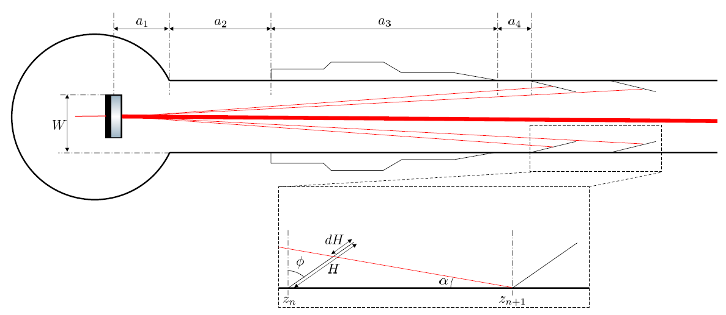
Baffles
source: M. Andrés-Carcasona et al. arXiv:2307.14104 [gr-qc]
Analogous to aLIGO and adV the vacuum system will be equipped with conical baffles shielding the aperture from stray light due to mirror finite aperture and aberrations
Baffles in ET will start at end of the cryotraps connected to the mirror vacuum towers
Position of first baffle: 32m (HF), 72m (LF)
Recursive formula for distances of other baffles
W= farthest point form which photons should be shielded
Distance between baffles increases rapidly with distance from the main mirrors
Nr of baffles needed for various pipe diameters,
Assuming unequal (minimum) or equal spacing
Beampipe radius
Mirror radius
Default configuration for simulations

Slide 6
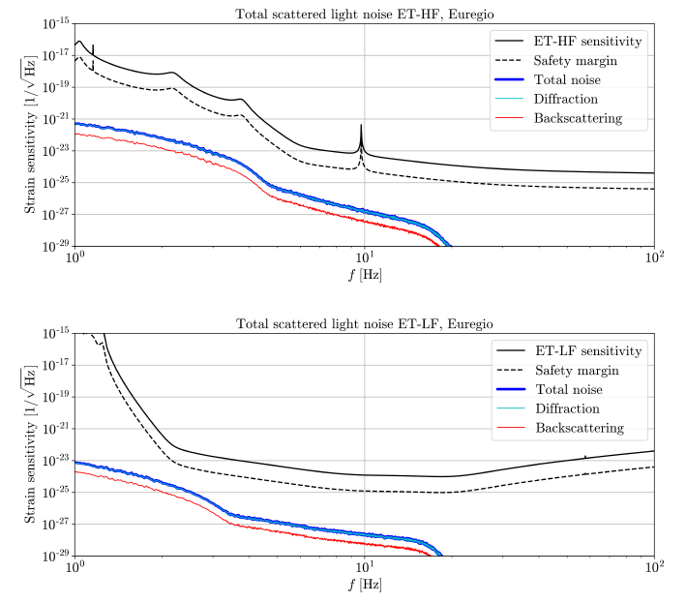
Scattered light simulation
Contains many ingredients:
Mirror surface quality impacts BRDF
Longitudinal vibration of baffles induce phase shifts
Various sources of noise & mitigation:
Diffraction: serrate edges of baffles
Backscattering
Reflection on edges: serrating
Shining surfaces: do not expose beam pipe to photons

Slide 7
Effect of dust
Source: A. Moscatello at 2nd ET annual meeting, Orsay, 13-16 November 2023

Slide 8
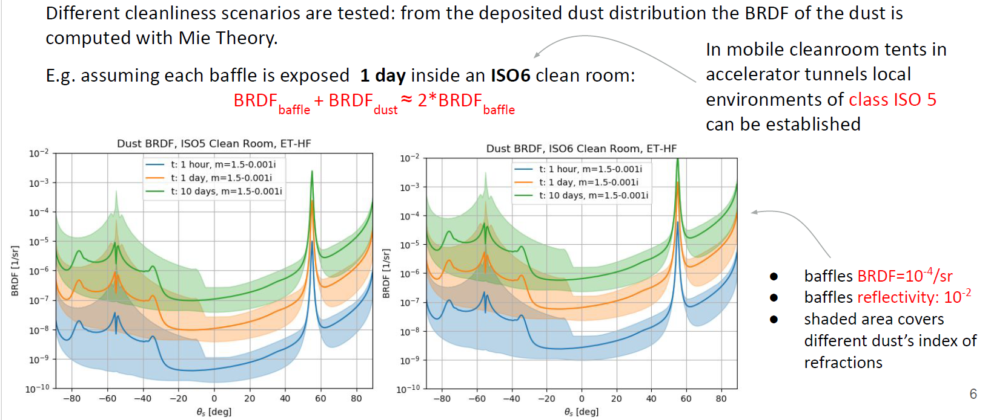
Dust on Baffles
Source: A. Moscatello at 2nd ET annual meeting, Orsay, 13-16 November 2023

Slide 9
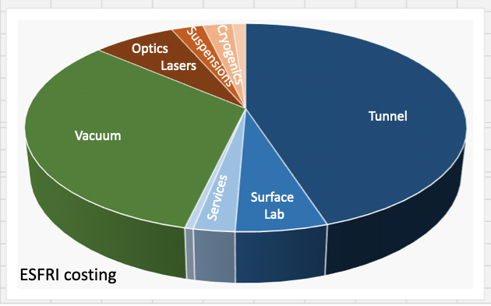
Contribution to ET’s cost and logistics:
Assuming Virgo approach:
13000 tons of raw steel
8000 modules 15 m long
8 modules/day production (includes leak and extensive quality control checks)
240 pumping stations every 500m (5000 l/s effective, ionic, getter, auxiliary turbo molecular)
720 gate valves (250 mm)
48/72 gate valves (1 m diameter)
10 ovens (each 4 modules at times) operating ~3 years 24/7 for air-firing
4 cleaning systems
Bakeout (2G heat dissipation is ≈ 250 W/m @ 150°C )
Largest UHV system in the world:
1m diameter pipes, length 120 km
Volume: 9.4 × 10⁴ m3
Surface area: 3.8 × 10⁵ m2
Total cost assuming scaling from Virgo:
560 M€ (1/3rd of construction cost)
Lots of time and cost saving possible on several of these items:
Material type: various steel species with varying price
Amount of material: thickness & weight
Length of sections: produced off or on site?
Types of pumps: varying capacity
Less valves: but high risk for leaks
Avoid heat treatment and bakeout: ferritic steel vs stainless

Slide 10
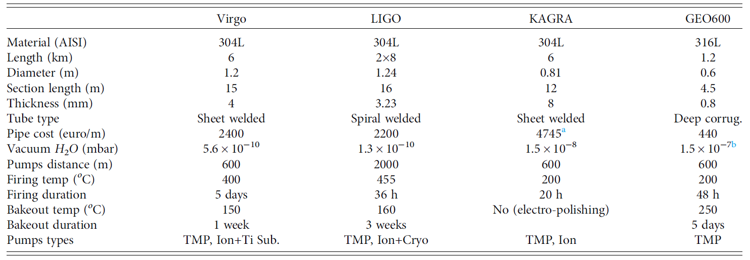
Different designs in 2nd gen interferometers:
From: A. Grado et al J. Vac. Sci. Technol. B 41, 024201 (2023)
All stainless steel
Thick walls require
no stiffeners
Thin walls require
corrugation
Very low cost
Large Energy cost
& Logistics!

Slide 11
Concerted effort between ET and CERN
DESIGN
(Mechanical stability, supports, etc.)
MATERIAL
(Welding, manufacturing, cleaning, etc.)
VACUUM
(Layout, pumps, gauges, bake-out, etc.)
Studies
PRODUCTION
MEASUREMENT
Pre-prototyping
FABRICATION
& TEST
Solution 1
FABRICATION
& TEST
Solution 2
FABRICATION
& TEST
Solution n
Pilot sector
Source: C. Scarcia at 2nd ET annual meeting, Orsay, 13-16 November 2023

Slide 12
Beampipe structural materials
Einstein Telescope
Cosmic Explorer
Austenitic stainless steel
(304L)
Mechanical properties
Formability and weldability
Corrosion resistance
(native)
Vacuum performance
(requires HT heat treatment)
Cost
(raw material)
Non ferromagnetic
(µ_{R} ≈ 1)
Ferritic stainless steel
Mechanical properties
Formability and weldability
Corrosion resistance
(native)
Vacuum performance
(native)
Cost
(raw material, 30-50% less than austenitic)
Ferromagnetic
(µ_{R} > 200)
Mild steel
Mechanical
properties
Formability and weldability
Corrosion resistance
(requires treatment)
Vacuum performance
(native)
Cost
(raw material, 80-85% less than austenitic)
Ferromagnetic
(µ_{R} ≈ 100- 200)
Source: C. Scarcia at XIII ET Symposium, Cagliari, 8-12 May 2023

Slide 13
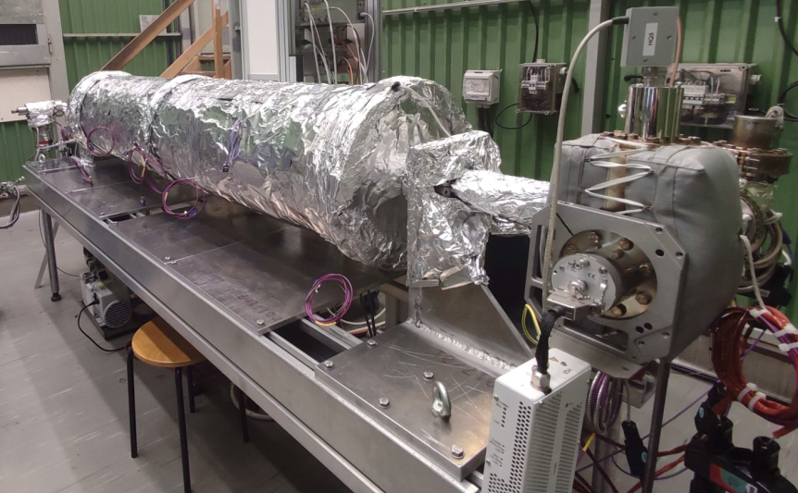
Material/vacuum
Reliable and predictable outgassing rate measured with a dedicated test bench.
Ø 400 mm x 2100 mm.
Thickness < 2 mm.
Corrugated solution.
Pumping speeds scaled to ET dimensions.
Materials:
AISI 304L vacuum-fired [austenitic SS]
S315MC [mild steel]
AISI 441 [ferritic SS]
Objectives:
Verify water outgassing modelling.
Ultimate pressure after 80°C and 150°C bake-out.
Estimate outgassing rate of materials.
Source: C. Scarcia at 2nd ET annual meeting, Orsay, 13-16 November 2023

Slide 14
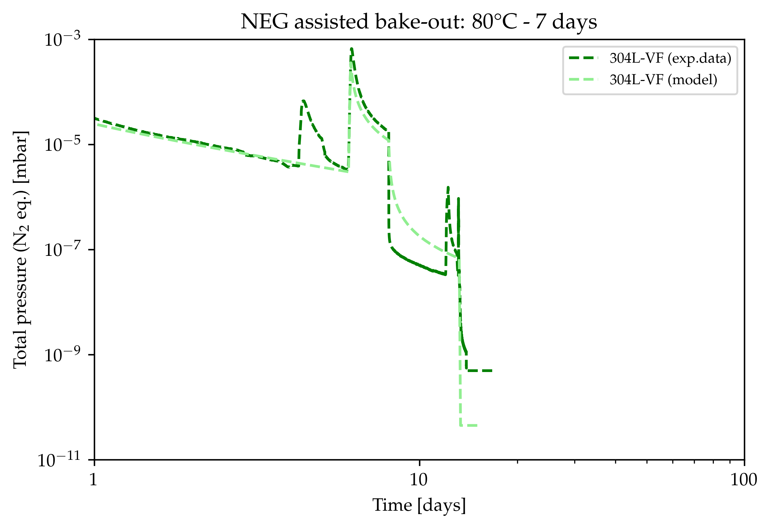
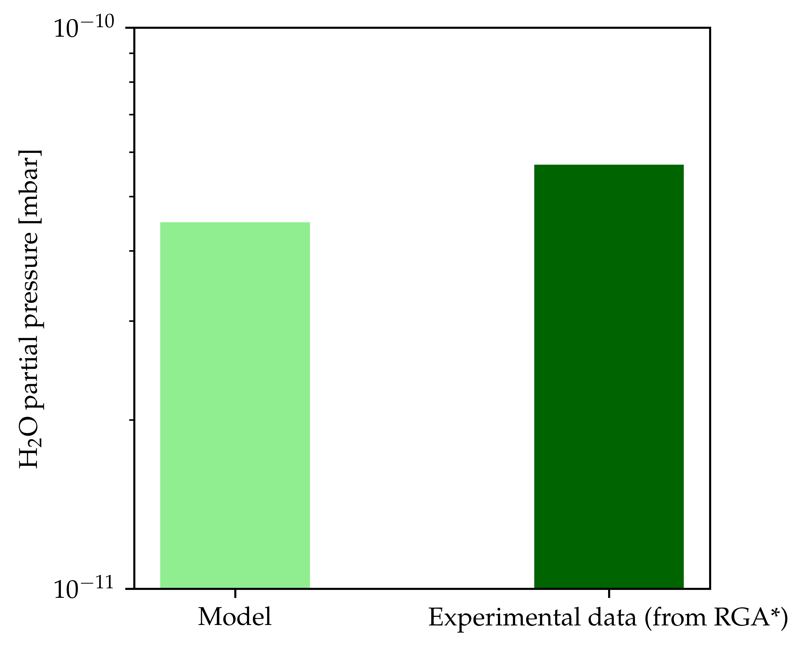
Material/vacuum
Experimental verification of beneficial effects of increased pumping speed during heating.
Water pressure calculated from mass 18 signal
The difference between the model and the experimental data is of 20%
Source: C. Scarcia at 2nd ET annual meeting, Orsay, 13-16 November 2023

Slide 15
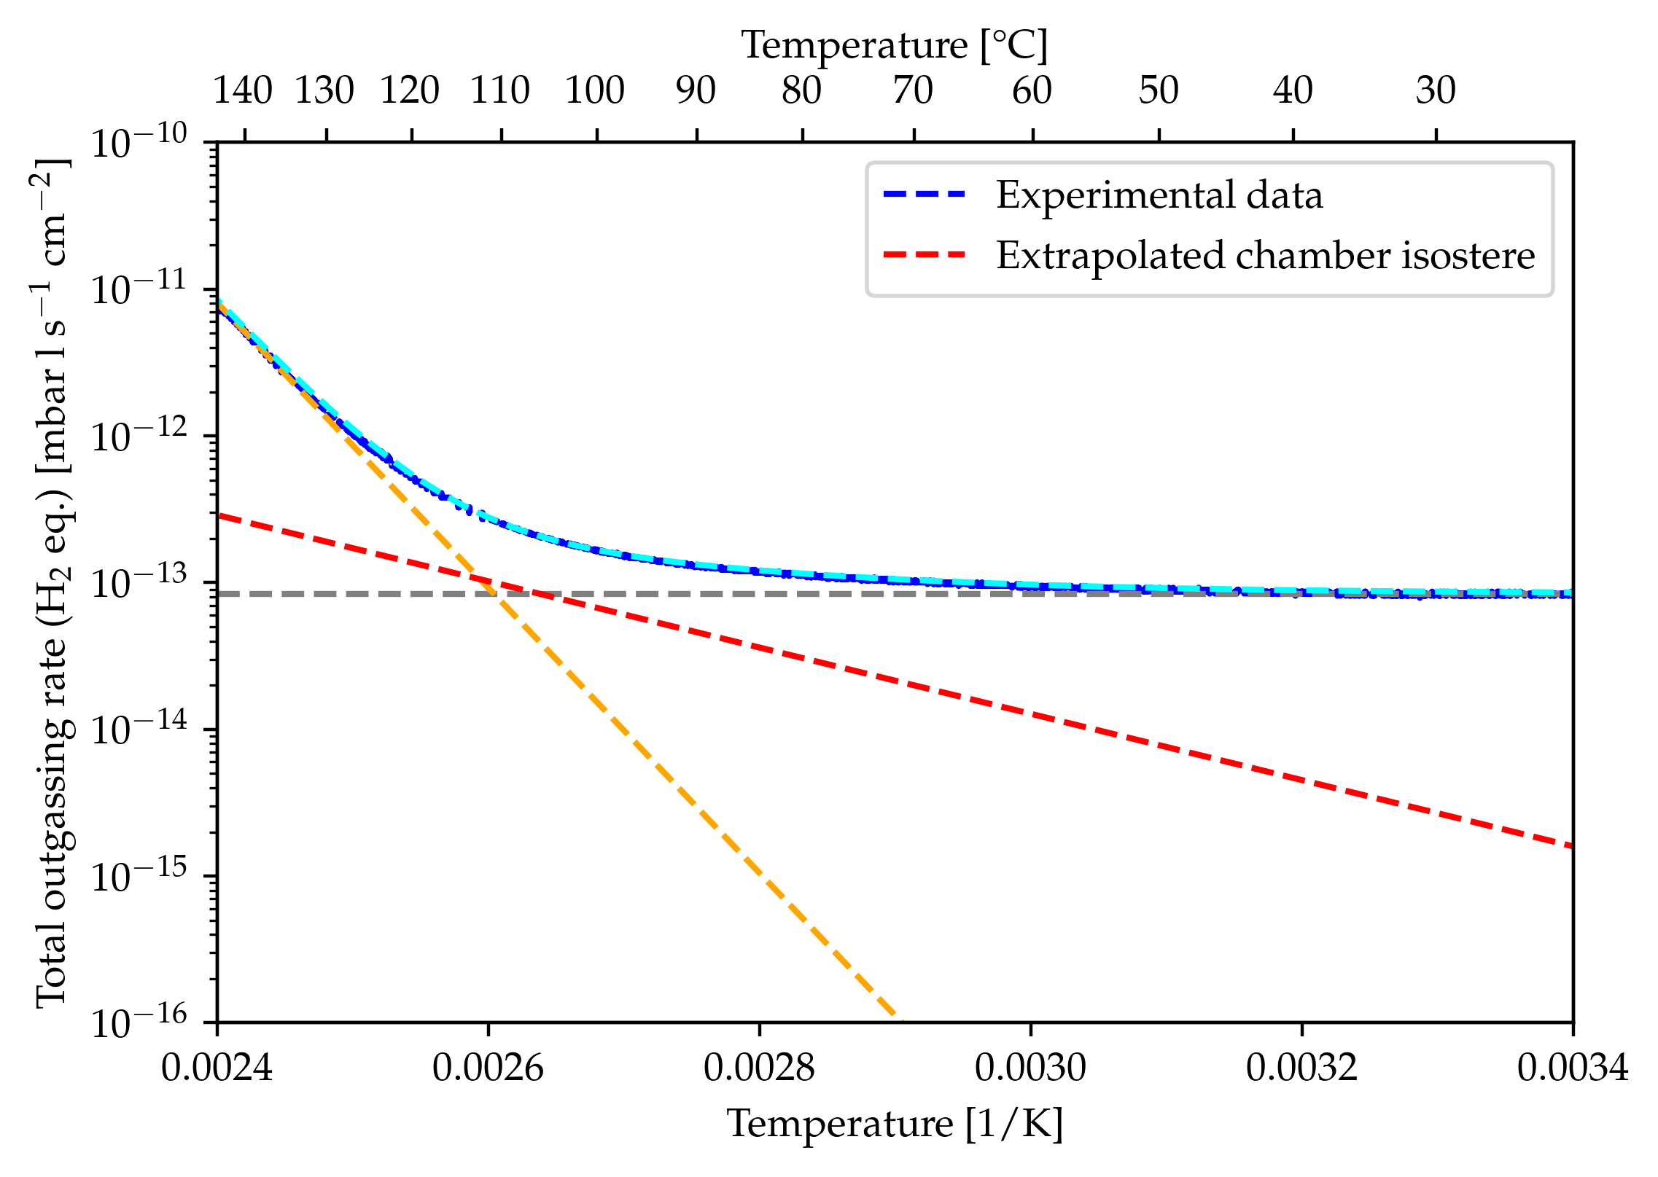
Outgassing rate vs temperature
Example:
304L-VF chamber
Hydrogen
Water-like
Instruments & gauges
q_{H2} ≈ 1.5×10⁻¹⁵
mbar l s⁻¹ cm⁻²
Source: C. Scarcia at 2nd ET annual meeting, Orsay, 13-16 November 2023

Slide 16
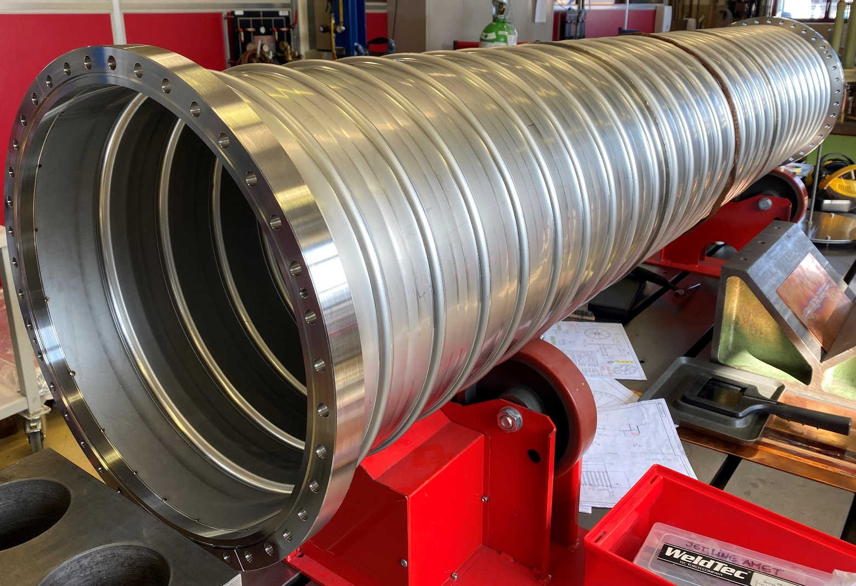
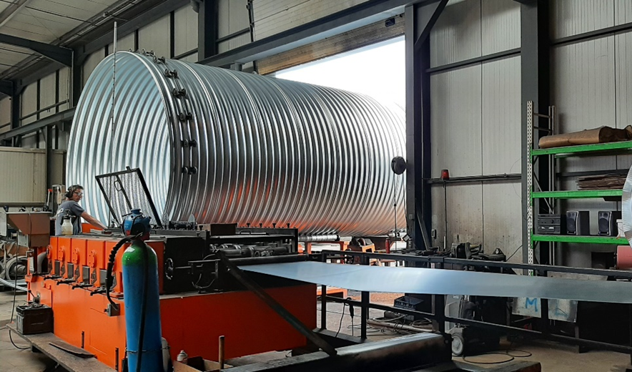
Design
Proved mechanical stability of a corrugated pipe.
For the pilot sector: Preparation of the technical specifications for a price inquiry following CERN’s purchasing rules.
Corrugated pipe: Ø 1000 x 1.5 - 2 mm
Smooth pipe: Ø 1000 x 3 - 4 mm
Contact with industry to evaluate the feasibility of a large-scale production of the corrugated solution.
Source: C. Scarcia at 2nd ET annual meeting, Orsay, 13-16 November 2023

Slide 17
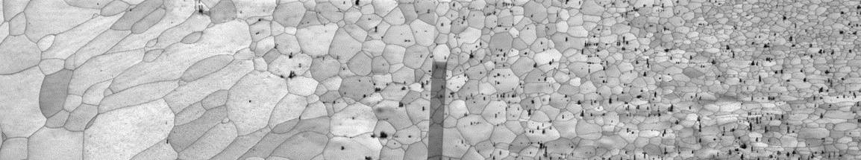
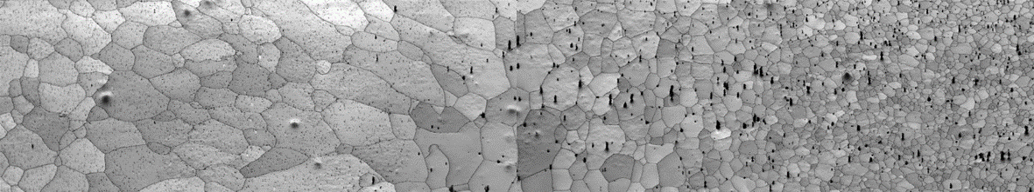
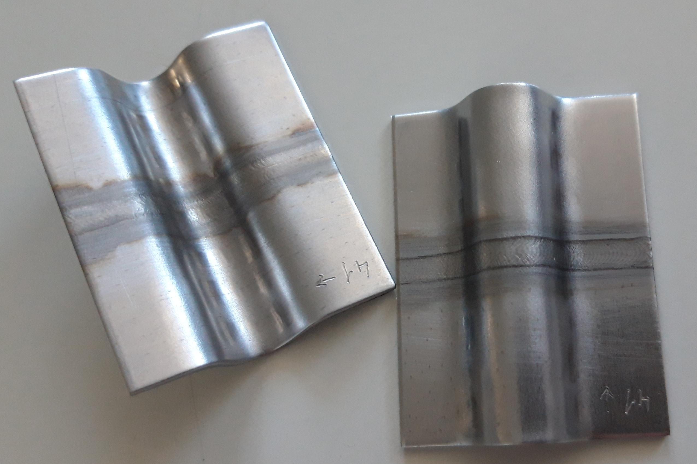
Welding
See also Alexey’s talk
Welding of ferritic stainless steels:
conclusive and positive tests
Identification of the source of welding problem (grain coarsening, martensite precipitation, etc.)
Selection of a ferritic SS with better weldability (AISI 441, industrial partner).
Improved welding parameters (characterization w/ Univ. of Ghent).
Improved manufacturing steps (cracking during corrugation solved).
Test welding techniques other than TIG (laser CW v. Pulsed).
In preparation for the pilot sector:
Price inquiry for raw material (coils).
(preliminary contacts w/ APERAM, Arvedi, AST)
TIG on AISI 444
TIG on AISI 441
Credit: UGhent
TIG on AISI 441
Credit: CERN

Slide 18
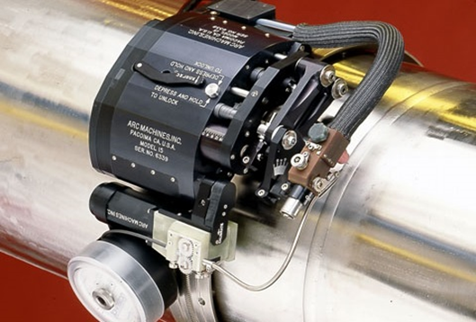
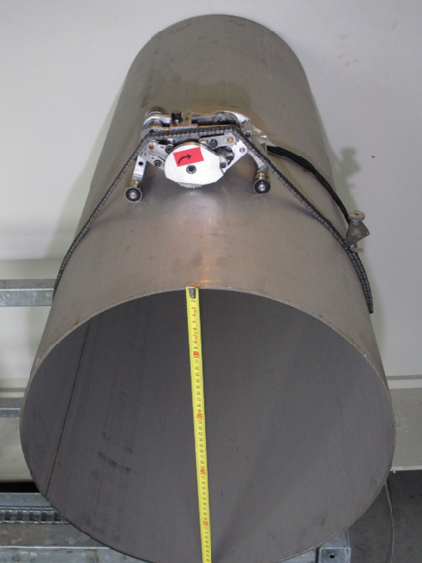
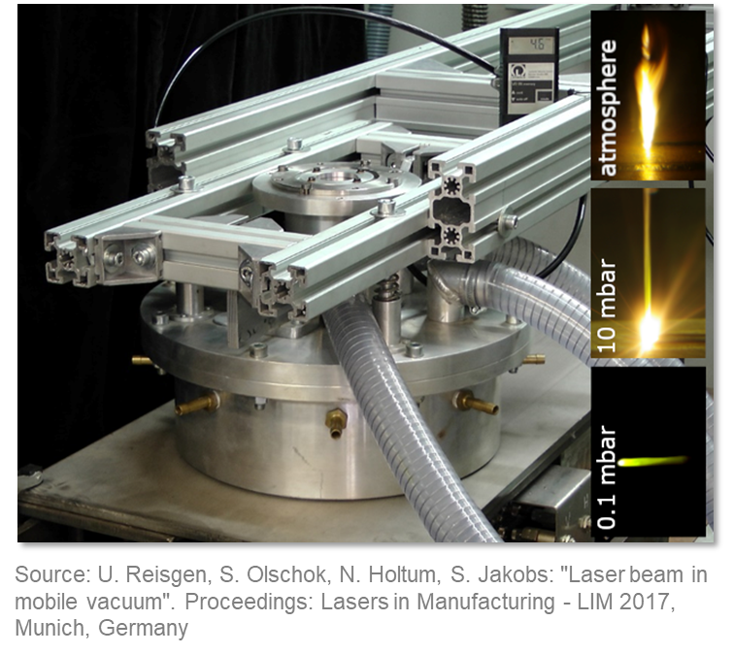
Automated Welding under vacuum
New Interreg proposal submitted with UAntwerpen
RWTH Aachen, FEF, Werkhuizen Hengelhoef
New ways to tackle productivity rate and welding quality.
FEF GmbH, RWTH Aachen, Werkhuizen Hengelhoef and APERAM collaborated for the preliminary design of a forming-welding machine:
Laser beam welding under movable vacuum (30 mbar)
Possibility to weld realistically up to 500 m long sections
Possibility to integrate continuous QC monitoring (ultrasonic or X-ray imaging)
Credit: Arc Machines Inc.
Space between ET beampipes very limited.
New compact and customizable orbital welding tools integrating laser seam tracker and endoscopes.
In case of a repair during operation, use of light and compact orbital milling machine.
→ Minimum space required 40/50 cm between two stacked tubes (insulation included)

Slide 19
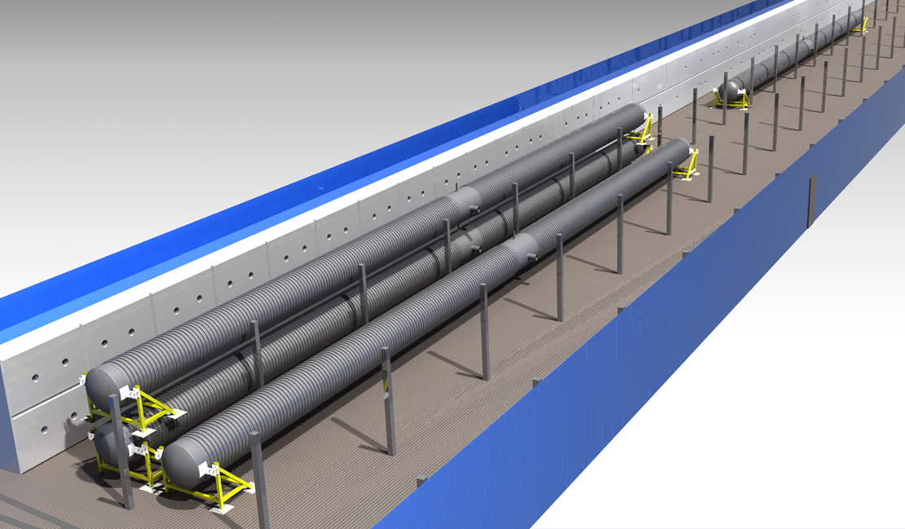
Outlook: CERN pilot sectors
Up to 4 tubes Ø 1 m x 50 m
Corrugated or VIRGO-like solution (stacked or adjacent)
Possibility to test different materials
Pumping speeds scaled to ET dimensions
The installation will serve to test:
Installation and alignment of supports and tubes.
Welding and assembly tools and methods.
Leak detection scenarios
Ultimate pressure and outgassing measurement after bake-out.
We are open for other experimental measurements:
Dust concentration and displacement inside the tube.
Installation and alignment of baffles inside the tube.
Vibration transfer function studies.
Preliminary schedule
Main deliverable: provide design report by end 2025

Slide 20
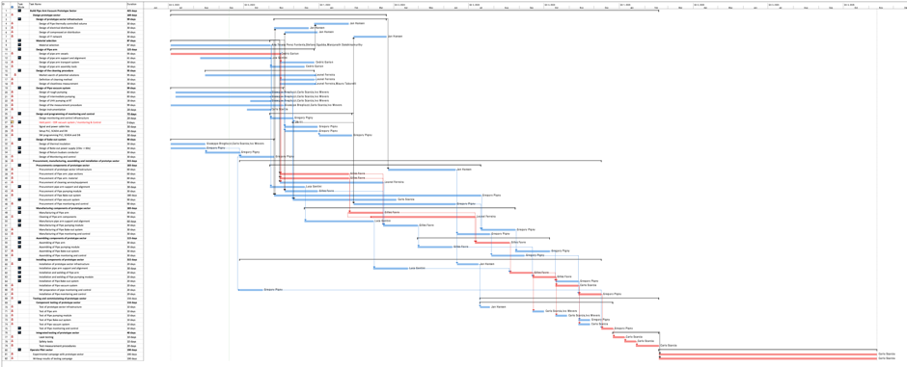
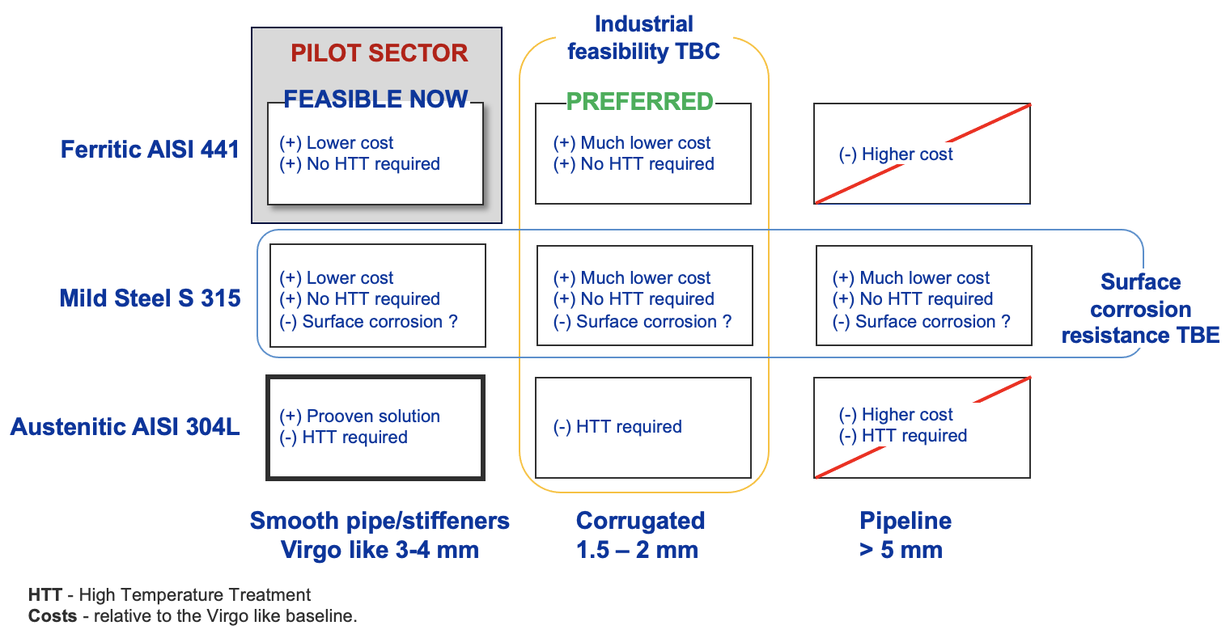
General Planning
Observations:
Design of pipe arm in the critical path.
Hold point to line up choices for the vacuum system and bakeout equipment.
Design
As the corrugated beampipe cannot be fabricated in due time with the required UHV characteristics, it is kept only for design studies while seeking a valid industrial partner.
The VIRGO geometry beampipe made of 4-mm thick AISI 441 is now prioritized for the first test with the pilot sector.
The support system of the pilot sector will be compatible with beampipes of different geometries.
NEXT: A review on material and design of the beampipe for the pilot sector will be organized in the coming months with an international panel.

Slide 21
Conclusions & Outlook
Lots of simulations on various effects:
Residual gas and pumping scheme
Light scattering and baffles
Dust on baffles and free falling dust
Many other: alignment, cleaning, installation, safety
Completing requirements document
CERN activities currently focus on
Material choices
Pipe and support structure design
Acquisition of materials and services
Planning the production of first pilot sector
Production of preliminary TDR by end 2024
Pilot sectors ready for testing by end 2025
Input from Flanders
UGent: Materials, procurement, manufacturing (see Alexey’s talk)
UAntwerpen: Support on pilot sector design and installation New hiring completed: P. Revathi will join CERN team as of Jan 2024

