Slide 1
Einstein Telescope Observational Science
Archisman Ghosh

Slide 2
Plan of the talk
Observational science with the ET
ET Observational Science Board
Involvement of Flanders / Flemish researchers

Slide 3
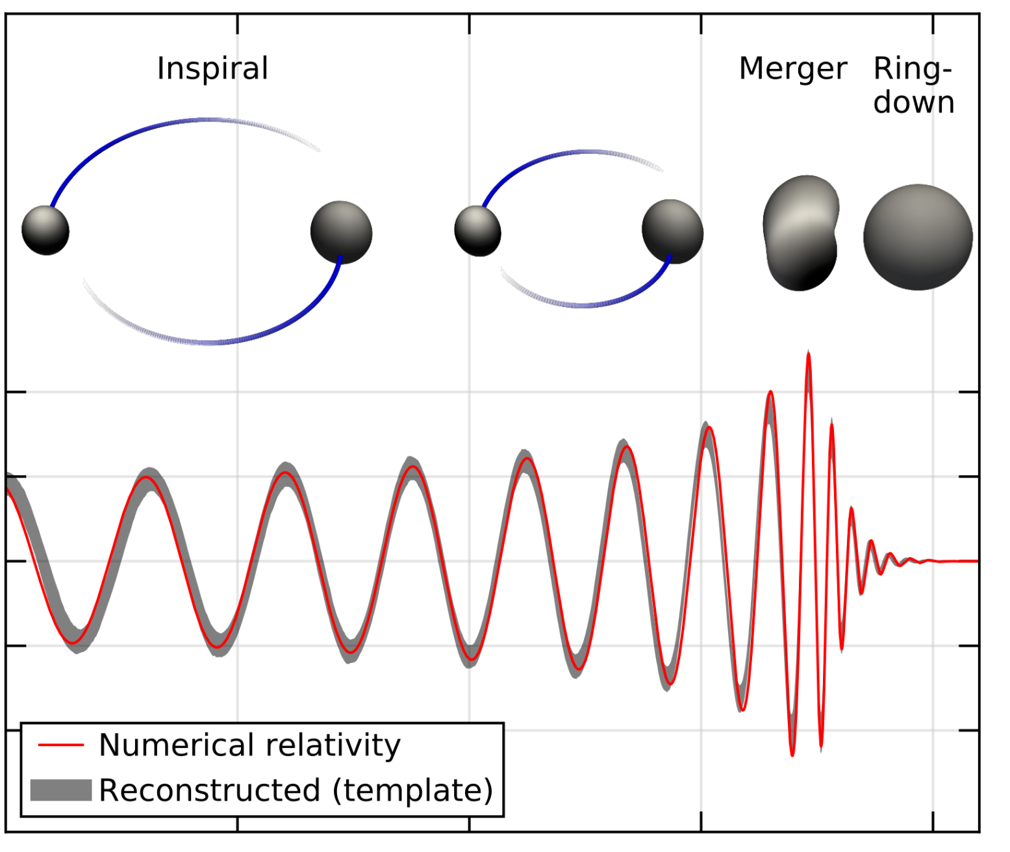
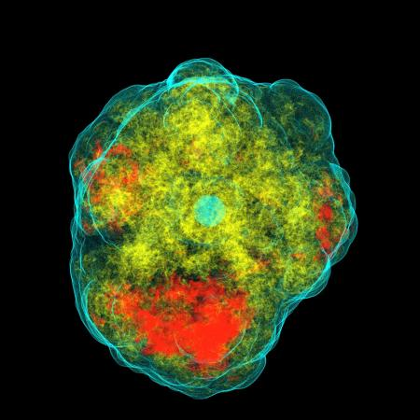
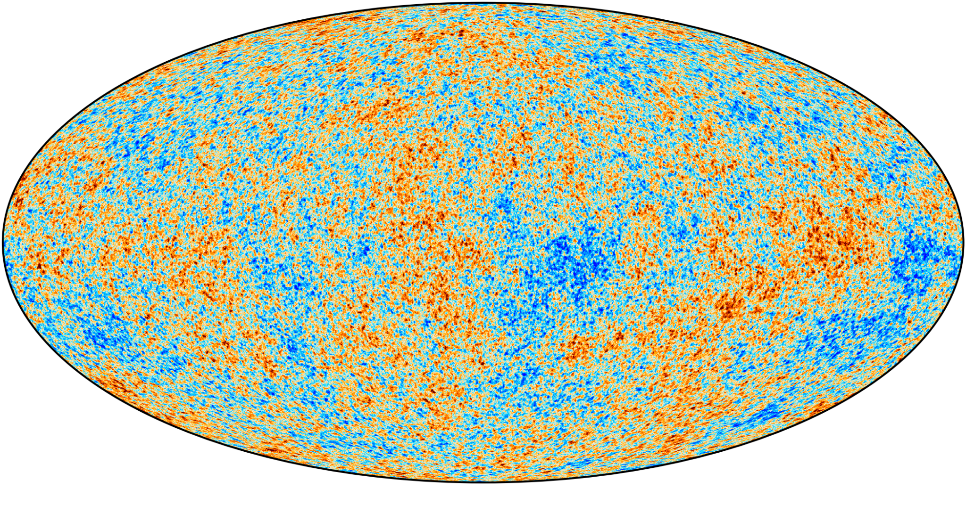
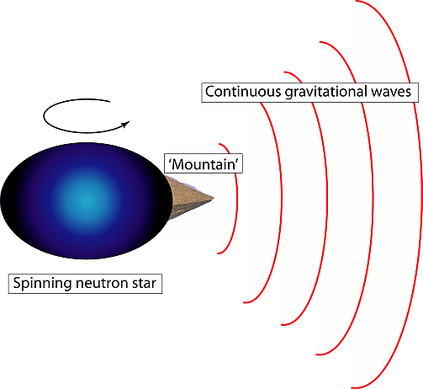
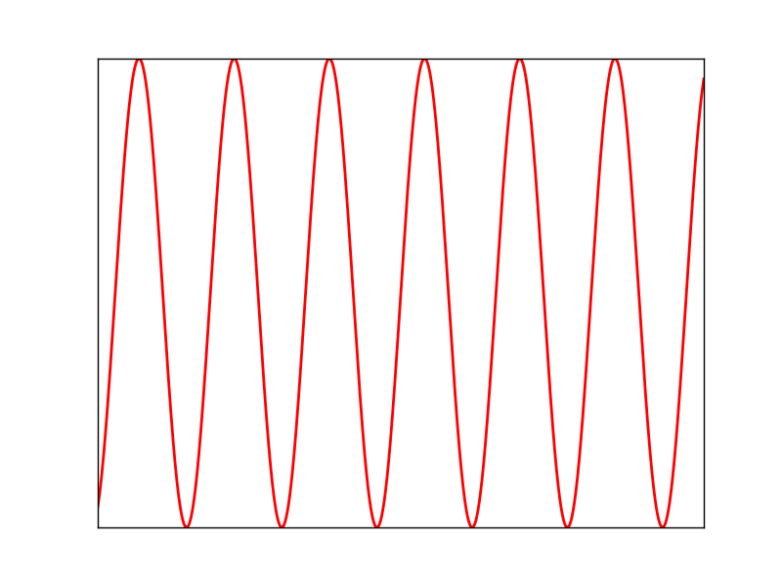
GW sources
Mergers of binaries of black holes and neutron stars
Bursts
(supernovae)
GW background
(astrophysical and cosmological)
Spinning neutron stars

Slide 4
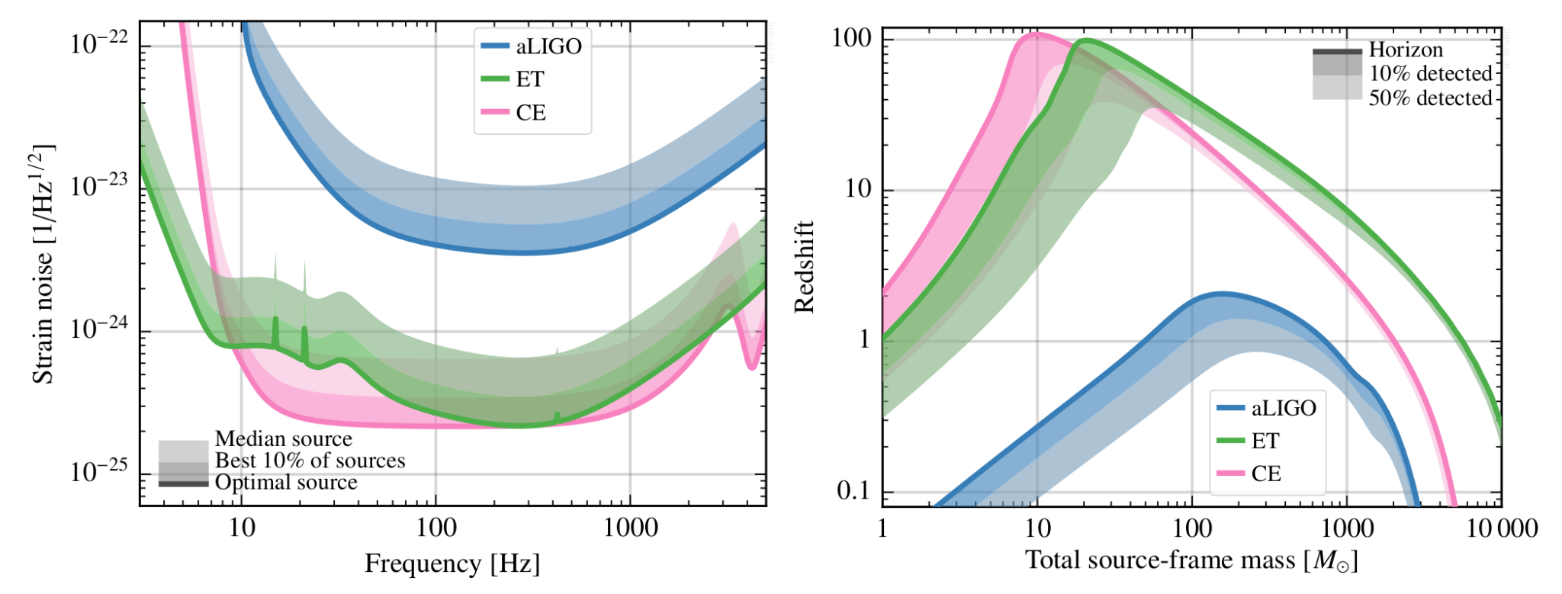
ET sensitivity
10 × current detectors
Low-freq improvement

Slide 5
ET detection capability: binary mergers

Slide 6
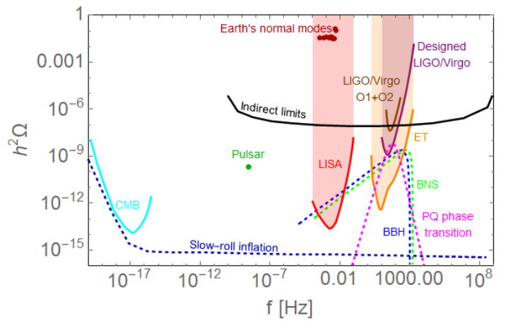
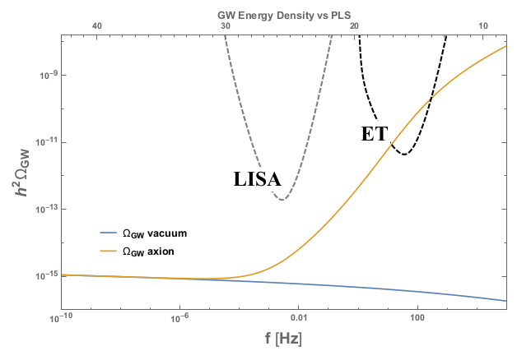
ET detection capability: GW background

Slide 7
ET science
Black hole properties: origin (stellar / primordial), evolution, demography
Near-horizon physics, probing the nature of compact objects
Neutron star properties: strongly coupled matter, QCD, exotic matter
Multimessenger astronomy
Dark matter: primordial black holes, axion clouds, …
Dark energy and modifications of gravity at cosmological scales
New sources: supernovae, isolated neutron stars, stochastic background!

Slide 8
ET Observational Science Board
Formed in Nov 2021 with a mandate to:
Investigate science case for ET
Produce ET blue book (summer 2024)
Develop analysis tools required for science extraction
Release a series of mock data challenges
Develop data analysis platform and computational infrastructure
Foster relations with other GW experiments
Foster relations with the external EM/neutrino communities

Slide 9
ET Observational Science Board
10 Divisions:
Fundamental physics
Cosmology (coordinated jointly by AG)
Population studies
Multimessenger observations
Synergies with other GW observatories
Nuclear physics
Stellar collapse and isolated neutron stars
Waveforms
Common tools
Data analysis platform

Slide 10
ET Observational Science Board
Organization / coordination via (monthly) telecons, biannual in-person meetings
ET Symposium @ Cagliari, May 2023
Science presentations (talks / posters) over a broad range of topics
ET Annual Meeting @ Orsay, November 2023
Blue book coordination
Multimessenger astronomy
Mock data challenges

Slide 11
ET Observational Science Board
Science case and blue book contribution from Flanders
UAntwerpen:
Stochastic background data analysis and source separation
VUB:
Stochastic background theory: topological defects and phase transitions
UGent:
Cosmography, large scale structure of the universe, supernovae, exotic compact objects
KULeuven:
Astrophysics, tests of GR, GW lensing, GW null stream, supernovae
Blue book writing: significant input from many members! Dálya, Blasi, Mariotti …

Slide 12
High visibility in Virgo and ET
Being in the forefront of LVK data analysis is necessary to bridge current efforts to ET
Active participation in telecons, Virgo weeks, LVK meetings, ET symposia & meetings
Collaboration membership / travel: FWO-IRI
A few highlights:
Freija Beirnaert (UGent): best poster prize in data analysis in Cardiff LVK Meeting 2022
Kamiel Janssens (UAntwerpen) and Alba Romero (VUB): two of the three winners of Virgo awards 2023 announced earlier this month!

