Slide 1
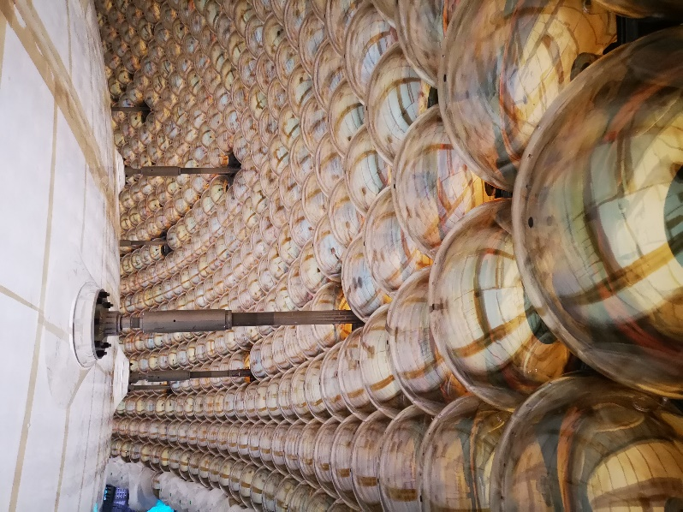



JUNO Neutrino
Experiment
Amina Khatun, Barbara Clerbaux,
Feng Gao, Félix Rosso, ​
Hui Wang, Marta Colomer, ​Pierre-Alexandre Petitjean(finished),
Téo Bruffaerts, Yifan Yang
2024-11-28

Slide 2
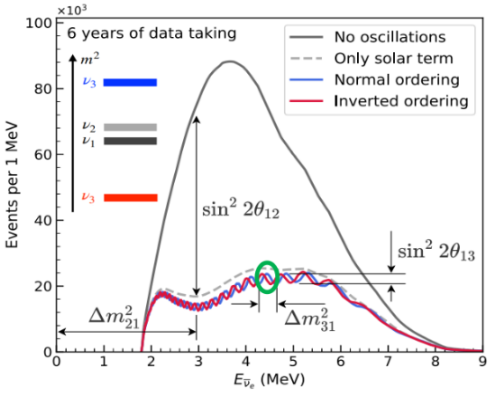
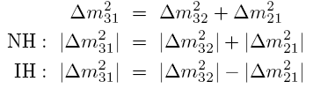
JUNO Physics: main goal
▶ JUNO (Jiangmen Underground Neutrino Observatory) is a medium baseline reactor neutrino experiment (53 km from the nuclear cores), located in China.
The main objective is to study reactor neutrino oscillations to:​
determine the neutrino mass hierarchy using neutrino flux coming from 6 nuclear reactors.​
Precision measurement of neutrino oscillation parameters​

Slide 3
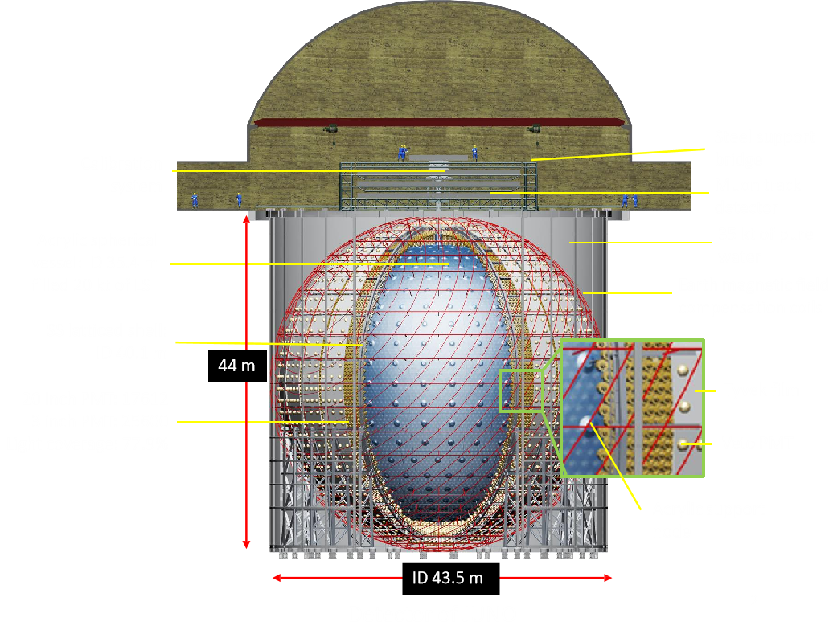
JUNO experiment
Central detector
20 kton liquid scintillator (LS)
78% PMT coverage
Energy resolution:
  RMS:3% @1MeV​
  Linearity<1%
Veto detector
35kt of pure water
~10% PMT coverage

Slide 4
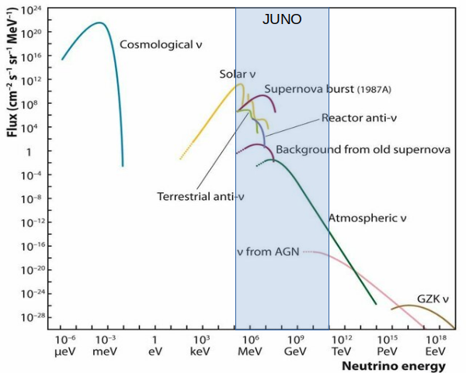
JUNO‘s Multi-Physics Potential

Slide 5
JUNO Status
JUNO Civil Construction finished in 2021.
JUNO Central detector finished in Nov.2024.
JUNO filling will start in Dec. 2024.
Water filling: 2 months
LS filling: 6 months
JUNO data taking will happen in 2025 !

Slide 6
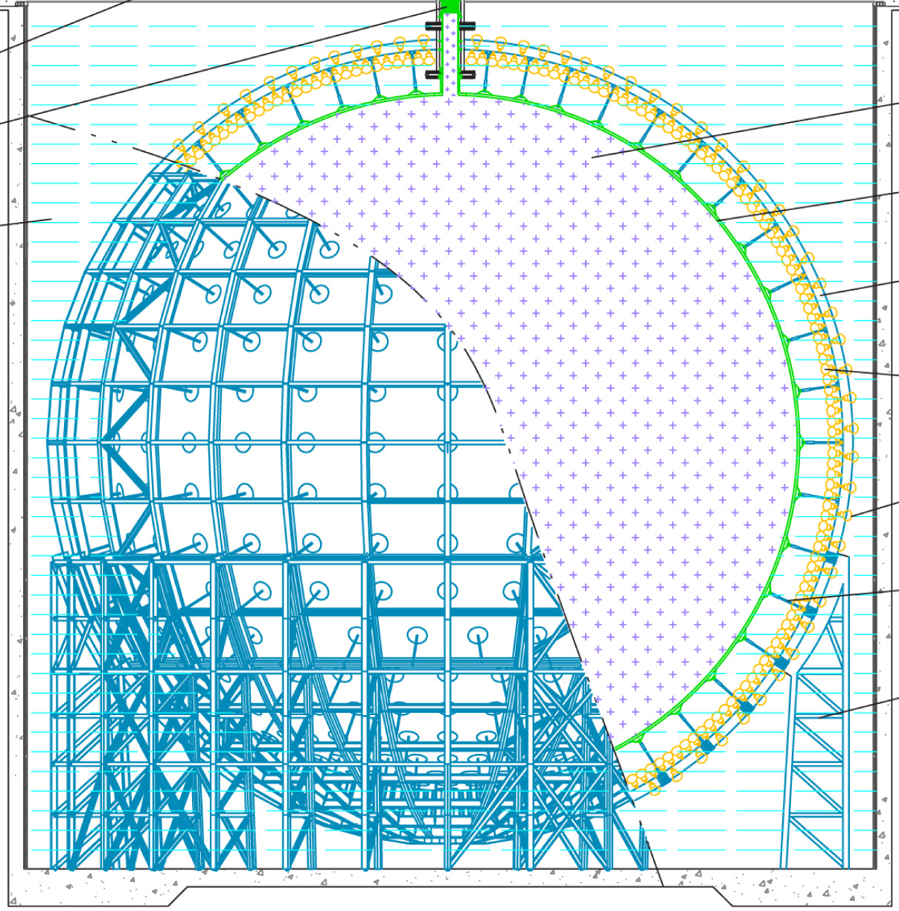
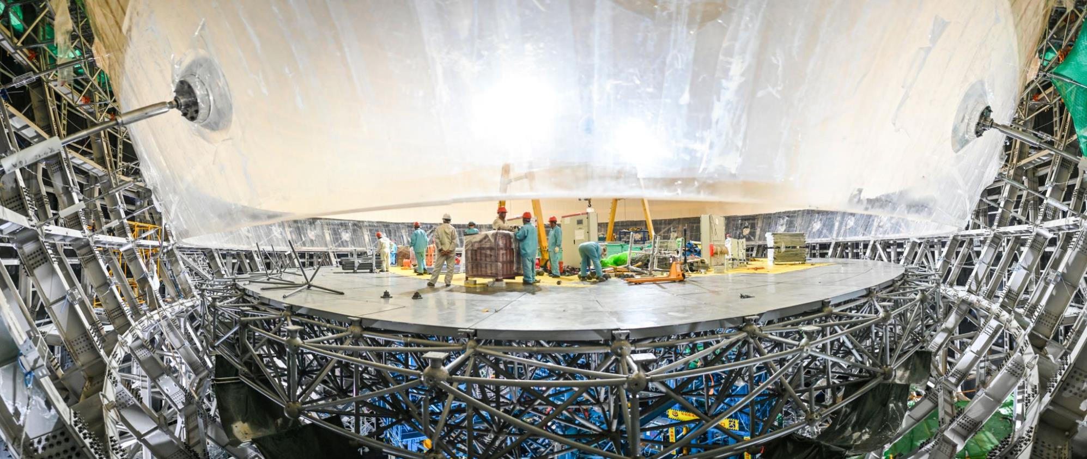
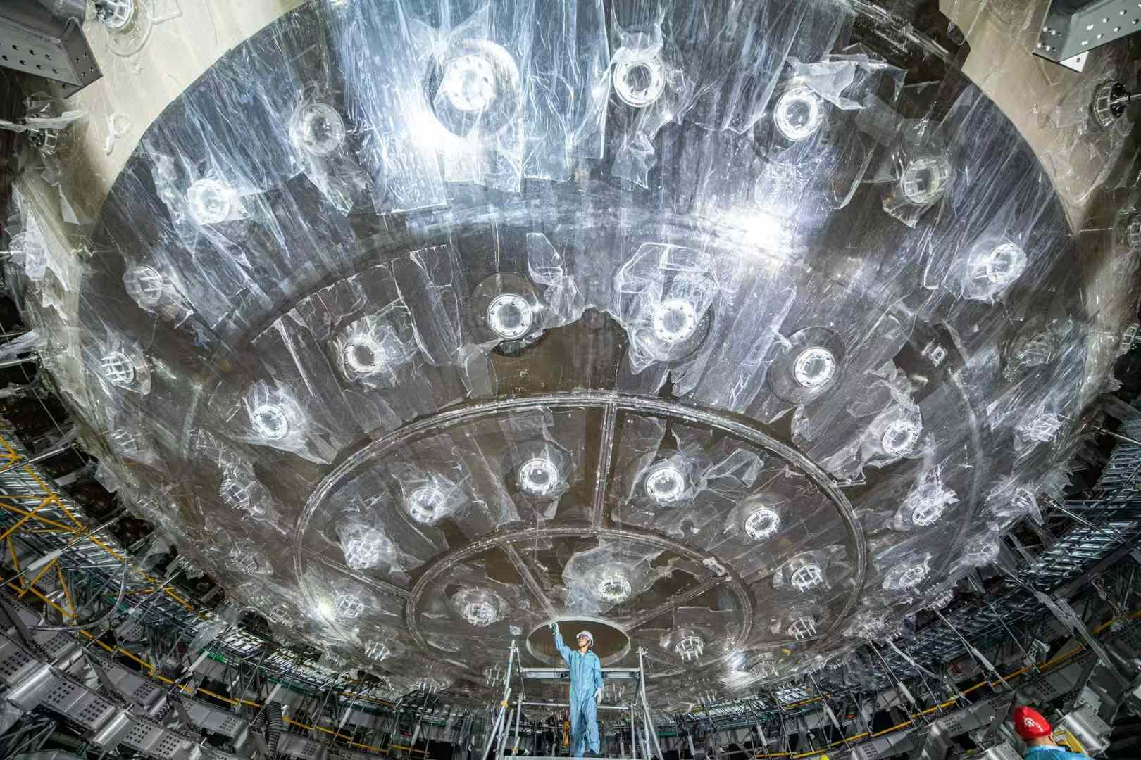
JUNO detector Status：Acrylic Vessel
12cm thickness
    Shaping, sanding/polishing, cleaning, machining and protection, maintaining
    high transparency (>96%)
    low surface background (< 5 ppt U/Th)
Installation of -3 layer
bottom chimney
Oct.2024

Slide 7
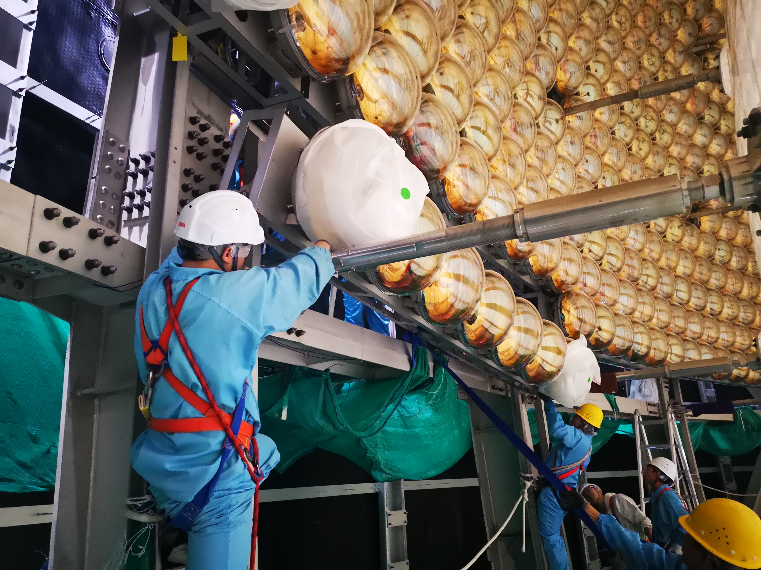
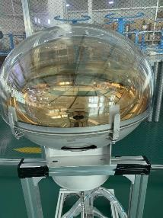
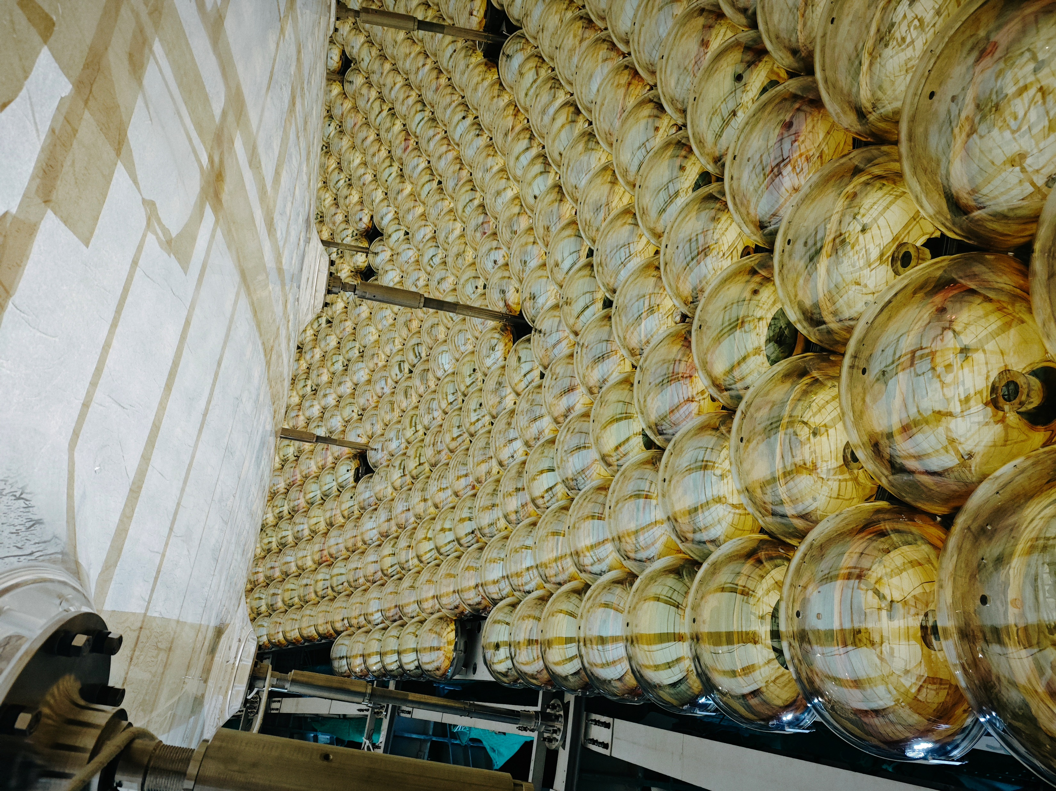
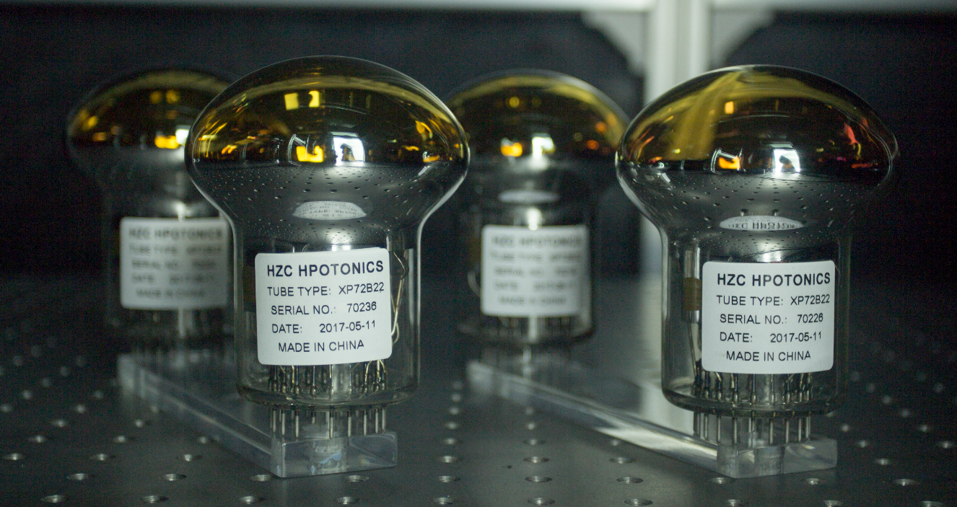
JUNO detector Status：PMTs
20inch PMT
 | LPMT (20-inch) |  | SPMT (3-inch)
 | Hamamatsu | NNVT | HZC
Quantity | 5000 | 15012 | 25600
Charge Collection | Dynode | MCP | Dynode
Photon Detection Efficiency | 28.5% | 30.1% | 25%
Dynamic range for [0-10] MeV | [0, 100] PEs |  | [0, 2] PEs
Coverage | 75% |  | 3%
3inch PMT

Slide 8
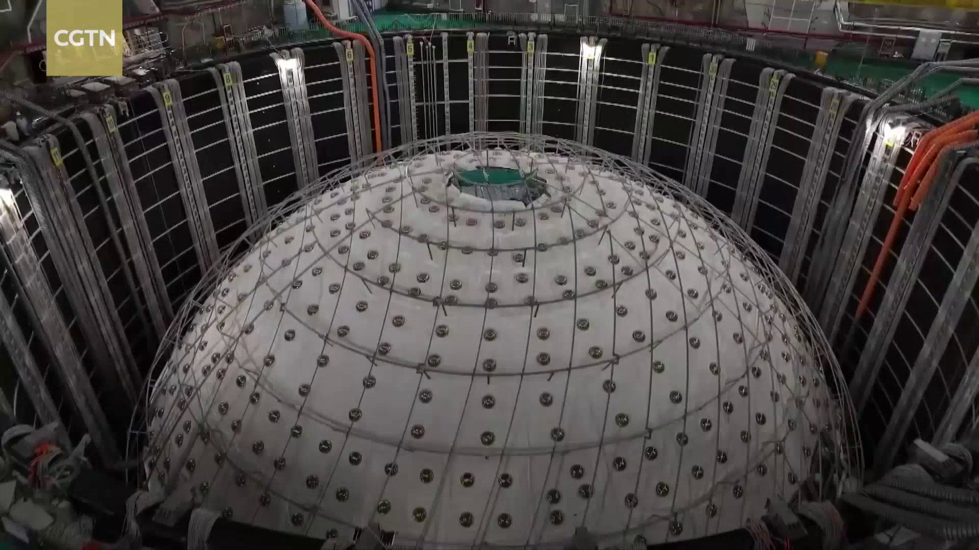
JUNO detector Status：PMTs

Slide 9
Part II: JUNO electronics

Slide 10
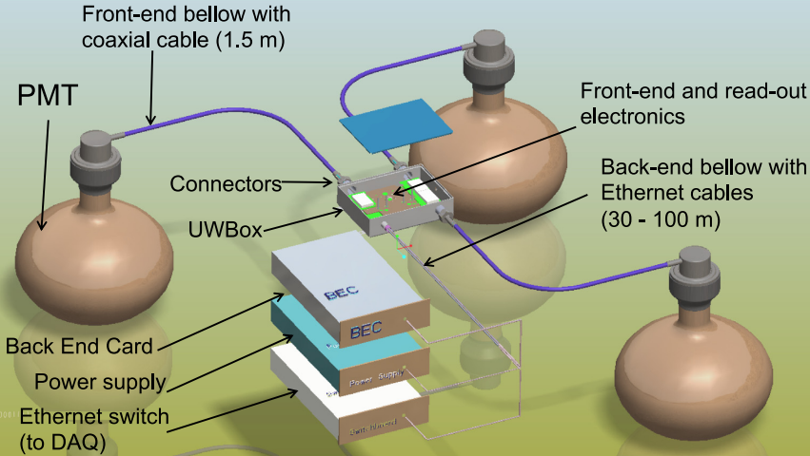
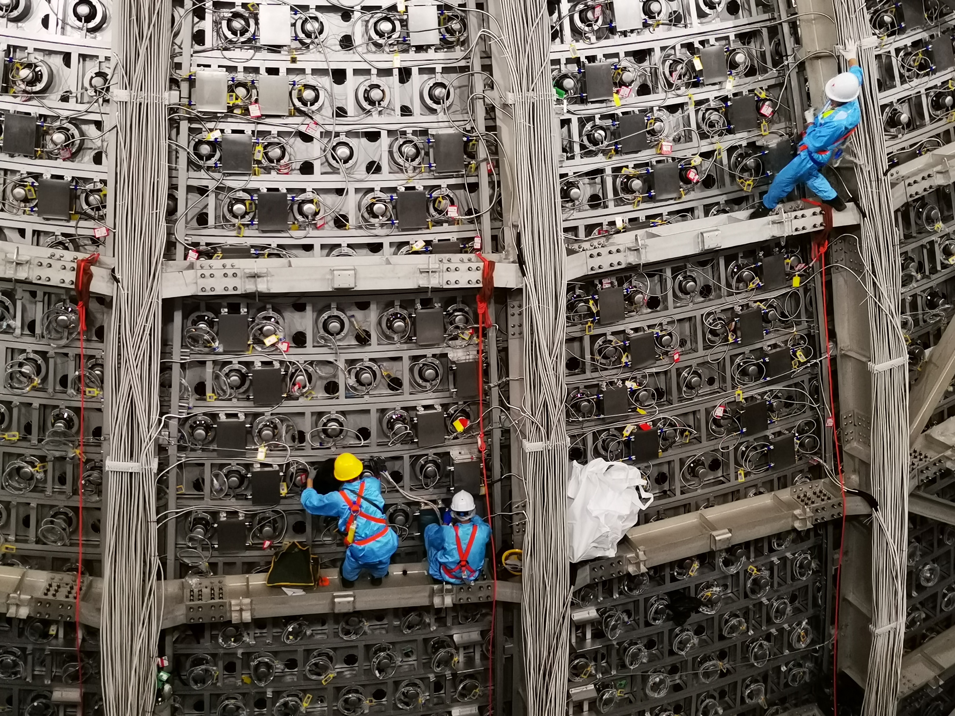
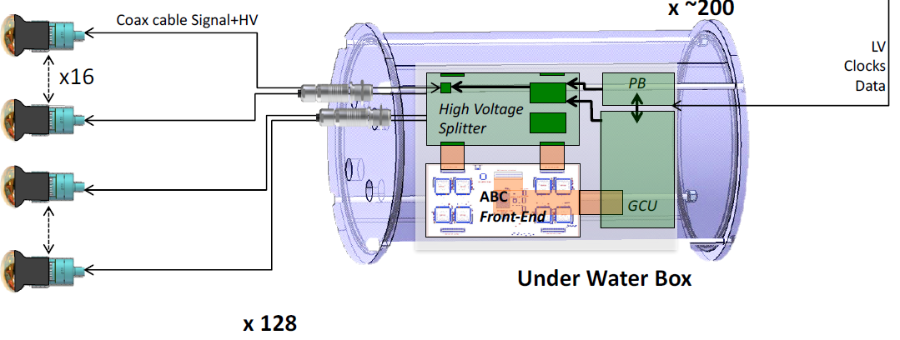
JUNO detector Status：Under water Electronics
    LPMT electronics
    Noise: 0.05 PE
    Resolution: <10%@1PE, <1%@100PE
    Failure rate: < 0.5%/6 years

Slide 11
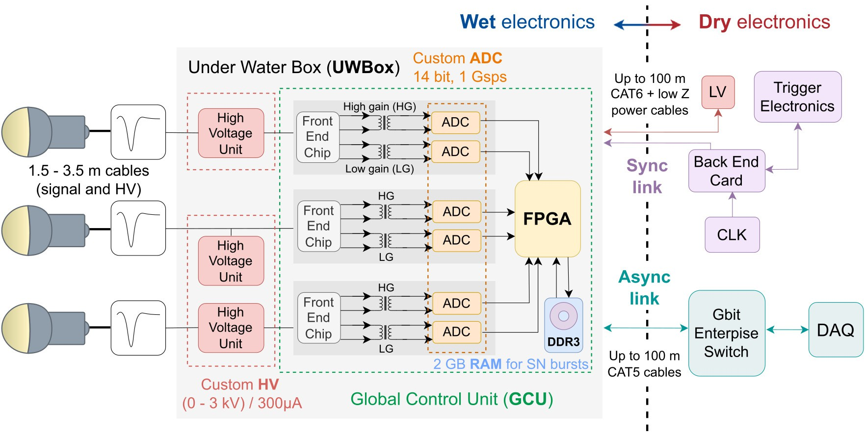
Large PMT Electronic Chain - Overview

Slide 12
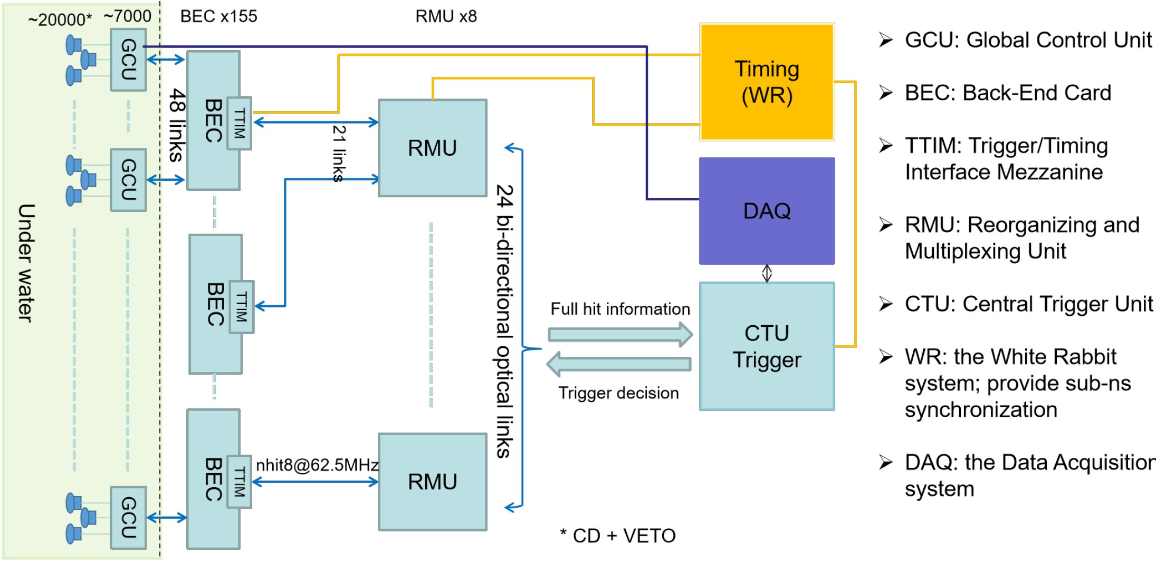
Trigger system in JUNO experiement

Slide 13
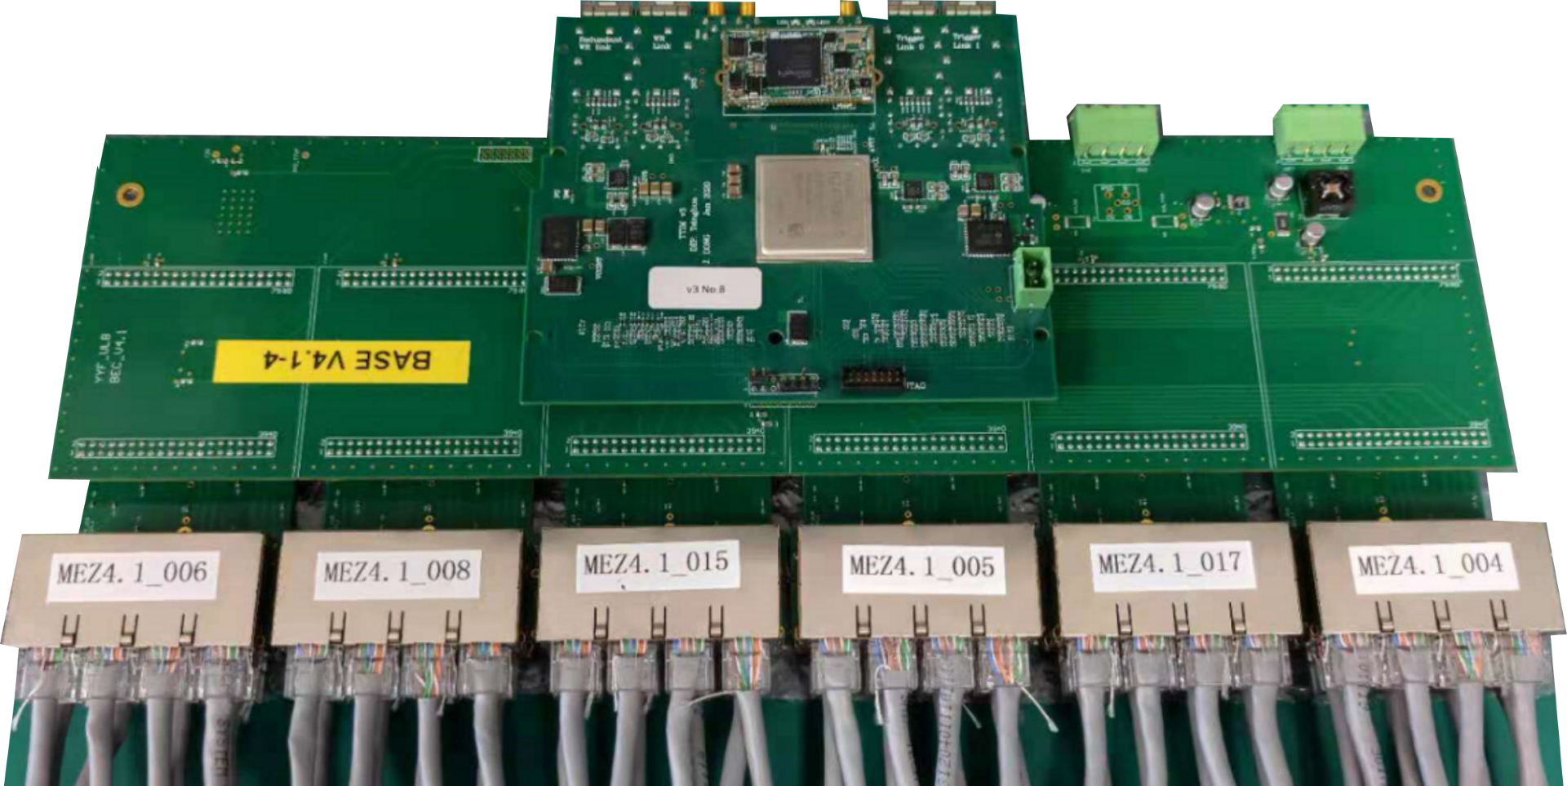
Back-End Card
The BEC is in direct communication with the underwater electronics
Desined by Yifan, verfication by Yifan & PierreAlexandre
▶ One base board
▶ Six mezzanines, each of them interface with GCU through 8 RJ45
▶ One trigger/time interface mezz (TTIM) carry a FPGA , provides time and clock from the white rabbit, collect full hit information.

Slide 14
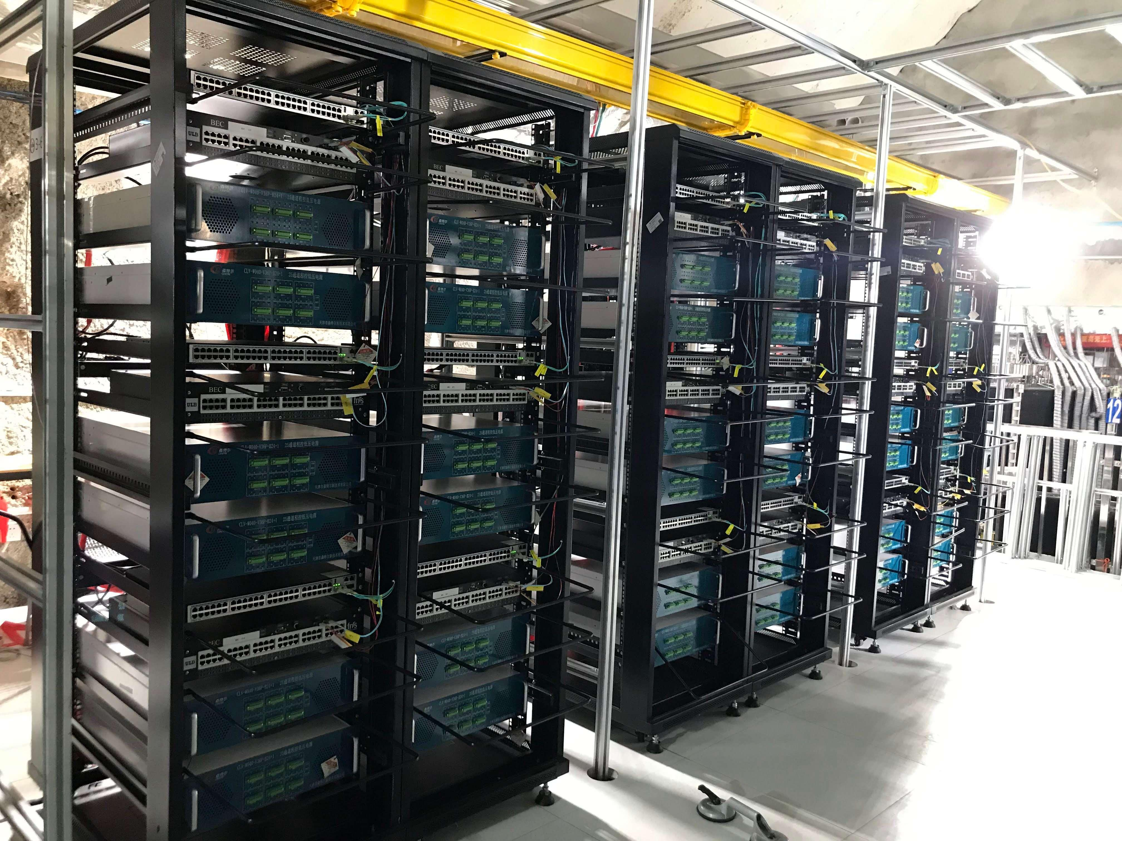
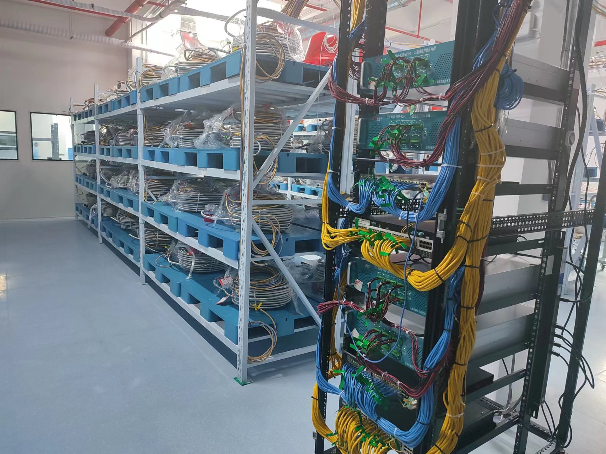
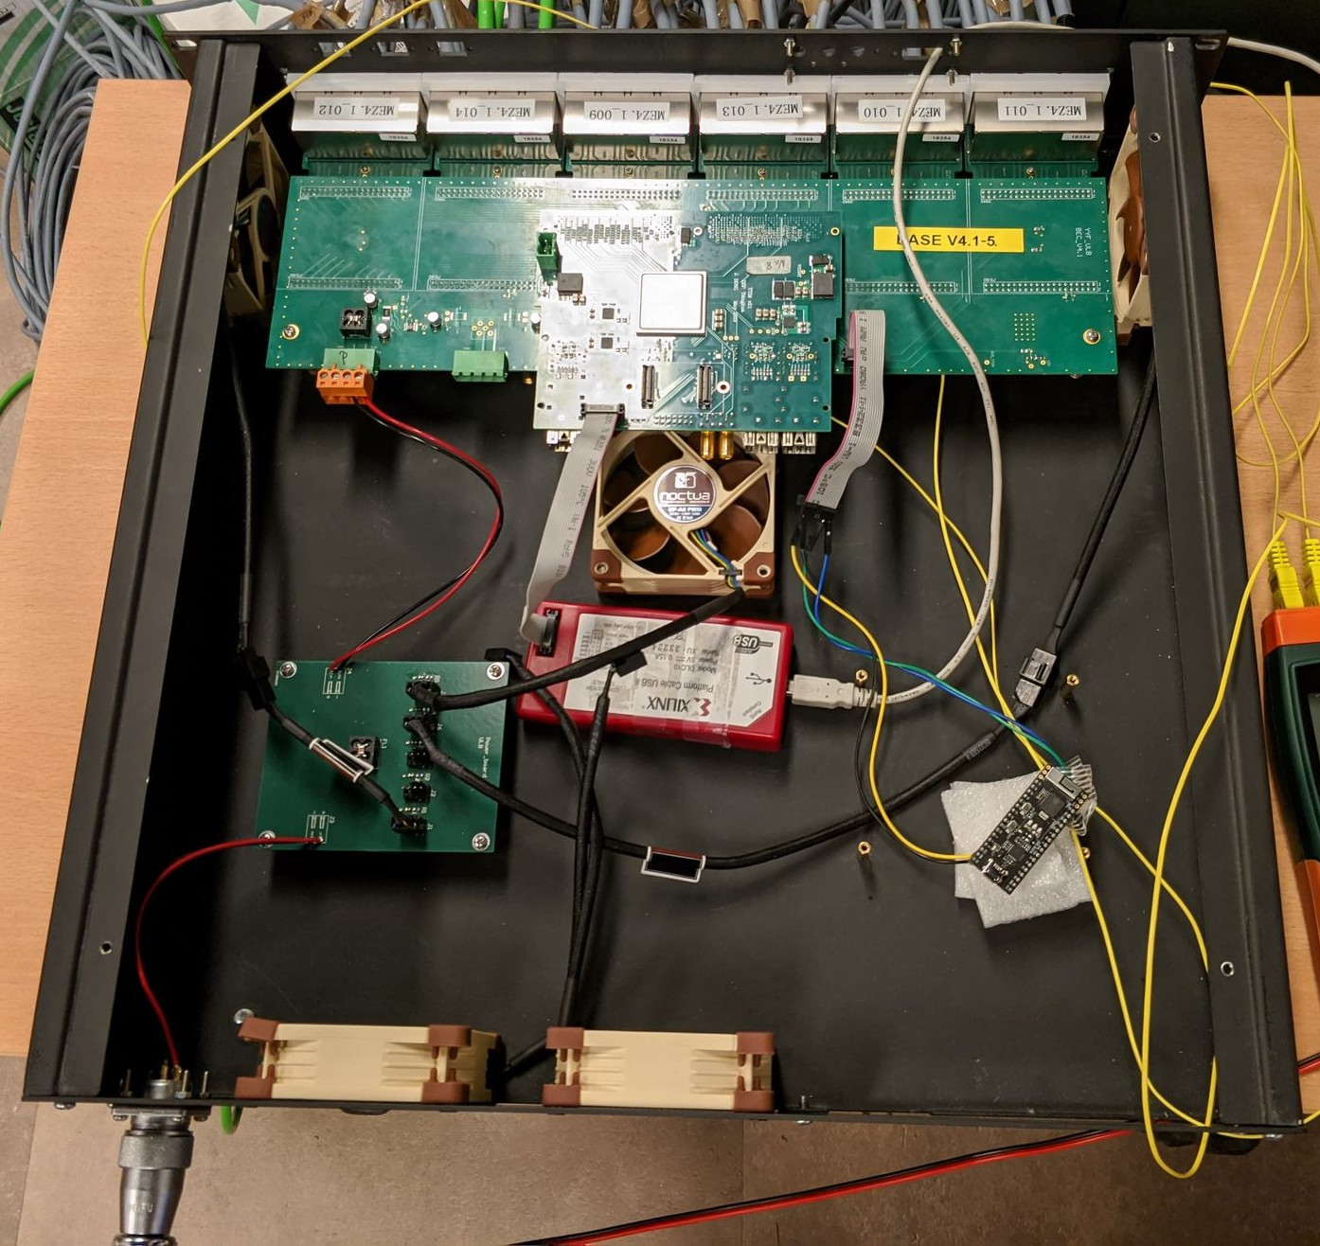
Back-End Card Process
Commissioning
Design and verification
Mass production
Kunshan Facility Tests
Installation Process
Light-off Tests
Integrated Testing
Trigger chain testing
Installation
Self-testing
Longterm monitoring
Kunshan Facility Tests
Self-testing
Integrated testing
Mass production
Self-testing
Design and verification
Self-testing
Integrated Testing

Slide 15
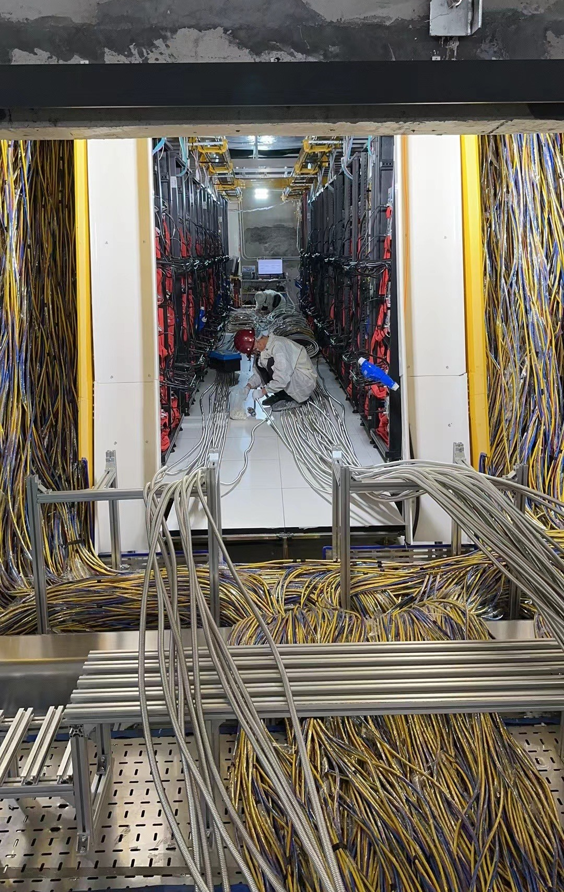
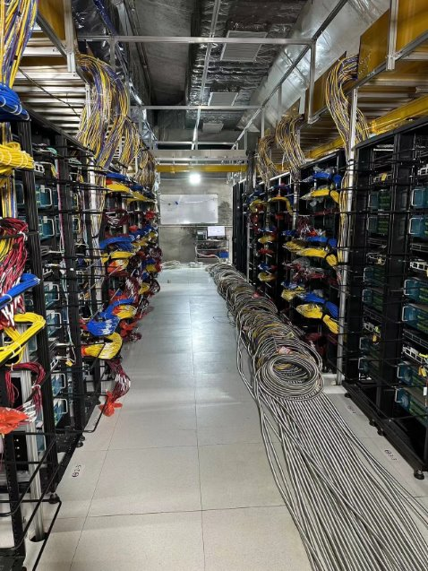
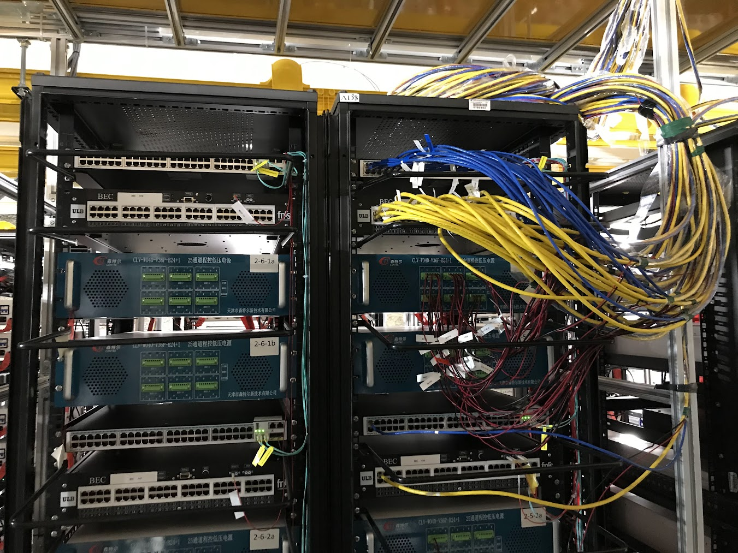
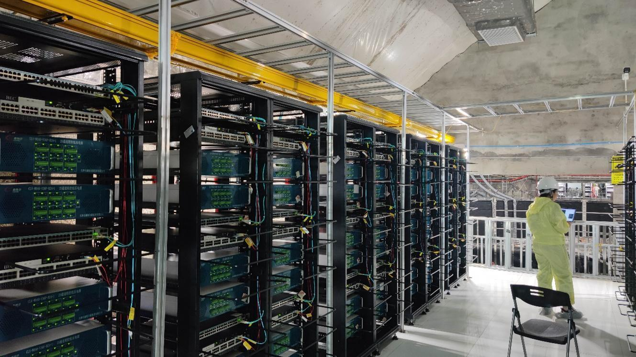
JUNO detector Status：Above water Electronics
DAQ-Switch
BEC (48 ch)
PowerSupply (24+1ch)
PowerSupply (24+1ch)

Slide 16
Part III: current activities in IIHE

Slide 17
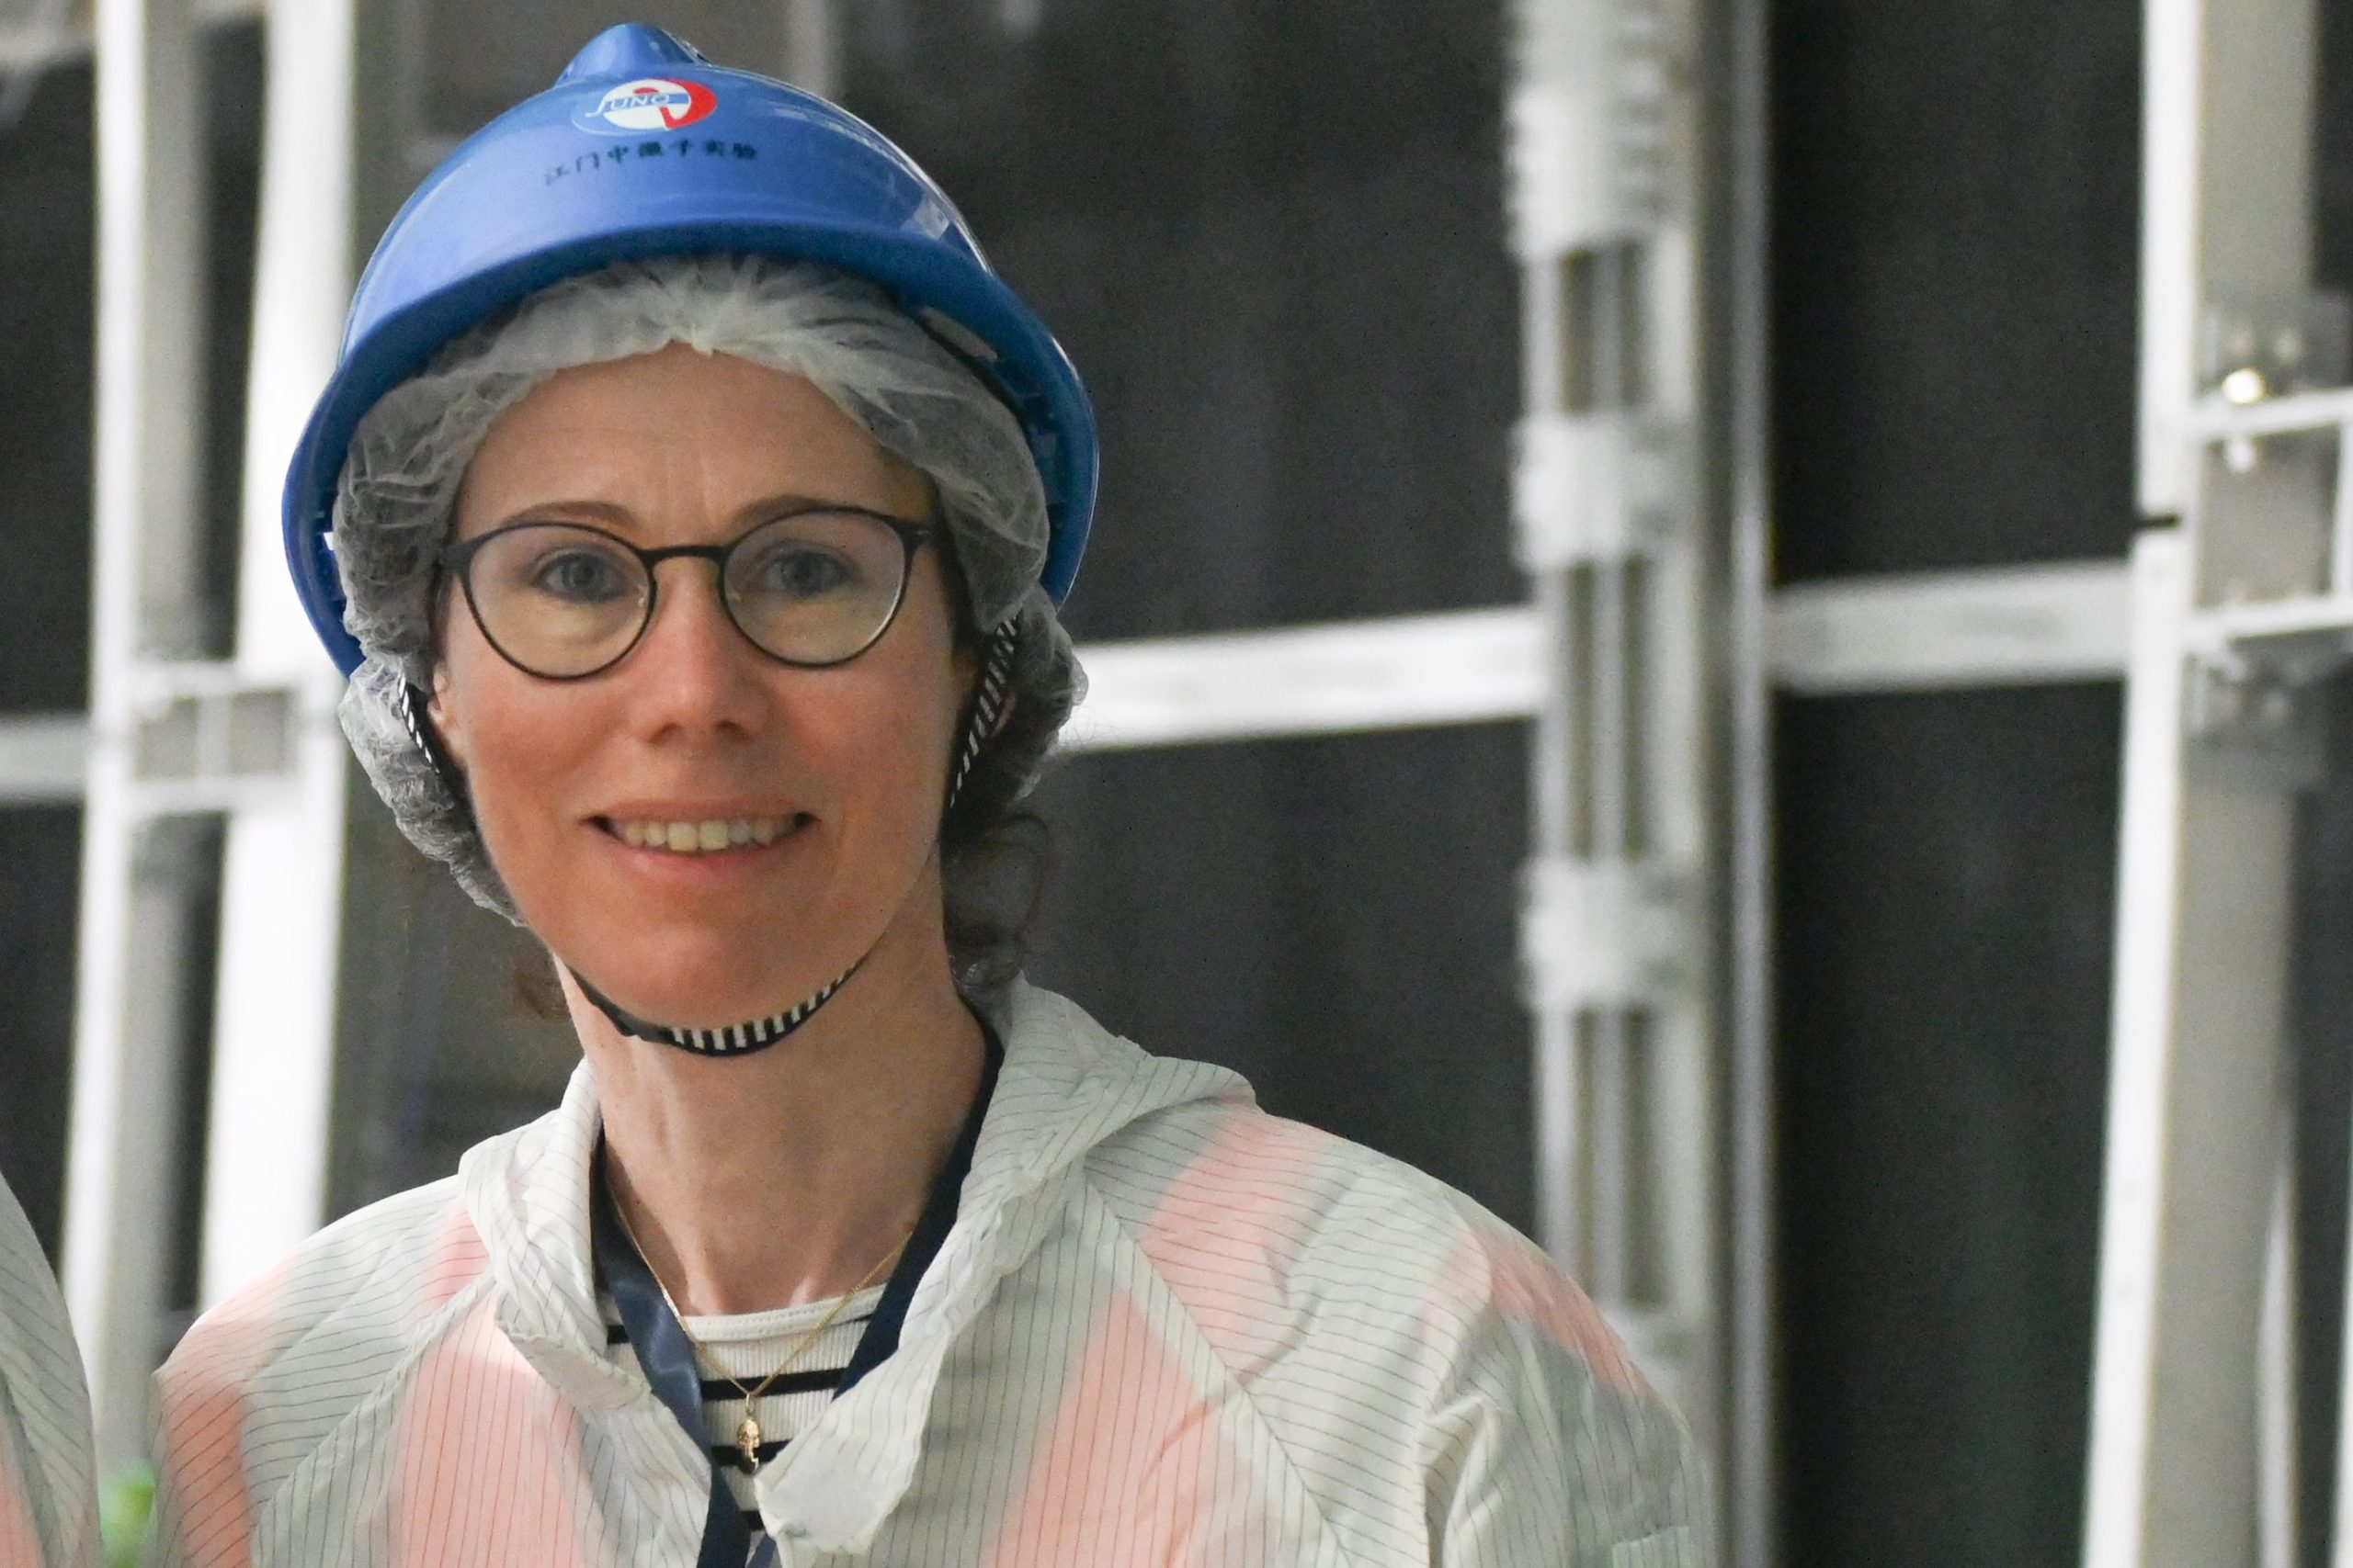



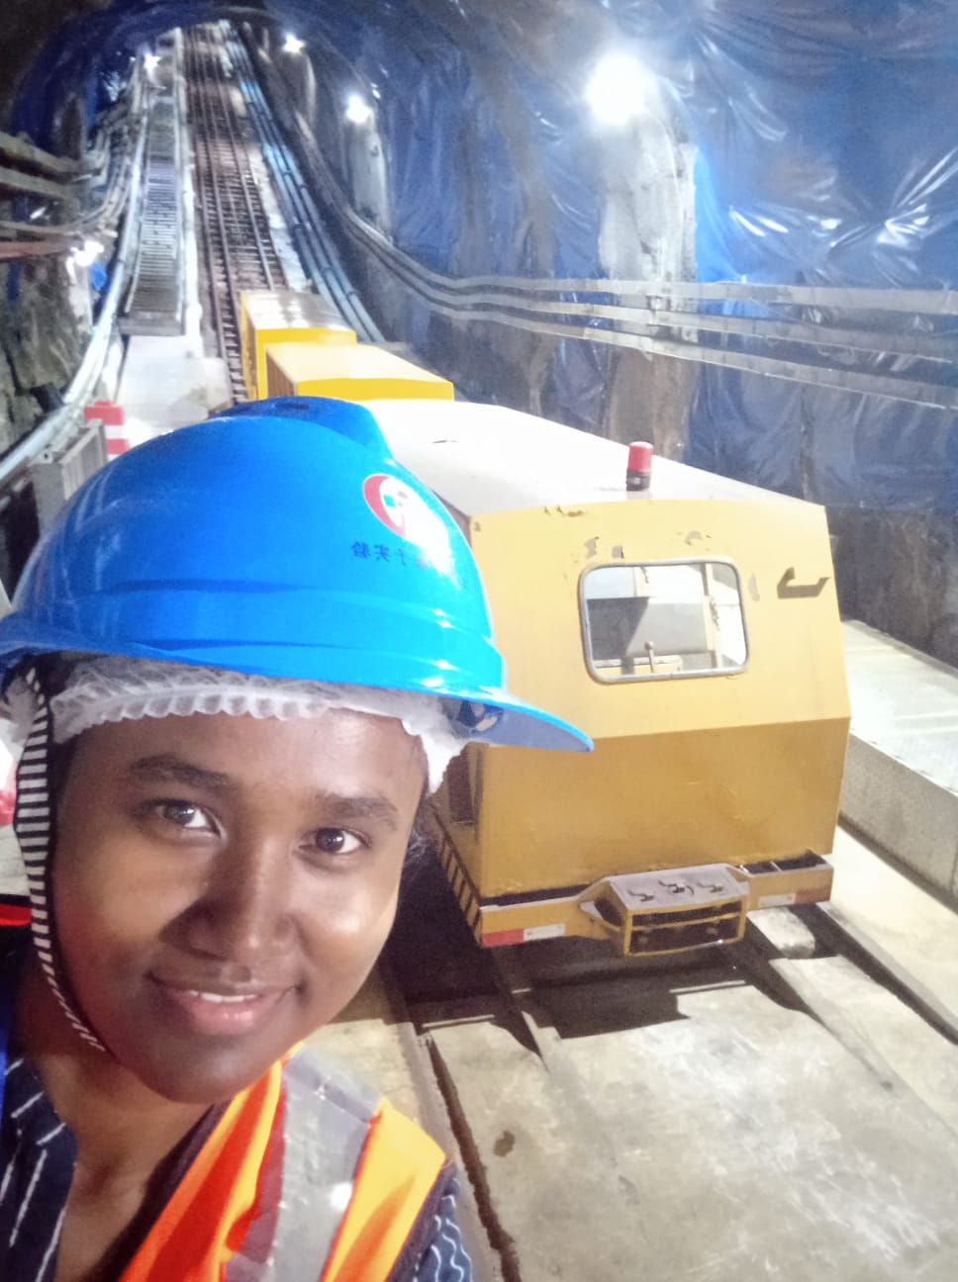
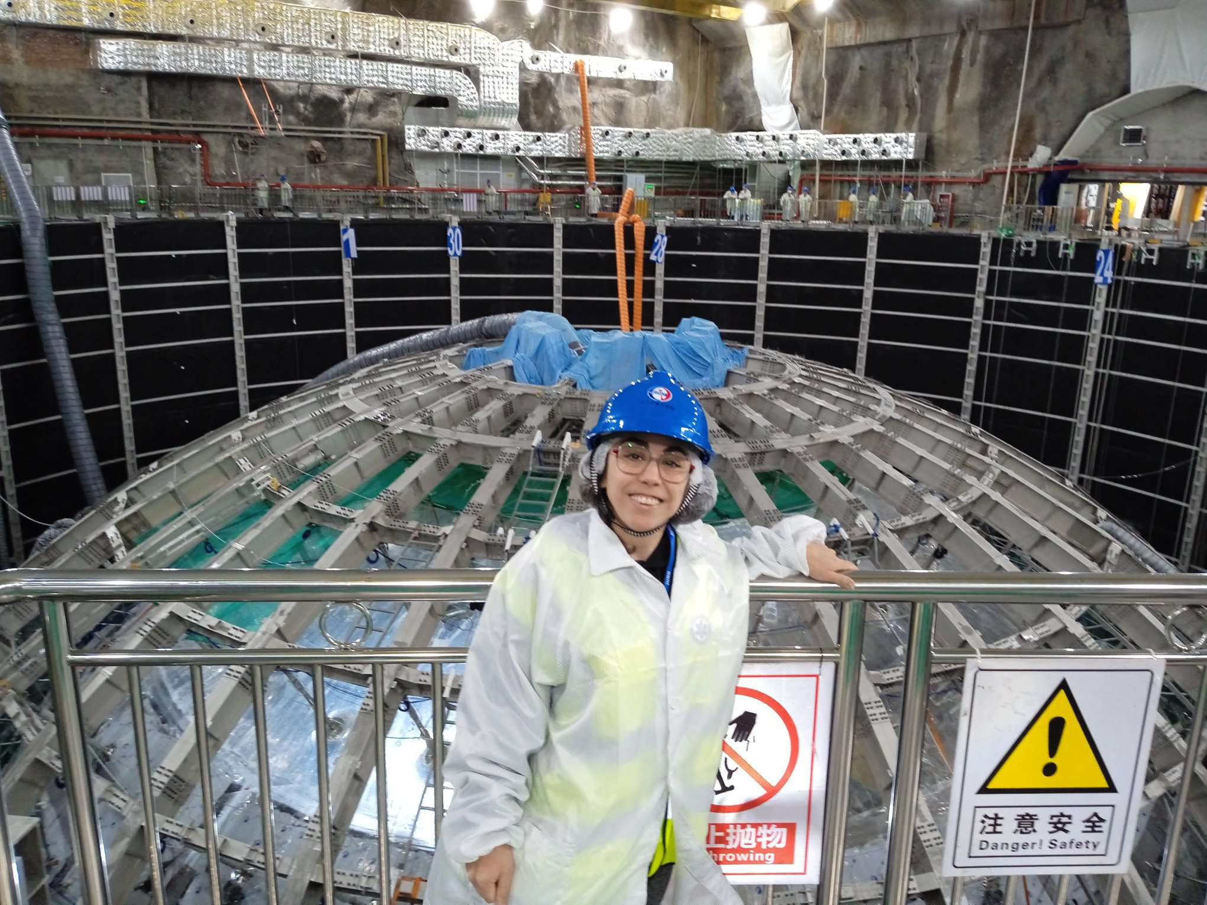

BEC/Trigger
commissioning
Atmospheric neutrinos
(CCSN) Core Collapse
Supernova neutrinos
f
d
Yifan & Hui & Feng
Trigger analysis in light off test
BEC monitoring
Marta & Amina & Feng
Event Classification
Event reconstruction
Oscillation study
NMO Sensitivity study
Marta & Pierre-Alexandre
CCSN model discrimination
Event classification
NMO Sensitivity study
R&D activities (see Gilles’ talk)

Slide 18
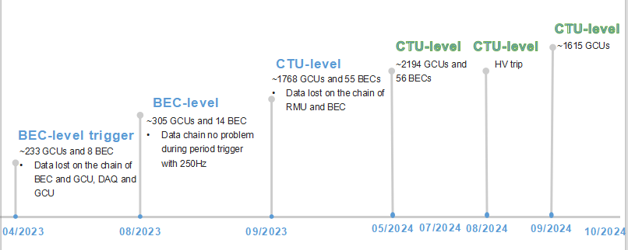
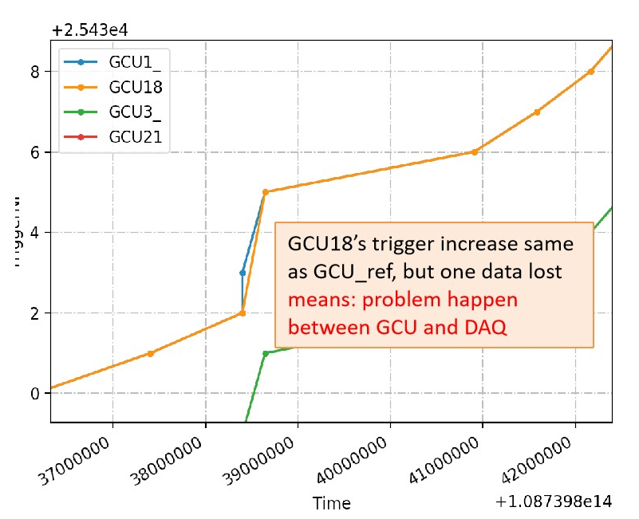
BEC/Trigger commissioning: light-off test
Since April 2023, there have been several light-off tests.
From 22.Nov, light-off test for all electronics is ongoing every day (lunch time).
Our group is doing the trigger study, checking the synchronization and link performance.
TriggerID
solved by increase the size of GCU buffer
Time[unit: 5ms]

Slide 19
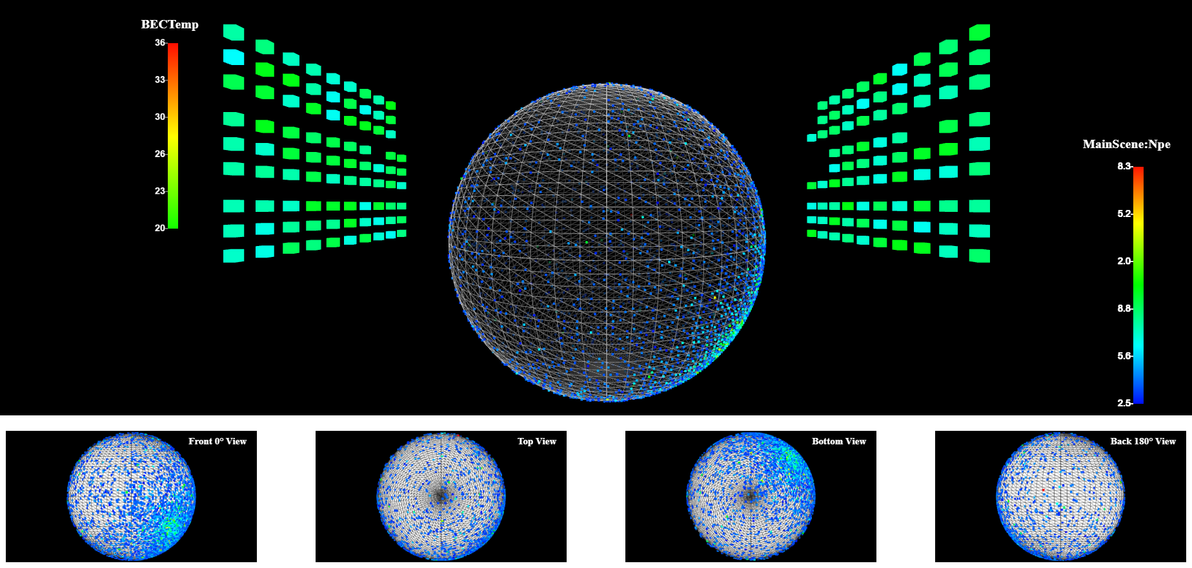
WebDisplay of BEC Temperature and JUNO Event: Npe
Really BEC Temperature
from onsite
Neutron capture from simulation file of atmospheric neutrion intereaction

Slide 20
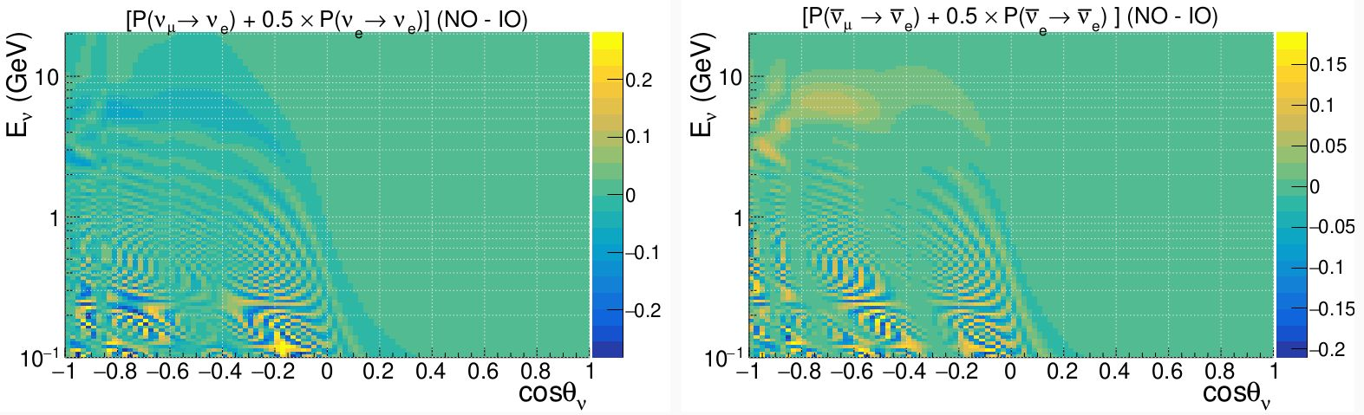
Atmospheric neutrinos: NMO Sensitivity
Atmospheric neutrinos provide independent sensitivity to NMO via matter effects.
Combing reactor and atmospheric neutrino oscillations has the potential to maximize JUNO’s total sensitivity
reactor anti-neutrinos at low energies
atmospheric neutrinos at high energies(GeV level)
Anti-neutrino
Error on θν_{e}~15 deg
Reconstruction of energy, direction, and PID selection are crucial for NMO
measurement with atmospheric neutrinos

Slide 21
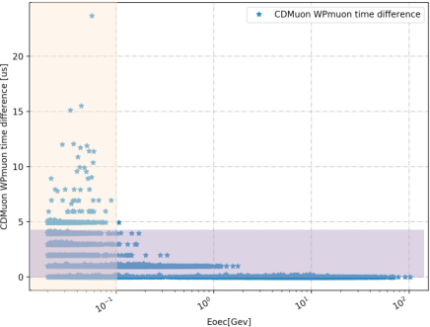
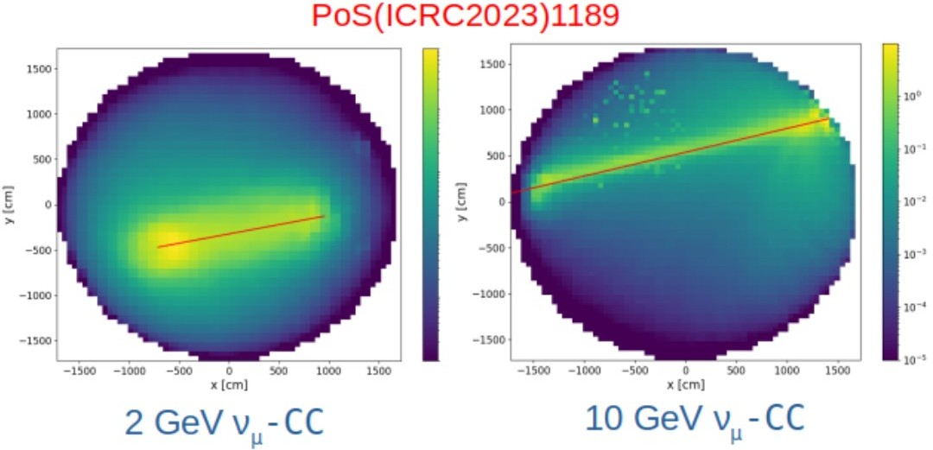
Atmospheric neutrinos: Classify Event and reconstruction
>Pick up atmospheric neutrinos from muon: ~4 muons per second VS ~4 neutrinos per day
Using the Erec and time information bwtween CD and Veto to improve the Tag effienicy.
>Good energy (~10%) and direction (∼9/15 degrees for muon/electron neutrino) reconstruction.
Reconstruct the photon emission probability distribution based on the PMT hit charges and times.

Slide 22
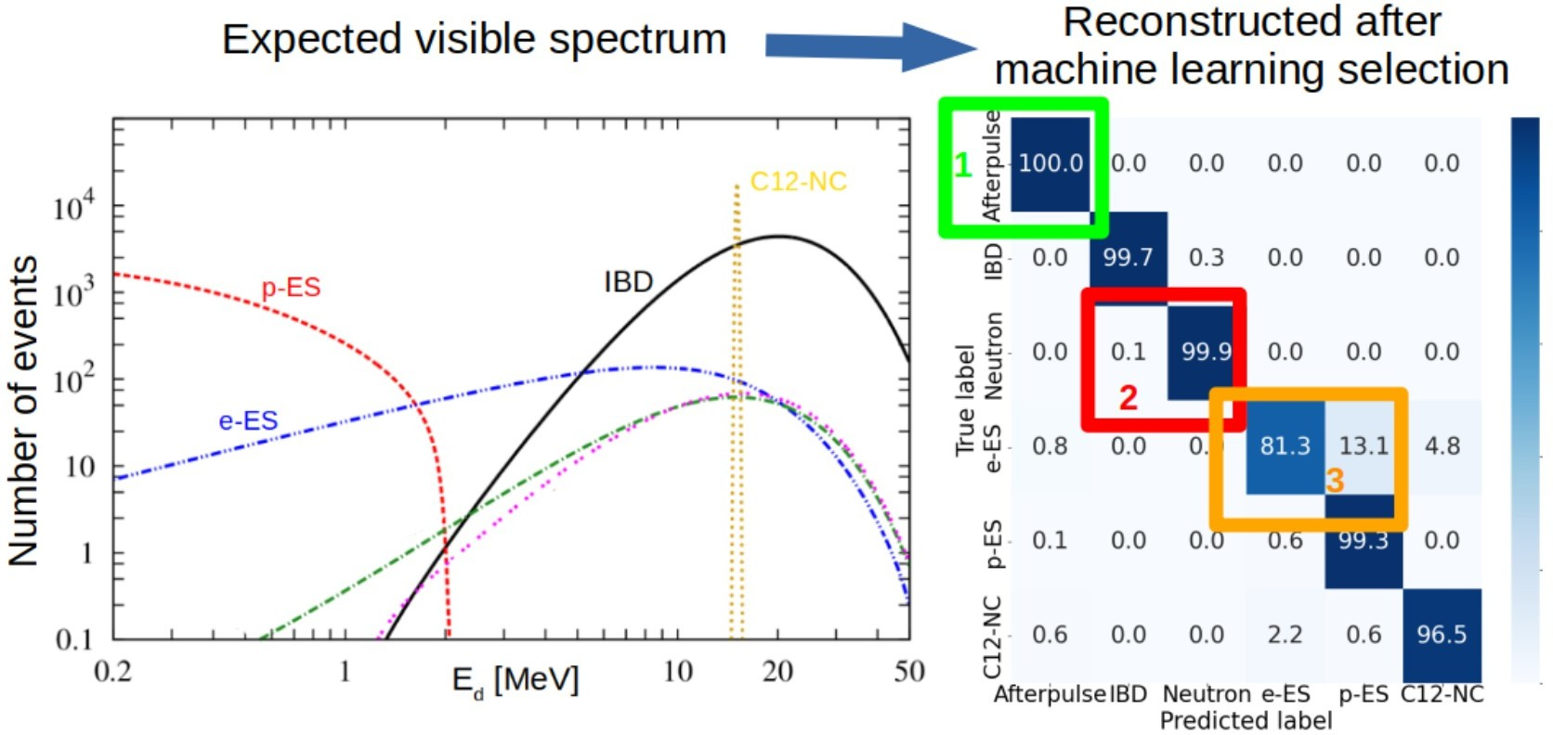
Supernova neutrinos with JUNO: Event classification
Goal of the event selection: JUNO is sensitive to ALL neutrino flavors -> separate the different channels
  1) Remove AP (afterpluses)
  2) Select prompt and delayed IBD signals (coincidences)
  3) Separate proton VS electron scatterings
Trigger lost from BEC for OSIRIS is 0

Slide 23
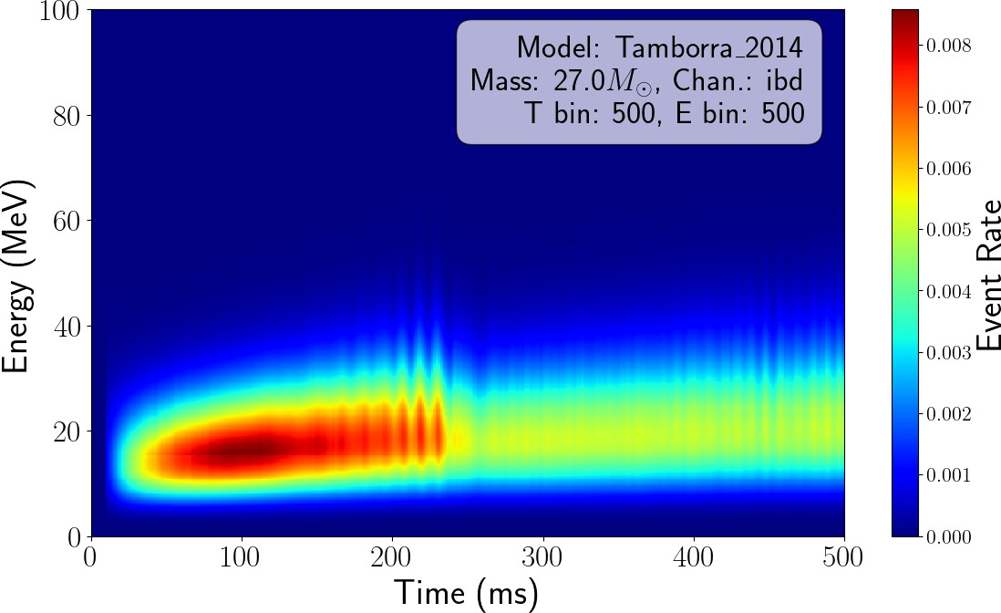
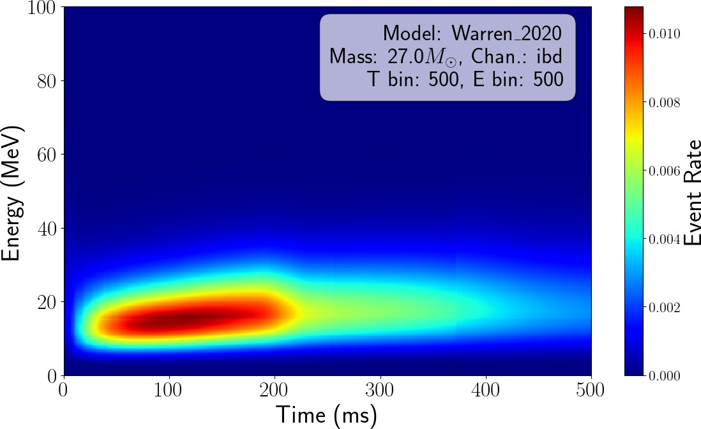
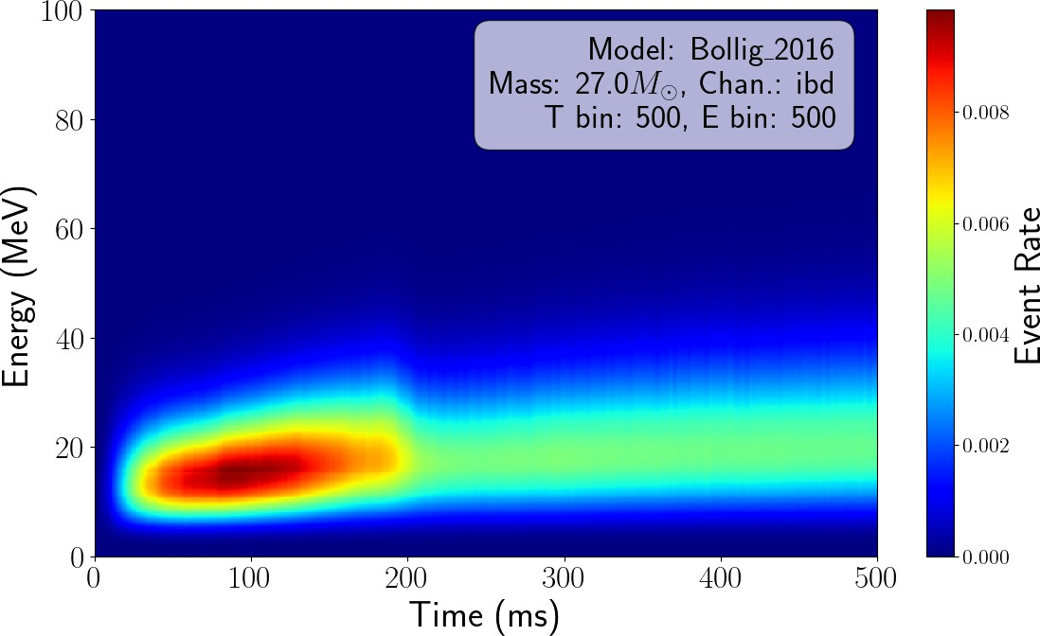

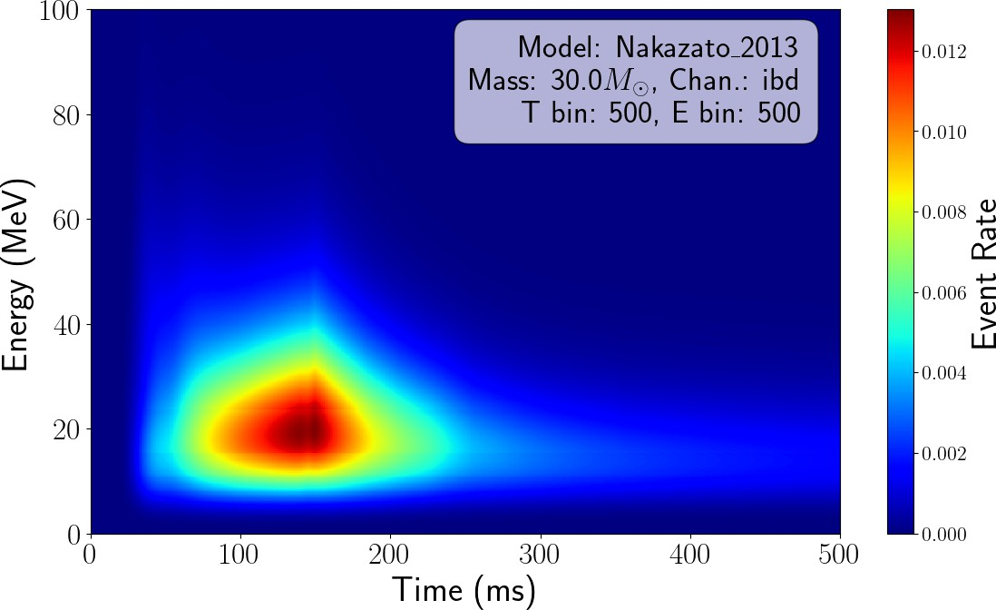
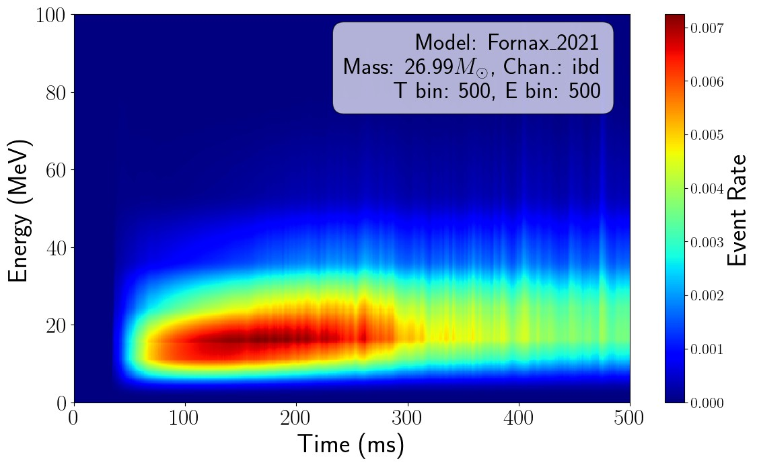
Supernova neutrinos: CCSN model discrimination
Using the time and energy information to get a knowledge about CCSN mechanism -> models
Effective model discrimination shown in both IBD and vpES channels (IBD more sensitive) up to a distance of 20- 30 kpc.
(a) Tamborra
(b) Warren
(c) Bollig
IBD channel
(d) Shukhbold
(e) Nakazato
(f) Fornax

Slide 24


Involvement in commissioning in water phase
During water phase:
Water filling will start in a month: Amina and Marta will take water shift onsite in January
ULB team + two master students working on:
    Understanding the water simulations and tunning the trigger for water
    Muon and atmospheric neutrino detection with water data
    Online Event classification (OEC) and CCSN Monitor in water

Slide 25
Summary
BEC/Trigger
commissioning
Atmospheric neutrinos
(CCSN) Core Collapse
Supernova neutrinos
f
d
Yifan & Hui & Feng
Trigger analysis in light off test
BEC monitoring
Marta & Amina & Feng
Event Classification
Event reconstruction
Oscillation study
NMO Sensitivity study
Marta & Pierre-Alexandre
CCSN model discrimination
Event classification
NMO Sensitivity study
R&D activities (see Gilles’ talk)

Slide 26
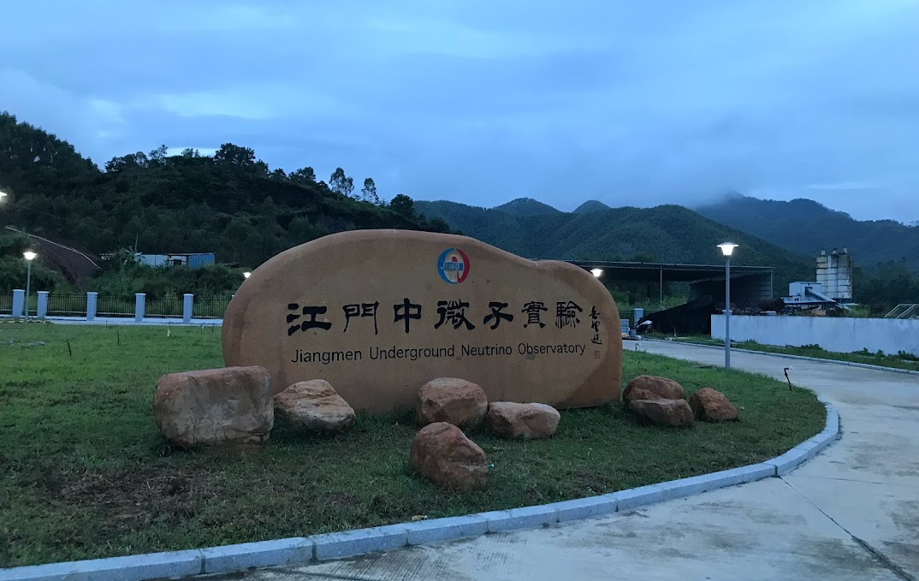
Thank you for your attention!

Slide 27
Backup

Slide 28
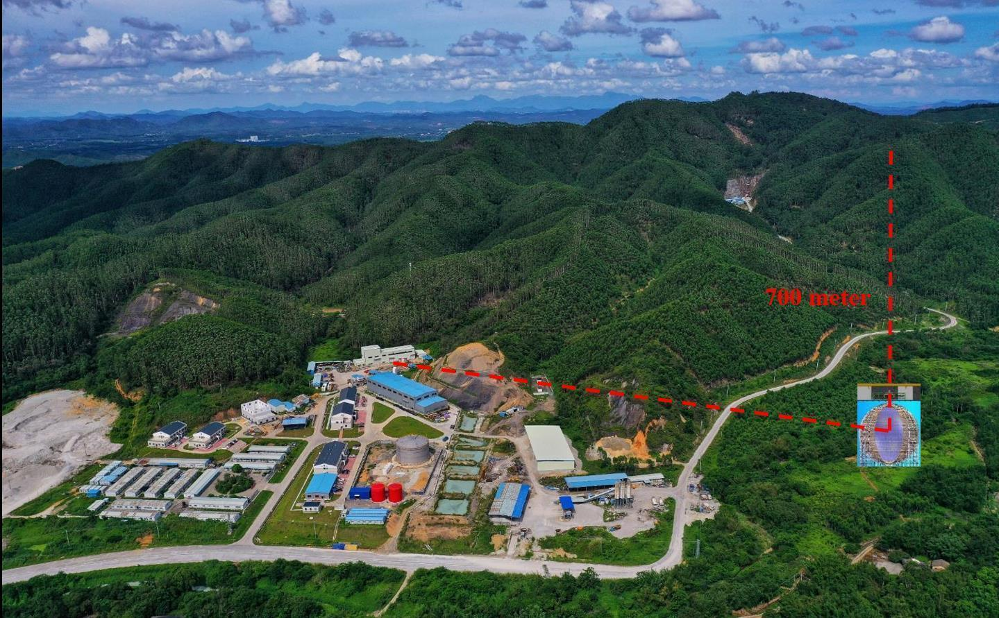
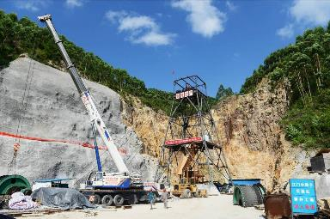
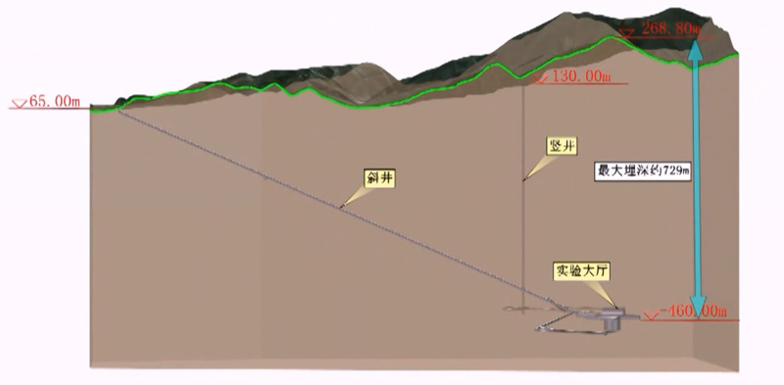
JUNO onsite
~ 600m vertical shaft, ~1300m sloped tunnel

Slide 29
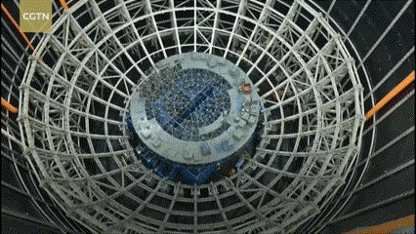
JUNO detector Status：steel structure

Slide 30
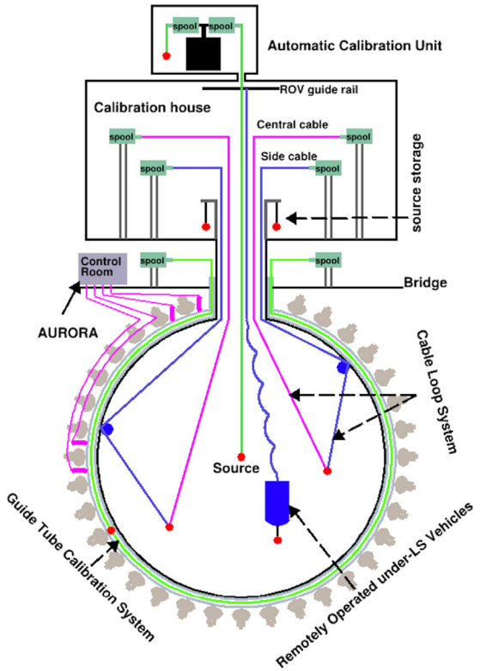
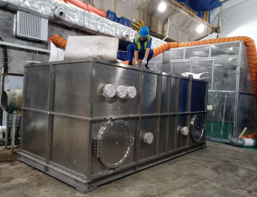
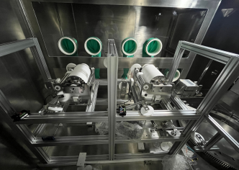
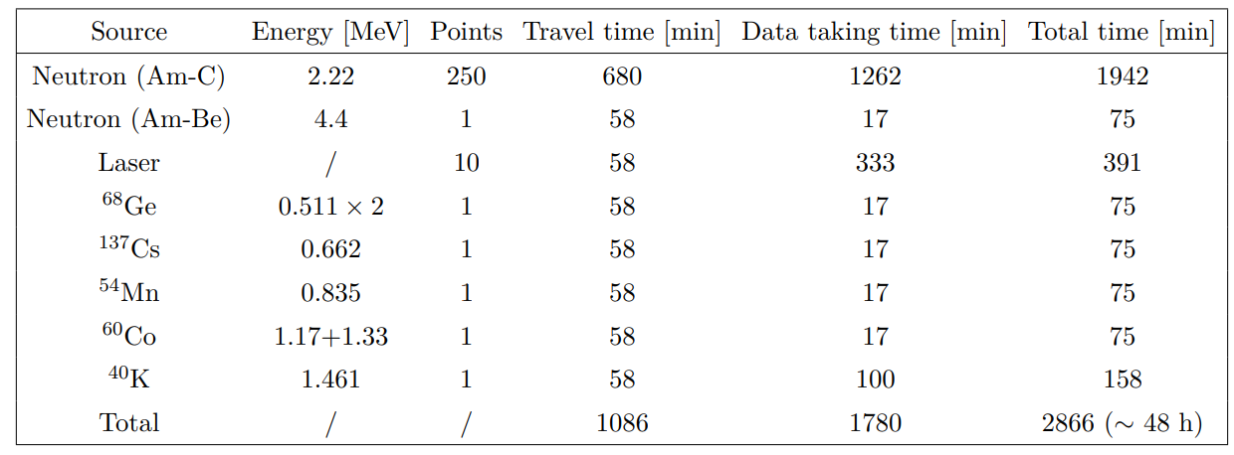
JUNO detector Status：Calibrations
Calibrate energy scale and non-linearity to better than 1%

Slide 31





JUNO detector Status：Radiopurity control &Cleaning
Pressure water for Acrylic Vessel
vacuum cleaner + cloth wipe
vacuum cleaner + static dusting brush
static dusting brush
Experiment Hall Average cleanliness is class 46,000 since 2022.07
(requirement < class 100,000)
Average radon concentration in air is 160 Bq/m³ since 2022.08 (requirement < 200 Bq/m³)

Slide 32
Challenge: LS detector for ν_{atmo}
For Atmospheric neutrinos study:
Matter effects on oscillations are dependent on zenith angle since it is directly related to the oscillation baseline length.
Neutrino directionality (cosθ) is mandatory to the atmospheric neutrino.
For LS detector
Scintillation light is isotropic, Cherenkov light is only a few percent: no direct directional information.

Slide 33


Methodology for the directionality reconstruction
The scintillation light received by a PMT is the superposition of light from many points on particle tracks inside the detector.
The track depicts distinct shapes of nPE(t) for PMTs at different angles, which then reflected in the PMT waveforms.

Slide 34








JUNO detector Status：Liquid Scitillator
5000 m³ LAB storage tank
1) Al₂O₃ for optical transparency
2) Distillation for radiopurity
Mixing LAB with PPO and bis-MSB
All plants are individually tested, and all requirements are satisfied
85%
1800 m SS pipes to underground
15%
OSIRIS to monitor the LS quality
4) Gas stripping to remove Rn and O₂
3) Water extraction to remove radioactive impurities

Slide 35


Atmospheric neutrinos: Classify vatm and muon
Challenge 1: ∼4 muons per second VS ∼4 neutrinos per day
If save all muon waveforms , the data transmission is 217 MB/s, while the aim is to 60MB/s.
Idea: Using the Erec and time information bwtween CD and Veto to improve the Tag effienicy.
Atm v:
CD PMTs got hits Firstly
Muon:
CD PMTs got hits after WP PMTs

Slide 36

Atmospheric neutrinos: Neutron identification
Why we want to identify neutron events?
Benefit to Atm v PID (v-antiv separation)
How to select neutrons with simple cuts: target->secondary events
Selecting neutrons with simple cuts
Selecting neutrons with machine learning
neutron selection
efficiency
purity
cuts
93.1%
98.9%
machine learning
99.7%
97.3%

Slide 37


Atmospheric neutrinos: Event reconstruction
Challenge 2:Good energy (∼ 10%) and direction (∼ 20◦) reconstruction.
Idea: Reconstruct the photon emission probability distribution based on the detected PMT hit charges and times.
Error on θν_{μ}~9 deg
Error on θν_{e}~15 deg

Slide 38


Atmospheric neutrinos: L/E dependence of neutrino oscillation
One year atmospheric data will observe the neutrino oscillation with more than 5𝝈 confidence level
Error on θν_{e}~15 deg

Slide 39


Supernova neutrino with JUNO:NMO sensitivity
Thanks to CCSN flux, we want to determine the NMO thanks matter effect inside the star.
Main advantage: in case of explosion detected by JUNO, we don’t need to wait 10 year of data taking from reactor anti-neutrino to be able to discriminate between the two NMO.
Method used : χ2 test using Asimov method.
Trigger lost from BEC for OSIRIS is 0

