Slide 1
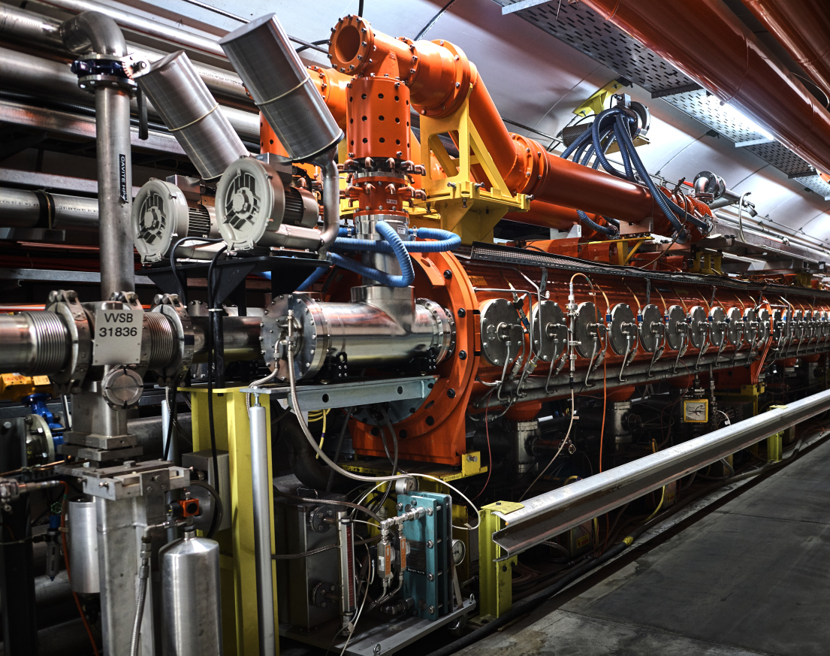
Non-collider Physics in Belgium
E. Cortina Gil
UCLouvain

Slide 2



Introduction
Non-collider Physics in Belgium
Small fraction of the HEP community involved.
Smaller teams
Smaller budgets and resources available
Less global visibility
Excellent training experience
All aspects should be covered: Simulation, Operation, Construction, Analysis.
Excellent local visibility
Three experiments:
NA62
SHiP
milliQan

Slide 3
NA62

Slide 4

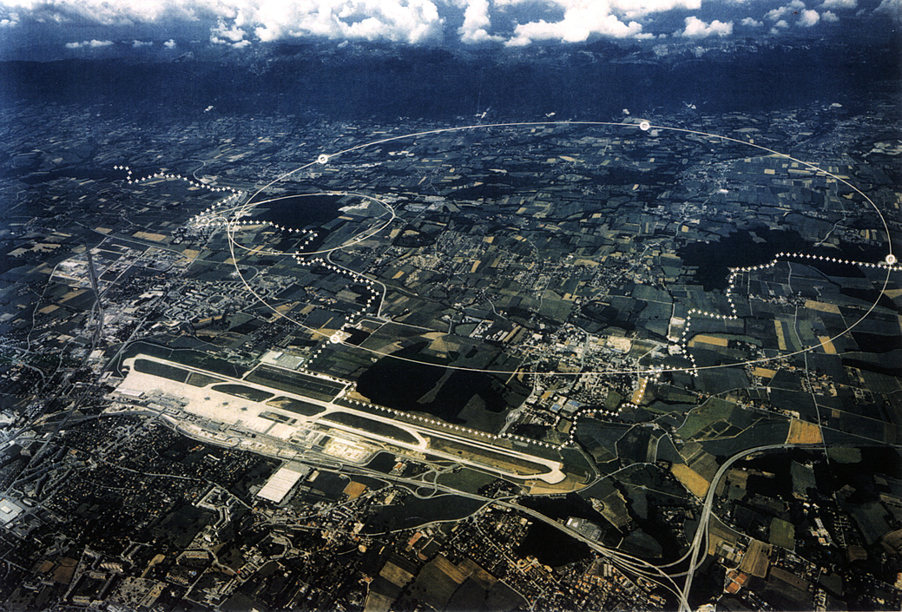
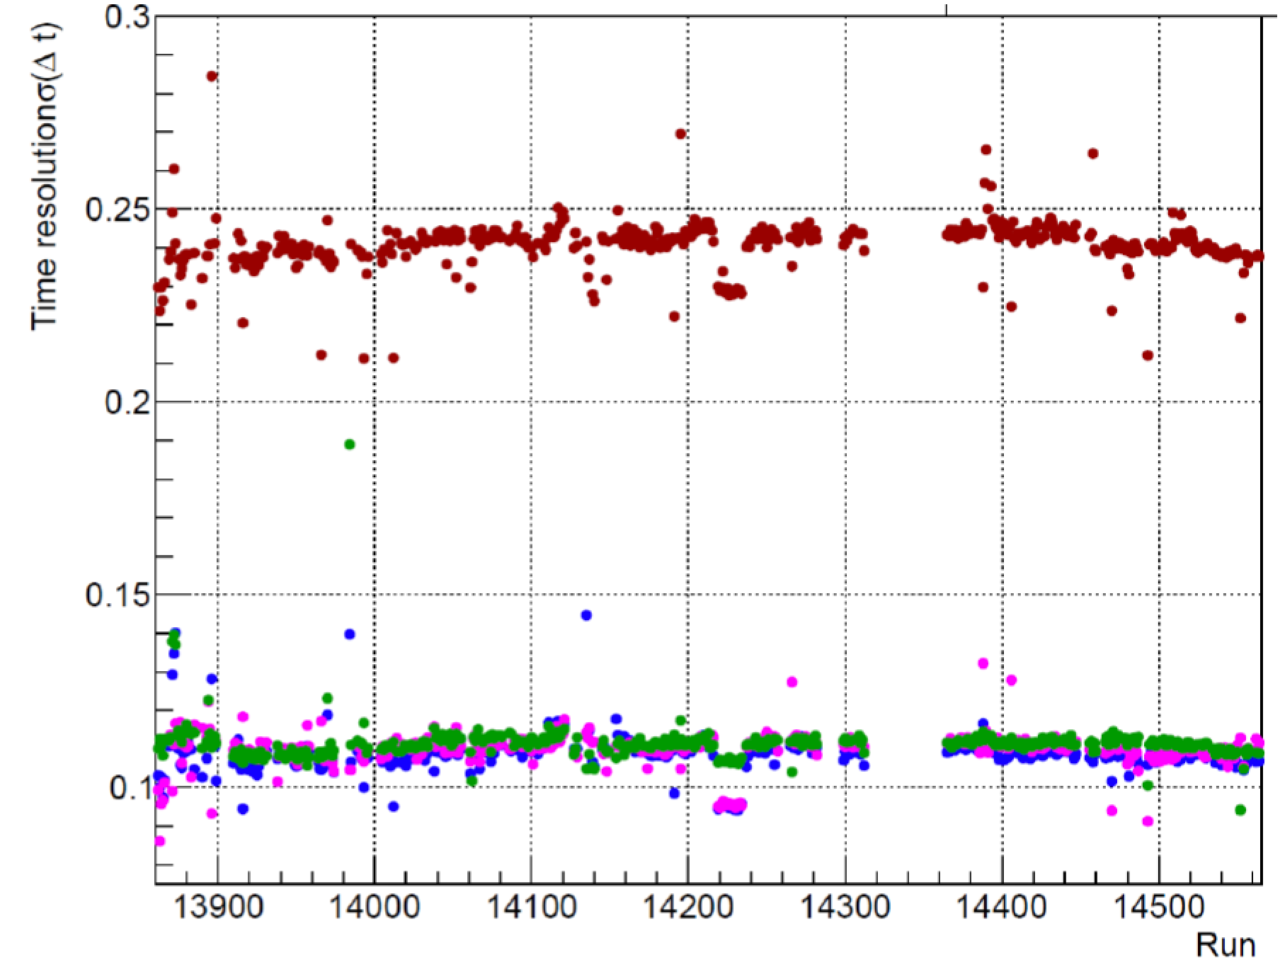
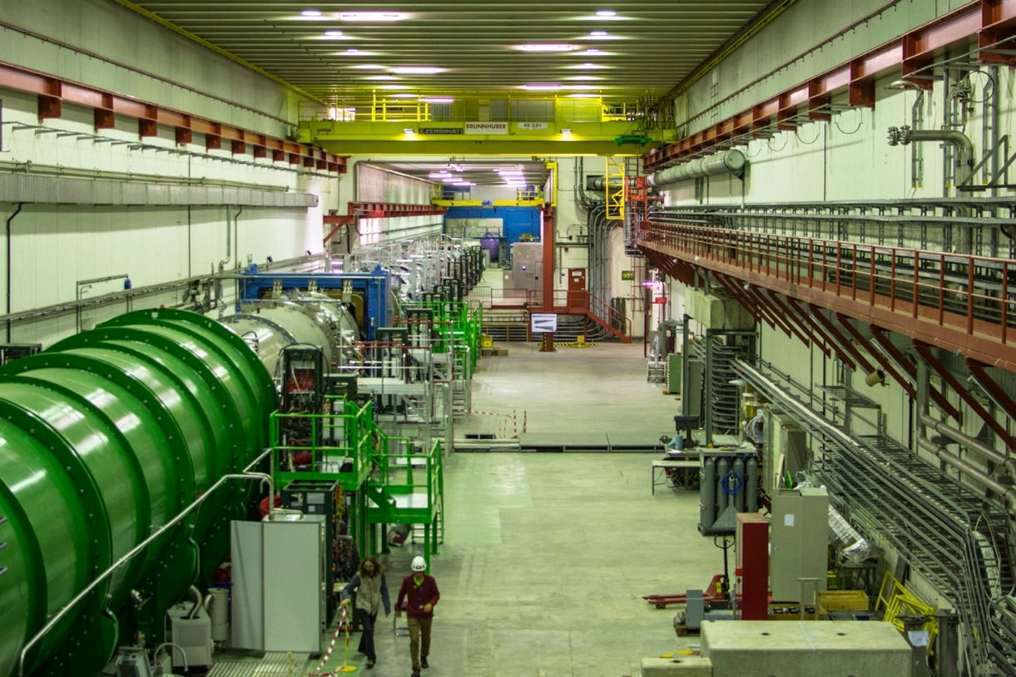
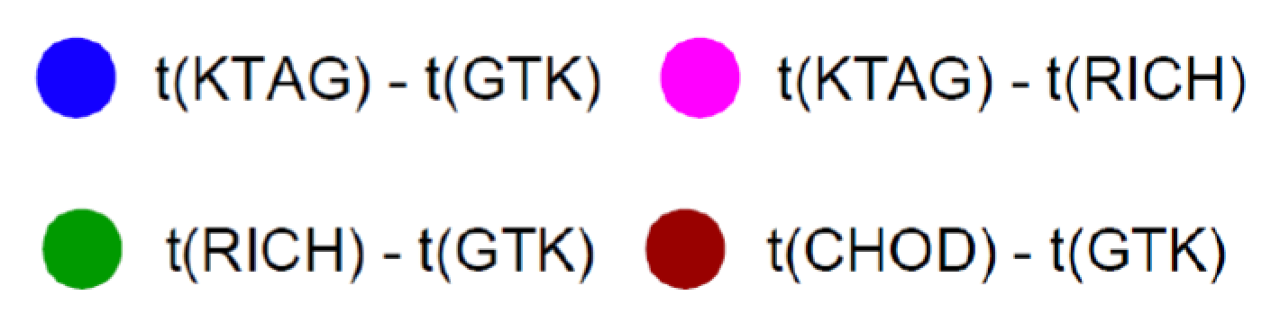
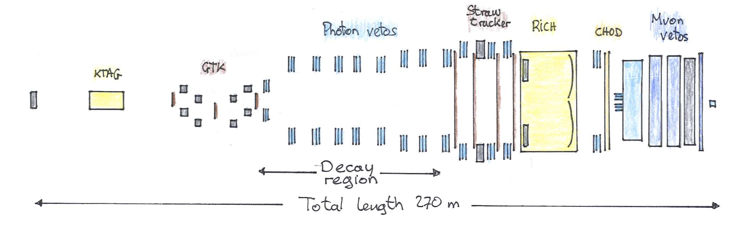
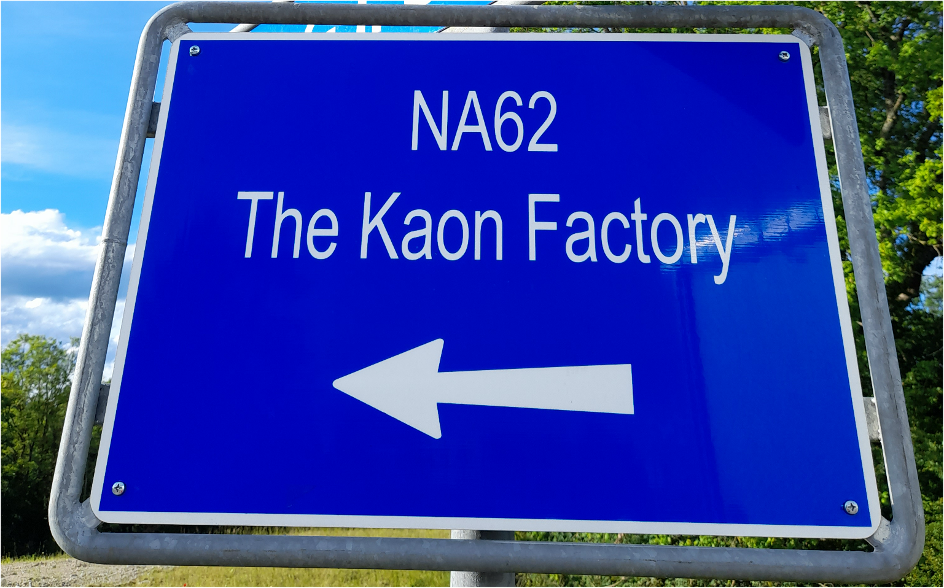
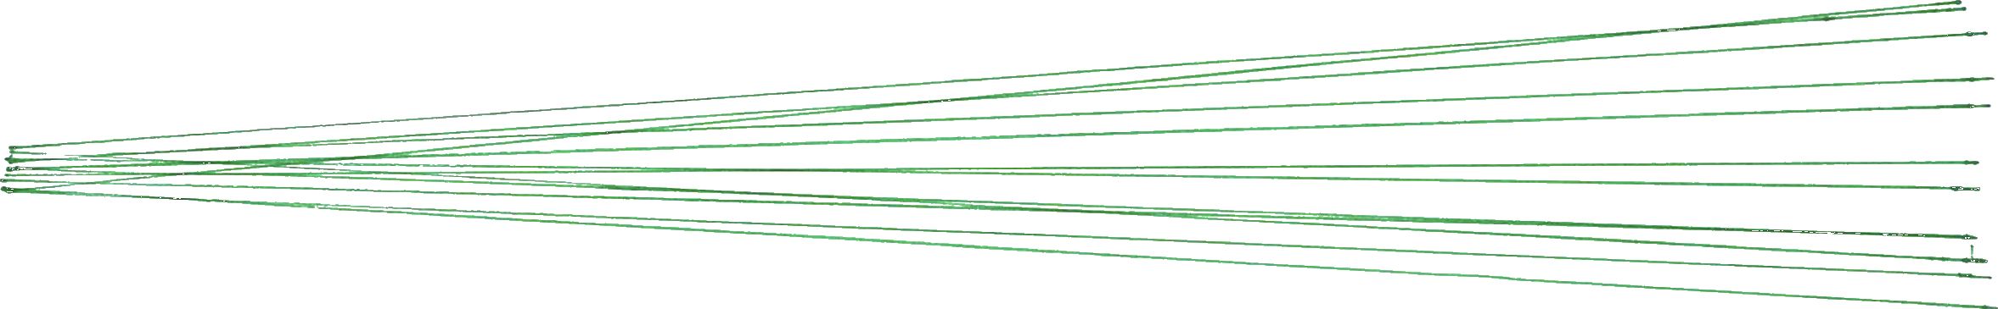
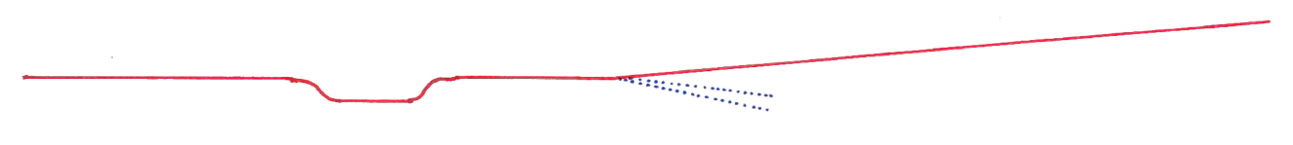
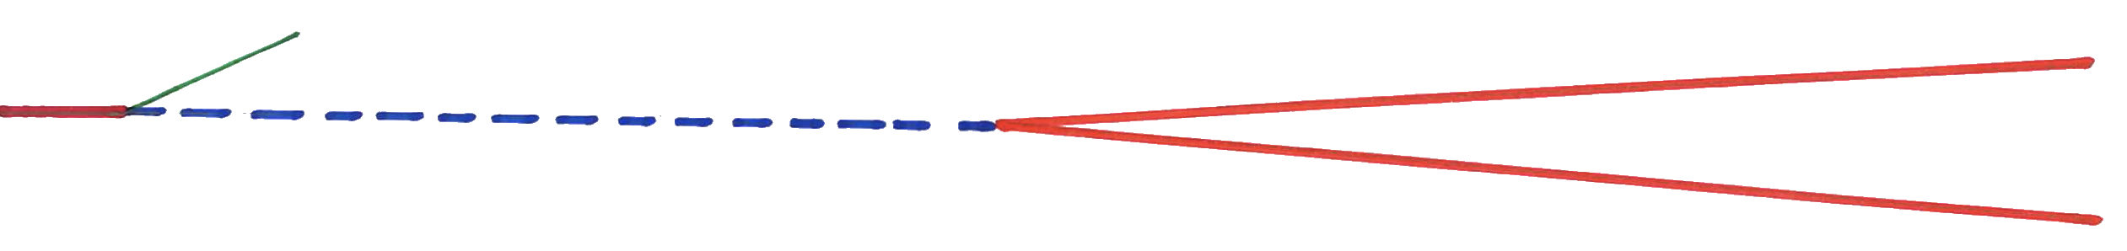

NA62 experiment
Kaon experiment at CERN SPS
Main goal: Measurement of $K^{+}→π^{+}ν\overline{ν}$
Broader physics program
LFV/LNV in K⁺ decays
Hidden sector particle searches
Two operation modes:
Kaon mode
Dump mode
NA62
SPS
LHC
Kinematic reconstruction
PID
Photon hermiticity
Sub-ns timing

Slide 5

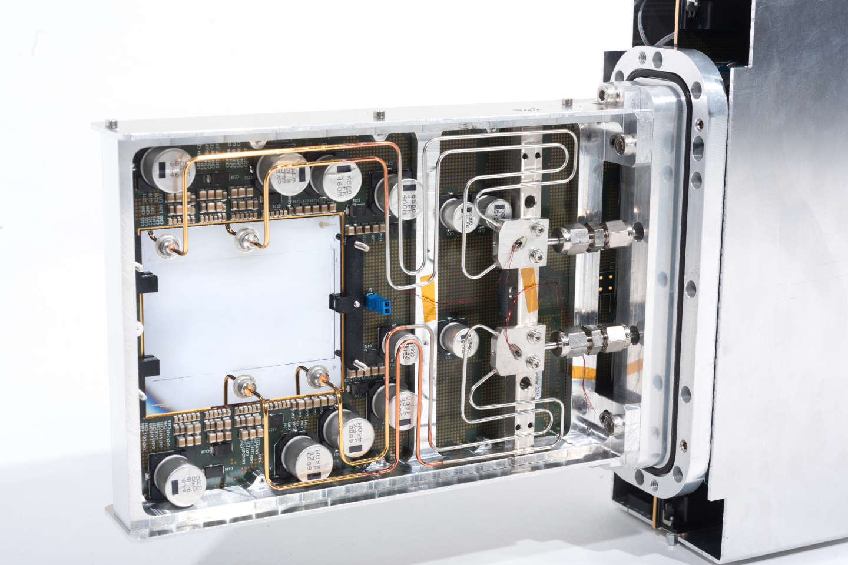
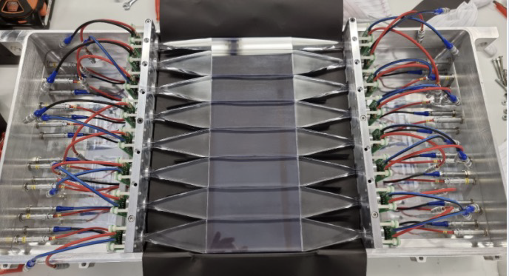
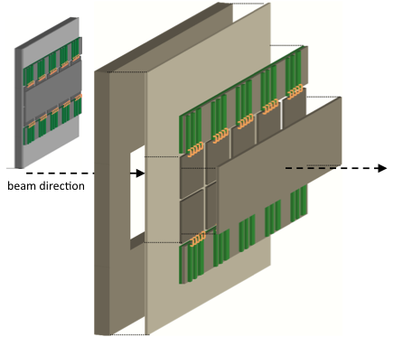
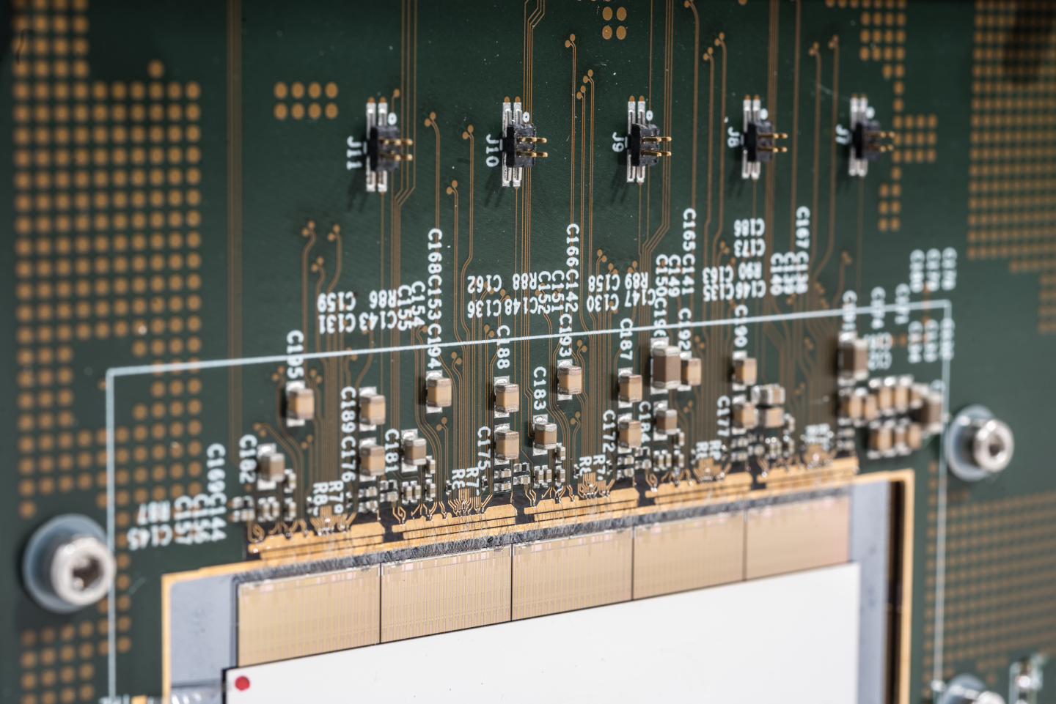
Timeline
Upgrade:
4th GTK station
Rainbow collimator
Veto counter
ANTI0
HASC2
Technical Design
First beam
Proposal
End of data
taking
2005
2012
2013
2020
2021
2028
2029
2006
2011
2014
2019
2022
2027
2007
2010
2015
2018
2023
2026
2008
2009
2016
2017
2024
2025
Approval

Slide 6
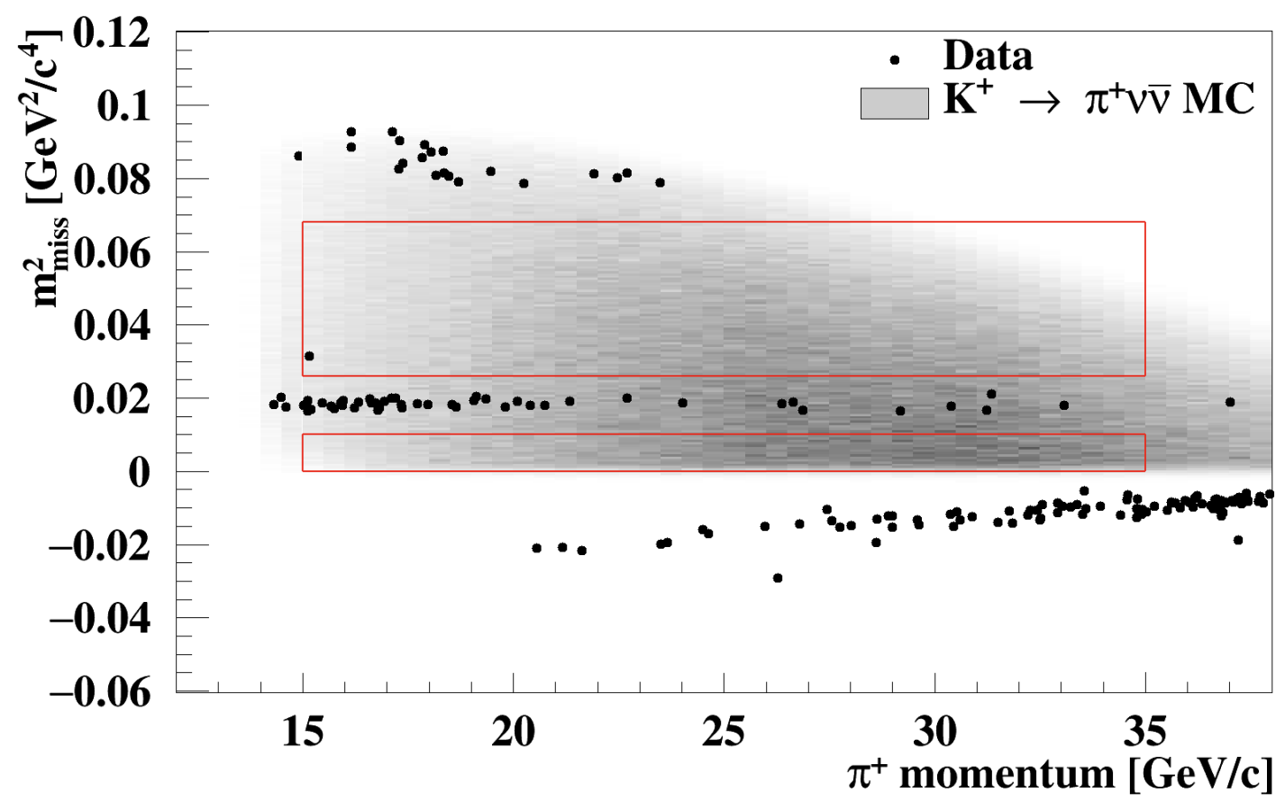
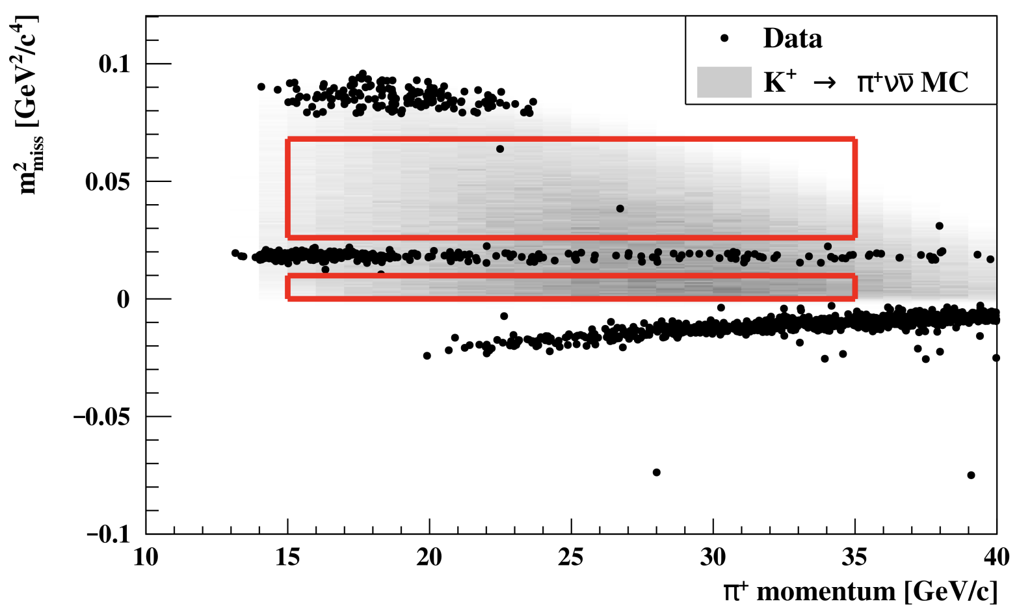
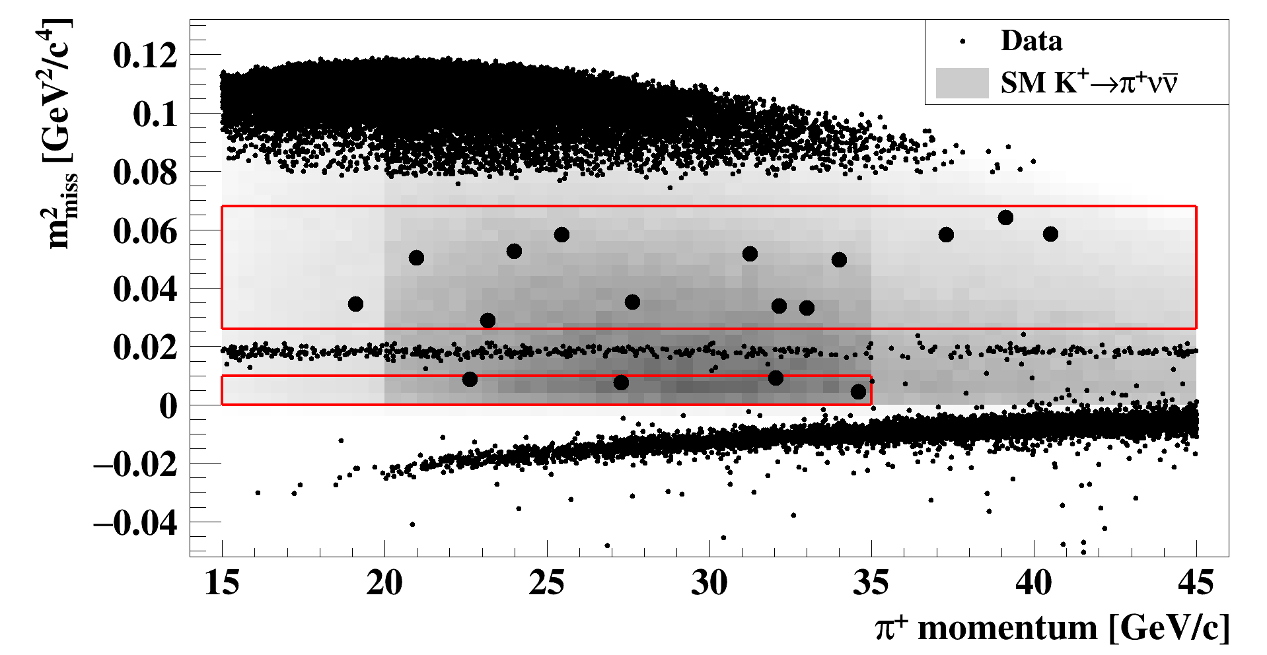
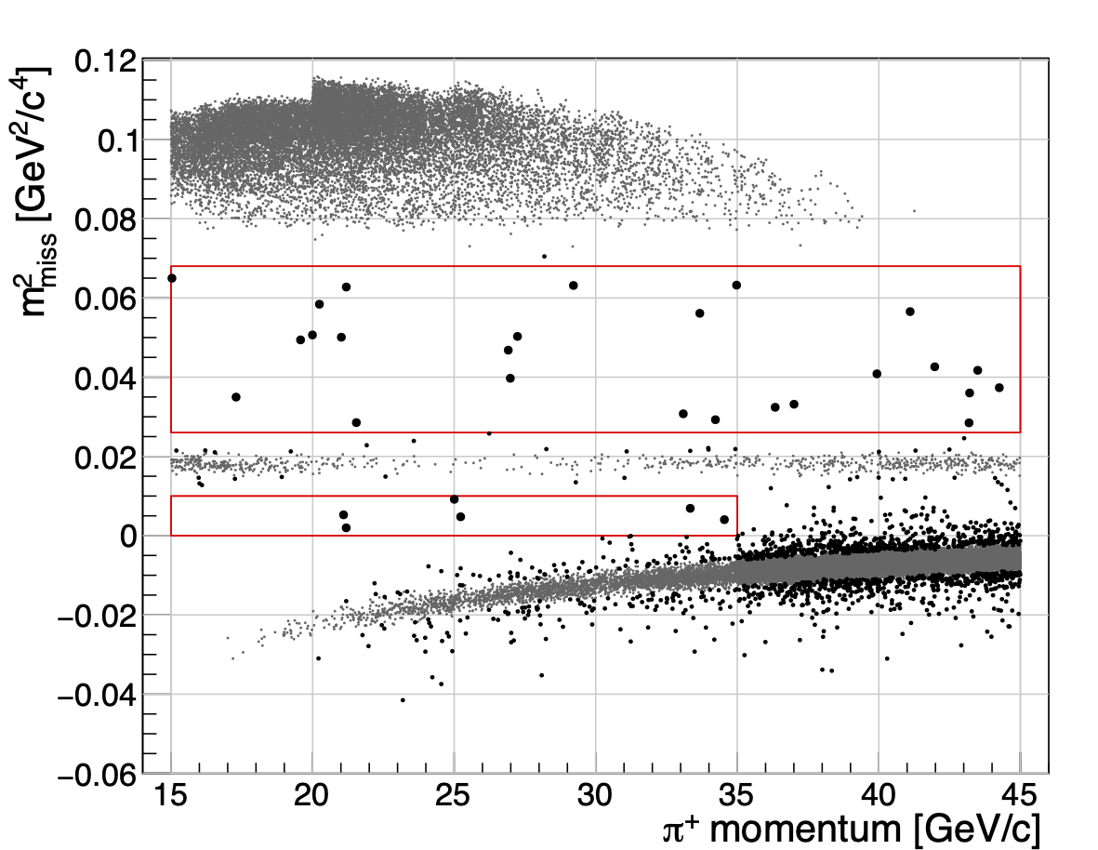
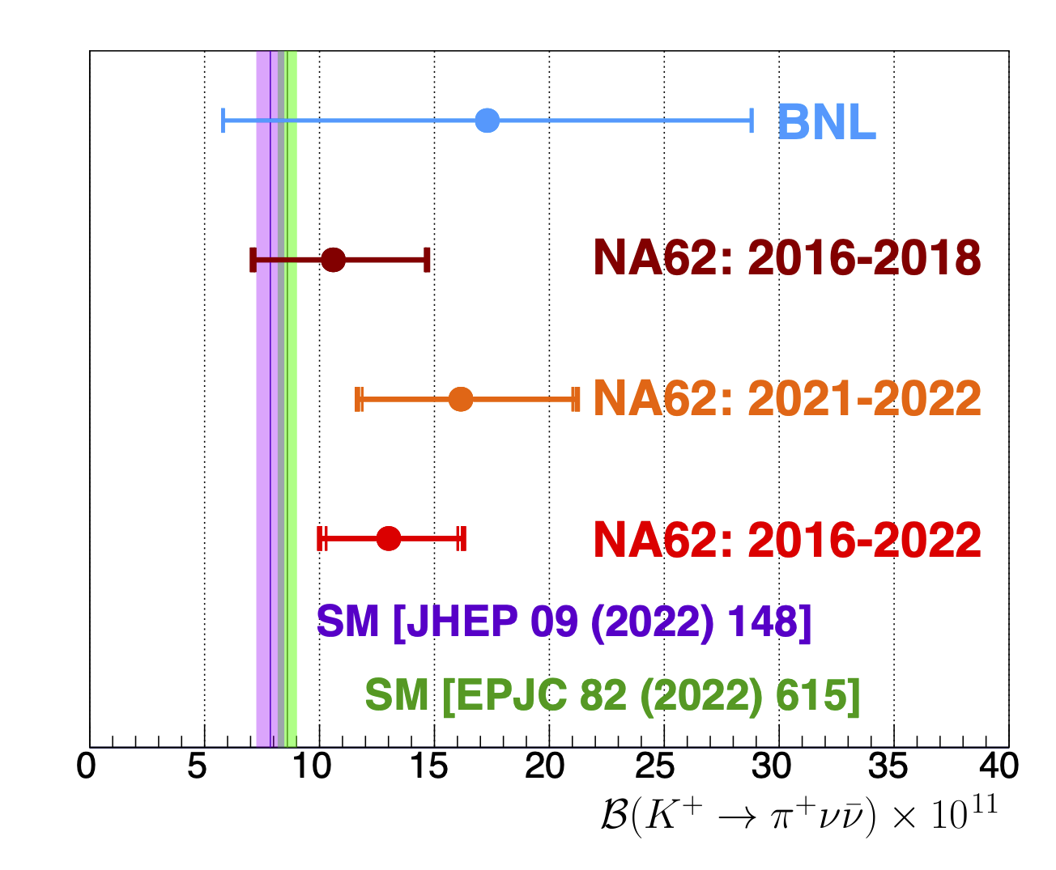
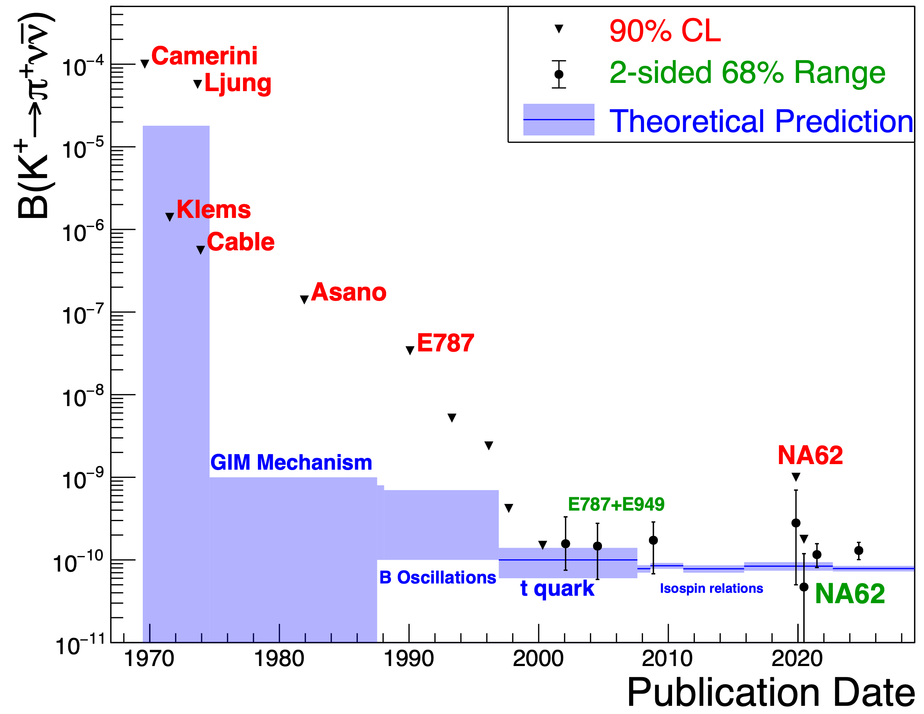
Results: $K^{+}→π^{+}ν\overline{ν}$
2016 data [PLB 791 (2019) 156]
2017 data [JHEP 11 (2020) 042]
2018 data [JHEP 06 (2021) 093]
2021-22 data [JHEP 02 (2025) 191]

Slide 7
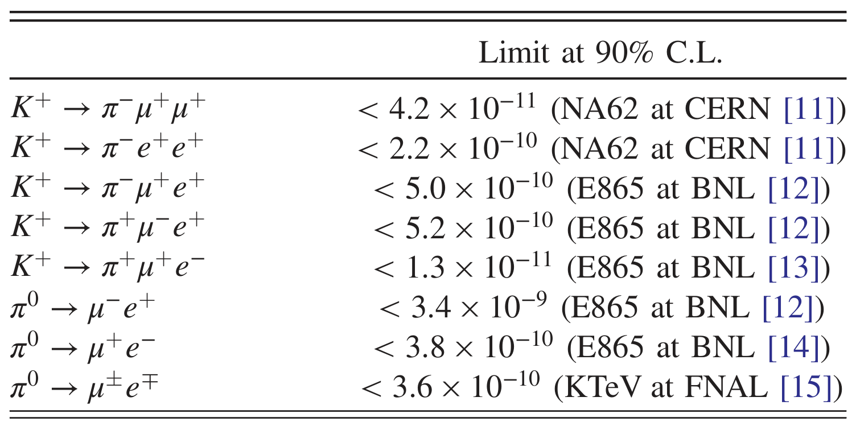
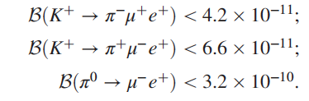
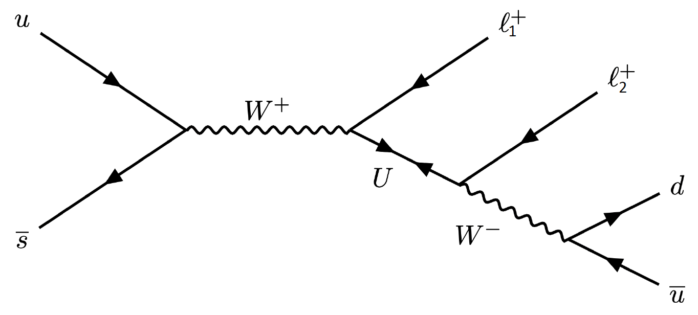
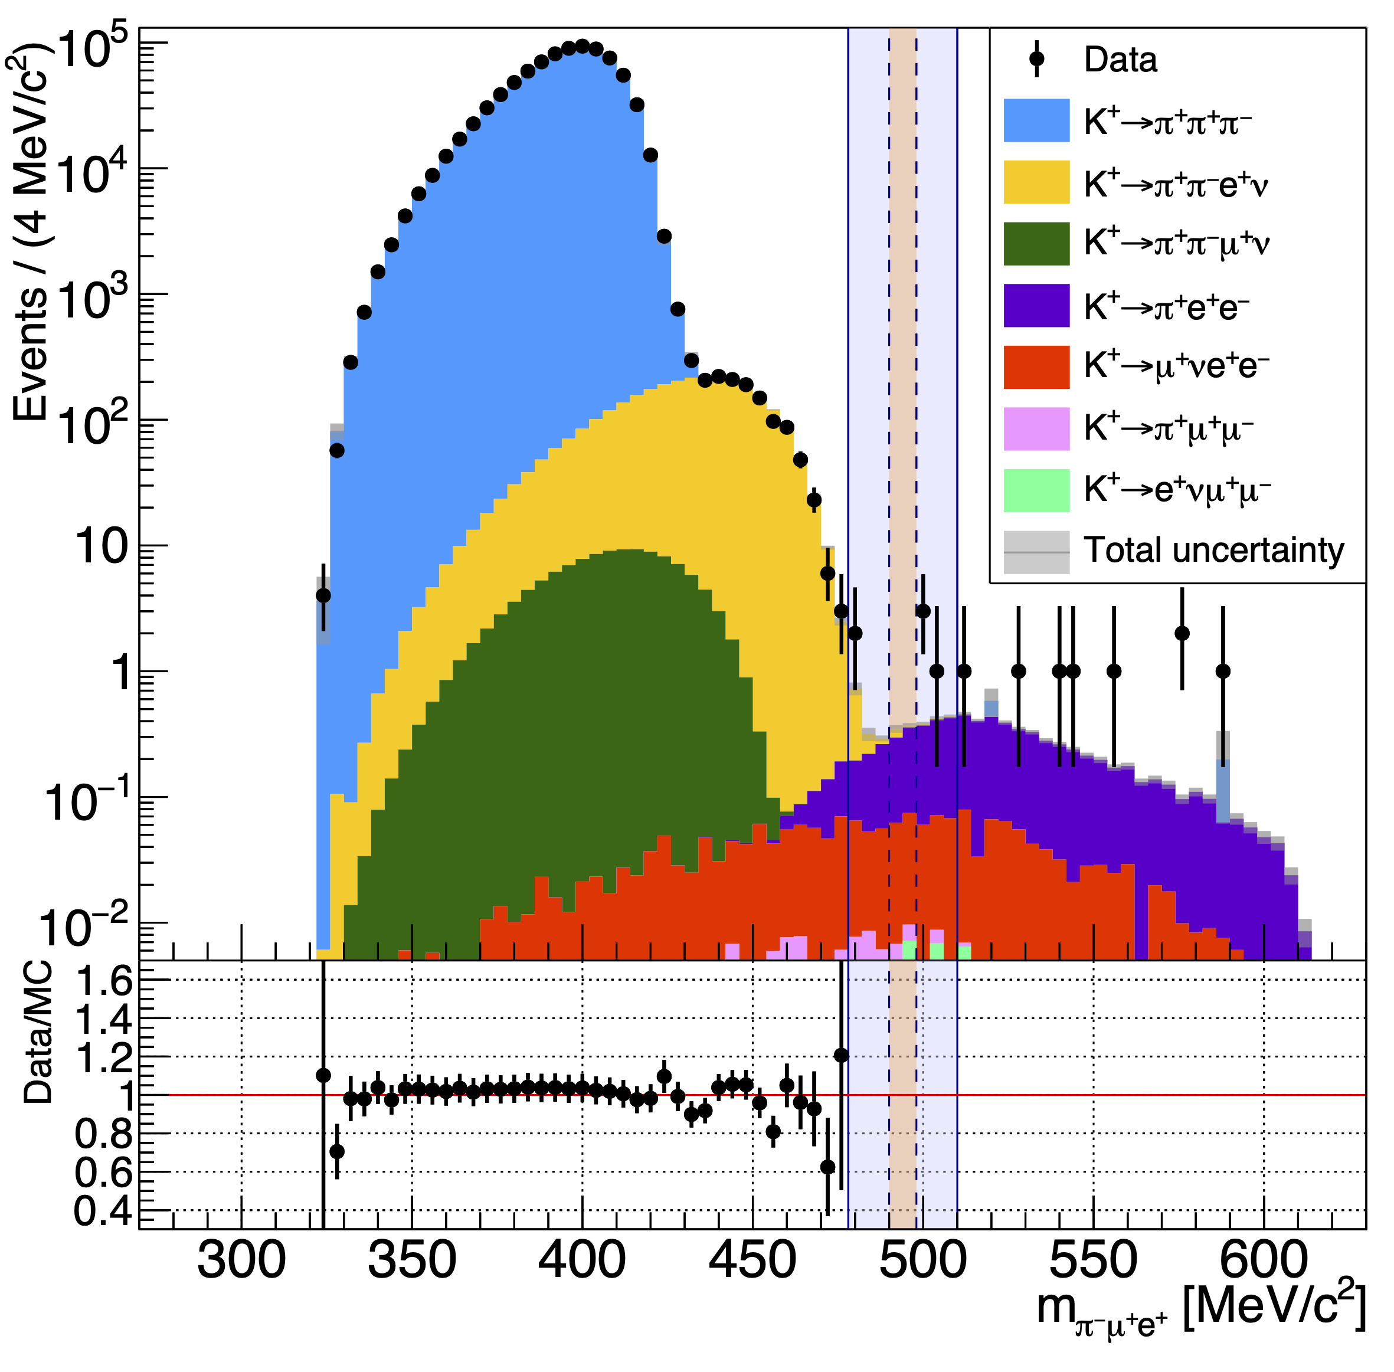
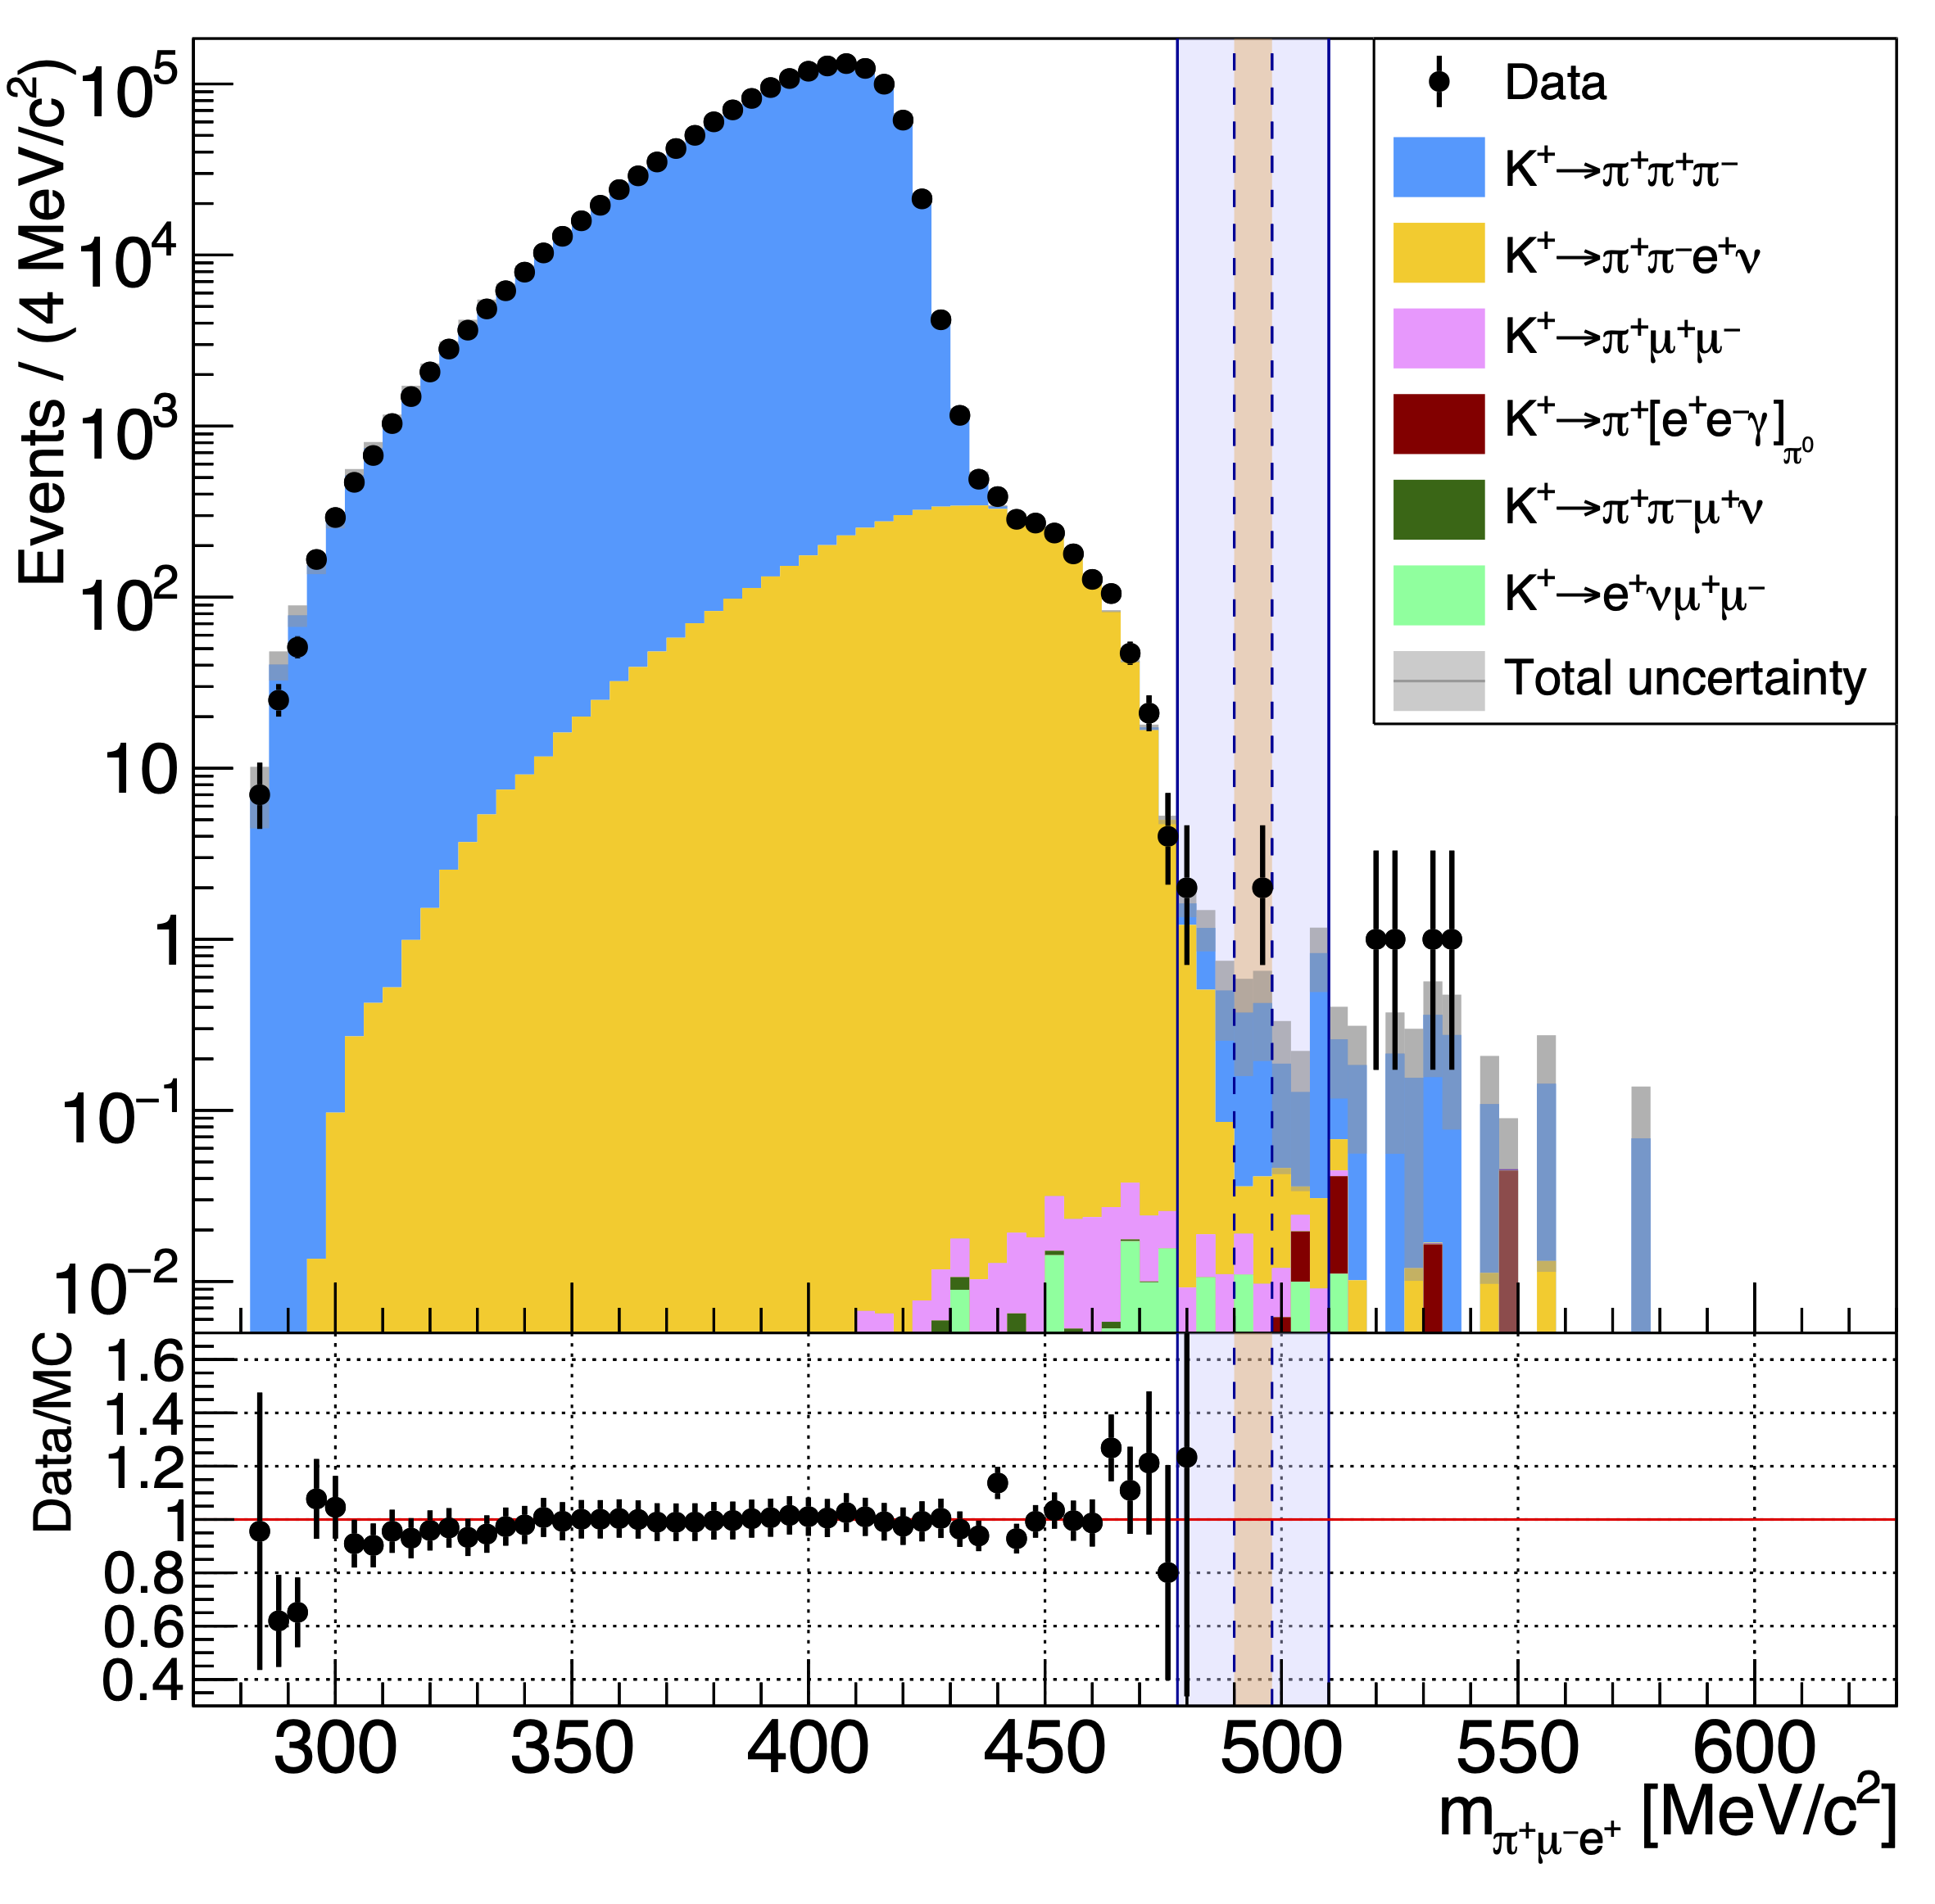
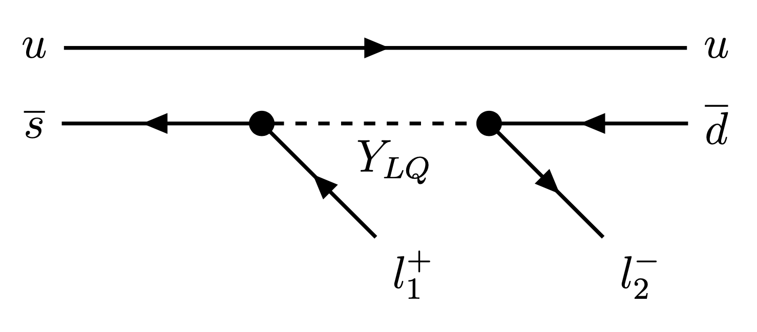

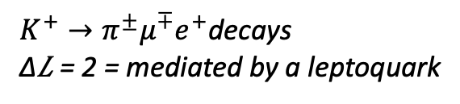
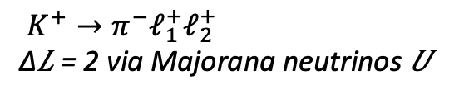

Results: LFV/LNV in $K^{+}→π^{±}ℓ_{1}^{∓}ℓ_{2}^{+}$
Situation in 2018
PRL 127, 131802 (2021)
$K^{+}→π^{−}ℓ_{1}^{+}ℓ_{2}^{+}$
Δ𝐿 = 2 via Majorana neutrinos 𝑈
$$K^{+}→π^{−}μ^{+}e^{+}$$
2017-2018 run
$$K^{+}→π^{+}μ^{−}e^{+}$$
$K^{+}→π^{±}μ^{∓}e^{+}$decays
Δ𝐿 = 2 = mediated by a leptoquark

Slide 8
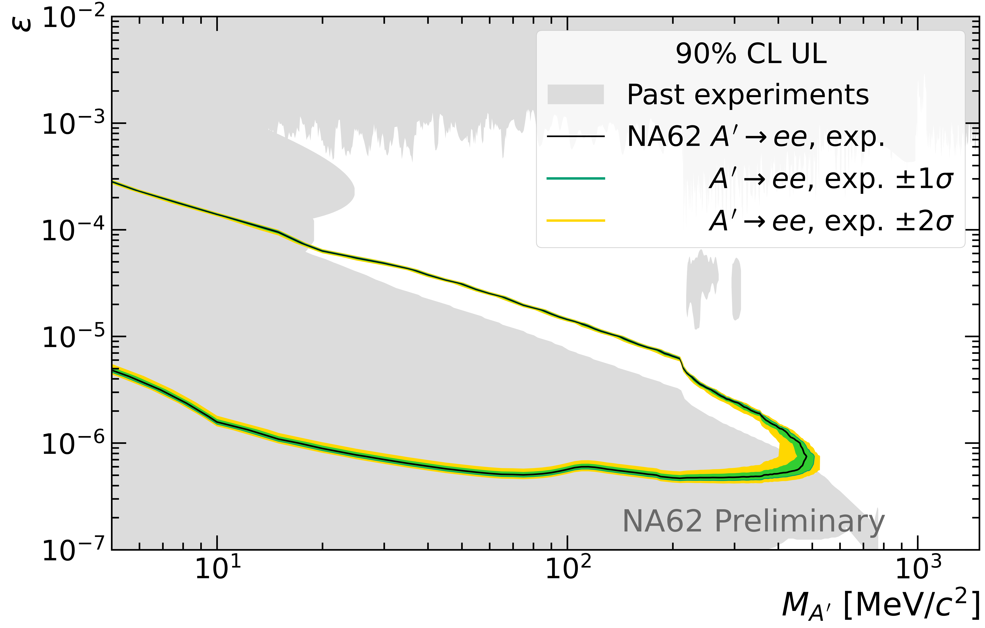
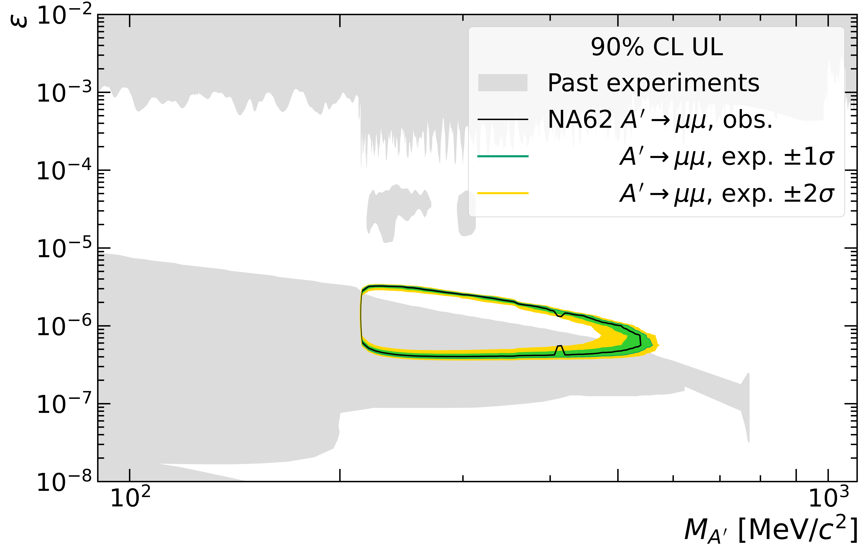
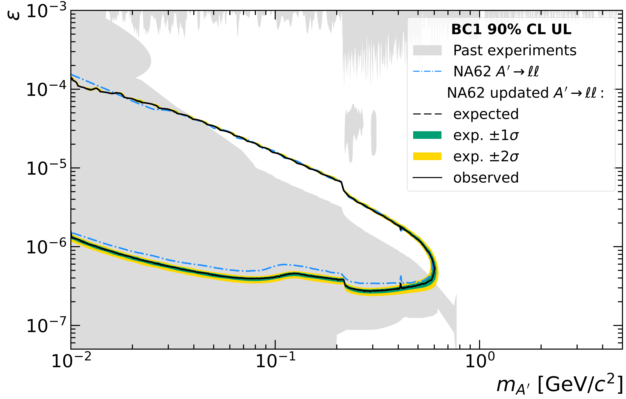
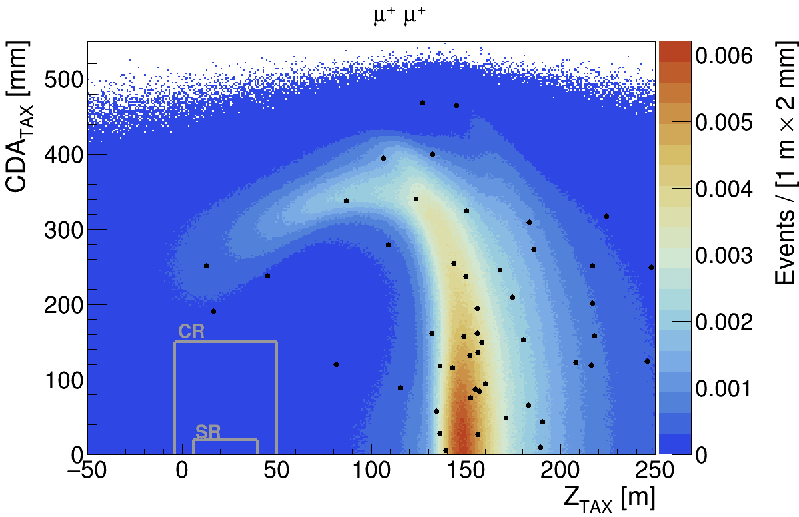
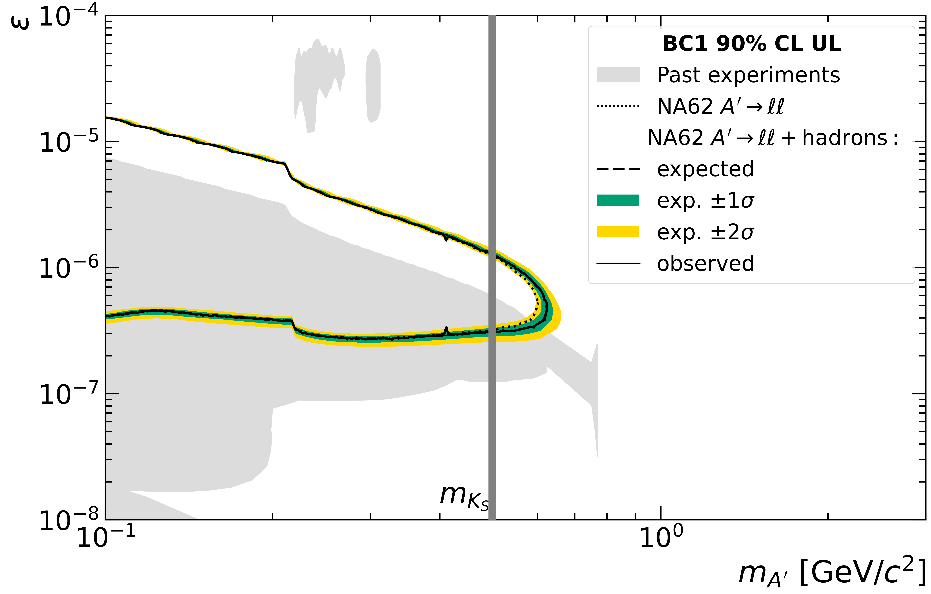
Results: Beam Dump
1.4 10¹⁷ POT taken in 2021
Runs in 2023, 2024, 2025
Improved trigger and beam setup
~10¹⁸ POT … analysis ongoing
Solid analysis technique
PRL 133, 111802 (2024)
JHEP 09 (2023) 035
EPJ C 85, 571 (2025)

Slide 9
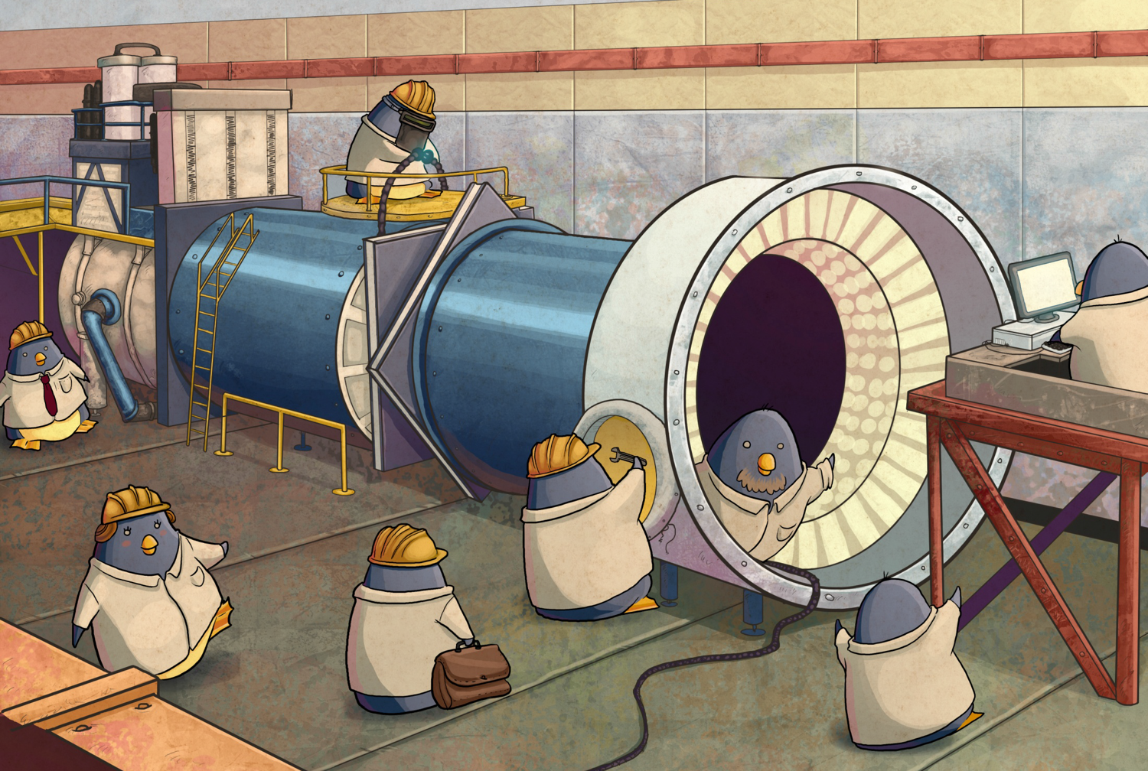
Summary
Successful experimental program over 20 years
1 Staff, 5 PhD students, 11 Postdocs
> 30 papers (JHEP, PLB,PRL)
Excellent and sustained support from FNRS-IISN
Personnel :1 phD student, 4 Postdocs
Equipment, Running Budget and M&O
Future:
End of data taking (June 2026)
Still several years to fully analyze all data
Excellent data quality with the world largest sample of K⁺ decays

Slide 10
SHiP

Slide 11

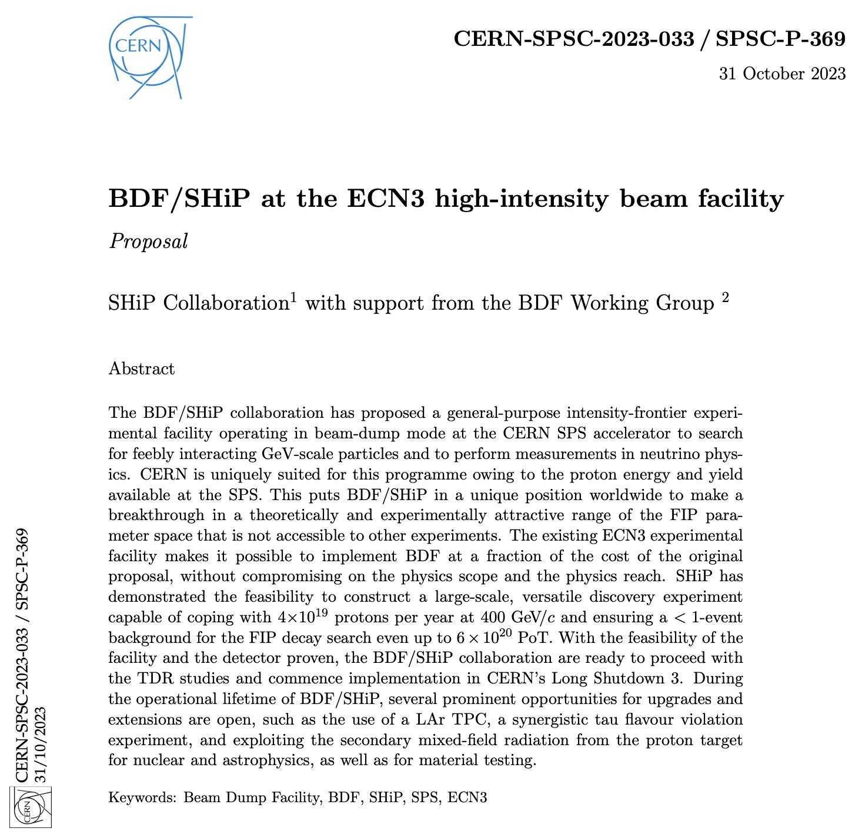
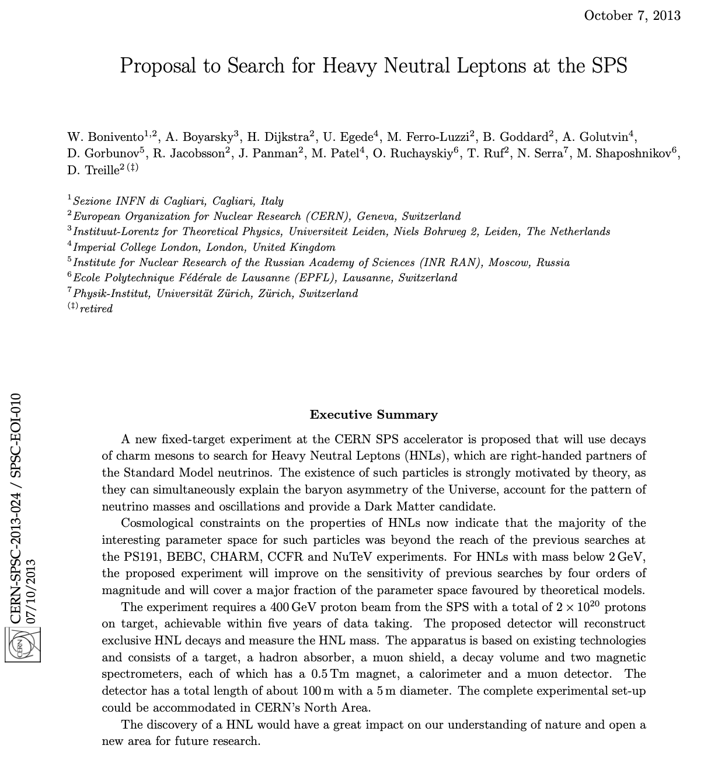
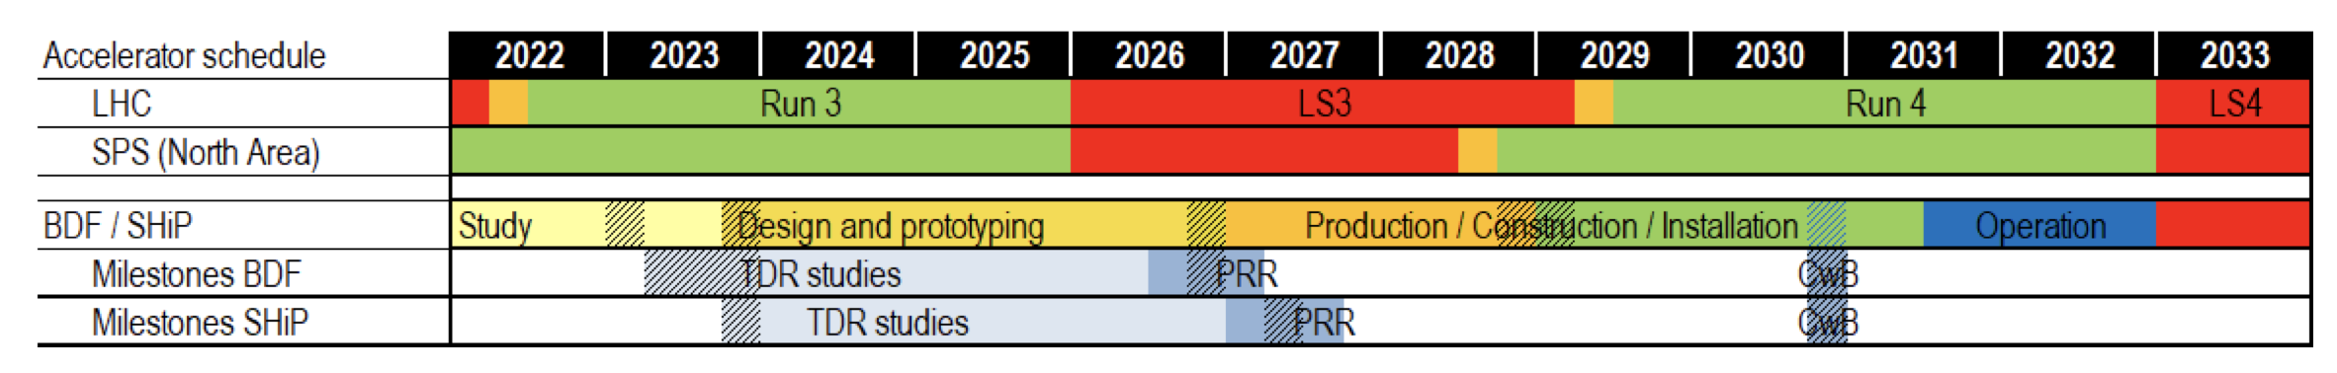
The SHiP experiment
The initial proposal for a new fixed-target experiment at SPS was submitted in 2013
A search for long-lived feebly-interacting particles (FIP) in charmed meson decays
Go beyond the (past and future) collider reach for displaced signatures
A discovery experiment capable of characterizing new physics
A technical design study for a new high-intensity physics program launched by CERN Council
The project was approved by CERN Research Board in March 2024
CERN-SPSC-2023-033
CERN-SPSC-2013-024
11

Slide 12
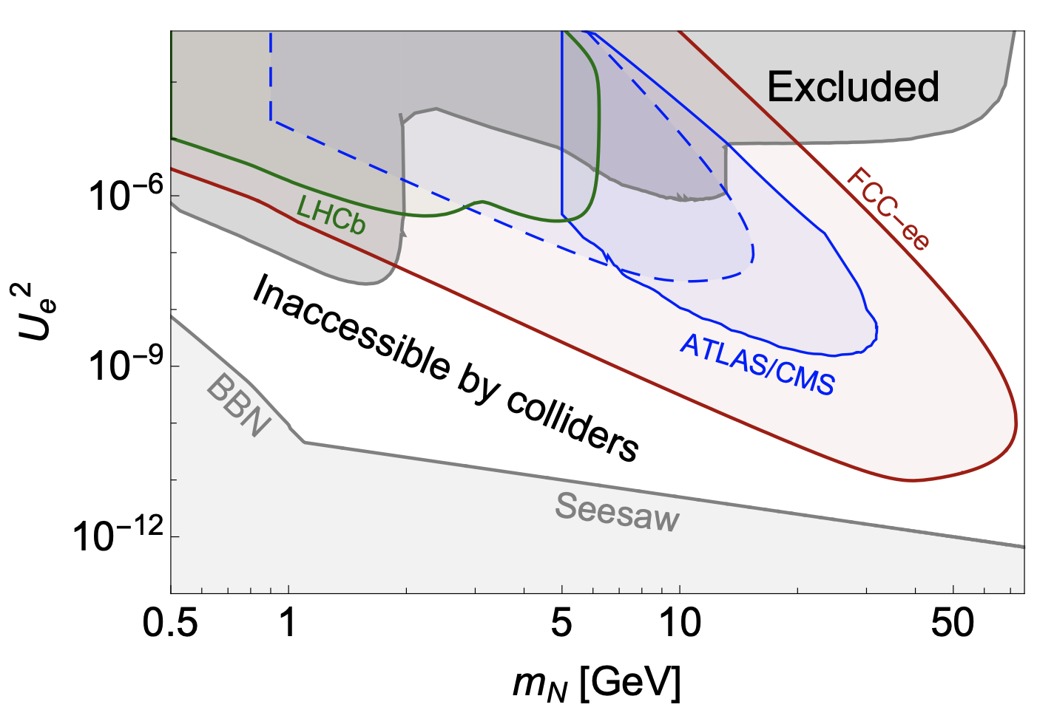
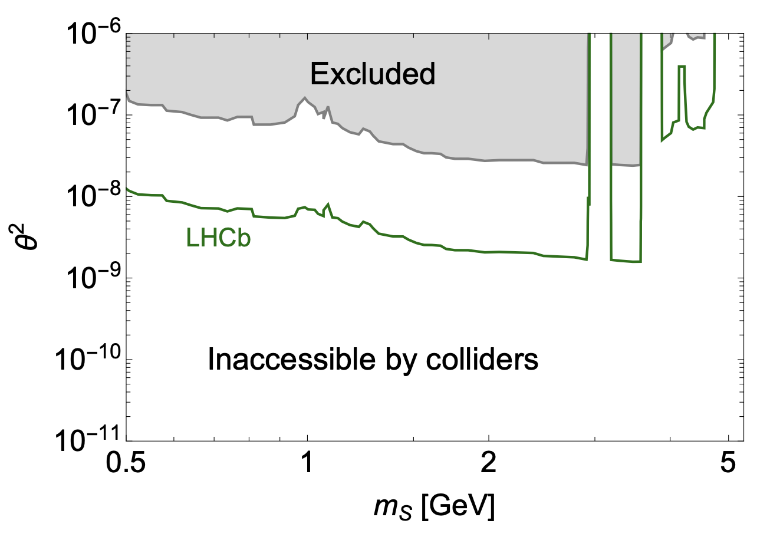
SHiP: Physics program
Search for new physics:
Light dark matter (LDM)
Portals to hidden sector (HNLs, ALPs, etc.)
Capable of reaching the «physical floor» in the phase space of a much larger lifetime acceptance that can not be probed at colliders
Unique access to SM neutrinos:
Rich neutrino physics program with sensitivity to NC and CC production channels for all types of neutrino
Several orders of magnitude more statistics to measure tau neutrino and antineutrino deep inelastic scattering cross sections
Study tau neutrino magnetic moment, neutrino-induced charm production, PDFs
12

Slide 13
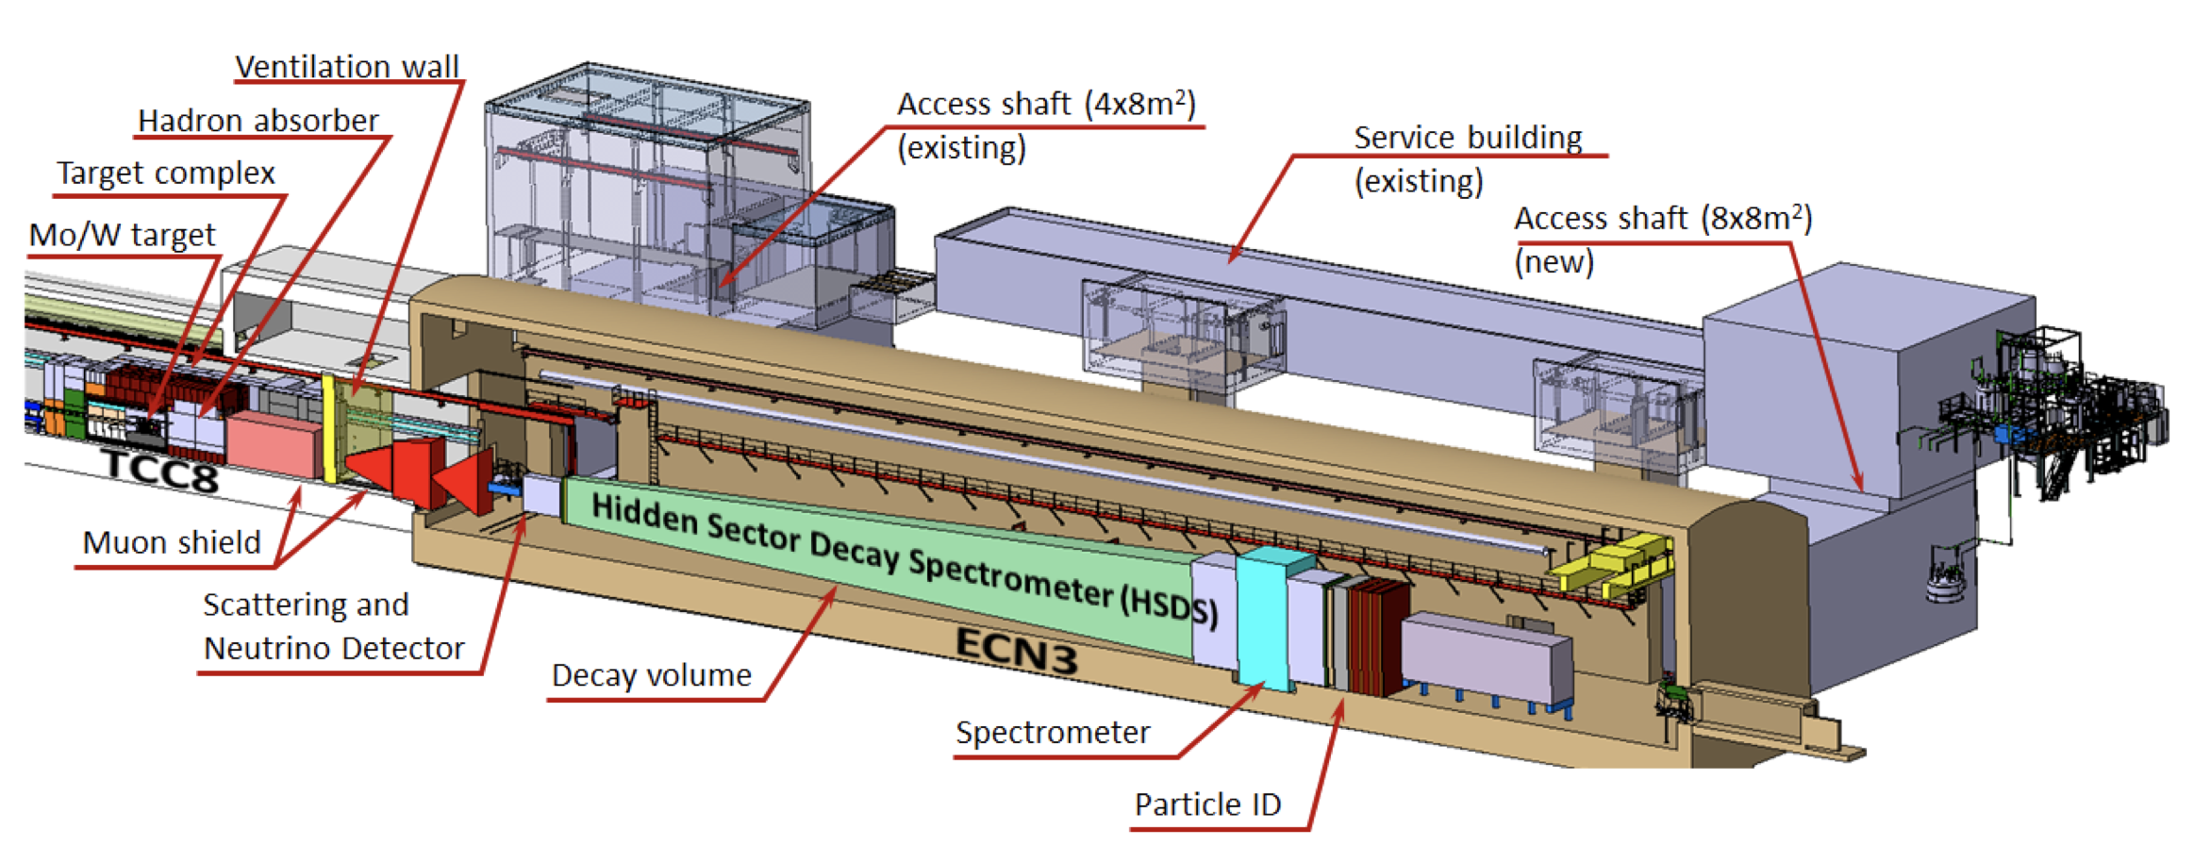
SHiP: Detector systems
A beam-dump experiment: a high-density tungsten target followed by a hadron absorber
An active muon shield to deflect 2x10¹⁰ energetic muons escaping the target per spill
The upstream Scattering and Neutrino Detector (SND) to study light dark matter scattering and SM neutrinos
The downstream Hidden Sector Decay Spectrometer (HSDS) to reconstruct the decay vertices of FIPs and perform particle identification
13

Slide 14
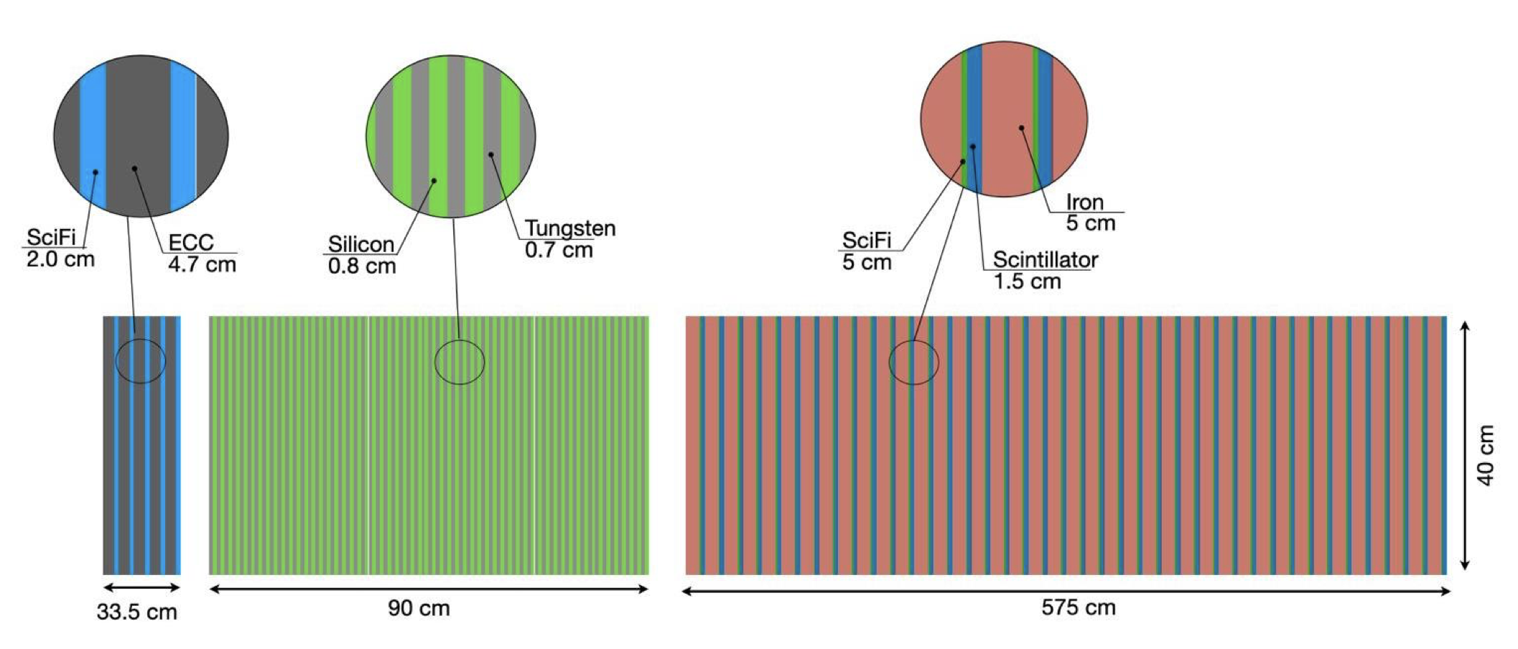
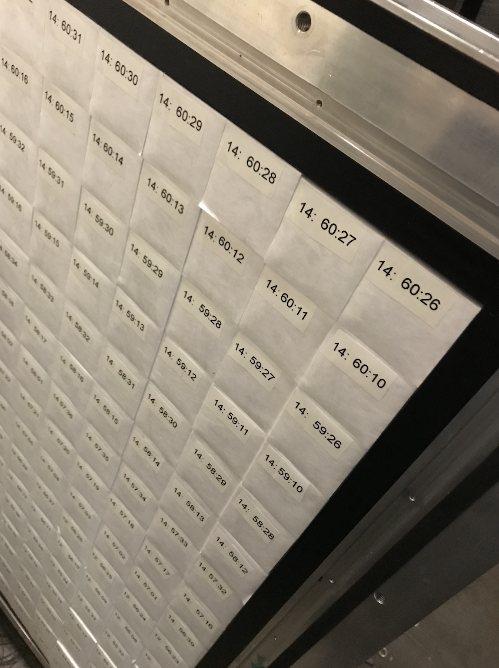
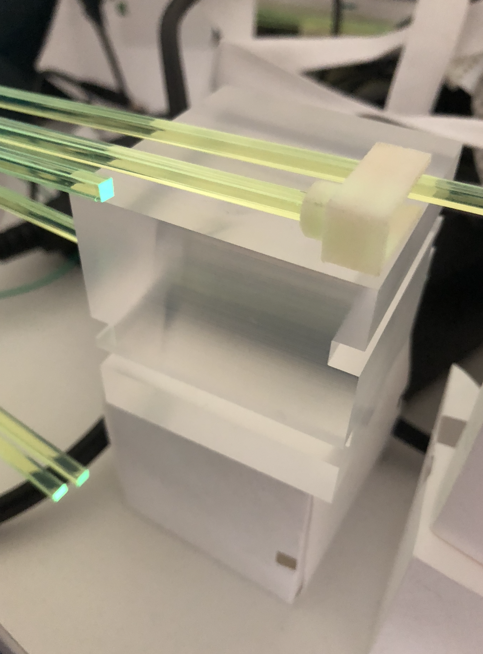
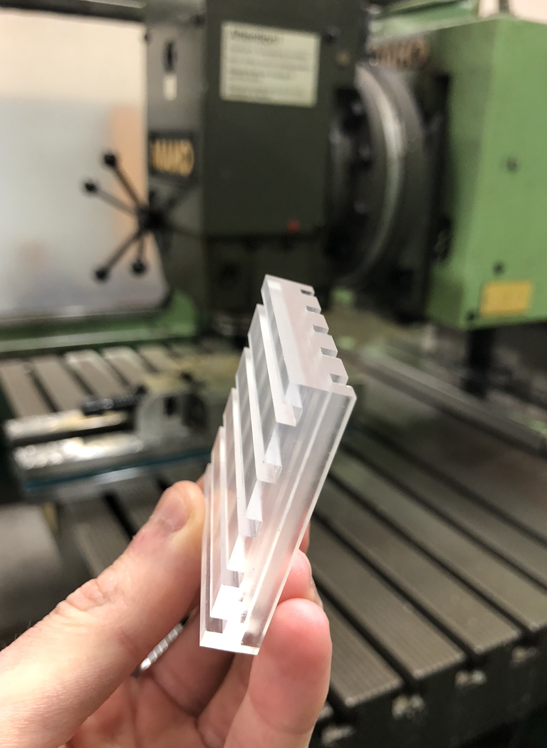
SHiP: A new calorimeter design
Give a new life to the scintillation material from the SoLid experiment in Belgium!
Composition: EJ-200 plastic scintillator detector with 40x40x1 cm³ layers made of 5x5x1 cm³ tiles
Each detector layer optically isolated with XY optical fiber readout (BCF-91A) fed through grooves at 1 cm pitch
Design options:
Veto: a charge particle upstream veto system (similar to SND@LHC); a few active layers with high detection efficiency
TileCal: a sampling calorimeter with active and 5 cm-thick passive (iron) layers
14

Slide 15
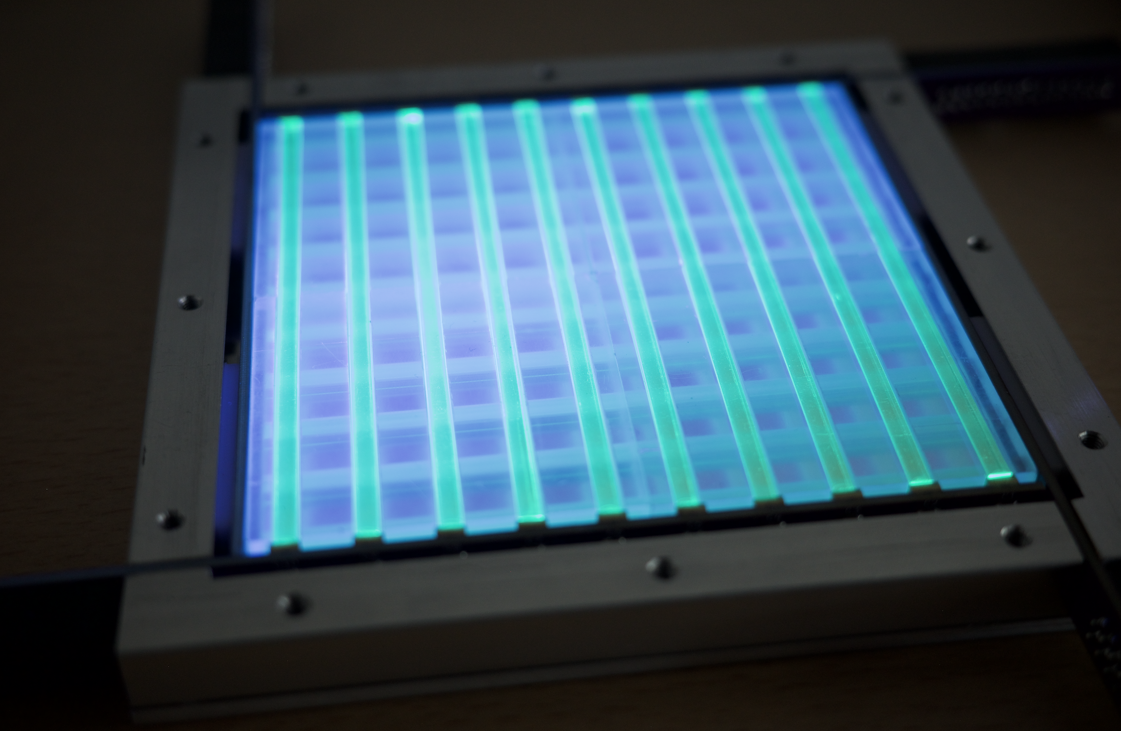
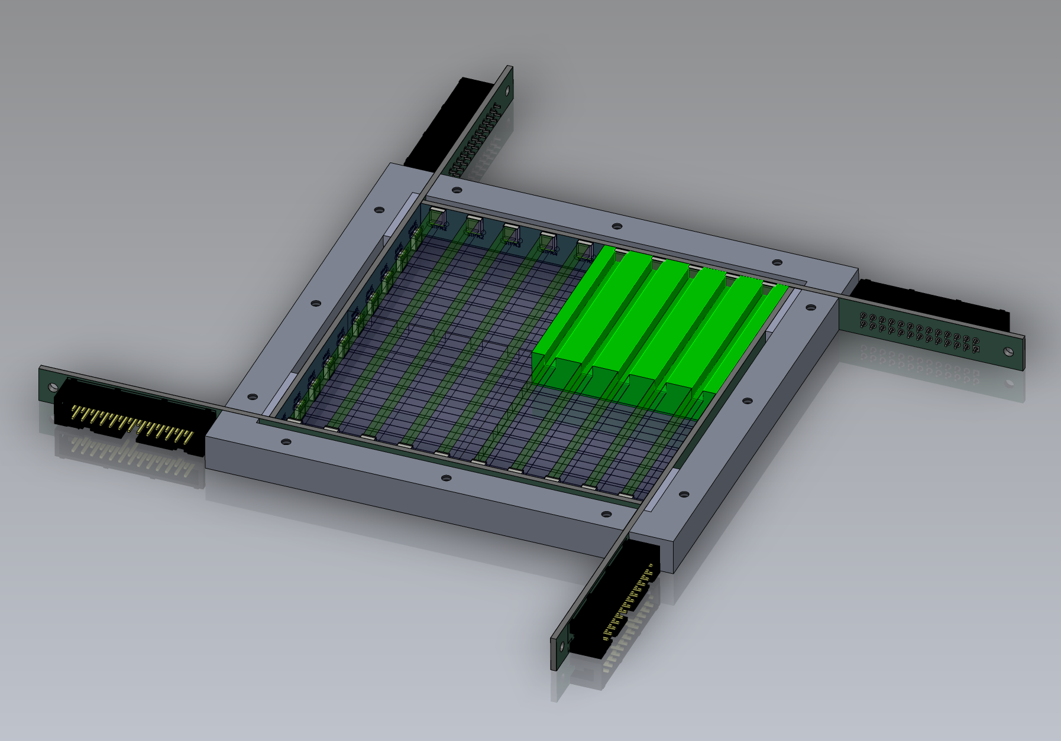
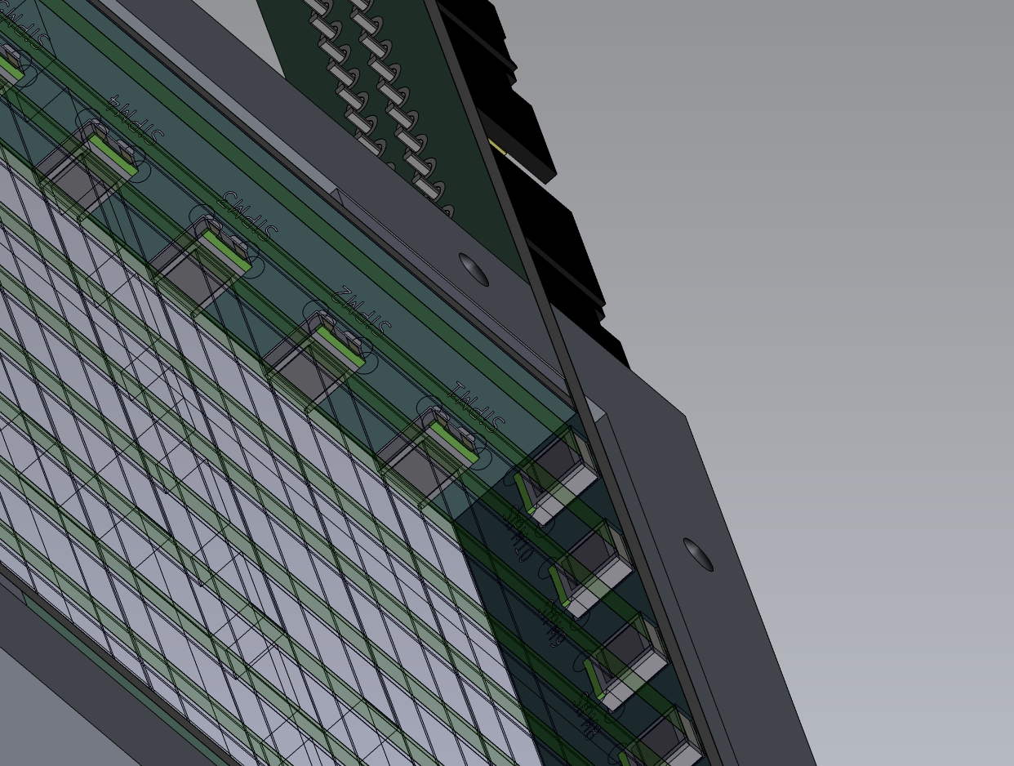
SHiP: Calorimeter prototype
At UGent, we built the first prototype this year
Double-sided SiPM readout in X and Y
The full detector will contain 6 planes and will be used in upcoming test beams at CERN later this year
15

Slide 16
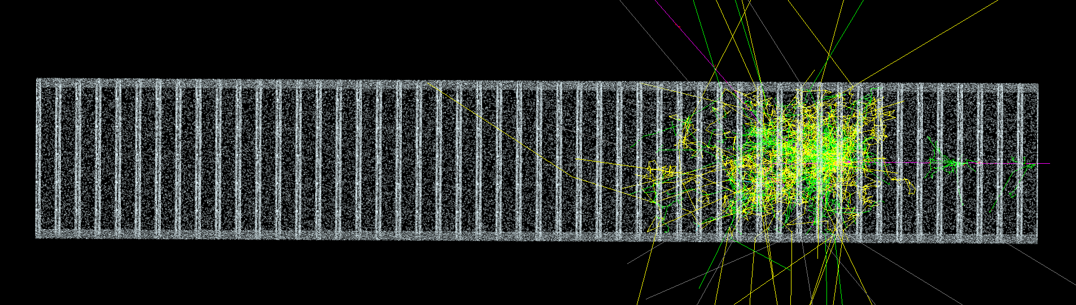
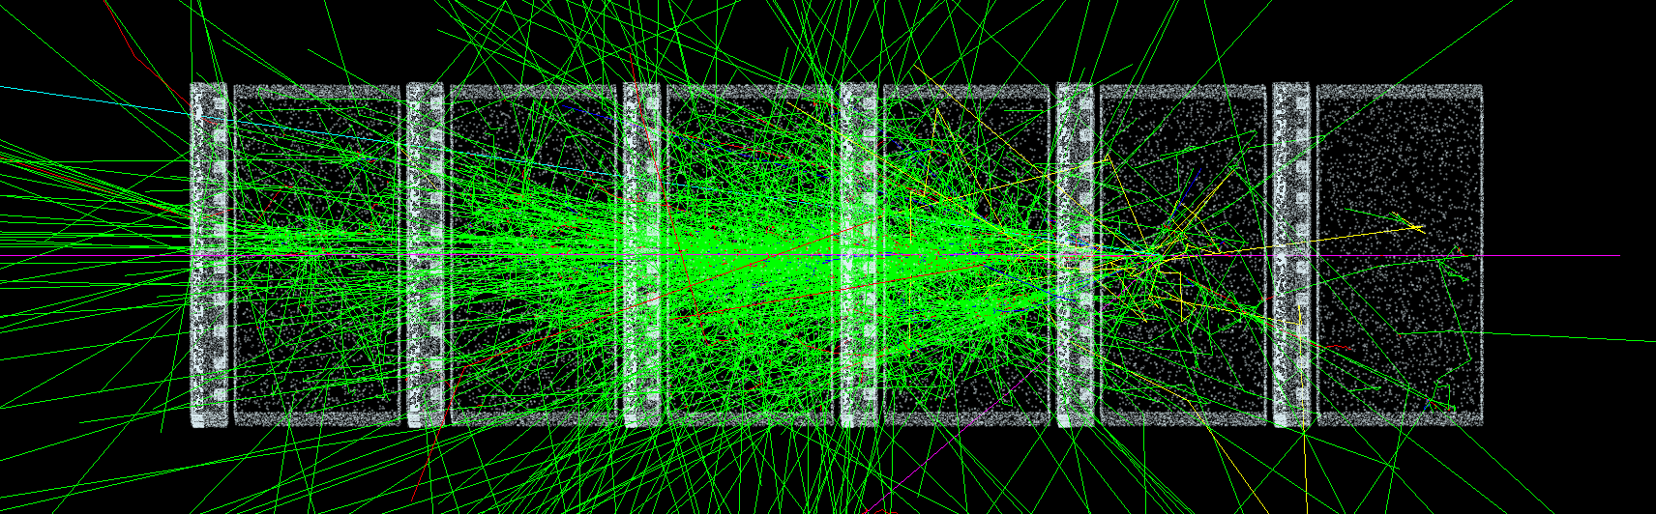
SHiP: Simulation model
10 GeV $π^{−}$ beam, optical photons not visualized
Full size: 50x50 cm², 50 layers
Developed a dedicated simulated calorimeter design with extruded plastic scintillators, optical fibers, and iron absorbers
A test beam prototype with 6 layers of 10x10 cm² modules
Single SiPM readout per fiber
Granularity mainly defined by the availability of readout electronic channels
Test beam prototype: 10x10 cm², 6 layers
Dimensions: 10x10x36 cm³
Weight: ≈ 30 kg
Readout channels: 120
16

Slide 17



SHiP: High-precision layers
Designing high-precision layers (4x6m²) based on GEM technology for PID system
Allow for precise tracking in hadronic showers
Better particle identification with improved shower directionality reconstruction
The first test beam is foreseen later this year
17

Slide 18

SHiP: Future and funding
UGent became an official member of SHiP in 2024
Already well-established collaborations with SND and PID detector groups of SHiP
Engaged in a substantial R&D program with detector design and test beam studies
UGent was successful in getting one FWO postdoctoral fellowship researcher this year (2025-2028) for this project
Several test beams at CERN are scheduled this year
UGent will study its first detector prototypes for calorimeter and high-precision detector systems
18

Slide 19
milliQan

Slide 20





milliQan experiment
Millicharges particles? (mCPs)
assume dark sector fermion coupled with extra U(1)
appears as fermion with arbitrary small charge from kinetic mixing with hypercharge
any process with electrons, produces mCPs!
17m of rock shield
33m
η=0.1
43 deg
Detection principle
go to low-background area close to LHC collisions
drainage gallery above CMS!
require 4 coincident scintillation detections of single photo-electrons

Slide 21


Timeline and funding
milliQan history
technically part of CMS, but in practise independent collaboration of ~35 people
Belgium in milliQan
VUB joined in 2019
financed participation with small university funds, contributed to commissioning
one FWO CMS postdoc with small milliQan contribution ('21-’24)
50% parttime PhD student from FWO-FNRS WEAVE on mCPs from cosmic ray interactions ('24-'27)
joint 25% parttime PhD student with UCLouvain from milliQan institute in Lebanon ('25-'26)
Paper submitted in June 2025: arXiv:2506.02251 [hep-ex]
Paper accepted by PRL on August 20, 2025. https://doi.org/10.1103/rtp1-679h
21

Slide 22



milliQan experiment
Bar detector
4 layers of 4x4 “bars”
each bar a 5x5x60cm scintillator + PMT
mCP signal is single photoelectron in 4 bars in straight line, within 15ns
side, front and back panels veto cosmics and beam muons
constructed in ‘23
collected 125fb⁻¹ in '23-'24, >56fb⁻¹ in '25
First results this Summer
unique sensitivity below ~20 GeV
arXiv:2506.02251, accepted by PRL
37 authors, 3 from VUB
our contribution: fine timing calibration (“time-walk”)

Slide 23



milliQan experiment
Slab detector
larger surface, less scintillator depth
increase acceptance at high mass
construction finished Fall ‘24
data analysis forthcoming
1 VUB student, new shared student with UCLouvain
also started search for production from atmosphere
joint FWO-FNRS WEAVE project with IceCube colleagues ULB
Future? FORMOSA
much higher production rate forward
2025: demonstrator operational next to FASER
480m downstream of ATLAS
new challenge from beam backgrounds
full detector aiming for FPF

Slide 24
Summary

Slide 25
Introduction
Summary
Small but very active community
Participating in three experiments in different phases.
All three experiments are CERN based with focus in the search of new physics.
Exploring regions not accessible by large colliders
Excellent « school » for experimental physics
For PhD students , but also for the more senior members.
Man power
Atractiveness: difficult to compete with big experiments
Reduced funding
Some projects are not well funded
Requiring « imaginative » solutions
Several subdetectors are inherited or recovered

Slide 26
BACKUP

Slide 29


NA62: Beam Dump

Slide 30



SHiP: Energy resolution
Full-sized detector: expect ${0.60}/{\sqrt{E}}$ (pions) and ${0.31}/{\sqrt{E}}$ (electrons), dominated by statistical fluctuations
Test beam prototype:
Require 10 MeV of deposited energy in the first scintillator layer
Pions: resolution is limited by the constant term due to significant shower leakage (lateral and longitudinal)
Electrons: sufficient containment of EM showers over the full energy range
30

Slide 31


SHiP: Time resolution
The ‘slow’ BCF-91A WLS fibers are used (decay time of ≈ 12 ns)
Trigger on the 10th photoelectron or the average photon arrival time
The intrinsic detector time resolution is below 1 ns
Expect it to be further worsened (and mainly driven) by the electronic noise
31

