Slide 1
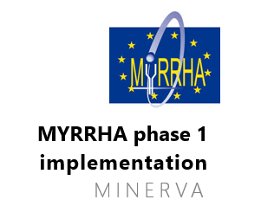






Belgium in Nuclear Physics, including Myrrha
Gerda Neyens
On behalf of the Belgium Nuclear Physics community and the Myrrha project
RECFA Meeting
September 12, 2025 Brussels, Belgium

Slide 2
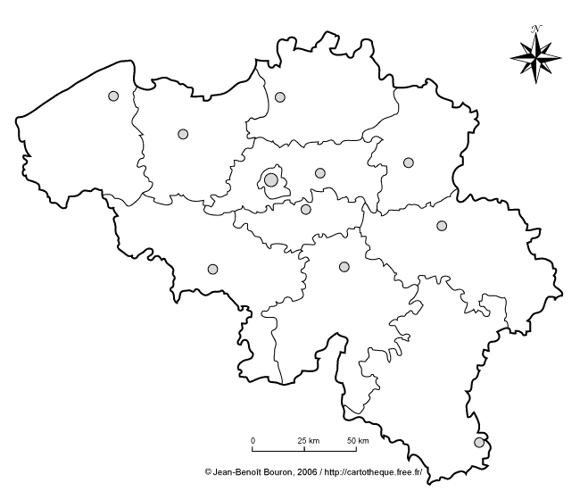



Nuclear Physics in Belgium
Nuclear physics is the study of the atomic nucleus, its constituents, its structure, nuclear reactions and the properties of strongly interacting matter in its various forms.
Nuclear physics experiments
Nuclear theory

Slide 3
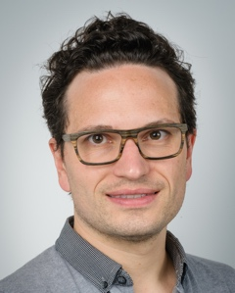
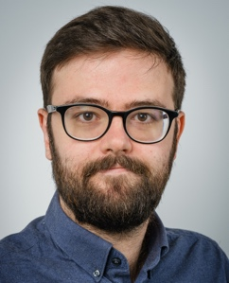
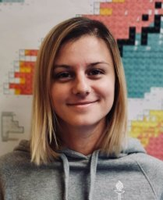
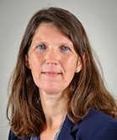
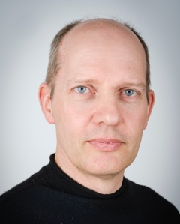
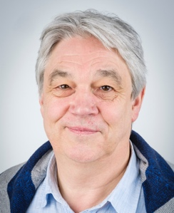
Researchers in Experimental Nuclear Physics
Nuclear and Radiation Physics, KU Leuven
6 staff, 25 PhD, 9 post-doc
4 instrument specialists
1 research expert
Thomas E. Cocolios
Ruben de Groote
Agi
Koszorus
Gerda Neyens
Riccardo Raabe
Nathal Severijns
Structure of exotic nuclei
State-of-the-art Laser and decay spectroscopy
and Nuclear reactions
Precision tests of Standard Model
Radioisotope production and purification
Radioactive molecules production and spectroscopy
Leading roles in European research boards:
NS: Belgian representative in the ISCC
RR: member Group for the Upgrade of ISOLDE
TEC: Belgian representative in the MEDICIS Coll. Board
TEC: member of the PRISMAP coordination committee
GN, PVD: former ISOLDE Physics Group Leaders
GN, PVD: former members of NuPECC

Slide 4

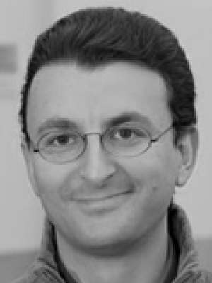
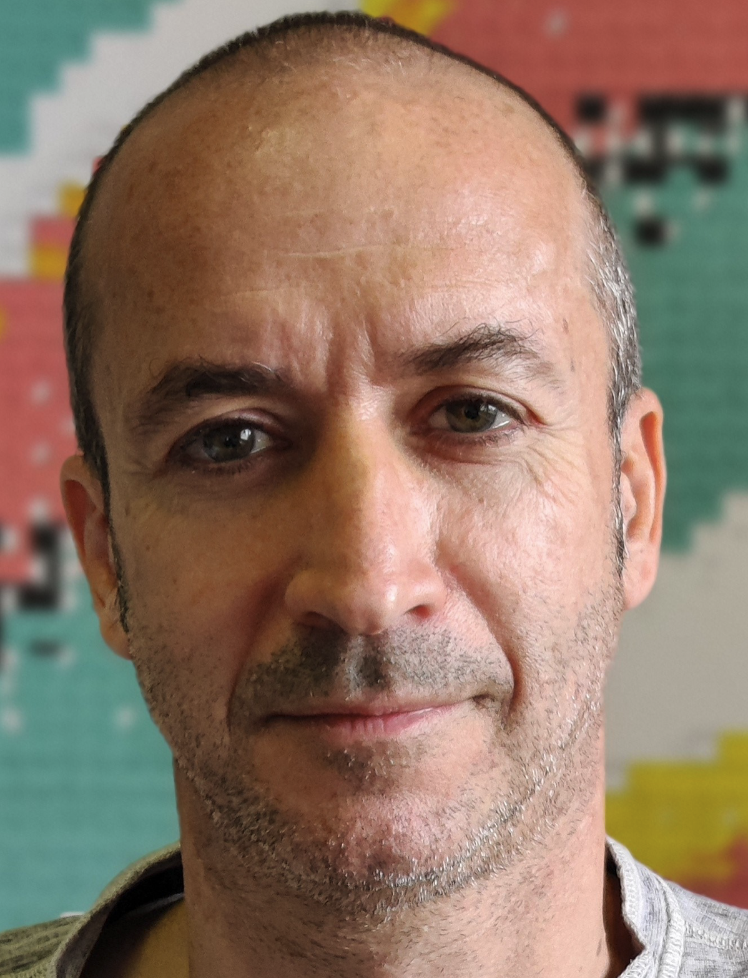
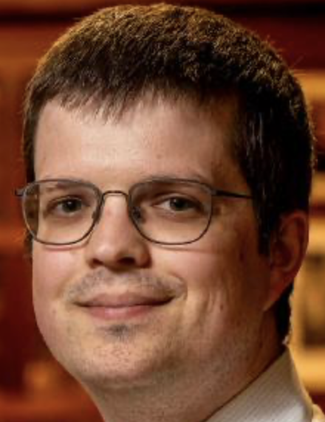
Researchers in Theoretical Nuclear Physics
Institut d’Astronomie et d’Astrophysique (IAA)
3 staff, 4 PhD, 3 post-doc
Leading roles in European research boards:
NC: Management Committee of various COST Actions, ESNT
SG: Belgian representative of NuPECC
SG: member of the ILIMA board (FAIR, GSI)
SG: member of the PANDORA coll. (ELI-NP, RCNP, iThemba)
Nicolas Chamel
Stephane Goriely
Wouter Ryssens
Global nuclear structure models (nuclear mass models, fission probabilities, …)
Nuclear reaction models for nucleosynthesis applications
High-density EOS for neutron stars and gravitational wave physics
Access to Supercomputers is essential !
(CECI, VSC, LUMI, Mare Nostrum, …)

Slide 5

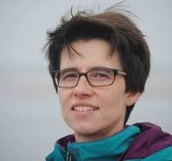



Researchers in Theoretical Nuclear Physics
Members of “Theoretical Nuclear and Statistical Physics”
2 staff, 6 PhD, 1 post-doc
Member of the T2K and ESSνSB collaborations
Natalie Jachowicz
Jan Ryckebusch
Modelling neutrino-nucleus cross sections
Short-range structure of the nucleus
Strong collaborations with SBND research groups at Fermilab, neutrino groups in Geneva, Madrid, Sevilla, Wrocław

Slide 6

Experimental Nuclear Physics in Belgium – impact on other fields
Other research disciplines make use of radioisotopes for research in material sciences, for testing the Standard Model of particle physics at low energy and for the development of new medical isotopes in collaboration with University hospitals
Medical isotope research (the Belgian MEDICIS Consortium)
ISOL@Myrrha project
Initiated during IAP-Phase VI
(BriX: 2007-2011)
(nano and quantum)materials
Testing the Standard Model

Slide 7
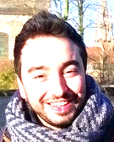
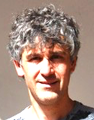
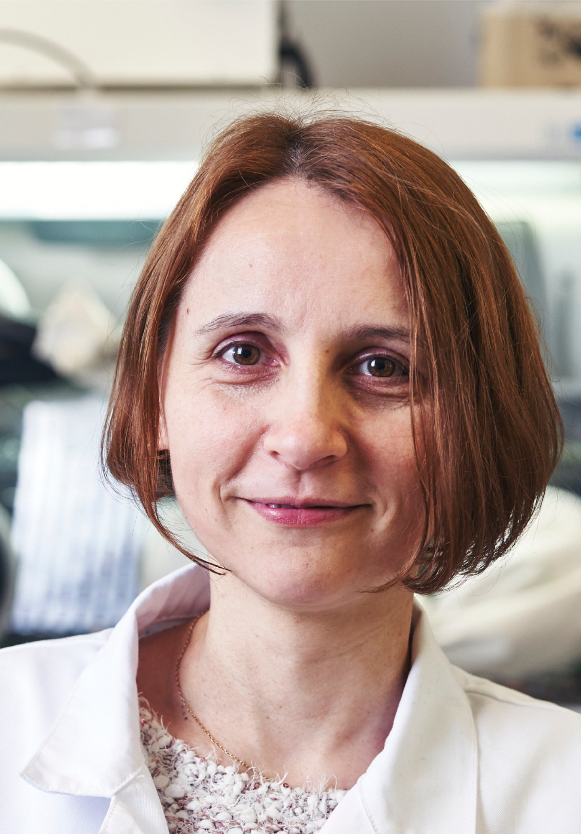
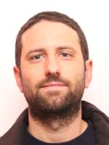
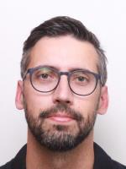
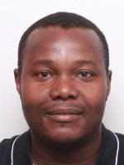
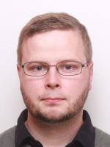
Researchers in Applied Nuclear Physics
Member from Nuclear and Radiation Physics, KU Leuven
3 PhD, 1 post-doc
2 instrument specialists
Radioisotope production and purification
(including medical isotopes)
Thomas E. Cocolios
Members from Quantum Solid State Physics, KU Leuven
(nano) materials
4 PhD, 1 post-doc
1 instrument specialist
Lino Pereira
André Vantomme
ISOL@MYRRHA members from SCK CEN
4 PhD
2 instrument specialists
Radioisotope production: targets and ion sources
Ion beam purification
Mass separation
Beamlines for users
Lucia
Popescu
Dinko
Atanasov
Joao Pedro Ramoz
Donald Hongbu
Kim Rijpsta
Agi
Koszorus

Slide 8
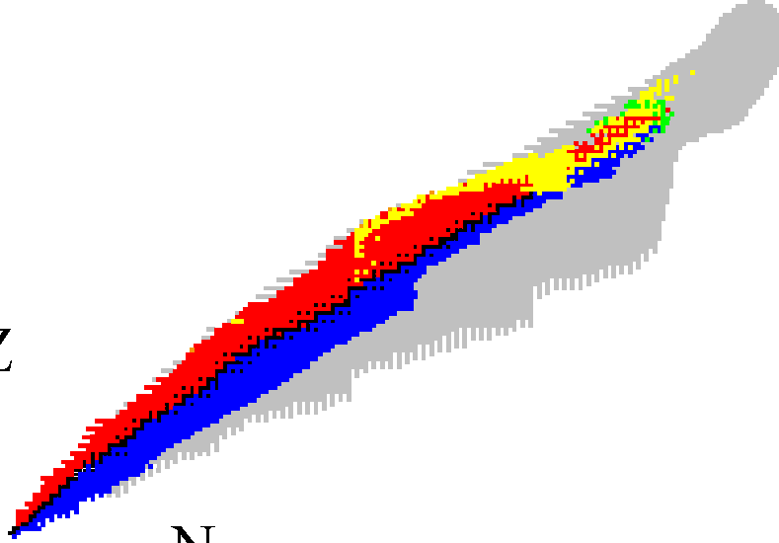









There are more than 3000 radioisotopes available with half-lives from few μs up to millions of years
Periodiek
Observed radioactive nuclei (~ 3200)
stable nuclei (~ 250)
Unobserved isotopes (~ 6000)
systeem
50
40
30
20
10
0
protons
drip lines (limits of existence)
0 10 20 30 40 50
neutrons

Slide 9
The production of Radioactive Ion Beams
ISOL: Isotope Separation On-Line
Projectile Fragmentation and in-flight Separation
High-quality RI beams:
Research on the Precision frontier
Very exotic isotopes:
➔ Study the limits of existence
Operational:
CERN-ISOLDE (protons, 2 μA, 1.4 GeV)
GSI-UNILAC/SHIP (heavy ions, 1 μA, 11.4 MeV/A…)
JYFL-IGISOL (heavy ions, refractory elements)
GANIL-SPIRAL1 (fragmentation products + ISOL)
GANIL-SPIRAL2 (heavy ions, 10μA - 1 mA, 14.5 MeV/A)
In preparation:
2026: S3-LEB coupled to SPIRAL2
2027: DESIR coupled to SPIRAL1 (later also SPIRAL2)
2030: ISOL@MYRRHA (protons, 500 μA, 100 MeV)
Operational:
GSI-SIS18 + FRS Fragment separator
GSI-UNILAC +SHIP Velocity filter
GANIL + LISE Fragment separator
In preparation:
2028: FAIR-SIS100 + super-FRS
➔ Complementary facilities where different types of experiments are performed

Slide 10
European Experimental Research ON and WITH Radioisotopes and Radioactive Ion Beams (RIB’s)
12 operational large-scale (accelerator) infrastructures
19 smaller-scale infrastructures
7 under construction (FAIR, SPIRAL2 +S3/DESIR, ISOL@MYRRHA, …)
Taken from the NuPECC
Nuclear Physics Long Range Plan 2024

Slide 11
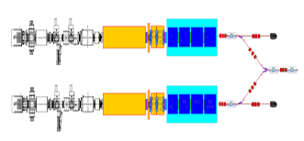
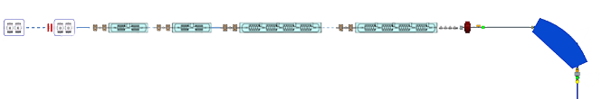
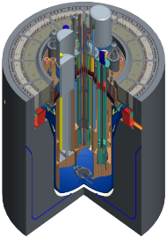
MYRRHA a Pan-European Large Research Infrastructure based on Accelerator Driven System
Phase 1
Linear accelerator
Phase 2
100 MeV
4 mA protons
600 MeV
+ Proton Target Facility (200 μA)
+ Fusion Facility (2-4 mA)
Main objectives
Demo of ADS at pre-industrial scale
Demonstrate Efficient transmutation
Flexible fast neutron irradiation facility
Phase 3
Reactor
LBE
Sub-Critical
~100 MWth
Adapted from Hamid Aït Abderrahim, General Manager of Myrrha
Notes:
What is MYRRHA
What offers

Slide 12

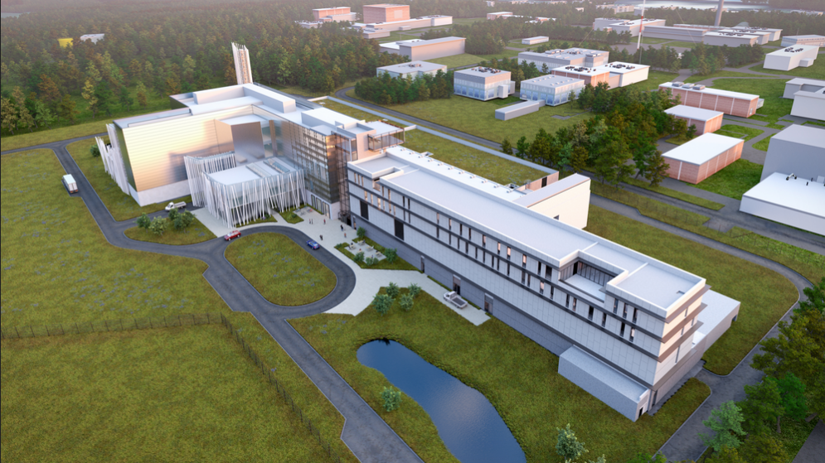

Phase 1: MINERVA
Construction ongoing at SCK CEN (Belgium)
MYRRHA phase 1
implementation
MINERVA
LINAC 100 MeV protons
Proton Target Facility (PTF)
= ISOL@MYRRHA (200 μA)
Fusion Facility (FF) (4 mA)
ISOL@MYRRHA is part of MINERVA:
a RIB facility offering long beamtimes for high-precision experiments
U- and Th-based targets for pure fission fragment beams
Some other isotopes using specific targets
Adapted from Lucia Popescu, Head of Physics and Target Research (PTR) group

Slide 13
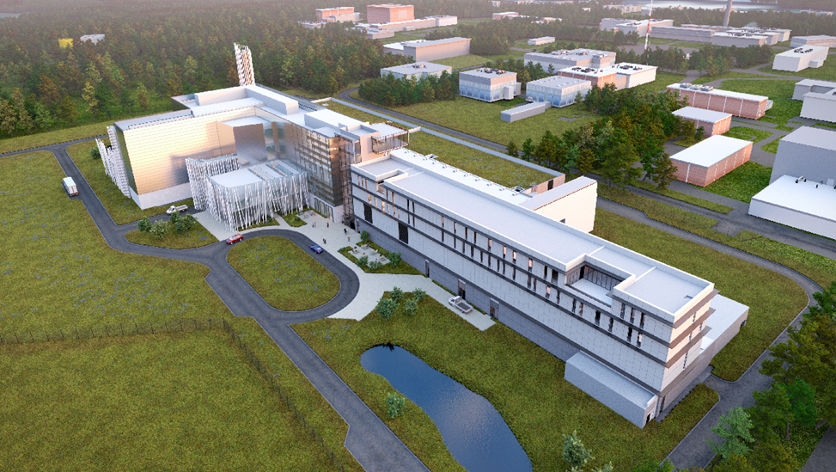
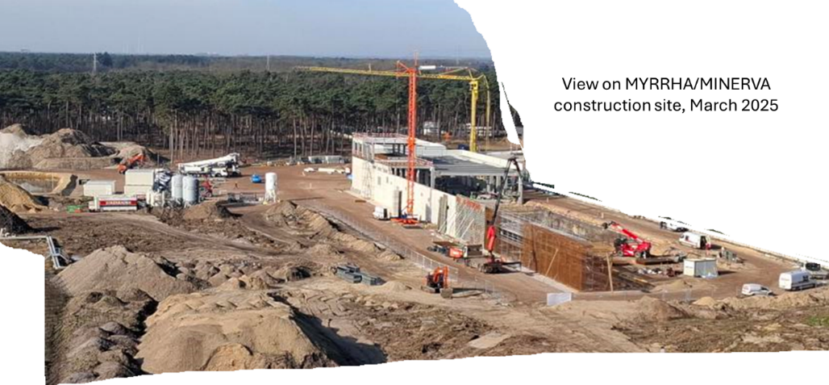
MINERVA Timeline
Groundbreaking AUB/CCB
(Auxiliary Units & Cryogenic Compressor Buildings)
Ground-breaking Accelerator Tunnel (followed by other buildings)
Start Accelerator
installation
(followed by other systems)
Start accelerator commissioning (staged from inj to HEBT)
Start Commissioning User Facilities
Q4 2024
Q1 2026
Q3 2027
Q2
2029
Q4 2030
Adapted from Adrian Fabich, Director Minerva Design & Build

Slide 14
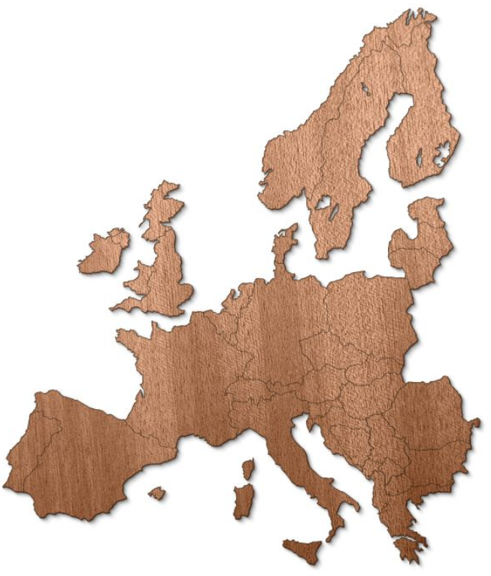

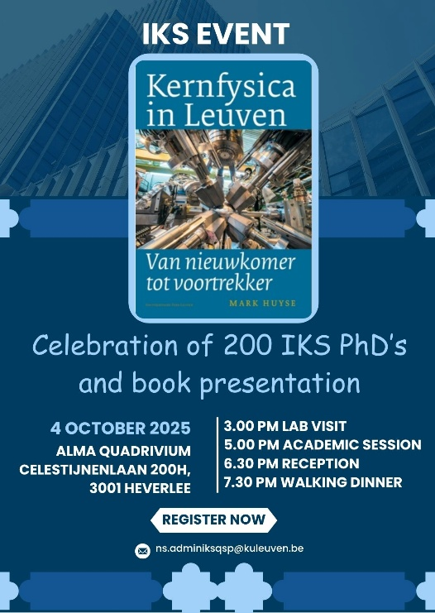






BELGIAN strategy in experimental nuclear physics
Aligned with the 2024 Nuclear Physics Long Range Plan
Develop in-house innovative methods and instrumentation
Since 1980ies: apply these methods at European radioactive beam facilities for
Nuclear structure research
Fundamental interaction research (precision tests of Standard Model)
Materials research
Medical isotope production
We are playing leading roles (experiments and policy making) at
ISOLDE and MEDICIS at CERN (CH)
GANIL-SPIRAL1-SPIRAL2: S3 and future DESIR (F)
IGISOL facility at Jyvaskyla (FI)
PSI (CH) (neutron-EDM and muonic X-ray spectroscopy)
GSI-UNILAC (DE)
Future ISOL@MYRRHA (B)

Slide 15
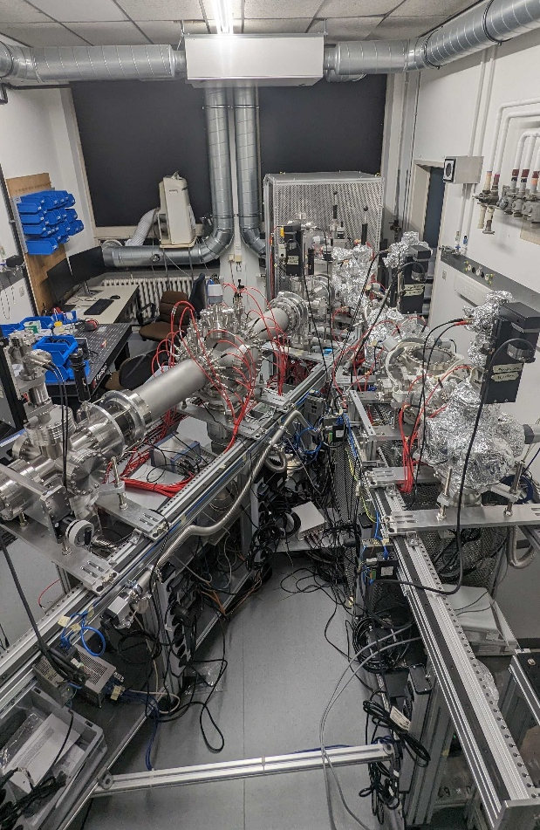
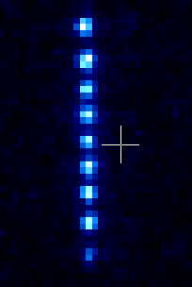
Developing next-generation experiments at IKS-KU Leuven
Novel experiments for precision nuclear physics
Ion beam purification and preparation
Details of the lab will be available in
Review of Scientific Instruments, accepted August 2025 ( arXiv:2506.18552v1)
REBEL: towards high-precision laser-RF-spectroscopy on radioactive isotopes and molecules
Koszorus
STRIPE: towards high-precision studies of unexplored nuclear properties and testing symmetries of Nature using high-precision ion traps
October ‘24
9 ions in the trap
De Groote

Slide 16
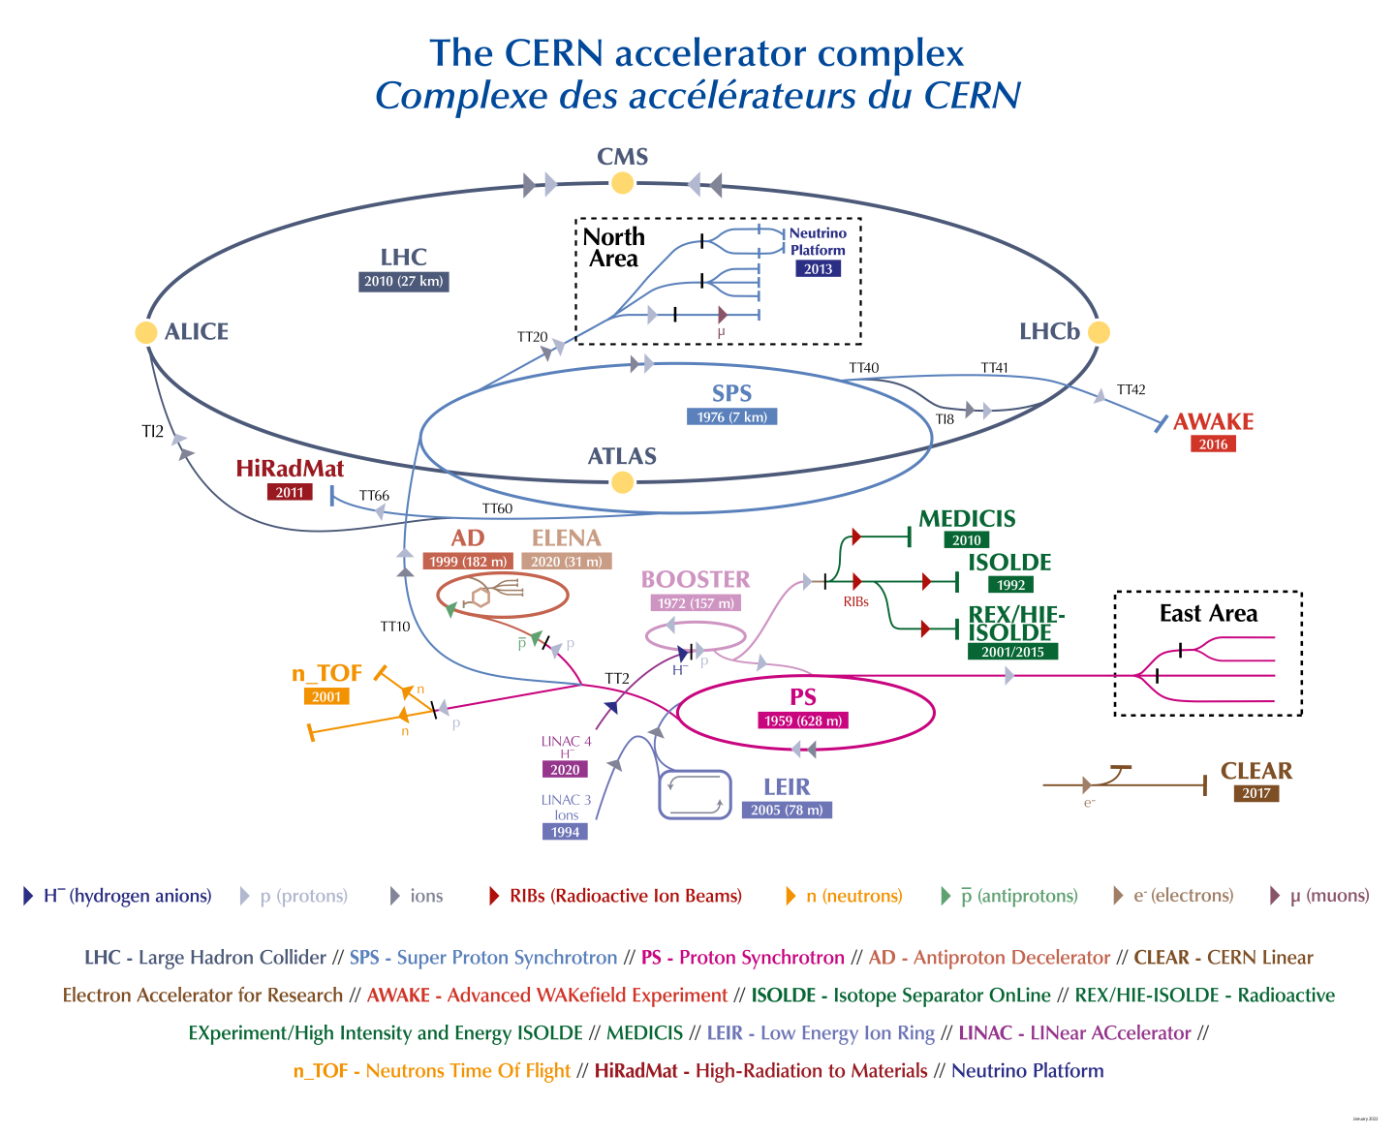
The facilities at CERN where Belgian Nuclear Physicist are active
ISOLDE takes proton beam from LINAC4/Booster
(1.4 GeV, 2 μA) to produce radioisotopes using Isotope Separation On Line (ISOL).
MEDICIS collects long-lived radioisotopes (from ISOLDE or from elsewhere) through off-line isotope separation.

Slide 17
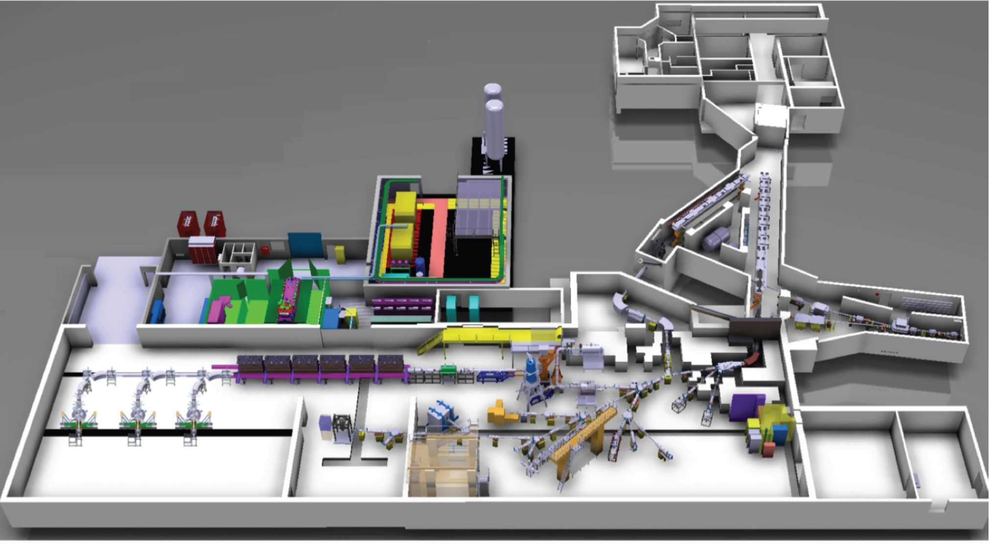
The ISOLDE facility
MEDICIS
Target stations
1.4 GeV protons from PS booster
HIE-ISOLDE post accelerator (7.5 MeVA)
High-energy experiments
mass separators
Low Energy Experiments (40-50 keV)

Slide 18
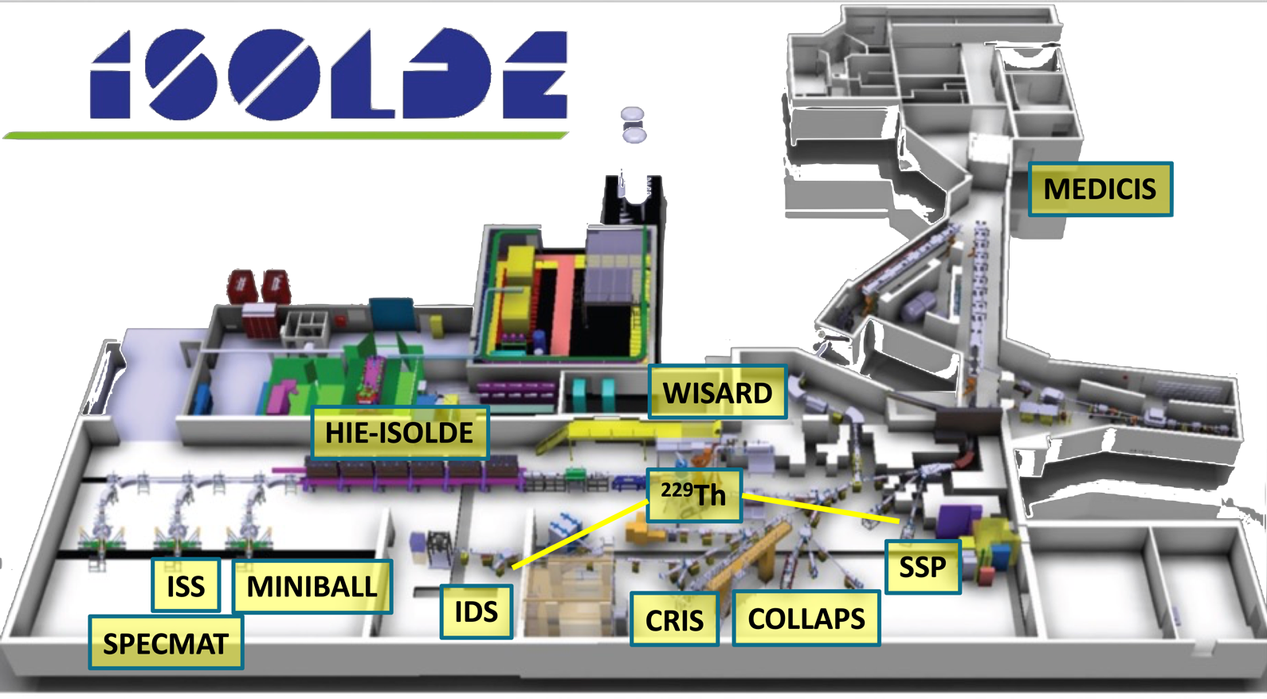
Research Programmes at ISOLDE led by KU Leuven
CERN proton beam
KU Leuven groups have leading roles in 10 (out of 15) permanent experimental set-ups
and in MEDICIS

Slide 19
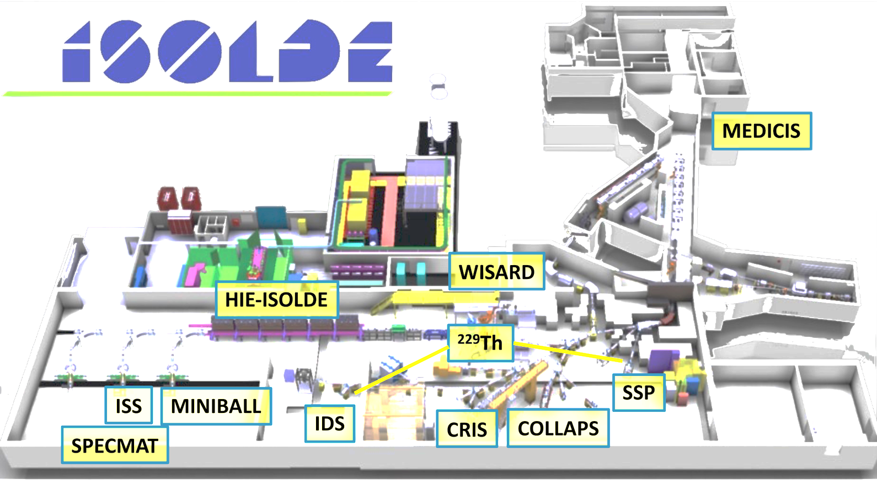


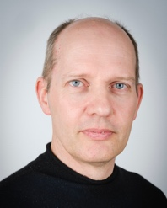
Research Programmes at ISOLDE led by KU Leuven
Highlights:
Nature Physics 17, 2021: laser spectroscopy N=32
Nature 607, 2022: laser spectroscopy N=82 (132Sn)
Nature 617, 2023: ^{229m}Th nuclear clock energy
Nature Physics 20, 2024: laser spectroscopy 100Sn
1- Nuclear structure studies
The ²²⁹Th nuclear clock isomer
Laser Spectroscopy at CRIS, COLLAPS, RILIS
Decay spectroscopy at the IDS
Reaction studies at the HIE-ISOLDE accelerator (with Miniball, ISS, SpecMat)

Slide 20
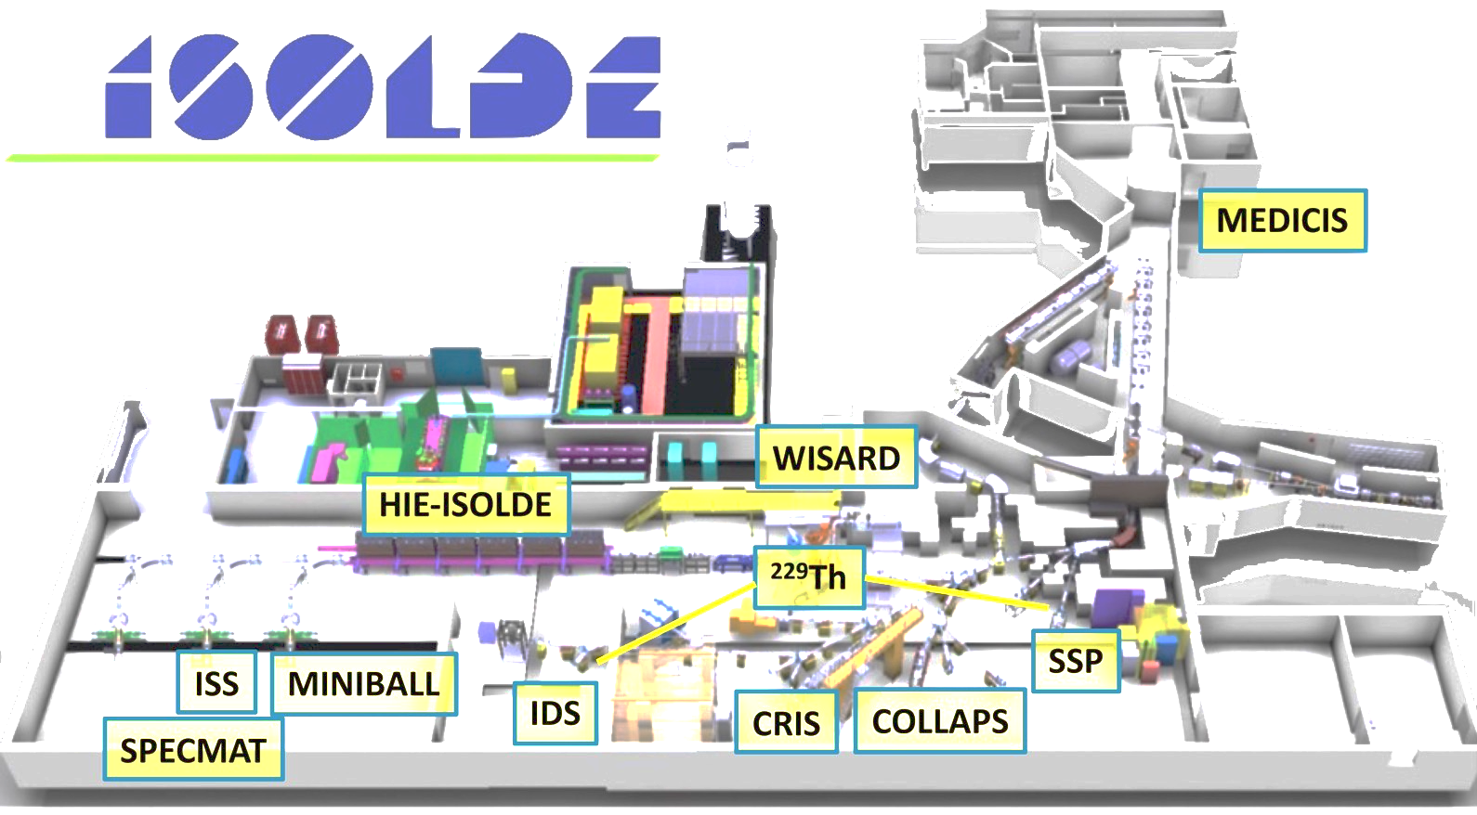

Research Programmes at ISOLDE led by KU Leuven
Highlights:
Rev Mod Phys, 2018: β spectrum-shape description
Phys Rev C, 2020: β-ν correlation from β-p coincidences
Nature 617, 2023: Radiative decay of ^{229m}Th:crystal properties
Phys. Rev. Lett. 125, 2020: SnV in diamond
2- Weak interaction studies
WISArD (search for scalar and tensor weak interaction currents)
- β-ν correlation
- β spectrum shape
3- Quantum solid state physics (SSP): Radioactive nuclei as probes for innovative materials studies
Defects in diamond for quantum technologies
Materials for ^{229m}Th solid-state nuclear clock

Slide 21

Research Programmes at ISOLDE led by KU Leuven
MEDical Isotopes Collected from ISOLDE@CERN
Belgian MEDICIS partners:
KU Leuven, VUB, Univ Gent, SCK CEN
PRISMAP (European network for the supply of radioisotopes for research):
Belgian Members (supplying):
KU Leuven, SCK CEN
Belgian USERS (receiving isotopes):
KU Leuven, U Antwerpen, VUB, SCK CEN
Member of the PRISMAP Industrial Board:
Cristiana Gameiro from IBA
4- Isotope production and purification
Radioisotope purification at CERN (laser ionization/molecules)
Production of (purified) innovative medical radioisotopes for research
Highlights:
Sci. Rep., 2023, 2025: production and purification of ²²⁵Ac
Pharmaceutics, 2022: purification and preclinical work with ¹⁵³Sm from BR2

Slide 22
Research Programmes at ISOLDE led by KU Leuven
Highlights:
Nature 581, 2020: first study of ²²⁶RaF
Phys. Rev. Lett. 127, 2021: RaF isotope shifts
Nature Physics 20, 2024: ²²⁶RaF laser cooling scheme
Nature Comm. 16, 2025: ²²⁶RaF spectroscopy
Science, 2025: magnetization distribution in ²²⁵RaF
CRIS
5- Radioactive molecules production and spectroscopy
Production of radioactive molecules (also for beam purification)
Spectroscopy of radioactive molecules
Opens a new interdisciplinary field of research: EDM studies using radioactive molecules

Slide 23
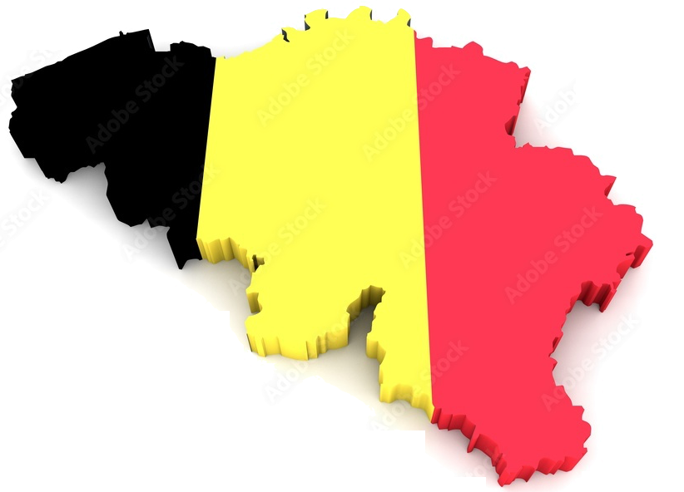

Bring ISOLDE expertise towards ISOL@MYRRHA
Expert group for initiating an ISOL@Myrrha users community
From SCK: Lucia Popescu - coordinator
From KU Leuven / SCK CEN: Agota Koszorus
From KU Leuven: Thomas Cocolios, Ruben de Groote, Gerda Neyens, Lino Pereira
From UZ Leuven: Frederik Cleeren
An ISOL-type radioactive beam facility at SCK CEN (Mol, Belgium)

Slide 24
Funding resources in Experimental Nuclear Physics in Belgium
European
ERC: one ongoing (TEC), two finished (RR and PVD)
Marie-Curie individual fellowships (post-doc)
PRISMAP (access to purified isotopes for medical research: KU Leuven, SCK CEN, UZ Leuven)
Marie-Curie Doctoral Networks (one recently finished, two new ones in preparation)
FWO
International Research Infrastructures (ISOLDE/GANIL-SPIRAL2)
Supports travel, local instrumentation specialists, MoU’s and operational costs of specific devices at ISOLDE and GANIL/SPIRAL2 (Consortium staff: 11 KU Leuven, 1 Univ Ghent, 2 VUB)
Research projects (2 max per university staff)
PhD/PD positions, operational costs for specific experiments, equipment for specific experiments; bilateral grants with, e.g., South Africa
PhD and Post-doc individual fellowships
Odysseus type II (individual return grant, new ZAP R. de Groote, KU Leuven)
FWO/FNRS
Excellence of Science (EOS)
PhD/PD positions, some operational costs (Consortium staff: 3 KU Leuven, 3 ULB, 2 Univ Mons)
KU Leuven
Research council (C1 BOF, young prof grant)
PhD/PD positions, some consumables, some equipment (consortium: 7 IKS staff members)
SCK CEN / MYRRHA
1 temporary prof position at KU Leuven (5 years, A. Koszorus)
2.5 Meuro/year goes to ISOLDE and MEDICIS research

Slide 25
Summary
Belgian experimental nuclear physicists have expertise in - isotope and RIB production (including laser ion sources)
- ion trapping and manipulation
- precision experiments with isotopes and neutrons
- decay spectroscopy (α, β, γ)
- laser spectroscopy and laser polarization
- muonic atom spectroscopy
- nuclear reactions for nuclear structure research
- materials characterization using RIB’s
Belgian scientists play leading roles in new developments at ISOLDE-CERN, GANIL-SPIRAL2, GSI/UNILAC, PSI, JYFL
Belgian scientists are involved in the science policy of existing and planned new facilities (ISOLDE, SPIRAL2, ISOL@MYRRHA)
In view of the revival of Nuclear Energy and the upcoming Myrrha
➔ Belian would benefit from more university groups in experimental nuclear physics

Slide 26

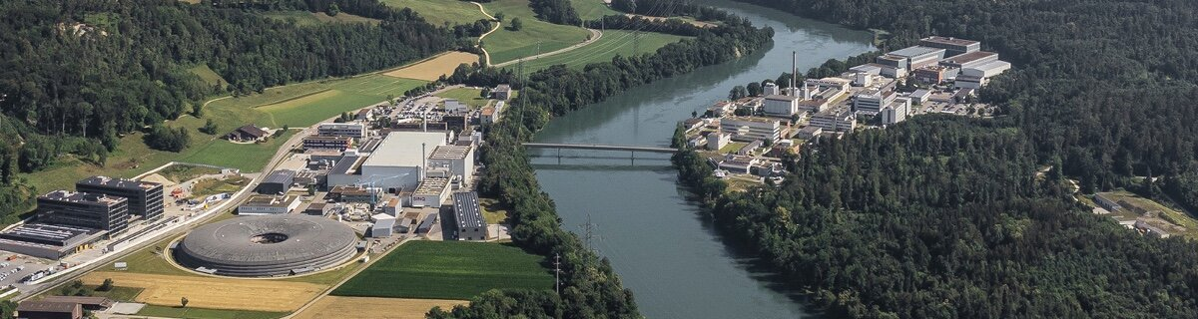

Beyond CERN: neutrons and muons @ PSI
Highlights:
Phys Rev Lett, 2020: best limit on the neutron EDM
J. Low T Phys. 2024, MMC for muonic atoms
Heritage Science, 2023: antique knob fibula
i- n2EDM from ultra cold neutrons
Development of precision magnetometers
Axion search
ii- Muonic atoms
Absolute charge radii of rare isotopes (muX/ReferenceRadii/QUARTET)
Ordinary muon capture of isotopes involved in 0𝜈2β searches (MONUMENT)
Heritage science (MIXE)

Slide 27
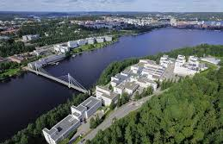
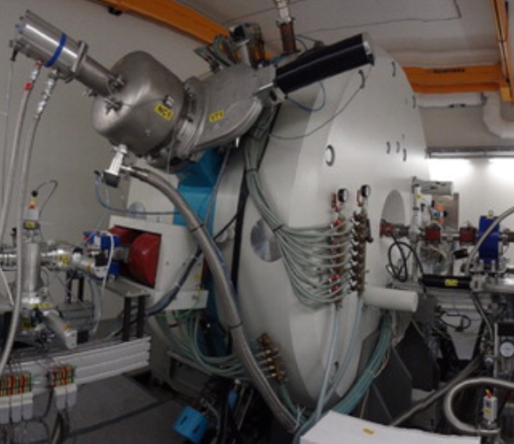
Beyond CERN: Accelerator lab @JYU
Highlights:
Nature Communications (2021),
Phys Rev Lett 133 (2024): combined ultra-sensitive laser and mass spectrometry
Physics Letters B (2021), Physics Letters B (2024): high precision laser spectroscopy (octupole moments)
i- in-source laser spectroscopy
Pushing towards N=Z and proton dripline
ii- Novel technique development
In-trap laser spectroscopy and ultra-cold radioactive isotopes
Ultra-sensitive MR-TOF assisted laser spectroscopy

Slide 28


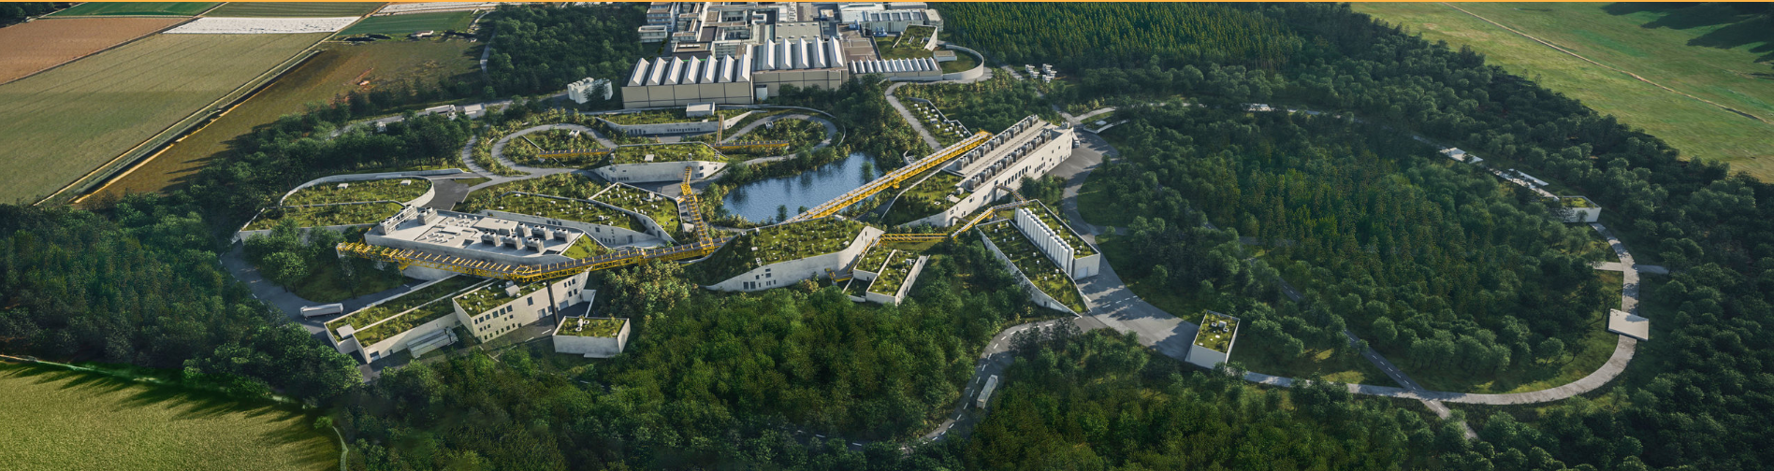
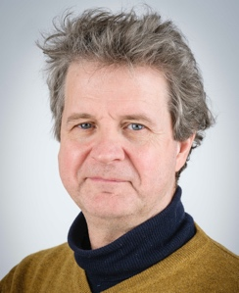
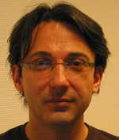
Beyond CERN: GSI/HIM
Highlights:
In Preparation, 2025: HFS of 8⁻ K-isomer in ²⁵⁴No
Phys. Rev. Res., 2024: First sub-GHz spectrum of ²⁵⁴No
Nature, 2024: Isotope shift of No and Fm isotopic chains
Nature, 2016: First optical transition in No
Atomic and Nuclear structure studies of the heaviest elements by atom-at-a-time laser spectroscopy
Search for optical transitions
Influence of relativistic effects in atomic shell
Nuclear properties and the roll of nuclear-shell effects
Test state-of-art atomic and nuclear theory models
Implementation of IKS-developed IGLIS method to achieve higher resolution
Piet Van Duppen
Rafael
Ferrer
Instrument specialist

Slide 29

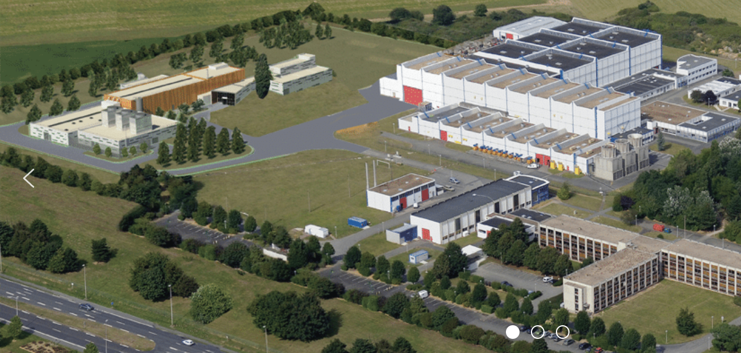
Beyond CERN: GANIL/SPIRAL2
Highlights:
Nucl. Instr. Meth. B, 2013: Conceptual studies and design of the S3-LEB
Nucl. Instr. Meth. B, 2023: First off-line results with S3-LEB
Phys. Rev. Res., 2024: First sub-GHz spectrum of 254No at GSI
S3-Low Energy Branch @ SPIRAL2
IGLIS technique developed at IKS: laser spectroscopy apparatus with enhanced resolution and sensitivity
To be applied at S3-LEB for N=Z and heavy-element studies
State-of-the-art Nd:YAG-pumped dye laser system and laser ion source
DESIR coupled to SPIRAL1/SPIRAL2
Provide expertise in collinear laser spectroscopy and high-precision ion trapping
Piet Van Duppen
Rafael
Ferrer
Instrument specialist

Slide 30




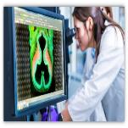
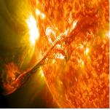
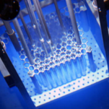
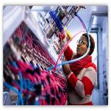
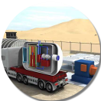
MYRRHA’s Application Portfolio
SNF*/ Waste
Multipurpose
hYbrid
Research
Reactor for
High-tech
Applications
Radio-isotopes
Fusion
Mat.& Fuel GEN IV
Fundamental research
*SNF = Spent Nuclear Fuel
Support to
SMR LFR
Courtesy Hamid Aït Abderrahim
Notes:
What is MYRRHA
What offers

