Slide 1


Belgian contribution
to CMS phase-2 upgrade
Pascal Vanlaer (IIHE-ULB)
RECFA visit, September 12, 2025

Slide 2
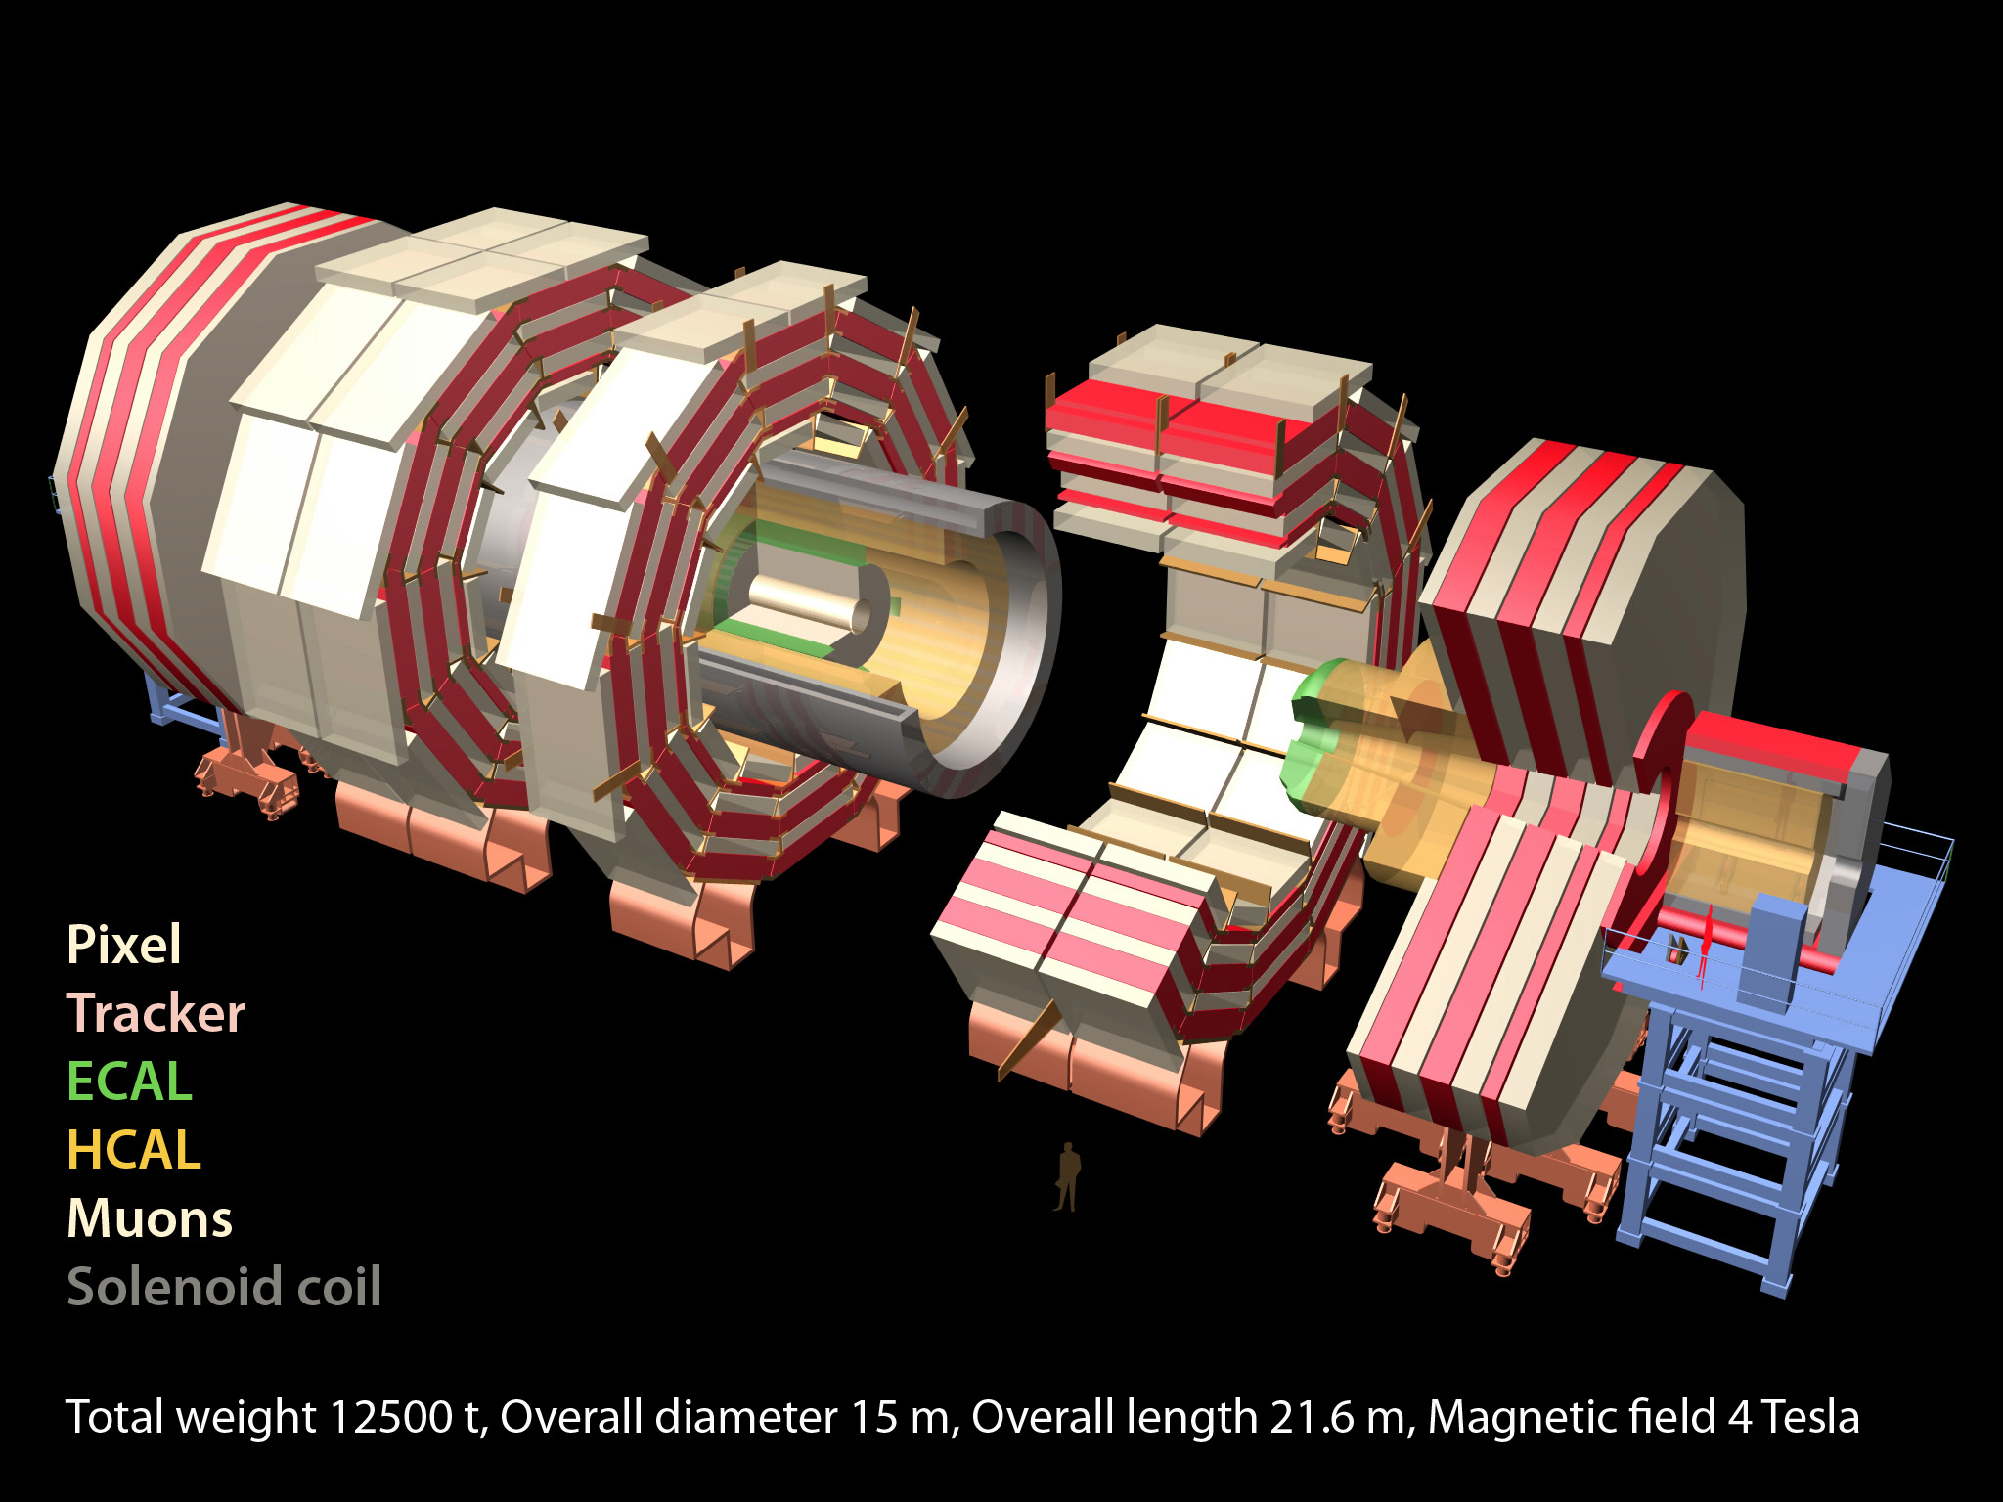
New Tracker
Tracks in hardware trigger (L1) up to η∼2.5
Coverage closer to the beam (up to η∼4)
More precise momentum and impact parameter
Radiation tolerant - high granularity - less material
New Endcap Calorimeters
Radiation tolerant
High granularity
Muons
Complete resistive plate chambers coverage in forward region
Extend coverage up to η∼2.8
Replace electronics
CMS
extensive upgrade for
precision H boson physics
extended acceptance for beyond-standard model physics
Barrel ECAL
Replace electronics
Cool crystals/photodetectors
Trigger/data acquisition
L1 with tracks and rate up to ∼750 kHz
L1 Latency 12.5 µs
HLT output rate up to 10 kHz
Barrel HCAL
Replace photodetectors
New Timing Layer for charged particles
50ps resolution for in-time pileup suppression and velocity measurement

Slide 3
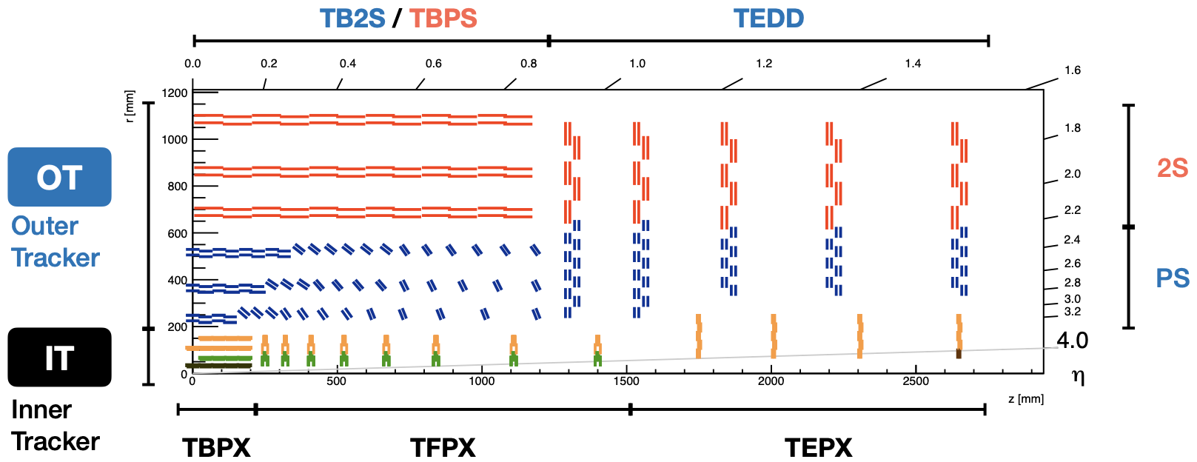
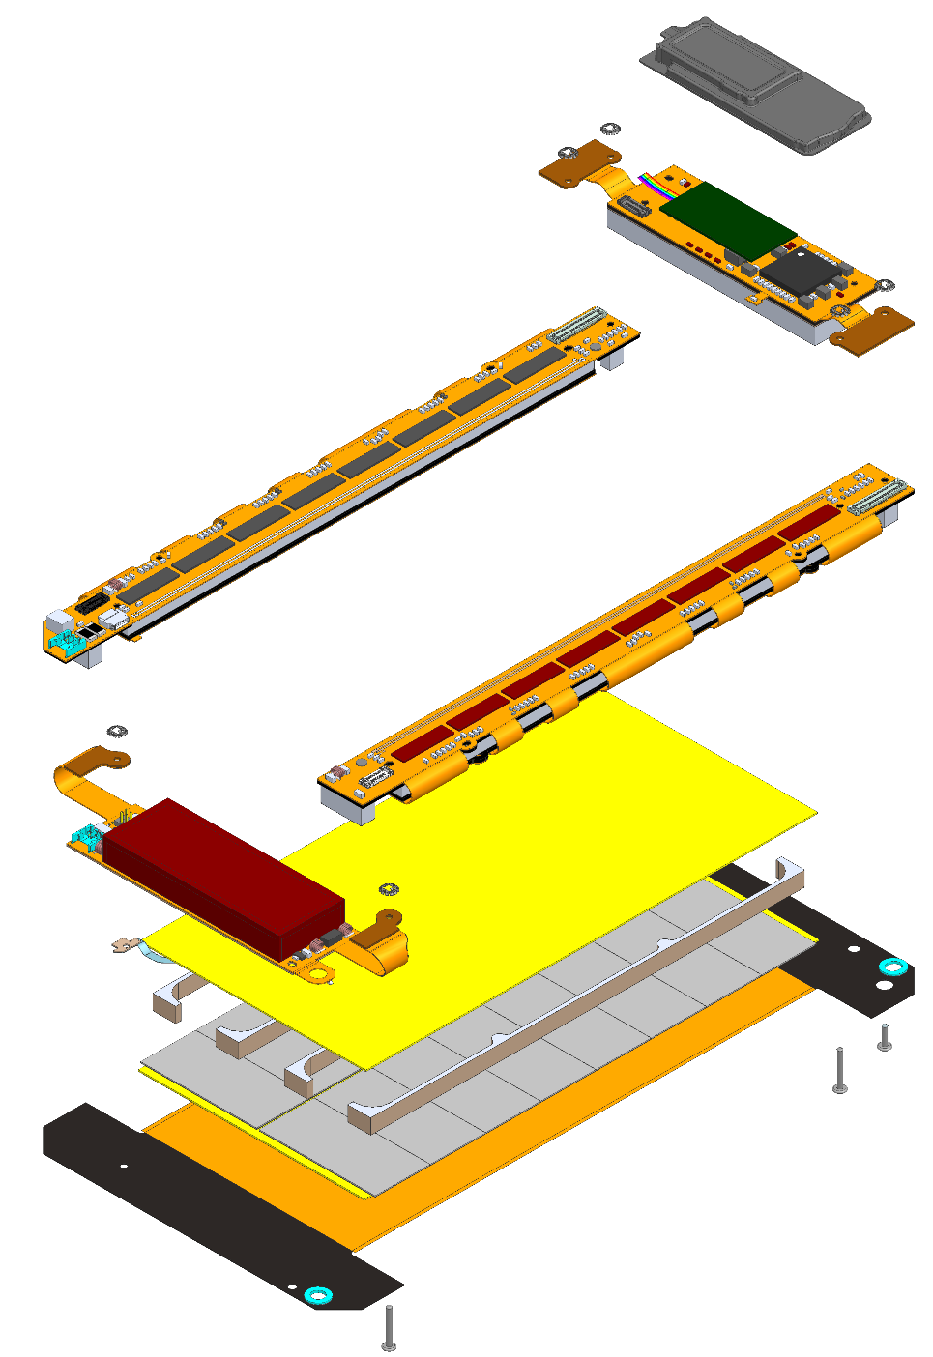
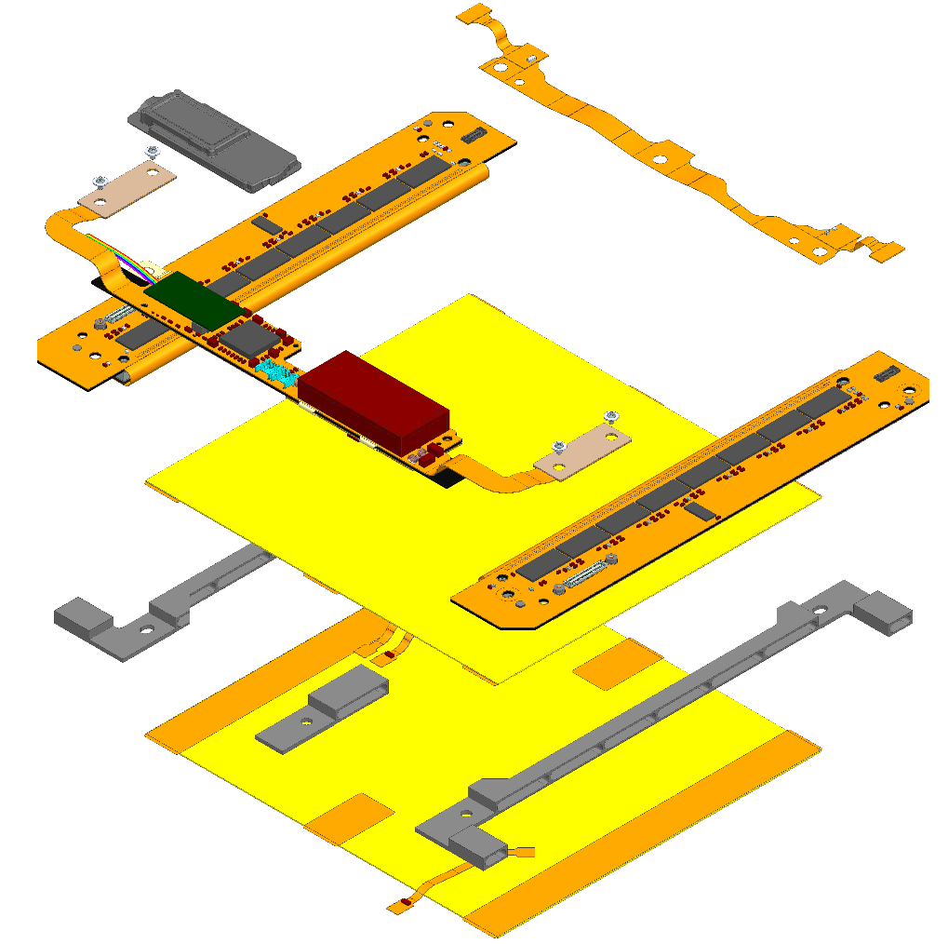
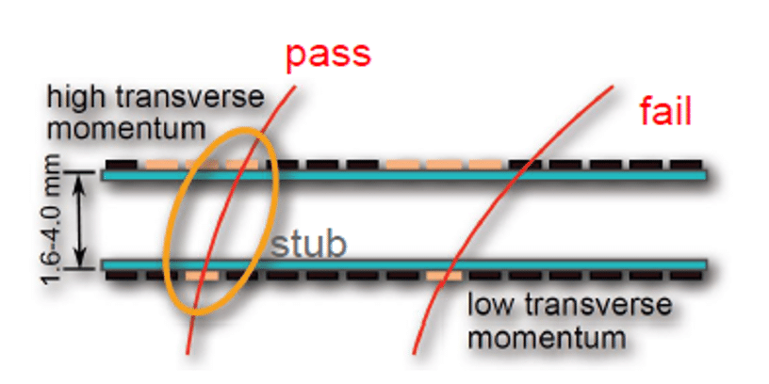
Tracker upgrade
PS
2S
Outer tracker modules will provide “stubs” (pairs of correlated hits) at 40MHz, for tracking at 1st trigger level
Belgian focus: 2S modules and Outer Tracker endcap TEDD

Slide 4
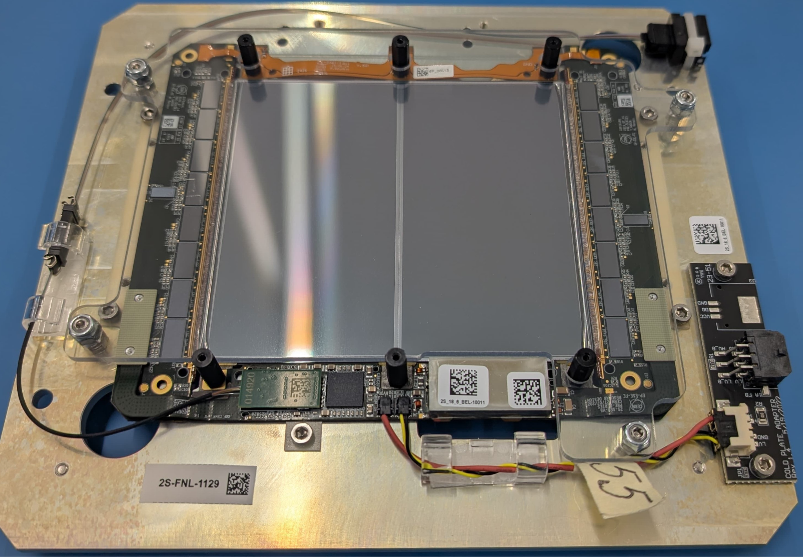



2S modules
In Belgium, all HEP-exp groups collaborate to:
Deploy 1 of the 7 production sites
Build and fully test ~1500 out of 7608 2S modules by July 2027
at IIHE, by ~35 persons from UAntwerpen, UGent, ULB and VUB
>100 modules already built since July 2025
we just reached our nominal throughput of 24 modules per week
module production drives the Outer Tracker project schedule
We also contribute to tools, test setups and supplies for the Outer Tracker project

Slide 5
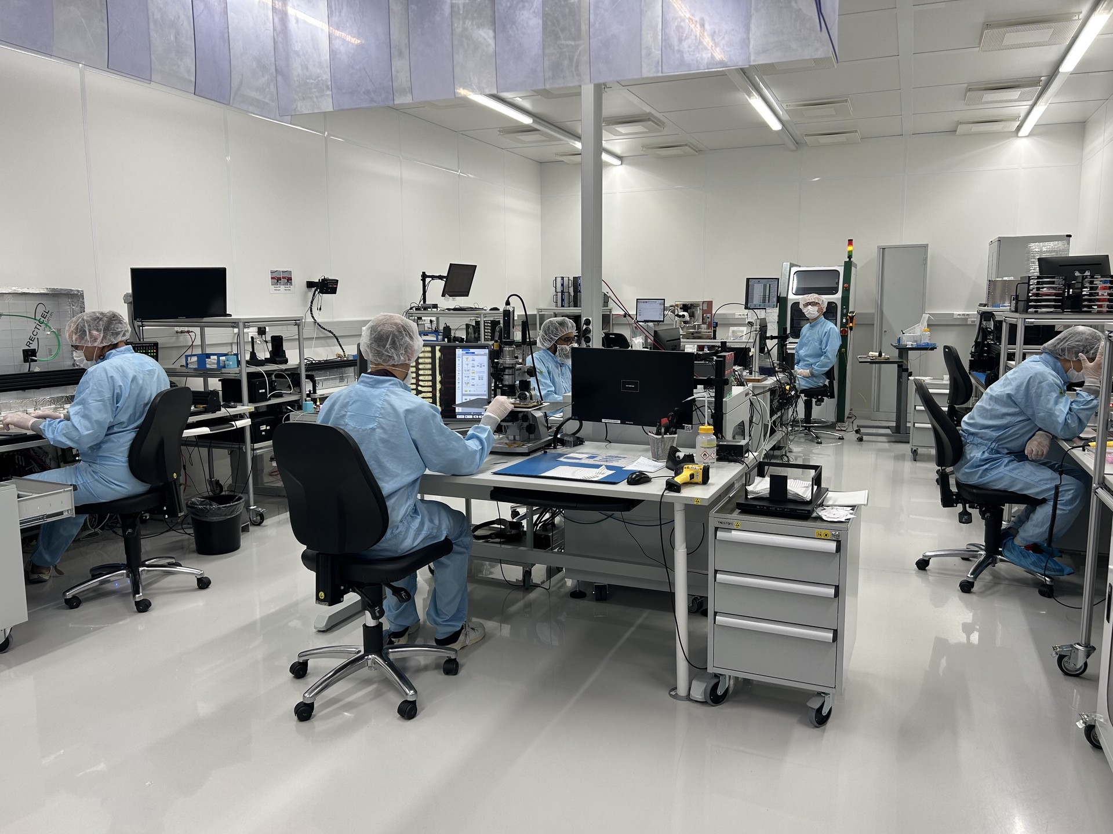
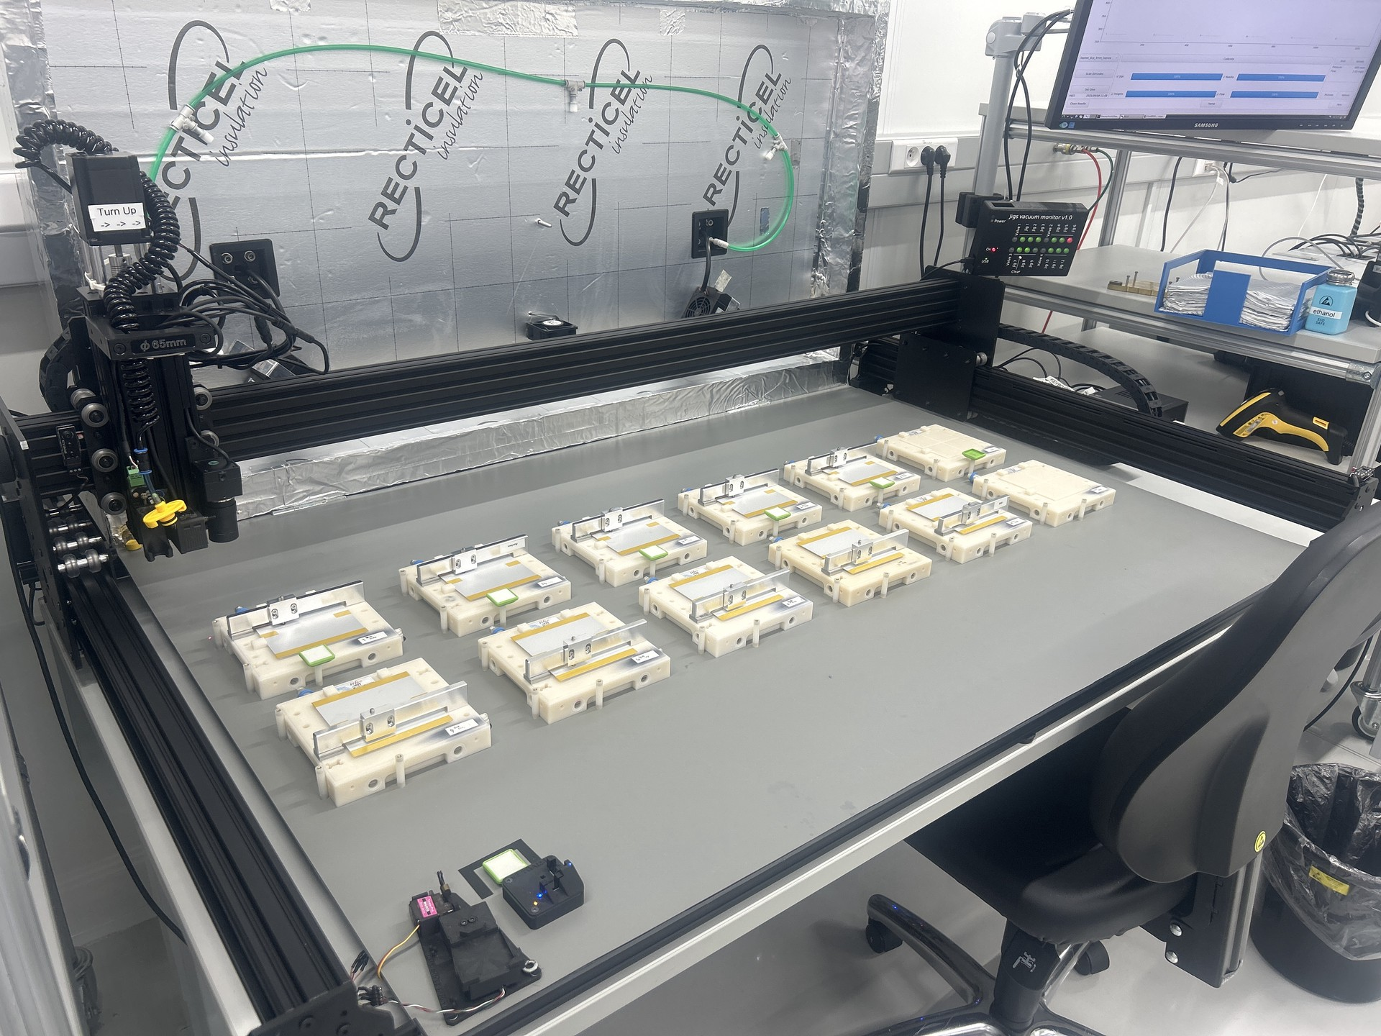
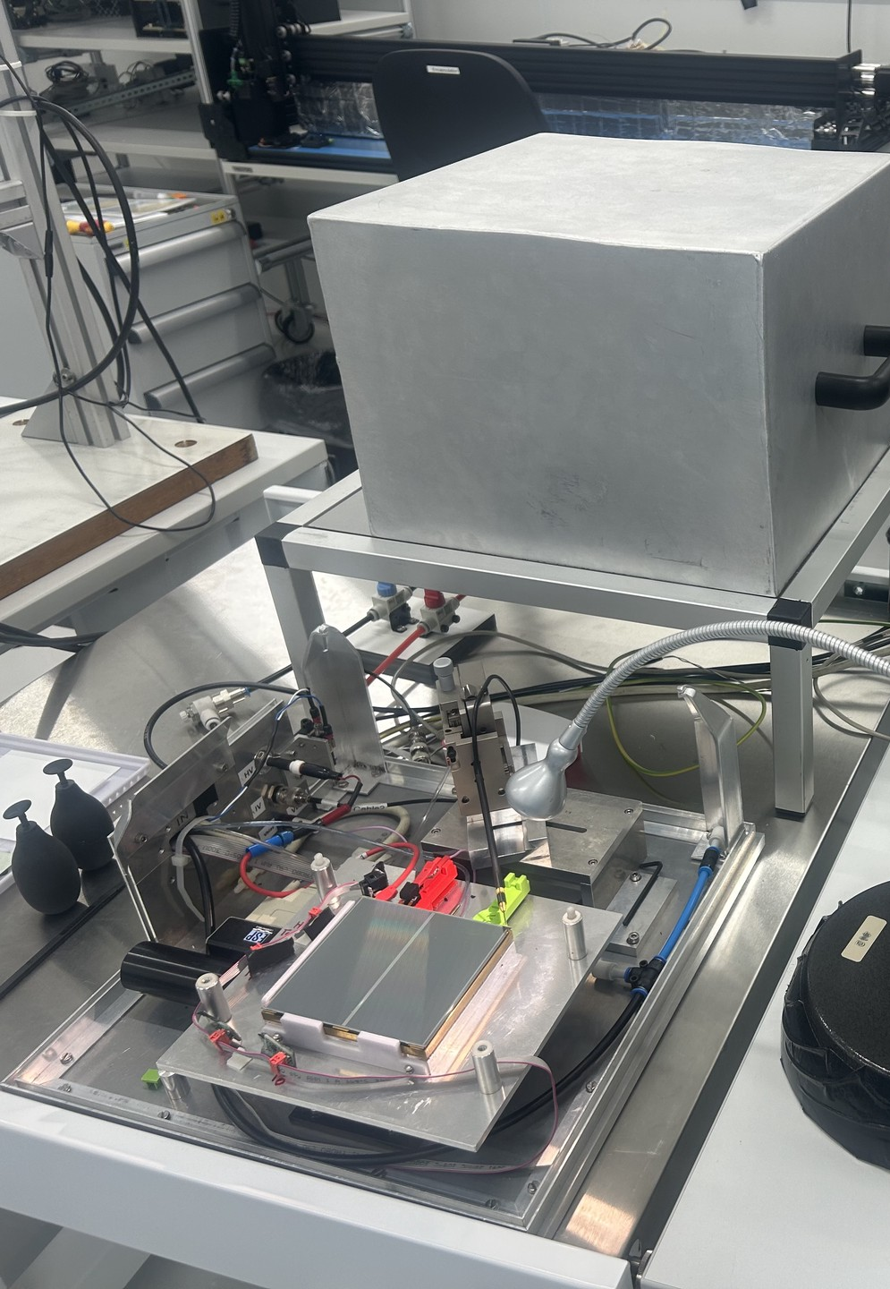
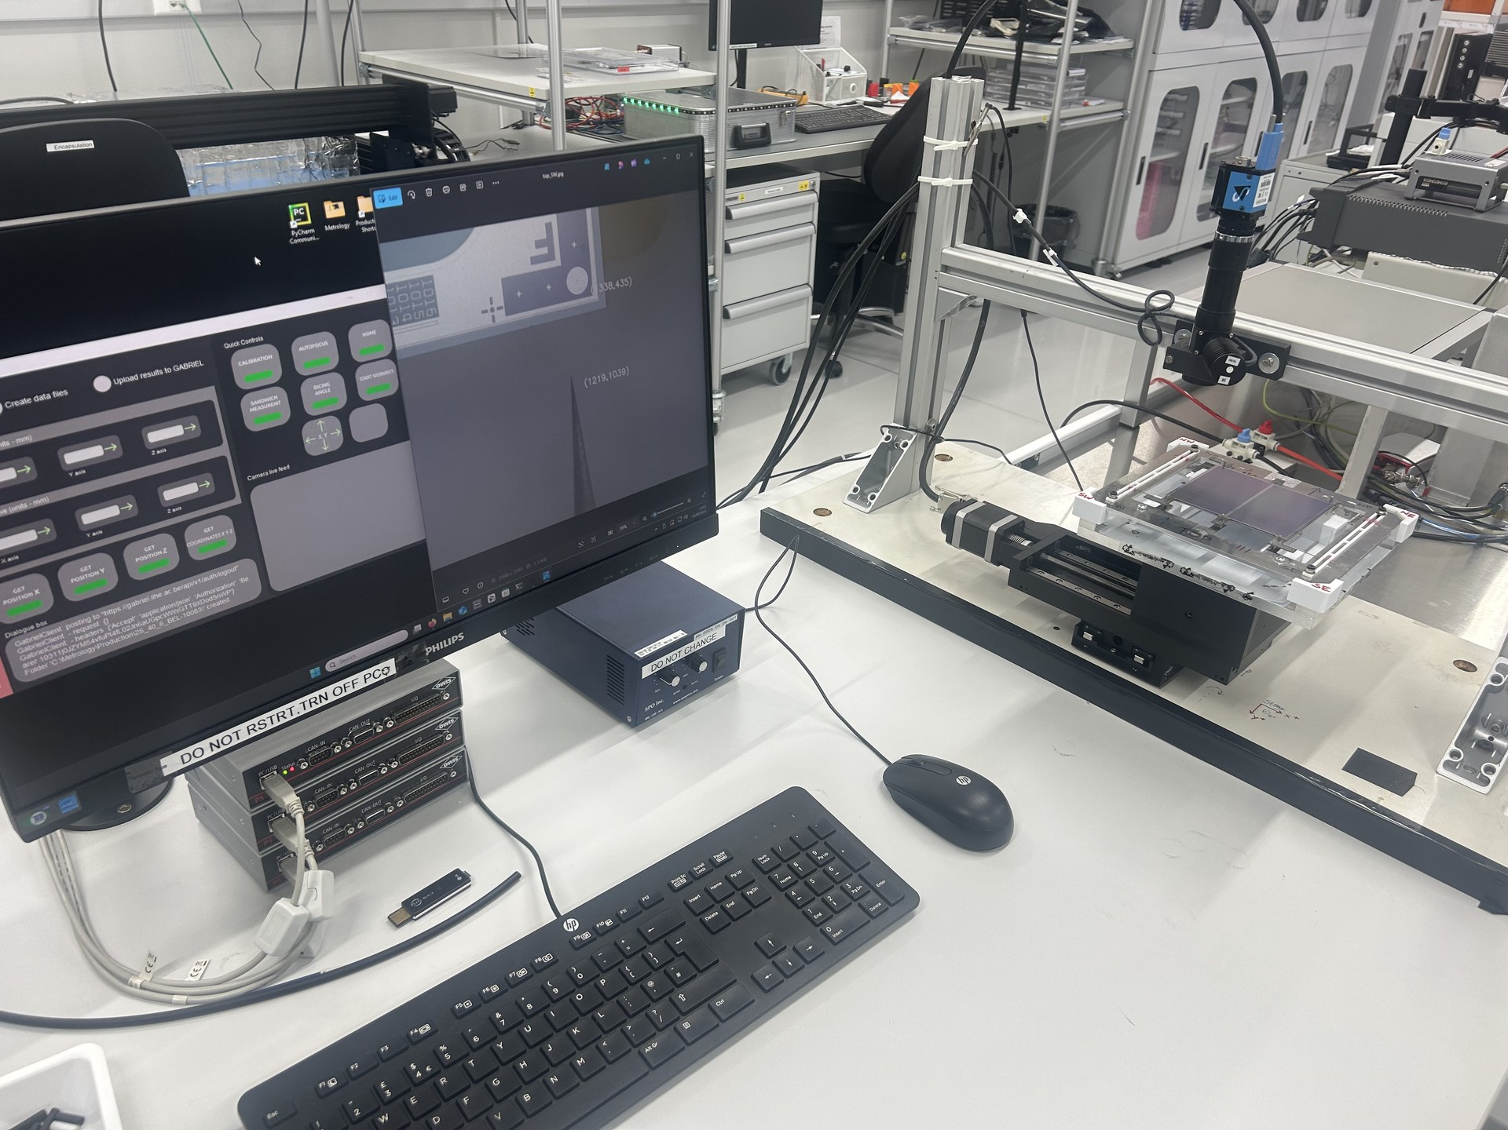
2S module production site at IIHE
I-V setup
Robot + jigs
Local developments started in 2017
clean room, glue doser, gluing robots, Si I-V setup, metrology, one type of jig (also for other 2S sites)
local database, production planner, GUI’s
Other jigs, setups for functional tests (KIT design), thermal cycling setup (Fermilab design)
Industrial wire bonding equipment; high-end digital microscopes; dry storage,...
Capacity of 6 modules per day
Metrology

Slide 6
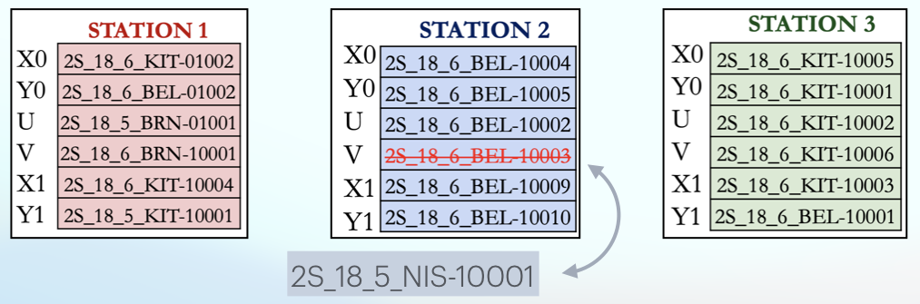
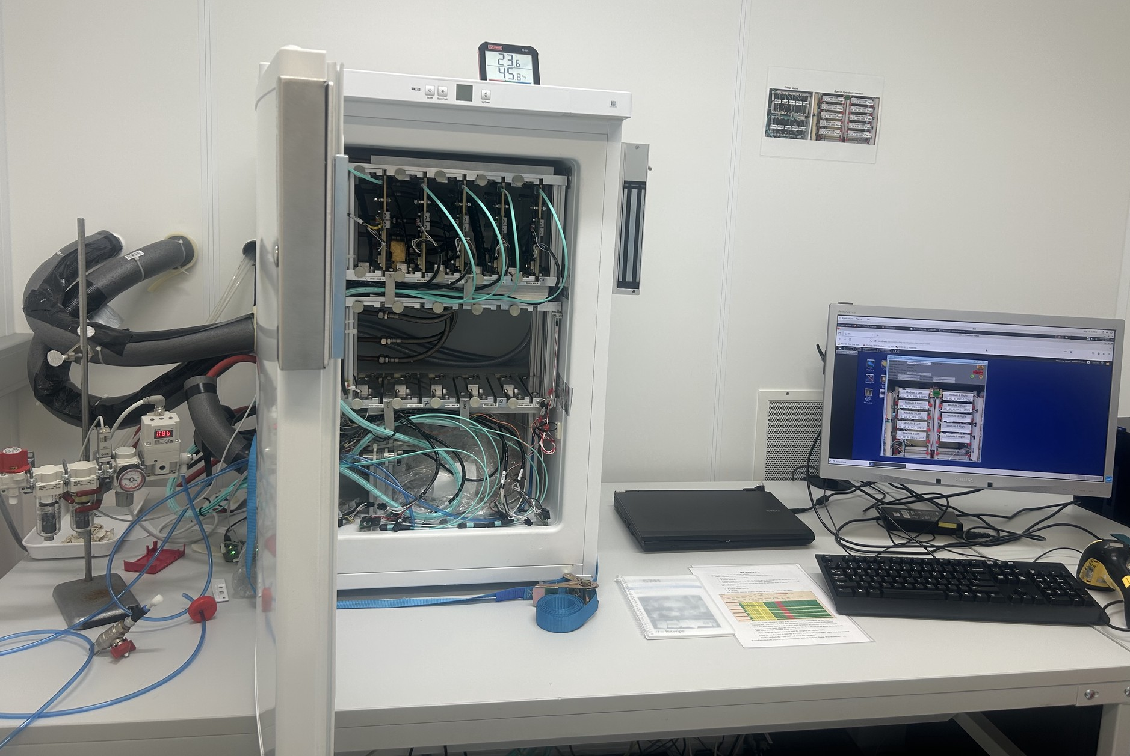
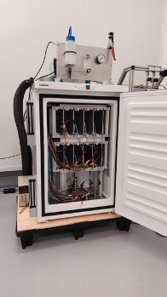
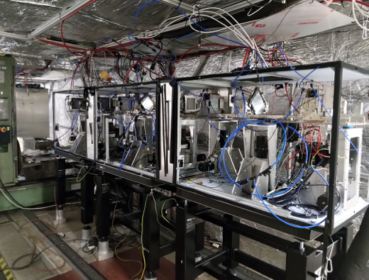
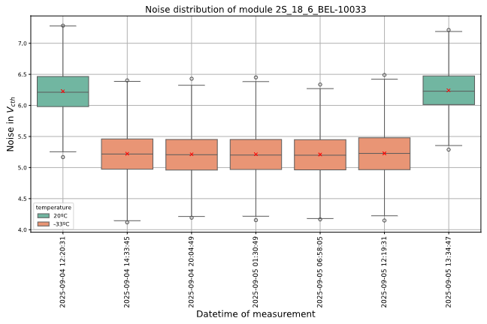
We make fine modules...
MUonE 2025 test run
7(→6) production modules out of 18
Two thermal cycling setups in Belgium
at IIHE at UCLouvain
Noise of a module at 20°C and -33°C during 5 thermal cycles

Slide 7
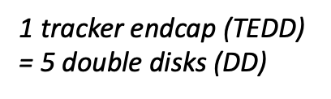


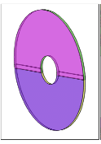
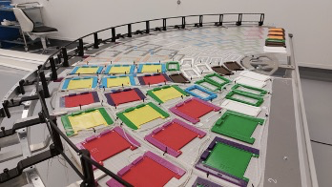
Dees and Double-Disks
In UCLouvain:
Design TEDD services
Design Dee integration process and deploy 1 Dee integration facility
Integrate 12 Dees
Deploy 1 of the 2 DD integration facilities
Integrate 5 DD
Also, Christophe Delaere is Outer Tracker project coordinator
1 Dee = 170 modules

Slide 8
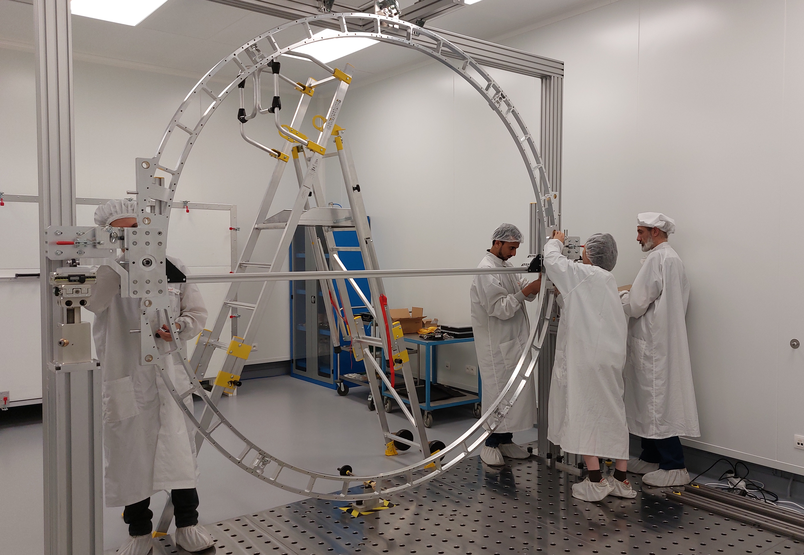
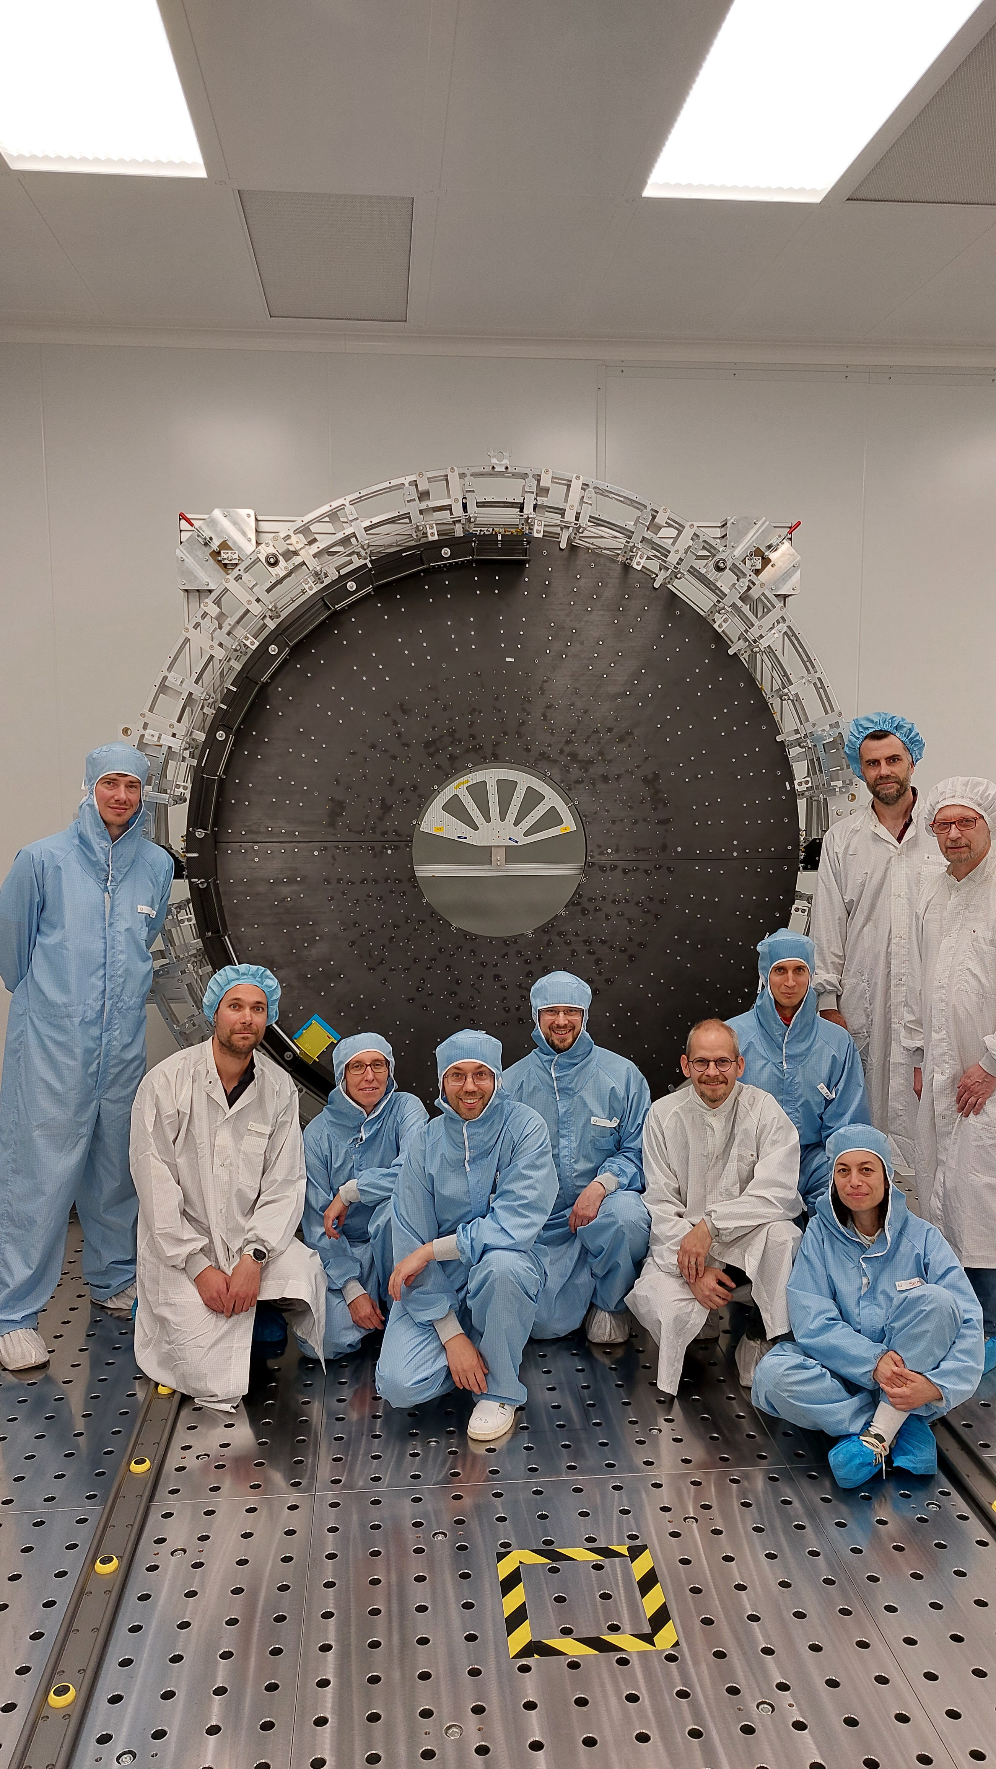
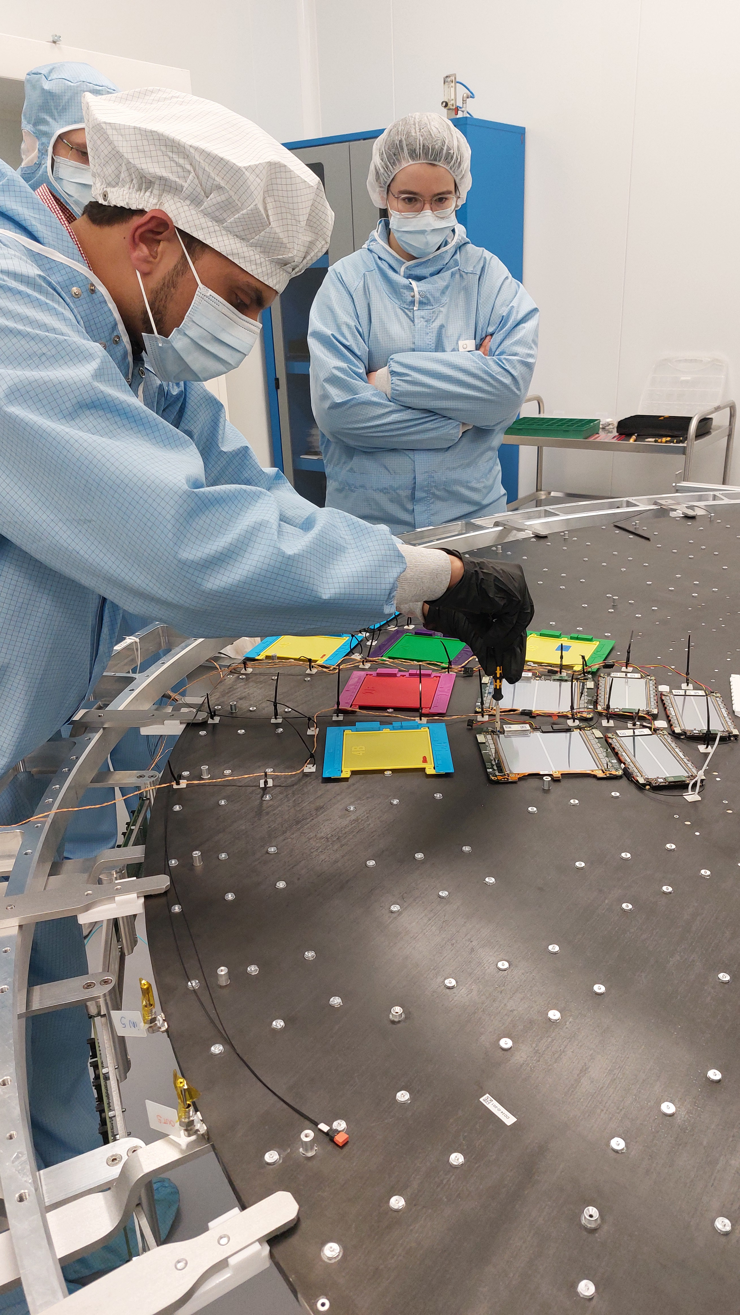
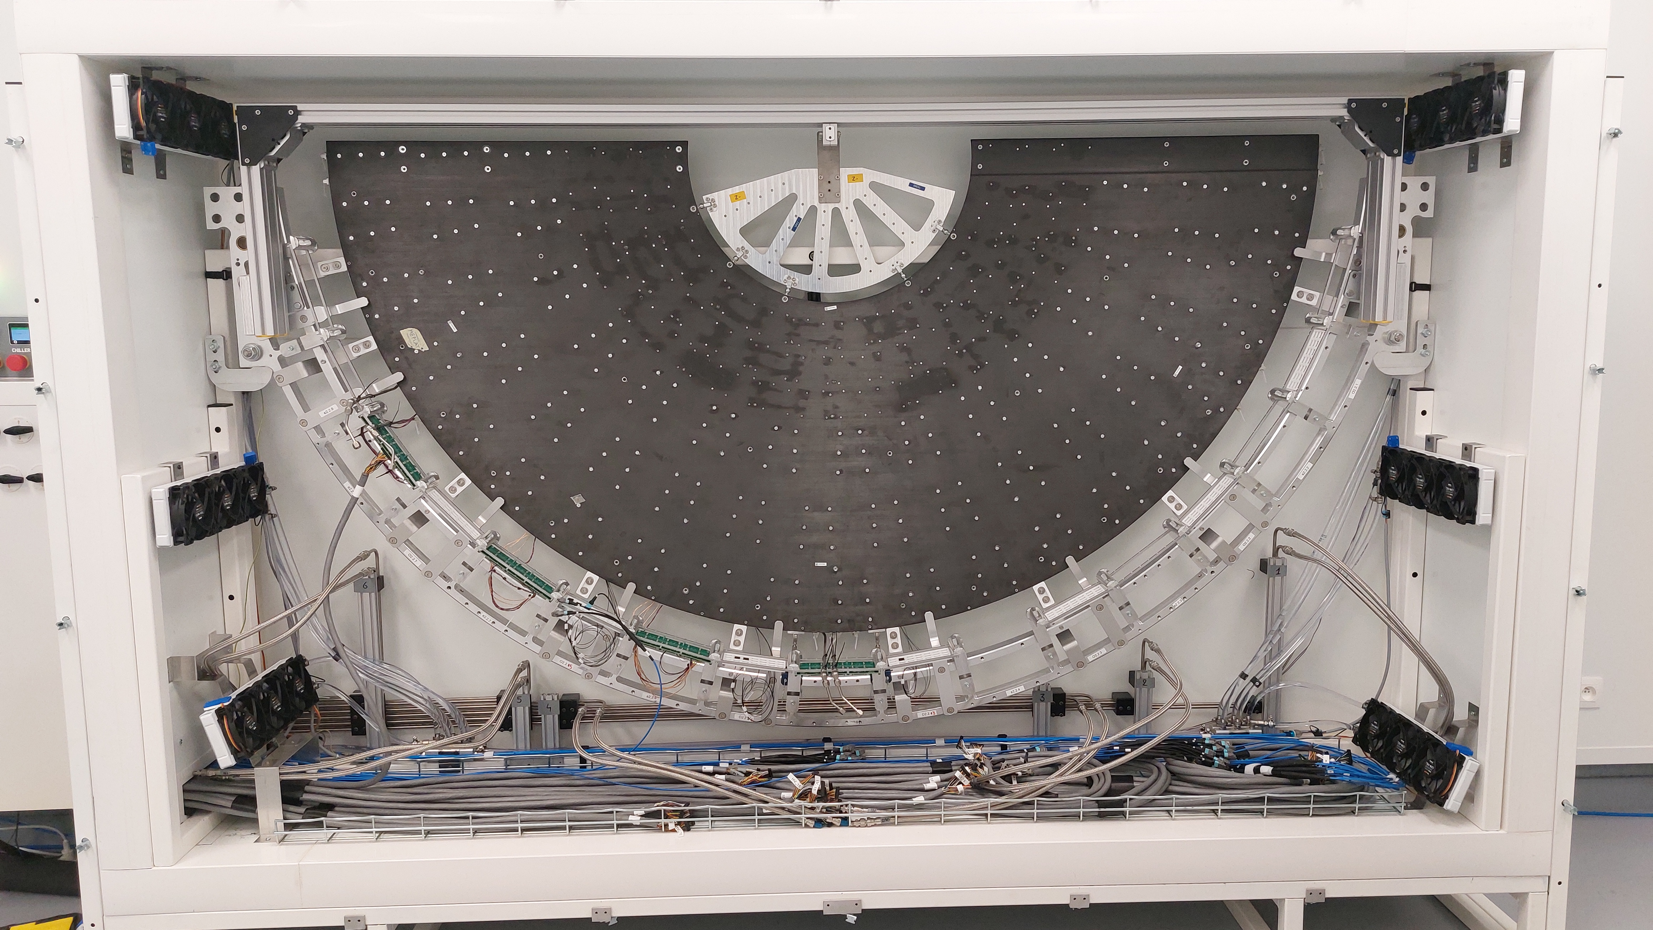
Dee and DD integration at UCLouvain
DD structure assembly exercise
Services design was validated with mockups
First Dee integration test done in April together with DESY and Lyon teams
Dee test box is functional
DD assembly was exercised successfully
Dee test box
Dee integration exercise

Slide 9
Tracker upgrade - financial contribution
Financially and personpower-wise, the largest Belgian contribution to a HEP project so far
~12M€ contribution to CORE, essentially all is paid already
~2M€ lab equipment
~50%/50% from both community research funds FNRS and FWO
a very important project for us
possible thanks to the strong and sustained support from our funding agencies

Slide 10
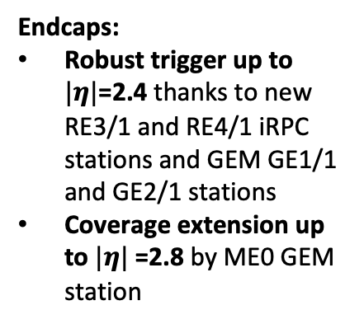
Muon system upgrade
Endcaps:
Robust trigger up to $|η|$=2.4 thanks to new RE3/1 and RE4/1 iRPC stations and GEM GE1/1 and GE2/1 stations
Coverage extension up to $|η|$=2.8 by ME0 GEM station
improved RPC stations
ME0 station
GEM stations
Belgium contributes to these two important upgrades of the CMS muon system

Slide 11
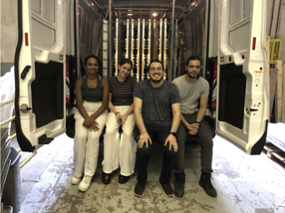
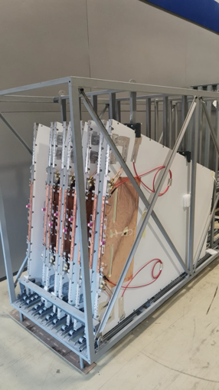
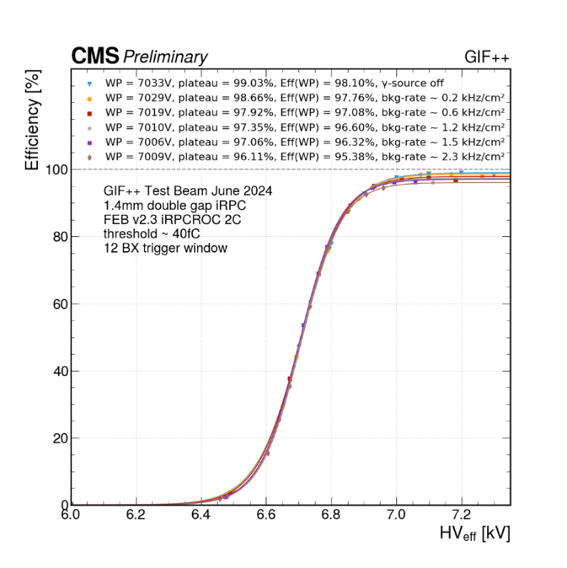

CMS iRPC
A major upgrade of the CMS muon system for HL-LHC
UGent is the main assembly site for CMS iRPC detectors, outside CERN
Built more than 20 RE3/1 and RE4/1 chambers in 2023
All chambers are tested for QCs (gas tight, cosmics, etc.)
Actively involved in test beams at CERN

Slide 12
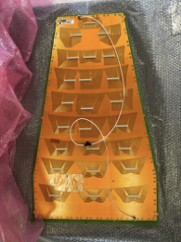
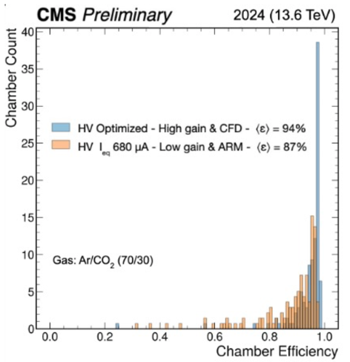
CMS GEM
UGent is one of the assembly sites for GEMs
ULB designed GEM readout board and contributed to tests of electronics
GE1/1 installation ended in 2020; taking data since
Belgium contributes to the operations and leads the online software developments (DAQ & Detector Control System)
Since 2014 UGent focuses on ME0
Management: Gilles De Lentdecker – GEM project manager (now Muon system project manager)

Slide 13
Muon system upgrade - financial contribution
No contribution to CORE cost
Supported essentially by R&D conventions

Slide 14
Teams
UAntwerpen: 1 research scientist (part-time), 1 engineer (part-time), 1 technician (main project), 1 PhD student (part-time)
UCLouvain: 1 academic (part-time), 1 research scientist (part-time), 2 post-doc researchers (full time), 2 PhD students (part-time); support from 1 designer, 1 technician, 2 electronics technicians and local workshop
UGent: 1 research scientist (part-time), 1 technician (part-time), 1 post-doctoral researcher (full time), up to 4 PhD students
ULB: 3 academic (part-time), 1.5 research engineers (part-time), 3.5 technicians (main project), 3 post-doctoral researchers (full time), 1.5 PhD students (R&D); part-time contribution of analysis team (7 post-doctoral researchers and 5 PhD students doing 1day/week); support from local IT staff
VUB: 2 academic (part-time), 2 research scientists or engineers (full time), 2 post-doctoral researchers (full time or main project), PhD students (R&D)
Since last RECFA visit, the number of tenured research engineers has improved
1 to 2 full-time research scientists or engineers are stabilized in each group
ratio of professors to engineers is still somewhat restrictive for detector R&D

Slide 15
Other points
funding PhD students to work on CMS detector upgrade is difficult
competitive calls effectively favour theses in data analysis
funding personpower to prepare phase-2 data analysis is not easy
competition with Run 3 operations and analysis
Thank you for your attention !

Slide 16
backup

Slide 17
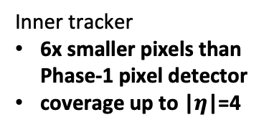
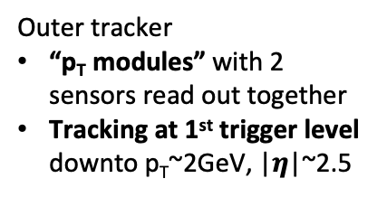
Tracker
Outer tracker
“p_{T} modules” with 2 sensors read out together
Tracking at 1st trigger level downto p_{T}~2GeV, |$η$|~2.5
Inner tracker
6x smaller pixels than Phase-1 pixel detector
coverage up to |$η$|=4
p_{T} resolution
d₀ resolution
More precise track parameters compared to Phase-1 tracker
Extended coverage, allowing e.g. better forward jet reconstruction

Slide 18
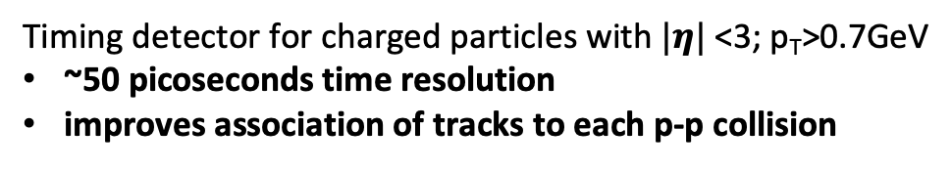
MIP Timing Detector
Improves lepton isolation
Makes b-tagging robust wrt. pile-up
Allows velocity measurement for massive particles
For charged particles
For neutral particles when decay vertex is reconstructed
Timing detector for charged particles with $|η|$<3; p_{T}>0.7GeV
~50 picoseconds time resolution
improves association of tracks to each p-p collision
Endcap timing layer (ETL)
Ultrafast Si detectors (low-gain APD)
~1x3mm² pixels
Barrel timing layer (BTL)
LYSO:Ce crystals + SiPM
~1cm² cells

Slide 19
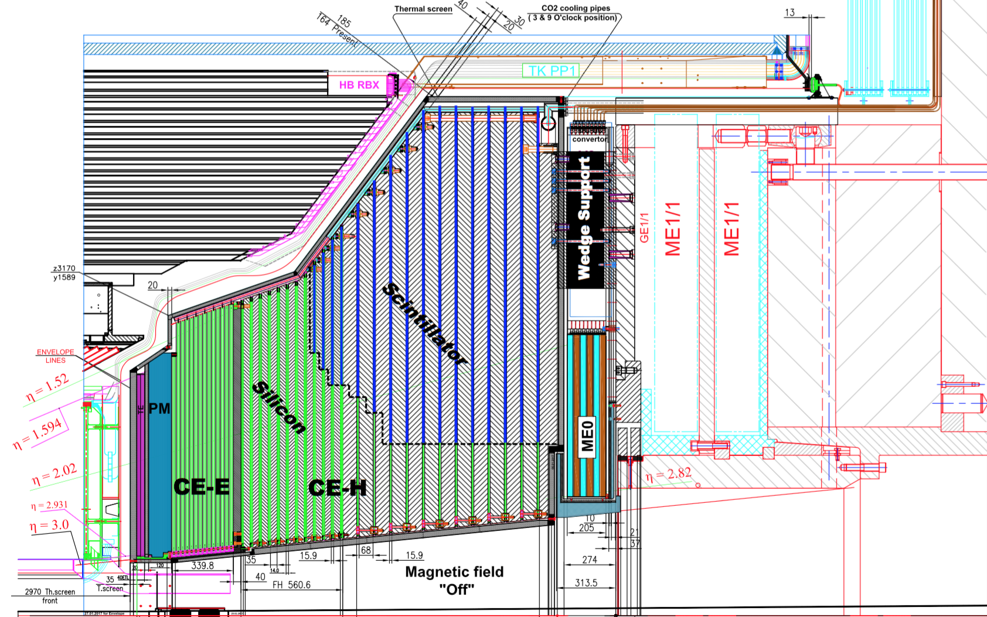
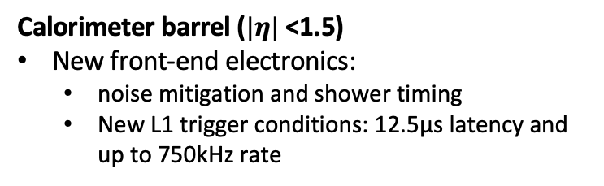
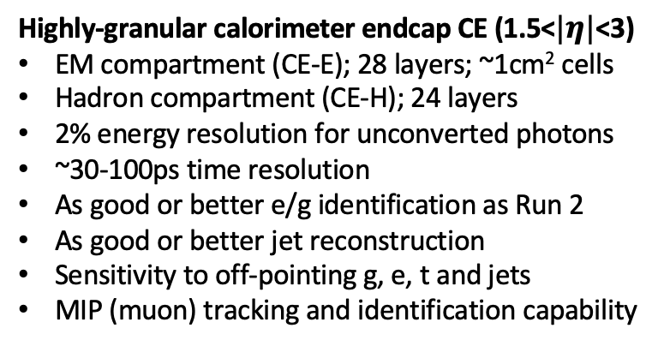
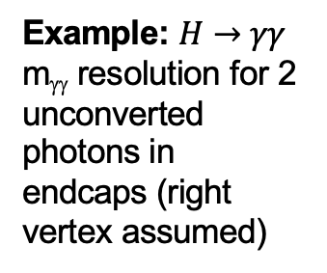
Calorimeters
Highly-granular calorimeter endcap CE (1.5<$|η|$<3)
EM compartment (CE-E); 28 layers; ~1cm² cells
Hadron compartment (CE-H); 24 layers
2% energy resolution for unconverted photons
~30-100ps time resolution
As good or better e/g identification as Run 2
As good or better jet reconstruction
Sensitivity to off-pointing g, e, t and jets
MIP (muon) tracking and identification capability
Example: $H→γγ$
m_{γγ} resolution for 2 unconverted photons in endcaps (right vertex assumed)
Calorimeter barrel ($|η|$<1.5)
New front-end electronics:
noise mitigation and shower timing
New L1 trigger conditions: 12.5µs latency and up to 750kHz rate

Slide 20
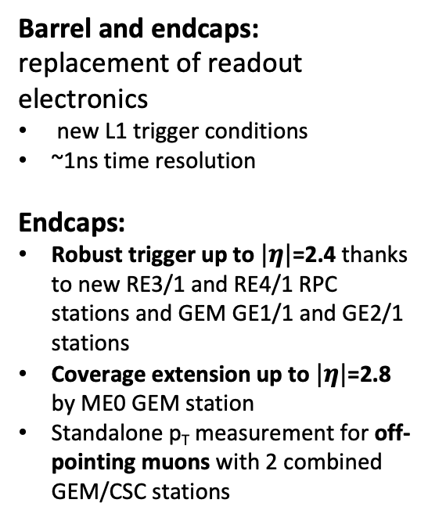
Muon system
improved RPC stations
Barrel and endcaps: replacement of readout electronics
new L1 trigger conditions
~1ns time resolution
Endcaps:
Robust trigger up to $|η|$=2.4 thanks to new RE3/1 and RE4/1 RPC stations and GEM GE1/1 and GE2/1 stations
Coverage extension up to $|η|$=2.8 by ME0 GEM station
Standalone p_{T} measurement for off-pointing muons with 2 combined GEM/CSC stations
ME0 station
GEM stations

