Slide 1

RECFA Visit to Belgium
Dr. Hans Willems, Secretary-General Research Foundation – Flanders
September 12, 2025
Classificatie 2

Slide 2
Agenda
R&D in Flanders
About the FWO
Flanders’ funding of high-energy physics

Slide 3
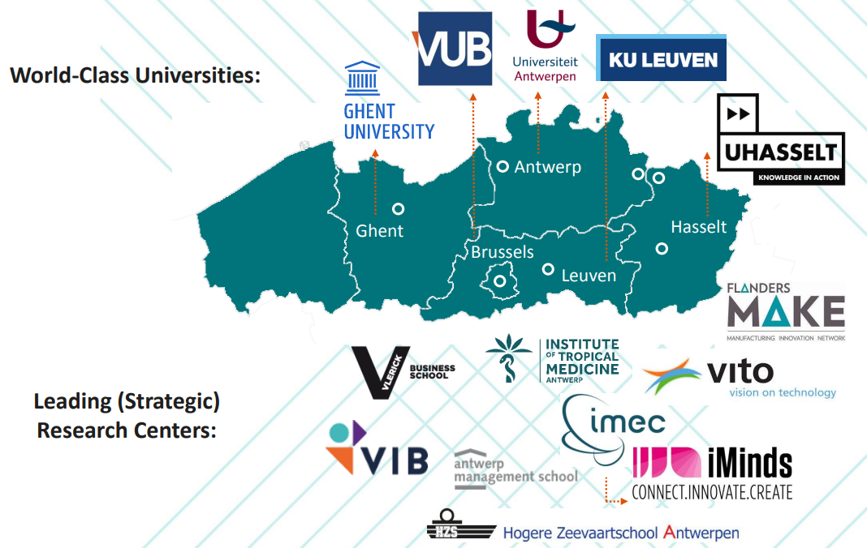
Main Research Performing Centers

Slide 4
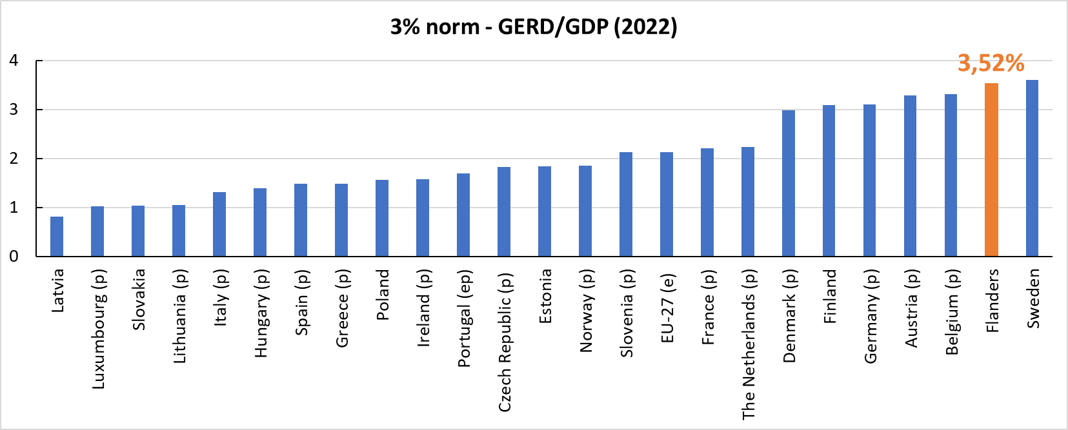

R&D investments: ± 3,52 % GDP (Flemish Region – 2023) ± 3,61 % GDP (Flemish Community – 2023) (population: ± 6.850.000 in 2025)
R&D personnel: ± 73.100 FTE (Flemish Community 2023) (1% population – 2,12% working force) (2021)
Totale O&O-intensiteit in Vlaanderen 2013-2023 “3% nota” (juli 2025), ECOOM, p.12

Slide 5
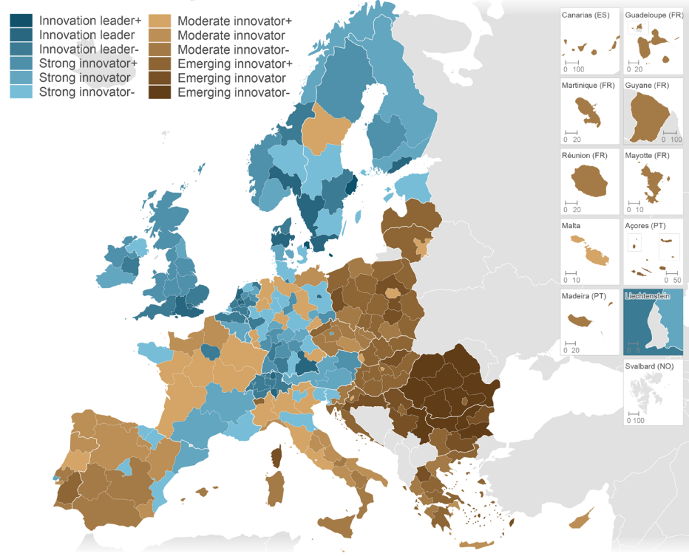
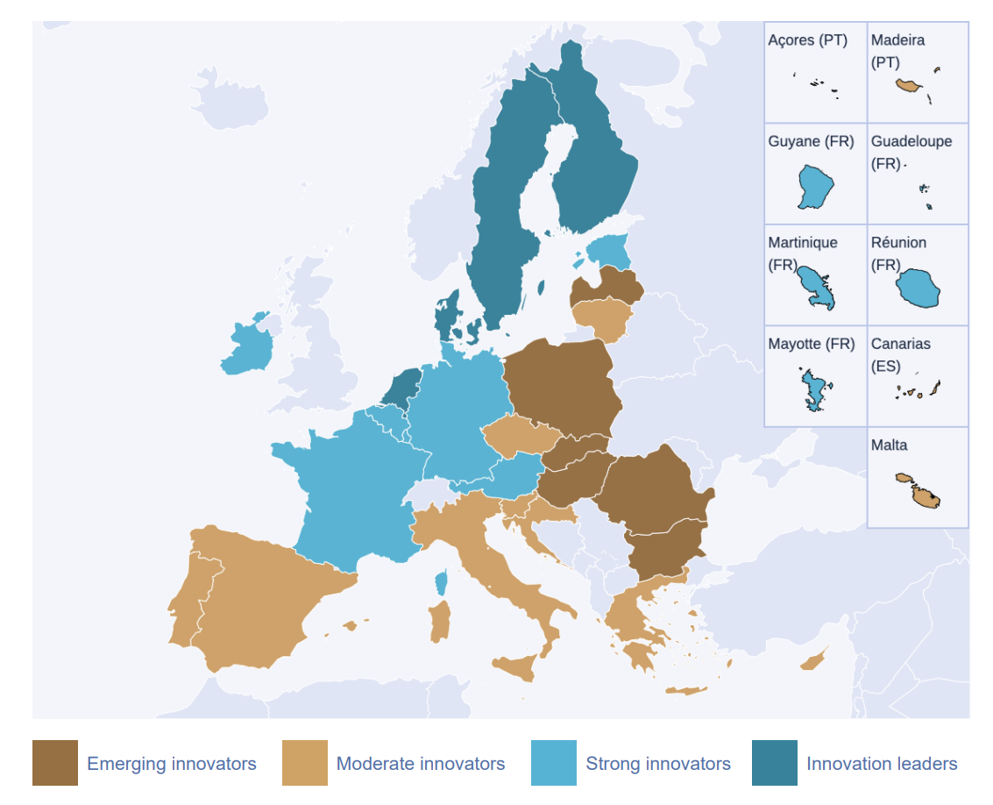
Regional Innovation Scoreboard 2025: Flanders – 31st (out of 246 regions) as innovation leader
European Innovation Scoreboard 2025: Belgium – 6th place as strong innovator
European Innovation Scoreboard 2025, EC, p. 10; Regional Innovation Scoreboard 2025, EC, p. 7;
Classificatie 4

Slide 6
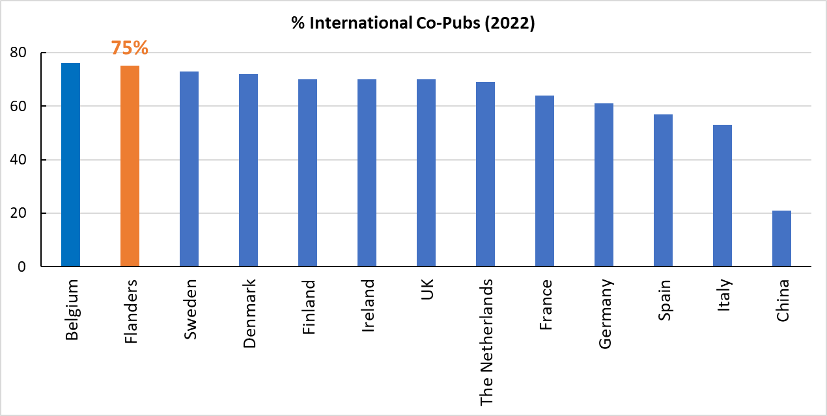
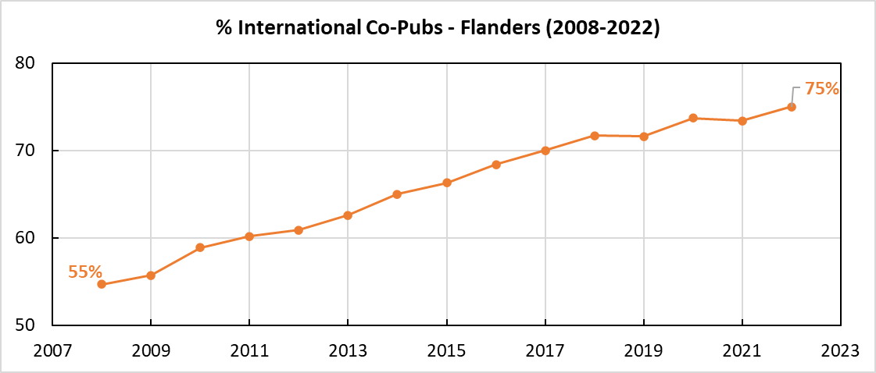
Scientific papers
almost 1% world (2022) – ± 33/10.000 inhabitants (2022)
75% of publications have international co-author (2022)
Vlaams Indicatorenboek 2023, ECOOM, 4.1.5

Slide 7
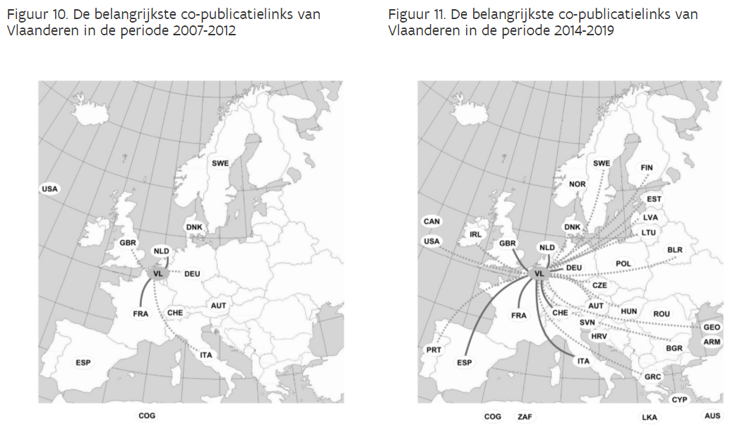
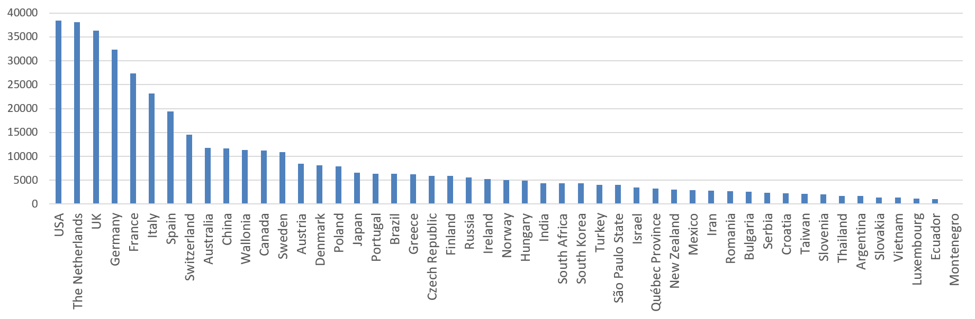
WoS Co-Publications Flanders period 2008-2021 (20/05/2021)
Vlaams Indicatorenboek 2023, ECOOM, 4.1.5 H2020 country profiles - Belgium

Slide 8
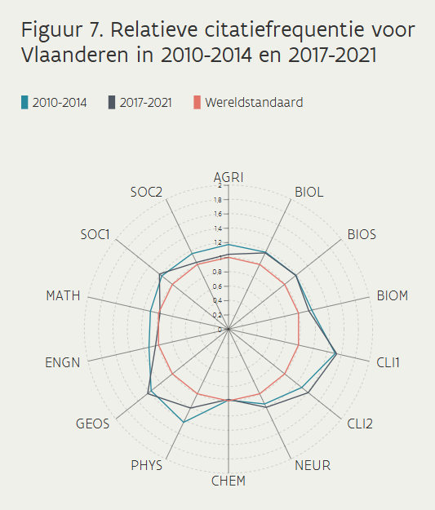
Relative Citation Frequency Flanders
World standard

Slide 9


About the FWO
Funding of fundamental & strategic research
Funding programmes
Individual researchers (pre-, post-doc, mobility)
Research teams (projects, SBO, TBM, brain gain Odysseus,…)
Research infrastructure
Scientific prizes
Bottom-up in all disciplines
Scientific excellence and interuniversity competition
Transparent and equal opportunities

Slide 10
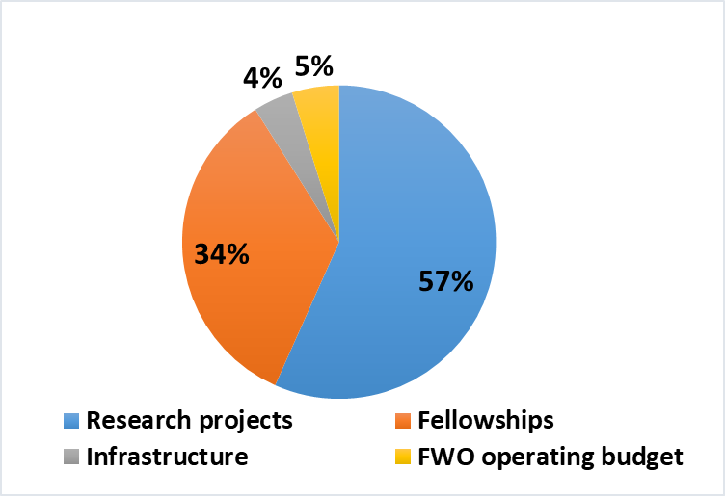



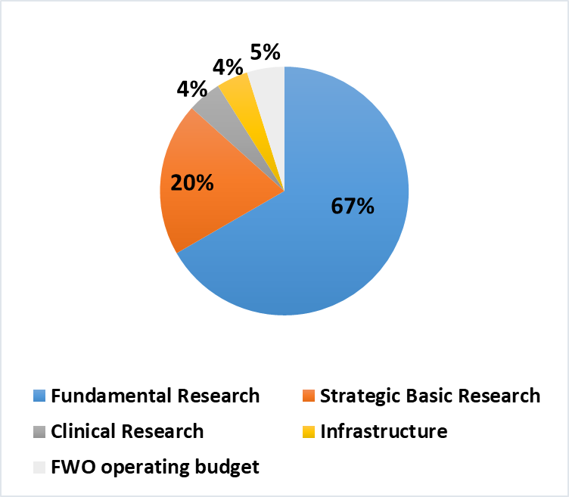



Budget 2025:
445 mio EUR
± 1150 Predocs (basic)
± 850 Predocs (strategic basic)
± 900 Postdocs
± 2400 Predoc&Postdoc (projects)
69% Predocs 31%
49% Postdocs 51%
24,4% Predocs (basic)
29,8% Predocs (strategic basic)
17,3% Postdocs Junior
23,6% Postdoc Senior
17% Projects
55% Predocs 45%
46% Postdocs 54%
2024

Slide 11
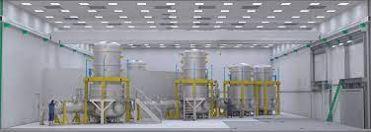
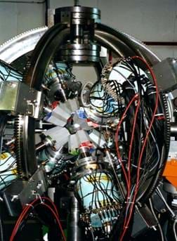
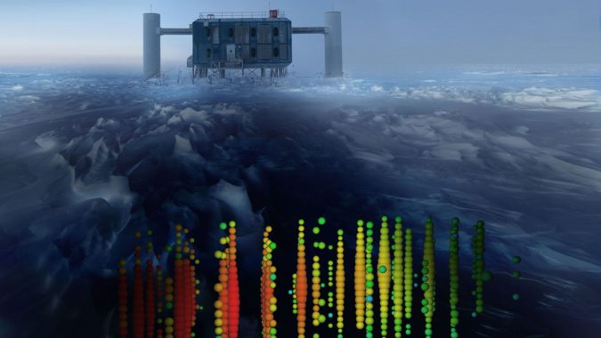
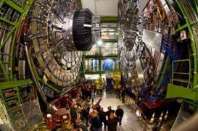
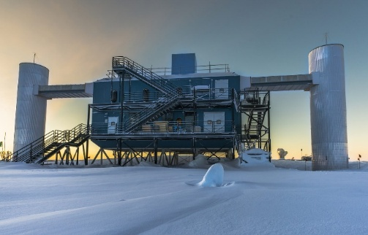
The importance of High-Energy Physics
Combined efforts leading to some of the largest scientific collaborations in the world.
10.000+ publications
1.500+ researchers
1.000+ projects

Slide 12
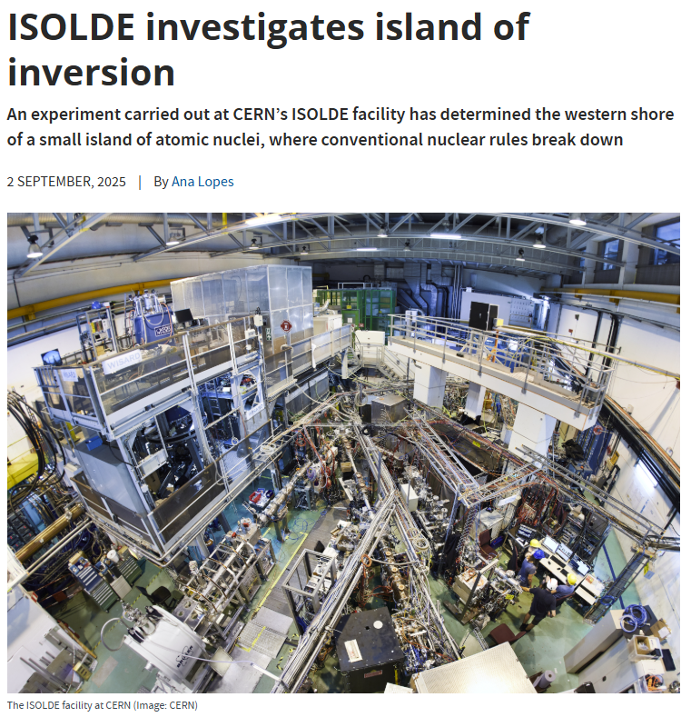
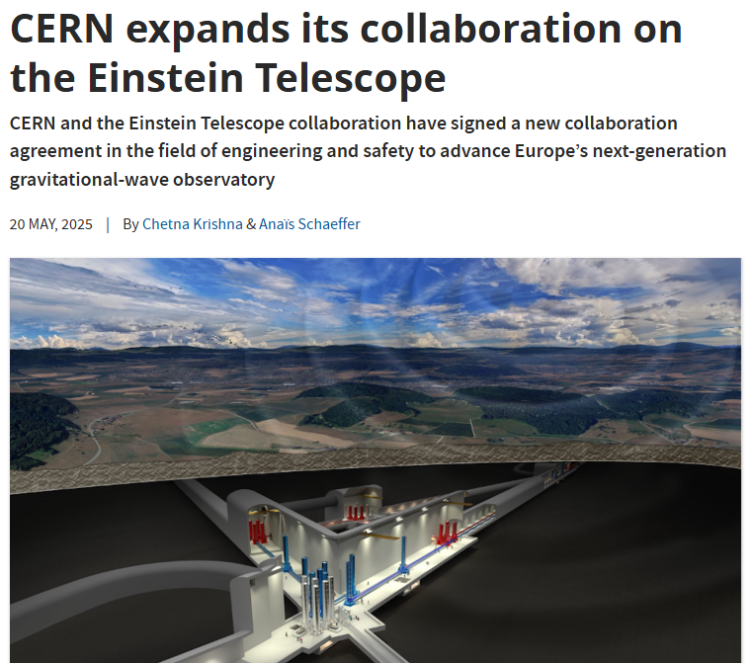
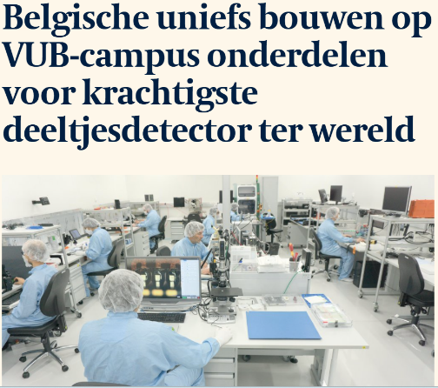
Flanders’ funding of high-energy physics
The FWO invests in the following projects:
● CERN ● Einstein Telescope
● IceCube ● ISOLDE-SPIRAL2
● …

Slide 13
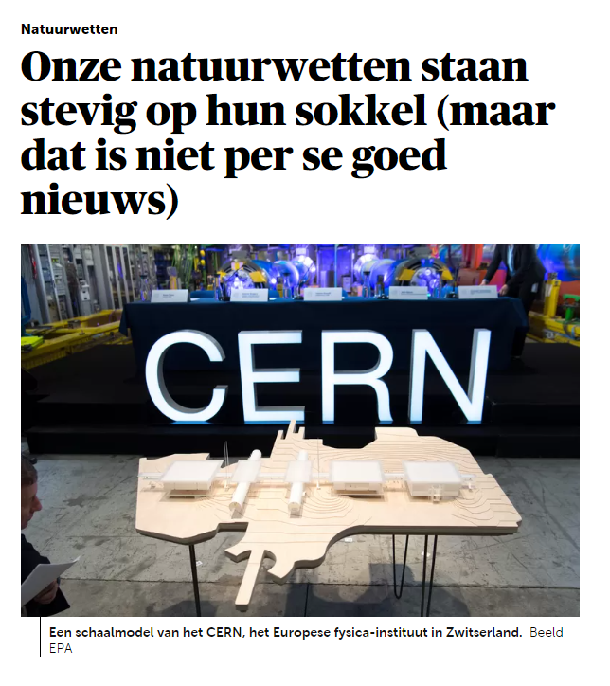
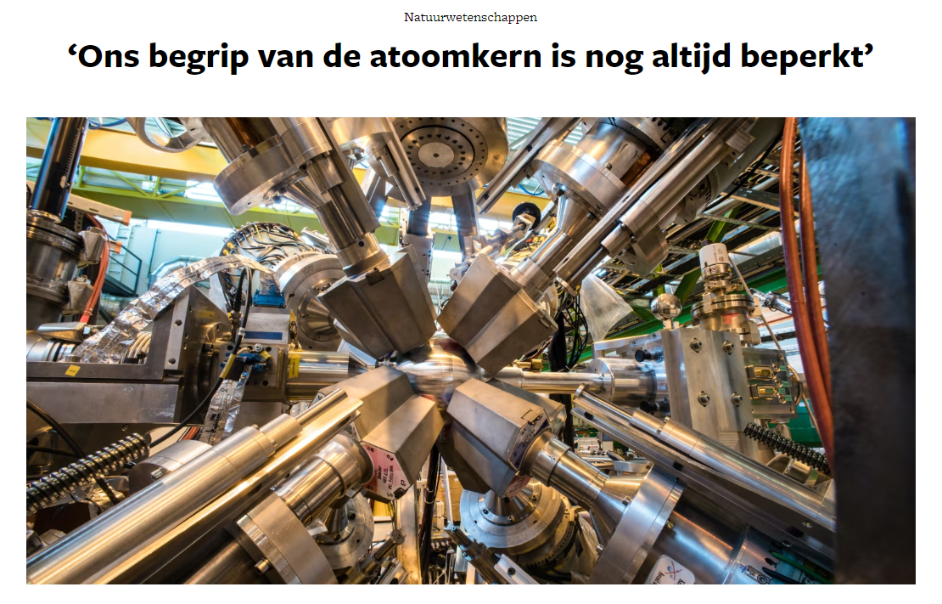
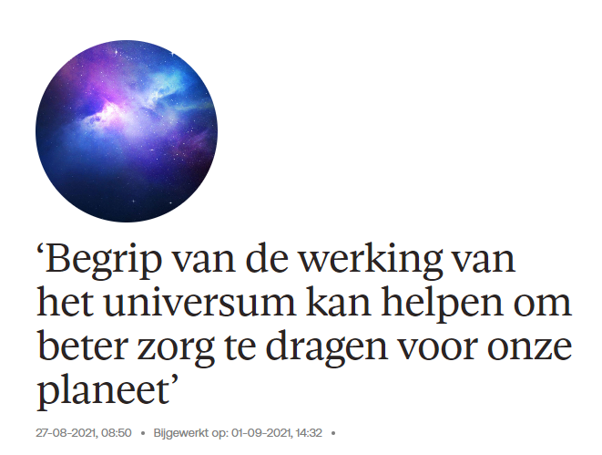
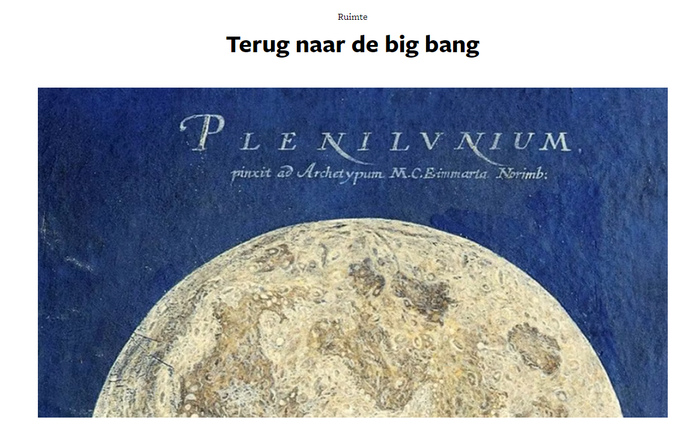
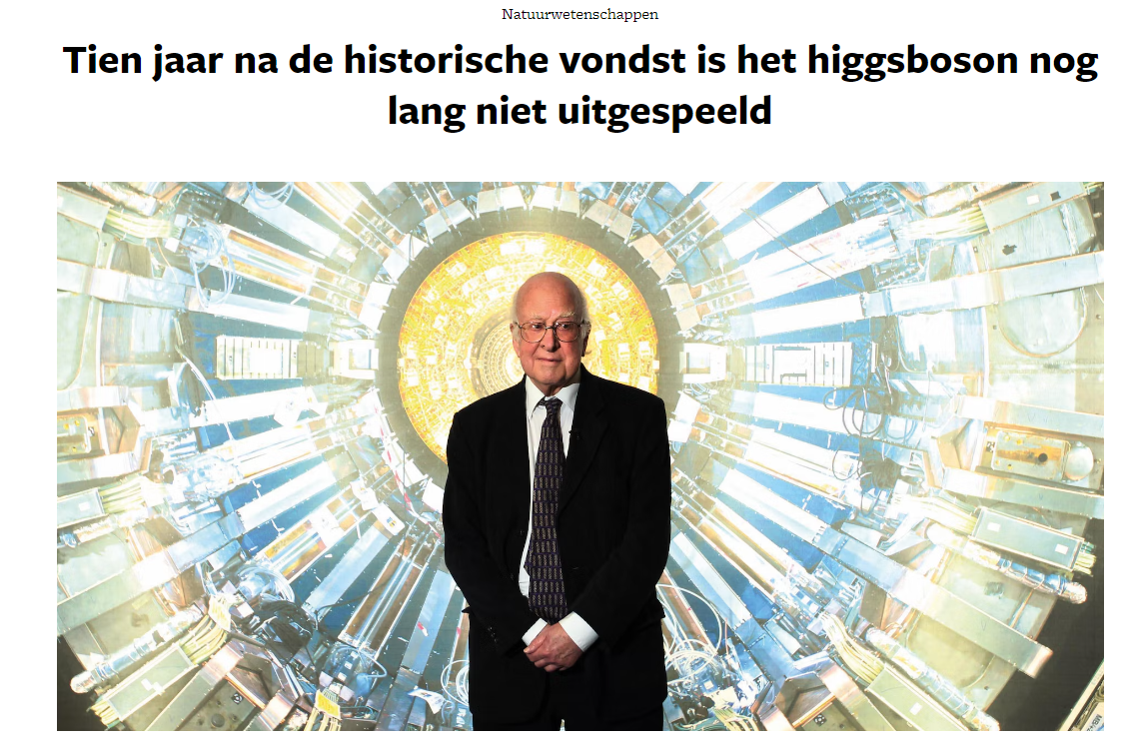
Project in the spotlight - CERN
Notes:
With the 27 km circumference Large Hadron Collider (LHC) at CERN and the monumental detectors around it, scientists from all over the world have access to the most advanced tools to continue this exploration.
The Compact Muon Solenoid (CMS) detector allows to investigate and test many theoretical ideas that are being proposed to answer these questions.

Slide 14
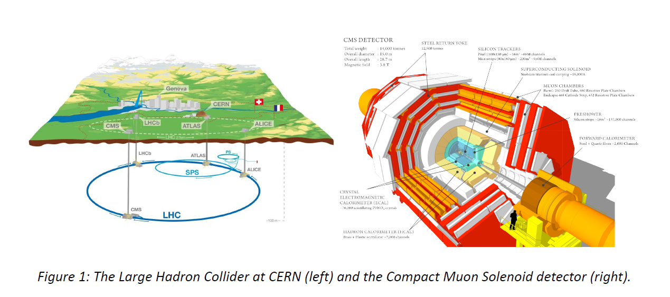
Project in the spotlight - CERN
Notes:
With the 27 km circumference Large Hadron Collider (LHC) at CERN and the monumental detectors around it, scientists from all over the world have access to the most advanced tools to continue this exploration.
The Compact Muon Solenoid (CMS) detector allows to investigate and test many theoretical ideas that are being proposed to answer these questions.

Slide 15
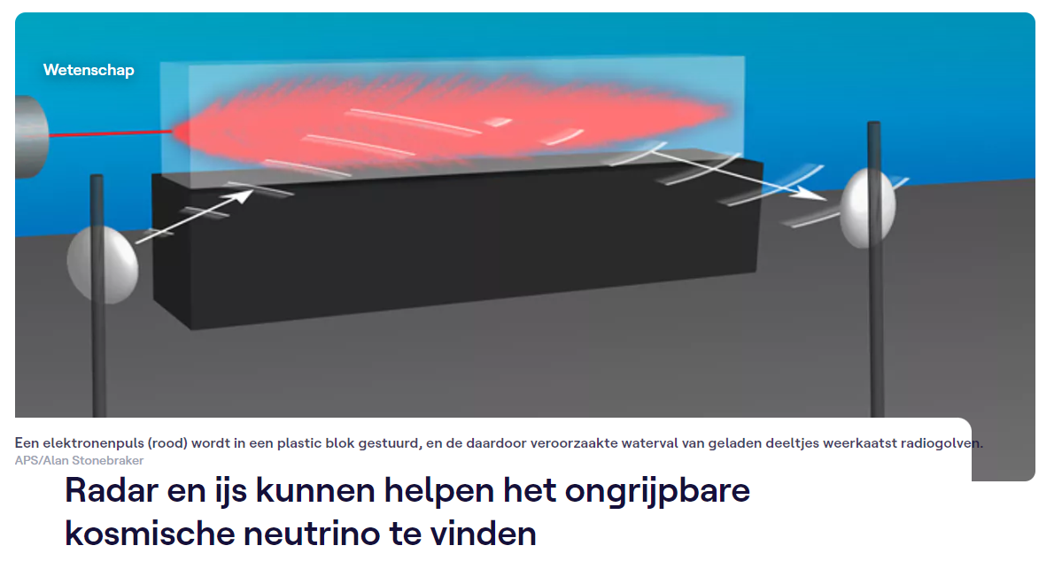
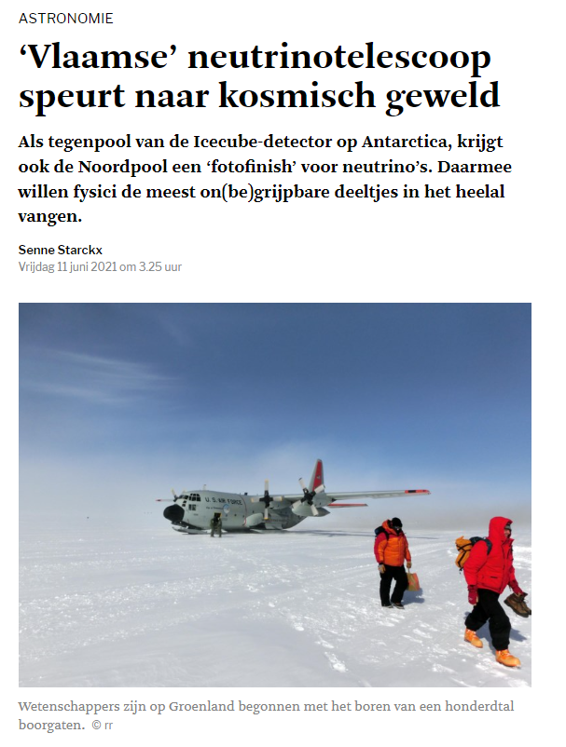
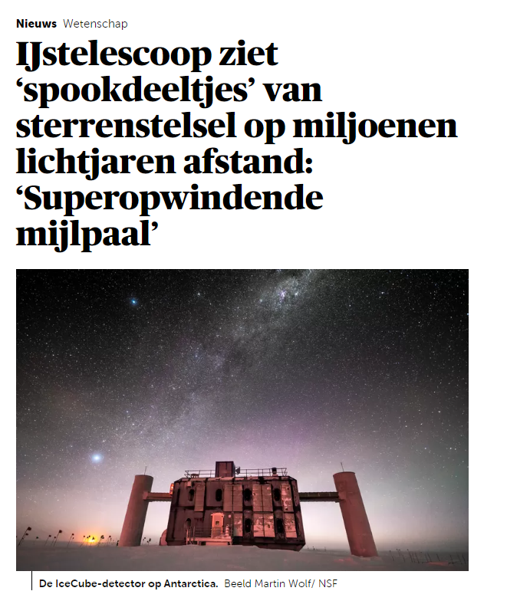
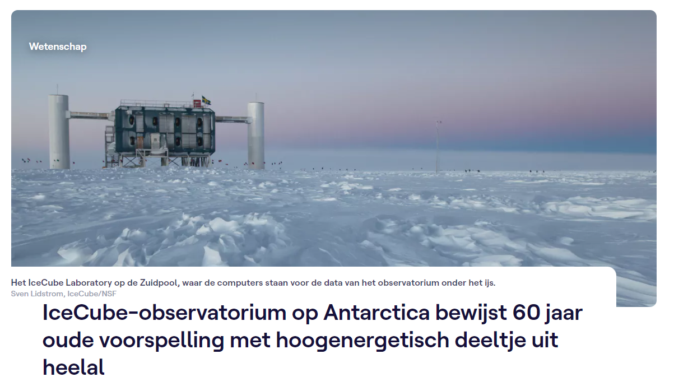
Project in the spotlight - ICECUBE
Notes:
The discovery of cosmic high-energy neutrinos by IceCube has opened a new era, dubbed neutrino astronomy and announced as the “breakthrough of 2013”.
The sources of the cosmic neutrinos still remain a mystery, but one expects that they originate from the same cataclysmic phenomena as the cosmic rays.
As such, cosmic high-energy neutrinos will enable us to identify the sources of cosmic rays and obtain insight in the inner engines of cosmic phenomena.
The IceCube observations have indicated that to achieve this.

Slide 16
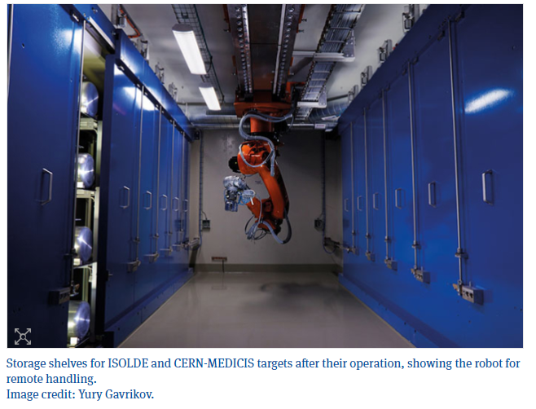
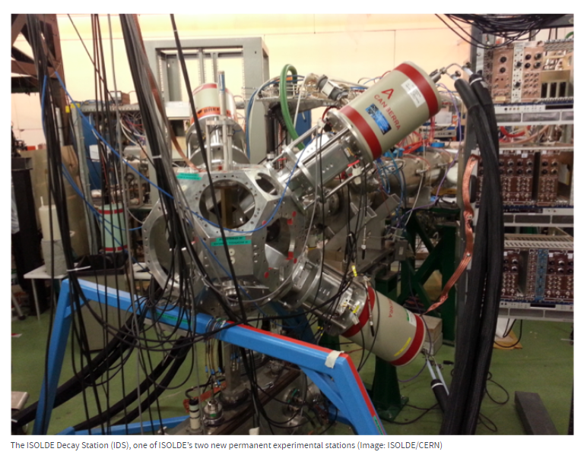
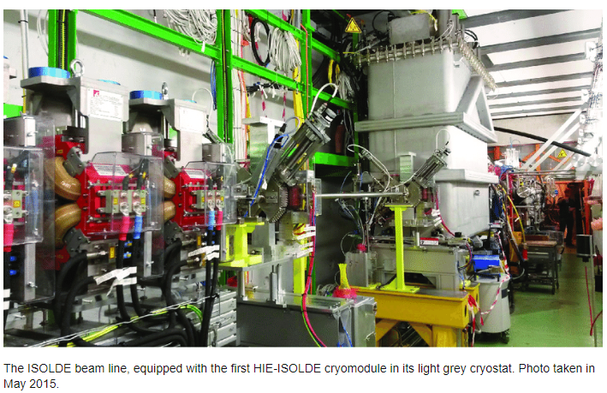
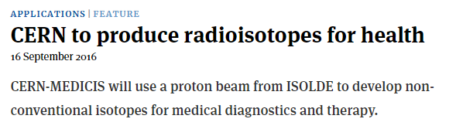
Project in the spotlight – ISOLDE-SPIRAL 2

Slide 17
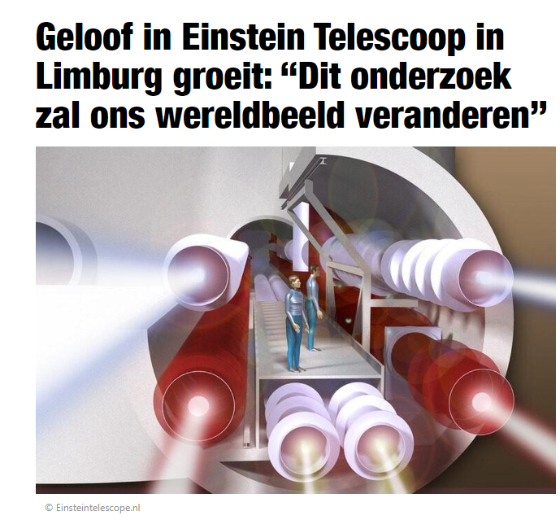
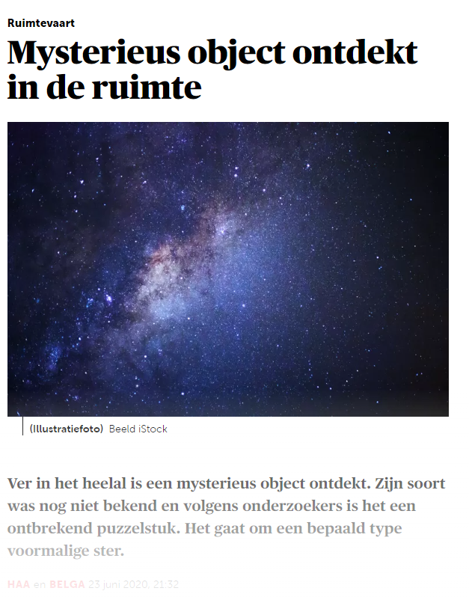
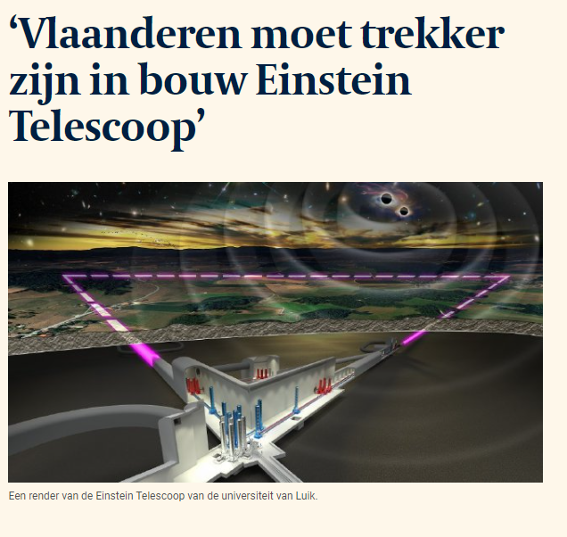
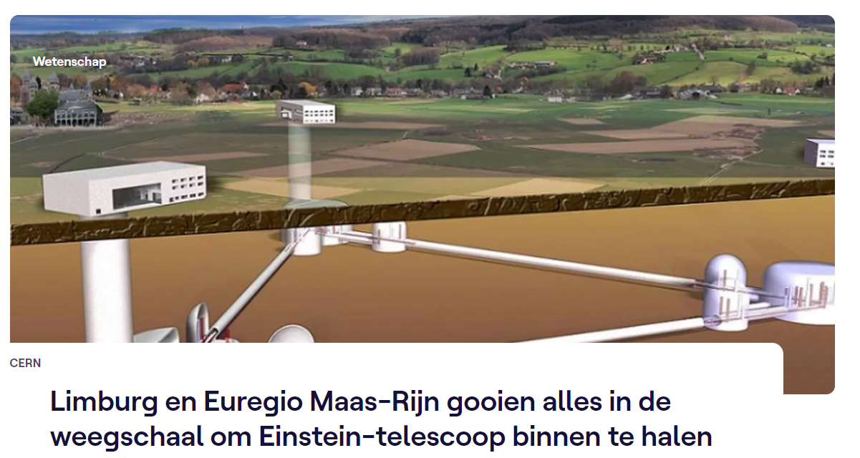
Project in the spotlight – EINSTEIN-TELESCOPE
Notes:
The first detections of gravitational waves since 2015 and the dawn of the multi-messenger astronomy era have demonstrated the enormous scientific potential of gravitational-wave observatories and provided a solid basis for the future of gravitational-wave (astro-)physics.
The Einstein Telescope is envisioned as the pioneer of a new generation of gravitational wave detectors designed to realize this potential.
The Belgian-Dutch-German border area is identified as a promising location to site the Einstein Telescope.

Slide 18
Thank you for your attention

