Slide 1
RECFA Visit to Belgium Dr. Ir. Véronique Halloin, F.R.S.-FNRS Secretary General 12 September 2025
Notes:
Dear all,
Thank you for inviting me to take the floor today in my capacity of secretary general of the FNRS, 8 years after the last recfa visit to Belgium

Slide 2
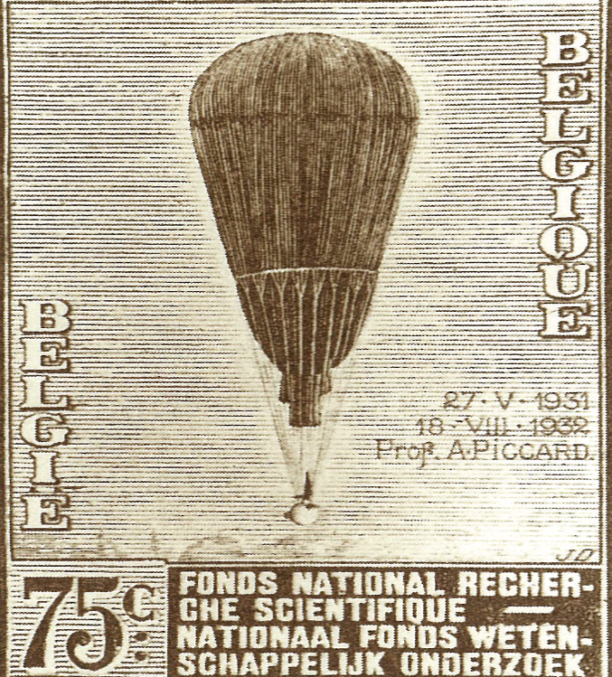
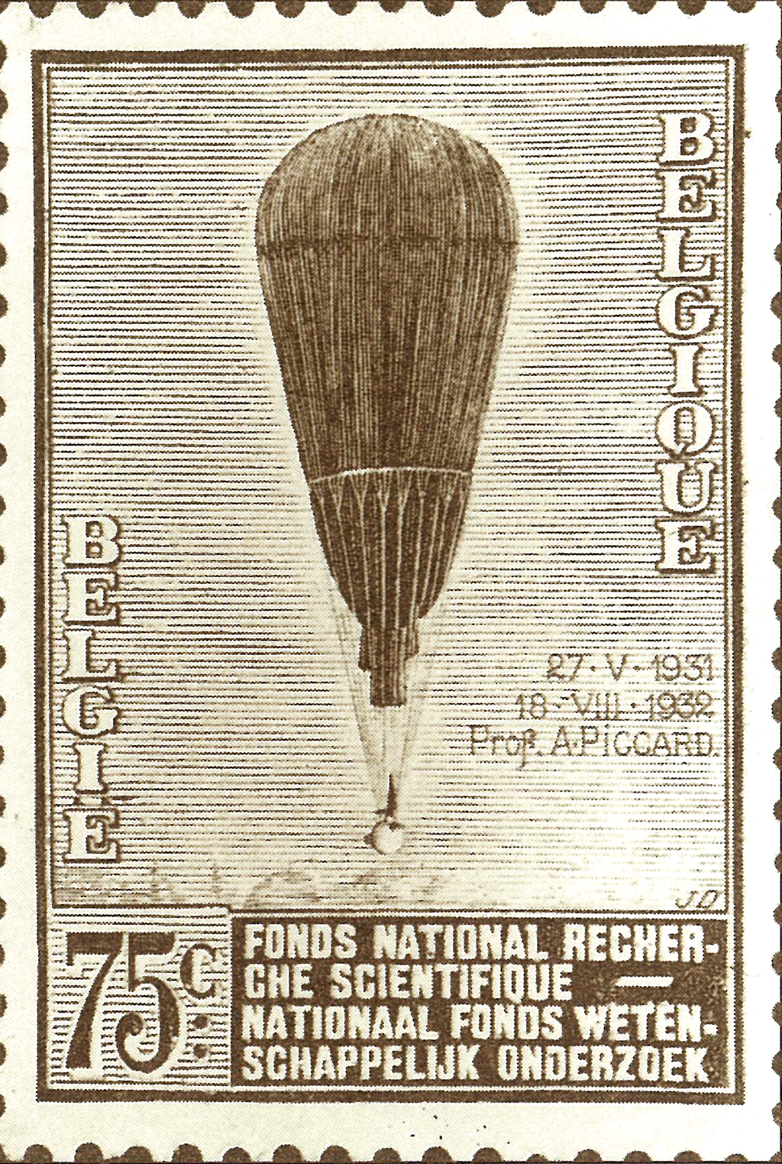
BELGIUM & HIGH-ENERGY PHYSICS : A PIONEERING ROLE…
FNRS
National Fund for Scientific Research
FWO (Flanders)
&
F.R.S.-FNRS (FNRS – French Community)
1928
Notes:
First of all, I'd like to point out that Belgium played a pioneering role in the development of high-energy physics, thanks in particular to the FNRS, the national fund for scientific research, created in 1928 as a private foundation of public utility.
It was one of the first research funding agencies in Europe.
The fnrs is no longer national, due to the evolution of the Belgian political landscape. In the early nineties, it has been split into two separate funding agencies: the FWO for the Flemish region and the F.R.S.-FNRS, for French speaking belgium, which I'll call FNRS hereafter for brevity's sake.

Slide 3
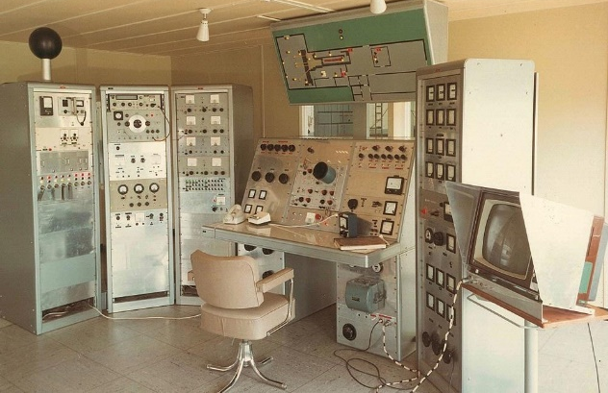
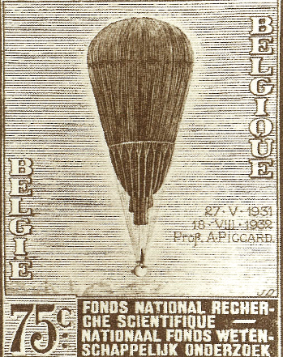


BELGIUM & HIGH-ENERGY PHYSICS : A PIONEERING ROLE…
Interuniversity Institute for Nuclear Science
1928
1947
Notes:
The IISN, Interuniversity Institute for Nuclear Sciences, was created in 1947 to contribute to the study of one of the biggest concerns of the latter half of the 20th century: the basic constituents of matter.

Slide 4



BELGIUM & HIGH-ENERGY PHYSICS : A PIONEERING ROLE…
Belgium: one of the
12 founding States
1928
1947
1954
Notes:
This was quite pioneering; indeed, CERN was created 8 years later, in 1954. Belgium was one of the 12 founding member States.

Slide 5
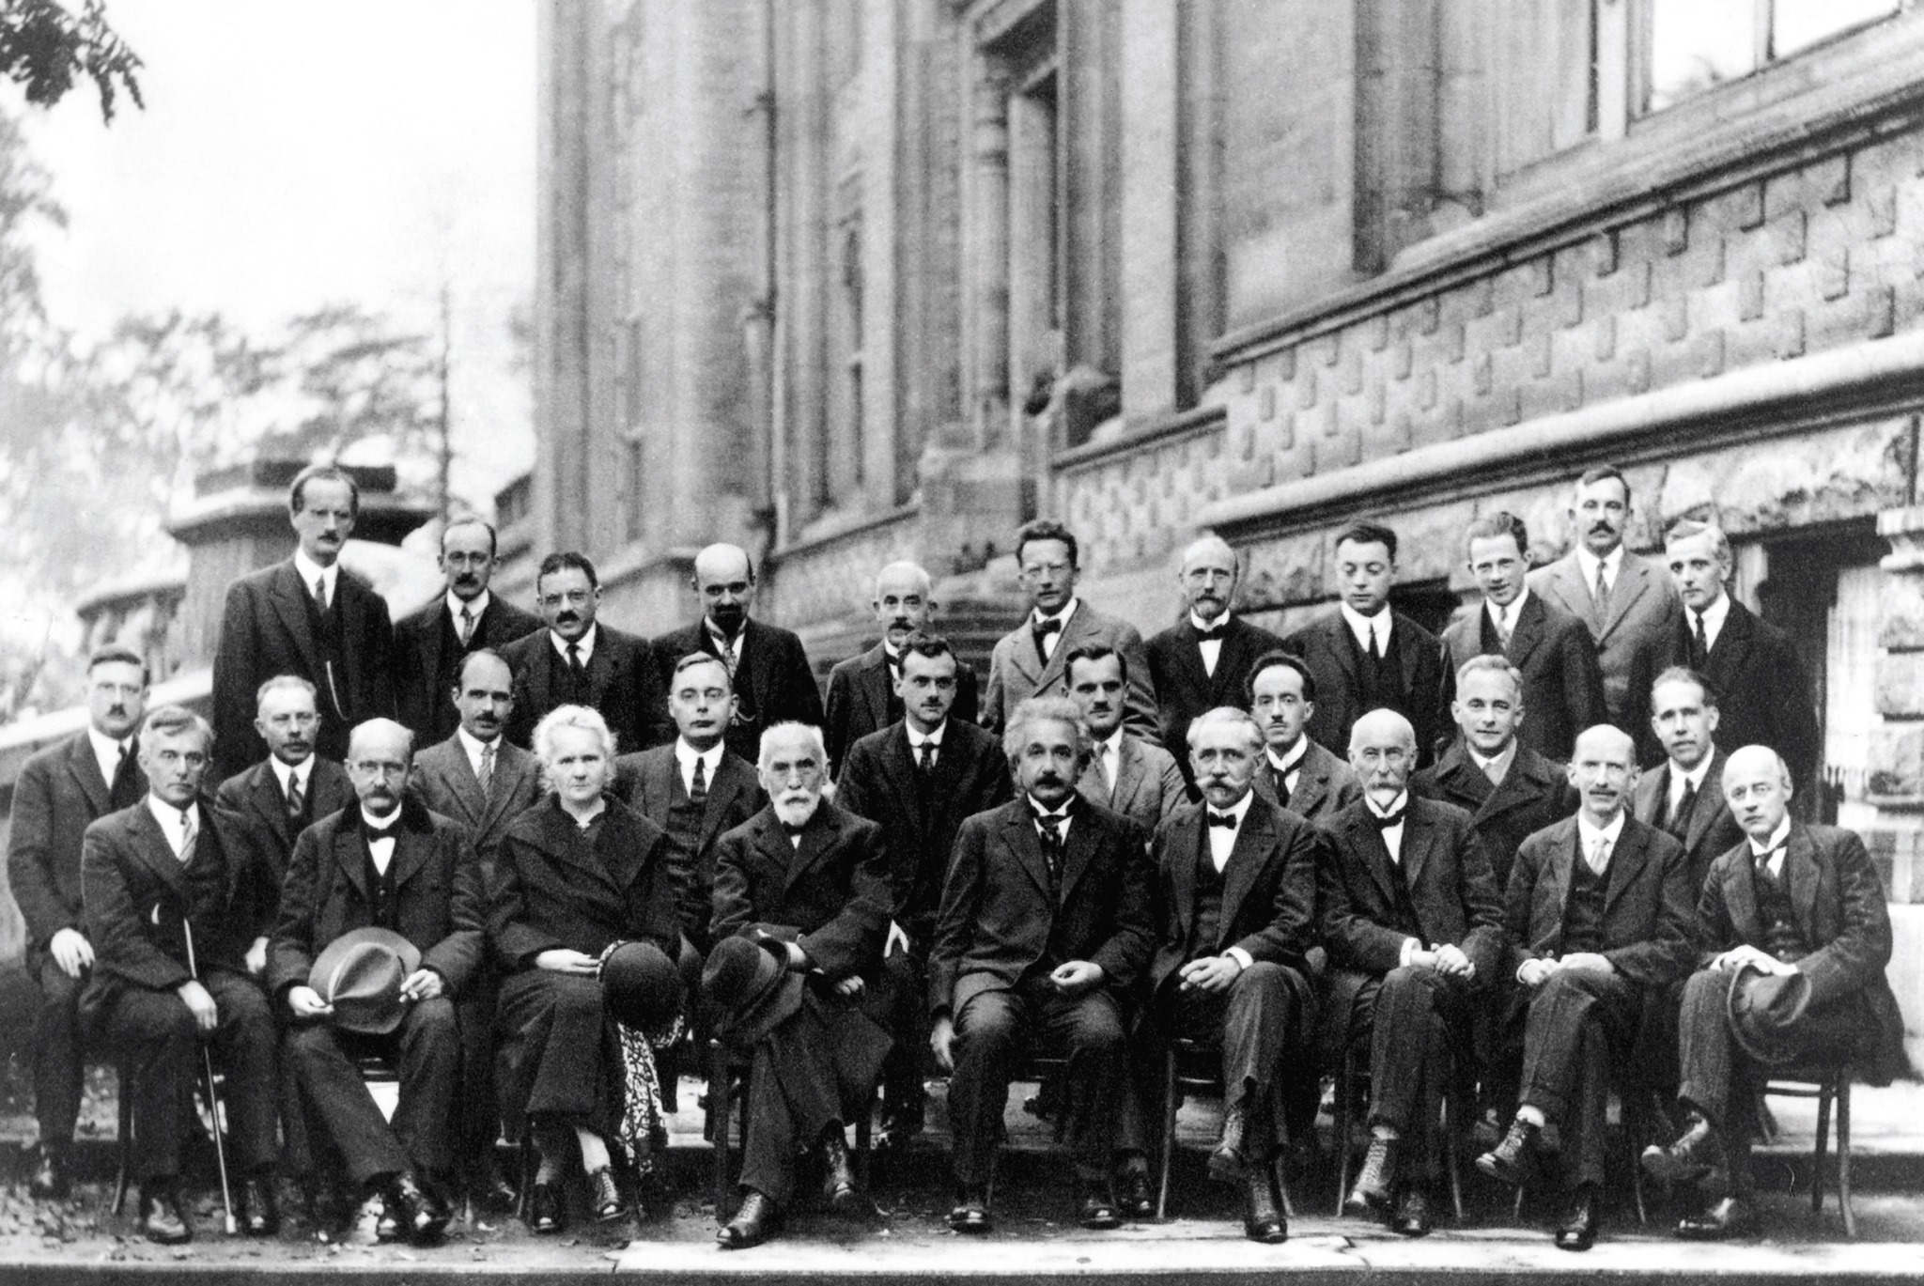
BELGIUM & HIGH-ENERGY PHYSICS : A PIONEERING ROLE…
International Solvay Institutes
for Physics
1912
1928
1947
1954
Notes:
And if we talk about belgium's pioneering role in physics, it would be a shame not to mention the criation of the International Solvay Institute for Physics by Ernest Solvay in 1912.
Who are still very active today.

Slide 6
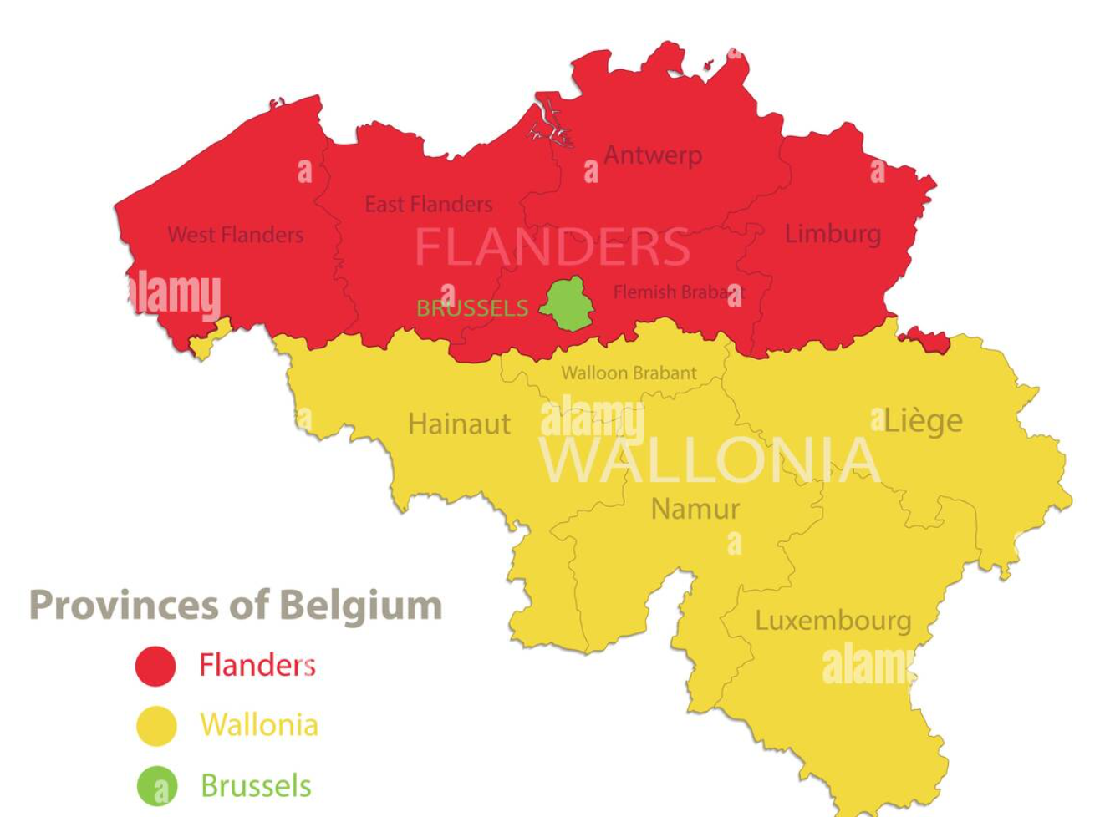
1. R&I LANDSCAPE IN BELGIUM
Belgium, a federal State: → Belgian contribution to Cern, partial exemption from payroll withholding tax for researchers
Regions and Communities responsible for education and research
Notes:
Belgium is a federal state, with three regions and three communities.
It is the federal state that pays the contribution of Belgium to cern, i.e. approximately 35 million Swiss francs.
The federal government has also put in place an important mechanism of partial exemption from payroll withholding tax for researchers
Regions and communities are responsible for education and research.

Slide 7
1. R&I LANDSCAPE IN BELGIUM
Belgium, a federal State: → Belgian contribution to Cern, partial exemption from payroll withholding tax for researchers
Wallonia region
applied research and innovation
French speaking community
(Wallonia Brussels Federation WBF)
basic research (FNRS, Universities)
Notes:
In French-speaking Belgium, in the southern half of the country, in yellow, we have a Wallonia region, in yellow, and a Brussels region, in green, run by two different governments. They fund applied research and innovation.
And both regions forms the French-speaking community, that support basic research via the FNRS and universities. It is also called wallonia brussels federation and has its own government.
I must say that this explanation was the most complicated part of my presentation.

Slide 8

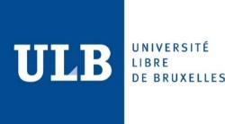



2. HIGHER EDUCATION AND RESEARCH IN WBF(1)
Population: ~ 4,8 million
5 research based universities (3 comprehensive ones)
BA, MA, Doctoral training
basic and applied research
1 funding agency for basic and strategic research: F.R.S.-FNRS
Notes:
Belgium's French-speaking community is relatively small, with a population of 4.8 million, and 5 research-based universities, 3 of which are complete.
They offer BA and MA programs, as well as doctoral training.
Basic and applied research is carried out here.
The is one main funding agency for basic and strategic research, the fnrs already mentioned.

Slide 9
2. HIGHER EDUCATION AND RESEARCH IN WBF(1)
Population: ~ 4,8 million
5 research based universities (3 comprehensive ones)
BA, MA, Doctoral training
basic and applied research
1 funding agency for basic and strategic research: F.R.S.-FNRS
2022-2023: ~100.000 students (BA & MA)
~ 13.000 new MA graduates (~20% in STEM)
~ 1.000 PhD graduates (~50% in STEM)
Small scientific communities (all fields) very open to the world:
68,5% WBF scientific publications with international co-authors (SCOPUS)
Notes:
Of course, the figures for degrees awarded by universities must be seen in relation to the size of the community.
Around 100,000 students in bachelor's and master's programs. Around 13,000 new masters graduates per year, of which 20% in STEM. Around 1,000 phd graduates per year, 50% of them in stem.
Our small scientific communities are nevertheless very open to the world, with a bit less than 70% of publications made with international co-authors.

Slide 10
3. BELGIUM: A KEY PLAYER IN RESEARCH IN PHYSICS (1)
WBF publications (% of the total)
Notes:
And on this radar diagram, we can see the distribution of the publications made by WBF researchers, according to the descriptor fields in scopus. We can see that there are particularly many in the field of medicine but also in physics and astronomy: they count for 13,2% of the WBF publications identified in scopus over the last decade.

Slide 11
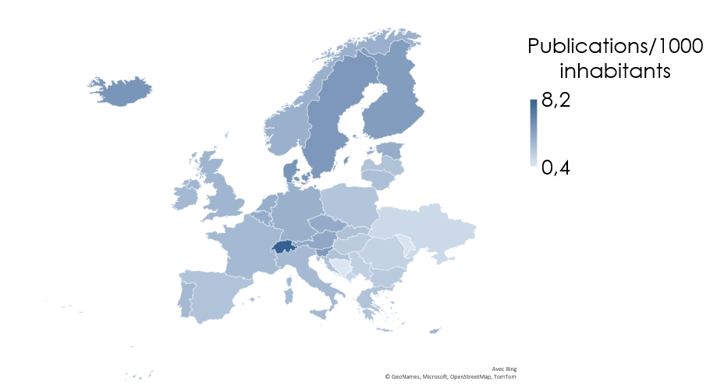
3. BELGIUM: A KEY PLAYER IN RESEARCH IN PHYSICS (1)
Publications in physics / astronomy from 2015 to 2024 (Scopus), per 1000 inhabitants: Belgium at rank 7 in Europe
Comparison with neighbouring countries:
Switzerland: 8,2
Belgium: 3,7
Netherlands: 3,6
Germany: 3,5
UK: 3,2
France: 2,9
Notes:
Despite its small size, Belgium is a key player in physics research. I am well aware that the number of publications is not di(i)rectly correlated to the quality of research, and that publish or perish is an harmful drift.
But it remains an interesting proxy for the activity and the size of a community of researchers.
If we relate the number of publications in physics and astronomy over a de(est)cade to the population of a country, per 1.000 inhabitants, Belgium comes at rank 7 in Europe, and at ranks 8 in the world. In Europe Belgium is behind Switzerland and the Nordic countries but ahead of countries such as Germany, UK or France.

Slide 12
3. BELGIUM: A KEY PLAYER IN RESEARCH IN PHYSICS (2)
Most frequently acknowledged sources of funding in Belgian publications
in physics / astronomy (2015-2024, Scopus)
# citations
Notes:
To be a key player in your field, you obviously need financial resources to fund researchers, equipment and operating costs, including mobility and international collaborative projects. We have identified the most frequently acknowledged sources of funding in Belgian publications in physics and astronomy over a period of 10 years. These are publications involving at least one author affiliated to a Belgian institution, as collected in scopus. The FNRS, in purple, is cited about 3.400 times, at about the same level as the ERC in blue. The FWO IN GREEN is cited in about 5400 publications. Interestingly, the ratio between the FWO and the FNRS citations is exactly the same as the ratio between the Flemish population and the French speaking population.
(2011-2021

Slide 13


4. THE FUND FOR SCIENTIFIC RESEARCH – FNRS (1)
Private foundation of public interest (1928)
Fundamental research in all fields of science (bottom-up) + fundamental strategic research (life sciences, transitions, …)
Expertise in science administration, policy, and evaluation
Calls for proposals (interuniversity competitions)
~ 70 International scientific commissions and jurys (almost 20,000 international experts)
Notes:
Let's turn to the FNRS. We support basic research in all fields of science, but also strategic basic research in certain areas, where more direct industrial or societal impacts are expected at shorter term. As with all research funding agencies, we obviously have expertise in the fields of science administration, policy and evaluation. All our calls for proposals are organized as inter-university competitions, and to evaluate the thousands of funding applications received each year, we draw on a database of 20,000 international experts to carry out remote evaluations, and organize meetings of some 70 international scientific commissions and juries.

Slide 14
4. THE FUND FOR SCIENTIFIC RESEARCH – FNRS (1)
Private foundation of public interest (1928)
Fundamental research in all fields of science (bottom-up) + fundamental strategic research (life sciences, transitions, …)
Expertise in science administration, policy, and evaluation
Calls for proposals (interuniversity competitions)
~ 70 International scientific commissions and jurys (almost 20,000 international experts)
Employer of ~ 2,000 researchers at all stages of their scientific careers
A range of funding instruments
Notes:
We are the contractual employer of 2,000 researchers at various stages of their careers, hosted by the 5 universities that make their facilities available to them. And of course, we offer a variety of funding instruments.

Slide 15
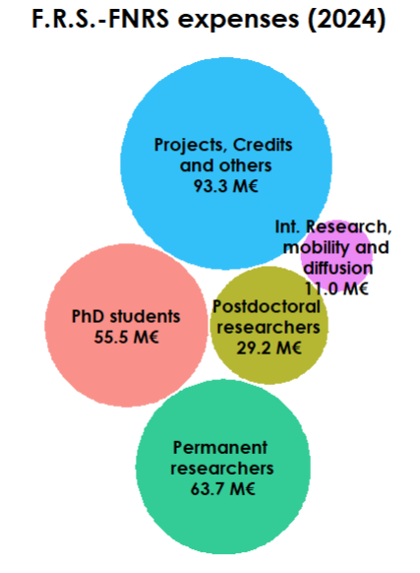
4. THE FUND FOR SCIENTIFIC RESEARCH – FNRS (2)
Notes:
Here you can see how much we spend on our main funding instruments: €55.5m on grants for PhD students, 29.2m on salaries for young post-docs on 3-year contracts, €63.7m for just over 400 researchers on permanent contracts, €93.3m on research projects and equipments. Staff for these projects are recruited and employed by the host university. And 11 M€ for international collaborative research, mobility and dissemination.

Slide 16

5. F.R.S.-FNRS SUPPORT TO RESEARCH IN PHYSICS (1)
FNRS total funding in High-Energy Physics: 78,5M€ over ten years
~ 11M€ in 2024
Notes:
Let's take a closer look at our financial support for high-energy physics research. It has amounted to 78.5 million euros over the last ten years. There has been a marked increase in recent years. About half it comes from the IISN, the other half from the FNRS other funding instruments.

Slide 17
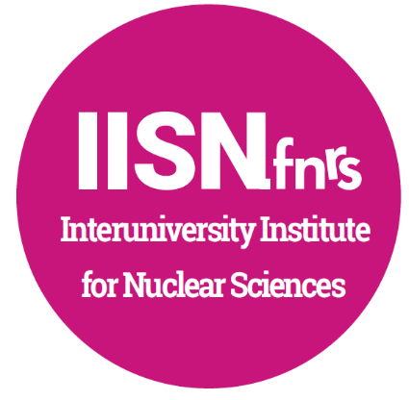
5. F.R.S.-FNRS SUPPORT TO RESEARCH IN PHYSICS (2)
1. IISN.fnrs
IISN virtual institute
4 to 7 M€/year (WBF and Federal Funding)
Long-term funding of recurrent and renewable projects, in particle physics (accelerators, detectors, theoretical studies, …), astro-particle physics
A dedicated international scientific committee
Notes:
Just over half come from IISN. It is only virtual inter-university institute at the FNRS, And has been in existence for almost 80 years.
It is dedicated to long-term funding of recurrent and renewable projects, in particle physics and astro-particle physics . This applies to accelerators, detectors , but also theoretical studies.
Projects are selected by a dedicated international scientific committee.

Slide 18
5. F.R.S.-FNRS SUPPORT TO RESEARCH IN PHYSICS (3)
2. Other FNRS funding instruments
(Inter-university competition in all scientific fields)
161 Grants and Fellowships awarded between 2015 and 2024 (based on IISN promoters or co-promoters) | #
Research Fellows (ASP) | 31
FRIA doctoral grants (FRIA) | 54
Postdoctoral Researchers (CR) | 55
Scientific collaborators | 8
Permanent Researchers (CQ, MR, DR) | 13
Notes:
Second type of support: salary of researchers for whom we are the employer. Grants and fellowships are awarded within the framework of calls that are organized on the basis of a bottom-up approach, inter-university competition in all scientific fields.
Over the last de(est)cade, promoters and co-promoters funded by the IISN institute have benefited from about 85 phd students, 55 young post-doc on 3-year contracts, 8 scientific collaborators, and 13 permanent researchers. They are researchers with a permanent contract, which is a specificity of the FNRS. And thus a total of 161 researchers on the pay roll of the FNRS

Slide 19

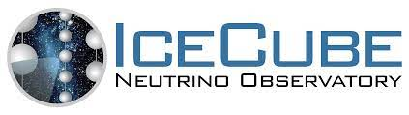
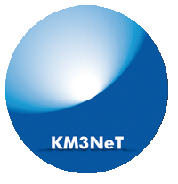


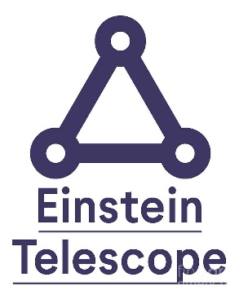
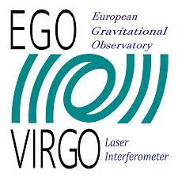
5. F.R.S.-FNRS SUPPORT TO RESEARCH IN PHYSICS (4)
Examples of contributions & projects funded:
CERN (CMS, NA62…)
IceCube, KM3Net, JUNO (Neutrino Physics)
Pierre Auger (astroparticle physics)
Einstein Telescope, VIRGO (Gravitational Waves)
Notes:
Here are some examples of contributions and projects funded
It gives a massive support to research at Cern, of course for the CMS detector on the LHC, NA62, and other fields of research at Cern, such as the search for dark matter.
IISN also funds Neu(new)trino physics, especially by contributing to the construction and the M&O of the ice-cube neutrino observatory. But also gives support to the JUNO collaboration.To Pierre Auger, in astrophysics particle.
The IISN has recently funded projects related to the future Einstein telescope, that deals with gravitational waves. It also contributes to VI(e)RGO collaboration

Slide 20

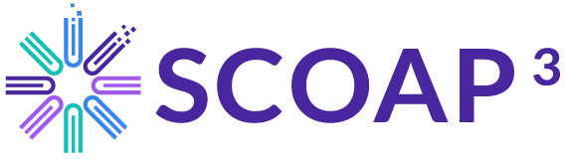
6. BELGIAN STRONG LINK WITH CERN
One of the CERN 12 founding Member States
In 2024: 142 CERN users from Belgian institutions
FNRS contribution to Upgrade CMS Phase II: ~6,5M€ (2018 – 2026)
Participation in SCOAP3
FCC : feasibility study, governance models, funding models, …
Notes:
Belgium has long-standing links with CERN
IN 2024, 124 users from Belgian institutions took part in research at CERN. We recently contributed €6.5 million to the CMS phase II upgrade. IISN also provides financial support to the important scoap initiative for open access to publications in particle physics.
And of course, we're keeping a close eye on the future FCC collider, both in terms of the feasibility study and the governance and funding models.

Slide 21
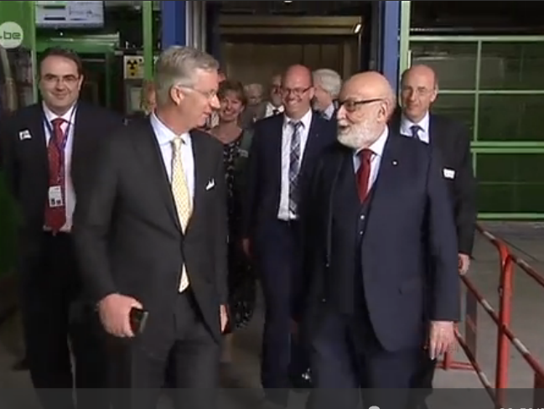
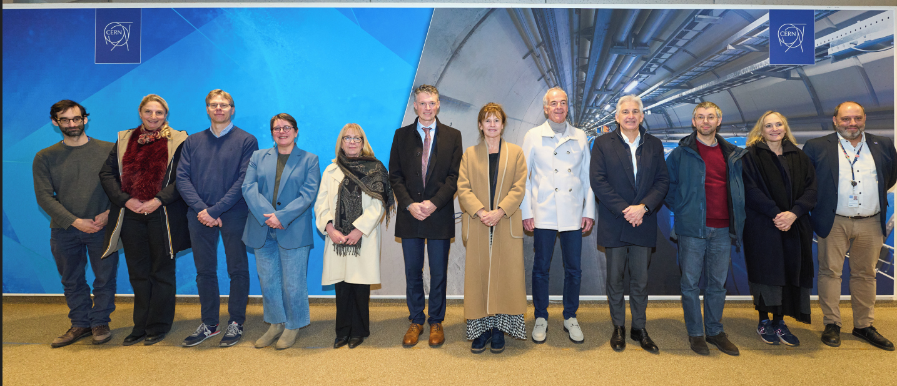
Notes:
Our authorities recognize the importance of cern.
Here is our NoBel prize François Englert with the King of Belgium visiting Cern 1à years ago
And here are the 5 rectors of Belgian French speaking universities visiting cern last December.

Slide 22
Belgian research in high-energy physics stands out for its excellence, combining cutting-edge theoretical insights with world-class experimental contributions.
Its scientists play a leading role in major international collaborations, from CERN to advanced detector development. This commitment to innovation and precision places Belgium at the forefront of global discoveries in fundamental physics.
CHATGPT
Notes:
Thank you for your attention. I leave you with this appreciation of high-energy physics research in Belgium, as written by chatgpt.

