Slide 1
Presentation JUNO
Notes:
<number>

Slide 2
Goal : Determine the contribution of cosmic muons in the detector
Layers’ efficiency of the Top Tracker

Slide 3
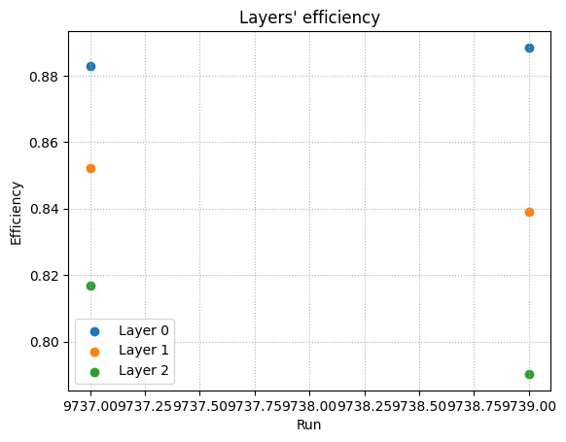
Layer’s efficiency of the Top Tracker
Calculated with TT data and CD data
Run 9737 : 7021 events
Run 9739 : 6984 events
Efficiency :
Notes:
<number>

Slide 4
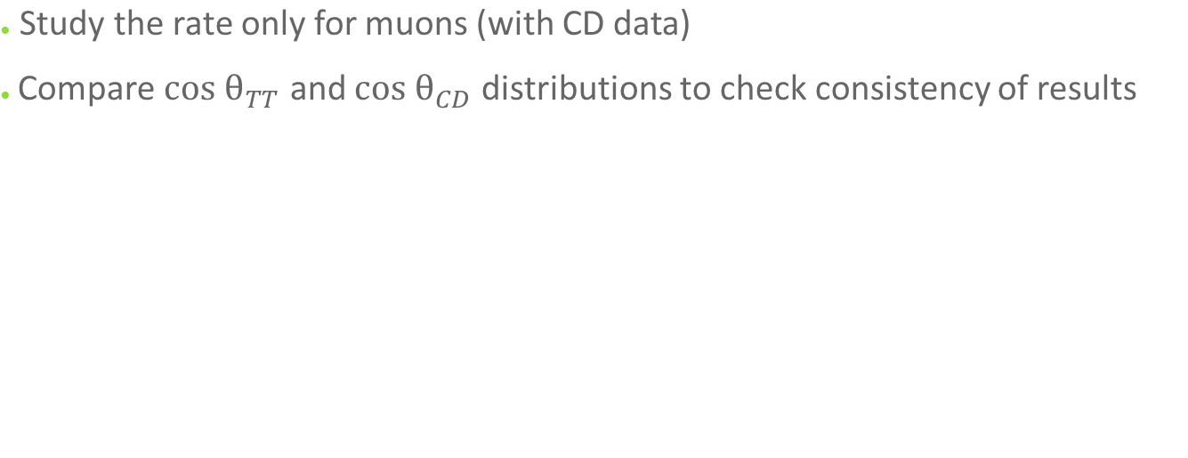
What next?
Notes:
<number>

