Slide 1
The CMS Experiment Upgrades
for the High Luminosity LHC
Bruxelles April 11, 2014
D. Contardo - IPN Lyon CNRS/IN2P3

Slide 2
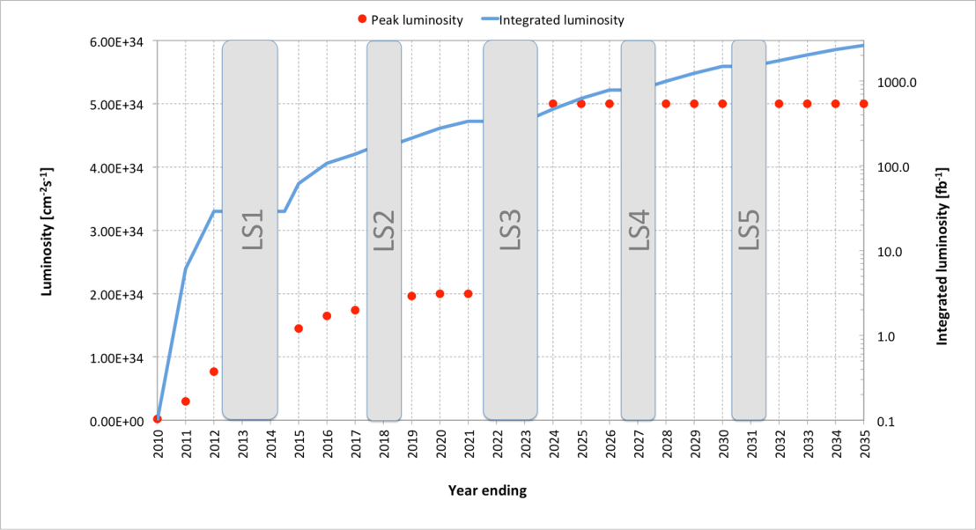
Outline
Overall LHC operation program from 2010 to 2035 with the Long Shutdown periods (LS) for consolidation and upgrades
Instantaneous luminosity (cm⁻²s⁻¹)
LS1 2013/14
LS3 2023/mid-25
LS5 2033
Integrated luminosity (fb¹)
LS2 mid-2018/19
LS4 2029
LHC (Phase 1)
  Accelerator and experiments were designed to operate with p-p collisions at 14 TeV cm energy, 1 x 10³⁴ cm⁻²s⁻¹ instantaneous luminosity, and up to 500 fb⁻¹ integrated (∼ 10 years) - during this period the instantaneous luminosity will already be doubled requiring a first stage of upgrades

Slide 3
Outline
LS1 2013/14
LS3 2023/mid-25
LS5 2033
Integrated luminosity (fb¹)
Instantaneous luminosity (cm⁻²s⁻¹)
LS2 mid-2018/19
LS4 2029
High Luminosity LHC (Phase 2)
Update to the European Strategy for Particle Physics: “Europe’s top priority should be the exploitation of the full potential of the LHC, including the high-luminosity upgrade of the machine and detectors with a view to collecting ten times more data than in the initial design, by around 2030” Adopted by the CERN Council in Brussels in May 2013
  Accelerator and experiments will upgrade to operate at ≥ 5 x 10³⁴ cm⁻²s⁻¹ instantaneous luminosity, and up to 3000 fb⁻¹ integrated (≥ 10 years)

Slide 4

The first three years of LHC operation (2010-2012)
Beam in 2012
1368 bunches of ∼ 1-2 x10¹¹ protons spaced by 50 ns
CM energy of 8 TeV
Luminosity reach 8x10³³ Hz/cm² ∼ 20 p-p interactions per crossing
Mean fill length ~ 6 hours
Stable beam 35% of time in 2012
Data registered in ATLAS and CMS
∼ 98% of detector in operation
∼ 94% of delivered luminosity recorded ~ 30 fb⁻¹ (2011+12)
LS1 2013/14
LS3 2023/mid-25
LS5 2033
LS2 mid-2018/19
LS4 2029
And consolidation of the Standard Model but no evidence yet of new physics

Slide 5
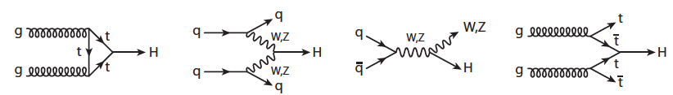
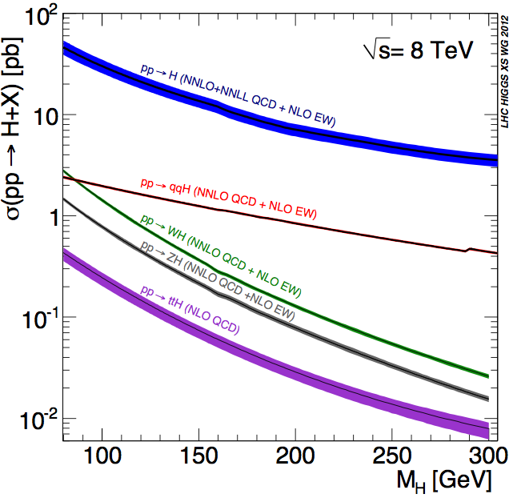
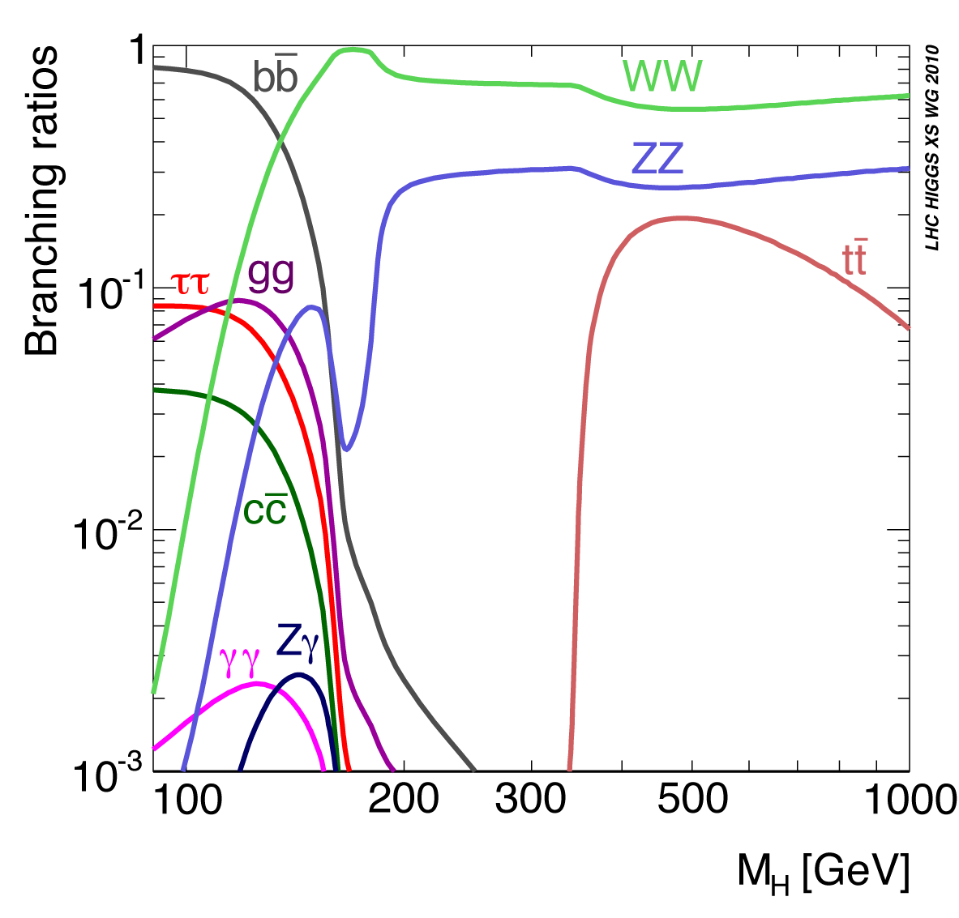
Higgs boson: Standard Model prediction
Gluon Fusion
Vector Boson Fusion
Associated production
ttH
VBF
Discovery channels: H→γγ - H→ZZ→4l (very good mass resolution ∼ 1%) - H→ WW
Others channels: bb, ττ decays hard to identify in huge background

Slide 6
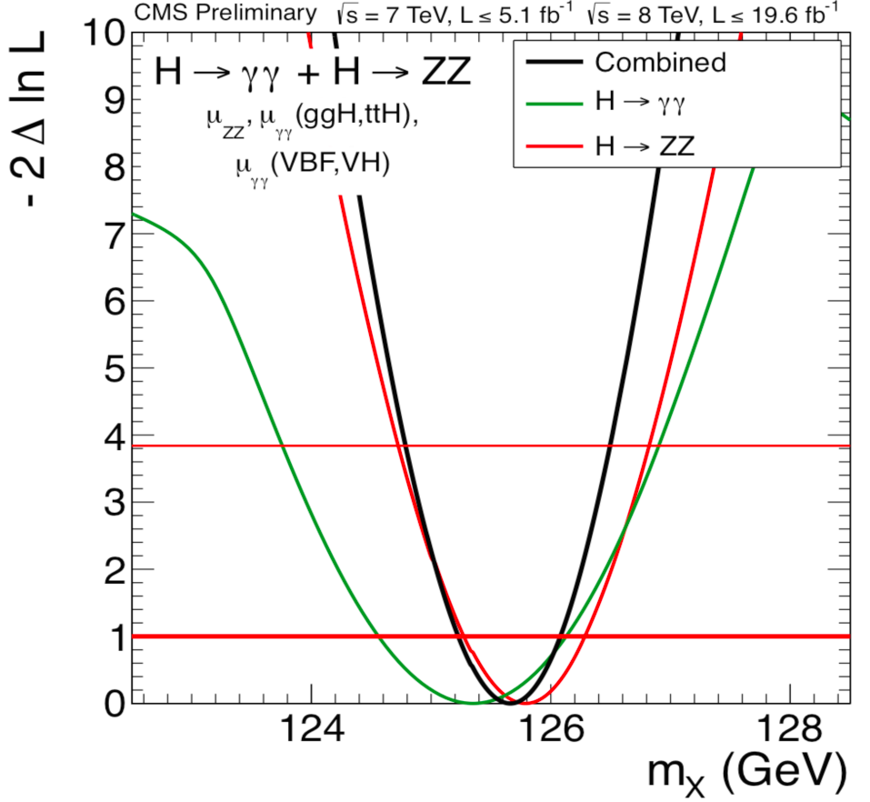
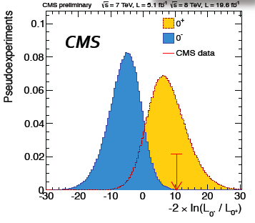
Higgs boson: Measured properties so far (30 fb⁻¹)
Today ATLAS+CMS have ∼ 1400 Higgs events
VBF
M = 125.7 ± 0.3 ± 0.3 GeV
Strength of coupling is proportional to the mass
and spin/parity = 0⁺ as expected in Standard Model
This is a Higgs boson but it doesn’t exclude non‐SM
Spin 0+ it is a scalar particle

Slide 7
The next steps in the physics program
  From ECFA workshop Oct. 1-3, 2013
  https://indico.cern.ch/conferenceDisplay.py?confId=252045

Slide 8
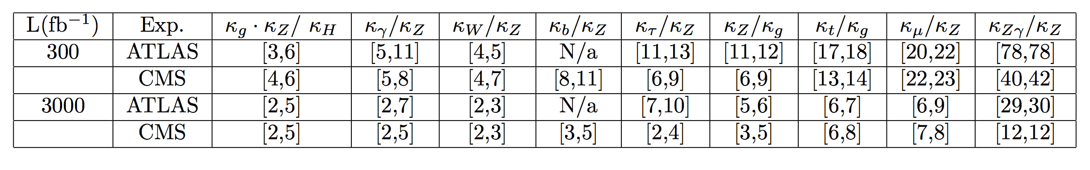
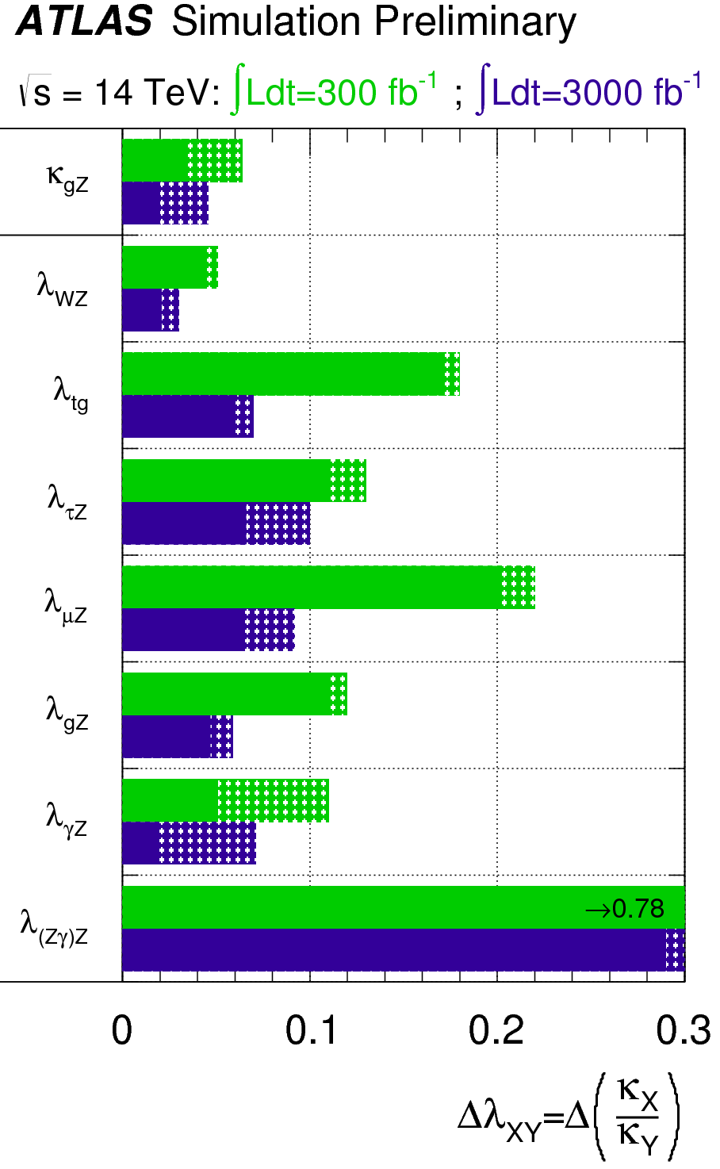
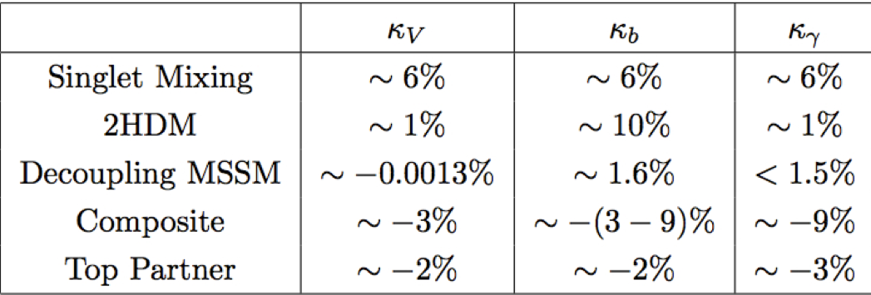
  Higgs boson: coupling precise measurements
HL-LHC (3000 fb⁻¹) > 3M Higgs for precise measurements
VBF
Importance of theory and systematic errors
With 3000 fb⁻¹: typical precision 2-8% per experiment → ∼ 2x better than with 300 fb⁻¹
Sensitivity to new physics scenarios with no new particles observable at HL-LHC
Dashed:
theoretical
Uncertainty

Slide 9
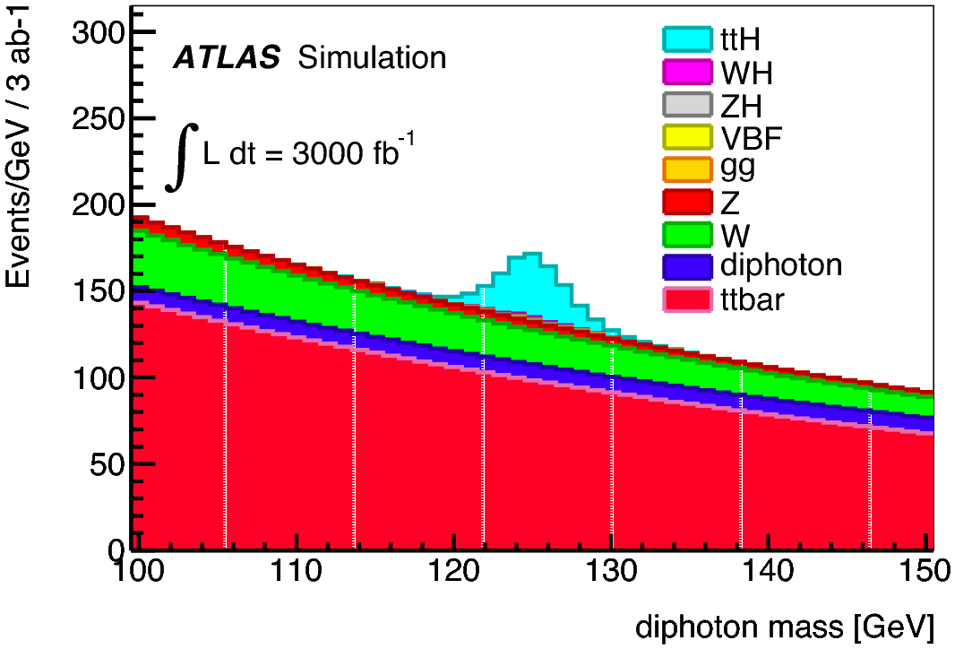
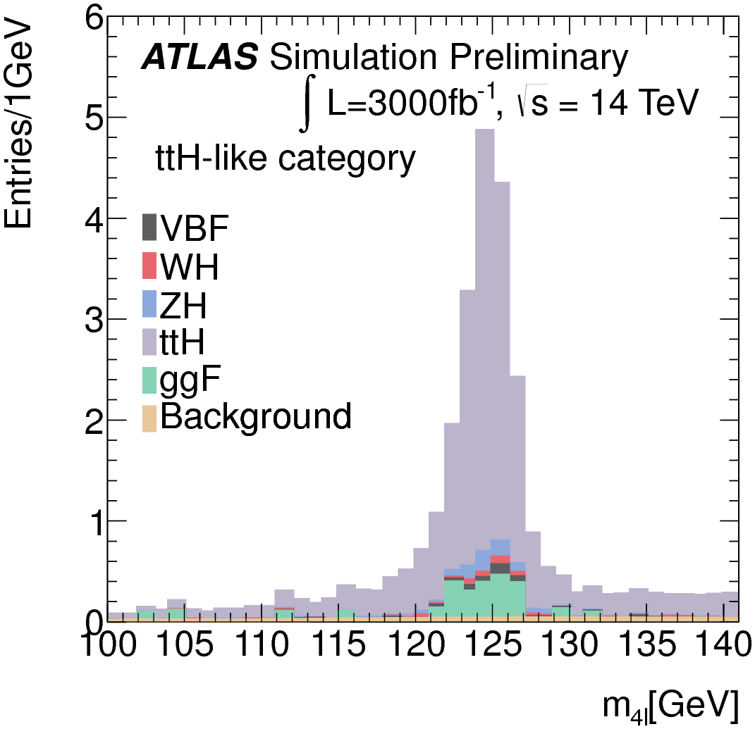
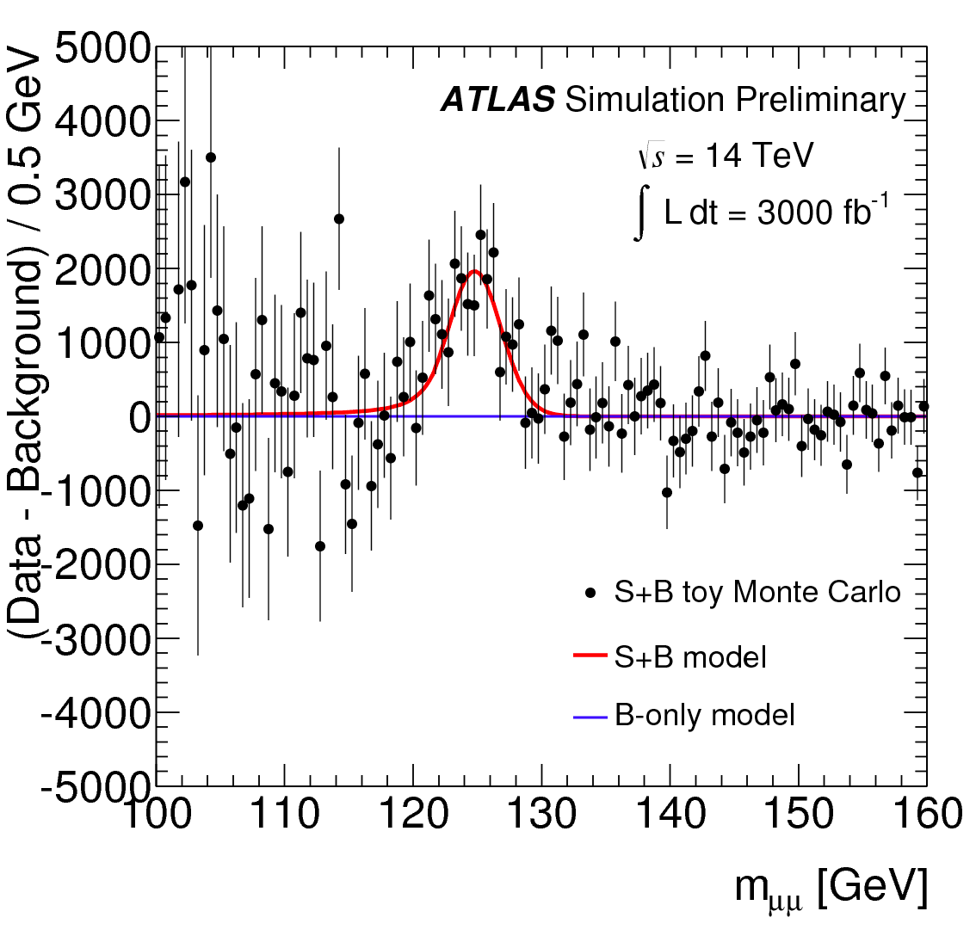
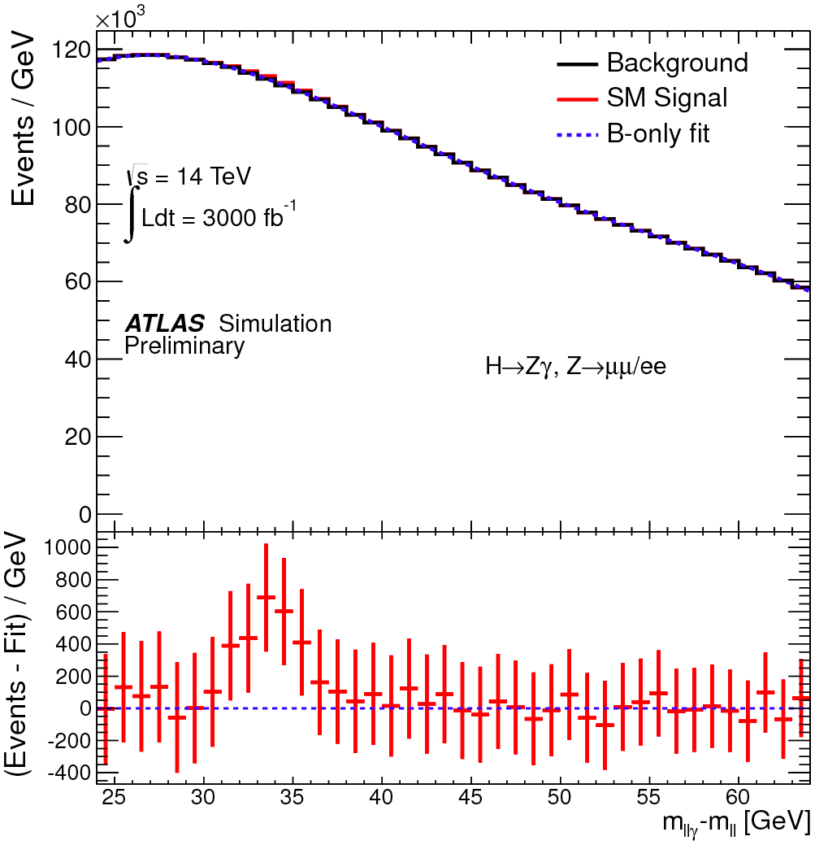
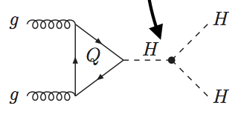
Higgs boson: rare production process and decay
Signals only accessible with 3000 fb⁻¹ with errors limited by statistics
ttH → γγ or ZZ
30 fb⁻¹: 6xSM cross-section
3000 fb⁻¹: expect > 5σ sensitivity - Higgs-top coupling can be measured to about 10%
H → γγ
VBF
H → ZZ
H → µµ (coupling to fermions of second generation) ∼ 10% precision on production
H → Zγ (compositeness) ∼ 20% precision on production
HH production (probe Higgs potential) HH→bbγγ - HH→bbττ… studies on going tens of events expected ~ 30% precision per experiment
g_{HHH}~ λv

Slide 10
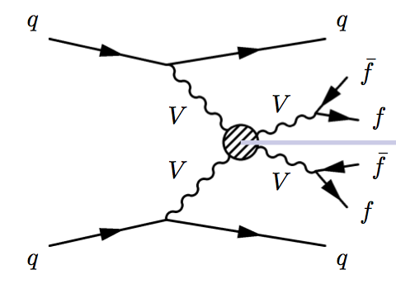
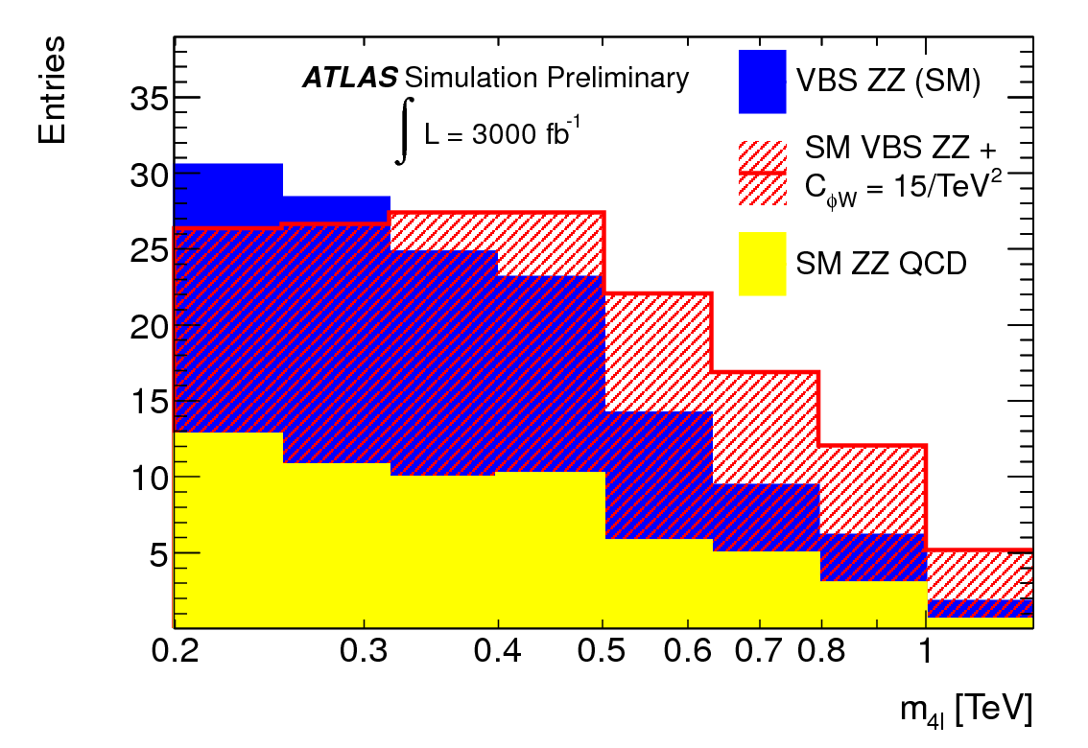
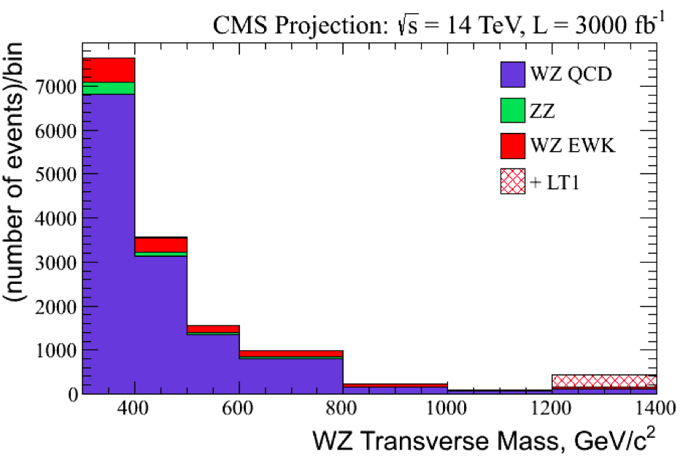
Vector Boson Scattering
Test of Higgs role in cancelling VBS divergence in SM can be measured to 30% (10%) with 300 (3000) fb⁻¹
If new physics exists: sensitivity to anomalous triple or quartic couplings increases by factor of ~ 2 from 300 to 3000 fb⁻¹
VBS ZZ→ 4l
VBS WZ→ 3l + Etmiss
SM (with Higgs)
New physics
WW scattering aQGC
Background

Slide 11
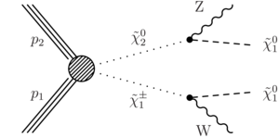
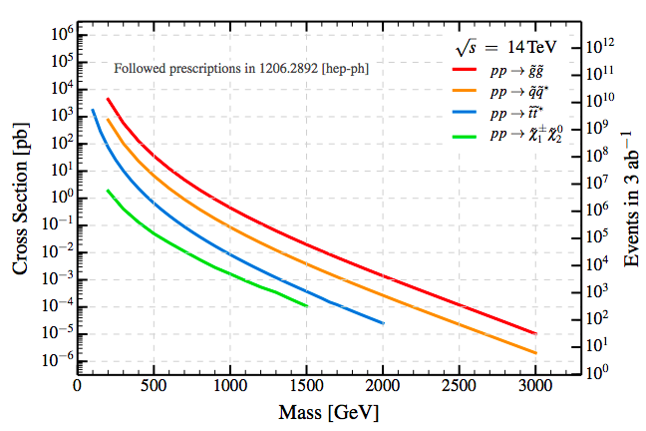
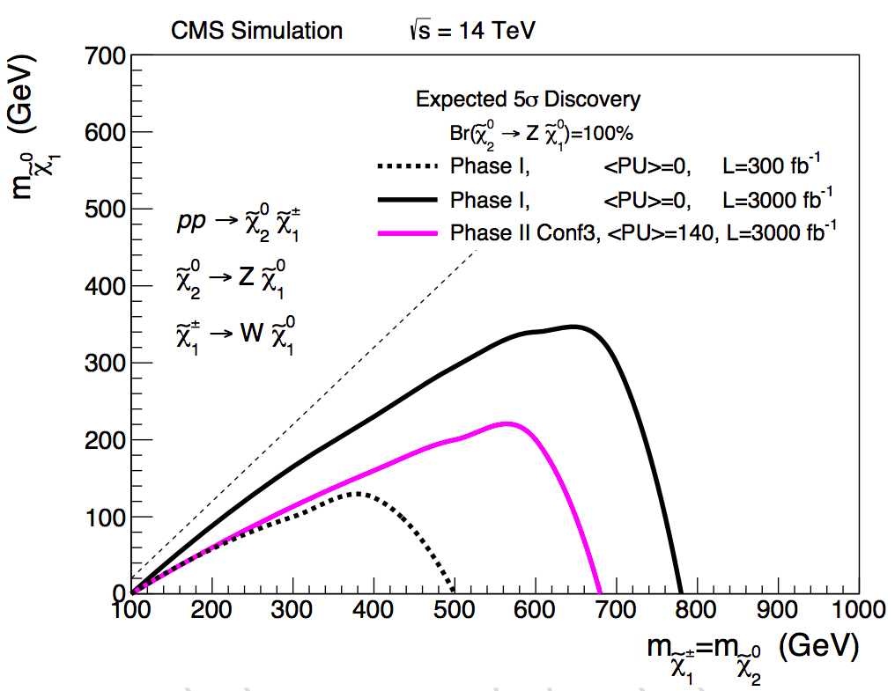
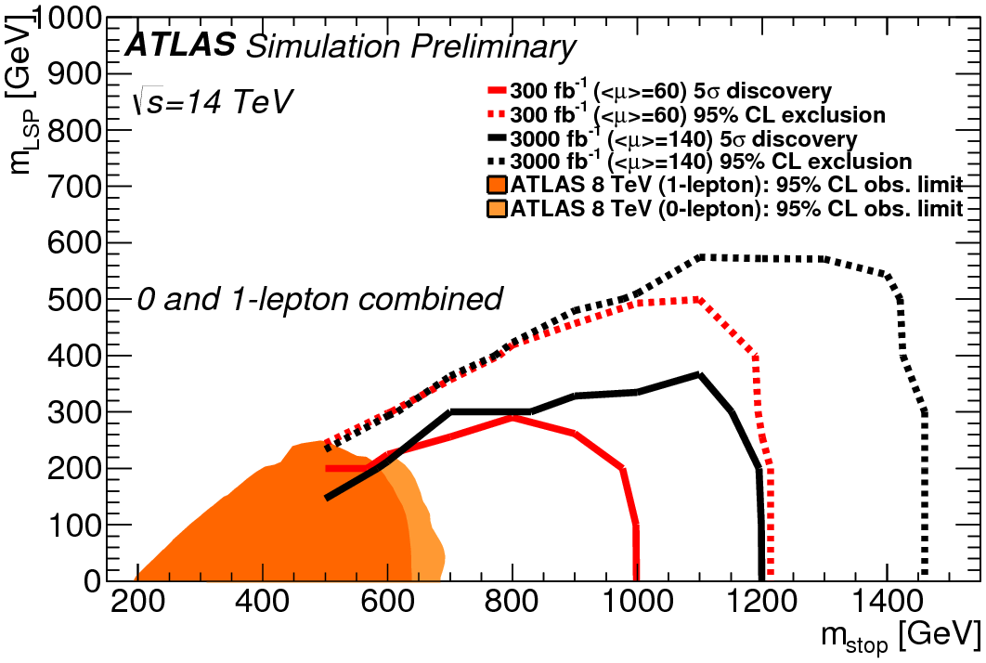
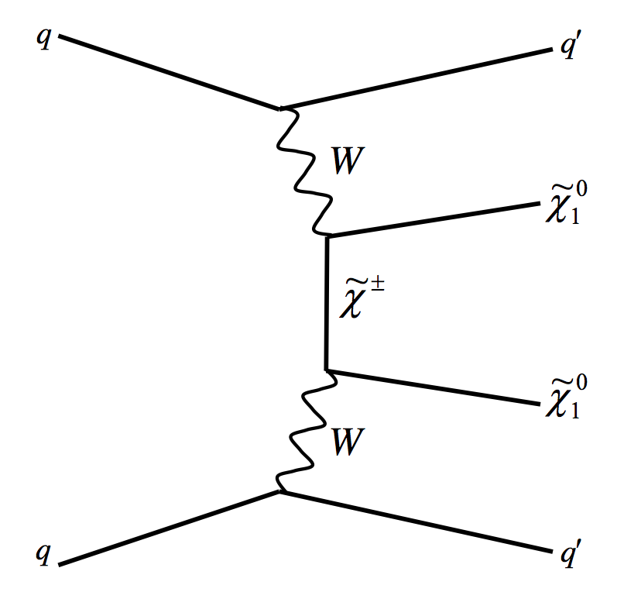
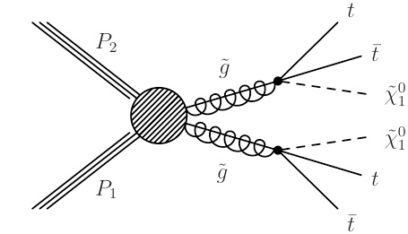
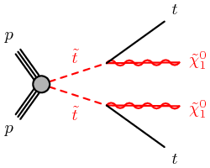
Search for SUperSYmmetry particles
Direct production of chargino/neutralino
And also:
Production of stop
VBF Dark matter
production of gluinos

Slide 12
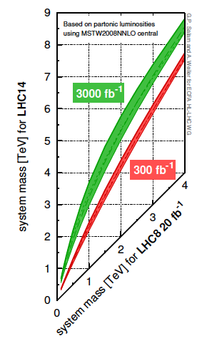
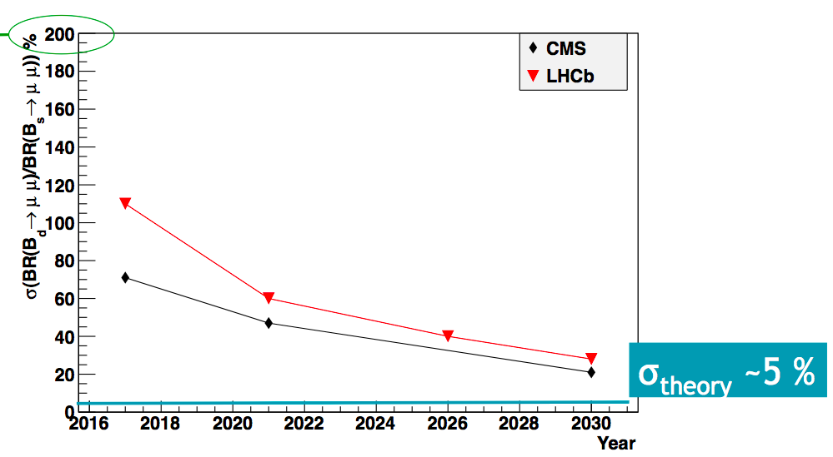
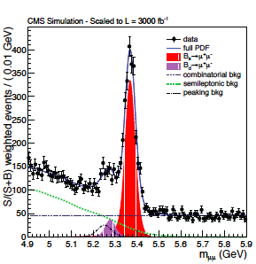
And many other studies
Overall mass reach for BSM new particles
Direct search of BSM Higgs (2HDM description)
Heavy vector-like quarks
Indirect searches in flavor physics
FCNC decays
Quark Gluon Plasma physics
BR(B_{d}→µµ)/BR(B_{s}→µµ)

Slide 13
The CMS experiment

Slide 14
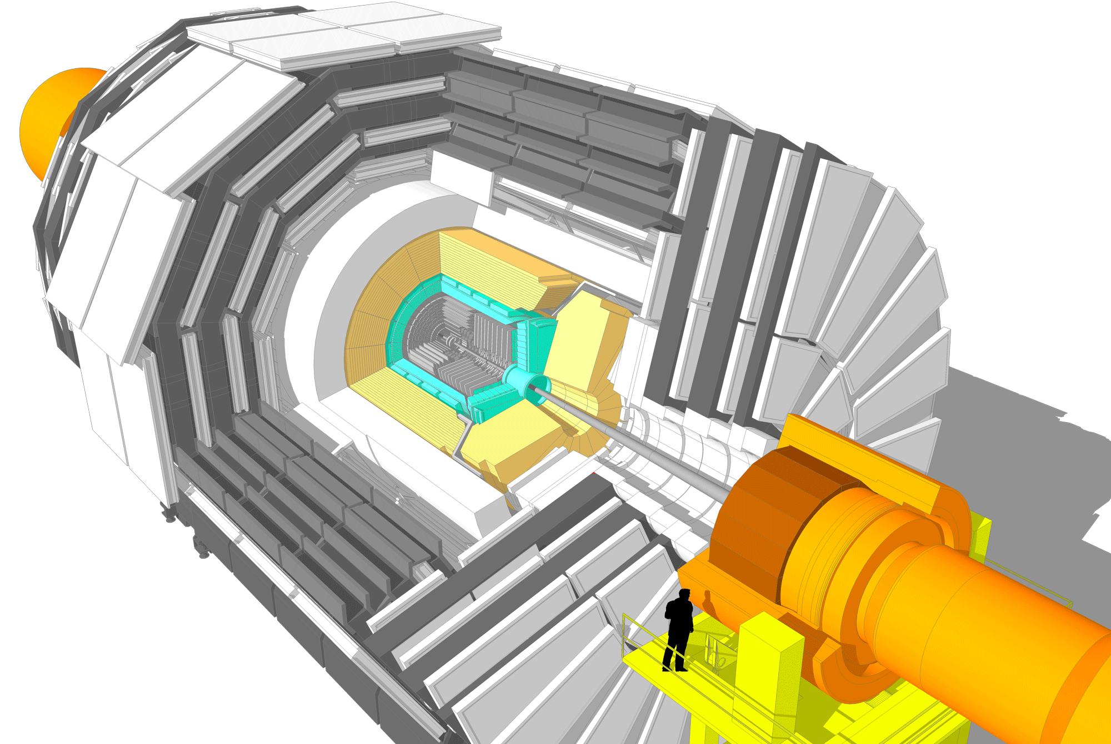
  The original CMS detector
Magnet: 3.8 T Solenoid
Electomagnetic Calorimeter
Lead Tungstate (PbWO₄)
  Barrel: 61K crystals
  Endcaps: 15K crystals
Barrel
250 Drift Tubes (DT) and
480 Resistive Plate Chambers (RPC)
Endcaps
473 Cathode Strip Chambers (CSC)
432 Resistive Plate Chambers (RPC)
Hadronic Calorimeter
  Barrel & Endcaps: Brass/Plastic scintillator tiles and WLS fiber 7kCh
  Forward: Steel/Quartz fiber
  Cerenkov calo. 2kCh
Tracker:
Pixel detector
100x150µm² ~ 1 m² ~ 66 Mch
Strip detector
80-180 µm ~ 200 m² ~ 9.6 Mch
  DAQ Trigger:
  Level 1 hardware (Calorimeters and Muons)
  3.2µs latency, 100 kHz output
  Computing farm (Tracker)
  ~ 200 ms latency, 1 kHz output of stored data
Total weight 14000 t
Overall diameter 15 m
Overall length 28.7 m

Slide 16
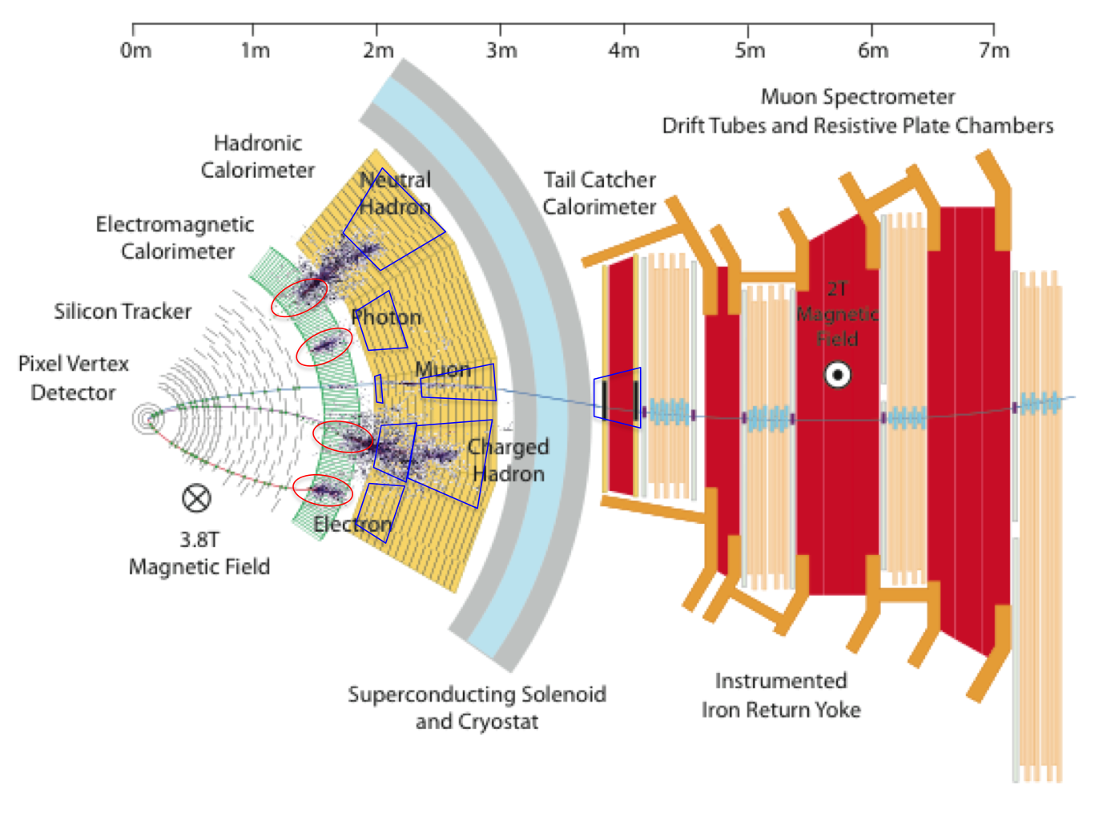
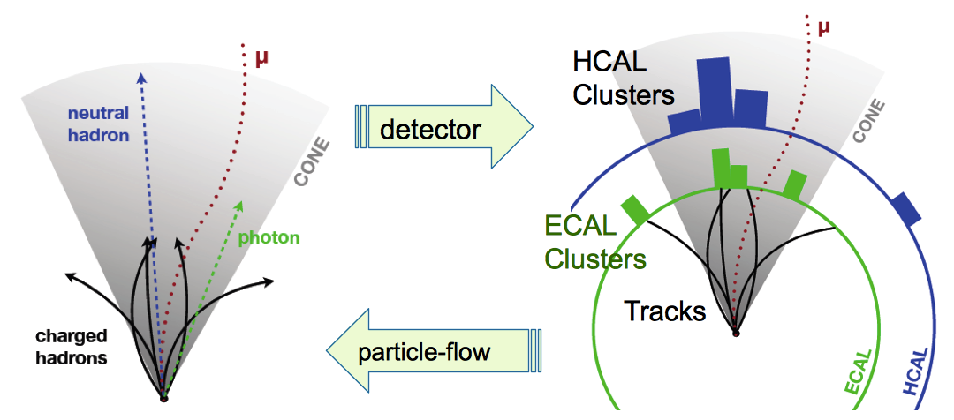
From measurements to physics results
CMS
Detector measures charge deposits:
  Charged particles (tracker)
  e/γ (electromagnetic calorimeter)
  Hadrons π … (hadronic calorimeter)
  μ (gas chambers)
Sophisticated algorithms combine all information to reconstruct:
  Physics objects
    Identified and isolated particles - Jets - total and missing energy
  Decay of fundamental particles
    W, Z, H, t, τ …
  Correct apparatus effect with Monte-Carlo simulation

Slide 17
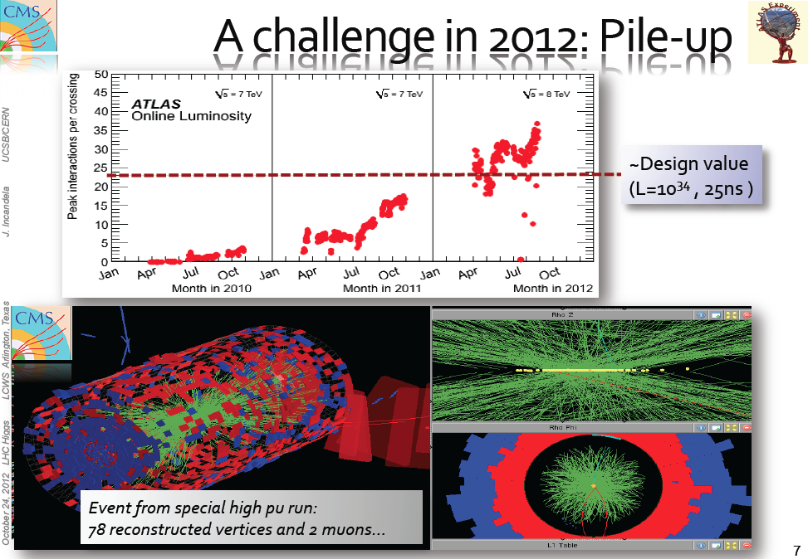
High luminosity: The experimental challenges
Operational issues
  Data volume increases
  → detector read-out bandwidth becomes insufficient
Performance issues
  Number of event passing selection for data acquisition increases
  → Need to raise thresholds losing acceptance for physics
  Occupancy increases and detector granularity becomes insufficient
  → Reconstruction efficiencies drop and fake rates increase degrading
  association of particles to vertex of origin

Slide 18
High luminosity: The experimental challenges
Improve detector configuration and granularity and use new technologies (not available at construction time)
Increased processing power and high bandwidth links for data transfer (mostly commercial)
Develop radiation hard components (needs specific R&Ds)

Slide 19
The LHC Phase 1 upgrades

Slide 20
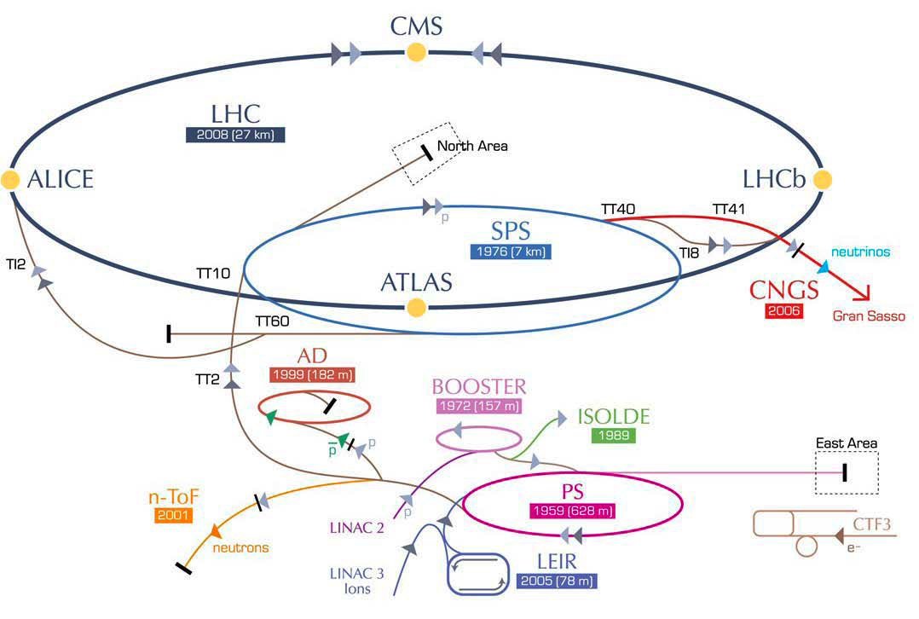
The LHC Phase 1 upgrades
LS1 2013/14
LS3 2023/mid-25
LS5 2033
LS2 mid-2018/19
LS4 2029
Accelerator upgrade in LS1:
CM energy: 8 → 13-14 TeV
bunch spacing: 50 → 25 ns
Accelerator upgrade in LS2:
Injection chain upgrade
  ATLAS and CMS prepare to operate at 2 x 10³⁴ cm⁻²s⁻¹ with ∼50 p-p interactions/crossing (Pile-Up), and margin up to 70 PU - with ∼300 fb⁻¹ integrated luminosity by 2023, all detectors can sustain up to 500 fb⁻¹ → upgrades are mainly in Pixel and hardware trigger and are staged from LS1 to LS2

Slide 21
  CMS Phase 1 upgrades (are under construction)
Muons in LS1
Consolidate DT read-out
Complete CSC and RPC in forward - 4th station
Increase granularity in CSC forward 1st station
Endcap Calorimeters upgrades staged from LS1 to LS2
New HF and HCAL Frontend and Backend
Install new Pixel detector
at the end of 2016
Commissioning new L1 trigger in parallel to operation in 2015
High processing power and bandwidth

Slide 22
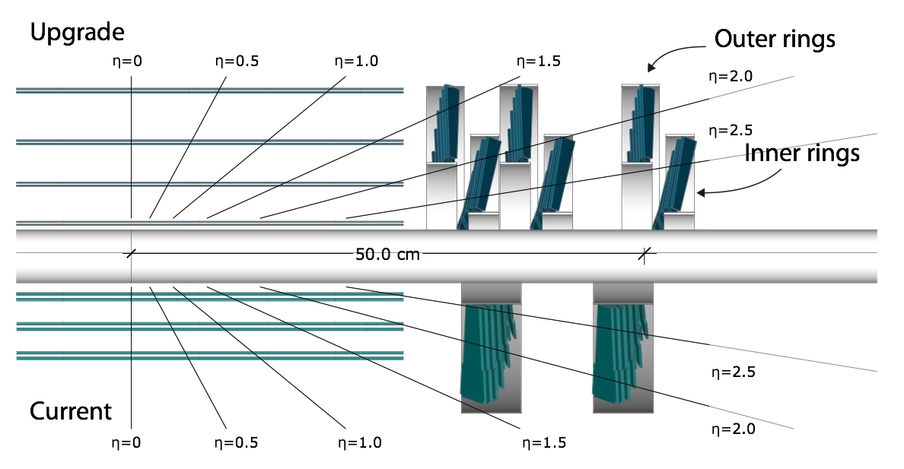
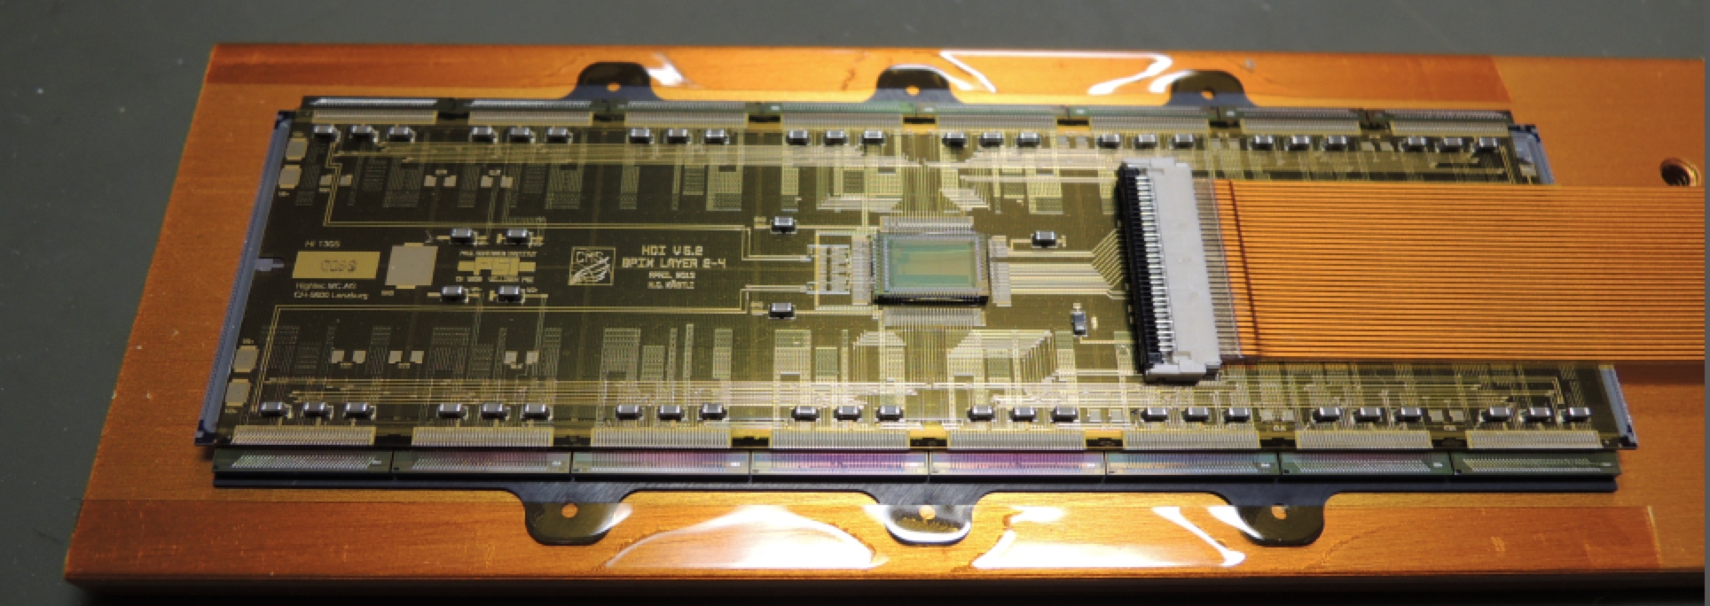
CMS Phase 1 new Pixel detector
4 layers/3 disks (1 more space-point - extended range from lower to larger radius)
  3 cm to 16 cm radius
New readout chip (no data loss)
  Tolerate rates up to PU 100
Less material: CO2 cooling, new cabling & DC/DC powering
  Weight divided by a factor 2.5 in barrel
→ Reduced γ conversion - higher efficiency, lower fake rate - improved IP resolution
ATLAS is implemented similarly an additional inner Pixel layer at 3 cm
22

Slide 23
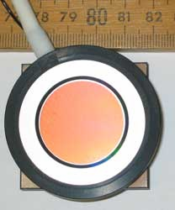
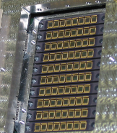
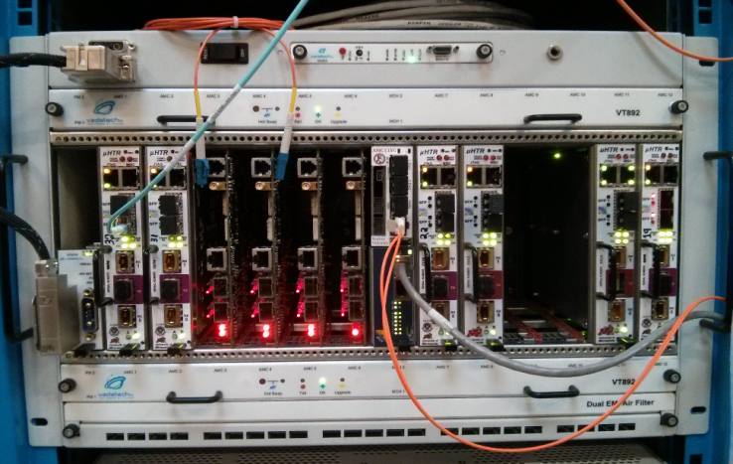
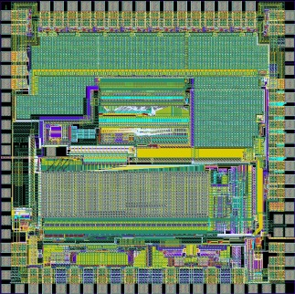
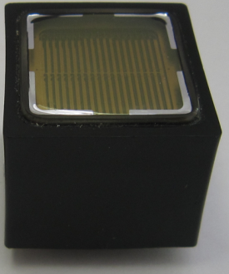
CMS Phase 1 HCAL upgrade
Replace photosensors with new technologies
  Multi-anode PMTs & SiPMs (higher granularity of readout - depth segmentation)
Replace Front-End and Back-End electronics
  Improved background rejection with timing in new FE chip
Improved calibration - improved shower reconstruction for neutral energy,
improved isolation in trigger and offline analyses
HPDs
SiPMs
QIE10 (HF)
QIE11 (HBHE)
New µTCA Back-end
Single to dual readout PMTs
A
B
A
B

Slide 24
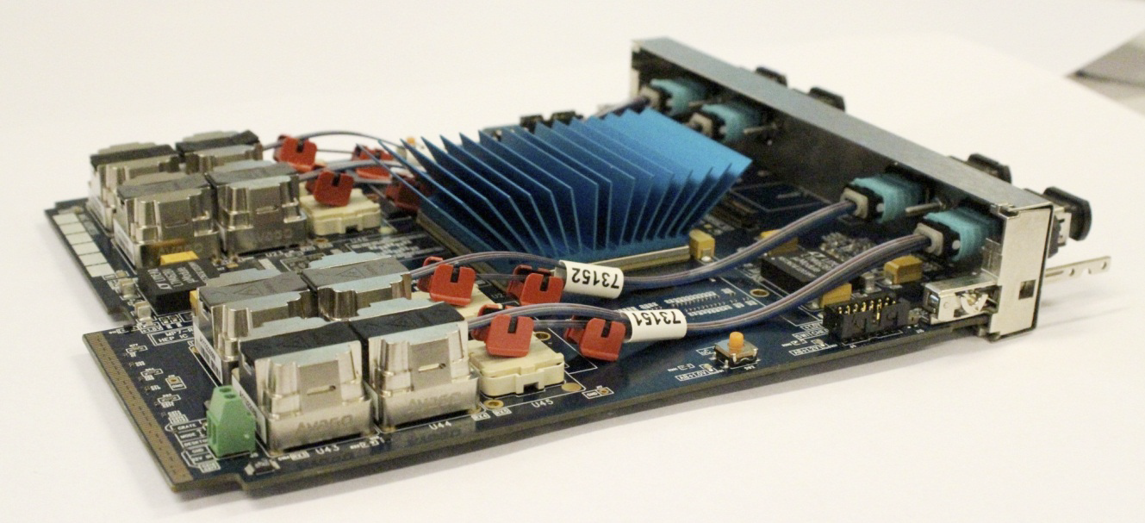
CMS Phase 1 L1-Trigger upgrade
  Modern FPGAs and µTCA backplane technology for high bandwidth and processing power - new architecture for calorimeter with a full event in one processor
    This allows higher calorimeter granularity and earlier combination of muon systems to provide better precision on trigger objects and more sophisticated selection algorithms
  e, γ and µ isolation and jet finding with PU subtraction - τ finding with narrower
  cone new algorithms with correlated quantities (e.g. invariant mass…)
ATLAS is implementing similar improvements through calorimeter readout and muon upgrades and change of trigger backend electronics
MP7 board Virtex 7 and 72 I/O links at 10Gpbs
Demonstrator of Calorimeter trigger in µTCA crate

Slide 25
The High Luminosity (Phase 2) upgrades

Slide 26
The High Luminosity LHC (Phase 2) upgrade
LS1 2013/14
LS3 2023/mid-25
LS5 2033
LS2 mid-2018/19
LS4 2029
HL-LHC upgrade:
Improve beam focus and overlap at Interaction Points
  CMS prepare to operate at 5 x 10³⁴ Hz/cm² (with leveling), <PU> 125, up to ∼ 3000 fb⁻¹ integrate luminosity, with operation margin up to PU∼200 to increase luminosity if performance allows - need to solve detector aging, high occupancy, rate and radiation hardness issues

Slide 27
Driving requirements for the upgrades
Performance
  Mitigation of PU effect - critical to fully exploit High Luminosity potential:
  Need high granularity and precision
  - Tracker performance is critical
Example of tracking performance degradation with Phase 1 detector when increasing PU

Slide 28
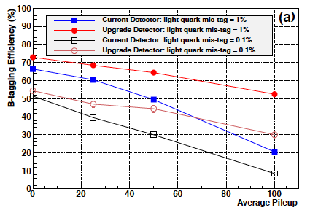
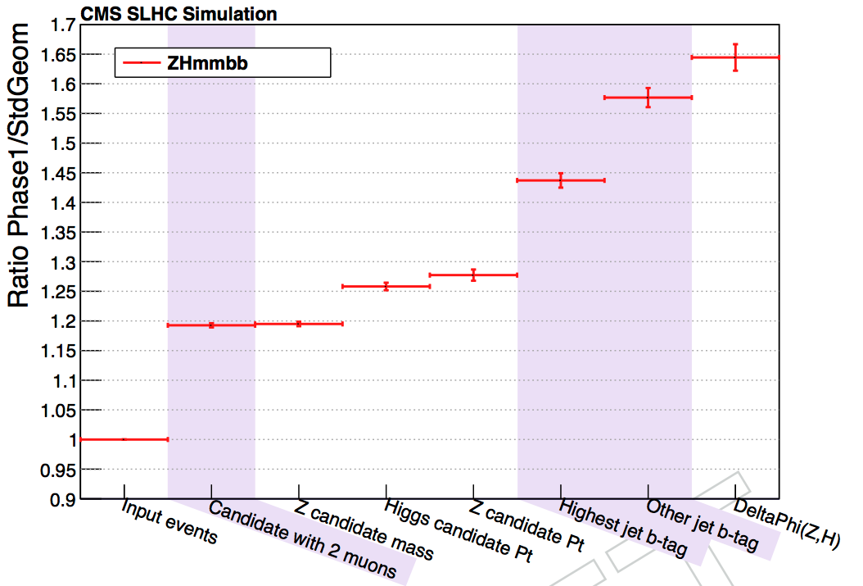
Driving requirements for the upgrades
Performance
  Mitigation of PU effect - critical to fully exploit High Luminosity potential:
  Need to maintain/improve track reconstruction efficiency and resolution on track origin (association of tracks at primary vertex & identification of secondary vertices)
H → bb selection
Z → 2 µ selection
CMS: ZH→ 2μ2b
Example of the benefit with new pixel detector in Phase 1 upgrade:
~ 65% gain in statistics in the ZH → 2µ2b measurement

Slide 29
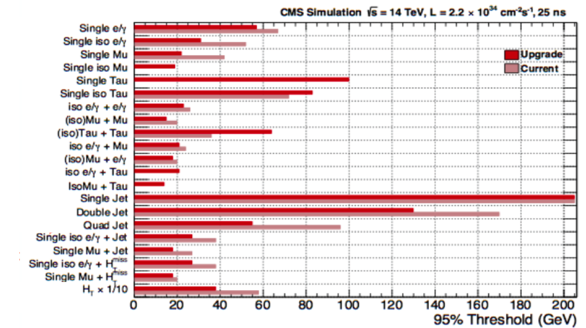
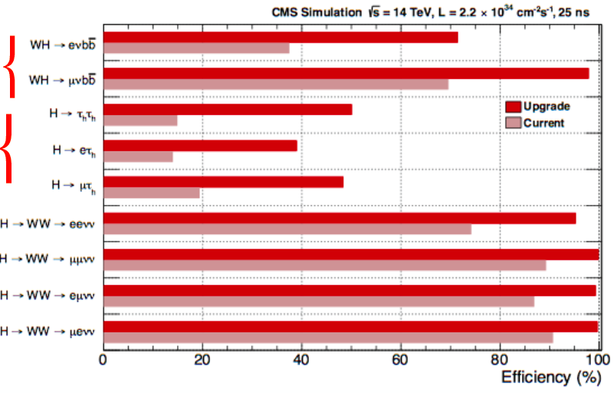
Driving requirements for the upgrades
Performance
  Physics events acceptance - critical to measure rare processes:
    Need improved trigger: increased bandwidth - precision of inputs - more sophisticated algorithms
Example of improvements with the CMS hardware trigger level upgrade for Phase 1 and impact on physics channel acceptance
The present level of thresholds must be maintained at HL-LHC despite the
higher rates and PU increase

Slide 30
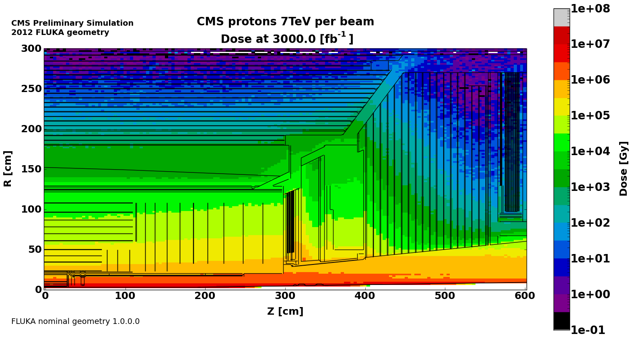
Driving requirements for the upgrades
Operation
Longevity of detector components and radiation tolerance:
Replace detectors as needed with new technologies - it is an opportunity to improve the performance
Data flow:
  Need high readout bandwidth and fast processing - replace large
  fraction of read-out
And constraints
  Integration in present CMS
  Duration and logistics of work in LS
  Radiation levels in LS
  Schedule and cost
  Collaboration involved in Phase 1 upgrades, data taking and analyses
Preliminary study of fluence in CMS tracker after 3/ab
Preliminary study of dose in CMS tracker
and Endcap calorimeters after 3/ab

Slide 31
CMS Phase 2 Upgrades
New Tracker
Radiation tolerant - high granularity - less material
Tracks in hardware trigger (L1)
Coverage up to η ∼ 4
Muons
Replace DT FE electronics
Complete RPC coverage in forward region (new GEM/RPC technology)
Investigate Muon-tagging up to η ∼ 4
New Endcap Calorimeters
Radiation tolerant - high granularity
Investigate coverage up to η ∼ 4
Barrel ECAL
Replace FE electronics
Trigger/DAQ
L1 (hardware) with tracks and
rate up ∼ 500 kHz to 1 MHz
Latency ≥ 10µs
HLT output up to 10 kHz
https://cds.cern.ch/record/1605208/files/CERN-RRB-2013-124.pdf

Slide 32
Broad-brush steps for Phase 2 completion, based on Dec. 13 schedule
2014 | 2015 | 2016 | 2017 | 2018 | 2019 | 2020 | 2021 | 2022 | 2023 | 2024 | 2025
TP
TDR
LS2
LS3
Technology R&D
Technical Design
Prototyping
Engineering Design
Pre-series
Construction/Production
Installation Commissioning
R&D funds
CORE funds
Note: specific project schedules depend on construction time and component production is staged (Off-detector RO, services… come later) → overlaps of the different steps

Slide 33
CMS Phase 2 Tracker

Slide 34
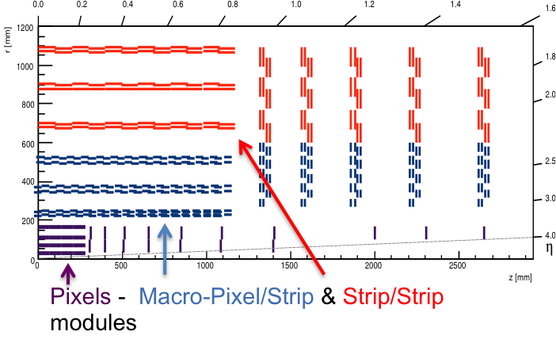
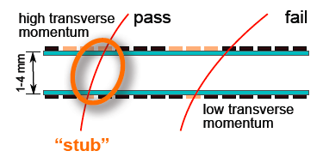
Tracker conceptual design
High Granularity with short strips and small pixels
  Strip pitch ∼ 80-90 µm & length ∼ 2.5 to 5 cm
  Pixel pitch ∼ 25-30 µm and ∼ 100 µm length
Powerful concept to implement tracks in hardware trigger
  2 sensor modules to select track “stubs” of Pt≥2GeV for trigger readout (40MHz)
    Strip-Strip (SS) in outer layers and Macro Pixel-Strip (PS) in inner (z meas.)
Extension of Pixel coverage up to ∣η∣∼ 4
  Reduce rate of fake jets due to PU for VBF/VBS physics
Concept for on detector selective data readout

Slide 35
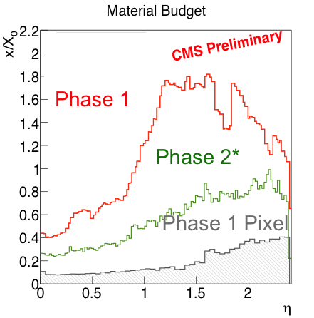
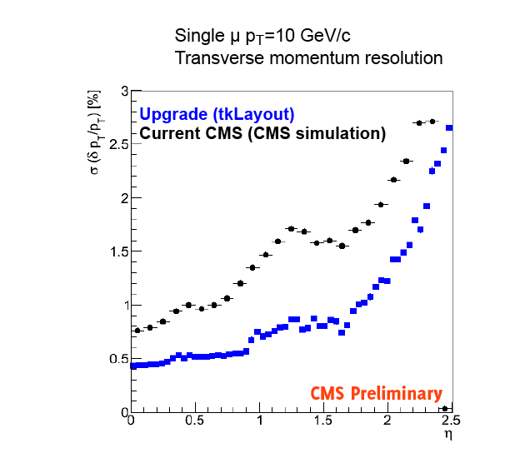
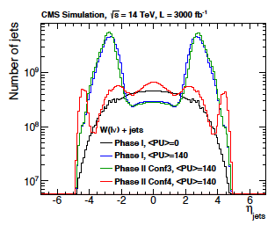
Tracker performance enhancement
Light materials with DC/DC powering, CO2 cooling, light module assembly
  Improved track Pt resolution & reduce rate of γ conversion
  ex. HH→ bbγγ - ttH → γγ - H → µµ - B_{s,d}→ µµ…
CMS
µ Pt = 10 GeV
B_{s,d}→µµ
Extension of pixel coverage up to ∣η∣∼ 4
  Associate jets to tracks - vertex to mitigate pile-up effect
  Expect significant improvements for all VBF
  processes: Higgs - BSM dark matter & for VBS
0 PU
Jet rate without & with pixel
coverage extension at 140 PU

Slide 36





R&D on Silicon sensors
For outer tracker sensors have been studied up to 1.5e15n_{eq}/cm²
  n-in-p sensors show adequate radiation tolerance
  Thin (200µm) sensors offer significant advantages
    lower bias voltage and less leakage current
    signal stable vs annealing over long times
For Pixels radiation tolerance up to ≳ 10¹⁶n_{eq}/cm²
  Planar n-in-n and n-in-p technologies
    98% efficiency after 10¹⁶n_{eq}/cm²
    Study pixel geometry and thickness (∼100µm)
  3D sensors
    ATLAS IBL radiation tolerance up to 5x10¹⁵ n_{eq}
    Study configuration and thickness (∼100µm)
sparse
dense
CNM 3D sensors

Slide 37




R&D on readout and modules (outer tracker)
Light module assembly - validated with FEA - building mock-up
CO2 cooling
based on pixel Phase 1 dev. 100kW power - common with ATLAS
SSA/MPA ASIC
65 nm being designed
CBC ASIC
130 nm
Pixel-Strip module
Strip-Strip module
Concentrator ASIC
130 and/or 65 nm
GBT 65 nm & Optical Link
dev. low power - compact
packaging wo connector - based on
common dev. for LHC experiments
DC-DC conversion
based on pixel Phase 1
common dev. with ATLAS
Flex hybrid - Flip-Chip assembly - possibly TSV for inter-chip connection
2 prototypes tested at DESY - 2 CBC chips - FPGA emulation of concentrator and of GBT on GLIB prototype DAQ board - validate concept of selective RO

Slide 38




R&D on Silicon-Strip Outer Tracker
Mechanical structures
  Concept for outer barrel and endcap is selected
  Decide inner barrel concept in 2014
CO2 cooling
  Need 100kW - build on pixel Phase 1 - common development with ATLAS
Back-end electronics for trigger track reconstruction
  Pattern recognition with Associative Memories or propagation from layer to layer in FPGA followed by fit in FPGA
  - demonstrators being developed - build on ATLAS FTK - existing high BW/
  processing boards - generic R&D on custom AM ASICs
  DAQ building on Phase 1 board developments for Pixel and Trigger

Slide 39
CMS Phase 2 Calorimeter upgrades
New Endcap Calorimetry - presently two concepts are considered:
      Shashlik EE + HE-rebuild tower geometry as present CMS
      High Granulaity CALorimeter (HGCAL) based on CALICE concept
And also investigate coverage extension and benefit of precise timing

Slide 40



Replacement of Electromagnetic calorimeter with Shashlik
EE Shashlik provides a similar structure to
the current electromagnetic calorimeters
  With more compact design - higher granularity
R&D to demonstrate radiation tolerance
  Crystals - LYSO/CeF3
  Wave-Length Shifter solutions
  - Quartz capillaries…
  Scintillating fibers silica fused/crystals doped
  with Ce3
  Photo-detector technology - GaInP/SiPM
GaInP sensor

Slide 41

Rebuild of Hadronic Calorimeter
Rebuild HE with:
  Radiation tolerant material
  Higher granularity (η/φ - longitudinal)
  Closer to IP behind EE Shashlik or HGCAL
R&D to demonstrate radiation
  Different geometry (finger tiles)
  And different materials - liquid scintillator and other options

Slide 42


High-Granularity Calorimeter (HGCAL)
Silicon-lead ECAL & 4λ silicon-brass
shower-max HCAL
  Fine-grained pads from 0.9 cm² to 1.8 cm²
  Fine depth segmentation ∼ 30/12 planes in
  ECAL/SiHCAL
  3.7/1.4 Mchannels & 420/250m² of silicon
  sensors in ECAL/SiHCAL
  Full shower topology to mitigate PU effect
Back HCAL as HE-rebuild (lower radiation level)
R&D sensors, cooling, reconstruction & electronics
    Build on ILC/CLIC & CALICE developments
  Many common areas of R&D with tracker and other systems upgrades
    Si sensors 320µm 8” wafers with 200µm & 100µm depletion
    Readout chain - service
VBF Jet (no PU)
Tiling of 8” hexagonal Si-sensors modules

Slide 43






Precision timing
Time of flight measurement could provide PU mitigation for neutrals
  precision of ∼ 10 ps allows energy deposit association to vertex in the range of ∼ 1 cm
Generic R&D on
  PMT-MCP or “Ionization-MCP”
  Silicon sensors : highly doped Si sensor
  SiPM, HAPD
Could allow implementation in preshower or
embedded layer or full calorimeter signal
Current ECAL barrel timing performance (∼ 100 ps with APD and 40 ns shaping) can be optimized
with new VFE electronics
RMS (ns)
GEANT4 simulation crystals 1cm slices
Prototype waveform digitizer on a LAPPD mockup, 15 GSa/s
Classical PMT-MCP
“Ionization-MCP”

Slide 44
CMS Phase 2 Muon upgrades
Current detectors are expected to survive 3000 fb⁻¹
  Studies on long term operation & aging mitigations are ongoing
New forward Muon detectors
  GEM - RPC bakelite/glass with low resistivity

Slide 45


New forward Muon detectors
  Complete muon stations at 1.6 < |η| < 2.4
  to reduce trigger rates
      GEMs in 2 first stations (improve Pt resolution)
      RPCs in 2 last (timing resolution to reduce bgd)
  Consider increase of the muon coverage
  up to |η| ∼ 3-4 coupled to extension of new
  calorimeter and pixel → Increase physics
  acceptance for physics channels with multi-
  lepton final state
H→ZZ (4µ) without/with ME0 extension

Slide 46


Trigger/DAQ upgrades
Track trigger will reduce rates through
  High momentum resolution of leptons - sharp thresholds
  Isolation for e/γ/μ/τ - reduce background
  Association of particles to same primary or secondary vertex - reduce combinatorial effect of PU in multi-particle/jet triggers
  Gain ∼ 10 for lepton triggers - will allow maintaining low trigger thresholds
Increase of L1 bandwidth from 100 kHz to 500/1000 MHz will provide flexibility
  Allocate bandwidth to specific triggers - driven by physics or lower track-trigger efficiency
  Preliminary ∼ 20-40% threshold reduction - may also allow to tolerate higher PU
Computing trigger output at 10 kHz - preserve present rejection rate
Lepton trigger rate
reduction by a factor 5 to 10 with track at L1

Slide 47


Computing and Software upgrade
Resources needed for computing at HL-LHC are large - but not unprecedented
  Flat resources will only allow ½ to 10 times less CPU power than needed
    Cloud federation may be a way to build our next Grid
    Will need major software developments for proper usage of specialized track processing (GPUs) and/or multi-core processors
Virtualization is the key
technology behind the Cloud

Slide 48

Infrastructure and installation
Infrastructure
  Replacement of quadrupoles at Interaction Region will need new shielding
  After 15 years of operation many systems will be inoperable or unmaintainable
  Capacity of services for new detectors might not be sufficient
    Cooling systems - electrical power
  Civil engineering needed on surface should be planed in advance
Radiation and activation issues will become more and more challenging
    Work in LS3 will need to satisfy safety rules
    cooling time - specific procedures
    - shielding & handling tools
    First estimates indicate that LS at
    HL-LHC will be ∼ LS1 x 30 in dose
  Duration of LS3 must be minimized
    Need careful preparation of
    sequence of intervention and
    important and skilled manpower
    Present estimates 2 - 3 years

Slide 49
Conclusion
The discovery of a Higgs boson was a crucial step in our understanding of fundamental physics, but we know that the SM is not an ultimate theory of particle physics and there is compelling reason to believe that new physics should manifest at the TeV scale
The LHC at 300 fb⁻¹ and then 3000 fb⁻¹ will be the unique facility to explore the Higgs properties and search for new particles in the next decades
Preparing detectors for the highest luminosity and radiation levels will be a challenge - the HL-LHC schedule is tight at the same time the collaborations are analyzing data and preparing upgrades for phase 1

