Slide 1
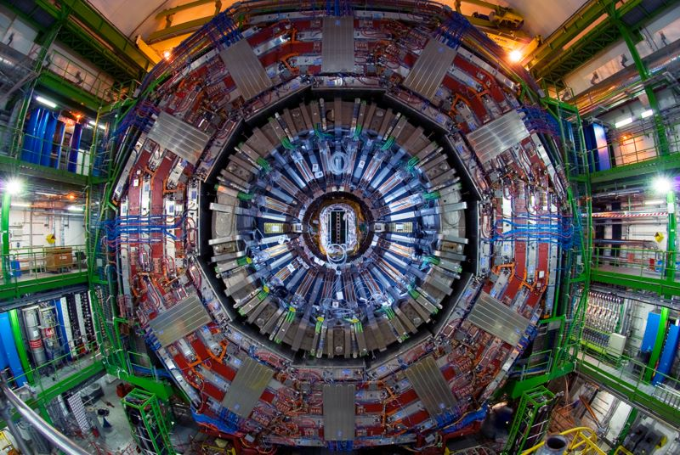


Commissioning and optimisation
of the CMS L1 ECAL Trigger
during LHC Run 1
Nadir DACI
IIHE Internal Seminar
24/02/2014

Slide 2
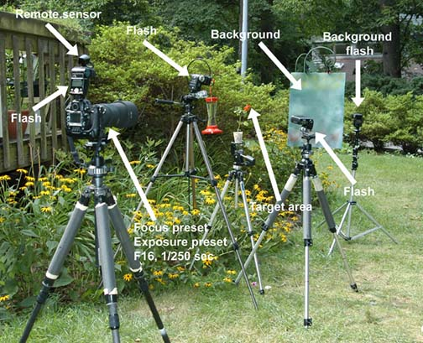
OUTLINE
Triggering on signals of interest at the LHC
The Level-1 ECAL Trigger
Optimisation of the ECAL Spikes rejection
Treatment of the ECAL crystals transparency loss
Performances through LHC Run 1

Slide 3
Triggering on signals of interest at the LHC

Slide 4
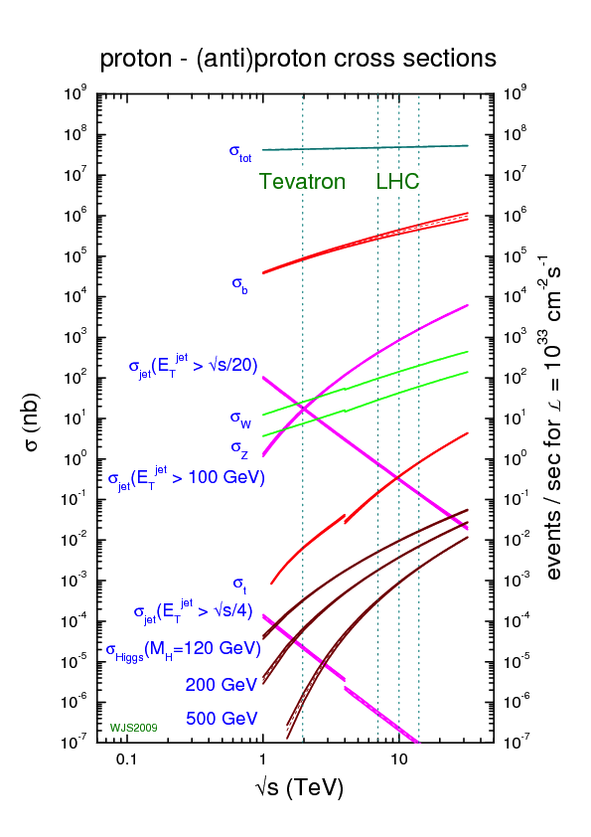
Triggering on rare signals
The online selection of rare signals, a real challenge : the example of the H boson
σ [nb]
The H boson is much rarer than the W/Z and b :
σ(H) ~10⁻⁴ x σ(W/Z) and ~10⁻⁸ x σ(b)
1 H per 10¹⁰ pp collisions
A very high collision rate is therefore needed to probe the existence of the H boson
⇒ @ Inst. Luminosity 10³³ cm⁻²s⁻¹ : 1 H boson / 100s
Trigger system : picks signal-like events among the overwhelming background events
The trigger algorithms define the phase space available for any analysis :
- efficient signal selection
- control samples, performance studies
3.10⁷
pp
3.10⁵
b
O(10)
W/Z
H(150)
√s [GeV]
LHC 7-8 TeV

Slide 5
Collisions intensity and pile-up
To probe rare phenomena, the LHC increased progessively the instantaneous luminosity :
from 10²⁹ (2010) to 10³³ (2012) cm²s⁻¹
High average pile-up : 21 PU events / BX in 2012
⇒ optimisations of the trigger and reconstruction algorithms (especially tracks and vertices)
Average pile-up
(2012, 8 TeV)
<PU> = 21
2012
20 fb⁻¹
Peak instantaneous luminosity
5 fb⁻¹
2011
2010
36 pb⁻¹

Slide 6
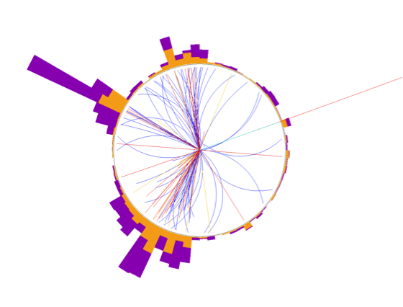
The CMS detector : basic requirements
Reconstruct and identify individual particles (Particle Flow) ⇒ fine granularity
Separate charged particles, tracking, vertexing, momentum measurement
⇒ intense B field, multi-layer tracker finely segmented, hermetic muon detector
Energy and position resolution
⇒ compact, homogeneous calorimeters
Geometric acceptance ⇒ hermetic detector
Charged hadron
HCAL deposit
Muon
Photon
ECAL deposit
Individual particles
Neutral hadron
Filter the high LHC collision rate as well as read the high number of individual channels
⟹ Trigger and Data Acquisition System
Optimisation of the available bandwidth
⇒ control of the trigger rate according to the CMS physics goals
⇒ tune energy thresholds, identification, isolation…

Slide 7
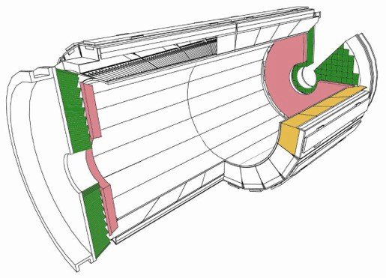
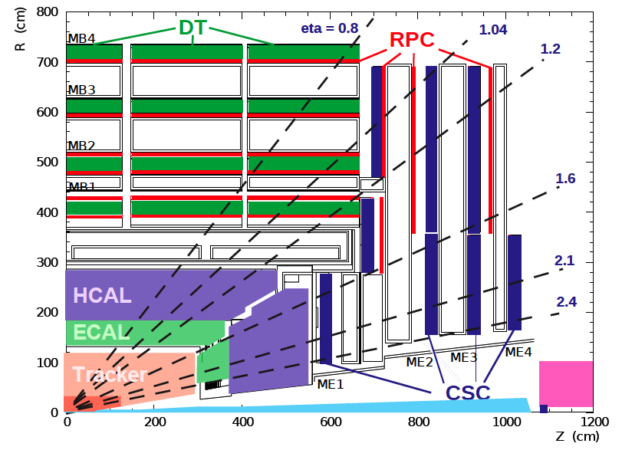
ECAL
Le détecteur CMS
HCAL
TRACKER
MUON DETECTOR

Slide 8
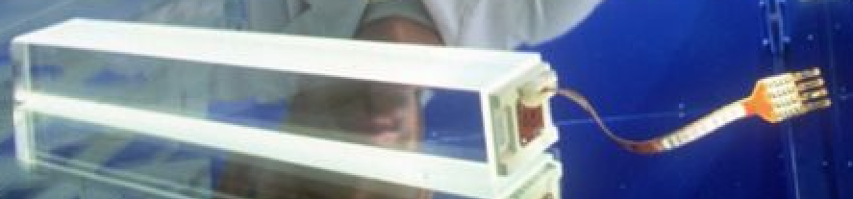
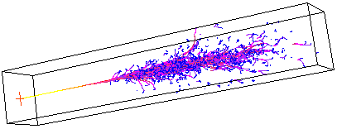
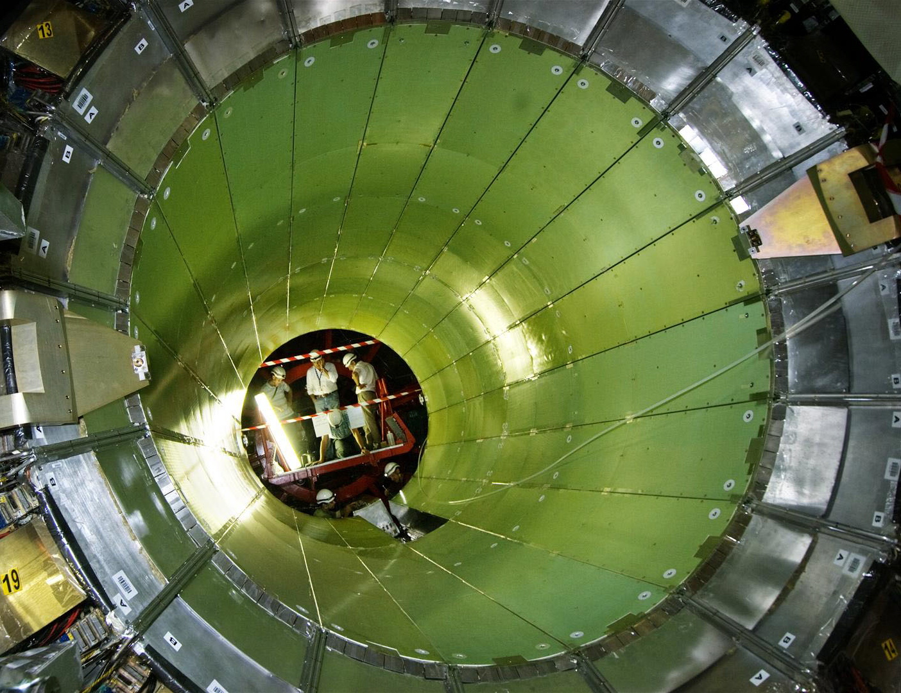
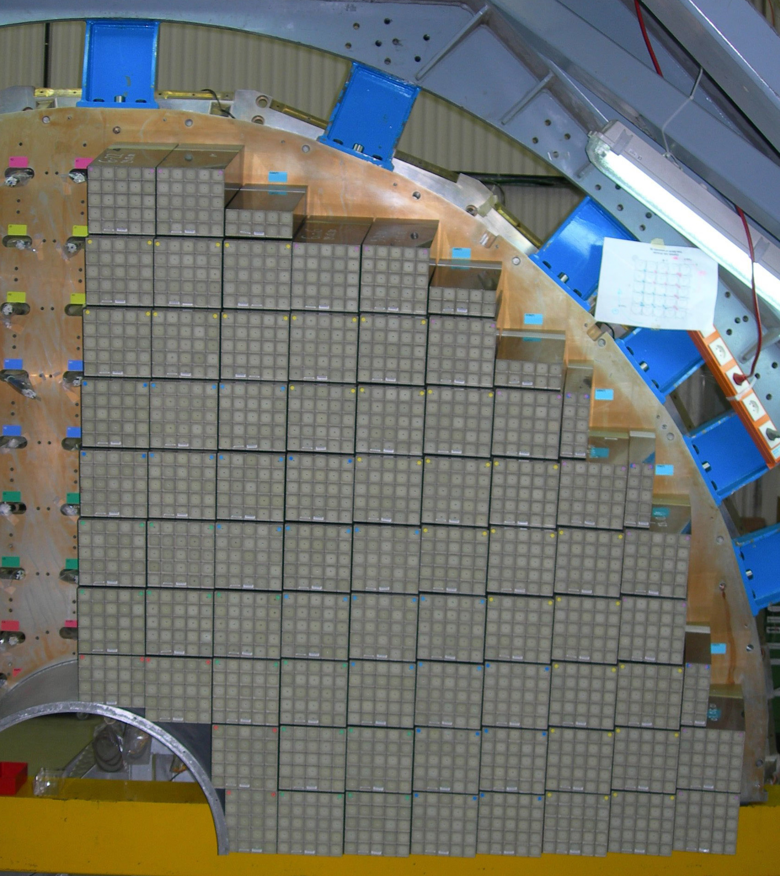
The Electromagnetic CALorimeter
The ECAL comprises 75848 crystals made of lead tungstate (PbWO₄)
⇒ dense (8,28 g/cm³) and short radiation length (0,89 cm)
⇒ compact : 80% of the energy from an EM shower is contained in a single crystal
⇒ fast : 80% of the scintillation light is emitted within 25 ns
~ (R_{Moliere})²
~ (22mm)²
Photodetector readout
⇒ barrel : Avalanche PhotoDiodes (APD)
26 X₀ ~ 23 cm
Barrel
(36 supermodules)
Endcaps
(4 half-circles)
The ECAL is compact, hermetic and finely segmented

Slide 9
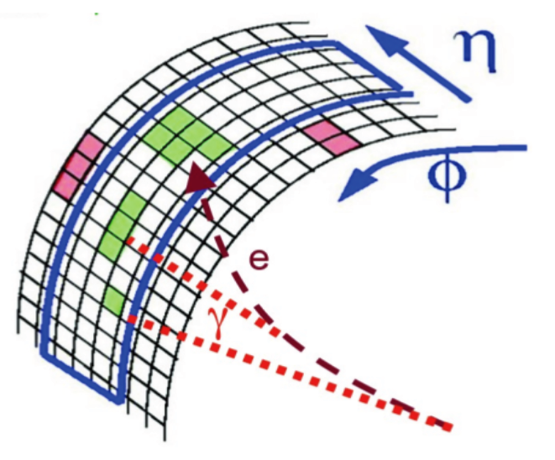
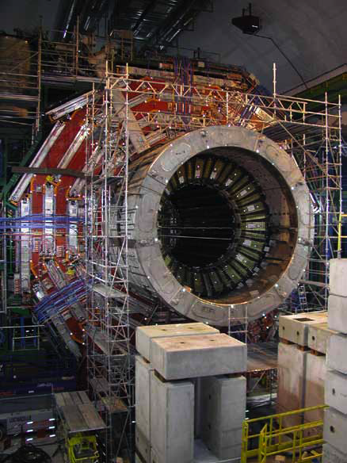
Electron reconstruction
Electrons play a major role in several high priority analyses (e.g. H→ZZ→4L)
The electron trajectory is curved by the magnetic field in the φ direction
The electrons interact with the material* in front of the ECAL, thus radiating Bremsstrahlung
Energy deposits in single crystals are gathered into clusters
A super-cluster groups the main deposit from the incident electron, as well as deposits from Bremsstrahlung photons
Track : association of hits from the innermost to the outermost tracker layer, accounting for the magnetic field and Bremsstrahlung probability
(*)
+ B field
⇒ spread in φ : Bremsstrahlung

Slide 10
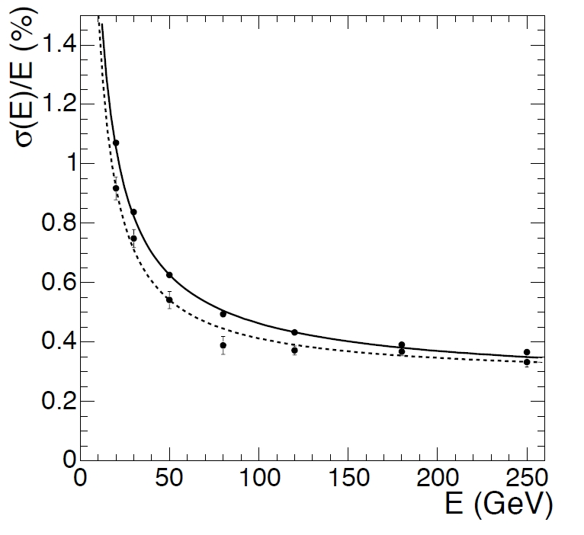
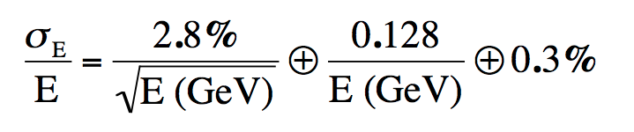
Electron energy resolution
ECAL intrinsic resolution (electron beams) ⟹ constant term of 0,3% (above 250 GeV)
Material budget, intense magnetic field ⟹ Bremsstrahlung
⟹ advanced clustering algorithms
The resulting effective electron energy resolution reaches 2% above 70 GeV

Slide 11
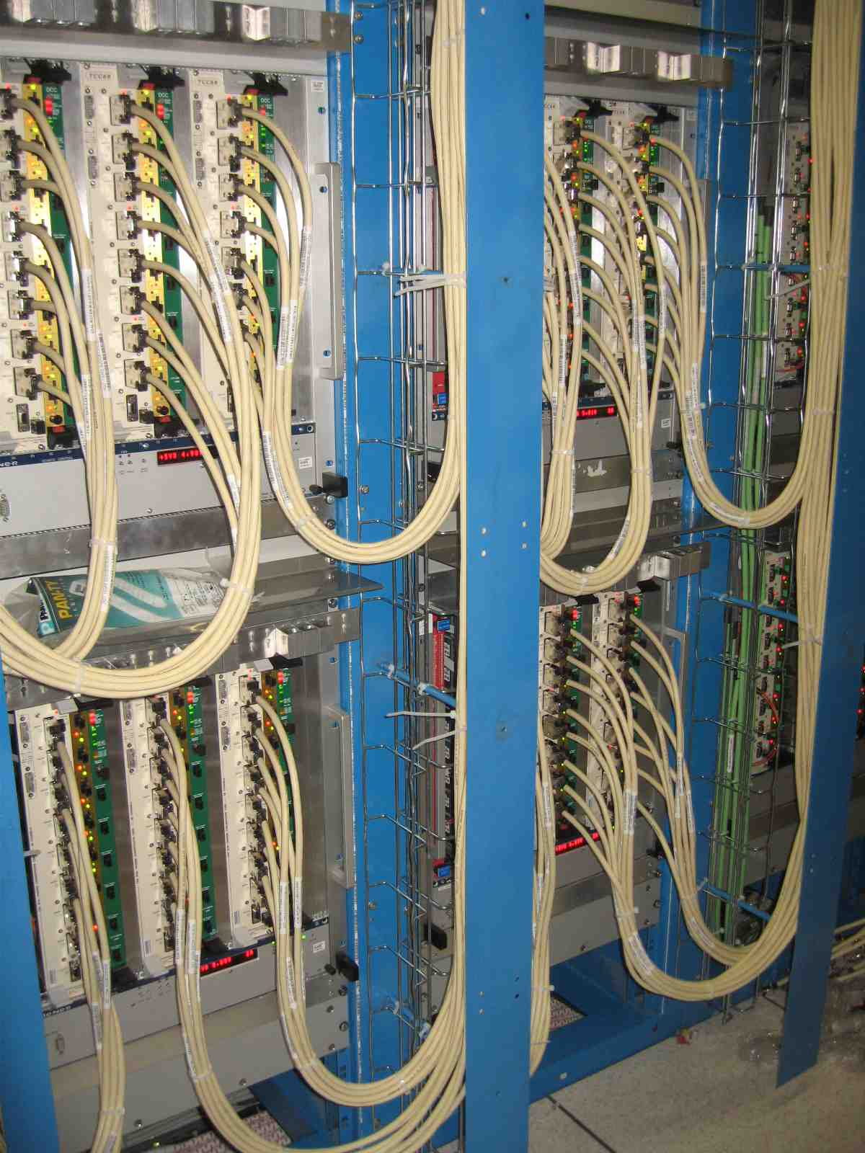
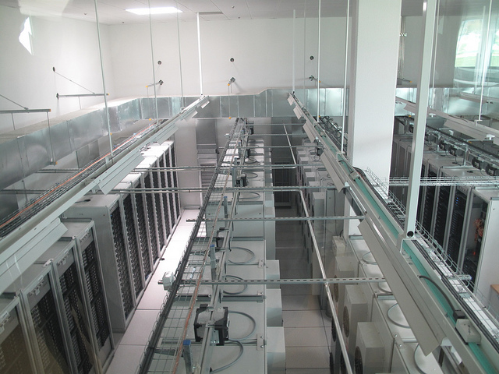
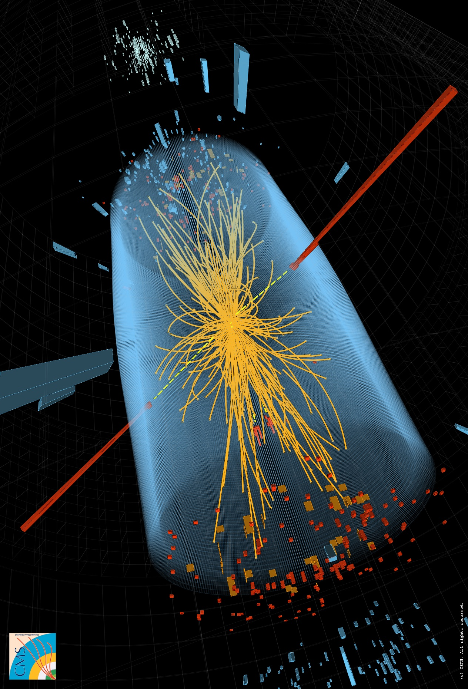
Trigger strategy
CMS uses a two-level trigger system : Level-1 and High Level
L1 : trigger electronics ⇒ coarse granularity data from calorimeters and the muon detector
HLT : reads data from all individual channels in all sub-detectors passing L1 zero-suppression ⇒ similar to the offline reconstruction
LHC pp
40 MHz
1 PB/s
L1 Output
100 kHz
2.5 GB/s
HLT Output
300 Hz - 1 KHz
225 MB/s

Slide 12
Trigger strategy : Level-1
The Level-1 uses the local readout electronics to filter the information as soon as possible in the decision chain
⇒ process in parallel the data coming from independant regions of the detector
Filter : 40 MHz ⇒ 100 kHz
L1 latency (buffer) : 3,2 μs
Local readout data from regions of the calorimeters and the muon systems (DT, CSC, RPC)
⇒ candidates : EG, Mu, Jet, Tau
⇒ global quantities :
had., em., total and missing E_{T}

Slide 13
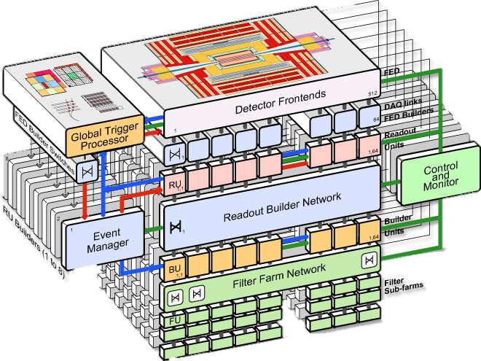
Trigger strategy : High Level
The HLT treats 10⁵ events per second selected by the L1
⇒ CPU farm (13k cores, équivalent to 20k cores with hyperthreading)
⇒ 160 ms / event ; total HLT output rate : 1 kHz
Sequential reconstruction similar to the offline reconstruction
HLT algorithms divided into sub-levels, e.g. for the electron paths :
L2 : super-clusters reconstruction & selection : regions centered around L1 EG candidates
L2.5 : tracking ⇒ matching tracks & super-clusters
L3 : final selection of the electron candidates

Slide 14
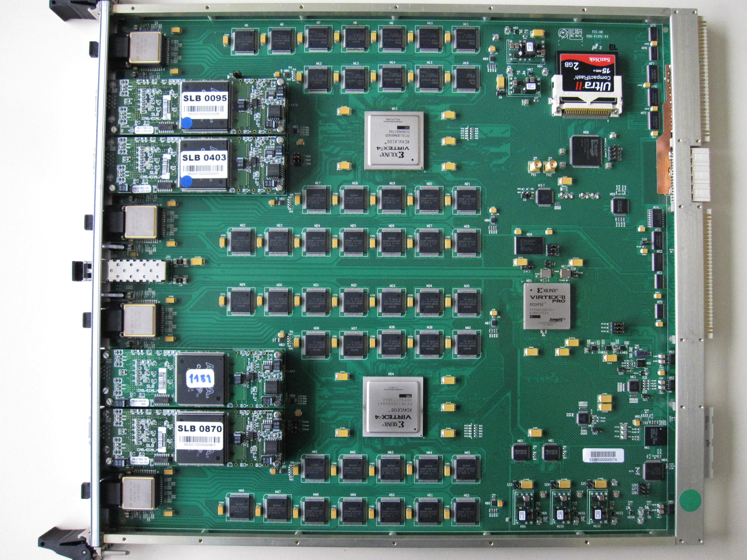
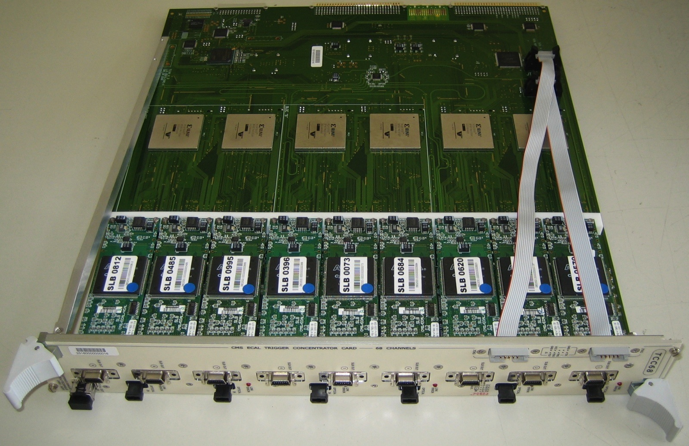
The Level-1 ECAL Trigger

Slide 15
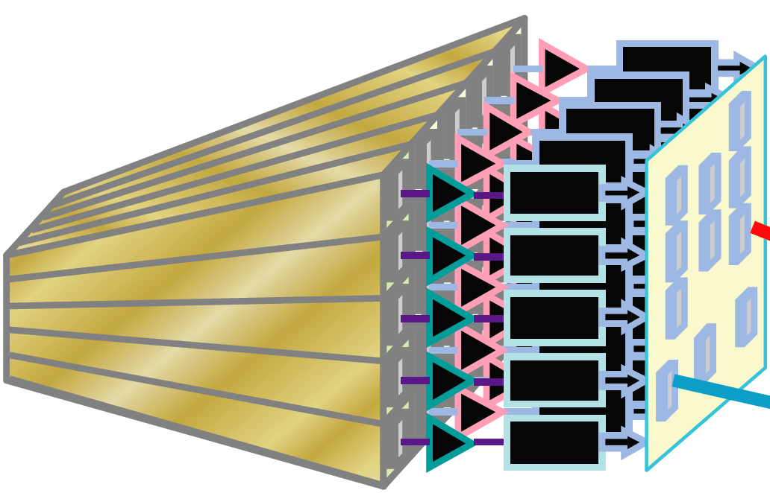
Level-1 electron selection
HCAL
GμT
1 tower
(5x5 crystals)
800 Mb/s
1.2 Gb/s
RCTGCT
L1 Accept
3.5 μs
⇒ 100 kHz
GT
TCC
x 68/48 (EB/EE)
Trigger primitives (TP) :
∑E_{T} over a tower
HCAL
ECAL
RCT : sends the 4+4 highest E_{T} candidates from each region
GCT : selects the 4+4 highest E_{T} candidates
L1 EG candidates
TP maximizing locally E_{T} (HIT)
+ maximum E_{T} adjacent TP (MAX)
HIT
MAX
Fine Grain
VETO : discriminate electrons and hadrons
Fine Grain : 90% E_{T} of a TP must be in 2 adjacent bands if E_{T}(TP)>6 GeV
H/E : E_{T} ratio between a HCAL tower and the corresponding ECAL tower
⇒ Cut : H/E < 5% (applied if L1 E_{T} > 2 GeV)
CANDIDATE STREAMS
4 isolated candidates :
- at least a « quiet corner » ⬄ ∑(5 adjacent towers) < 3.5 GeV
- the 8 neighbour towers of the HIT must pass both Fine Grain et H/E vetoes
4 non-isolated candidates
EM deposit :
- narrow in η
spread in φ

Slide 16
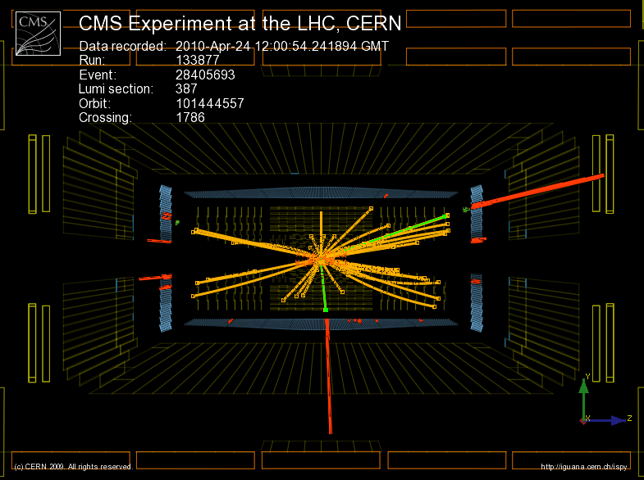
L1 EG trigger efficiency
Matching electrons / L1 EG candidates
⇒ candidate in the RCT region containing the tower where the electron deposits the most energy
Efficiency=fraction of probes triggering L1EGX
Unbinned fit : Heavyside ⊗ Crystal Ball
Tag & Probe : pure and unbiased electron sample
Z→e⁺e⁻ : 60 < m_{ee} < 120 GeV
Identification & isolation (selection efficiency : 80%)
σ_{iηiη} , h/e , ΔΦ , Δη , rel. iso(tracker+ecal+hcal) , hits
tag (E_{T} > 20 GeV) ⇒ triggers L1 EGX
probe (E_{T} > 5 GeV) ⇒ evaluate the efficiency
1 tower = 5x5 crystals

Slide 17
L1 EG trigger efficiency : 2011
Resolution limited by the L1 granularity L1 (2 towers)
Barrel
Spike rejection
Barrel, Endcaps
Threshold: 15 GeV
Plateau > 99%
Inefficiency : masked problematic channels
RESPONSE
Inflexion point @ 50% eff
Depends on L1 calibration
0.5
SHIFT barrel-endcaps
energy deposited in the ECAL pre-shower absent @ L1
transparency loss in the endcaps

Slide 18
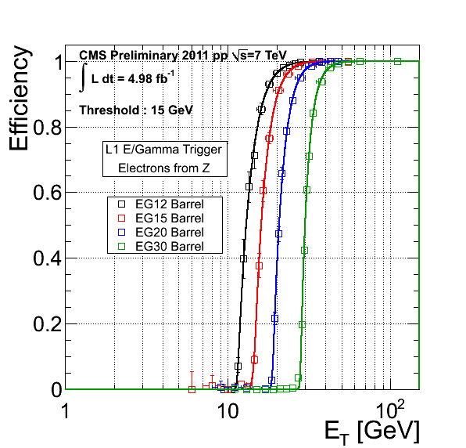
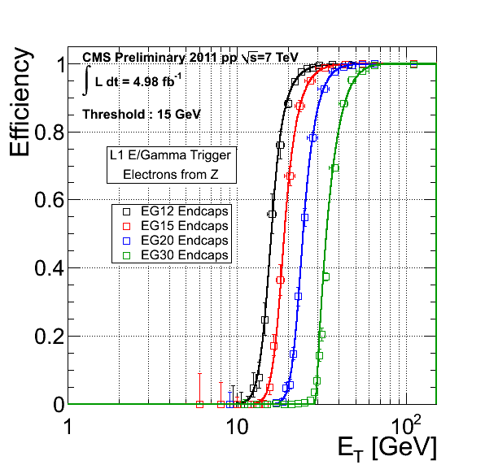
L1 EG trigger efficiency : 2011
Barrel (12,15,20,30 GeV)
Endcaps (12,15,20,30 GeV)
EG15 | EB | EE
50%
95%
99%
100 GeV
50% | EB | EE
EG12 | 13.0 GeV | 16.0 GeV
EG15 | 16.1 GeV | 19.1 GeV
EG20 | 20.7 GeV | 24.6 GeV
EG30 | 29.9 GeV | 33.7 GeV

Slide 19
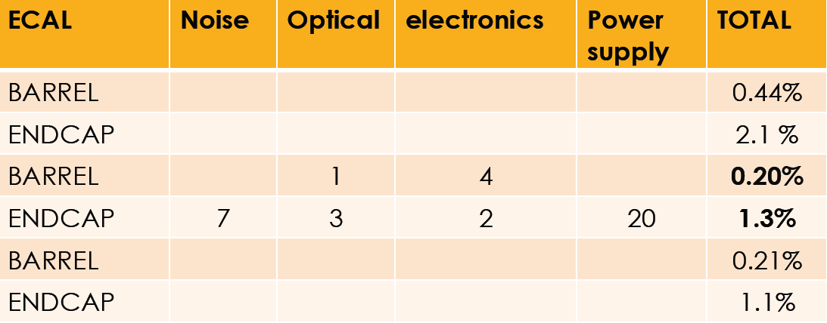
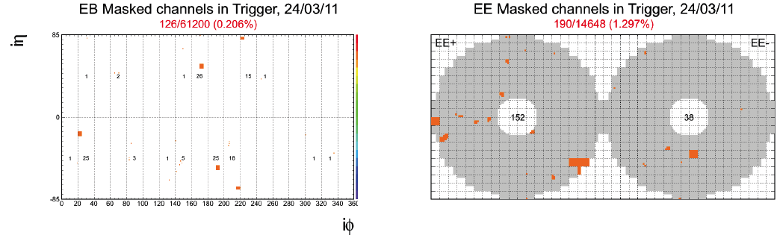
Active channels
The problematic crystals, towers and regions (optical links, power, electronics…) can be masked in the L1 decision chain
⇒ prevents problematic channels to induce high trigger rates
Excellent geometric acceptance : 99.8% (barrel) 98.7% (endcaps)
⇒ masking stable through Run 1 data taking (2010-2012)
2010
2011
2012

Slide 20
Sources of inefficiency
Source | Barrel | Endcaps | Barrel | Endcaps
Inefficient electrons | 7803 | 3216
Pre-firing | 74 | 110 | 0.95% | 3.42%
Post-firing | 135 | 68 | 1.73% | 2.11%
Fine-Grain (FG) | 87 | 0 | 1.11% | 0.00%
H/E | 1166 | 734 | 14.94% | 22.82%
Masked towers | 249 | 0 | 3.19% | 0.00%
Masked bands | 0 | 496 | 0.00% | 15.42%
Masked crystals | 58 | 1 | 0.74% | 0.03%
Spikes | 3282 | 0 | 42.06% | 0.00%
Energy spread | 509 | 298 | 6.52% | 9.27%
Pre/post-firing : an electron from BX n triggers at BX (n-1) or (n+1) (sampling phase shifts) ⟹ estimation: match the electron to L1 candidates from BX-1 and BX+1
Reconstructed electron energy deposit and corresponding trigger primitives (TP):
- FG and H/E : check rejection of the TP corresponding to the main deposit within a single tower
- Masking (tower / strip / crystal), Spike rejection : check rejection of the 2 maximum E_{T} towers
- Spread : [2 max E_{T} towers ⟹ ∑ TP < 15 GeV ] while [all towers ⟹ ∑ TP > 15 GeV ]

Slide 21
Regional efficiency
BARREL
EB+
Z scale : 0.85 - 1
EB-
EE-
EE+
ENDCAPS

Slide 22
Response of the ECAL crystals
Particles passing through ECAL crystals create defects hence degrading their transparency thus their response ⟹ especially @ high η
The increasing collision intensity made ECAL sensitive to this phenomenon as soon as 2011 data taking
The ECAL laser control system measures the crystals’ response regularly during the data taking runs ⟹ calibration (for offline reconstruction)

Slide 23
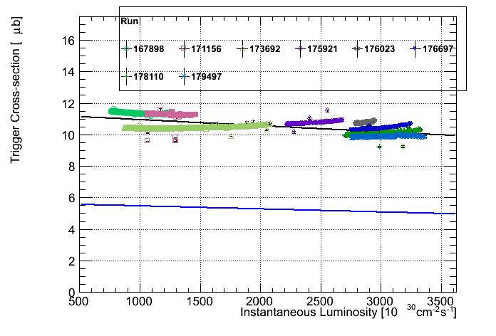
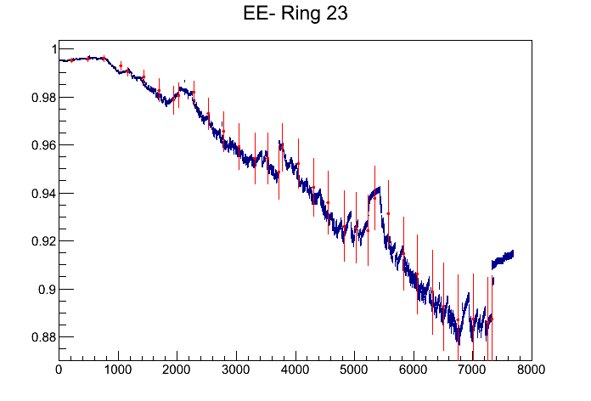
Response of the ECAL crystals
Decrease of the trigger rate
with the increasing inst. luminosity
for successive runs at a constant inst. lumi.
with time within the same run
04/2011
11/2011
Average relative transparency
Weekly correction procedure
transparency loss increases with η
⇒ corrections only in the endcaps
average response in 11 rings (φ)
transparency loss over a week
⇒ weekly corrections of the crystals calibration in the trigger electronics
2.6 < η < 2.8

Slide 24
L1 transparency corrections
Barrel, E. data, E. emulation (15 GeV)
Emulation of the full L1 chain
apply the corrections to the 33 weeks of 2011 data taking
increase of the efficiency in the Endcaps : 10%
narrower efficiency curve closer to the Barrel curve
EG15 | EE data | EE corrected
50%
95%
99%
100 GeV
24

Slide 25
L1 EG resolution
Résolution des candidats L1 EG : écart entre E_{T}(e±) et E_{T}(L1)
Barrel
Endcaps
Relative online/offline ET difference
Crystal Ball distribution
power law if E_{T}(L1) < E_{T}(e±)
gaussian law otherwise
⇔ excess of L1 candidates underestimating E_{T}(e±)
⇔ Bremsstrahlung escaping the two TP of a L1 c.
Transparency corrections (Endcaps)
improve L1 resolution : narrower
improve L1 response : centered on 0

Slide 26
Performances : 2011 vs 2012
Barrel, Endcaps (20 GeV) 2011
Barrel, Endcaps (20 GeV) 2012
95% efficiency (barrel/endcaps) :
2011 : 27.9 GeV / 34.3 GeV
2012 : 27.6 GeV / 32.0 GeV
Excellent efficiency in 2011 ⇒ narrower curves in 2012
Efficiency in the endcaps closer to the barrel ⇐ transparency corrections
+ L1 EG calibration in the RCT accounts for the ECAL pre-shower in 2011
HLT algorithms (e.g. Higgs analyses) seeded by unprescaled L1 algorithms
⇒ The algorithms L1 EG 8 GeV (2010), 15 GeV (2011) et 20 GeV (2012) were maintained un-prescaled
⇒ maintain an efficient data acquisition for the CMS physics goals

Slide 27
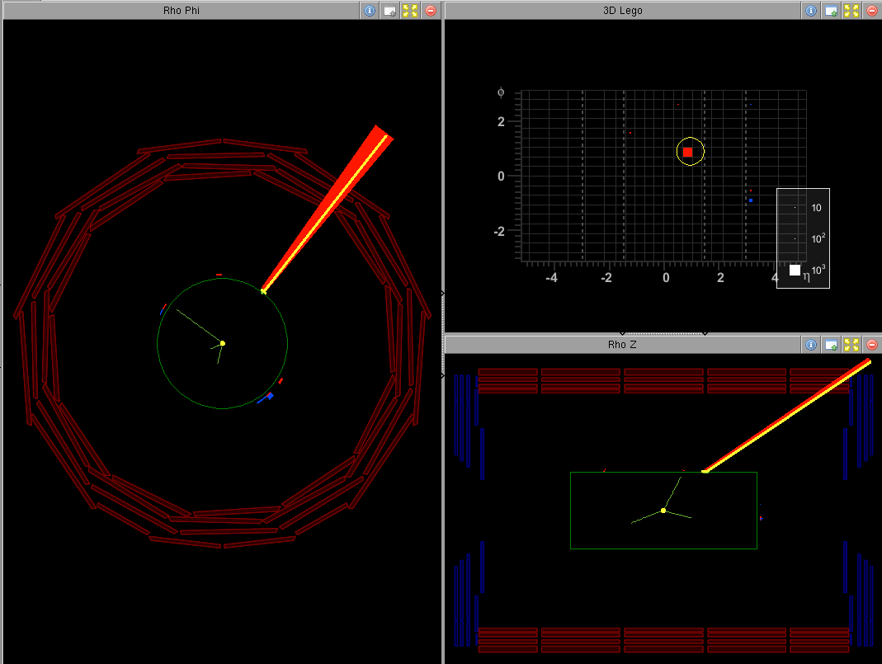
ANOMALOUS SIGNALS IN THE ECAL
Notes:
Schéma particule → APD ➔ spike + Event display spike + rates

Slide 28
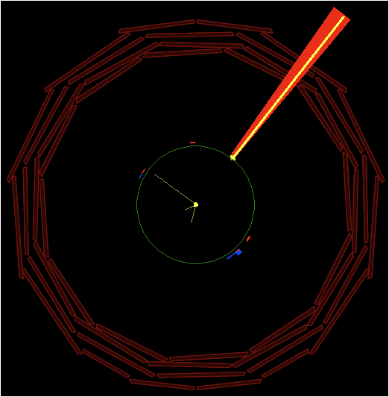
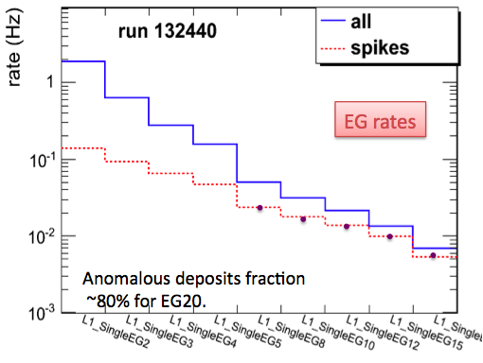
Anomalous signals in the ECAL
Interaction of neutrons with the APD material
⇒ production of protons ionizing the APD silicon
⇒ very high energy signals isolated in single crystals : « spikes »
Production rate proportionnal to the instantaneous luminosity :
⇒ 1/370 minimum bias interactions ; 5 times more spikes at <PU> = 100
Rate increasing with√s : 1/600 (0,9 TeV), 1/552 (2,36 TeV), 1/370 (7 TeV)
The spikes saturate the bandwidth of the L1 EG algorithms at high thresholds
⇒ In the context of increasing collisions intensity, their rejection is critical
Notes:
taux_spikes(√s)=9.926543577526e-05 * √s
1.920492456474e-04

Slide 29
Spike rejection
Offline and online rejection algorithms
OFFLINE
« Swiss cross » : C_{S} = (1 - E₄ / E₁) < 0,95
⇒ An EM shower déposits 80% of its energy within a single crystal
⇒ A spike is entirely in a single crystal
Time shift : direct interaction with the APD
⇒ no scintillation time (~10 ns)
⇒ the signal appears earlier than EM showers
ONLINE
η
φ
EM Shower (VetoBit=1)
2 (crystals ∈ φ strip) E_{T} > S₁
(B+Bremsstrahlung ⇒ φ spread)
Spike (VetoBit=0)
E_{T}(tower) > S₂
⇒ primitive set to 0 GeV

Slide 30
Optimisation of the rejection procedure
The rejection efficiency increases with S₁ (eliminates noisy crystals) but the electron selection efficiency decreases
Low energy electrons : can be mis-identified, but their towers have E_{T} < S₂
High energy electrons : deposit enough energy ⇒ well identified
Only cases potentially problematic : intermediate cases (E_{ele} ~ S₂ when S₂ is low)
Emulation of the L1 EG chain on the 2010 data :
S₁ ∈ {152, 258, 289, 350, 456, 608} MeV / S₂∈ {8,12,18} GeV
S₂= 8 GeV
Working point : 258 MeV ; 8 GeV
Rejects 96% of the spikes
Keeps 98% (pT>20 GeV : 99.6%) of the electrons which trigger a L1 EG threshold of 8 GeV.
Optimise the L1 EG bandwidth :
Trigger rate (L1 EG 12 GeV) ⇒ divided by 3
L1 rate : 70 kHz ⇒ 19 kHz
@ 2.10³²
L1 Threshold (GeV) | 12 | 15 | 20 | 30
Rate reduction factor | 3.4 | 4.3 | 6.0 | 9.6

Slide 31
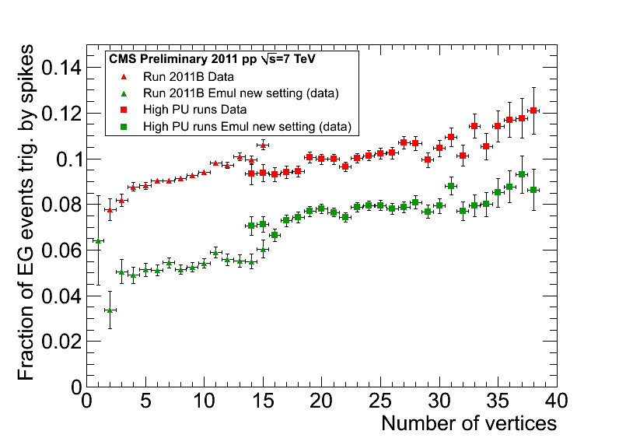
Impact of the pile-up
Residual spikes contamination in the 2011 data
⇒ fraction of events where a spike triggers an algorithm L1 EG 15 GeV
The contamination increasies lineairly with the reconstructed number of vertices
Flexibility of the rejection algorithm ⇒ new working point
⇒ similar performances on the electrons
⇒ divides the contamination by a factor 2
New working point used in 2012
⇒ flexibility to adapt the rejection procedure to a higher pile-up

Slide 32
CONCLUSION

Slide 33
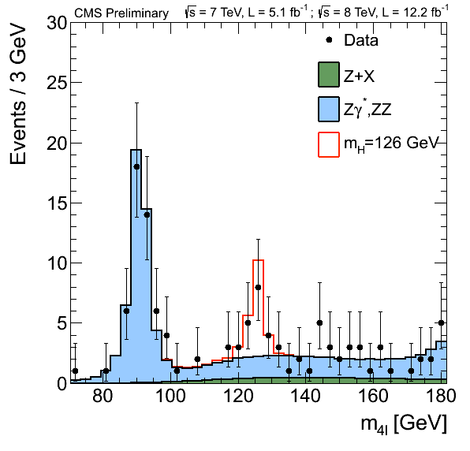
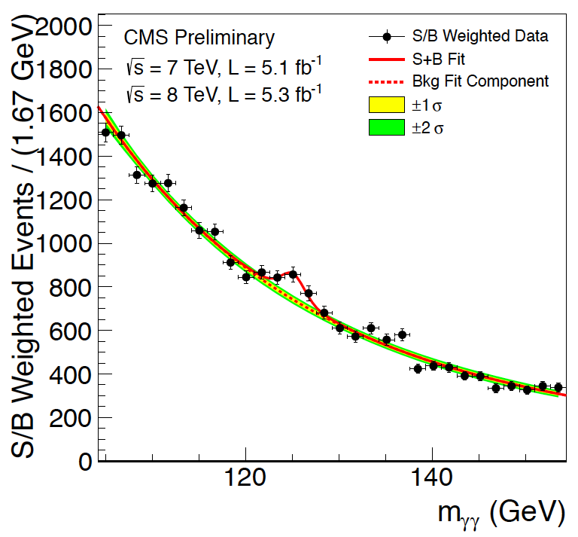
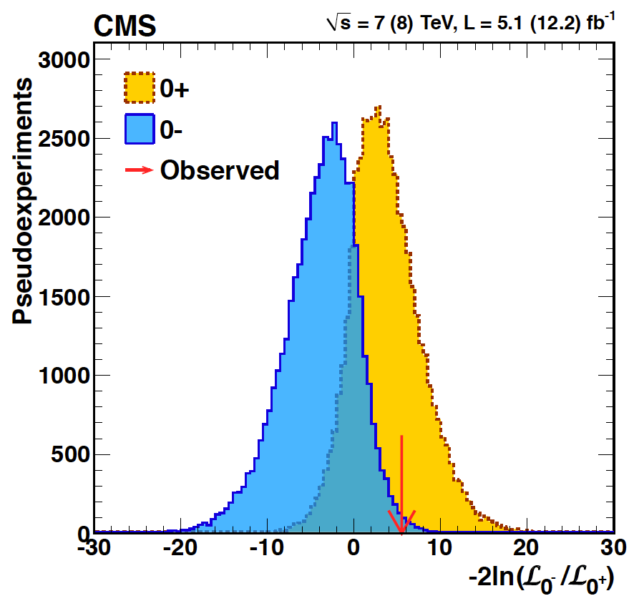
Conclusion
CMS uses a high granularity hermetic detector, and an intense magnetic field
⇒ excellent resolution + reconstruction of individual particles
The two-level trigger system optimises the event filtering at the earliest readout stages
The flexibility of the L1 allowed to maintain excellent performances of the electron/photon trigger during the LHC Run 1 (2010-2012)
The ECAL spikes are efficiently rejected, and the degradation of the crystals response with time is successfully mitigated
Maintain unprescaled thresholds at low enough values
⇒ acquisition of the data needed to achieve the CMS physics goals
Mass ZZ*→4L
Discrimination 0⁺/0⁻
ZZ* channel
Mass γγ
CMS PAS HIG-12-041
CMS PAS HIG-12-015
CMS-HIG-12-041-001

Slide 34
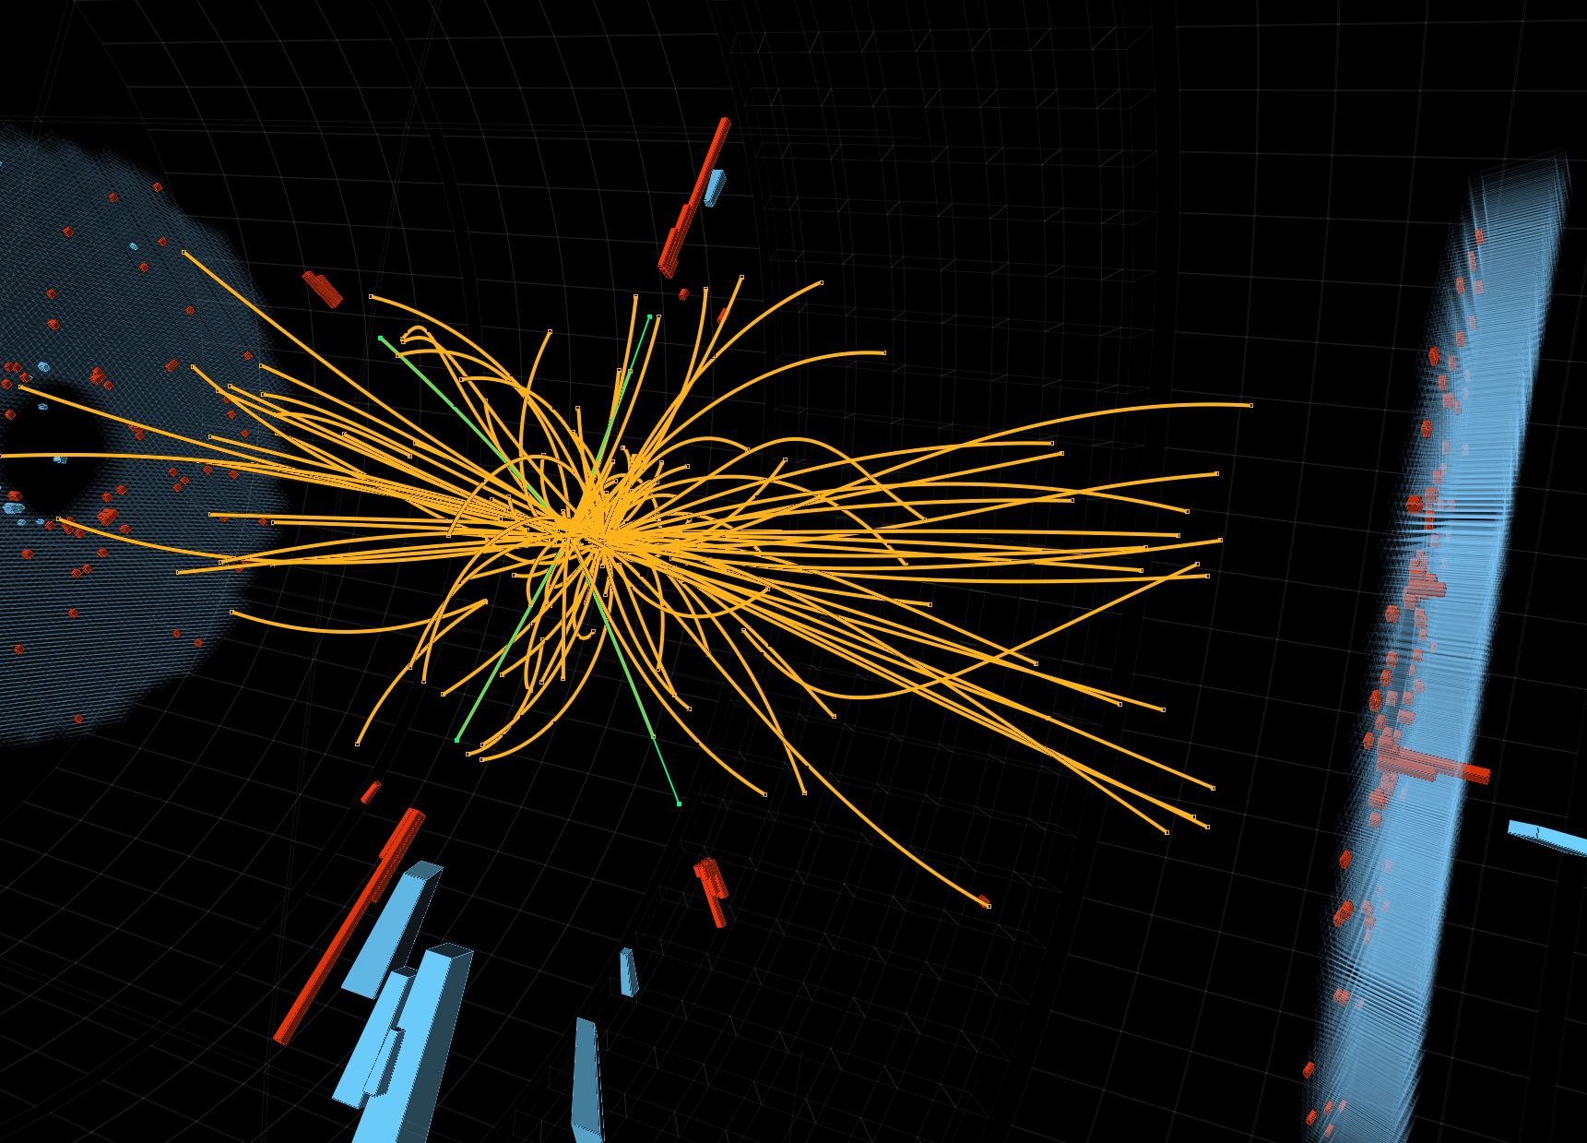

THANKS FOR YOUR ATTENTION

Slide 35
BACKUP

Slide 36
ECAL Readout

Slide 37
ECAL Trigger : strip E_{T}
Makes signal proportional to E
Base, ampl. gain, intercalibration
Adds samples from 5 crystals within a strip
Weighted sum of 5 consecutive samples
⟹ optimises signal extraction
⟹ minimises pile-up contamination
⟹ dynamic subtraction of the pedestal
Peak
12 bits
Find a local maximum
⟹ compares a weighted sample to the previous and next samples (25 ns shift)
⟹ identify BX

Slide 38
ECAL Trigger : trigger primitive
Adds strip E_{T} into tower E_{T}
12 bits ⟹ 10 bits
Compress tower E_{T} using a LUT
10 bits ⟹ 8 bits
TP
9 bits
Computes the FG bit
⟹ by the FE (Barrel)
or the TCC (Endcaps)

Slide 39
Readout
and trigger electronics
FE : stores signal from individual xtals in buffer and produces TP (EB) / pseudostrips (EE)
TCC : finalizes TP in EE ; classify TP in 3 levels of interest ⟹ SRP ; compress info (LUT)
SLB : auxiliary cards plugged on the TCC, store TP and sends them to the RCT
shift RCT/TCC clock ⟹ synchronizes TP transmission ⟹ BX assignment
SRP : determines readout mode of the towers : (E_{T}<1 , 1<E_{T}<2 , E_{T}>2) ⇔ (ZS , full tower , 3x3)
⟹ reduces ECAL data from 1.5 MB to <100 KB
CCS : distributes clock, configures FE, provides interface with TTS
TTS : pre-scale or stop trigger from FE or TCC in case of buffer saturation
DCC : in case of L1Accept, DCC receives crystals signal samples from FE, TP from TCC and readout flags from SRP, then apply the ZS according to these flags

Slide 40
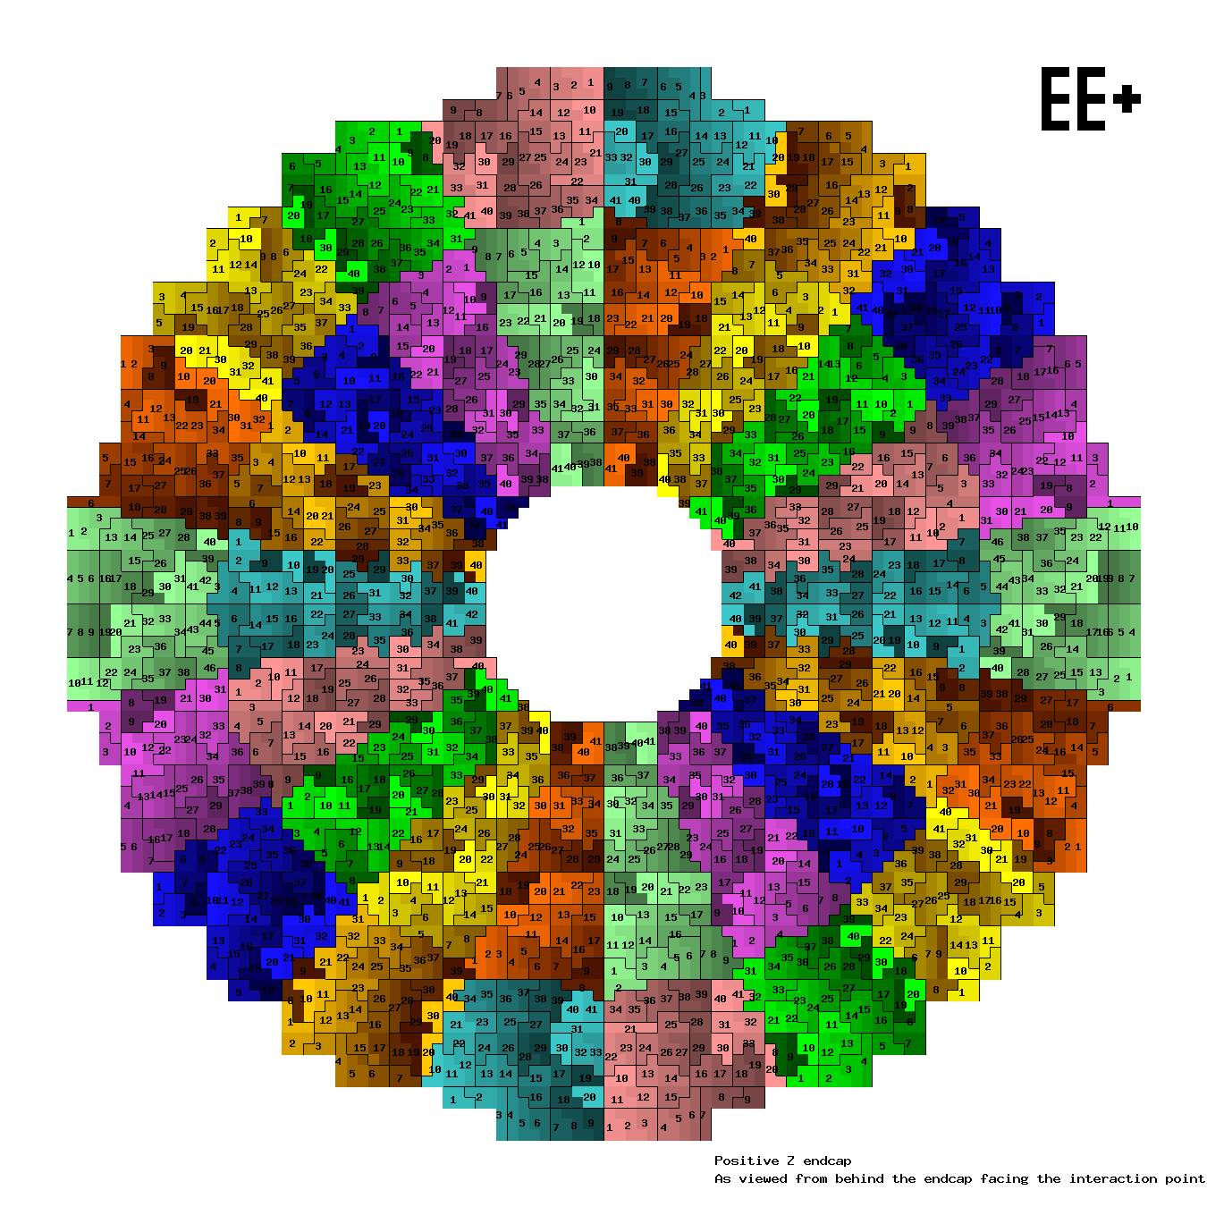
Pseudo-strips and trigger towers : endcaps
- Numbered areas : pseudo-strips
- Colored areas = 20o in f = 1 TCC
- Trigger towers : solid lines

Slide 41
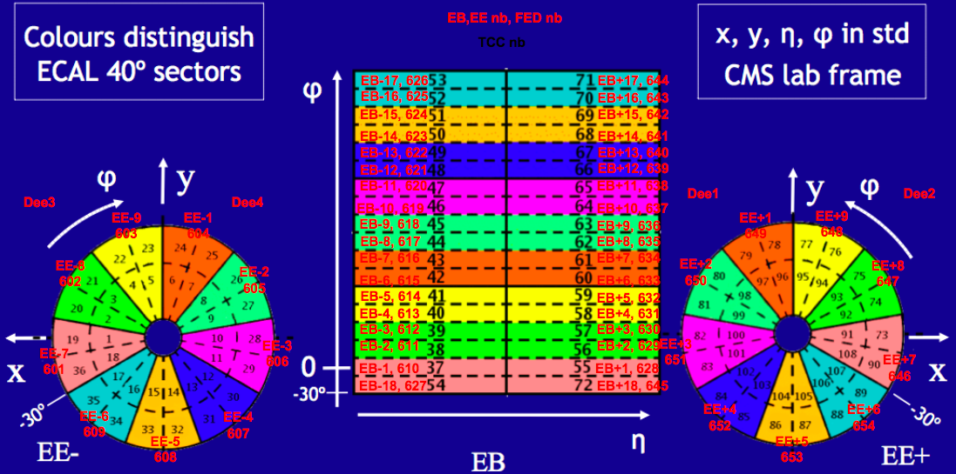
TCC mapping

Slide 42
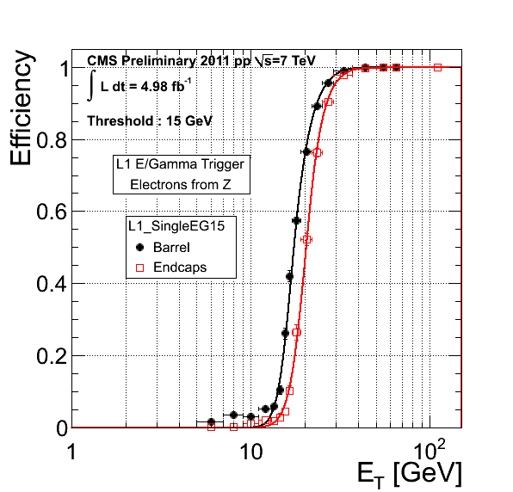
L1 efficiency given HLT selection (seeding)
EB, EE (EG15)
Electrons offline selection taken from :
Ele27_CaloIdVT_CaloIsoT_TrkidT_TrkIsoT
EG15 | EB | EE
50%
95%
99%
100 GeV
ε(27 GeV) = 95.9% (EB) / 90.9% (EE)

Slide 43
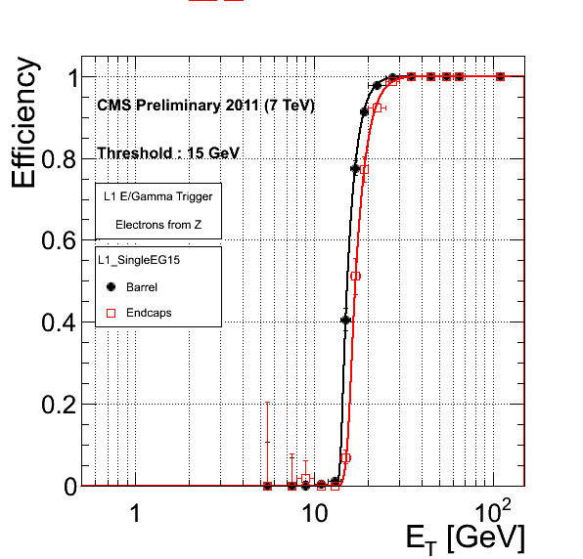
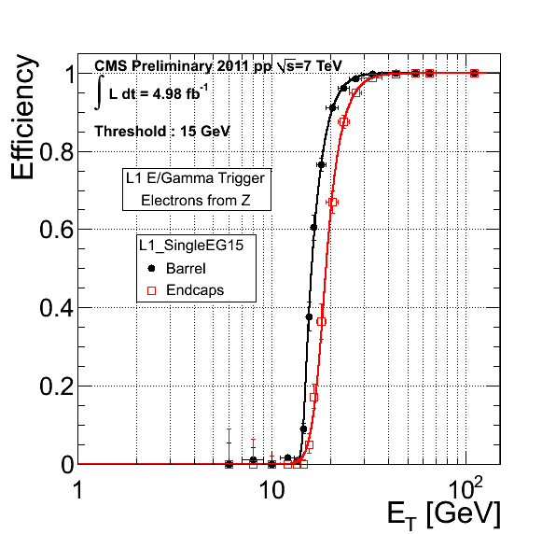
L1 EG efficiency in simulation
Simulation : EB, EE (EG15)
Data : EB, EE (EG15)
EG15 | EB | EE
50%
95%
99%
100 GeV
EG15 | EB | EE
50%
95%
99%
100 GeV
43

Slide 44
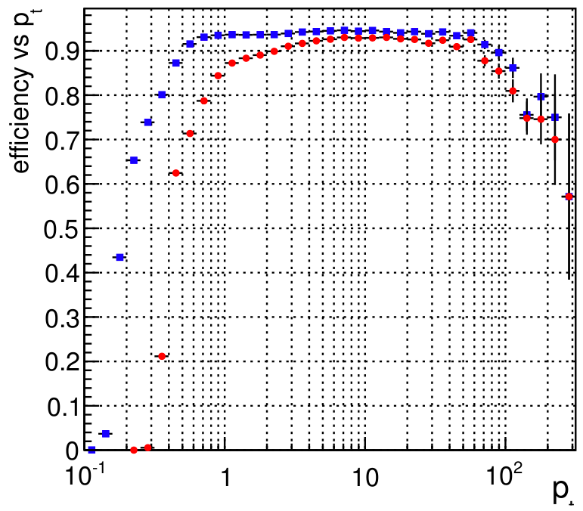
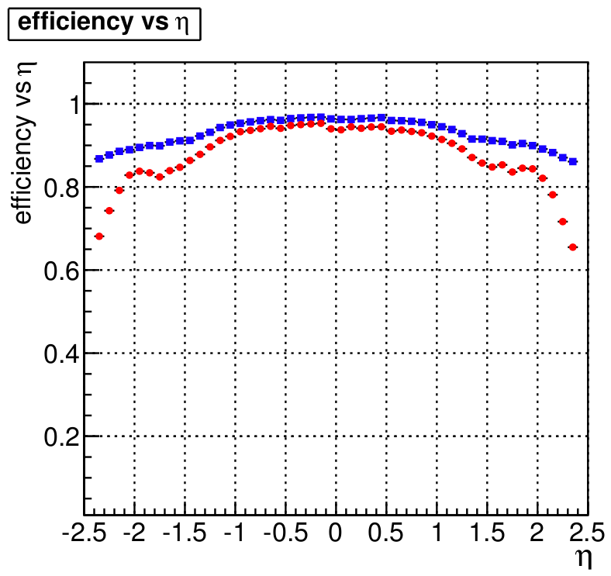
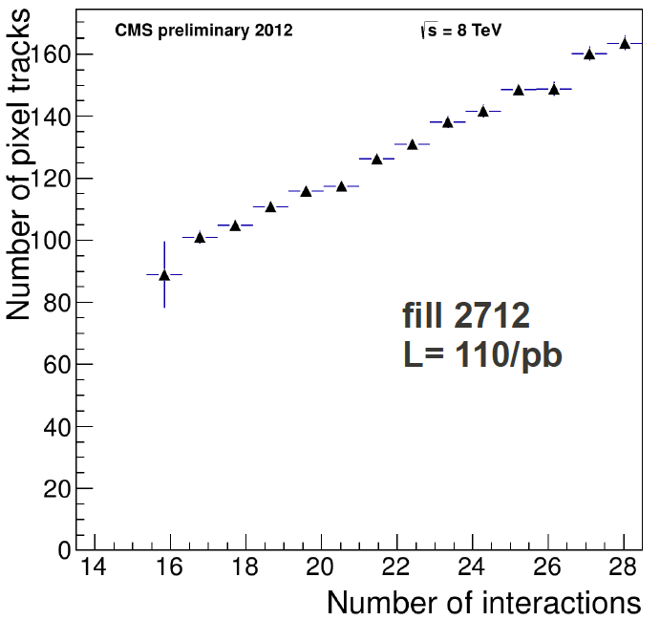
Trigger strategy : HLT performances
L’efficacité de reconstruction des traces, et la linéarité par rapport au nombre de points d’interaction, sont des éléments cruciaux pour l’optimisation du déclenchement
N_{tracks} vs PU
HLT
hors-ligne
HLT
hors-ligne

Slide 45
Reconstruction of ee resonances
Notes:
Masse Zee résolution
EB EE
Data 1,51 2,36
MC 1,29 1,78

Slide 46
Le trajectomètre
Le trajectomètre comporte 66M de pixels de silicium (100x150 μm²) & 9,3M de bandes de silicium (10cm x 80μm, 25cm x 180μm)
Détecteur hermétique entourant le centre du détecteur (L=5,8 m ; D=2,5m ; |η|<2,5)
⇒ couche interne à 4,4 cm de l’axe des faisceaux
Pixels : 3 couches, Bandes : 10 couches
Reconstruction d’une trace : algorithme itératif
⇒ germe dans les pixels ⇒ extrapolation en hélice (B, interaction dans la matière)
⇒ association d’un hit par couche jusqu’à la couche externe ⇒ ajustement (χ²)

Slide 47
Le calorimètre hadronique
Calorimètre à échantillonage comportant ~6 couches successives associant :
- des absorbeurs en laiton pour initier et absorber les cascades hadroniques
- des tuiles scintillantes en plastique pour mesurer l'énergie des hadrons
Le HCAL est inséré entre un calorimètre électromagnétique compact et l’aimant
L’aimant constitue un absorbeur supplémentaire pour le sous-système extérieur (HO)
La mesure de l’énergie transverse manquante dépend fortement de son herméticité
La réponse du HCAL est centrée sur 1, avec une dispersion inférieure à 5%

Slide 48
Détecteur de muons
Les muons interagissent peu : ils ne sont pas stoppés par le détecteur interne
Le détecteur de muons comporte un tonneau contenant 4 stations équipées de 250 chambres DT et deux bouchons contenant chacun 468 chambres CSC
Un ensemble de chambres RPC (6 couches dans le tonneau et 3 par bouchon) fournit un système de déclenchement rapide et indépendant (redondance)
DT : tubes à dérive
CSC : chambre à bande cathodique
RPC : chambre à plaque résistante
Chaque chambre comporte plusieurs couches
48

