Slide 1
Constraints on Higgs couplings from a combination of ATLAS and CMS measurements
W. Verkerke (Nikhef)
ATLAS-CONF-2015-044 / CMS-PAS-HIG-15-002
Seminar Brussel – 16 October 2015
1

Slide 2
Outline of this presentation
Introduction
Higgs boson phenomenology & interpretation framework
Combination procedure & experimental inputs
Signal strength measurements
Constraints on Higgs boson couplings
Most generic parametrizations
2

Slide 3
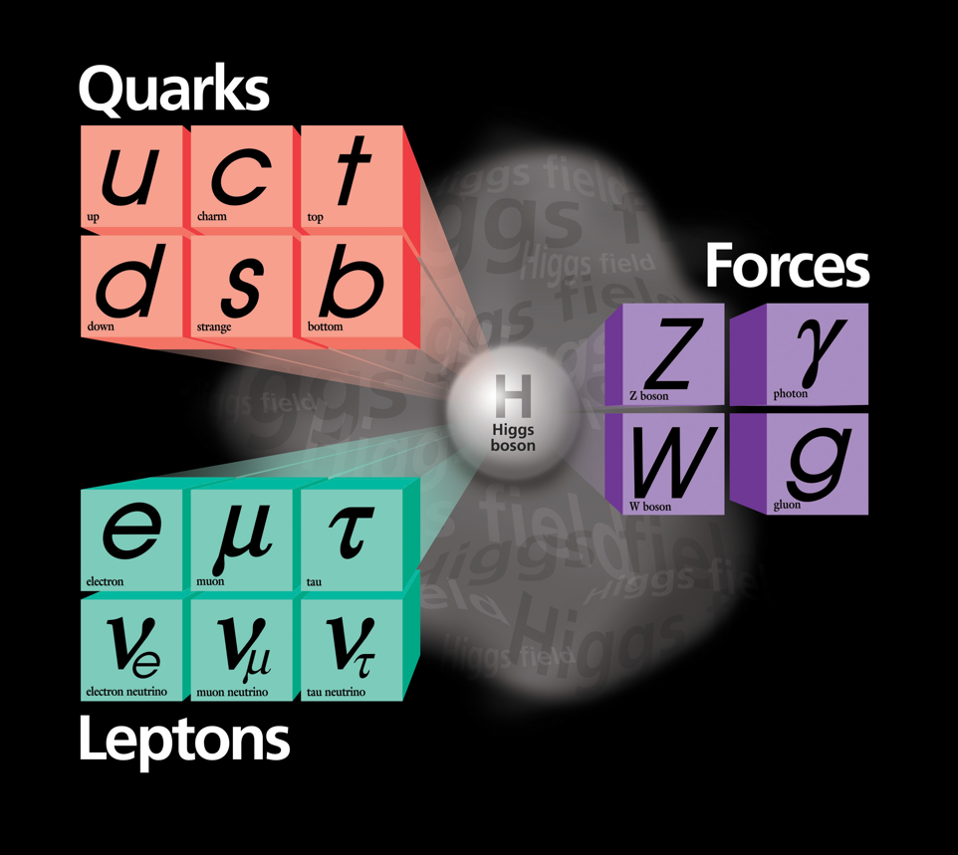
Introduction – Brout-Englert-Higgs mechanism in the SM
The Brout-Englert-Higgs mechanism plays a pivotal role in the Standard Model
3

Slide 4
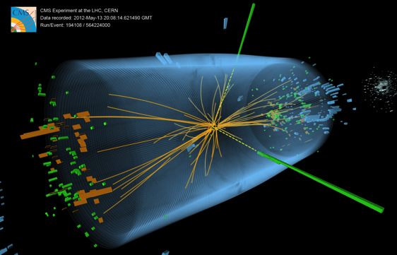
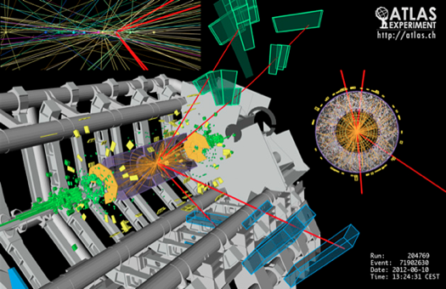
Run 1- Discovery of SM-like Higgs boson
Discovery of Standard-Model like Higgs boson in 2012 offers opportunity to investigate Higgs sector of nature in detail
4

Slide 5
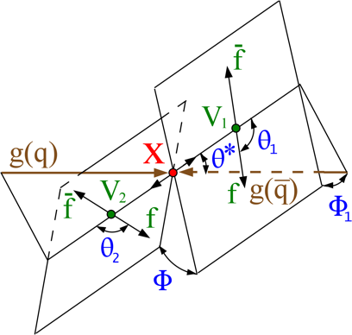
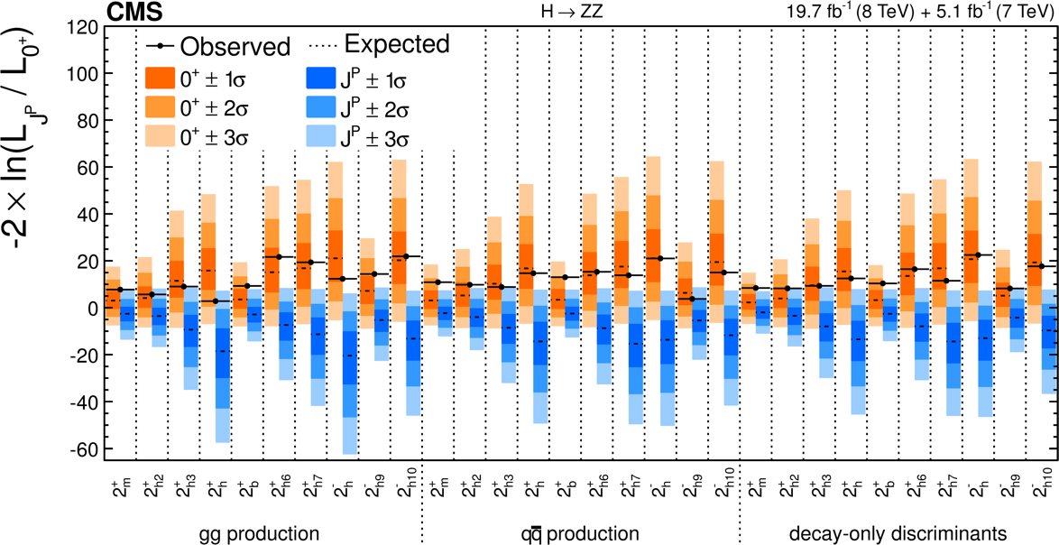
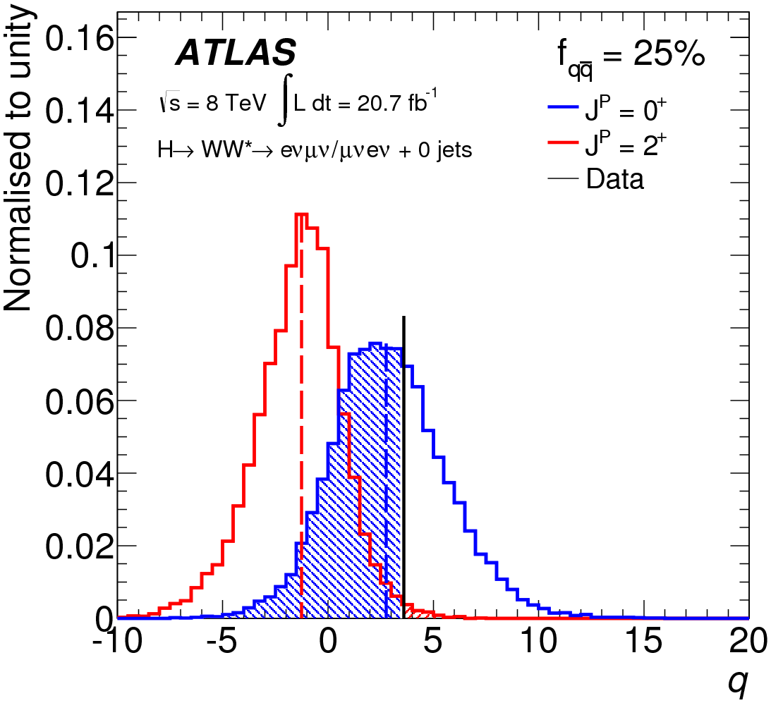
The observed Higgs boson is a spin-0 particle, compatible with CP-even
Angular analysis of CMS and ATLAS run-1 data rules out spin-2 at >99.9% C.L.
H→ZZ
PRD 92 (2015) 012004
Eur. Phys. J. C75 (2015) 231
5

Slide 6
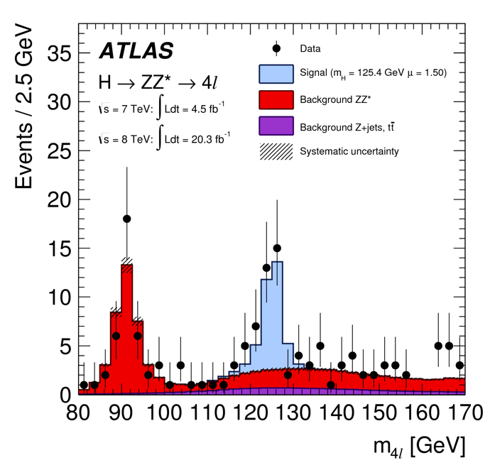
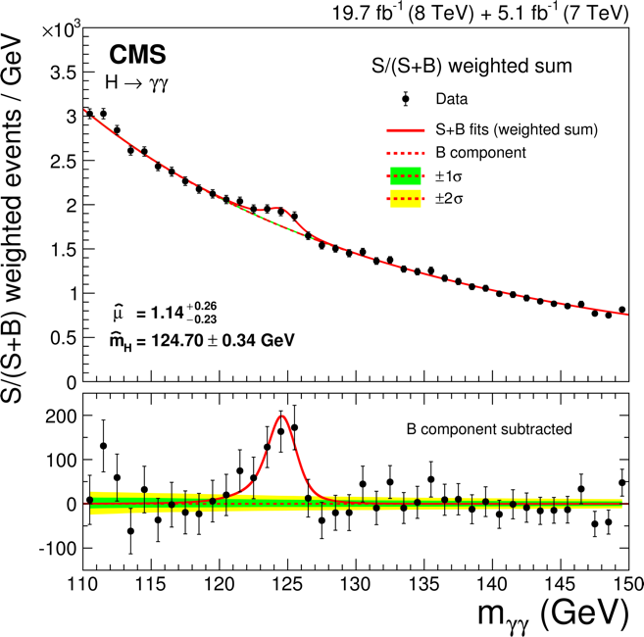
Mass of Higgs boson measured with <0.2% precision
Higgs boson mass is only parameter unconstrained by SM
But crucial in SM prediction of Higgs production and decay rates
Measurement based on H→ZZ* and H→γγ final states, for which invariant mass can be reconstructed with high precision
Phys. Rev. D. 90, 052004 (2014)
Eur. Phys. J. C 74 (2014) 3076
6

Slide 7
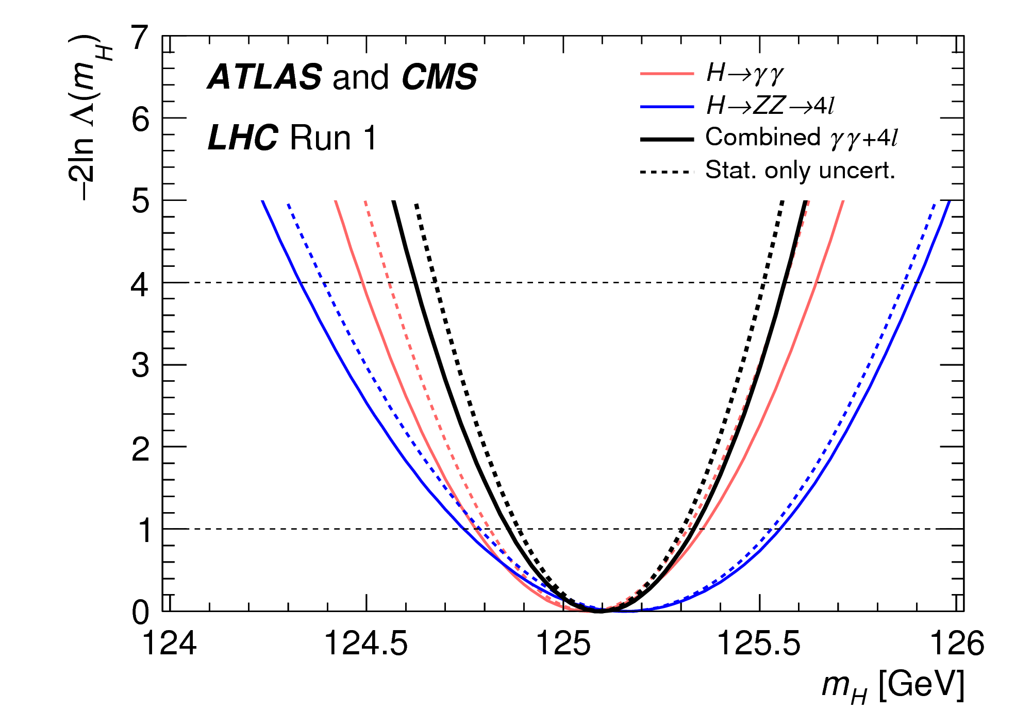
Mass of Higgs boson measured with <0.2% precision
Result from combination of ATLAS and CMS results
PRL 114 (2015) 191803
M_{H} = 125.09 ± 0.24 GeV [ ±0.21 (stat.) ±0.11(syst.) ]
7

Slide 8
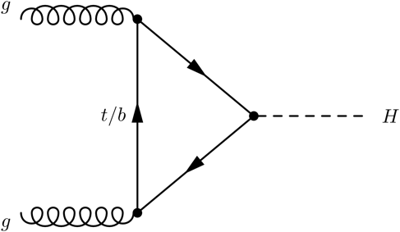
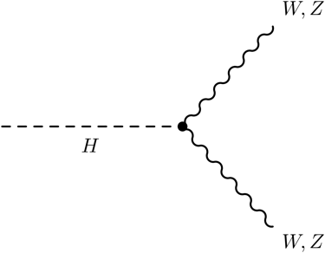
Today’s focus - Higgs boson couplings
Rich experimental area of Higgs properties: the Higgs coupling strength to other SM particles, e.g.
All coupling strengths predicted by SM, given known Higgs boson mass
Accessible in various combinations and admixtures. Large variety of ATLAS & CMS observed Higgs boson decay rates
Powerful test of nature of Higgs boson: SM, or subtly different?
gg → H
H → VV
8

Slide 9
Higgs bosons – Alternatives to the SM Higgs boson
What else could the 125 GeV state be? Many alternative theories exist, for example
Light CP-even h(125) of a Two Higgs Doublet Model (h,H,H±,A)
Pseudo NG boson from higher energy theory (Composite Higgs)
Goal here is not to pick a specific model – but to develop a generic framework to quantify possible deviations in Higgs couplings from SM
In either case couplings of BSM h(125) candidate (slightly) different from SM Higgs boson
9

Slide 10
Outline of this presentation
Introduction
Higgs boson phenomenology & interpretation framework
Combination procedure & experimental inputs
Signal strength measurements
Constraints on Higgs boson couplings
Most generic parametrizations
10

Slide 11
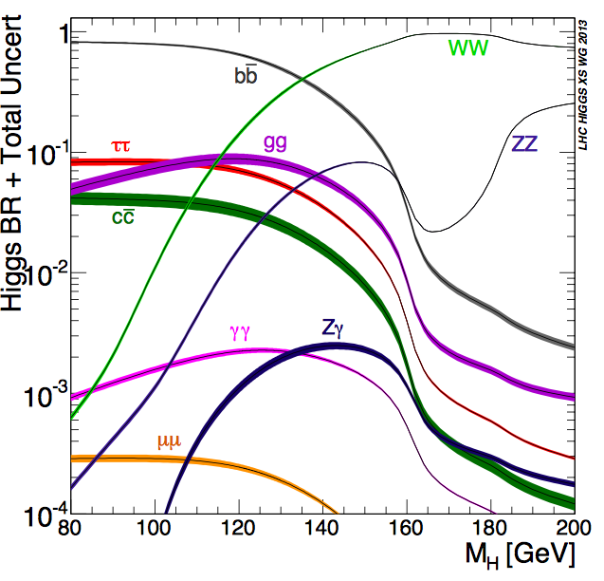
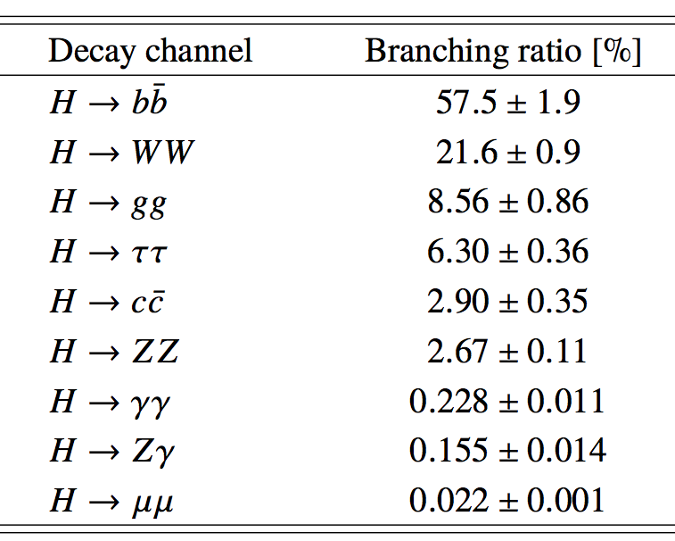
Standard Model Higgs boson decays
m_{H}=125.09 GeV
SM BR theory uncertainties
2-5% for most important decays
The natural width of the Higgs boson is expected to be very small (<< resolution)
See “Handbook of LHC Higgs Cross Sections: 3. Higgs Properties” (arXiv:1307.1347) for further details on Higgs phenomenology
11

Slide 12
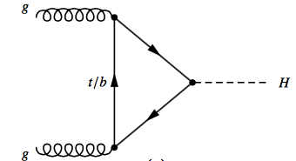
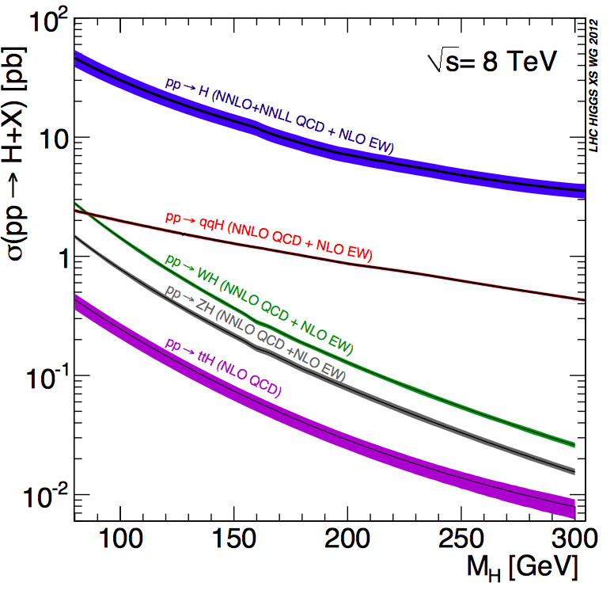
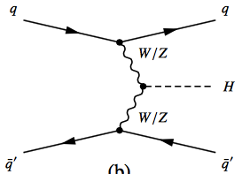
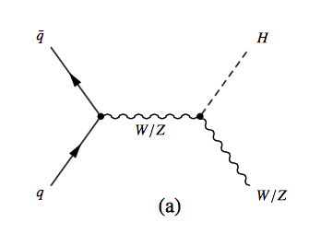
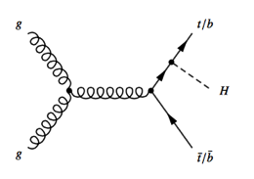
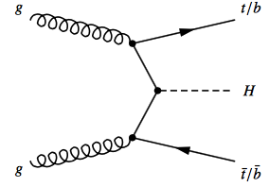
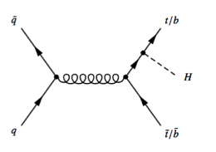
Higgs boson production in the SM
m_{H}=125.09 GeV
ggF
VBF
VH
ttH
12

Slide 13
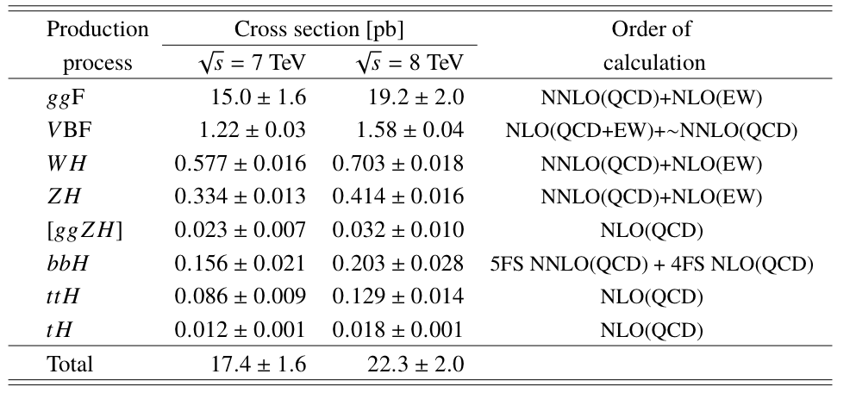
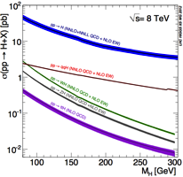
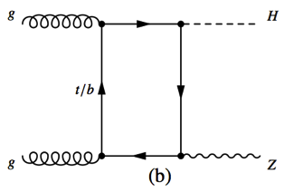
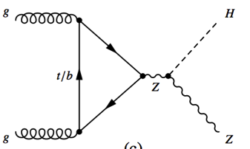
Higgs boson production in the SM
ttH
Gluon-initiated ZH production represents ~8% of total ZH cross-section, has harder p_{T} distribution
Modeled separately because Higgs coupling structure of gg→ZH is different from qq→ZH
HZZ
13

Slide 14
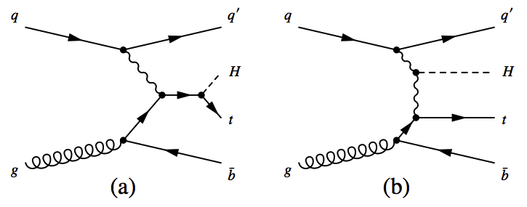
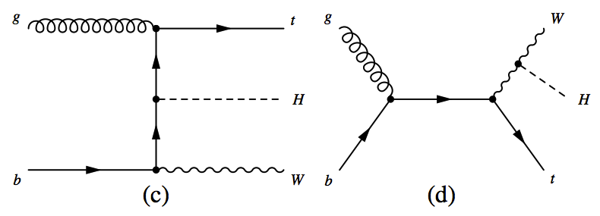
Higgs boson production in the SM
WWH
WWH
ttH
ttH
Very small SM cross-section due to almost completely destructive interference For opposite sign W/t Higgs couplings, σ(tHqb) increases by factor 13 and σ(WtH) by factor 6
14

Slide 15
Higgs boson production in the SM
Diagrams similar to ttH, but experimentally not really distinguishable from ggF and 100x smaller in SM
15

Slide 16
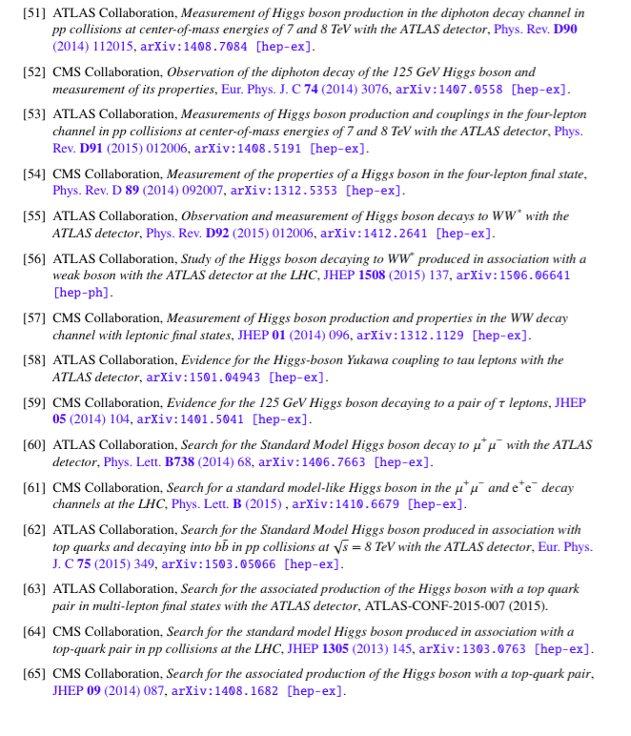
Higgs production and decay – Run 1 input measurements
ATLAS,CMS Higgs signal strength measurements, and signal searches used in this combination are documented in 17 journal publications
16

Slide 17
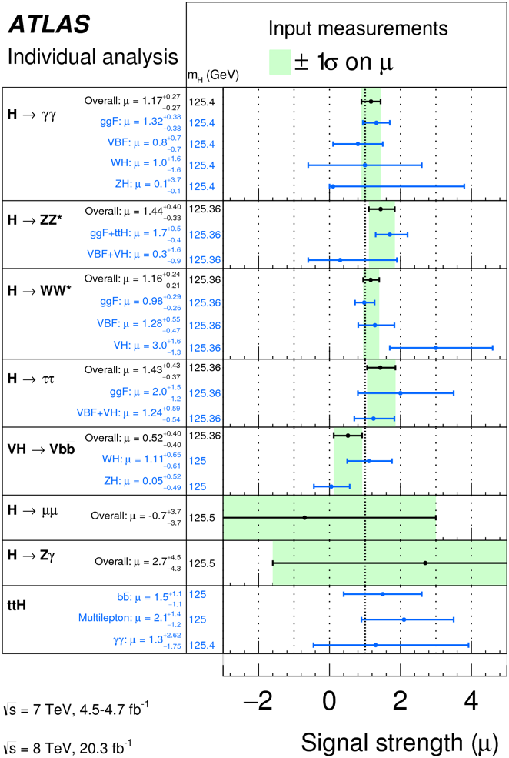
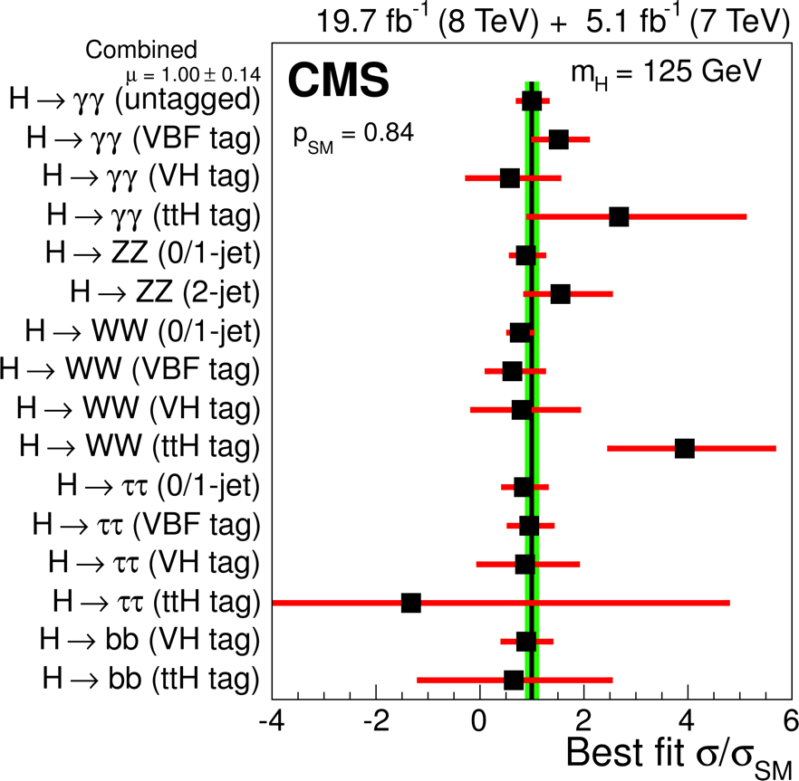
Higgs production and decay – Run 1 measurements
Signal strength fits of individual experiments
EPJC 75 (2015) 212
By fitted production mode
By tagged production mode
17

Slide 18
Understanding signal strengths for process i → H → f
Signal strength μ is observed rated normalized by SM prediction
Disentangling production (μ_{i}) & decay (μ_{f}) always requires assumption of narrow Higgs width.
Additional assumptions required when combining measurements, e.g
μ_{VBF}^{γγ}
Assumes SM value of decay BRs
Assumes SM value of production σ’s
18

Slide 19
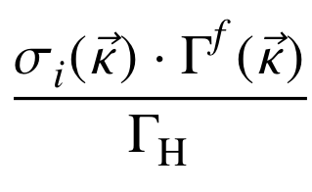
Interpretation beyond signal strengths – the κ framework
See “Handbook of LHC Higgs Cross Sections: 3. Higgs Properties” (arXiv:1307.1347) for further details κ framework
Alternative one can disentangle deviations in production and decay with explicit modeling of Higgs width
Introduce functions κ_{j} → describe deviations from SM predictions.
so that for κ_{j}=1 → σ_{i}, Γ_{f}, Γ_{H} give SM prediction
μ_{VBF}^{γγ}
19

Slide 20
Interpretation beyond signal strengths – the κ framework
Parameters κ_{j} correspond to LO degrees of freedom
Example for ggF production of H→VV
σ_{ggF} = (1.06 κ_{t}² + 0.01κ_{b}² -0.07κ_{b}κ_{t}) σ_{ggF}(SM)
Γ_{W,Z} = κ²_{W,Z} Γ_{W,Z}(SM)
NB: σ_{ggF}(SM) from NNLO(QCD) + NLO(EW) calculation!
20

Slide 21
The κ framework – the total width
Note that total H width scales all observed cross-sections
Since Γ_{H} is not yet directly measured with a meaningful precision, must make an assumption on Γ_{H} to interpret cross-sections in terms of Higgs couplings.
E.g. in absence of BSM H decays (invisible, undetected etc…), can assume SM width, adjusted by effect of k-rescaled couplings
21

Slide 22
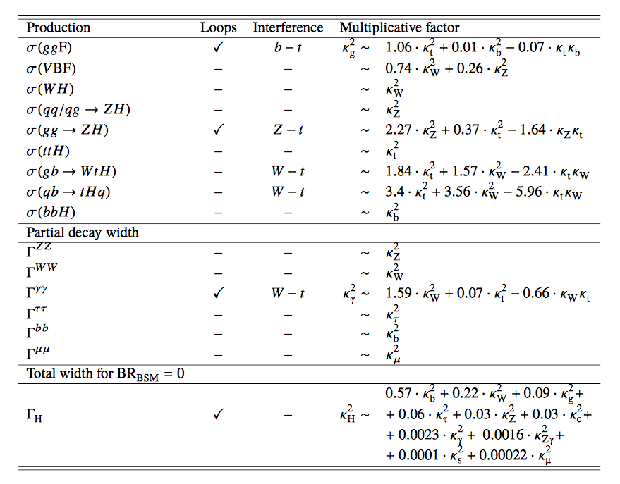
The kappa framework – the dictionary
Factors depend on
Assumed value m_{H},
Calculations of σ,Γ
Kinematic selections
22

Slide 23
The kappa framework – the dictionary
Processes with interference allow (in principle) to measure the relative sign of coupling strengths
Since all interferences considered always involve the top quark, choose sign of top coupling positive by construction (no loss of generality) → can allow data to constrain sign of b,W,Z coupling w.r.t top quark coupling
ttH
HWW
23

Slide 24
Outline of this presentation
Introduction
Higgs boson phenomenology & interpretation framework
Combination procedure & experimental inputs
Signal strength measurements
Constraints on Higgs boson couplings
Most generic parametrizations
24

Slide 25
Signal strength measurements by ATLAS and CMS
Each experiment has O(15) signal strength measurements focusing on a wide variety of production and decay models
Measurements of μ_{i}^{f} entering combined analysis
Dominated by ggF
Includes gg→ZH
Includes tH
H→invisible
Difficult due to large backgrounds
CMS measurement exists, but not in time for combination
Extremely small cross-section
25

Slide 26
Signal strength measurements by ATLAS and CMS
CMS and ATLAS also performed off-shell measurements in WW/ZZ that allow to constrain Higgs width with assumptions
Not included in this combination (was included in ATLAS combination)
CMS and ATLAS also performed searches for H→invisible
in VH, VBF production modes
Not included in this combination (included in CMS combination, and separate combination by ATLAS )
Each experiment has O(15) signal strength measurements focusing on a wide variety of production and decay models
Measurements of μ_{i}^{f} entering combined analysis
Dominated by ggF
Includes gg→ZH
Includes tH
H→invisible
26

Slide 27
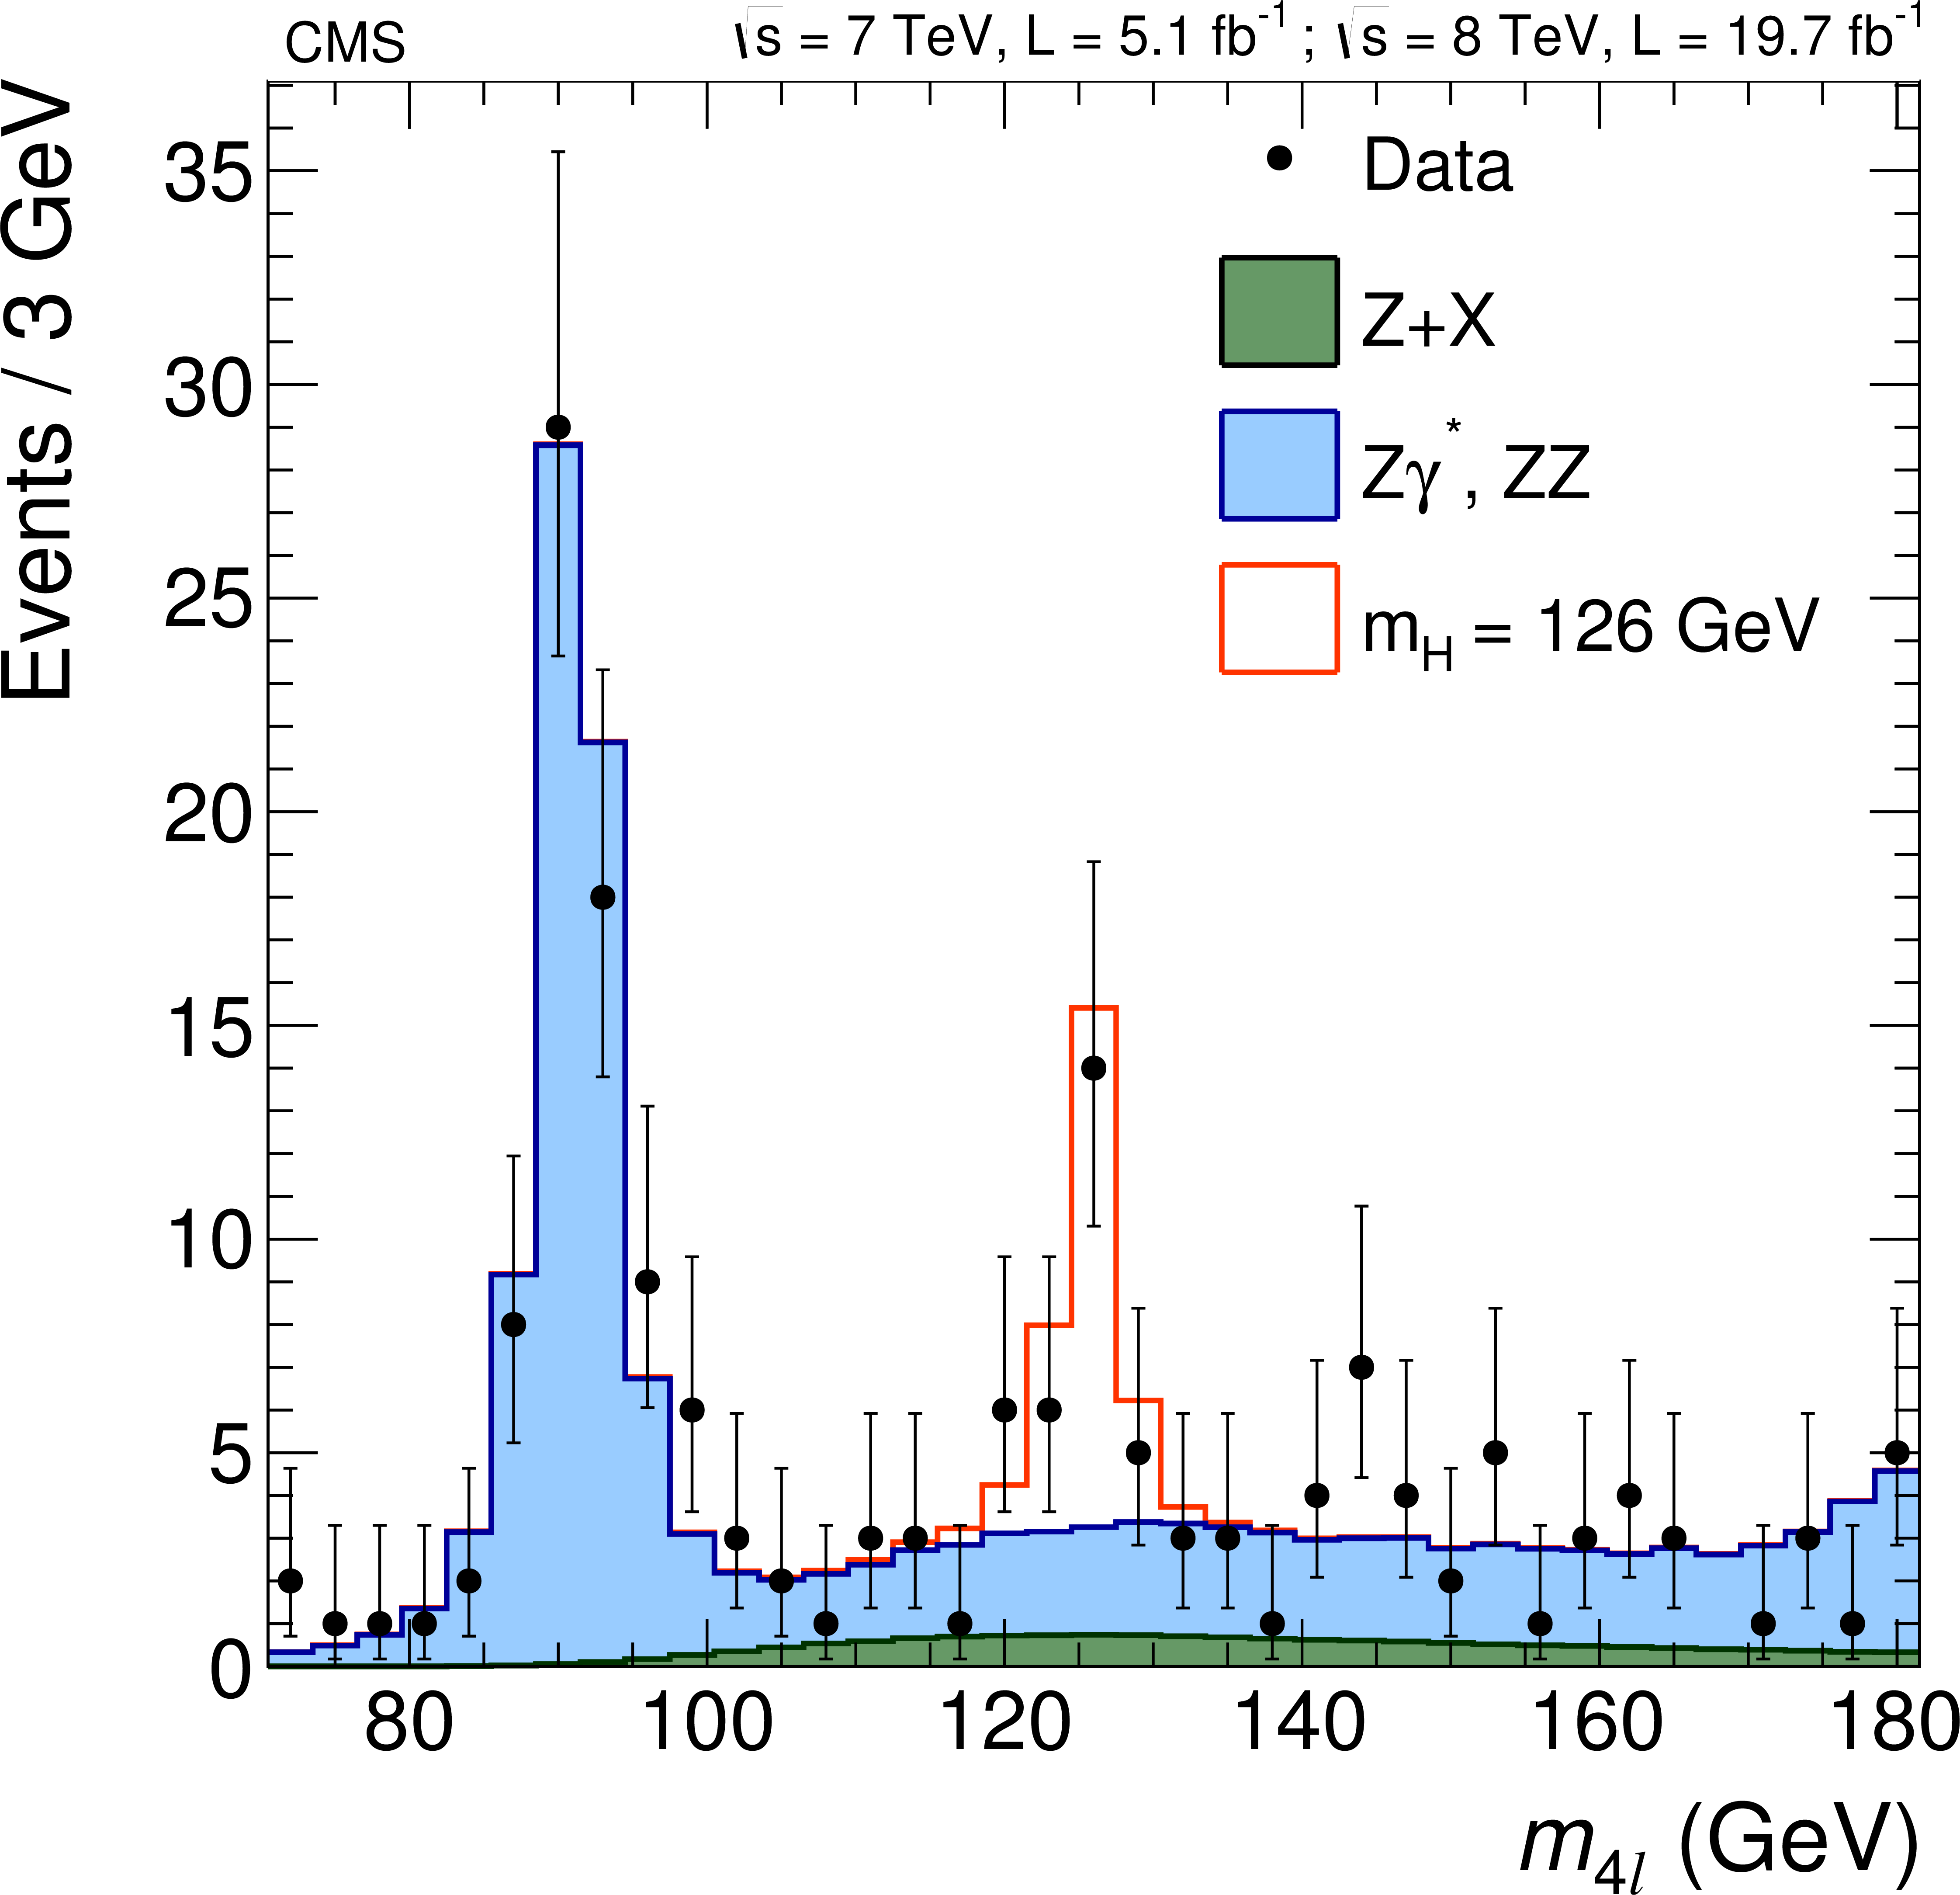
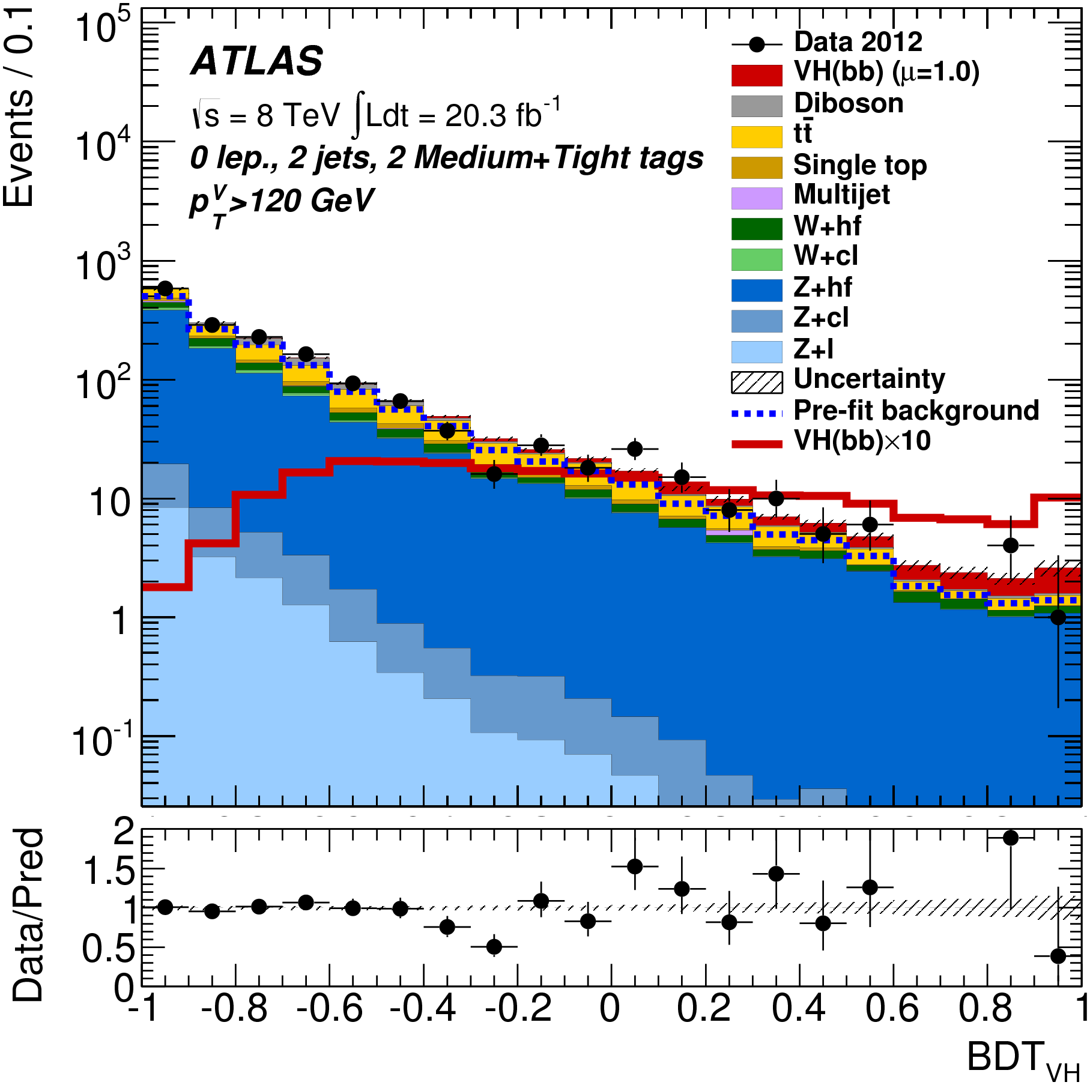
Anatomy of a single measurement
Every measurement consists of one or more signal regions, designed to selected target Higgs production/decay
Distribution of a (multivariate) discriminant is interpreted in terms of sum of signal and background contributions
“Low bkg / high mass resol.” (H→ZZ*)
“High bkg / worse resol.” (WH→bb)
JHEP01(2015)069
Phys. Rev. D 89 (2014) 092007
27

Slide 28
Profile likelihood formalism for (systematic) uncertainties
Build likelihood function for each signal, control region of the data
i→H→f
Background
Inclusive SM cross-section
Acceptance (from MC)
Efficiency (from MC)
Higgs BR
Luminosity
28

Slide 29
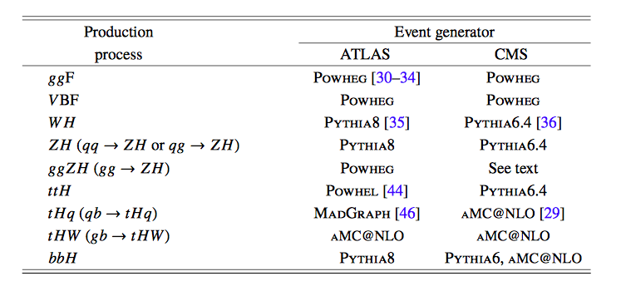
Profile likelihood formalism for (systematic) uncertainties
Assume SM Higgs boson for acceptance & efficiency
Build likelihood function for each signal, control region of the data
*
i→H→f
Background
Inclusive SM cross-section
Acceptance (from MC)
(*) Higgs p_{T} distribution of ggF production reweighted to match HiRes 2.1calculation (includes NNLO and NNLL QCD corrections)
Efficiency (from MC)
Higgs BR
Luminosity
29

Slide 30
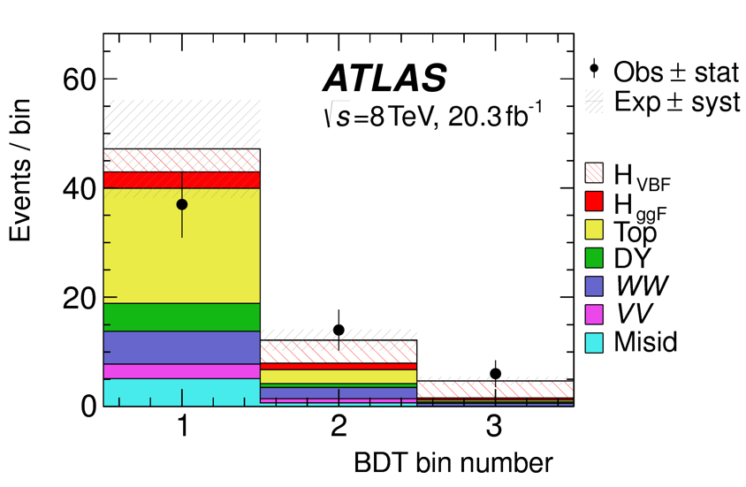
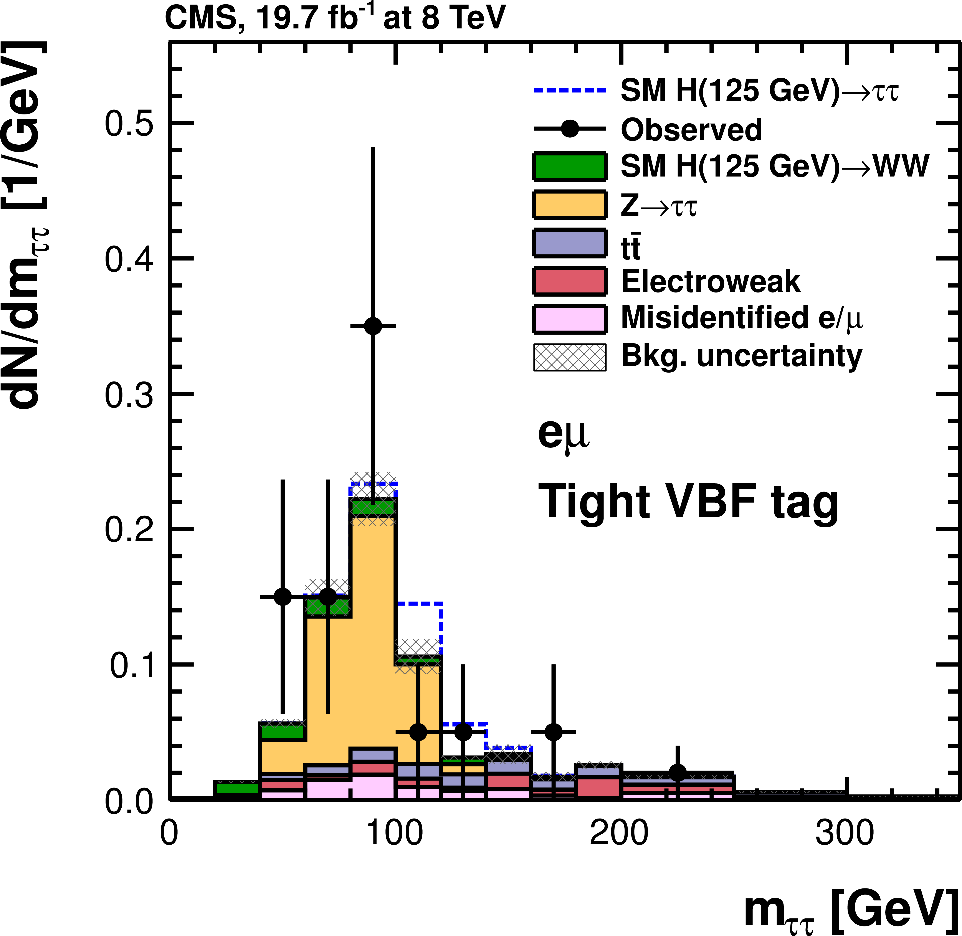
Decomposition of Higgs signal contributions in channels
Channels selections hardly ever 100% pure in production process (especially ‘untagged’) → separately model distributions from all contributing Higgs production processes
Some channels also not 100% pure in decay mode (e.g. H→WW selection has contributions of H→ττ decays). Interpret such contributions as Higgs signal (of appropriate type) in coupling analysis
“Untagged” H→WW channel
H→ττ channel
Phys. Rev. D 92, 012006 (2015)
J. High Energy Phys. 05 (2014)
30

Slide 31
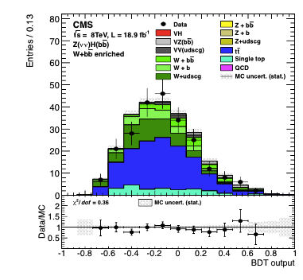
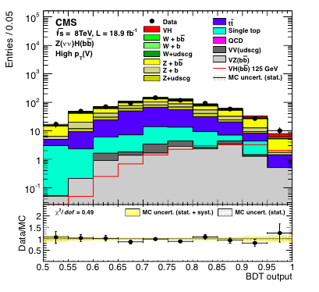
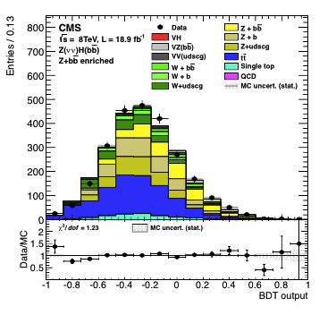
Measurements of backgrounds often data-driven using control regions
x
PRD 89 (2014) 012003
W+b(b) enriched control region
Z+b(b) enriched control region
31

Slide 32
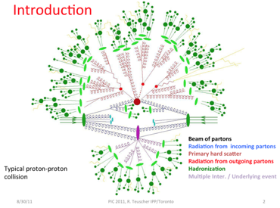
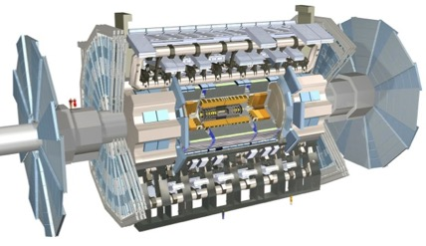
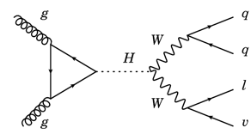
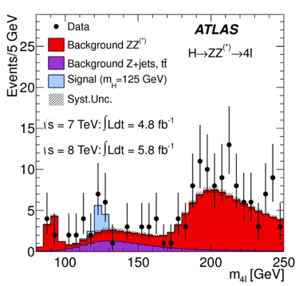
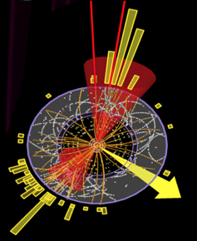
Most expected distributions subject to systematic uncertainties
Expected distributions mostly derived from simulation chain
Simulation of ‘soft physics’ physics process
Simulation of detector
LHC data
Underlying event
Parton shower model
Energy scales
Efficiencies…
Simulation of high-energy physics process
QCD scale PDF uncertainty
Reconstruction of the data
Analysis Event selection
32

Slide 33
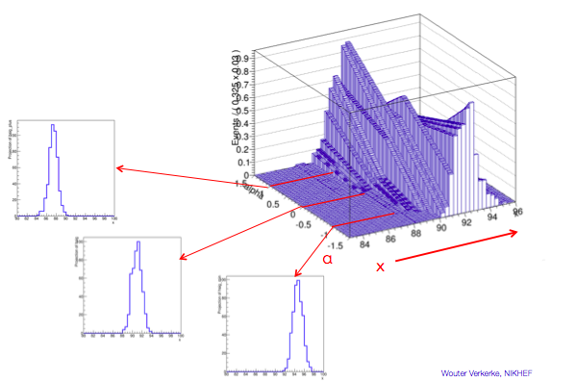
Profile likelihood formalism for (systematic) uncertainties
Extend description of each signal/background distribution so that it can describe distribution under a wide range of parameters for which the true values are unknown (energy scales, QCD scales…)
Illustration: modeling of energy scale uncertainty
S(N|θ=-1)
S(N|θ)
S(N)
S(N|θ=0)
Signal Probability model for any value of energy scale param θ
S(N|θ=+1)
33

Slide 34
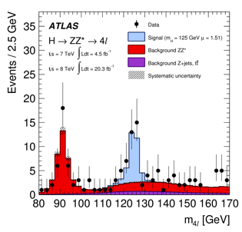
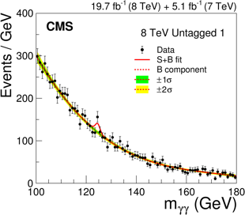
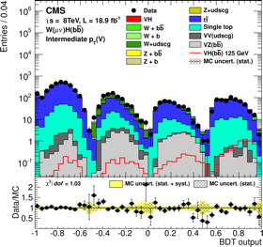
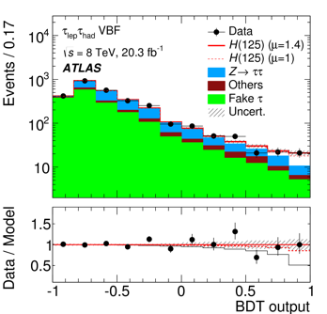
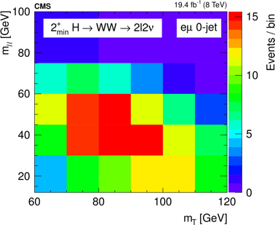
Profile likelihood formalism for (systematic) uncertainties
Correlated parameters as needed between channels, experiments
ATLAS ZZ
CMS γγ untagged
CMS bb
ATLAS ττ
VBF μ-τ_{had}
CMS WW
0-jet
ATLAS detector systematic (only correlated between ATLAS measurements)
L_{ATLAS,ZZ}(N|μ,θ_{QCDscale},θ_{ATLASDet},θ,θ,θ,…)
L_{ATLAS,τττ}(N|μ,θ_{QCDscale},θ_{ATLASDet},θ,θ,θ,…)
Fully correlated theory uncertainty
L_{CMS,WW}(N|μ,θ_{QCDscale},θ_{CMSDet},θ,θ,θ,…)
34

Slide 35
Correlated uncertainties in ATLAS/CMS combination
Full combination describes ~580 signal regions & control regions from both experiments. Grand total of ~4200 nuisance parameters, related to (systematic) uncertainties
Correlation strategy of nuisance parameters a delicate and complicated task
Detector systematic uncertainties → follow strategy of ATLAS and CMS internal combinations (generally correlated within, not between experiments)
Signal theory uncertainties (QCD scales, PDF, UEPS) on inclusive cross-sections generally correlated between experiments.
Signal theory uncertainties on acceptance and selection efficiency are uncorrelated between experiments, as these are small and estimation procedures are generally different.
PDF uncertainties on signal cross-sections uncorrelated between channels, except WH/ZH = correlated (effect of ignoring other correlations is ≤1%)
No correlations assumed between Higgs BRs (except for WW/ZZ). Effect of ignoring correlations shown to be generally small, except for a few specific measurements, in which case full correlation structure is retained
35

Slide 36
Statistical treatment – profile likelihood
Θ: vector of ~4200 nuisance parameters
From L(ATLAS+CMS) construct the profile likelihood for a statement on the parameter(s) of interest α
68% Confidence interval defined by a rise of 1 unit in Λ(α) (asymptotic limit)
α
α
36

Slide 37
Outline of this presentation
Introduction
Higgs boson phenomenology & interpretation framework
Combination procedure & experimental inputs
Signal strength measurements
Constraints on Higgs boson couplings
Most generic parametrizations
37

Slide 38
Reminder – the signal strengths in the individual channels
Signal strength fits of individual experiments/channels
By tagged production mode
By fitted production mode
38

Slide 39
The global signal strength
Assuming SM ratios of production cross-sections and decay rates
NB: Theory uncertainties on the inclusive SM cross-section enter through denominator in Higgs signal strength
Most precise result at the expense of the largest assumptions
Stat and Th.Sig of comparable size (Th.Sig dominated by ggF cross-section uncertainty)
39

Slide 40
Higgs signal strength by production and decay mode
Production signal strengths
(SM values of BRs assumed)
Decay signal strengths
(SM value of production σ’s assumed)
SM p-value
25%
SM p-value
60%
2.3σ from SM
SM
SM
40

Slide 41
Significance of combined observations
Comparing likelihood of the best-fit with likelihood assuming μ_{prod}=0 or μ^{decay}=0 we obtain:
Production process | Observed Significance(σ) | Expected Significance (σ)
VBF | 5.4 | 4.7
WH | 2.4 | 2.7
ZH | 2.3 | 2.9
VH | 3.5 | 4.2
ttH | 4.4 | 2.0
Decay channel
H→ττ | 5.5 | 5.0
H→bb | 2.6 | 3.7
VBF production and H→ττ now established at over 5 σ.
ggF and H→ZZ,γγ,WW already established by each experiment
41

Slide 42
Signal strength in V,F-mediated production by decay
Measure ggF+ttH production “fermion-mediated” and VBF+VH production “boson-mediated” for each decay mode (No assumption on SM production or decay rates needed for individual channels)
Can also measure combined ratio μ_{VBF+VH}/μ_{ggF+ttH} = over all decay modes without assumptions on SM decay rates (BRs cancel in ratio)
SM p-value
62%
42

Slide 43
Outline of this presentation
Introduction
Higgs boson phenomenology & interpretation framework
Combination procedure & experimental inputs
Signal strength measurements
Constraints on Higgs boson couplings
Most generic parametrizations
43

Slide 44
Constraints for Higgs couplings to fermions, bosons
Assume universal scaling parameters for Higgs couplings to fermions (κ_{F}), bosons (κ_{V})
Assume only SM physics in loops, no invisible Higgs decays, κ_{F,V}≥0
44

Slide 45
Constraints for Higgs couplings to fermions, bosons
Expanding parameter ranges to include negative couplings
Positive WW contour reduced due to preferred negative solution
Negative k_{F} very disfavored by combination
Likelihood contour for negative k_{F} solution different for channels with interference contributions
45

Slide 46
Constraints on tree-level Higgs couplings
Assume only SM physics in loops, no invisible Higgs decays
Fit for scaling parameters for Higgs couplings to W, Z, b, t, τ, μ
NB: low measured value of κ_{b} reduces total width Γ_{H} → all κ_{i} measured low [w.r.t μ=1.09]
κ_{t} dominated by ggF, H→γγ loop processes
46

Slide 47
Constraints on tree-level Higgs couplings
Within current precision
Higgs couplings scale with
particle masses
Observed κ_{μ} compatible with 0
Running masses (MS scheme)
47

Slide 48
Allowing for BSM contributions in Higgs coupling interpretations
Results shown so far assumed no invisible (BSM) Higgs decays nor BSM contributions to loops. Now drop these assumptions.
Represent loop processes (ggF, H→Z/γγ) with effective params (κ_{g},κ_{γ}), rather than assuming SM content
Allowing BSM Higgs decays (invisible, undetected etc…) to increase the total width
‘effective coupling’
Measurement of k_{t} dominated by ttH
‘SM resolved’
If BR_{BSM} >0 then all observed cross-sections lowered by common factor
48

Slide 49
Limit on invisible Higgs decays from Higgs couplings
Concept: set limit on BR to (invisible, undetected) Higgs decays
When κ_{H} is modeled by 6+2 κ_{i}’s it has no strong upper bound → BR_{BSM} not bounded (Γ_{H} due to large κ_{H} or to large BR_{BSM}?) → Must introduce some assumptions to bound κ_{H}
Scenario 1 – Assume 6 tree-level couplings at SM (k=1), but leaving 2 effective couplings for loops floating
Scenario 2 – Keep all 6+2 coupling parameters floating, but bound vector boson couplings κ_{W},κ_{Z}≤1 (Bound k_{V}≤1 occurs naturally in many BSM physics models, e.g. Electroweak Singlet, 2HDM, MCHM…)
(alternatively, use off-shell coupling strength measurements to constrain Γ_{H}, albeit with additional assumptions)
49

Slide 50
Focus on effective couplings for loop processes
‘Scenario 1’
Fix all tree-level Higgs couplings to SM (κ_{W,}κ_{Z,}κ_{b,}κ_{t,}κ_{μ,}κ_{τ}=1) and BR_{inv}=0
50

Slide 51
Constraints on Higgs couplings allowing BSM physics in loops & decays
‘Scenario 2’
κ_{t} dominated by ttH process (ggF,Hγγ loops no longer contribute)
BR_{BSM} < 0.34 at 95% C.L. (assuming κ_{V}≤1)
Effective
couplings
51

Slide 52
Focus on up/down-type fermion and lepton/quark asymmetries
Several BSM physics models (notably 2HDM), predict asymmetries in couplings between up-type and down-type fermion couplings, and between lepton and quark couplings
Since goal is to measure asymmetry, directly parameterize model in terms of ratios of coupling strength modifiers
Assume no BSM physics in loop processes. No assumption on invisible decays needed, since no assumption on Γ_{H} needed (total width cancels in ratio of couplings)
52

Slide 53
Focus on up/down-type fermion and lepton/quark asymmetries
Several BSM physics models (notably 2HDM), predict asymmetries in couplings between up-type and down-type fermion couplings, and between lepton and quark couplings
Negative solution for λ_{du} (just) excluded due to low Hbb, high ttH, t-b interference in ggF )
53

Slide 54
Outline of this presentation
Introduction
Higgs boson phenomenology & interpretation framework
Combination procedure & experimental inputs
Signal strength measurements
Constraints on Higgs boson couplings
Most generic parameterizations
54

Slide 55
Generic parameterizations
Goal of (most) generic parameterizations is to provide summary of Higgs coupling constraints while make minimal number of assumptions and with minimal exposure to theory uncertainties
All results shown today can be derived from these generic parametrizations once correlation matrix is provided
Will allow legacy Run-1 Higgs coupling results to be re-evaluated in future, e.g. when new theory calculations are available with reduced uncertainties
Most generic model is signal strength model with ratios
Choose ggF H→ZZ as reference channel since it is the cleanest channel and has the smallest systematic uncertainty
Ratios of cross-sections and BRs reduce exposure to dominant theoretical uncertainties on inclusive cross-sections
55

Slide 56
Signal strength models with ratios
Inclusive theory uncertainties shown on SM prediction
Largest discrepancy is seen in BR^{bb}/BR^{ZZ}, at the level of 2.4 σ
Driven by combination of high ttH→leptons, ZH→ZZ, low VH→bb (while ttH→bb is not high)
NB: Correlation matrix will be provided for final paper version
56

Slide 57
Alternatively, measure ratio of coupling strengths
No assumption on Higgs total width needed, as Γ_{H} cancels in all expressions
(these can be fully
expressed in terms of λ_{WZ} and λ_{Zg})
57

Slide 58
Higgs coupling model with ratios
Same qualitative features as generic signal strength ratio model
NB: Correlation matrix will be provided for final paper version
58

Slide 59
Higgs coupling model with ratios
gg→ZH: Z-t interference H→γγ & tH : W-t interference
NB: Correlation matrix will be provided for final paper version
59

Slide 60
Summary & outlook
ATLAS and CMS Higgs boson coupling results have been combined, sensitivity on signal strength improved by almost √2
Decay to ττ and VBF production established at more than 5σ level
The most precise results on Higgs boson production and decay and constraints on its couplings have been obtained at O(10%) precision
Different parameterizations have been studied: all results all consistent with the SM predictions within uncertainties: SM p-value of all combined fits in range 10%-88%
LHC Run-2 at 13 TeV, precision will be improved during the coming years thanks to higher energy, larger integrated luminosity, progress in the theory predictions, and ability to integrate more measurements (differential σ) when moving beyond κ-framework.
ATLAS+CMS run-1
stat.unc
syst.unc
√s=8 → 13 TeV
σ(ggF) x 2.3
σ(VBF) x 2.4
σ(ttH) x 3.9
60

Slide 61
(Backup slides)

Slide 62
P-values w.r.t Standard Model for all models

Slide 63
Adjustments made to the input measurements
Apart from correlations, some other adjustments were made to individual ATLAS and CMS measurements to achieve consistency
All ATLAS and CMS channels modified to assume a Higgs boson mass of 125.09 GeV (value of combined mass measurement)
CMS includes bbH, tH, ggZH production processes where relevant
ATLAS now uses Stewart-Tackman prescription of jet-bin uncertainties for the H→WW channel (so uncertainties have understandable correlation with CMS H→WW measurement)
CMS adopts signal cross-section calculations from YR3 for all channels
CMS adopts unified prescription of treatment of Higgs boson p_{T}
Cross section values for dominant backgrounds estimated from simulation have been harmonized between ATLAS & CMS
Both experiments have adopted the same correlation scheme for the signal theory uncertainties

Slide 64
Couplings k_{V} vs k_{F} – likelihood scans by channel

Slide 65
Coupling combination with off-shell measurements

Slide 66
Correlation matrix of ATLAS generic measurements

Slide 67
Contributions of loop processes to sign(k_{t})

Slide 68
Minimal Composite Higgs models: MCHM
A possible solution for scalar hierarchy problem is that H is not elementary particle, but pseudo Nambu Goldstone boson arising from a higher energy theory (a SO(5)/SO(4) model)
MCHM4: SM fermions embedded in spinorial representations of SO(5)
MCHM5: SM fermions embedded in fundamental representations of SO(5)
Attractive feature of these models is that Higgs couplings are modified in a simple form w.r.t. SM and relate to compositeness scale MCHM4: MCHM5:
SM: ξ=0, f=∞
MCHM compositeness scale
68

Slide 69
Minimal Composite Higgs models: MCHM
MCHM4
ξ<0.12 (95% C.L.) SM exp: <0.23
f>710 GeV SM exp: >510 GeV
MCHM5
ξ<0.10 (95% C.L.) SM exp: <0.17
f>780 GeV SM exp: >600 GeV
69

Slide 70
Physics motivated SM extensions – Composite Higgs models
MCHM4/5 trajectories (manually) overlaid on new ATLAS/CMS combined measurement of (k_{V},k_{F})
ξ=0.1
ξ=0.3
ξ=0.2
ξ=0.1
ξ=0.2
ξ=0.3
MCHM4
MCHM5
70

Slide 71
SM extensions with additional H fields – Electroweak Singlet
The simplest extension of the SM Higgs sector adds a single EW scalar field to SM doublet field,
Both have non-zero VEV, Mixing between singlet state and surviving doublet state
Two CP-even Higgs bosons h and H, assumed to have different masses
Coupling properties of h(125) in EWS different from that in SM
SM: k=1, k’=0
ATLAS
ATLAS
(new ATLAS+CMS combined: μ_{h} = 1.09 ± 0.11)
71

Slide 72
SM extensions with additions H fields – 2 Higgs doublets
Models with 2 Higgs Doublet fields have 5 Higgs bosons h,H,A, H⁺,H⁻, with 6 theory parameters
4 masses m_{h},m_{H},m_{A},m_{H±}
Ratio of VEVs: tan(β) = v₁/v₂ [ with v₁² + v₂² = (246 GeV)² ]
Mixing angle α between h, H:
What limits can we set on α,β assuming observed h(125) is light CP-even Higgs of the 2HDM model?
Gauge invariants imposes relation between α,β and 2HDM h,H couplings to bosons and fermions relative to SM
72

Slide 73
SM extensions with additions H fields – 2 Higgs doublets
Imposing Glashow-Weinberg condition to suppress FCNCs, four solutions are obtained for Higgs boson couplings to vector bosons (k_{V}), up/down-type quarks (k_{u},k_{d}) and leptons (k_{l})
“fermiophobic”
“MSSM-like”
73

Slide 74
SM extensions with additions H boson – 2 Higgs doublets
Results – 2HDM type 2
Remapped to 2HDM-Type 2
Measured fundamental couplings
κ_{V}=sin(β-α)
κ_{u}=cos(α)/sin(β)
κ_{d}=-sin(α)/cos(β)
κ_{l}=-sin(α)/cos(β)
SM alignment limit cos(β-α)=0
74

Slide 75
SM extensions with additions H boson – 2 Higgs doublets
Type 1
Type 2
Lepton-specific
Flipped
75

Slide 76
SM extensions with additions H boson – 2 Higgs doublets
Type 1
Type 2
NB: New ATLAS+CMS combined result does not yet eliminate negative sign solutions
Flipped
Lepton-specific
Flipped
76

Slide 77
Beyond 2HDM-Type 2 – A simplified MSSM (hMSSM)
In MSSM mixing between h and H is described by
Radiative corrections (primarily involving top/stop quarks)
If sub-leading correction δ₁ is ignored → can express M_{S} fully in m_{A}, tanβ → can express coupling scale factors for κ_{V},κ_{u},κ_{d} in m_{A} and tanβ
77

Slide 78
Simplified MSSM
Limits in m_{A},tanβ space from light Higgs couplings in simplified MSSM model
κ_{V}
SM decoupling limit at m_{A}=∞
κ_{u}
κ_{d}
78

Slide 79
Limit on invisible Higgs decays from Higgs couplings
Assuming SM-like treel-level couplings (loop couplings profiled)
Assuming kV<1 (loop and fundamental couplings profiled)
ATLAS BR_{u.i.} <0.27 (95% C.L) exp<0.37
CMS BR_{u.i.} < 0.32 (95% C.L.) exp<0.42
ATLAS BR_{u.i.}<0.49 (95% C.L.) exp<0.48
CMS BR_{u.i.} <0.57 (95% C.L.) exp<0.52
ATLAS observed better than SM expected due to observed global strength > 1
79

Slide 80
Limit on invisible Higgs decays from Higgs couplings
New combined ATLAS+CMS result
BR_{u.i.} < 0.34 (95% C.L.) assuming kV<1 (all couplings floating)
Assuming SM-like fundamental couplings (loop couplings profiled)
Assuming kV<1 (loop and tree-level couplings profiled)
ATLAS BR_{u.i.} <0.27 (95% C.L) exp<0.37
CMS BR_{u.i.} < 0.32 (95% C.L.) exp<0.42
ATLAS BR_{u.i.}<0.49 (95% C.L.) exp<0.48
CMS BR_{u.i.} <0.57 (95% C.L.) exp<0.52
ATLAS result better than SM expected due to observed global strength > 1
80

Slide 81
What about direct limits on H→inv decays
Searches for associated (VH) or VBF Higgs productions with H→invisible decays also set limits on Br_{inv}
Experimental signature: associated products plus large missing ET
Individual ATLAS and CMS searches in ZH, WH and VBF channels set limits between 182% and 28%
Direct searches assume SM Higgs production rate!
PRL 112, 201802 (2014)
EPJC 74 (2014) 2980
EPJC 74 (2014) 2980
EPJC (2015) 75:337
CMS-PAS-EXO-12-055
CMS-PAS-HIG-14-038
VBF searches most powerful…
ATLAS-CONF-2015-004
ATLAS HIGG-2015-03
ATLAS Direct Combined result: BR_{inv} < 0.25 at 95% C.L. (<0.27 expected)
CMS Direct Combined result: BR_{inv} < 0.46 at 95% C.L. (<0.35 expected)
CMS PAS HIG-14-038
81

Slide 82
Combining direct and indirect measurements
Indirect measurements from couplings measure sum of invisible decays (BR_{inv}) and undetected decays (BR_{undet}, e.g. BSM H decays to lepton+jets)
Direct searches requiring MET only constrain invisible decays (BR_{inv})
Can (weakly) constrain BR_{undet} by combining direct & indirect measurements
Direct searches included: VBF H(inv) and Z(ll)H(inv)
82

Slide 83
Combining direct and indirect measurements
Alternatively, (conservatively) assume BR_{undet}=0 → Both direct and indirect searches measure BR_{inv}
In direct searches can release assumption of SM production rate → substitute measured rate from couplings fit
In coupling fit can release assumption k_{V}<1 → direct limit on BR_{inv} is sufficiently strong to bound Γ_{H}
Most general result (assumes only BR_{undet}=0)
ATLAS: BR_{inv}<0.23 at 95% C.L. (exp <0.24) CMS: BR_{inv}< 0.49 at 95% C.L. (exp<0.32)
Includes VBFHinv+ZllHinv
(assumes kV<1)
ATLAS
83

Slide 84
Interpreting H→inv as BSM physics: Higgs portal model
Higgs portal model: h decays to invisible WIMP pairs → Can map BR(h→WIMP) to WIMP/nucleon cross-section
BR(h→χχ)
σ(Nχ→Nχ)
NB: σ depends on assumed spin Χ
ATLAS: BR_{inv}<0.22 at 90% C.L
CMS: BR_{inv}<0.51 at 90% C.L
CMS-PAS-HIG-13-030
84

