Slide 1

Probing extreme QCD through ridge-like
correlations at high energy colliders
Raju Venugopalan
Brookhaven National Laboratory/
Heidelberg University
VUB, Brussels, May 13, 2016

Slide 2
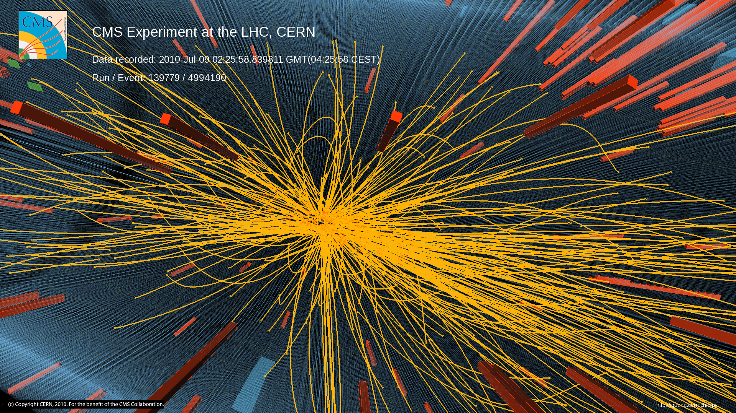
High Multiplicity pp collisions
Notes:
2

Slide 3
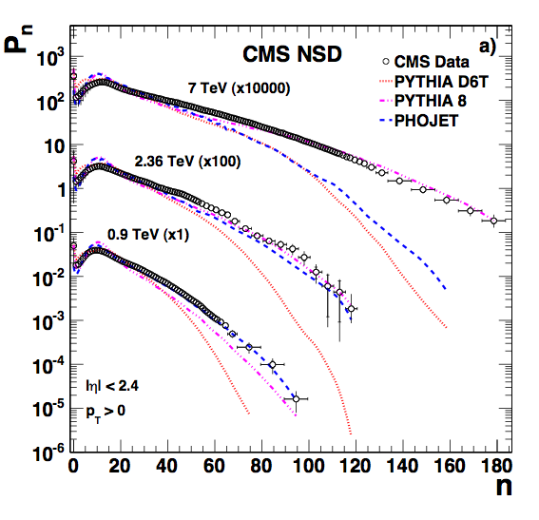
High Multiplicity pp collisions
High Multiplicity events are rare in nature
Very high particle density regime
Is there anything peculiar happening there?
Notes:
3

Slide 4
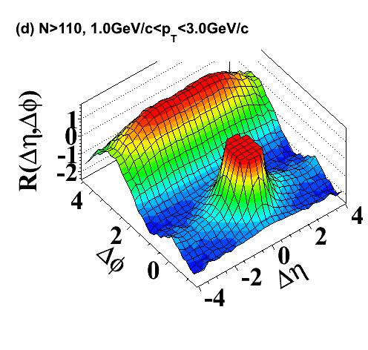
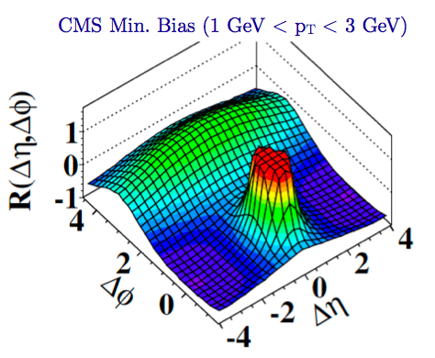

Two particle correlations: CMS results
Di-hadron
correlations
“Discovery”
associated
Δϕ
trigger
Observation of Long-Range Near-Side Angular Correlations in Proton-Proton Collisions at the LHC CMS Collaboration (Vardan Khachatryan (Yerevan Phys. Inst.) et al.). JHEP 1009 (2010) 091
Cited by 448 records
5th most cited CMS paper to date!

Slide 5
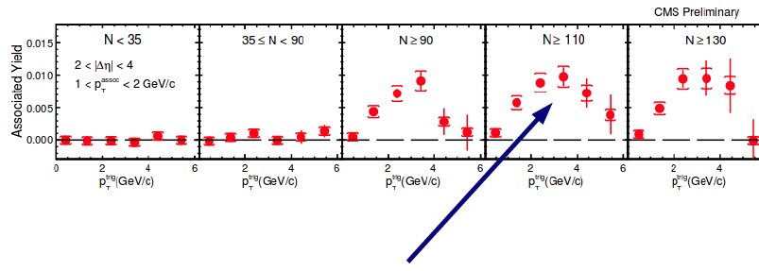
The ridge
Evidence of a semi-hard scale in the data ?

Slide 6
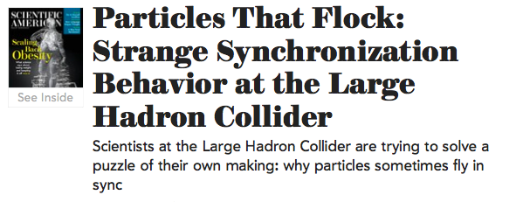
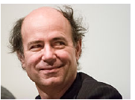
Scientific American, February (2011)
The high-energy collisions of protons in the LHC may be uncovering
“a new deep internal structure of the initial protons,” says Frank Wilczek of the Massachusetts Institute of Technology, winner of a Nobel Prize
“At these higher energies [of the LHC], one is taking a snapshot of the proton with higher spatial and time resolution than ever before”

Slide 7
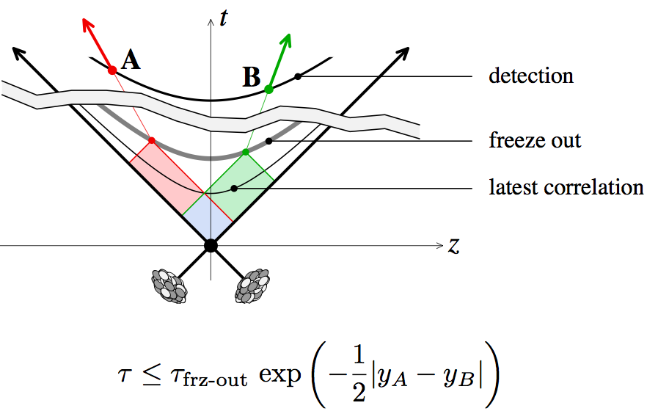
Long range rapidity correlations as a chronometer
Long range correlations sensitive to very early time (fractions of
a femtometer ~ 10⁻²⁴ seconds) dynamics in collisions

Slide 8
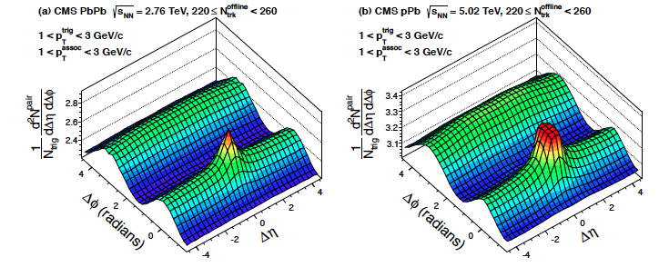
Striking results from LHC p+A collisions
p+A ridge much large than p+p at same multiplicity
and nearly as large as that in peripheral Pb+Pb collisions

Slide 9
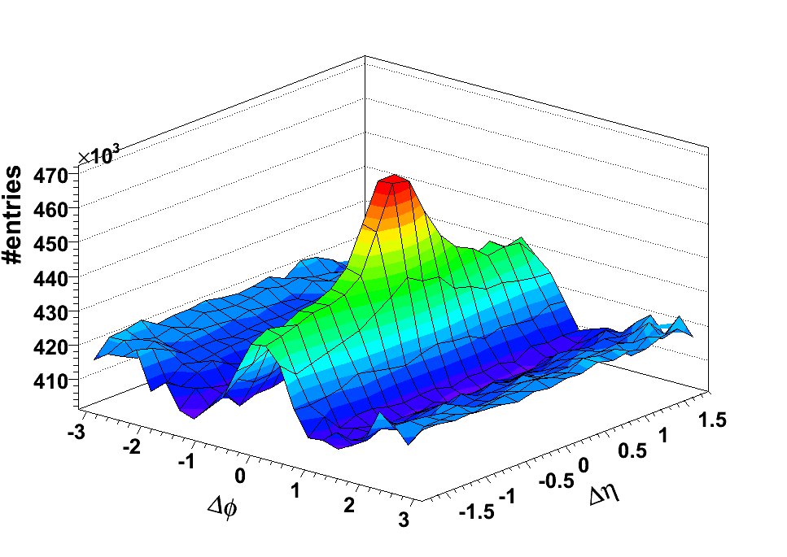
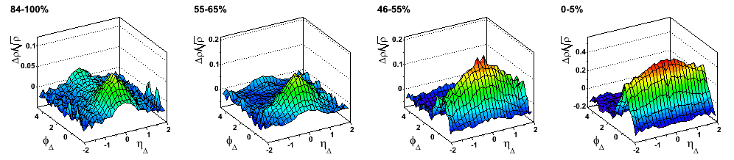
The ridge in A+A collisions
Au+Au 0-10%
STAR arXiv:0909.0191
3 < p_{t,trigger} < 4 GeV
p_{t,assoc.} > 2 GeV
83-94%
55-65%
46-55%
0-5%
STAR Preliminary
STAR Preliminary
STAR Preliminary
STAR Preliminary
η_{Δ} width
In (central) A+A, the ridge is commonly interpreted as hydrodynamic “hubble”
flow of initial “stringy” structures in rapidity
The structures in the Δφ direction decomposed into the
V_{n} Fourier “Flow moments”

Slide 10
What’s the underlying QCD dynamics?
Is it the initial state dynamics arising from rare configurations in the hadron wavefunctions?
Is it final state collective flow of the world’s smallest droplets?
Or, is it some combination, where there is a smooth transition from one description to the other?
Option 1 stretches to the limit our understanding of the quark-gluon structure
Of the hadron
Option 2 stretches to the limit the applicability of thermodynamic and
Hydrodynamic concepts in high energy physics

Slide 11
The initial state in rare, high multiplicity events

Slide 12
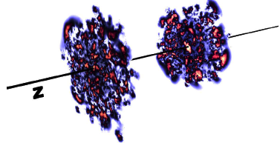
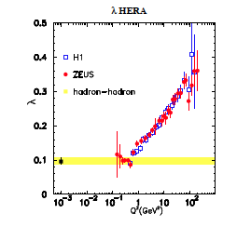
High multiplicities + small systems = gluon saturation
What does it take to produce~ 150 hadrons per 5 units of rapidity in a single p+p event ?
For λ=0.14, get about 13 gluons produced in 5 units ~ min.bias hadron multiplicity
λ=0.3: ~45 gluons in 5 units,
λ=0.4: ~90 gluons in 5 units, in ball park…
Very rapid growth of gluon dist. in such events…

Slide 13
High multiplicities + small systems = gluon saturation
What does it take to produce~ 150 hadrons per 5 units of rapidity in a single p+p event ?
Such rapid growth, in an “independent parton”
picture lead to very large gluon radii, R_{g} > 1 fm

Slide 14
High multiplicities + small systems = gluon saturation
What does it take to produce~ 150 hadrons per 5 units of rapidity in a single p+p event ?
Saturation regulates this by adding increasingly “smaller” gluons of size 1/Q_{s}(x) with decreasing x (increasing energy)
π
π
π
Lappi:
arXiv 0711.3039
π
N_{g} ~ 100 in 5 units for Q_{S}² ~ 2 GeV² : a semi-hard scale !
π

Slide 15
High multiplicities + small systems = gluon saturation
What does it take to produce~ 150 hadrons per 5 units of rapidity in a single p+p event ?
Saturation regulates this by adding increasingly “smaller” gluons of size 1/Q_{s}(x) with decreasing x (increasing energy)
π
π
π
Event generators (such as EPOS) that describe data in high multiplicity events, build in a saturation scale …
π
π

Slide 16
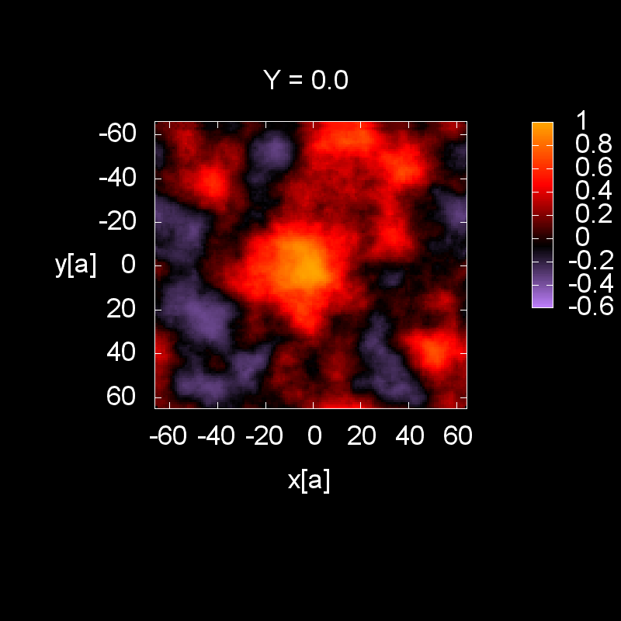
High multiplicity events:
“dense-dense” hadron-hadron collisions
Incoming nuclei are Color Glass Condensates: Highly occupied gluon states with maximal occupancy allowed in QCD

Slide 17
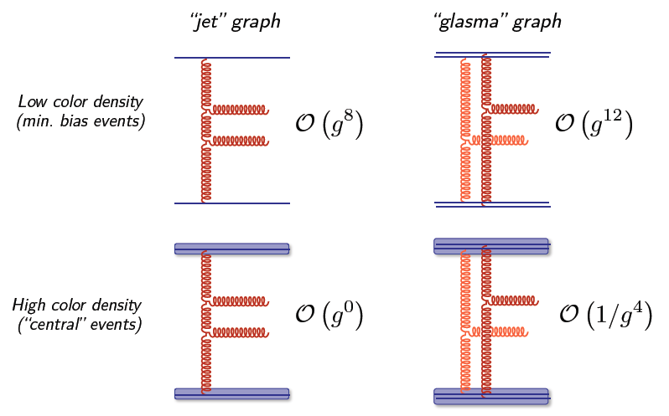
2 particle correlations in pQCD: counting powers

Slide 18
2 particle correlations in pQCD: counting powers
Gluons with k_{T} ~ Q_{S} resolve
n ~ 1/g² color sources
Effective coupling: g*n ~ 1/g
Glasma graphs enhanced in high mult. events by α_{S}⁻⁸

Slide 19
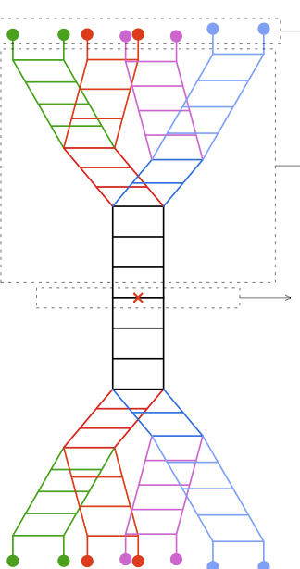
Glasma graphs:
computing multi-particle production in strong fields
Large quantum corrections/strong field insertions absorbed in RG evolution of W’s –can be computed in QCD (JIMWLK eqns.)
“Multi-pomeron” insertions in old language of Reggeon field theory
- similar “Schwinger-Keldysh” formal techniques as pair production in QED, and Hawking radiation in Gravity

Slide 20
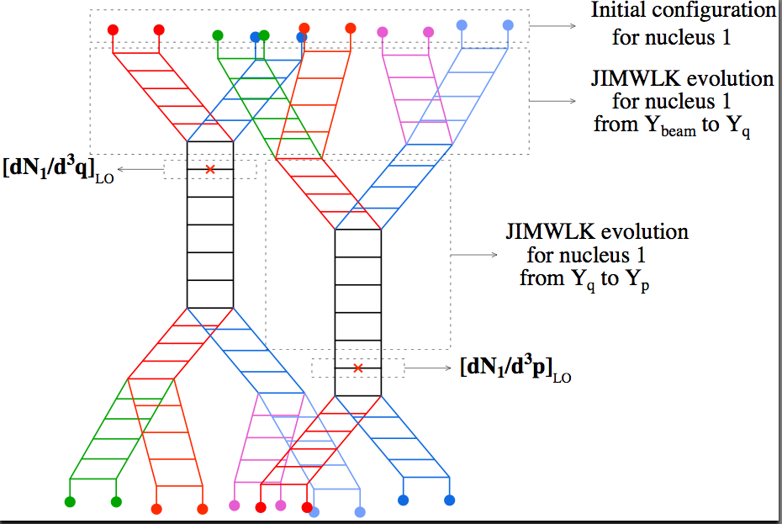
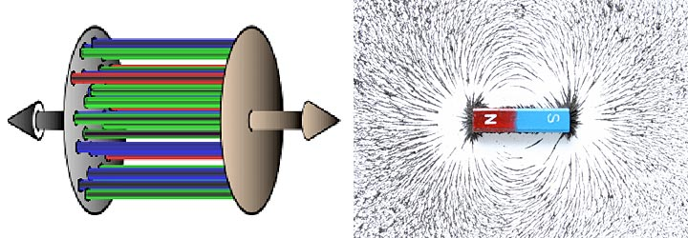
High multiplicity events: two particle correlations
Evolution for
Nucleus 2
Framework includes both QCD bremsstrahlung (Logs)
and multiple scattering (higher twist power corrections)

Slide 21
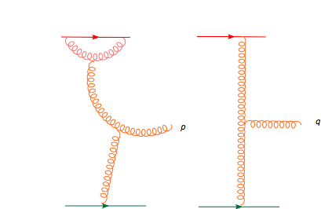
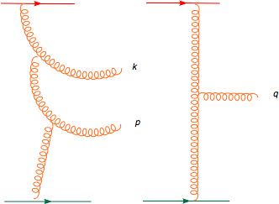

Glasma graphs: two particle correlations
RG evolution:
Dumitru,Gelis,McLerran,RV: 0804.3858
Gelis, Lappi, RV, arXiv: 0807.1306
+
+ …
Keeping leading logs to
all orders (NLO+NNLO+…)

Slide 22
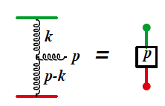
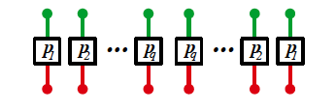
Lasing gluons: Stimulated emission from Glasma flux tubes
Dumitru,Gelis,McLerran,RV (2008)
Dusling,Fernandez-Fraile,RV (2009)
Gelis,Lappi,McLerran (2009)
Color combinatorics of cut graphs: a negative binomial distribution

Slide 23


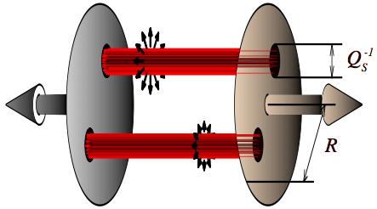
Lasing gluons: Stimulated emission from Glasma flux tubes
Dumitru,Gelis,McLerran,RV (2008)
Dusling,Fernandez-Fraile,RV (2009)
Gelis,Lappi,McLerran (2009)
Color combinatorics of cut graphs: a negative binomial distribution
k=1: Bose-Einstein dist.
k=∞: Poisson distribution
For Q_{S}² ≈ 1/S_{T}
close to a Bose-dist!

Slide 24
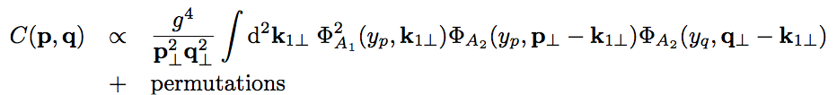
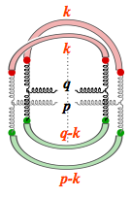
Nearside collimation: quantum interference of glue
Dumitru,Dusling,Gelis,Jalilian-Marian,Lappi,RV, arXiv:1009.5295
RG evolved leading Glasma contribution expressed in terms of “unintegrated gluon distributions” in the proton
Proton 1
Proton 2
This is an approximation to the “full monty”: valid for Λ_{QCD} < Q_{S} ≤ p_{T}
…we will pay for this sin amply

Slide 25
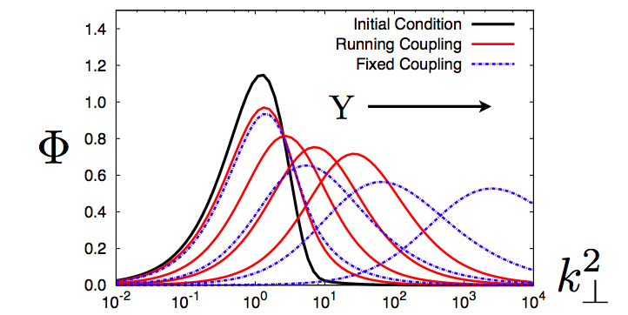
Collimated yield ?
From RG evolution
of JIMWLK (BK)eqn.
Q₀
Dominant contribution from
| p_{T}-k_{T}| ~ |q_{T}-k_{T}| ~ |k_{T}| ~ Q_{S}
This gives a collimation for ΔΦ ≈ 0 and π

Slide 26
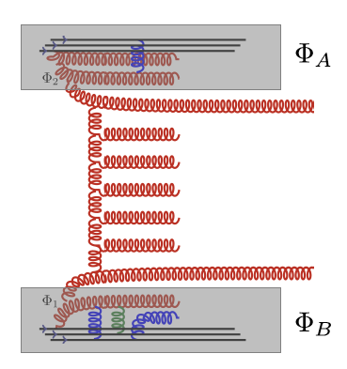
Angular structure from (mini-) jet radiation
p
G_{BFKL}
Computed to NLL
Colferai,Schwennsen,Szymanowski, 1002.1365
q
Mini-jets: give a ΔΦ ≅ π collimation
LHC p+p & p+A “ridge” results test as well
the structure of bremsstrahlung radiation between jets

Slide 27
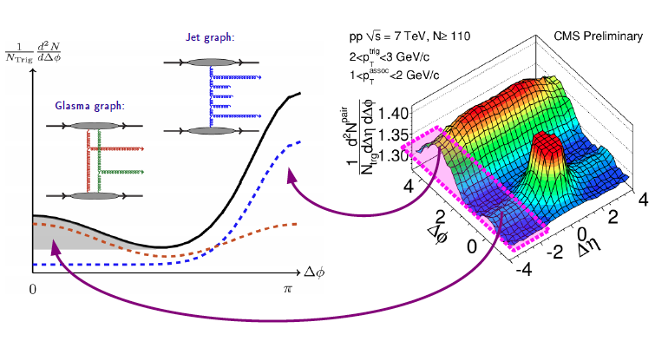
Anatomy of long range collimation

Slide 28
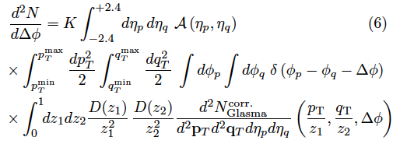


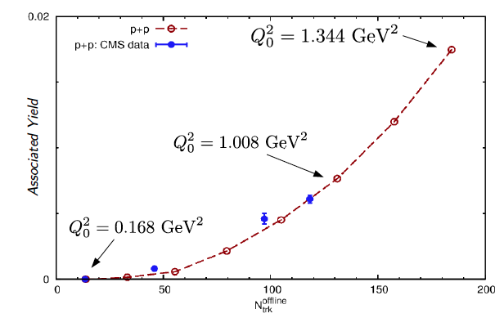
Quantitative description of pp ridge
Dusling,RV:PRL108 (2012)262001
Dependence on transverse
area cancels in ratio…
Rarer and rarer
gluon configurations
probed in the proton

Slide 29
Dusling,RV, PRD 87, 051502 (R) (2013); arXiv:1302.7018

Slide 30
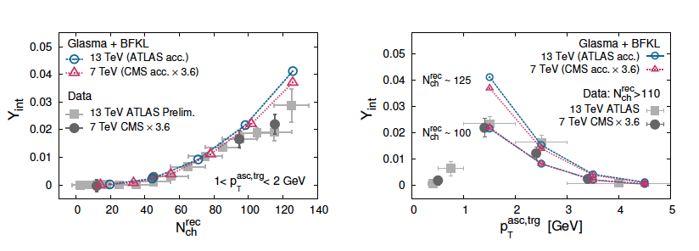
Dusling, Tribedy,Venugopalan
aXiv: 1509.04410, PRD (2016)

Slide 31
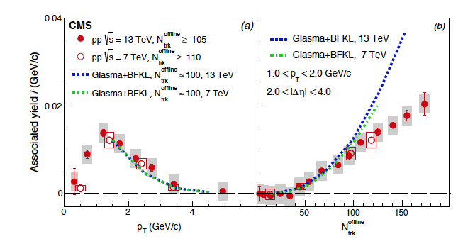
CMS, arXiv:1510.03068, PRL (2016)

Slide 32
Striking results from LHC p+A collisions
p+A ridge much large than p+p at same multiplicity
and nearly as large as that in peripheral Pb+Pb collisions

Slide 33
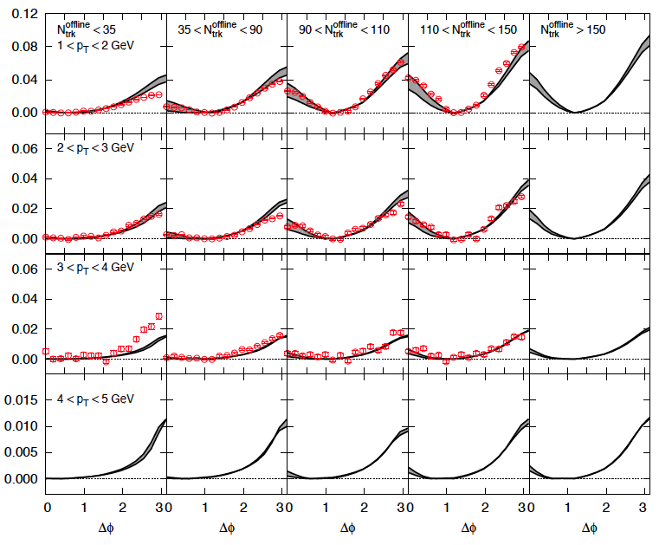
Systematics of p+Pb associated yield
Dusling, RV: 1211.3701
1302.7018

Slide 34
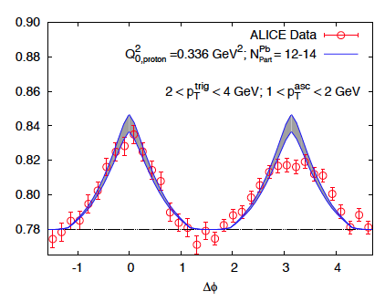
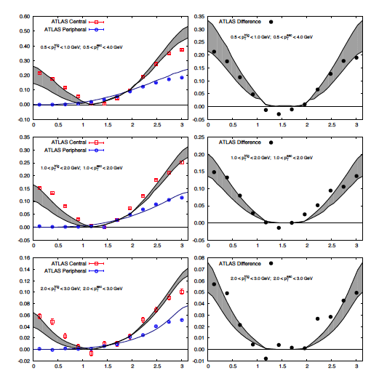
“Jet subtracted” p+Pb ridge
Similar subtraction
in RHIC d+Au to
extract ridge

Slide 35
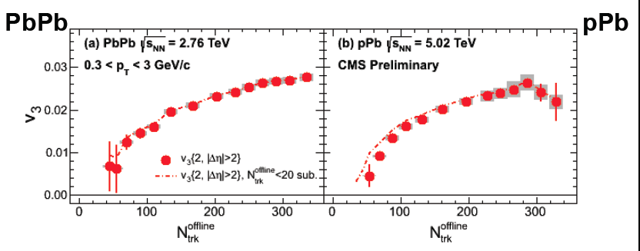
v₃ in LHC pA collisions
CMS 1305.0609
v₃ > 0 not obviously obtained from Glasma graphs
in k_{T} factorization approximation
Only even moments obtained…problematic for
initial state approaches ?

Slide 36
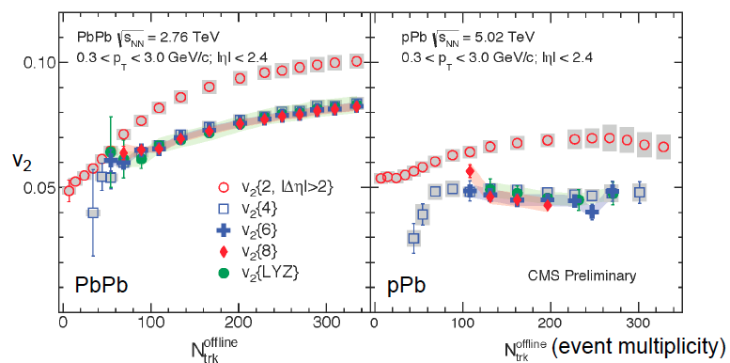
Higher cumulants of elliptic flow
A number of simple models of
eccentricities give
“Linear response”
Natural in hydro… more generic ?
Bzdak,Bozek,McLerran, arXiv:1311.7325
Bzdak, Skokov, arXiv: 1312.7349
Li, Ollitrault, arXiv:1312.6555,
Basar,Teaney, arXiv:1312.6770

Slide 37
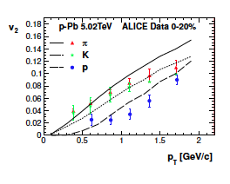
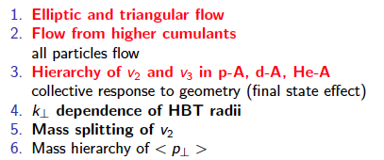
Collective flow in small size systems?
Bozek,Broniowski,Torrieri, 1307.5060
Werner et al., 1307.4379

Slide 38
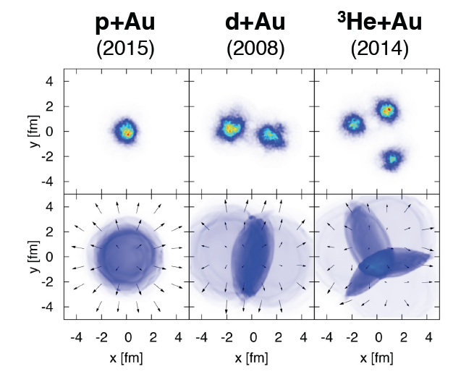
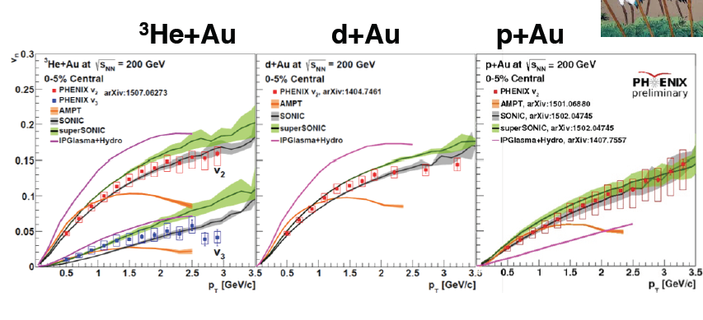
Studies of small size systems at RHIC

Slide 39
Hydrodynamics in small systems?

Slide 40
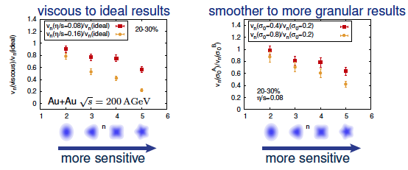
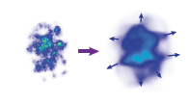
Hydrodynamics in p+A collisions?
Schenke,Jeon,Gale
Hydrodynamics efficiently converts spatial anisotropy into momentum anisotropy – these may explain the
large v_{n} moments – as well as the equivalence of 4, 6 and 8 particle cumulants

Slide 41
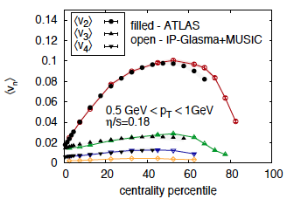
Hydro in A+A: quantitative description out to peripheral centralities
IP-Glasma= initial state
MUSIC=event.by.event. hydro
Schenke,RV, PRL 113 (2014) 102301
Remarkable agreement of IP-Glasma+MUSIC with data out to
fairly peripheral overlap geometries…

Slide 42
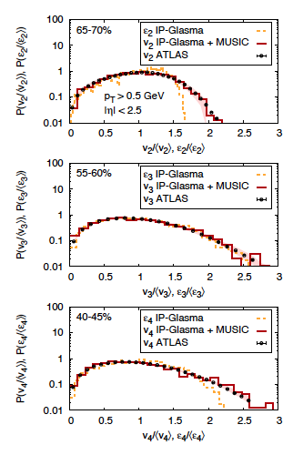
Hydro and event-by-event-flow fluctuations
This IP-Glasma+ model describes event-by-event anisotropy fluctuations
for a wide window of collision centralities

Slide 43
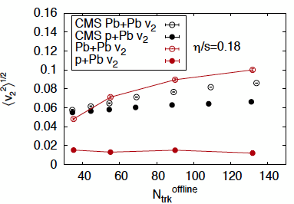
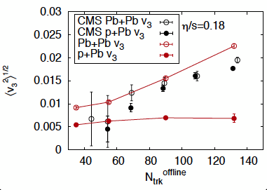
Hydro in p+A
Schenke,RV, PRL 113 (2014) 102301
In contrast, shape and magnitude of IP-Glasma+MUSIC results completely
off from the data

Slide 44
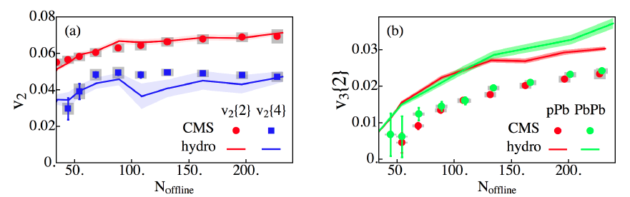
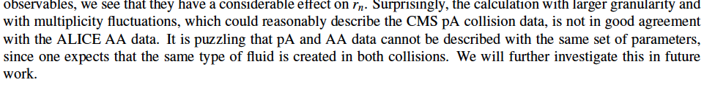
Hydro in p+A
Kozlov et al., 1412.3147
p+A Glauber
p+A Glauber
Reasonable agreement/trend – however…
Also, Glauber models do not capture the event-by-event distribution of v₂ in A+A
Renk,Niemi, arXiv:1401.2069

Slide 45
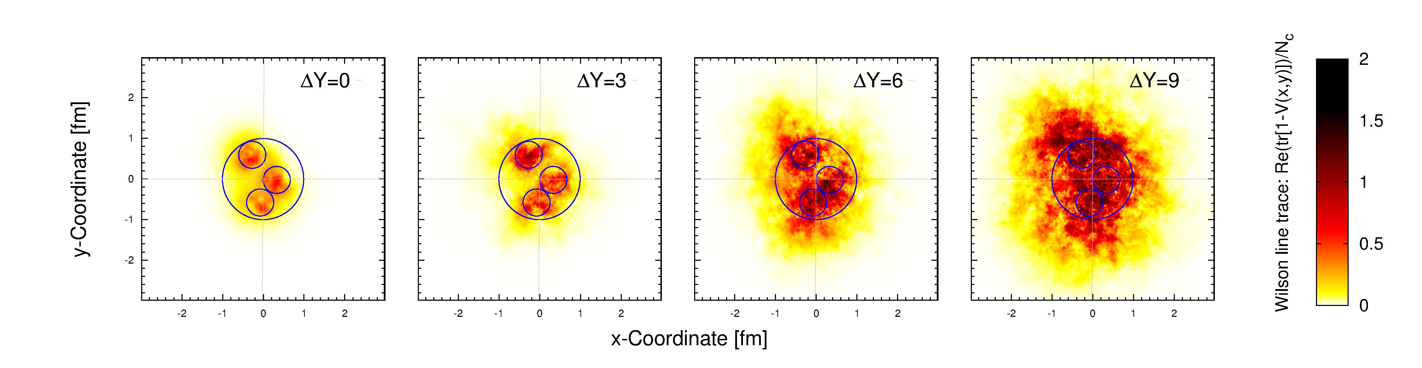
Shape matters ?
Schenke,Schlichting, 1407.8458
Re (tr[1 − V (x, y)])/Nc from solutions of the JIMWLK RG equation in rapidity
Rare ridge events may trigger on rare proton shape fluctuations

Slide 46


Shape matters ?
Schenke,Schlichting, 1407.8458

Slide 47


Hydro in small size systems: sensible or not ?
Two frequently used measures: Reynolds # and Knudsen #
Bzdak et al., arXiv:1304.3403
Denicol, Niemi, arXiv:1404.7327
Hydro good for Kn < 0.5, marginal for
K < 1 transient regime; K > 1 free streaming

Slide 48

Surprising ATLAS results in p+p
Loizides, review 1602.09138

Slide 49


Significant v_{n} moments in p+Pb out to large p_{T}

Slide 50

And the jet at “low” p_{T}
Pb+Pb
“Jets” are clearly quenched in A+A collisions
– no sign of quenching in p+A and p+p…

Slide 51

Previously ignored initial state contributions can mimic final state contributions and explain systematics of the data
Hydrophone versus hydrophobe:
Muddying the waters
“A theory is something nobody believes, except the person who made it. An experiment is something everybody believes, except the person who made it.”

Slide 52
Are there sources of v₃ in the Glasma?
For k_{T} ≤ Q_{S}: coherent multiple scattering contributions
are important – all of same order in QCD coupling
×
×
Paying for one’s sins: Not included in k_{T} factorization framework used in previously shown calculations
Can be computed by solving Yang-Mills equations for the Glasma
Lappi,Srednyak,RV: 0911.2068
Kovchegov,Wertepny, 1212.1195

Slide 53


Azimuthal anisotropy from Yang-Mills Dynamics
Schenke,Schlichting,RV,1502.01331

Slide 54
Azimuthal anisotropy from Yang-Mills Dynamics
Schenke,Schlichting,RV,1502.01331
Proof in principle that large v₂ and v₃ can be generated at early times in the Glasma
Much work to be done to understand the N_{ch} dependence, conversion of
gluons to hadrons, …

Slide 55

Higher cumulants from Glasma domains
Dumitru,McLerran,Skokov, 1410.4844
Not clear if simple model is right… but Yang-Mills dynamics contains
non-trivial multi-parton correlations that can “flip” the sign relative to
the Glasma graph
Lappi,Schenke,Schlichting,RV,
In preparation

Slide 56


Four particle correlations in proton-proton collisions

Slide 57

Higher cumulants from Glasma domains

Slide 58



Higher cumulants from Glasma domains
Dumitru,McLerran,Skokov, 1410.4844
Simple model: express intrinsic higher point
correlators as correlators of produced particles
with a target field in a color domain,
averaged over all orientations of the field.
“A” term is the correlation induced between projectile particles due to color field orientation of target (more generically, non-Gaussian correlations)
The N_{c} term is the “connected Glasma graph” (Gaussian correlations)
N_{D} is # of color domains – few in p+A, several in A+A

Slide 59


My personal viewpoint
Talk by S. Schlichting at Quark Matter 2015

Slide 60
Outlook
Ridge correlations in p+p and p+A are providing novel insight into multiparticle correlations in the hadron wavefunctions and into multiparticle production in rare events
The p+A data do not fit neatly into simple paradigms and may cause us to reexamine these
We live in exciting times!

Slide 61

Intriguing CMS result

